Slide 1
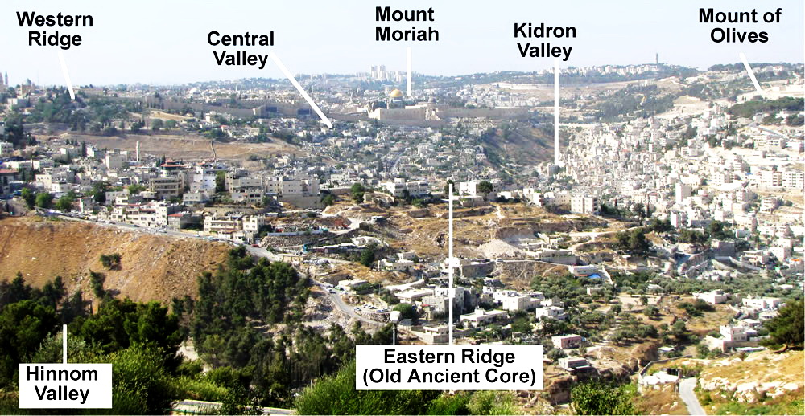
LESSON 33
WEEK 33 OF 52
(Jer. 19-40; 2Kg. 24,25)
THROUGH THE BIBLE IN 2018
Last time we saw Judah’s continued decline; this time her destruction.
“Thus saith the LORD, Go and get a potter’s earthen
bottle, and take… and go forth unto the valley of the son of Hinnom… and proclaim there the words that I shall tell thee” (19:1,2).
The valley of Hinnom lay southwest of the wall and was the ‘city dump’ where they discarded and burned their garbage. It was used as a ‘high place’ [worship of fire god Molech], and where something else was burned –
“And they build the high place… which is in the valley
of Hinnom, to burn their sons and daughters in the fire; which I commanded them not…” (Jer. 7:31).
It was at this place that God sent Jeremiah to tell of
the judgment that was about to descend upon them like a tidal wave.

Slide 2
Because the city dump fires burned continuously in the valley of Hinnom, it became known as ‘Gehenna,’ a picture [foretaste] of the sites & smells of ‘HELL’, which Christ used as an illustration –
“Ye have heard that it was said by them of old time,
Thou shalt not kill; and whosoever shall kill shall be
in danger of the judgment. But I say unto you, That
whosoever is angry with his brother without cause
shall be in danger of the judgment… whosoever shall
say, Thou fool, shall be in danger of hell fire… Where
the worm dieth not, and the fire is not quenched”
(Mt. 5:22; Mk. 9:48).
Christ used the valley of Hinnom as a back drop for
His teaching on man’s sinful nature. One can sin
outwardly [commit murder] or inwardly [harbor
anger], both of which endangered his immortal soul –
“… the soul that sinneth, it shall die” (Ezek. 18:4);
which is the 2nd death in the lake of fire (Rev. 20:14).
T. or F. One sin can send the sinner to hell for eternity.

Slide 3
The Potsherd Gate opened to the valley of Hinnom where people would carry their broken pieces of pottery and dispose of them at the city dump. It was at this place of fire, stench, and death that Jeremiah was called to forecast the will of God. One of the reasons of His judgment on them
was for their inhumane treatment of children –
“… Hear ye the word of the LORD, O kings of Judah,
and inhabitants of Jerusalem; Thus saith the LORD of
hosts, the God of Israel; Behold, I will bring evil upon
this place, the which whosoever heareth, his ears
shall tingle. Because they have forsaken me and
estranged this place, and have burned incense in it
unto other gods, whom neither they nor their fathers
have known… and filled this place with the blood of
innocents… built also the high places… to burn their
sons with fire for burnt-offerings...” (19:3-5).
It must have been these of which the prophet wrote –
“The heart is deceitful above all things, and
desperately wicked: who can know it?” (17:9).

Slide 4
“Therefore, the days come, that this place shall no more be called the valley of Hinnom, but the valley of slaughter… I will cause them to fall by the sword before their enemies, and by the hands of them that seek their lives [Babylonian army]: and their carcasses will I give to be meat for the fowls of the air, and the beasts of the earth. And I will
make this city desolate… I will cause them to eat the
flesh of their sons and the flesh of their daughters...
I will break this people and this city, as one breaketh
a potter’s vessel…” (19:6-11).
As Jeremiah announced God’s judgment, he broke
a pot (19:10), which represented the upcoming
destruction of Jerusalem and Judah. God would
also send a famine into the land, which would result
in severe food shortages. As the Babylonian army
laid siege to Jerusalem, famine would be so horrific,
that its inhabitants would be forced to resort to
cannibalism.
God’s judgment in the O.T. took on many forms.

Slide 5
In a short time, the Babylonians would exact God’s punishment on those who perpetrated this heinous act of infanticide –
“… and there were they justly punished for the blood
of the tortured children burned alive in sacrifice to
Molech. Such cruelty to children never contemplated
by the loving heart of God”
(Williams Bible Commentary, p. 542).
“Thus will I do unto this place, saith the LORD, and to
the inhabitants thereof, and even make this city as
Tophet” (19:12).
What is Tophet?
Williams Commentary –
“Tophet, so-called from Toph, a drum, which was
beaten to drown the agonizing cries of the burning
children. They were innocent, but their murderers
were guilty, and therefore, judged” (Ibid, p. 542).

Slide 6
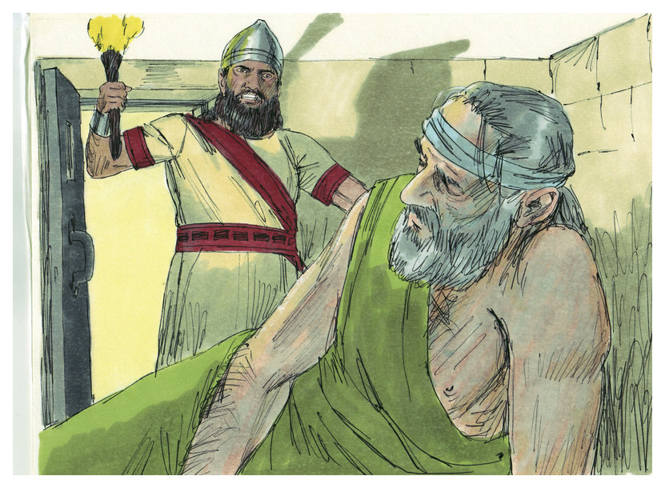
The reaction of Jeremiah’s indictment?
“Now Pashur [head of temple security]… heard that Jeremiah prophesied these things. Then Pashur smote Jeremiah the prophet, and put him in the stocks…” (20:1,2).
Jeremiah was arrested, flogged and shackled. He was released the next day, but not before pronouncing judgment on the officer who would watch in terror all the things of which Jeremiah had spoken –
“… I will make thee a terror to thyself, and to all thy friends: and they shall fall by the sword of their enemies… I will give all Judah into the hand of the king of Babylon, and he shall carry them captive into Babylon…” (20:4).
Pashur, and all those like him, would either die during the invasion or be carried into Babylonian captivity.

Slide 7
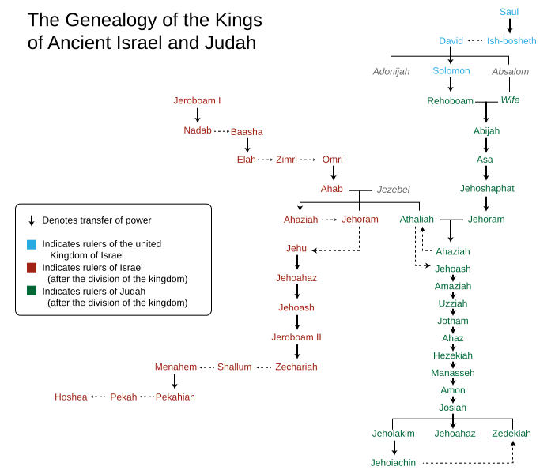
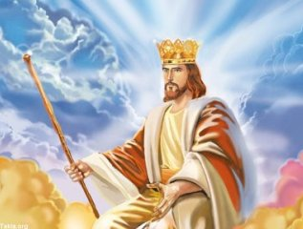
After denouncing a series of evil kings (Ch. 21,22) who had ruled Judah, Jeremiah spoke of a righteous King –
“Behold, the days come, saith the LORD, that I will raise unto David a righteous Branch, and a King shall reign and prosper, and execute judgment and justice in the earth. In his days Judah shall be saved, and Israel shall dwell safely: and this is his name whereby he shall be called, THE LORD OUR RIGHTEOUSNESS” (Jer. 23:5,6).
God had promised Israel through the Davidic Covenant (2Sam. 7:16), that a king would sit on the throne in Jerusalem, but that promise came to an end as David’s branch was ‘cut off’ as the last king of Judah was carried into captivity by the Babylonians. So what did God do?
God would fulfil His promise through a righteous Branch.
In the future, there would be another KING to come—
The Lord Jesus Christ and of His reign and His kingdom there would be no end.

Slide 8
JEREMIAH’S VERSION
“The Word that came to Jeremiah concerning all the people of Judah in the [4th] year of Jehoikim the son
of Josiah king of Judah, that was the first year of Nebuchadnezzar king of Babylon” (Jer. 25:1).
Now in Jeremiah’s 23rd year of ministry (25:3), Jehoikim was the king of Judah and Nebuchadnezzar the king of Babylon, the year 607 B.C. [Ussher]. God would use the Babylonian king to carry out His judgment on the southern kingdom –
“Behold, I will send and take all the families of the north, saith the LORD, and Nebuchadnezzar the king of Babylon, my servant, and will bring them against this land… and will utterly destroy them… And this whole land shall be a desolation… and these nations shall serve the king of Babylon [70] years” (Jer. 25:9-11).
God’s hammer was about to fall on Judah, but, 70 years?

Slide 9
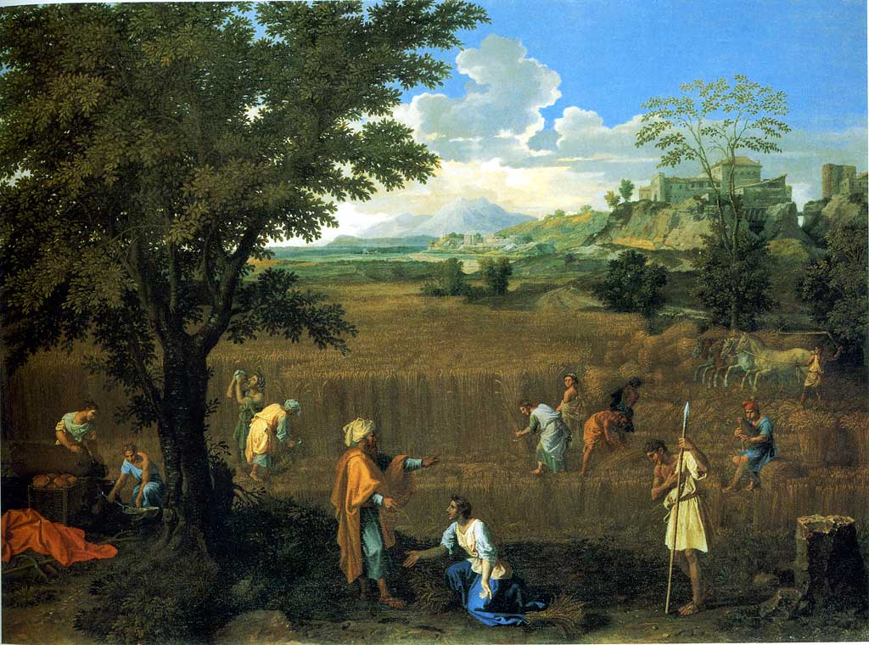
“And I will bring the land into desolation: and your enemies which dwell therein shall be astonished at it. And I will scatter you among the heathen, and will draw out a sword after you: and your land shall be desolate, and your cities waste. Then shall the land enjoy her Sabbaths, as long as it lieth desolate… even then shall the land rest, and enjoy her Sabbaths… Because it did not rest in your Sabbaths, when ye dwelt upon it”
(Lev. 26:32-35).
Under the Law of Moses, the land was to remain uncultivated [fallow] every 7th year (Lev. 25:3-5), which was a Sabbath’s rest for the land, but Israel did not heed this admonition. Part of Israel’s upcoming punishment was to have the land to rest for all the previous years this law had not been observed, i.e. 70-years.
Eventually, God’s laws are always carried out.

Slide 10
2KINGS’ VERSION
“In his days Nebuchadnezzar king of Babylon came up, and Jehoiakim became his servant [3] years: then he turned and rebelled against him… and God sent [raiding bands] against Judah to destroy it, according to the word of the LORD, which he spake by the prophets” (2Kg. 24:1,2).
The Babylonian king entered Judah in 607 B.C. as leader
of the next world empire and deported some residents
of Judah including Daniel (Dan. 1:1-3).
Jehoakim revolted but was eventually taken prisoner
and deported to Babylon himself, but escaped and
returned to Jerusalem where he died (2Chron. 36:6).
“Surely at the commandment of the LORD came this
upon Judah, to remove them out of his sight, for the
sins of [evil king] Manasseh, according to all that he
did; And also for the innocent blood that he shed: for
he filled Jerusalem with innocent blood; which the LORD
would not pardon… So Jehoakim slept with his fathers:
and Jeoiachin his son reigned in his stead” (2Kg. 24:3-6).

Slide 11
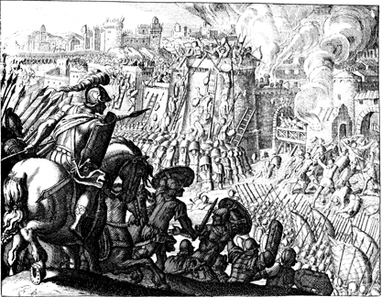
DESTRUCTION OF JERUSALEM
“And in the [5th] month, on the [7th] day of the month, which is the [19th] year of king Nebuchadnezzar king of Babylon, came Nebuzar-adan, captain of the guard… unto Jerusalem… And all the army of the Chaldees, that were with the captain of the guard, brake down the walls of Jerusalem round about…” (2Kg. 25:8-10).
Jerusalem fell for good reason – “And the LORD God of their fathers sent to them by his messengers, rising up betimes, and sending; because he had compassion on his people, and on his dwelling place: But they mocked the messengers of God, and despised his words, and misused his prophets, until the wrath of the LORD arose against his people” (36:15,16)…

Slide 12
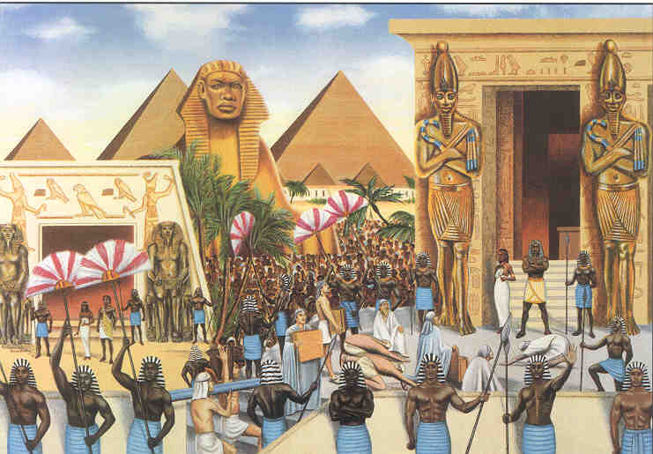
2CHRONICLES’ VERSION
“Then the people of the land took Jehoahaz the son of Josiah, and made him king in his father’s stead in Jerusalem. Jehoahaz was [23] years when he began to reign, and he reigned [3] months in Jerusalem” (2Chron. 36:1,2).
After Josiah’s sudden death, the people of Judah placed their favorite son of Josiah, Jehoahaz, on the throne, but he was dethroned by king Neco of Egypt (36:3) after 3-mo. reign, who then put another son, Jehoiakim on the throne (36:4).
God had ample evidence to bring judgment upon Judah but, Ahaz & Manasseh were the final straws with their practice of infanticide. Jehoakim died and replaced by his son, Jehoiachin, who like his father also did evil (24:9).

Slide 13
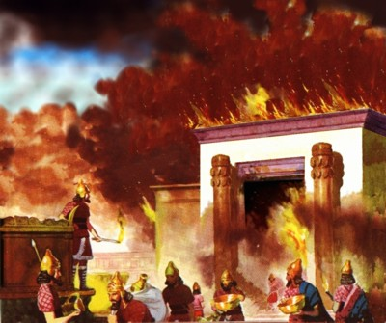
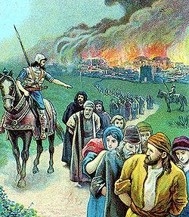
“…Therefore he brought upon them the king of Chaldees, who slew their young men with the sword… and had no compassion upon young man or maiden, old man, or him that stooped for age: he gave them all into his hand. And all the vessels of the house, great and small… he brought to Babylon. And they burnt the house of God… and burnt all the palaces thereof with fire…” (2Chron. 36:17-19).
For more than 350-years, God had warned the Jews of His sore displeasure at their practice of idolatry through many prophets. As He promised Solomon, that if they did not heed, He would drive them from their land and vacate the temple, and that He did in dramatic fashion.
“And them that had escaped from the sword carried he away to Babylon; where they were servants to him and his sons until the reign of the kingdom of Persia”
(2Chron. 36:17-20).
Those who didn’t die would be exiled for 70-years.

Slide 14
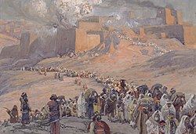
JEREMIAH’S VERSION (cont’d)
“Now these are the words of the letter that Jeremiah sent from Jerusalem… to all the people whom Nebuchadnezzar had carried away captive from Jerusalem to Babylon; After that Jehoiachin the king and the queen… were departed from Jerusalem” (Jer. 29:1,2).
In 596 B.C., Jeremiah wrote a letter to all those taken into Babylonian captivity including Judah’s last king & queen.
What did the letter say? Be prepared for a long stay.
“Thus saith the LORD of hosts… unto all that are carried away captive, whom I have caused to be carried away from Jerusalem unto Babylon; Build ye houses, and
dwell in them; and plant gardens… take ye wives, and beget sons and daughters; that ye may be increased there, and not diminished” (29:4-6).
God told them to continue to live life in a foreign land.

Slide 15
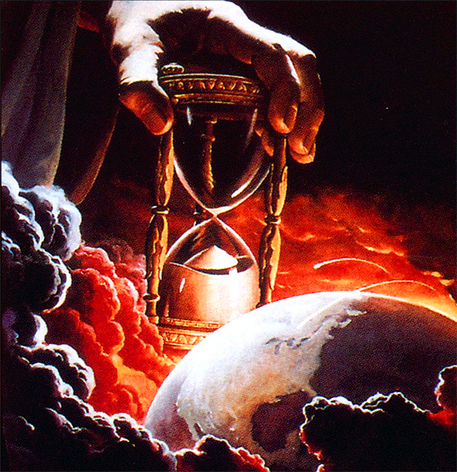
Jeremiah again lapsed into a yet future time –
“Alas! For that day is great, so that none is like it: it is even the time of Jacob’s trouble, but he [spiritual Israel] shall be saved out of it” (30:7).
Jeremiah described that terrible day as the pangs of childbirth –
“Ask ye now, and see whether a man doth travail with child? Wherefore do I see every man with his hands on his loins, as a woman in travail, and all faces are turned into paleness” (30:6).
The tribulation will be the unbridled wrath of God on an unbelieving world with Israel being the focus of His chastisement.
“For it shall come to pass in that day… that I will break the yoke from off thy neck… for I am with thee” (30:8).
Only Christ’s return will bring the tribulation to a close.

Slide 16
NEW COVENANT
“Behold the days come, saith the LORD, that I will make a new covenant with the house of Israel, and with the house of Judah: Not according to the covenant that I made with their fathers in the day that I took them by the hand to bring them out of the land of Egypt; which my covenant they brake, although I was an husband unto them… this shall be the covenant… After those days… I will put my law in their inward parts, and write it in their hearts; and will be their God, and they shall be my people. And they shall teach no more every man his neighbor, and every man his brother, saying, Know the LORD: for they shall all know me, from the least to the greatest of them… for I will forgive their iniquity, and I will remember their sin no more” (31:31-34).

Slide 17
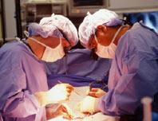
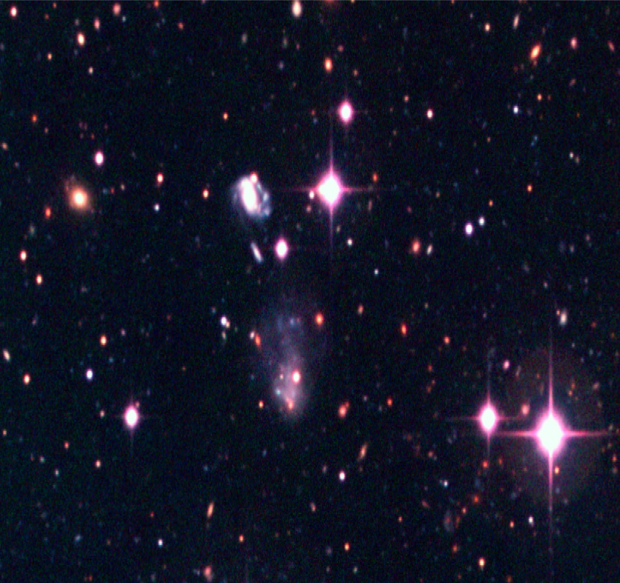
ISRAEL’S HEART TRANSPLANT
Perhaps the greatest good news of all for Israel.
Despite their pitiful attempt at keeping the Law of
Moses, God will give them a NEW covenant, one
which will not be written on tablets of stone, which
THEY COULD NOT KEEP. This time He will write it on
their new hearts [spiritual heart transplant], and
then, and only then, will they be able to obey God.
For 1,000 years every Jew given this new covenant
will obey every command of God—EVERY ONE!
Finally, they will be a ‘holy nation’ (Exo. 19:6).
How sure is God that He is able to do it?
“… the sun for a light by day… moon and stars for a
light by night… if these ordinances depart from
before me, saith the LORD, then the seed of Israel also shall cease from being a nation before me for ever” (31:35,36).
If the celestial bodies stop giving their light, then God will stop making Israel His covenant nation.

Slide 18
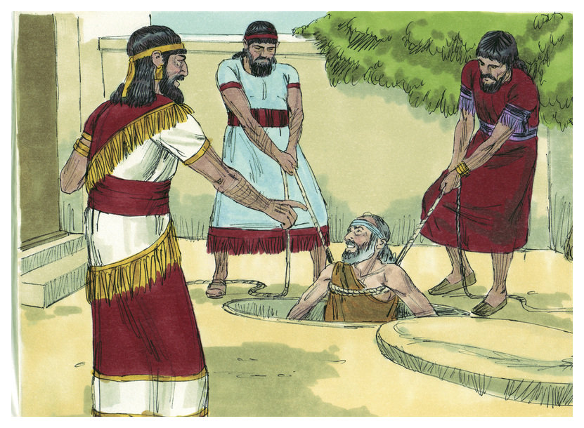
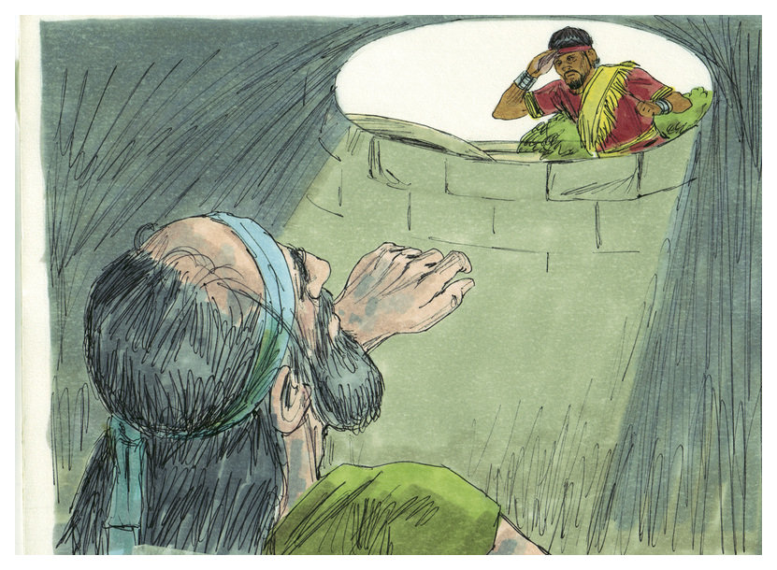
JEREMIAH’S IMPRISONMENTS
“Five phases of Jeremiah’s prison experiences are recorded: (1) He is arrested in the gate and committed to a dungeon on the false charge of treason (Jer. 37:11-15); (2) he is released from the dungeon, but restrained to the court of the prison; (3) He is imprisoned in the miry dungeon of Malchiah (Jer. 38:1-6); (4) he is again released from the dungeon and kept in the prison court (Jer. 38:13-28) until the capture of the city; (5) carried in chains from the city by Nebuzar-adan, captain of the guard, he is finally released at Ramah (Jer. 40:1-4) – (Old Scofield, p. 814).
One of his several imprisonments was in a cistern used to gather rainwater and was deep enough they had to lower him with ropes. With no water in it, he was forced to drink the slime on the bottom.
“Then took they Jeremiah, and cast him into the dungeon of Malchiah… they let down Jeremiah with cords. And In the dungeon there was no water, but mire: so Jeremiah drank the mire” (38:6).

Slide 19
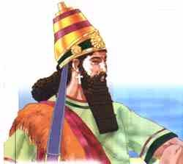
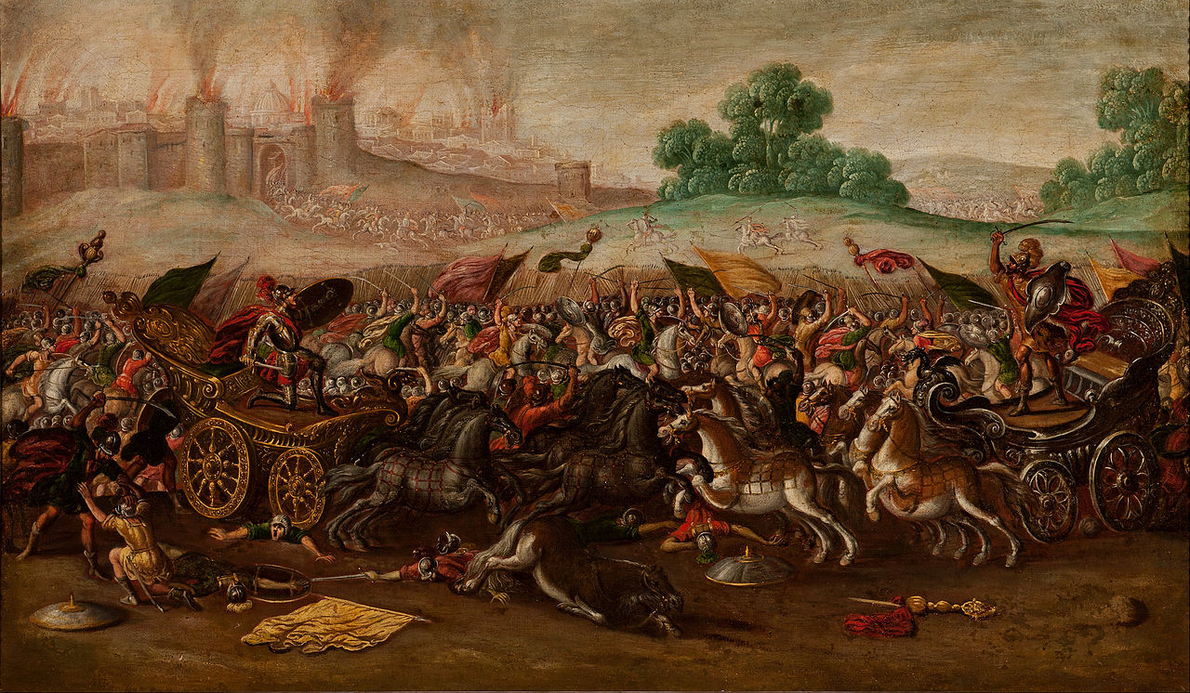
“Thine enemies roar in the midst of thy congregations … they have cast fire unto the sanctuary…” (Psa. 74:4,7).
This psalm likely referred to Nebuchadnezzar’s invasion and destruction of Jerusalem.
“O God, the heathen are come into thine inheritance; thy holy temple have they defiled; they have laid Jerusalem on heaps. The dead bodies of thy servants have been given meat unto the fowls of the heaven, the flesh of thy saints unto the beasts of the earth. Their blood have they shed like water round about Jerusalem; and there was none to bury them. We are become a reproach to our neighbors, a scorn and derision to them that are round about us. How long LORD? Wilt thou be angry for ever?... We are brought very low” (Psa. 79:1-3).
The assault on Jerusalem by the Babylonian army was devastating. Everything that God had given Israel was now gone, but His anger would not last forever.

Slide 20
2KINGS’ VERSION (Cont’d)
“And Nebuchadnezzar king of Babylon came against the city, and his servants did besiege it. And Jehoachin … went out to the king of Babylon… and took him in the [8th] year of his reign. And he carried out thence
all the treasures of the king’s house… [and] which Solomon had made in the temple of the LORD… he carried away all Jerusalem…[10,000] captives… none remained, save the poorest sort of the people of the land” (24:11,12).
Nebuchadnezzar looted Jerusalem & began the Jewish deportation to Babylon.
“And the king of Babylon made his father’s brother king… Zedekiah was [21]… and he reigned [11] years in
Jerusalem… and he did that which was evil in the sight
of the LORD, according to all that Jehoiakim had done”
(24:17-19).

Slide 21
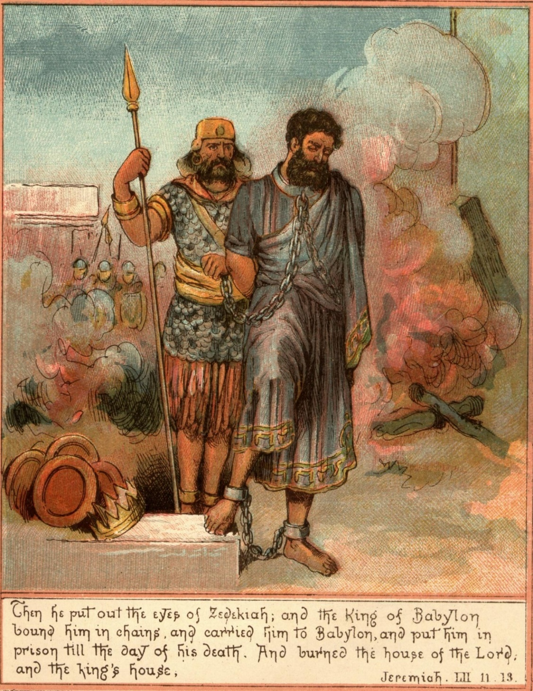
After Jehoiakin’s deportation to Babylon, the Babylonians installed Jehoiakim’s brother [Zedekiah] as puppet king of Judah (but not recognized by the Jewish people as their king). Despite Babylon’s total domination of Judah, “… Zedekiah rebelled against the king of Babylon” (2Kg. 24:20).
“And it came to pass… that Nebuchadnezzar king of
Babylon came… against Jerusalem, and pitched
against it; and they built forts against it round about.
And the city was besieged… the famine prevailed in
the city, and there was no bread for the people of
the land… and the king [Zedekiah] went the way
toward the plain. And the army of the Chaldees
pursued the king, and overtook him in the plains of
Jericho… and gave judgment upon him. And they
slew the sons of Zedekiah before his eyes, and put
out the eyes of Zedekiah, and bound him… and
carried him to Babylon” (25:1-7).
The last thing Zedekiah saw before he was blinded
and deported, was the murder of his sons.

Slide 22
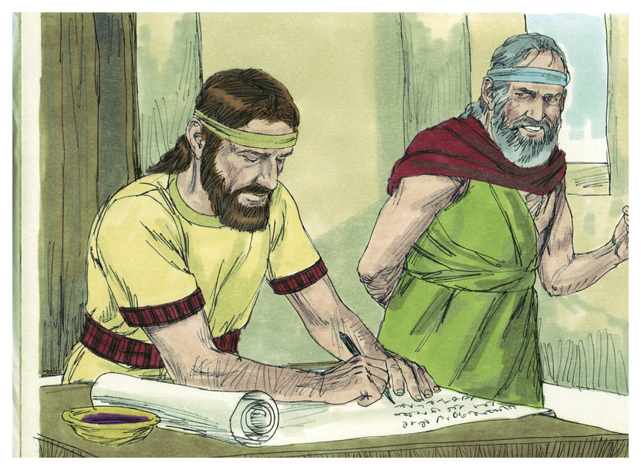
JEREMIAH’S RELEASE
“The word that came to Jeremiah from the LORD, after that Nebuzar-adan had let him go from Ramah, when he had taken him being bound in chains among all that were carried away captive of Jerusalem and Judah, which were carried away captive into Babylon” (Jer. 40:1).
The Babylonian captain of the guard released Jeremiah, acknowledging that he had accurately prophesied these events as God’s chastisement on the Jewish people (40:2). He told him he could go wherever he wanted—he could stay in the land of Israel, or he could go with the rest of the captives to Babylon, where he would be protected and cared for (40:4).
Jeremiah decided to go to Mizpah, temporary capital after Jerusalem was destroyed (40:6).
For the moment, Jeremiah was alive and safe, but for how long?
Next time – Jeremiah’s Lamentations; the prophet Habakkuk

