Slide 1
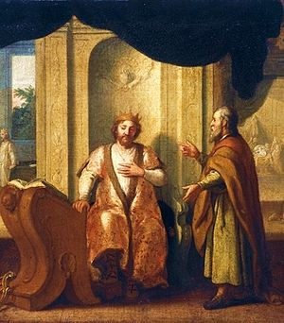
THROUGH THE BIBLE IN 2018
Last time we saw the coronation of Israel’s greatest king, David. This time, we see God implement the Davidic Covenant.
LESSON 19
WEEK 19 OF 52
(2Sam.6-12–1Chron.17-19)
“When it came to pass, when the king sat in his house, and the LORD had given him rest round about from all his enemies; that the king said unto Nathan the prophet, See now, I dwell in an house of cedar, but the ark of God dwelleth within curtains. And Nathan said to the king, Go, do all that is in thine heart; for the LORD is with thee” (2Sam. 7:1-3; 1Chron. 17:2).
Nathan initially told David to go ahead with his plans for building a permanent structure for the ark in Jerusalem, but he spoke prematurely.

Slide 2
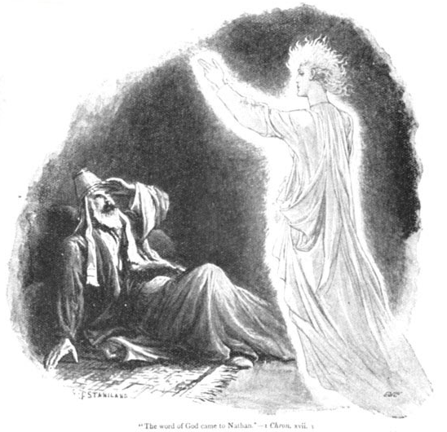
“And it came to pass that night, that the word of the LORD came unto Nathan, saying, Go and tell my servant David, Thus Saith the LORD, Shalt thou build me an house for me to dwell in? Whereas I have not dwelt in any house since the time that I brought up the children of Israel out of Egypt, even to this day, but have walked in a tent and in a tabernacle” (7:4-6).
That same night, God spoke to the prophet Nathan and told him it was not His priority at the moment to build a house for the ark, but He wanted David to build a different house!
“Now therefore so shalt thou say unto my servant David… I took thee from the sheepcote… to be ruler over my people … Israel. And I was with thee whithersoever thou wentest, and have cut off all thine enemies out of thy sight, and have made thee a great name…” (7:8,9).
What was the LORD trying to tell David?

Slide 3
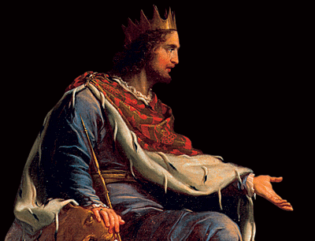
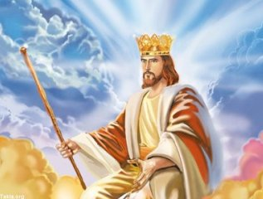
THE HOUSE OF DAVID
“And when thy [David’s] days be fulfilled, and thou [David] shalt sleep with thy fathers [David’s death],
I [Christ] will set up thy [David’s] seed after thee [David]… and I [Christ] will establish his [David’s] kingdom. He [David] shall build an house for my name [Christ’s], and I [Christ] will establish the throne of his [David’s] kingdom for ever. I [Christ] will be his [David’s] father, and he [David] shall be my son…” (7:12-14).
The LORD laid out the plans to built an eternal and royal house of David, that is, a kingdom would begin under David as the king of God’s chosen nation Israel, and after David’s death, it would continue without end until the final KING sat on the throne of David ruling over the entire earth—
The Son of God, the LORD Jesus Christ!

Slide 4
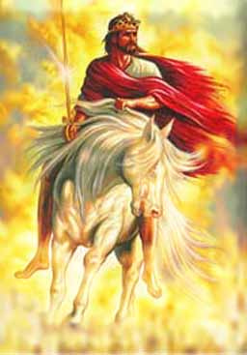
THE DAVIDIC COVENANT
God added the DAVIDIC COVENANT to the previous
‘Abrahamic Covenant,’ a holy beginning [Abraham] of a
holy nation [Israel]. The addition of a holy King [David]
to reign over a holy Kingdom is in preparation for…
… the King of kings to return to establish THE KINGDOM
OF HEAVEN on earth (Rev. 19:11).
“… If he [David and future kings who sit on David’s
throne] commit iniquity, I [Christ] will chasten him
[them] with the rod of men, and with the stripes of the
children of men: But my mercy shall not depart from
him [them], as I took it [the promise of a kingdom]
from Saul, whom I put away before thee” (7:14,15).
Christ promised David that He would never wrench the
kingdom away from him like He did Saul, that He would
show incredible mercy to him and his successors, but
He would hold David and the kings to follow accountable for their actions [sins].

Slide 5
ETERNAL HOUSE OF DAVID
“And thine house and thy kingdom shall be established for ever before thee: thy throne shall be established for ever. According to all these words, and according to all this vision, so did Nathan speak unto David” (7:17,18).
David’s reaction?
“Then went king David in, and sat before the LORD, and he said, Who am I, O Lord God? And what is my house, that thou hast brought me hitherto?... Thou hast done these great things, to make thy servant know them” (7:18-21).
Ever the humble servant, David can’t believe God had chosen him for such a great honor, but he accepted it with grace –
“Therefore now let it please thee to bless the house of thy servant, that it may continue forever before thee: for thou, O Lord God, hast spoken it: and with thy blessing let the house of thy servant be blessed for ever” (9:29).

Slide 6
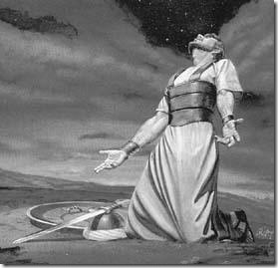
“Lead me in thy truth, and teach me: for thou art the God of my salvation; on thee do I wait all the day (Psa. 25:5); The LORD will give strength unto his people; the LORD will bless his people with peace (29:11); Blessed is the nation whose God is the LORD; and the people whom he hath chosen for his own inheritance (33:12). O continue thy lovingkindness unto them that know thee; and thy righteousness to the upright in heart (36:10). LORD, make me to know mine end, and the measure of my days, what it is; that I may know how frail I am” (39:4).
After receiving news of the ‘Davidic Covenant,’ David turned his thoughts to learning more about God, developing a heart bent toward the Creator, the brevity of his own life compared to the eternal state of God, and how frail he was in contrast to the omnipotence [all power] of God.

Slide 7
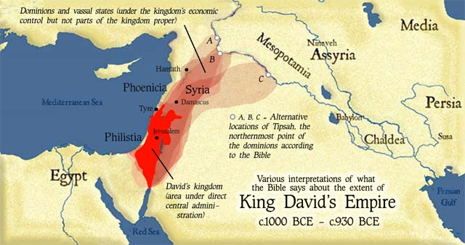
“And after this it came to pass, that David smote the Philistines, and subdued them… and he smote Moab… and so the Moabites became David’s servants… David smote also Hadadezer… as he went to recover his border at the river Euphrates… and when the Syrians of Damascus came to succor Hadadezer… David slew the Syrians [22,000] men”
(2Sam. 8:1-5).
The Davidic Covenant promised that David and
his kingdom would have ‘rest’ from his enemies (7:11), so he defeated them all!
“And he put garrisons in Edom… and all they of Edom became David’s servants. And the LORD preserved David whithersoever he went, And David reigned over all Israel… executed judgment and justice unto all his people” (8:14).

Slide 8
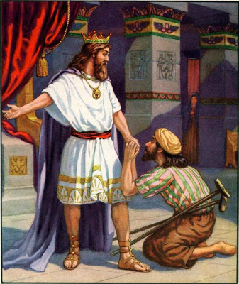
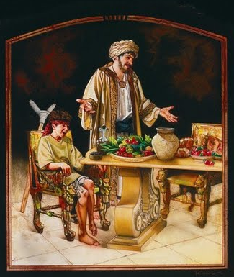
DAVID’S KINDNESS
Not only was David a powerful warrior, but he also
had a heart of gold. As a youth, he had sworn a
lifelong friendship with Jonathan, Saul’s son, and
now that Saul & Jonathan were both dead, he asked
whether there was anyone left of their family that
he could show kindness to –
“And David said, Is there yet any that is left of the
house of Saul, that I may shew him kindness for
Jonathan’s sake?” (9:1).
Mephibosheth was Jonathan’s lame son, so David
cared for and treated him like his own son –
“Thou therefore… shall till the land for him… bring
in the fruits… shall eat bread always at my table…
So Mephibosheth dwelt in Jerusalem: for he did eat continually at the king’s table; and was lame on both his feet” (9:10,13).

Slide 9
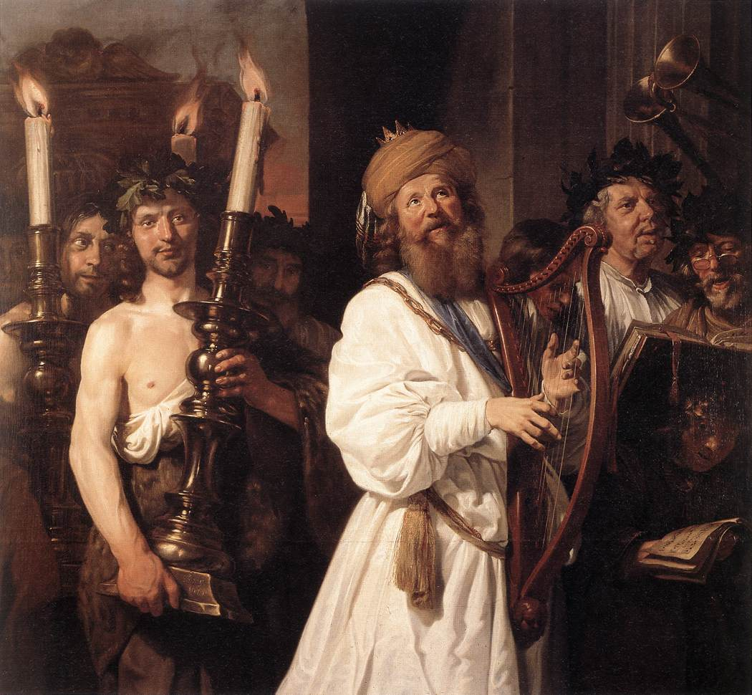
“Gather my saints together unto me; those that
have made a covenant with me by sacrifice”
(Psa. 50:5).
A psalm by Asaph, a Levite and musician, who
reminded Israel they had two obligations: 1st
to their God [faith]; and 2nd to man [works],
as instructed in keeping the two sets of
commandments. He wanted them to know
they will be judged on both and to demonstrate
their love by bringing a sacrifice to God.
“God looked down from heaven upon the
children of men, to see if there were any that
did understand, that did seek God” (53:2).
This psalmist spoke for God asking, Is there
anyone down there listening to Me?
Can we not ask the same question during this present dispensation of the grace of God?
IS THERE ANYONE DOWN THERE LISTENING TO ME??!!!

Slide 10
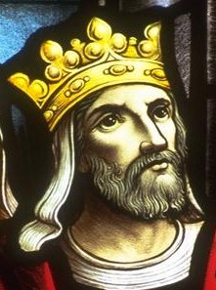
“That thy beloved may be delivered; save with thy right hand, and hear me… Gildead is mine, and Manasseh is mine… Moab is my washpot; over Edom will I cast out my shoe, Philistia, triumph thou because of me. Who will bring me into the strong city? Who will lead me into Edom?... Through God we shall do valiantly: for he it is that shall tread down our enemies” (60:6-12).
This psalm was written at the time David was fighting his enemies in order to give Israel rest from war which God had promised. It is clear that David depended totally on God for his victories.
“Unto thee, O God, do we give thanks… [for our victories over the enemies of Israel]” (75:1).
Not only did David ask God for help, he was careful to thank Him when it came. Do you?

Slide 11
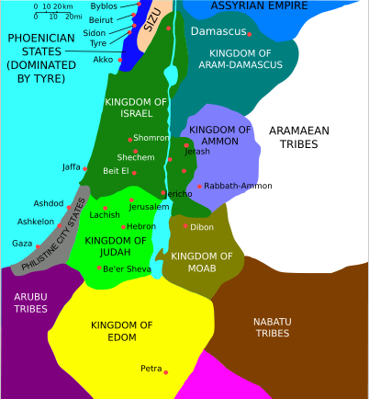
DAVID’S DIPLOMACY
Not only was David a brilliant military commander, he was not above using diplomacy to avoid war when possible. Here is a case in point –
“And it came to pass after this, that the king of the children of Ammon died, and Hanun his son reigned in his stead. Than said David, I will shew kindness unto Hanun… as his father shewed [unspecified] kindness unto me. And David sent to comfort him by the hand of his servants… And David’s servants came into the land of the children of Ammon” (2Sam. 10:1,2).
David the diplomat sent an envoy to the new king [Hanun] of Ammon, to bring about a treaty that would ensure a friendly neighbor on his eastern border, but because Israel had earlier defeated them during the period of the Judges, they were skeptical of David’s intentions.

Slide 12
“And the princes of the children of Ammon said… hath not David rather sent his servants unto thee, to search the city, and to spy it out, and to overthrow it? Wherefore Hanun took David’s servants, and shaved off one half of their beards, and cut off their garments in the middle, even to their buttocks, and sent them away” (10:3,4).
The Israelite envoy was mis-treated and disgraced by cutting their beards and partially removing their modest apparel.
Knowing this was tantamount to a declaration of war, Hanun gathered as many other forces of neighboring kingdoms as he could muster, to await the assault of the Israeli army—a total of [33,000] mercenary soldiers to fight with him (10:6-10), but they were soundly defeated by Israel (10:14,15).

Slide 13
The Ammonites accepted defeat but the Arameans [Sryia] did not – “And when the Syrians saw that they were smitten before Israel, they gathered themselves together” (10:15).
This time David led the battle himself –
“And when it was told David, he gathered all Israel together, and passed over Jordan… And the Syrians
set themselves… against David, and fought with him” (10:17). What happened?
“And the Syrians fled before Israel; and David slew…” [7,000] foot soldiers riding chariots
(1Chron. 19:18).
The larger message?
“And when all the kings that were servants to Hadarezer saw they were smitten before Israel, they made peace with Israel…” (10:19).
Want peace? Have a strong military!

Slide 14
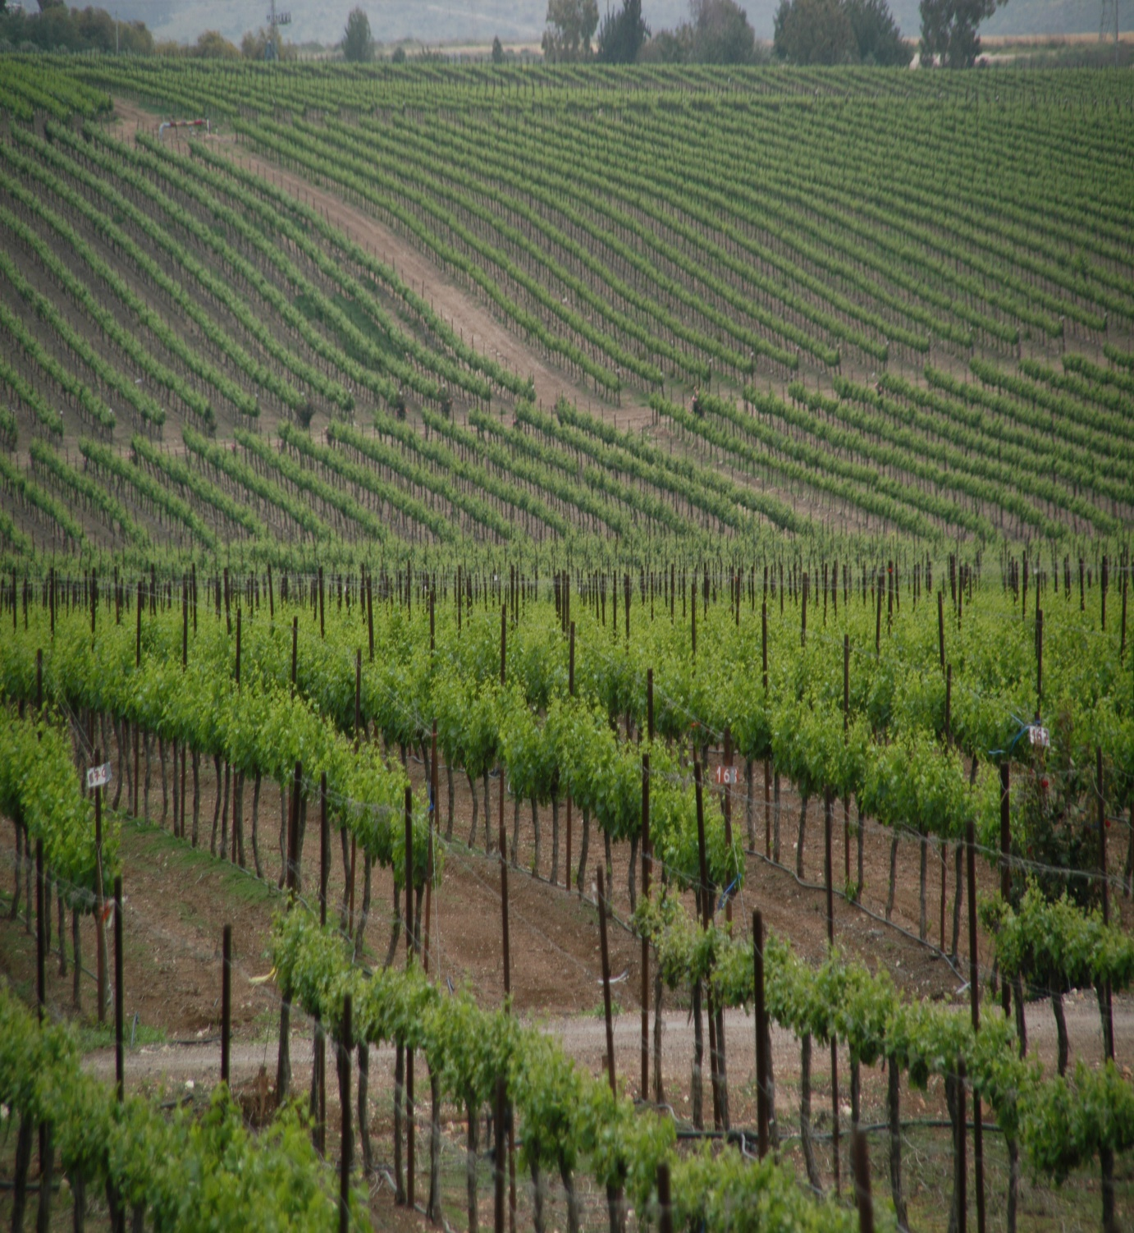
“Some trust in chariots, and some in horses: but we will remember the name of the LORD our God. They are brought down and fallen: but we are risen, and stand upright”
(Psa. 20:8).
This psalm of David fits perfectly with the Ammonite–Syrian war. David did not win because he had more soldiers or chariots—
he won because God was on his side.
“Thou waterest the ridges thereof abundantly: thou settlest the furrows thereof: thou makest it soft with showers… the pastures are clothed with flocks; the valleys also are covered over with corn…” (65:10-15).
David praised God for His abundant provisions in their land of promise.

Slide 15
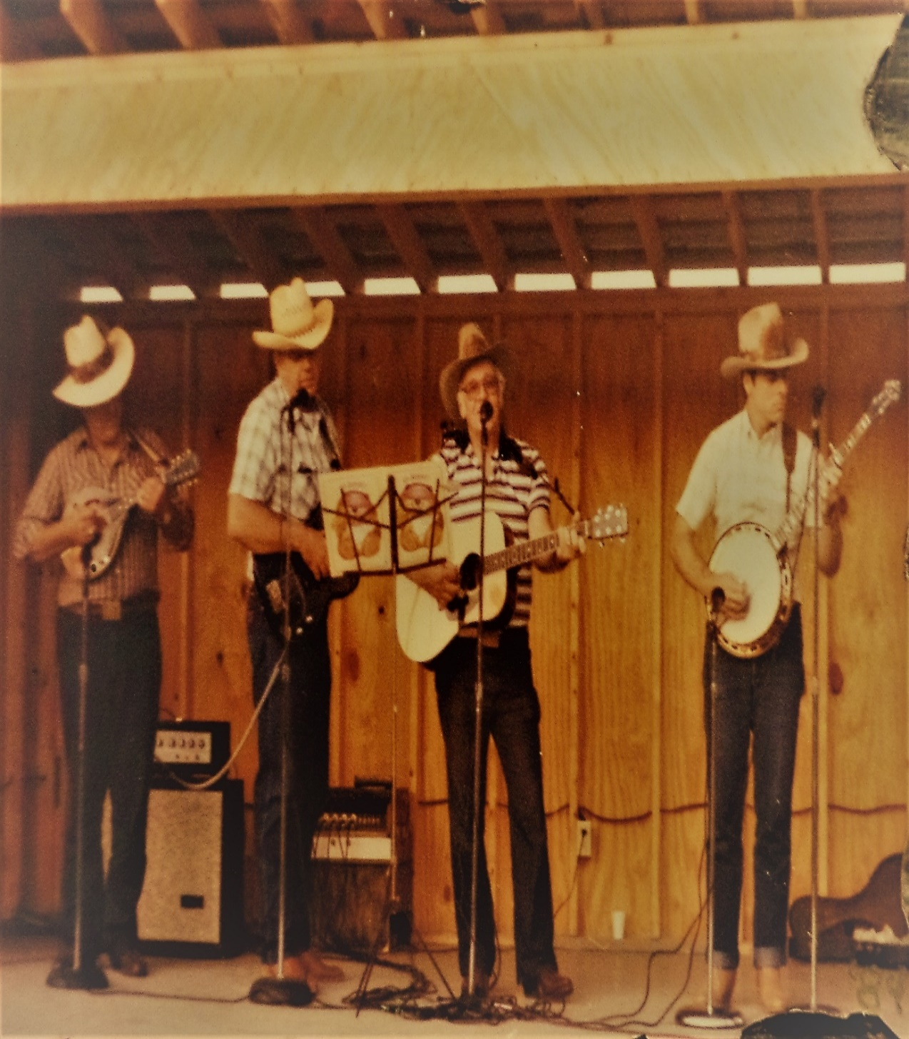
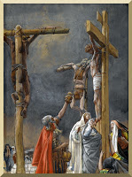
My Dad used to quote this psalm almost every time we played bluegrass music in public—
“Make a joyful noise unto the LORD…” (66:1), with an emphasis on noise. And, the next psalm when we finished – “God be merciful…” [on our audience] (67:1).
Next David wrote of the yet future time when Christ would agonize on the Cross –
“They gave me also gall for my meat: and in my
thirst they gave me vinegar to drink” (69:21).
And, prophecy of Judas’ demise which Luke quoted –
“For it is written in the book of Psalms, Let his habitation be desolate… his bishoprick [position of authority] let another take” (Acts 1:20 c.f. Psa. 69:25), i.e. Matthias who replaced Judas as one of the 12
(Acts 1:26).

Slide 16
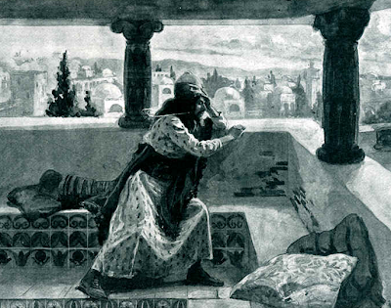
DAVID’S GREAT SIN
“And it came to pass, after the year expired, at the time when kings go forth to battle, that David sent Joab and his servants with him, and all Israel; and they destroyed the children of Ammon… but David tarried still at Jerusalem” (2Sam. 11:1).
David had previously defeated the Ammonites, but they continued to be hostile toward Israel, so in the spring of the year [1,035 B.C.] David sent his commander, Joab, to fight them again. For some unknown reason, David remained in Jerusalem.
“And it came to pass in an evening tide, that David arose from his bed, and walked upon the roof of the king’s house: and from the roof he saw a woman washing herself; and the woman was very beautiful to look upon” (11:2).

Slide 17
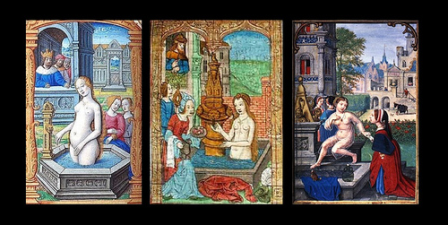
“And David sent and enquired after the woman… Is
not this Bath-sheba… the wife of Uriah the Hittite?
And David sent messengers, and took her; and she
came in unto him, and he lay with her… and she
returned to her house” (11:3,4).
David, what were you thinking??!!
“Let no man say when he is tempted, I am tempted
of God; for God cannot be tempted with evil, neither
tempteth he any man. But every man is tempted,
when he is drawn away of his own lust, and enticed.
Then when lust hath conceived, it bringeth forth sin:
and sin, when it is finished, bringeth forth death
[condemnation]” (Jas. 1:13-15).
David’s sin nature caused him to look at Bath-sheba
which aroused [lust and enticement]. He could
have, he should have, stopped, but he didn’t because he acted and had her brought to him [sin], which brought condemnation/separation of a righteous relationship with God [state].

Slide 18
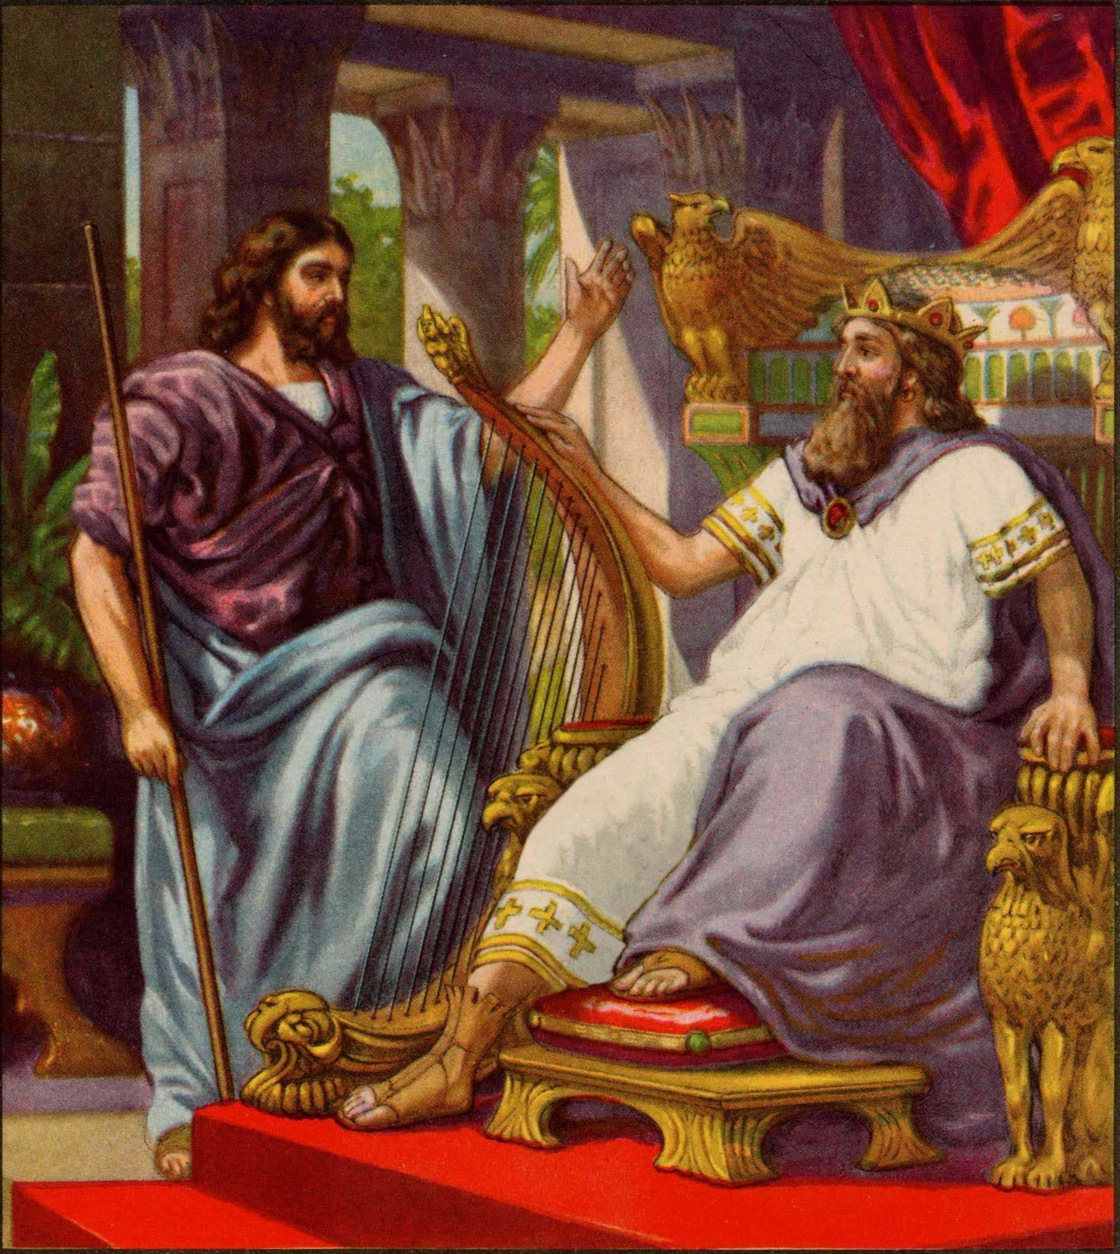
“And the woman conceived, and sent and told David, and said, I am with child. And David sent to Joab, saying, Send me Uriah the Hittite. And Joab sent Uriah to David” (11:5,6).
Then David compounded his sin.
“And when Uriah was come unto him, David demanded of him how Joab did… how the war prospered. And David said to Uriah, Go down to thy house… And Uriah departed out of the king’s house, and there followed a mess of meat from the king. But Uriah slept at the door of the king’s house with all the servants of his lord, and went not down to his house” (11:7-9).
Upon meeting Uriah, David made small talk and then bribed him to go home [to be with his wife], but Uriah’s honor would not permit him to do so.

Slide 19
“And Uriah said unto David, The ark, and Israel, and Judah, abide in tents; and my lord Joab… in the open fields; Shall I then go into mine house, to eat and to drink, and to lie with my wife?... I will not do this thing… David called him; and he made him drunk…” (11:11,13).
David’s conspiracy grew deeper until he committed the unthinkable –
“… David wrote a letter to Joab… set ye Uriah in the forefront of the hottest battle… that he may be smitten, and die… And when the wife of Uriah heard that Uriah her husband was dead, she mourned… when the mourning was past, David sent and fetched her to his house, and she became his wife, and bare him a son. But the thing that David had done displeased the LORD” (11:14,15,26,27).

Slide 20
“And the LORD sent Nathan unto David” (12:1).
Nathan told David a story of a rich man who stole a
poor person’s only lamb, which angered David who
said the thief should die (12:3-5)! And then Nathan
dropped a bombshell –
“And Nathan said to David, Thou art the man…” (12:7).
Nathan told David all the LORD had given him –
“I anointed the king over Israel, and I delivered thee
out of the hand of Saul; And I gave thee thy master’s
house… wives…” (12:7,8).
But, his sin nature was not satisfied—he had taken
something that didn’t belong to him. David could
have [should have] been put to death for having
committed adultery & murder (Exo. 21:12: Lev. 20:10),
but he wasn’t because of his heartfelt repentance.
However, his actions and consequences thereof would impact the remainder of his life and that of Israel in the future.

Slide 21
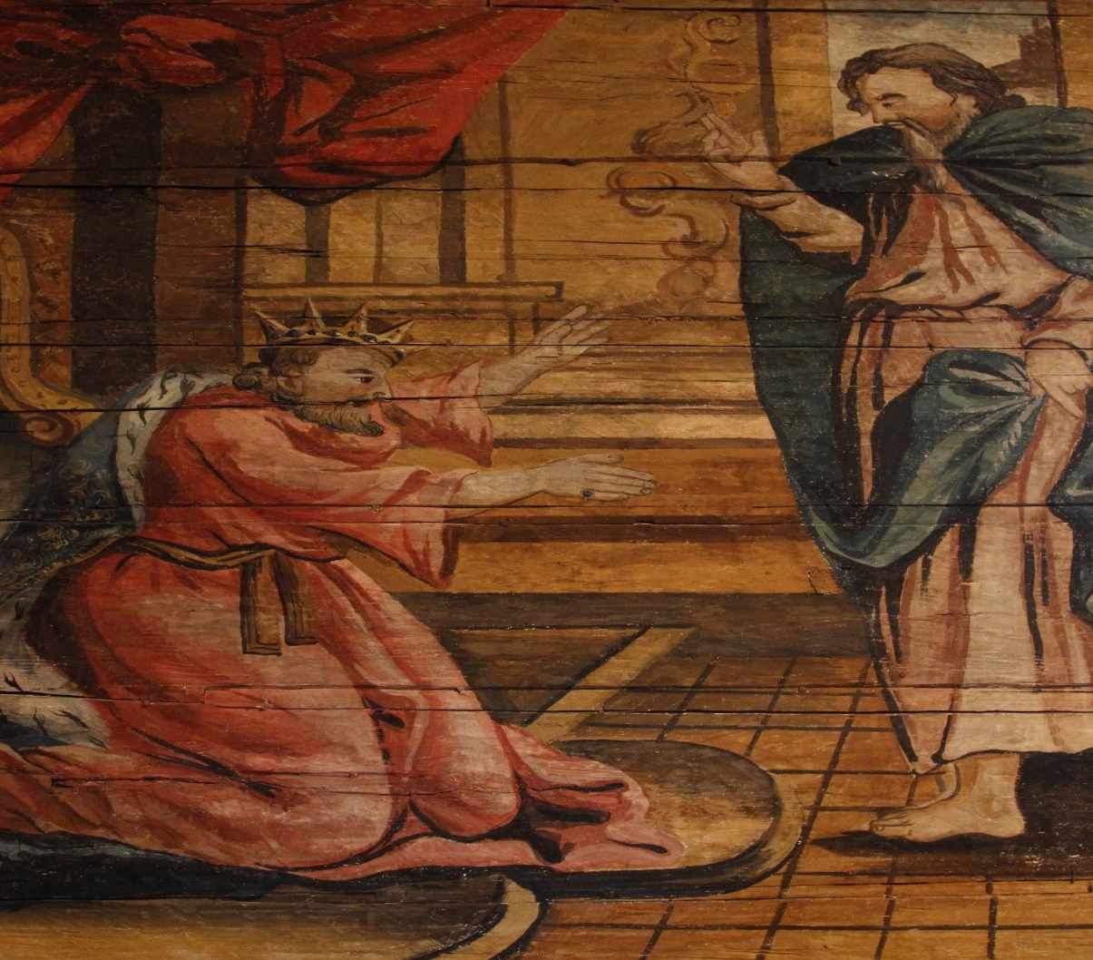
DAVID’S PUNISHMENT
“And David said unto Nathan, I have sinned against the
LORD. And Nathan said…thou shalt not die… the child
shall surely die” (12:13,14).
David was beside himself with grief – “David besought
God for the child… lay all night upon the earth… neither
did he eat bread… on the [7th] day, the child died…”
(12:16-19).
Those around him were astonished at David’s quick
recovery from the infant’s death, but he answered –
“While the child was yet alive, I fasted and wept… who
can tell whether God will be gracious to me, that the
child may live? But now he is dead, wherefore should I
fast? Can I bring him back again? I shall go to him, but
he shall not return to me” (12:22,23).
David understood he could only see the child in the next eternal life. What did God do next? He gave him another son, Solomon (12:24) to continue the DAVIDIC COVENANT.
Next time – David’s son Absalom attempts a coup

