Slide 1
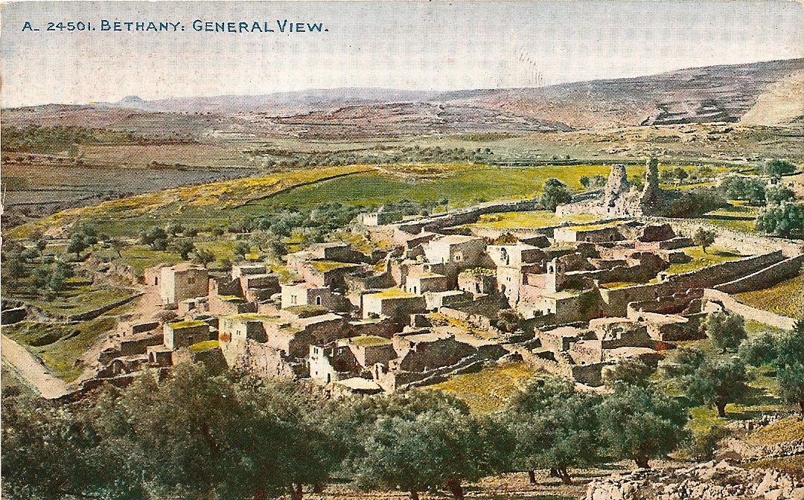
LESSON 44
WEEK 44 OF 52
(Mt. 19-22; Mk. 10-12; Lk. 18,19; Jn. 11,12)
THROUGH THE BIBLE IN 2018
Jesus nears the end of His earthly ministry.
RAISING OF LAZARUS
“Now a certain man was sick, named Lazarus, of Bethany, the town of Mary and her sister Martha… whose brother Lazarus was sick. Therefore his sisters sent unto him, saying, Lord, behold he whom thou lovest is sick. When Jesus heard that, he said, This sickness is not unto death, but for the glory of God, that the Son of God might be glorified thereby. Now Jesus loved Martha, and her sister, and Lazarus” (Jn. 11:1-5).
An important and well known event nearing the end of
Christ’s earthly ministry and sign #7 in the Book of John. Jesus had become friends with this family and now one is nigh unto death so word is sent to Jesus.

Slide 2
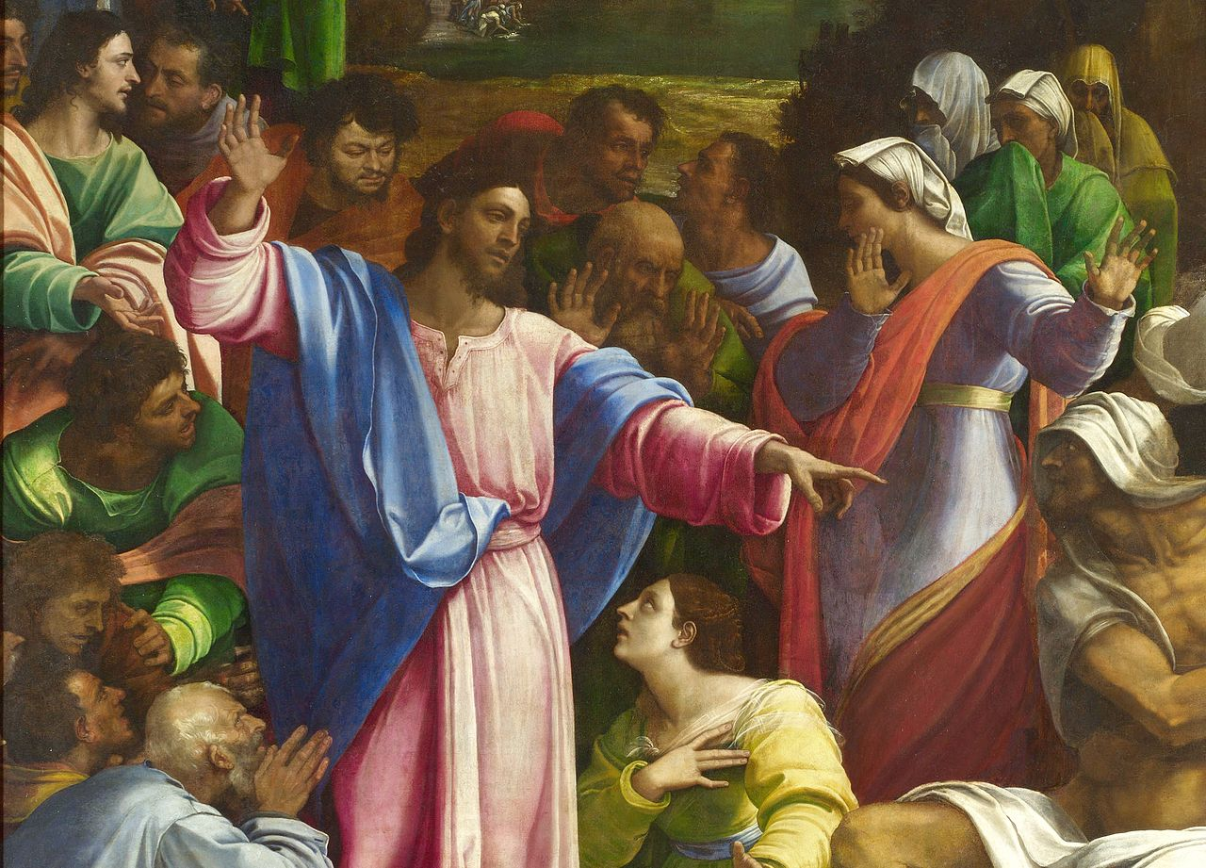
RAISING OF LAZARUS (cont’d)
Because of His love for their brother, the sisters believed Jesus would immediately come to him. When Jesus received the news, He said something unexpected –
“This sickness is not unto death, but for the glory of God, that the son of God might be glorified” (11:4).
Jesus didn’t mean Lazarus was not sick enough to die [he did die!], but rather his sickness and death would be used, again, to show that Jesus was the promised Son of God.
“When he heard… that he was sick, he abode 2-days still… then after that… Let us go into Judea again” (11:6,7).
When Jesus received the news of Lazarus, He waited 2-more days before going to Bethany. What?
He wanted to make sure Lazarus was DEAD! But why??
Didn’t He love him like He said? He could have healed him before he died, but He didn’t.
He could have healed him, but He didn’t want to heal him.

Slide 3
RAISING OF LAZARUS (cont’d)
“Then said Jesus unto them plainly, Lazarus is dead. And I am glad for your sakes that I was not there, to the intent ye may believe… let us go to him” (11:14,15).
He didn’t want to heal him, raise him from the dead.
“Then when Jesus came , he found that he had lain in the grave 4-days already… many Jews came to Martha and Mary, to comfort them… then Martha, as soon as she heard that Jesus was coming, went… said unto Jesus, Lord, if thou hadst been here, my brother had not died… Jesus saith unto her, Thy brother shall rise again. Martha saith… I know that he shall rise again in the resurrection at the last day” (11:17-24).
Upon arrival in Bethany, Martha mildly chastised Jesus, but He comforted her by saying Lazarus would raise from death, but she thought that He was talking about the 1st resurrection (Rev. 20:5) at the beginning of the millennial kingdom. Jesus meant something different.

Slide 4
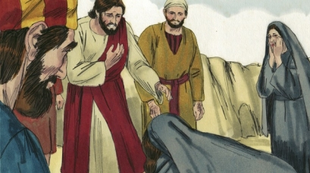
RAISING OF LAZARUS (cont’d)
“Jesus said unto her, I am the resurrection, and the life: he that believeth in me, though he were dead, yet shall he live… Believeth thou this?” (11:25,26).
Jesus told Martha what Jews AT THAT TIME needed to believe in to be saved, Him, and that if they did, they would have eternal life. Martha’s response?
“… Yea Lord: I believe that thou art the Christ, the son of God, which should come into the world” (11:27).
Anything there about His death, burial, & resurrection?
No, then it was their gospel, but not our gospel.
“When Jesus therefore saw her weeping… he groaned in the spirit, and was troubled… Where have ye laid him?... Come and see. Jesus wept… this man should not have died” (11:33-37)?
Jesus was stirred seeing their grief; but, some in the crowd still blamed Him for Lazarus’ death.

Slide 5
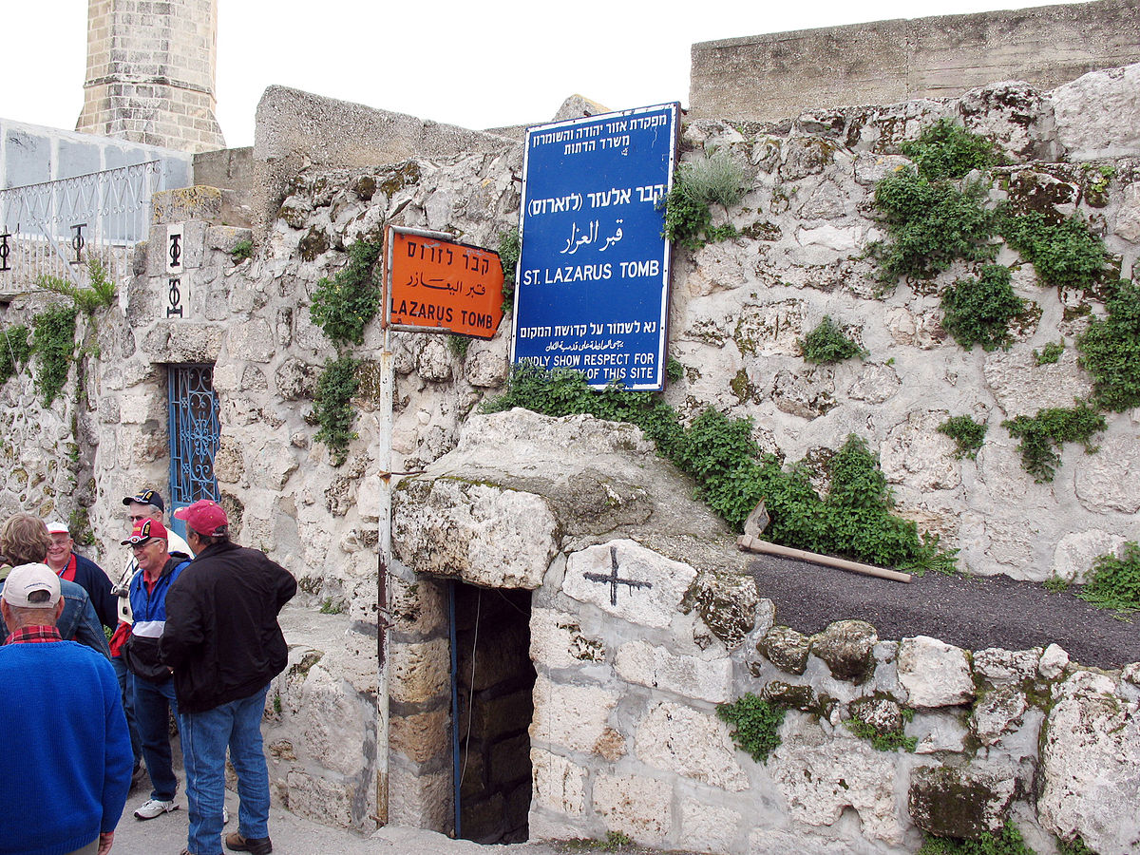
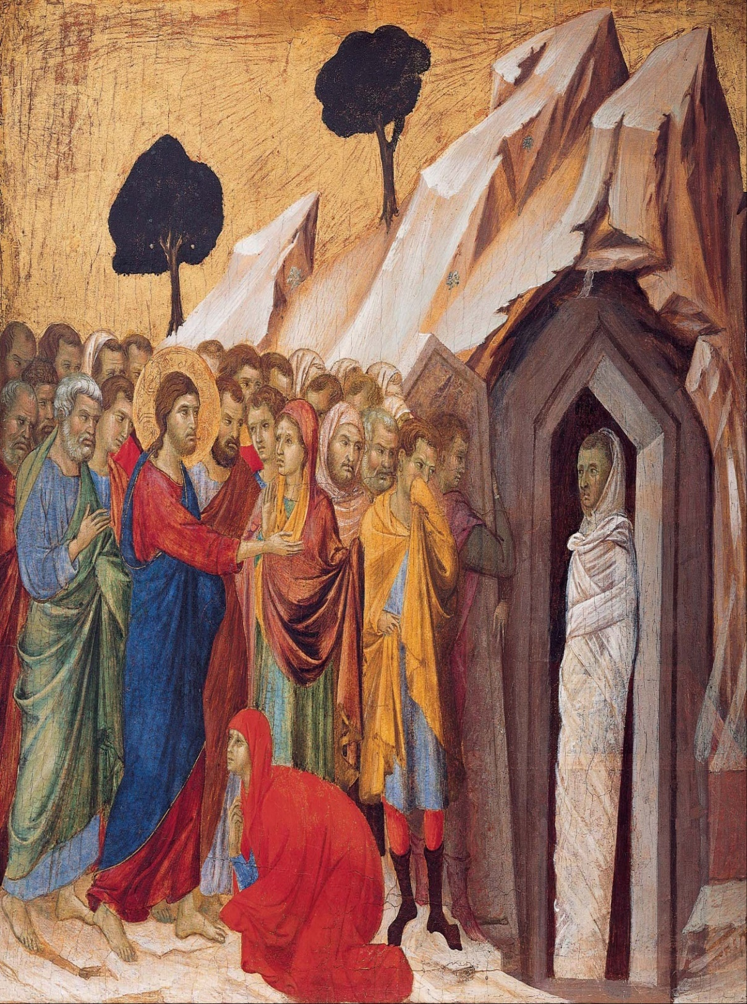
JESUS AT LAZARUS’ GRAVE
“… Lord, by this time he stinketh: for he hath been dead 4-days… Lazarus, come forth… he that was dead came forth, bound hand and foot with graveclothes… Loose him, and let him go” (11:39-44).
It has been said that if Jesus had not called Lazarus by name, every dead person in Jerusalem would have come from the grave. Why was this a resuscitation and not a resurrection? Jesus called Lazarus from the grave, but he again died or he would still be living in Jerusalem. One never dies again after a resurrection.
Why is this such an important event?
The raising of Lazarus is a preview of Christ as He was raised from the dead—a resurrection [not a resuscitation] because He is still alive, sitting at the right hand of the Father where He currently dispenses His grace to all who believe, not just in Him, but in His finished work of salvation.

Slide 6
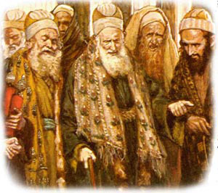
THE PHARISEES PLOT
“Then gathered the chief priests and the Pharisees a council… for this man doeth many miracles. If we let him thus alone, all men will believe on him: and the Romans shall come and take away both our place and nation… Caiaphas, being the high priest [said]… one man should die for the people, and that the whole nation perish not… he prophesied that Jesus should die for that nation” (11:47-51).
The plot thickens as Jesus avoided Jerusalem [Judea] –
“Then from that day forth they took counsel together for to put him to death. Jesus therefore walked no more openly among the Jews… went thus… Ephraim… [Pharisees said] What think ye, that he will not come to the feast [Passover]” (11:53-56)?
If Jesus came to the upcoming Passover, which was required of every Jew, there they would take him (11:57).

Slide 7
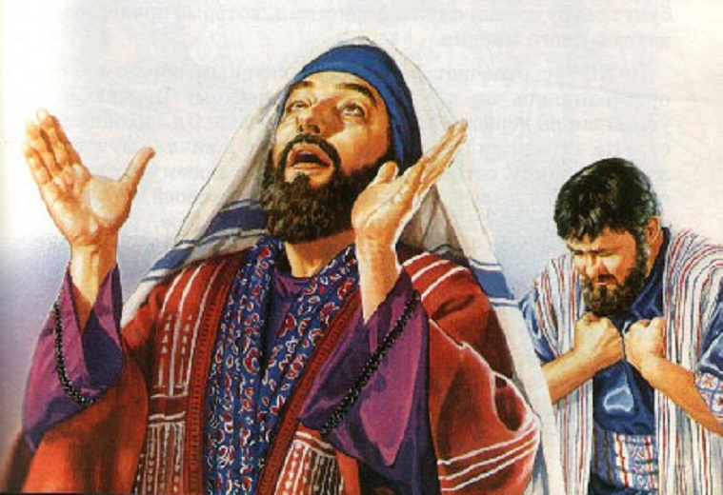
THE PHARISEE & THE PUBLICAN
“And he spake this parable… Two men went up into the temple to pray; the one a Pharisee [self righteous], and the other a publican [sinner]… The Pharisee [said] … God, I thank thee, that I am not as… this publican. I fast twice in the week, I give tithes… the publican… would not lift up so much as his eyes unto heaven, but smote upon his breast, saying, God be merciful to me a sinner” (Lk. 18:9-13).
This prayer has become known as the “sinner’s prayer” and is used by many in Christendom to bring the lost to Christ.
In it’s setting under Law, the publican was petitioning [begging] God for mercy as did every Jew who brought his blood sacrifice to the temple.
Today under grace, Christ’s sacrifice secured, we appropriate it by faith, “For by grace are ye saved… through faith… not of works [begging]…” (Eph. 2:8,9).

Slide 8
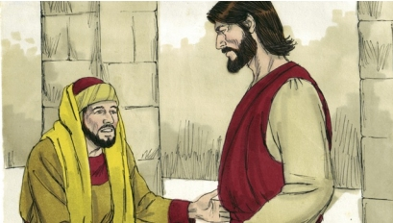
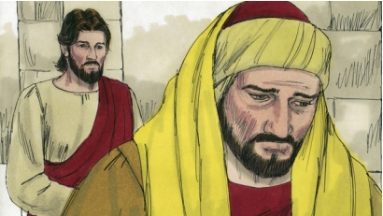
THE RICH YOUNG RULER
“And a certain ruler asked him, saying, Good Master,
what shall I do to inherit eternal life?... All these [laws]
have I kept from my youth up… Yet lackest thou one
thing: sell all that thou hast, and distribute unto the
poor… when he heard this he was very sorrowful: for
he was very rich” (Lk. 19:18-23).
This is an important dispensational illustration. A rich,
young, Jewish ruler asked Jesus about obtaining eternal
life. His response? Keep the Law! The young man
thought he had done so, but was ‘laying up treasures
on the earth’ (Mt. 6:19). Asking what else he could do,
Jesus said, sell everything and give it to the poor. He
couldn’t [wouldn’t] do that –
“It is easier for a camel to go through an eye of a
needle than a rich man to enter into the kingdom of God” (18:25).
The young ruler proved He didn’t believe in Jesus nor His kingdom where everything would be
provided to those who were part of it.

Slide 9
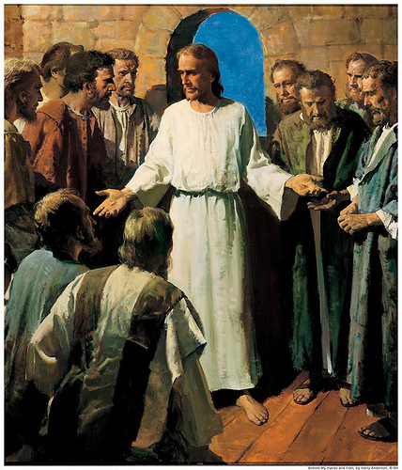
CHRIST’S DEATH FORETOLD
“Behold, we go up to Jerusalem, and all things that are
written by the prophets concerning the Son of man shall
be accomplished… delivered to the Gentiles… mocked…
spitefully entreated… spitted on… they shall scourge him,
and put him to death… 3rd day he shall rise again”
(Lk. 18:31-33).
Nearing the end of His ministry, Christ told the 12 what
was imminent—His death, burial, and resurrection.
That’s the gospel Paul later preached –
“Moreover, brethren, I declare unto you the gospel which
I preached unto you, which also ye have received… stand
… ye are saved… Christ died for our sins… was buried… he
rose from the dead” (1Cor. 15:1-4).
How much of Christ’s 3-year earthly ministry did the 12
preach that gospel?
“And they understood none of these things: and this saying was hid from them…” (Lk. 18:34).
They never preached Paul’s gospel during Christ’s earthly ministry because it wasn’t theirs.

Slide 10
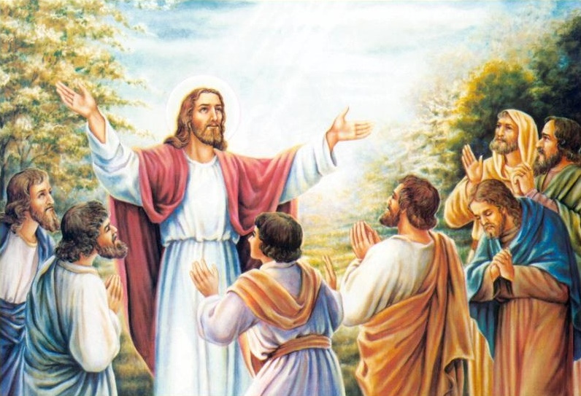
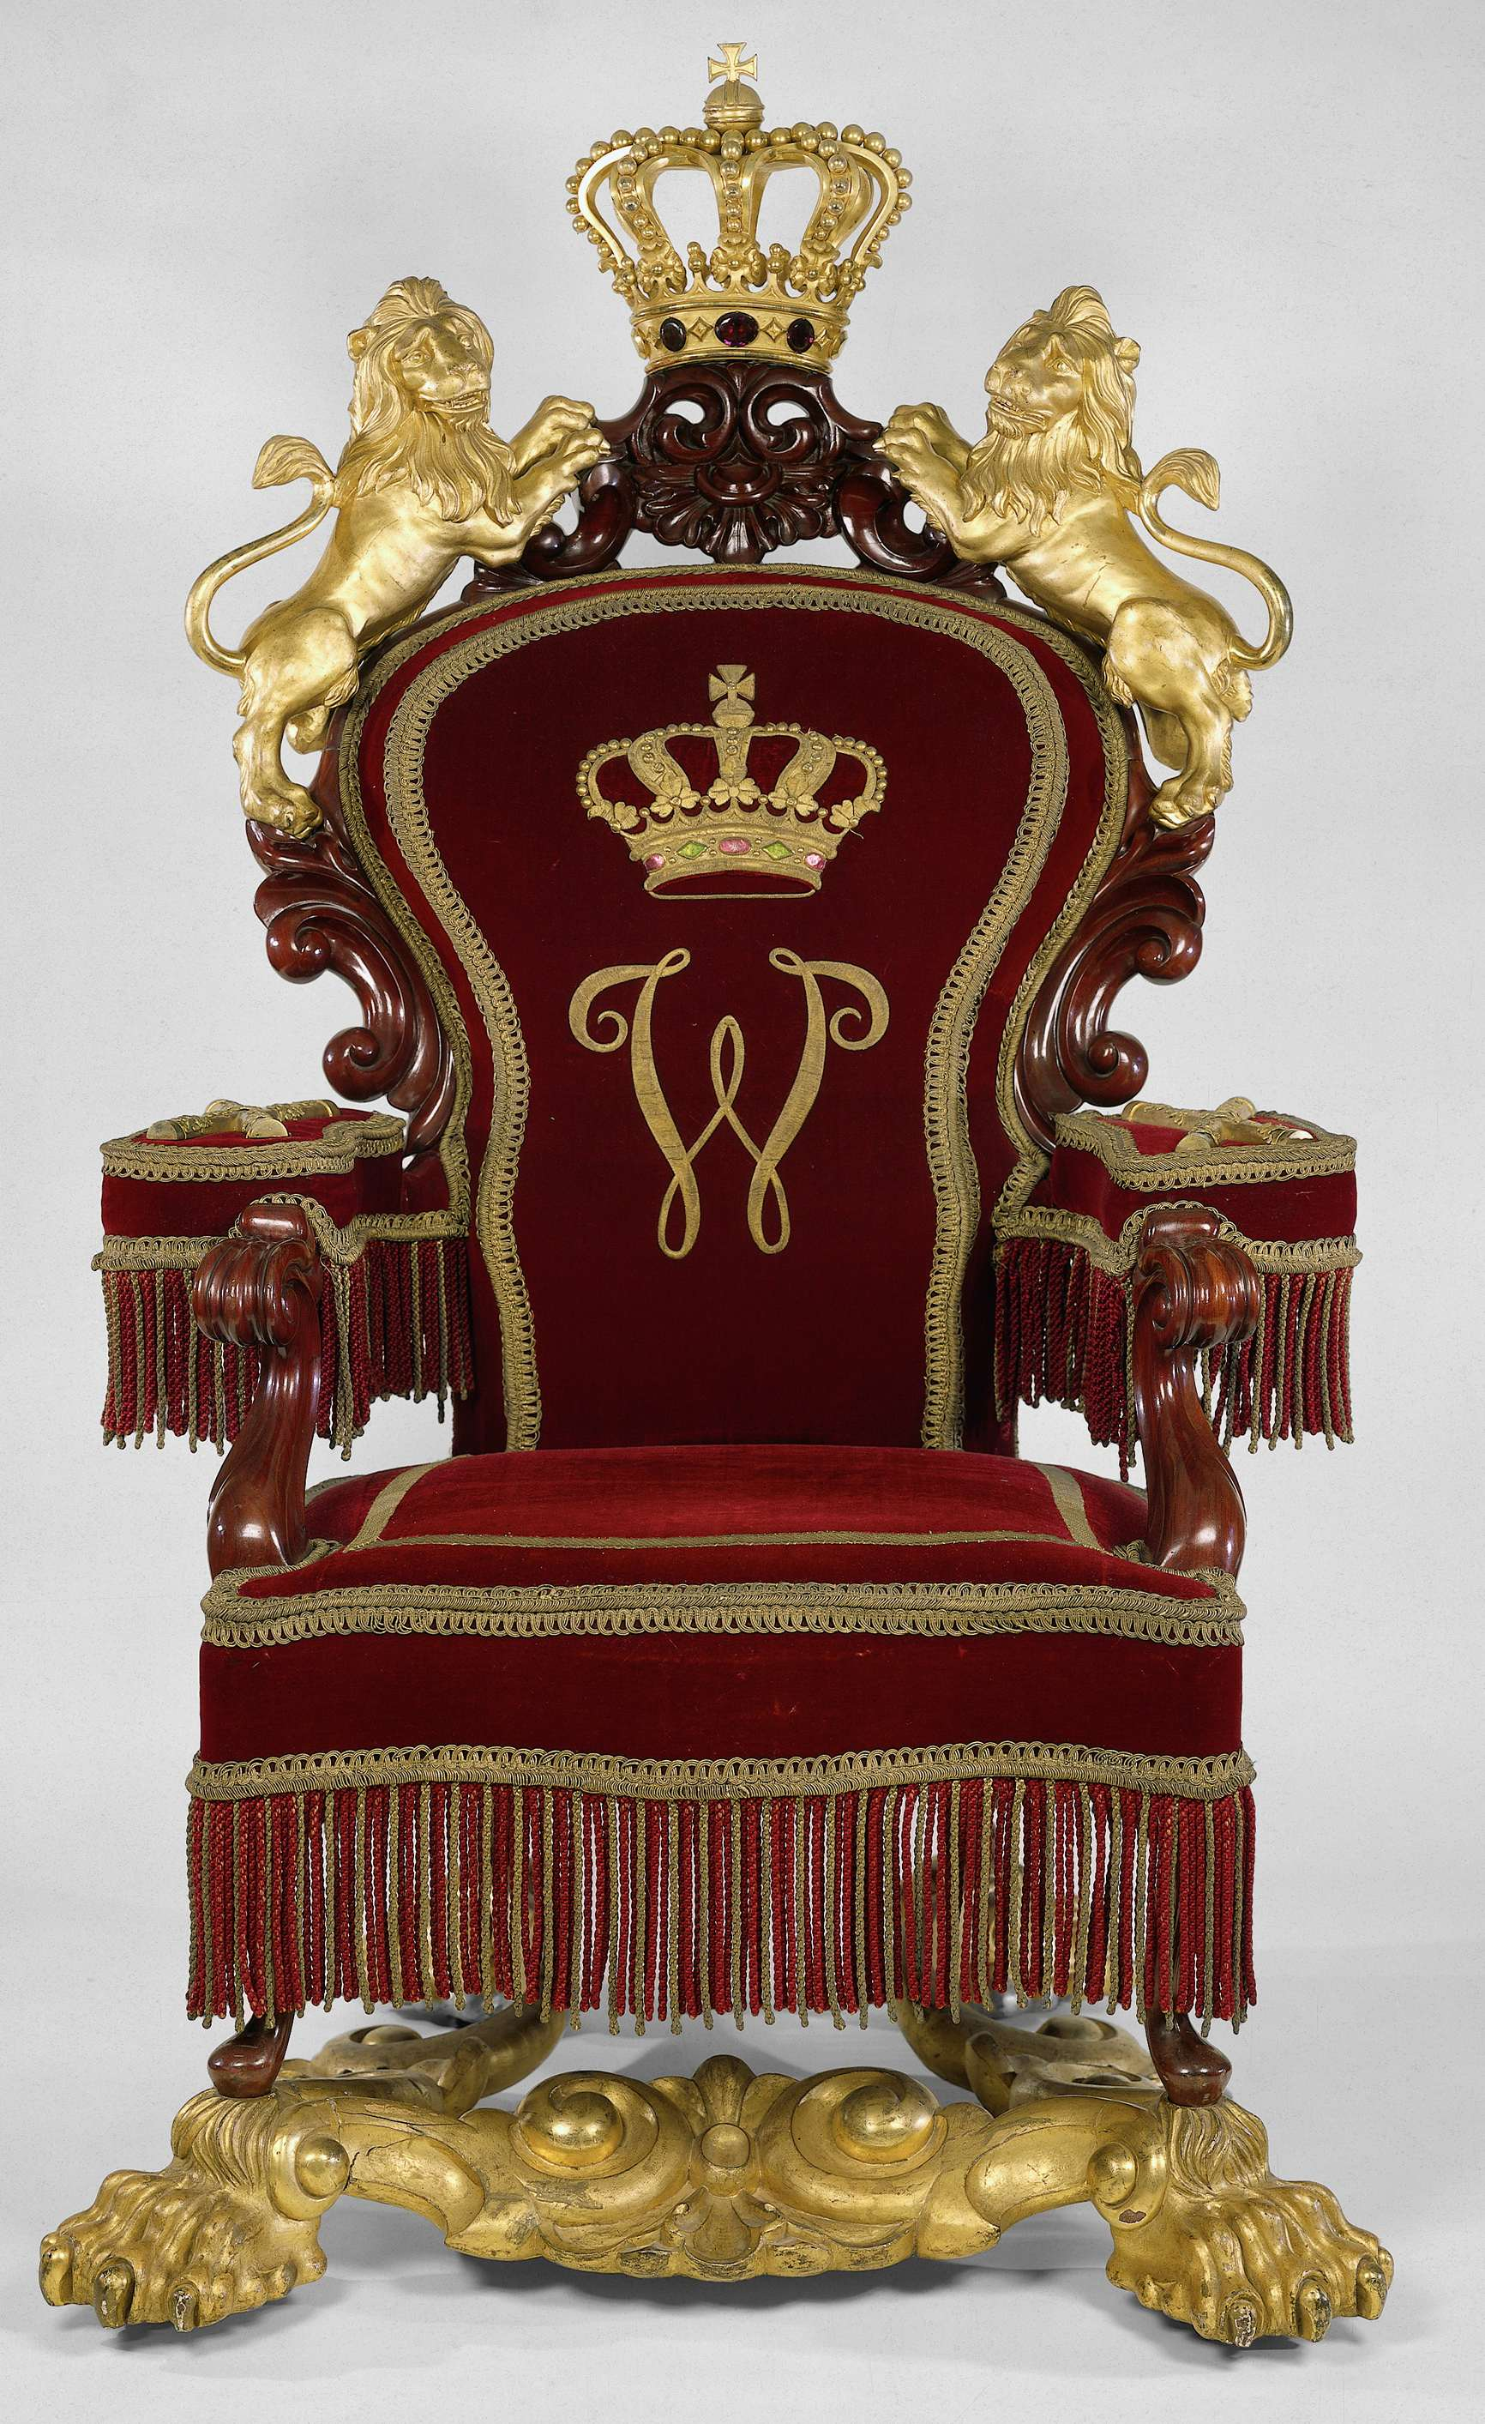
THE 12 QUESTION JESUS
“Then answered Peter and said unto him, Behold, we have forsaken all, and followed thee; what shall we have thereof? And Jesus said unto them… ye which have followed me, in the regeneration when the Son of man shall sit in the throne of his glory, ye also shall sit upon 12-thrones, judging the 12-tribes of Israel” (Mt. 19:27,28).
Unlike the rich, young ruler, the 12 Disciples had given up everything and followed Jesus, so they asked Him to what could they look forward? He answered that they were going to be part of His millennial government—Theocracy. As God, He would rule as King over the earthly kingdom. They, too would be given important responsibility, sitting on thrones, ruling over the nation of Israel. They will largely be figureheads, however, as Israel will have a pure heart, and be obedient to the will of God.

Slide 11
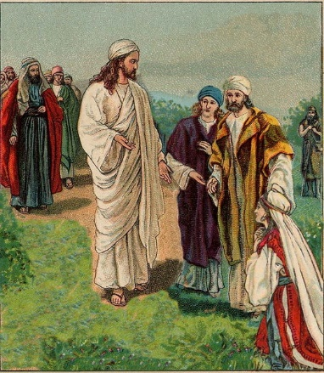
TO MINISTER—NOT TO BE MINISTERD TO
“Then came to him the mother of Zebedee’s children with her sons… desiring a certain thing of him… Grant that these my 2-sons may sit, the one on thy right hand, and the other on the left, in the kingdom… [Jesus] Ye know not what ye ask… it shall be given to them for whom it is prepared of my Father… whosoever will be great among you, let him be your minister; and whosoever will be chief among you, let him be your servant: Even as the Son of man came not to be ministered unto, but to minister, and to give his life a ransom for man” (21:20-28).
Jesus had already told them of their privileged position in the kingdom [thrones], but here tells them to get busy and do what it is they have been called for in this life—servanthood.

Slide 12
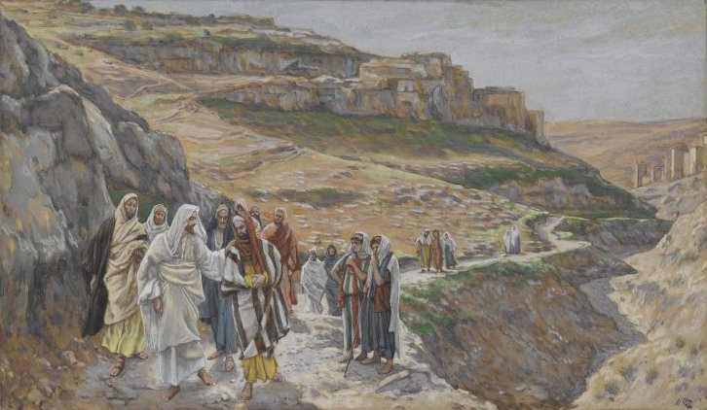
THE POSTPONED KINGDOM
“… he added a parable, because he was nigh to
Jerusalem, and because they thought the kingdom of
God should immediately appear… a certain nobleman
went into a far country to receive for himself a kingdom,
and to return… Occupy till I come. But his citizens
hated him… We will not have this man to reign over us”
(Lk. 19:11-14).
The nobleman was Christ who went to a far country
[heaven], which meant the kingdom would be delayed
and Israel was to be in charge until He returned with the
kingdom. But, the [unsaved] citizens of the nation
hated the nobleman [Christ], and declared they didn’t
not want Him to reign over them in the kingdom. Christ
was telling them, the kingdom would not only be delayed
but, He had taken it from them and given it to others –
“Therefore I say unto you, The kingdom of God shall be taken from you, and given to a nation [true, spiritual Israel] bringing forth fruits thereof” (Mt. 21:43).

Slide 13
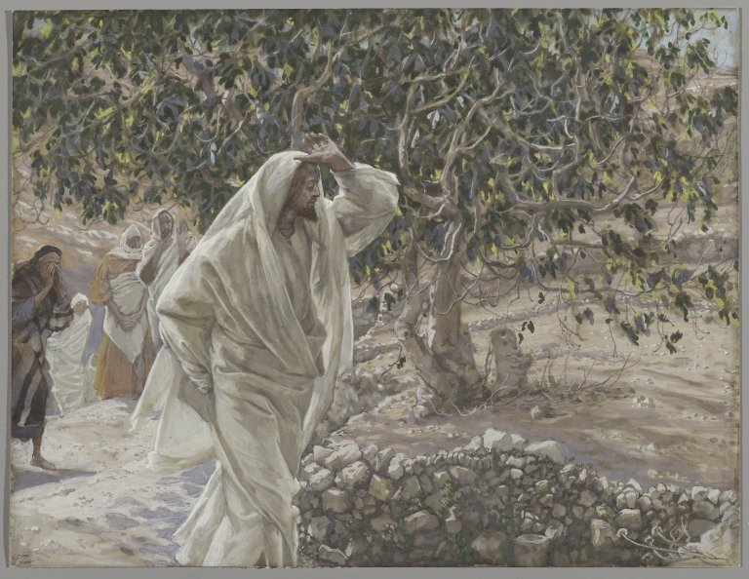
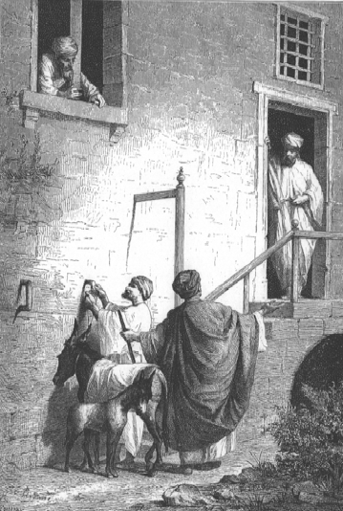
THE KING COMETH
“And when they drew nigh unto Jerusalem… unto the mount of Olives, then sent Jesus 2-disciples, saying unto them, Go into the village… ye shall find a ass tied, and a colt with her: loose them, and bring them unto me… All this was done, that it might be fulfilled which was spoken by the prophet… Behold, thy King cometh unto thee, meek, and sitting upon an ass, and a colt the foal of an ass” (Mt. 21:1-5).
Zechariah prophesied that Jesus would enter Jerusalem on a previously unridden colt, and He did.
THE BARREN FIG TREE
“… as he returned to the city, he hungered. And when he saw a fig tree, he came to it, and found nothing thereon, but leaves only… the fig tree withered away” (21:18,19).
The fig tree represented fruitless Israel who, after her rejection of Messiah, would wither away until His return.

Slide 14
JESUS WEEPS OVER JERUSALEM
“And when he was come near, he beheld the city, and wept over it, Saying, If thou hadst known… the things which belong unto thy peace! But, now they are hid from thine eyes” (Lk. 19:41).
He felt not only the pain of His own rejection, but the devastation that would fall upon the city
in the future because of Israel’s rejection of Him –
“For the days shall come upon thee, that thine enemies shall cast a trench about thee, and compass thee round… on every side. And shall lay thee even with the ground… not leave one stone upon the other; because thou knewest not the time of thy visitation” (19:43,44).
In A.D. 70, General Titus of the 10th Roman Legion destroyed the city of Jerusalem as Christ said.

Slide 15
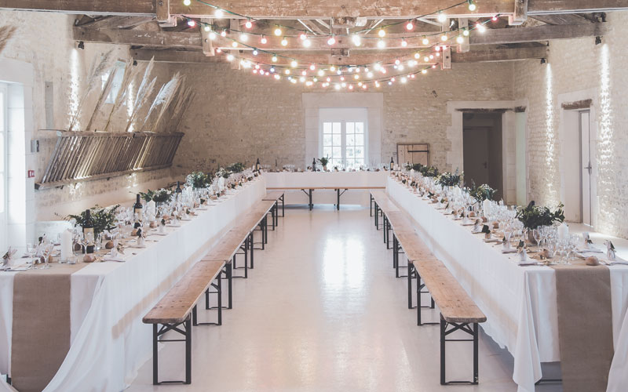
THE WEDDING FEAST
“The kingdom of heaven is like unto a certain king [God],
which made a marriage for his son [Christ], and sent forth
his servants to call them [Israel] that were bidden to the
wedding: and they would not come… they made light of it,
an went their ways [mocked & rejected Messiah]… when
the king [God] heard thereof, he was wroth: and sent
forth his armies [10th Roman legion], and destroyed those
murderers [Jews], and burned up their city [Jerusalem]…
they which were bidden were not worthy [1st century
Israel]… So [in the future] the servants [144,000 Jews]
went out into the highways [tribulation]… they found both
good [saved] and bad [unsaved]… a man which had not on
a wedding garment… bind him [antichrist] hand and foot…
cast him into outer darkness… weeping and gnashing of
teeth” (Mt. 22:1-14). The 1st [John Baptist] and 2nd [Christ’s ministry] invitations to Israel were rejected and ended in A.D. 70 when Jerusalem was destroyed. In the tribulation, new invitations will be sent for the wedding, but a false bridegroom will be apprehended and cast into hell.

Slide 16
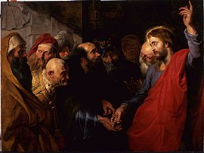
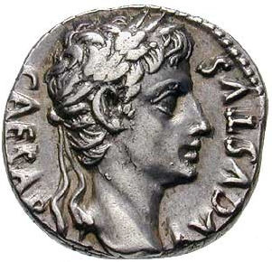
RENDER UNTO CAESAR
“Then went the Pharisees, and took counsel how they might
entangle him in his talk… Tell us… Is it lawful to give tribute to
Caesar, or not…” (Mt. 23:15-17).
Again they tried to trap Him, this time in opposition to those
who supported king Herod. If Jesus said no, then He would
be defying their king; if He said yes, then He would be going
against God. They had Him cornered, right?
“But Jesus perceived their wickedness… Why tempt ye me,
ye hypocrites? Shew me the tribute money… Whose is this
image?... Caesar’s… Render therefore unto Caesar the things
that are Caesar’s; and unto God the things that are God’s”
(Mt. 22:15-21).
Christ told them they were required to support the
government [taxes], which God had introduced during Noah’s
day, and which Paul later confirmed – “Render to all their
dues: tribute to whom tribute is due” (Rom. 13:7).
To God we owe everything else.

Slide 17
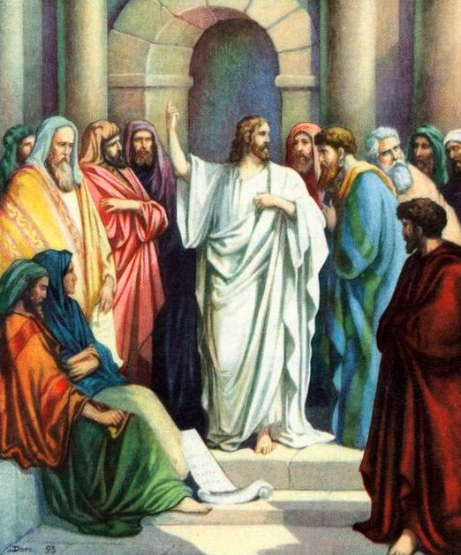
THE RESURRECTION
“The same day came to him the Sadducees, which say there is no resurrection, and asked him, Saying, Master, Moses said, If a man die, having no children, his brother shall marry his wife, and raise up seed unto his brother (Deut. 25:5). Now there were with 7-brethren: and the 1st, when he had married a wife, deceased… let his wife to his brother. Likewise, the 2nd also, and the 3rd… unto the 7th. Therefore in the resurrection whose wife shall she be of the 7? For they all had her” (22:23-28).
The harder they tried to stump Him, the more ignorant they looked. Jesus told them that procreation was for this life only, that when saved Jews would be resurrected in the kingdom there wouldn’t be marriage nor childbearing, but rather have resurrected bodies like that of angels.
The Sadducees denied the resurrection and accepted only the Pentateuch [1st five books]. What did Jesus do? He quoted
Moses, that He was the God of the living, so that the Patriarchs then must be alive [Paradise] and will be part of the kingdom.

Slide 18
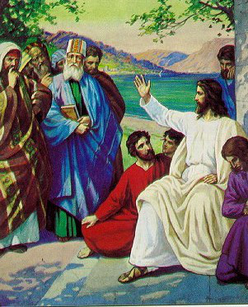
THE GREATEST COMMANDMENT
“… a lawyer, asked him a question… Master, which is the great commandment in the law? Jesus said unto them, Thou shalt love the Lord thy God with all thy heart, and with all thy soul, and with all thy mind. This is the 1st and great commandment. And the 2nd is like unto it, Thou shalt love thy neighbor as thyself. On these two commandments hang all the law and the prophets” (Mt. 22:35-40).
The common denominator is love: love God with every thing you have; love your fellowman the same. The lawyer agreed with Jesus, “Master, thou hast said the truth… And to love him with all the heart… and to love his neighbor as himself, is more than all whole burnt-offerings and sacrifices” (Mk. 12:32,33).
Jesus commended him, “… Thou art not far from the kingdom of God” (12:24), but did he love Messiah?
They didn’t ask Him any more questions.

Slide 19
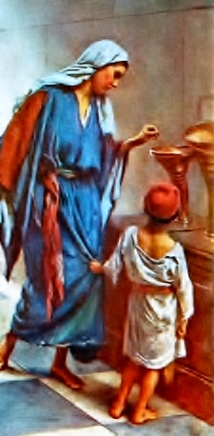
THE WIDOW’S MITE
“And Jesus sat over against the treasury, and beheld how the people cast money into the treasury: and many that were rich cast in much. And there came a certain poor widow, and she threw in 2-mites, which make a farthing. And he called unto him the disciples, and saith unto them, Verily I say unto you, That this poor widow hath cast more in, than all they which have cast into the treasury: For all they did cast in of their abundance; but she of her want… even all her living”
(Mk. 12:41-44).
The tithe [10%] was mandated under the Law but here Jesus saw a poor widow give more than required, someone who had good reason to give little—gave exceedingly. Why?
Undoubtedly, she gave out of love. She didn’t give to be noticed, perhaps she gave her all because she had enough to eat that day or because she had love for the Messiah who was sent to save her from her sin. She was a type of every saved Jew receiving a heart transplant in the kingdom.

Slide 20
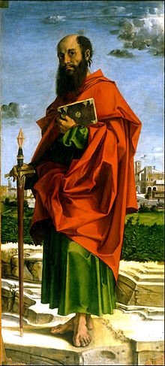
GIVING UNDER GRACE
That system of giving has changed during the dispensation of grace. One was REQUIRED to give under Law, but Paul says that command has been dropped –
“I speak not by commandment [to give]… For ye know the grace of our Lord Jesus Christ, that, though he was rich, yet for your sakes he became poor, that ye through his poverty might be rich” (2Cor. 8:8,9). Here Paul reveals the updated truth on giving under grace—Christ was rich [heaven] but became poor [earth, cross], so that we who are poor [earth] could be rich [heaven].
“For if there be first a willing mind, it is accepted according to that a man hath… not according to that he hath not (8:12)… Every man according as he purposeth in his heart, so let him give; not grudgingly, or of necessity, for God loveth a cheerful giver” (9:7). The widow gave out of what she didn’t have; God doesn’t ask us to do that, but rather out of what He has so graciously given us – YOU DECIDE HOW MUCH HE HAS GIVEN YOU!

Slide 21
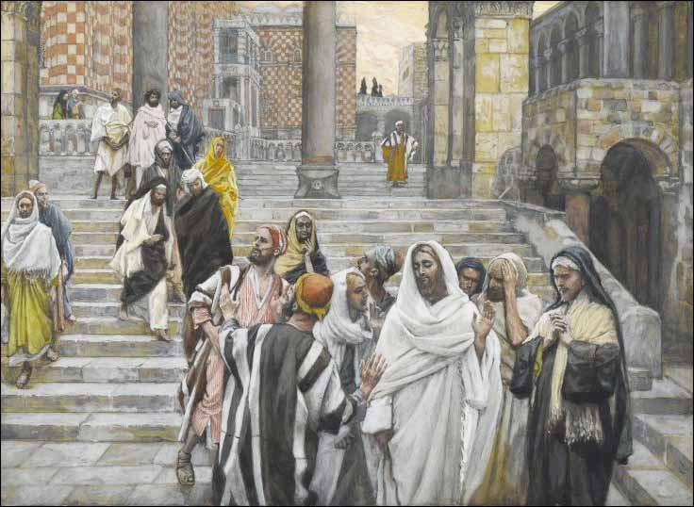
Next time – The Olivet Discourse:
the tribulation and 2nd coming.

