Slide 1
THROUGH THE BIBLE IN 2018
Lesson 1
Week 1 of 52
Gen. 3-11; Job 1,2
Last time we studied:
The 6 days of creation (Gen. 1:1-31)
Man’s test, failure, and means of redemption
(Gen. 2:7-3:7)
Expulsion from paradise (Gen. 3:23,24)

Slide 2
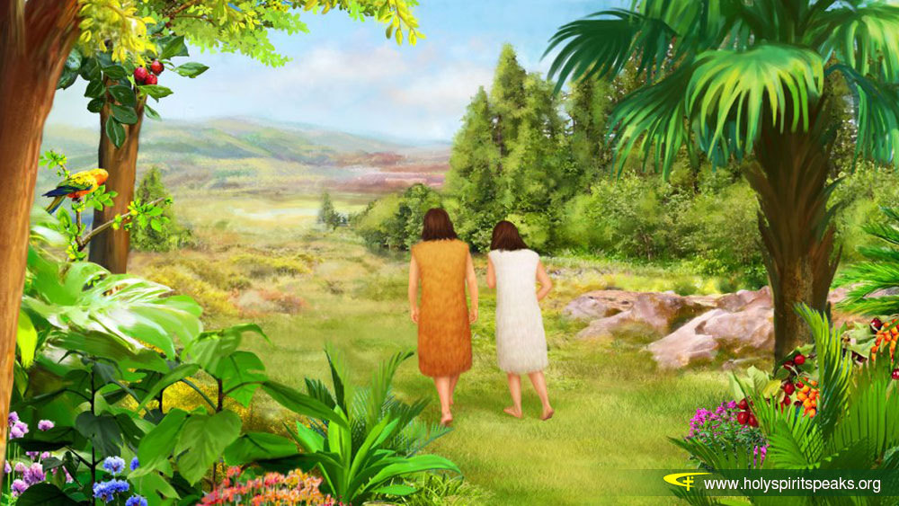
Adam & Eve
Though they were banished from paradise, they still had a very long life to live [930 yr. (Gen. 5:5)] and the first thing God did was to give them children to propagate the earth –
“And Adam knew Eve his wife; and she conceived, and bare Cain, and said, I have gotten a man from the LORD”
(Gen. 4:1).
Eve believed her firstborn was the promised Redeemer (Gen. 3:15), but she was wrong.
Adam & Eve had another son, Abel –
“… Abel was a keeper of the sheep, but Cain was a tiller of the ground” (Gen. 4:2).
What have we learned of the ground?
“… cursed is the ground for thy sake” (Gen. 3:17), but of an animal God had sacrificed and clothed them in His righteousness (Gen. 3:21).

Slide 3
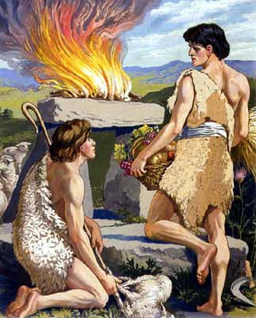
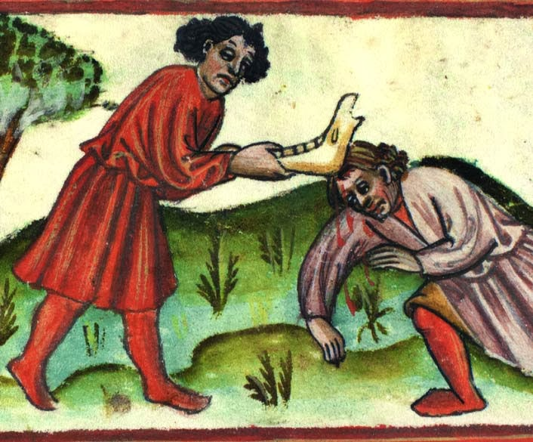
CAIN & ABEL
These two sons of Adam and Eve were very different; One was godly and one wasn’t –
“By faith Abel offered a more excellent sacrifice than Cain…” (Heb. 11:4); Abel’s a bloody sacrifice; Cain’s a bloodless one.
Why? Cain rebelled and followed the leading of Satan –
“Not as Cain, who was of that wicked one, and slew his brother. And wherefore slew he him? Because his own works were evil, and his brother’s righteous” (1Jn. 3:12).
Adam & Eve had another son, Seth (Gen. 4:24) who became the lineage of Christ (Lk. 3:38). Whereas, Adam had been made in the image of God (Gen. 5:1), Seth was born in the fallen image of his father, Adam (Gen. 5:3), as has every person born since (Eph. 2:2,3).

Slide 4
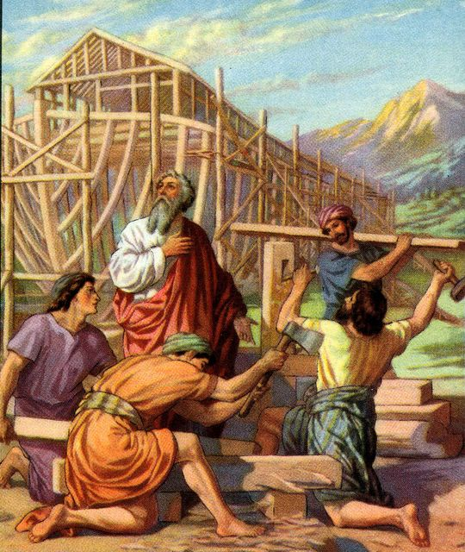
THE FLOOD
About 2,400 B.C. God destroyed the earth and every thing in it with water. Why?
“And God saw the wickedness of man was great in the earth, and that every imagination of the thoughts of his heart was only evil continually” (Gen. 6:5).
How grieved was God with the rebellion of mankind?
“And it repented [was sorry] the LORD that he had made man on the earth, and it grieved him at his heart” (Gen. 6:6).
That is, all except for Noah –
“But Noah found grace in the eyes of the LORD” (Gen. 6:8). Why?
“By faith Noah, being warned of God of things not seen as yet (2:5; 7:4), moved with fear, prepared an ark to the saving of his house…” (Heb. 11:7).

Slide 5
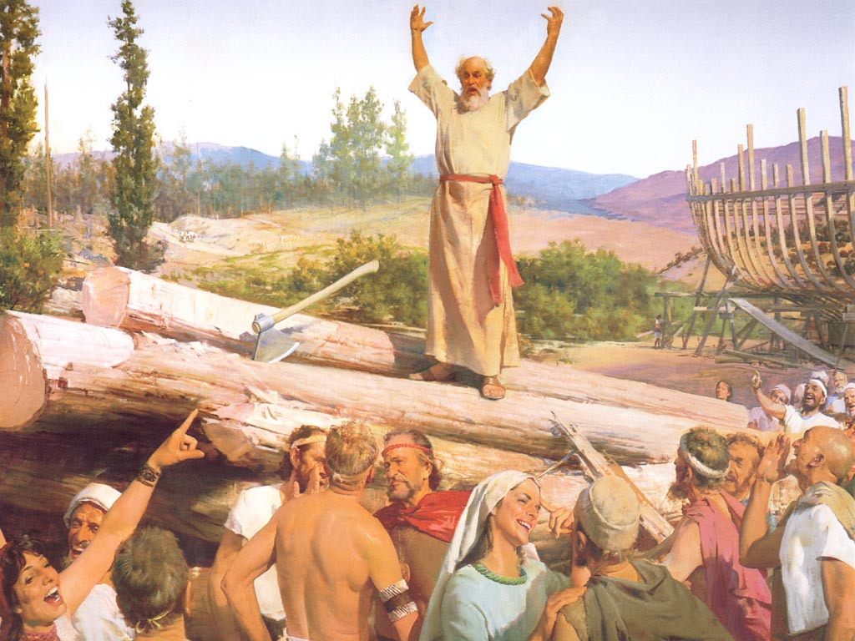
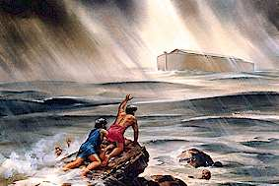
Noah believed [faith] God when told a flood
was coming, which he kept not just to himself –
“But spared not the old world, but saved Noah the eighth person, a preacher of righteousness, bringing in the flood upon the world of the ungodly” (2Pet. 2:5).
How many converts did Noah get?
His wife, his 3 sons, and their wives.
How long did Noah preach?
“… yet his [man’s] days [on the earth] shall be
an hundred and twenty years” (Gen. 6:3).
God would give mankind 120 years to accept His offer of safety in the ark, the time it took Noah and his sons to build the ark.

Slide 6
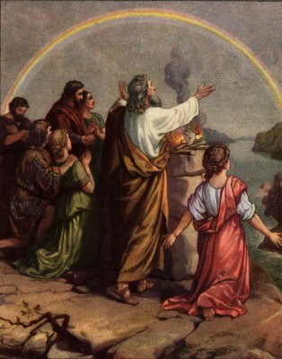
Facts: rained 40 d/n (7:4); water on earth 150 days (7:24); water receded in 150 days (8:3); got off the ark in 377 days/1 yr. 17 days (8:19). Guess what was the first thing Noah did after the ark landed on dry land –
“And Noah builted an alter unto the LORD; and took of every clean best, and of every clean fowl, and offered burnt offerings on the alter”(Gen. 8:20).
As a result God promised –
“… I will not again curse the ground any more for man’s sake; for the imagination of man’s heart is
evil from his youth” (Gen. 8:21). God knew He couldn’t destroy the earth every time man rebelled. He would come up with a different course of action.
“And God blessed Noah and his sons [Shem, Japheth, Ham], and said unto them, Be fruitful, and multiply, and replenish the earth” (Gen. 9:1).

Slide 7
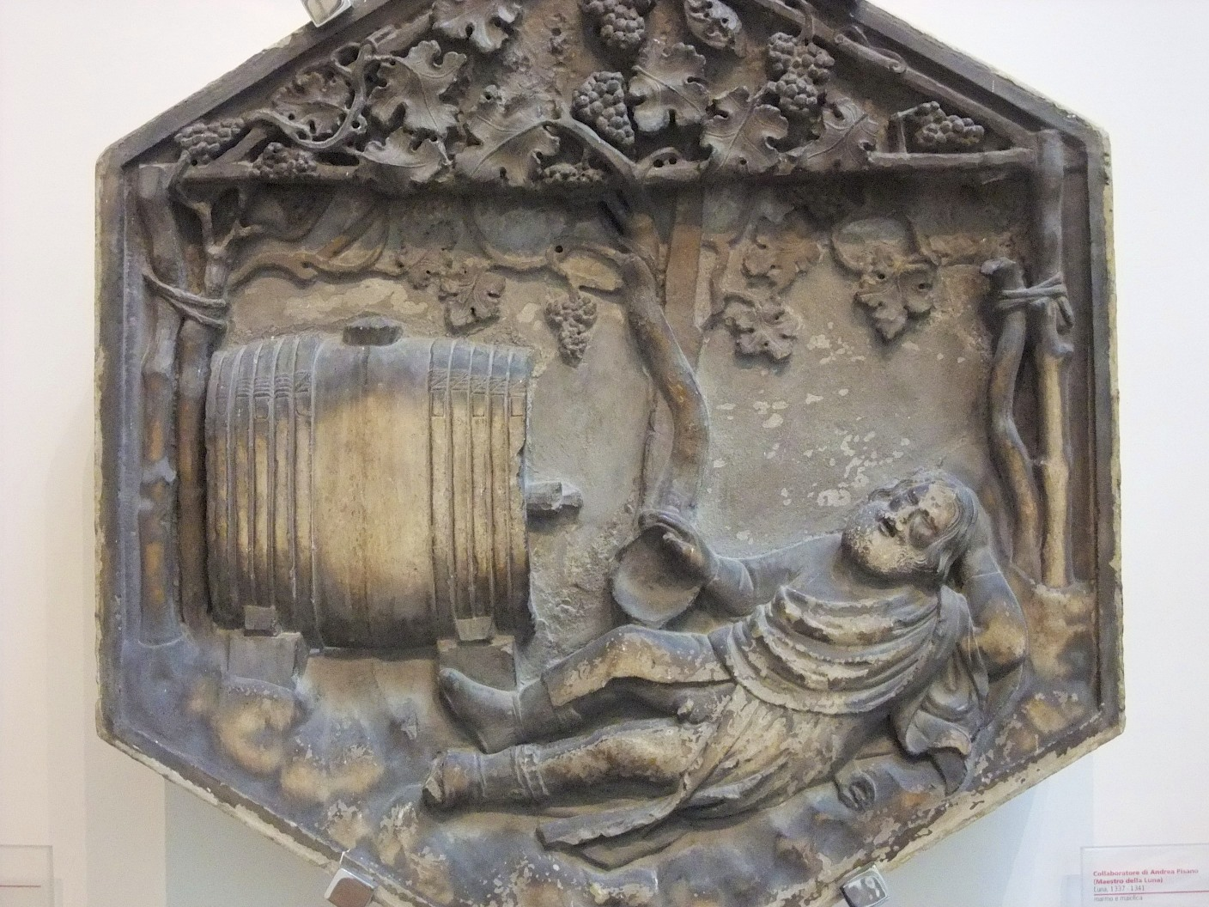
SONS OF NOAH
Noah’s sons, Shem, Japheth, and Ham would be the beginning of the “… Gentiles divided in their lands… in their nations (Gen. 10:5).
But it would not start well –
“And Noah began to be a husbandman, and he planted a vineyard. And he drank of the wine, and was drunken; and he was uncovered in his tent” (Gen. 9:20,21).
Ham dishonored his father by looking at his nakedness; the two other sons shielded themselves from seeing him (Gen. 9:22,23).
“And Noah awoke from his wine, and knew what his younger son had done to him. And he said, Cursed be Canaan; a servant of servants shall he be unto his brethren” (Gen. 9:24,25).

Slide 8
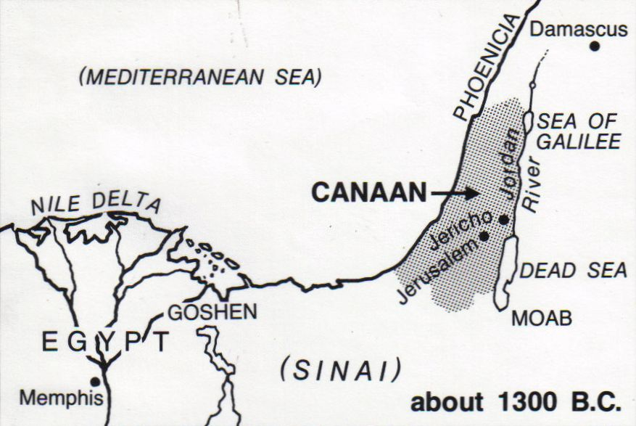
The curse didn’t fall on Ham but on his son Canaan.
How? When?
Canaan and his descendants would inhabit a land NOT given to them of God, but given to Shem and his descendants [Abraham].
The Canaanites would show the same ungodly, pagan, immoral behavior as did Ham.
As a result, God gave them sufficient time to leave (Gen. 15:16), but if they refused, they were to be driven from their land.
If they refused to go, they were to be put to death.

Slide 9
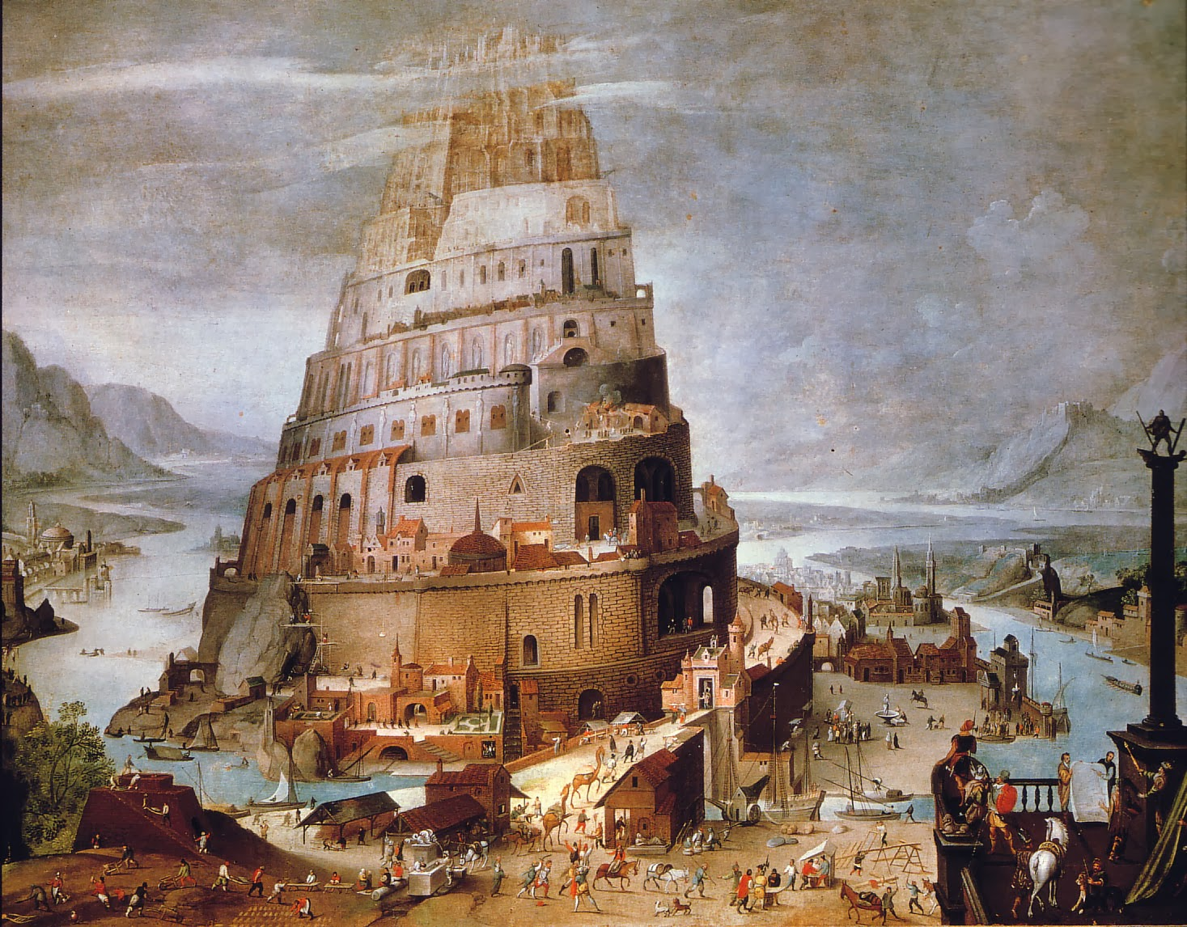
TOWER OF BABEL
“And the whole earth was of one language, and of one
speech. And it came to pass, as they journeyed from the
east, that they found a plain in the land of Shinar; and
they dwelt there” (Gen. 11:1,2).
Instead of spreading out and forming Gentile nations as
God had commanded, they congregated in one place.
“And they said one to another… let us build us a city
[single nation of people] and a tower, whose top may
reach unto heaven…” (Gen. 11:3,4a).
Instead of worshipping Noah’s God, they built a tower
to reach the gods of their evil imaginations.
“… let us make us a name [for ourselves], lest we be
scattered aboard upon the face of the whole earth”
(Gen. 11:4b).
Instead of praising the name of God, they followed Satan and his desire to have them praise themselves [mankind].

Slide 10
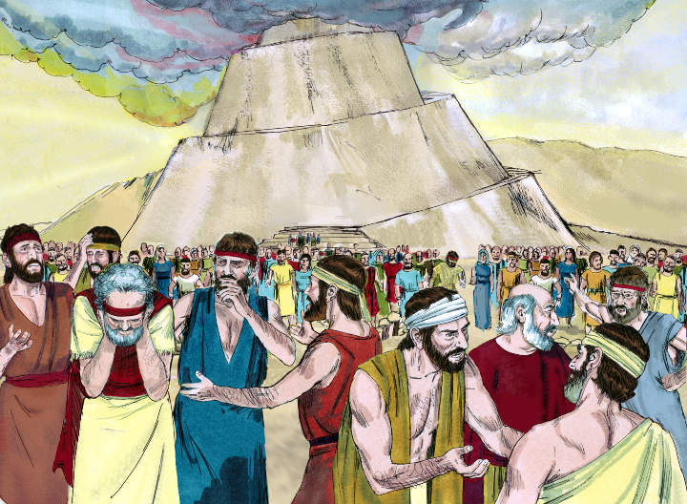
“And the LORD came down to see the city and the tower, which the children of men builded… Behold, the people is one… now nothing will be restrained from them, which they have imagined to do” (Gen. 11:5,6).
God knew He had to do something or else things would be exactly as they were before the flood.
“… Let us go down there confound their language, that they may not understand one another’s speech” (Gen. 11:7).
He confounded their language so that they were forced to stop construction.
Eventually they dispersed, “… and from thence did the LORD scatter them abroad upon the face of all the earth” (Gen. 11:9).
But their rebellion didn’t end.

Slide 11
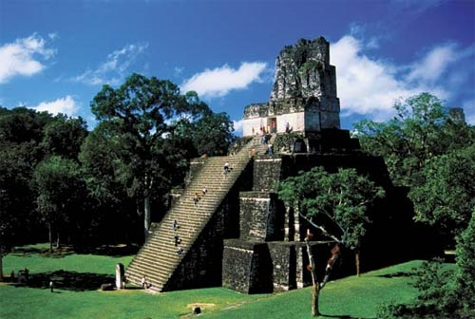
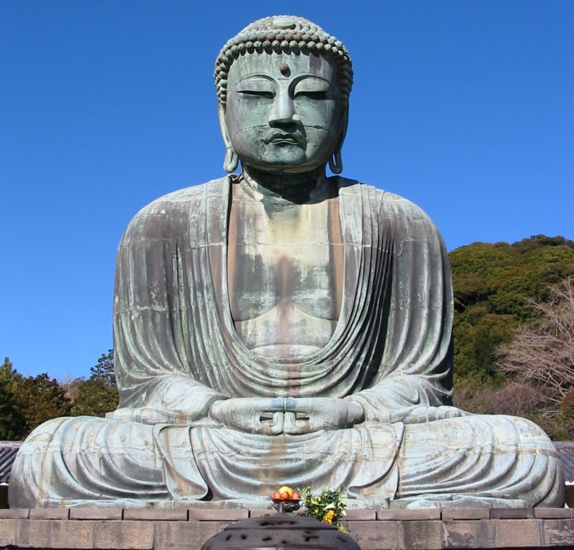
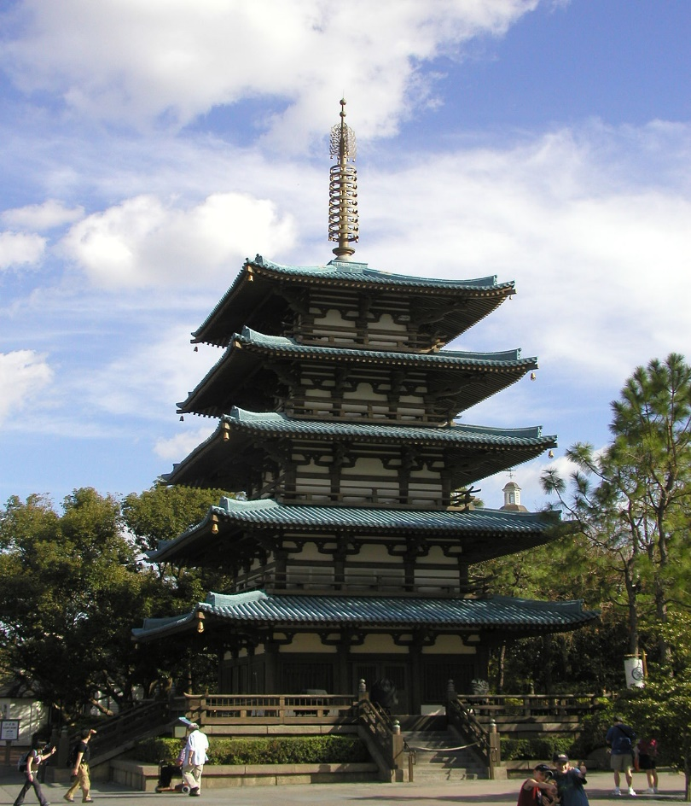
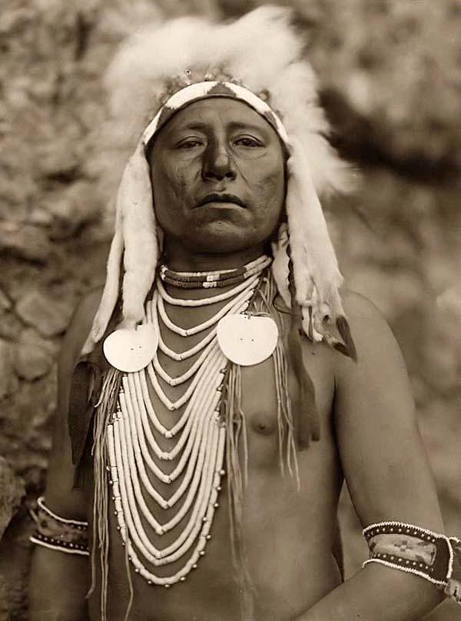
Their rebellion against God went with them all over the earth.

Slide 12
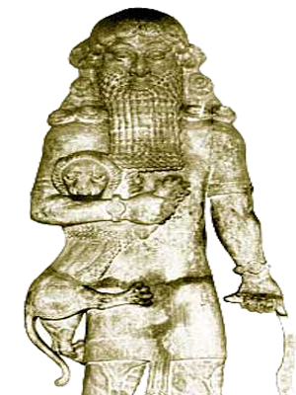
The rebellion that began at the tower of Babel was the beginning of a world-wide Satan induced practice of idolatry that began with one man –
“And Cush begat Nimrod: he began to be a mighty one in
the earth… And the beginning of his [Satan’s] kingdom was Babel…” (Gen. 10:8,10).
The Apostle Paul cited this fact, “For the mystery of iniquity doth already work…” (2Thess. 2:7).
Not only does Satan’s rebellion continue in the world today, but it will culminate in a yet future day –
“… then shall that Wicked [one] be revealed…” (2Thess. 2:8).
Satan’s influence in the world that began at Babel will culminate when the Antichrist manifests himself at the ½ point of the tribulation –
“… so that he [Antichrist] as God sitteth in the temple of God, shewing himself that HE IS GOD” (2Thess. 2:4).

Slide 13
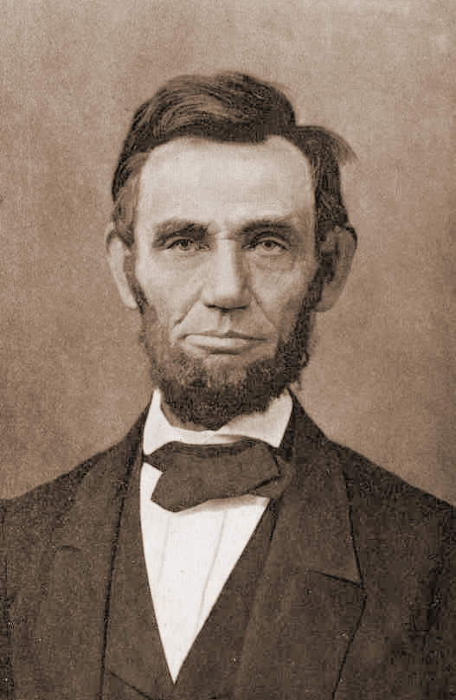
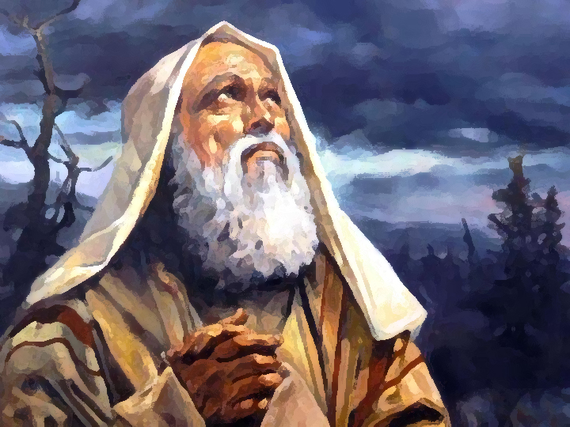
After God created man [4,000 B.C.], it took mankind 1,600 years to rebel against God
before He destroyed them with a flood
[2,400 B.C.]. It took less than 400 years after
the flood to have the whole human race rebel against God a second time.
The descendants of Noah formed unholy
nations after their own name.
What would God do?
God would search the world until He found
the right man through whom He would form
a Holy nation after His Name.
That man would be ABRAHAM (Gen. 11:25-27).
Sorry, wrong Abraham.
But before that we are going to study the
BOOK OF JOB.

Slide 14
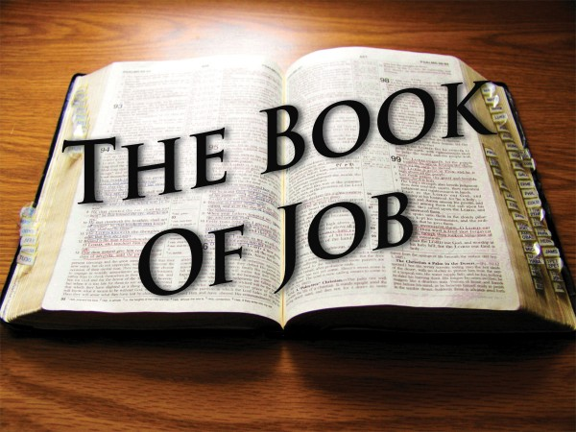
Why the Book of Job now?
Because we are studying the Bible chronologically and Job is believed to have lived just before God’s call of Abraham.
The Book of Job is considered ‘wisdom literature’ like Psalms (praise); Proverbs (divine wisdom); Ecclesiastes (life); Song
of Solomon (marriage), etc.
The overriding theme of Job is suffering.

Slide 15
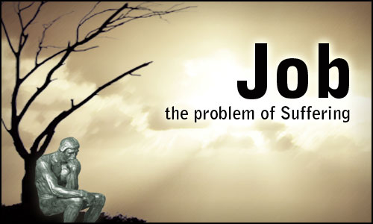
Why does a book belong in the Bible that records the seemingly undeserved suffering of a righteous man who loses his material wealth, children, and health, whose wife tells him to curse God and die, whose friends condemn rather than console him, and to whom God appears to turn a deaf ear?
For our study. Though written in antiquity, this story is still relevant today. Job’s predicament often mirrors situations we find ourselves today–financially, emotionally, physically, spiritually. He seems alone in his despair, and it seems Satan is attacking and God is no where to be found. Like Job, we often ask why life is so unfair, why bad things happen to good people who are trying their best to live a godly life. We know we should not curse God, but is it wrong to question God and His doings? But should we demand anything of God? This book will help us to answer these and many other questions.

Slide 16
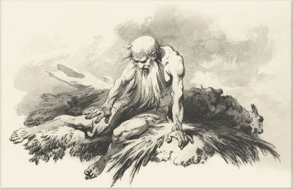
Author
The author is unknown. Some believe it to be Job himself, Elihu
(the 4th friend), Moses, Solomon, Hezekiah, Isaiah, Ezra, or an
eye witness to the story (Job lived 140 years after being restored
to good health [Job 42:16] which would have allowed plenty of
time for the events to be recorded by inspiration for future
canonization).
Date
The date Job lived is unknown. Most scholars believe it was
slightly before the patriarchal period (2,000 B.C.-2,200 B.C.), the
time of Abraham, Isaac, and Jacob. The reason is that Job lived 140 years after these events happened he would have most likely lived over 200 years which corresponds to the life spans of others during that time: Noah 950 years (Gen. 9:29); Terah (Abram’s father) 205 years (Gen. 11:32); Abraham 175 (Gen. 25:7); Isaac 180 (Gen. 35:28); Jacob 147 (Gen. 48:28).
Another indication that Job took place in the post-flood patriarchal period is that his wealth was accrued in livestock (Job 1:3; 42:12) which was the same for Abraham (Gen.12:16; 13:2) and Jacob (Gen.30:43; 32:5). There are no references to the Mosaic law, holy days, tabernacle, etc. Job was a common 2nd millennium B.C. Semetic name.

Slide 17
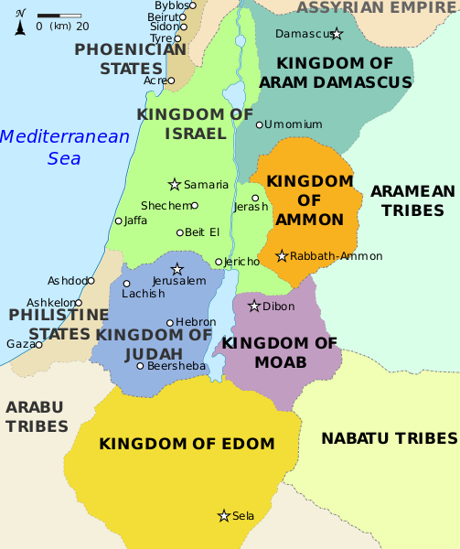
Location
Job lived in the land of Uz (Job 1:1), which scholars believe predated and then conquered by Edom (Oba. 1:1) being directly West across the Arabian desert from Ur of the Chaldees (Babylon).
Oldest book in the Bible
Job is believed to be the oldest of the canonized Scriptures.
The 1st five books of the Bible [Penteteuch] were written by Moses (Josh. 8:31; 1Kg. 2:3; Lk. 2:22) during his lifetime (1,400-1,500 B.C.), by the inspiration of God (2Tim. 3:16; 2Pet. 1:21).
It is believed that Job was written at the time the events took place during Job’s lifetime (2,000-2,200 B.C.).

Slide 18
PROLOGUE
The book of Job begins with one of the oldest and most important lessons in the Bible, yet it
is one of the most important today = the righteousness of man.
Genesis 1 (Gen. 1:26,27) & 2 (Gen. 2:7) describe creation of mankind, Gen. 3 the fall (Gen. 3:6,7) and banishment from Eden (Gen. 3:23,24). Gen. 4 shows the mercy of God as He pointed man back to God – one accepted (Gen. 4:4), one rejected (Gen. 4:5). Abel’s was
God’s way, Cain’s man’s way. Prior to the flood the overwhelming majority elected to follow Cain’s way, few God’s way. After the flood and the tower of Babel, that rebellion continued.
In the book of Job we pick up the same theme – a righteous man living in an evil world.
Job had a large family (1:2), considered to be a divine blessing (Ruth 4:15; 1Sam. 2:5). Job
was the greatest of all men in the east and incredibly wealthy (1:3). Job was the most influential and respected person in that area. Job offered burnt offerings (1:4,5) for his rebellious children.
He was a beckon of light in an otherwise dark world with his endurance and perseverance through suffering (Jas. 5:11). The reader also should not be ignorant of God’s importance, or His intended end – that His mercy & compassion toward mankind is the ultimate lesson taught.

Slide 19
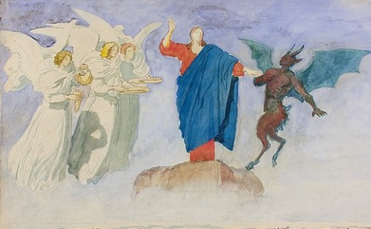
One day angels (38:7) come to appear before God
(1:6) and Satan (lit., the accuser) came along. We
see that Satan had access to heaven. God speaks
to Satan (1:7,8), Satan answers (1:9).
God points out the virtue of Job but Satan
answered God, pointing an accusing finger toward
Job (1:9). Satan doesn’t refute the fact that Job is
a righteous man, but implies that Job is following
God not because of pure motives (he really loves
Him), but rather only for what he receives from
God (1:10). Satan contends that God has insulated
Job from anything but good, that as long as Job continues to do good, he will be further blessed. Satan’s accusation is that Job’s faith is really based on a self-serving, less than holy intent. A sub-theme of Job is the inner motive of the believer.
Why do we become believers? Is it simply a means to an end? Is it only to get to heaven, or to escape hell? Or, is it because we really love God and want to live our life for Him?

Slide 20
Satan challenges God concerning Job (1:11).
Was Job blessed because he loved God, or did he
love God because he was blessed?
Satan was betting that Job loved God because of
the blessings he received from God, and that if
those things were taken away Job’s faith would
quickly fade.
This accusation was also an indictment against
God. Satan reckoned that the only way God can
get man to follow Him is for them to get some
thing in return.
Satan reasoned that if God were to remove material gain, man would quickly lose interest in God. God allowed Satan to take anything but Job’s life (1:12).
The stage is set for the remainder of the book. Will Job continue to trust God if he loses everything but his life? God says he is mine, and Satan believes he can draw him away.
Who wins? Stay tuned!

Slide 21
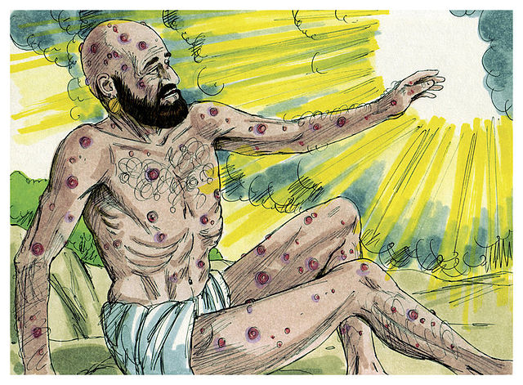
NEXT TIME – JOB 1:12 – Ch. 39

