Slide 1
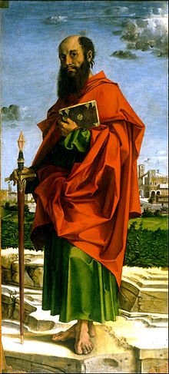
LESSON 49
WEEK 49 OF 52
(1Cor. 15,16; 2Cor. 1-13; Rom. 1-10)
THROUGH THE BIBLE IN 2018
Last time – Paul’s Macedonian churches; This time – The house churches in Rome
PAUL’S GOSPEL
“… the gospel which I preached unto you… ye have received… ye stand… ye are saved… which I also received… Christ died for our sins… buried … rose again the 3rd day…” (1Cor. 15:1-4).
Paul’s newly revealed gospel (A.D. 53) given exclusively to him was hidden from the 12, “… put him to death: and the 3rd day he shall rise again. And they understood none of these things… was hidden from them…” (Lk. 18:33,34). Why was it hidden?
“Which none of the [Satan’s] princes of this world knew: for had they known it, they would not have crucified the Lord of glory” (1Cor. 2:8).
Christ kept secret His own death, burial, and resurrection until after the fact, so it was too late for Satan to do anything about it.

Slide 2
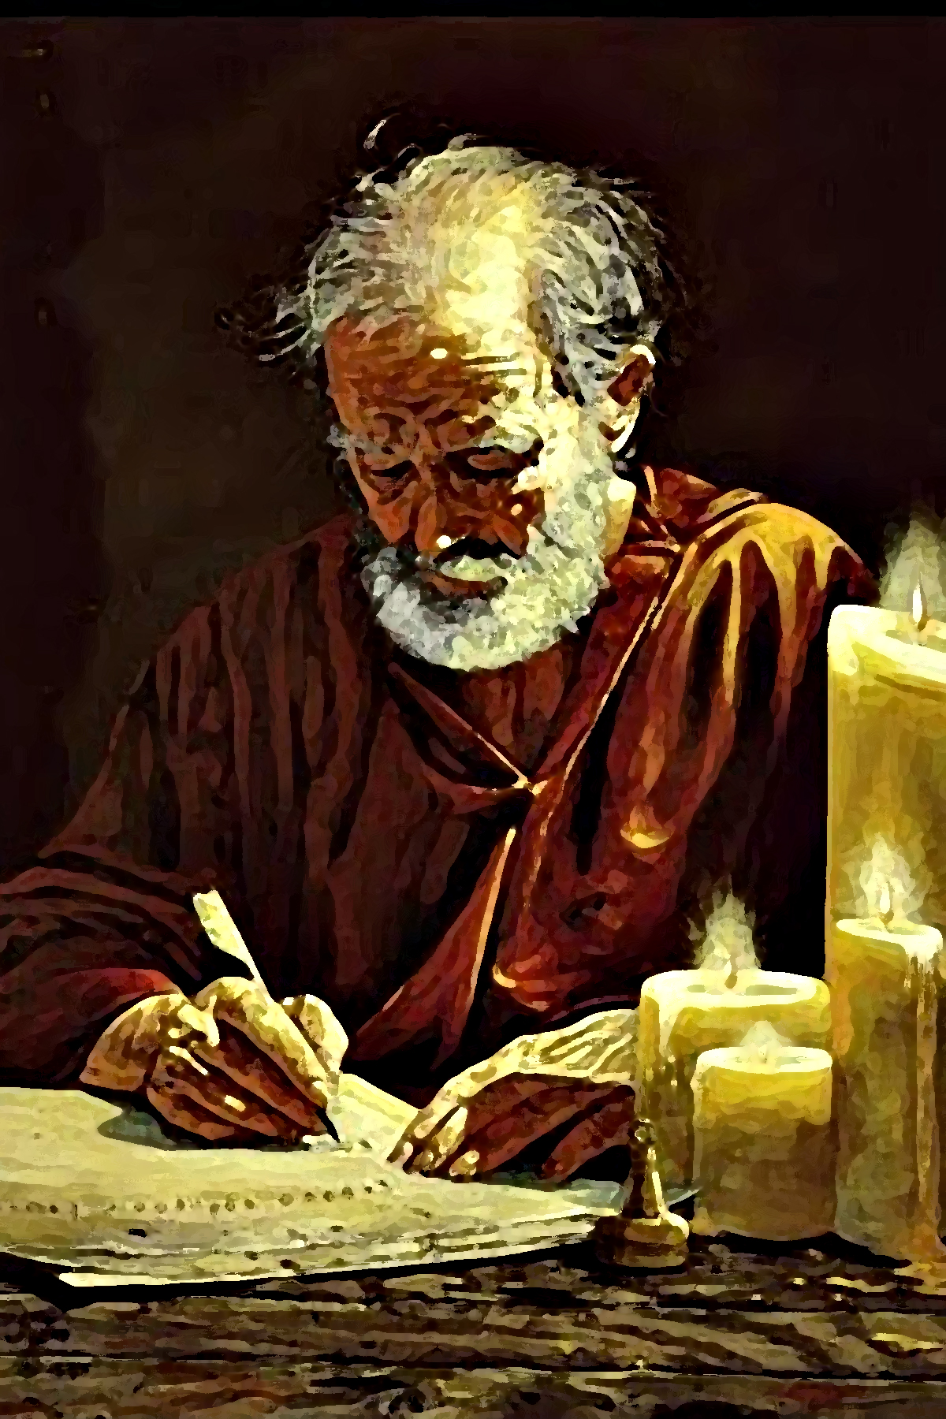
Some say that Paul should not have been an apostle like the 12. Paul agreed, he was not like the 12 Apostles. Listen to the reason why –
“And that he was seen of Peter, then of the 12: After that, he was seen of above 500 brethren at once… After that… James… And last of all he was seen of me also, as of one born out of due time. For I am the least of the apostles, that I am not meet to be called an apostle, because I persecuted the [kingdom] church of God. But by the grace of God I am what I am: and his grace which was bestowed upon me was not in vain: but I labored more abundantly than they all: yet not I, but the grace of God which was with me” (15:5-10).
Paul did NOT receive his apostleship because he earned it—he didn’t! He deserved condemnation, but by the grace of God he was called, and so are we. Paul’s ministry was greater than that of the 12, not because of him, but because he labored for the highest cause.

Slide 3
BELIEVERS CHANGED
“Behold, I shew you a mystery; We shall not all sleep [one generation will be alive at the rapture, but their mortal, corruptible bodies will be changed], but we [living] shall all be changed [how long will the change take?], in a moment, in the twinkling of an eye… for the trumpet shall sound [the last moment (1Thess. 4:16)], and the dead [he now turns to the dead] shall be raised incorruptible... For this corruptible must put on incorruption [dead will be given a sinless body] and this mortal [temporary] must put on immortality [the new body will last forever] then shall be brought to pass the saying that is written, Death is swallowed up in victory (Isa. 25:8) [Paul already wrote that ‘the last enemy that shall be destroyed is that of death’ (15:26), which Christ did when HE ROSE FROM THE DEAD. Through Him, believers shall raise from the dead and be given a new, immortal, sinless, body fashioned after His (Phil. 3:20)…

Slide 4
OUR RESURRECTION (cont’d)
O death, where is thy sting? O grave, where is thy victory? [Satan, the author of death (Heb. 2:14,15), struck fear in the hearts of mankind, but that changed with Christ. NOW, Christ provides the believer with a new, eternal life, and an immortal body]. The sting of death is sin [Satan assumed that power because of sin which brought forth death at the fall of Adam] and the strength of sin is the law [the Law was meant to point out man’s sinfulness]. But thanks be to God, which giveth us the victory through our Lord Jesus Christ”
[all mankind must face the 1st physical death (Heb. 9:27), but believers will escape the 2nd spiritual death through the resurrection of our bodies (1Cor. 15:51-57).
Unbelievers will die twice—the 1st physical death [grave]; the 2nd spiritual death, “And death and hell were cast into the lake of fire. This is the 2nd death” (Rev. 20:14). Aren’t you thankful that’s not you??!!

Slide 5
MORE TRUTHS
“I beseech you, brethren (ye know the house of Stephanus, that it is the firstfruits of Achaia, and that they have addicted themselves to the ministry of the saints). That ye submit yourselves unto such, and to everyone that helpeth with us, and laboureth” (16:15,16). Here’s one addiction that won’t hurt you, but rather will help you gain rewards for all eternity—laboring for Christ.
“Aquila and Priscilla salute you much in the Lord, with the church that is in their house” (16:19). The early church started in private houses (as did we).
“All the brethren greet you. Greet ye one another with an holy kiss” (16:20). In today’s climate, we cannot keep cultural norms of the 1st century A.D.
“The salutation of me Paul with mine own hand” (16:21). Paul signed his letters to prevent forgeries.

Slide 6
2CORINTHIANS (A.D. 55)
“Blessed be God… Father of mercies, and the God of all comfort; Who comfortheth us in all our tribulation, that we may be able to comfort them which are in any trouble, by the comfort wherewith we ourselves are comforted of God” (2Cor. 1:3,4).
Paul begins his 2nd letter to the church in Corinth with an instruction—as God comforts us during our trials & tribulations, we should then help comfort others who are going through their own challenges of life.
“Lest Satan should get an advantage of us: for we are not ignorant of his devices” (1:11).
Satan is a master at what he does and if we do not know what they are, we are likely to fall into his many traps. The Bible has much to say about the ministry of Satan. Do you know what his main tactic was at creation? Against Israel in the O.T.? During the Gospels? More importantly, what he is doing right now!

Slide 7
MINISTERS OF THE NEW TESTAMENT
“[Christ] Who also hath made us able ministers of the new testament: not of the letter, but of the spirit: for the letter killeth, but the spirit giveth life (3:6).
The New Testament [Covenant] was given to Israel, “Behold, the days come, saith the Lord, that I will make a new covenant with the house of Israel, and with the house of Judah” (Jer. 31:31-34), along with other promises: great nation [Israel]; land [Palestine]; King [Christ], and this aspect which is the forgiveness of sin.
We, the Body of Christ, were never promised Israel’s covenants, except the last one—forgiveness. This is what Paul writes here, that we are to able ministers of the truth that Christ shed His blood for our sin. Israel’s was based on a covenant [legal] contract from God; ours based simply on the grace of God. When we believe the gospel, we are forgiven every sin as the Holy Spirit places us into Christ, giving us eternal life.

Slide 8
SATAN’S DEVICES
Speaking of Satan’s tactics, here is a most treacherous one –
“But if our gospel be hid, it is hid to them that are lost: in whom the god of this world [Satan] hath blinded the minds of them that believe not, lest the light of the glorious gospel of Christ, who is the image of God, should shine unto them… For God, who commanded the light to shine out of darkness, hath shined in our hearts, to give the light of the knowledge of the glory of God in the face of Jesus Christ” (4:3,4).
How much power does Satan have? To keep the unbeliever blind to the truth of salvation until he chooses to want to see, then God removes the blinders. The light of Christ first lit the dark universe (Gen. 1:3); the darkest part of the universe today?
The heart of an unbeliever.
Another tactic of Satan today is…

Slide 9
SATAN’S DEVICES (cont’d)
“For such are false apostles, deceitful workers, transforming themselves into the apostles of Christ. And no marvel: for Satan himself is transformed into an angel of light. Therefore it is no great thing if his ministers also be transformed as the ministers of righteousness; whose end shall be according to their works” (11:13-15).
Satan has used every trick in the Book [Bible] in order to deceive mankind, but no where is his deception more
egregious and dangerous than during this Church age. This passage tells us that TODAY Satan [and his demons] are transforming themselves into something that looks genuine but is a fake—taking the TRUTH and changing it, ever-so-slightly into HERESY. Examples –
1. There is good in everyone; 2. There are many roads to heaven; 3. Good people go to heaven; 4. We’re spiritual Israel; 5. God is love, everyone will be saved; 6. There is no hell, etc., etc., etc.

Slide 10
AFFLICTION
“For all things are for your sakes, that the abundant grace might through the thanksgiving of many, abound to the glory of God. For which cause we faint not; but though our outward man perish, yet the inward man is renewed day by day. For our light affliction, which is but for a moment, worketh for us a far more exceeding and eternal weight of glory. While we look not at the things which are seen, but at the things which are not seen: for the things that are seen are temporal; but the things which are not seen are eternal” (4:17,18).
Anyone who has a chronic or life threatening disease should study this passage. We usually get better from our ailments, but not always. When it is clear that Christ isn’t going to heal us, then we should stop looking at things from the physical & temporal, and begin to see them from the spiritual & eternal.
Look at Paul’s example…

Slide 11
“… there was given to me a thorn in the flesh [eye disorder?], the messenger of Satan to buffet me… For this thing I besought the Lord thrice… depart from me. And he said unto me, My grace is sufficient for thee: for my strength is made perfect in weakness. Most gladly therefore will I rather glory in my infirmities, that the power of Christ may rest upon me. Therefore I take pleasure in infirmities, in reproaches, in necessities, in persecutions, in distresses for Christ’s sake: for when I am weak, then I am strong” (12:7-10).
God allowed Satan to give Paul a painful eye disorder, so he prayed 3X to have it removed, but each time the answer was NO. What good is a missionary who can’t see? Not much under his own power, but depending on Christ at every step, Paul could do anything! And he did! He would rather suffer physically and have the power of God with him, than have normal eyes and be without the power Christ. So should we!

Slide 12
DEATH
“For we know that if our earthly house of this tabernacle were dissolved [death], we have a building of God, an house not make with hands, eternal in the heavens. For in this we groan, earnestly desiring to be clothed upon with our house [body] which is from heaven: If so be that being clothed we shall not be found naked… For we walk by faith, not by sight. We are confident, I say, and willing rather to be absent from the body, and to be present with the Lord” (5:1-8).
No Bible writer spoke of death more than Paul. Why?
Because Christ revealed to him what every believer will face at the moment of death. Here, he tells us that Christ has prepared a new, glorified, eternal body that is waiting for us when we die, in fact, as this body shuts down we groan, desiring that new body. There is no intermediary state [purgatory]—to be absent from this body means to be immediately present with the Lord.

Slide 13
A GREATER COMMISSION
“For the love of Christ constraineth us [holds us together]… he died for all, that they which live should not henceforth live unto themselves, but unto him which died for them, and rose again. Wherefore henceforth know we no man after the flesh: yea, though we have known Christ after the flesh, yet now henceforth know we him no more [in that way]. Therefore if any man be in Christ, he is a new creature: old things are passed away; behold, all things are become new” (5:14-16).
The commission given to the 12 to go to all the world to tell everyone [Jews & Gentiles] of the Messiah, was later rescinded (Gal. 2:9) and replaced with this invisible and far more spiritual one: the love of Christ holds all believers together [One Body]; Christ died and rose for all; as a result, we should now live for Him; His earthly ministry now replaced with His heavenly ministry…

Slide 14
A GREATER COMMISSION (cont’d)
… the believer is IN-CHRIST; he is the only new thing created since God created the universe; concerning the believer, everything is new [dispensation, life in-Christ, life under grace, Body of believers, citizenship in heaven, etc.]; every old thing [sin’s condemnation, striving to keep a system of laws, God’s favoritism on one nation (Israel), etc.] has all passed away [for now].
“And all things are of God, who hath reconciled us to himself by Jesus Christ, and hath given to us the ministry of reconciliation… God was in Christ, reconciling the world unto himself, not imputing their trespasses unto them…. hath committed to us the word of reconciliation … we are ambassadors for Christ…” (5:18,19).
This is an invisible, vertical commission whereby God has joined together Himself and believing man through Christ, who has erased all sin; in one word, be ye… RECONCILED [to God]; that’s our ambassadorship.

Slide 15
ADDITIONAL TRUTHS
“Be ye not unequally yoked together with unbelievers… what communion hath light with darkness?... Where- fore come out from among them, and be ye separate saith the Lord…” (6:14,17).
This should be true in the life of the believer in many aspects of life including marriage.
GIVING UNDER GRACE
Today there is no COMMAND [demand] to give (8:8) as under the Law as we are inspired to give because Christ gave so much, “For ye know the grace of our Lord… he was rich [heaven], yet for your sakes he be poor [earth], that ye through his poverty [death] might be rich [eternal life]” (8:9). So we don’t give because we have to—we give because we love Christ, “God loveth a cheerful giver” (9:7). Paul’s advice? If Christ has not blessed you, don’t give! If he has, “Thanks be unto God for his unspeakable gift [eternal life]” (9:15).

Slide 16
PAUL’S TRANSLATION TO HEAVEN
On his 1st journey, Paul was undoubtedly stoned to death and then translated to heaven, “I knew a man in Christ about 14-years ago… such an one caught up to the 3rd heaven… unto paradise…” (12:1-4a). He wasn’t permitted to write much about it (12:4b), except, “… having a desire to depart, and to be with Christ; which is far better” (Phil. 1:23).
SIGNS OF AN APOSTLE
“Truly the signs of an apostle were wrought among you in all patience, in signs, and wonders, and mighty deeds” (12:12). Paul had all the same gifts of the 12 apostles, until they, too, were rescinded late in his ministry.
TRINITY
“The grace of the Lord Jesus Christ, and the love of God, and the communion of the Holy Spirit, be with you all. Amen” (13:14).

Slide 17
ROMANS (A.D. 57)
Though not written until A.D. 57 [5th chronologically], Romans is placed 1st among the Church epistles. Why?
It contains many essential doctrines of Christ not only
for this dispensation of grace, but all the ages up until eternity future. The major one, the doctrine of salvation:
Ch. 1. “Because that, when they knew God, they glorified him not as God” (1:21). Most of mankind quickly spurned God after He created them—the Gentiles failed God.
Ch. 2. “Thou that makest thy boast of the law, through breaking the law dishonourest thou God?” (2:23)—The Jews failed God.
Ch. 3. “For all have sinned, and come short of the glory of God” (3:23). The whole human race failed God.
Ch. 4. “For what saith the Scripture? Abraham believed God, and it was counted unto him for righteousness” (4:3) – When God called, Abraham went; he was saved by faith
(his actions proved his faith).

Slide 18
ROMANS (cont’d)
Ch. 5. “But God commended his love for us… while we were yet sinners, Christ died for us” (5:8). Christ came to earth to die for sinners.
Ch. 6. “Know ye not, that so many of us as were baptized into Jesus Christ were baptized into his death: that like as Christ was raised up from the dead by the glory of the Father, even so we should walk in the newness of life” (6:3,4). The one baptism for the Church (Eph. 4:5) is this spiritual, waterless, one—the moment we believe, the Holy Spirit places us into Christ’s death, burial, and resurrection, thus completely identifying us with Him in the newness of life.
Ch. 7. “For that which I do I allow not: for what I would, that do I not; but what I hate, that I do… in my flesh dwelleth no good thing” (7:15). The flesh is always in rebellion against God; that’s why we do what we do; there is nothing good in the flesh.

Slide 19
Ch. 8. “So then they [unbelievers] that are in the flesh cannot please God. But ye are not in the flesh, but in the Spirit, if so be that the Spirit of God dwell in you. Now if any man have not the spirit of Christ, he is none of his [unsaved] (8:8,9)… For as many as are led by the Spirit of God, they are the sons of God… we are the children of God: And if children… heirs of God, and joint-heirs with Christ” (8:14-17). How do we overcome the rebellion of the flesh? We get saved, wherein we receive the Holy Spirit, Who then leads us in the ways of God against that rebellion. As a result, we receive the same eternal inheritance given by the Father to the Son. And, there is there NO dissolution clause – “Who shall separate us from the love of Christ?... Nay, in all these things we are more than conquerors through him that loved us…” (8:35-39).
Once saved, nothing or no one can take us out of our eternal position in-Christ.

Slide 20
CHAPTERS 9-11 DEAL WITH ISRAEL
Ch. 9. “But Israel, which followed after the law of righteousness, hath not attained... Wherefore?
Because they sought it not by faith, but… by the works
of the law. For they stumbled…” (9:31,32). Israel missed the importance of the Law of Moses as they believed their keeping of it saved them. It did not. If man can be saved by his own efforts [works], then we don’t need
God nor His Son who died on a cross for our sin.
Ch. 10. “Brethren, my heart’s desire and prayer to God for Israel is, that they might be saved” (10:1). Despite Israel’s prideful heart, Paul desperately wanted them to be saved, but the majority won’t until Christ returns.
Ch. 11. “What then? Israel hath not [been saved]… God hath given them the spirit of slumber… through their fall salvation is come unto the Gentiles” (11:7,811). During this parenthetical Age of Grace, as God closed one door [Israel], he opened another [Gentiles]. That’s us!

Slide 21
Next time – THE APOSTLE OF THE GENTILES
“For I speak to you Gentiles, inasmuch as
I am the apostle of the Gentiles, I magnify mine office” (Rom. 11:13).

