Slide 1
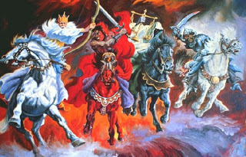
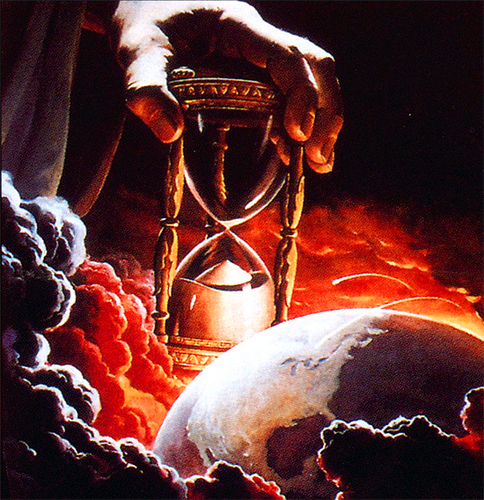
THROUGH THE BIBLE IN 2018
LESSON 29
WEEK 29 OF 52
(Isa.13-27; Hos.1-14)
Last time Israel saw the judgment of God with the first Assyrian invasion & relocation of Jews into captivity. This time a view of the future apocalypse.
“Howl ye; for the day of the LORD is at hand; it shall come as a destruction from the Almighty. Therefore shall all hands be faint, and every man’s heart shall melt: And they shall be afraid: pangs and sorrows shall take hold of them; they shall be in pain as a woman that travaileth [labor pains]… the day of the LORD cometh both with wrath and fierce anger, to lay the land desolate: and he shall destroy the sinners thereof out of it. For the stars of heaven… shall not give their light: the sun shall be darkened… the moon shall not cause her light to shine. And I will punish the world for their evil…” (Isa. 13:6-11).
Again, Isaiah gives a frightening picture of the tribulation;
7-years of hell on earth! To follow this age of God’s grace.

Slide 2
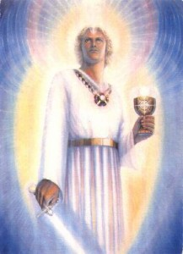
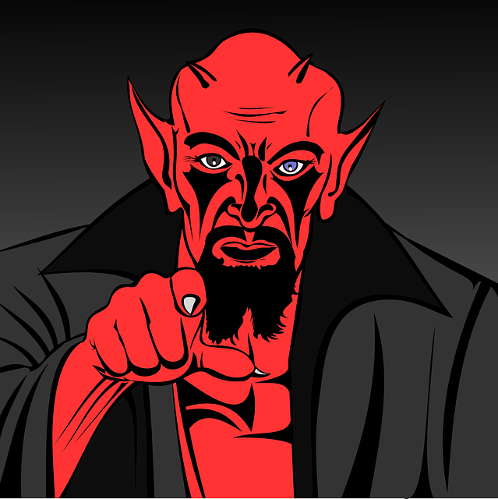
Isaiah moved from the tribulation to Lucifer and his origin –
“How art thou fallen from heaven, O Lucifer, son of the morning! How art thou cut down to the ground, which didst weaken the nations! For thou hast said in thine heart, I will ascend into heaven, I will exalt my throne above the stars of God: I will sit also upon the mount of the congregation, in the sides of the north: I will ascend above the heights of the clouds: I will be like the most High. Yet thou shalt be brought down to hell…” (Isa. 14:12-15).
Lucifer was God’s favorite angel, but he threw it all away when he became jealous, and made the decision to want to be like God. He will fail, but in the process he will take
many with him to the lake of fire –
“… WIDE is the gate… BROAD is the way… MANY there be which go in…” (Mt. 7:13,14).
Satan loses the war, but he wins many battles for souls.

Slide 3
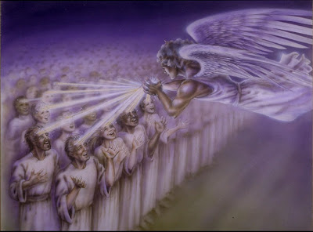
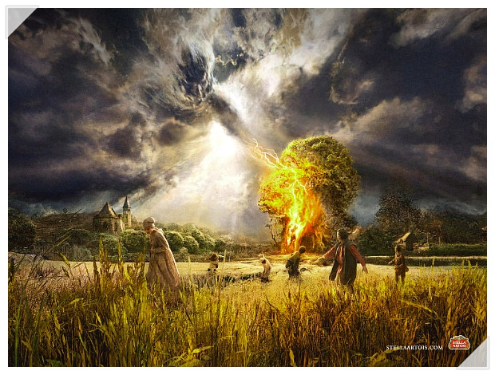
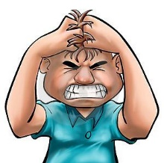
THE TRIBULATION (cont’d)
“Behold, the LORD maketh the earth empty, and maketh it waste, and turneth it upside down… the inhabitants of the earth are burned, and few men left…” (24:1-6).
Isaiah speaks of the terrible cost of the tribulation,
and John the Revelator pin points it further –
“And the 4th angel poured out his vial upon the sun; and power was given unto him to scorch men with fire. And men were scorched with great heat, and blasphemed the name of God… they repented not
to give him glory” (Rev. 16:6-10).
Even with the wrath of God, there is no repentance.
“The earth is utterly broken down… shall reel to and fro like a drunkard… and it shall fall” (Isa. 24:19,20).
God will shake the earth; nothing can withstand His
judgments on a sin cursed world.

Slide 4
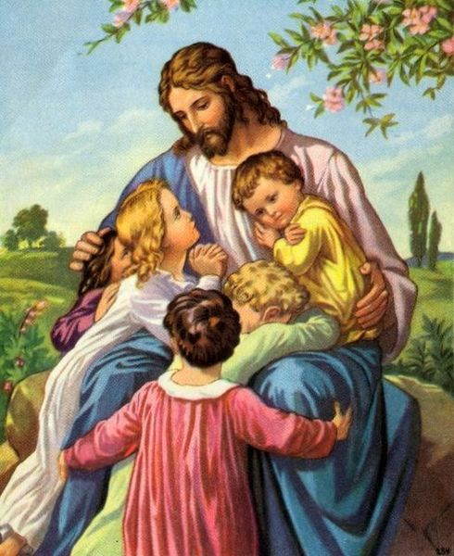
Isaiah goes from the tribulation to the kingdom age –
“O LORD, thou art my God: I will exalt thee; I will praise thy name (Isa. 25:1)… He will swallow up death in victory; and the Lord God will wipe away tears from off all faces; and the rebuke of his people shall he take away from off all the earth… And it shall be said in that day, Lo, this is our God; we have waited for him, and he will save us… rejoice in his salvation” (25:8,9).
The tribulation will be immediately followed by the kingdom age, that time promised to believing Israel when the Son of God returns to earth and brings heaven with Him –
“But Jesus said, Suffer little children, and forbid them not, to come unto me: for such is the kingdom of heaven. And he laid his hands on them…” (Mt. 19:14).
Children readily accept what adults choose to argue over.

Slide 5
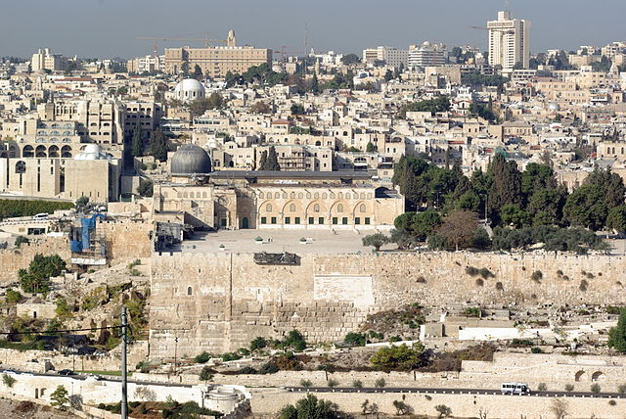
THE KINGDOM (cont’d)
“And it shall come to pass in that day, that the great trumpet shall be blown, and they shall come which were ready to perish in the land of Assyria, and the outcasts in the land of Egypt, and shall worship the LORD in the holy mount at Jerusalem” (27:13).
In a yet future day, Israel will be regathered [here listed 2-nations where they were held captive] and placed in the land promised them from the time of Abraham. It’s principle city, Jerusalem, is where Messiah will reign.
“And they shall be gathered together, as prisoners are gathered in the pit, and shall be shut up in the prison, and after many days shall they be visited. Then the moon shall be confounded, and the sun ashamed, when the LORD of hosts shall reign in mount Zion, and in Jerusalem and before his ancients gloriously” (24:22,23).

Slide 6
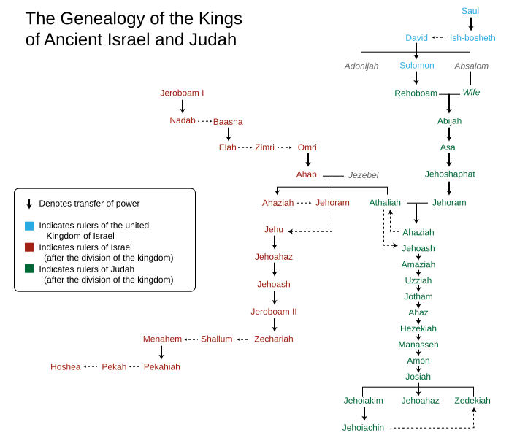
KING HEZEKIAH
“Now it came to pass in the 3rd year of Hoshea son of Elah king of Israel, that Hezekiah the son of Ahaz king of Judah began to reign. [25] years old was he when he began to reign: and he reigned [29] years in Jerusalem… And he did that which was right in the sight of the LORD, according to all that David his father did” (2Kg. 18:1-3).
At this time, 678 B.C., King Shalmaneser V had invaded Israel [died and replaced by Sargon II] and took the first wave of Jewish captives back to Assyria. If Judah did not turn from her evil ways, God would do the same to her. But, God gave her one more chance; He would raise up
a godly king, who would bring about the 3rd spiritual reform since the kingdom divided –
“He [Hezekiah] removed the high places… He trusted in the Lord God of Israel… LORD was with him… rebelled against the king of Assyria, and served him not” (18:4-7).

Slide 7
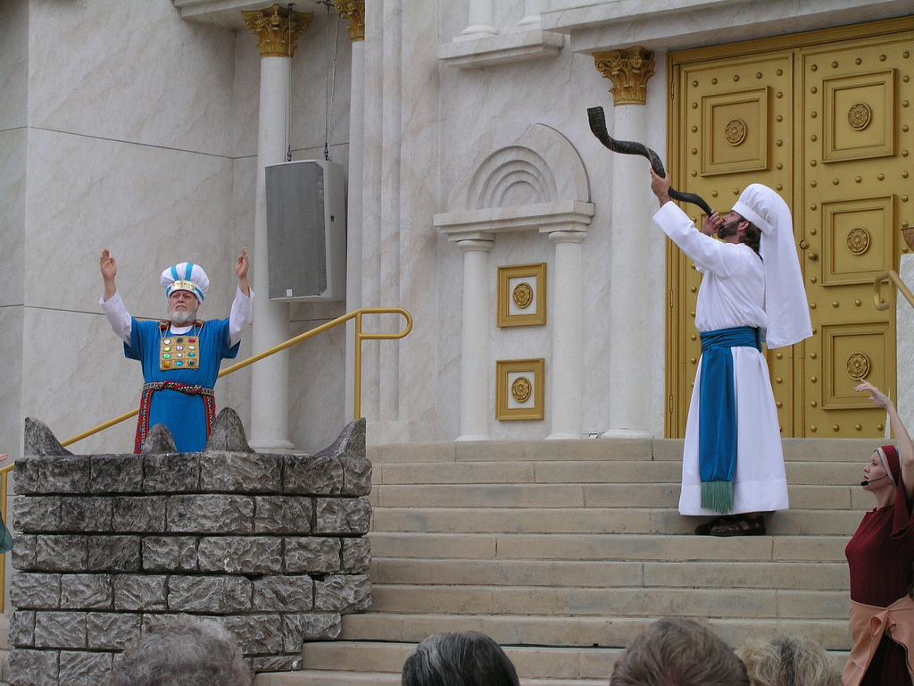
3rd SPIRITUAL REVIVAL
“He [Hezekiah] in the 1st year of his reign… opened the doors of the house of the LORD… he brought in the priests and the Levites, and gathered them together… And said unto them, Hear me, ye Levites, sanctify the house of the LORD your God of yours fathers, and carry forth the filthiness out of the holy place. For our fathers have trespassed, and done that which was evil in the eyes of
the LORD… have forsaken him… Also they have shut up
the doors… put out the lamps, and have not burned
incense nor offered burnt-offerings in the holy place…
for lo, our fathers have fallen by the sword, and our sons… daughters… wives are in captivity for this. Now it is in my heart to make a covenant with the LORD God of Israel,
that his fierce wrath may turn away from us”
(2Chron. 29:3-9).
Hezekiah re-instated Levitical temple worship, which previous kings had abolished.

Slide 8
HEZEKIAH REVIVIAL
“Then Hezekiah the king rose early, and gathered the rulers of the city, and went up to the house of the LORD. And they brought [7] bullocks… [7] rams… [7] he goats, for a sin-offering for the kingdom, and for the sanctuary, and for Judah. And he commanded the priests the sons of Aaron to offer them on the altar of the LORD… So they killed the bullocks, and the priests received the blood, and sprinkled it on the altar… to make an atonement for all Israel… And all the congregation worshipped, and singers sang, and the trumpeters sounded: and all this continued until the burnt-offerings was finished… the king and all that were present with him bowed themselves, and worshipped” (29:20-29).
This was the worship system God intended for Israel from the time of Moses and the wilderness tabernacle.
But, would it be too little, too late?

Slide 9
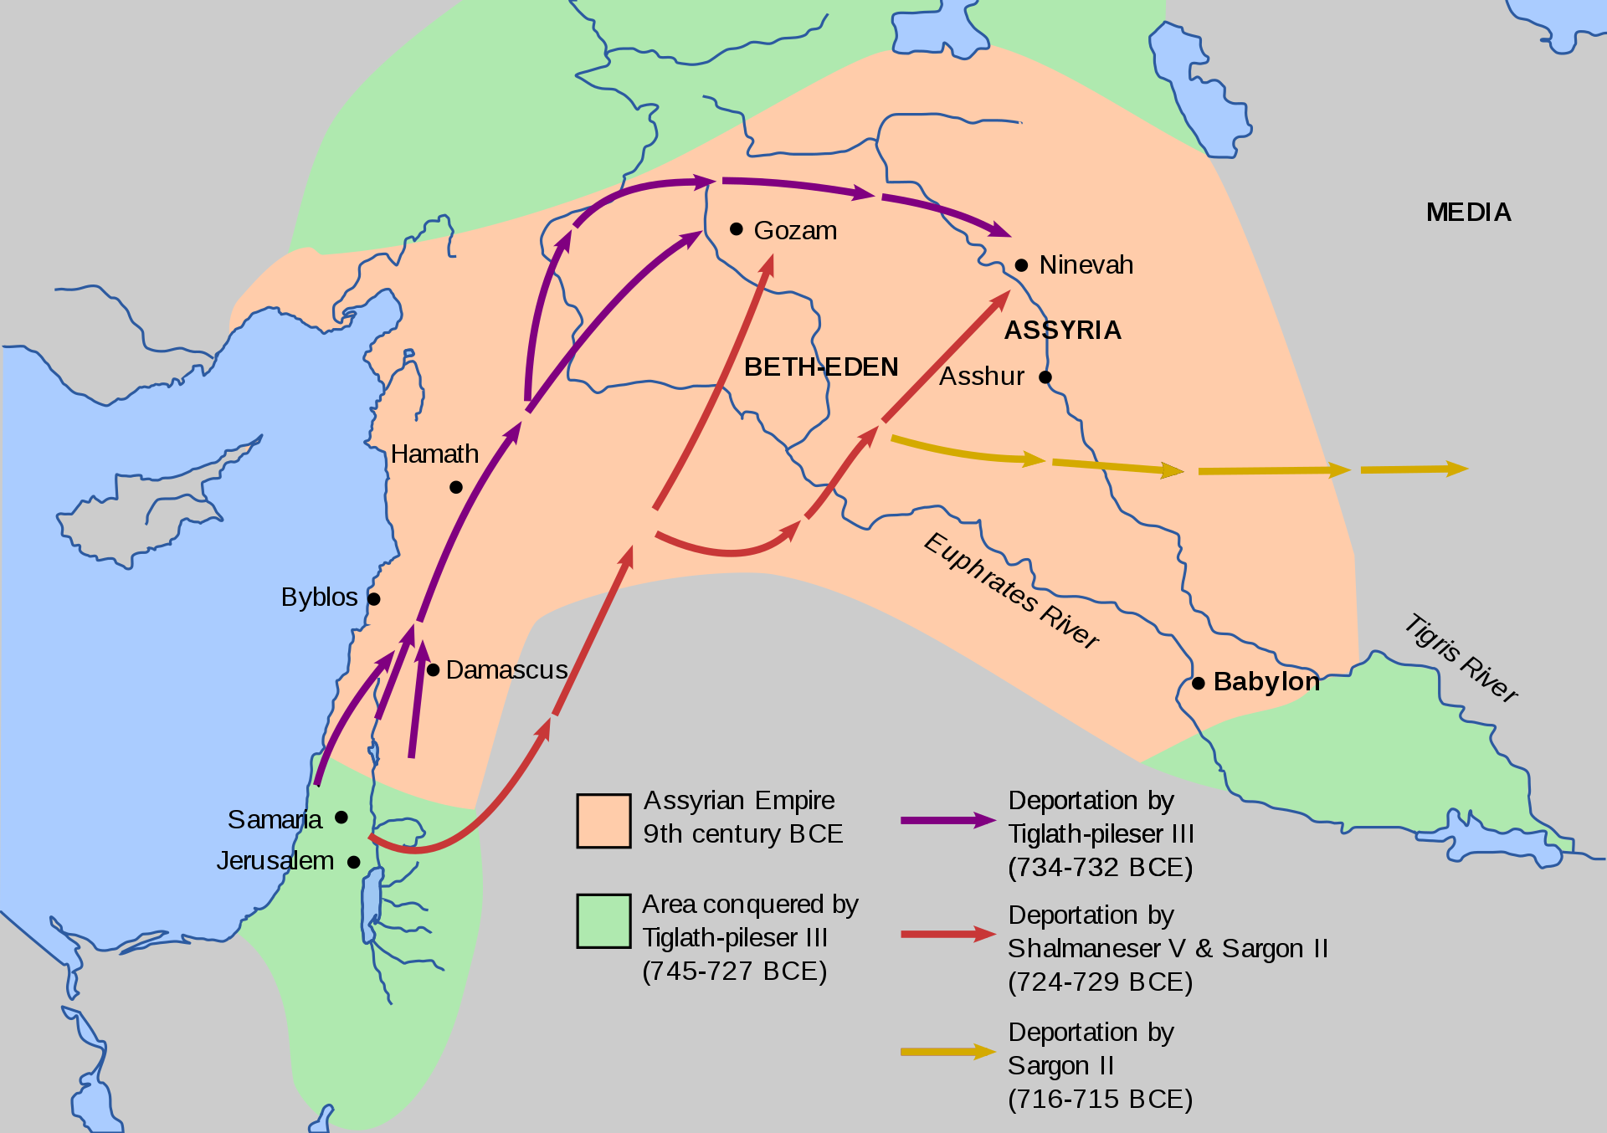
ASSYRIA INVADES JUDAH
“Now in the [14th] year of king Hezekiah did Sennacherib king of Assyria come up against all the fenced cities of Judah, and took them” (18:13).
Previous kings [Tiglath-pileser; Shalmaneser; Sargon] of Assyria [now a world empire], had conquered the middle east, including the northern kingdom [Israel] and deported Jews back to Assyria. Now Sennacherib invaded Judah and captured its cities and had Jerusalem in his sights. He told the Jewish people not to listen to Hezekiah, but to surrender, “I will come and take you away to a land like your own land, a land of corn and wine… olives and honey, that ye may live and not die: and hearken not unto Hezekiah, when he persuadeth you, saying the LORD will deliver us” (18:32).
Who will Judah listen to? Sennacherib or Hezekiah?

Slide 10
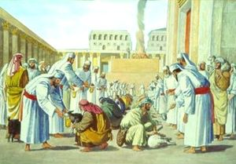
PASSOVER
“And Hezekiah sent to all Israel and Judah, and wrote letters also to Ephraim and Manasseh, that they should come to the house of the LORD at Jerusalem, to keep the Passover unto the LORD God of Israel… in the [2nd] month” (30:1,2).
Hezekiah tried to recruit those in Judah and those in Israel who had not been deported to Assyria, to come to Jerusalem to keep the first Passover of his reign. Normally celebrated in the 1st month of the year, he had to delay it for one month, “For they could not keep it at that time, because the priests had not sanctified themselves sufficiently, neither had the people gathered themselves together to Jerusalem” (30:3).
The proclamation went out from ‘Dan to Beer-sheba,’ “that they should keep the Passover… at Jerusalem: for they had not done it of a long time (30:5)… Then they killed the Passover [lamb] on the 14th day of the 2nd month” (30:15).

Slide 11
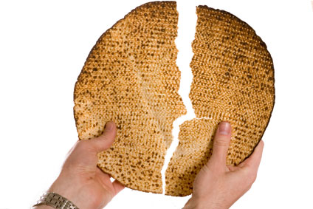
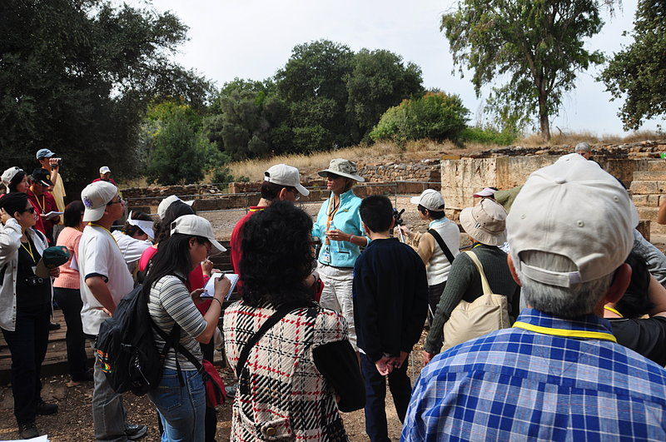
UNLEAVENED BREAD
“And the whole assembly took counsel to keep other [7] days…” (30:23).
Not only did Hezekiah have his people to keep the Passover, he had them continue the 7-days feast of Unleavened bread.
Now what?
“Now when all this was finished, all Israel that were present went out to the cities of Judah, and brake the images in pieces, and cut down the groves, and threw down the high places and the altars out of Judah and Benjamin, in Ephraim also and Manasseh, unto they had utterly destroyed them all. Then all the children of Israel returned, every man… to his own city” (31:1).
This is the archeologically recovered pagan worship site in Dan.

Slide 12
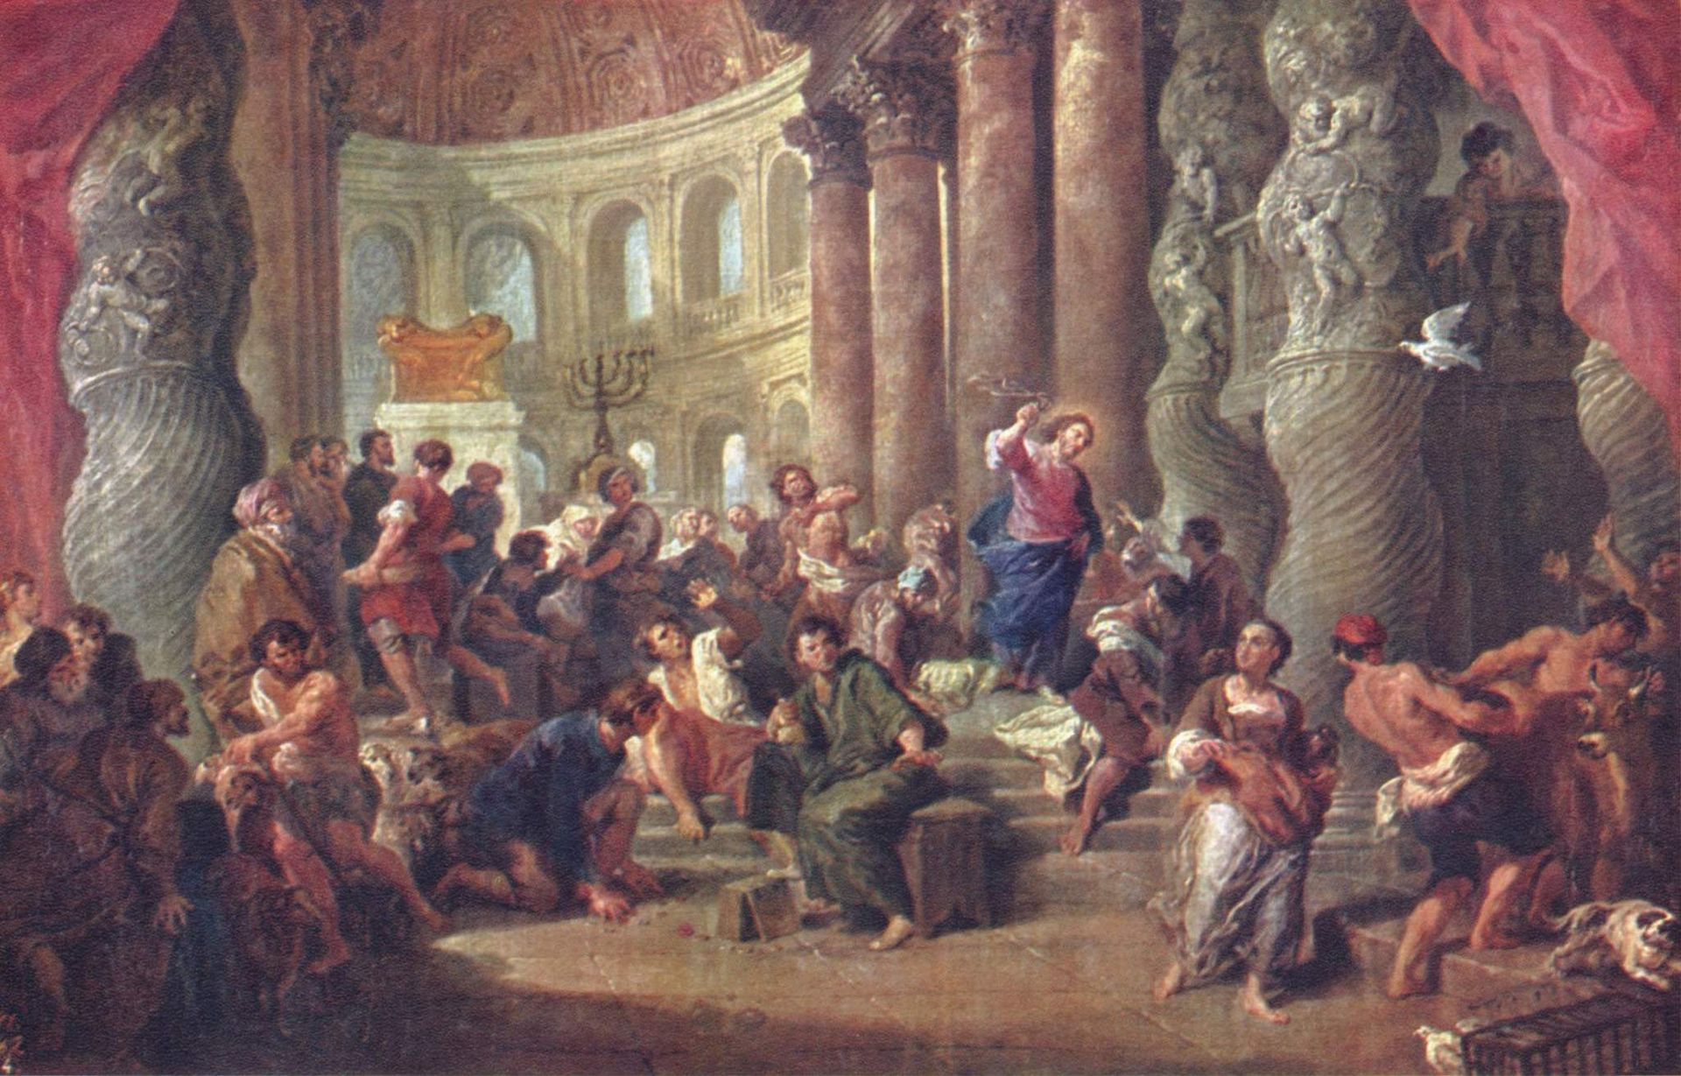
MORE WORSHIP REFORMS
“And Hezekiah appointed the courses of the priests and the Levites after their courses, every man according to his service… and the burnt-offerings for the Sabbaths, and for the new moons, and for the set feasts, as it is writing in the Law of the LORD… and the tithe of all things… and laid them in heaps. In the 3rd month they began to lay the foundation of the heaps and finished them in the 7th month… Then Hezekiah commanded to prepare chambers in the house of the LORD” (31:2-11).
King Hezekiah restored full Mosaic Law worship system. In a 4-month period, ‘the tithe of all things’ brought so much to the temple that chambers or store houses had to be built to hold it all. Judah was doing right before God.

Slide 13
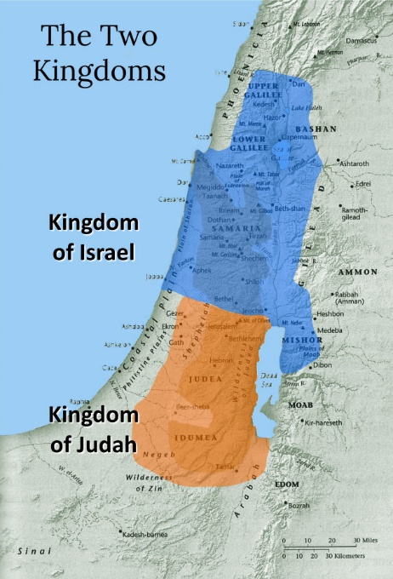
KING HEZEKIAH’S REIGN
“And thus did Hezekiah throughout all Judah, and wrought that which was good and right and truth before the LORD his God. And in every work that he began in the service of the house of God, and in the law, and in the commandments, to seek God, he did it with all his heart, and prospered” (31:20,21).
In the year 726 B.C. [Ussher], Hezekiah had restored the southern kingdom [Judah] to its position like under King David, and is proof that when leaders and others work together, everyone doing their part, God notices and gives His approval. This was true at that time under the system of Law, and continues to be true today during this age of grace. It’s all about teamwork.

Slide 14
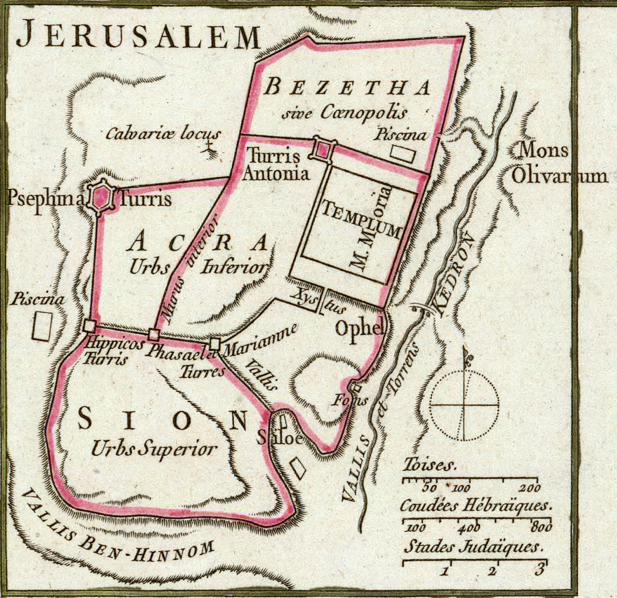
“Great is the LORD, and greatly to be praised in the city of our God, in the mountain of his holiness… For, lo, the kings were assembled, they passed by together. They saw it, and so they marveled; they were troubled, and hasted away. We have thought of thy lovingkindness, O God, in the midst of thy temple… Let mount Zion rejoice, let the daughters of Judah be glad… for this is our God for ever and ever: he will be our guide even unto death” (Psa. 48:1-14).
This psalm could have been written about Hezekiah’s godly reign, extoling Zion, the temple, and the people of Judah who again placed their faith and trust in their God.
But, what comes next?

Slide 15
THE BOOK OF HOSEA
“The word of the Lord that came unto Hosea, the son of Beeri, in the days of Uzziah, Jotham, Ahaz, and Hezekiah, kings of Judah, and in the days of Jeroboam the son of Joash, king of Israel” (Hos. 1:1).
This minor prophet, Hosea, means ‘salvation’ but nothing is known of him except that his father’s name was Beeri. He had a long ministry through 4-kings of Judah.
“Hosea was a contemporary of Amos in Israel, and of Isaiah and Micah in Judah, and his ministry continued after the first, or Assyrian, captivity of the northern kingdom (2Kg. 15:29). His style is abrupt, metaphorical, and figurative. Israel is Jehovah’s adulterous wife, repudiated, but ultimately to be purified and restored… summed up in 2-words, Lo-ammi, ‘not my people,’ and Ammi, ‘my people’…” (Old Scofield, p. 921).
The Jews had gone from ‘my people’ to ‘not my people.’

Slide 16
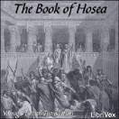
OPENING
“The beginning of the word of the LORD by Hosea. And the LORD said to Hosea, Go, take unto thee a wife of whoredoms and children of whoredoms: for the land hath committed great whoredom, departing from the LORD. So he went and took Gomer… will cause to cease the kingdom of the house of Israel” (1:2-3).
This allegory [figurative story about a real event] depicts Hosea marrying an adulterous woman [Gomer], who represents the northern kingdom/ Israel.
At that time, Israel had spurned the worship of their God for the worship of other pagan gods; she was committing spiritual adultery, which violated the 1st Commandment and brought forth the chastisement of God upon her.

Slide 17
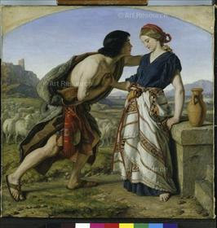
The 1st child is a son and named Jezreel, named after the site of a massacre by king Jehu (1:3). The 2nd child was named, “Lo-ruhamah [meaning ‘she is not loved’]: for I will no more have mercy upon the house of Israel: but I will utterly take them away [Assyrian captivity]” (1:6). The 3rd child, a son, “Call his name Lo-ammi: for ye are not my people, and I will not be your God” (1:9). The great “I AM THAT I AM” said to Moses to say to the Israelites, was no more—I am not the God of Israel!
“Plead with your mother, plead: for she is not my wife, neither am I her husband… For their mother has played the harlot: she that conceived them hath done shamefully: for she said I will go after my lovers, that give me my bread and water…” (2:2,5).
God’s covenant relationship with Israel was akin to that of a husband & wife. Everything was fine until she was unfaithful—what could gods give her that God didn’t?

Slide 18
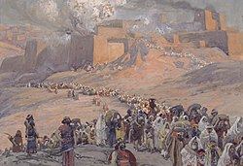
ISRAEL’S FUTURE
“For the children of Israel shall abide many days without a king… without a sacrifice… afterward shall the children of Israel return, and seek the LORD their God…” (3:4,5).
Like other prophets, Hosea prophesied of Israel’s upcoming 70-year exile; first by the invasion of the Assyrians, and then by the Babylonians. It was God’s chastisement for their persistent idol worship. As captives in foreign lands, the Jews would not have access to their worship system—the temple, burnt-offerings, Sabbaths, etc., during the exile, but God will remember them when they cry out to Him with repentance, and He will restore them to their own promised land at end of the 70-years. Then temple worship will be restored.

Slide 19
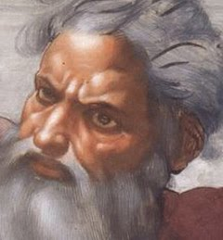
GOD’S ANGER
“When I would have healed Israel, then the iniquity of Ephraim was discovered, and the wickedness of Samaria (7:1)… Woe unto them! For they have fled from me: destruction unto them! (7:13)… For Israel is swallowed up: now shall they be among the Gentiles as a vessel wherein is no pleasure (8:8)… They sacrifice flesh for the sacrifices of mine offerings, and eat it; but the LORD accepteth them not; now will he remember their iniquity, and visit their sins (8:13)… For Israel hath forgotten his Maker, and buildeth temples… but I will send a fire upon his cities and it shall devour the palaces thereof (8:14).”
It sounds like God is angry. But, what caused God to become so angry?

Slide 20
ISRAEL’S MISTAKE
“My people are destroyed for lack of knowledge: because thou has rejected knowledge, I will also
reject thee… seeing thou hast forgotten the law of thy God, I will also forget thy children” (3:6).
Israel’s failure to keep the Law given to Moses to give to them was tantamount to unbelief. They didn’t believe God enough to serve only Him. They were wrong, and would pay dearly for it.
“O Israel thou hast destroyed thyself; but in me is thine help. I will be thy king: where is any other that may save thee in all thy cities? (13:9).
Despite their rejection of Him, God promised He would make of them a holy nation, and He will, but it will not come until the 2nd coming of Messiah.
Next time – Isaiah’s woes

