Slide 1
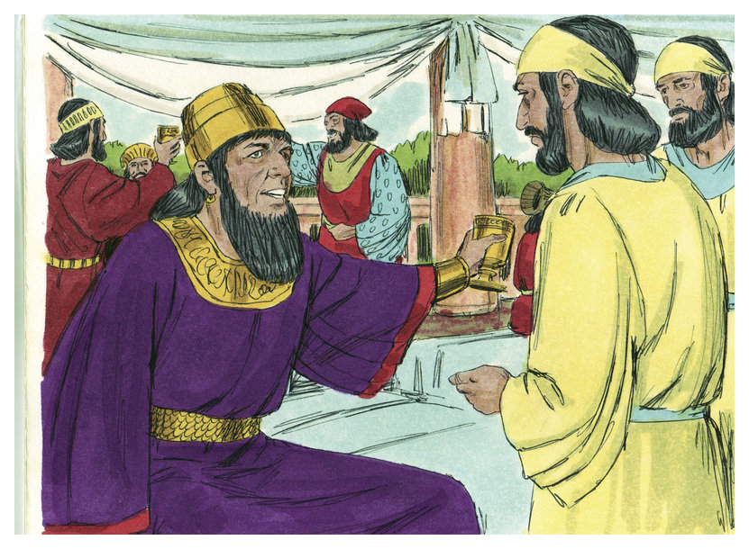
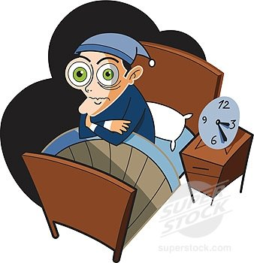
LESSON 39
WEEK 39 OF 52
(Est. 6-10; Ezr. 7-10; Neh. 1-13; Malachi)
THROUGH THE BIBLE IN 2018
Last time we saw the Jews’ delay in building the temple; this time God’s protection of those who remained in Persia.
“On that night could not the king sleep, and he commanded to bring the book of the chronicles; and they were read before the king…” (Est. 6:1).
The same night as the 1st banquet, King Xerxes couldn’t sleep and asked for the court records where he heard that, through an oversight, Mordecai had not been rewarded for having prevented the assassination of the king 5-years earlier (2:2 c.f. 2:22). The next day Haman came to ask the king’s permission to hang Mordecai, but now the tables had been turned [God’s sovereignty], and it was Mordecai whom the king blessed instead of Haman (6:10).

Slide 2
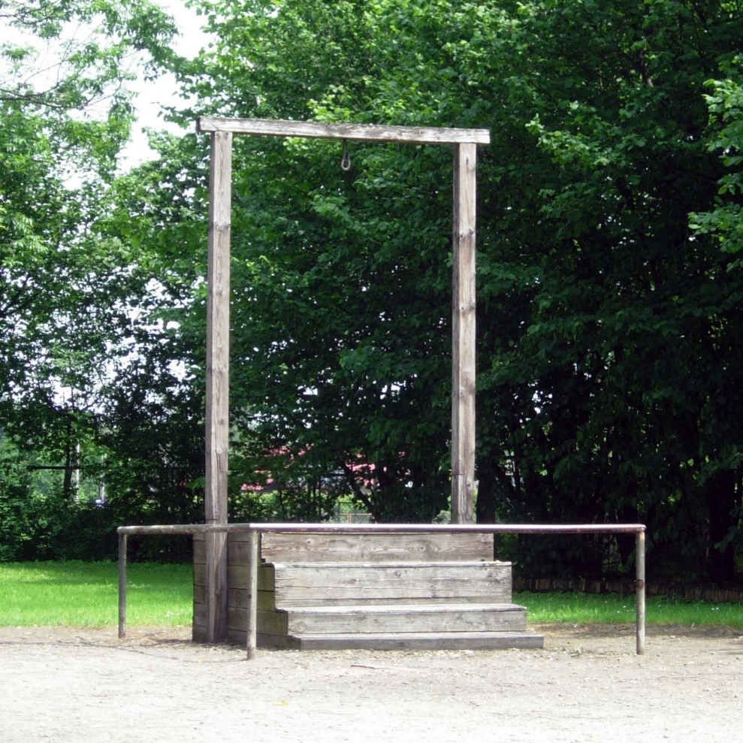
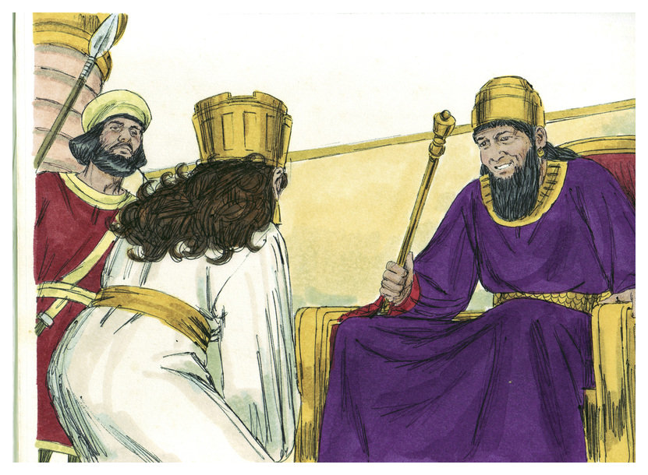
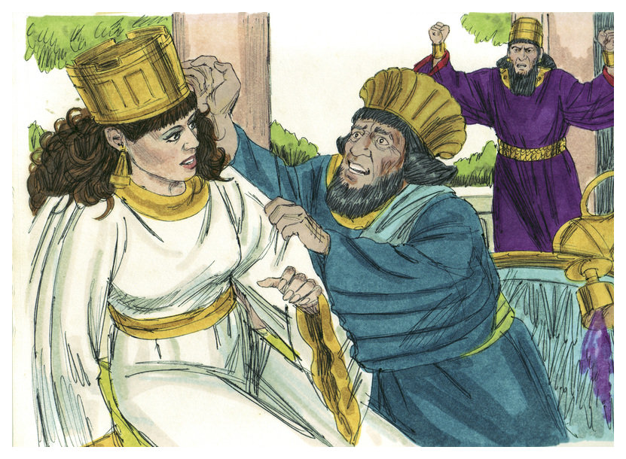
“So the king and Haman came to banquet with Esther the queen, and the king said again unto Esther… what is thy petition… the queen answered… let my life be given me… and my people… we are sold, I and my people, to be destroyed… [king asked] Who is he… And Esther said, The adversary and enemy is this wicked Haman. Then Haman was afraid before the king and queen… So they hanged Haman on the gallows that he had prepared for Mordecai…” (7:1-6).
Haman [led by Satan] had nearly brought about the annihilation of all the Jews in Persia, but God prevented it through the efforts of Queen Esther and her Uncle Mordecai.
“The king took off his ring, which he had taken from Haman, and gave it unto Mordecai… And Esther spake yet again before the king, and fell down at his feet… [her petition?] reverse the letters by Haman… to destroy the Jews which are in all the king’s provinces” (8:2-5).
Not only did Mordecai take Haman’s place of authority, but…

Slide 3
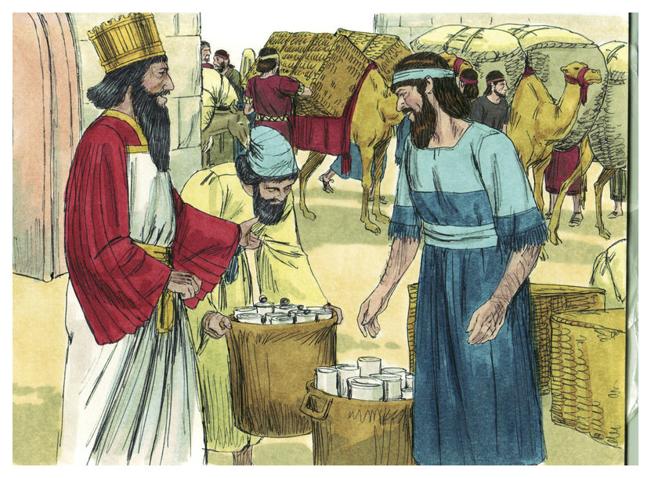
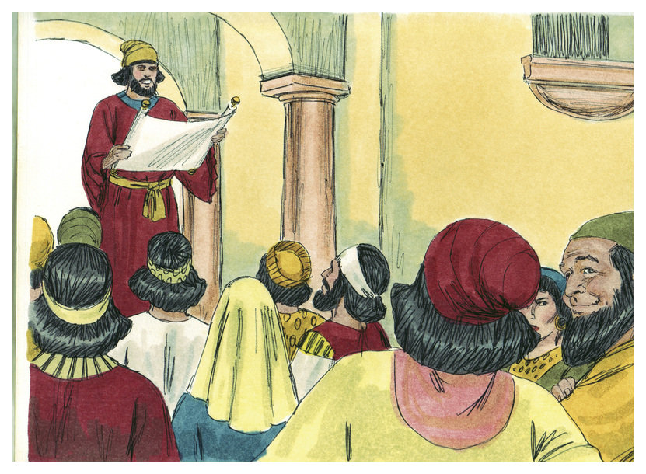
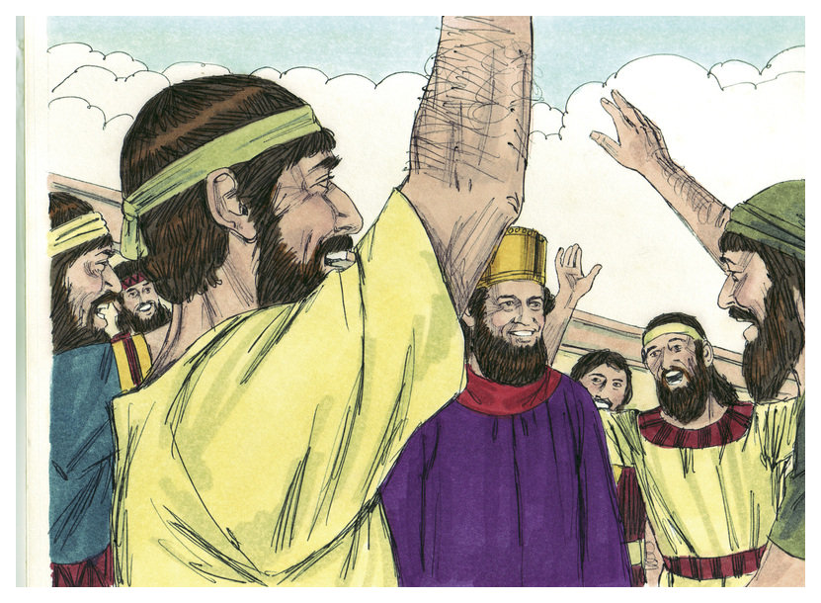
… new letters were sent out to every Persian province –
“Then were the king’s scribes called… and sent letters by
posts on horseback, and riders on mules, camels… Wherein
the king granted the Jews which were in every city… to stand
for their life, to destroy, to slay, and to cause to perish, all the
power of the people and province that would assault them…
to take the spoil of them for a prey… and the Jews had light,
and gladness, and joy, and honour…” (8:9-11,16).
The king’s new decree gave the Jews protection and a place of
high honor everywhere in the empire—all by the hand of God.
“And Mordecai wrote these things, and sent letters unto all
the Jews that were in all the provinces… to stablish this
among them… 14th and 15th day of the month Adar [March]…
yearly… as the days wherein the Jews rested from their
enemies… from sorrow to joy” (9:20-22).
Another letter was sent establishing the 2-day Feast of Purim, not by Mosaic Law, but by Mordecai & Esther to remember God’s help at a critical moment in their people’s history.

Slide 4
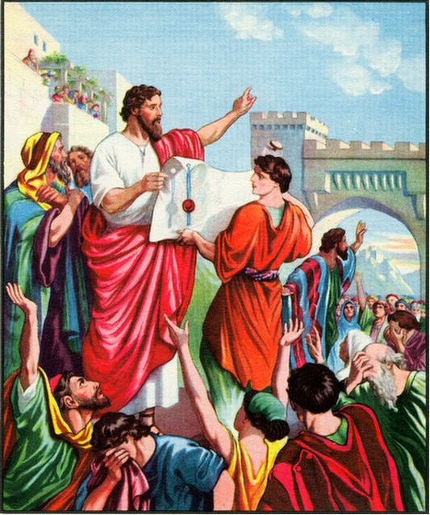
“Now after these things, in the reign of Artaxerxes king of
Persia, Ezra… son of Phinehas… Eleazar… Aaron the chief
priest. This Ezra went up from Babylon; and he was a ready
scribe in the law of Moses… and the king granted him all
his request, according to the hand of the LORD his God
upon him… For Ezra had prepared his heart to seek the law
of the LORD, and to do it, and to teach in Israel statutes and
judgments” (Ezr. 7:1-6,10).
This is the 2nd return of exiles [4-5,000] to Jerusalem under
the scribe [priest] Ezra, who was passionate about the LORD
and the Law of Moses. Artaxerxes, son of Xerxes
[Ahasuerus], decreed that everything that would be needed,
money, food, etc., should be given the Jews (7:21,22) –
“Blessed be the LORD God of our fathers, which hath put such a thing as this in the king’s heart… I was strengthened as the hand of the LORD was upon, and I gathered together out of Israel chief men to go up with me” (7:27,28).
Ezra was abundantly thankful to God and the king for allowing more Jews to go home.

Slide 5
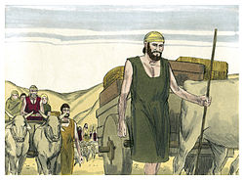
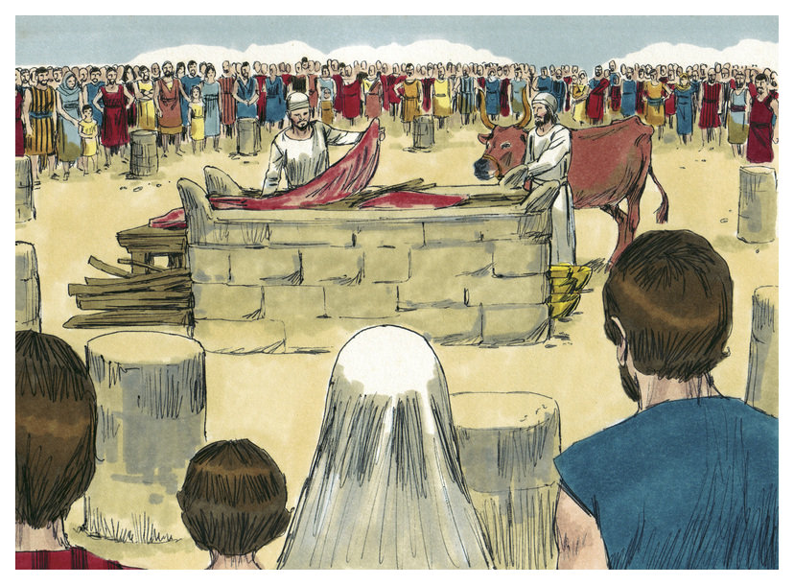
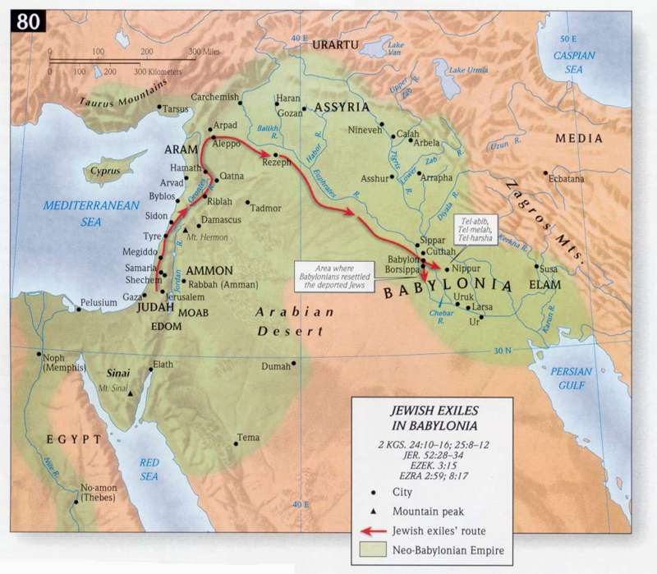
Their journey from Babylon to Jerusalem was a very difficult journey of about 900 miles, with lots of valuable treasures, but unaccompanied by soldiers –
“So took the priests and Levites the weight of the silver, and the gold, and the vessels, to bring them to Jerusalem unto the house of God… and the hand of God was upon us, and he delivered us from the hand of the enemy… And we came to Jerusalem…” (8:30-32).
After a rest, Ezra and company brought their treasures to the temple, and worshipped the God of Israel –
“Now on the 4th day was the silver and gold and the vessels weighed… come out of captivity, offered burnt-offerings unto the God of Israel…” (8:33-35).

Slide 6
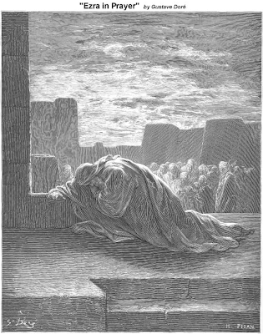
Though thankful to be home, Ezra found things in Israel not what they should have been –
“Now when these things were done, the princes came to me saying, The people of Israel, and the priests, and the Levites, have not separated themselves from the people of the lands… they have taken of their daughters for themselves, and for their sons; so that the holy seed have mingled themselves with the people of those lands… And when I heard this thing, I rent my garment… I fell upon my knees, and spread out my hands unto the LORD… I am ashamed… for our iniquities…” (9:1-6).
Ezra poured out his heart to God, who had chastened Israel with captivity but mercifully brought them home again, to what? More disobedience to God?
Intermarriage with those of pagan Gentile nations was what started this before with Solomon (1Kg. 11:1-5); now they were going down the same road, again.

Slide 7
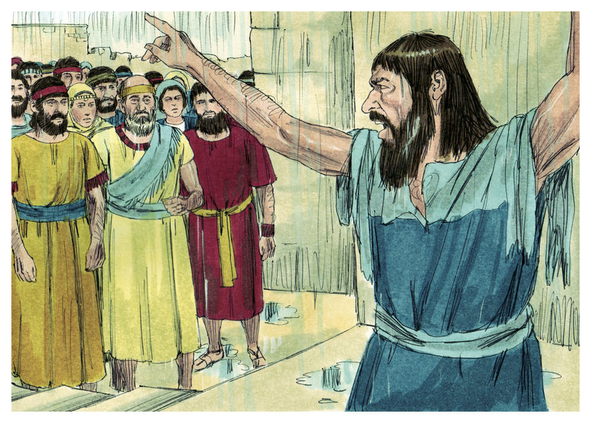
“Now when Ezra had prayed, and when he had confessed, weeping and casting himself down before the house of God, here assembled unto him out of Israel a very great congregation of men and women and children: for the people wept very sore” (10:1).
What did Ezra do?
“Now therefore let us make a covenant with out God to put away all the wives, and such as are born of them, according to the counsel of my lord, and of those that tremble at the commandment of our God; and let it be done according to the law” (10:3).
The decision was made that all those Jews who had married outside their nation would divorce them and send them back to their own nation. It was difficult
to see families split, but it was better than to take the chance of Israel further declining spiritually to the point that God would give them up entirely.

Slide 8
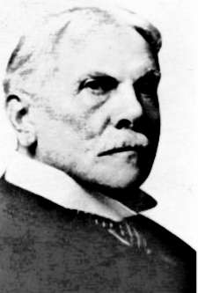
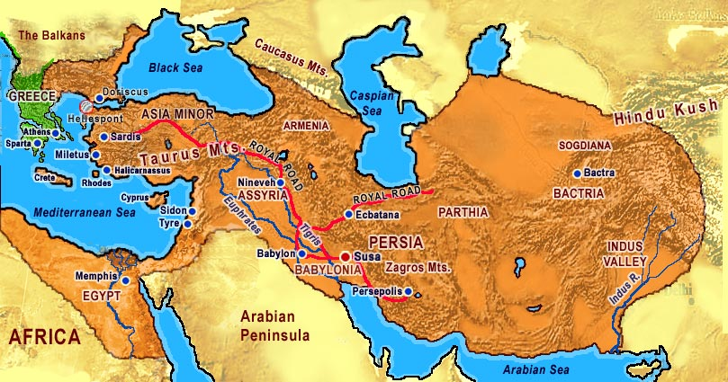
THE BOOK OF NEHEMIAH
“Fourteen years after the return of Ezra to Jerusalem, Nehemiah led up a company (444 B.C.) and restored the walls and the civil authority. Of those events this book is the record… The events recorded in Nehemiah cover a period of 11 years [Ussher]” (Old Scofield, p. 541).
“The words of Nehemiah… it came to pass… as I was in Shushan the palace” (Neh. 1:1).
Many of the Jews of the norther kingdom assimilated into the Assyrian culture, but Jews of the southern kingdom kept their identity and returned in 3-separate groups:
Zerubbabel (Ezr. 1:1-2:2) in 536 B.C. (50,000)
Ezra (Ezr. 7:1-10) in 458 B.C. (5,000)
Nehemiah (Neh. 2:11) in 444 B.C.
The Persian king asked why his cupbearer (Nehemiah) was so forlorn – “… the wall of Jerusalem is broken down, and the gates thereof are burned with fire” (1:3).

Slide 9
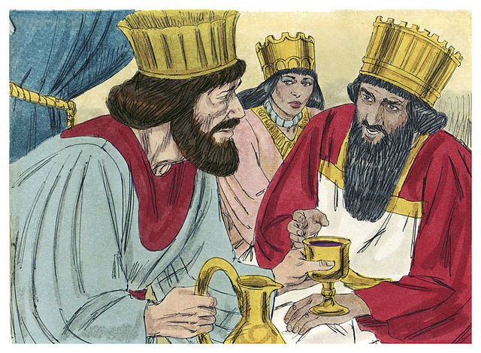
NEHEMIAH’S PRAYER
It was Nehemiah’s prayer that he could lead another group of Jews back to Jerusalem to do the important repairs needed, especially repairing the wall of the city, which had been destroyed by Nebuchadnezzar during his attack of Jerusalem.
“And it came to pass… in the 20th year of Artaxerxes the king… And the king said to me, (the queen also sitting by him,) For how long shall thy journey be?... So it pleased the king to send me…” (2:1,6).
Like before, the king of Persia provided the materials [timbers] needed to rebuild the gates of the city (2:8).
Off Nehemiah went to Jerusalem, but what did he find there?
“So I came to Jerusalem… And I arose in the night, I and some few men with me; neither told I any man what my God had put in my heart to do…

Slide 10
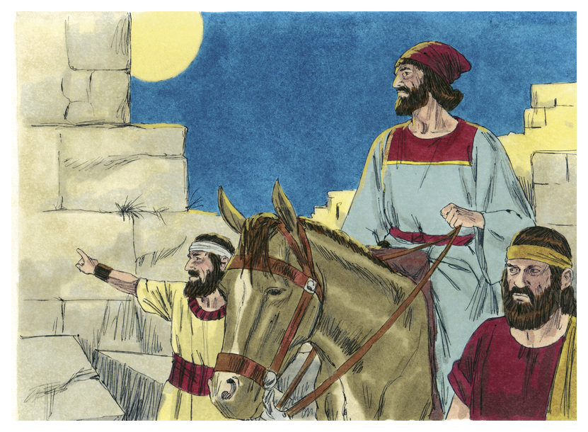
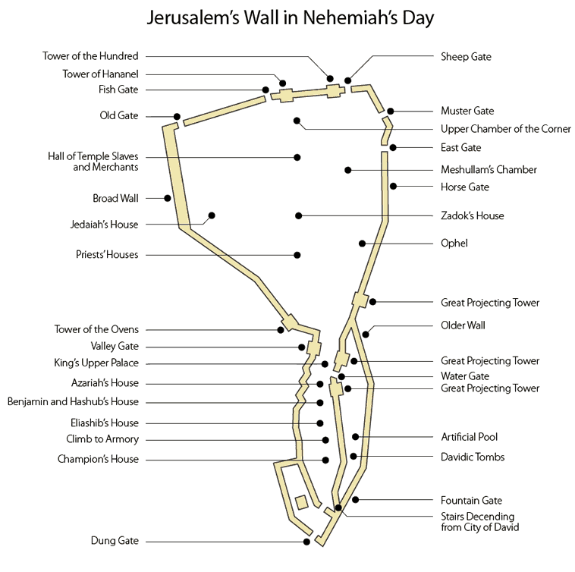
NEHEMIAH INSPECTS THE WALL
“…neither was there any beast with me, save the beast that I rode upon. I went out by night by the gate of the valley, even before the dragon well, and to the dung gate, and viewed the walls of the Jerusalem, which were broken down, and the gates thereof were consumed with fire… Then I went to the gate of the fountain… And the rulers knew not whither I went, or what I did; neither had I as yet told it to the Jews, nor to the priests… nor to the rest that did the work” (2:11-16).
Nehemiah rode his beast around part of the wall and the gates of the city during a night inspection. Parts of it were impassable, so he had to turn back to where he began –
“Then said I unto them, Ye see the distress that we are in, how Jerusalem lieth waste, and the gates thereof are burned with fire…

Slide 11
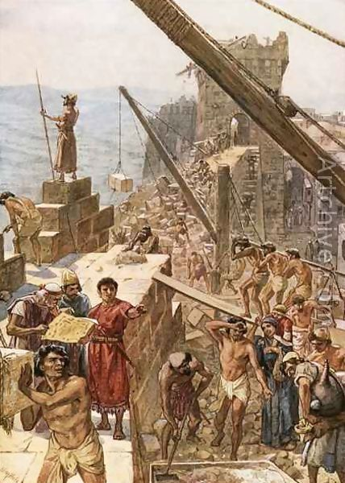
“… come, and let us build up the wall of Jerusalem, that we be no more a reproach” (2:17).
The once mighty and proud nation of Israel and Jerusalem, it’s capital, lay in ruins—the laughing stock of those around them. It was time for Nehemiah to put his architectural plan of God into action –
“Then I told them of the hand of my God which was good upon me… Let us rise up and build… the God of heaven, he will prosper us; therefore we his servants will arise and build…” (2:18-20).
THE BUILDERS OF THE WALL
The genius of Nehemiah came out in the execution of his [God’s] plan to rebuild the wall. Families who lived near sections of the wall worked on their sections, “… from the door of their house (3:20,21)… over against their house (3:22)… by his house” (3:23). This evoked pride of craftsmanship and ultimate security.

Slide 12
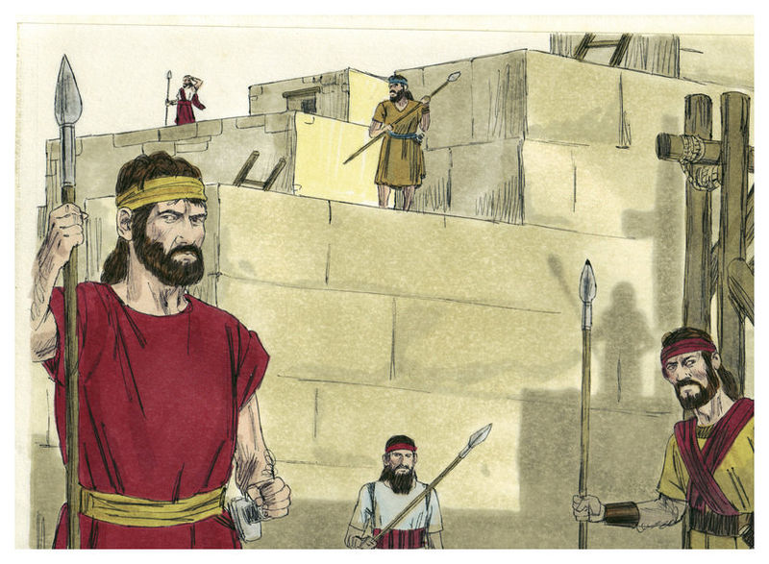
“Then Eliashib the high priest rose up with his brethren
the priests, and they builded the sheep gate… fish gate…
old gate... broad wall… valley gate… dung gate… gate of
the fountain… the wall of Ophel… horse gate… east gate…
of the corner unto the sheep gate…” (3:1-32).
Nehemiah’s report of the building of the wall moved in a counter-clockwise motion, beginning and ending at the sheep gate. Of course, the immense building project was
not without its opposition –
“But it came to pass, that when Sanballat heard that we builded the wall, he was wroth, and took great indignation, and mocked the Jews…” (4:1).
Some self-imposed [Gentile] leaders tried to stop the
project, and demoralized the Jews in their work. What did Nehemiah do? “Nevertheless we made our prayer unto
our God, and set a watch against them day and night…” (4:9).
They prayed, set guards at every post; the worked went on.

Slide 13
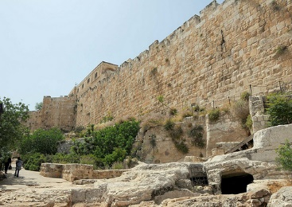
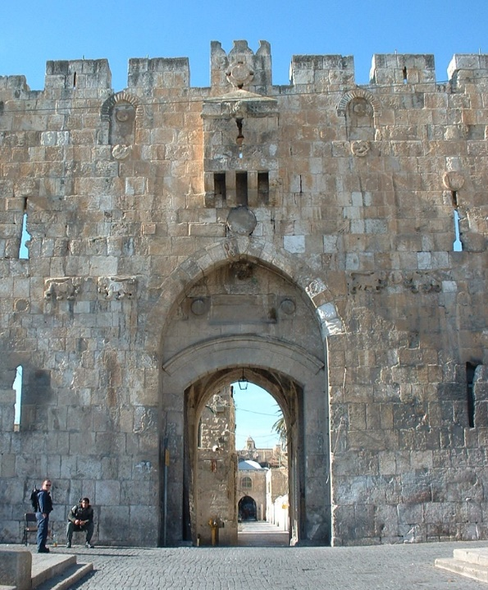
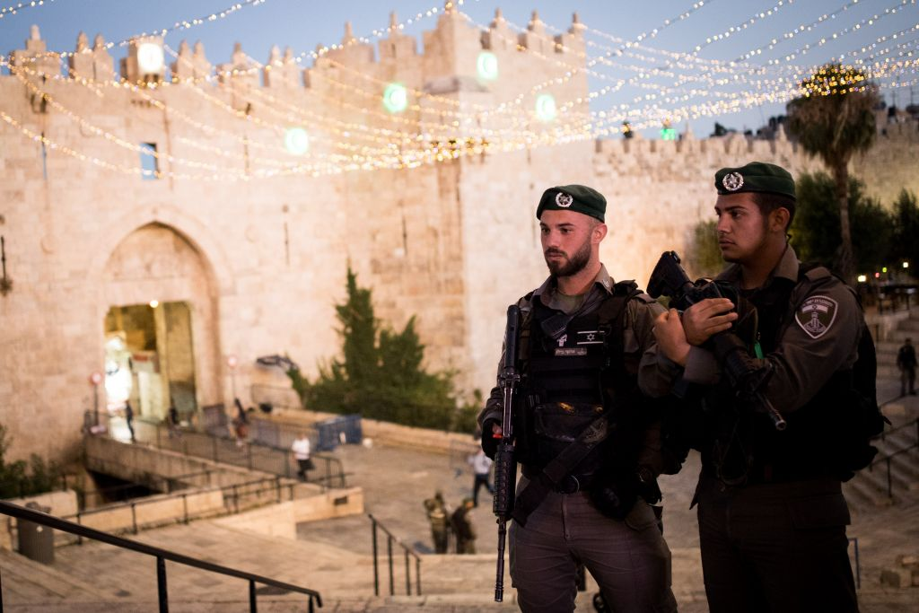
THE FINISHED WALL
“So the Wall was finished… that when all our enemies heard thereof, and all the heathen that were about us saw these things, they were much cast down… they perceived that this work was wrought of our God” (6:15,16).
The wall was finished in 52 days [515 B.C.]. Those who had looked on the building project with disdain now had to admit that such a herculean task had to have been completed by the hand of God.
“Now it came to pass, when the wall was built, and I had set up the doors… Let not the gates… be opened until the sun be hot… let them shut the doors, and bar them and appoint watches… every one in his watch” (7:1).
The final part of the project was the setting of the doors in the gates of the wall. Security was still a problem, so the doors were only opened a few hours during the day, while watchmen guarded the gates.

Slide 14
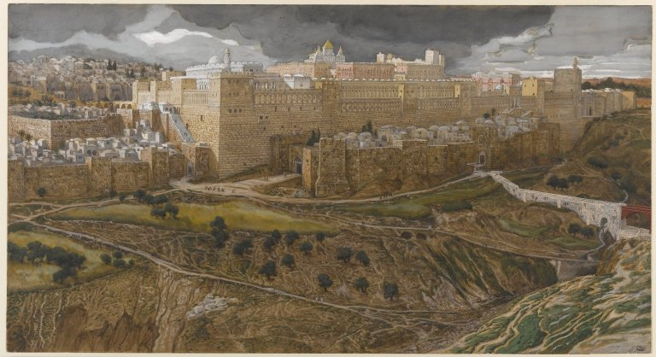
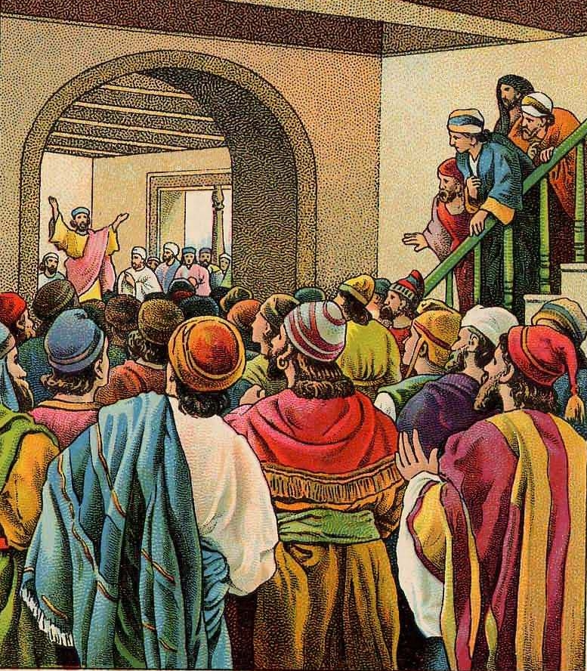
EZRA READS THE LAW
“And all the people gathered themselves together as one man into the street that was before the water gate; and they spake unto Ezra the scribe to bring the book of the Law of Moses… And Ezra the priest brought the law before the congregation… and he read… and the ears of the people were attentive unto the book of the law” (Neh. 8:1-3).
Finally, Israel seemed back on the right spiritual track with God. They longed to hear the Word of God read to them, and they listened attentively.
“And the rulers of the people dwelt at Jerusalem: the rest of the people also cast lots, to bring 1/10
to dwell in Jerusalem the holy city, and nine parts
to dwell in other cities” (11:1).
One tenth of Israel’s population was to live in Jerusalem [rulers, priests, Levites], the others in cities scattered throughout the land.

Slide 15
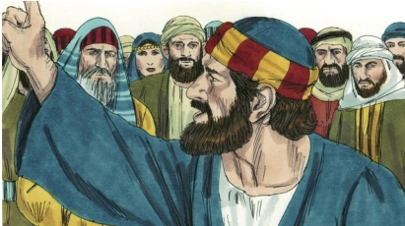
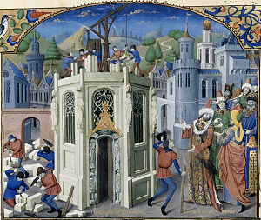
DEDICATION SERVICE
“And at the dedication of the wall of Jerusalem
they sought the Levites… to keep the dedication
with gladness, both with thanksgiving, and with
singing, with cymbals, psalteries, and with harps”
(12:27).
Not only did Nehemiah organize and carry out the
building of the wall of Jerusalem, but he oversaw
the dedication service at its completion. Levites
came from every location to participate in their
thanksgiving to God.
NEHEMIAH’S REBUKE
Nehemiah cleansed the temple of evil doers, “… I
cast forth all the household stuff of Tobiah out of the chamber. Then I commanded, they cleanse the chambers [temple]… What evil thing is that ye do, and profane the Sabbath day?... Ye shall not give your daughters unto their [pagan] sons…” (13:8-25). After his 2-year stay to Persia (13:6), Nehemiah returned to Jerusalem to find the Jews backslidden again! When will they ever learn?

Slide 16
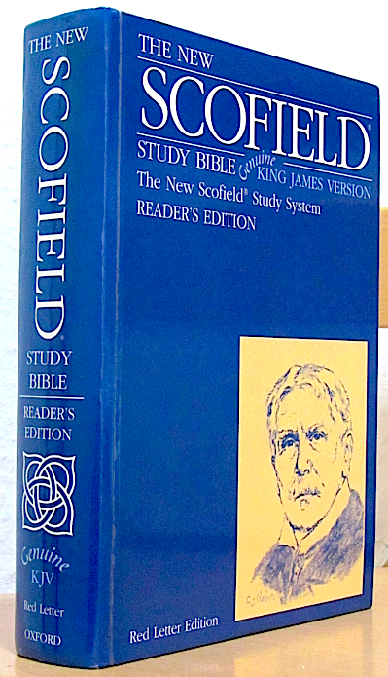
“When the LORD turned again the captivity of Zion, we were like them that dream. Then was our mouth filled with laughter, and our tongue with singing: then said they among the heathen, The LORD hath done great things to them. The LORD hath done great things for us; whereof we are glad”
(Psa. 126:1-3).
This last psalm written of the joy of the captives who returned to their homeland, but how soon the joy was replaced by spiritual apathy and backsliding.
BOOK OF MALACHI
“Malachi, ‘my messenger,’ the last of the prophets to the restored remnant after the 70 years captivity, probably prophesied in the time of confusion during Nehemiah’s absence (Neh. 13:6)… gives a moral judgment of God on the remnant… their worship was formal and insincere” (Old Scofield, p. 980).
Nothing is known of Malachi outside of the book that bears his name.

Slide 17
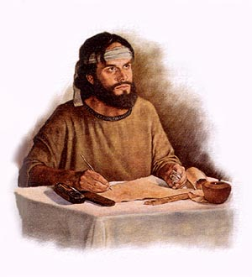
“The burden of the word of the LORD to Israel by Malachi” (Mal. 1:1).
The setting is during the two year absence of Nehemiah when he returned to Persia, and the Jews underwent a profound spiritual backsliding.
The priests had become corrupt, the economy was in shambles because of food shortages, and there was no king of Israel to lead them [Israel was permitted to return to their home under Cyrus, but they remained under the domination of the Persian Empire, and present king Artaxerxes]. In the 140 years since their return, Israel had backslidden to about the same spiritual condition they were before their exile, the only difference, they had given up idol worship for good.
What did God do?
He sent them another prophet, Malachi.

Slide 18
“I have loved you, saith the LORD. Yet ye say, Wherein hast thou loved us? Was not Esau Jacob’s brother?... yet I loved Jacob, and I hated Esau, and laid his mountains and his heritage waste…” (1:2,3).
Malachi begins his letter of chastisement, again like other prophets, with a history lesson—God formed Israel because of His love for her.
But, the nation responds, How did you loved us?
God answered, Because I chose Jacob and his lineage to build my nation, which was not the normal fashion of choosing the eldest son.
Esau had NO interest in his birthright [the spiritual, Abrahamic covenant; he DID have an interest in the physical inheritance, which he also lost to Jacob the deceiver]. Because he was destitute of faith, God rejected Esau in favor of Jacob; Esau’s lineage & land [Edom] cursed; Jacob’s blessed & holy.

Slide 19
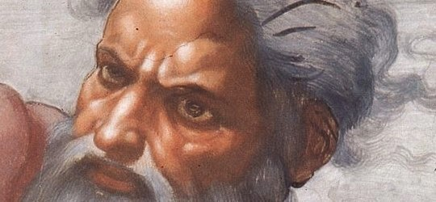
GOD IS DISHONORED
“A son honoureth his father, and a servant his master: if then I be a father, where is mine honour? ... O priests, that despise my name. And ye say, Wherein have we despised thy name? Ye offer polluted bread upon my altar… if ye offer the lame and sick, is it not evil?” (1:6-14).
Though the priests were making a meager attempt at keeping the Mosaic worship system, God would not accept it—they were using old bread, and diseased and handicapped animals, which the Law specifically forbade (Lev. 22:17-30) –
“And now, O ye priests, this commandment is for you. If ye will not hear… I will send a curse upon you… Therefore have I also made you contemptible and base before all the people, according as ye have not kept my ways…” (2:1,9).
Here we go again.

Slide 20
“Even from the days of your fathers ye are gone away from mine ordinances, and have not kept them… Will a man rob God? Yet ye have robbed me. But ye say, wherein have we robbed thee? In tithes and offerings. Ye are cursed with a curse: for ye have robbed me, even this
whole nation [Israel]” (3:7-9 c.f. 1:1).
Not only did the priests offend God, so did the people.
How? They were shortchanging God’s statutes for tithes and offerings, without which there was a limited sacrificial system, which endangered their spiritual relationship with
Jehovah [Christ]. If the priests didn’t get sufficient means to operate the temple, then Israel could not have their sins ‘covered,’ the priests would not have the means to live on, nor would widows & orphans be cared for (Deut. 14:27-29). If they did, “Bring ye all the tithes into the storehouse… I will open the windows of heaven, and pour you out a blessing…” (3:10). Are we, the Body of Christ, under that kind of conditional relationship? NO!

Slide 21
PROPHECY OF JOHN THE BAPTIST
“Behold, I will send my messenger [John], and he shall prepare the way before me: and the Lord, whom ye see seek, shall suddenly come to his temple…” (3:1).
As the last prophet [Malachi] spoke, God then went silent for 400-years, but Malachi tells the reader that, in the future, someone will prepare the way for the Messiah. That will be John the Baptist, the same prophesied by Isaiah (Isa. 40:3).
“Behold, I will send you Elijah the prophet before the coming of the great and dreadful day of the LORD…” (4:5).
Was John the Baptist that Elijah, or will he be one of the two witnesses during the tribulation? The latter!
Next time – The 1st coming of Messiah to His chosen and covenant nation Israel.

