Slide 1
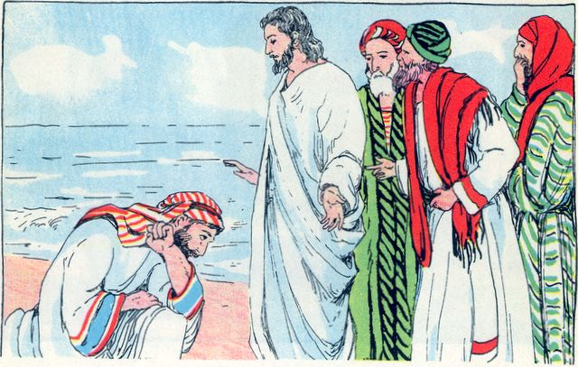
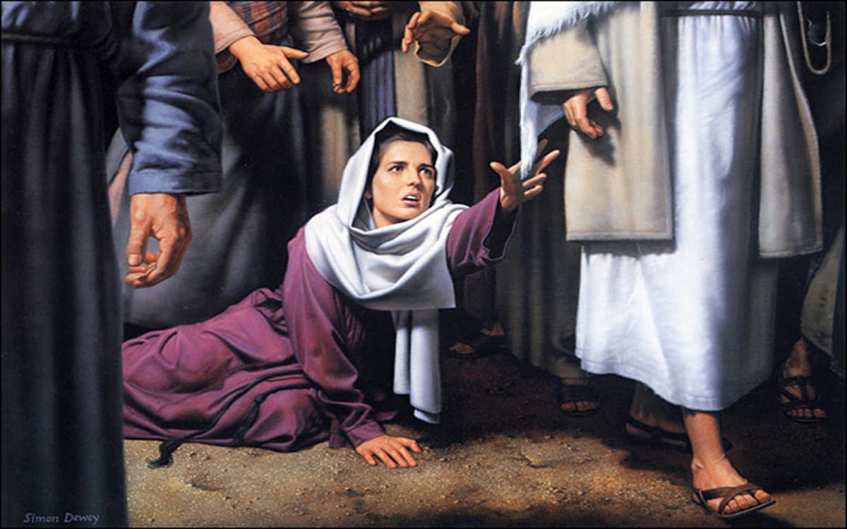
LESSON 42
WEEK 42 OF 52
(Mt. 10,14-17; Jn. 6)
Mk. 4-9; Lk. 9)
THROUGH THE BIBLE IN 2018
More of Christ’s earthly ministry to Israel.
HEALING OF JAIRUS’ DAUGHTER
“And when Jesus was passed over again by ship unto the
other side, much people gathered unto him… And, behold,
there cometh one of the rulers of the synagogue, Jairus by
name; and when he saw him, he fell at his feet, and besought
him greatly, saying, my little daughter lieth at the point of
death: I pray thee, come and lay thy hands on her, that she
may be healed; and she shall live. And Jesus went with him…” (Mk. 5:21-24).
Along the way, a woman with an issue of blood for 12 yr.
came close enough behind him to touch His garment (5:25),
believing [faith] if she touched Him, she would be healed
(5:28), and she was (5:29,34). Spiritual meaning?

Slide 2
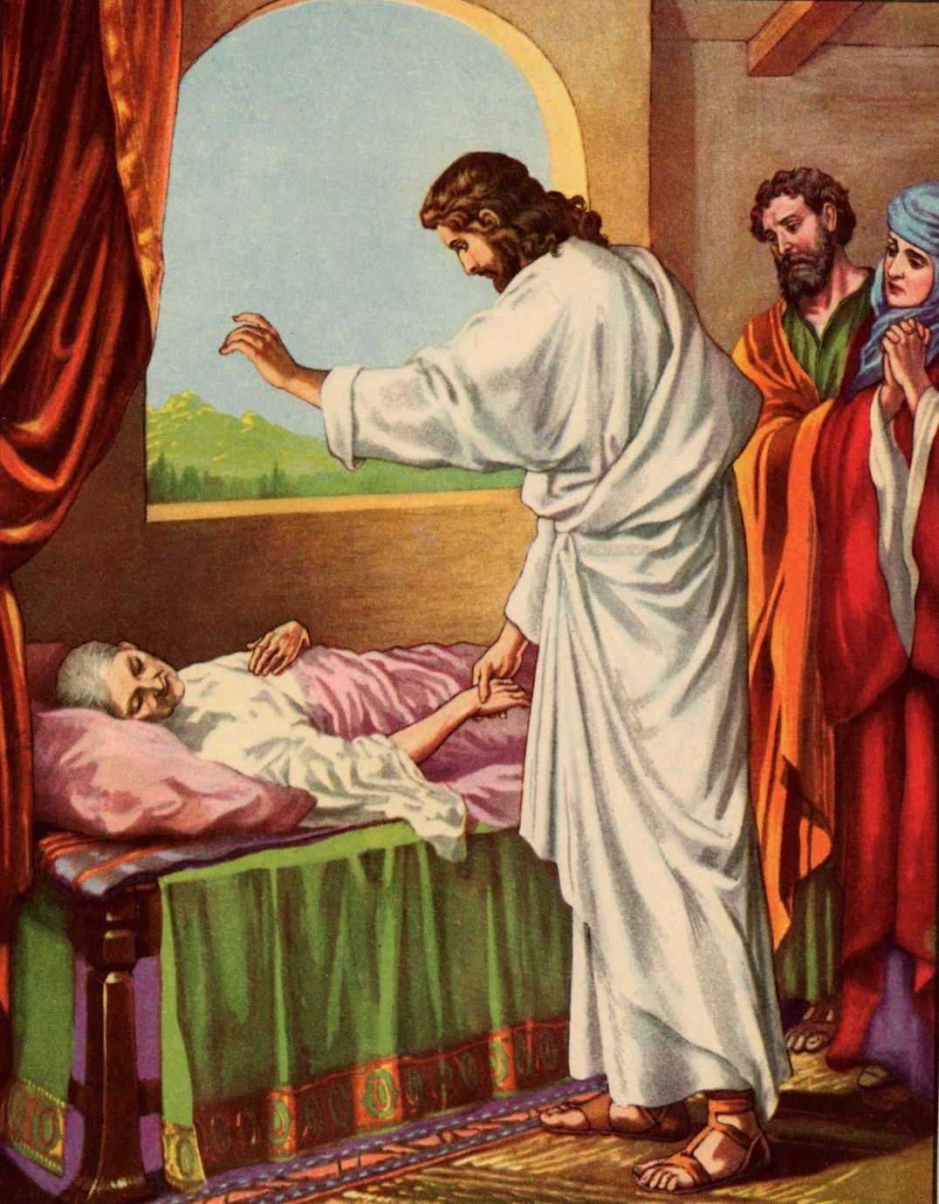
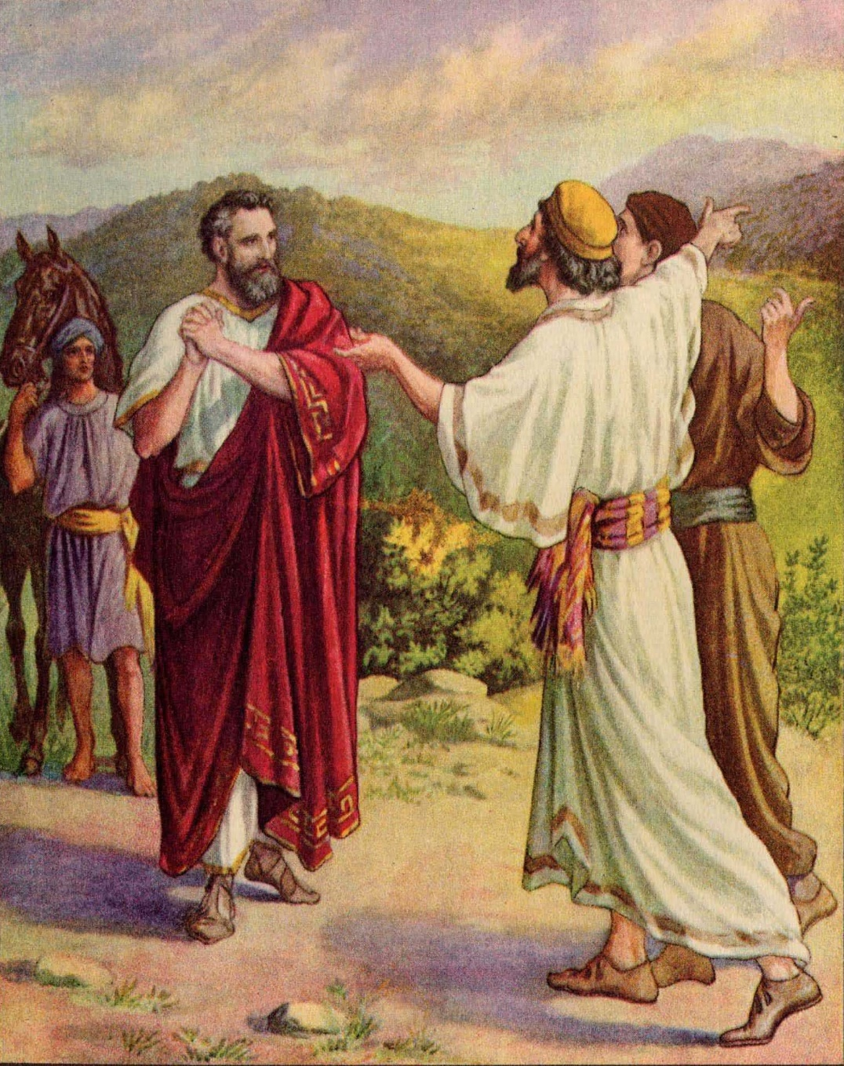
The rampant disease reflected Israel’s moribund [dire] spiritual condition. If only the whole
nation would have come to Him in faith, like this woman, He would have healed them all physically, but more important, spiritually.
“… there came from the ruler of the synagogue’s house
certain which said, Thy daughter is dead… [Jesus] Be not
afraid, only believe” (5:35,36).
After healing the 1st woman, news came that Jairus’
daughter had died, but Jesus said, not be to afraid, but to
have faith.
“And he cometh to the house… and seeth the tumult, and
them that wept and wailed greatly… saith unto them, Why
make ye this ado, and weep? The damsel is not dead, but
sleepeth. And they laughed him to scorn, but when he
had put them all out, he taketh the father and the mother…
and entereth in where the damsel was lying” (5:38,39).
Most in Israel laughed at and scorned Christ’s ministry, but
a few would have faith that He was the Son of God.

Slide 3
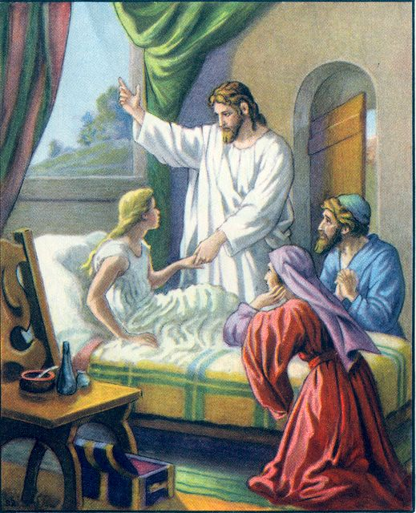
“And he took the damsel by the hand, and said unto her, Talitha cumi: which is, being interpreted,
damsel, I say unto you, arise. And straightway the damsel arose, and walked; for she was of the
age of 12-years. And they were astonished with a great
astonishment” (5:41,42).
This is the 2nd time 12 was referenced—it is Israel’s number:
God used the 12 sons of Jacob to form the12 tribes of Israel;
12 apostles will sit on 12 thrones ruling over the 12 tribes of
Israel during the millennial kingdom.
In the first part of this passage, a woman with an issue of
blood is the only one who seeks out Jesus by faith and is
healed; here, in the 2nd part, Jesus is asked to seek out the
dead, who is then raised back to life. Spiritual meaning?
Few will seek out Jesus in His 1st coming [who has come to
shed His blood]; but at His 2nd coming He will raise Israel to
new spiritual life where she will be strong enough to finally
walk on two spiritual feet, and be nourished by the bread
of life, “… commanded that something be given her to eat”
(5:43).

Slide 4
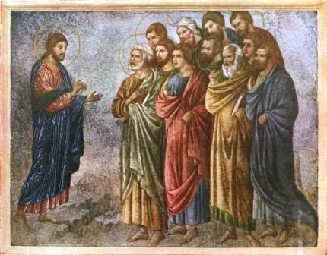
COMMISSION
“And when he had called unto him his 12 disciples…” (Mt. 10:1) – The 12 were chosen as disciples – “a learner, pupil, a follower, one who follows both the teacher and the teaching” (Bullinger’s Lexicon, p. 226). They were ‘trainees,’ which explains why they made so many mistakes. Because the leadership knew nothing of what Jesus had come to do, “Jesus answered and said unto him [Nicodemus], Art thou a master of Israel, and knowest not these things?”— Jesus began His own school of theology to teach them the truth. Why 12 pupils? It is the number that represents Israel.
“Now the names of the 12 apostles are these; the first, Simon, who is called Peter, and Andrew his brother; James the son of Zebedee, and John his brother; Philip, and Bartholomew; Thomas, and Matthew the publican; James the son of Alphaeus [the Less], and… Thaddaeus; Simon
the Canaanite [Zealot], and Judas Iscariot…” (Mt. 10:2-3).

Slide 5
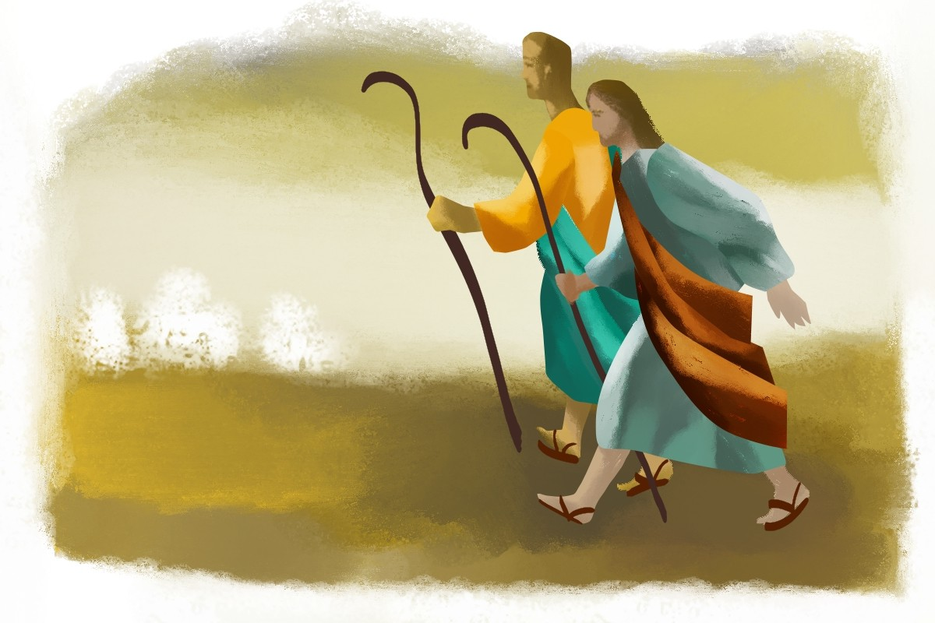
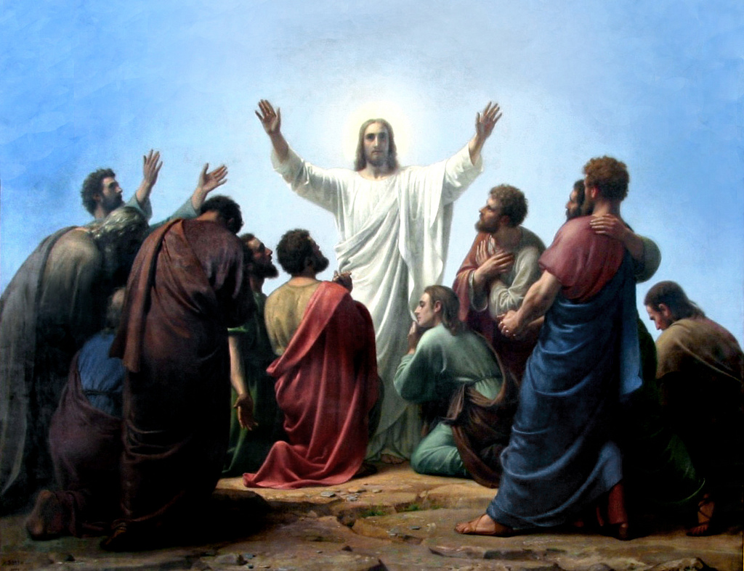
“And when he had called unto him his 12 disciples, he gave them power against unclean spirits, to cast them out, and
to heal all manner of sickness and all manner of disease”
(Mt. 10:1).
Because Satan was working overtime, Jesus gave the 12
power to do exorcisms and to heal the afflicted. Next He
gave them a mission, but to whom?
MISSION
“These 12 Jesus sent forth, and commanded them, saying,
Go NOT into the way of the Gentiles, and into any city of the Samaritans enter ye NOT: But go rather to the lost sheep of the house of Israel. And as ye go, preach, saying, The kingdom of heaven is at hand. Heal the sick, cleanse the lepers, raise the dead, cast out demons; freely ye have received, freely give” (10:5-8).
The 12 Disciples, having learned and been empowered by the Master, are now ones who are ‘sent forth’ [apostles] in
a ministry to the world? No, to unsaved Israel!

Slide 6
Is that our mission? Y or N.
Why not?
Are you to seek out only unsaved Jews? Y or N.
Is there anything there about believing in Christ’s death, burial,
and resurrection? Y or N.
Why not?
Because it hadn’t happened yet, nor had it been revealed to the
12 as good news – “… And they shall scourge him, and put him
to death: and the 3rd day he shall rise again. And they understood
none of these things: and this saying was hid from them, neither
knew the things which were spoken” (Lk. 18:33,34).
Why was it hid from them [12]? It wasn’t their gospel!
They were taught to believe that Christ was going to set up His kingdom of heaven on earth—of which the O.T. prophets prophesied was coming. Is that our good news? Y or N.
Our good news of Christ’s death, burial, and resurrection wasn’t revealed to the 12, but to Paul.
Are these 2-good news, the same? Y or N. Why not?
God meant them to be ‘rightly divided’—the one in the Gospels was Israel’s; the one in the Pauline epistles was ours. Now do you see the difference, know which one is yours? Great!

Slide 7
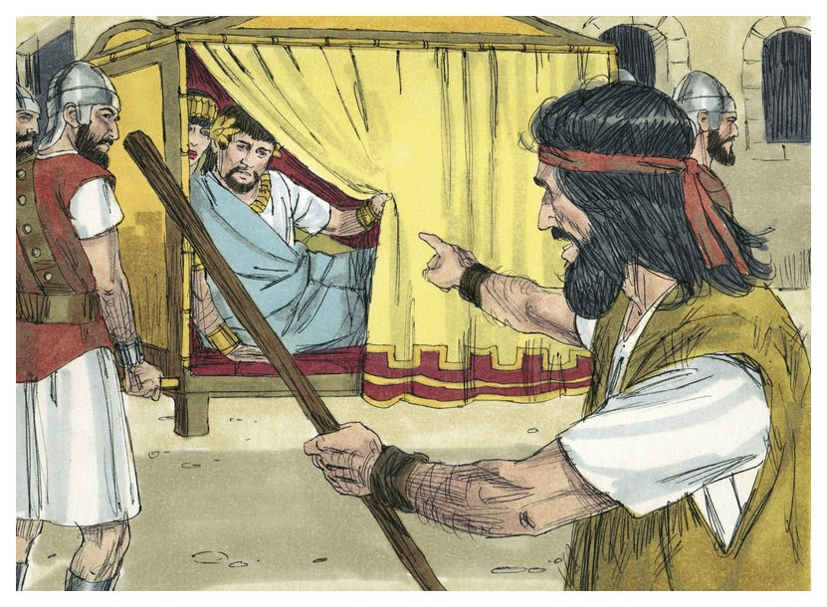
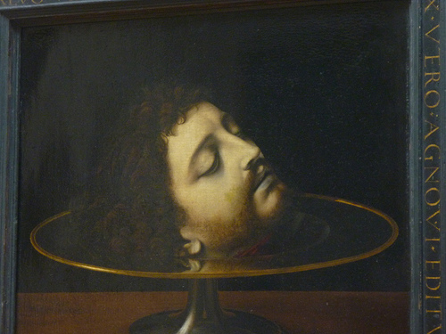
JOHN THE BAPTIST’S DECLINE & DEATH
“At that time Herod the tetrarch heard of the fame of Jesus, and said unto his servants, This is John the Baptist; he is risen from the dead; and therefore mighty works do shew forth themselves in him. For Herod had laid hold on John, and bound him, and put him in prison for Herodias’ sake, his brother Philip’s wife” (Mt. 14:1-3).
John called out the adulterous relationship of king Herod Antipas who had taken his brother Philip’s wife, Herodias –
“For John said unto him, It is not lawful for thee to have her” (14:4). Antipas arrested John and put him in prison (14:5), but on the birthday of the king, he promised to grant any request of his step-daughter, Salome. She chose John’s head on a platter (14:8), which Herod, though reluctant, agreed to carry out (14:10).
Because of his misgivings about it, Herod wondered whether Jesus was John raised from the dead by the works He performed.

Slide 8
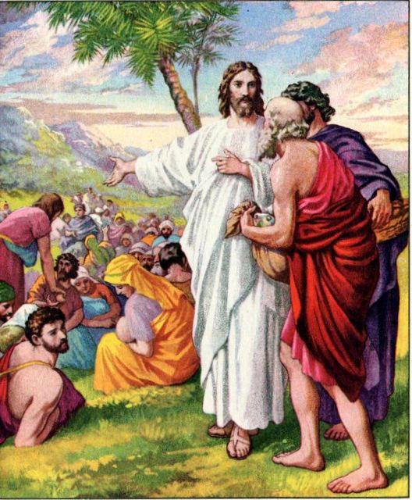
FEEDING THE 5,000
“After these things Jesus went over the sea of Galilee, which is the sea of Tiberias. And a great multitude followed him, because they saw the miracles which he did on them that were diseased… When Jesus lifted up his eyes, and saw a great company come unto him, he saith unto Philip, Whence shall we buy bread, that these may eat?” (Jn. 6:1-5).
Christ performed 8-signs in the Book of John [proof to Israel of His Messiahship]. This is #4, and the only one recorded in all 4-Gospels.
After the 12 returned from their preaching mission, they were excited to tell Jesus all they had done, so they sought a secluded place to eat and talk (Mk. 6:30,31), but the large crowd interrupted their plan. Jesus tested Philip by asking where they could buy enough bread to feed the crowd that had gathered. Philip failed the test, saying they didn’t have enough money for that much bread (Jn. 6:6).

Slide 9
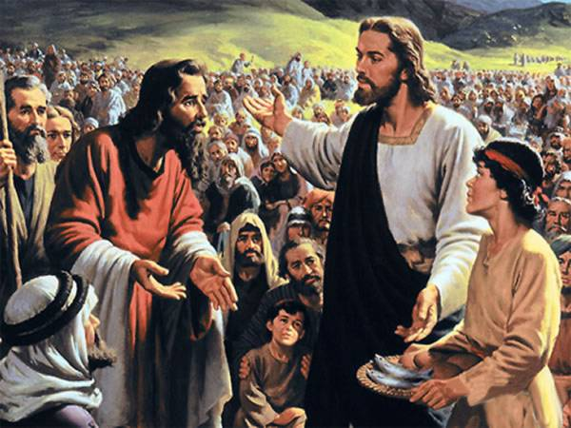
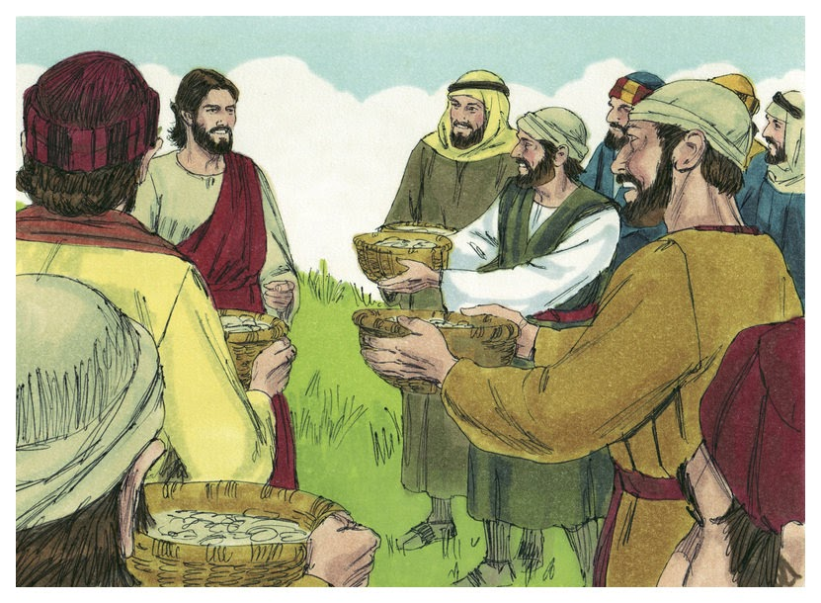
FEEDING THE 5,000 (Cont’d)
“One of his disciples, Andrew, Simon Peter’s brother, saith unto him, There is a lad here, which hath 5 barely loaves, and two small fishes: but what are they among so many? And Jesus said, Make the men sit down… in number about 5,000” (6:8-10).
Philip lacked any faith, Andrew, not much more, but Jesus was teaching them to have faith in God [Him] –
“And Jesus took the loaves; and when he had given thanks, he distributed to the disciples… to them that were set down; and likewise of the fishes... When they were filled, he said… Gather up the fragments that remain… and filled 12 baskets … over and above… that had been eaten” (6:11-13).
Spiritual meaning? Little is much in the hands of the Master; also a snapshot of the abundance during the Millennium –
“Behold, the days cometh [kingdom]… that the plowman shall overtake the reaper…” (Amos 9:13).

Slide 10
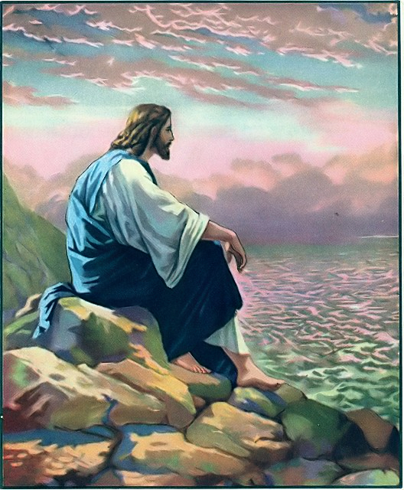
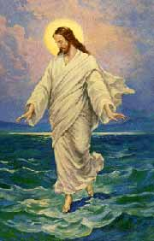
“When Jesus therefore perceived that they would come and take him by force, to make him a king, he departed again into a mountain himself alone” (6:15).
The multitudes were ecstatic and wanted to make Him their king, but He rejected that notion. Why?
At the 2nd coming, He would rule as King, but this time He came to die for their sins. They wanted Him to be King for
more free lunches (6:26), which was not what He was about.
WALKING ON THE SEA
“And when evening was now come, his disciples went down into the sea, and entered into a ship… toward Capernaum… now dark… arose a great wind… they see Jesus walking on the sea and drawing nigh unto the ship… he said unto them, It is I; be not afraid” (6:16-21).
This is the 5th sign of John. Whereas, the feeding of the 5,000 was a type of the kingdom, this of the tribulation, which can only be stilled [brought to completion] by Christ.

Slide 11
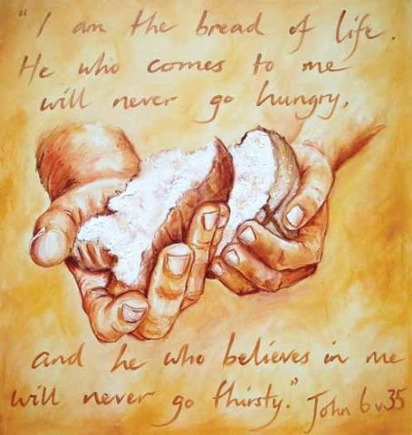
THE BREAD OF LIFE
“Jesus answered them and said, Verily, verily, I say unto you, Ye seek me, not because ye saw the miracles, but because ye did eat of the loaves, and were filled. Labour not for the meat which perisheth, but for that meat which endureth unto everlasting life, which the Son of man shall give unto you… believe on him he hath sent” (6:26-29).
Following the feeding of the 5,000, Jesus told the crowds that bread was not as important as the ‘bread of life,’ [Himself] which He offered them.
“… Moses gave you not that bread from heaven [manna]… And Jesus said I am the bread of life: he that cometh to me shall never hunger… And this is the will of him that sent me, that every one which seeth the Son, and believeth on him, may have everlasting life: and I will raise him up at the last day” (6:32-40).
In the wilderness God sent manna from heaven to sustain them, but Christ offered much more… eternal life.

Slide 12
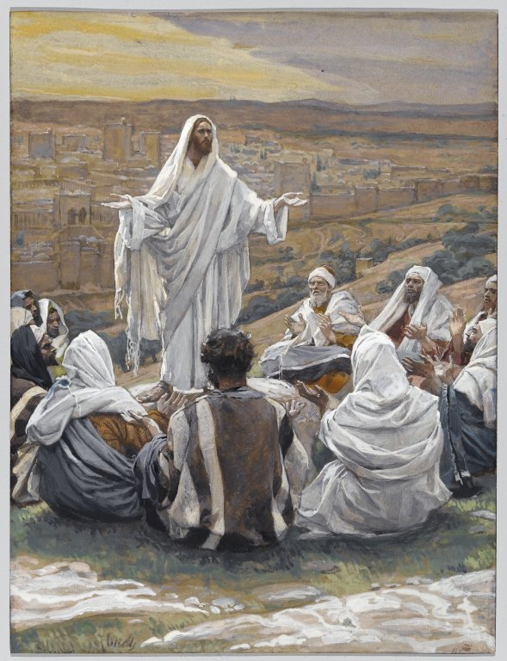
THE BREAD OF LIFE (Cont’d)
“Then Jesus said unto them, Verily, verily, I say unto you… Whoso eateth my flesh and drinketh my blood, hath eternal life; and I will raise him up at the last day” (6:53,54).
Catholicism [and early Protestantism] teach this is to be taken literally, His body & blood, but first they must turn the bread into Christ’s body and wine into His blood [transubstantiation] and then dispense to those who are worthy, i.e. in a state of grace—
sacramentalism = salvation by sacrament.
What Jesus meant was they were to believe He was the Son of God and hearers were to ingest that spiritual truth to nourish one’s spirit as one ingests physical food to nourish his body – “… no man can come unto me, except it [spiritual food] were given unto him of my Father” (6:65).
At this [no more physical bread], many stopped following Him (6:66).

Slide 13
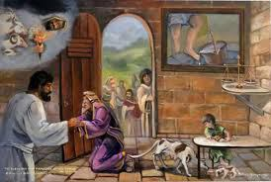
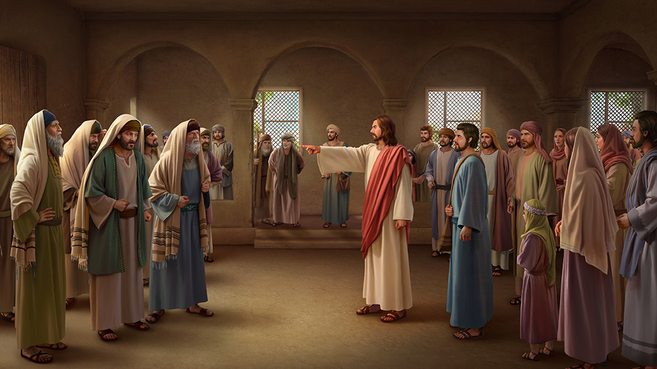
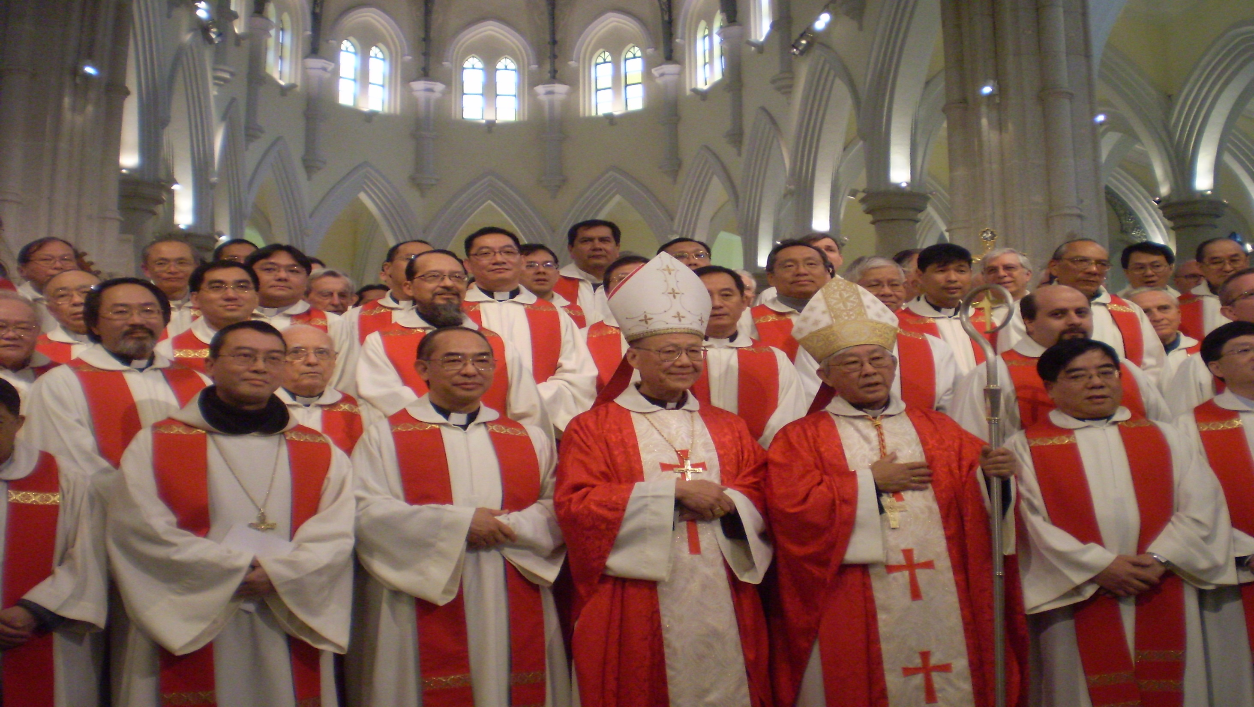
THE SYROPHENCIAN WOMAN
The 2nd of 2 Gentile accounts in the Gospels. Jesus
encountered a Syrophenician woman whom He initially
ignored, but then addressed her – “I am not sent but
unto the lost sheep of the house of Israel” (Mt. 15:24).
Jesus Christ’s earthly ministry was to unsaved Israel,
but this Gentile believed He would help her, and He
rewarded her faith only because she recognized her
secondary position compared to the Jews—
”… It is not meet to take the children’s [Jews] bread,
and cast it to dogs [Gentiles]. And she said, Truth,
Lord: yet the dogs eat of the crumbs which fall from their masters’ table… O woman, great is thy faith” (15:26,27). He had come as Israel’s Messiah, but 2-Gentiles believed it more than most Jews.
THE PHARISEES REBUKED
“… Well hath Isaiah prophesied of you hypocrites… this people honor me with their lips, but their heart is far from me… in vain do they worship me… [keep] commandments of men” (Mk. 7:6,7).
They rejected His Messiahship but kept manmade rules. Is history not repeating itself today?

Slide 14
SIGNS
“When it is evening, ye say, It will be fair weather: for the sky is red… O ye hypocrites, ye can discern the face of the sky; But can ye not discern the signs of the times? A wicked and adulterous generation seeketh after a sign; and there shall no sign be given unto it, but the sign of the prophet Jonah” (Mt. 16:2-4).
Israel was taught to look for signs to authenticate God’s promises, especially that of the coming Messiah –
“And this shall be a sign unto you; Ye shall find the babe wrapped in swaddling clothes, lying in a manger” (Lk. 2:12).
When you find a baby boy born of a virgin, wrapped in swaddling clothes and lying in a feeding trough, know that…
HE IS THE MESSIAH!
But, now that God had given them proof, they should have believed it! Why would they ask for more proof? Because they had NO FAITH, therefore Jesus told them no more signs were coming, except one—the sign of Jonah.

Slide 15
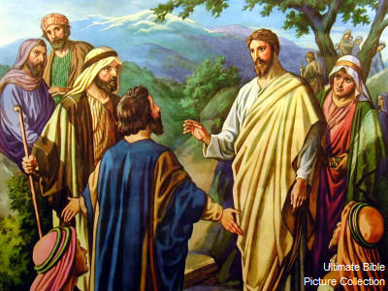
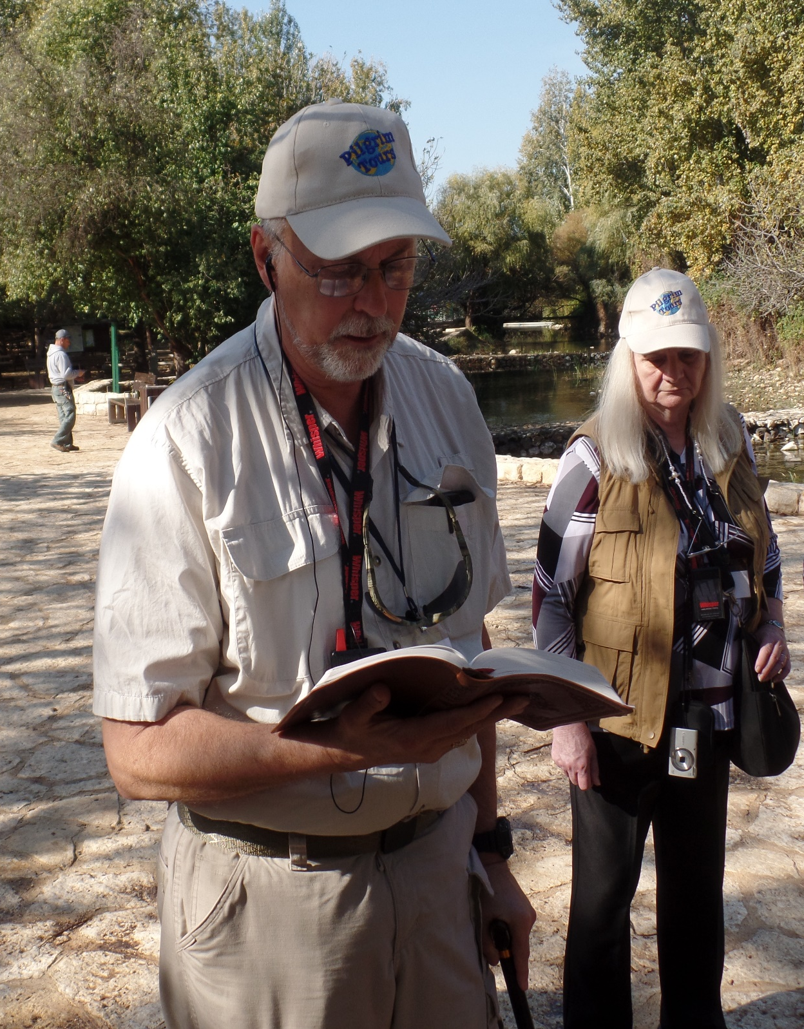
WHO AM I?
“When Jesus came into the coasts of Caesarea Philippi, he asked his disciples, saying, Whom do men say that I the son of man am?” (16:13).
Jesus asked the 12 a simple question, Who do the people of Israel say that I am? They answered, “Some say that thou art John the Baptist: some, Elijah; and others, Jeremiah, or one of the prophets… But whom say ye that I am” (16:14,15).
Then Peter stepped forward and answered for the group –
“Thou art the Christ, the Son of the living God. And Jesus answered and said unto him, Blessed art thou [Peter]… For flesh and blood hath not revealed it unto thee, but my Father which is in heaven” (16:16,17).
The Father would not only know who would be saved (Jn. 6:65), but what He would reveal to those who were saved, e.g., Peter’s confession of Christ.
Caesarea Philippi (2018)

Slide 16
THE KINGDOM CHURCH
The Jews were still under the Law, which meant they had to keep the commandments; they were also required to be water washed, but the most important aspect of the Jews’ faith was to believe that Jesus was their long awaited and promised Messiah –
“And I say also unto thee, That thou art petros, and upon this Petra I will build my church…” (16:18).
Many have misinterpreted this passage –
“There is in Greek a play on words, “thou art Peter [petros—literally, ‘a little rock’], and upon this rock [Petra] I will build my church. He does not promise to build His church upon Peter, but upon Himself [Christ]”
(Old Scofield, p. 1021).
Never would God consider building Israel’s Church on a little pebble [like Peter], but rather on a large corner-stone foundation, Christ, the Messiah!

Slide 17
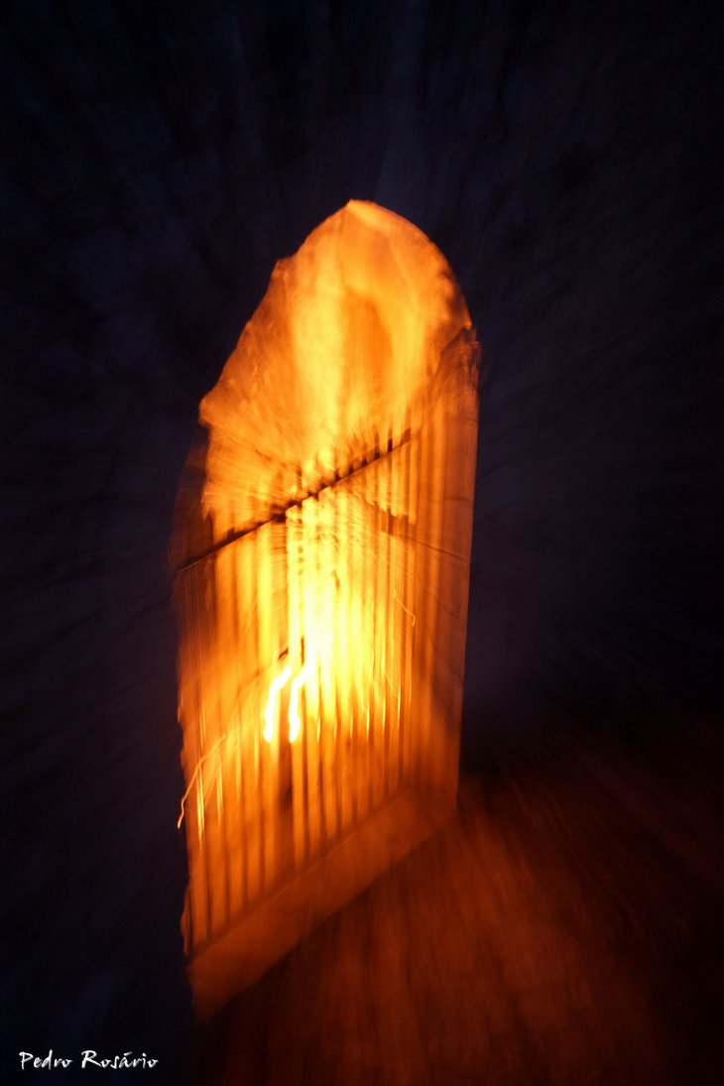
THE GATES OF HELL
“… and the gates of hell shall not prevail against it” (16:18).
What does that mean?
After Christ’s death, He descended into hell to bear the punishment for the sins of mankind, but He did not remain there –
“Whom God hath raised up, having loosed the pains of death: because it was not possible that he should be holden of it (Acts 3:24)... Thou shalt not leave my soul in hell, neither wilt thou suffer thine Holy One to see corruption” (Acts 2:27).
Christ is the only person to have escaped hell once sent there. Had He not, then there would be no 2nd coming, and no establishment of the kingdom Church (1) at the start of the Millennium.
(1) “Gr. Ecclesia (ec = “out of,” kaleo = “to call”), an assembly of called-out ones. The word is used of any assembly…” (Old Scofield, p. 1021).

Slide 18
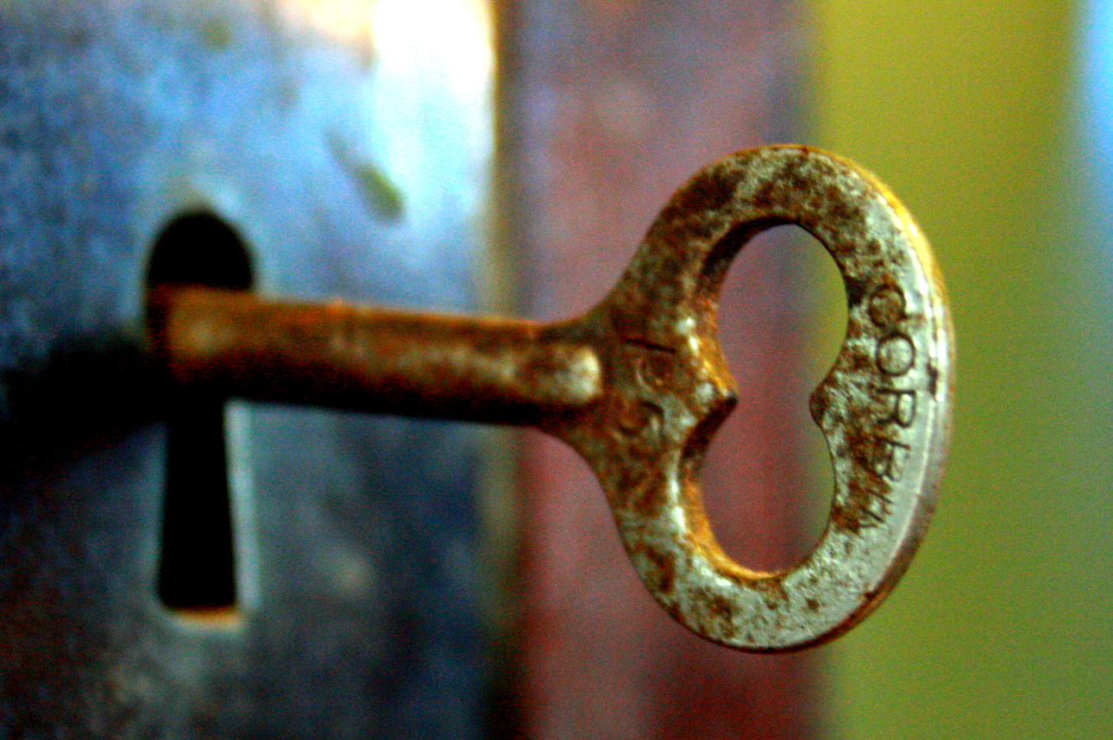
KEYS OF THE KINGDOM
“And I will give unto thee the keys of the kingdom of
heaven: and whatsoever thou shalt bind on earth shall
be bound in heaven; and whatsoever thou shalt loose
on earth shall be loosed in heaven” (16:19).
Another very controversial passage—some believing
that which is spoken of here is the present Church and
that priests can forgive sinners their sin and place them
in a state of grace and eligible for heaven. Right?
Wrong. This reference preceded that which Jesus was
about to bestow on the 12. Keys are a reflection of
one’s authority and no one in the kingdom will have
more authority than the 12 –
“… Verily I say unto you, That ye which have followed
me, in the regeneration when the Son of man shall sit
in the throne of his glory, ye also shall sit upon 12 thrones, judging the twelve tribes of Israel” (Mt. 19:28). The decisions the 12 Apostles make during the kingdom will have the authority of God both in heaven and earth.

Slide 19
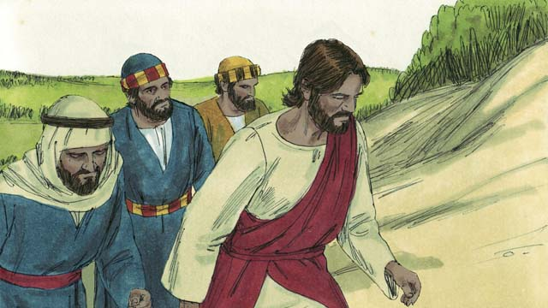
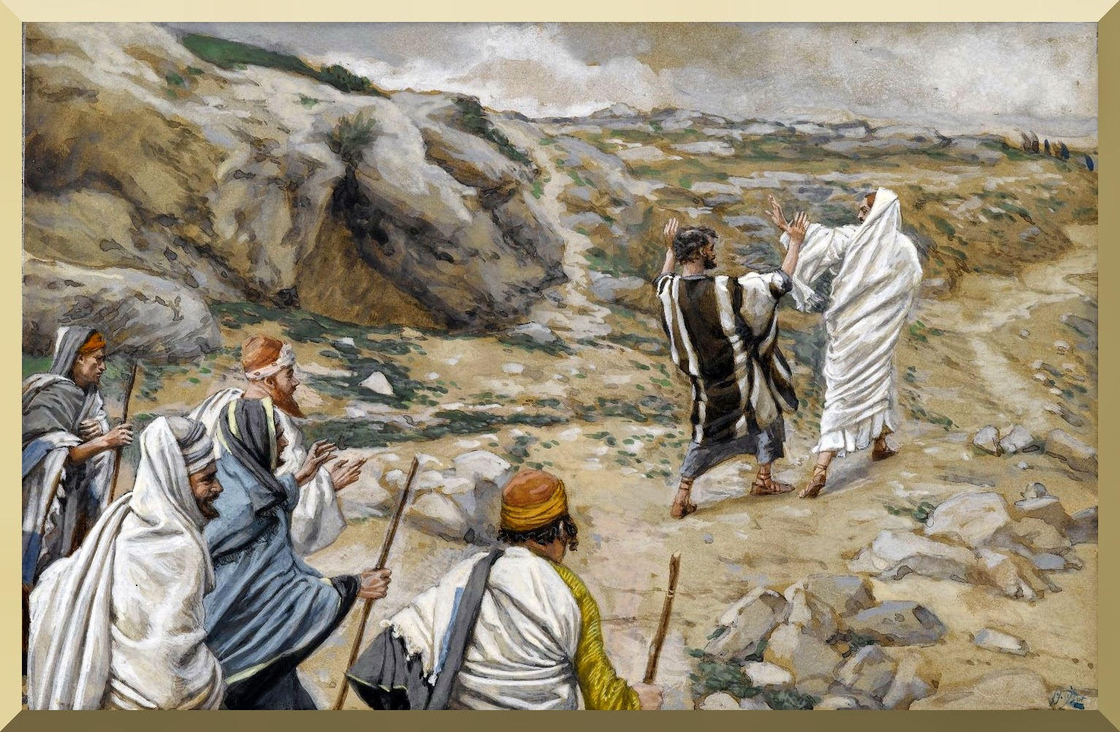
GET BEHIND THEE SATAN
After this exchange, Jesus told the 12 that He must go to Jerusalem, be killed and raised the 3rd day (16:21).
Peter’s response?
“Then Peter took him, and began to rebuke him… this shall not be unto thee… [Jesus] Peter, Get thee behind me, Satan: thou art an offense unto me: for thou savourest not the things that be of God, but those that be of men” (16:22,23).
Jesus was trying to tell them that the will of the Father was for Him to go to Jerusalem and to suffer death, burial, and resurrection, the reason He came to earth.
And Peter objected! He was looking at it from the human standpoint of losing a friend—Christ, from God’s position of Him being the Savior of the world.
“… There be some standing here, which shall not taste of death, till they see the Son of man coming in his kingdom” (16:28).

Slide 20
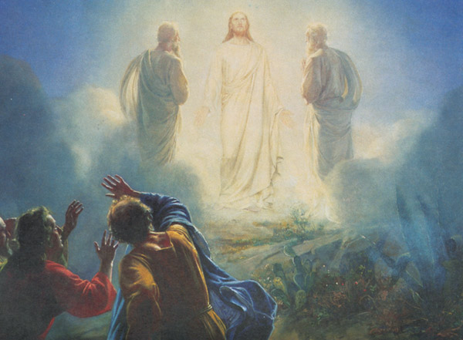
TRANSFIGURATION
“And after 6 days Jesus taketh Peter, James, and John his brother, and bringeth them up into an high mountain… and was transfigured before them: and his face did shine as the sun, and his raiment was white as the light… there appeared unto them Moses and Elijah talking with them… Peter said unto Jesus, Lord, it is good for us to be here… let us make here 3 houses: one for thee, and one for Moses, and one for Elijah…” (17:1-4).
Peter, James, and John saw a glimpse of what Christ is going to look like when He comes the 2nd time to establish His kingdom of heaven on earth. He will bring Moses and Elijah and all the O.T. saints with Him, and they will all live in houses in the holy city for a thousand years.
Next time – More of Christ’s earthly ministry.

