Slide 1
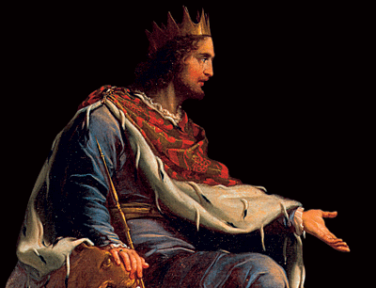
THROUGH THE BIBLE IN 2018
LESSON 25
WEEK 25 OF 52
(Eccl.1-6; 1Kg.10-14)
Last time we saw Solomon build the temple; this time Solomon’s heart is turned away from God.
“Boast not thyself of tomorrow; for thou knowest not what a day may bring forth. Let another man praise thee, and not thine own mouth; a stranger, and not thine own lips” (Prov. 27:1).
No one knows for sure what tomorrow will bring, so it is better to do one’s best today rather than brag about what you will do in the future. Likewise, if you are being productive, better to let someone else speak of your accomplishments than to do it yourself, and sound prideful.

Slide 2
“He that turneth away his ear from hearing the law, even his prayer shall be abomination” (28:9).
To ignore written spiritual things of God [Bible], and then try to counsel God in prayer is an abomination to Him. We seek God’s counsel; He wants our prayer, but not our instruction. Does God hear every prayer?
“If I regard iniquity in my heart, the LORD will not
hear me (Psa. 66:18)… But your iniquities have
separated you and your God, and your sins have
hide his face from you, that he will not hear
(Isa. 59:2)… [the wicked] then he shall be judged,
let him be condemned: and let his prayer become
sin” (Psa. 109:7). On the other hand –
“… the prayer of the upright is his delight”
(Prov. 15:8)…The effectual fervent prayer of a
righteous man availeth much” (Jas. 5:16). God
wants our prayer to be consistent with the spiritual
set apart [sanctified] position we have in-Christ. As
we grow in the faith, we will pray better.

Slide 3
“Correct thy son, and he shall give thee rest; yea, he shall give delight unto thy soul” (29:17).
A parent has two choices concerning the correction of children:
1. Correct your children when they are young [short term without rest]; And, enjoy a life long rest [from problems]; a delightful life.
Or, don’t correct your child when they are
young [short term rest], and experience an
extended life without rest [continuous problems];
a loathsome life.
“The words of the Preacher, the son of David, king
in Jerusalem… and have gotten more wisdom than
all they that have been before me… I made great
works; I builded houses… servants and maidens…
silver and gold…” (Eccl. 1:1; 2:4,7,8).
Sounds like the writer is Solomon.

Slide 4
THEME OF ECCLESIASTES
“Vanity of vanities, saith the Preacher, vanity of vanities; all is vanity” (1:2; 12:8).
In so many words, Solomon is asking the age old philosophic question, What is the meaning of
life? Strong’s Concordance, p. 1437, defines vanity as “emptiness, transitory.”
The theme of this book is that life without God is
transitory and empty, i.e. meaningless.
“Vanity, in Ecclesiastes, and usually in Scripture,
means, not foolish pride, but the emptiness in final
result of all life apart from God. It is to be born, to
toil, to suffer, to experience some transitory joy,
which is nothing in view of eternity, to leave it all,
and to die” – Old Scofield, p. 696.
“What profit hath a man of all his labour which he
taketh under the sun? (1:3).
It is Solomon’s goal to proclaim to mankind that a
life devoid of God is a meaningless, fleeting
existence. Against the backdrop of eternity, this life is momentary,
at best; a speck of time in God’s vast timeline.

Slide 5
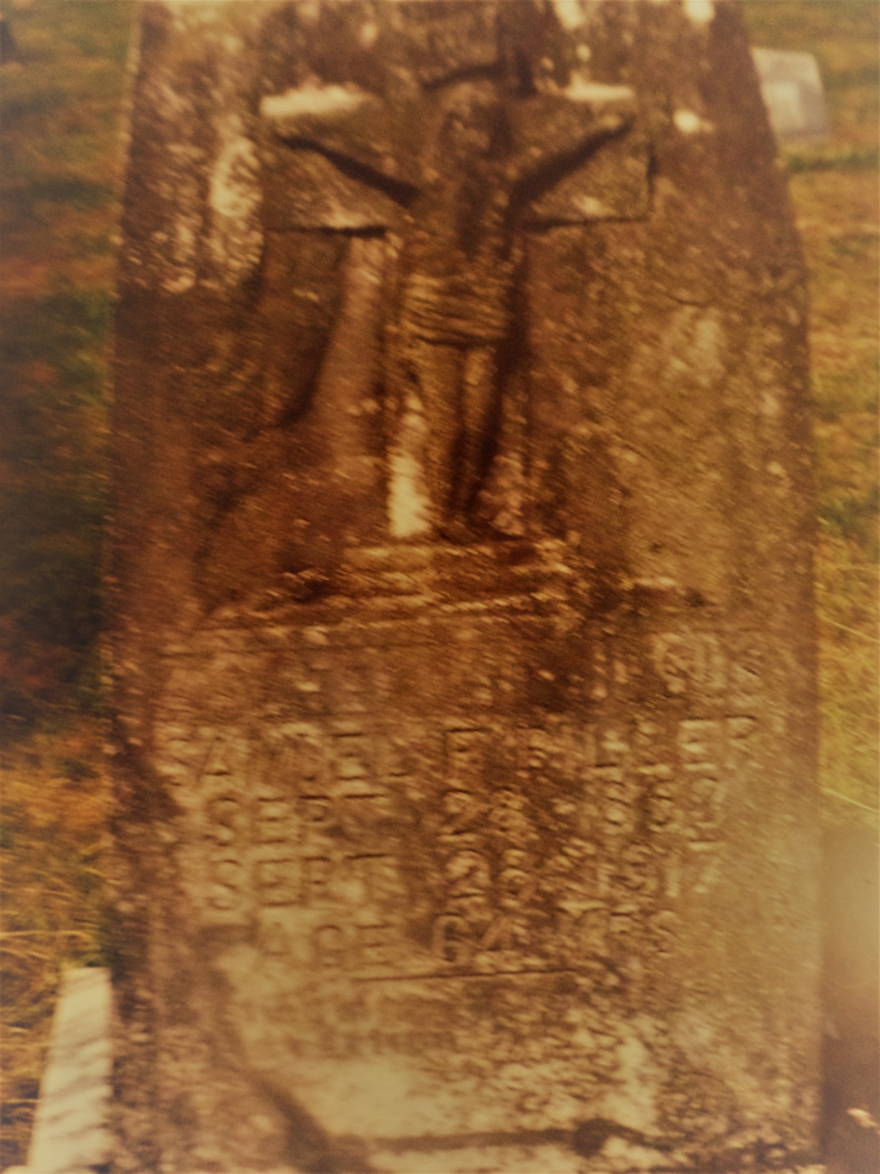
“One generation passeth away… another generation cometh… the earth abideth forever” (1:4).
Compared to the earth, this life is temporal and death is the only certainty. One is born and then dies, another takes his place– Samuel F. Biller [my great-grandfather], 1858-1917, “Asleep in Jesus.”
“The sun also ariseth, and the sun goeth down, and
hasteth to his place where he arose. The wind goeth
toward the south, and turneth… unto the north;
it whirleth about continuous, and the wind returneth
again according to his circuits. All the rivers run into
the sea; yet the sea is not full; unto the place from
whence the rivers come… they return again”(1:5-7).
Solomon uses nature as the perfect example of the
repetitiveness of existence in this life on planet earth.
And, then he reaches a striking conclusion –
“The thing that hath been, it is that which shall be;
and that which is done is that which shall be done:
and there is no new thing under the sun” (1:9).
Life… death… life… death… life… death (ad infinitum).

Slide 6
THEME OF ECCLESIASTES
“Vanity of vanities, saith the Preacher, vanity of vanities; all is vanity” (1:2; 12:8).
In so many words, Solomon is asking the age old philosophic question, What is the meaning of
life? Strong’s Concordance, p. 1437, defines vanity as “emptiness, transitory.”
The theme of this book is that life without God is
transitory and empty, i.e. meaningless.
“Vanity, in Ecclesiastes, and usually in Scripture,
means, not foolish pride, but the emptiness in final
result of all life apart from God. It is to be born, to
toil, to suffer, to experience some transitory joy,
which is nothing in view of eternity, to leave it all,
and to die” – Old Scofield, p. 696.
“What profit hath a man of all his labour which he
taketh under the sun? (1:3).
It is Solomon’s goal to proclaim to mankind that a
life devoid of God is a meaningless, fleeting
existence. In the backdrop of eternity, this life is
a speck of time in God’s vast timeline.

Slide 7
“Without faith it is impossible to please God” (Heb. 11:6). Paul made this profound statement
more than a thousand years later. Solomon attempted to prove it during the age in which he lived.
“I have seen all the works [man] that are done under the sun; and, behold all is vanity [emptiness]
and vexation [suffering] of the spirit [of man]” (1:14).
As king of Israel and the most wise person on earth,
Solomon was in a perfect position to observe the
lives of those under him and what he saw was
temporal, without real meaning, like a dog chasing
its tail.
“For in much wisdom is much grief: and he that
increaseth in knowledge increaseth sorrow” (1:18).
God given wisdom was a 2-edged sword for
Solomon: it allowed him to see that which most
others couldn’t see; but, what he saw saddened
him— life is hard and then you die. That’s why he
was inspired of God to write this book to
encourage man to live a faith based life.

Slide 8
“I said in mine heart, Go now, I will prove thee with mirth, therefore enjoy pleasure: and, behold, this also is vanity” (2:1).
Next Solomon began to investigate what mankind believes makes a good life—pleasure, but he
concluded there was no intrinsic value in it. Paul wrote concerning the ‘last days’ of the Church
age – “For men shall be lovers of their own selves…
lovers of pleasures more than lovers of God” (2Tim. 3:4).
Most will seek their own pleasure instead of God.
“I sought in mine heart to give myself unto wine…” (2:3).
Alcohol [drugs] will not make your life better, but it
might make it much worse.
“I made great works; I builded houses… planted vine-
yards… servants and maidens… silver and gold” (2:4).
As the richest and most powerful person in the world,
Solomon could build, buy, obtain, anything he wanted,
but, “I looked on all the works that my hands had
wrought… and behold, all was vanity [emptiness] and
vexation [suffering] of [my] spirit, and there was no profit under the sun” (2:11).

Slide 9
“There is nothing better for a man, than that he should eat and drink, and that he should make his soul enjoy good in his labour. This also I saw, that it was from the hand of God” (2:24).
Solomon reckoned that the best man could hope for was to enjoy the simple things of life such as eating and drinking, and his work, which he did enjoy, “… my heart rejoiced in all my labour”(2:10). Notice these things become blessings only to those
who believe they are from God. Paul agreed –
“Let him that stole steal no more: but rather let him
labour, working with his hands the thing which is
good, that he may have to give to him that needeth
(Eph. 4:28)… Charge them that are rich in this world,
that they be not highminded, nor trust in uncertain
riches, but in the living God, who giveth us richly all
things to enjoy; that they do good, that they be rich in
good works, ready to distribute [do the Lord’s work]
…” (1Tim. 6:17,18).
This life can bring joy, but enjoyment comes when we
recognize the source – “All things were created by him [Christ] and for him [Christ]” (Col. 1:18).

Slide 10
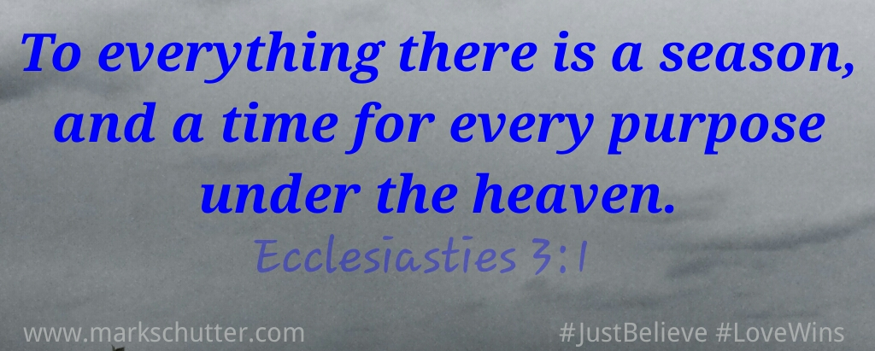
“For God giveth to a man that is good in his sight wisdom, and knowledge, and joy: but to the sinner he giveth travaileth, to gather and to heap up, that he may give to him that is good before God” (2:26).
Remember, Israel was under a conditional relationship with God—their obedience brought
blessings; their disobedience brought chastisement
and suffering from God (Deut. 28:1,15).
Next Solomon compiled a list of those things which are
polar opposites in this life, but are common to all of
mankind..

Slide 11
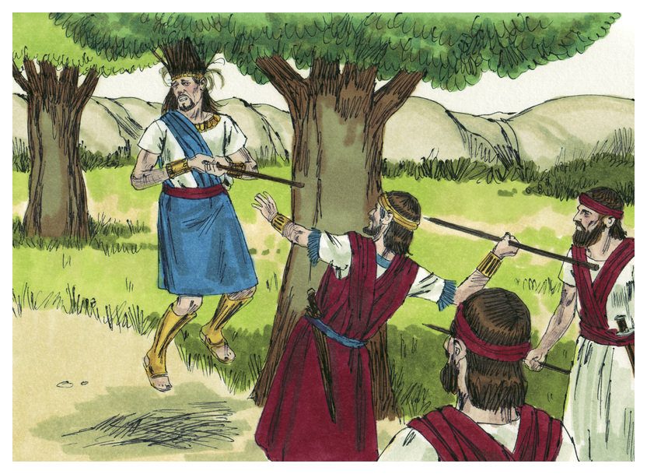
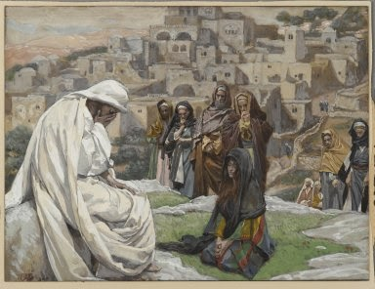
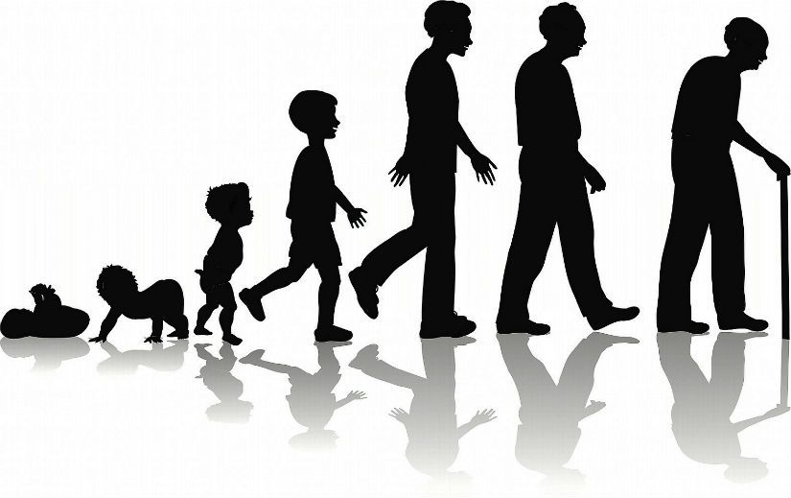
“A time to be born, and a time to die; a time to plant, and a time to pluck up that which is planted” (3:2).
Solomon began with two things [life & death] which man has no control over because they belong to God. The same is true for nature as they have a beginning and an end.
“A time to kill, and a time to heal; a time to break down, and a time to build up” (3:3).
Solomon must have heard many stories about his warrior father who sometimes was forced to take lives [by God’s will], while at other times was able to save lives. War with his enemies caused David to destroy nations, but times of peace enabled him to help nations to prosper.
“A time to weep… a time to mourn…” (3:4).
David wept as he left Jerusalem during Absalom’s coup,
and mourned his death when he was killed.

Slide 12
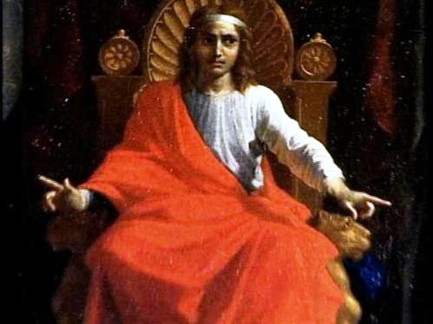
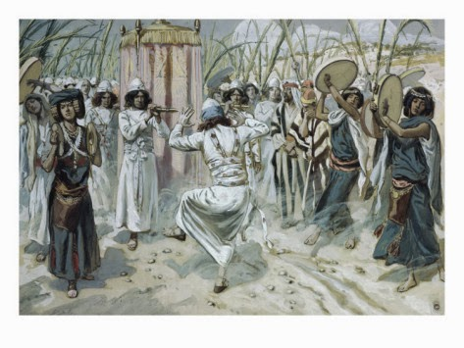
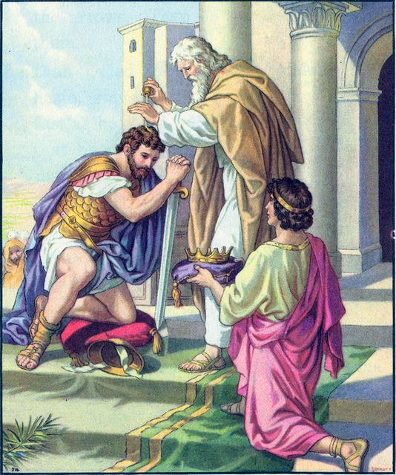
“… a time to laugh… and a time to dance” (3:4).
Though David had much tragedy in his life, he also had much joy—on this occasion when he brought the ark to Jerusalem.
“… a time to embrace, and a time to refrain from embracing” (3:5a).
David had several wives to embrace, but he should have refrained from embracing Bath-sheba (but then Solomon would not have been born).
“A time to get, and a time to lose; a time to keep, and a time to cast away” (3:6).
David knew exactly when God wanted him to assume the throne of Israel, and when to relinquish it to his son Solomon.
“A time to love, and a time to hate; a time of war, and a time of peace” (3:8).
Most kings love peace and hate war—but, both are probable in this life. King David experienced both.

Slide 13
“He [God] hath made everything beautiful in his time: also he hath set the [ages] in their heart, so that no man can find out the work that God maketh from the beginning to end” (3:11).
To, “to everything there is a season”(3:2-8), Solomon added that God has made each activity of man’s life ‘beautiful’ or appropriate in respect
to time, e.g. a time to be born, a time to die. He also
declared that though we cannot know everything
about God from the beginning to the end [because it
would take a mind as big as God’s], He has placed a
very strong desire in each of us to want to know what
comes next—tomorrow, next year, old age, life after
death, etc.
“What profit hath a man of all his labour, which he
taketh under the sun?” (1:3).
The answer he wants is, NOTHING.
Solomon [God] wants us to see that our labor in life,
though very necessary in the physical realm, cannot
produce these important spiritual truths, only God can.

Slide 14
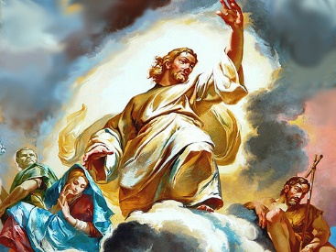
“I said in my heart, God shall judge the righteous
and the wicked: for there is a time there for every
purpose and for every work” (3:17).
There is a time to be born and a time to die and a
time to be judged – “And as it is appointed unto
men once to die, but after this the judgment”
(Heb. 9:27).
“There is a sore evil which I have seen under the
sun, namely, riches kept for the owners thereof to
their hurt. But those riches perish by evil travail:
and he begetteth a son, and there is nothing in his
hand. As he came forth of his mother’s womb,
naked shall he return to go as he came, and shall
take nothing of his labour…” (5:13-15).
Solomon made 2-points: greed often backfires and
all can be lost with nothing to give to your children;
and, even if it were not lost, no one is going to take any of it with them when they die.

Slide 15
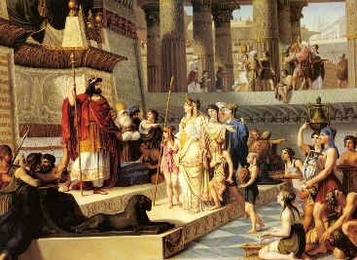
“And when the Queen of Sheba heard of the fame of Solomon concerning the name of the LORD, she came to prove him with hard questions” (1Kg. 10:1).
As previously stated, rulers from all over the world came to pay homage to Solomon and hear his wisdom (4:34). Sheba is modern Yemen, on the coast of the Arabian peninsula, about 1,200 miles from Jerusalem. The queen wanted to see if he was as wise as others said he was.
“And she came to Jerusalem with a very great train, with camels that bare spices, and very much gold, and precious stones: and when she was come to Solomon, she communed with him of all that was in her heart. And Solomon told her all her questions: there was not any thing hid from the king, which he told her not” (10:2).
The queen arrived with a very large entourage, gifts, and lots of questions, which Solomon answered to her great satisfaction.

Slide 16
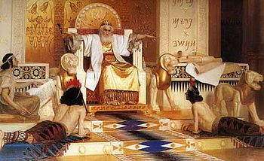
SOLOMON’S EXTRAVAGANCE
“Now the weight of gold that came to Solomon in one year was [25 tons/50,000 lb.]. Beside that he had of the merchantmen, and of the traffic of the spice merchants, and of all the kings of Arabia, and of the governors of the country… Moreover, the
king made a great throne of ivory, and overlaid it with the best gold” (10:14,18).
Solomon possessed incredible wealth and he was not above using it for his own indulgences.
“For the king had at sea a navy… bringing gold, and silver, ivory, and apes and peacocks. So king Solomon exceeded all the kings of the earth for riches and wisdom. And all the earth sought to Solomon, to hear his wisdom, which God had put in his heart” (10:22-24).
Can you not see where this is going?

Slide 17
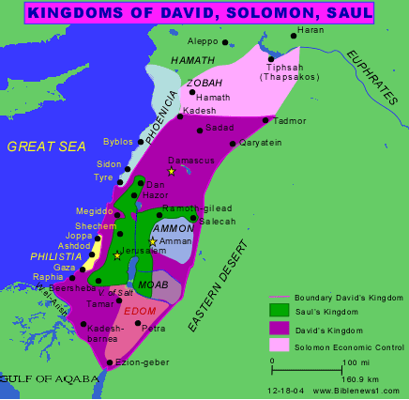
SOLOMON’S HEART TURNED FROM GOD
“But king Solomon loved many strange women, together
with the daughter of Pharaoh, women of Moabites,
Ammonites, Edomites, Zidonians, and Hittites” (11:1).
Because of his fabulous wealth, lifestyle, and exalted
position as the most important person in the world,
Solomon forgot his first love [God] and the instructions
imposed on him under the Law with Moses’ warning
as Israel was about to enter the promised land –
“Neither shall he [king] multiply wives to himself, that
his heart turn not away: neither shall he greatly multiply
to himself silver and gold… when he sitteth upon the
throne of his kingdom that he write a copy of the Law…
he shall read all the days of his life… learn to fear the
LORD… to keep all the words of this law… to do them. That his heart be not lifted above his brethren…” (Deut. 17:17-20).
—TOO LATE!

Slide 18
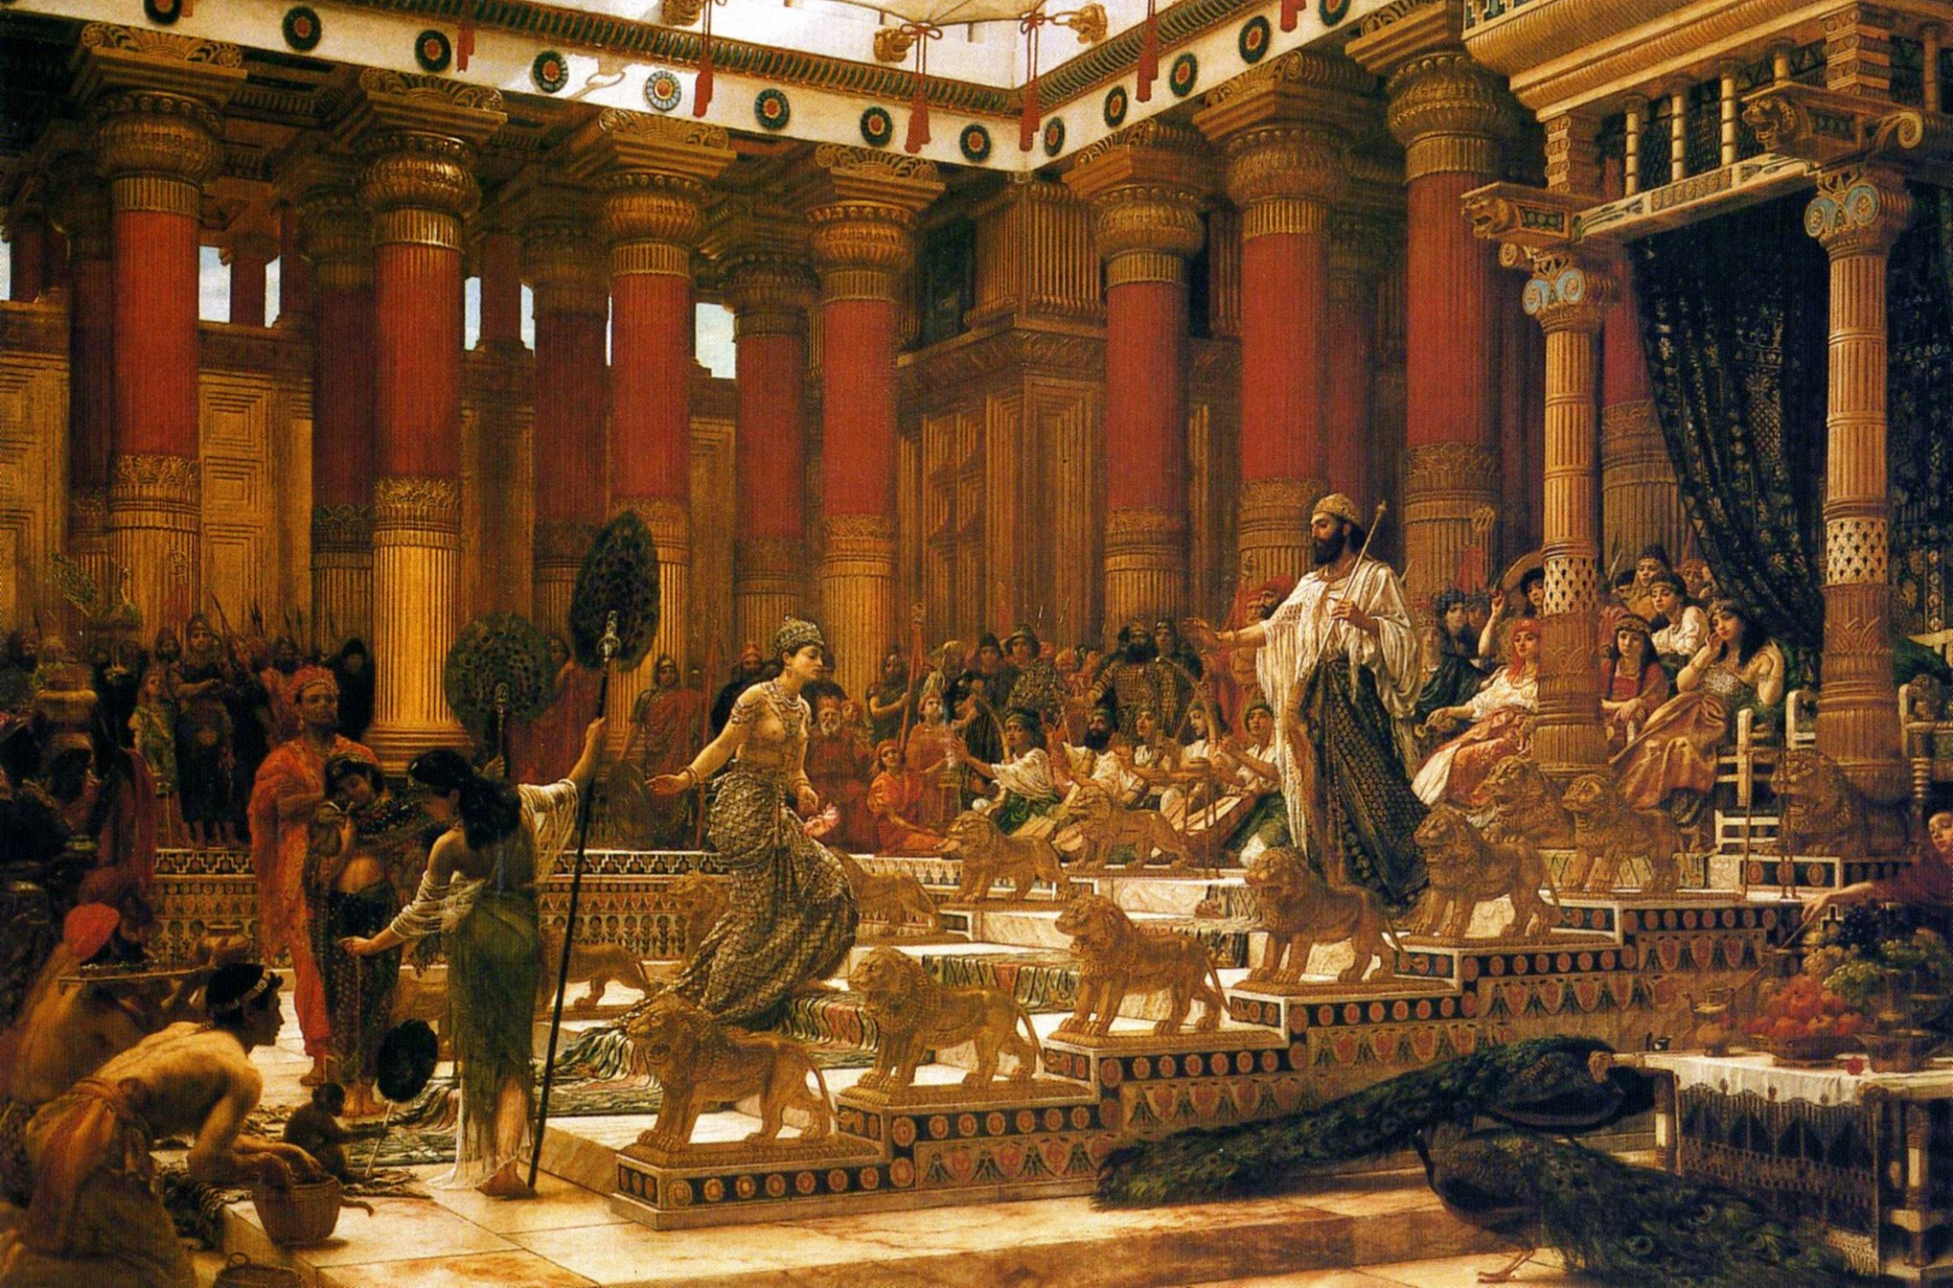
“… Ye shall not go in to them, neither shall they come in unto you: for surely they will turn away your heart after their gods: Solomon clave unto these in love. And he had [700] wives, princesses, and [300] concubines: and his wives turned away his heart. For it came to pass, when Solomon was old, that his wives turned away his heart after other gods: and his heart was not perfect with the LORD his God, as was the heart of David his father” (11:2-4).
All the godly wisdom given him did not prevent king Solomon from breeching his relationship with the God of Israel as he allowed these forbidden wives (Deut. 7:3) to lead him into idol worship –
“For Solomon went after Ashtoreth the goddess of the Zidonians… Milcom the abomination of the Ammonites. And Solomon did evil… and went not fully after the LORD, as did David his father” (11:5,6).

Slide 19
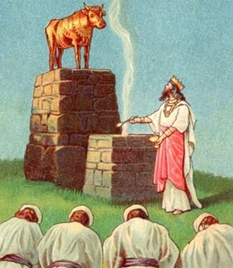
SOLOMON’S ABOMINATION
“Then did Solomon build an high place for Chemosh, the abomination of Moab, in the hill
that is before Jerusalem, and for Molech, the abomination of the children of Ammon. And like wise did he for all his strange wives, which burnt incense and sacrificed unto their gods” (11:7,8).
Solomon’s spiritual degradation led him to build idol worship sites on the Mt. of Olives, where
Jesus would agonize before His crucifixion.
“And the LORD was angry with Solomon, because his heart was turned from the LORD God of Israel… and commanded him concerning this thing, that
he should not go after other gods: but he kept not that which the LORD commanded” (11:9,10).
Solomon’s failure?
He didn’t follow God’s Words.

Slide 20
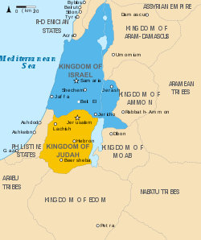
THE CONSEQUENCES OF SOLOMON’S SIN
“Wherefore the LORD said unto Solomon, forasmuch as
this is done of thee, and thou hast not kept my covenant
and my statutes… I will surely rend the kingdom from thee,
and will give it to thy servant. Notwithstanding in thy days
will I do it for David thy father’s sake: but I will rend it out
of the hand of thy son” (11:11,12).
Solomon’s foolishness caused all of God’s efforts through
David to form of Israel ONE UNITED KINGDOM, to cease.
Jesus later said, “A kingdom divided against itself cannot
stand [one of God; one of Satan]” (Mt. 12:25). But,
because of His love for David, God would wait until the
death of Solomon to bring it to pass –
“And he [Ahijah the prophet] said to Jeroboam, Take thee
[10] pieces… saith the LORD… will give [10] tribes to thee”
(11:29-31). Jeroboam was chosen to be the future king of the northern kingdom composed of 10 tribes. What did Solomon do? “… sought therefore to kill Jeroboam… fled into Egypt… until the death of Solomon” (11:40).

Slide 21
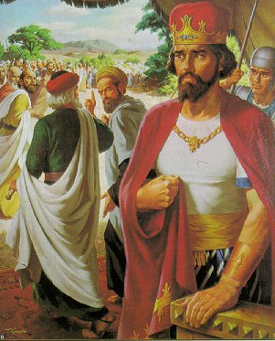
THE DEATH OF SOLOMON
“And the time that Solomon reigned in Jerusalem over all
Israel was [40] years. And Solomon slept with his fathers,
and was buried in the city of David his father: and
Rehoboam his son reigned in his stead (11:42,43)… And
Rehoboam went to Schechem… where all Israel came to
make him king” (12:1).
Rehoboam, refused the advice of his elders to lower the
high taxes imposed by his father Solomon (12:8), which
caused the northern kingdom to rebel –
“So Israel rebelled against the house of David” (12:19),
and the 10 northern tribes made Jeroboam their king
(12:20). Because he knew those under him would want
to go to Jerusalem to worship (12:27), his evil heart was
exposed when he built “two calves of gold,” placing one
in “… Bethel, and the other put he in Dan. And this thing
became a sin” (12:29).

Slide 22
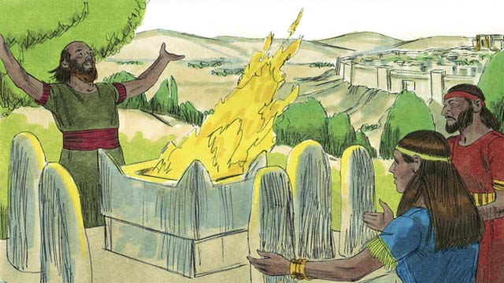
THE JUDGMENT AND DEATH OF JEROBOAM
“After this thing Jeroboam returned not from his evil way, but made again of the lowest of the people priests of the high places: whosoever would, he consecrated him, and became one of the priests of the high places. And this thing became sin unto the house of Jeroboam, even to cut it off, and to destroy it from off the face of the earth (13:33,34)… And the days which Jeroboam reigned were [22] years: and he slept with his fathers, and Nadab his son reigned in his stead” (14:20).
JUDAH’S APOSTASY UNDER REHOBOAM
“And Rehoboam the son of Solomon reigned in Judah… [41] when he began to reign, and he reigned [17] years in Jerusalem… Judah did evil in the sight of the LORD… for they also built them high places…” (14:21-23).
Next time – Civil war between the two kingdoms

