Slide 1
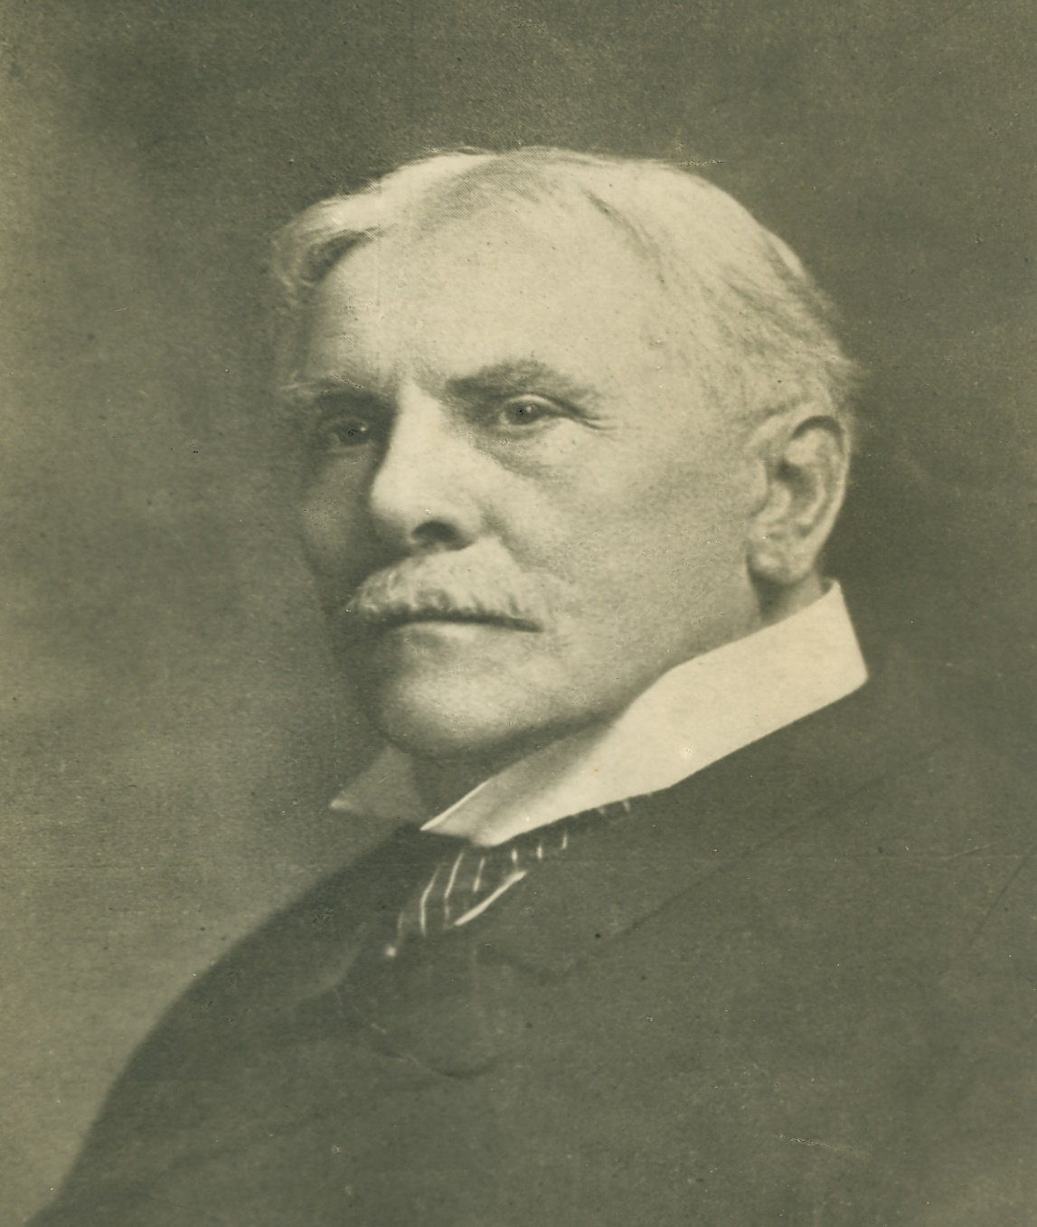
LESSON 38
WEEK 38 OF 52
(Ezra 1-3; Haggai;
Zech. 1-14; Est. 1-5)
THROUGH THE BIBLE IN 2018
Last time we saw the miraculous
life of Daniel; this time God brings
the Jewish captives home.
“EZRA, the first of the post-captivity books (Ezra, Nehemiah, Esther, Haggai, Zachariah, and Malachi), records the return to Palestine under [Jewish governor] Zerubbabel, by decree of [Persian king] Cyrus, of a Jewish remnant who laid the temple foundations (536 B.C.). Later (458 B.C.) Ezra followed, and restored the law and ritual. But the mass of the nation, and most of the princes, remained by preference in Babylonia and Assyria, where they were prospering. The post-captivity books deal with that feeble remnant which alone had a heart for God… The events recorded in Ezra cover a period of 80 years [Ussher]” (Old Scofield, p. 529).

Slide 2
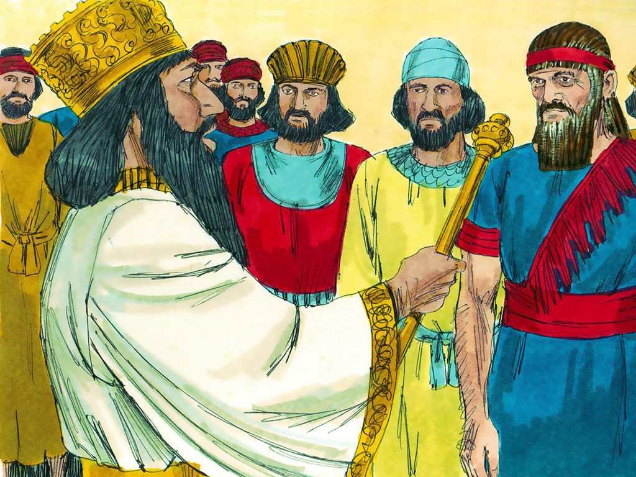
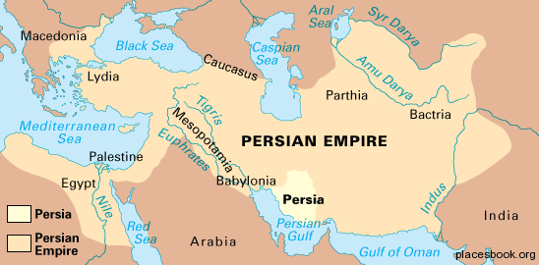
CYRUS’ DECREE
“Now in the first year of Cyrus king of Persia, that the word of the LORD by the mouth of Jeremiah might be fulfilled, the LORD stirred the spirit of Cyrus king of Persia, that he made a proclamation throughout all his kingdom, and put it also in writing, saying, Thus saith Cyrus… The LORD God of heaven hath given me all the kingdoms of the earth; and he hath charged me to build him an house at Jerusalem, which is in Judah… He is the God…” (Ezra 1:1-3).
Exactly as Jeremiah prophesied, in the year 536 B.C., the God of Israel stirred the heart of the king of the Persian empire to build Him a house [temple] in Jerusalem. Though he sounded like a believer, in fact,
he continued to worship the Persians gods [Bel, Nebo].
He did, however, carry out the will of God to terminate the Jewish captivity by giving the Jews a good reason to go home—build God another house.

Slide 3
“And whosoever remaineth in any place where he sojourneth, let the men of his place help him with silver… gold… goods… beside the freewill-offering for the house of God that is in Jerusalem” (1:4).
Cyrus’ charge also included the procurement of the funds to rebuild the temple and that was to come from the Persians who were neighbors and friends with the Jews during their captivity. This was reminiscent of the Jews in Egypt who were given sufficient resources from the Egyptians to build everything necessary for the wilderness tabernacle.
“Then rose up the chief of the fathers of Judah and Benjamin, and the priests, and the Levites, with all them whose spirit God had raised, to go up to build the house of the LORD, which is in Jerusalem” (1:5).
The leaders, spiritual and otherwise, spearheaded the effort to go home.

Slide 4
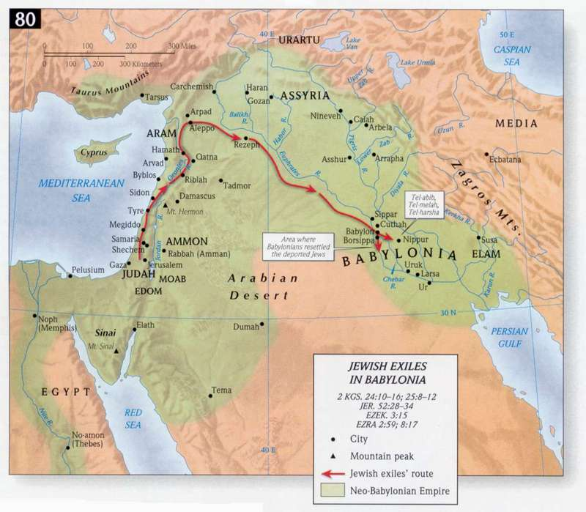
“Also Cyrus the king brought forth the vessels of the house of the LORD, which Nebuchadnezzar had brought forth out of Jerusalem, and had put them
in the house of his gods… All the vessels of gold
and of silver were [5,400]… bring up with them of
the captivity that were brought up from Babylon
unto Jerusalem” (1:7-11).
The holy objects confiscated by Nebuchadnezzar,
70-years earlier, were now being returned to their rightful owners, all by the will of God –
“That saith of Cyrus, He is my shepherd, and shall perform all my pleasure: even saying to Jerusalem, Thou shalt be built; and to the temple, Thy foundation shall be laid” (Isa. 44:28).
God was carrying out another ‘exodus,’ but unlike
the Egyptian exodus, they would not take 40-years
of wandering to reach their final destination.

Slide 5
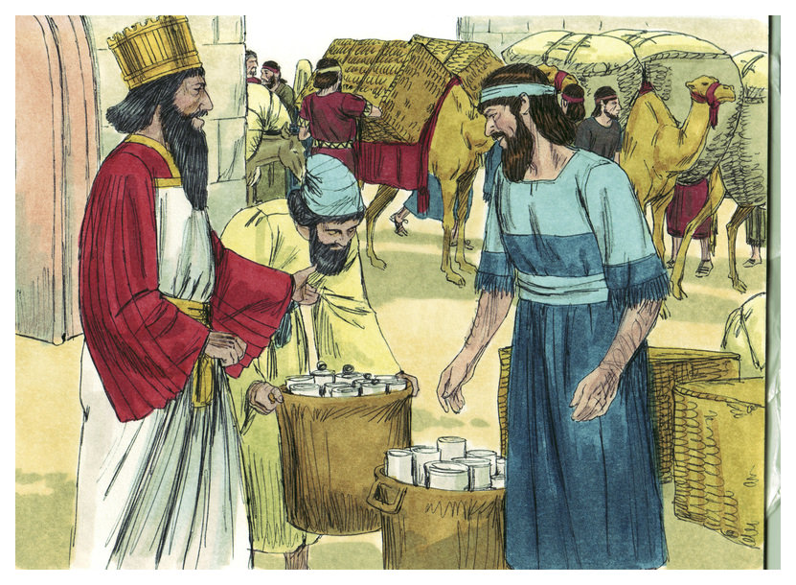
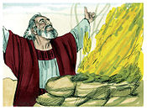
JEWISH RETURNEES
Ezra stated that a total of 49,897 Jews returned from Babylon to the land of Israel (2:64,65).
“And when the [7th] month was come, the children of Israel were in the cities, the people gathered themselves together as one man to Jerusalem. Then stood up Jeshua… and his brethren the priests, and Zerubbabel [governor of Judah]… builded the altar of the God of Israel, to offer burnt-offerings thereon, as it is written in the law of Moses the man of God. And they set the altar upon his bases… and they offered burnt-offerings thereon unto the LORD… morning and evening” (3:1-3).
Either in the 7th month after they began their journey or in the 7th month of the year [October], the Jews reached the land of Israel. Jeshua, a priest of the order of Aaron, oversaw the building of the altar.

Slide 6
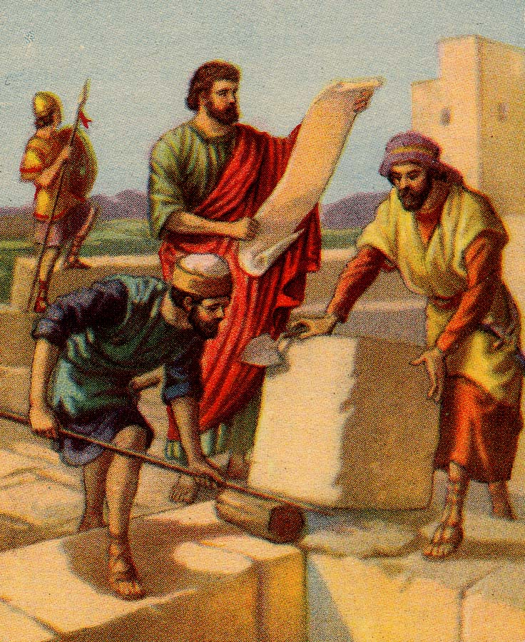
“They kept also the feast of tabernacles, as it is written, and offered the daily burnt-offerings by number, according to the custom, as the duty of ever day required … new moons, of all the set feasts of the LORD that were consecrated… every one willingly offered a freewill-offering unto the LORD…” (3:4,5).
These were the 1st sacrifices in 70-years since the temple had been destroyed by Nebuchadnezzar
(586 B.C.). The regular worship system had been
re-instated and things were going well, for the moment. The Jewish people gave generously to pay for the various building projects.
“Now in the [2nd] year of their coming… in the [2nd] month, began Zerubbabel… Jeshua… appointed the Levites [20] years old and upward to set forward the work of the house of the LORD” (3:8).
The work on the new temple had begun.

Slide 7
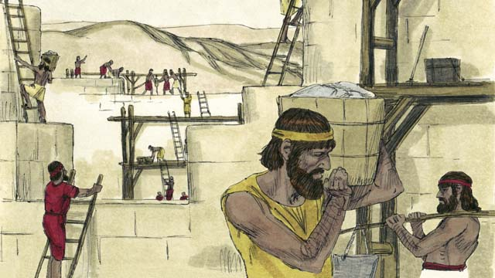
SINGING WHILE THEY WORKED
“And when the builders laid the foundation of the temple of the LORD, they set the priests in their apparel with trumpets, and Levites the sons of Asaph with cymbals, to praise the LORD, after the ordinance of David king of Israel” (3:10).
The Levites serenaded the construction workers as they worked on the temple, reminiscent of the time when David brought the ark to Jerusalem amidst singing and dancing. Some of the older men remembered and pined after Solomon’s temple –
“But many of the priests and Levites and chief of the fathers, who were ancient men, that had seen the first house… So that the people could not discern the noise of the shout of joy from the weeping… was heard afar off” (3:12,13).
The young rejoiced; the old wept.

Slide 8
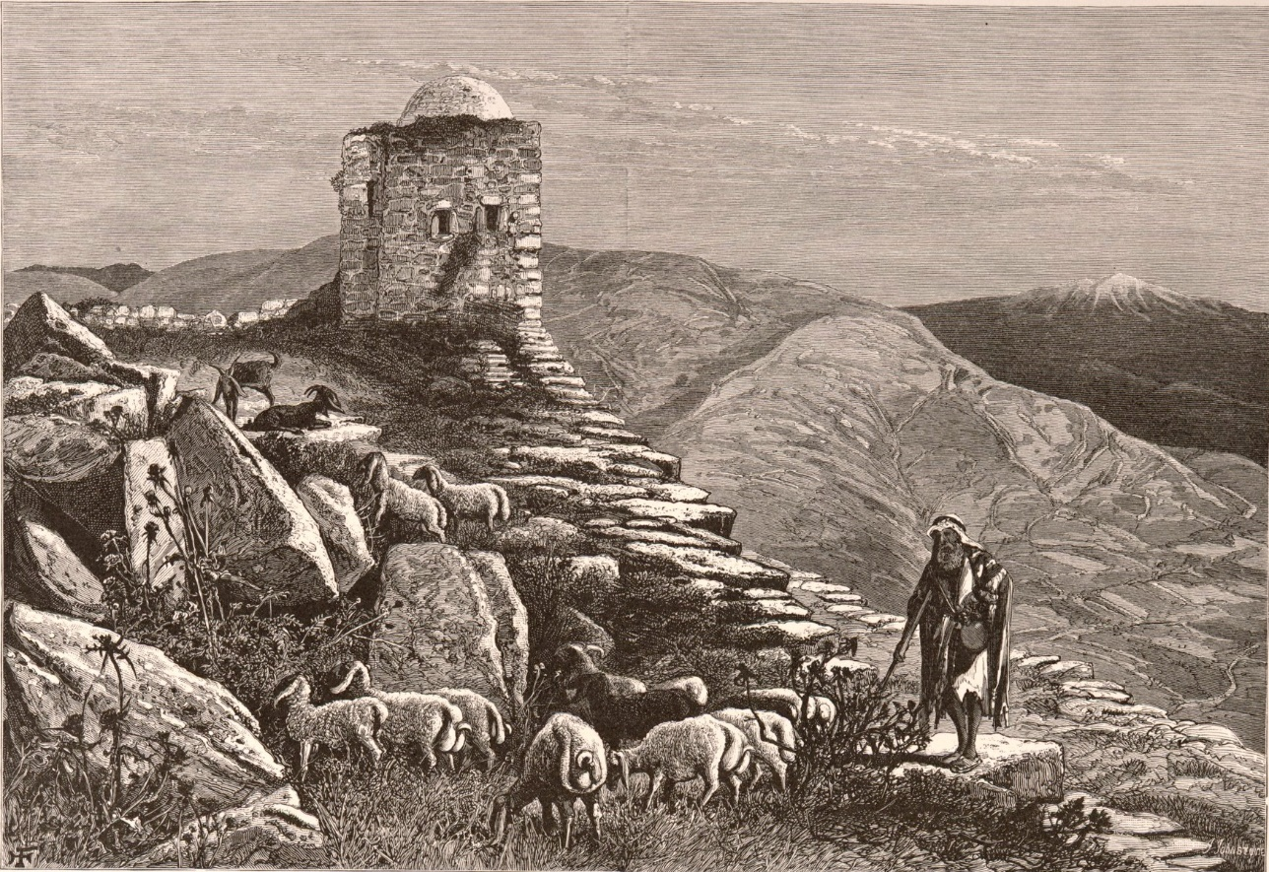
TROUBLE FROM THE SAMARITANS
“Now when the adversaries of Judah and Benjamin heard that the children of the captivity builded the temple… Then they came to Zerubbabel… and said unto them, Let us build with you: for we seek your God, as ye do; and we do sacrifice unto him since the days of Esar-haddon king of Asshur, which brought us up hither” (4:1,2).
When Assyria conquered the northern kingdom in 722 B.C., Jews were deported, leaving behind the poor and weak to tend the land. They also brought some Assyrians to tend the land, which led them to intermarry with the Jews left behind (2Kg. 17:23,24). Because they settled in Samaria, they became known as ‘Samaritans,’ a mixed Jewish/Assyrian people. They were very poor and not accepted by either nation. They showed up in Jerusalem wanting to help build the temple, but were denied.

Slide 9
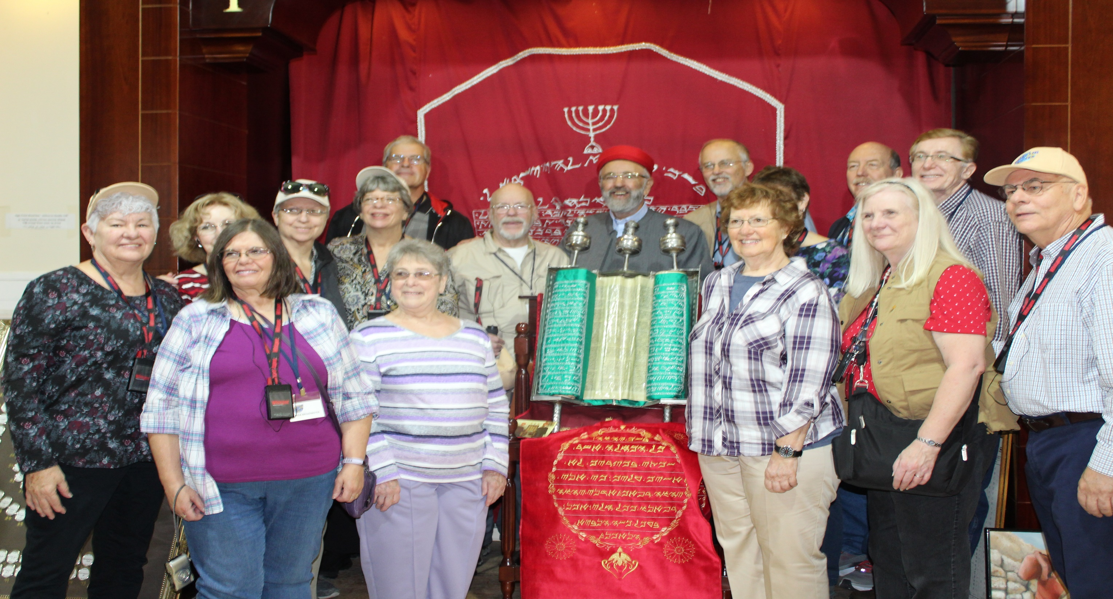
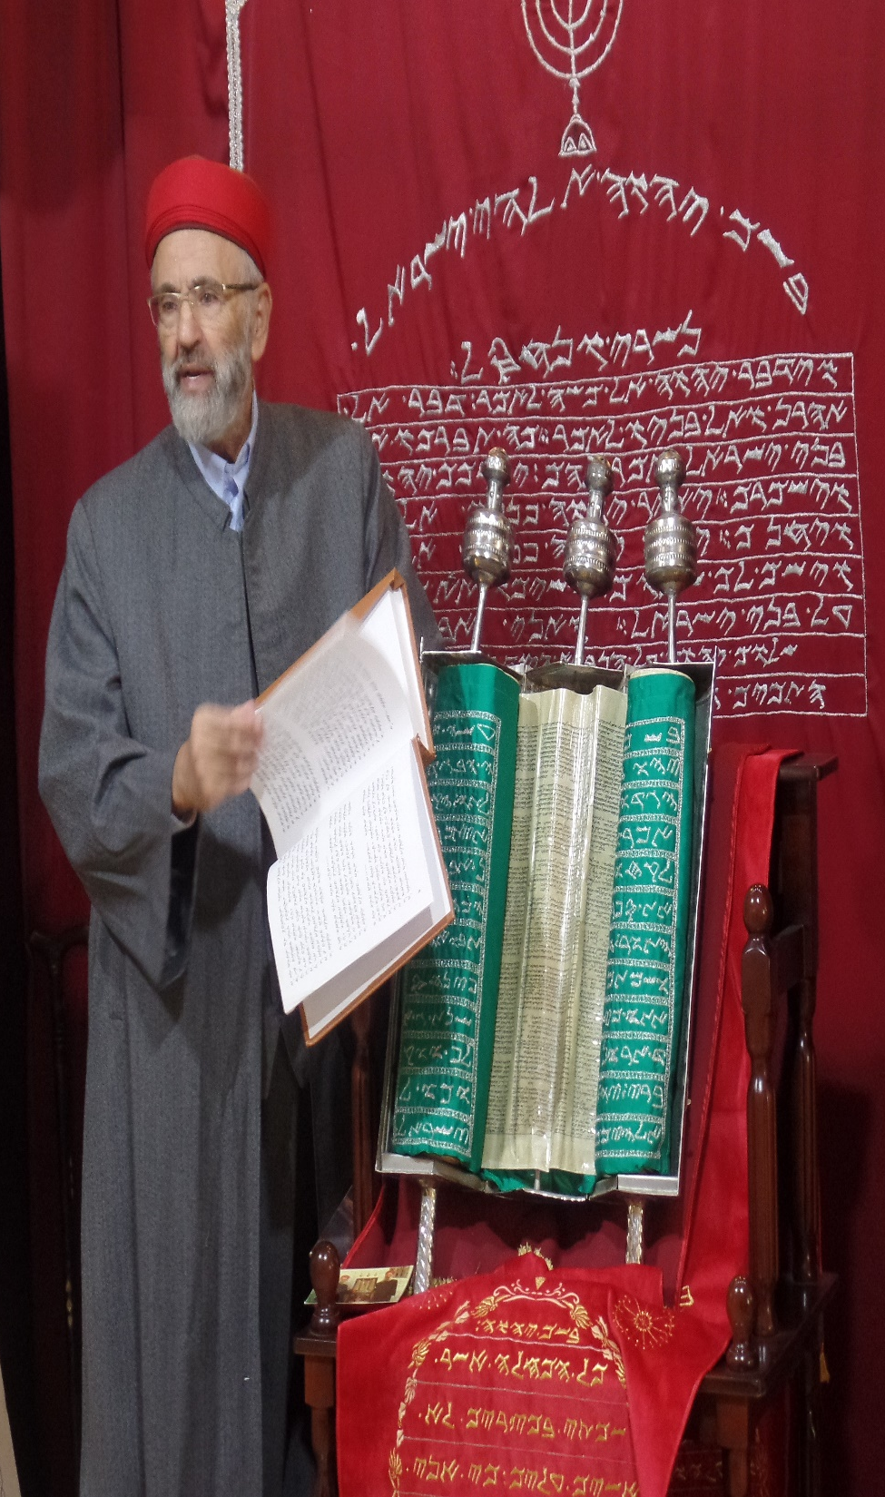
A Samaritan priest in Nablus (2018)
The Samaritans said they worshiped the same God as the Jews, but they worshiped other gods as well –
“They feared the LORD [God of Israel], and served their own gods… neither do they after… the law and commandment which the LORD commanded the children of Jacob, whom he named Israel (2Kg. 17:32-34,41).
The Samaritans had a ‘reverential regard’ for the God of Israel, but they kept only the Pentateuch [1st 5 books of the O.T.], instead of recognizing all the other books of the O.T.
“… Ye [Samaritans] have nothing to do with us to build an house unto our God… then the [Samaritans] weakened the hands of the people of Judah, and troubled them in building” (4:3,4).
The Samaritans were offended and tried to interfere with the building project by disrupting the flow of materials and by causing dissension between the parties, Israel & Persia, so much so that the Persian king caused the production to cease, “… to cause these men to cease, and this city be not builded…” (4:21).

Slide 10
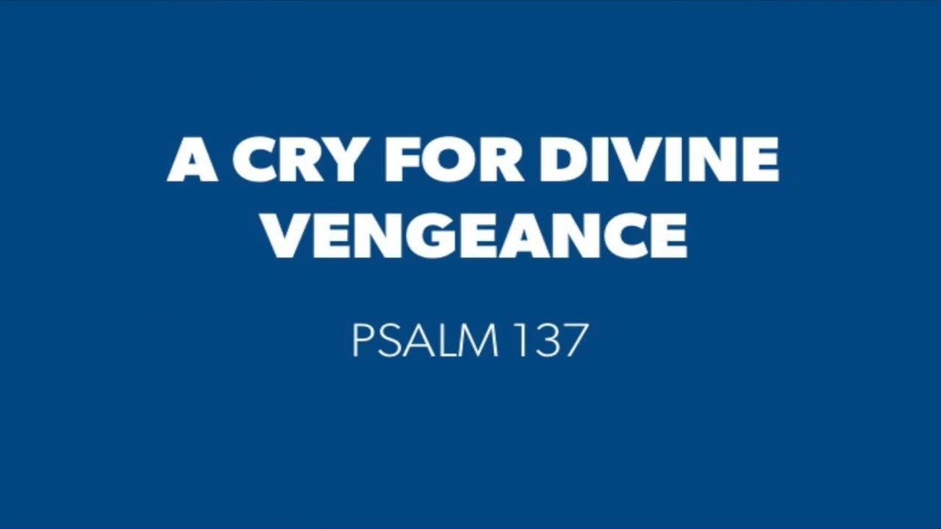
The rebuilding of Jerusalem had been stopped in 535 B.C. because of the Samaritans, but God would have none of it. In 520 B.C., King Darius of Persia confirmed the original order of Cyrus for the Jews to build the temple (6:2), and the work stoppage was ended –
“Let the work of this house of God [resume]… Moreover I made a decree… expenses be given unto these men, that they be not hindered” (6:7,8).
Not only did Darius allow the construction to resume, but he made sure they had enough money to complete it.
PSALM 137
“By the rivers of Babylon, there we sat down, yea, we wept, when we remembered Zion… For there they that carried us away captive required of us a song… saying, Sing us one of the songs of Zion. How shall we sing… in a strange land?” (137:1-3).
The Jews were mocked in Babylon, but now they were home.

Slide 11
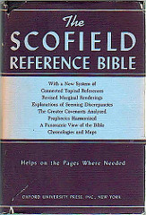
“Then the prophets, Haggai the prophet, and Zechariah prophesied unto the Jews that were in Judah and Jerusalem” (Ezr. 5:1).
Things had ground to a halt in Jerusalem because of the problems with the Samaritans. What did God do?
He sent more prophets to speak to Israel –
“HAGGAI was a prophet of the restored remnant after the 70 years’ captivity. The circumstances are detailed in Ezra and Nehemiah. To hearten, rebuke, and instruct that feeble and divided remnant was the task of Haggai, Zechariah, and Malachi. The theme of Haggai is the unfinished temple, and his mission to admonish and encourage the builders. Haggai’s ministry lasted less than 1-year [Ussher] ” (Old Scofield, p. 962).
“In the 2nd year of Darius the king [Persia]… came the word of the LORD by Haggai the prophet unto Zerubbabel, governor of Judah, and to Joshua, the high priest… saying, the time that the LORD’S house should be built” (Hag. 1:1,2).

Slide 12
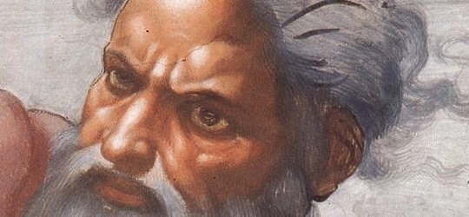
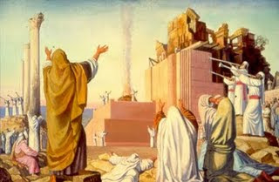
Israel was back in its land, a temporary altar had been constructed and the sacrificial system of worship had been reinstituted (Ezr. 3:1-6), but work on the 2nd temple languished, and after a 15-year hiatus, a spiritual apathy
had set in, which provoked the God of Israel to speak to
His nation –
“Then came the word of the LORD by Haggai the prophet, saying, Is it time for you, O ye [Israel], to dwell in your [finished] house, and this house lie waste?” (1:3).
The [49,000+] Jews that returned from 70 years of captivity had quickly built houses for themselves, but now they had become indifferent to finishing the house of the LORD. Israel was back to their old ways of self-centered, narsacistic thinking, so God was again chastening them with poor economic conditions because of their indifference to Him –
“Ye have sown much, and bring in little… ye clothe you,
but there is none warm” (1:6).

Slide 13
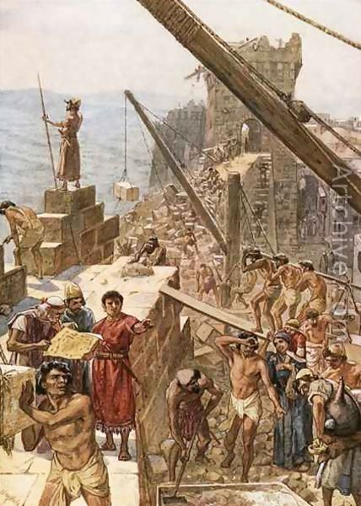
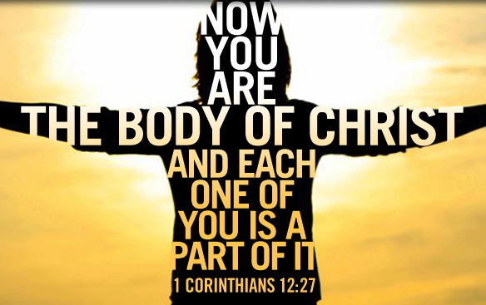
So what are the Jews to do?
“Thus saith the LORD of hosts; Consider your ways. Go to the mountain, and bring wood, and build the house; And I will take pleasure in it, and I will be glorified, saith the LORD” (1:7,8).
GOD [via Haggai] – GET STARTED!!! But, did they?
They did – “Then Zerubbabel… and Joshua… with all the remnant of the people, obeyed the voice of the LORD their God, and the words of Haggai…” (1:12). How?
“And the LORD stirred up the spirit of Zerubbabel… and the spirit of Joshua… and the spirit of all the remnant of the people; and they came and did work in the house of the LORD of hosts, their God” (1:14).
Would to God that He would stir each of our spirit’s today and that we would get busy and build His present house –
“… let every man take heed how he buildeth thereupon… Know ye not that ye are the temple of God” (1Cor. 3:10-15).

Slide 14
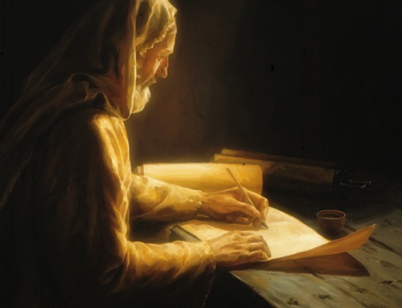
“In the [7th] month… came the word of the LORD by the prophet Haggai… Speak to Zerubbabel… to Joshua… to the people… Who is left among you that saw this house in her first glory? And how do ye see it now? Is it not in your eyes in comparison
of it as nothing?” (2:1,2).
As the construction of the 2nd temple continued, many of the older Jews who remembered the 1st temple complained it did not have the grandeur of Solomon’s temple. Haggai’s answer was that it didn’t matter, it was still the house of God, and that both would pale in comparison to the temple
that would exist during the Millennium –
“The glory of this latter house [millennial temple] shall be greater than of the former…” (2:9).
The house was less important that the fact that Christ was in the house, with His people Israel.

Slide 15

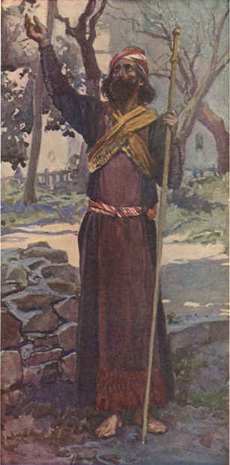
“ZECHARIAH, like Haggai, was a prophet to the remnant which returned after the 70 years… both advents of Christ are in Zechariah’s prophesy… He has given the mind of God about the Gentile world-powers surrounding the restored remnant… the test, as always, being their treatment of Israel” (Old Scofield, p. 965).
His ministry spanned 33 years [Ussher].
“In the [8th] month, in the [2nd] year of Darius [king of Persia], came the word of the LORD unto Zechariah, saying… turn unto me, saith the LORD, and I will turn unto you… Be not as your fathers, unto whom the former prophets have cried… turn from your evil ways… but they did not hear, nor hearken unto me…” (Zech. 1:1-4).
Zechariah was a Levite born in Babylon (Neh. 12:1,16), like Jeremiah & Ezekiel, was also a priest. He was with the 49,000+ returnees after the captivity, a young man when God called him – “… speak to this young man” (2:4).

Slide 16
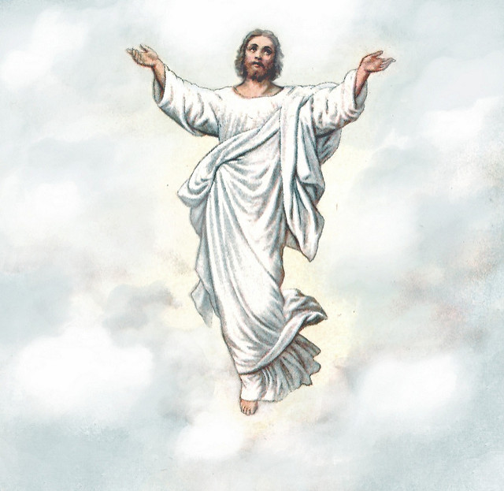
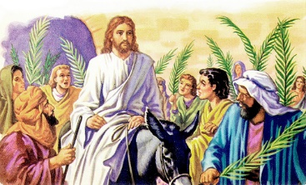
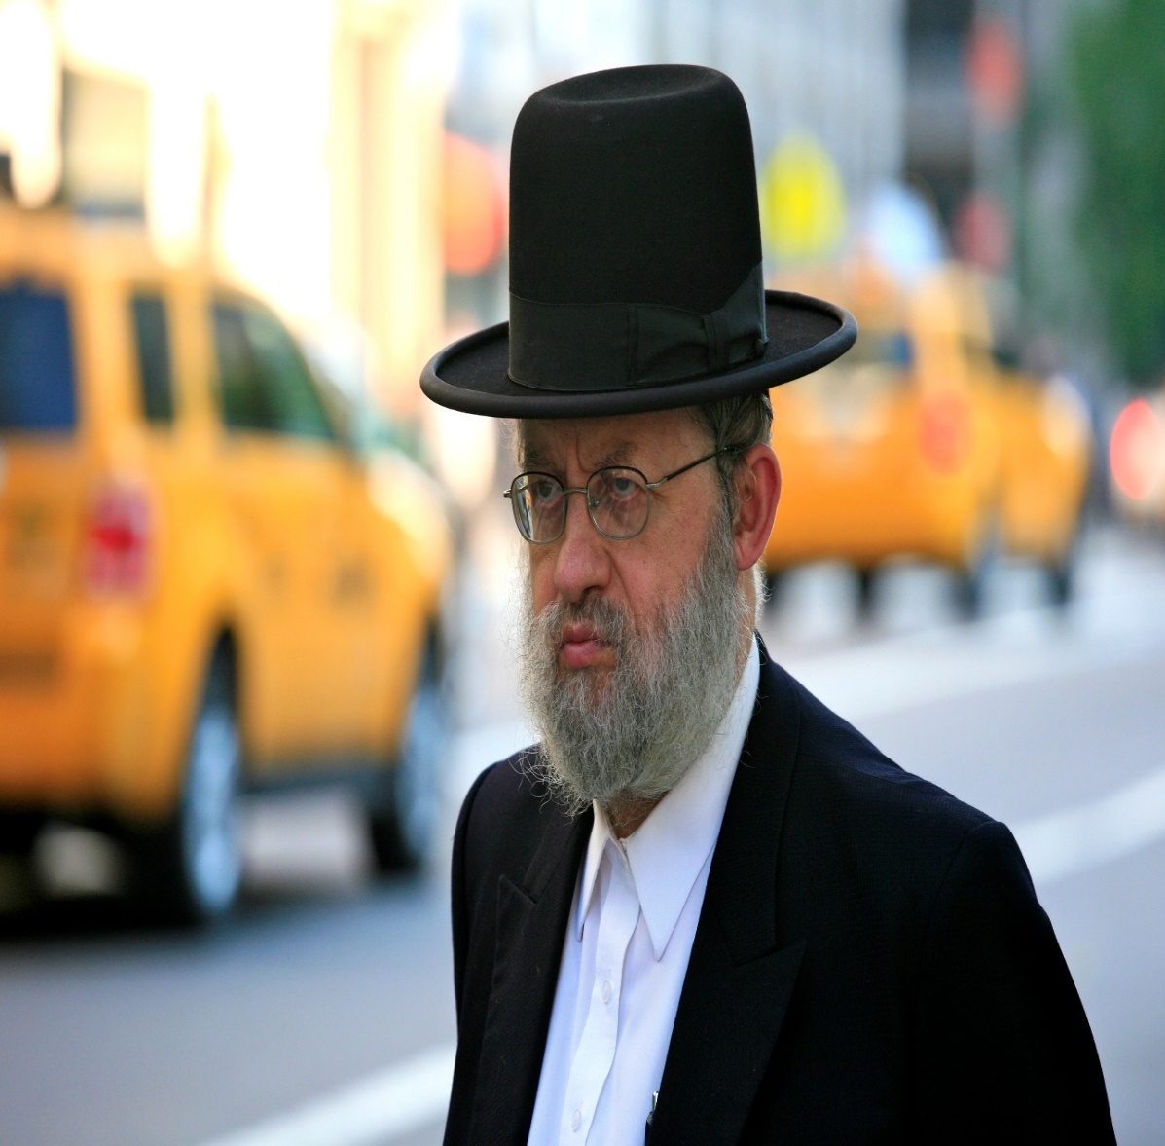
A RESPECTOR OF PERSONS
“Thus saith the LORD; in those days [end times] it shall
come to pass, that 10 men shall… take hold of the skirt
of him that is a Jew, saying, We will go with you: for we
[Gentiles] have heard that God is with you [Jews]” (8:23).
During the Millennium, Israel will be a holy nation, a
kingdom of priests, so when a Gentile wants to know
something of Christ, they will seek out and ask a Jew.
1ST COMING
“Rejoice greatly, O daughter of Zion…behold, thy King
cometh unto thee: he is just, and having salvation;
lowly, and riding upon a donkey, and upon a colt the
foal of a donkey” (9:9).
Zechariah prophesied of Christ’s entry into Jerusalem in 31 A.D., in humility, to die for man’s sins.
2nd COMING
“And I will pour upon the house of David… the spirit of grace… and they shall look upon me whom they pierced, and they [Jews] shall mourn for him as one mourneth for his only son…” (12:10).

Slide 17
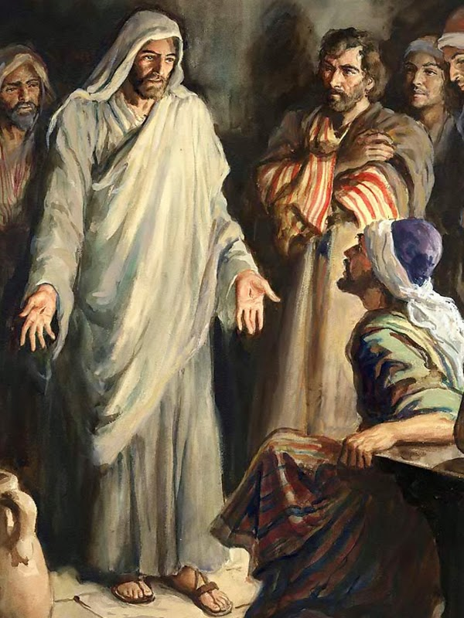
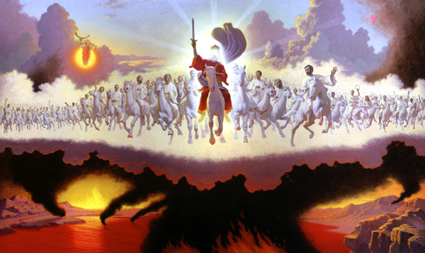
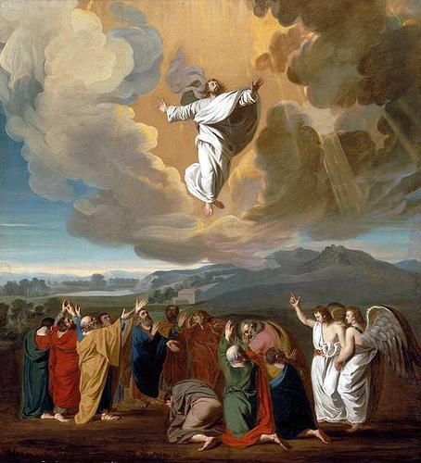
‘Doubting Thomas’ walked by sight and so will remnant
Israel upon Christ’s 2nd coming—Thomas believed when
he saw; so will they, and understand and mourn the fact
they missed His 1st coming.
“And it shall come to pass, that in all the land, saith the
LORD, two parts therein shall be cut off and die; but the
third shall be left therein. And I will bring the third part
through the fire, and will refine them as silver… as gold…
and they shall call on my name, and I will hear them: I
will say, It is my people: and they shall say, The LORD is
my God” (13:8,9).
1/3 of Jews [~5 m.] will be saved out of the tribulation.
“And his feet shall stand in that day upon the mount of
Olives, which is before Jerusalem on the east… shall
cleave in the midst… and ye shall flee to the valley…”
(14:4,5).
Christ will return from whence He left at His ascension (Acts 1:9), and He will split the mount providing a way of escape for those under attack in Jerusalem.

Slide 18
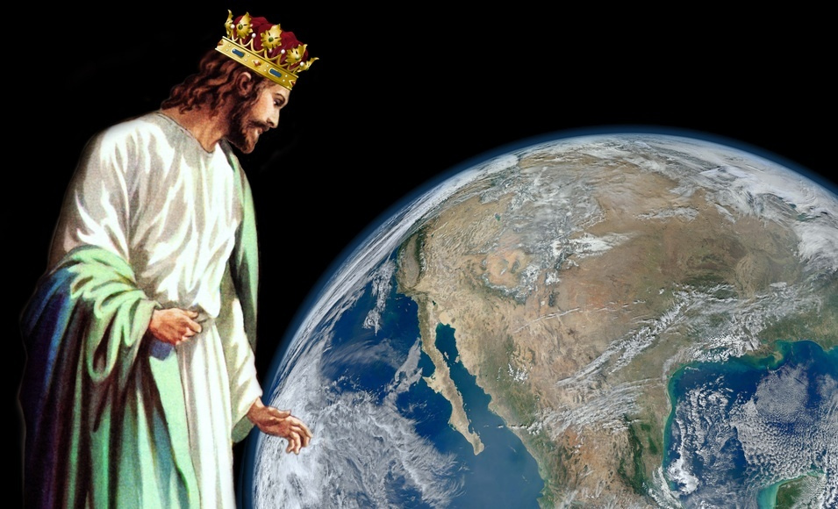
THE KINGDOM COMES TO EARTH
“And the LORD shall be king over all the earth: in that day [kingdom] shall there be one LORD, and his name one” (14:9).
Christ Jesus will be KING and fulfill the prayer of which He once instructed the 12 to pray –
“After this manner [not pray this prayer ever time you meet] therefore pray ye [the 12 who were looking for that earthly kingdom to soon be established]:
Our Father which art in heaven, Hallowed be thy name…
THY KINGDOM COME [please Lord, let your kingdom come]…
THY WILL BE DONE IN EARTH, AS IT IS IN HEAVEN [so that YOUR WILL, will be done in all the earth]…” (Mt. 6:9,10).
The prayer Christ taught the 12 Disciples would not be fulfilled in their lifetime [didn’t know it], nor in ours [we know it]. Would God want us, the Church, to constantly pray a prayer that has no possible hope of being fulfilled until after we’re gone? Think about it.

Slide 19
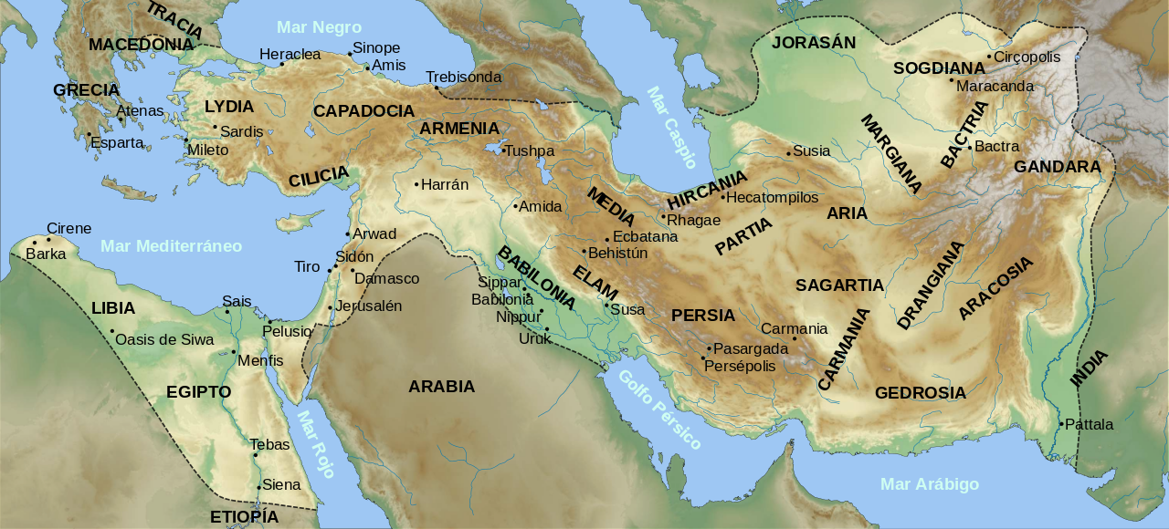
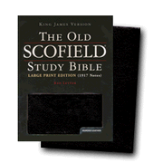
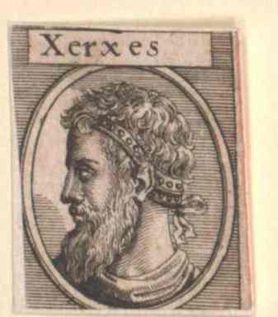
“The significance of the Book of Esther is that it testifies to the
secret watch care of Jehovah over dispersed Israel. The name
of God does not once occur, but in no other book of the Bible is
His providence more conspicuous. A mere remnant returned to
Jerusalem. The mass of the nation preferred the easy and
lucrative life under the Persian rule. But God did not forsake
them. What he here does for Judah, He is surely doing for all
the covenant people…” (Old Scofield, p. 558). The events
recorded in Esther cover a period of 12 years [Ussher].
“Now it came to pass in the days of Ahasuerus [Xerxes], (this is
Ahasuerus which reigned, from India even unto Ethiopia, over
[127] provinces)… sat on the throne of his kingdom, which was
in [Susa] the palace… in the 3rd year of his reign, he made a
feast unto all his princes and servants; the power of Persia and
Media… being before him” (Est. 1:1-3).
This book is about a Jewish woman [Esther] who married a Gentile king [Xerxes], which is opposite of RUTH. No mention of God, no worship, no prayer, but God’s providence is with them throughout.

Slide 20
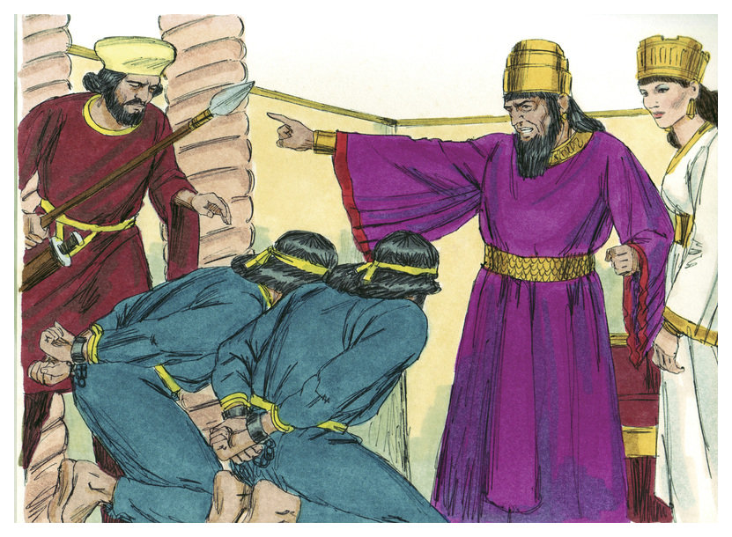
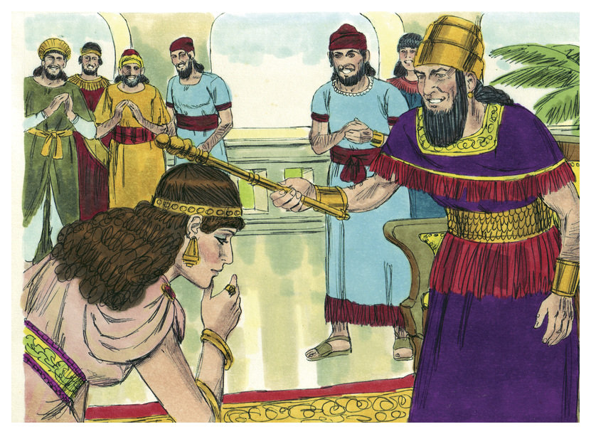
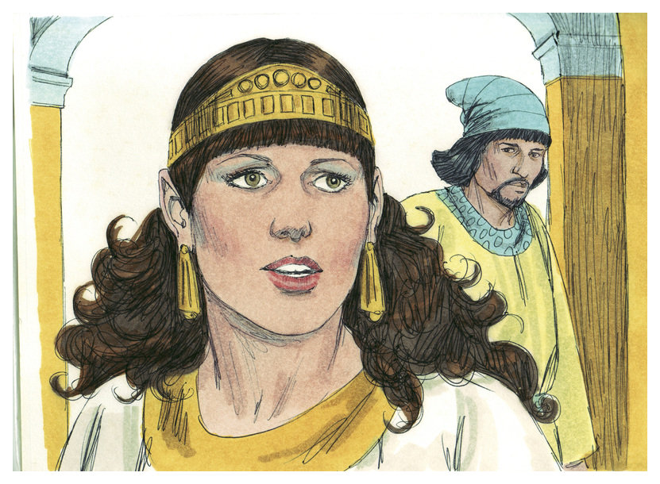
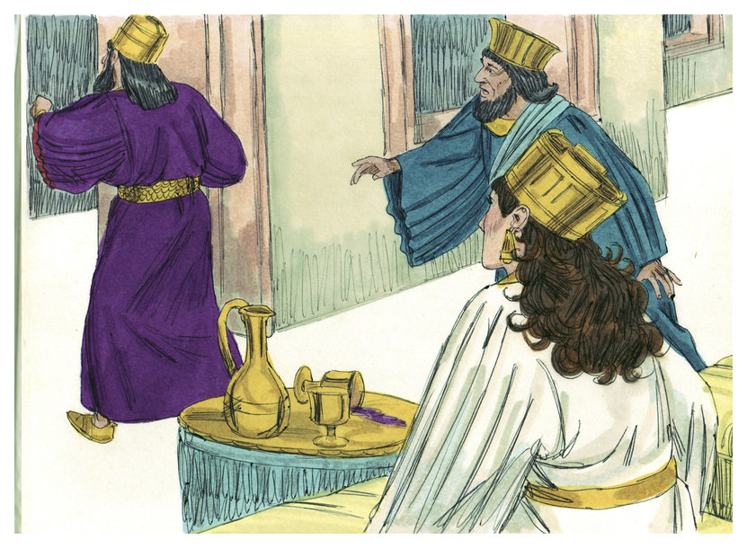
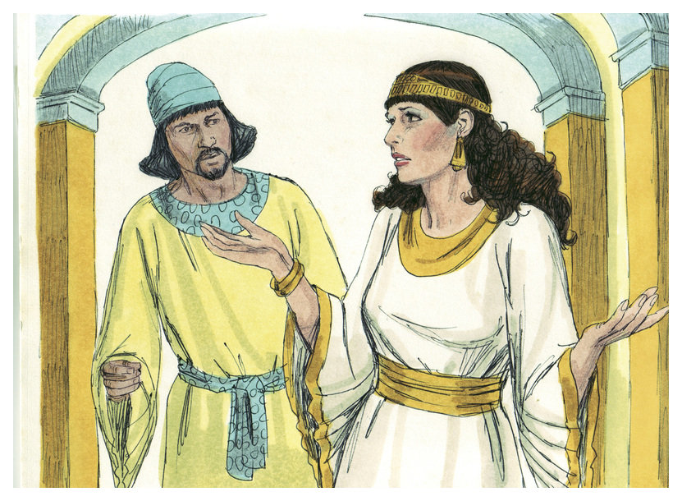
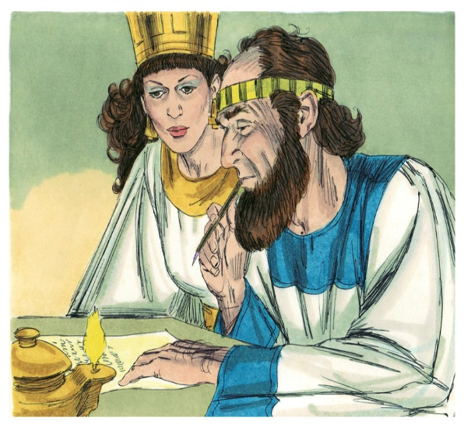
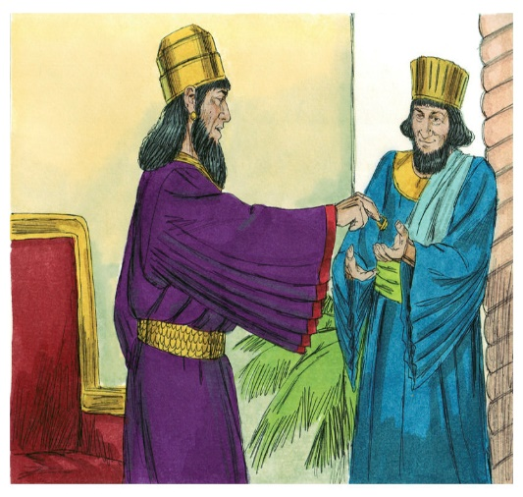
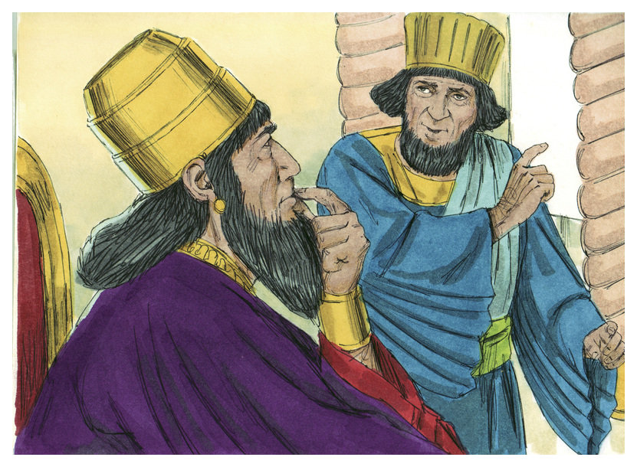
STORYLINE FOR ESTHER
While the Jewish returnees were struggling to
rebuild the temple and city of Jerusalem, this
story takes place in Persia. Xerxes is king and
Vashti, his queen, refused to make an
appearance at a royal party, which made the
king angry (1:12), and she was deposed (1:22).
Mordecai, a Jew from the tribe of Benjamin, had a beautiful cousin, Esther, whom he raised (2:7), was introduced to the king, who fell in love with her, but didn’t know she was a Jewess, which she kept a secret (2:8-10). Eventually the king chose Esther out of many to be his queen (2:17).
Next Mordecai heard of a plot to kill the king, told Esther who told the king who had them executed (2:21-23). Haman became 2nd to the king, and required everyone bow to him (3:1-3), but Mordecai refused because he was a Jew (3:4,5), which so enraged Haman (3:6) that he presented a plan before the king to exterminate all Jews scattered over the empire (3:8-12), and willing to pay the king a great sum to do so (3:9). Mordecai was grieved (4:1-3) as was Esther (4:4), as she was shown the decree (4:8). If Esther kept quiet, the Jews would die; if she exposed herself as a Jew, she might die (4:14). She asked Mordecai, “What do I do” (4:15)?

Slide 21
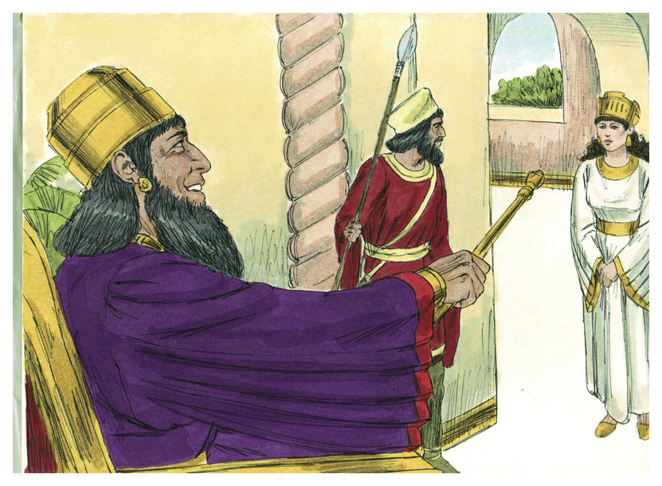
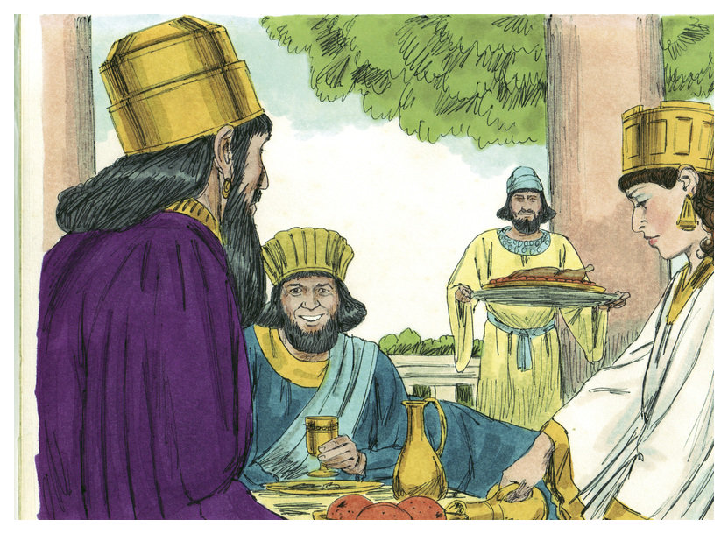
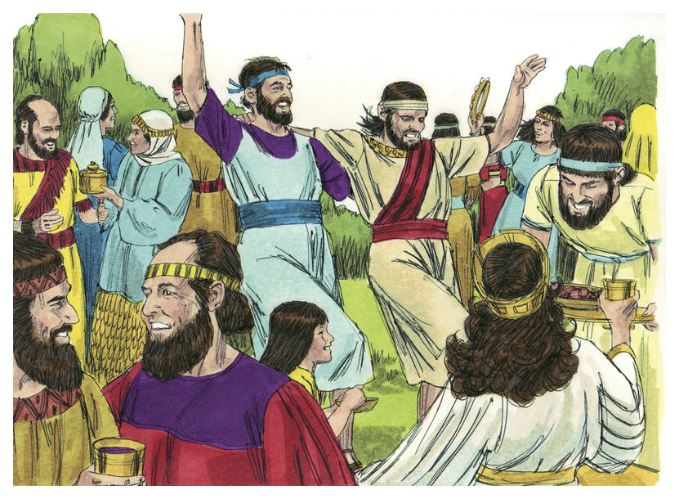
Queen Esther knew she had to do something or else the Jews in Persia would be annihilated. She acted, and went to the king’s throne room (4:1). When the king saw her, he motioned her to come to him and asked her what her
request was, and that he would fulfill it (4:2,3).
Her request was simple, please come to a banquet and bring Haman with you (5:4). The king agreed and summoned Haman to the banquet (5:5). There, the king asked Esther what her request was (5:6). Esther told the king that she would tell him the next day at another banquet (5:7).
Haman, joyful of his favored position and authority, conspired to build a gallows and hang Mordecai, which would allow him to settle the Jewish question once-and-for-all, so he ordered the gallows to be made to hang
him (5:14).
Next time – Guess who gets hung?

