Slide 1
LESSON 5
WEEK 5 OF 52
(Gen. 48–Exo. 18)
THROUGH THE BIBLE IN 2018
Last time we saw God place the descendants of Jacob [Israel] into ideal conditions in Egypt while a world-wide famine devastated other nations.
THE DEATH OF JACOB
“And Joseph fell upon his father’s face, and wept upon him and kissed him... commanded his
servants the physicians to embalm his father… My father made me swear, saying, Lo I die: in my grave which I have digged for me in the land of Canaan, there shalt thou bury me… Pharaoh said, Go up, and bury thy father… For his sons carried him into the land of Canaan, and buried him in
the cave of the field of Machpelah, which Abraham bought… And Joseph returned into Egypt, he and his brethren, and all that went up with him to bury his father…” (50:1,2,5,6,13,14).
After their father’s burial in Canaan, the sons feared Joseph might turn on them with revenge
for what they did to him, but he responded –
“But as for you, ye thought evil against me; but God meant it unto good, to bring to pass, as it is
this day to save much people alive. Now therefore fear ye not … he comforted them… spake
kindly unto them” (50:20,21).

Slide 2
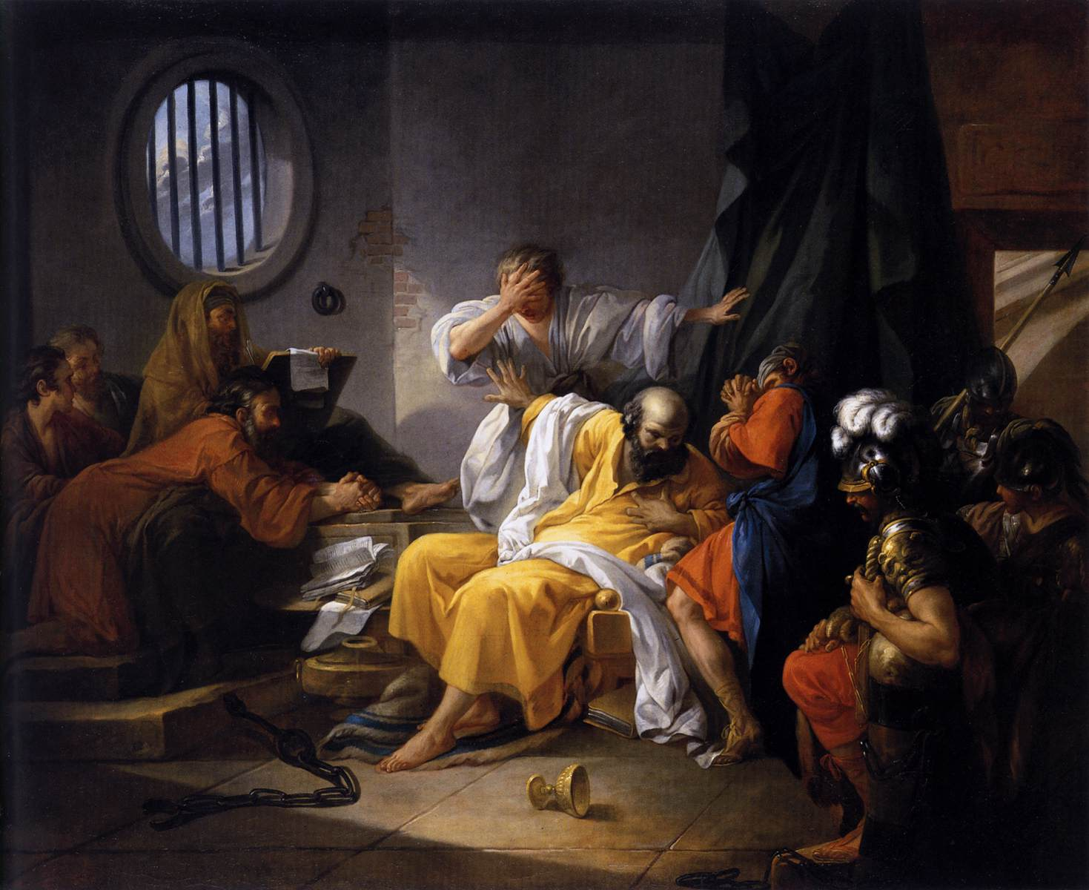
THE DEATH OF JOSEPH
“And Joseph dwelt in Egypt, he, and his father’s house: and
Joseph lived [110] years… And Joseph said unto his brethren, I
die: and God will surely visit you, and bring you out of this land
unto the land which he sware to Abraham, to Isaac, and to Jacob
… ye shall carry up my bones from hence. So Joseph died… and
they embalmed him, and he was put in a coffin [box, chest, ark]
in Egypt” (50:22-26).
Jacob’s family consisting of seventy souls (Exo. 1:5) had come
from Canaan because of the famine and God kept them there
until they were all dead (1:6). Now what will God do?
“And the children of Israel were fruitful… increased abundantly,
and multiplied… and the land was filled with them” (Exo. 1:7).
In the peace and safety of Egypt, God was carrying out His
promise to Abraham that Israel would be a plenteous nation, but that caused concerned with a new Pharaoh who did not know the good Joseph had done for the Egyptians, and he was concerned for their size (1:8,9).

Slide 3
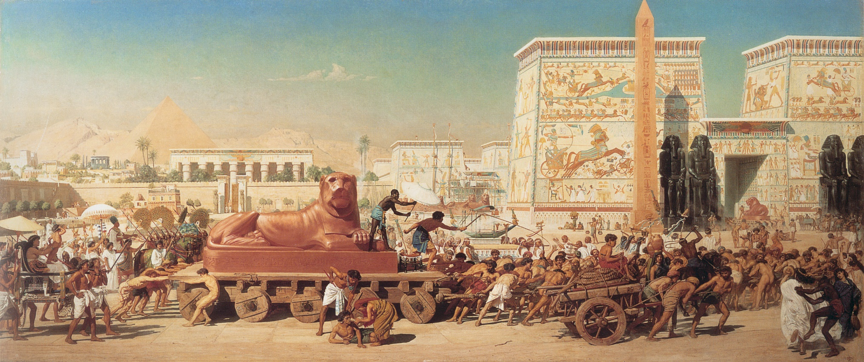
TASKMASTERS
“Therefore they did set over them taskmasters to afflict them with their burdens… But the more they afflicted them, the more they multiplied and grew. And they were grieved because of the children of Israel. And the Egyptians made the children of Israel to serve with rigour: And they
made their lives bitter with hard bondage, in mortar, and in brick, and in all manner of service in the field…” (1:11,12).
Did the Israelites like this treatment? No, but it was a time when God was growing their nation and giving them a reason to want to leave Egypt when He called them to do so.

Slide 4
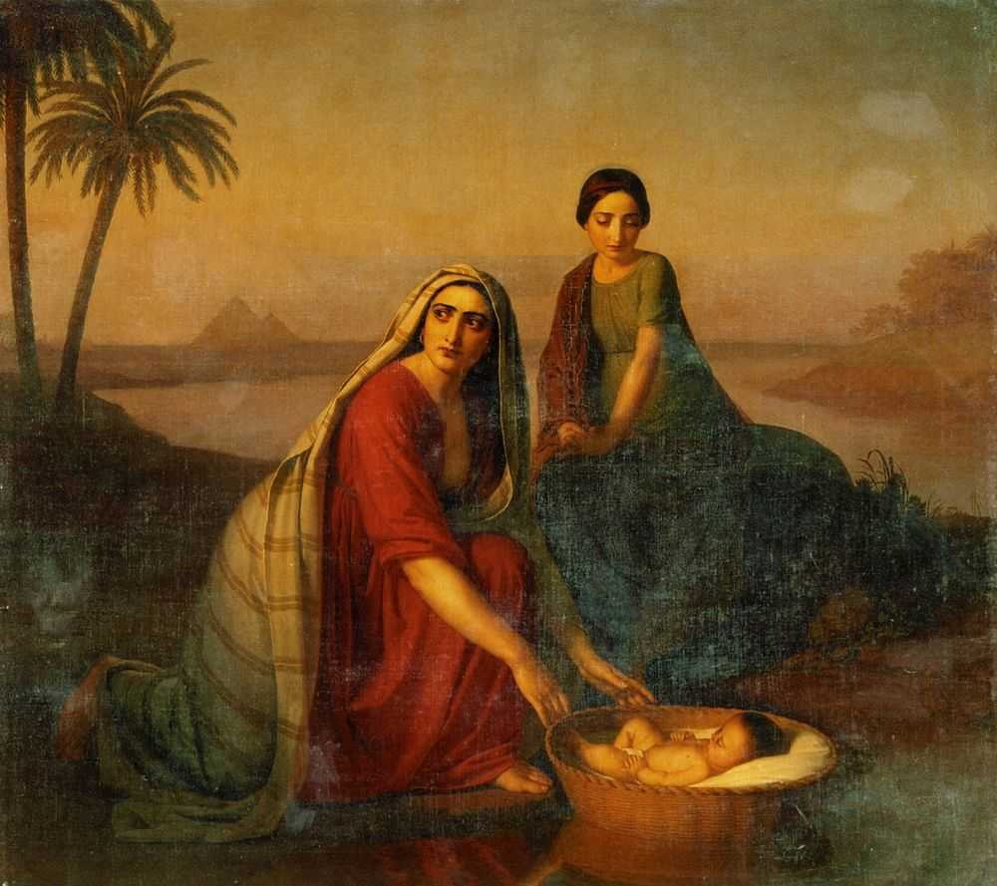
EGYPTIAN BIRTH CONTROL
Because the Israelites were greatly increasing, Pharaoh conspired to decrease their birth rate by killing each Hebrew baby boy born (1:16), but it
didn’t work – “But the midwives fear God, and did
not as the king of Egypt commanded them, but
saved the men children alive” (1:17).
Pharaoh retaliated – “… every son that is born ye
shall cast into the river, and every daughter ye shall save” (1:22).
But that would not stop God in carrying out the next phase of his plan –
“… the woman conceived, and bare a son… a goodly child, she hid him three months. And when she could not longer hide him, she took for him an ark [box] of bulrushes… and put the child therein…” (2:1,2).

Slide 5
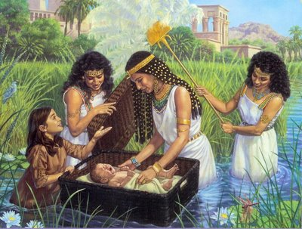
THE RESCUE
“And the daughter of Pharaoh… saw the ark [box,
coffin]… she sent her maid to fetch it… And when
she opened it, she saw the child… she had
compassion on him, and said, This is one of the
Hebrews’ children” (2:5,6).
The Hebrew baby was spared because of the mercy
of Pharaoh’s daughter who claimed him as her own,
calling him Moses – “Because I drew him out of the
water” (2:9,10).
As babies do, Moses grew up and eventually
noticed the burden on his own people (2:11).
“And he spied an Egyptian smiting an Hebrew … he
saw there was no man, he slew the Egyptian, and
hid him in the sand… Now when Pharaoh heard this thing, he sought Moses. But Moses fled… and dwelt in the land of Midian: and he sat down by a well” (2:12).

Slide 6
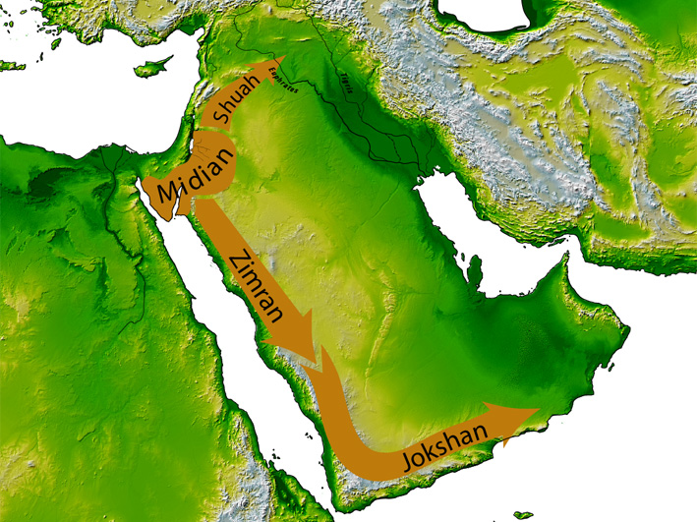
MOSES IN MIDIAN
“Now the priest of Midian [Jethro] had [7] daughters…
And Moses was content to dwell with the man: and
he gave Moses Zipporah his daughter. And she bare
him a son… Gershom” (2:16,21,22).
Moses had safely fled the angry Pharaoh to the land
of Midian and given refuge, a wife, and son.
But, things were not going well for the Israelites in
Egyptian bondage who cried out to God who heard
their prayer (2:23-25).
“Now Moses kept the flock of Jethro his father-in-law,
the priest of Midian: and he led the flock to the
backside of the desert, and came to the mountain of
God, even Horeb [Sinai]” (3:1).
God had Moses alone and now would reveal to him
the plans & purposes concerning Israel.

Slide 7
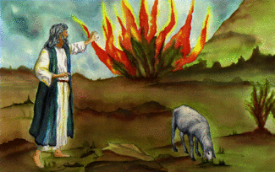
THE CALL OF MOSES: THE BURNING BUSH
“And the angel of the LORD appeared unto him in a
flame of fire out of the midst of a bush… the bush
was not consumed” (3:1,2).
As Moses turned to look at it, Christ spoke to him –
“Moses, Moses… Here I am… draw not nigh hither:
put off thy shoes from off thy feet, for the place
whereon thou standest is holy ground… I am the
God of Abraham… Isaac… Jacob. And Moses hid his
face; for he was afraid to look upon God” (3:4-6).
God identified Himself to Moses, and what His plans were for the Israelites –
“… I have surely seen the afflictions of my people, which are in Egypt… by reason of the task-masters; I know their sorrow. And I am come down to deliver them… and to bring them up out of that land unto a good land and a large, unto a land flowing with milk and honey: unto the place of the Canaanites…” (3:7,8).
Okay, but what does that have to do with Moses since he has already escaped Pharaoh?

Slide 8
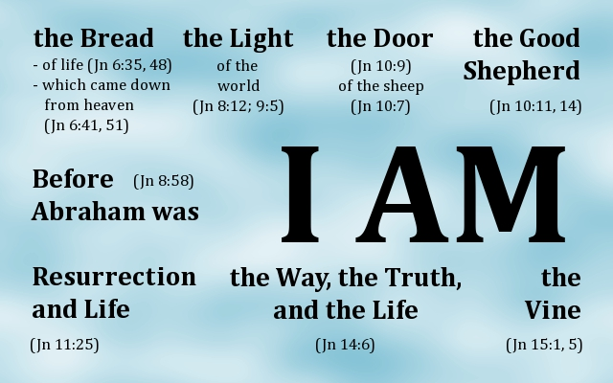
“Come now therefore, and I will send thee
[Moses] unto Pharaoh, that thou mayest
bring forth my people the children of Israel
out of Egypt” (3:10).
And, immediately Moses agreed, right?
No.
“… Who am I, that I should go to Pharaoh…
[God says] – I will be with thee...” (3:11,12).
Only after God told Moses He would be with
him did Moses agree to go to Egypt, but he
had one more concern –
“When I come unto the children of Israel… they shall say to me, What is his name? what shall I say unto them? And God said unto Moses, I AM THAT I AM… I AM hath sent me unto you” (3:11-14).
When God asks you to do something, and you say I can’t, would it make any difference to know that Christ is with you? – “To whom God would make known what is the riches of the glory of this mystery among the Gentiles; which is CHRIST IN YOU, the hope of glory” (Col. 1:27).

Slide 9
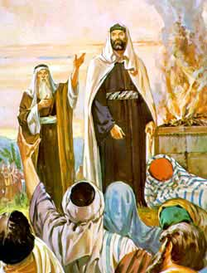
“And the LORD said unto Moses, When thou goest to return into Egypt, see that thou do all those wonders before Pharaoh, which I have put in thy hand…” (4:21). “… And Moses and Aaron went and gathered together all the elders of the children of Israel: And Aaron spake all the words which the LORD had spoken unto Moses, and did the signs in the sight of the people. And the people believed… they bowed their heads and worshipped” (4:29-31; 1Cor. 1:22).
The Israelites believed God, now it was up to Moses to convince Pharaoh to release the Hebrew captives.
“And afterward Moses and Aaron went in, and told Pharaoh, Thus saith the LORD God of Israel, let my people go, that they may hold a feast unto me in the wilderness” (5:1).

Slide 10
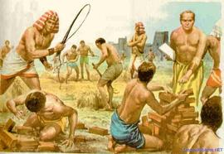
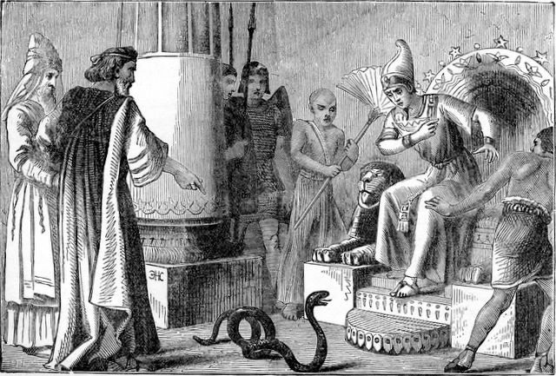
Pharaoh’s reaction was to increase the burden on
the Hebrews –
“Let there more work be laid upon the men, that
they may labour therein… Ye shall no more give
the people straw to make brick… let me go and
gather straw for themselves. So the people were
scattered abroad throughout all the land of Egypt
to gather stubble instead of straw. And the
taskmasters hated them…” (5:9-13).
Now God will use signs & wonders to convince
Pharaoh that He is the great I AM.
“And Moses and Aaron went in unto Pharaoh, and
they did so as the LORD commanded them: and
Aaron cast down his rod… and it became a serpent. Then Pharaoh also called the wise men and sorcerers… they also did in like manner… but Aaron’s rod swallowed up their rods. And he hardened Pharaoh’s heart, that he hearkened not unto them; as the LORD had said” (7:10-12).

Slide 11
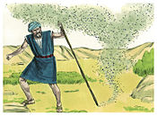
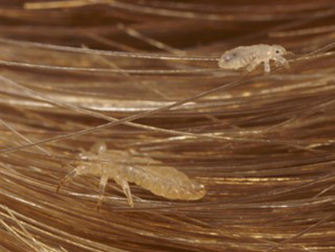
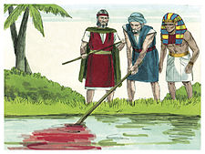
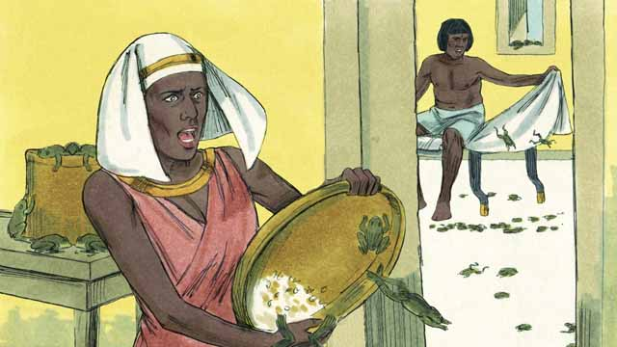
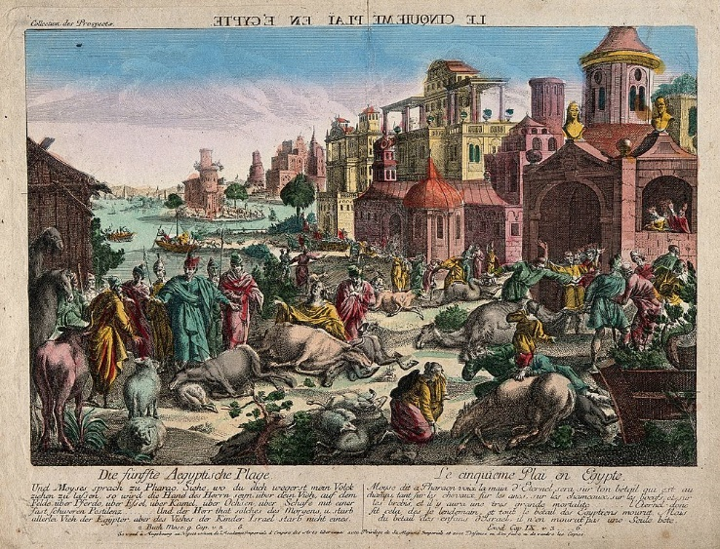
“And Moses and Aaron did so, as the LORD commanded; and he
lifted up the rod, and smote the waters that were in the river…
were turned to blood… Pharaoh’s heart was hardened, neither did
he hearken unto them, as the LORD had said” (7:20).
“… Let my people go, and if thou refuse to let them go, behold I will smite all thy borders with frogs” (8:1).
“…Stretch out thy rod, and smite the dust of the land, that it may become lice throughout all the land of Egypt” (8:16).
“… swarms of flies…” (8:21).
Finally, Pharaoh relented, “I will let you go, that ye may sacrifice to
the LORD your God in the wilderness; only ye shall not go very far
away” (8:28), but he lied – “And Pharaoh hardened his heart at this
time also, neither would he let the people go” (8:32).
“And the LORD did that thing on the morrow, and all the cattle of
Egypt died: but of the cattle of the children of Israel died not one” (9:6).

Slide 12
6TH judgment – boils on man & beast (9:10)
7th judgment – hail (9:22)
8th judgment – locusts (10:13)
Through all of these judgments of God,
Pharaoh remained firm. Why?
“But the LORD hardened Pharaoh’s heart, so
that he would not let the children of Israel
go” (10:20).
9th judgment – darkness (10:22)
“They saw not one another, neither rose any
from his place for three days: but all the children of Israel had light in their dwellings” (10:23).
Again, Pharaoh seemed to relent –
“… Go ye serve the LORD; only let your flocks and your herds be stayed…” (10:24).
Moses refused the offer, and again – “But the LORD hardened Pharaoh’s heart, and he would
not let them go” (10:27).

Slide 13
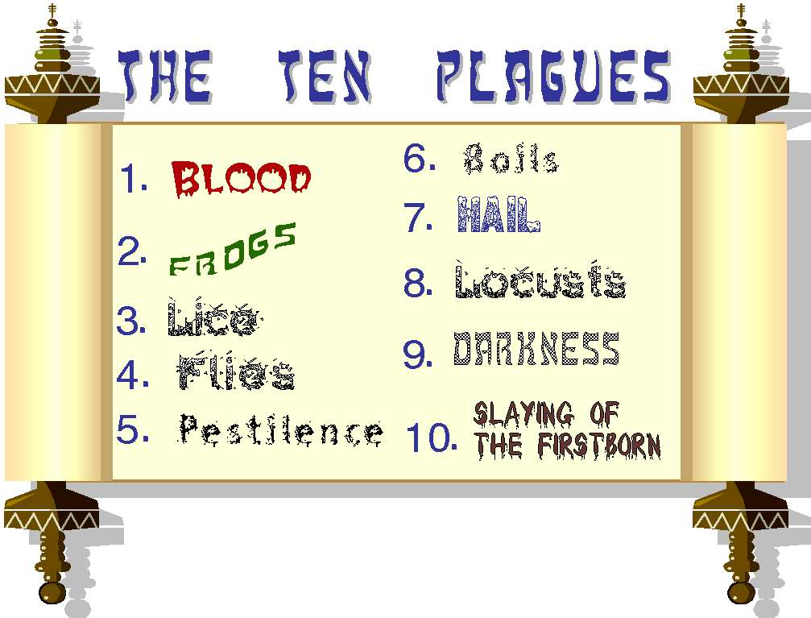
10th PLAGUE REVEALED
“… Yet will I bring one more plague upon Pharaoh, and upon Egypt; afterwards he will let you go hence: when he shall let you go, he shall surely thrust you out hence altogether” (11:1).
God’s last plague on Egypt would ensure the release
of the entire nation of the Hebrew people from their captivity all at once.
“And Moses said, Thus saith the LORD, About midnight will I go out in the midst of Egypt: And all the firstborn in the land of Egypt shall die, from the firstborn of Pharaoh that sitteth on his throne, even unto the firstborn of maidservant that is behind the mill; and all the firstborn of the beasts. And there shall be a great cry throughout all the land of Egypt, such as there was none like it, nor shall be like it any more” (11:4-6).

Slide 14
THE PASSOVER REVEALED
“And the LORD spake unto Moses and Aaron in the land of Egypt, saying, this month shall be
to you the beginning of the months: it shall be the [1st] month of the year to you… In the [10th]
day of this month they shall take to them every man a lamb… without blemish, a male of the
[1st] year: ye shall take it out from the sheep [separate]…keep it up unto the [14th] day… shall
kill it in the evening. And they shall take the blood, and strike it on the two side posts and on
the upper door post of the houses, wherein they shall eat it… roast with fire, and unleavened
bread… bitter herbs…” (12:1-8).
This Passover was a picture of the sacrificial offering of the Lord Jesus Christ, which would not
ensue for another 1,450 years.
“And the blood shall be to you for a token [type] upon the houses where ye are; and when I see
the blood, I will pass over you, and the plague shall not be upon you to destroy, when I smite the
land of Egypt” (12:13).
During the dispensation of the grace of God, our faith in the shed blood of Christ will spare us the
judgment of God—when He sees Christ’s blood, His judgment will pass over us, but not for those
who believe not – “… For even Christ our passover [Lamb] is sacrificed for us” (1Cor. 5:7).

Slide 15
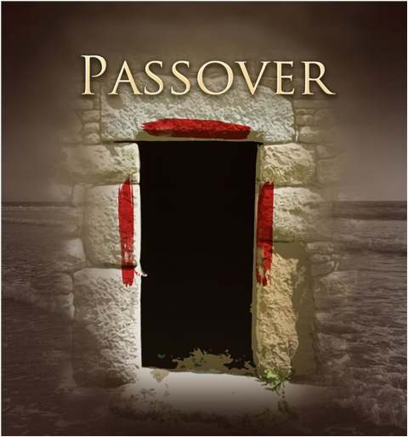
THE PASSOVER FULFILLED
“And it came to pass, that at midnight the LORD smote all the firstborn in the land of Egypt, from the firstborn of Pharaoh that sat on the throne unto firstborn of the captive that was in the dungeon; and all the firstborn of cattle… For there was a great cry in Egypt: for there was
not a house where there was not one death” (12:29).
God kept His Word and carried out the 10th judgment on Egypt, but every Hebrew house was spared when He saw blood.
Why had God hardened Pharaoh’s heart not to let His people go until this time?
God had waited to reveal the 10th plague to show believers [Jews] and unbelievers [Egyptians] alike that salvation resides in God alone and that one day a Redeemer was coming—One who would die for the sins of all!

Slide 16
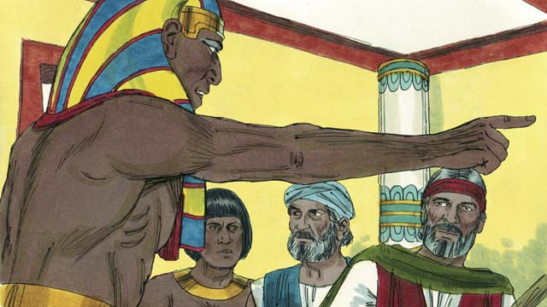
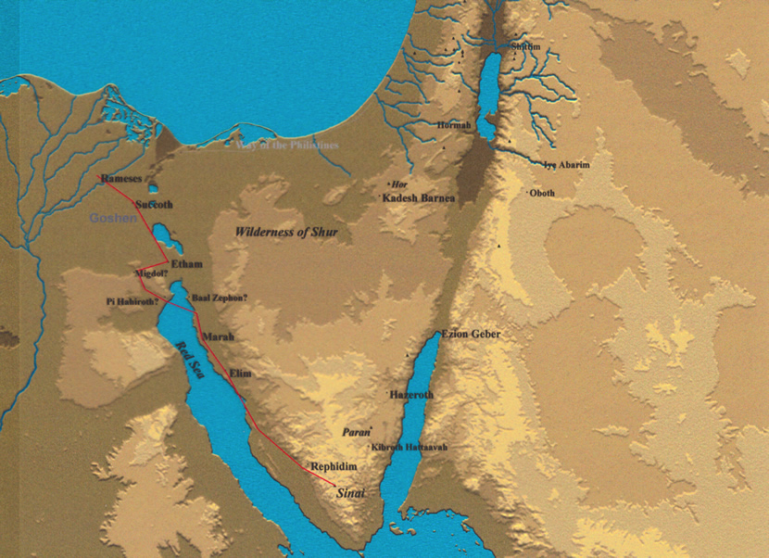
PHARAOH’S CAPITULATION
“And Pharaoh rose up in the night… and he called Moses and Aaron by night, and said, Rise up, and get you forth from among my people, both ye and the children of Israel: and go, serve the LORD, as ye have said… might send them out of the land in hast… took their dough before it was leavened… and the children of Israel did according to the word of Moses” (12:30,31).
In haste, the Israelites left Egypt, beginning the first part of their journey –
“And the children of Israel journeyed from Rameses to Succoth, about [600,000] on foot that were men…” (12:37,38).
“Now the sojourning of the children of Israel, who dwelt in Egypt, was [430] years” (12:40).

Slide 17
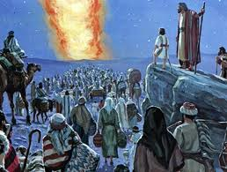
THE EXODUS
“And Moses took the bones of Joseph with him: for he had straitly sworn the children of Israel, saying, God will surely visit you: and ye shall carry my bones away hence with you” (13:19).
Joseph’s request was fulfilled.
“And they took their journey from Succoth, and encamped in Etham, in the edge of the wilderness. And the Lord went before them by day in a pillar of
a cloud… and by night in a pillar of fire…” (13:20,21).
“Speak unto the children of Israel, that they turn and encamp… by the [Red] sea (14:2)… But the Egyptians pursued after them… and his army overtook them encamping by the sea… and they [Israelites] were sore afraid: and the children of Israel cried out to the LORD” (14:9,10).

Slide 18
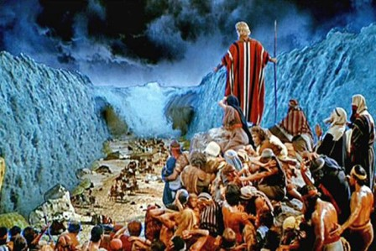
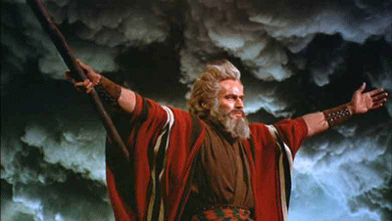
GOD DELIVERS
The people had already begun to murmur (14:12) when Moses told them to “fear not” and that “the LORD shall fight for you…” (14:13,14).
“But lift thou up thy rod, and stretch out thine hand over the sea, and divide it; and the children of Israel shall go on dry ground through the midst of the sea” (14:16).
“And the children of Israel went into the midst of the sea upon the dry ground: and the waters were a wall unto them on their right hand, and on their left… Stretch out thine hand over the sea, that the waters may come again upon the Egyptians…” (14:22,26).
Israel was saved, the Egyptians destroyed.

Slide 19
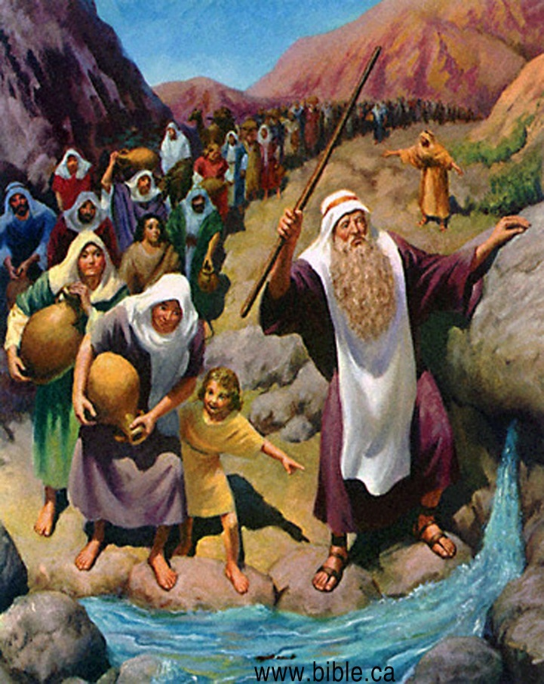
ISRAEL MURMURS
“The people shall hear, and be afraid: sorrow shall take hold on the inhabitants of Palestina” (15:14).
Word of God’s great miracle spread quickly so that the inhabitants of Canaan began to fear the God of Moses.
Next God led the Israelites to the ‘wilderness of Shur’ and after 3 days had no water (15:22). The water in Marah was bitter so the people began to murmur (15:24), but God turned it into ‘sweet’ water (15:25). They traveled on to Elim into the wilderness of Sin, and again they murmured (16:1,2) –
“… Would to God we had died by the hand of the LORD in the land of Egypt… ye have brought us forth into this wilderness, to kill the whole assembly with hunger” (16:3). God’s response?

Slide 20
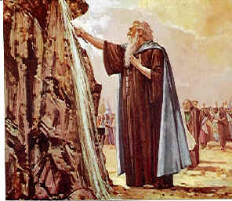
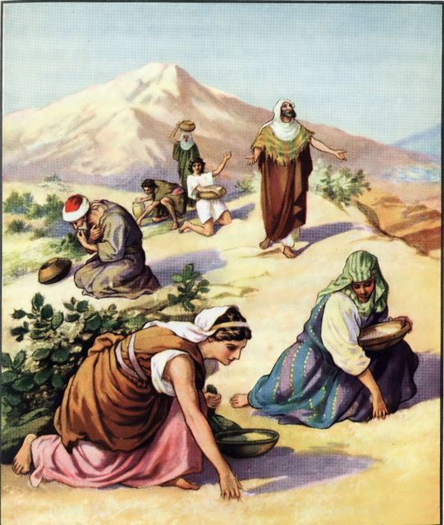
MANNA FROM HEAVEN
“Then said the LORD unto Moses, Behold, I will rain bread from heaven for you…” (16:4)… And when the dew that lay was gone up… there lay a small round thing… on the ground… It is manna… it was like coriander seed, white; and the taste of it was like wafers made with honey” (16:14,15,31).
GOD INSTITUTES THE SABBATH
“Tomorrow is the rest of the holy Sabbath unto the LORD… he giveth you on the [6th] day the bread of two days… So the people rested on the [7th] day” (16:23-30).
Israel journeyed on to Rephidim (17:1), where they again murmured (17:2). This time God told Moses to smite the rock which produced fresh water (17:6,7).
Then Israel appears at the mountain of God, but…

Slide 21
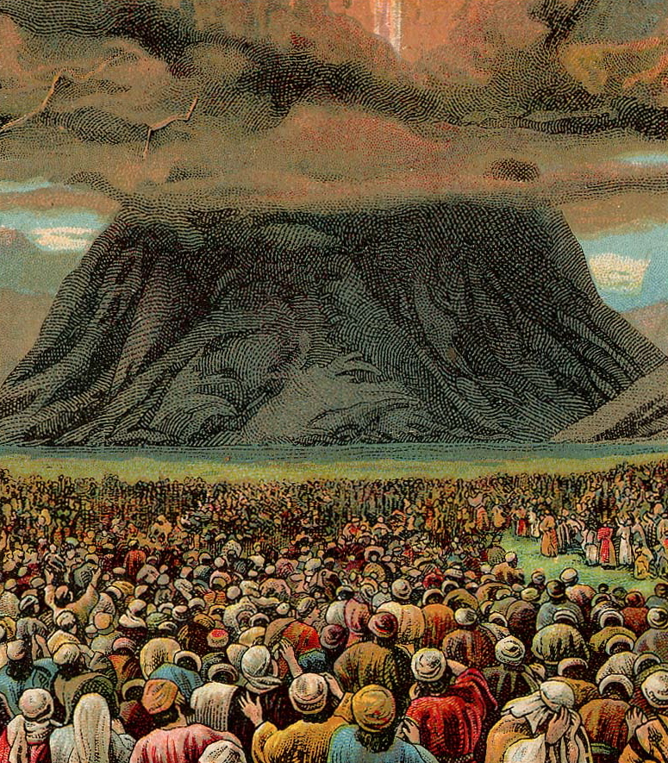
WHY WERE THE 10 COMMANDMENTS PLACED IN A COFFIN? ITS FIRST RESPONSE DEATH?
Next time – Exo. 19-39

