Slide 1
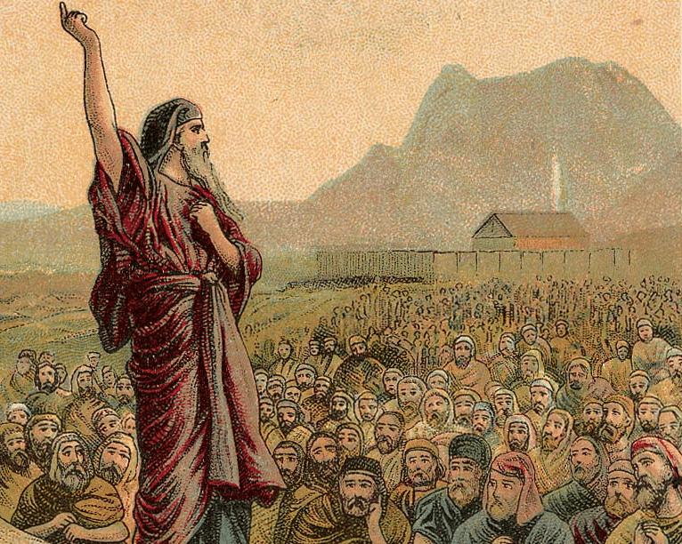
THROUGH THE BIBLE IN 2018
LESSON 8
WEEK 8 OF 52
(Lev. 19–Num. 6)
Last time we saw Moses set up the tabernacle and Aaron and his sons begin to carry out their duties as the priesthood of Israel.
A HOLY NATION
“And the Lord spake unto Moses, saying, Speak unto the congregation of the children of Israel, and say unto them, Ye shall be holy: for I the LORD your God am holy” (19:1).
“Ye shall… keep my Sabbaths… turn ye not unto idols, nor make to yourselves molten gods… (19:2-4).
God had created a new nation, one after His own name, and one He wanted to be holy like Him.
But, would they? Stay tuned.

Slide 2
“Speak unto the children of Israel… After the doings of the land of Egypt, wherein ye dwelt, shall ye not do: And after the doings of the land of Canaan, whither I bring you, shall ye not do; neither shall ye walk in their ordinances. Ye shall do my judgments, and keep mine ordinances, to walk therein… ” (18:1-5).
Moses gave the Israelites everything God wanted them to know, but could they accomplish the task of being a holy nation?
If they didn’t, there would be consequences –
“Ye shall therefore keep my statues and my judgments, and shall not commit any of these abominations… For whosoever shall commit any of these abominations, even the souls that commit them shall be cut off from among the people” (18:26-29).

Slide 3
HOLY NATION
These ordinances covered every aspect of life (18-20):
Discreetness – “None of you shall approach to any that is near of kin to him, to uncover their nakedness… thy father… thy mother… [step mother]… brother… sister... daughter… son… [aunt]… [uncle]… [daughter-in-law]… etc. ” (18:6-19).
Why did God have to spell out this moral conduct?
Because the pagans practiced them, including incest, but the Israelites were not to.
What else?
“Thou shalt not lie with mankind, as with womankind: it is an abomination” (18:22).
Like those before the flood (Rom. 1:26,27), the pagans practiced homosexuality, as well as…
“Neither shalt thou lie with any beast to defile thyself therewith…” (18:23) – bestiality.
“Defile not ye yourselves in any of these things: for in all these the [Gentile] nations are defiled which I cast out before you” (18:24 c.f. Rom. 1:24,26,28). More???
“Do not prostitute thy daughter, to cause her to be a whore; lest the land fall into whoredom, and the land become full of wickedness” (18:29).

Slide 4
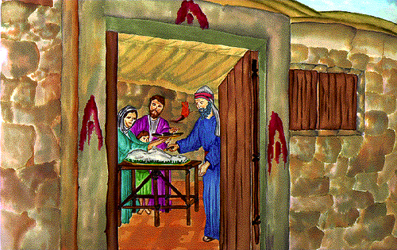
FEAST DAYS
“These are the feasts of the LORD, even holy convocations, which ye shall proclaim in their seasons” (23:4).
It was very common in the ancient world for the pagans to practice holidays throughout the
year. Therefore, God set aside 7-holy days [Feasts], which Israel would keep all having an important spiritual significance.
PASSOVER
“In the [14th] day of the [1st] month at evening is the
LORD’s Passover” (23:5).
On a specific day every spring—the 14th day after the
1st new moon following the spring equinox (March 21),
Israel was to celebrate Passover, which involved killing
an unblemished year old lamb.
Though they didn’t know it, the Israelites rehearsed
Christ’s crucifixion. Christ died at sundown on the 14th
day of Nisan in A.D. 31, on Passover.

Slide 5
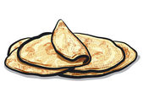
UNLEAVENED BREAD
“And on the [15th] day of the same month is the feast of unleavened bread unto the LORD: [7] days ye must eat unleavened bread. In the first day ye shall have an holy convocation [yearly Sabbath]: ye shall do no servile work therein” (23:6,7).
This week long feast commemorated eating bread
without yeast in their haste to leave Egypt during the Exodus. This spring holy week began and ended with a yearly Sabbath.
Again, without realizing it, for 1,400+ years, the Israelites rehearsed the entombment [burial] of Christ, who had no sin [leaven represented sin].
This was all in preparation of the 3rd holy day
that fell within that spring holy week, but would not begin until Israel came into their land.

Slide 6
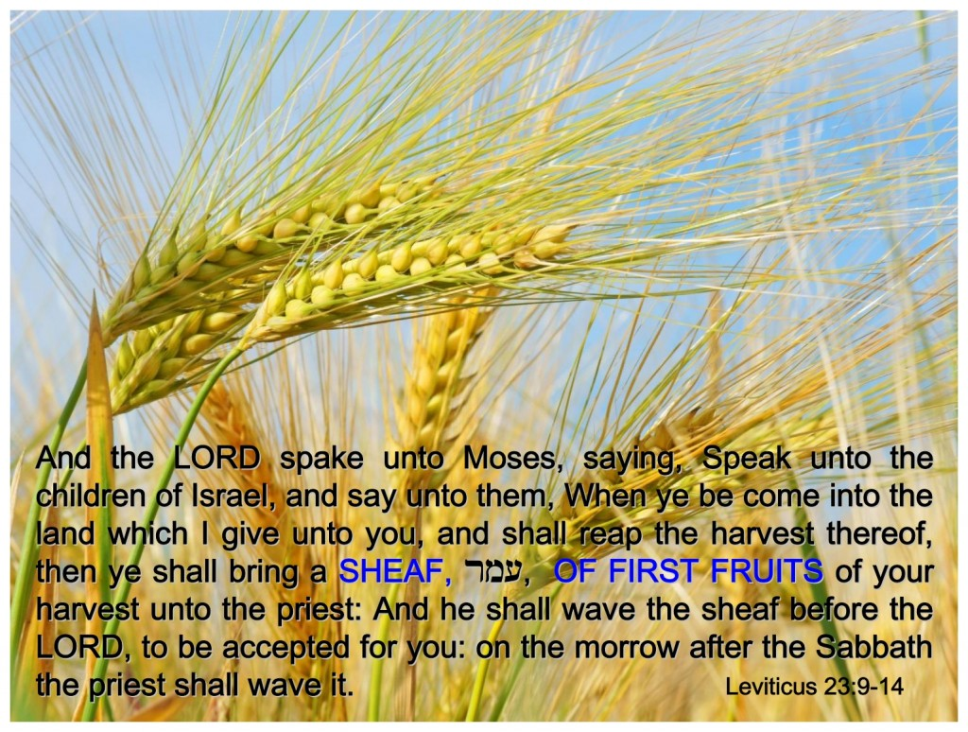
FIRSTFRUITS
“… When ye be come into the land [Canaan] which I give unto you, and shall reap the harvest thereof, then ye shall bring a sheaf of the firstfruits of your harvest unto the priest… on the morrow after the [weekly] Sabbath…” (23:10,11).
This was Israel’s 3rd spring holy feast day, which fell after Passover but before the end of the week long celebration of Unleavened bread, always falling on
Sunday. After Israel had gained possession of their land and began to sow and reap crops, the first sheaf offering of the spring crop was to be given to the priest.
Again, without knowing it, the keeping of this holy day was a rehearsal of the resurrection of Christ, which would take place exactly 72 hours after His death on the cross and fall each year on Sunday [Easter].

Slide 7
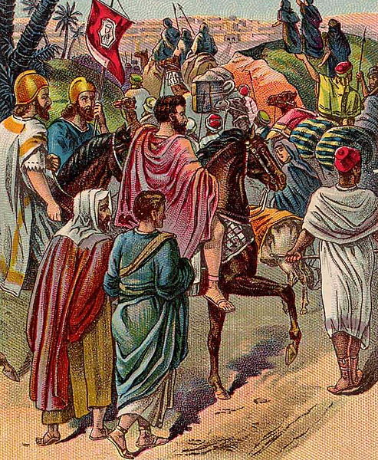
THE HOLY DAYS OF ISRAEL
Passover, Unleavened bread, and Firstfruits were
given of God as types to foreshadow the death,
burial, and resurrection of Christ.
But as God foreknew that Israel would harden their hearts against their Messiah, He would give them a
4th holy day 50-days after Christ’s resurrection.
This would give the Jewish people who were
scattered all over the known world time to go home and think about what they had just seen in Jerusalem: the death, burial, and resurrection of Jesus of Nazareth. But, 50-days later they would return to Jerusalem to hear the Holy Spirit confirm to them
‘the wonderful works of God’ (Acts 2:11).

Slide 8
PENTECOST
“And ye shall count unto you from the morrow after the Sabbath, from the day that ye brought the sheaf of the wave-offering; seven Sabbaths shall be complete: Even unto the morrow after the seventh Sabbath shall ye number fifty days…” (23:15,16).
The Israelites were to start counting following the feast of FIRSTFRUITS – the day after the 7th Sabbath, or 50-days later, would be the next, 4th and last spring holy day.
It was one of three required attendance holy
days (Unleavened bread, Pentecost, Tabernacles), and would be used of God to bring enlightenment to the nation of Israel of the Messiahship of Christ
via outpouring of the Holy Spirit.

Slide 9
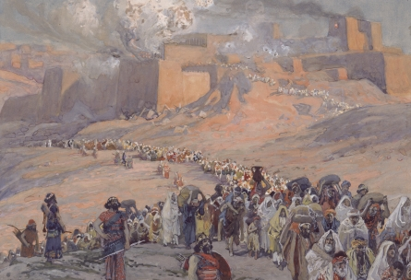
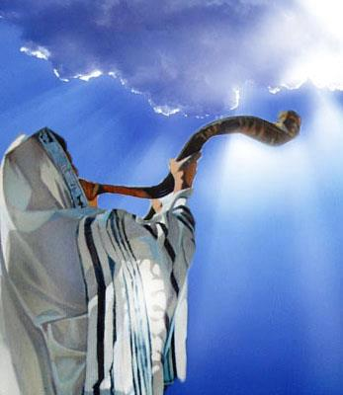
Leviticus 23 then presents the fall holy days given
to Israel during their stay in the wilderness of Sinai.
After the possessing their land, God would call the
Jewish nation to come again to Jerusalem to
celebrate 3 more holy days during the autumn, all
having important spiritual significance.
TRUMPETS
“Speak unto the children of Israel, saying, in the 7th
Month [October], in the [1st] day of the month, shall
ye have a Sabbath, a memorial of blowing of
trumpets, an holy convocation” (23:24).
Whereas, the spring holy days foreshadowed the 1st
coming of Christ [death, burial, resurrection]; the fall
holy days pre-figured His 2nd coming to the earth. In
Israel’s past, trumpets were used to ‘call the assembly’ for an important announcement. On this occasion, trumpets will be used to alert Israel of the promised return of their Messiah.

Slide 10
DAY OF ATONEMENT
“Also on the [10th] day of this [7th] month there shall
be a day of atonement: it shall be an holy convocation
unto you; and ye shall afflict your souls, and offer an
offering made by fire unto the LORD… For whatsoever
soul it be that shall not be afflicted in that same day,
he shall be cut off from among his people” (23:27).
Ten days following the Feast of Trumpets came the
2nd fall holy day – the Day of Atonement. Israel was
to feel intense sorrow for their sin and express it
before their Holy God.
What they didn’t know, was that this holy day foreshadowed the realization that they had rejected and crucified their Messiah, but now He was willing to forgive them if they believed on Him – “And
I will pour upon the house of David, and upon the inhabitants of Jerusalem, the spirit of grace and of supplications: and they shall look upon me whom they have pierced, and they shall mourn for him, as one mourneth for his only son, and shall be in bitterness for him…” (Zech. 12:10).

Slide 11
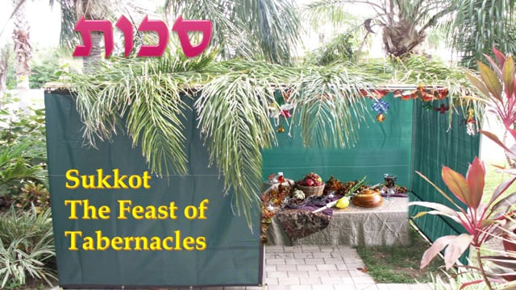
FEAST OF TABERNACLES
“… the [15th] day of this [7th] month shall be the
feast of tabernacles for [7] days unto the LORD…
branches of palm trees… Ye shall dwell in booths
[7] days; all that are Israelites born shall dwell in
booths… And Moses declared unto the children
of Israel the feasts of the LORD” (23:34-44).
The final holy day given to Israel was that of
Tabernacles, which was the kingdom of heaven
hope of their people since their inception.
What they didn’t know, is that hope could not
be accomplished until Christ’s 2nd coming, when they do repent and accept Him as their Messiah. He will forgive them of all their sin and then usher in this 1,000 year kingdom of heaven on earth – “Behold the days come, saith the LORD, that the plowman shall overtake the reaper… And I will bring again the captivity of my people of Israel… And I will plant them upon the land, and they shall no more be pulled up out of their land which I have given them…” (Amos 9:13-15).

Slide 12
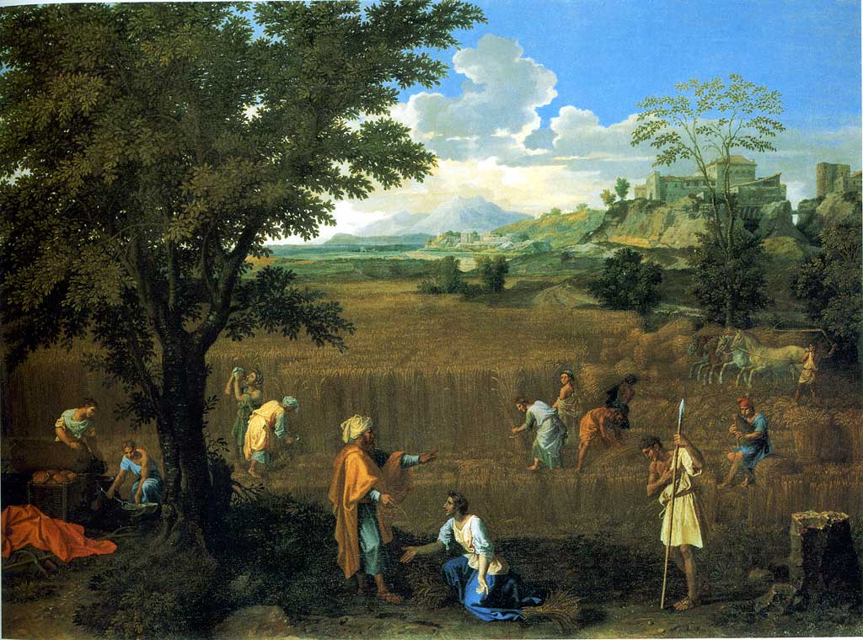
A SABBATH FOR THE LAND
“And the LORD spake unto Moses in mount Sinai, saying,
Speak unto the children of Israel, and say unto them,
When ye come into the land which I give you, then shall
the land keep a Sabbath unto the LORD… [6] years thou
shalt sow thy field, and [6] years thou shalt prune thy
vineyard, and gather in the fruit thereof; But in the [7th]
year shall be a Sabbath of rest unto the land… thou shalt
neither sow thy field, nor prune thy vineyard” (25:1-7).
Every 7th year the land was to lie uncultivated [fallow],
and every 50th year they should hold a jubilee which
included 3-observances: 1. a Sabbath’s rest of the land;
2. Israelite slaves freed; 3. any lands relinquished
because of impoverishment, were to be restored to
their original owners (25:10-13).
Israel would soon find out what would happen when they didn’t follow God’s instructions.

Slide 13
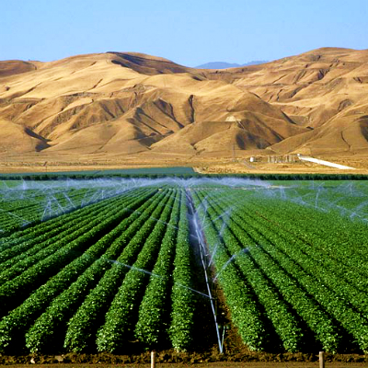
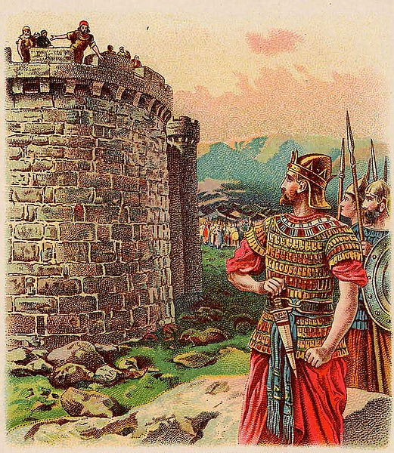
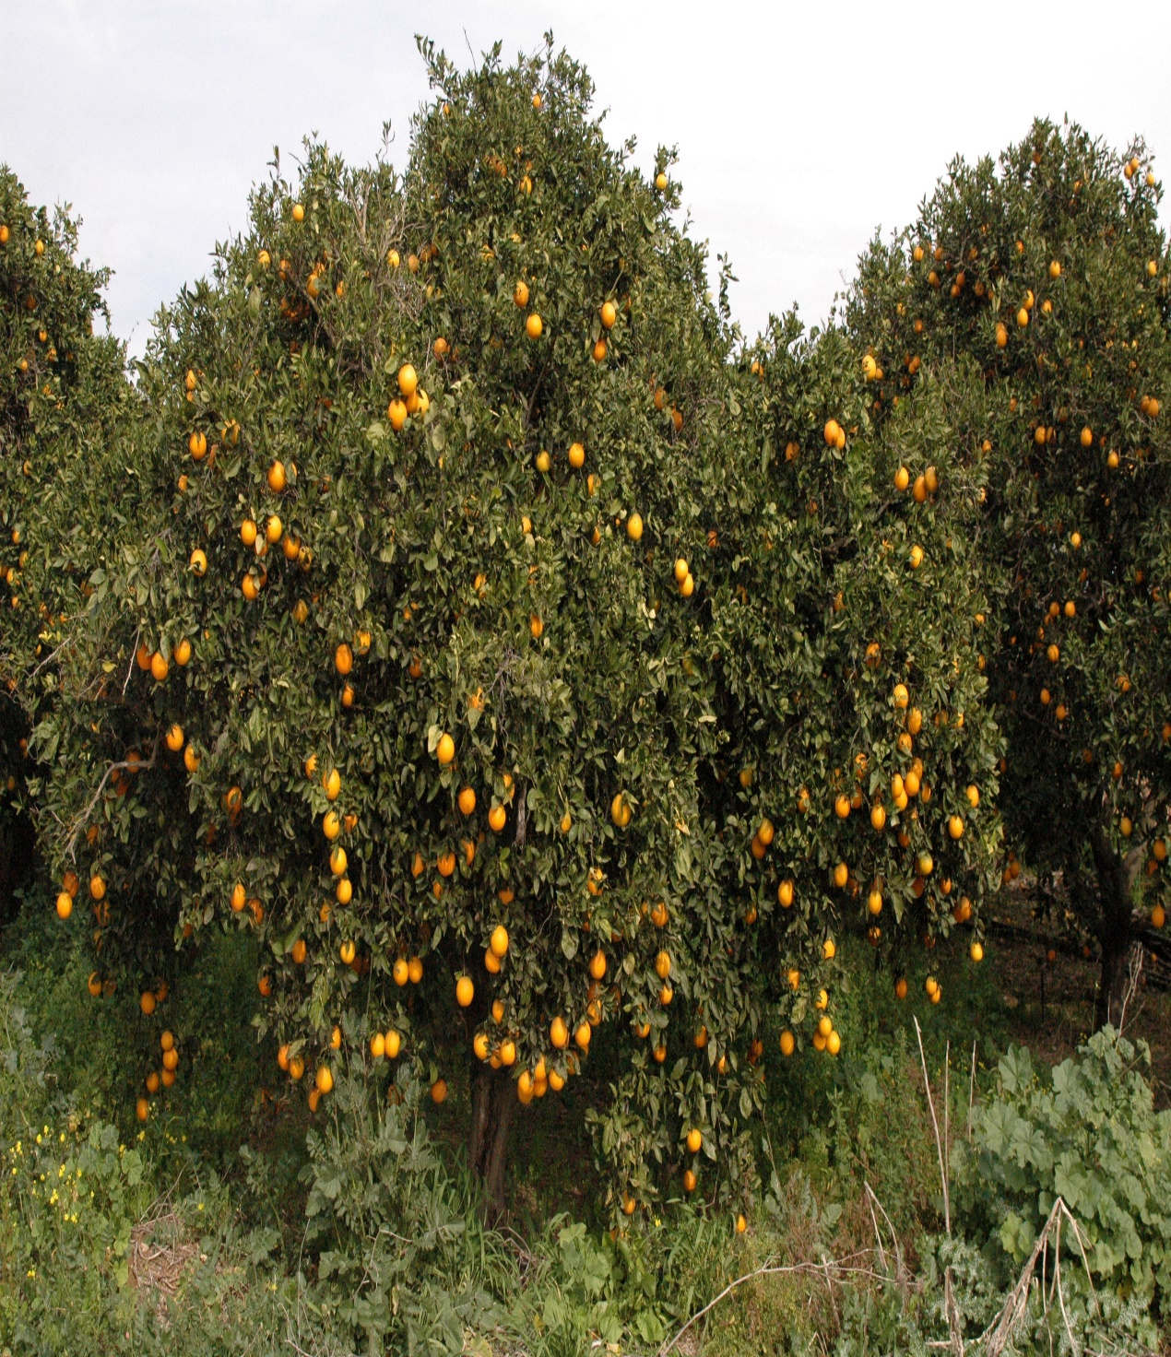
CONDITIONAL BLESSINGS ON THE LAND
“Ye shall make you no idols nor graven images…
neither ye set up any image of stone in your land, to
bow down unto it…” (26:1).
Not only did God want the Israelites to be holy, but
He also wanted them to treat the land like it was
holy. If they did –
“Then I will give you rain in due season, and the land
shall yield her increase, and the trees of the field shall
yield their fruit…
…and dwell in your land safely. And I will give peace in
the land… And [5] of you shall chase an [100], and an
[100] of you shall put [10,000] to flight…” (26:4-6).
The land and its people would prosper above every
nation of the world if only Israel would obey God.
But, would they?

Slide 14
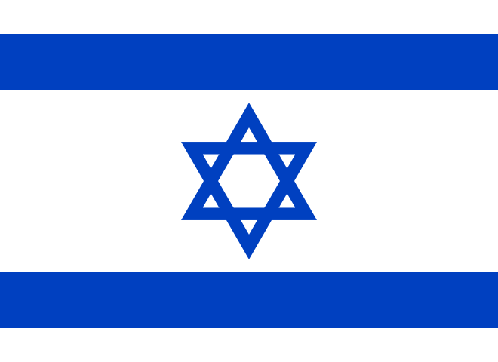
THE GOD OF ISRAEL
“And I will walk among you, and will be your
God, and ye shall be my people” (26:12).
God’s relationship with Israel under the Old
Covenant was conditional—if they obeyed Him –
“But if ye will not hearken unto me… I will do
this to you… I will appoint over you terror… I will
set my face against you, and ye shall be slain
before your enemies… punish you… plagues…
pestilence [disease]…” (26:14-31).
Knowing Israel would NOT obey Him, God
began to forecast some of their chastisements
He would use on them – “I will bring the land into desolation… I will scatter you among the heathen, and will draw out a sword after you… and your cities waste. Then shall the land enjoy
her Sabbaths, as long as it lieth desolate…” (26:32-39).
This referenced the destruction of Israel by Nebuchadnezzar and the 70-year Babylonian captivity.

Slide 15
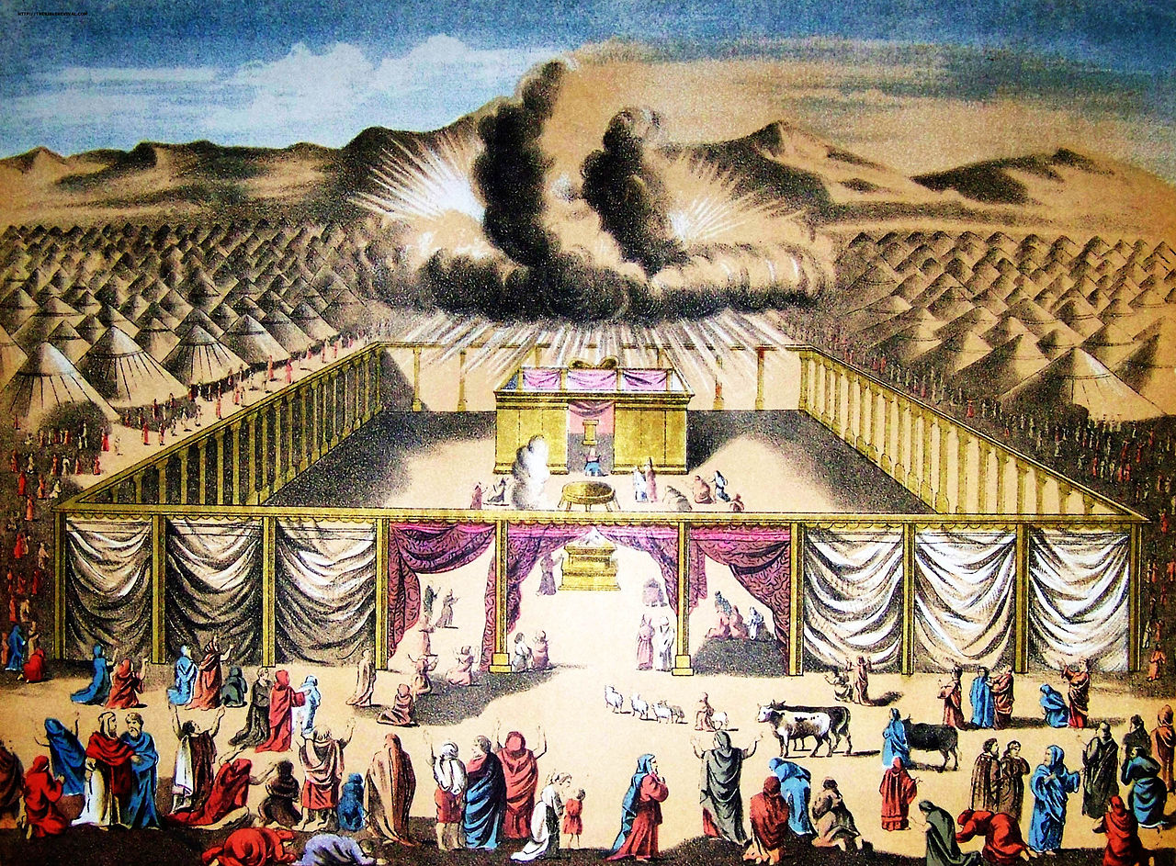
CENSUS
“And the LORD spake unto Moses in the wilderness of Sinai, in the tabernacle of the congregation, on the first day of the [2nd] month, in the [2nd] year after they were come out of the land of Egypt, saying, Take ye the sum of all the congregation of the children of Israel, after their families, by the house of their fathers, with the number of their names, every male… from twenty years old and upward, all that are able to go forth to war in Israel: thou and Aaron shall number them by their armies” (Num. 1:1-3).
One month after the tabernacle and the Levitical priesthood were put into operation, God commanded a census be taken in the wilderness of Sinai—men, 20 years and older, who were capable of bearing arms.

Slide 16
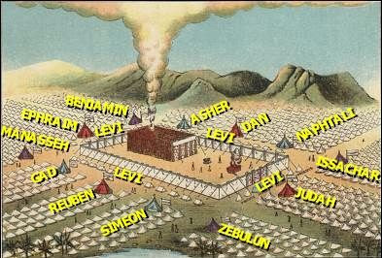
“These are those that were numbered, which Moses
and Aaron numbered, and the princes of Israel, being
twelve men, each one was for the house of his
fathers… Reuben [46,500]; Simeon [59,300]; Gad
[45,650]; Judah [74,600]; Issachar [54,400]; Zebulon
[57,400]; Ephraim [40,500]; Manasseh [32,200];
Benjamin [35,400]… all they that were numbered
were numbered were [603,550]… Only thou shalt
not number the tribe of Levi…” (1:44-47).
The Levites were not counted because they were
made up of both priests and those who tended to
the tabernacle, but the two sons of Joseph [Ephraim
& Manasseh] were counted making 12 tribes.
“But thou shalt appoint the Levites over the tabernacle of testimony, and over all the veils thereof… they shall bear the tabernacle… and when the tabernacle is setteth forward, the Levites shall take it down… set it up: and the stranger that cometh nigh shall be put to death” (1:50,51).

Slide 17
ARRANGEMENT OF THE CAMP
“And on the east side toward rising of the sun shall
they of the standard of the camp of Judah pitch
throughout their armies… And those that do pitch
next unto him shall be the tribe of Issachar… Then
the tribe of Zebulun… on the south side… Reuben…
And those by him shall be the tribe of Simeon…
Then the tribe of Gad… on the west side… Ephraim…
by him Manasseh… then the tribe of Benjamin... Dan
shall be on the north side…by him… Asher… Then
Naphtali… And the children of Israel did according
to all that the LORD commanded Moses” (2:1-34).
The wilderness camp was so organized that it began
to look like a military encampment, which is exactly
what God wanted—a well disciplined, organized,
nation who would take and follow orders from their Commander-In-Chief.

Slide 18
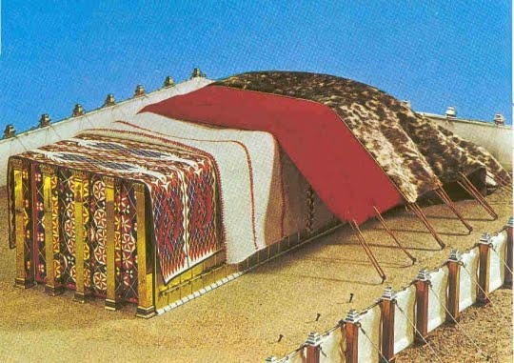
The camp was to operate like mobile unit.
When God gave the command to move the
encampment, specified individuals knew
exactly what to do to accomplish it –
“Take also the sum of the sons of Gershom…
from [30] years old and upward until [50]
years old… to do the work in the tabernacle…
they shall bear the curtains of the tabernacle…
covering… the hangings of the court, and the
hanging for the door of the gate of the court…”
(4:22-28).
Though given charge of tearing down & setting
up, they had to be very careful how to do it –
“But thus do unto them, that they may live, and not die, when they approach unto the most holy things: Aaron and his sons shall go in, and appoint them every one to his service and to his burden. But they shall not go in to see when the holy things are covered, lest they die” (4:19,20).

Slide 19
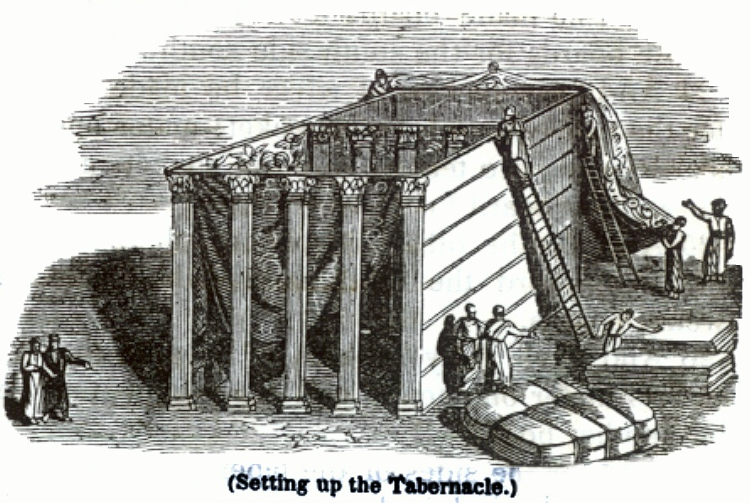
“As for the sons of Merari… [30] years old… [50] years… this is the charge of their burden… the boards of the tabernacle… bars… pillars… sockets… pins… cords… According to the commandment of the LORD they were numbered by the hand of Moses, everyone according to his service, and according to his burden: thus were they numbered of him…” (4:29-33).
The census was not only used to count the Israelites, but to assign jobs that were used in the
assembling of the tabernacle. Every job was important, but it had to be done right –
“For we are labourers together with God… According to the grace of which is given unto me [Paul],
as a wise master builder… let another buildeth thereon. But let every man take heed how he
buildeth thereupon” (1Cor. 3:9,10).

Slide 20
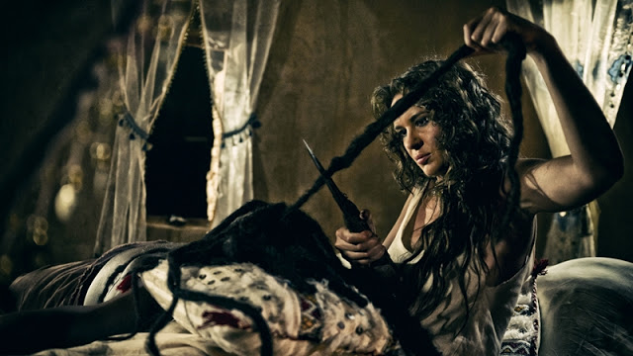
NAZARITE VOW
God called Israel to be a holy nation, but He
also called some to be especially holy –
“… When either man or woman shall separate themselves to vow a vow of a Nazarite, to separate themselves unto the LORD… He shall separate himself from wine and strong drink… no razor shall come upon his head…” (6:1-6).
The most well know person in the O.T. to take this vow was Samson.
But, the one it epitomized [type] through separation and willingness to bear the burdens for God was the LORD Jesus Christ.
Next time – The Operation and mobilization of the Tabernacle (Num. 6 – 22)
“For, lo, thou shalt conceive, and bear a son; and
no razor shall come on his head: For the child
shall be a Nazarite unto God from the womb…”
(Jud. 13:5).

