Slide 1
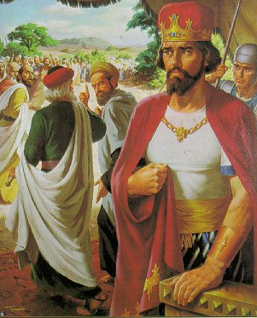
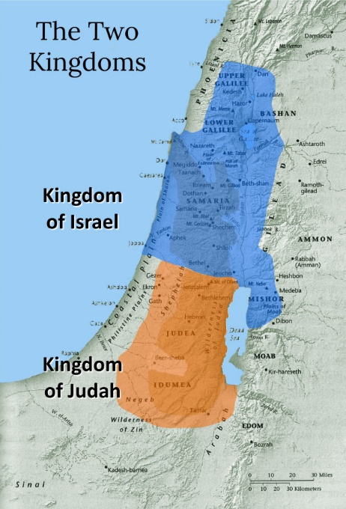
THROUGH THE BIBLE IN 2018
LESSON 26
WEEK 26 OF 52
(1Kg.15-22; Oba.)
Last time we saw Solomon’s heart turned away from God; this time a series of evil kings enter into a civil war between the two kingdoms.
“And there was war between Rehoboam and Jeroboam all the days of his life” (1Kg. 15:6).
God’s plan for a united kingdom of Israel with one king over a god-fearing nation had come to an end, as Israel was at war with itself: King Rehoboam of the southern kingdom [Judah]; and King Jeroboam of the northern kingdom [Israel].
Satan would influence both kingdoms to backslide into idol worship, but the northern kingdom would fare worse as every king save 1 would permit the practice of idolatry. Of the 20 rulers of the southern kingdom [Judah], only 8 would follow God like King David, with 4 of them leading spiritual reforms.

Slide 2
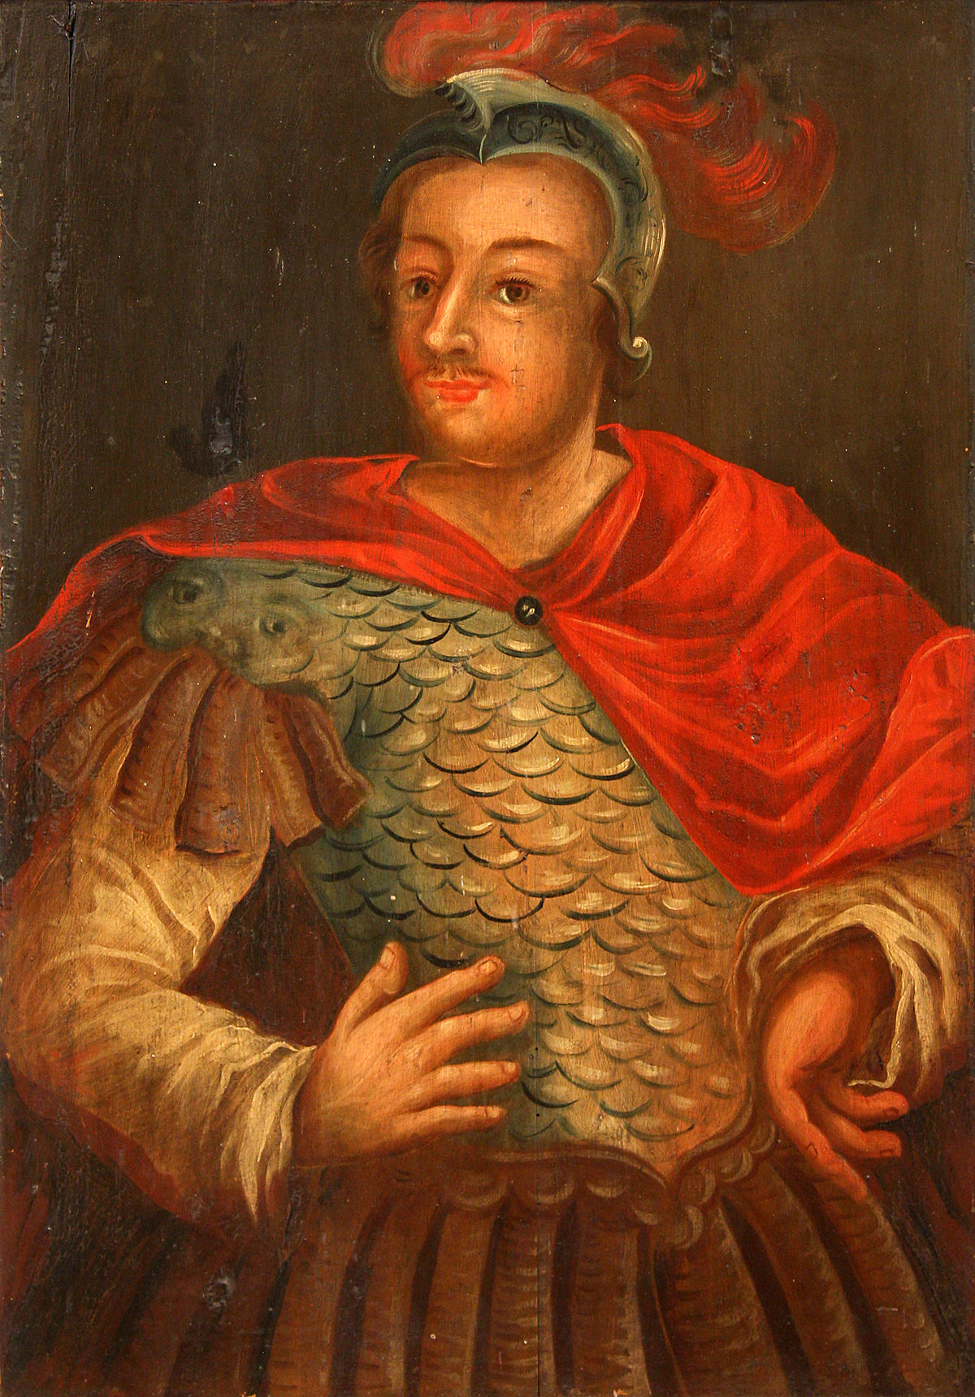
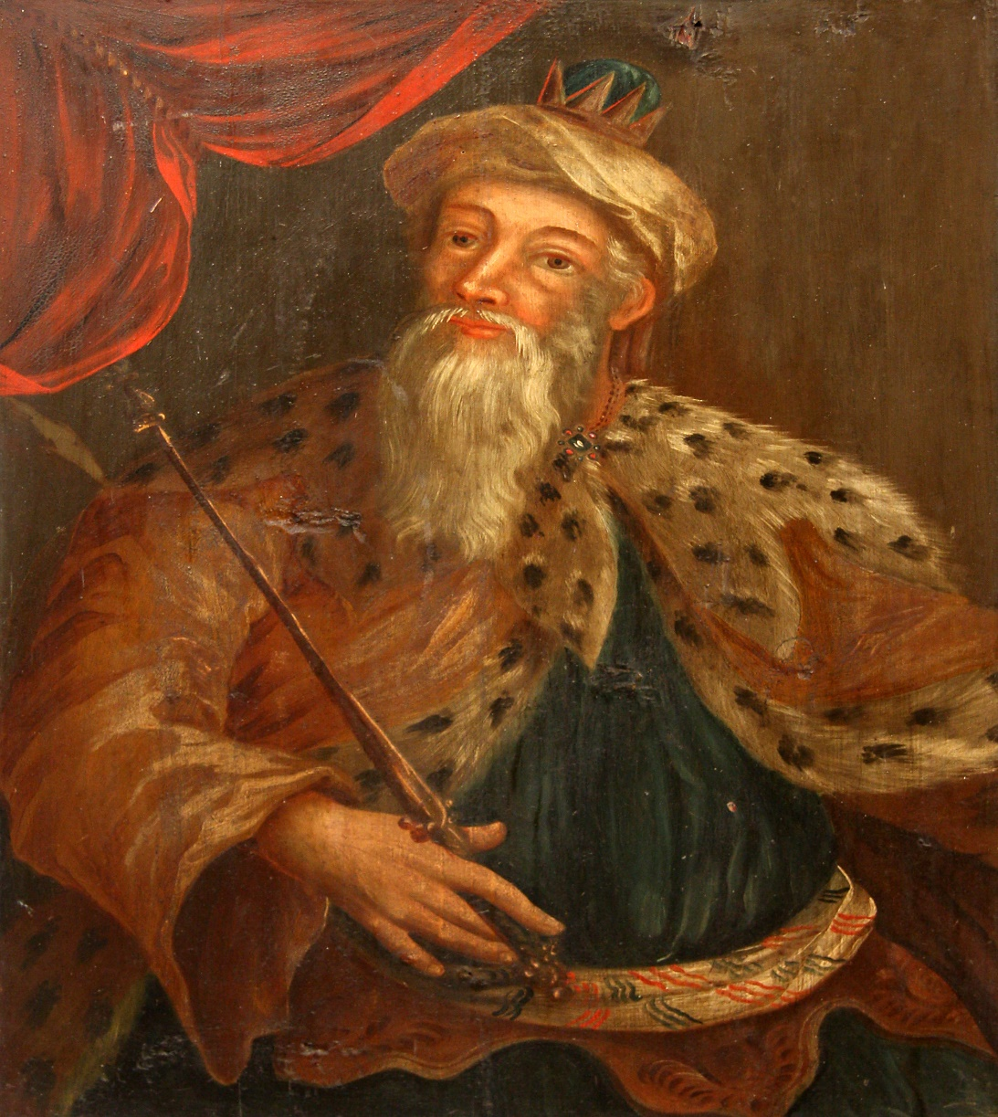
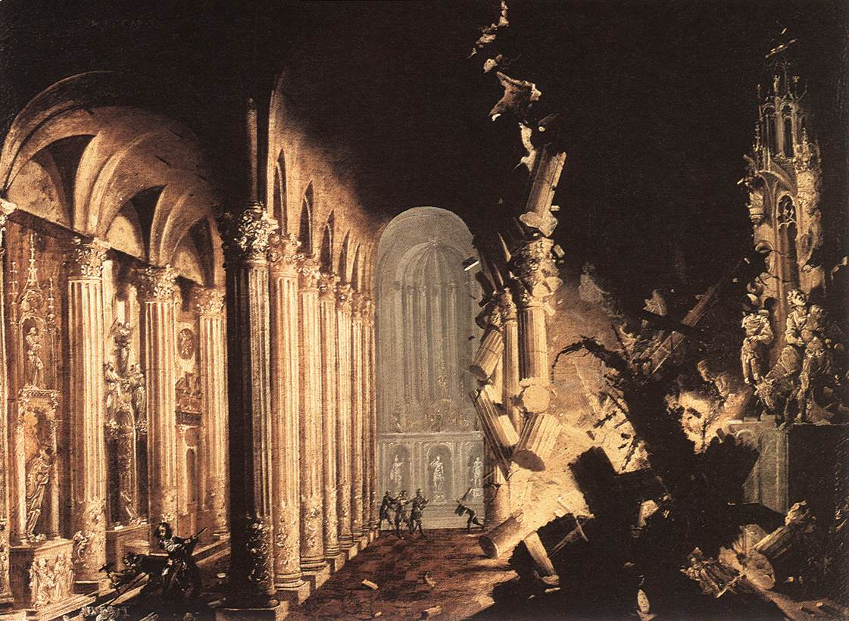
CIVIL WAR
“… it came to pass, that God smote Jeroboam and all Israel
before Abijah and Judah. And the children of Israel fled
before Judah: and God delivered them into their hand. And
Abijah and his people slew them with a great slaughter: So
there fell down slain of Israel [500,000] men… the children
of Judah prevailed, because they relied upon the LORD God
of their fathers… Neither did Jeroboam recover… and the
LORD struck him, and he died” (2Chron. 13:15-20).
Judah defeated Israel with God’s help.
GOOD KING ASA
“… he had no war in those years; because the LORD had
given him rest… For he took away the altars of the strange
gods, and the high places, and brake down the images… And
commanded Judah to seek the LORD God of their fathers,
and to do the law and the commandments… And Asa had an
army… of Judah [300,000] and Benjamin [280,000]…” (14:3,4).
He would need it because His 10-years of peace was interrupted by a vast foreign army.

Slide 3
KING ASA BATTLES THE ETHIOPIANS
“And there came out against them Zerah the Ethiopian with an host of [1 million] chosen men, being mighty men of valour… And Asa went out to battle him… and Asa cried unto the LORD his God… help us, O LORD… in thy name we go against this multitude … let no man prevail against thee… the LORD smote the Ethiopians before Asa… They smote all the cities… And returned to Jerusalem ” (14:9).
The Ethiopian invasion was defeated, again with God’s help.
1st SPIRITUAL REFORM
“And the Spirit of God came upon Azariah the son of Oded: And he went out to meet Asa, and said to him… the LORD is with you, while ye be with him… but if ye forsake him, he will forsake you (15:1,2)… And when Asa heard these words … he put away the abominable idols out of all the land of Judah and Benjamin… entered into a covenant to seek the LORD God of their fathers with all their heart and soul” (15:8-12).

Slide 4
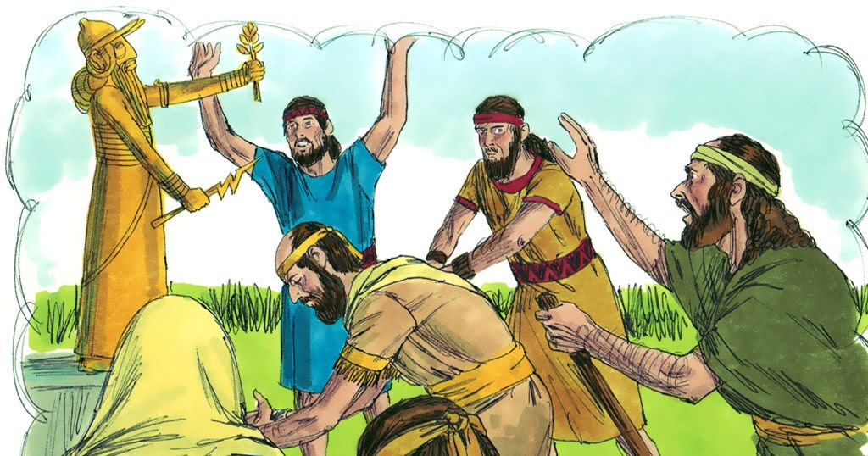
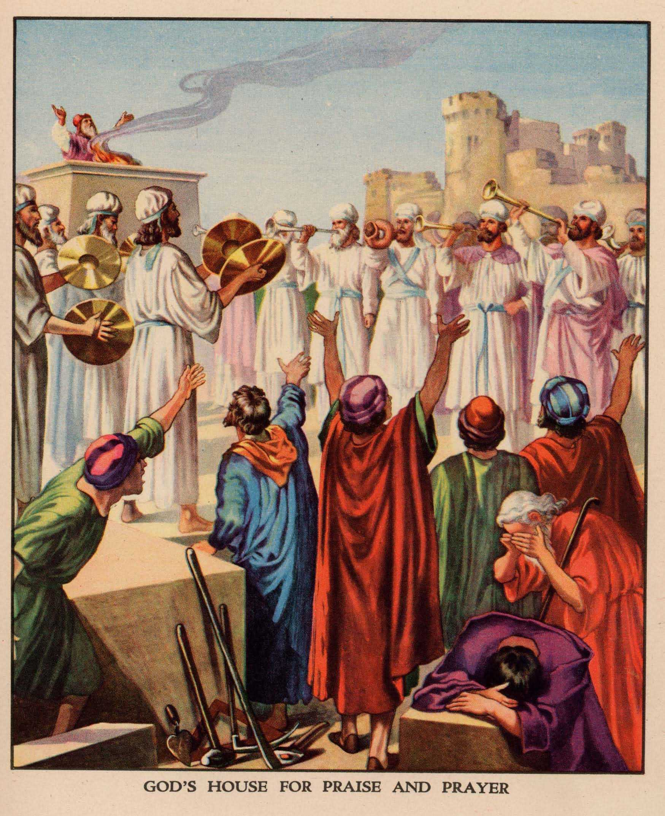
1st SPIRITUAL REFORM (continued)
“That whosoever would not seek the LORD God of Israel should be put to death, whether small or great, whether man or woman… All Judah rejoiced at the oath: for they had sworn with all their heart, and sought him with their whole desire; and he was found of them…” (15:13-15).
King Asa attempted to prompt Judah to return to the pledge given Moses to serve none other than the God of Israel, and those who refused, i.e. idol worshippers were to be put to death as the Law required – “And thou shall stone him with stones, that he die (Deut. 13:10)… And also concerning… the mother of Asa the king, he removed her from being queen, because she had made an idol in a grove: and Asa cut down her idol, and stamped it out, and burnt it at the brook of Kidron (15:16)… But the high places were not taken away out of Israel… the heart of Asa was perfect all his days” (15:17).
Asa could not control what went on in the northern kingdom.

Slide 5
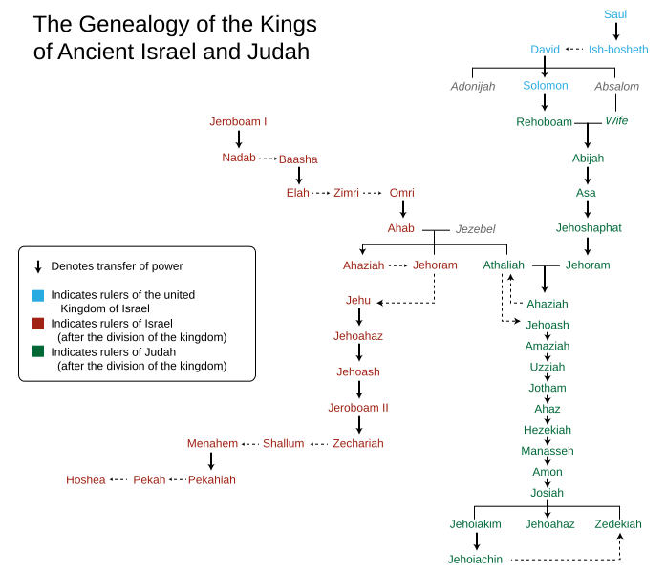
KINGS OF JUDAH [total 20; 19 men,1 woman]
“And Abijah slept with his fathers; and they buried him in the city of David: and Asa his son reigned in his stead… And [41] years reigned he in Jerusalem… And Asa did that which was right in the eyes of the LORD, as did his father” (1Kg. 15:8).
Solomon was followed by Rehoboam who was followed by Abijah who was followed by Asa, as kings of Judah.
KINGS OF ISRAEL [total 19 men]
“And Nadab the son of Jeroboam began to reign over Israel… and he did evil in the sight of the LORD, and walked in the way of his father… he made Israel to sin… (15:25,26)… Basha [slayed Nadab and took the throne]… he did evil in the sight of the LORD, and walked in the way of Jeroboam… he made Israel to sin” (15:33,34).
One evil king after another in the northern kingdom, none of them in the lineage of King David.

Slide 6
KINGS OF ISRAEL
“… began Elah the son of Baasha to reign over Israel … And Zimri went in and smote him, and killed him… and reigned in His stead… For all the sins of Baasha, and the sins of Elah his son, by which they sinned… made Israel to sin, in provoking the LORD God of Israel to anger with their vanities (16:8-13)… But Omri [took the throne when Zimri committed suicide] wrought evil in the eyes of the LORD, and did worse than all that were before him” (16:25).
The kings of Israel were going from bad to worse.
“So Omri slept with his fathers… and Ahab his son reigned in his stead” (16:28).
When one thinks Satan cannot cause man’s nature to become more evil, he did –
“And Ahab the son of Omri did evil in the sight of the LORD above all that were before him” (16:30).

Slide 7
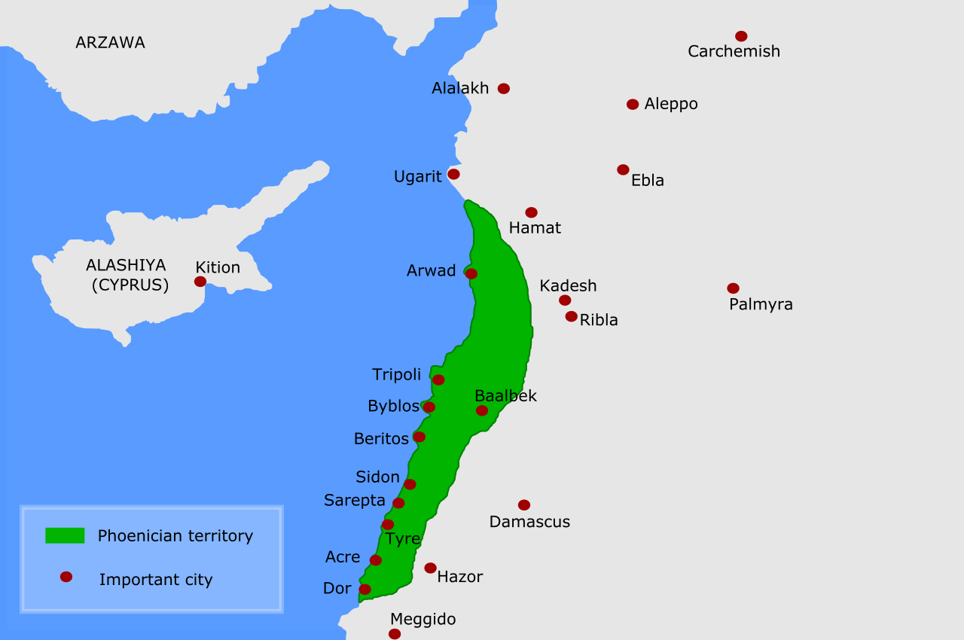
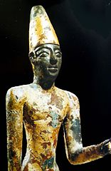
King Omri made an peace treaty with the Phoenicians [later known as Tyre & Sidon] and secured it with the marriage of Ahab and Jezebel, daughter of the king of Phoenicia –
“… that he took to wife Jezebel the daughter of Ethbaal king of the Zidonians, and went and served Baal, and worshipped him. And he reared up an altar for Baal in the house of Baal, which had built in Samaria. And Ahab made a grove; and Ahab did more to provoke the LORD God of Israel to anger than all the kings of Israel that were before him” (16:31-33).

Slide 8
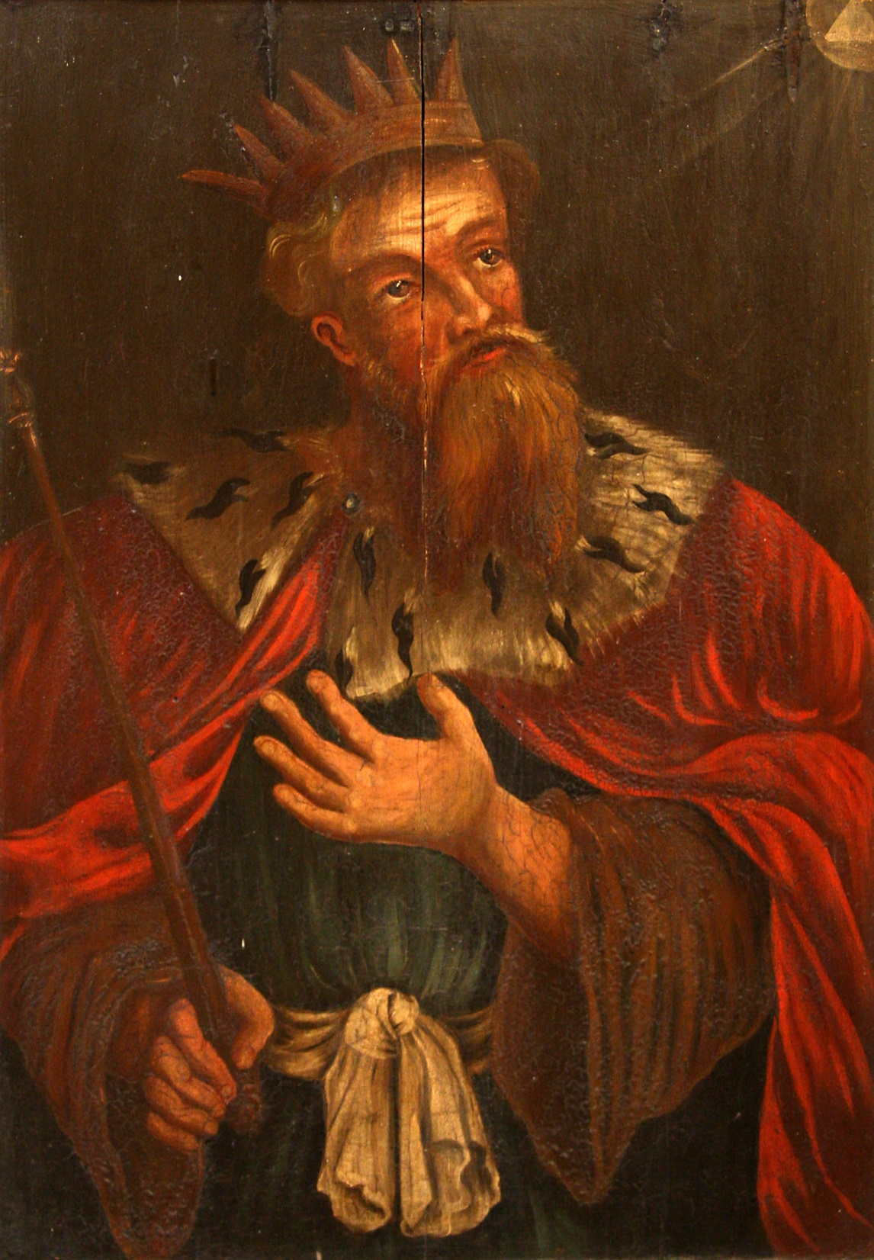
KING JEHOSHAPHAT
“And Jehoshaphat his son reigned in his stead, and strengthened himself against Israel… And the LORD was with Jehoshaphat, because he walked in ways of his father David, and sought not unto Baalim… And his heart was lifted up in the ways of the LORD: moreover he took away the high places and groves out of Judah… he sent… to teach in the cities of Judah… and had the book of the law of the LORD with them… (2Chron. 17:1-9).
Jehoshaphat succeeded Asa to the throne of Judah, and like his father was a man of God, implementing a 2nd spiritual revival. He tore down more pagan sites and sent teachers throughout Judah to teach the Law of Moses to the Jewish people.
“And the fear of the LORD fell upon all the kingdoms of the lands that were round about Judah, so that they made no more war against Jehoshaphat” (17:10).

Slide 9
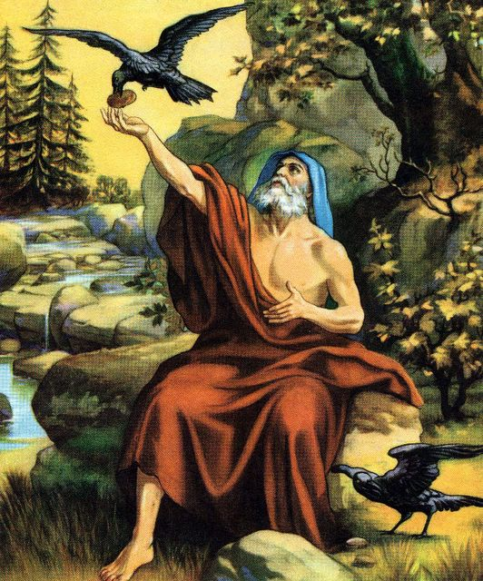
ELIJAH THE PROPHET
“And Elijah the Tishbite, who was of the inhabitants of Gilead, said unto Ahab, As the LORD God of Israel liveth, before whom I stand, there shall not be dew nor rain these years, but according to my word” (1Kg. 17:1).
Elijah, which means “Yahweh is my God” was called to go to the palace of King Ahab (Jezebel) [N. kingdom] and inform him that his God was the only true God of the Israelite people—not Baal [god of rain].
“Get thee hence… and so he went and did according to the word of the LORD… and the ravens brought him bread and flesh in the morning… evening; and he drank of the brook. And it came to pass after a while, that the brook dried up, because there had been no rain in the land” (17:3-7).
Elijah obeyed God, hid from Ahab, as he waited for the drought [to last 3 ½ years] while the ravens fed him.

Slide 10
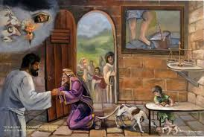
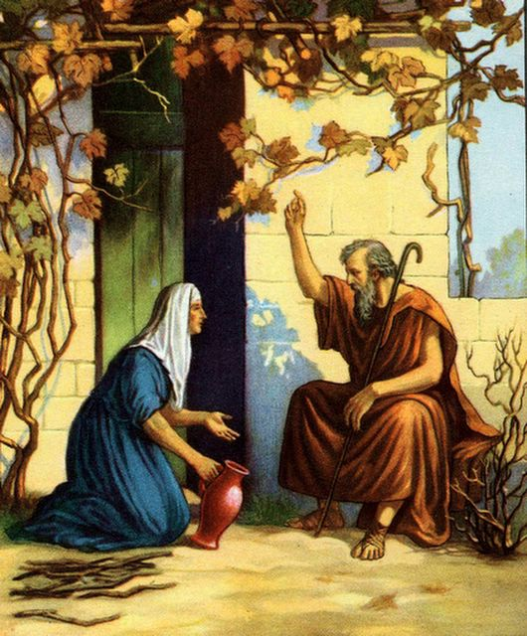
“And the word of the LORD came unto him saying, Arise, get
thee to… Zidon, and dwell there: behold, I have commanded
a widow woman there to sustain thee” (17:8).
Next God directed Elijah to go to the home town of Jezebel
where a widow would feed him. When he got there Elijah
asked for a drink of water and then for something to eat
(17:10,11), but she answered, “As the LORD liveth, I have
not a cake, but an handful of meal… and a little oil…” (17:12).
A poor Syrophenican woman [Gentile] who believed in the
God of the Israelites. Where will we see this again?
“But he [Christ] said, It is not meet to take the children’s
[Israel’s] bread and cast it to the dogs [Gentiles]” (Mt. 15:26),
meaning that God’s plan was directed first to Israel. The woman persisted, “And she said, Truth, Lord: yet the dogs eat of the crumbs which fall from their masters’ table. And Jesus answered, O woman, great is thy faith… And her daughter was made whole from that very hour” (Mt. 15:27,28).
God was blessing Israel because of His covenant promises; however, these two events show that a small number of Gentiles believed in the God of Israel, and were blessed secondarily.

Slide 11
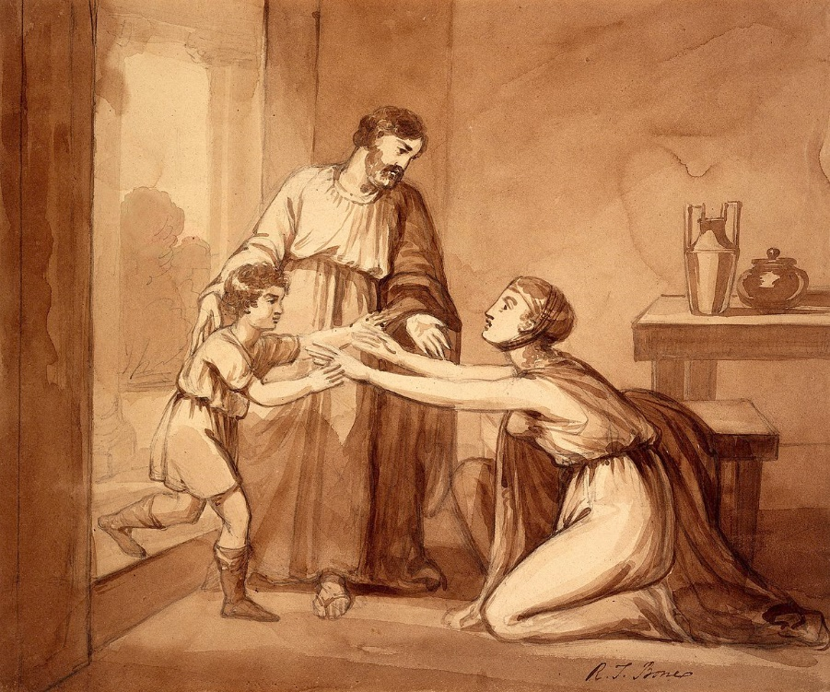
“And Elijah said unto her, Fear not; go and do as thou hast said: but make me thereof a little cake first, and bring it to me, and after make for thee and for thy son… And she went and did according to the saying of Elijah: and she, and he, and her house did eat many days” (17:13-16).
God had enough to spiritually feed everyone—Jews and Gentiles.
“And it came to pass… that the son of the woman…
fell sick… that there was no breath left in him.
And she said to Elijah, What have I to do with thee,
O thou man of God?... And he stretched himself
upon the child thee times, and cried unto the LORD,
and said, O LORD my God, I pray thee, let this child’s
soul come into him again… he revived” (17:17-24).
This event represented the power of God in that it
was the 1st instance of someone being resuscitated
from death. It’s hidden meaning combined with
that of the Syrophencian woman during Christ’s
earthly ministry was that God had a plan to revive
the Gentiles in addition to that of His nation Israel.

Slide 12
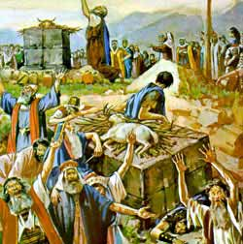
MT. CARMEL
“And it came to pass after many days, that the word of the LORD came to Elijah in the third year, saying, Go, shew thyself unto Ahab… I will send rain upon the earth” (18:1).
In the 3rd year of the drought, God sent Elijah to inform Ahab that it would soon end, but it would involve a test between the prophet of God and the prophets of Baal –
“And Elijah said unto the [450] prophets of Baal, Choose you one bullock… call on the name of your gods, but put no fire under it (18:25)… called on the name of Baal from morning until noon, saying, O Baal, hear us. But there was no voice… And it came to pass at noon, that Elijah mocked them…” (18:26,27) – Cry louder, maybe he’s busy, maybe he took a trip, or is asleep! Wake him up!
They tried harder, even committing self-mutilation (18:28), but nothing worked (18:29). Now, it was Elijah’s turn.

Slide 13
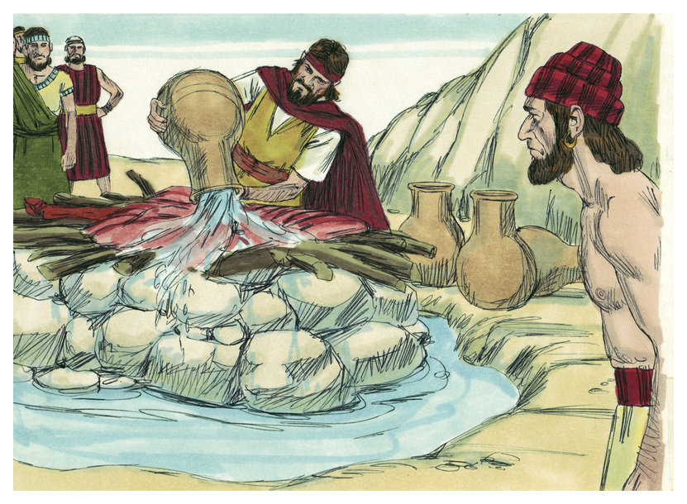
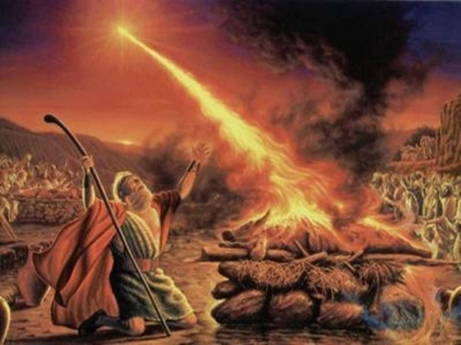
“And Elijah said unto all the people, Come near unto me… 12 stones… built an altar in the name of the LORD: and he made a trench about the altar… put the wood in order… and said, Fill 4-barrels of water, and pour it on the burnt-sacrifice, and on the wood … Do it the second time… Do it the third time. And the water ran round about the altar; and he filled the trench with water… Elijah said, LORD God of Abraham, Isaac, and of Israel… let it be known this day that thou art God in Israel…”
(18:30-36).
Would God grant Elijah’s request?
“Then the fire of the LORD fell and consumed the burnt-sacrifice, and the wood, and the stones, and the dust, and licked up the water in the trench. And when all the people saw it, they fell on their faces: and they said, The LORD, he is the God” (18:38,39).

Slide 14
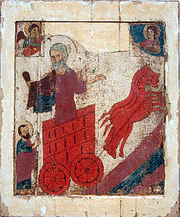
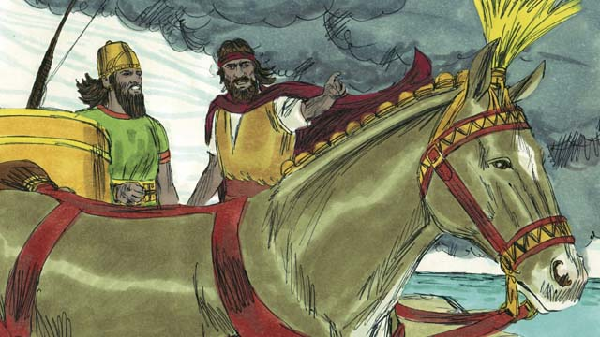
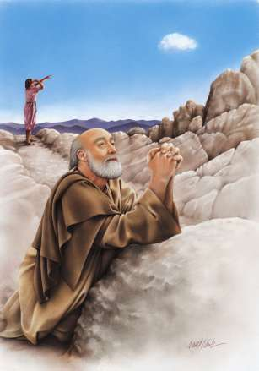
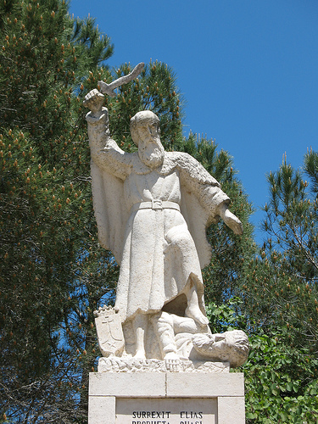
“And Elijah said unto them, Take the prophets of Baal; let not one of them escape… Elijah brought them down to the brook Kish and slew them there” (18:40).
After the slaughter of the prophets of Baal (Deut. 13:15), Elijah went back up on Mt. Carmel to pray for rain, “And Elijah went up to the top of Carmel; and he cast himself down upon the earth… and said to his servant, Go up now, look toward the sea… There is nothing… Go again [7] times… the 7th time… there ariseth a little cloud out of the sea… And [God] said, Go up, say unto Ahab, Prepare thy chariot… that the rain stop thee not… was black with clouds… and there was a great rain… and Ahab rode, and went to Jezreel. And the hand of the LORD was on Elijah … and ran before Ahab…” (18:40-46).
Elijah made a mockery of Ahab and his prophets of Baal, and even returned to the king’s palace in a foot race to tell Queen Jezebel all that had happened.

Slide 15
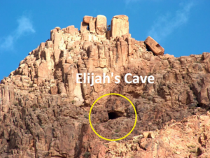
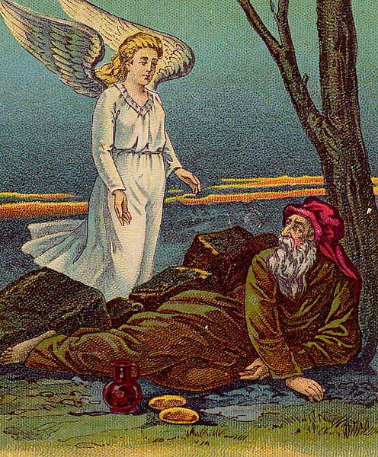
ELIJAH BACKSLIDES
Despite his faith at Carmel, Elijah let a 24-hour death threat from Jezebel (19:2) to completely unravel him. First, he hid and asked God to die (19:4), an angel gave him food and water (19:6) for the journey he was about to take. Though not told to, Elijah went on a 40-day, 200-mile journey from Beer-sheba to Mt. Sinai. Elijah was running away in fear (19:3). The death threat on him caused him to be so depressed he believed all in Israel had abandoned God and he was the only one left –
“… for the children of Israel have forsaken thy covenant… I, even I only, am left; and they seek my life, to take it away” (19:10). In a cave on Mt. Sinai, the LORD informed him there were [7,000] in Israel who had not bowed their knee to Baal” (19:18).
It was time to appoint a new prophet.

Slide 16
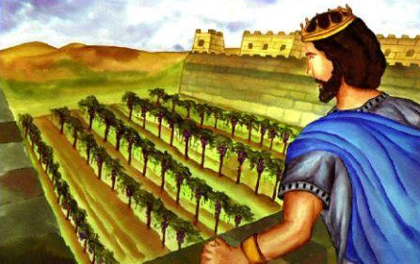
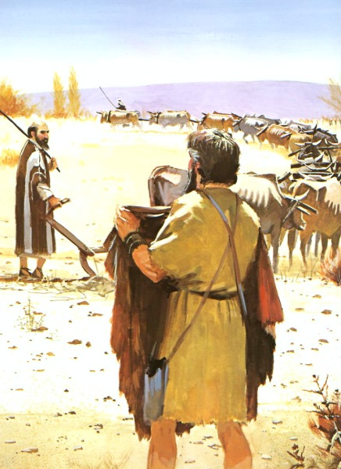
ELISHA’S CALL AS PROPHET
“So he departed thence, and found Elisha the son of Shaphat, who was plowing with 12-yoke of oxen… Elijah passed by him, and cast his mantle upon him. And he left the oxen, and ran after Elijah… I will follow thee” (19:19).
Elisha immediately accepted the call of God.
KING AHAB & QUEEN JEZEBEL
Their evil was shone when they had a neighbor murdered when he refused to sell them a vineyard (21:1-16). Elijah
met Ahab in the vineyard and told him –
“Thus saith the LORD, in the place where dogs licked the blood of Naboth [neighbor] shall dogs lick thy blood” (21:19).
“But there was none like unto Ahab, which did sell himself to work wickedness in the sight of the LORD, whom Jezebel his wife stirred up…” (21:25,26).
Ahab & Jezebel’s evil days should have been up, but…

Slide 17
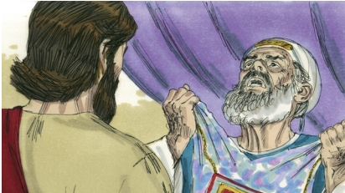
AHAB’S REPENTANCE
“And it came to pass, when Ahab heard those words, that he rent his clothes, and put sackcloth upon his flesh, and fasted… the word of the LORD came to Elijah saying, Seest thou how Ahab humbleth himself before me, I will not bring the evil in his days: but in his son’s days will I bring the evil upon his house” (21:27-29).
An evil man had a change of heart and was spared the destruction due him. But, his evil does not go unpunished and will fall upon his son.
“Ahaziah the son of Ahab began to reign over Israel in Samaria… and he did evil in the sight of the LORD, and walked in the way of his father, and mother… For he served Baal, and worshipped him, and provoked to anger the LORD God of Israel” (22:51-53).

Slide 18
Jehoshaphat next faced a fierce battle from nations to his south – “Thus saith the LORD, be not afraid nor dismayed by reason of this great multitude; for the battle is not yours, but God’s,” the same promise of faith David made before fighting Goliath (2Chron. 20:15; 1Sam. 14:47). When the king’s army came to the invading armies, all they found were dead men. The LORD had put them in a cross fire and they shot and killed each other –
“And when Judah came… to the wilderness, they looked unto the multitude, and behold, they were dead bodies fallen to the earth, and none escaped (20:24)… Now [jumping] Jehoshaphat slept with his fathers… buried in
the city of David, and Jehoram his son reigned in his stead… he wrought evil in the eyes of the LORD (21:1,6)… the LORD would not destroy the house of David… as he promised to give a light to him and his sons for ever” (21:7).
God upheld the Davidic Covenant made with King David.

Slide 19
NEXT SERIES OF KINGS
Ahaziah succeeded Jehoram [after given an incurable disease of the bowels] (21:18), who also did evil (22:4),
and was then killed by Jehu (22:9). Athaliah (Ahaziah’s wicked mother & daughter of Jezebel) took revenge and had all the royal family of Judah killed. With no males remaining except for an infant [Johash], who was hid for 6-years (22:12), she ruled as queen of Judah during that time. Jehoash assumed the throne at age [7] who then had the evil queen put to death (23:15).
Jehoida, high priest under Jehoash, carried out the 3rd spiritual reform, broke down the house of Baal, and re-established burnt-offerings to God – “And Jehoida made a covenant between him, and between all the people… that they should be the LORD’s people” (23:16).
The 8th century B.C. was a bloody, evil time but God raised up Jehoida to do His work of keeping Mosaic Law.

Slide 20
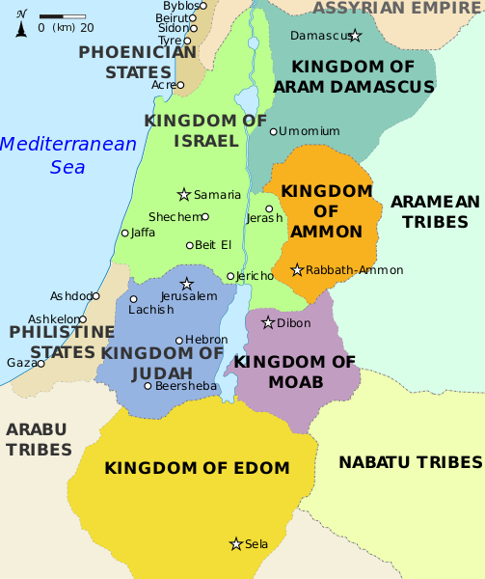
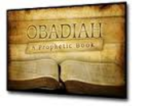
OBADIAH (“worshipper of Yahweh”)
“Internal evidence seems to fix the date of Obadiah’s ministry in
the reign of the bloody Athaliah [878 B.C.]… first of the writings of
the prophets…” Old Scofield, p. 941.
The first of the minor prophets, shortest book in the O.T., it is one
of bleakness during a largely godless period during Israel’s past, a
book of God’s judgment on the enemies of Israel.
“The vision of Obadiah. Thus saith the LORD God concerning Edom
… Arise ye, and let us rise up against her in battle… thou art greatly
despised… Esau… violence against thy brother Jacob…” (1-14). God had nothing good to say
about Edom, a constant enemy of Israel, founded by Esau, the brother of Jacob – “For the day
of the LORD is near upon the heathen… not be any remaining of the house of Esau” (16). The remnant of Edom will be totally annihilated during the tribulation, “But upon mount Zion shall
be deliverance… house of Jacob shall possess their possessions (17)… They have said, Come, let
us [Edom] cut them [Israel] off from being a nation (Psa. 84:4)… Arise, O God, judge the earth:
for thou shalt inherit all nations” (Psa. 82:8).
Next time – the ministry of the prophets Elisha and Jonah

