Slide 1
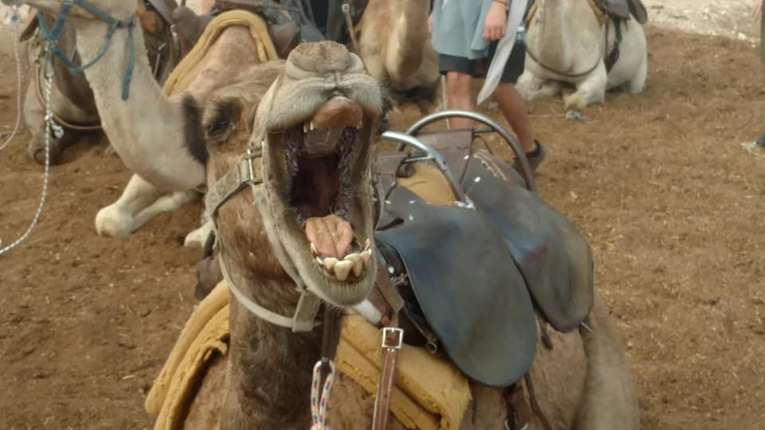

Slide 2
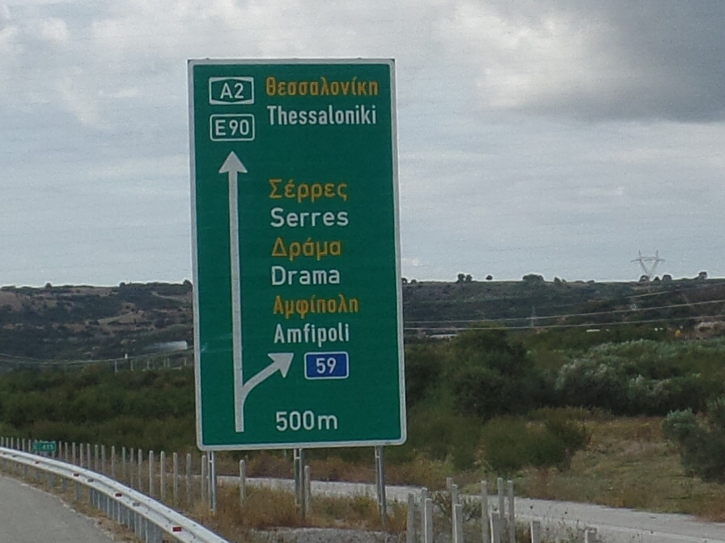
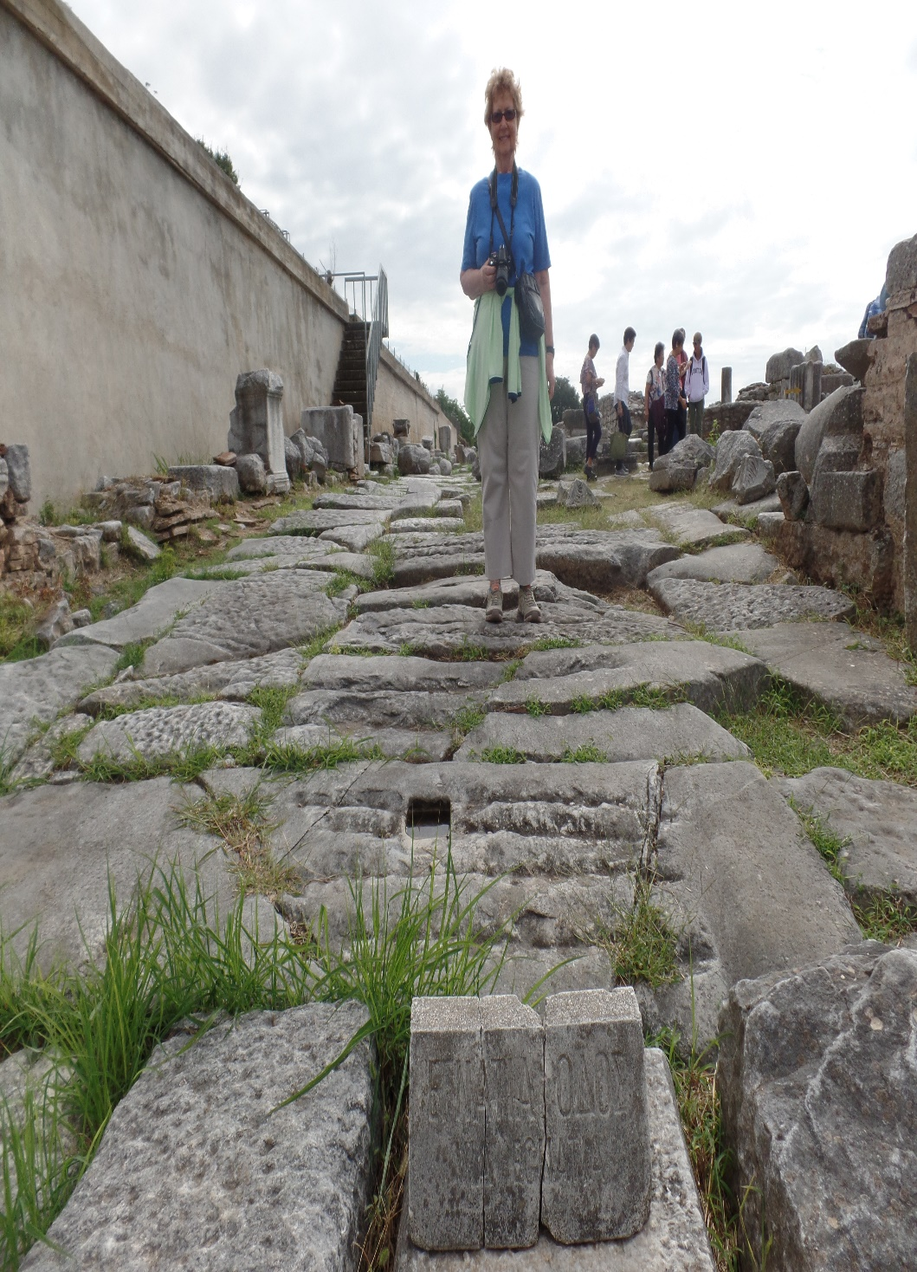
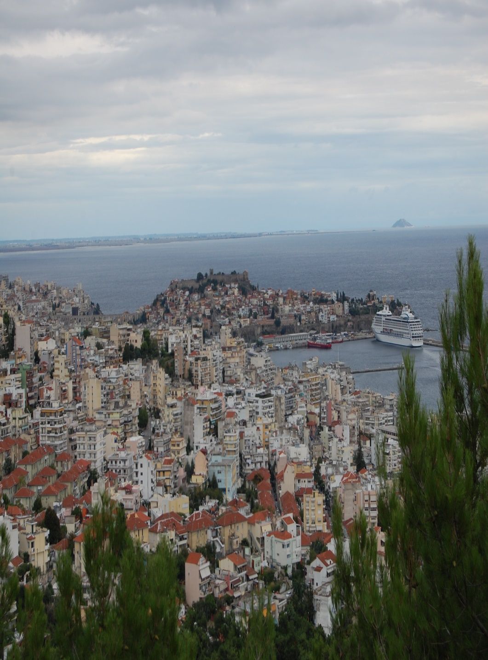
LESSON 48
WEEK 48 OF 52
(Acts 17-19;
1 & 2 Thess.
1Cor. 1-14)
THROUGH THE BIBLE IN 2018
Last time – Paul’s Galatian churches; This time – His Macedonian churches
MACEDONIA
Leaving Philippi on the Ignatian Way [Roman road], Paul moved on to Thessalonica –
“Now when they had passed through Amphipolis and Apolonia, they came to Thessalonica, where was a synagogue of the Jews: And Paul, as his manner was, went in unto them, and 3-Sabbath days reasoned with them out of the scriptures” (Acts 17:1,2).
In 3-weeks, Paul, Silas, and Timothy led many to Christ in this city, “Opening and alleging, that Christ must needs have suffered, and risen again from the dead; and this Jesus, whom
I preach unto you, is Christ” (17:3). Some Jews believed, and “… devout Greeks [Gentiles] a great multitude” (17:4).

Slide 3
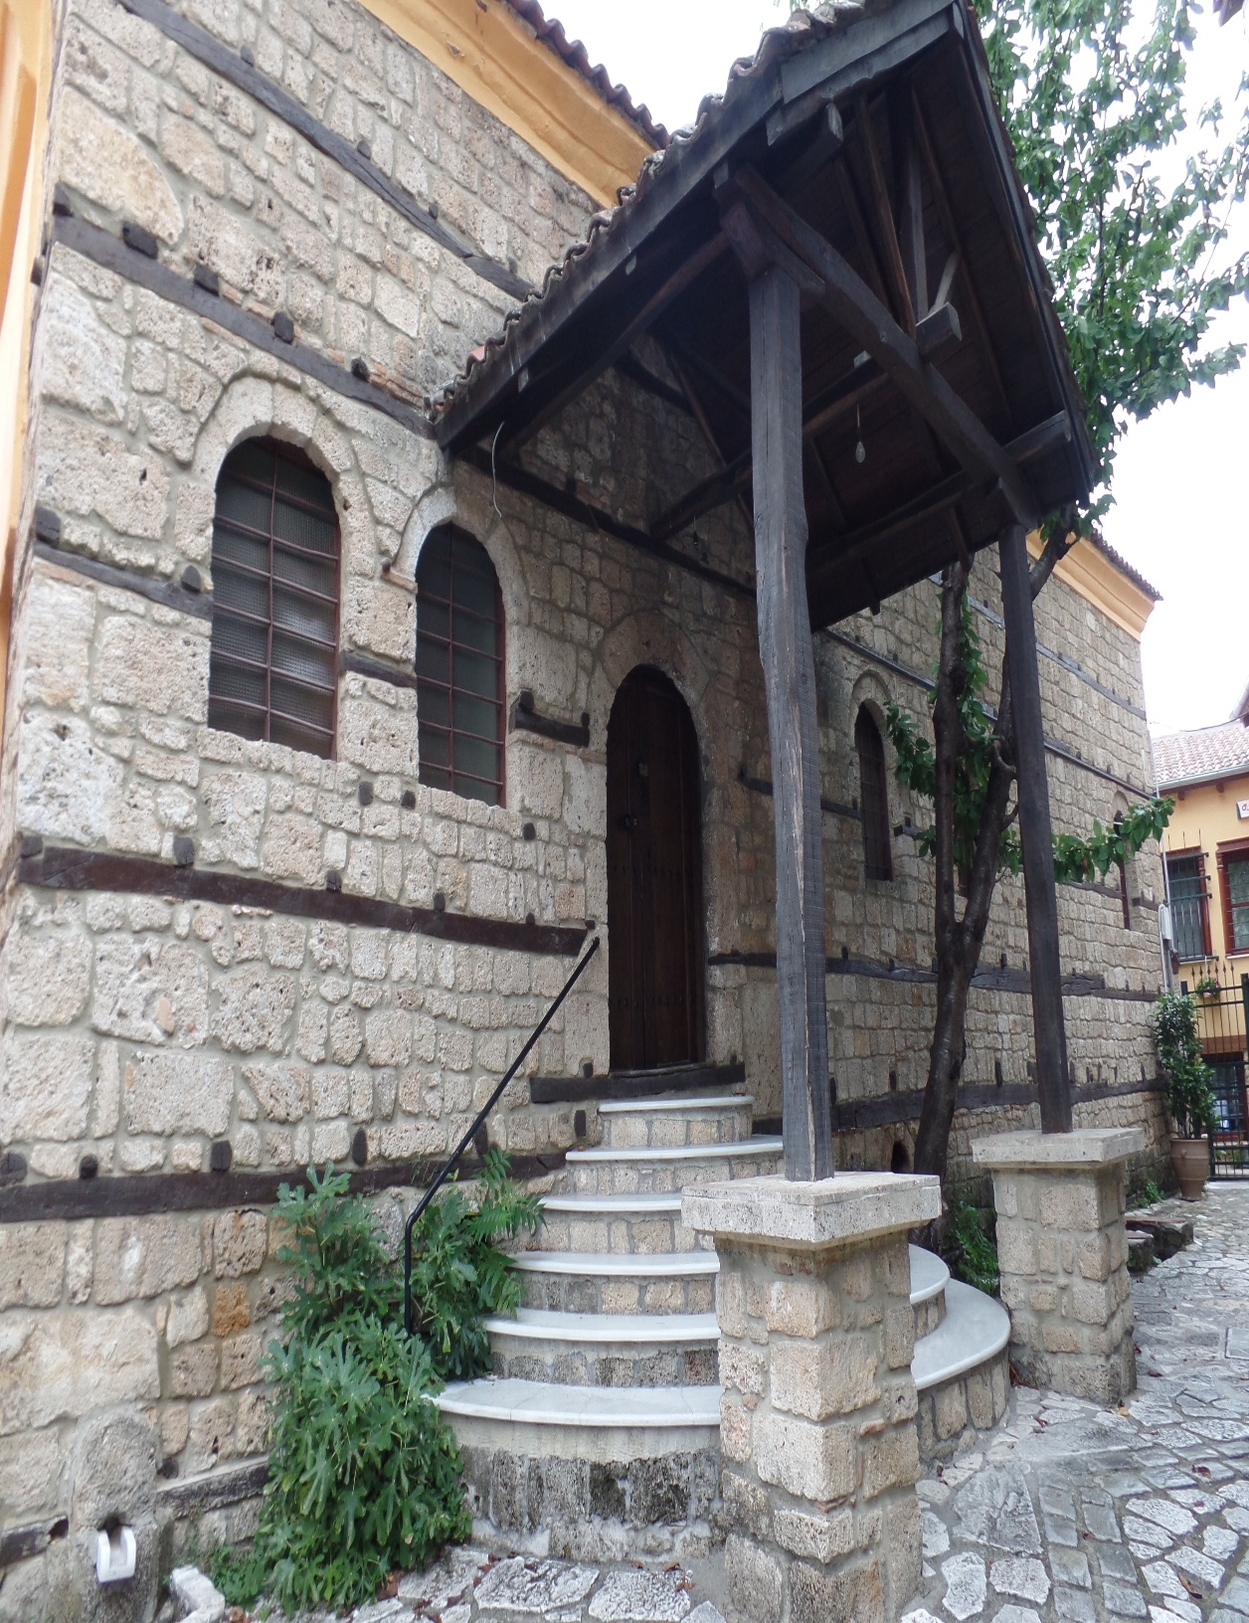
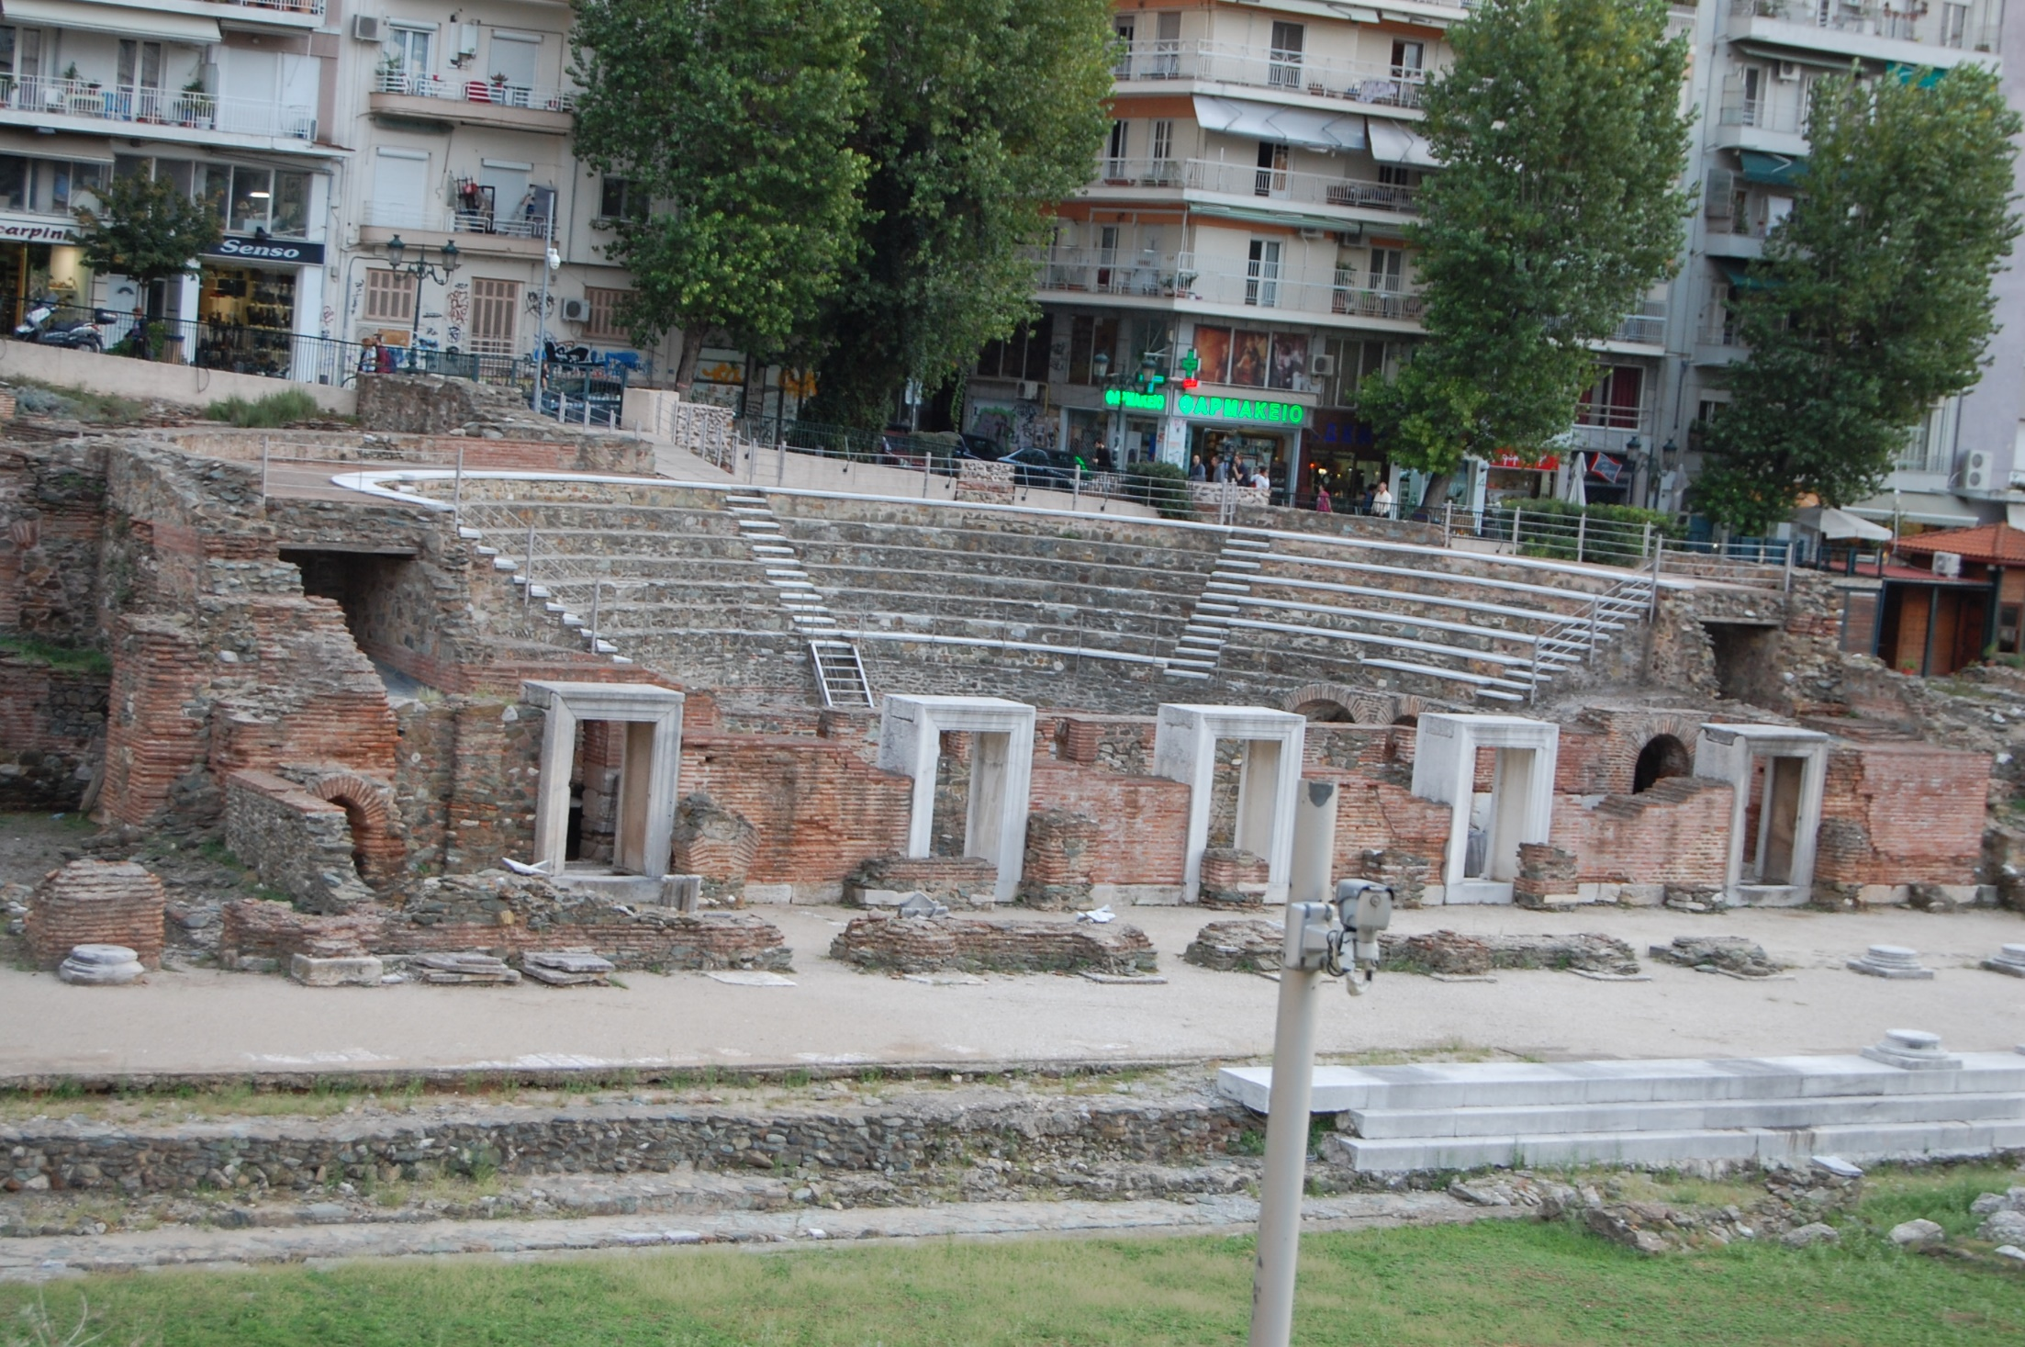
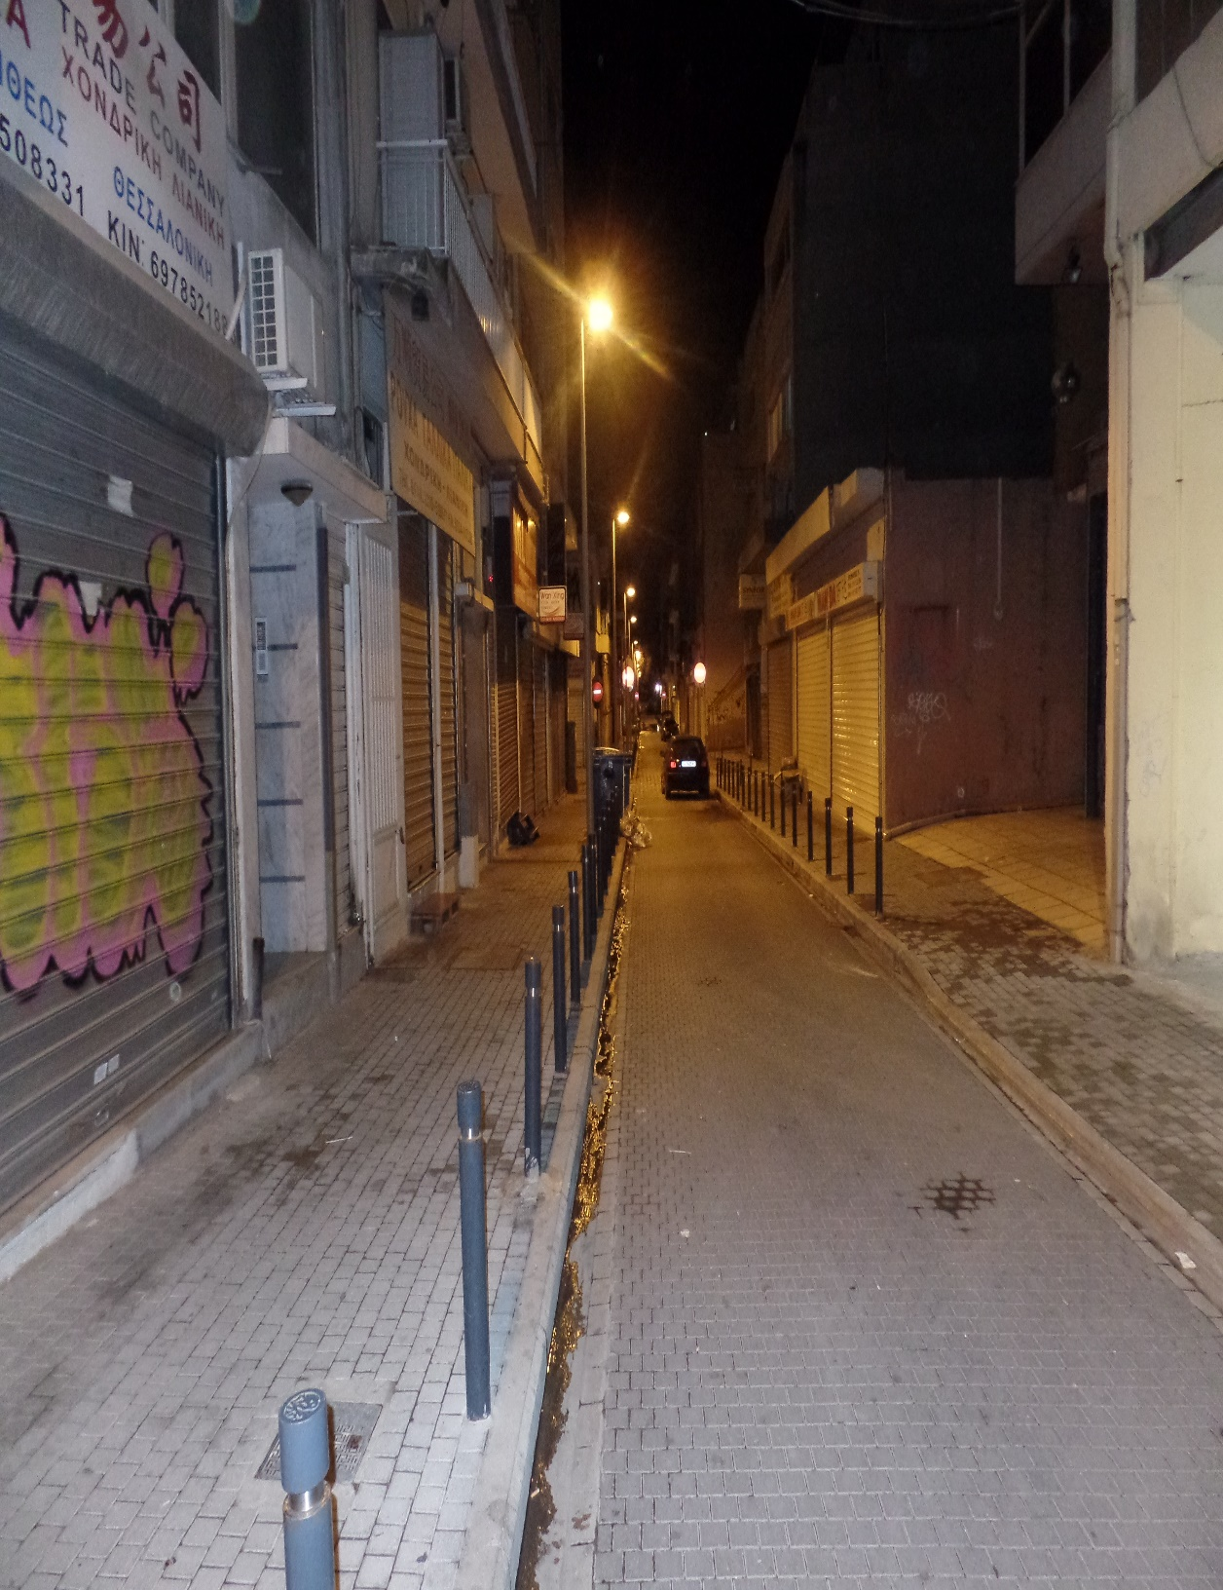
PAUL PERSECUTED
“But the Jews which believed not, moved with envy, took unto them certain lewd fellows of the baser sort, and gathered a company, and set all the city on an uproar… And the brethren immediately sent away Paul and Silas by night unto Berea: who coming thither went into the synagogue of the Jews” (17:5,10).
Paul established a model church in Thessalonica in just 3-weeks, but was forced to flee the city because of death threats, not before Luke wrote –
“These [Paul & company] that have turned the world upside down…” (17:6).
Next Paul arrived in Berea and said of these Bereans –
“These were more noble than those in Thessalonica, in that they received the word with all readiness of mind, and searched the scriptures daily, whether those things were so” (17:11).
Great advice then; even better today!

Slide 4
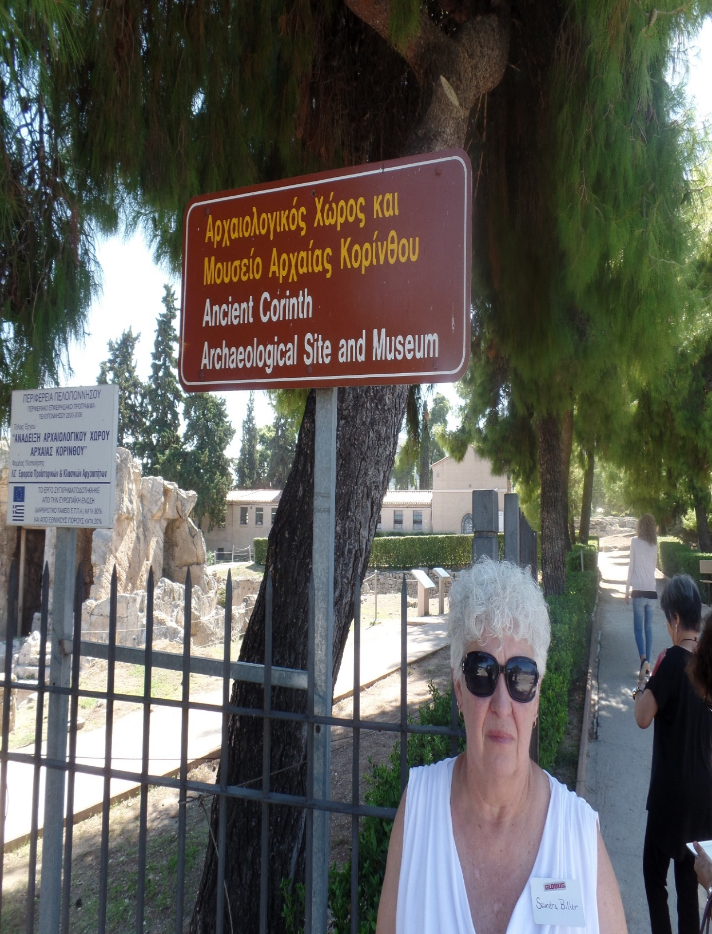
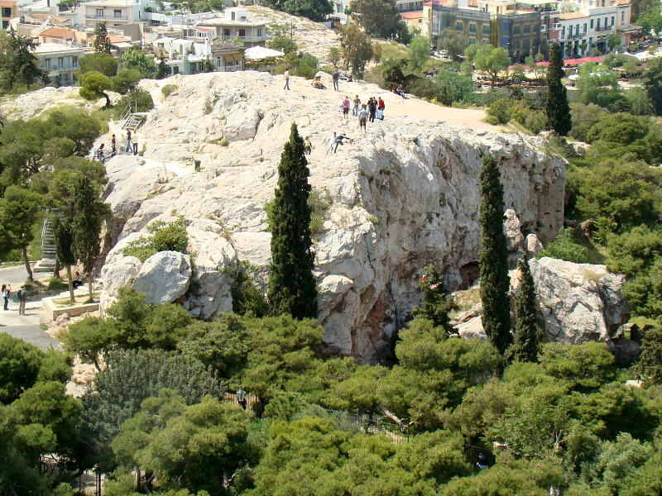
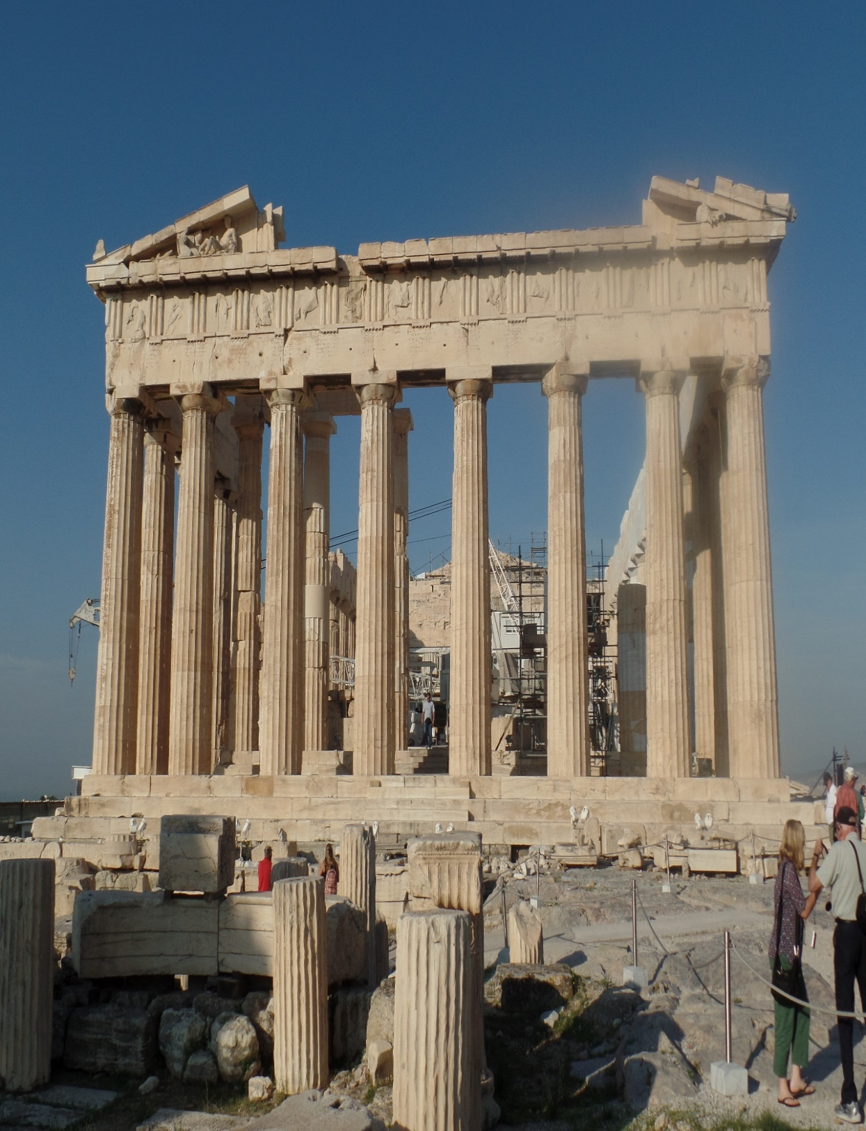
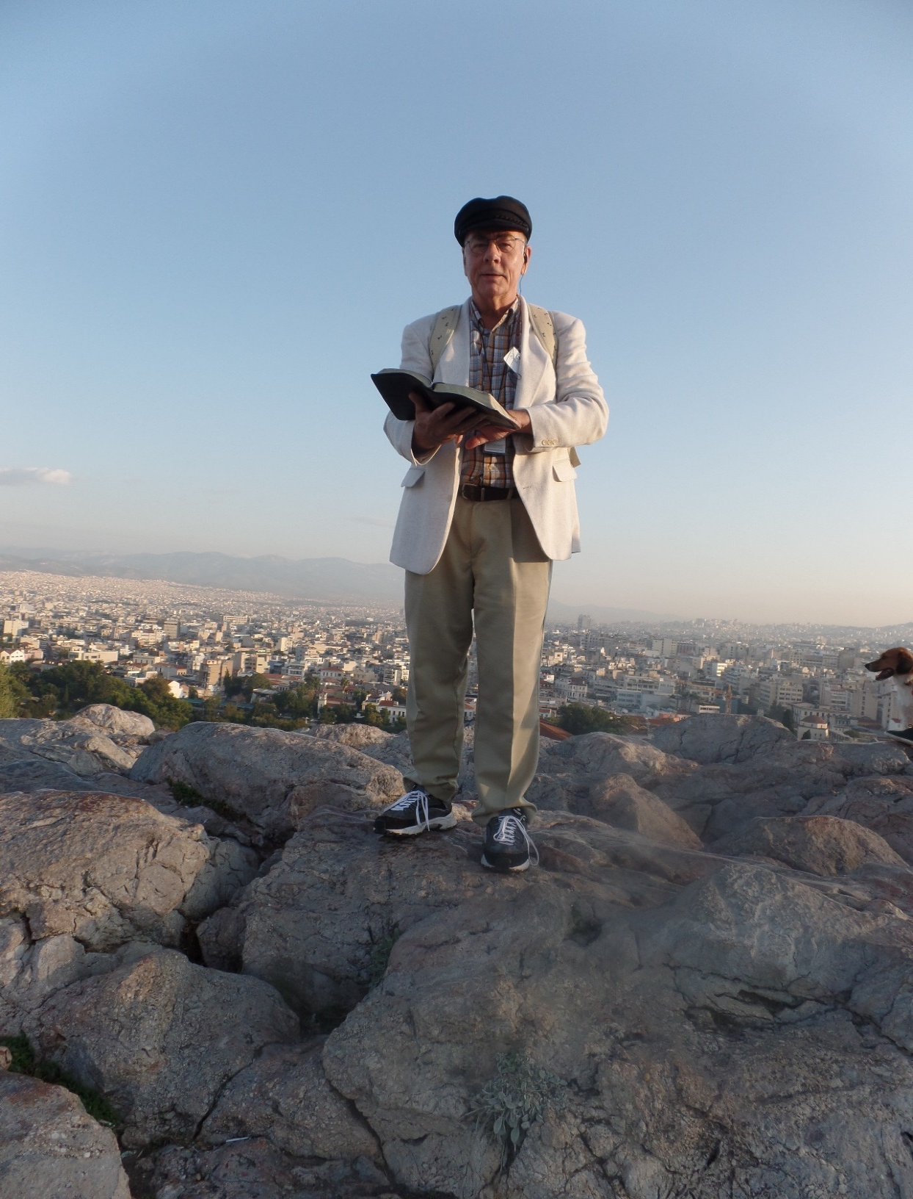
ATHENS
“Now while Paul waited for them [Silas, Timothy,
Luke] at Athens, his spirit was stirred in him when he saw the city wholly given to idolatry” (17:16).
Nowhere did Paul find worse idolatry than in Athens where, “… I found an altar… TO THE UNKNOWN GOD. Whom therefore ye ignorantly worship, him declare I unto you” (17:23).
On Mars Hill, Paul told the pagan worshipers about His God, “… seeing that he is Lord of heaven and earth, dwelleth not in temples made with hands; neither is worshipped with men’s hands, as though he needed
any thing, seeing he giveth to all life, and breath, and
all things” (17:24,25).
The intellectual Athenians called Paul a babbler (17:18), especially, “… when they heard of the resurrection of the dead… mocked” (17:32). Paul, down in the spirit, went on to Corinth, where he wrote his first two…
Mars Hill, Athens
(2015)

Slide 5
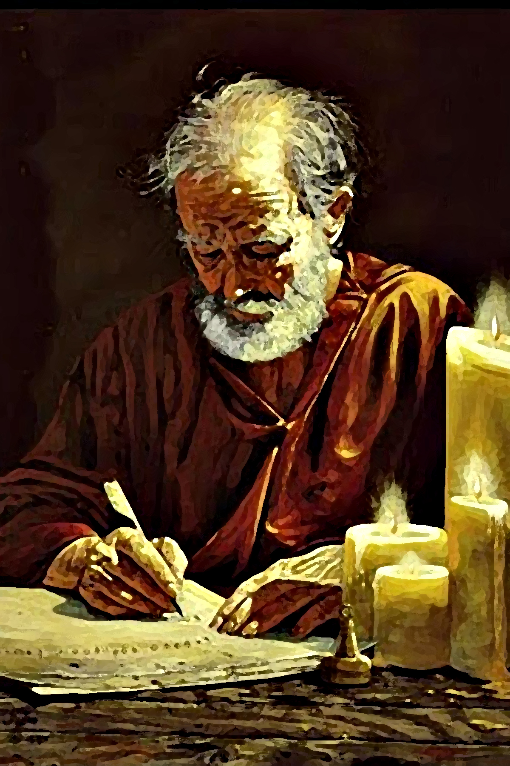
EPISTLES TO THE THESALONIANS (A.D. 51,52)
“Paul, and Silvanus, and Timothy, unto the church of the Thessalonians which is in God the Father and in the Lord Jesus: Grace be unto you, and peace, from God the Father, and the Lord Jesus Christ. We give thanks to God always for you all, making mention of you in our prayers, remember without ceasing your work of faith, and labour of love, and patience of hope… Knowing you, brethren, beloved, your election of God… ye became followers of us, and of the Lord… to wait for his Son from heaven, whom he raised from the dead… delivered us from the wrath to come” (1Thess. 1:1-10).
Believers today, whom we are to pray for, are in-Father God and in-Christ, because of which, we are to faithfully serve. Grace [undeserved favor] always precedes peace [with God]. Election = God called you; you didn’t call God; following Paul’s pattern brings you to Christ, who will save us from the tribulation to come.

Slide 6
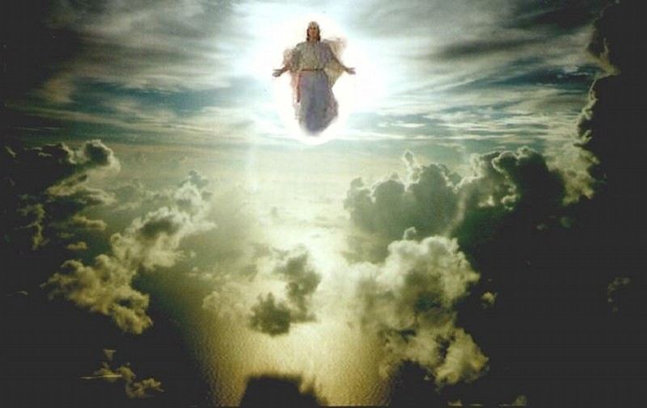
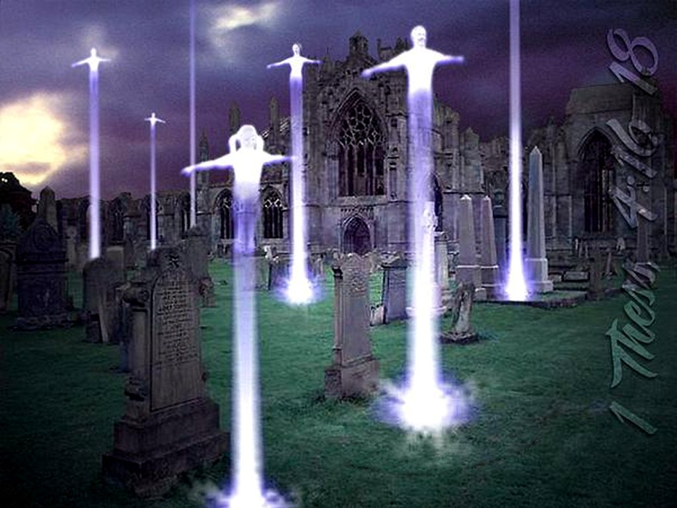
RAPTURE
“But I would not have you to be ignorant, brethren, concerning them which are asleep, that ye sorrow not, even as others which have no hope. For if we believe that Jesus died and rose again [gospel], even so them also which sleep [dead] in Jesus will God bring with him… For the Lord himself shall descend from heaven with a shout… voice of the archangel… trump of God: the dead in Christ shall rise first: Then we which are alive and remain shall be CAUGHT UP together with them in the clouds, to meet the Lord in the air: and so shall we ever be with the Lord. Wherefore comfort one another with these words” (4:13-18).
All believers during this Church age [dead or alive] will be taken to heaven. Unlike the 2nd coming of Christ, the rapture [Latin, rapturo] is without signs or warnings; occurring “in the twinkling of an eye” (1Cor. 15:52); a most comforting thought, indeed!

Slide 7
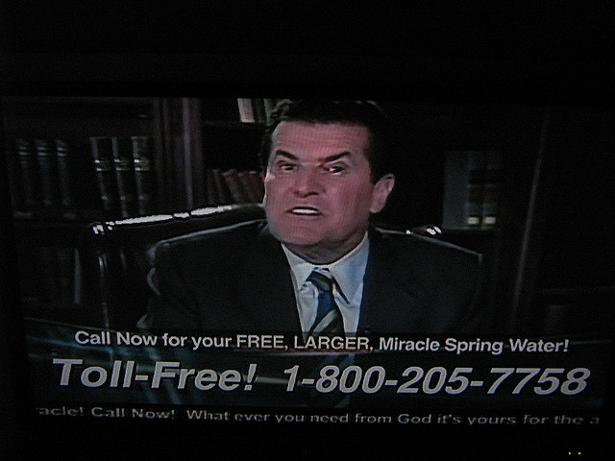
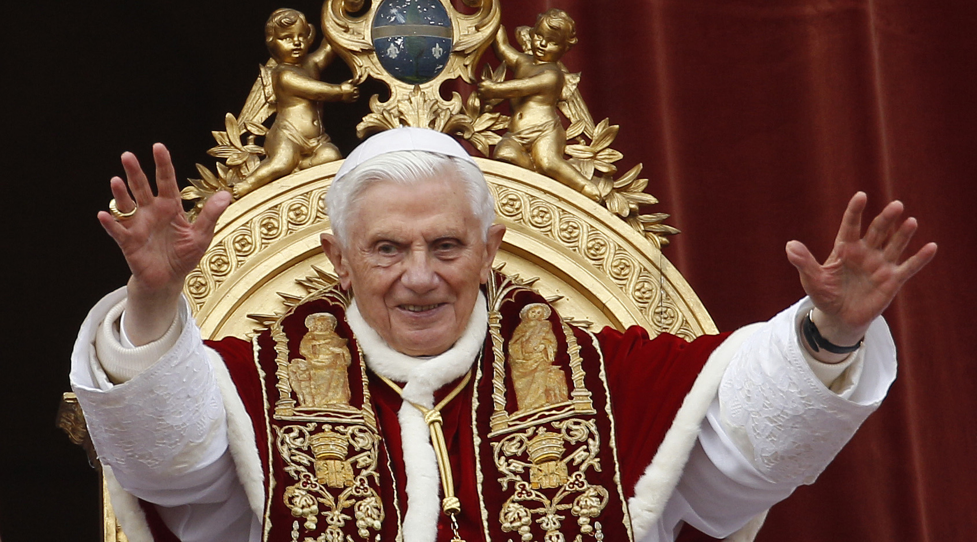
SATAN’S DECEITS
“Now we beseech you, brethren, by the coming of our Lord Jesus Christ, and by our gather together unto him. That ye be not soon shaken in mind, or be troubled, neither by spirit, nor by word, nor by letter as from us, as that the day of Christ [rapture] is at hand… for that day shall not come, except there come a falling away first, and that man of sin [antichrist] be revealed, the son of perdition… exalteth himself above all that is called God, or that is worshipped: so that he as God sitteth in the temple of God, shewing himself that he is God. Remember ye not, that, when I was yet with you, I told you these things” (2Thess. 2:1-5).
Paul re-affirmed to believers they had NOT missed the rapture as some were reporting, because 1st there had to be: 1). departing, i.e. rapture; 2). apostasy, i.e. turn from the truth of God. Paul had previously taught them, but Satan had caused them to NOT believe it.

Slide 8
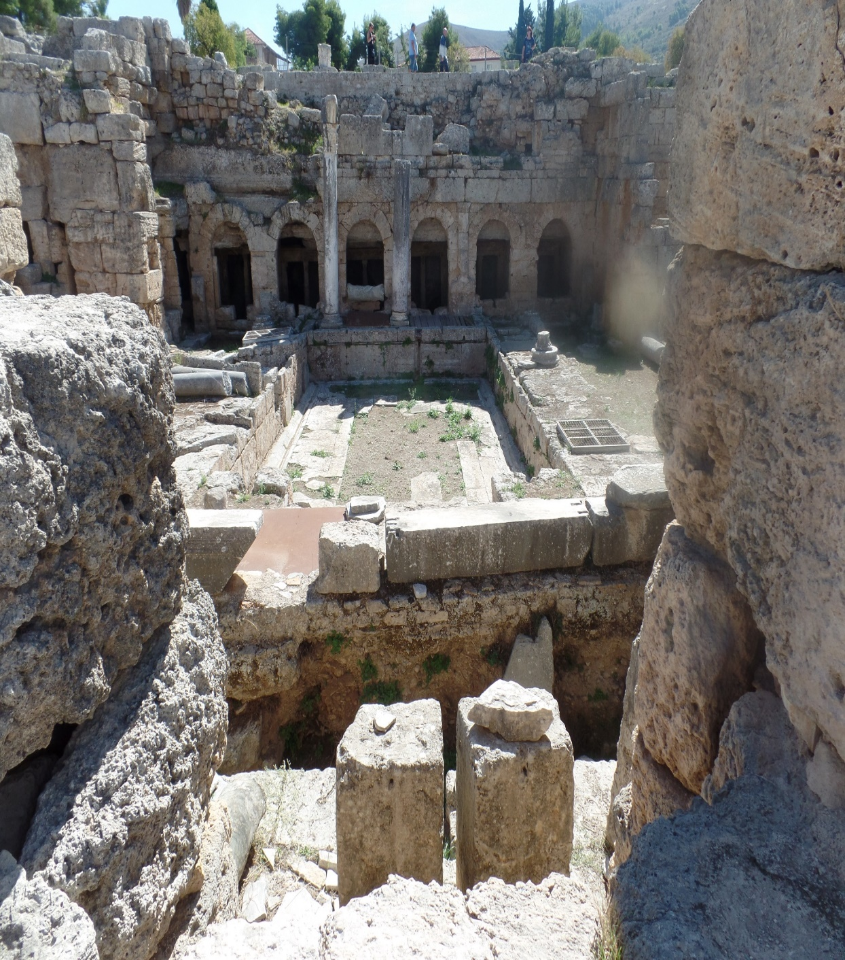
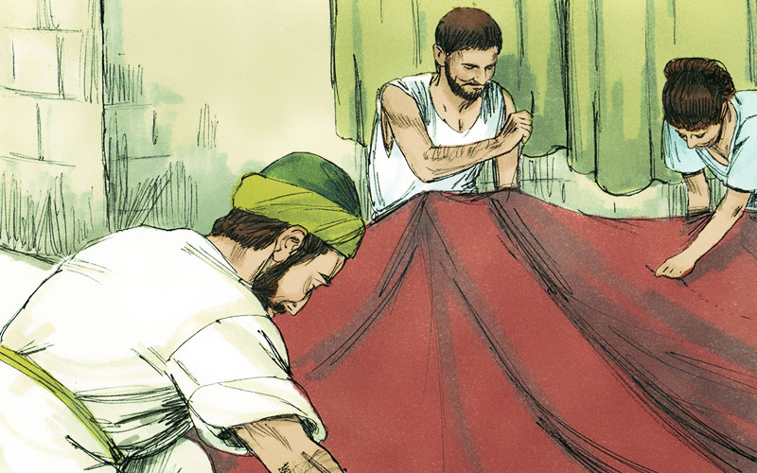
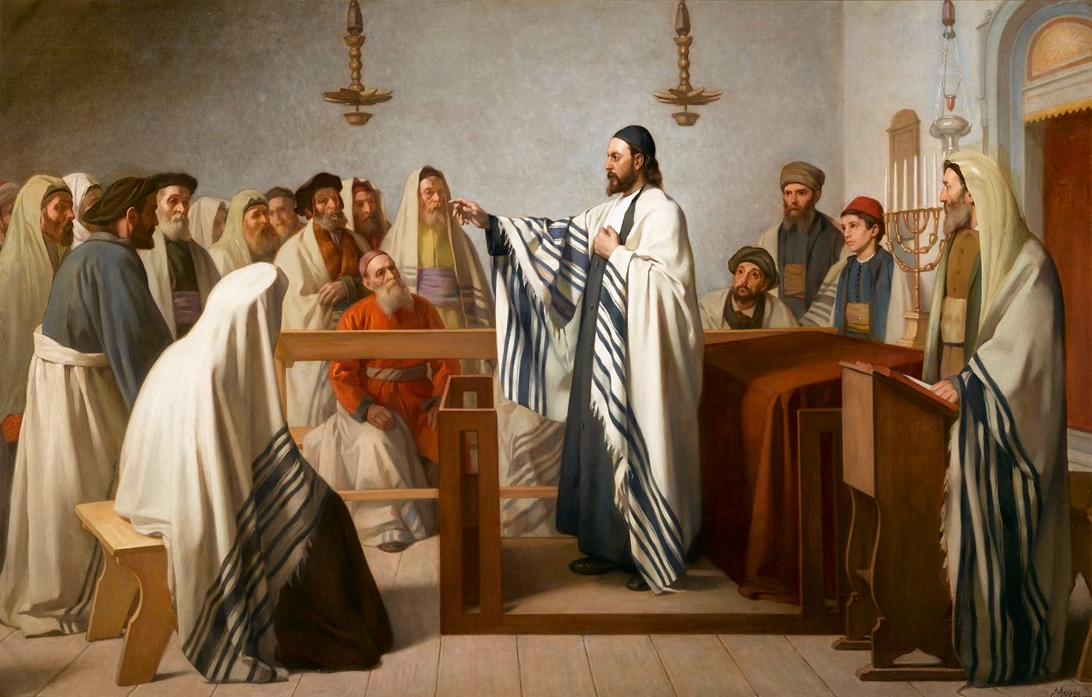
CORINTH
“After these things Paul departed from Athens, and
came to Corinth; And found a certain Jew named Aquila,
born in Pontus, lately come from Italy, with his wife
Priscilla. And because he was of the same craft, he
abode with them… they were tentmakers” (Acts 18:1-3).
Discouraged because of little results in Athens, this
couple helped pick up Paul’s spirits since they had much
in common.
“And he reasoned in the synagogue every Sabbath, and
persuaded the Jews and Greeks [Gentiles]… that Jesus
was the Christ. And when they opposed… and
blasphemed… said unto them, Your blood be upon your
own heads; I am clean: from henceforth I will go unto
the Gentiles” (18:4).
As usual, Paul’s custom was to go to the Jews 1st, but
when they rejected His message of Christ, he started a church next door, “… Justus, whose house joined hard to the synagogue” (18:7).

Slide 9
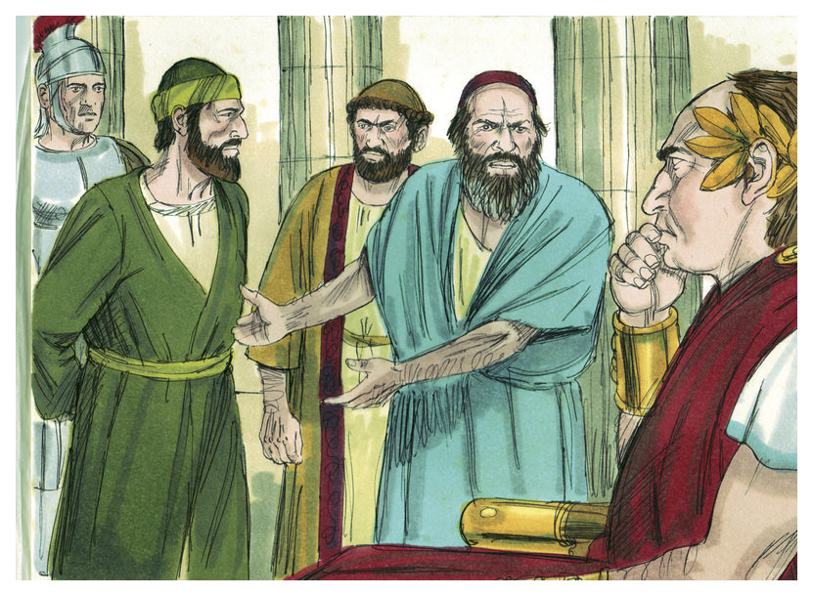
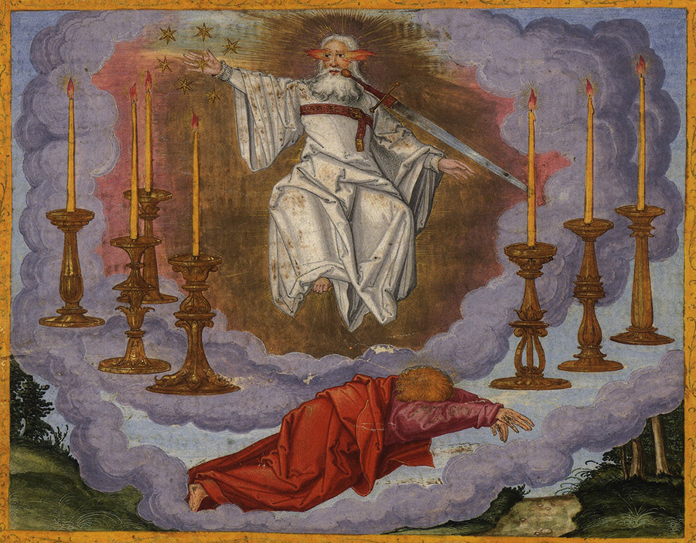
CORINTH (cont’d)
“Then spake the Lord to Paul in the night by a vision, Be not afraid, but speak, and hold not thy peace: For I am with thee, and no man shall set on thee to hurt thee: for I have much people in this city. And he continued there 1-year and 6-months, teaching the word of God among them” (18:9,10).
Christ spoke to Paul telling him the many death threats he received would not come to fruition, because Corinth was a large city and he would have a fruitful ministry there for 18 months. But, it would not be without challenges –
“And when Gallio was the deputy of Achaia, the Jews made insurrection with one accord against Paul, and brought him to the judgment seat, Saying, This fellow [Paul] persuaded men to worship God contrary to law” (18:12,13).
Then Paul was arrested and brought before the…

Slide 10
… Roman procounsel Achaia [southern Greece], Gallio, on breaking Roman law which forbid a new up-start religion called ‘Christianity,’ why Aquila & Priscilla had been deported from Rome (18:3). Rome permitted other religions if they were non-controversial, as this one surely wasn’t! The Roman governor determined it was a religious squabble, and dismissed the parties –
“… if it be a question of words and names, and of your law, looked ye to it; for I will be no judge of such matters. And he drave them from the judgment seat” (18:15,16).
Paul had stood before this judgment seat and had his case heard, and a decision rendered. Soon Paul would write of a spiritual judgment seat, “For we must all appear before the judgment seat of Christ; everyone may receive the things done in his body… he hath done, whether it be good or bad” (2Cor. 5:10).
Each believer will give an account before Christ.

Slide 11
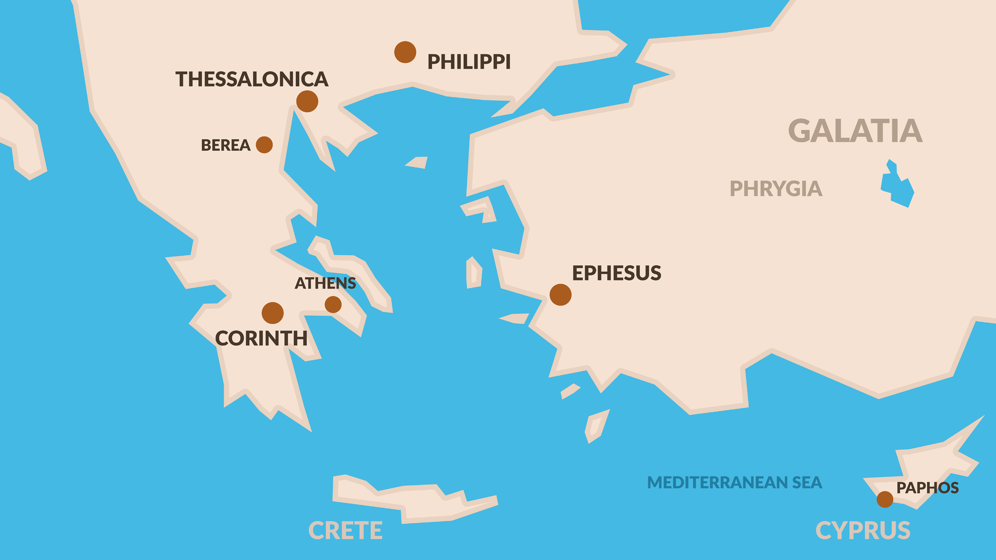
APOLLOS
“And it came to pass, that, while Apollos was at Corinth…” (18:24-26).
Apollos, a Jew from Alexandria, Egypt, an eloquent and learned man in the Scriptures, came to Corinth –
“And he began to speak bodly in the synagogue: who when Acquila & Priscilla had heard, took him unto them, and expounded unto him the way of God more perfectly” (18:24-26).
Guess what this young dynamic couple did? They gave Apollos THE GRACE MESSAGE! Just because someone appears to be smarter than you doesn’t mean they know more than you know. Don’t be afraid, like this young couple, to tell them of the latest update from God—the message of God’s grace and dispensation to the Gentiles, which Christ gave to Paul, which Paul gave to the Body of Christ.
From Corinth, Paul sailed to Ephesus.

Slide 12
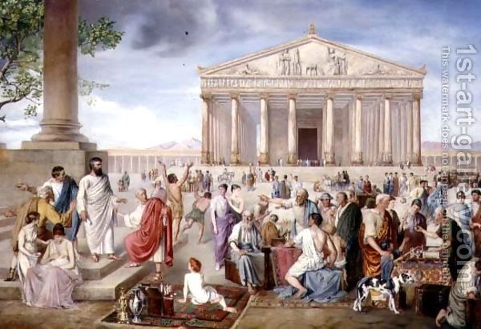
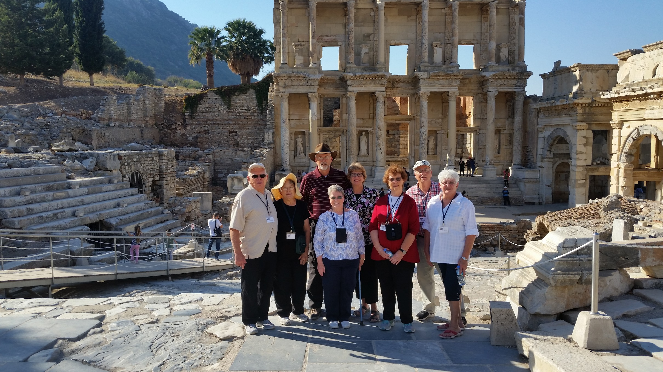
EPHESUS (A.D. 53-56)
“… Paul having passed through the upper coasts came to Ephesus… And he went into the synagogue, and spake boldly for the space of 3-months… disputing daily in the school of Tyrannus. And this continued by the space of 2-years; so that all they which dwelt in Asia heard the word of the Lord Jesus, both Jews and Gentiles”
(19:1,8-10).
Paul spent his longest time in Ephesus, 3 years, and established a school, which sat next to the large library, where he got the word out to all of Asia, “… the name
of the Lord Jesus was magnified… and many that believed came… So mightily grew the word of God and prevailed…” (19:18-20).
Later, Paul recalled that time – “Ye know, from the 1st
day I came into Asia… I have been with you all seasons… serving the Lord with all humility… tears and temptations … I kept back nothing…” (20:18-20).
School of
Tyrannus
(2015)

Slide 13
1CORINTHIANS (A.D. 53)
“Paul, called to be an apostle of Jesus Christ through the will of God… Unto the church of God which is at Corinth, to them that are sanctified in Christ Jesus, called to be saints, with all that in every place call upon the name of Jesus Chris our Lord…” (1Cor. 1:1-3).
During that 3-year stay in Ephesus, Paul wrote 2-letters to the Corinthian church where he had just come from. They are long letters because they had many problems. Following his cursory opening, Paul got to the point –
“And I, brethren, could not speak unto you as unto spiritual, but as unto carnal, even as unto babes in Christ. I have fed you with milk, and not with meat… ye were not able to bear it, neither yet now are ye able” (3:1,2).
Though saved, the Corinthian believers were immature, always wanting something despite all they had been given (1:7). They were divided (1:10), fleshly (1:26)…

Slide 14
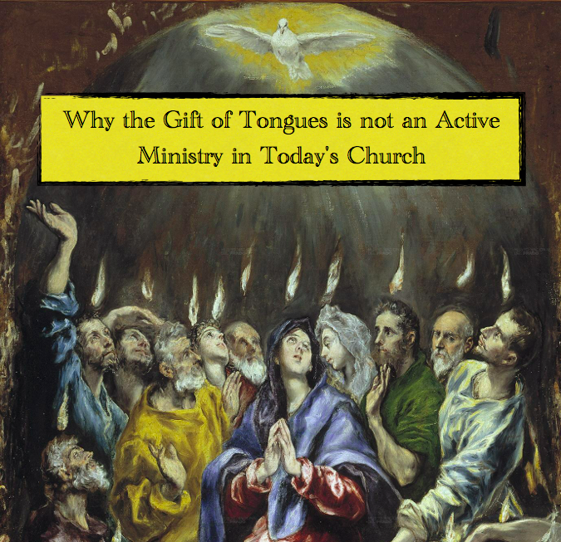
… seeking only the gifts of the Spirit that were the most flashy like tongues, “Wherefore tongues are for a sign, not to them that believe, but to them that believe not…” (14:22).
The gift of tongues, still present but soon to pass away in the early church, was being abused by fleshly believers.
Paul corrected them and pointed out are for a sign.
Are we Gentiles to seek after signs? No.
“For the Jews require a sign… But we preach Christ crucified, unto the Jews a stumblingblock, and unto the Greeks foolishness” (1:22,23).
Tongues had first been given to Israel as a ‘sign’ of God’s judgment on them, “In the law it is written, With men of other tongues and other lips will I speak unto this people; and yet for all that will they not hear me, saith the Lord” (14:21). Tongues continued to be a sign to unbelieving Jews of God’s impending judgment on them.

Slide 15
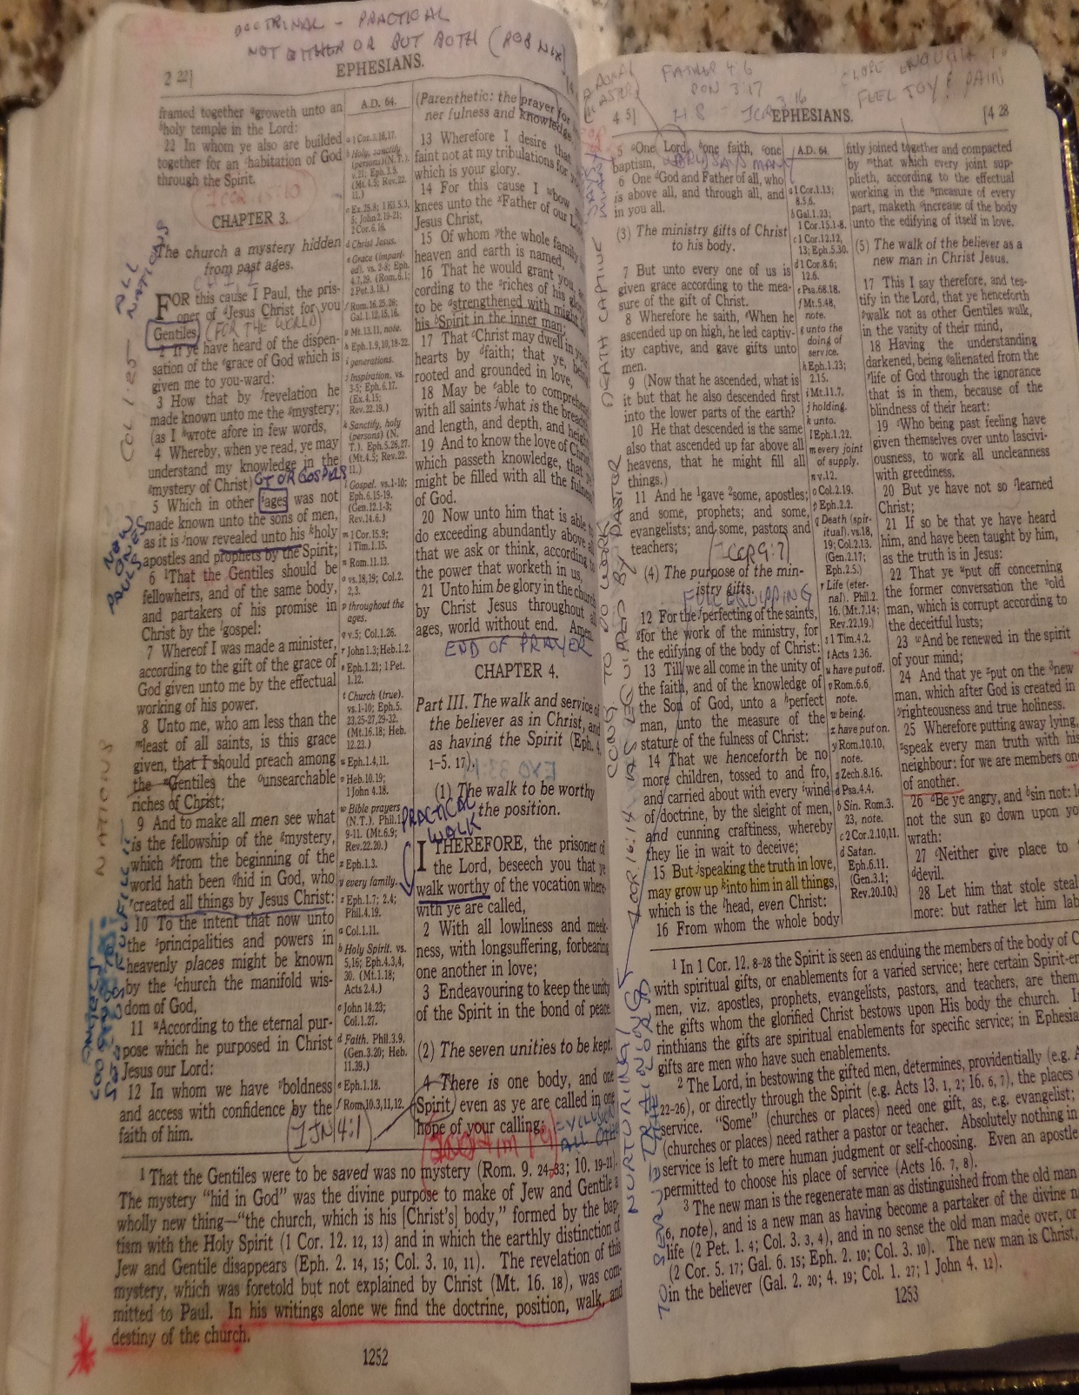
SIGN GIFTS PASSING AWAY
God’s program with Israel included SIGNS, which were supernatural acts needed for the Jews to believe, but now with Israel was being set aside in unbelief, many
of these SIGN gifts were being rescinded –
“Charity [love] never faileth: but whether there be prophecies, they shall fail; whether there be tongues, they shall cease; whether there be [supernatural] knowledge, it shall vanish away” (1Cor. 13:8).
Why? Because they were being replaced with something each believer could possess without any supernatural ability, THE WORD OF GOD –
“For we know in part, and we prophesy in part. But when that which is perfect is come [Bible], then that which is in part [gifts] shall be done away” (14:9,10).
The age of grace brought with it the finished Bible
(Col. 1:25). Now we have God’s last Word on all truth.

Slide 16
CIRCUMCISION PASSING AWAY
The SIGN gifts were not the only things passing away with the change of dispensations [Law to Grace], but also were the rituals steeped in the Jews religion –
“Circumcision is nothing, and uncircumcision is nothing, but the keeping of the commandments of God [Law of Moses] (7:19)… For in Jesus Christ neither circumcision availeth any thing, nor uncircumcision (Gal. 5:6)… In whom also ye are circumcised with the circumcision made without hands, in putting off the body of the sins of the flesh by the circumcision of Christ” (Col. 2:11).
Circumcision was a physical rite required of Jews in their covenant relationship with God (Gen. 17:7), but that had now passed. In his early ministry, Paul circumcised Jews, e.g. Timothy (Acts 16:3), until revealed new Body truth. Then he STOPPED as it had been replaced by a spiritual circumcision without hands, that is, by Christ who cuts away the sins of each believer.

Slide 17
WATER WASHING PASSING AWAY
“I thank God that I baptized none of you, but Crispus and Gaus… And I baptized also the household of Stephanas: besides, I know not whether I baptized any other. For Christ sent me NOT TO BAPTIZE, but to preach the gospel… For the preaching of the cross is to them that perish foolishness; but unto which are saved it is the power of God” (1Cor. 1:14-18).
Water washing, “divers washings” (Heb. 9:10) was an integral part of the Law and required for Jews to be saved during Christ’s earthly ministry (Mk. 16:16). But, under Grace replaced by a more powerful washing…
THE BLOOD OF CHRIST! Like circumcision, Paul baptized a few early in his ministry, but when revealed greater Body truths, HE STOPPED; the physical replaced by the spiritual – “For by one Spirit are we all baptized into one body, whether we be Jews or Gentile… Now ye are the body of Christ…” (1Cor. 12:13,27).

Slide 18
A NEW GOSPEL
Not only did the SIGN gifts, circumcision, and the water rite pass away, so did their gospel, “Jesus went about all Galilee, teaching in their synagogues, and preaching the gospel of the kingdom” (Mt. 4:23), which was to the Jews only, “I am not sent but unto the lost sheep of the house of Israel” (15:24). That was and will be in the tribulation (Mt. 24:14), Israel’s good-news, but that was replaced by a new gospel given to Paul –
“Moreover, brethren, I declare unto you the gospel which I preached unto you, which also ye have received, and wherein you stand. By which ye are saved… For I delivered unto you first of all that which I received, how that Christ died for our sins according to the scriptures… he was buried… he rose again the 3rd day” (1Cor. 15:1-4).
Israel’s gospel was believing in the Messiah—ours extended to include HIS FINISHED WORK.

Slide 19
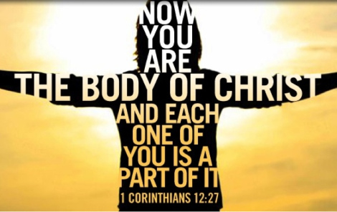
THE BEMA SEAT
“According to the grace of God which is given unto me, as a wise masterbuilder, I have laid the foundation, and another [members of His Body] buildeth there-on… Now if any man build upon this foundation gold, silver, precious stones… he shall receive a reward... hay, wood, stubble… shall be burned, he shall suffer loss: but he himself shall be saved; yet so as by fire. Don’t you know that ye are the temple of God, and that the Spirit of God dwelleth in you?” (1Cor. 3:10-16).
We, members of the Body, are NOT to build upon Peter’s foundation, i.e. the kingdom church, but Paul’s which is the church destined for the heavenlies. There is a big difference—if you ignore it, or make it the same, then will suffer the loss of reward at the Judgment seat of Christ in heaven. Though there will be a future Millennial temple in Jerusalem, we the Body of Christ are to concentrate on the temple of our own body.

Slide 20
FOLLOW ME
“Be ye followers of me [Paul], even as I also am of Christ” (11:1).
What’s that mean? Aren’t we to follow Christ?
Absolutely! During this age of grace, the only way we can follow the resurrected, ascended, and seated Christ in heaven, is to follow the instructions He gave to Paul to give to us, the Body of Christ –
“For though ye have 10,000 instructors in Christ, yet have ye not many fathers: for in Christ Jesus I [Paul] have begotten you through the gospel. Wherefore I [Paul] beseech you, be ye followers of me” (4:17).
Want more?
“If any man think himself to be a prophet, or spiritual, let him acknowledge that the things that I write unto you are the [grace] commandments of the Lord” (14:37).
Could it be any clearer?

Slide 21
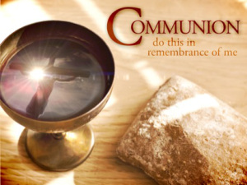
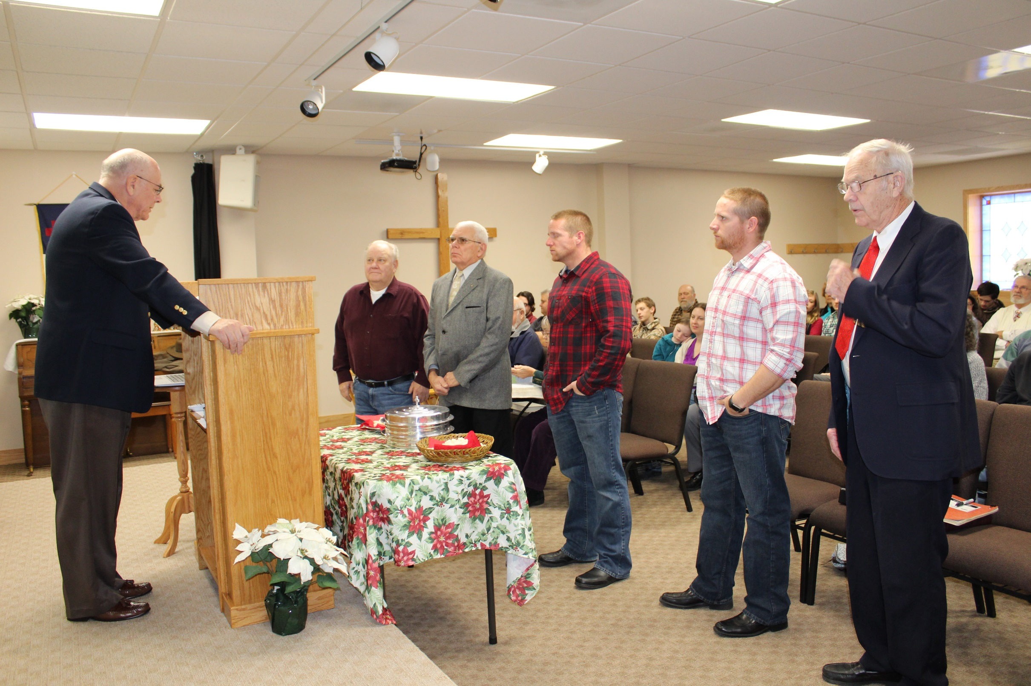
THE LORD’S TABLE
“For I have received of the Lord that which also I delivered unto you… when he had given thanks, he brake it, and said, Take, eat: this is my body, which is broken for you: this do in remembrance of me… he took the cup… saying, This cup is the new testament in my blood: this do ye, as oft as ye drink it, in remembrance of me. For as often as ye eat this bread, and drink this cup, ye do shew the Lord’s death till he come”
(11:23-26).
Paul received a direct revelation from Christ to invite believers to participate in the Lord’s Supper. Many in
Christendom see it as the means of salvation—it is not.
It is one option to remind believers of Christ’s sacrifice for sin. Remember, in 53 A.D. when this was written, the Bible was yet incomplete—they had only circulating
letters to read [not the whole Bible], so Communion was an easy way of remembering what Christ did for us.

Slide 22
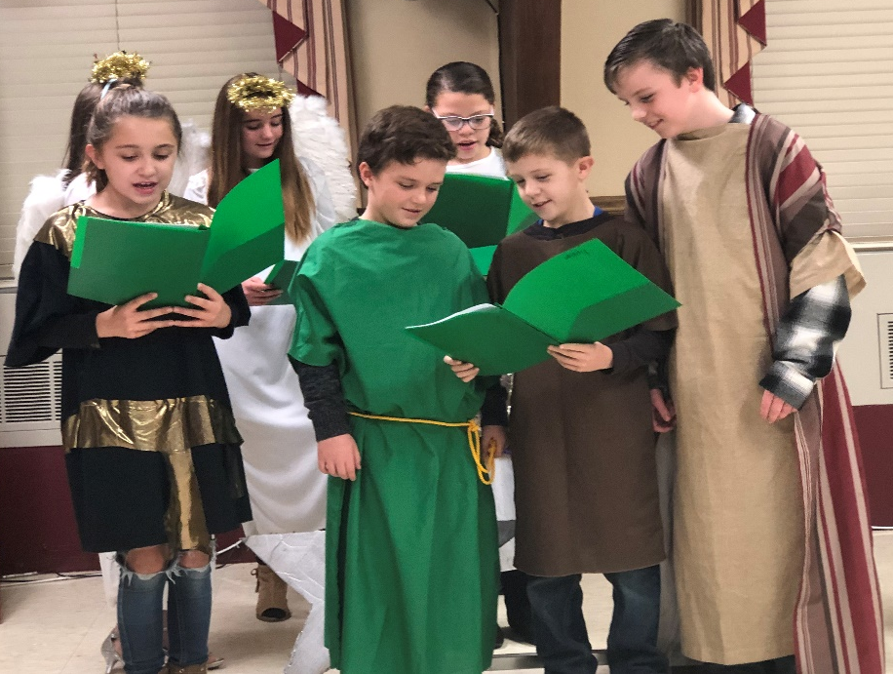
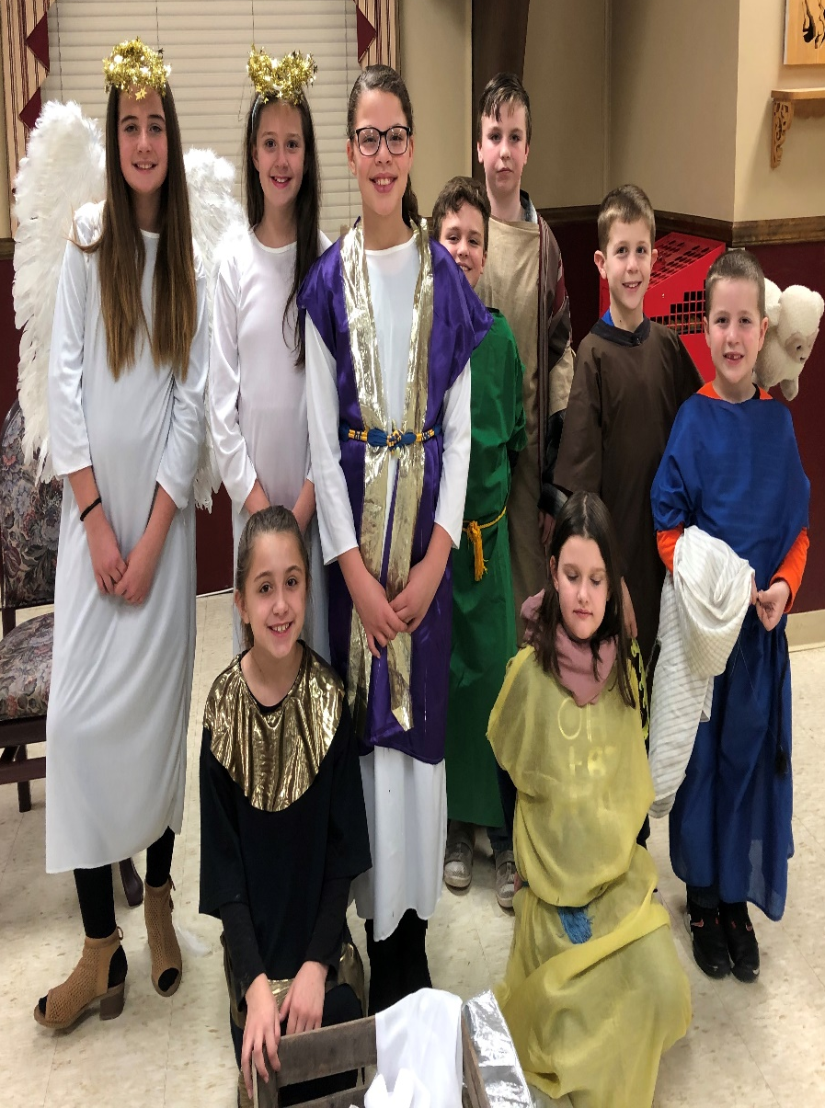
Next time – continuing the teachings and walk of the believer during this present dispensation of grace.

