Slide 1
THROUGH THE BIBLE IN 2018
LESSON 36
WEEK 36 OF 52
(Ezek. 23-42)
Last time we saw the calling of the prophet Ezekiel; this time his judgment on Israel and the nations.
THE BOILING POT
“Again in the 9th year, in the 10th month, in the 10th day of the month, the word of the LORD came unto me saying… write thee the name of the day, even of this same day: the king of Babylon set himself against Jerusalem this same day” (24:1,2).
In the 9th year of Jehoikin’s [and Ezekiel’s] exile the king of Babylon laid siege to Jerusalem [January 588 B.C.].
“… Set a pot… and pour water into it… every good piece, the thigh and the shoulder; fill it with the choice bones… make it boil well… Woe to the bloody city, to the pot whose scum is therein…” (24:1-6).
The boiling pot of stew turned to scum. It represented unrepentant Judah.

Slide 2
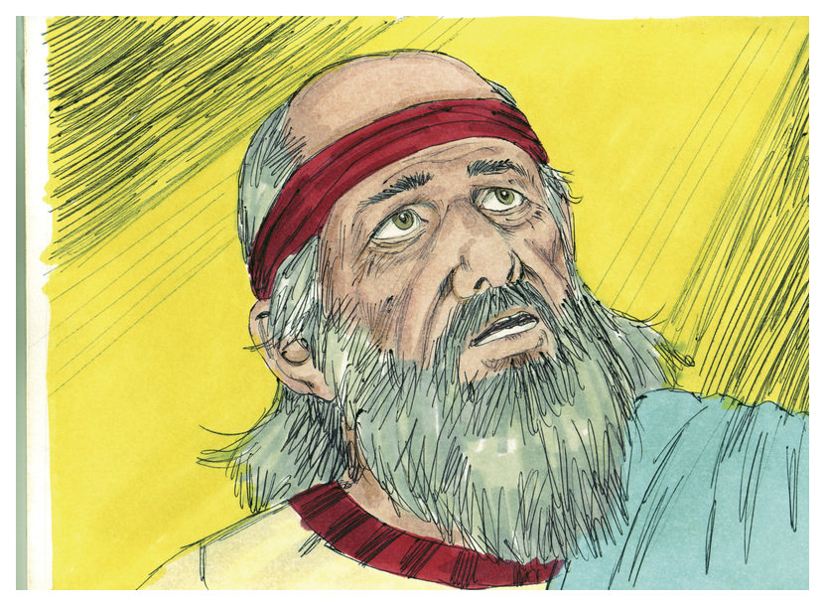
NO MOURNING FOR THE DEAD
“… Son of man, I take away from thee the desire of
thine eyes… yet neither shall thou mourn nor weep,
neither shall thy tears run down. Forbear to cry, make
no mourning for the dead… at evening my wife died;
and I did in mourning as I was commanded” (24:15-18).
God commanded Ezekiel NOT to mourn for the dead
who had been killed in the assault on Jerusalem,
because their deaths were the result of God’s judgment
on their sin. To make it personal for Ezekiel and those
gathered for his wife’s funeral, they were told NOT to do
the traditional public mourning normally afforded the
death of a family member, but rather –
“And ye shall do as I [God] have done… ye [Ezekiel] shall
not mourn nor weep [outwardly]; but ye shall pine away for your iniquities [sin], and mourn [inwardly] one toward another” (24:22,23).
In both cases, they were to suppress their natural urge to mourn, but instead to think on their sin.

Slide 3
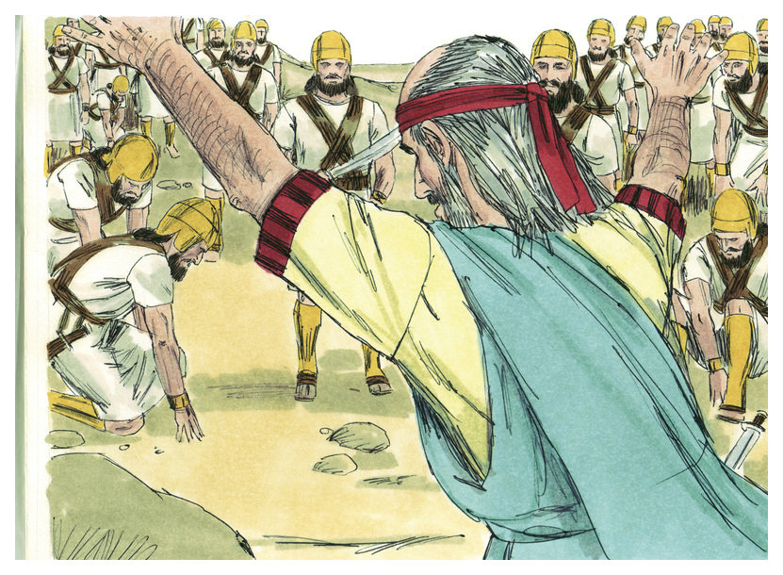
JUDGMENT ON THE NATIONS
After being called as a prophet of God, Ezekiel spent the first 4-5 years [up to chapter 24] prophesying about the destruction of Jerusalem. Now that it had happened, God turned Ezekiel’s attention to the evil nations that surrounded Israel [chapter 25-32].
“Son of man, set thy face against the Ammonites, and prophesy against them; and say… Behold therefore I will deliver thee to the men of the east for a possession… Because thou hast clapped thine hands, and stamped thy feet, and rejoiced in heart with all thy despite against the land of Israel… I will stretch out mine hand upon thee, and will deliver thee for a spoil to the heathen… I will destroy thee” (25:1-7).
God then pronounced judgment on Ammon because of their joy at Israel’s defeat by Nebuchadnezzar.

Slide 4
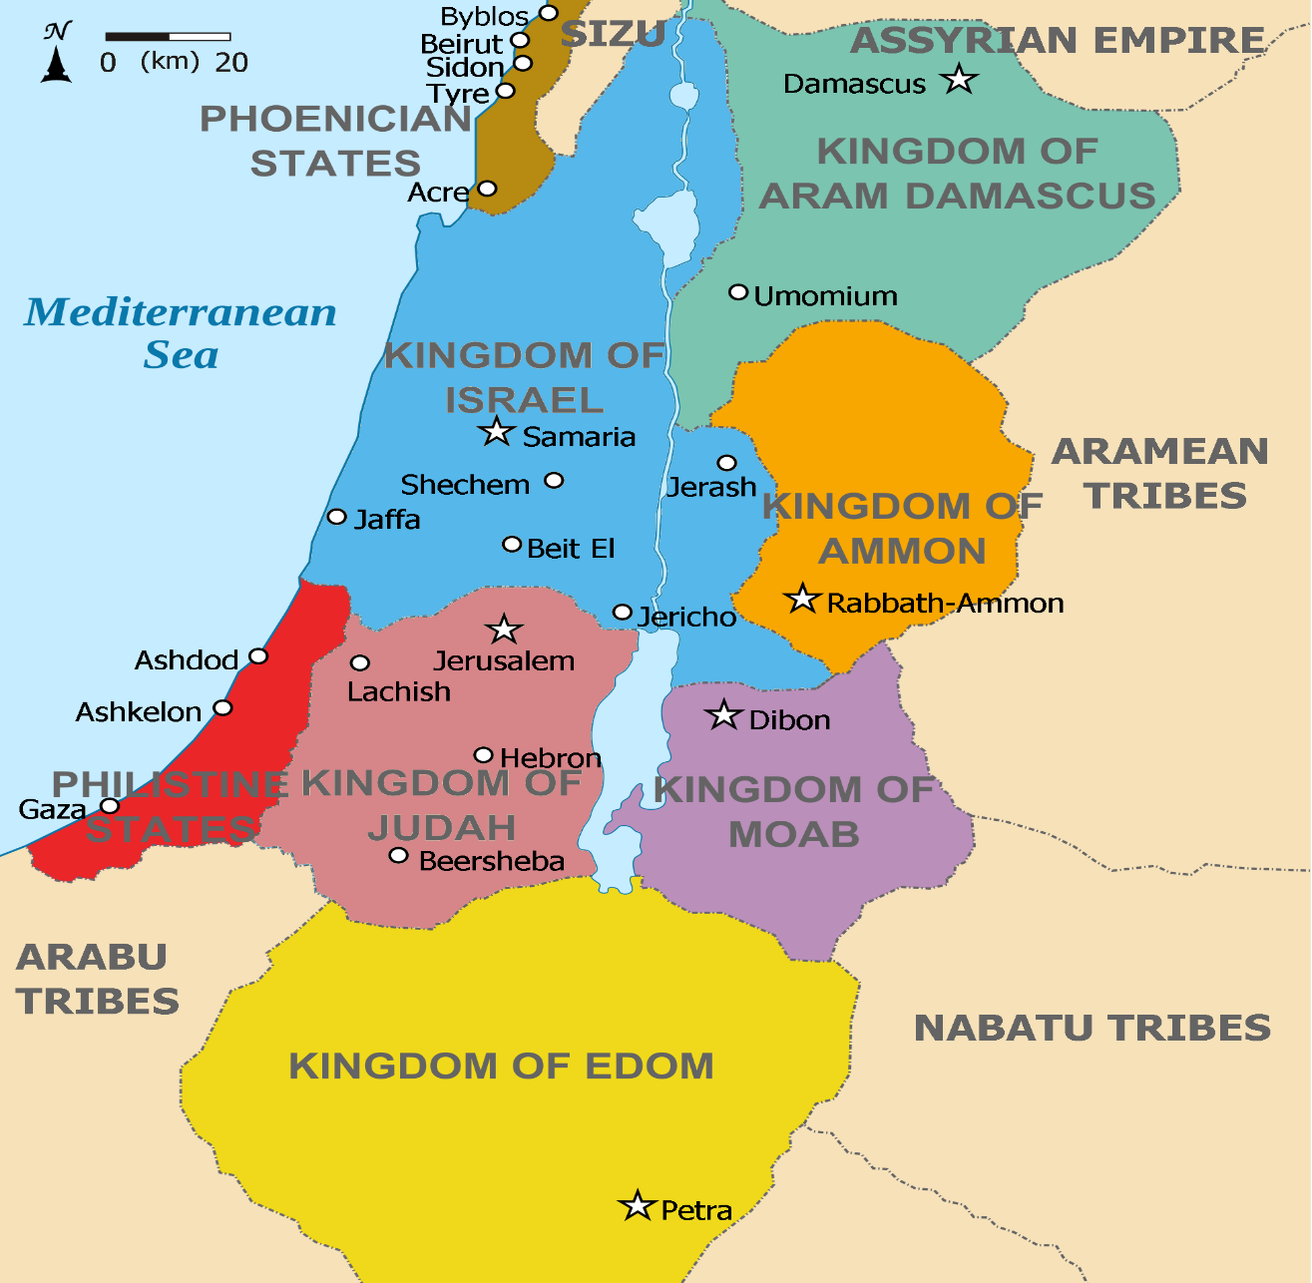
Next Ezekiel pronounced God’s judgment on Moab
(25:8,9); Edom (25:12-14); Philistia (25:15-17). The
justice of God would not permit Him to withhold
judgment for the flagrant sins of His people [Jews],
then how could He not hold the Gentile nations
accountable as well? He did –
“I will destroy thee [Ammon]; and thou shalt know
that I am the LORD” (25:7); I will execute judgments
upon Moab; and they shall know that I am the LORD
(25:11); I will lay my vengeance upon Edom (25:14);
I will execute great vengeance upon them [Philistines]
with furious rebukes; and they shall know that I am
the LORD” (25:17). God was also keeping another
promise –
“And I will make of thee [Abraham] a great nation [Israel]… and I will bless them that bless thee, and curse him that curseth thee…” (Gen.12:2,3).
This is a perfect example of the outworking of the ABRAHAMIC COVENANT!

Slide 5
JUDGMENT ON TYRE
“And it came to pass in the 11th year… that the word
of the LORD came unto me, saying, Son of man,
because that Tyrus hath said against Jerusalem, Aha
[laugh], she is broken… laid waste: Therefore… I am
against thee, O Tyrus, and will cause many nations to
come up against thee, as the sea causeth his waves to
come up. And they shall destroy the walls of Tyrus…
break down her towers… it shall become a spoil to the
nations… they shall know that I am the LORD” (26:1-6).
Ezekiel’s [God’s] next judgment fell on Tyre, one of
the Phoenician states with whom David & Solomon
[1,000-900 B.C.] had good relations during their time.
In 587 B.C., Tyre was a competitor with Israel for trade
routes to Egypt. She laughed at Israel’s fall because
it would profit her commercially. But, she did not know God would hold her accountable.
Next is a continuation of an important subject previously revealed in Isaiah Ch. 14.

Slide 6
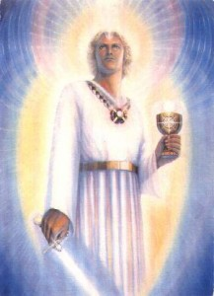
“The word of the LORD came again unto me, saying, Son of man, say unto the prince [king] of Tyrus [Tyre]…
because thine heart is lifted up, and thou hast said, I am
a God, I sit in the seat of God… [Ezekiel says] yet thou art
a man, and not God, though thou set thine heart as the heart of God…” (28:1,2).
After pronouncing judgment on the city (Ch. 26,27), the prophet turned to the ruler, Ethbaal III, who ruled Tyre from 591-572 B.C. As revealed here, the king saw himself as a ‘god,’ which Ezekiel rejected, but the king persisted saying he was wiser than the prophet Daniel (28:3).
God would use Babylon to destroy the king of Tyre and his nation (27:26,27), but not before God used this setting to continue the description of the most ignominious person in the Bible whose pride exceeded even the king of Tyre –
“How art thou fallen from heaven, O Lucifer…
I will… I will… I will… I will be like the most High [God]”
(Isa. 14:12-17).

Slide 7
“Thou has been in Eden the garden of God; every precious stone was thy covering… workmanship of thy pipes that thou was created…” (28:13).
Facts: Lucifer was created; he was beautiful [even as a serpent when he deceived Eve in the garden of Eden (Gen. 3:1-7)]; had the greatest voice of any created being – “… when I [God] laid the foundations of the earth… When all the [angels] sang together… shouted for joy” (Job 38:7). Lucifer led the singing & shouting.
“Thou art the anointed cherub that covereth; and I have set thee so; thou wast upon the holy mountain of God; thou hast walked up and down in the midst of the stones of the fire” (28:14).
Facts: God chose Lucifer to be the chief angel and gave him him unrestricted access to God’s abode in the 3rd heaven (Job 1:6; 2:1).
No one was closer to God than Lucifer, until…

Slide 8
“Thou was perfect in thy ways from the day that thou wast
created, till iniquity was found in thee… thou has sinned”
(28:15,16).
After unbelief, what is man’s greatest sin? Pride that makes one want to be a god! That’s what Lucifer wanted to be, and that’s what he offered to Eve –
“For God doth know that in the day ye eat thereof, then your eyes shall be opened, and ye shall be as gods…”
(Gen. 3:5).
That is what he convinced the king of Tyre he was –
“… thou has said, I am a God” (28:2).
God’s judgment would come on the king of Tyre –
“Behold, I will bring upon Tyrus, Nebuchadnezzar king of Babylon, a king of kings, from the north with horses… chariots… He shall slay with the sword… I will make thee a desolate city…” (26:7,19).
Another Gentile nation who mocked Israel was destroyed.

Slide 9
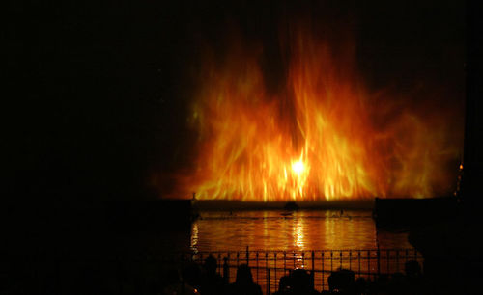
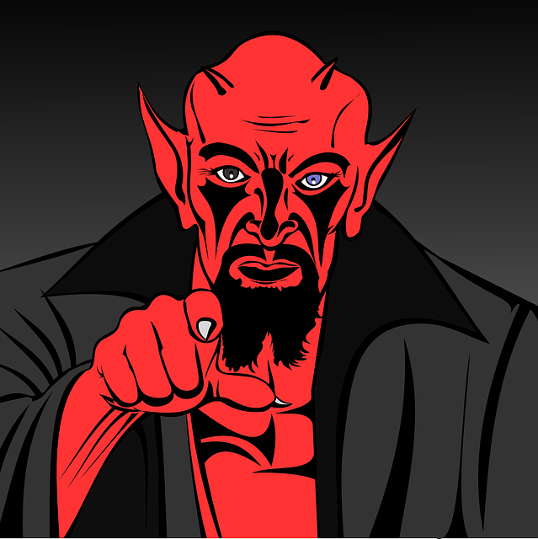
We know what happened to Tyre, but what about Satan? How and when does his end come?
Answer – Tyre’s destruction is a snapshot of what happens to Satan –
“… therefore I will bring forth a fire from the midst of thee [Tyre], it shall devour thee, and I will bring thee to ashes upon the earth in the sight of all them that behold thee” (28:18).
Tyre’s demise will be by FIRE, and so will that of Satan…
… except Satan’s demise will take all of eternity –
“And the devil that deceived them was cast into the lake of fire and brimstone, where the beast and the false prophet are, and shall be tormented day and night for ever and ever” (Rev. 20:10).
Anyone who rejects Christ will join him!

Slide 10
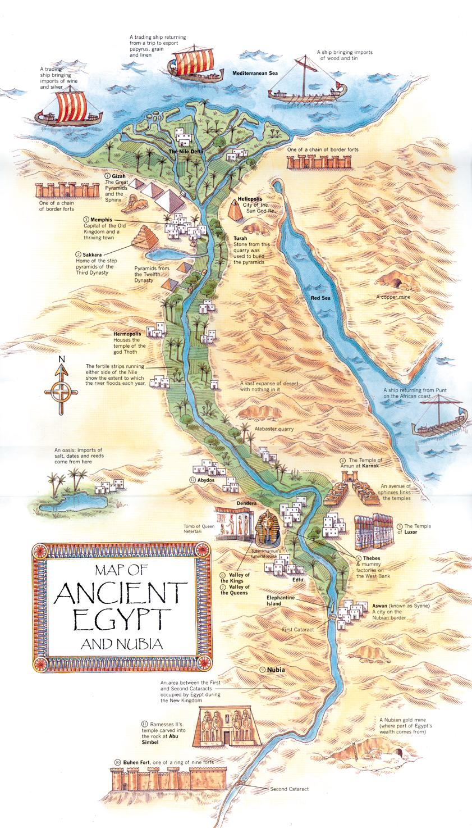
JUDGMENT ON EGYPT
“In the 10th year… the word of the LORD came unto me saying, Son of man, set thy face against Pharaoh of Egypt, and prophesy against him, and against all of Egypt… behold I will bring a sword upon thee… And the land of Egypt shall be desolate and waste; and they shall know that I am the LORD: because he [Pharaoh] hath said, The river is mine, and I have made it” (29:1,2).
God brought judgment on Egypt for 2-reasons: they formed an alliance with Judah to try to prevent what God was bound to do—use Babylon to invade and destroy Jerusalem; and, because Pharaoh, like the king of Tyre, believed he was a god.
Nebuchadnezzar will invade and destroy Tyre, but they had no money (29:18), so God led the king of Babylon to invade Egypt who had great wealth which he plundered –
“… I [God] will give the land of Egypt to Nebuchadnezzar… he shall take her [wealth]… it shall be the wages for his army” (29:19).
The Babylonian army was paid from confiscated Egyptian booty.

Slide 11
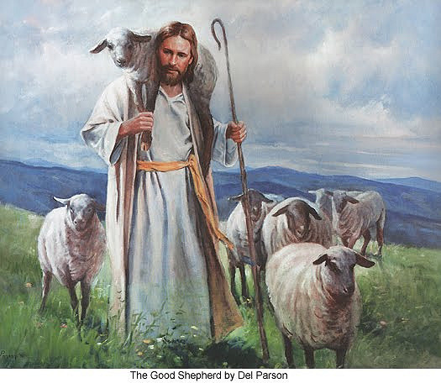
THE LOST SHEEP
“For thus saith the LORD God… so will I seek out my
sheep, and will deliver them out of all places where
they have been scattered… I will seek that which was
lost (34:11,12,16)… the Son of man is come to save
that which was lost (Mt. 18:11)… I am not sent but
unto the lost sheep of the house of Israel” (Mt. 15:24).
The shepherd is most concerned about his lost sheep.
“What [shepherd], having [100] sheep, if he lose [1]…
doth not leave the [99]… and go after that which is lost,
until he find it? And when he hath found it, he layeth
it on his shoulders, rejoicing… I say unto you, that like-
wise joy shall be in heaven over one sinner that repenteth, more than over [99] just persons, which need no repentance?” (Lk. 15:1-7)—Guess who the shepherd will be during the kingdom?
“And I will set up one shepherd over them, and he shall feed them, even my servant David… he
shall be their [Israel’s] shepherd” (34:23).
Once Christ has found and saved true, spiritual Israel, David will shepherd them in the Millennium.

Slide 12
The first part of Ezekiel’s ministry was to tell the nation of Israel their sin [idolatry] and God’s judgment: the destruction of the land, Jerusalem, the temple, the end of kings, and the captivity of its citizens. The next section [Ch. 33-36] deals with Israel’s future restoration –
“Moreover the word of the LORD came unto me, saying, Son of man, when the house of Israel dwelt in their own land, they defiled it by their own way and by their doings [idolatry]… Wherefore I poured out my fury upon them… And I scattered them among the heathen… dispersed through the countries… And when they entered unto the heathen, whither they went, they profaned my holy name… But I had pity for mine holy name…Thus saith the LORD, I do not this for your sakes, O house of Israel, but for mine holy name’s sake…” (36:16-23).
God’s final restoration of Israel will not be because of them, but Him—His Name impugned for her sin…

Slide 13
… His holy Name restored when they become His holy nation –
“For I will take you from among the heathen, and gather you out of all countries, and I will bring you into your own land. Then will I sprinkle clean water upon you, and ye shall be clean: from all your filthiness, and from all your idols, will I cleanse you. A new heart also will I put within you: and I will take away the stony heart out of your flesh and I will give you an heart of flesh. And I will put my spirit within you, and cause you to walk in my statutes, and ye shall keep my judgments, and do them. And ye shall dwell in the land that I gave to your fathers; and ye shall be my people, and I will be your God” (36:24-28).
Facts: At the end of the tribulation, God regathers the Jews to their land; He will wash them [water baptism], as John the Baptist tried to do (Mk. 1:4), because every O.T. priest was required to be washed. But now…

Slide 14
… under the New Covenant, the whole nation will become a nation of priests requiring water washing [sprinkling]; He will give them a spiritual heart transplant, taking away their stony heart [like Jonah had], giving them a sacred [Holy] heart like Christ has, and like Him, they will keep His commandments, they will not sin again… “And ye [true, spiritual, saved Israel] shall be unto me a kingdom of priests, and an holy nation” (Exo. 19:6).
At the beginning of the kingdom, Israel will be the Holy nation of God. But, He wants them to never forget that He does this, “Not for your sakes [Israel] do I this, saith the LORD God,” but for HIS SAKE! After His 2nd coming [Trumpets], Christ saves them in 1 day [Atonement]; He washes them + a heart transplant + indwelling H.S. =
A Holy Nation.
He said He would make Israel a holy nation and He does.
Then His name will be glorified in all of Israel for 1,000 yr.!

Slide 15
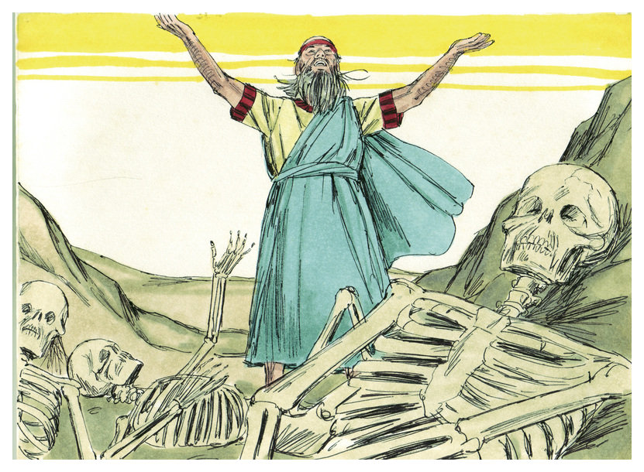
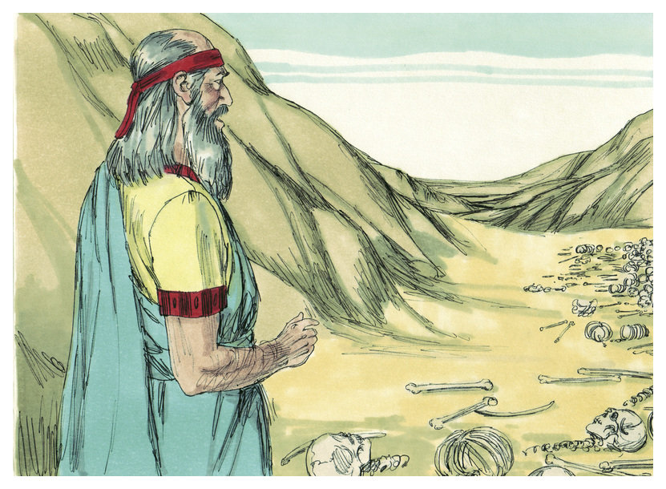
VISION OF THE DRY BONES
“The hand of the LORD was upon me, and carried me
out in the spirit… and set me down in the midst of the valley which was full of bones, and caused me to pass by them round about: and, behold, there were very many… very dry. And he said unto me, Son of man, can these bones live? And I answered, O Lord God, thou knowest” (37:1-3).
Jews then and now doubted that God will ever restore Israel to their former glory under king David, but here God gave Ezekiel a vision that should have forever answered their doubts –
“Again he said unto me, Prophesy upon these bones, and say unto them, O ye dry bones, hear the word of the LORD… I will lay sinews [tendons] upon you… cover you with skin… put breath in you, and ye shall live, and ye shall now that I am the LORD” (37:4-6).

Slide 16
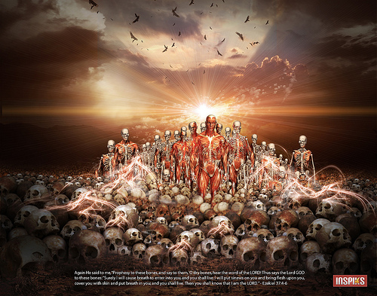
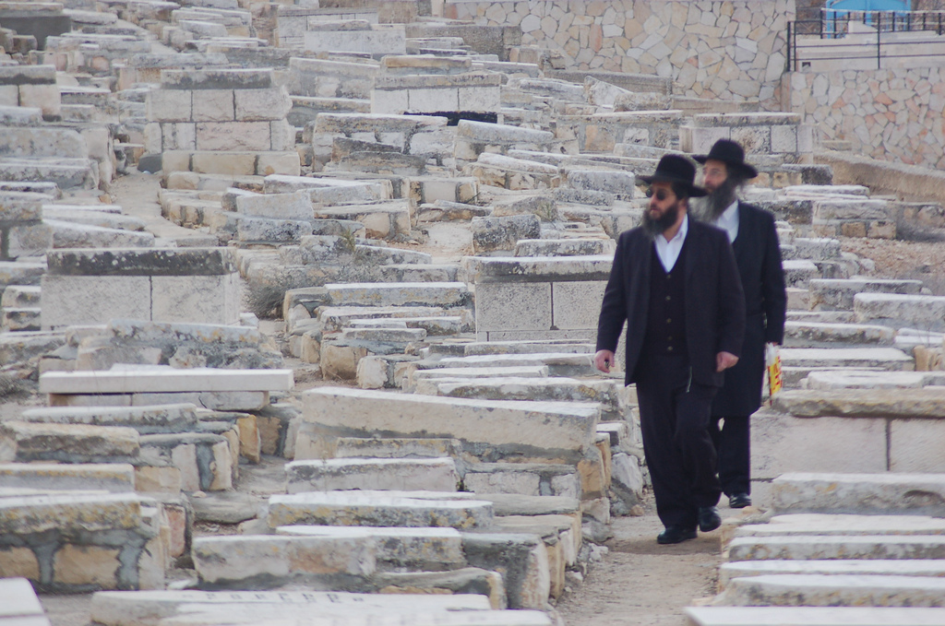
“So I prophesied as I was commanded: and as I prophesied, there was a noise, and behold a shaking, and the bones came together… but there was no breath in them. Then said he unto me, Prophesy unto the wind… and say to the wind… breathe upon these slain… and the breath came into them, and they lived… Son of man, these bones are the whole house of Israel: behold, they say, Our bones are dried, and our hope is lost… Thus saith the Lord God; Behold, O my people, I will open your graves, and cause you to come up out of your graves, and bring you into the land of Israel… and shall put my spirit in you, and ye shall live… then shall ye know that I the LORD have spoken it, and performed it (37:7,8)… I will take the children of Israel from among the heathen… I will make one nation… one king… neither shall they be divided… any more at all” (37:21,22).
At the beginning of the earthly kingdom, Israel will be ‘one nation under God, indivisible, with liberty and justice for all.’

Slide 17
GOG AND MAGOG
Again, Ezekiel looks into the future to the beginning of the tribulation [Jacob’s trouble] –
“… Son of man, set thy face against Gog, the land of Magog, the chief prince of Mesheck and Tubal, and prophesy against him… I will turn thee back, and put hooks into thy jaws, and I will bring thee forth, and all thine army… Persia, Ethiopia, and Libya with them… Gomer… shall come into the land… against the mountains of Israel…” (38:1-8).
In the 1st year of the tribulation, these mostly Islamic nations led by the ruler of Russia, will descend on Israel, but in the confusion they will attack each other, “every man’s sword shall be against his brother” (38:21). But, it is God who wins the victory, “I will smite thy bow (39:3)… thou shall fall upon the mountains of Israel” (39:4).
God will NOT allow any nation nor alliance of nations [Islam] to destroy Israel.

Slide 18
MILLENNIAL TEMPLE
“In the 25th year of our captivity… in the 14th year after the
city was smitten, in the selfsame day the hand of the LORD
was upon me, and brought me thither… into the land of
Israel, and set me upon a very high mountain…” (40:1,2).
In the 25th year of captivity and the 14th year after Jerusalem
and the temple were destroyed [574 B.C.], the Spirit brought
Ezekiel to Jerusalem to show him visions of a 3rd temple,
which will be built during the Millennium. He was provided
with the measurements and chambers or rooms in the
temple complex (40:5-5), some of which Christ referred to –
“In my Father’s house are many [rooms]… I go to prepare
a place for you. I will come again, and receive you unto
myself; that where I am, there ye may be also” (Jn. 14:1-3).
Facts: My Father’s house is NOT heaven, it is the temple in
Jerusalem (Jn. 2:16); Christ went back to heaven to await His
2nd coming, when He will reside in the 3rd temple with the
12 Apostles living with Him in these rooms in the temple.
THE BIBLE KNOWLEDGE COMMENTARY,
Chariot Victor Pub., p. 1303.

Slide 19
MILLENNIAL TEMPLE (cont’d)
“Afterward he bought me to the gate… looketh toward the
east… And the glory of the LORD came into the house… So
the Spirit took me up, and brought me into the inner court;
and, behold the glory of the LORD filled the house” (43:1-6).
Ezekiel had earlier [Ch. 10,11] saw the departure of the LORD,
He was now witnessing the future return and filling of this
kingdom temple with the presence of the LORD [Christ].
“And he said unto me, Son of man, the place of my throne,
and place of the soles of my feet, where I will dwell in the
midst of the children of Israel for ever…” (43:7).
Christ’s throne will be inside this Millennial temple where He
will be visibly enthroned as KING & HIGH PRIEST.
“And these are the measures of the altar… Son of man… to
offer burnt-offerings thereon, and to sprinkle it with blood”
(43:13,18).
The sprinkling of the blood of burnt-offerings will be a
memorial for Christ’s once-for-all sacrifice for sin (Heb. 9:26).
THE BIBLE KNOWLEDGE COMMENTARY,
Chariot Victor Pub., p. 1303.

Slide 20
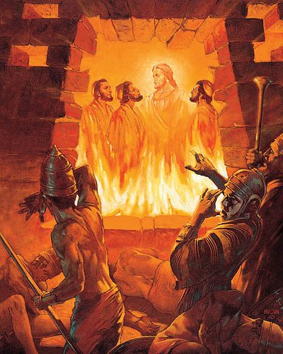
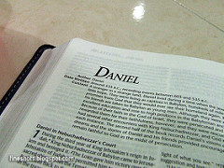
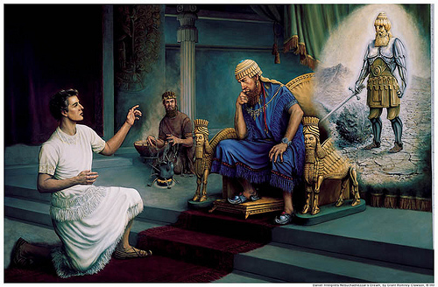
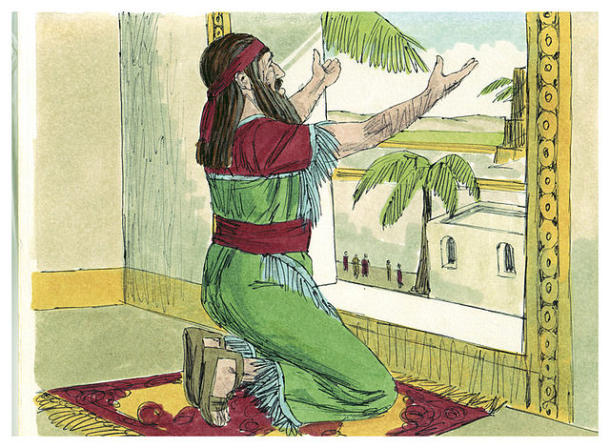
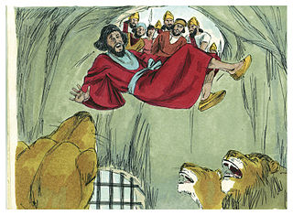
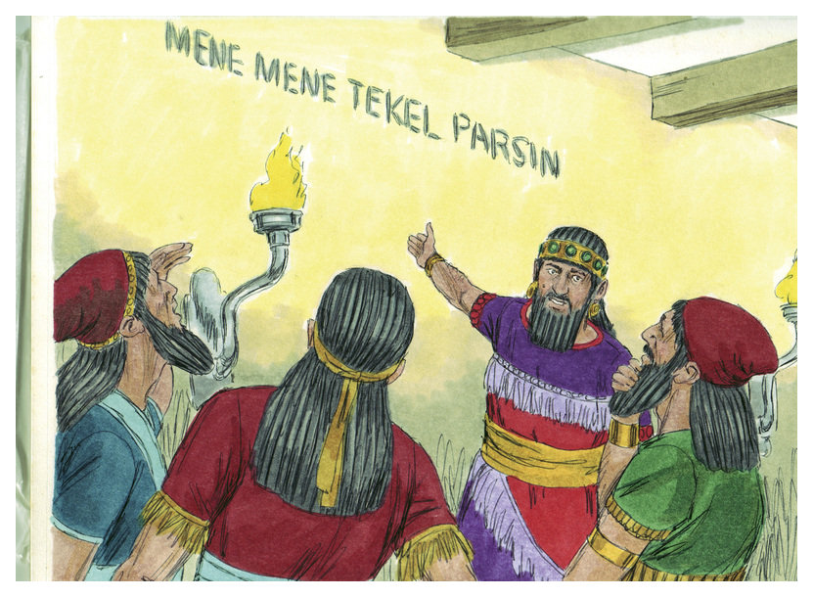
Next time – The Book of Daniel

