Slide 1
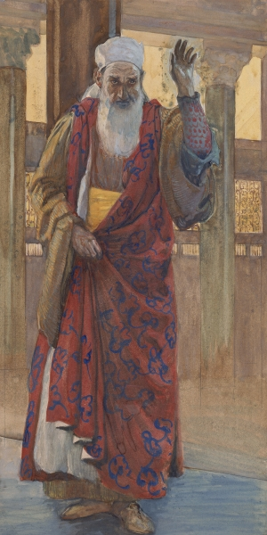
THROUGH THE BIBLE IN 2018
LESSON 31
WEEK 31 OF 52
(Isa. 49-66; Nahum)
Last time we saw Isaiah’s woes; this time more future prophecy of Israel.
“Listen, O isles, unto me; and hearken, ye people, from far; The LORD hath called me from the womb… made my mouth like a sharp sword; in the shadow of his hand hath he hid me, and made me a polished shaft; in his quiver hath he hid me; And
said unto me, Thou art my servant, O Israel, in whom I will be glorified” (Isa. 49:1-3).
It was clear to Isaiah that Israel was NOT the nation God had called—she was not saved, and thus could not be God’s light to
the Gentile nations, e.g., Nineveh [Jonah]. Who could save both Jews and Gentiles? Messiah.
Messiah would be called from the womb for that purpose, His
Words like a sharp sword and a pointed arrow; Messiah would
be gloried when Israel was saved.

Slide 2
From the out calling of Israel at Mt. Sinai until Pentecost Israel had failed to be the nation of God –
“Then I said, I have laboured in vain, I have spent my strength for
nought, and in vain…” (49:4), but God would not give up on His
spiritual experiment. He would find a way to bring salvation to
the Jewish people and that would be through His Son –
“And now saith the LORD that formed me from the womb to be
his servant, to bring Jacob again to him, Though Israel be not
gathered, yet shall I be glorious in the eyes of the LORD, and
my God shall be my strength” (49:5).
The coming Messiah’s responsibility was to save Israel who will
then be used of God to take salvation to the Gentile nations so
that the whole world will know God –
“And he said, It is a light thing that thou [Christ] shouldest be my
servant to raise up the tribes of Jacob… I will give thee for a light
to the Gentiles, that thou mayest be my salvation unto the end of
the earth” (49:6).

Slide 3
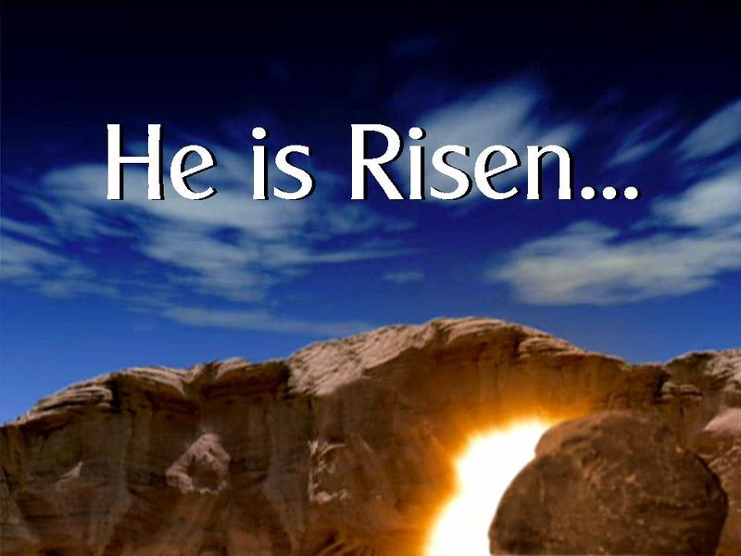
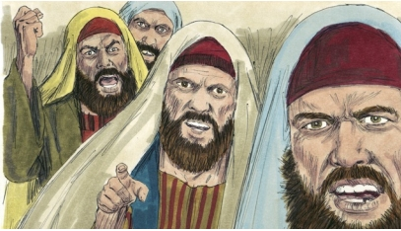
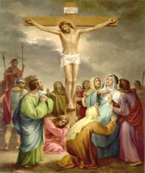
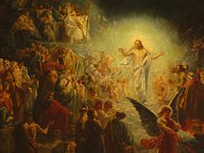
“Thus saith the LORD, the Redeemer of Israel, and his Holy One to him whom man despiseth, to him whom the nation abhorreth… the LORD that is faithful…” (49:7).
It will not be easy, however, because in His 1st coming He would be despised by men and rejected by the nation He came to save, but in His rejection He would be faithful!
“Thus saith the LORD, In an acceptable time have I heard thee, and in a day of salvation have I helped thee: and I
will preserve thee, and give thee for a [new] covenant of the people…” (49:8).
On Pentecost, Peter said – “Therefore did my heart rejoice, and my tongue was glad; moreover also my flesh shall rest in hope: Because thou wilt not leave my soul in hell, neither wilt thou suffer thine Holy One to see [bodily] corruption” (Acts 2:26,27).
The Father heard His Son from Hades, delivered Him and preserved Him for man’s redemption [New Covenant].

Slide 4
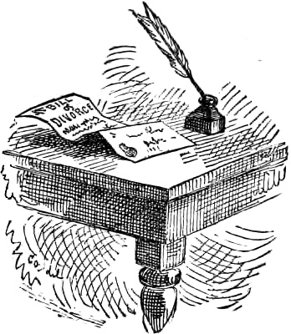
“Thus saith the LORD, Where is the bill of your mother’s divorcement, whom I have put away?... Behold for your iniquities have ye sold yourselves, and for your transgressions is your mother put away” (50:1).
God’s relationship with Israel was so strained that He
wrote her a ‘bill of divorcement,’ permitted under the
Law of Moses (Deut. 24:1). The Grounds?
Spiritual infidelity, and because she was clearly at
fault, she was required to leave their place of abode
[homeland]. God would cast her out of the land for
70-years as punishment for her iniquities. She was
disgraced before the only One who truly loved her.
How can she undo the damage caused?
“Look unto Abraham your father, and unto Sarah that
bare you…” (51:2).
Israel should turn back and see, even in their advanced
years, how faithful Abraham & Sarah had been to the
God who had called them to birth a new nation.

Slide 5
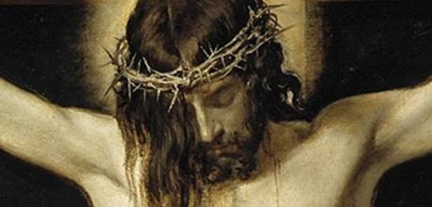
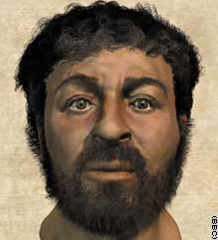
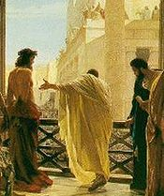
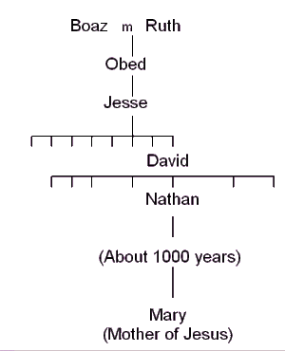
PREINCARNATE DESCRIPTION OF CHRIST
“For he shall grow up before him as a tender plant, and as a root out of a dry ground: he hath no form nor comeliness; and when we shall see him, there is no beauty that we should desire him” (53:2).
The Messiah will be of the lineage of David, born into a spiritually barren culture; His appearance will not be as royalty, but common like every man.
“He is despised and rejected of men; a man of sorrows, and acquainted with grief: and we hid as it were our faces from him… esteemed him not” (53:3).
How much more can a man be despised & rejected than for his own to yell, “Crucify him”? (Mk. 15:14).
“He was oppressed… afflicted, yet ye opened not his mouth: he is brought as a lamb to the slaughter… the LORD
hath laid on him the iniquity of us all” (53:7,6).

Slide 6
AN INVITATION
“Ho, every one that thirsteth, come ye to the waters, and he that hath no money; come ye, buy, and eat (55:1)… Incline your ear, and come unto me: hear, and your soul shall live; and I will make an everlasting covenant with you (55:3)… and nations that knew
not thee shall run unto thee because of the LORD thy God, and
for the Holy One of Israel” (55:5).
Isaiah told everyone, Israel and the nations alike, to come to
God! If you’re thirsty—freely drink! If you’re hungry and have
no money, come and eat! It’s free! Come to Jerusalem! That’s
where God is! Don’t walk, RUN! Israel will show you how to
offer sacrifices to their God—just come! Don’t wait! Come now!
“Let the wicked forsake his way, and the unrighteous man his
thoughts: and let him return unto the LORD, and he will have
mercy upon him…” (55:7).
Isaiah was pleading with the world to take a personal inventory
before it was too late—judgment was coming! It is coming on all
the unsaved, Jew and Gentile alike.

Slide 7
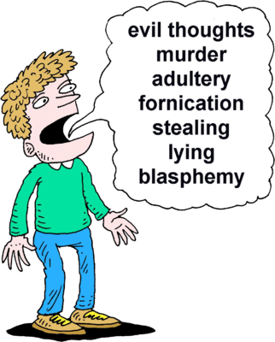
GOD’S WAYS—NOT MAN’S WAYS
“For my thoughts are not your thoughts, neither are your ways my ways, saith the LORD. For as
the heavens are higher than the earth, so are my ways higher than your ways, and my thoughts
than your thoughts…” (55:8,9). Why are God’s thoughts and ways superior? 2-reasons:
He’s God, we’re not; 2. He is holy, we’re sinners – “Wherein time past ye
walked according to the course of this world, according to the prince of the
power of the air, the spirit that now worketh in the children of disobedience.
Among whom also we all had… in the lusts of the flesh, fulfilling the desires
of the flesh and of the mind; and were BY NATURE the children of wrath…”
(Eph. 2:1-3).
It should not be difficult for believers today to see why everyone since
Adam has failed before God—WE WERE PROGRAMED TO FOLLOW SATAN!
But, it can be changed! How? For those today, it is, 1. to be saved (1Cor. 15:1-4); 2. to be
retrained – “Let this mind be in you, which was also in Christ Jesus (Phil. 2:5); For the grace of
God that bringeth salvation hath appeared to all men. Teaching us that, denying ungodliness, and
worldly lusts, we should live soberly, righteously, and godly in the present world” (Tit 2:11,12).
It is an act of grace that the Holy Spirit is willing to retrain us to be like Christ.

Slide 8
So shall my word be that goeth forth out of my mouth:
it shall not return to me void, but it shall accomplish that which I please, and it shall prosper in the thing whereto I sent it” (55:8,9,11).
God cannot lie (Tit. 1:2), therefore every thing He says must be truth. If He makes a promise, it must be fulfilled. God made a promise to Abraham that He would create a large nation [Israel] from him. He did – 15 million. He gave them a promised land—they’re on it. He promised them a royal King in the likeness of David—He’s coming [rejected at 1st coming; will be accepted at the 2nd coming]; He promised them a New Covenant based on the Christ’s blood [means of redemption]—it, too, will be accepted at Christ’s 2nd coming.
Many promises have come to pass; some are yet future.
Stay tuned, and keep reading the Bible to see how it unfolds.

Slide 9
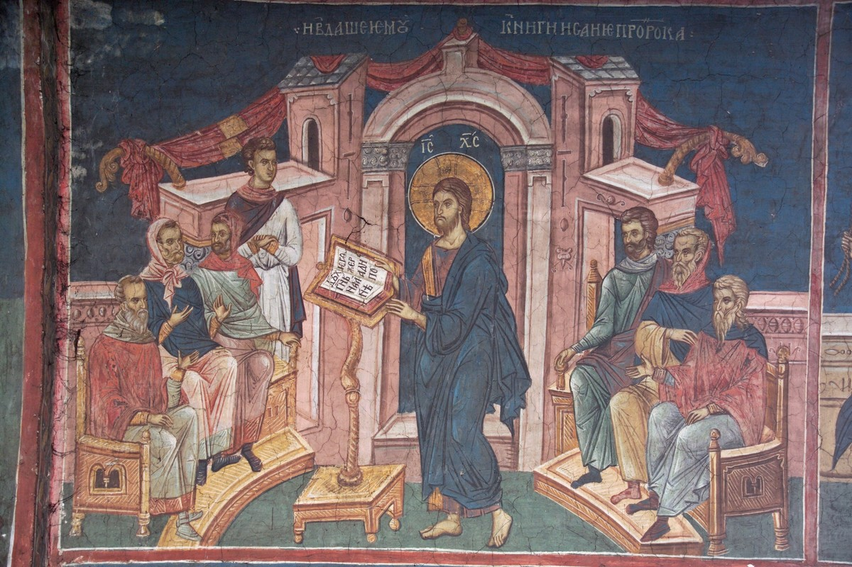
ACCEPTABLE YEAR OF THE LORD
“The Spirit of the Lord God is upon me; because the LORD hath anointed me to preach good tidings unto the meek; he hath sent me to bind up the broken-hearted, to proclaim liberty to the captives, and the opening of the prison to them that are bound; To proclaim the acceptable year of the LORD, and the day of vengeance of our God; to comfort all that mourn” (61:1,2).
Isaiah next prophesied of the time when Christ would teach in the synagogue at Nazareth –
“And he came to Nazareth, where he had been brought up: and as his custom was, he went into the synagogue on the Sabbath day, and stood up for to read. And there was delivered unto him the book of the prophet Esaias. And when he had opened the book, he found the place where it was written…” (Lk. 4:16; Isa. 61:1,2).

Slide 10
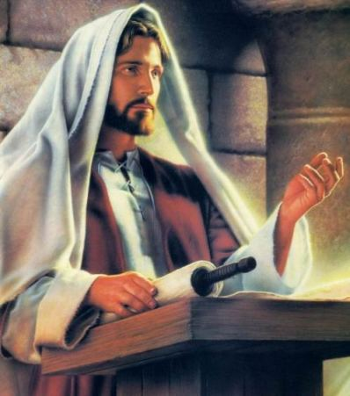
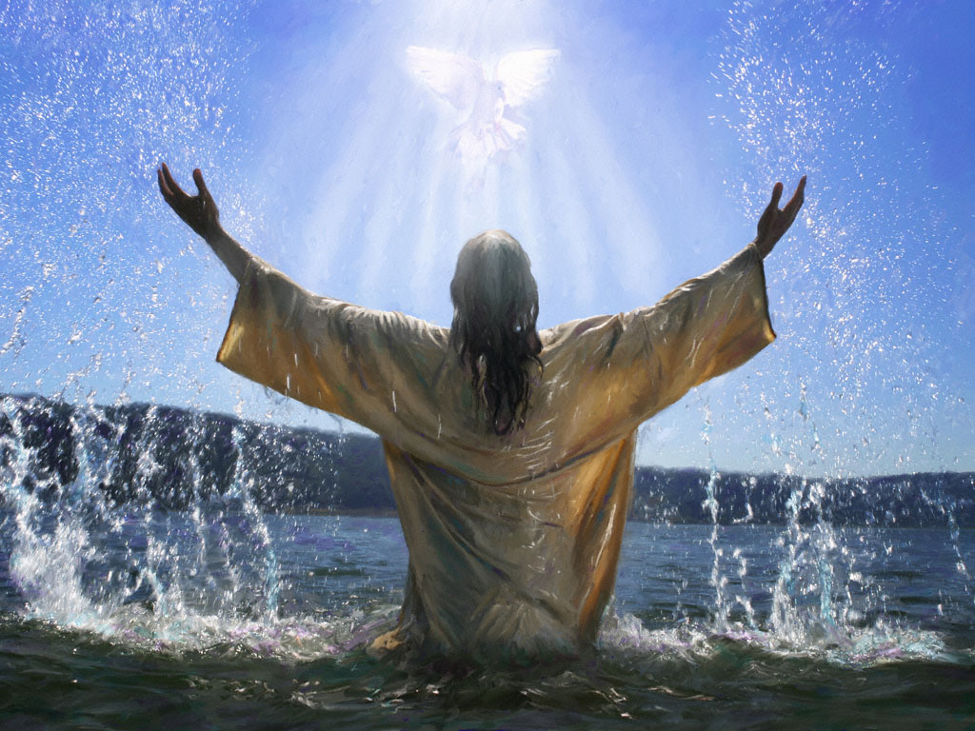
Christ opened the scroll and quoted the prophet Isaiah from chapter 61:1,2 –
“The Spirit of the Lord is upon ME, because he hath anointed ME to preach the gospel to the poor; he hath sent ME to heal the broken-hearted, to preach deliverance to the captives, and recovering of sight to the blind, to set at liberty them that are bruised, to preach the acceptable year of the Lord” (Lk. 4:18).
Christ confirmed everything Isaiah had promised—A Messiah was coming [ME]—HE WAS THAT MESSIAH, and that ministry prophesied of had already begun at the river Jordan –
“And Jesus, when he was baptized, went up straightway out of the water… he saw the Spirit of God descending like a dove, and lighting upon him” (Mt. 3:16 c.f. Isa. 42:1).

Slide 11
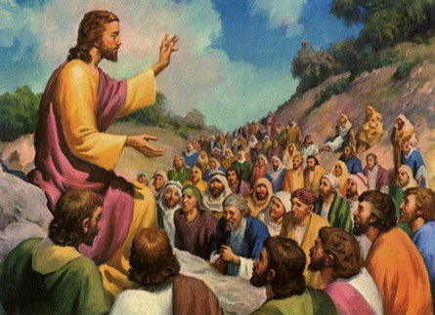
Chosen to preach what gospel?
“And Jesus went about all Galilee, teaching in their synagogues, and preaching the gospel of the kingdom… (Mt. 4:23a). What’s that?
Jesus preached of a kingdom on earth where all
[Jews & Gentiles] could be forgiven their sins by believing on Him [Messiah] –
“… liberty to the captives [of sin], and the opening of the prison to them that are bound [sinners]…”, which would, “bind up the broken-hearted” and give them hope (Isa. 61:1). This would not be accepted by the haughty, but was directed to, “… to the poor
[spiritually oppressed]… to set at liberty [to give freedom] them that are bruised [hopeless]”
(Lk. 4:18).
But, there was another practical, earthly component of this kingdom…

Slide 12
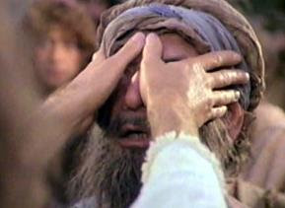
… He promised that kingdom would include physical healing –
“And Jesus went about all Galilee… preaching the gospel of the kingdom, and healing all manner of sickness and all manner of disease among the people” (Mt. 4:23).
Christ promised that kingdom would reverse the devastating affects of sin on health, “recovering of the sight to the blind” (Lk. 4:18), the same that Isaiah had promised 700-years earlier –
“… strengthen ye the weak hands, and confirm the feeble knees… the eyes of the blind shall be opened, and the ears of the deaf unstopped… the lame man shall leap like a [deer]” (Isa. 35:3-6).
This kingdom of heaven on earth that was first promised by the prophets was now confirmed by Christ in His earthly ministry.
May I ask you a question?

Slide 13
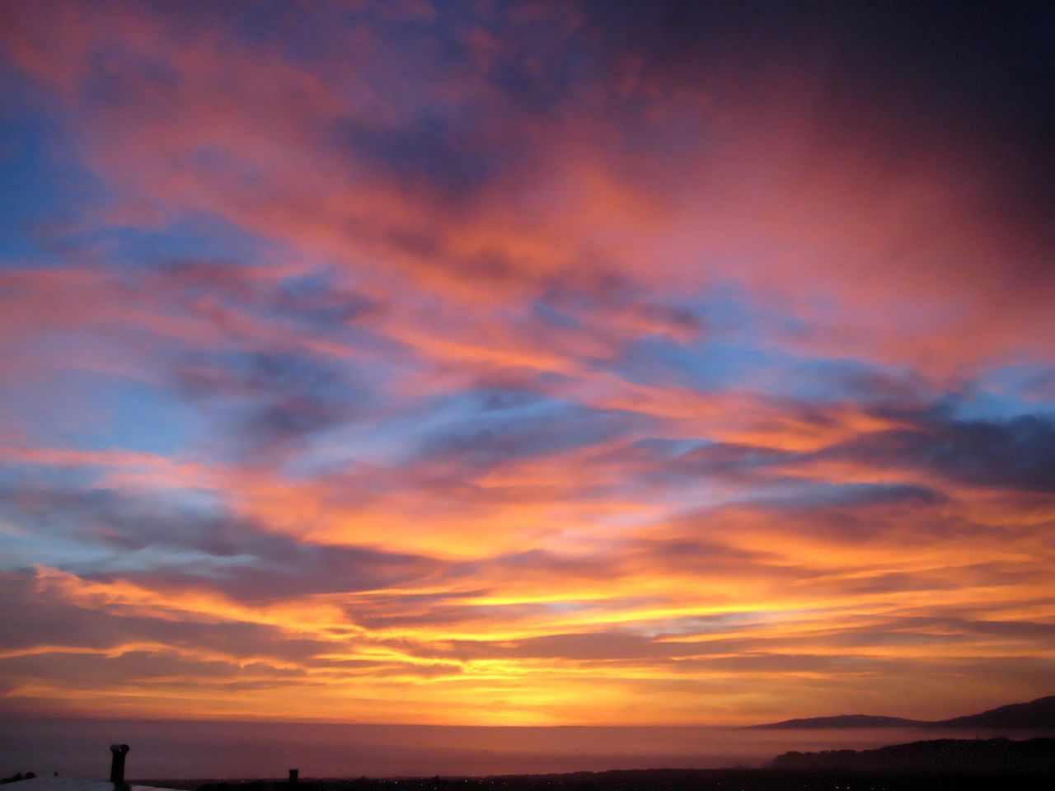
Is that promise with its gospel of the kingdom and universal physical healing with us today?
No. Why not?
Is Christ and His earthly kingdom established on earth today?
No. Why not? His offer of it was rejected and delayed until a yet future time. When?
That kingdom cannot be established until Christ’s 2nd coming and His world-wide acceptance as
the Messiah.
In that gospel [of the kingdom], is there any mention of His death, burial, and resurrection for
the remission of sins? No. Why not?
It was still hidden – “Then he took unto him the [12], and said unto them, Behold we go up to Jerusalem… delivered unto the Gentiles… mocked…spitefully entreated… scourge him, and put
him to death: and the [3rd] day he shall rise again. And they UNDERSTOOD NONE OF THESE
THINGS: and this saying was HID FROM THEM, neither knew they the things which were spoken” (Lk. 18:31-34).
Is every believer today healed like they will be in this future earthly kingdom? No. Why not?
“For this thing I besought the Lord thrice, that it might depart from me. And he said unto me,
My grace is sufficient for thee: for my strength is made perfect in weakness” (1Cor. 12:9).
In this age of GRACE, we are told to trust Christ even when we are NOT healed. Do you?

Slide 14
Notice where He finished reading –
“… To preach the acceptable year of the Lord. And he closed the book, and he gave it again to the minister, and sat down. And the eyes of all them that were in the synagogue were fastened on him” (Lk. 4:19).
Compare that to what Isaiah said –
“… To proclaim the acceptable year of the LORD, and the day of vengeance of our God…” (Isa. 61:2).
Christ left out ‘the day of vengeance’ because that refers to His 2nd coming when He will judge an unbelieving world. He finished his quote of Isaiah of His 1st coming like this – “And he began to say unto them, This day is this scripture fulfilled in your ears”
(Lk. 4:19).
As promised by Isaiah, Christ’s earthly ministry came, but was rejected (we are now in the parenthetical age of grace); the world awaits His day of vengeance!

Slide 15
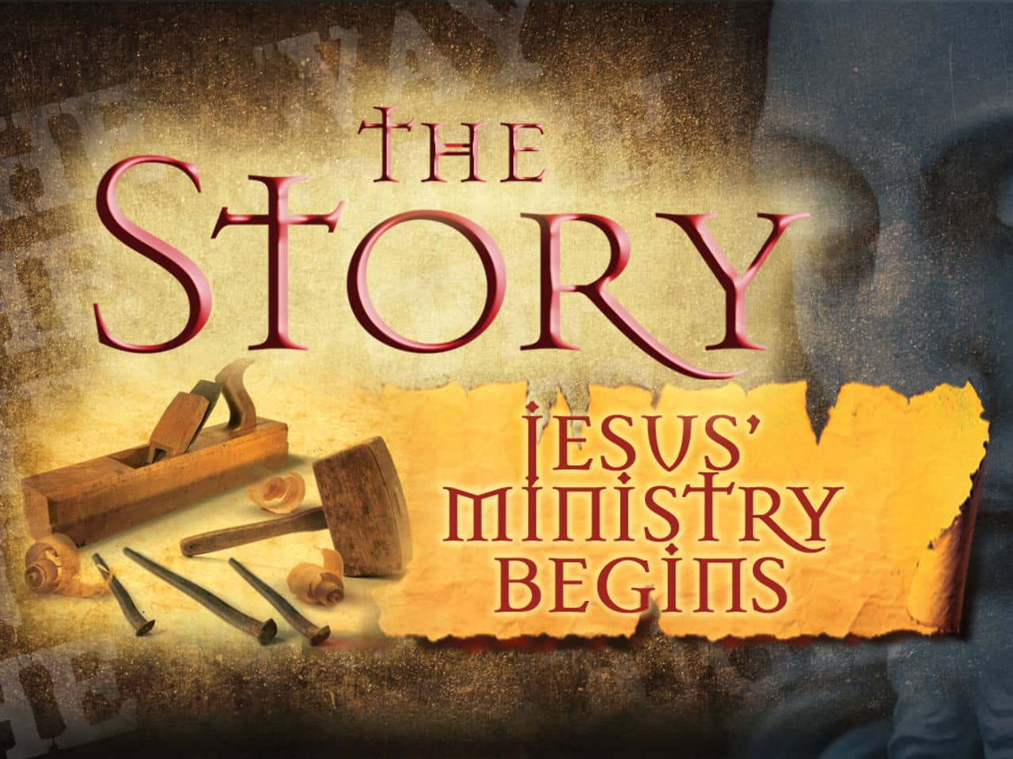
Christ omitted ‘the day of vengeance’ in the synagogue in
Nazareth because that was not part of His earthly ministry,
which was to layout the requirements to Jews who wanted
to be part of that kingdom:
Faith – “But as many as received him, to them gave he
power to become the sons of God, even to them that believe
on his name” (Jn. 1:12). One had to believe that He was the
long awaited Messiah that Isaiah prophesied would come to
save Israel.
2. Works – “He that believe and is baptized shall be saved…”
(Mk. 16:16). Water washing, which had been required of the
Levites in preparation for their priestly duties (Exo. 40:32),
was now expanded to the Jewish nation who were to be “a
kingdom of priests” (Exo. 19:6); some rejected – “But the Pharisees and lawyers rejected the counsel of God against themselves, being not baptized of him [John] (Lk. 7:32). Israel’s system was FAITH + works – “… to the scattered [12] tribes… Ye see that by his works how a man is justified, and not by faith only” (Jas. 1:1; 2:24). Is that how we [the Body of Christ] are saved today?

Slide 16
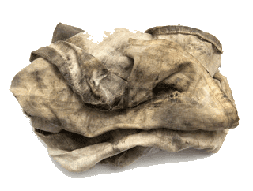
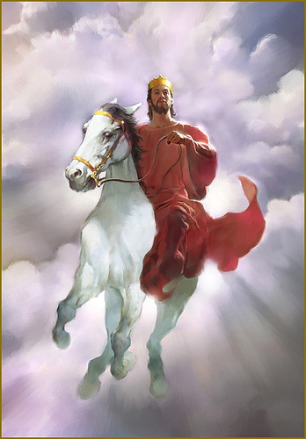
DAY OF VENGEANCE
“I have trodden the winepress alone; and of the people there was none with me: for I will tread them in mine anger, and trample them in my fury; and their blood shall be sprinkled upon my garments… For the day of vengeance is in mine heart, and the year of my redeemed is come” (Isa. 63:3,4).
Isaiah tells the reader that Christ’s judgment on the unsaved world will cause Him to produce world-wide death and destruction, the blood of which will stain His garments as He puts human-kind through the winepress of His wrath.
FILTHY RAGS
“But we all as an unclean thing, and all our righteousness are as filthy rags; and we all do fade as a leaf; and our iniquities, like the wind, have taken us away. And there is none that calleth upon thy name… for thou hast hid thy face from us, and hast consumed us, because of our iniquities” (64:6,7).
Man-made righteousness is like filthy rags before God.

Slide 17
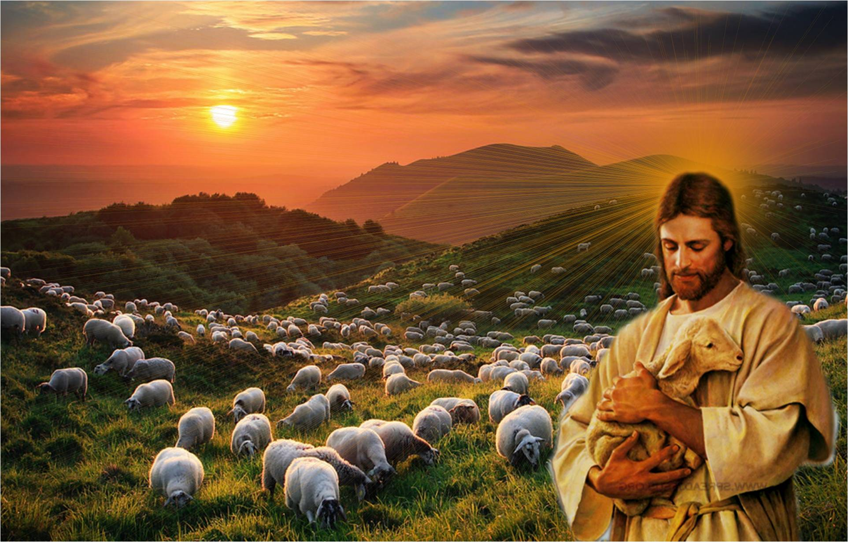
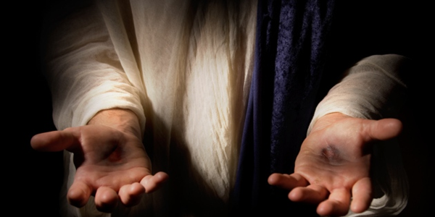
ISRAEL’S SALVATION
After Christ’s 2nd return and He pours out judgment on His enemies, He turns again to the nation of Israel –
“Who hath heard such a thing? Who hath seen such
things? Shall the earth be made to bring forth in one day? Or shall a nation be born at once? For as soon as Zion travaileth, she brought forth her children” (66:8).
If God created the earth in one day, is it not possible that He can save His favored nation in one day?
YES! ISRAEL WILL BECOME GOD’S NATION IN ONE DAY!
After waiting millennia, all Christ has to do is return a 2nd time and show her proof –
“… and they shall look upon me whom they have pierced: and they shall mourn…” (Zech. 12:10).
Finally, Israel will be the godly nation she was destined to be.

Slide 18
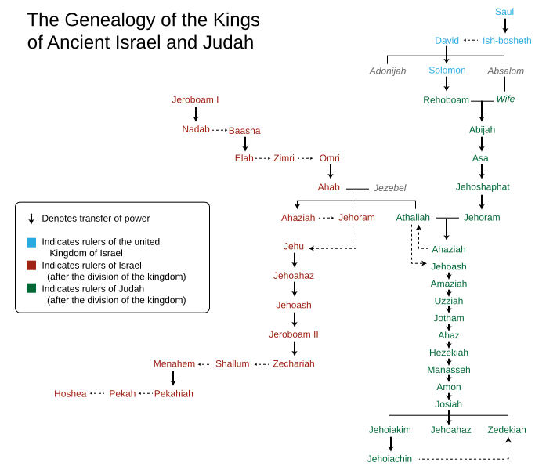
HEZEKIAH’S DEATH
“And the rest of the acts of Hezekiah, and all his might, and how he made a pool, and a conduit, and brought water into the city, are they not written in the book of the Chronicles of the kings of Judah? And Hezekiah slept with his fathers: and Manasseh his son reigned in his stead” (2Kg. 20:20,21).
Hezekiah was a good king of Judah and one of his major accomplishments was to build a 1,777 ft. tunnel to bring water from outside to inside the city (2Chron. 32:30). Assyria failed to discover the tunnel, which they could have used to defeat them. Hezekiah died and was replaced by his son Manasseh. Good or bad king?
“Manesseh was [12] years old when he began to reign, and reigned [55] years in Jerusalem… And he did that which was evil in the sight of the LORD, after the abominations of the heathen…” (21:1). Here we go again.

Slide 19
“Moreover Manasseh shed innocent blood very much… he made Judah to sin… did evil in the sight of the LORD…” (2Kg. 21:16).
Evil Manasseh carried out atrocities including infanticide, and scholars also believe one of his atrocities was the unusually cruel treatment of Isaiah [sawn in half] who prophesied against him (Heb. 11:36,37).
“… [Manasseh] slept with his fathers… and Amon his son reigned in his stead (2Kg. 21:18). Amon was [22] years old when he began to reign, and he reigned [2] years in Jerusalem… he did that which was evil in the sight of the LORD, as his father Manasseh did… served idols, that his father served… (21:19-22). And the servants of Amon conspired against him, and slew the king in his own house… and the people of the land made Josiah his son king in his stead… ” (21:23,24).
Fearing that Amon would continue to rule like his evil father, Manasseh, he was assassinated by advisors close to him and replaced by his young son, Josiah, who would not be like his evil father, and grandfather.

Slide 20
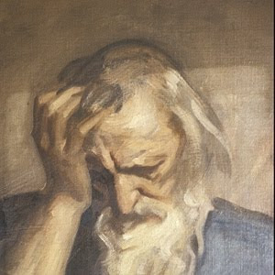
NAHUM
“Nahum prophesied during the reign of Hezekiah, probably about [150] years after Jonah. He had but one subject—the destruction of Nineveh… the city was destroyed nearly a century later, precisely as her predicted… the moral theme is: the holiness of Jehovah which must deal with sin in judgment”
(Old Scofield, p. 952).
“The burden of Nineveh. The book of the vision of Nahum the Elkoshite. God is jealous, and the LORD revengeth…the LORD will take vengeance on his adversaries, and reserveth wrath for his enemies. The LORD is slow to anger, and great in power, and will not at all acquit the wicked” (Nah. 1:1-3).
Nahum means “consolation” or “comfort” and nothing is known of him, not even the location of his hometown, Elokish.

Slide 21
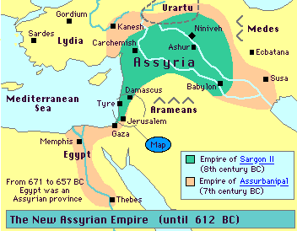
NAHUM (cont’d)
Nineveh, capital of Assyria, was settled shortly after the flood
[2,400 B.C.] (Gen. 10:11). It became a world empire during
the period of Israel’s divided kingdom [9-7th centuries B.C.].
Several Assyrian kings listed in the Bible invaded the northern
kingdom and in 733 B.C., Tiglath-pileser III (2Kg. 15:29) carried
the first Jews into Assyrian captivity. Sennacherib (2Kg. 18:13)
surrounded Jerusalem but was unable to conquer it [God’s
will]. God used Assyria to punish Israel [captivity], but then
God punished Assyria [along with the Babylonians] for being
too cruel to the Israelite captives.
“Woe to the bloody city!… the horsemen lifteth up the sword… there is a multitude of the slain, and a great number of carcases… they stumble upon their corpses… Behold I am against thee, saith the LORD of hosts… I will show the nations thy nakedness… kingdoms thy shame” (3:1-5).
No longer a call of repentance like Jonah, Nahum prophesied of its destruction; Nineveh fell to the Babylonians in 612 B.C., 100-years after Nahum’s prophecy.
Next time – the 4th and last spiritual reform of Judah under good king Josiah.

