Slide 1
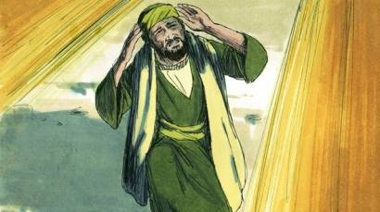
THROUGH THE BIBLE IN 2018
LESSON 16
WEEK 16 OF 52
(1Sam. 25–2Sam.4 )
Last time we saw King Saul become jealous and turn against David and threatened his life. Many of the psalms written by David are of this difficult time.
“In God I will praise his word, in God I have put my trust; I will not fear what flesh can do unto me” (Psa. 56:4).
David is still on the run trying to escape the persecution of Saul and constantly appealed
to God for deliverance from his enemies.
“In my distress I cried unto the LORD, and he
heard me” (120:1).
During this time, David has no one else to turn to except God, which becomes a common theme in this 10-year period in his life.

Slide 2
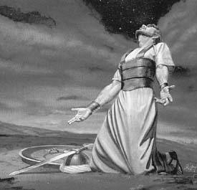
“Deliver me, O LORD, from the evil man; preserve me from the violent man” (140:1).
“LORD, I cry unto thee: make hast unto me; give ear unto my voice, when I cry unto thee. Let my prayer be set forth before thee as incense; and the lifting up of my hands as the evening sacrifice” (141:1,2).
“I cried unto the LORD with my voice; with my voice did I make supplications… When my spirit was overwhelmed within me, then thou newest my path… I cried unto thee, O LORD: I said, Thou art my refuge…”
(142:1-5).
David is on an emotional roller coaster, feeling the fear of capture by his enemies verses his devotion to the God who has preserved his life thus far.

Slide 3
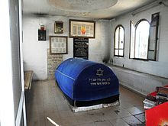
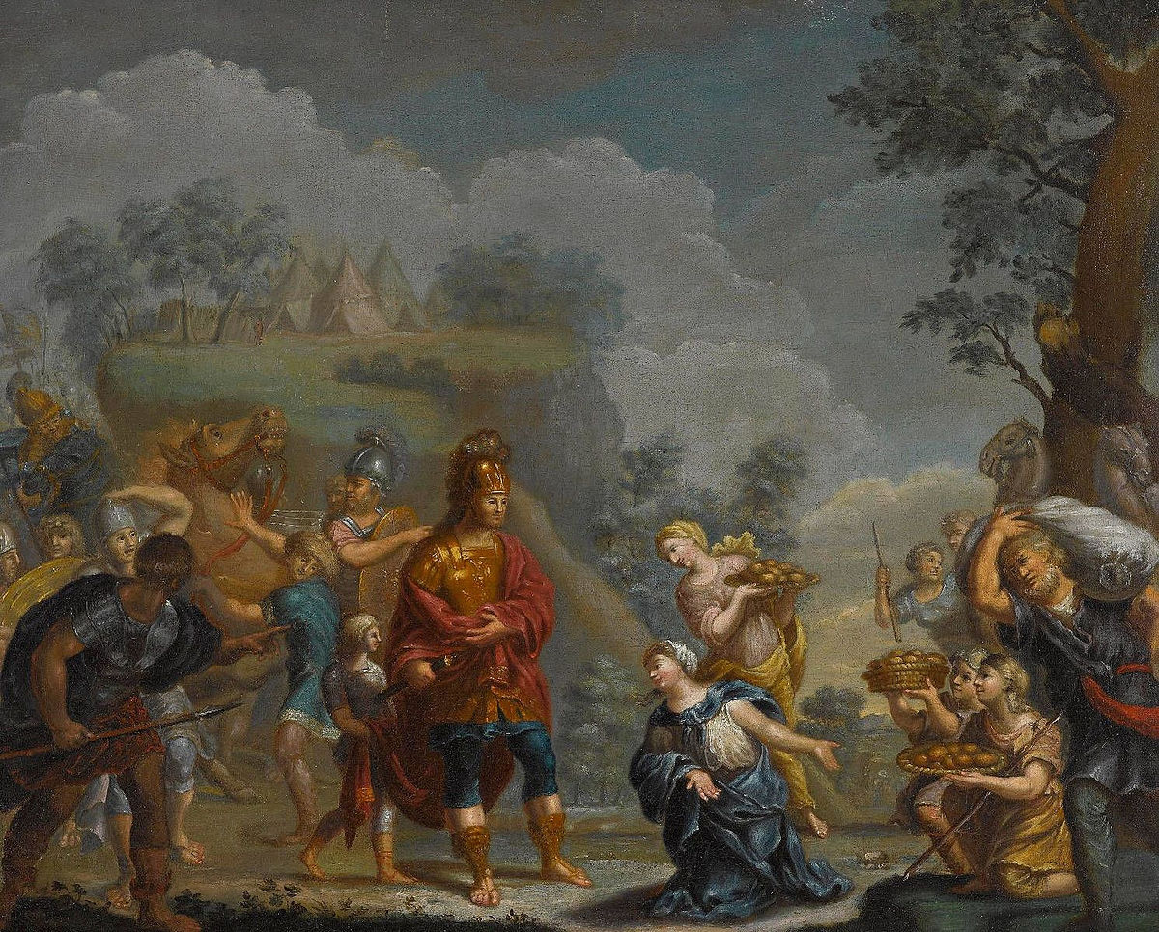
THE DEATH OF SAMUEL
“And Samuel died; and all the Israelites were gathered together, and lamented him, and buried him in his house at Ramah. And David arose, and went down to the wilderness of Paran” (1Sam. 25:1).
At Samuel’s death, David was still on the run.
THE WIVES OF DAVID
At this time, two more wives [Abigail, Ahinoam] were added to the house of David.
Previously, he had married Saul’s daughter, Michal (25:39-44).

Slide 4
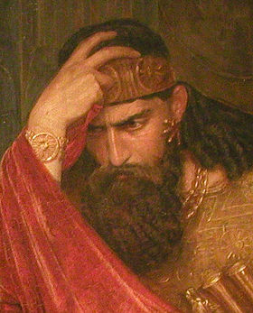
SAUL’S REMORSE
“Then said Saul, I have sinned: return, my son David: for I will no more do thee harm… I have played the fool, and have erred exceedingly” (26:21)…
“Then Saul said to [about] David, Blessed be thou, my son David: and thou shalt both do great things, and also shalt still prevail…” (26:25).
Finally, after about 8-years of intense persecution, Saul realized that God had chosen and protected David so that he could be the next king of Israel.
Saul no longer sought to kill David. But, there was one problem—either David didn’t know or didn’t believe Saul’s change of heart.

Slide 5
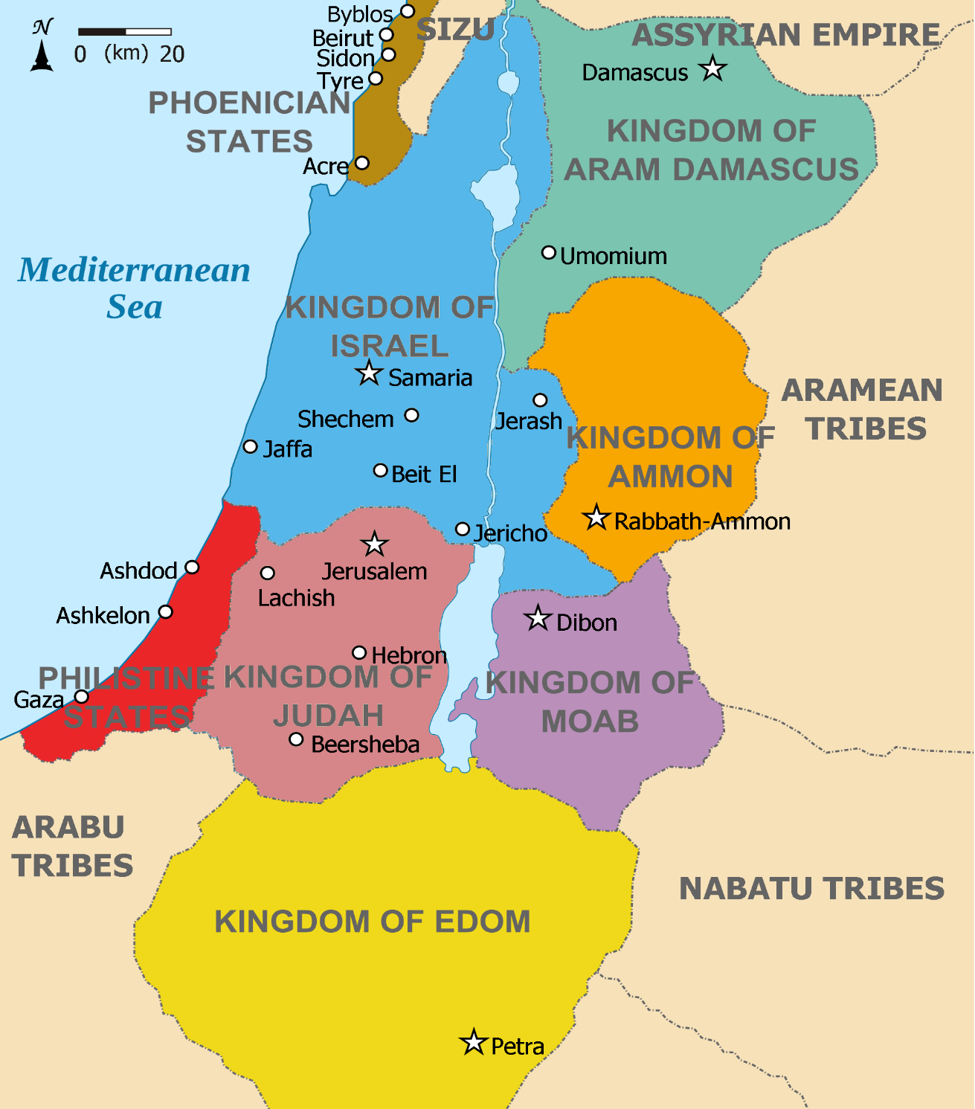
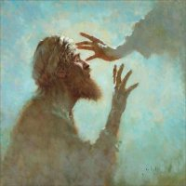
DAVID GOES TO THE ENEMY
“And David said in his heart, I shall now perish by the hand of Saul: there is nothing better for me than that I should speedily escape into the land of the Philistines…” (27:1).
More twists and turns as David sought safety from Saul whom he thought still wanted to kill him.
Of all places, David fled to Israel’s most bitter enemy, the Philistines, believing he might as well die there as to die at the hand of the king of Israel.

Slide 6
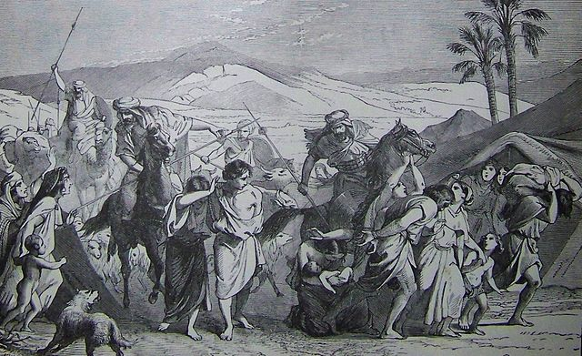
David, with his 2-wives, made a pact with the ruler of Gath [Gaza strip], Achish, where he would spend the next 16-months (27:7). Not only did he believe it gave him safety from Saul, but it allowed him time to hone his military skills he would later need as king. Given a city [Ziklag], David would form a small army and make skirmishes against other pagan tribes in the area –
“And David and his men went up, and invaded the Geshurites, and the Gezrites, and the Amalekites, for those nations were of old the inhabitants of the land… And David smote the land, and left neither man nor woman alive…” (27:8,9), But, he was not altogether honest, telling Achish that the attacks were against his own people in Judah – “And Achish believed David, saying, He hath made his people Israel utterly to abhor him; therefore he shall be my servant for ever” (27:12).

Slide 7
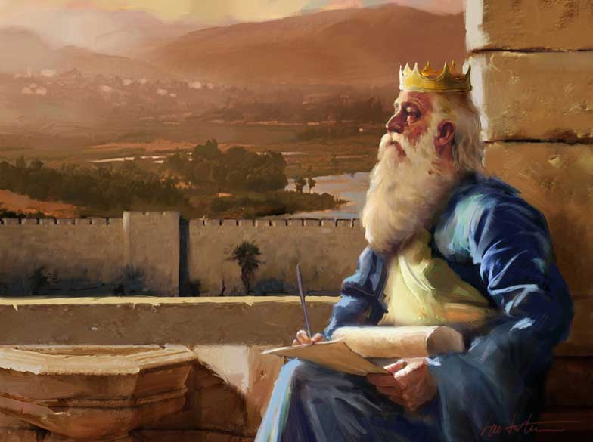
After he became king, David wrote these praises to God for His help when he needed it most –
“Keep me as the apple of thy eye, hide me under the shadow of thy wings” (Psa. 17:8).
“Plead my cause, O LORD, with them that strive with me: fight against them that fight me” (35:1).
“Save me, O God, by thy name, and judge me by thy strength” (54:1).
“O God, thou art my God; early will I seek thee: my soul thirsteth for thee, my flesh longeth for thee in a dry and thirsty land, where no water is” (63:1).

Slide 8
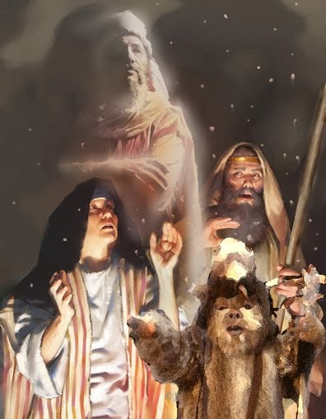
The Philistines began to plan another attack on the Israelites thinking that King Saul was too old to be an effective leader, and that David had joined their side.
Will David fight for or against Israel? What will Saul
do?
THE WITCH OF EN-DOR
“When Saul saw the host of the Philistines, he was afraid, and his heart greatly trembled. And when Saul enquired of the LORD, the LORD answered him not, neither by dreams… nor by prophets [Samuel was dead]” (28:5).
Since God didn’t answer him, Saul consulted a witch –
“Then said Saul unto his servants, Seek me a woman that hath a familiar spirit… Behold, there is a woman that hath a familiar spirit at En-dor… And Saul disguised himself… two men with him… came to the woman by night… I pray thee… bring me him [Samuel] up” (28:7,8).

Slide 9
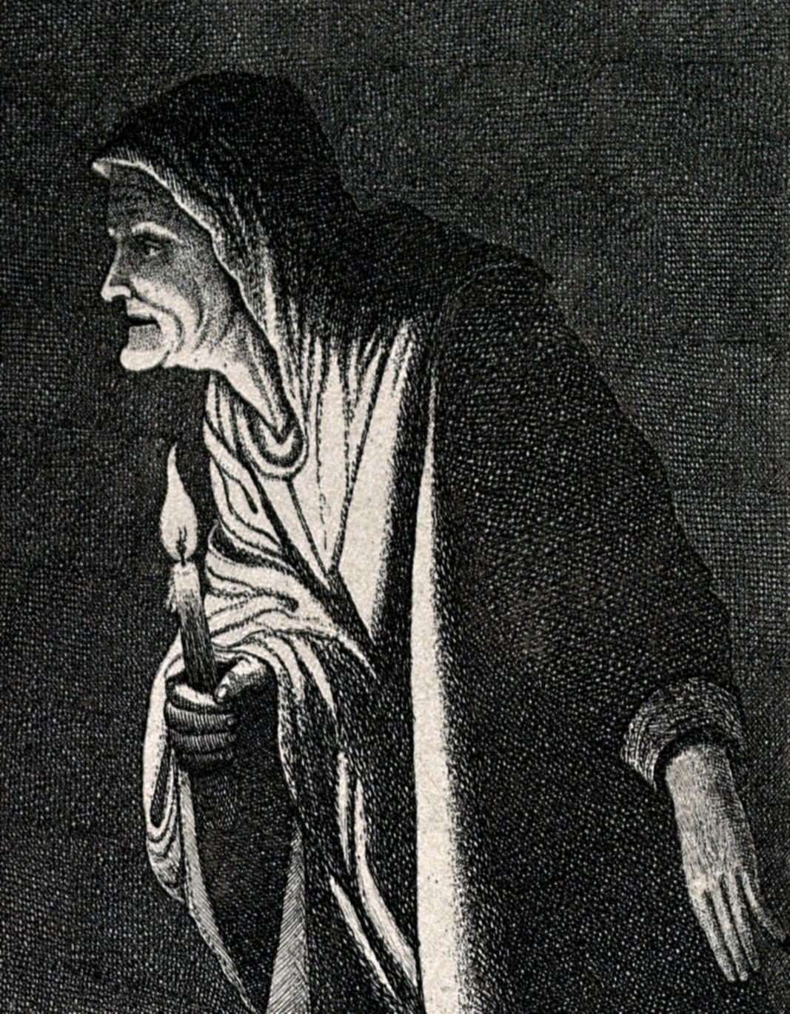
Saul asked the medium to contact the deceased Samuel to know what to do as he faced the Philistines. At first, she feared because Saul had banished the practice, but he convinced her to do so (28:9,10). Using Satanic powers to reach the dead (Deut. 18:10-12), the medium, believing she would reach a spirit representing Samuel, was shocked when Samuel appeared!
“And when the woman saw Samuel, she cried with a loud voice [eeek!!]: and the woman spake to Saul, saying Why hast thou deceived me? For thou art Saul…” (27:12).
When the woman described the apparition as “an old man… covered with a mantle… Saul perceived it was Samuel, and he stooped with his face to the ground, and bowed himself” (27:14).
On this occasion, God permitted Saul to communicate with Samuel one last time, but the news was not good.

Slide 10
“And Samuel said to Saul, Why hast thou disquieted me, to bring me up? And Saul answered, I am sore distressed; for the Philistines make war against me, and God is departed from me… therefore I have called thee, that thou mayest make known unto me what I shall do. Then said Samuel… for the LORD hath rent the kingdom out of thine hand, and given it to thy neighbor, even to David. Because thou obeyest not the voice of the LORD… Moreover the LORD will also deliver Israel with thee into the hands of the Philistines: and tomorrow shalt thou and thy sons be with me… [dead]” (28:16-19).
Samuel told Saul that Israel would be defeated and that he and his sons would be killed.
We don’t have to worry about the witch of End-dor
today, right?
Right. You do not have to worry about her…

Slide 11
Witch of En-dor
We should with the witch on National Highway, LaVale, MD!
Should we consult the powers of darkness (Eph. 2:2) concerning our destiny in the universe, or…
The God of the Bible who possesses all truth over the whole of Creation including you?
You decide!

Slide 12
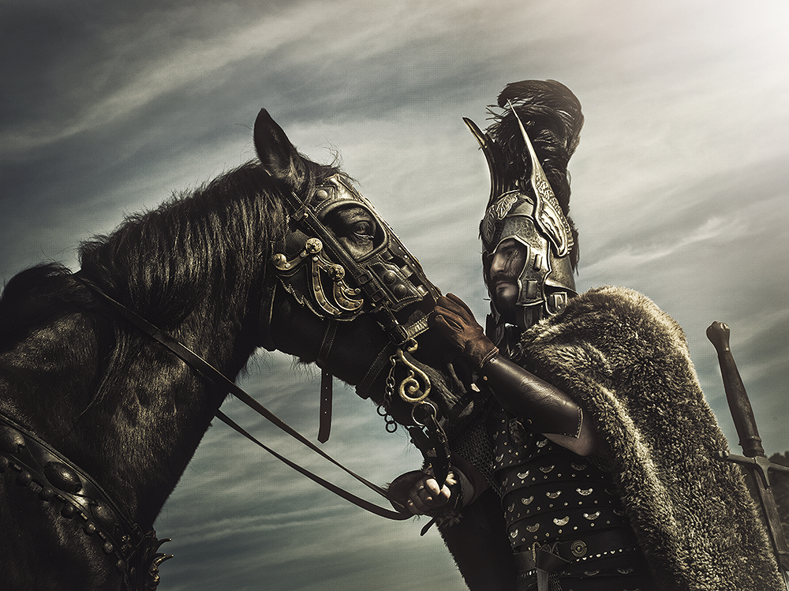
“And it came to pass in those days, that the Philistines gathered their armies together for warfare, to fight with Israel…” (28:1). The Philistines commanders did not trust David, that he might defect so they pulled him out of the battle before it began –
“… He shall not go up with us to the battle. So David and his men rose up early to depart in the morning, to return into the land of the Philistines. And the Philistines went up to Jezreel” (29:7-9).
David was relieved of his duties before he had to decide with whom to fight.
DAVID’S RETURN TO ZIKLAG
“And it came to pass, when David and his men were come to Ziklag… the Amalekites had invaded… So David… came to the city… it was burned with fire… wives, and their sons, and their daughters were taken captives… David and the people… lifted up their voice and wept…” (30:1,2). Now what?

Slide 13
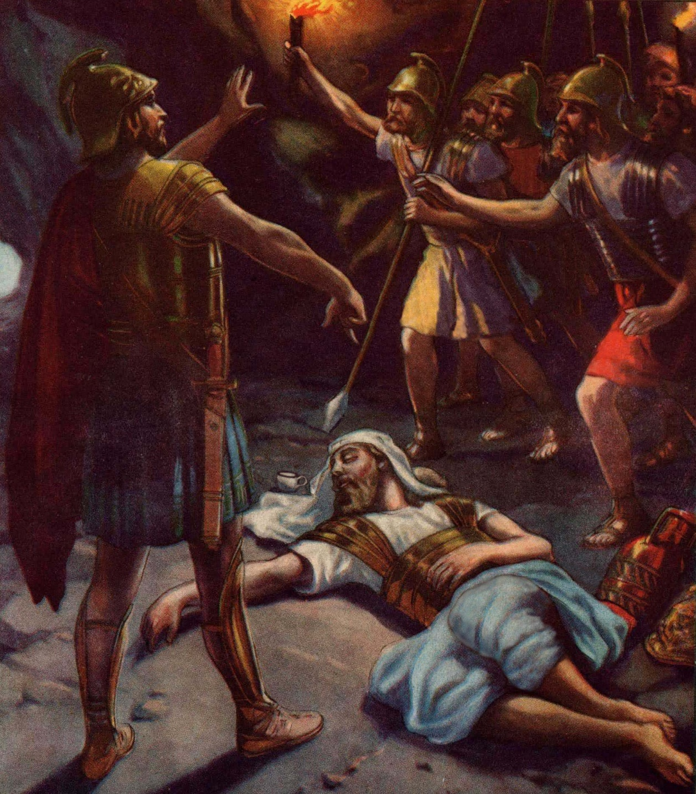
David avenged the destruction of his city and recovered that which was looted, even sharing it with his fellow countrymen in Judah, proving
where his real allegiance lay – “And when David came to Ziklag, he sent of the spoils unto the
elders of Judah, even to his friends, saying, Behold
a present for you of the spoil of the enemies of the LORD” (30:26).
THE DEATH OF SAUL
“Now the Philistines fought against Israel: and the men of Israel fled from before the Philistines, and fell down slain in mount Gilboa… followed hard upon Saul and upon his sons…” (31:1,2).
Israel was routed as Samuel prophesied and Saul and his sons were killed – “So Saul died, and his
[3] sons… all his men, that same day together…
cut off his head … fastened his body to the wall of Beth-shan” (31:7).

Slide 14
Psa. 18 was written by David after the death of Saul –
“I will love thee, O LORD, my strength (18:1)… Great deliverance giveth he to his king; and shewth mercy to his anointed, to David, and to his seed for evermore” (18:50).
Next David contemplated what God had on His agenda for Israel and himself –
“Behold, he [God] that keepeth Israel shall neither slumber nor sleep” (121:4).
“… so our eyes wait upon the LORD our God, until that he have mercy upon us” (123:2).
“If it had not been the LORD who was on our side, when men rose against us, then they had swallowed us up quick, when their wrath was kindled against us” (124:2,3).

Slide 15
“As the mountains are round about Jerusalem, so the LORD is round about his people from henceforth for ever” (125:2).
“The LORD shall bless thee out of Zion: and thou shalt see the good of Jerusalem all the days of thy life” (128:5).
“Many a time have they afflicted me from my youth, may Israel now say: yet they have not prevailed against him” (129:1-3).
“Let Israel hope in the LORD; for with the LORD there is mercy, and with him is plenteous redemption” (130:7).

Slide 16
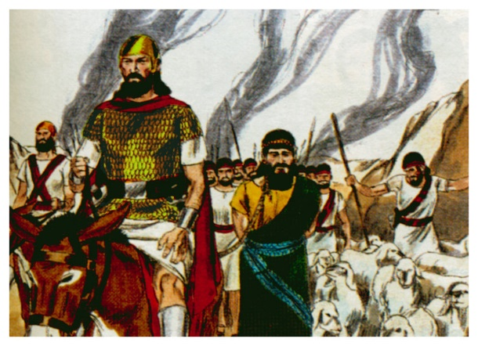
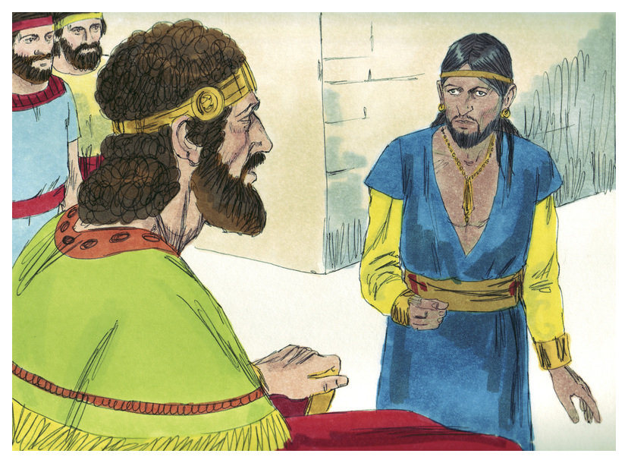
“Now it came to pass after the death of Saul, when David was returned from the slaughter of the Amalekites, and David had abode two days in Ziklag… (2Sam. 1:1)… on the 3rd day… a man came out of the camp from Saul… from whence camest thou… Out of the camp of Israel am I escaped… How went the matter [battle]? I pray thee, tell me. And he answered… many of the people [soldiers] are fallen and dead; and Saul and Jonathan his son are dead also… (1:2-5)… and I took the crown that was upon his [Saul] head… and have brought them hither unto my lord [David]… and they mourned, and wept, and fasted until evening, for Saul, and for Jonathan his son… and for the house of Israel; because they were fallen by the sword” (1:10-12).
Despite Saul’s harsh treatment of him, David mourned for the fallen king and his son.

Slide 17
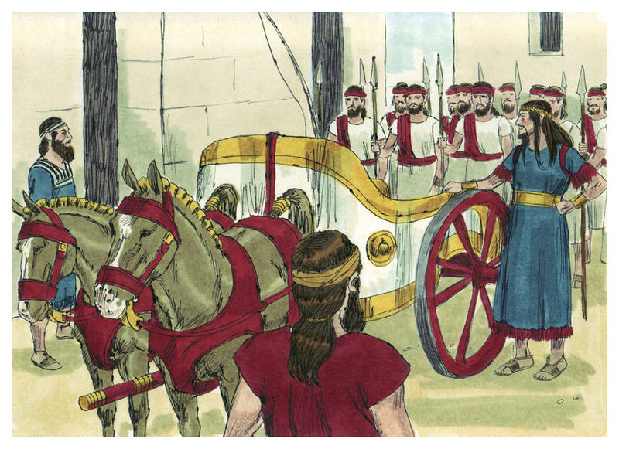
After the death of Saul – “And it came to pass after this, that David enquired of the LORD, saying, Shall I go up into any of the cities of Judah? And the LORD said unto him, Go up. And David said, Whither shall I go up? And he [LORD] said, Unto Hebron” (2:1).
God told David to go from Ziklag to Hebron, the city where the Patriarchs of Israel were buried.
“And the men of Judah came, and there they anointed David king over the house of Judah… And the time that David was king in Hebron over the house of Judah was [7] years and [6] months” (2:4,11).
Wanting Saul’s legacy to continue, Abner, captain of Saul’s army, made Ish-bosheth [fire of Baal], Saul’s youngest son king over the remaining 11-tribes of Israel (2:8-10).
Who do you think God wanted to be king over all Israel?

Slide 18
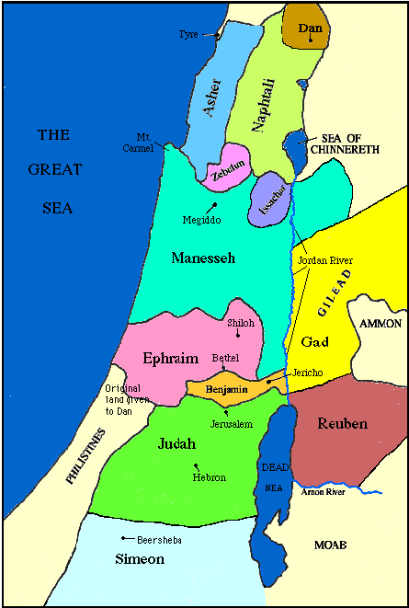
CIVIL WAR
Joab was the commander of David’s army and Abner of Saul’s
army and they squared off against each other. When it was
over David lost 20 soldiers and Abner 360 (2:30,31), but it
would be a long war between the two factions –
“Now there was long war between the house of Saul and the
house of David: But David waxed stronger, and the house of
Saul waxed weaker and weaker” (3:1).
Eventually there came a riff between Abner and Ish-bosheth
over Abner’s taking a concubine of Saul, which angered
Ish-bosheth. Not only did the two part company (3:7) –
“… as the LORD hath sworn to David, even so I [Abner] do to
him. To translate the kingdom from the house of Saul, and to
set up the throne of David over Israel and over Judah, from
Dan to Beersheba” (3:9,10).
Abner pledged to make David king over the whole kingdom of Israel, which was God’s plan.

Slide 19
To make sure Abner was acting in good faith, David made him return his 1st wife, Michal, to him –
“And he said, Well; I will make a league with thee: but one thing I require of thee, that is, Thou shalt not see my face, except thou first bring Michal Saul’s daughter…” (3:13), which
he did (3:15,16).
Because Abner had made this alliance with David, Joab got jealous –
“And when Abner was returned to Hebron, Joab took him aside in the gate to speak with him quietly, and smote him there under the [5th] rib, that he died, for the blood of Asahel his brother” (3:27).
Joab avenged the murder of his brother with the knife killing of his adversary Abner.

Slide 20
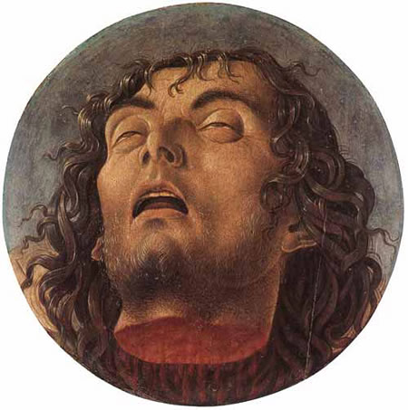
“And when Saul’s son [Ish-bosheth] heard that Abner was dead in Hebron, his hands were feeble, and all the Israelites were troubled” (4:1).
The report of the death of Abner [who had defected Ish-botheth and the 11-tribes of Israel], should have encouraged the king and his on-going battle with David, but it did not.
Two assassins from the tribe of Benjamin went to the Ish-bosheth’s palace and slew him [king] –
“For when they came into the house, he lay on his bed-chamber, and they smote him, and slew him, and beheaded him… And they brought the head of Ish-bosheth unto David at Hebron…” (4:7,8).
David did not approve of it and had the two assassins executed (4:11,12).

Slide 21
“The LORD hath heard my supplication; the LORD will receive my prayer (Psa. 6:9)… For thou hast made him a little lower than the angels, and hast crowned him with glory and honour” (8:5).
Here David recites a Messianic prayer that the LORD will humble Himself and become man.
“I will praise thee, O LORD, with my whole heart; I will shew forth all thy marvelous works (9:1)… The LORD is King for ever and ever; the heathen are perished out of his land (10:16)… The fool has said in his heart, There is no God. They are corrupt, that have done abominable works, there is none that doeth good” (14:1). Paul quoted this in Rom. 3:12.
“For thou wilt not leave my soul in hell; neither wilt thou suffer thine Holy One to see corruption” (16:10). Peter quoted this in Acts 2:31.

Slide 22
NEXT TIME – More PSALMS; 1CHRONICLES 1-6

