Slide 1
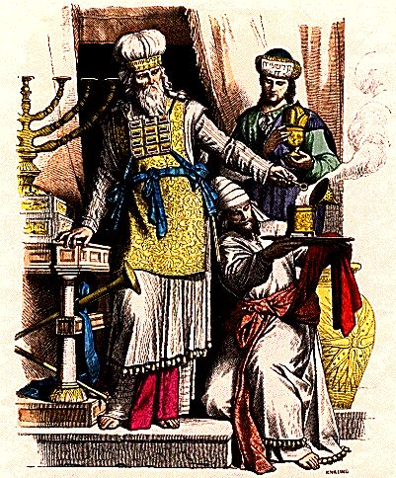
THROUGH THE BIBLE IN 2018
LESSON 37
WEEK 37 OF 52
(Ezek. 43-48; Joel;
Dan. 1-12)
Last time we saw Ezekiel’s description of the 3rd temple ; this time Joel & Daniel.
PURIFICATION PROCESS
“And thou shalt give to the priests the Levites that be of the
seed of Zadok, which approach unto me, to minister unto
me, saith the Lord God, a young bullock for a sin-offering…
[7] days shalt they purge the altar and purify it… upon the
[8th], and so forward, the priests shall make your burnt-
offerings upon the altar, and your peace-offerings; and I
will accept you, saith the Lord God” (43:19).
Similar to the dedication ceremonies carried out by Moses
at the wilderness tabernacle and Solomon at his temple,
Ezekiel says this millennial temple must be sanctified with
blood for 7-days. Beginning on the 8th day, a regular system of blood offerings will begin.

Slide 2
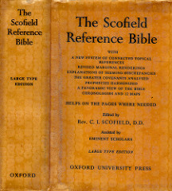
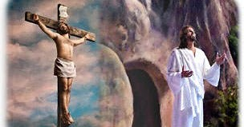
“Doubtless these offerings will be memorial, looking back to the cross, as the offerings under the old covenant were anticipatory, looking forward to the cross. In neither case have animal sacrifices power to put away sin” Heb. 10:4; Rom. 3:25 (Old Scofield, p. 890).
A regular system of blood offerings will be
re-instituted during Christ’s millennial reign, which will be accepted of God (Previously, under Isaiah, God would NOT receive them because of their idol worship—now He will).
Why would God re-institute the sacrifice of innocent animals after Christ has shed His blood for the atonement of all sin?
They will be a daily reminder to Israel and the Gentile world that Christ Jesus shed His blood for their sin.

Slide 3
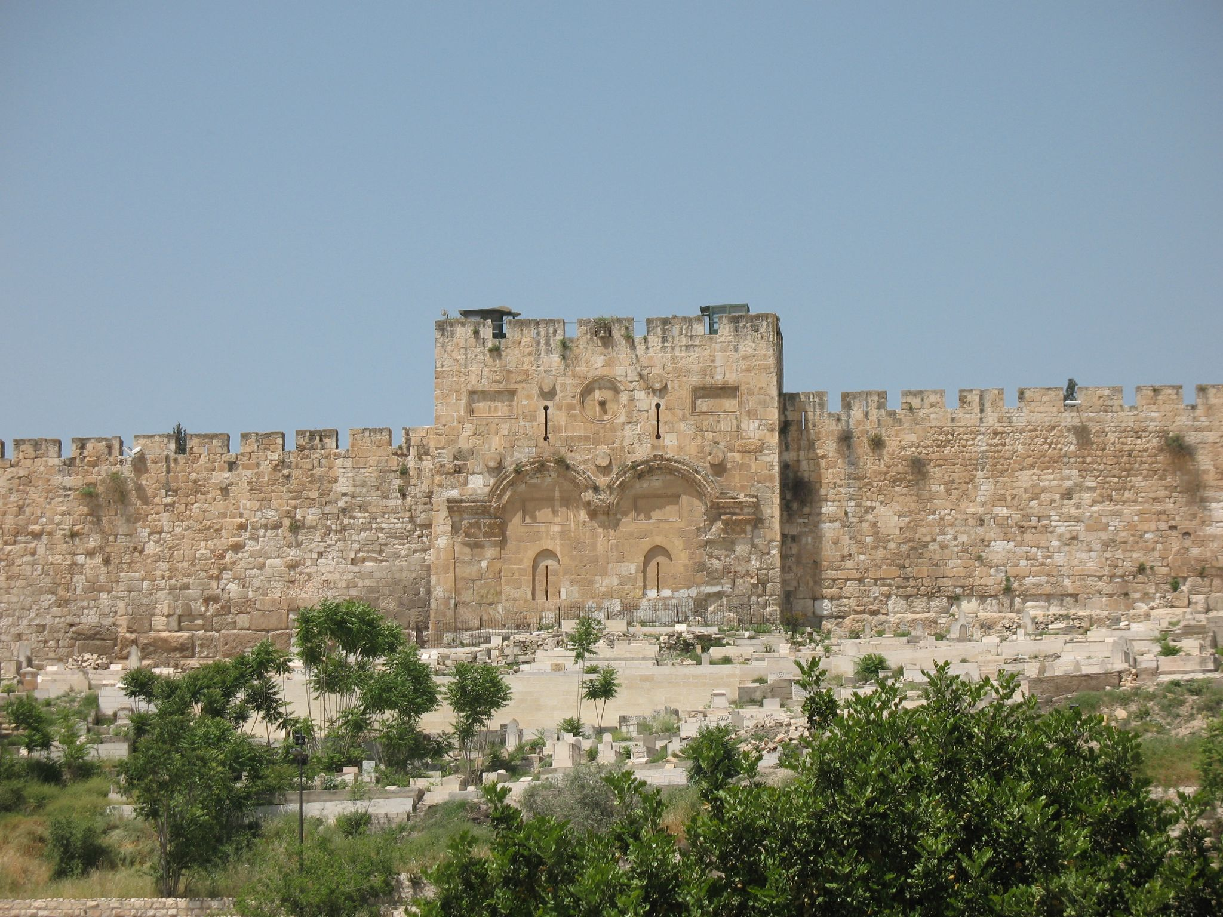
EASTERN GATE CLOSED
“Then he brought me back the way of the gate of the outward sanctuary which looketh toward the east; and it was shut. Then said the LORD unto me; This gate shall be shut, it shall not be opened, and no man shall enter in by it; because the LORD, the God of Israel, hath entered in by it, therefore it shall be shut” (44:1,2).
Because Christ entered the millennial temple through the eastern gate, it was to be forever closed [at right,
a 12th century eastern gate closed, a 1st century gate directly under after the entrance of Christ in 31 A.D.].
“It is for the prince; the prince, he shall sit in it to eat bread before the LORD…” (44:3).
The prince, already identified as king David (34:24; 37:24,25), will be given the honor of sitting in that closed off area where he fellowships with Christ.

Slide 4
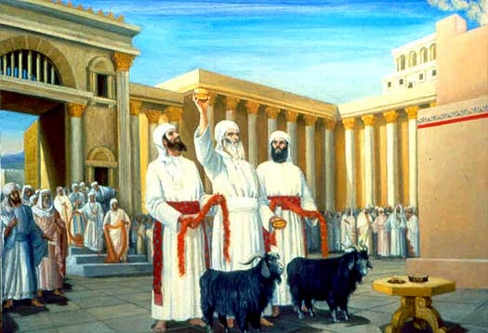
FUTURE TEMPLE PRIESTHOOD
“Thus saith the Lord God; No stranger, uncircumcised in heart… nor flesh, shall enter into my sanctuary… And the Levites… shall be ministers in my sanctuary… they shall slay the burnt-offerings and the sacrifice of the people… I will make them keepers of the charge of the house…” (44:9-14).
Though the whole nation will become ‘a kingdom of priests’ (Exo. 19:6), in that they will be a ‘light to the Gentiles,’ only the Levites will be permitted to carryout
the worship system in the millennial temple.
“They shall eat the meat-offering, and the sin-offering, and the trespass–offering; every dedicated thing in Israel shall be their’s” (44:29).
Nothing will be wasted, as the priests are given permission to eat the sacrifices after they have been offered to God.

Slide 5
HOUSES FOR THE PRIESTS
“Moreover, when ye shall divide by lot the land for inheritance … an holy portion of the land… shall be for the priests the ministers of the sanctuary… it shall be a place for their houses, and an holy place for the sanctuary” (45:1-4).
In the area outside the millennial temple, the priests are given a parcel of land to build houses and live in close to the temple.
“And a portion shall be for the prince [David] on the one side and on the other side… In the land shall be his possession in Israel” (45:7).
David will be given a parcel of land to live on which will be in close proximity to the millennial temple in Jerusalem.
“… ye shall have the passover, a feast of [7] days; unleavened bread shall be eaten… in the [7th] month, shall he do the like in the feast [tabernacles] of the seven days…” (45:21,25).
Two feast days, each lasting [7] days, will be celebrated, passover/unleavened bread [April] and tabernacles [October].

Slide 6
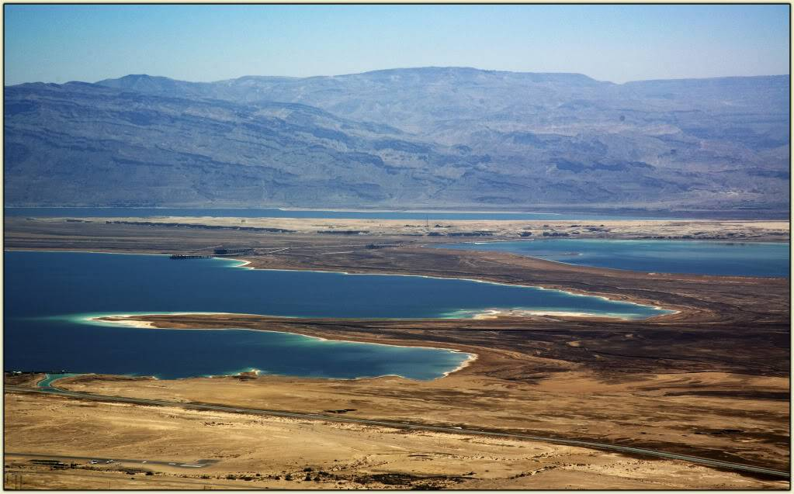
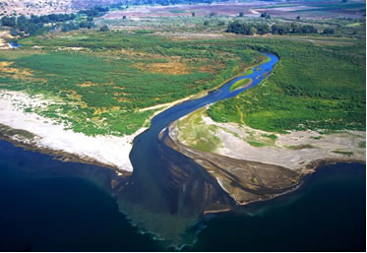
A RIVER OF LIVING WATER
“Afterward he brought me again unto the door of the house; and, behold waters issued out from under the threshold of the house eastward… (47:1).
To his astonishment, Ezekiel saw a vision of a river running under the temple and flowing eastward through the Kidron Valley onward to the Dead Sea –
“And it shall come to pass, that every thing that liveth, which moveth, whithersoever the rivers shall come, shall live: and there shall be a great multitude of fish…” (47:9,10).
The river of life flows from Jerusalem to the Dead Sea, which is presently about 33% salt [oceans are 6%]. Note: the river divides and one section flows to the Mediterranean (Zech. 14:8).

Slide 7
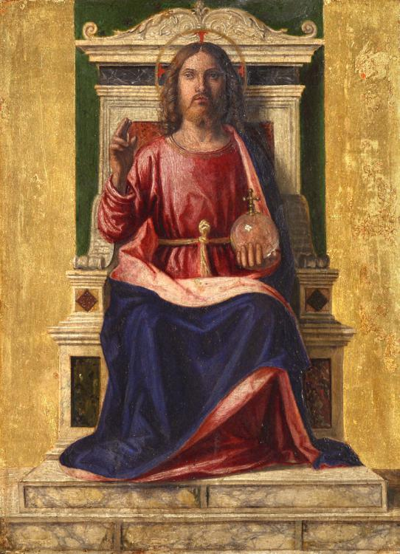
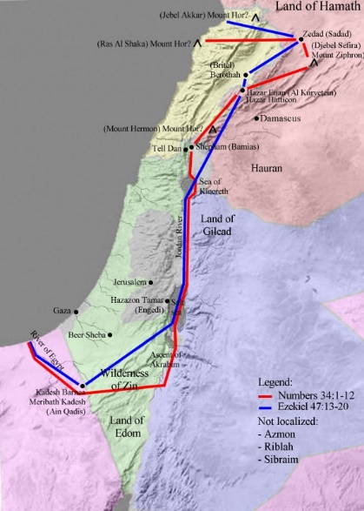
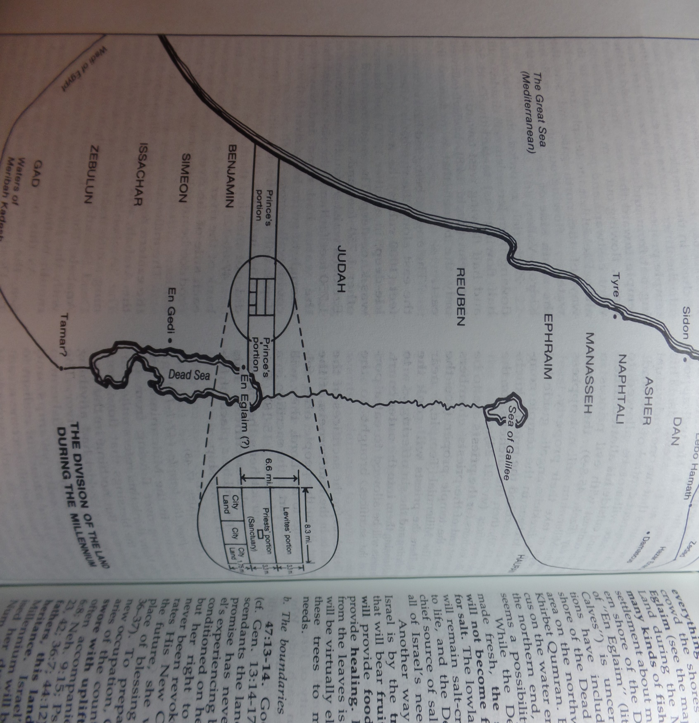
BORDERS OF THE LAND IN THE KINGDOM
“Thus saith the Lord God; This shall be the border, whereby ye shall inherit the land according to the twelve tribes of Israel…” (47:13-23).
The land given to Israel during the kingdom age will be nearly the same that God promised to Abraham –
“… Unto thy seed have I given this land, from the river of Egypt unto the great river, Euphrates” (Gen. 15:18).
DIVISION OF LAND IN THE KINGDOM
“… the names of the tribes… Dan… Asher… Naphtali… Manasseh… Ephraim… Reuben… Judah… Benjamin… Simeon… Issachar… Zebulun… Gad…” (48:1-9).
The tribes are listed from north to south with the temple, the Levites, priests, and king David’s parcel in the center portion. The last verse in Ezekiel –
“… and the name of the city… shall be, The LORD is there” (48:35).

Slide 8
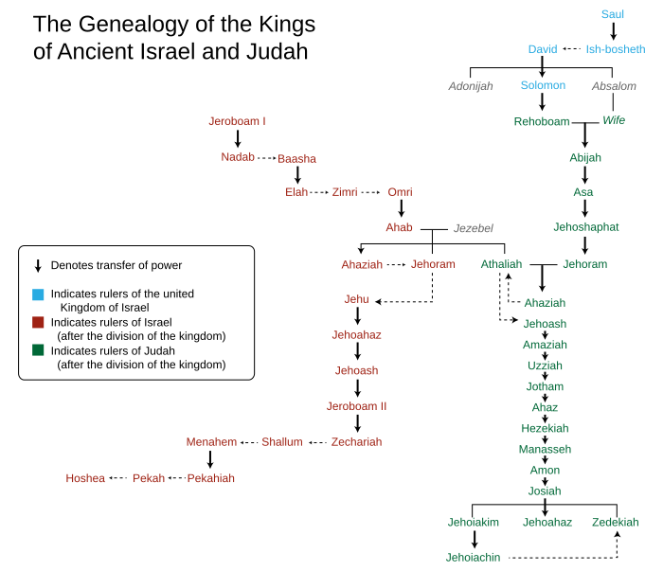
BOOK OF JOEL
“Joel, a prophet of Judah, probably exercised his ministry during the reign of Jehoash (2Chron. 22-24)… was a contemporary of Elisha. The plagues of insects, which the token of the divine chastening, give occasion for the unveiling of the coming day of the LORD’’
(Old Scofield, p. 930).
Scofield cites Joel’s ministry during king Jehoash of Judah, and uses Ussher’s date at 800 B.C. –
“The word of the LORD that came to Joel the son of Pethuel” (1:1).
The only background information is the name of his father. It begins abruptly and has a distinctive theme, fear, and perhaps the earliest of any tribulation teaching –
“Hear this, ye old men, and give ear… tell your children, and their children’s children…” (1:3).

Slide 9
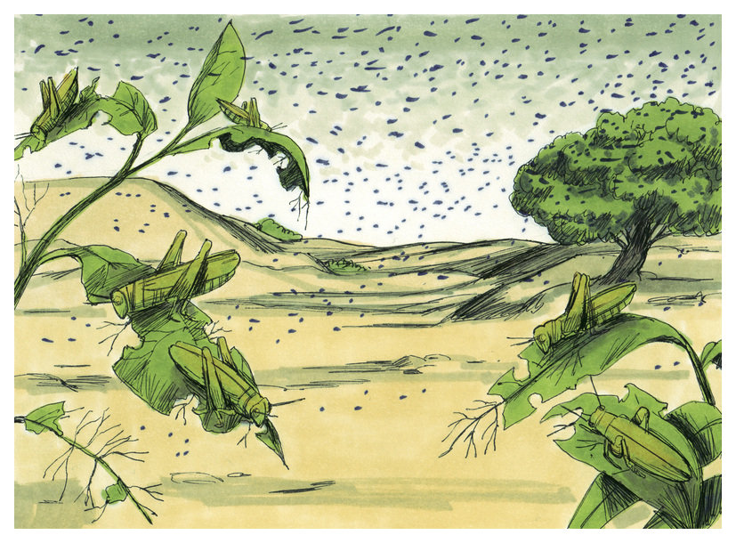
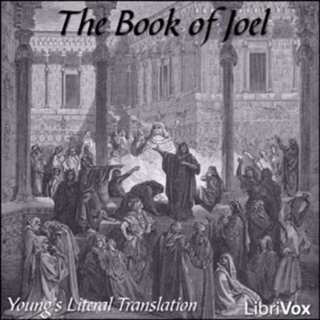
“That which the palmerworm hath left hath the locust eaten; and that which the locust hath left hath the cankerworm eaten; and which the cankerworm hath left hath the caterpillar eaten. Awake… For a nation is come up upon my land, strong, and without number, whose teeth are the teeth of a lion…” (1:4-6).
Though set prior to the invasion of the king of Assyria and destruction of the northern kingdom [Israel], this horrific vision is more likely a long range warning of the early days of the tribulation—a world wide plague of locusts –
“And I looked, and behold a pale horse… and power was given unto them over 1/4th part of the earth… with hunger, and with death” (Rev. 6:8).
Early in the tribulation, the antichrist is given power to kill ¼ of the earth’s population, partly by plague producing food shortages and starvation.

Slide 10
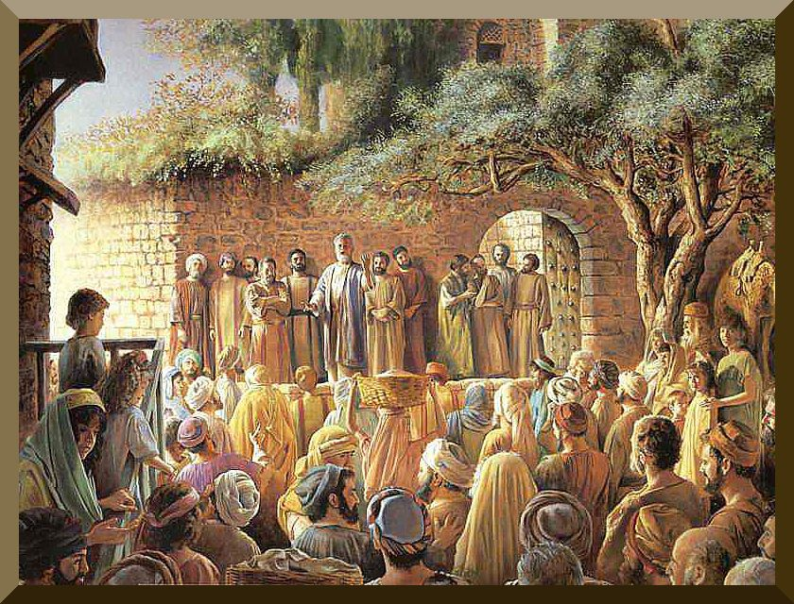
PETER ON PENTECOST
“But this is that which was spoken by the prophet Joel [Joel’s warning was of the tribulation. If Peter was quoting Joel, then Peter’s warning was of the same—the tribulation!] And it shall come to pass in the last days, saith God, I will pour out of my Spirit upon all flesh and your sons and your daughters shall prophesy, and your young men shall see visions, and your old men shall dream dreams. And on my servants and on my handmaidens I will pour out in those days of my Spirit; and they shall prophesy…” (Acts 2:16-18).
Joel’s prophesy of the out-pouring of the Holy Spirit upon all flesh was being fulfilled in preparation for the next major event in Israel’s future [tribulation].
The Holy Spirit would give believing Jews supernatural spiritual abilities in order to survive 7-years of hell on earth, but…

Slide 11
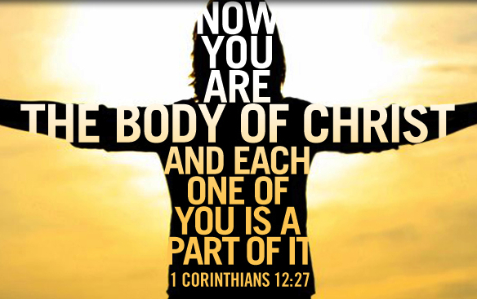
… Peter didn’t finish the passage spoken by Joel.
He left out the last part just like Christ did in the synagogue in Nazareth –
“And I will shew wonders in heaven above, and signs in the earth beneath, blood, and fire, and vapour of smoke: The sun shall be turned into darkness, and the moon into blood, before that great and notable day of the Lord come…” (Acts 2:19,20).
Why did Peter not finish Joel’s prophesy?
Just as it looked like the tribulation would begin, God put it on-hold. Why?
In order to usher in a previously unprophesied Mystery age [Church]; a new dispensation [Grace]; a new Apostle [Paul]; and a new body of believers [Body of Christ composed of mainly Gentiles].
Today God is not trying to save a nation, but believers-into-One-Body [Christ] from all nations.

Slide 12
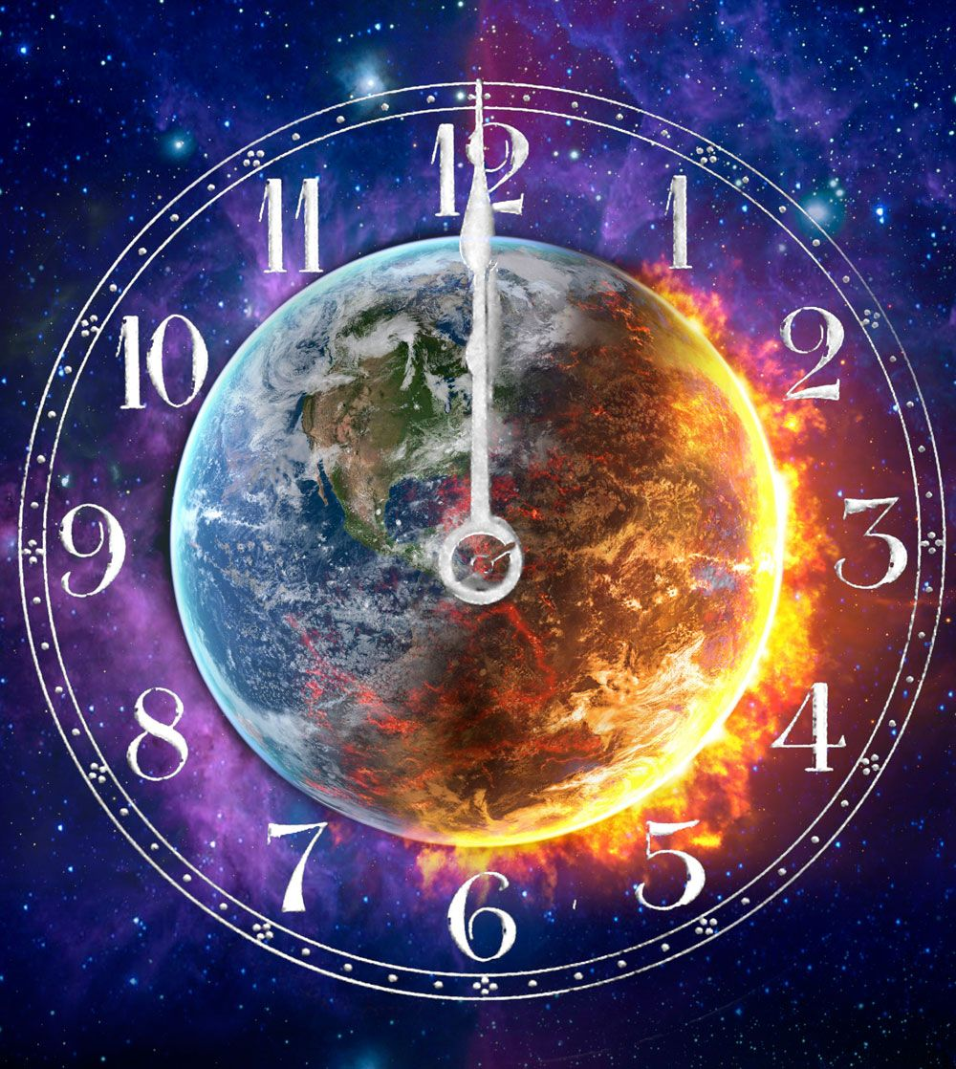
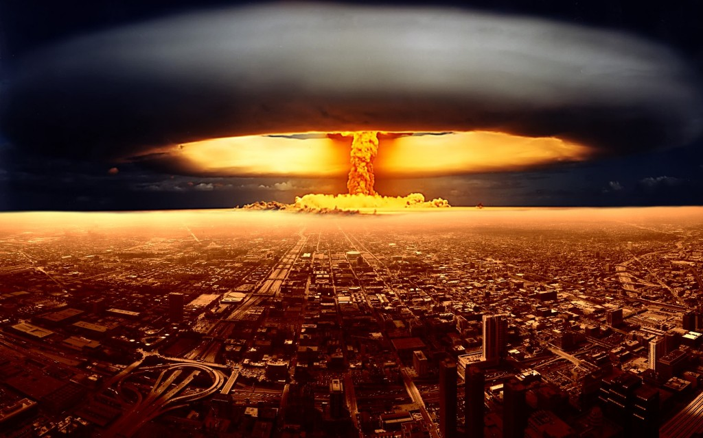
TRIBULATION (Cont’d)
“Alas for the day! For the day of the LORD is at hand, and as a destruction from the Almighty shall it come… the meat cut off before our eyes… the seed is rotten under their clods… barns are broken down… corn is withered… cattle are perplexed, because they have no pasture… fire hath devoured the pastures… the flame hath burned all the trees of the field… the rivers of waters are dried up…” (1:15-20).
God’s grace has run out and now His wrath is being poured out on an unbelieving world.
“The earth shall quake before them, the heavens shall tremble: the sun and the moon shall be dark, and the stars shall withdraw their shinning (2:10)… And I will shew wonders in the heavens and in the earth, blood, and fire, and pillars of smoke” (2:30).
A nuclear war? No. This destruction is beyond that of which man is capable; it is the wrath of God!

Slide 13
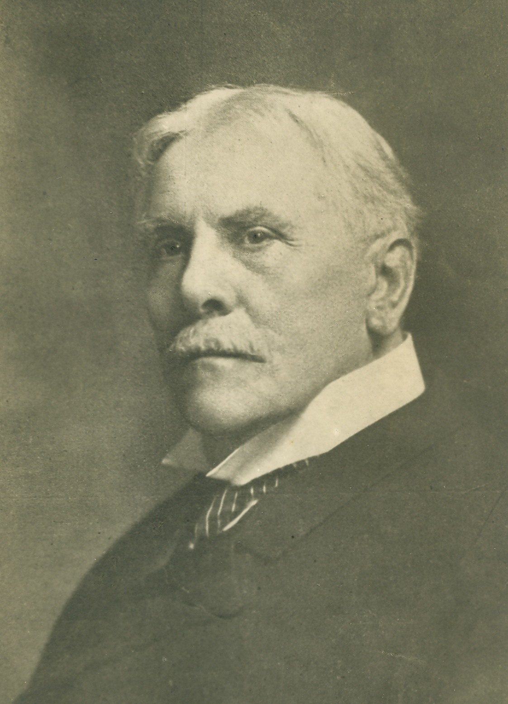
DANIEL
“Daniel, like Ezekiel, was a Jewish captive in Babylon. He was of royal or princely descent (1:3). For his rank and comeliness he was trained for palace service. In the polluted atmosphere of an oriental court he lived a
life of singular piety and usefulness. His long life extended from Nebuchadnezzar to Cyrus… Daniel is the indispensable introduction to the New Testament prophecy, the themes… manifestation of the man of sin, the great tribulation, the return of the LORD, the resurrections and the judgments… But Daniel is distinctively the prophet of the ‘times of the Gentiles’ (Lk. 21:24). His vision sweeps the whole course of Gentile world-rule to its end in catastrophe, and to the setting up of the Messianic kingdom… The events recorded in Daniel cover a period of 73 years [Ussher]” (Old Scofield, p. 898).

Slide 14
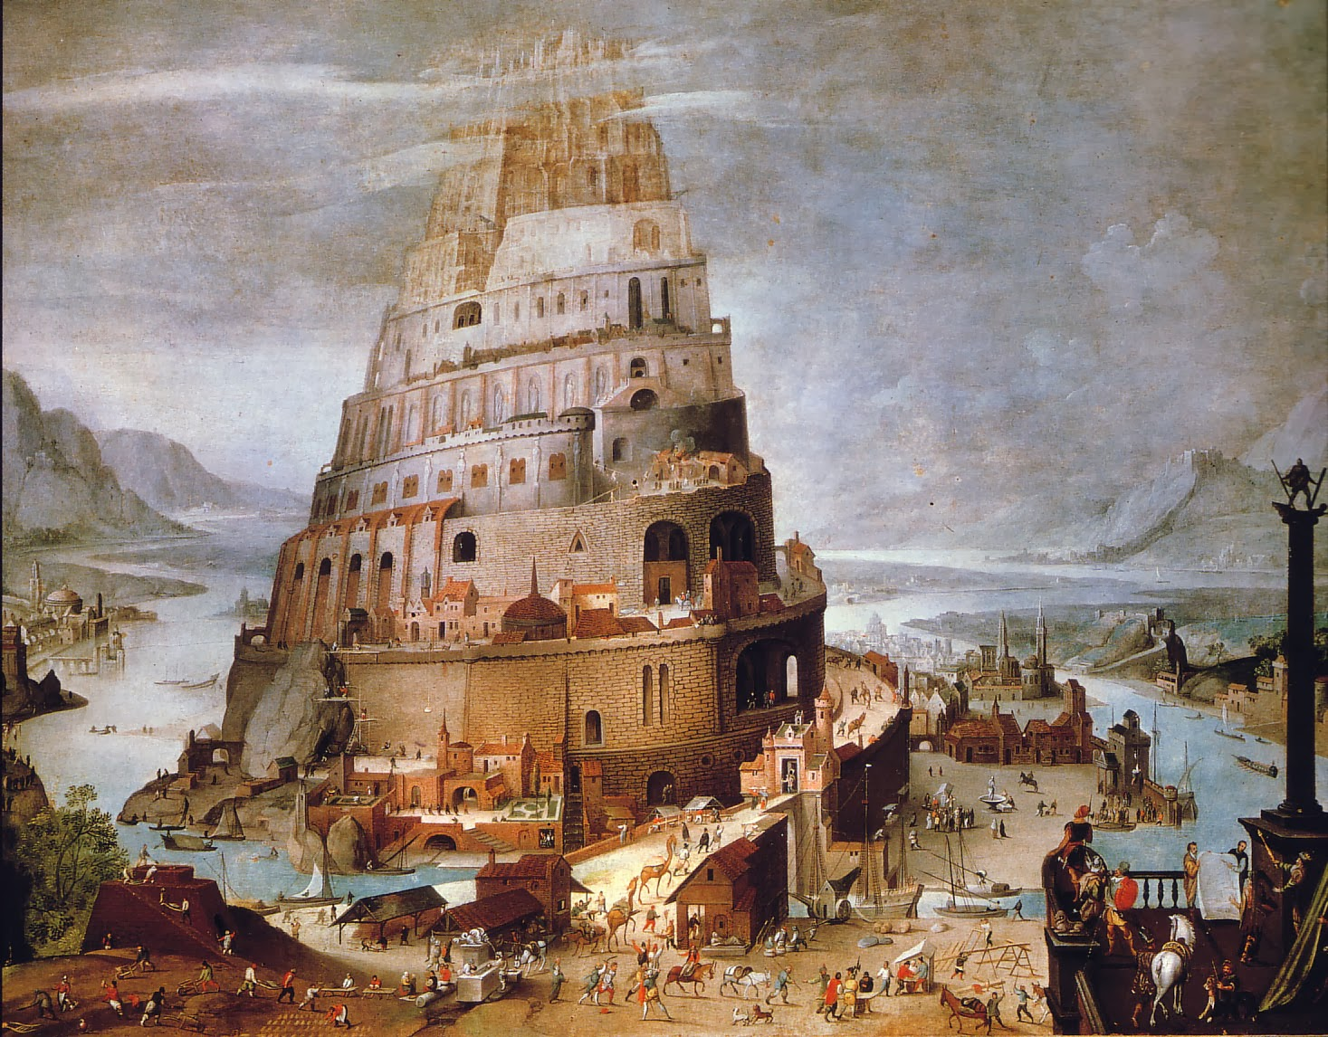
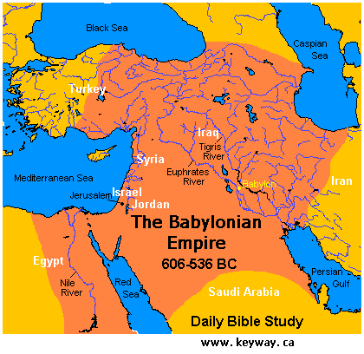
“In the 3rd year of the reign of Jehoikim king of Judah came Nebuchadnezzar king of Babylon unto Jerusalem, and besieged it. And the Lord gave Jehoiakim… into his hand, with part of the vessels of the house of God: which he carried into the land of Shinar to the house of his god; and he brought the vessels into the treasure house of his god” (Dan. 1:1,2).
In the year 607 B.C. Nebuchadnezzar attacked Jerusalem. As Jeremiah had prophesied it, the people did little to defend the city, and it was easily captured as was its king, Jehoiakim, the eldest son of Josiah. Nebuchadnezzar took some of the vessels from the temple and carried them back to the temple of his god in Shinar –
“And the beginning of his [Nimrod’s] kingdom was Babel… in the land of Shinar (Gen. 10:10)… they journeyed from the east, that they found a plain in the land of Shinar… let us build a city and a tower” (Gen. 11:2,4).
Nebuchadnezzar’s temple of his god was in the same place where Satan began the rebellion and Nimrod built the tower of Babel.

Slide 15
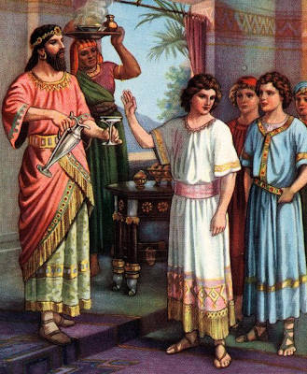
“And the king spake unto Ashpenaz the master of his eunuchs, that he should bring certain of the children of Israel, and of the king’s seed… Children in whom was no blemish, but well favoured, and skillful in wisdom… knowledge… science, and such as had ability in them to stand in the king’s palace, and whom they might teach the learning and the tongue of the Chaldeans [Babylonians]… And the king appointed them a daily provision of the king’s meat… so nourishing them 3-years, that at the end thereof they might stand before the king. Now among these were of the children of Judah, Daniel… Shadrach… Meshach… Abednego… But Daniel purposed in his heart that he would not defile himself with the portion of the king’s meat, nor with the wine… Now God had brought Daniel into favour and tender love with the prince of the eunuchs” (1:3-9).
No more than a teenager, Daniel proved his steadfast faith by not eating that which was forbidden in the Law of Moses (Exo. 34:15).

Slide 16
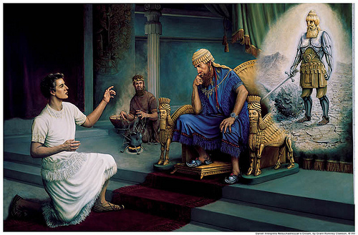
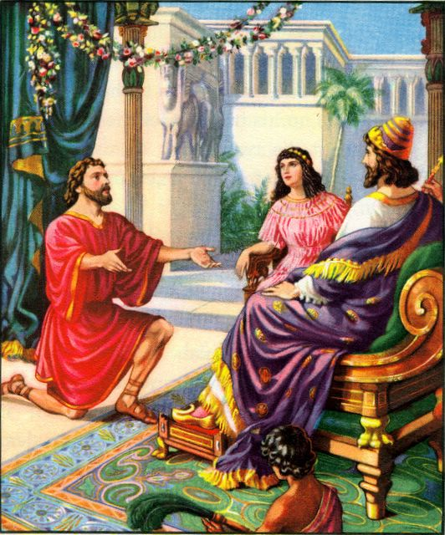
God gave Daniel great knowledge so he could discern those things that would come up in his position of responsibility in the king’s court –
“In the 2nd year of the reign of Nebuchadnezzar… dreamed dreams… his spirit was troubled… call the magicians… astrologers… sorcerers” (2:1,2), but they couldn’t interpret them (2:10,11), which angered the king (2:12). Then Daniel got his chance, “Then was the secret revealed unto Daniel (2:19)… He [God]… removeth kings, and setteth up kings (2:21)… there is a God in heaven that revealeth secrets… maketh known to the king what shall be in the latter days (2:28)… this is the dream and we will tell the interpretation thereof before the king” (2:36).
Nebuchadnezzar’s dream was that of an image of a man who encompassed 5-world empires, which would come one after another. They would be Gentile kingdoms who would rule over Israel during the “times of the Gentiles” (Lk. 21:24).

Slide 17
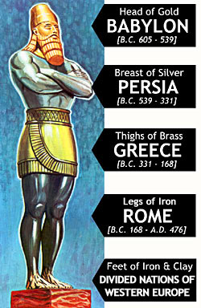
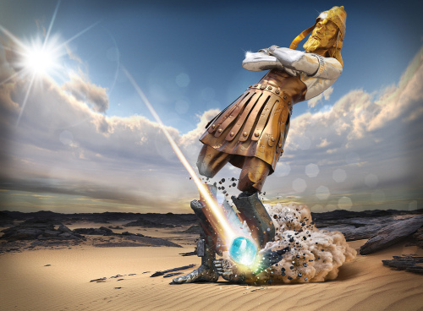
“… thou [Nebuchadnezzar] art this head of gold” (2:38).
BABYLON
“And after thee shall arise another kingdom inferior to thee…” (2:39a).
MEDIA-PERSIA
“… and another 3rd kingdom of brass…” (2:39b).
GREECE
“And the 4th kingdom shall be strong as iron…” (2:40).
ROME
“And as the toes of the feet were part of iron, and part of clay, so the
kingdom shall be partly strong, and partly broken [brittle]” (2:42).
EMPIRE OF THE LAST DAYS
“And in the days of these kings shall the God of heaven set up a
kingdom, which shall never be destroyed: and the kingdom… it shall
break in pieces and consume all these kingdoms, and it shall stand forever. Forasmuch as thou sawest that the stone [Christ]… it brake in pieces the iron, brass, clay, silver, and gold…” (2:44,45).
The final kingdom = MILLENNIAL KINGDOM OF GOD

Slide 18
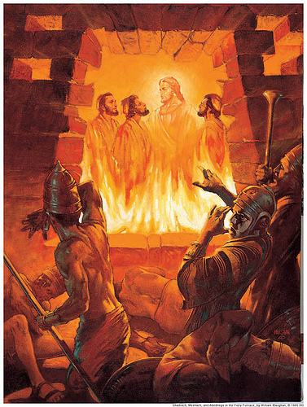
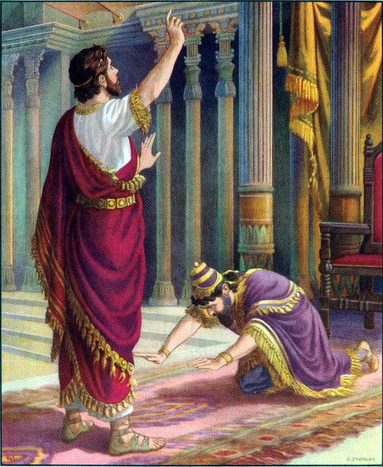
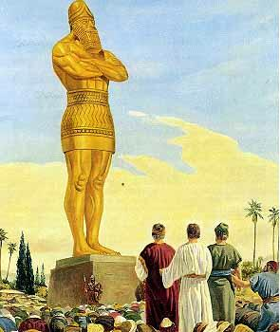
“Then the king Nebuchadnezzar fell upon his face, and worshipped Daniel… and said, Of a truth it is, that your God is a God of gods,
and Lord of kings, and a revealer of secrets (Deut. 29:29), seeing thou couldest reveal this secret. Then the king made Daniel a great man… made him ruler over the whole province of Babylon… over all the wise men of Babylon” (2:46-48).
God elevated Daniel so that he could minister over his fellow Jews while held in this 70-year captivity in Babylon [like Joseph in Egypt].
“Nebuchadnezzar the king made an image of gold… ye shall fall down and worship the golden image… whoso falleth… be cast into the midst of a burning fiery furnace” (3:1,5,6).
Filled with pride, the king had a golden image made of himself and
required worship of it. Guess who refused? Guess who survived
the fiery furnace? Guess who was with them?
“… Lo, I see 4-men loose, walking in the midst of the fire, and they have no hurt; and the form of the 4th is like the Son of God” (3:25).
Christ was with them!

Slide 19
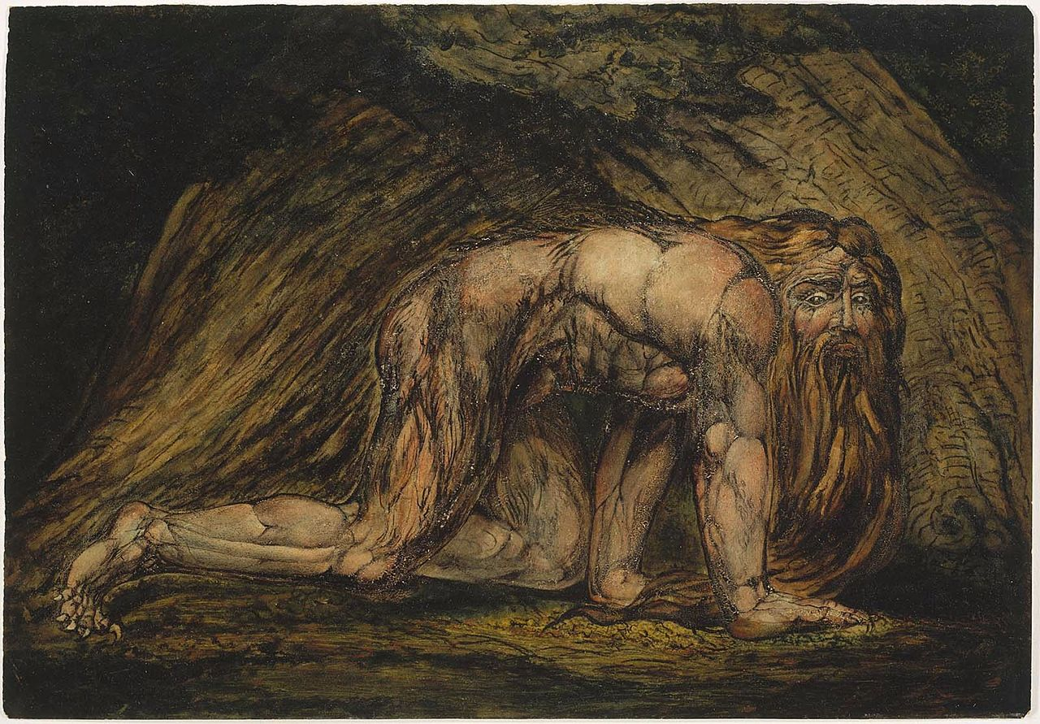
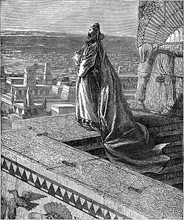
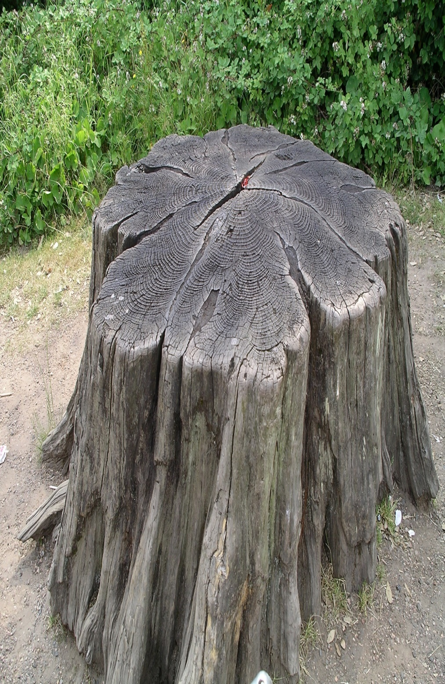
Daniel interpreted a 2nd dream for the king (4:5); a mighty tree
was cut down leaving only a stump (4:14,15), and that he would become like an animal (4:16), “… till thou know that the most High ruleth in the kingdom of men, and giveth it to whom soever he will” (4:25), which he did – “… lifted up my eyes unto heaven, and mine understanding returned to me, and I blessed the most High, and I praised and honoured him that liveth forever…” (4:34). His worldly power lost, he was humbled before God, who restored him and his throne for his faith.
With God, nothing is impossible!
WRITING ON THE WALL
Nebuchadnezzar died in 562 B.C., having reigned 43-years, and likely replaced by a grandson, who threw a party and praised the pagan gods (5:1-4). The same night a finger appeared and wrote on the wall that because he had not humbled himself like his grandfather, he would be slain and his kingdom given to another, Darius [king of Media] at the age of 62 (5:30,31).

Slide 20
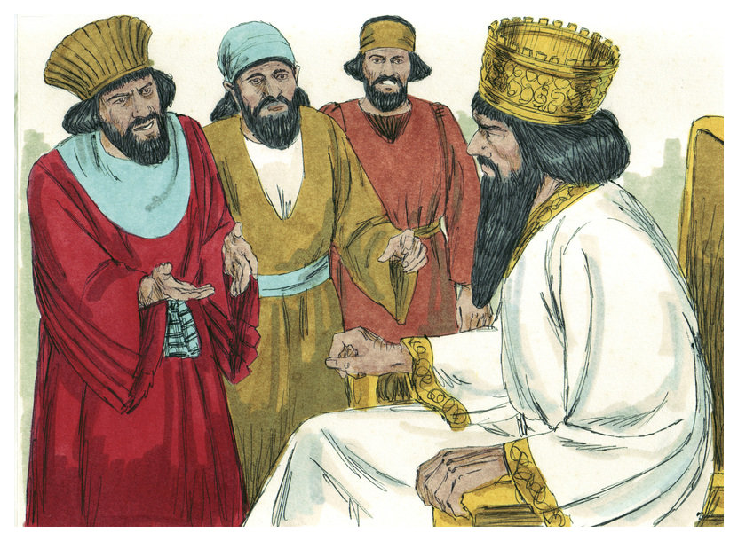
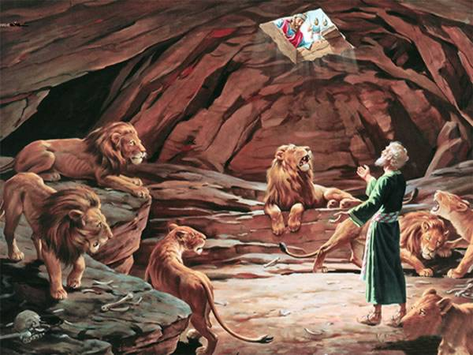
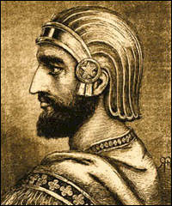
At this time [538 B.C.], Daniel was moved to king Darius’ palace in Shushan (6:3) where officials became jealous and hatched a plot to rid him—everyone must worship the king for 30-days, the king agreed (6:7-9).
“Then the king demanded, and they brought Daniel, and cast him into the den of lions… king spake and said unto Daniel, Thy God whom thou servest continually, he will deliver thee” (6:16). But, would God spare Daniel?
“My God hath sent his angel, and hath shut the lions’ mouths, that they have not hurt me… Then was the king exceedingly glad for him, and commanded that they should take Daniel up out of the den” (6:22,23).
Daniel survived again because of his faith.
“So this Daniel prospered in the reign of Darius [Medes], and in the reign of Cyrus the Persian” (6:28).
Daniel reasoned that the 70-years of captivity must soon be up according to Jeremiah (Jer. 25:11,12). What next?

Slide 21
After the death of Alexander the Great [Greek Empire], one of his generals, Antiochus Epiphanes IV [175 B.C.], would dominate Israel and desecrate the temple in Jerusalem, which foreshadows that of the ‘abomination of desolation’ (Mt. 24:15) by the Antichrist (8:24,25).
This is God’s timeline after the Jews were permitted to return and rebuild Jerusalem until Messiah is ‘cut off’ [483 yr.], leaving 1 week, or 7 yr., for the Antichrist led tribulation (9:24-27).
Daniel’s final vision (10:1-3) as the captives returned to Israel. Three kings of Persia would come (11:2), one of whom was Xerxes (Ahasuerus), 485-465 B.C., in the Book of Esther.
“But thou, O Daniel, shut up the words, and seal the book, even to the time of the end: many shall run to and fro, and knowledge shall be increased” (12:4). Daniel did NOT understand his end-time prophesy, but we should as we get closer to its fulfillment.
Next time – The Jews return home after 70-years of captivity.

