Slide 1
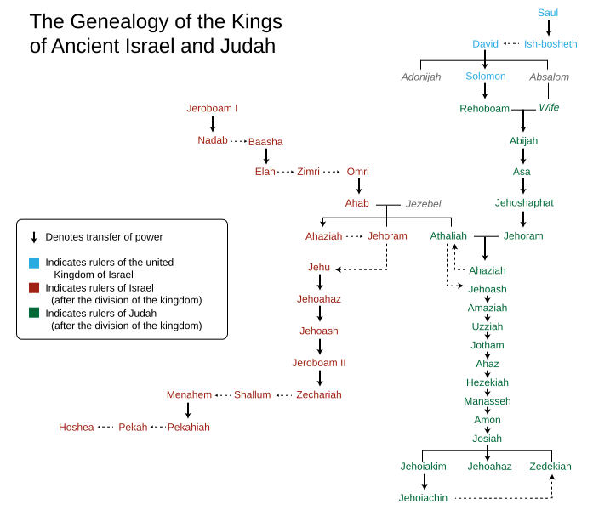
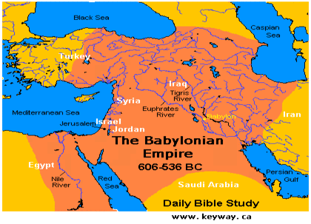
LESSON 32
WEEK 32 OF 52
(Zephaniah; Jer. 1-18)
THROUGH THE BIBLE IN 2018
Last time we saw future prophecy of Israel; this time Judah’s decline.
KING JOSIAH
“Josiah was [8] years old when he began to reign, and he reigned [31] years in Jerusalem… And he did that which was right in the sight of the LORD, and walked in all the way of David his father, and turned not aside to the right hand or to the left” (2Kg. 22:1,2).
Josiah had a long, prosperous reign (640-609 B.C.) over Judah and followed all the ways of the LORD and in the footsteps of David.
Elsewhere during his reign, the Babylonians [whom God would raise up to be the next world empire] conquered Nineveh in 612 B.C., and the Assyrian empire fell in 609 B.C.
Josiah was the last king of Judah to carry out a spiritual reform [the 4th] after Asa, Jehoshaphat, and Hezekiah.

Slide 2
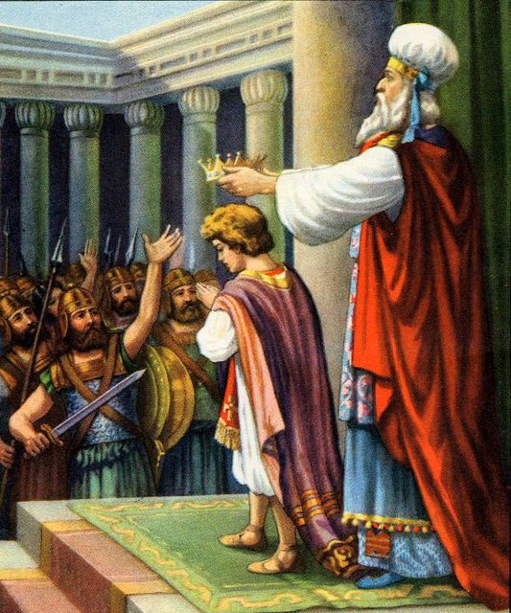
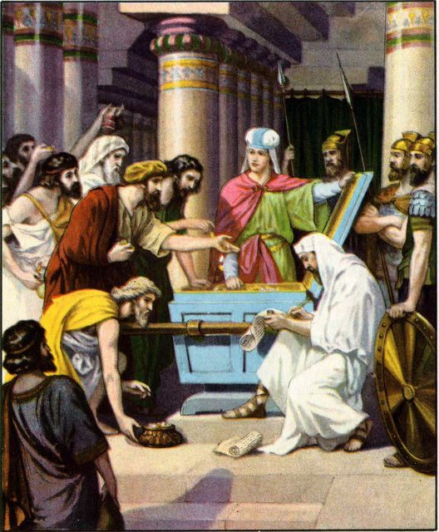
“Josiah was [8] years old when he began to reign… and in the [12th] year he began to purge Judah and Jerusalem from the high places, and groves, and the carved images, and the molten images. And they brake down the altars of Baalim in his presence… and stowed it upon the graves of them that had sacrificed unto them… cleansed Judah and Jerusalem” (2Chron. 34:4,5).
Josiah’s spiritual reform, begun at age 20, included not only destroying the ‘high places,’ but putting to death those who sacrificed to the gods.
REPAIR OF THE TEMPLE
“Now in the [18th] year of his reign, when he had purged the land… he sent… the governor of the city… to repair the house of the LORD his God” (34:8).
At 26, he collected money from all over the country and gave it to the high priest (34:9) who hired the workmen (34:10), “… And the men did the work faithfully” (34:12).

Slide 3
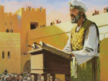
THE DISCOVERY OF THE LAW
“And when they brought out the money that was
brought into the house of the LORD, [the high priest]
found a book of the law of the LORD given by Moses”
(34:14).
During the process of the renovation of the temple, a
copy of the Law of Moses was discovered.
“And it came to pass, when the king had heard the
words of the law, that he rent his clothes” (34:19).
When Josiah heard that the Law had been found, he
tore his clothes, an act of repentance. Copies of the
Law of Moses had been destroyed under the previous
two evil kings [Manasseh and Amon]. Because of
Josiah’s faithfulness to God, judgment on Judah would
be postponed until after his death – “… thou shalt be
gathered to thy grave in peace, neither shall evil that
I bring upon this place…” (34:28).

Slide 4
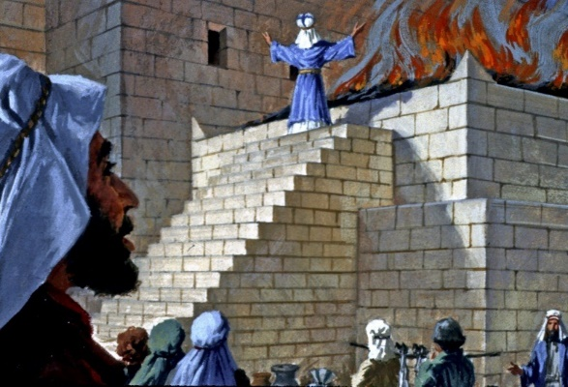
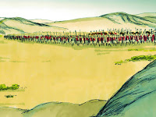
“Moreover Josiah kept a Passover unto the LORD in Jerusalem: and they killed the Passover [lamb] on the [14th] of the first month. And he set the priests in their charges, and encouraged them to the service of the house of the LORD (35:1,2)… And Josiah gave to the people, of the flock, lambs and kids, all for the Passover offerings… [30,000] total offerings” (35:7).
As part of his desire to re-establish the Law of Moses, Josiah kept the Passover as required.
JOSIAH’S DEMISE
More fearful of the Assyrians than the Babylonians, king Josiah tried to intercept the Egyptian army on their way to attack Babylon, “… and came to fight in the valley of Megiddo. And the archers shot at king Josiah… I am sore wounded… brought him to Jerusalem, and he died… buried with his fathers…” (35:22-24). Josiah was killed and buried in Jerusalem.

Slide 5
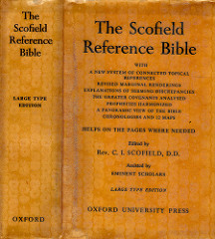
ZEPHANIAH
“This prophet, a contemporary of Jeremiah, exercised his ministry during the reign of Josiah. It was a time of revival, but the captivity was impending… inevitable. Zephaniah is in four parts: I. The coming invasion of Nebuchadnezzar a figure of the day of the LORD; II. Predictions of judgment on certain peoples; III. The moral state of Israel for
which the captivity was to come; IV. The judgment of the
nations followed by kingdom blessing under Messiah”
(Old Scofield, p. 959).
“The word of the LORD which came unto Zephaniah… in the
days of Josiah the son of Amon, king of Judah. I will utterly
consume all things from off the land, saith the LORD… I will
also stretch out my hand upon Judah, and upon the
inhabitants of Jerusalem… and them that are turned back
from the LORD” (1:1-6).
Zephaniah, “Yahweh has hidden,” probably means that
the Jewish remnant will be protected when God unleashes
His wrath on the evil doers of Judah—the southern kingdom.

Slide 6
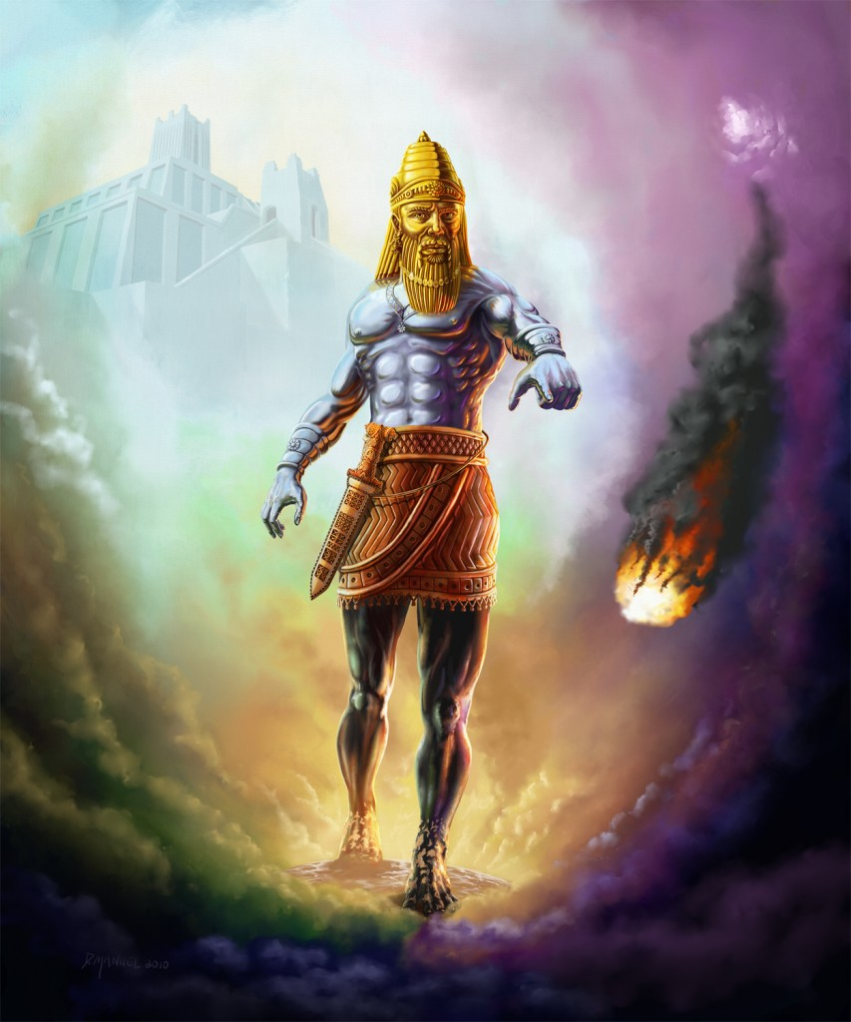
“Hold thy peace at the presence of the Lord GOD: for
the day of the LORD is at hand…” (1:7).
Zephaniah, speaking for God, used the upcoming
invasion of Nebuchadnezzar as a type or foreshadowing
of the tribulation. As the king of Babylon would destroy
Judah so will Christ destroy those who oppose Him at
His 2nd coming.
“The great day of the LORD is near… the mighty men shall
cry bitterly. That day is a day of wrath… trouble and
distress, a day of wasteness and desolation…” (1:14,15).
Jews had two calamities ahead, one near [Babylon]; one
distant [tribulation]. The 1st bad; the 2nd far worse.
“And I will bring distress upon men, that they shall walk like blind men, because they have sinned against the LORD… Neither their silver… gold shall be able to deliver them in the day of the LORD’S wrath… he will make a speedy riddance of all them that dwell in the land” (1:17,18).
Invasions of Nebuchadnezzar and Christ—both catastrophic; one local, one universal.

Slide 7
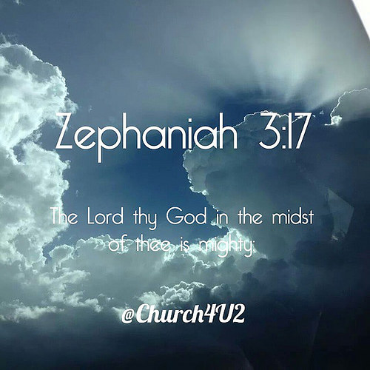
A UNIVERSAL LANGUAGE
“Therefore wait ye upon me, saith the LORD, until the day that I rise up to the prey: for my determination is to gather the nations… to pour out mine indignation, even all my fierce anger… For then will I turn to the people a pure language, that they may all call upon the name of the LORD, to serve him with one consent” (3:8,9).
At the beginning of the kingdom, one language will prevail.
KINGDOM BLESSINGS
“Sing, O daughter of Zion; shout, O Israel; be glad and rejoice with all the heart … the king of Israel, even the LORD… in the midst of thee is mighty; he will save, he will rejoice over thee with joy; he will rest in his love…” (3:14).
After Judah’s short and long term destruction, the kingdom will be established in Jerusalem, and the KING [Christ] will sit on David’s throne, the nation of Israel will receive a spiritual heart transplant—love, peace, and joy will exist for 1,000 yr.

Slide 8
JEREMIAH
“Jeremiah began his ministry in the 13th year of Josiah, about 60 years after Isaiah’s death. Zephaniah and Habakkuk were contemporaries of his earlier ministry, Daniel his later. After the death of Josiah, the kingdom
of Judah hastened to its end in the Babylonian captivity. Jeremiah remained in the land ministering to the poor remnant (2Kg. 24:14) until they went into Egypt, whither
he followed them, and where he died, early in the 70
years’ captivity. The events in Jeremiah cover a period
of 41 years” [Ussher’s dates] (Old Scofield, p. 772).
“The words of Jeremiah… to whom the words of the LORD
came in the days of Josiah the son of Amon king of Judah…
It came also in the days of Jehoiakim the son of Josiah… unto the end of the [11th] year of Zedekiah… unto the carrying away of Jerusalem captive…” (Jer. 1:1-3). The
book of Jeremiah spans the last series of the kings of Judah.

Slide 9
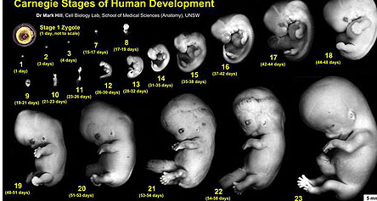
“Then the word of the LORD came unto me, saying, before I formed thee in the belly I knew thee; and before thou camest forth out of the womb I
sanctified thee, and I ordained thee a prophet unto the nations” (1:4,5).
Who formed Jeremiah in the womb?
Who knew him before He formed him in the womb?
Who ‘set-apart’ Jeremiah before he was born?
Who called Jeremiah to be a prophet before birth?
His father and mother? No.
“… all things were created by him and for him”
(Col. 1:18). Who’s the him?
Christ Jesus.
“Then the LORD [Christ] put forth his hand, and touched my mouth… LORD said unto me, Behold I have put my words in thy mouth” (1:9).
What if Jeremiah’s mother had the ‘right to choose’?

Slide 10
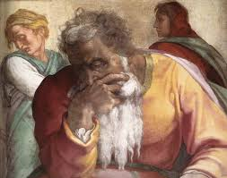
1st MESSAGE TO JUDAH
GLORY DAYS
“Go and cry in the ears of Jerusalem, saying, Thus
saith the LORD; I remember thee, the kindness of
thy youth, the love of thy espousals, when thou
wentest after me in the wilderness… Israel was
holiness unto the LORD” (2:1,2).
Jeremiah reminded the Jews what a wonderful
courtship Israel had with God in the beginning. Like
a young couple who first meet, how exciting and
how in love they were, getting to know each other,
and beginning to form a loving relationship that
would only grow stronger with time.
“And I brought you into a plentiful country, to eat the
fruit thereof and the goodness thereof…” (2:7a).
God had kept all his promises: a nation [Israel]; a
worship system [Law]; a land of promise, but…

Slide 11
FORSAKEN
“… my people have committed two evils; they have forsaken me… Is Israel a servant [of God]? Is he a home born slave [to the gods]…” (2:13,14).
God’s people had forsook Him by courting other
gods, to whom they were enslaved.
SHAME
“Hath a nation changed their gods, what are yet no gods? but my people have changed their glory for that which doth not profit (2:11)… Be astonished at this, and be horribly afraid (2:12)… the thief is ashamed when he is found, so is the house of Israel ashamed... But where are thy gods that thou hast made thee? Let them arise, if they can save thee in a time of trouble… O Judah” (2:26-28).
Mockingly, God told Judah to ask their gods to help them avoid the coming disaster.

Slide 12
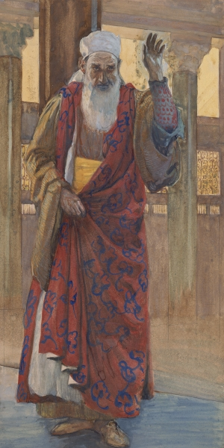
Under Isaiah, there was hope Judah would turn back to God. In much of Jeremiah’s ministry, that hope was now gone.
Isaiah – “TURN BACK BEFORE IT’S TOO LATE!”
Jeremiah – “Don’t resist, IT’S TOO LATE!”
God’s judgment was about to fall upon them!
That’s why Jeremiah has been given the unfortunate title of –
The ‘weeping’ prophet.
2ND MESSAGE TO JUDAH
“And I saw, when for all the causes whereby backsliding Israel committed adultery I had put her away, and given her a bill of divorce; yet her treacherous sister Judah feared not, but went and played the harlot also” (3:8).
God’s chastisement on Israel had no effect on Judah.

Slide 13
“Therefore pray not thou for this people, neither
lift up cry nor prayer for them, neither make intercession to me: for I will not hear” (7:16).
God told Jeremiah to stop praying for Judah, nor to
intercede for them, because He would not listen. They had gone too far; there was no turning back.
“Therefore thus saith the LORD God; behold, mine
anger and my fury shall be poured out upon this
place, upon man, and upon beast, and upon the
trees of the field, and upon the fruit of the ground;
and it shall burn, and shall not be quenched” (7:20).
God’s patience had run out. There was nothing
they could do now to appease the wrath that He was about to pour out on them. Their promised land, too, would receive His wrath and nothing could prevent it.

Slide 14
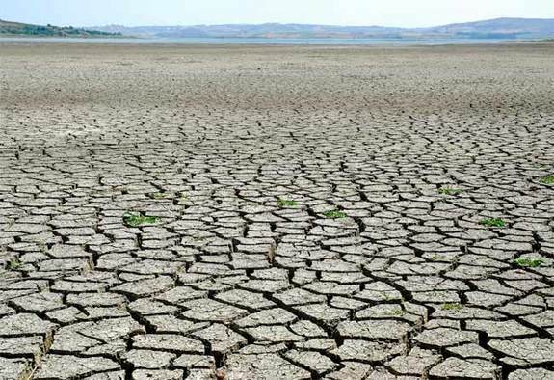
THE DROUGHT
“The word of the LORD that came to Jeremiah concerning the dearth” (14:1).
A conditional covenant, like Israel was under, meant blessings for obedience, and cursings for disobedience, one of which were droughts –
“And if ye will not yet for all this hearken unto me, then I will punish you [7] times more for your sins… your strength shall be spent in vain: for your land shall not yield her increase… (Lev. 26:18-20)… The LORD shall make the rain of thy land powder dry and dust: from heaven shall it come down upon thee, until thou be destroyed” (Deut. 28:24).
Drought producing famines was one way God punished Israel. The drought of which Jeremiah spoke would cripple Judah with life threatening starvation in preparation of Babylon’s invasion.

Slide 15
“Then said the LORD unto me, Though Moses and Samuel stood before me, yet my mind could not be toward this people: cast them out of my sight… And it shall come to pass, if they say unto thee, Whither shall we go forth? Then thou shalt tell them… Such
as are for death; and such as are for the sword…
and such as are for the famine… and such are for
the captivity…” (15:1,2).
God gave Jeremiah a history lesson in that once He made up His mind, He would not change it—not for Moses, Samuel, nor Jeremiah. His wrath was coming and there was nowhere to hide. It would come in
4-fold manner: some would die of disease & famine in the run up to the invasion. Many would die by the sword during the assault, and the remainder would be taken to Babylon in captivity.
Which one would you choose?

Slide 16
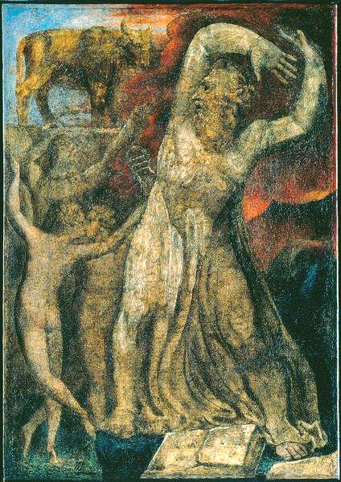
FALSE PROPHETS
“Then said I, Ah, Lord God! Behold, the prophets say unto them, Ye shall not see the sword, neither shall ye have famine; But I will give you assured peace in this place… I sent them not, neither have I commanded them, neither spake unto them:
they prophesy a false vision and divination, and a thing of nought, and the deceit of their heart” (14:13,14).
Satan, always mindful of what God was doing, did the opposite through false prophets. Whereas God was telling the true prophet [Jeremiah], that punishment was coming, the false prophets were telling those of Judah that things were fine—they had nothing to worry about concerning famines or invasions of foreign enemies. Satan often paints a rosier picture of things than is reality.

Slide 17
THE DECEITFUL HEART
“The heart is deceitful above all things, and desperately wicked: who can know it? I the LORD search the heart, I try the reigns, even to give every man according to his ways, and according to the fruit of his doings” (17:9).
Jeremiah contemplated why man makes such stupid and ungodly decisions when God has given man such extraordinary blessings. Israel had been given a prosperous nation, a homeland, protection from
their enemies, etc., but they had thrown it all away.
Why? Why? WHY??!!
God gave Jeremiah the answer to this age old question—man’s inherent sinful heart. Israel rebelled against God who had given them everything because Satan deceived them in that it wasn’t enough. God knows the heart and will judge accordingly.

Slide 18
JEREMIAH’S LAMENT
“Behold, they say unto me, Where is the word of
the LORD? Let it come now. As for me, I have not chastened from being a pastor to follow thee: neither have I desired the woeful day; thou knowest: that which came out of my lips was right before thee. Be not a terror unto me: thou art my hope in the day of evil. Let them be confounded that persecute me… let not me be confounded: let them be dismayed… let not me be dismayed: bring upon them the day of evil, and destroy them…”
(17:15-18).
Judah had forsaken God, but not Jeremiah, so he pleaded his case to be spared for his obedience. He had led Judah like a ‘shepherd,’ but his sheep had gone astray. Now he petitioned God to allow the inevitable to take place, let them be slaughtered!

Slide 19
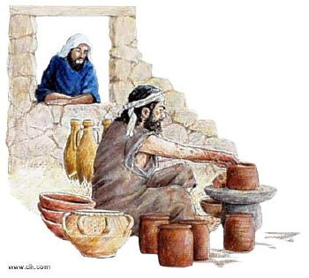
“The word which came to Jeremiah from the LORD,
saying, arise, and go down to the potter’s house, and
there I will cause thee to hear my words. Then I went
down to the potter’s house, and, behold, he wrought a
work on the wheel” (18:1-3).
Jehovah God [Christ] told Jeremiah to go to a potter’s
house where He would speak to him, so he did.
“And the vessel that he made of clay was marred in the
hand of the potter: so he made it again another vessel,
as seemed good to the potter to make it. Then the
word of the LORD came to me, saying, O house of Israel,
cannot I do with you as this potter? Saith the LORD.
Behold, as the clay is in the potter’s hand, so are ye in mine hand, O house of Israel” (18:4-6).
As the potter molded a pot he found a flaw in it, so not satisfied with it, he decided to start over with the same lump and make a new pot. As Jeremiah watched the potter do this, the LORD spoke to him and told him that as the Master Potter, His 1st pot [Israel] was flawed, so He would start over and form a new nation [spiritual Israel] from the old nation [sinful Israel].

Slide 20
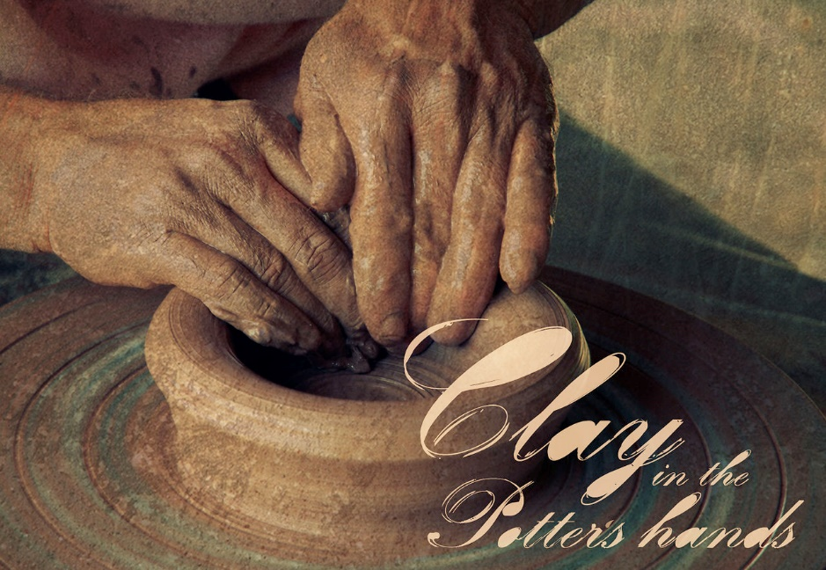
This is a perfect illustration of the two Israel's. God
created her, but she had a major flaw [kept breaking the
1st commandment], so He would smash her [judgment
by the invading Babylonian army], and then during the
kingdom of heaven on earth [1,000 years], true, spiritual,
Israel will be remade perfect by The Potter’s Hand!
God’s decision had been made—He would bring
judgment on the southern kingdom [Judah] as He had
on the northern kingdom [Israel], and Jeremiah was to
be the bearer of bad news –
“Because my people have forgotten me… I will scatter them as with an east wind before the enemy…” (18:15-17). How did the people of Judah take Jeremiah’s news?
“Then said they, Come, and let us devise devices against Jeremiah… Come, and let us smite him with the tongue, and let us not give heed to any of his words” (18:18).
They rejected it! And set about to conduct a smear campaign to slander him and everything he was preaching. And if that didn’t work, they were then ready to take more drastic measures against the prophet.

Slide 21
“Shall evil be recompensed for good? For they have digged a pit for my soul… therefore deliver up their children to the famine, and pour out their blood by the force of the sword; and let their wives be bereaved of their children, and be widows; and let their men be put to death; let their young men be slain by the sword in battle” (18:20,21).
If the smear tactics didn’t work, the people of Judah were all ready to dig a pit in order to imprison Jeremiah, so that they didn’t have to listen to his depressing news ever again.
Jeremiah had hoped his people would turn from their evil ways, but they had not, therefore he had no choice but to join God in His judgment of them—he prayed that famine, to be followed with the invasion, would take the lives of the unholy.
Next time – Judah practices infanticide.

