Slide 1
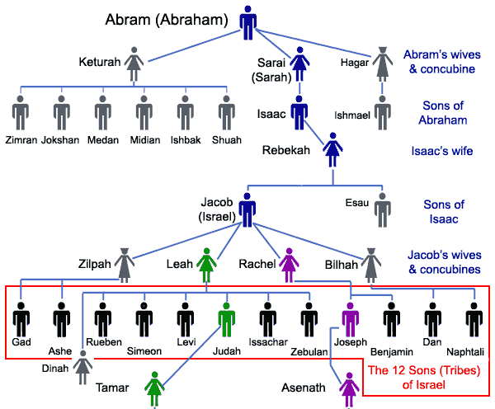
LESSON 4
WEEK 4 OF 52
(Gen. 30-47)
THROUGH THE BIBLE IN 2018
Last time we saw Jacob go to Haran to take a godly wife and have children, which is the basis of the covenant God gave to his grandfather Abraham and through his [Jacob’s] seed will the promise of a great nation be kept.
While there Jacob takes 2 wives & 2 concubines
and has 13 children; 12 sons +1 daughter:
Leah – Reuben, Simeon, Levi, Judah
Bilhah (Rachel’s handmaid) – Dan, Naphtali
Zilpah (Leah’s handmaid) – Gad, Asher
Leah – Issachar, Zebulon, Dinah (d.)
Rachel – Joseph, Benjamin
Unfortunately, Jacob’s family dynamics were less than
godly: he loved Rachel, but he was tricked into marrying
her sister Leah; With Leah he quickly had 4 sons, but
Rachel was barren so he took two handmaids who gave him more 4 children.
No where does God condone plural marriages (Gen. 2:24), but used it to carry out His plan.

Slide 2
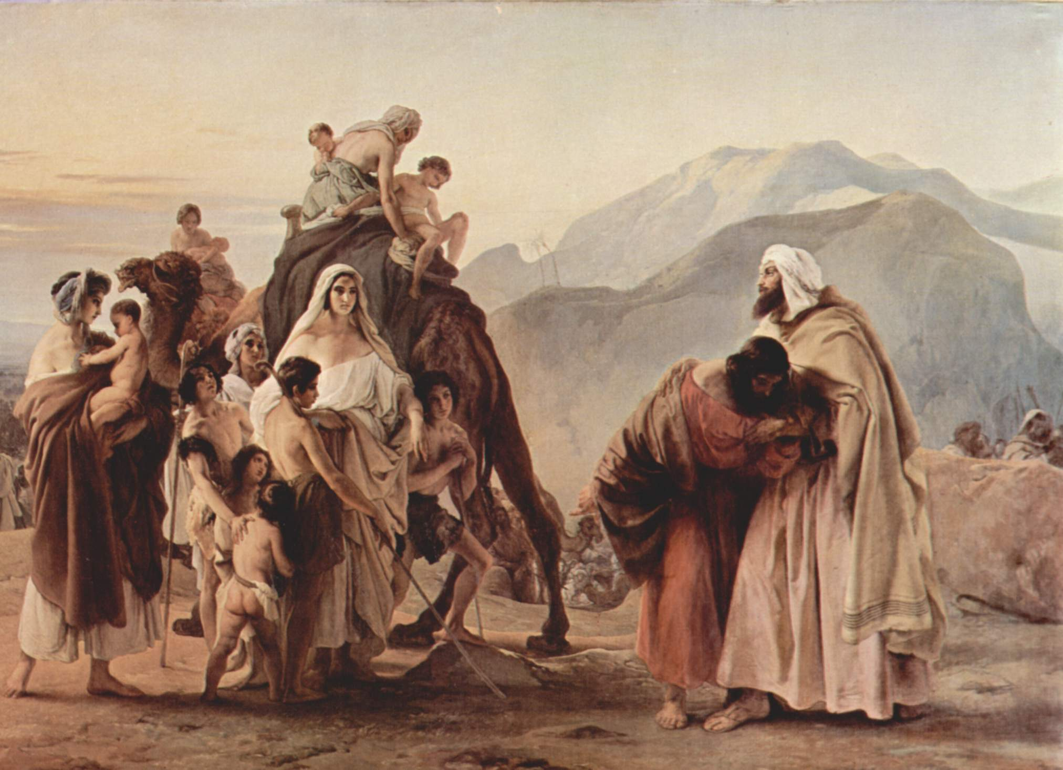
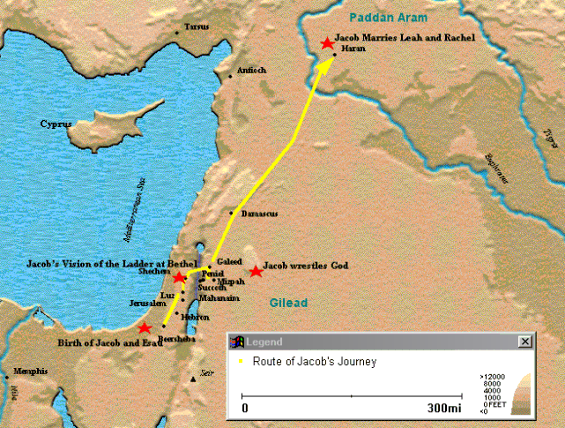
“And the LORD said unto Jacob, Return unto
the land of thy fathers, and to thy kindred;
and I will be with thee” (31:3). Then Jacob
rose up, and set his sons and his wives upon
camels; And he carried away all his cattle…
he had gotten in [Haran], for to go to Isaac
his father in the land of Canaan” (31:17,18).
After a twenty year stay in Haran (31:38),
Jacob, his family, and livestock returned
home. It was a bitter separation between
he and his Uncle Laban –
“… have I been twenty years in thy house; I
served thee [14] years for thy two daughters,
and [6] years for thy cattle; and thou hast
changed my wages ten times. Except the
God of my father… had been with me, surely thou hadst sent me away now empty…” (31:41,42).
The details were not pretty, but God used it to carry out the promises first given to Abraham.

Slide 3
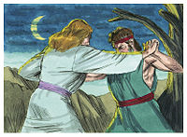
JACOB’S WRESTLING MATCH
“And Jacob was left alone; and there wrestled
a man with him until the breaking of the day.
And when he [Assailant] saw that he prevailed
not against him [Jacob], he [Assailant] touched
the hollow of his [Jacob’s] thigh… and was out
of joint… [the Assailant says] Let me go, for the
day breaketh. And he [Jacob] said, I will not let
thee go, except thou bless me… [blessing] Thy
name shall be called no more Jacob, but Israel…
And Jacob called the name of the place Peniel:
for I have seen God face to face, and my life is
preserved” (32:24-30).
Previously, Jacob had fought for the birthright and blessing of his father, but now he is engaged in a battle he cannot win because he is fighting against the Son of God. The one called the ‘heel catcher’ (25:26) is now caught. The life lived as Jacob was accomplished in the flesh, but now, that all must change. The name Israel means, God fights, so from now on it will be God [Christ] who fights the battle to complete the plans and promises destined for the nation of Israel.

Slide 4
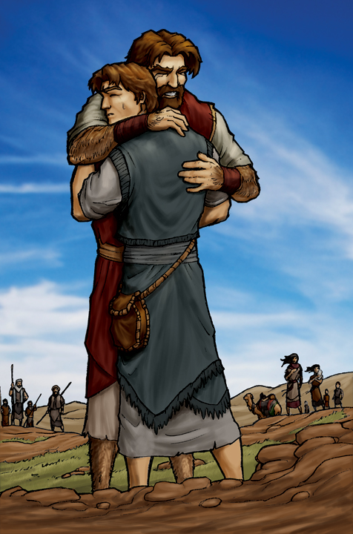
JACOB MEETS ESAU
“And Jacob lifted up his eyes, and look, and, behold Esau came…” (33:1).
Jacob had long feared this meeting with his estranged
brother over the stolen birthright and blessing, so he was prepared to offer him some of his wealth –
“… Esau said, I have enough, my brother; keep that thou hast unto thyself… So Esau returned that day
on his way unto Seir” (33:9:16).
God had worked the miraculous in the hearts of these two brothers. Jacob displayed a spirit of humility and generosity, and Esau was changed from one who sought revenge to that of wanting to be
reconciled with his estranged brother.
However, it would not be the end of hostilities between the descendants of the two nations:
Israel [Jacob] & Edom [Esau].

Slide 5
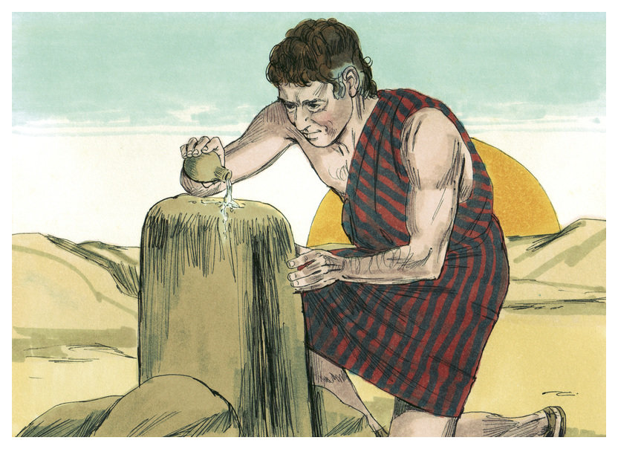
JACOB AT BETH-EL
“And God said unto Jacob, Arise, go up to Beth-el, and dwell there: and make there an altar unto God…” (35:1)… And God appeared unto Jacob again… and blessed him… I am God Almighty: be fruitful and multiply; a nation… shall be of thee, and kings shall come out of thy loins; And the land which I gave Abraham and Isaac, to thee I will give It, and
to thy seed after thee will I give the land…
And Jacob set up a pillar of stone… he poured oil thereon” (35:9-14).
Back in the land of Canaan, God appeared
to Jacob [Israel] again reiterating the same promise given to his father [Isaac] and grandfather [Abraham], that this is his land and that of his seed [the nation of Israel].

Slide 6
DEATH OF RACHEL
“And they journeyed from Beth-el… to Ephratha: and Rachel travailed, and she had hard labour… And it came to pass, as her soul was in departing (for she died) that she called his name Ben-oni: But his father called him Benjamin. And Rachel died, and was buried in the way to Ephratha, which is Bethlehem. And Jacob set a pillar upon her grave…” (35:16-20).
The last and only child of Jacob to be born in the land of Canaan was Benjamin.
Rachel named him ‘son of my sorrow’ but Jacob gave him a more positive name renaming him ‘son of my right hand.’
Rachel’s death would not be the last to cause Jacob heartache.

Slide 7
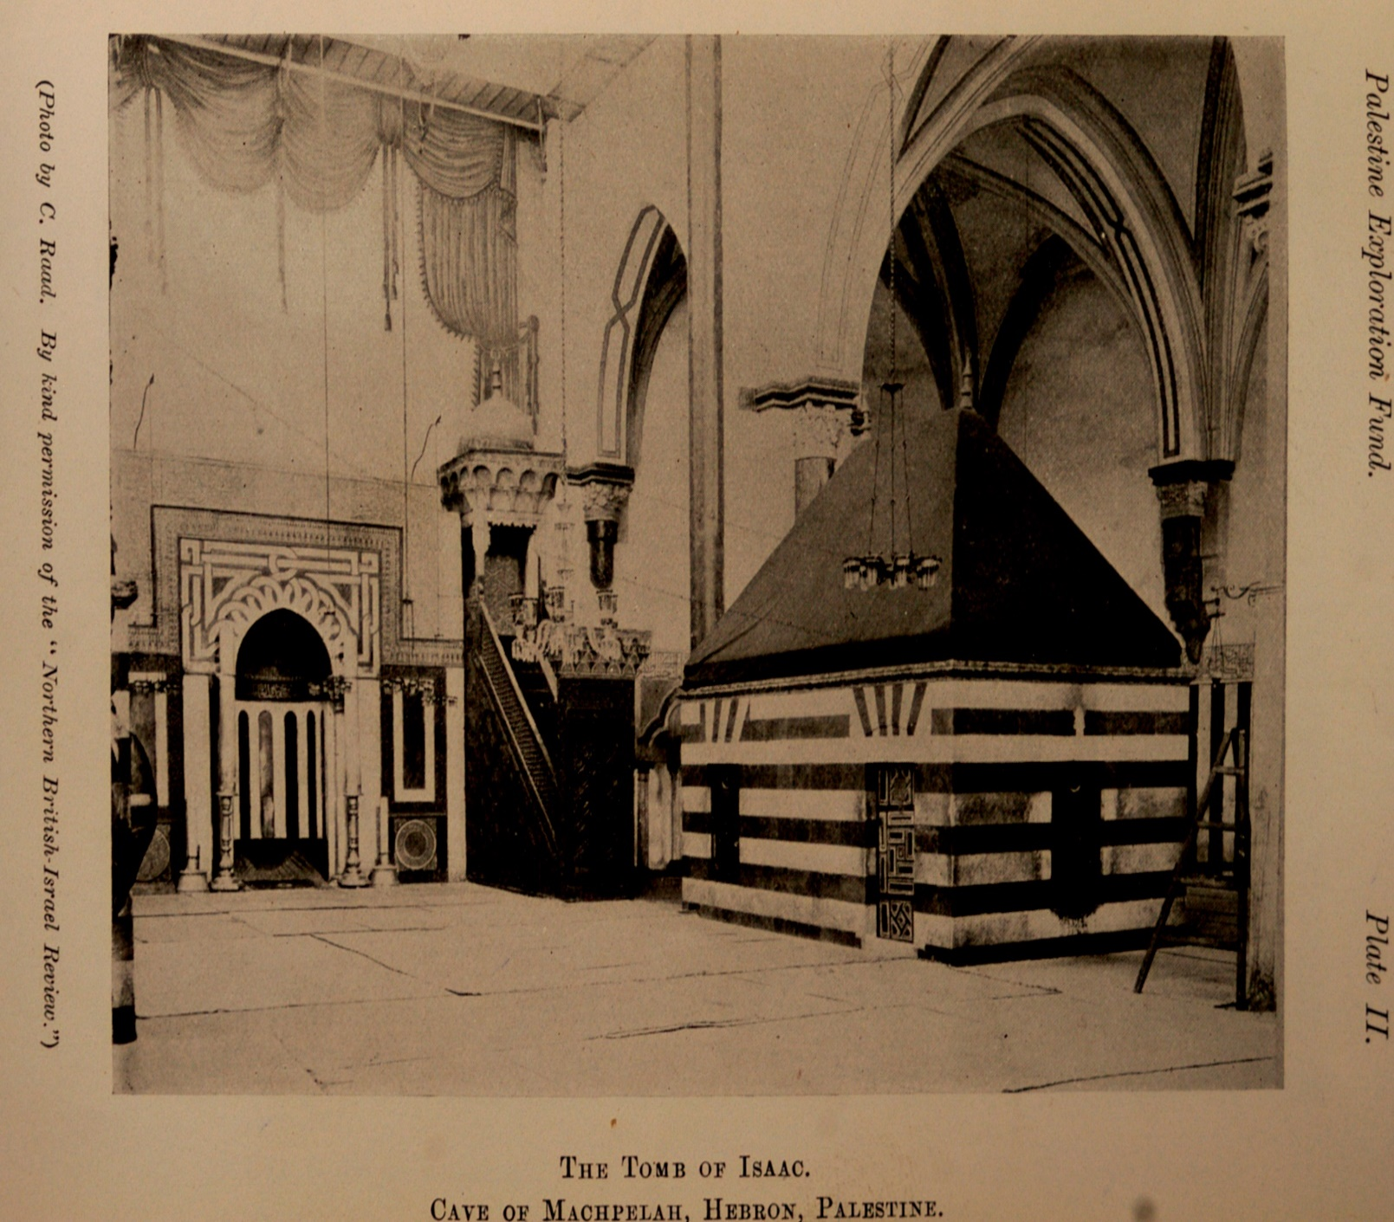
DEATH OF ISAAC
“And Jacob came unto Isaac his father unto
Mamre… which is Hebron… And the days
of Isaac were [180] years. And Isaac gave
up the ghost, and died, and was gathered
unto his people, being old and full of days:
and his sons Esau and Jacob buried him”
(35:27-29).
Isaac’s death meant the end of one era
and the beginning of another.
Jacob’s return to the land brought the
deaths of his beloved Rachel and his
honored father, Isaac, but God had
re-stated the promise of the land to him
and now he had 12 sons through whom
God would build a nation after His Name.
That Holy nation after God’s own Name is Israel, which means God fights!

Slide 8
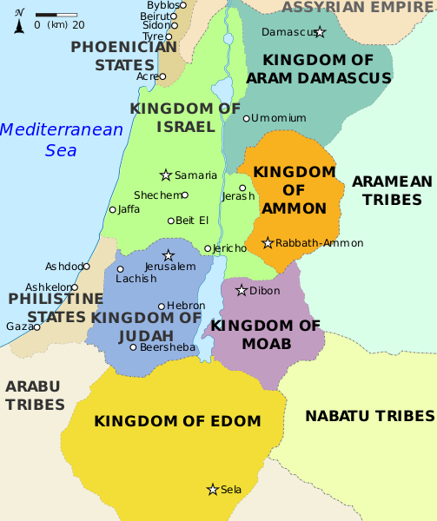
“Now these are the generations of Esau, who is Edom. Esau took his wives of the daughters of Canaan…” (36:1,2).
Unlike Isaac and Jacob who DID NOT take wives from among the Canaanites,
Esau did.
As a result, the Edomites would become sworn enemies of the Israelites to their north.
The Old Testament minor prophet Obadiah was written concerning conflict
between the two nations – “… I have made thee small among the heathen: thou art greatly despised” (Oba. 2).
The hated King Herod who conspired to kill the baby Jesus was part Edomite.

Slide 9
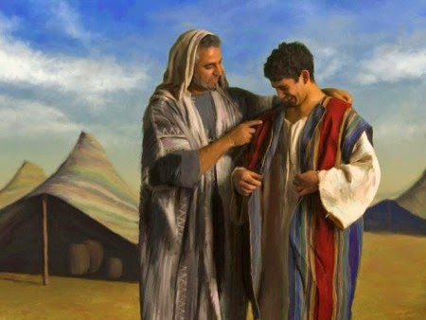
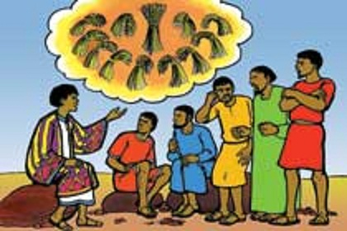
JACOB’S FAVORITE SON
“And Jacob dwelt… in the land of Canaan
(37:1)… Joseph, being [17] years old, was
feeding the flock with his brethren… now
Israel loved Joseph more than all his children,
because he was the son of his old age: and
he made a coat of many colours” (37:2,3).
Jacob did not hide his love for his favorite
son distinguishing him from the others with
a beautiful outward attire. What do you
think his brothers thought of that?
“And when his brethren saw that their father
loved him more than all his brethren, they
hated him, and could not speak peaceably unto him” (37:3,4).
If that wasn’t bad enough Joseph told them of the dream he had, “…For behold, we were binding sheaves in the field… your sheaves stood round about, and your sheaves made obeisance [bowed down] to my sheaf” (37:5-7).

Slide 10
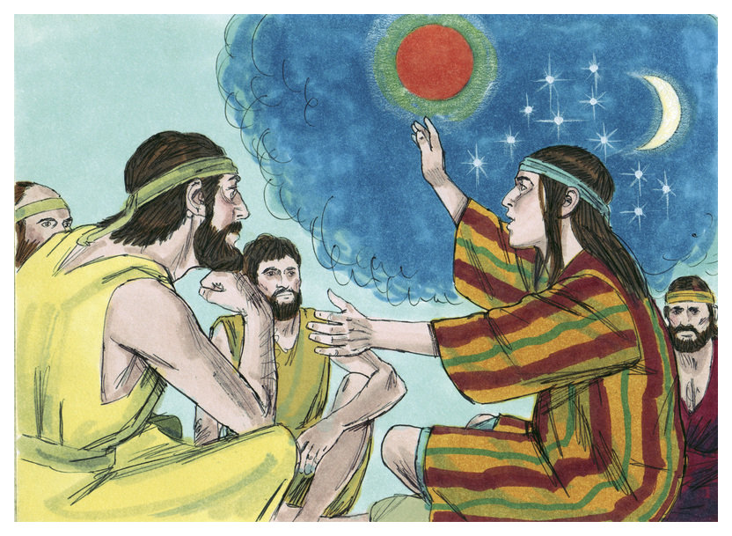
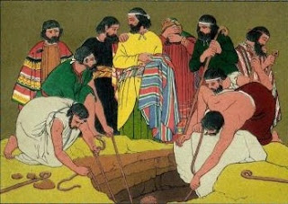
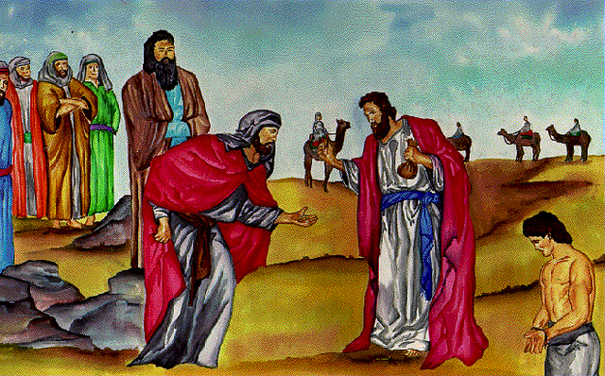
“And he dreamed another dream… behold, the sun
and the moon and the eleven stars made
obeisance to me” (37:9).
In the ancient times celestial bodies represented rulers and this dream symbolized the whole house of Jacob bowing down to Joseph in the future.
As one can imagine, these dreams didn’t sit well with
his family. But, it was God using the celestial bodies He
created as signs (Gen. 1:14) of future events He would
use to form His chosen nation.
“And his brethren envied him…” (37:11).
Not only did they envy Joseph, the brothers plotted to
kill him –
“Come now therefore, and let us slay him, and cast him into some pit, and we will say, Some evil beast hath devoured him…” (37:20,21). Judah rejected and instead decided to sell him – “… behold, a company of Ishmeelites came from Gilead with their camels… lifted up Joseph out of the pit, and sold Joseph… for [20] pieces of silver; and they brought Joseph into Egypt” (37:21-27).

Slide 11
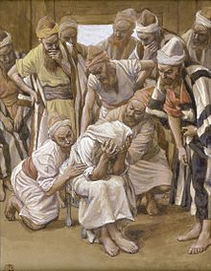
THE BROTHERS CONSPIRACY
“And they took Joseph’s coat, and killed a kid of the
goats, and dipped the coat in the blood… brought it
to their father… an evil beast hath devoured him…
and Jacob rent his clothes… and mourned his son
many days” (37:31-34).
Not only did the brothers sell one of their own, they
lied and conspired in order to deceive their father
who was beside himself with grief.
In spite of the brothers’ despicable behavior, God
used these events to bring about the promises made
to Abraham, Isaac, and Jacob.
“And Joseph was brought down to Egypt; and
Potiphar, captain of the guard, an Egyptian, bought
him of the hands of the Ishmeelites, which had
brought him down thither” (39:1).
Why has the story led the reader into Egypt? Where was God that He should allow such to occur?

Slide 12
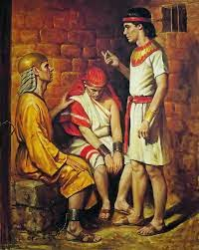
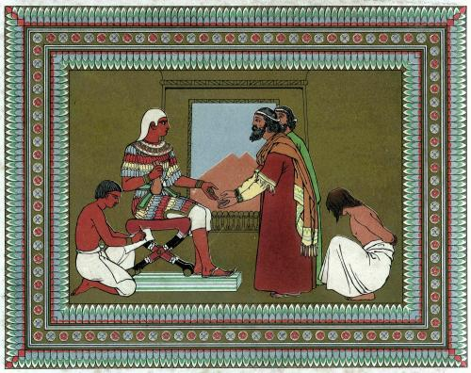
“And the LORD was with Joseph, and he was
a prosperous man; and he was in the house
of his master the Egyptian. And his master
saw that the LORD was with him, and that
the LORD made all that he did to prosper in
his hand. And Joseph found grace in his
sight and he served him: and he made him
overseer over his house…” (39:1-4).
God placed Joseph in an honorable position,
over the house of the captain of the guard.
But, Joseph must be tested –
“And it came to pass after these things, that
his master’s wife cast her eyes upon Joseph…
lie with me. But he refused… [he was set up]
Joseph’s master [Potiphar] took him, and put him into the prison… but the LORD was with Joseph… and the keeper of the prison committed to Joseph’s hand all the prisoners that were in the prison… the LORD made it to prosper” (39:7,8, 20-22).

Slide 13
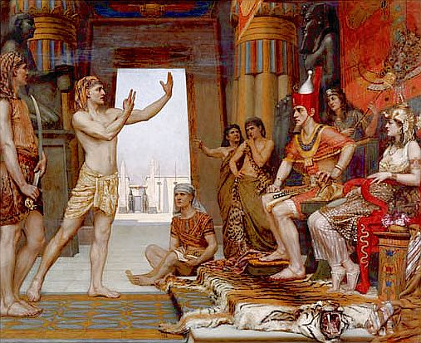
“And it came to pass at the end of two full
years, that Pharaoh dreamed… the dream of
Pharaoh is one: God hath shewed Pharaoh
what he is about to do… Behold, there come
[7] years of great plenty throughout all the
land of Egypt: And there shall arise after them
[7] years of famine… God will shortly bring it
to pass” (41:1,25,29,30,32).
Joseph explained to the king what God was
going to do – 7 years of plenty/7 of famine.
“… take up [20%] in the [7] plenteous years.
And that food shall be for store to the land
against the [7] years of famine. And the thing
was good in the eyes of Pharaoh… said unto
Joseph, Forasmuch as God hath shewed thee
all this, there is none so discreet and wise as thou art: Thou shalt be over my house… Only in the throne will I be greater than thou” (41:34-40).

Slide 14
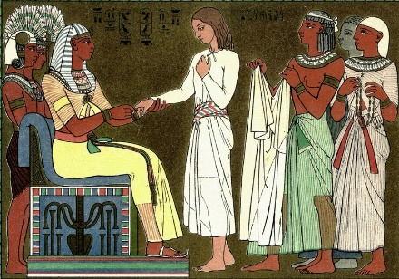
SECOND IN COMMAND
“And Pharaoh took off his ring from his hand, and put it
upon Joseph’s hand… and he made him ruler over all
the land of Egypt. And Pharaoh said unto Joseph, I am
Pharaoh, and without thee shall no man lift up his hand
or foot in all the land of Egypt” (41:42-44).
God had placed Joseph 2nd in command of all in Egypt.
But why?
“And unto Joseph were born two sons before the
famine came… the name of the firstborn Manasseh…
the second called Ephraim” (41:50-52)… And the [7]
years of plenteousness, that was in the land of Egypt,
were ended. And the [7] years of dearth began to
come… and the dearth was in all lands; but in all the
land of Egypt there was bread (41:53,54)… And the famine was over all the face of the earth: and Joseph opened all the storehouses… And all countries came into Egypt to Joseph to buy corn…” (41:56,57).

Slide 15
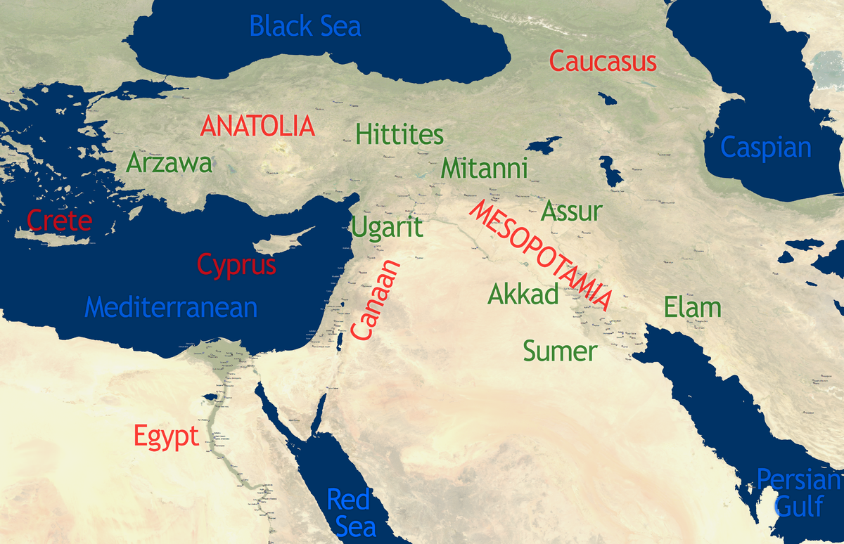
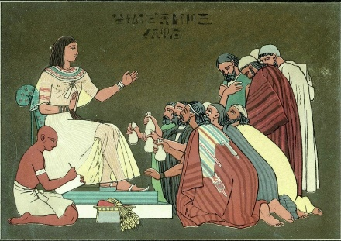
“Now when Jacob saw that there was corn in Egypt, Jacob said unto his sons… I have heard that there is corn in Egypt: Get you down thither, and buy for us from thence; that we may live, and not die. And Joseph’s ten brethren went down to buy corn in Egypt” (42:1-3).
Jacob’s ten sons [minus Benjamin] went to Egypt to buy food. Guess what they do?
“And Joseph was the governor over the land, and he it was that sold to all the people… and Joseph’s brethren came, and bowed down themselves before him… Joseph knew, but they knew not him” (42:6,7).
Where have we seen this before?
The dreams!

Slide 16
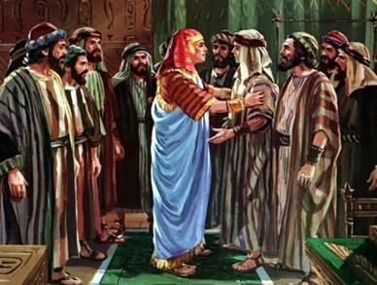
JOSEPH REVEALED TO HIS BROTHERS
“And Joseph said unto his brethren, Come near to me, I pray you. And they came near. And he said, I am Joseph your brother, whom ye sold into Egypt” (45:4).
After a period of time Joseph revealed himself to his brothers and asked that his father be brought to Egypt –
“Haste ye, and go up to my father, and say unto him, Thus saith thy son Joseph, God hath made me lord of all Egypt: come down unto me, tarry not. And thou shalt dwell in the land of Goshen, and thou shalt be near unto me, thou, and thy children, and thy children’s children…” (45:9,10).
Not only are the sons reconciled, but they are about to be joined by their father, Jacob [Israel]. But why in Egypt?

Slide 17
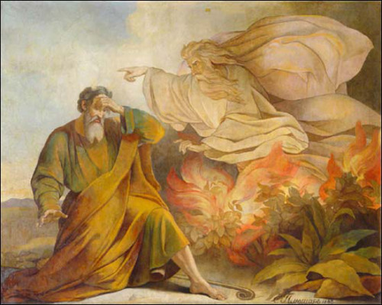
“And Israel took his journey with all that he had, and came to Beersheba, and offered sacrifices unto the God of his
father Isaac. And God spake unto Israel and said… I am God, the God of thy father
[Isaac]: fear not to go down into Egypt; for I will there make of thee a great nation” (46:1-3).
Previously, God said, DON’T GO TO EGYPT! DON’T GO TO EGYPT!! Okay, now go to Egypt. God’s timing is always perfect.
Now God has all the players in place to make His next big move.
“And the sons of Joseph, which were born him in Egypt, were [2] souls: all the souls of the house of Jacob, which came into Egypt, were [70]” (46:27).

Slide 18
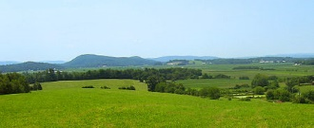
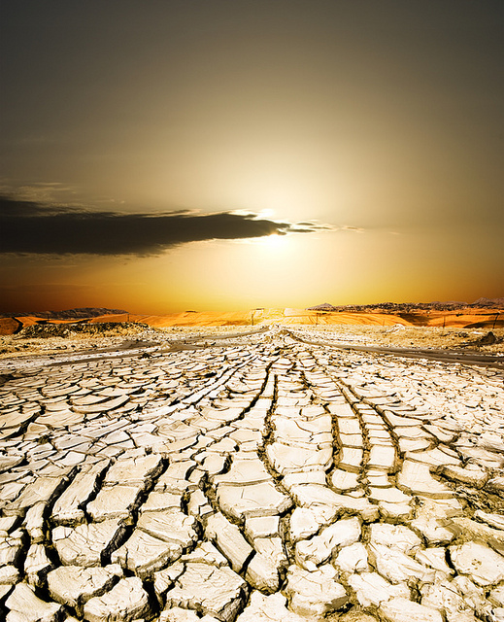
7 YEARS OF DEARTH
“Then Joseph came and told Pharaoh, and said, My father and my brethren, and their flocks, and their herds, and all that they have, are come out of the land of Canaan; and, behold, they are in the land of Goshen” (47:1).
God placed Jacob and his family where He
wanted them.
“And Joseph placed his father and his brethren, and gave them a possession in the land of Egypt, in the best of the land… And Joseph nourished his father and brethren, and all his father’s household… And the famine was very sore, so that the land of Egypt and all the land of Canaan fainted by reason of the famine” (47:11-13).
While the world suffered—Israel prospered.

Slide 19
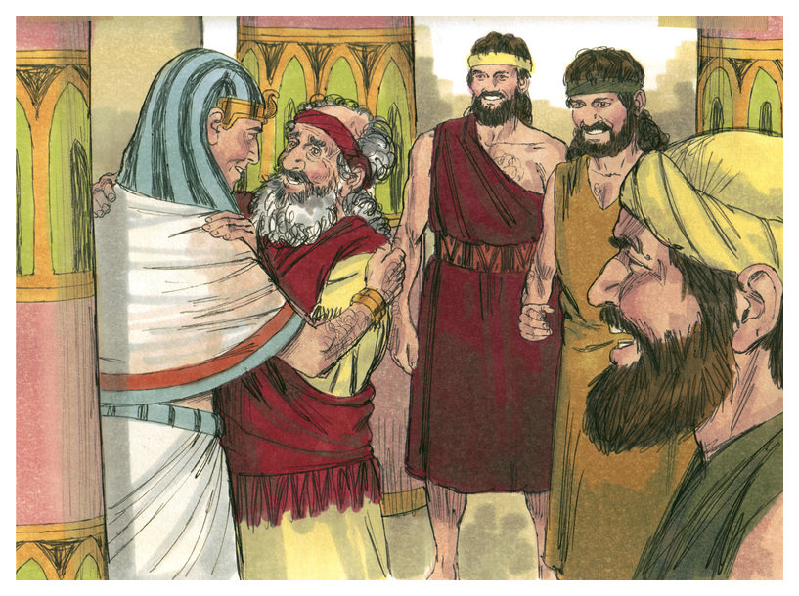
JACOB PREPARES FOR DEATH
“And Israel dwelt in the land of Egypt, in the country of Goshen; and they had possessions therein, and grew, and multiplied exceeding.
And Jacob lived in the land of Egypt [17] years: the whole age of Jacob was [147] years” (47:27,28).
God had taken very good care of Jacob and
his family, but He now prepares him for death.
“And the time drew nigh that Israel must die:
and he called his son Joseph, and said unto him… bury me not, I pray thee, in Egypt. But I will lie with my fathers… bury me in their buryingplace. And he [Joseph] said, I will do as thou hast said” (47:29,30).
Jacob had but one last request—to be buried with his father Isaac, and grandfather Abraham.

Slide 20
God is a Holy and remarkable GOD. After the flood when the Gentile nations spurned God a second time at the tower of Babel, He called a righteous man through whom he would form a nation after His Name.
But God’s plans are not always predictable as Abraham’s descendants had now been taken from their land [Canaan] in order to save them from a world-wide drought. But in the process, has given them a prosperous place [Land ‘O Goshen] to ‘multiply exceedingly.’
The major characters [Abraham, Isaac, Jacob] are born and then die after accomplishing God’s will, but what happened next?
The descendants of Israel were never promised the land of Egypt. How will God get them back to their Promised Land?
Stay tuned. Next time – Gen. 48-50; Exo. 1-18.

