Slide 1
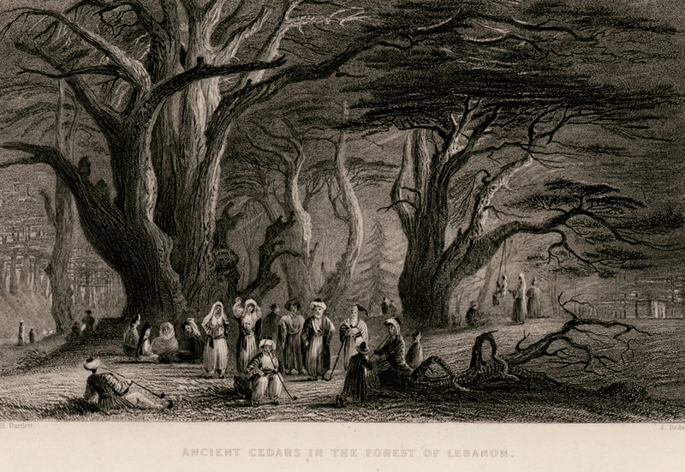
THROUGH THE BIBLE IN 2018
LESSON 24
WEEK 24 OF 52
(1Kgs.5-9; 2Chron.2-8)
Last time we looked at some of the more than 3,000 wisdom sayings called proverbs; this time we see Solomon begin to build the temple.
“And Hiram king of Tyre sent his servants unto Solomon… for Hiram was ever a lover of David” (1Kg. 5:1).
Hiram had helped David to build his palace and now Solomon asked him for assistance in building the temple –
“So Hiram gave Solomon cedar trees, and fir trees according to all his desire” (5:10).
Solomon recruited 30,000 Israelites (5:13) to harvest trees and to cut large stones and transport them “by sea in floats” to Jerusalem (5:9) –
“… so they prepared timber and stones to build the [temple]” (5:18).

Slide 2
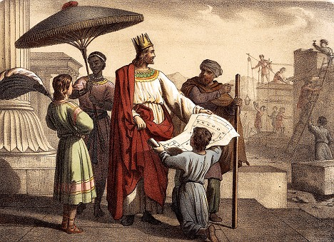
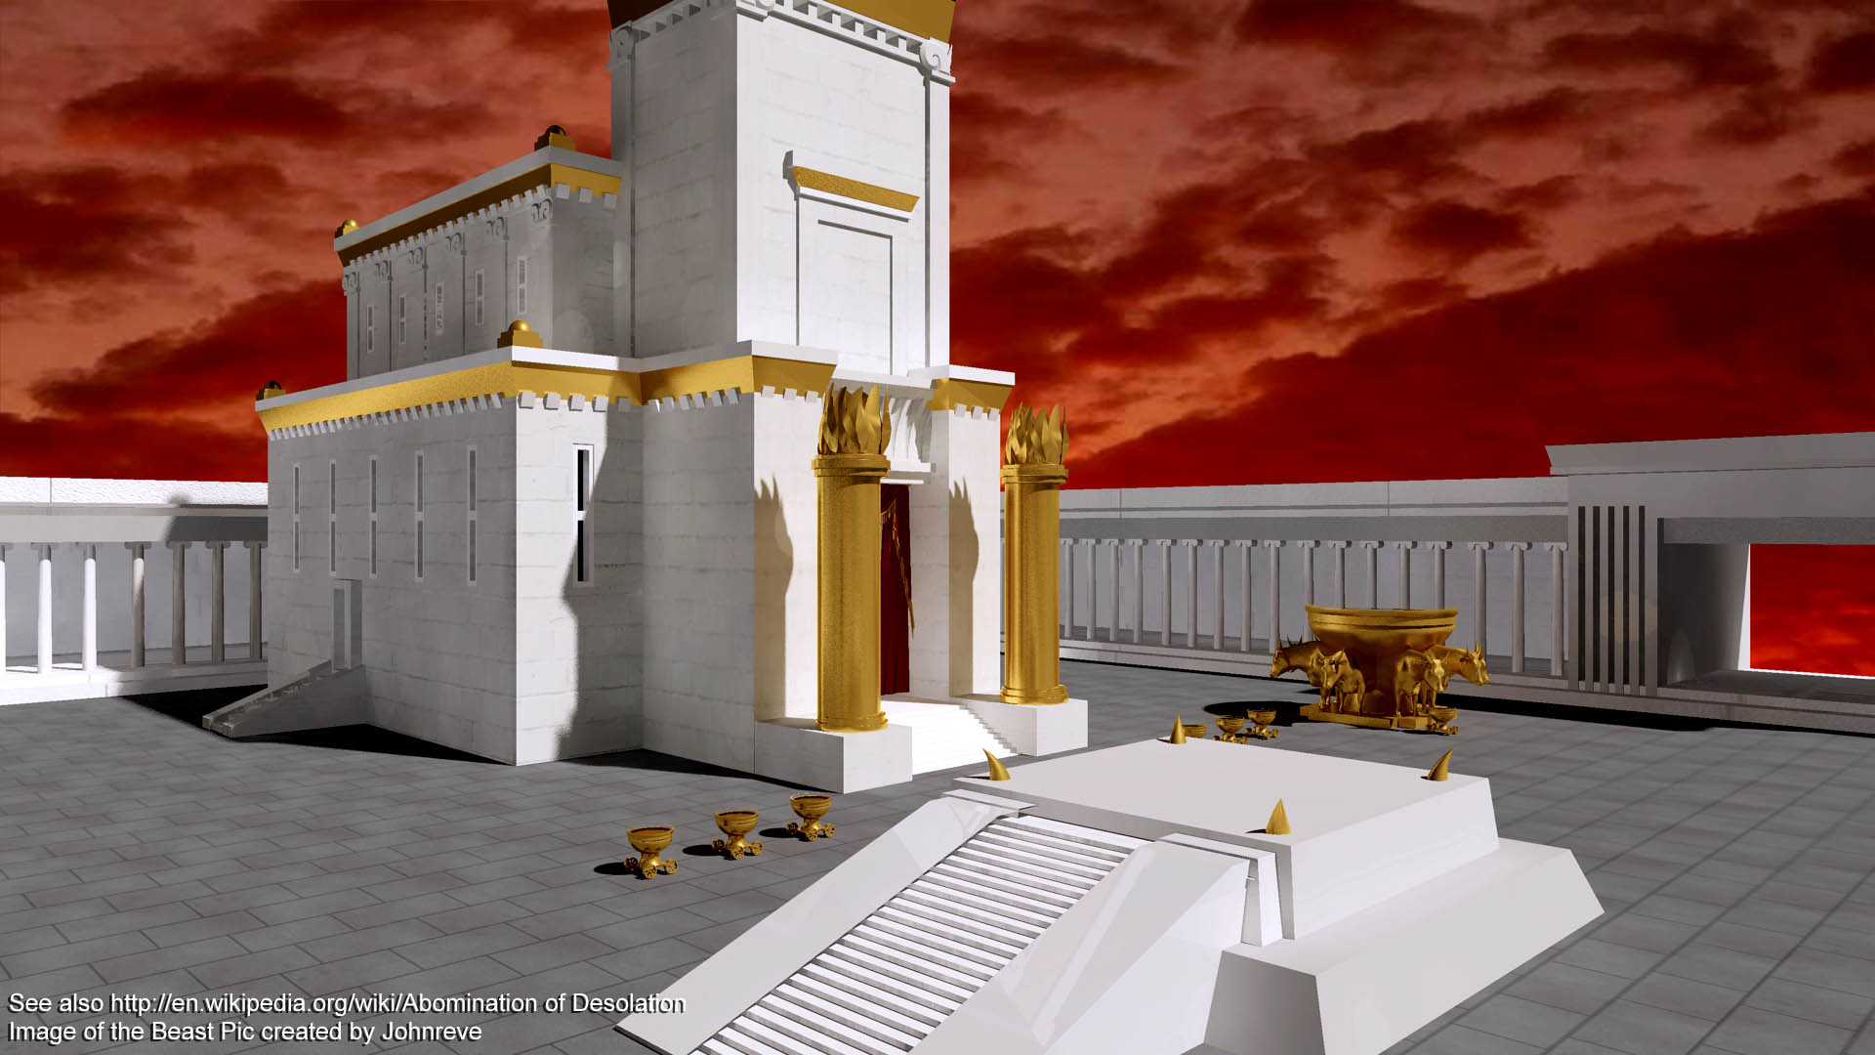
“And it came to pass in the [480th] year after the children
of Israel were come out of the land of Egypt [1446 B.C.], in
the [4th] year of Solomon’s reign over Israel… he began to
build the house of the LORD” (6:1).
Solomon reigned 40-years [971-931 B.C.], and he began
construction of the temple 4-years into his reign [966 B.C.].
TEMPLE SIZE
The temple was to be 90 ft. long, 30 ft. wide, 45 ft. high
[total 2,700 sq. ft.] (6:2,3). Though not huge by building
standards of the day, it’s exterior was of white limestone
embossed with gold (2Chron. 3:6) giving it a strikingly
beautiful appearance.
“And the house, when it was in building, was built of stone
made ready before it was brought thither: so that there
was neither hammer nor axe nor any tool of iron heard in
the house…” (6:7).
Because of its holiness, Solomon required the noisy stone/timber cutting to be done offsite.

Slide 3
“Then Solomon began to build the house of the LORD at
Jerusalem in mount Moriah, where the LORD appeared
unto David his father, in the place that David had prepared
in the threshing floor of Ornan the Jebusite. And he began
to build in the [2nd] day of the [2nd] month, in the 4th year
of his reign” (1Chron. 3:1,2).
The place where David had purchased the threshing floor
and used as the site for sacrifices [original site of Abraham’s
near sacrifice of Isaac], Mt. Moriah, Solomon began the
construction of the house of the LORD.
The holy place was lined with pine boards (3:5) – “And in
the most holy house he made two cherubims… overlaid…
with gold (3:10)… And he made the vail of blue and purple,
and crimson, and fine linen (3:14)… he made an altar of
brass (4:1)… lavers (4:6)… candlesticks of gold (4:7)… And
Solomon made all the vessels that were for the house of God (4:19).”
Solomon reproduced those things which were part of the original tabernacle built by Moses in the wilderness of Sinai 480 years earlier.

Slide 4
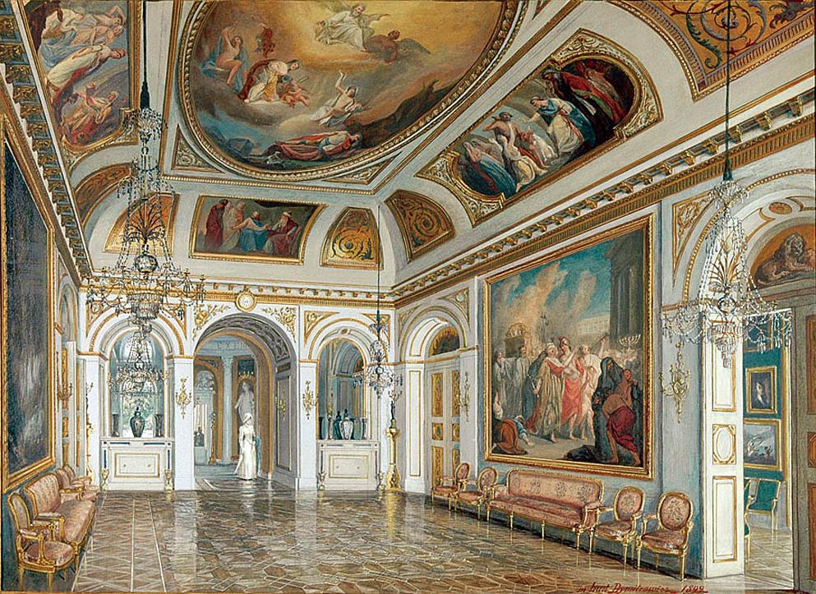
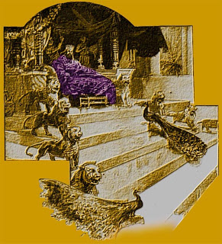
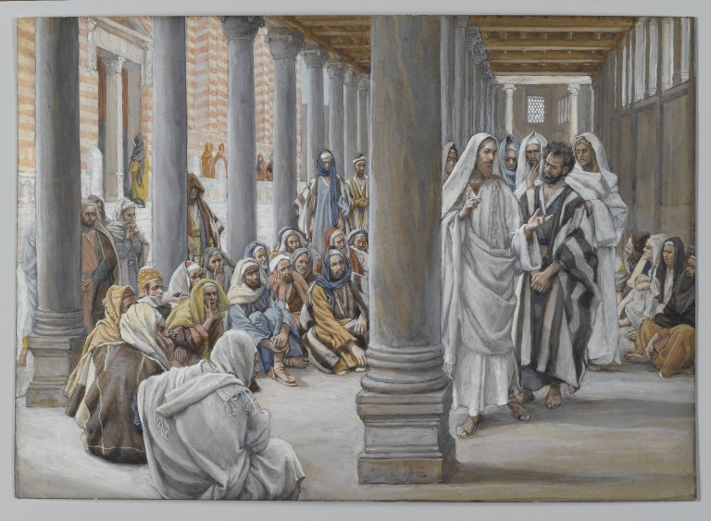
“… So was all he [7] years in building it [temple]. But
Solomon was building his own house [13] years, and he
finished his house” (1Kg. 7:1).
It took Solomon 7-years to build a house for God; 13-
years to build his own house because it was much larger
and more grand. Sound right to you?
“Then he made a porch for the throne where he might
judge, even the porch of judgment” (7:7).
Solomon’s porch [place of judgment] would have
important meaning during Christ’s earthly ministry –
“And Jesus walked in the temple in Solomon’s porch…
came Jews round about him… If thou be the Christ, tell
us plainly. Jesus answered them, I told you, and ye
believed not… because ye are not my sheep. My sheep
hear my voice, and I know them, and they follow me”
(Jn. 10:23-26).
In the ‘place of judgment’ Jesus told them they didn’t believe Him because they were unsaved.

Slide 5
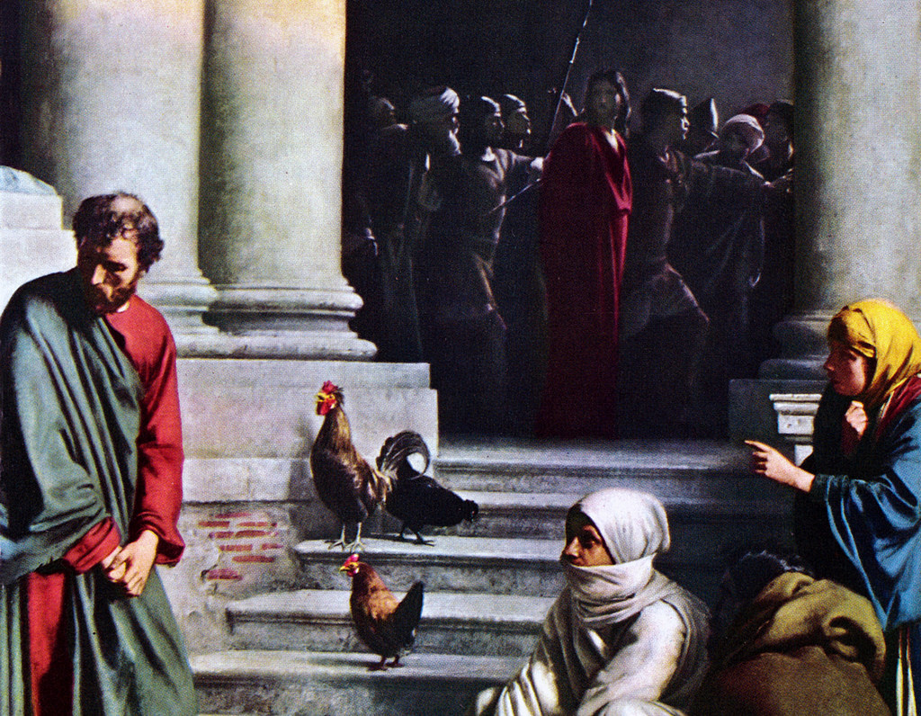
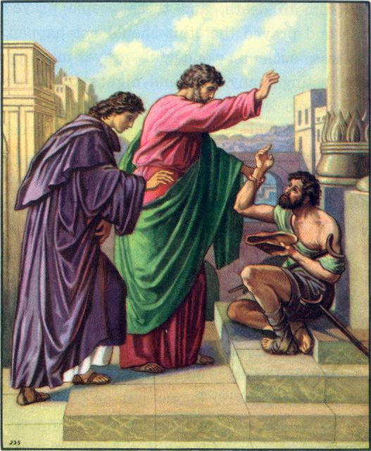
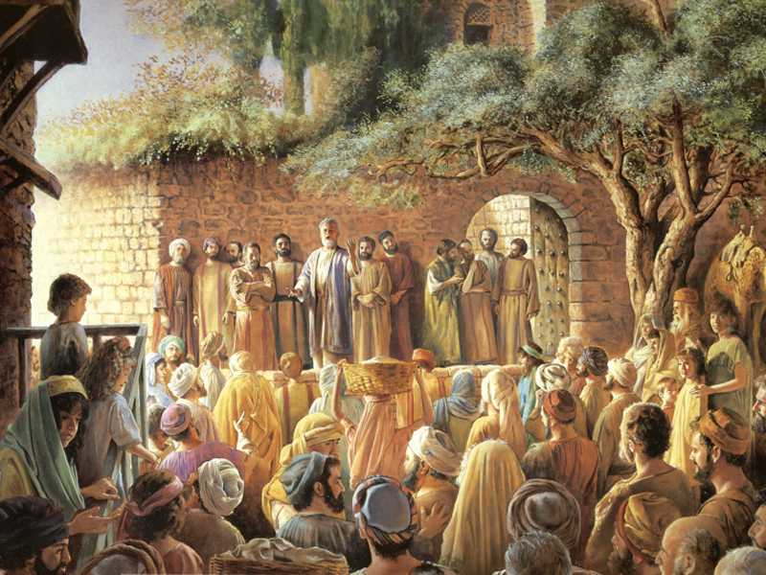
“But he denied, saying, I know not… And he went
out into the porch; and the cock crew” (Mk. 14:68).
Solomon’s porch was the site of Peter’s denials. It would also continue to be important in the early
ACTS period as Israel was still under the Law of
Moses and temple worship, as God continued to
try to reach them with miracles –
“And as the lame man which was healed held Peter and John, all the people ran together unto in the porch that is called Solomon’s, greatly wondering” (Act 3:11)…
“And by the hands of the apostles were many signs and wonders wrought among the people; and they were all with one accord in Solomon’s porch” (5:12).
Signs, wonders, and miracles were God’s proof He was ‘judging’ His favored nation, Israel, for their unbelief.

Slide 6
A skilled craftsman from Tyre “cast two pillars of brass … and he set up the pillars in the porch of the temple called the name Jachin… and Boaz” (7:15,21).
The left column was named for “Yaweh,” and the right “in Yaweh is strength” and were 27 ft. high and 18 ft. in circumference.
Next a giant laver was cast called the “molten sea” (7:23), 15 ft. in diameter and 7 ft. high, and could provide 2,000 baths [1,500 gal.] (26). There were also 10 smaller lavers containing 230 gal. of water each used for washing the sacrifices (7:27,38) during the purification ritual.
“So Hiram made an end of doing all the work that he made king Solomon for the house of the LORD” (7:40).

Slide 7
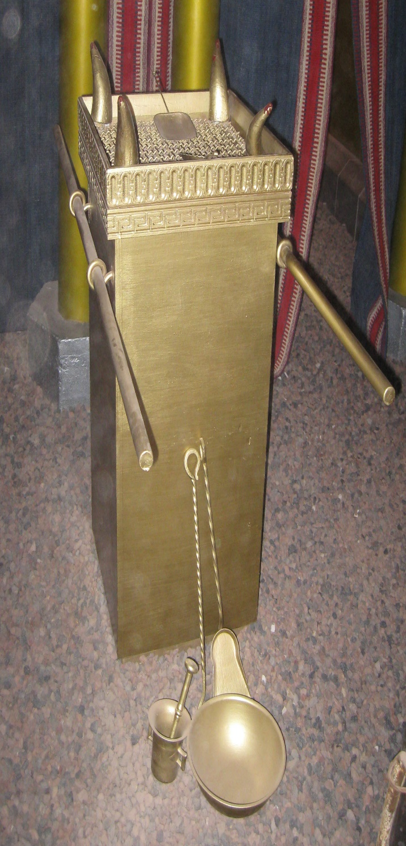
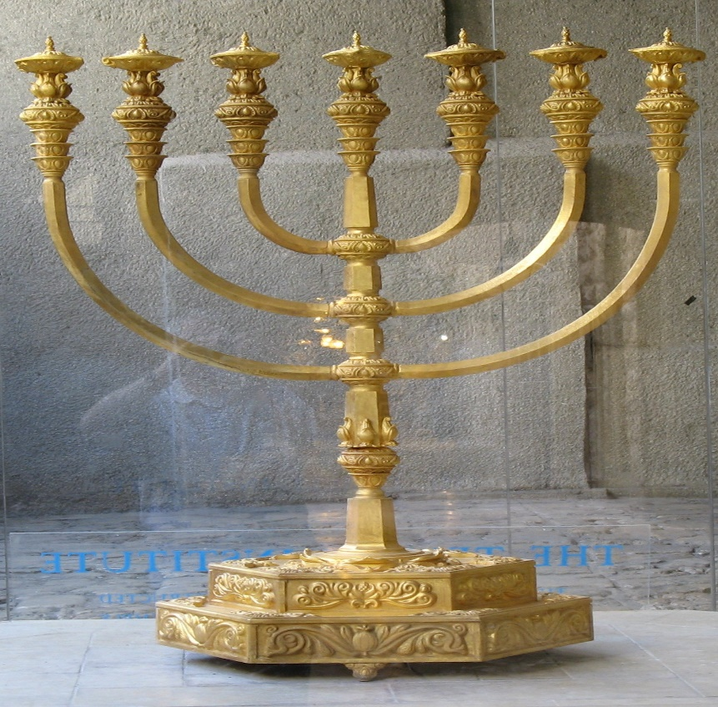
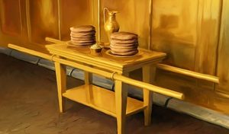
Whereas the objects outside the temple were made of bronze, which was so common that it wasn’t even weighed (7:47); those on the inside were made of gold –
“And Solomon made all the vessels that pertained unto the house of the LORD; the altar of gold, and the table of gold… And the candlesticks of pure gold… bowls… snuffers… censors of pure gold” (7:48-50).
“So was ended all the work that king Solomon made for the house of the LORD. And Solomon brought in the things which David his father had dedicated; even the silver, and the gold, and vessels, did he put among the treasures of the house of the LORD” (7:51).

Slide 8
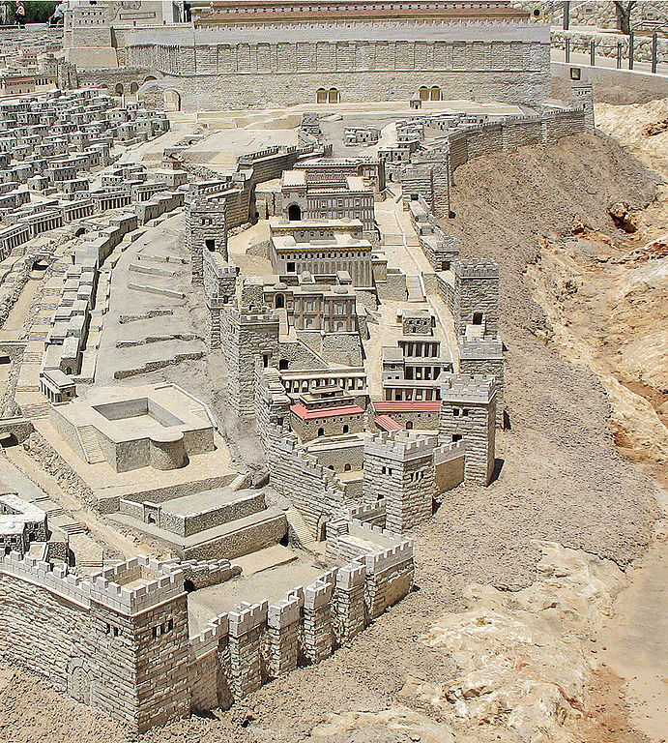
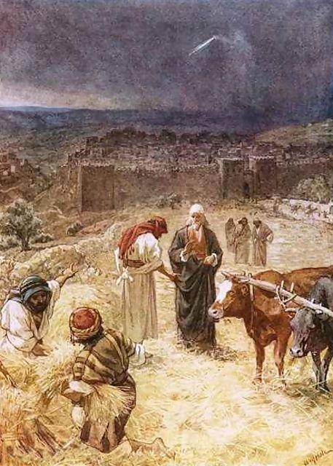
“Then Solomon assembled the elders of Israel, and all the heads of the tribes… that they might bring up the ark of the covenant of the LORD out of the city of David, which is Zion” (1Kg. 8:1).
Solomon summoned Israel to be present when the ark of the covenant [holiest possession] was moved from its site in the City of David to its new home in the temple.
This event occurred during the feast of tabernacles [October] (1Kg. 8:2) in 1059 B.C.
The temple was constructed on the threshing floor purchased by David from the Jebusite a short distance north of the City of David. This would be the final destination of Israel’s most precious object, the ark of the covenant.

Slide 9
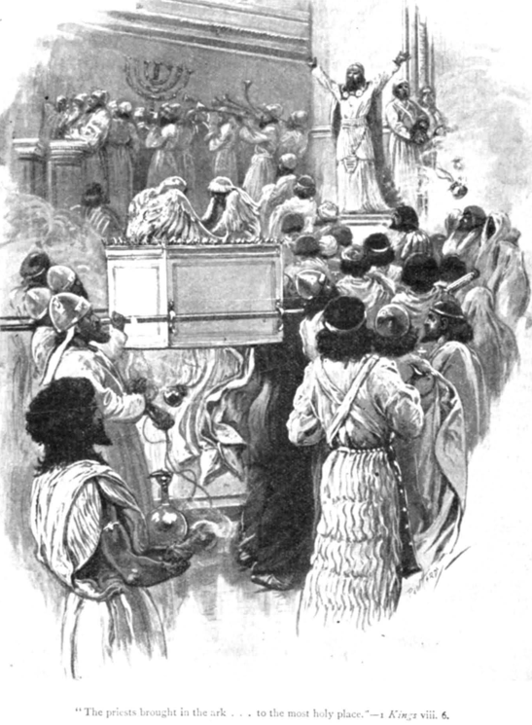
“And all the elders of Israel came, and the priests took up the ark. And they brought up the ark of the LORD, and the tabernacle of the congregation, and all the holy vessels that were in the tabernacle, even those did the priests and the Levites bring up. And king Solomon, and all the congregation of Israel, that were assembled unto him…” (1Kg. 8:3-5).
As David had led the processional for the transporting of the ark into Jerusalem, Solomon led the same from the City of David to the newly built temple a short distance to the north.
Unlike David’s first attempt, Solomon made sure the priests and the Levites were in charge of carrying the holy objects, especially the ark.
The only original object from the time of Moses was the ark of the covenant—everything else had been reproduced by Solomon.

Slide 10
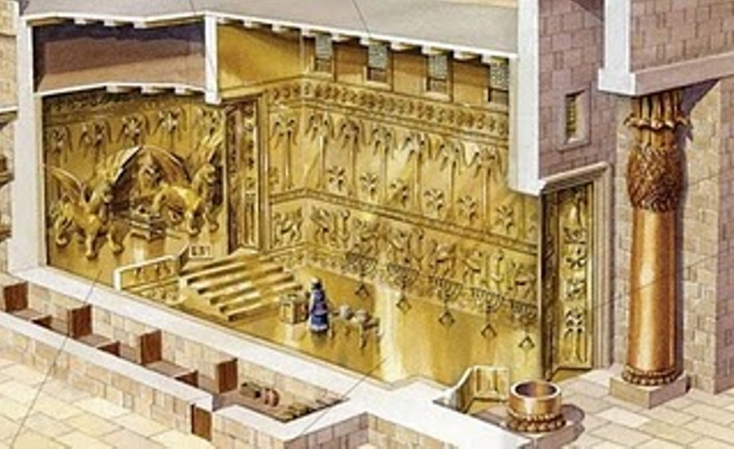
And the priests brought in the ark of the covenant of
the LORD unto his place, into the oracle of the house,
to the most holy place, even under the wings of the
cherubims…” (1Kg. 8:6).
The public stopped at the door of the temple, and the
priests alone went into the holy place, and then the
most holy place where they placed the ark between
the two cherubim.
“… the ends of the staves were seen out in the holy
place… they were not seen without: and there they are
unto this day” (1Kg. 8:8).
The priests left the staves in place as the Law called for –
“The staves shall be in the rings of the ark; they shall
not be taken from it” (Exo. 25:15).
The staves could be seen from the holy place, but not
from the outside of the temple. It also means 1Kings
had to have been written before the destruction of the temple in 586 B.C.

Slide 11
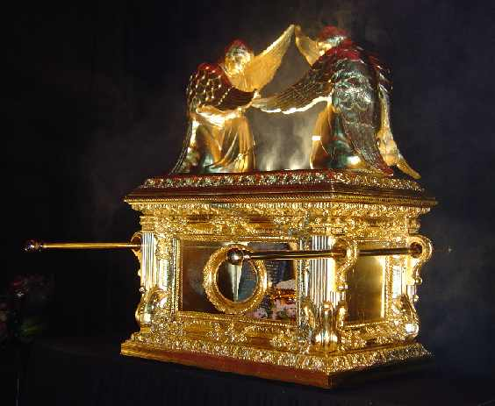
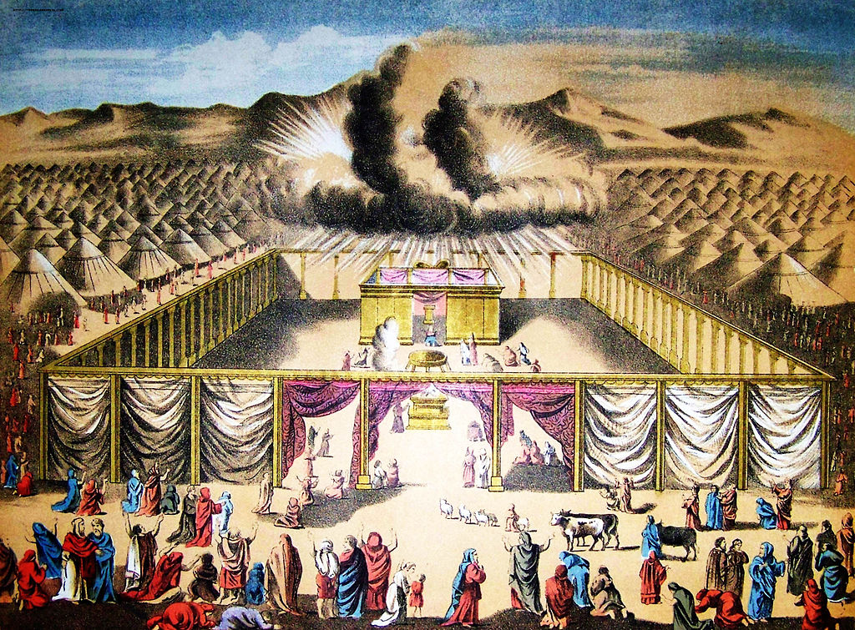
CONTENTS OF THE ARK
“There was nothing in the ark save the two tablets of
stone, which Moses put there at Horeb [Sinai], when
the LORD made a covenant with the children of Israel,
when they came out of the land of Egypt” (1Kg. 8:9).
Only the ten commandments remained, the pot of
manna and Aaron’s rod that budded were gone. The
Bible does not say what happened to them, but they
could have been stolen by the Philistines when they
captured the ark.
“And it came to pass, when the priests were come out
of the holy place, that the cloud filled the house of the
LORD. So that the priests could not stand to minister
because of the cloud: for the glory of the LORD had
filled the house of the LORD” (1Kg. 8:10,11).
The cloud represented the GLORY of the LORD just as it had when the wilderness tabernacle was dedicated at Mt. Sinai.

Slide 12
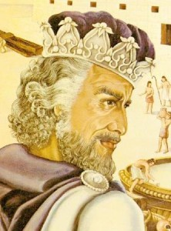
“Then spake Solomon, The LORD said that he would dwell in the thick darkness. I have surely built thee an house to dwell in, a settled place for thee to abide in forever” (1Kg. 8:12,13).
God seemed pleased with the House Solomon built for Him. Solomon hoped God will reside there forever.
But, will He?
“And the king turned his face about, and blessed all the congregation of Israel: and all the congregation of Israel stood. And he said, Blessed be the LORD God of Israel, which spake with his mouth unto David my father… Since the day that I brought forth my people Israel out of Egypt, I chose no city out of all the tribes of Israel to build an house, that my name might be therein; but I chose David to be over my people Israel … thy son… he shall build the house unto my name…
I have set there a place for the ark…” (1Kg. 8:14-21).

Slide 13
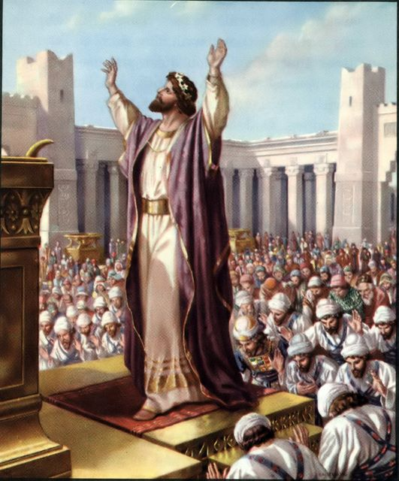
PRAYER OF DEDICATION
“And Solomon stood before the altar of the LORD in the
presence of all the congregation of Israel, and spread forth his hands toward heaven: And he said, LORD God of Israel, there is no God like thee… who keepest covenant and mercy with thy servants… Who hast kept with thy servant David… and hast fulfilled it with thine hand, as it is this day…” (8:22-24).
Standing on a special built bronze platform built for the
dedication ceremony (2Chron. 6:13), Solomon praised and blessed God for His faithfulness in keeping the promises [great nation, land, king & Kingdom, and now temple] He promised Israel. Solomon prayed that all the people of the world [Gentile nations] would know the God of Israel –
“… that all people of the earth may know thy name, to fear thee, as do thy people Israel…” (8:43).

Slide 14
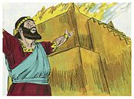
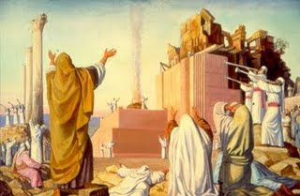
As he finished speaking, fire came from heaven –
“And when Solomon had made an end of praying, the fire came down from heaven, and consumed the burnt-offering and the sacrifices” (2Chron. 7:1).
Israel had experienced the same at the dedication of the wilderness tabernacle –
“And there came a fire out from before the LORD,
and consumed upon the altar the burnt offering… which when all the people saw, they shouted, and fell on their faces” (Lev. 9:24).
The Jews present at the dedication of Solomon’s temple did the same –
“And when all the children of Israel saw how the fire came down… they bowed themselves with their faces to the ground… and worshipped, and praised the LORD...” (2Chron. 7:3).

Slide 15
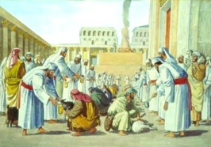
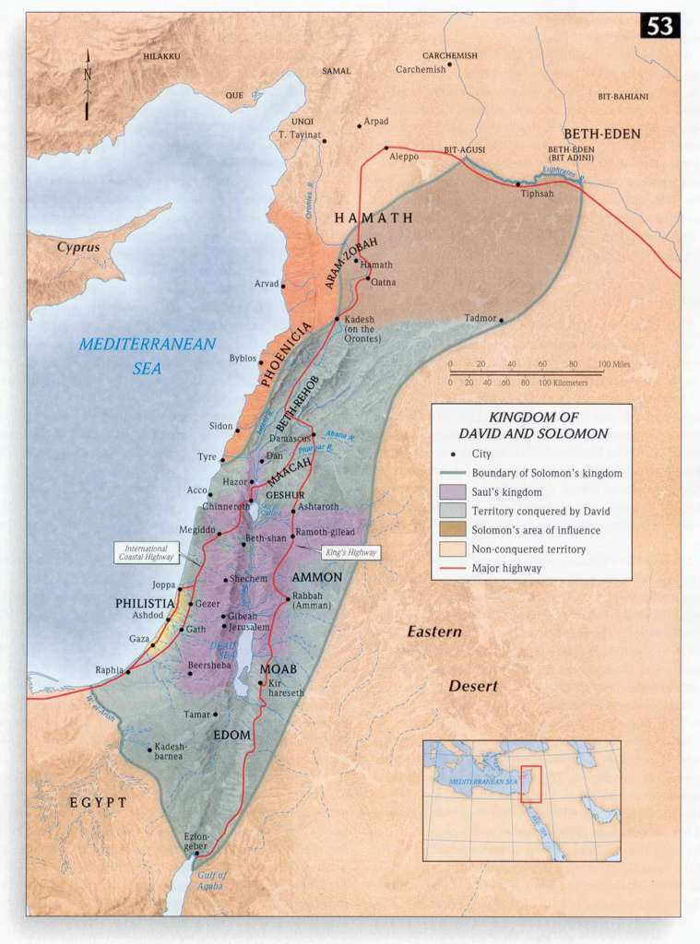
SOLOMON’S SACRIFICE
“And the king, and all Israel with him, offered sacrifice before the LORD” (1Kg. 8:62,63).
The king offered [22,000] cattle and [120,000] sheep as part of the dedication, which coincided with the feast of tabernacles, which normally lasted 7-days, but was extended to 14-days for this special occasion –
“And at that time Solomon held a feast, and all Israel with him, a great congregation, from the entering in of Hamath unto the river of Egypt, before the LORD our God, [7] days and [7] days, even [14] days” (8:65).
An incalculable number of Israelites attended the holy day celebration + dedication of the temple. They came from the Euphrates River in the north to Egypt in the south, their wandering was now over.
Or, was it?

Slide 16
PRAISE PSALMS
“O give thanks unto the LORD; for he is good: for his mercy endureth forever… O give thanks unto the God of gods… to the LORD of lords”
(Psa. 136:1).
These praise psalms could easily have been recited by Solomon during the dedication and sanctification of the temple.
“Behold, bless ye the LORD, all ye servants of the LORD, which by night stand in the house of the LORD. Lift up your hands in the sanctuary, and bless the LORD. The LORD that made heaven and earth bless thee out of Zion” (134:1,2).
“Praise ye the LORD… While I live will I praise the LORD: I will sing praises unto my God… the LORD shall reign forever, even thy God, O Zion, unto all generations” (146:1,2,10).

Slide 17
“Praise ye the LORD: for it is good to sing praises unto our God; for it is pleasant; and praise is comely… The LORD doth build up Jerusalem: he gathereth together the outcasts of Israel” (147:1,2).
“Praise ye the LORD. Praise ye the LORD from the heavens: praise him in the heights… Let them praise the name of the LORD: for he commanded, and they were created” (148:1,5).
“Praise ye the LORD. Sing unto the LORD a new song, and his praise in the congregation of saints. Let Israel rejoice in him that made him: let the children of Zion be joyful in their King” (149:1,2).
“Praise ye the LORD. Praise God in his sanctuary… Praise him for his mighty acts: praise him according to his excellent greatness… Let everything that hath breath praise the LORD. Praise ye the LORD” (150:1,2).

Slide 18
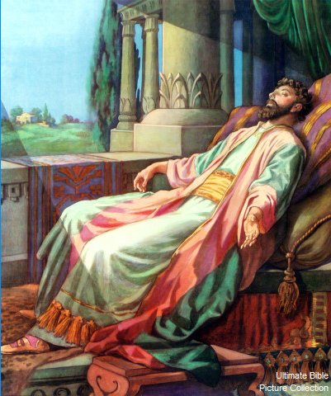
“And it came to pass, when Solomon had finished the
building of the house of the LORD, and the king’s
house… that the LORD appeared to Solomon the [2nd]
time, as he had appeared unto him at Gibeon. And
the LORD said unto him, I have heard thy prayer and
thy supplication, that thou hast made before me: I
have hallowed this house, which thou hast built, to
put my name there forever; and mine eyes and mine
heart shall be there perpetually” (1Kg. 9:1,2).
God appeared to Solomon in Jerusalem and told him
He had heard his prayer of dedication, that He had
sanctified the temple, where He would reside as the
God of Israel. But, if he or other kings would turn
from Him to idol worship He would exile Israel and
vacate the temple –
“… but go and serve other gods… then I will cut off Israel out of the land… and this house, which I have hallowed for my name, will I cast out of my sight…” (9:6,7).

Slide 19
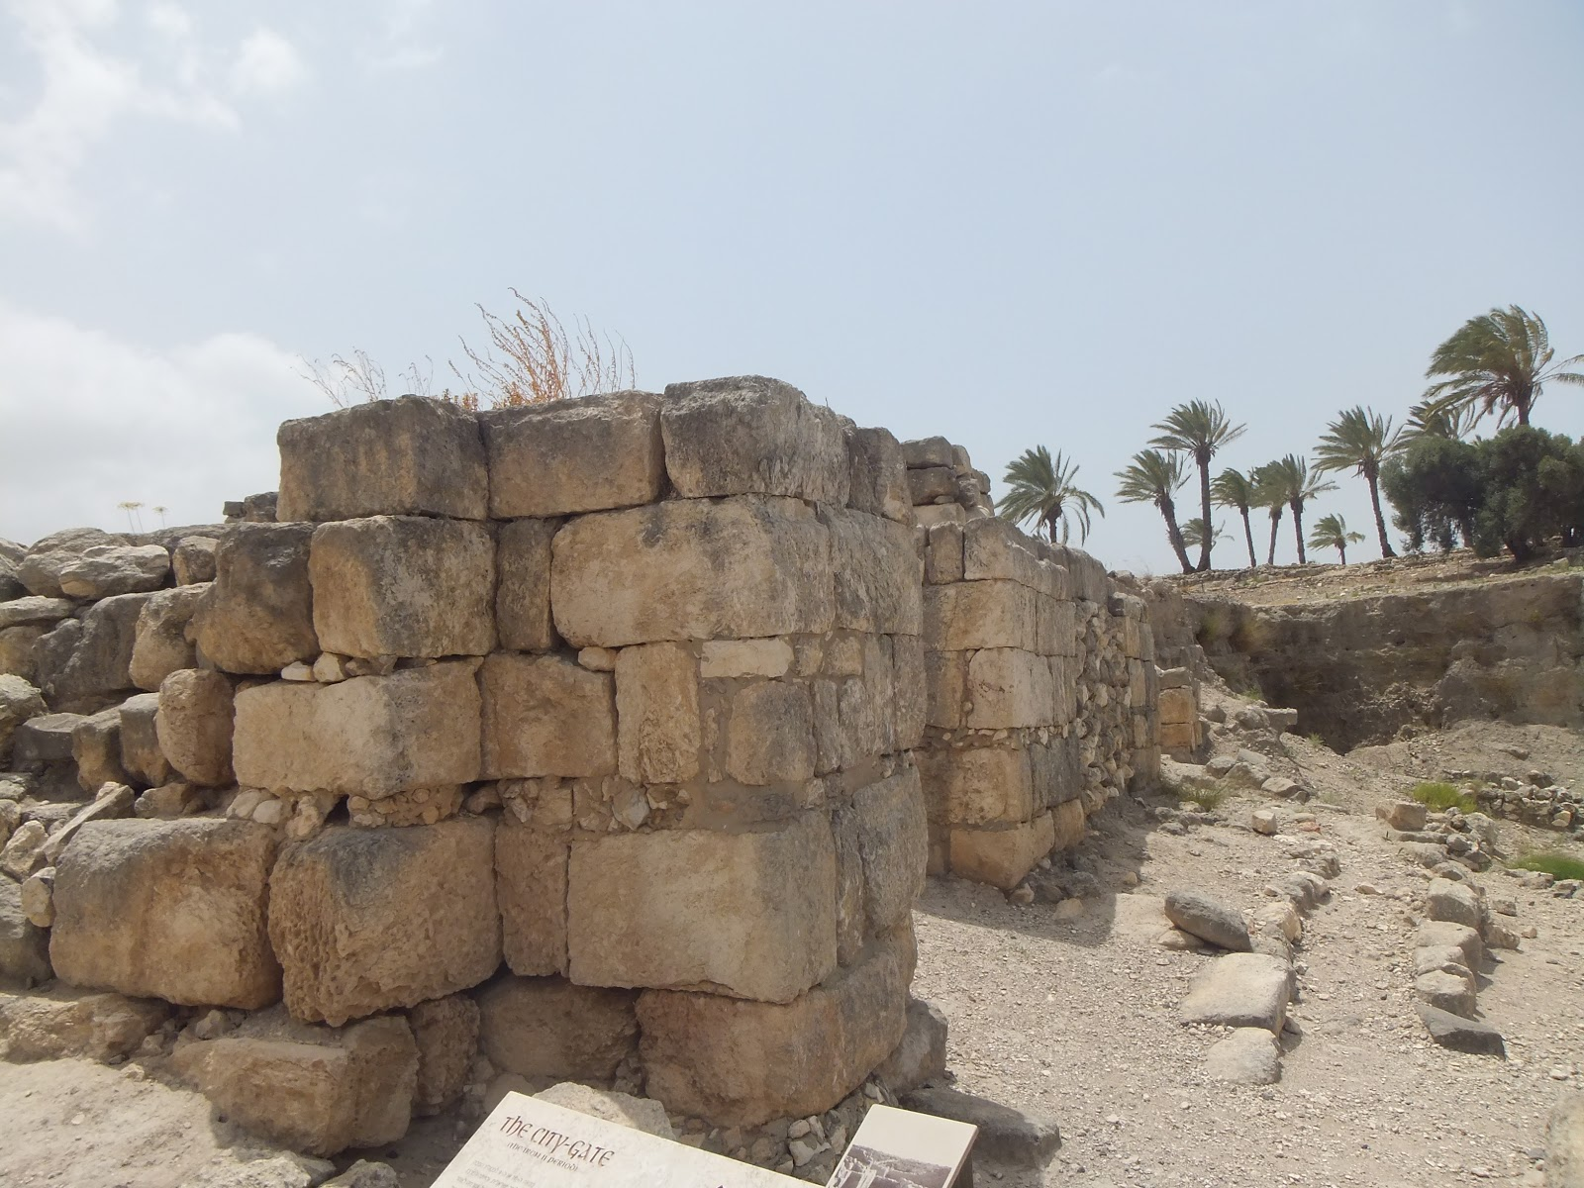
SOLOMON’S HALF-WAY MARK
“And it came to pass at the end of [20] years, when Solomon had built the two houses, the house of the LORD, and the king’s house”
(1Kg. 9:10).
Solomon had completed the first half of his 40-year reign as king of Israel and thus far had carried out an expansive building program beginning with the temple and his palace, which required raising taxes –
“And this is the reason of the levy which king Solomon raised…” (9:15).
Other building plans included doubling the size of Jerusalem; and building the fortress cities of Hazor [protected the northern territory], Megiddo [central], and Gezer [southern]. This building program made Israel stronger militarily, but it also caused tremendous hardship on the people.
FORTRESS AT MEGIDDO

Slide 20
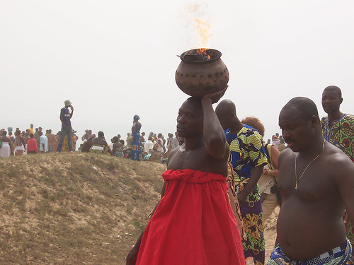
PROVERBS
“If thine enemy be hungry, give him bread to
eat; and if he be thirsty, give him water to
drink” (25:21).
Solomon’s wisdom showed him that some-
times it is better to reach out to an offender,
which is more likely to make reconciliation, than to push him away, which he will likely cause you more trouble.
“For thou shalt heap coals of fire upon his head, and the LORD shall reward thee” (25:21).
If someone’s fire went out, you should show them a kind gesture and carry some of your hot coals to restart your neighbor’s fire. Paul quoted these verses to make this point –
“Dearly beloved… Vengeance is mine… saith the Lord… Be not overcome of evil, but overcome evil with good” (Rom. 12:19-21).
Next time – Ecclesiastes

