Slide 1
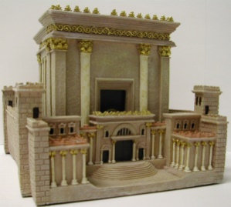

Slide 2
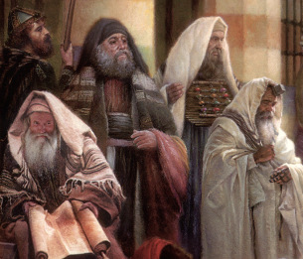
LESSON 45
WEEK 45 OF 52
(Mt. 23-26; Mk. 13,14;
Lk. 20-22; Jn. 13-17)
THROUGH THE BIBLE IN 2018
Passion week.
THOSE WHO SIT IN MOSES’ SEAT
“Then spake Jesus to the multitude, and to his disciples, Saying, The scribes and the Pharisees sit in Moses’ seat: All therefore whatsoever they bid you observe, that observe and do…”
(Mt. 23:1,2a).
Here, Jesus Himself, clearly instructs the crowds to continue to obey the authorities, i.e. keep the Law of Moses. Israel had been under the requirements of the Law since received at Mt. Sinai and continued to through the end of Christ’s earthly ministry, and beyond that, as we will see. Many in Christendom believe that His ministry was to us Gentiles during the Church age, but that cannot be the case. To follow Jesus’ instructions here would be tantamount to blasphemy. We can learn (Rom. 15:4), but we cannot follow Him as Israel was instructed to do.

Slide 3
THOSE WHO SIT ON MOSES’ SEAT (cont’d)
The Jews were to keep the Law, but they were not to follow the
example set by the religious leaders. Jesus called them
hypocrites because they taught one thing, but did another –
“… but do not ye after their works: for they say, and do not.
For they bind heavy burdens and grievous to be borne, and lay
them on men’s shoulders; but they will not move them with
one of their fingers. But all their works they do for to be seen
of men… love the uppermost rooms at feasts, and the chief
seats at the synagogues, and greetings in the markets, and to
be called of men, Rabbi… But be not ye called Rabbi: for one is
your Master, even Christ; and all ye are brethren…” (23:3b-8).
They were the worst possible examples of what a Jew should
be—they were arrogant, haughty, flaunted their title and
position, told others what to do, but didn’t do it themselves.
They loved to be looked at, listened to, and lifted up, but Jesus
said they were of their father the devil (Jn. 8:44).

Slide 4
WOES ON THE RELIGIOUS LEADERS
“But woe unto you, scribes and Pharisees, hypocrites! For ye shut up the kingdom of heaven against men: for ye neither go in yourselves, neither suffer ye them that are entering to go in” (23:13).
Christ wasn’t finished with them yet. Here, He laid perhaps the worst possible charge against them—they were not going to enter the kingdom of heaven, and, what’s worse, they were preventing others from entering as well.
That should be a word to the wise for this present dispensation of grace and those self-proclaimed leaders [preachers & teachers], who are not saved themselves and are leading others astray.
Now into the last week of His earthly life, Christ’s instructions were clearly that of the Old Covenant, and anyone who teaches otherwise—that, this is New Testament ground, is wrong.
BEWARE! The same admonishment applies today as then.

Slide 5
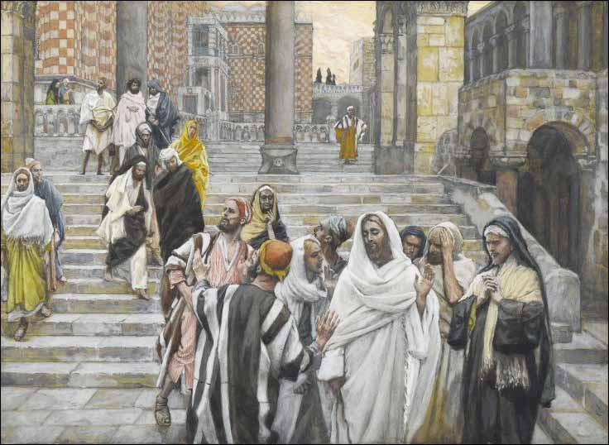
THE OLIVET DISCOURSE
“And Jesus went out, and departed from the temple: and his disciples came to him for to shew him the buildings of the temple… See ye not all these things?... There shall not be left here one stone upon another, that shall not be thrown down” (Mt. 24:1,2).
As the 12 were admiring the beauty of the temple, Christ looking ahead to 70 A.D., tells them it will be
utterly destroyed, just like it was in 587 B.C. by king
Nebuchadnezzar.
After leaving the temple, they withdrew to the Mt. of Olives where the 12 asked Him –
“Tell us, when shall these things be? And what shall be the sign of thy coming, and of the end of the world?” (24:3).
He was referring to Gen. Titus’ destruction of the temple in 70 A.D., but they thought He was talking about the tribulation, so they continued asking Him.

Slide 6
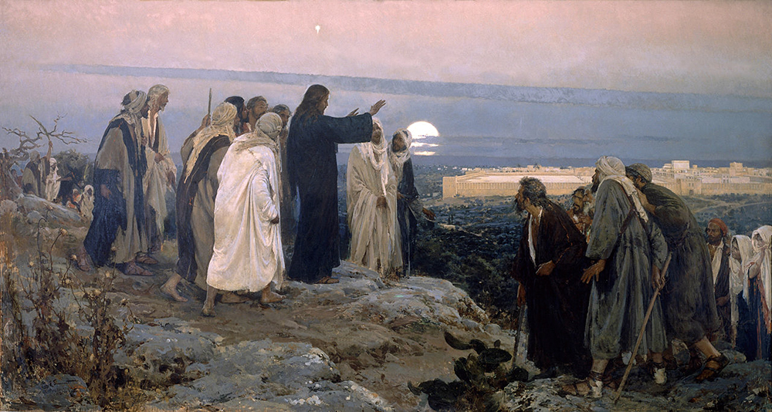
OLIVET DISCOURSE (Cont’d)
“And Jesus answered and said unto them [tribulation], Take heed that no man deceive you. For many shall come in my name, saying, I am Christ; and shall deceive man. And ye shall hear of wars and rumours of wars: see that ye be not troubled: for all these things must come to pass, but the end is not yet. For nation shall rise against nation… famines and pestilence, and earthquakes in divers places. All these are the beginning of sorrows… deliver you up… kill you… hated…” (24:4,5).
Here Christ provides a snapshot of the beginning of the 7-year tribulation, as revealed in the Book of Revelation and the seal judgments: Antichrist (6:2); war (6:4); famine (6:6); death (6:8).

Slide 7
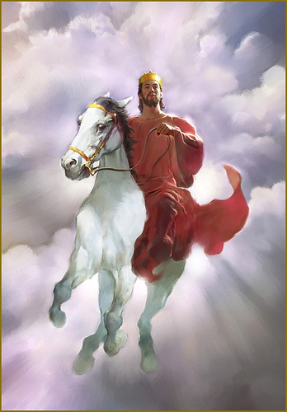
OLIVET DISCOURSE (Cont’d)
“But he that endureth unto the end, the same shall be saved. And this gospel of the kingdom shall
be preached in all the world for a witness unto all nations; and then shall the end come” (24:13,14).
This is the fulfillment of the so-called ‘Great Commission’ given the 12 at the end of the Gospels. It wasn’t carried out at that time, but it will during the 7-years of tribulation – “For then there shall be great tribulation, such as was not since the beginning of the world… nor ever shall be… immediately
after the tribulation… the sun be darkened… heavens shaken… shall see the Son of man coming in the clouds… with power and great glory” (24:21,29,30)—the dramatic return of Jesus Christ!

Slide 8
God’s prophetic program with Israel was interrupted after Christ’s death, burial, and resurrection to usher in the previously unrevealed Church Age [dispensation of grace]. It will conclude with the rapture of the Church, and then Israel’s program begins again with 7-years of tribulation followed by Christ’s 2nd coming, the Millennial kingdom, Great White Throne judgment, and eternity.

Slide 9
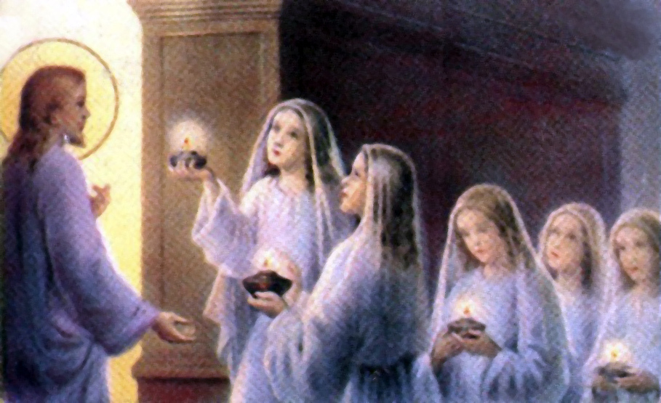
THE MILLENNIAL KINGDOM
“Then shall the kingdom of heaven be likened unto 10-virgins, which took their lamps, and went forth to meet the bridegroom. And 5 of them were wise, and 5 were foolish. They that were foolish took their lamps, and took no oil with them: But the wise took oil in their vessels with their lamps” (25:1-4).
Some Jews will be faithful to the preaching of the ‘gospel of the kingdom,’ but many will not—”Watch therefore, for ye know neither the day nor the hour the Son of man cometh” (25:13).

Slide 10
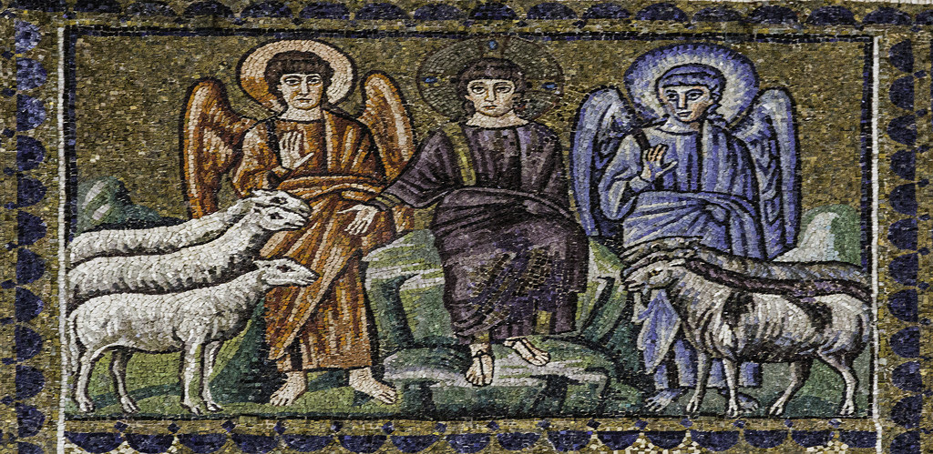
JUDGMENT OF THE GENTILE NATIONS
“When the Son of man shall come in his glory, and all the holy angels with him, then shall he sit upon the throne of his glory: And before him shall be gathered all [Gentile] nations: and he shall separate them one from another, as a shepherd divideth his sheep from the goats” (25:31,32).
After His dramatic 2nd coming and Israel is saved in one day (Isa. 66:8), Christ next judges those Gentiles who lived through the tribulation. Those who befriended Israel [sheep] will also be
saved into the kingdom; those who did not [goats] will be cast into hell – “And these shall go away into everlasting punishment: but the righteous into life eternal” (25:46).

Slide 11
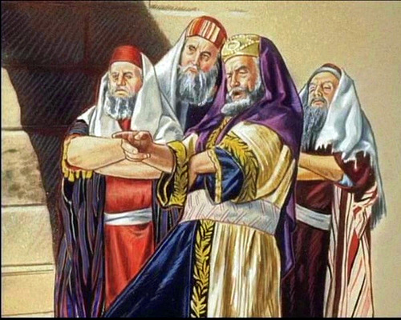
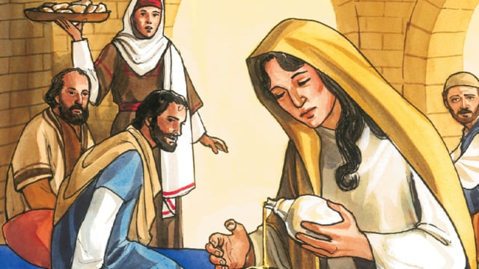
THE DEATH PLOT
“And it came to pass, when Jesus had finished all these sayings, he said unto his disciples, Ye know that after 2-days is the feast of the Passover, and the Son of man is betrayed to be crucified. Then assembled together the chief priests, scribes, and the elder of the people, unto the palace of the high priest, who was called Caiaphas, and consulted that they might take Jesus by subtility, and kill him” (26:1,2).
In 2-days Christ will die as the religious leaders plot.
JESUS ANOINTED
“Now when Jesus was in Bethany… there came a woman having an alabaster box of very precious ointment, and poured it on his head, as he sat at meat. But when the disciples saw it, they had indignation… sold for much… given to the poor” (26:6-9).
The 12 admonished Mary, but Jesus permitted it as it
was symbolic of His soon to be burial.

Slide 12
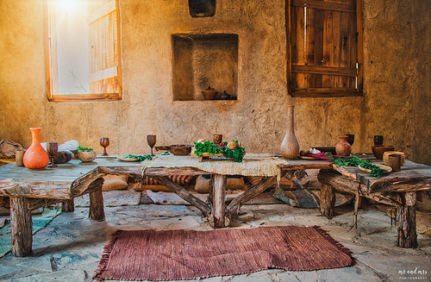
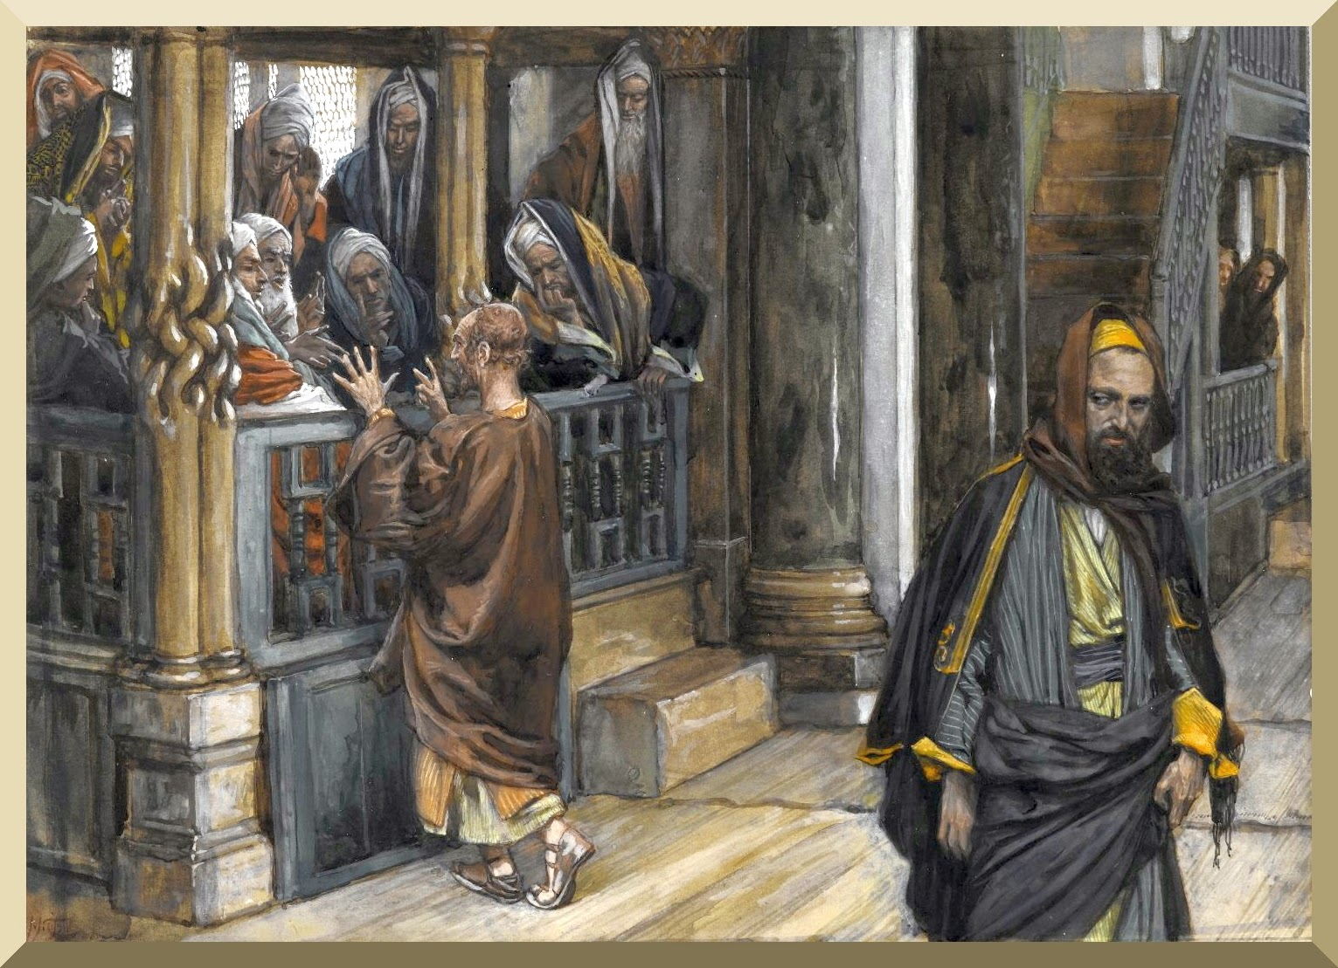
THE TRAITOR
“Then one of the 12, called Judas Iscariot, went unto the chief priests… What shall ye give me, and I will deliver him unto you?... 30-pieces of silver. And from that time he sought an opportunity to betray him” (26:14-16).
Disenchanted with Christ’s ministry, Judas betrayed Him for 30-pieces of silver. Satan hadn’t entered him yet, but he soon would (Jn. 13:27).
PREPARATION FOR THE PASSOVER
“… Where wilt thou that we prepare for thee to eat the Passover?... Go into the city at such a man… the Master saith, My time is at hand; I will keep the Passover at thy house with my disciples… the disciples did as Jesus had appointed them; and they made ready for the Passover” (Mt. 26:17-19).
The Passover meal was planned in a man’s upper room.

Slide 13
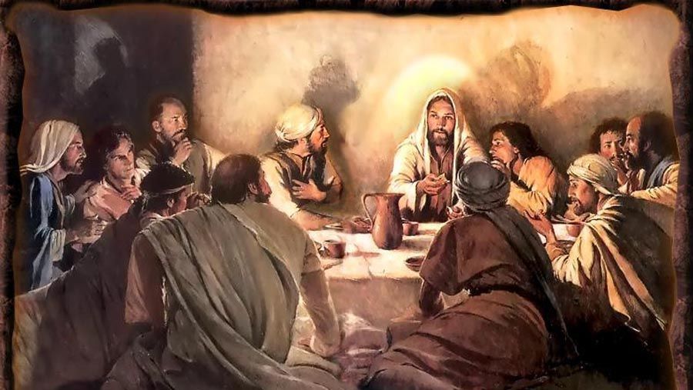
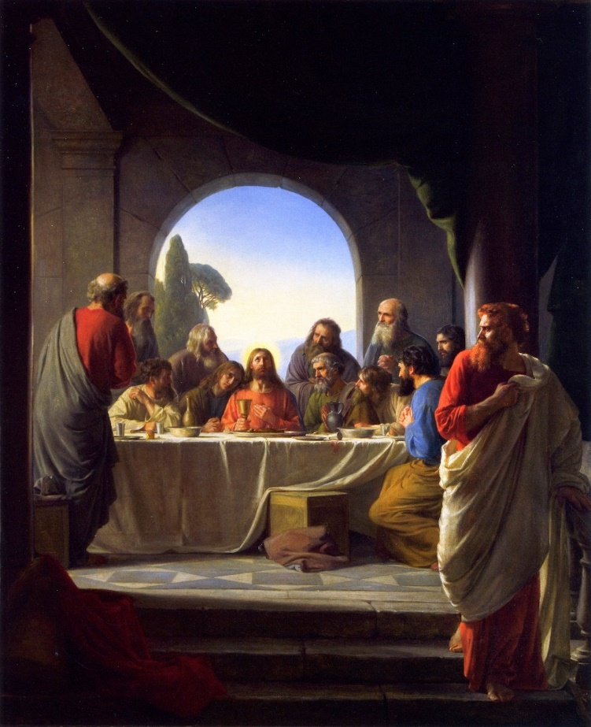
THE LAST PASSOVER
“Now when the evening was come, he sat down with the 12… I say that one of you shall betray me. And they were exceeding sorrowful… Lord, is it I? And he answered and said, He that dippeth his hand with me in the dish, the same shall betray me… it had been good for that man if he had not been born. Then Judas, which betrayed him… Master, is it I? He said unto him, Thou hast said (26:20-25)… after the sop Satan entered into him... Jesus said unto him, That thou doest, do quickly… went immediately out: and it was night” (Jn. 13:27,30).
Judas left under the cover of darkness, his dastardly deed revealed, but not quite completed.

Slide 14
JESUS FORTELLS PETER’S DENIAL
“Therefore, when he was gone out, Jesus, Now is the Son of man glorified, and God is glorified in him… yet a little while I am with you… whither I go, ye cannot come… Simon Peter said unto him, Lord, whither goest thou?... Thou shalt follow me afterwards… why can’t I follow thee now? I will lay down my life for thy sake… Verily, verily, I say unto thee, The crock shall not crow, till thou hast denied me thrice” (Jn. 13:31-38).
After Judas’ departure, Jesus spoke of His glorification and that He would leave them. Impetuous Peter stated that he would follow Him in martyrdom, if that were necessary. Peter, Peter. Not only wouldn’t Peter follow Jesus in death, he wouldn’t follow Him in life.
“Let not your heart be troubled… in my Father’s house are many [rooms]… I will come again… where I am, there ye may be also” (Jn. 14:1-3).
He was talking to the 12 about the temple, NOT YOU!!

Slide 15
THE LORD’S SUPPER
“And as they were eating [Passover], Jesus took bread, and blessed it, and brake it, and gave it to the disciples … Take, eat; This is my body… took the cup… drink ye all of it: For this is my blood of the new testament which is shed for many” (26:26-28).
The prophet Jeremiah prophesied of a coming New Covenant (Jer. 31:31-34), not like the one God originally made with Israel [Old Covenant], dedicated with the shedding of animal blood (Heb. 9:18-20); this one would be dedicated with the shedding of Christ’s
own blood –
“… but now once… hath he [Christ] appeared [in heaven] to put away sin by the sacrifice of himself” (Heb. 9:26).
The Passover meal, which represented Israel’s deliverance from Egypt, was now superseded by the once-and-for-all sacrifice of the Son of God for all sin.

Slide 16
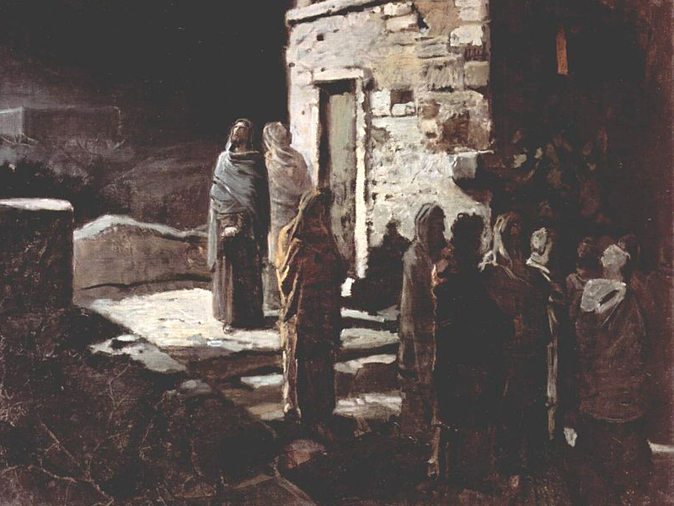
PROMISE OF THE SPIRIT
“And I will pray the Father, and he shall give you another Comforter [advocate], that he may abide with you for ever; I will not leave you comfortless; I will come to you [via the Holy Spirit]” (Jn. 14:16-18).
Either in the upper room or after leaving it and walking through the Kidron Valley to their next destination, Jesus shared with them the promise of the Holy Spirit –
“… It is expedient for you that I go away: for if I go not away, the Comforter will not come unto you; but if I depart, I will send him unto you. And when he is come, he will convict the world of sin, and of righteousness, and of judgment: of sin, because they believe not on me; of righteousness, because I go to my Father, and see ye no more; of judgment, because the prince of this world [Satan] is judged” (16:7-11).
The power of the Holy Spirit convicts: the sinner of his sin; need for salvation; Satan’s judgment at the cross.

Slide 17
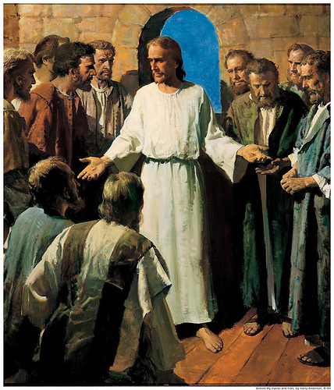
TROUBLE AHEAD
“And he said unto them, When I sent you without purse, and script, and shoes, lacked ye anything? And they said, Nothing… but now, he that hath a purse, let him take it, and likewise his scrip: and he that hath no sword, let him sell his garment and buy one. For I say unto you, that this that is written must yet be accomplished in me, And he was reckoned among the transgressors… And they said, Lord, behold, here are two swords. And he said unto them, It is enough” (Lk. 22:35-38).
Earlier when Christ sent the 12 out to preach the gospel of the kingdom (Mt. 10:7), He told them not to take a purse, money, a change of clothes, etc. Why?
He would ensure that everything they needed would be provided. Now, just before His arrest, He tells them they will need these things, even a sword, as things will get worse. When Christ supersedes one command with another, follow the latter.

Slide 18
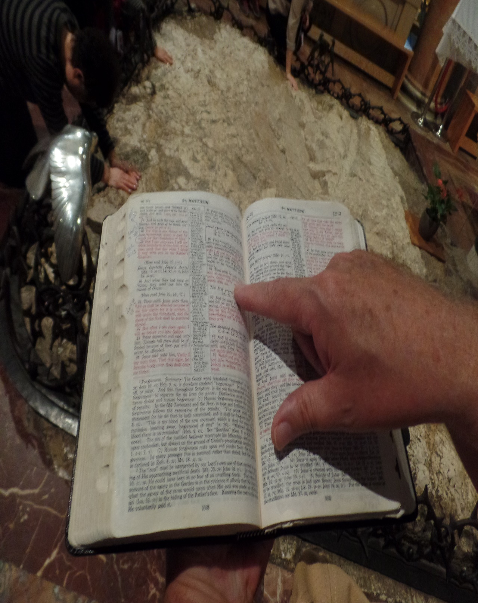
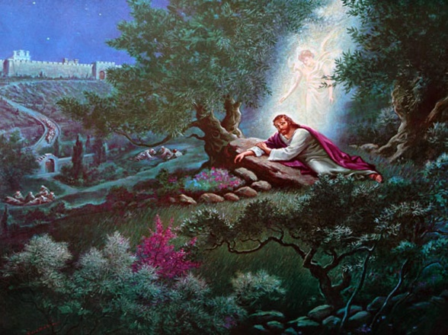
THE SHEEP SCATTERED
“… All ye shall be offended because of me this night: for it is written, I will smite the shepherd, and the sheep of the flock shall be scattered abroad. But after
I am risen again, I will go before you into Galilee” (Mt. 26:31,32).
This was the beginning of the longest night of His life.
GARDEN OF GETHSEMANE
“Then cometh Jesus with them into a place called Gethsemane… Sit ye here, while I go and pray yonder…
O my Father, if it be possible, let this cup pass from me… not as I will, but as thou wilt” (26:36-39).
Christ’s anguish was not death, as He knew He would be resurrected back to life, but rather that He had to bear the cup of iniquity—He would bear the total sins of mankind—that was an incomprehensible thought for the Son of God, but it was the will of the Father
that He do so.

Slide 19
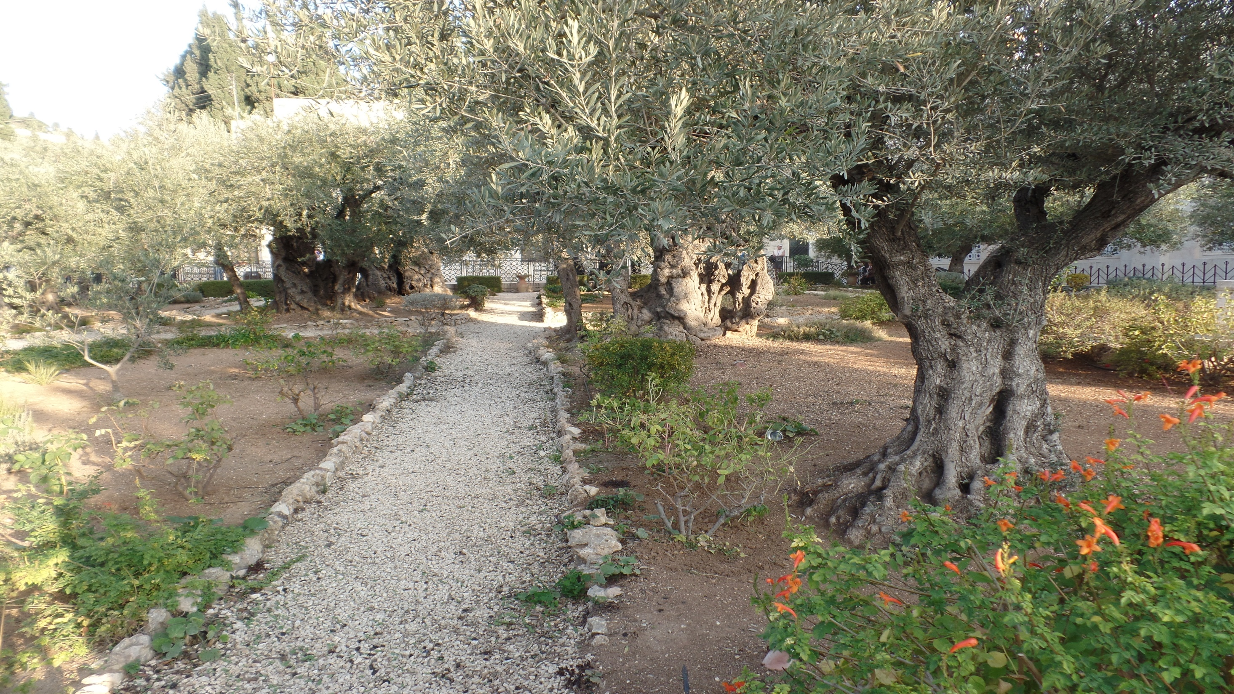
Garden of Gethsemane (2018)

Slide 20
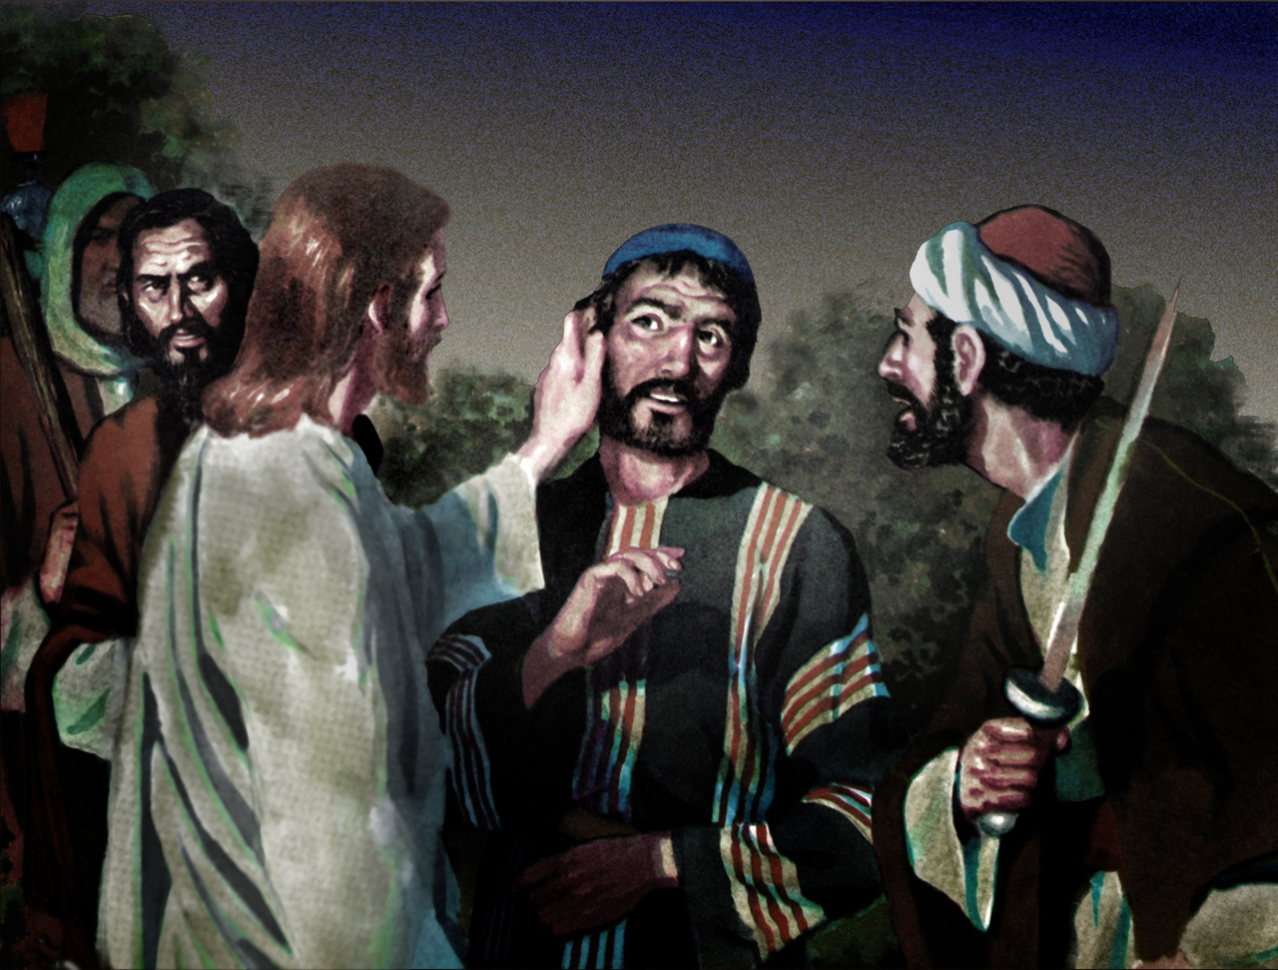
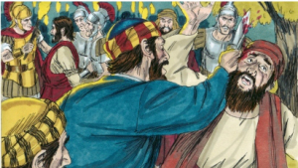
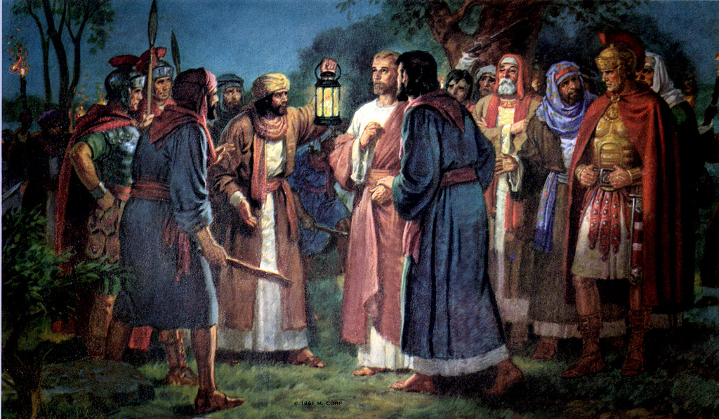
THE ARREST
“… Judas, one of the 12, came… a great multitude with swords… chief priests… Then came they, and laid hands on Jesus, and took him. And, behold, one of them which were with Jesus stretched out his hand, and drew his sword, and struck a servant of the high priest’s, and smote off his ear… Put up again thy sword… Thinkest thou that I cannot now pray to my Father, and he shall give me more than 12 legions [72,000] of angels?... But all this was done, that the scriptures of the prophets might be fulfilled. Then all the disciples forsook him, and fled” (26:47-56).
Judas betrayed Him with a kiss (26:48,49), whom Jesus called, ‘Friend’ (26:50), a reference from the O.T. – “Yea, mine own familiar friend, in whom I trusted, which did eat of my bread, hath lifted up his heel against me” (Psa. 41:9).
In the melee that ensued, Peter cut off a servant’s ear, which Jesus promptly healed (Lk. 22:51).
The 12 then fled as He predicted they would do.

Slide 21
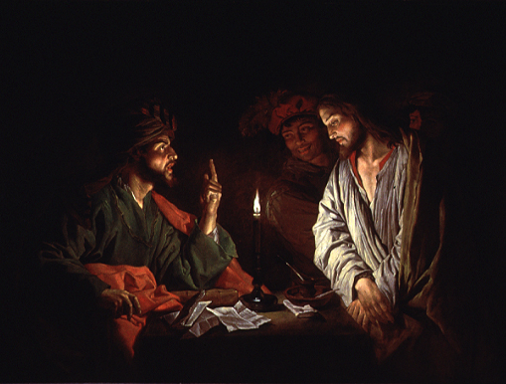
JESUS BEFORE CAIAPHAS/SANHEDRIN
“And they led Jesus away to the high priest: and with him were assembled all the chief priests and the elders and the scribes. And Peter followed him afar off, even into the palace of the high priest… sought for witness against Jesus to put him to death… And there arose certain, and bare false witness against him, saying, We heard him say, I will destroy this temple that is made with hands, and within three days I will build another made without hands… And the high priest stood up in the midst… Art thou the Christ, the Son of the Blessed? And Jesus said, I am: and ye shall see the Son of man… coming in the clouds of heaven… the high priest rent his clothes… they all condemned him to be guilty of death…” (Mk. 14:53-64).
Jesus is found guilty of blasphemy by the religious authority—STRIKE 1.

Slide 22
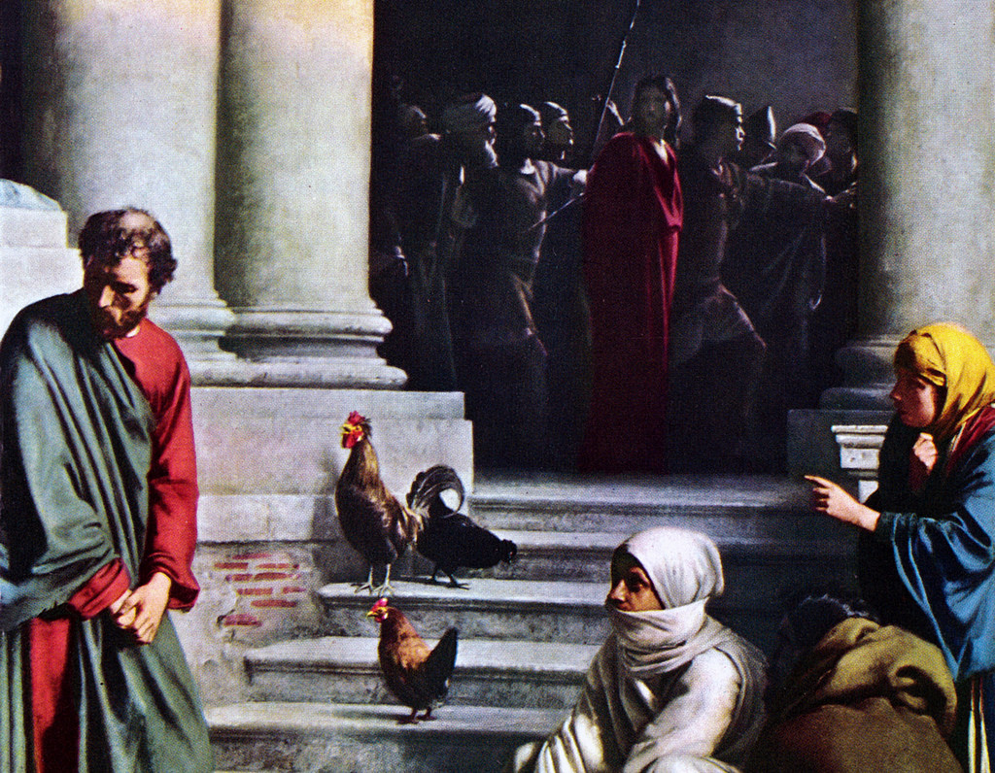
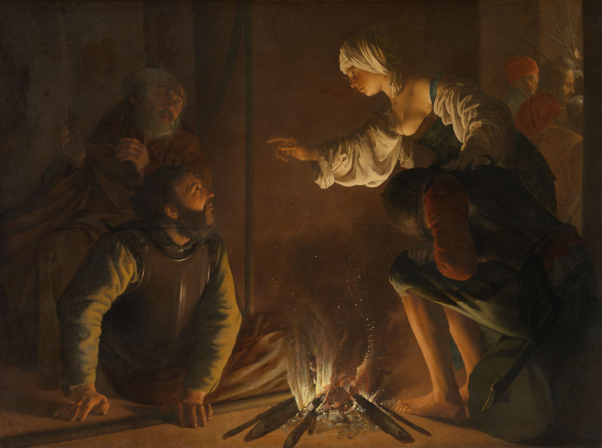
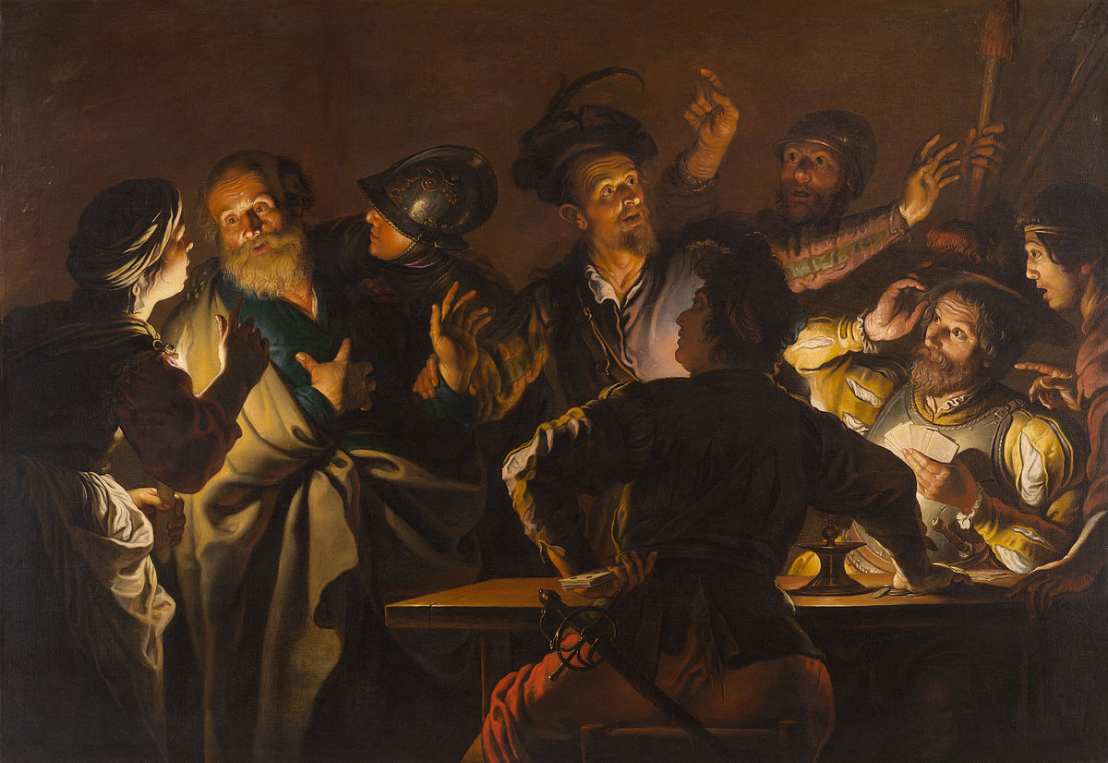
PETER’S DENIAL
“Then took they him, and led him, and brought him into the high priests’ house. And Peter followed afar off. And when they had kindled a fire in the midst of the hall, and were set down together, Peter sat down among them. But a certain maid beheld him as he sat by the fire… This man was also with him. And he denied him, saying, Woman, I know him not… another saw him… Thou art also of them. And Peter, Man, I am not… Of a truth fellow also was with him: for he is a Galilean. And Peter said, Man, I know not what thou sayest. And immediately, while ye yet spake, the cock crew. And the Lord turned, and looked upon Peter… And Peter went out, and wept bitterly” (Lk. 22:54-62).
One can’t imagine the heartbreak Peter felt in his weakness, but in 50+ days he would redeem himself in his sermon at Pentecost.

Slide 23
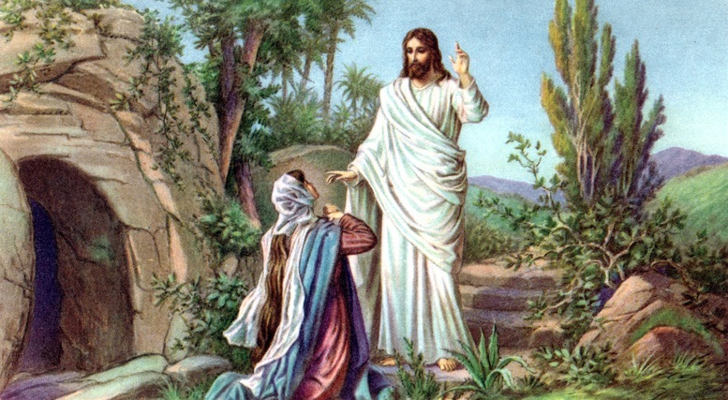
Next time –Christ’s death, burial, and resurrection

