Slide 1
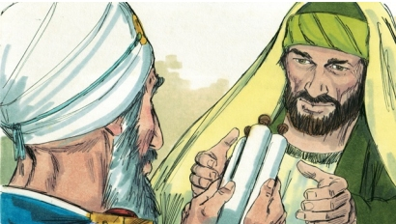
LESSON 47
WEEK 47 OF 52
(Acts 9-16; James;
Galatians 1-6)
THROUGH THE BIBLE IN 2018
Last time – Israel’s continued rebellion; This time – God reveals a new program
SAUL THE PERSECUTOR
“And Saul was consenting unto his [Stephen’s] death. And at that time there was a great persecution against the church which was at Jerusalem; and they were all scattered abroad… except the [12] apostles... As for Saul, he made havock of the [Jerusalem] church, entering into every house, and haling men and women committed them to prison (Acts 8:1-3)… And Saul, yet breathing out threatenings and slaughter against the disciples of the Lord, went unto the high priest, and desired of him letters to Damascus to the synagogues, that if he found any of this way… he might bring them bound unto Jerusalem” (9:2).
Saul of Tarsus had become Christ’s worst enemy. So scared were the believing Jews of Jerusalem, that they fled the city, so not to be arrested of those of ‘this way’ [Messianic Jews]. So he went…

Slide 2
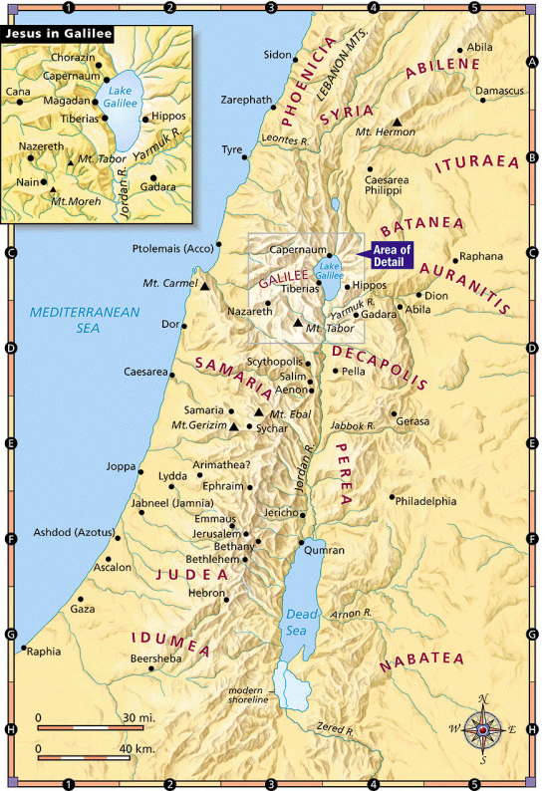
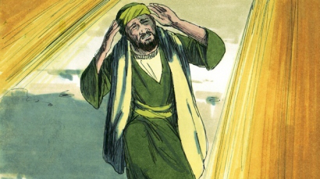
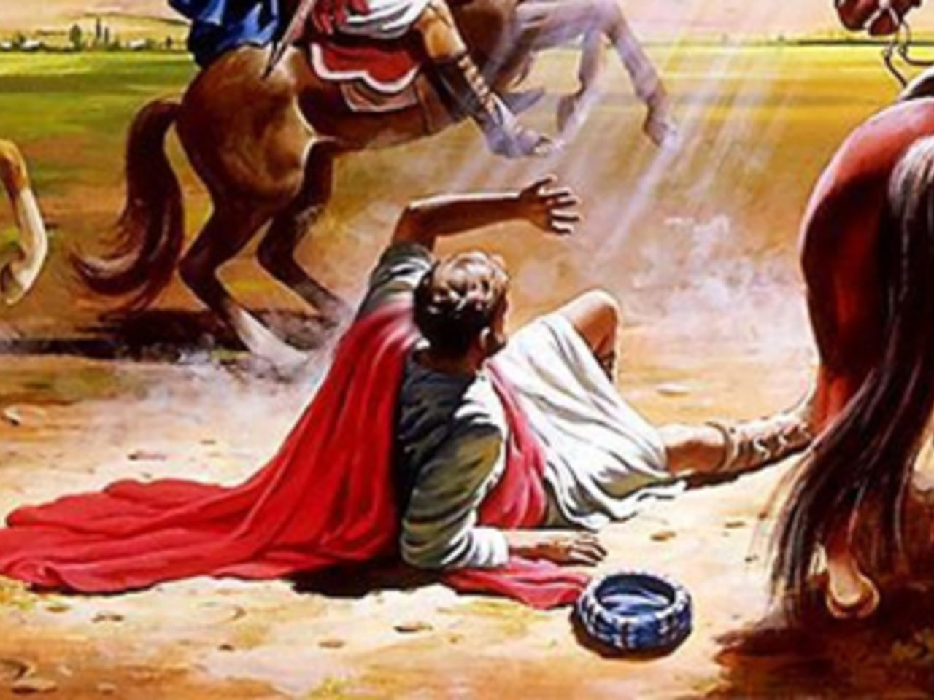
… after them, to Damascus, Syria, a trip of about 150 miles. But, before he made it into the city, something happened –
“And he journeyed, he came near Damascus: and suddenly there shined round about him a light from heaven: and he fell to the earth, and heard a voice saying unto him, Saul, Saul, why persecutes thou me?” (9:3,4).
Falling to the ground, Saul was blinded by an intense light, and out of it someone spoke to him –
“And he said, Who art thou, Lord? And the Lord said, I am Jesus whom thou persecutest…” (9:5).
He knew immediately who it was and what He wanted. In
a moment in time, Saul’s life was changed forever. He had
been Christ’s greatest enemy—from now on, he would be his greatest advocate and servant (A.D. 35) –
“And he trembling and astonished said, Lord, what will thou have me to do?”
Christ told Saul exactly what He wanted him to do!

Slide 3
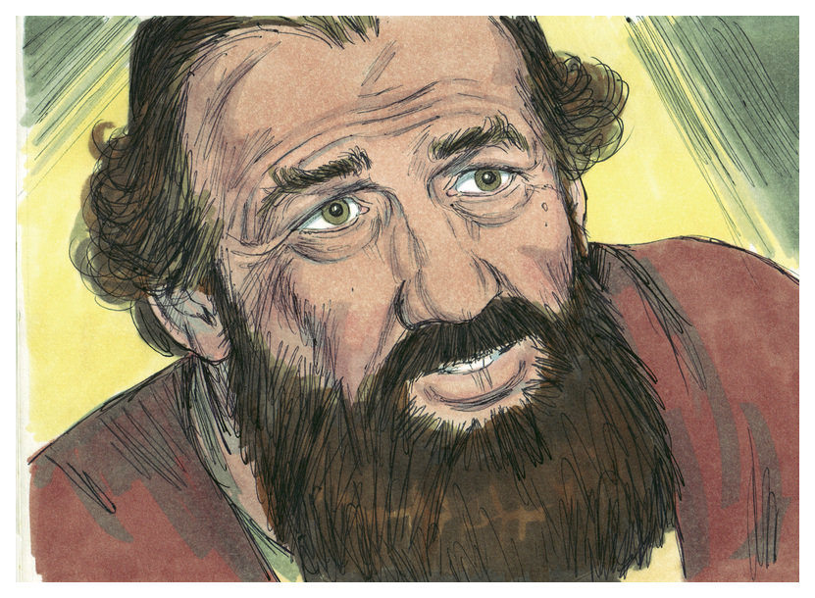
“Depart: for I will send thee far hence unto the Gentiles”
(Acts 22:21).
At that time, there was only one means of salvation,
believe that Christ was the Messiah (Mt. 16:16). Saul, now,
had no doubt of that! He knew he had been wrong, was
repentant and was prepared to do anything Christ asked him
to do. There was another requirement of salvation, water
washing (Mk. 16:16), but first, Saul who had been blinded by
the intense light, had to have his sight restored –
“And when I could not see for the glory of that light, being
led by the hand of them that were with me, I came into
Damascus. And one Ananias, a devout man of the law
[Jew]… came unto me, and stood, and said unto me, Brother
Saul, receive thy sight… For thou shalt be his witness unto all
men… arise, be baptized, and wash away thy sins, calling on the name of the Lord” (Acts 22:11-16).
Saul was blind for 3-days (9:9), the scales fell off and he was water baptized (9:18). We will see this repeated in Acts [Israel’s program]: 1). a salvation; 2). a miracle; 3. water washing [baptism], The 3-days of blindness reflected Saul’s spiritual blindness, but now had clear spiritual sight.

Slide 4
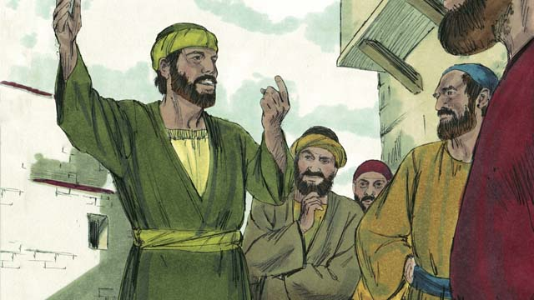
SAUL’S EARLY MINISTRY (A.D. 35-45)
“And straightway he preached Christ in the [Damascus] synagogues, that he [Christ] is the Son of God” (9:20).
More than 20-years later, Paul revealed what happened to him after his conversion and before he began to preach the simplest of all messages—Christ was the Son of God.
“But I certify you… that the gospel which was preached of me is not after man. For I neither received it of man, neither was I taught it, but by the revelation of Jesus Christ. For ye have heard of my [citizenship] in the Jews religion, how that beyond measure I persecuted the… [Jerusalem] church… and wasted it. And profited in the Jews religion above many my equals in mine own nation…. But when it pleased God… called me by his grace, to reveal his Son in me, that I might preach among the heathen [Gentiles]…” (Gal. 1:11-16).
Paul’s did not learn his gospel from Peter because he didn’t know it. He was revealed it from the ascended Christ—It was different, but it gave Jews even more reason to hate him!

Slide 5
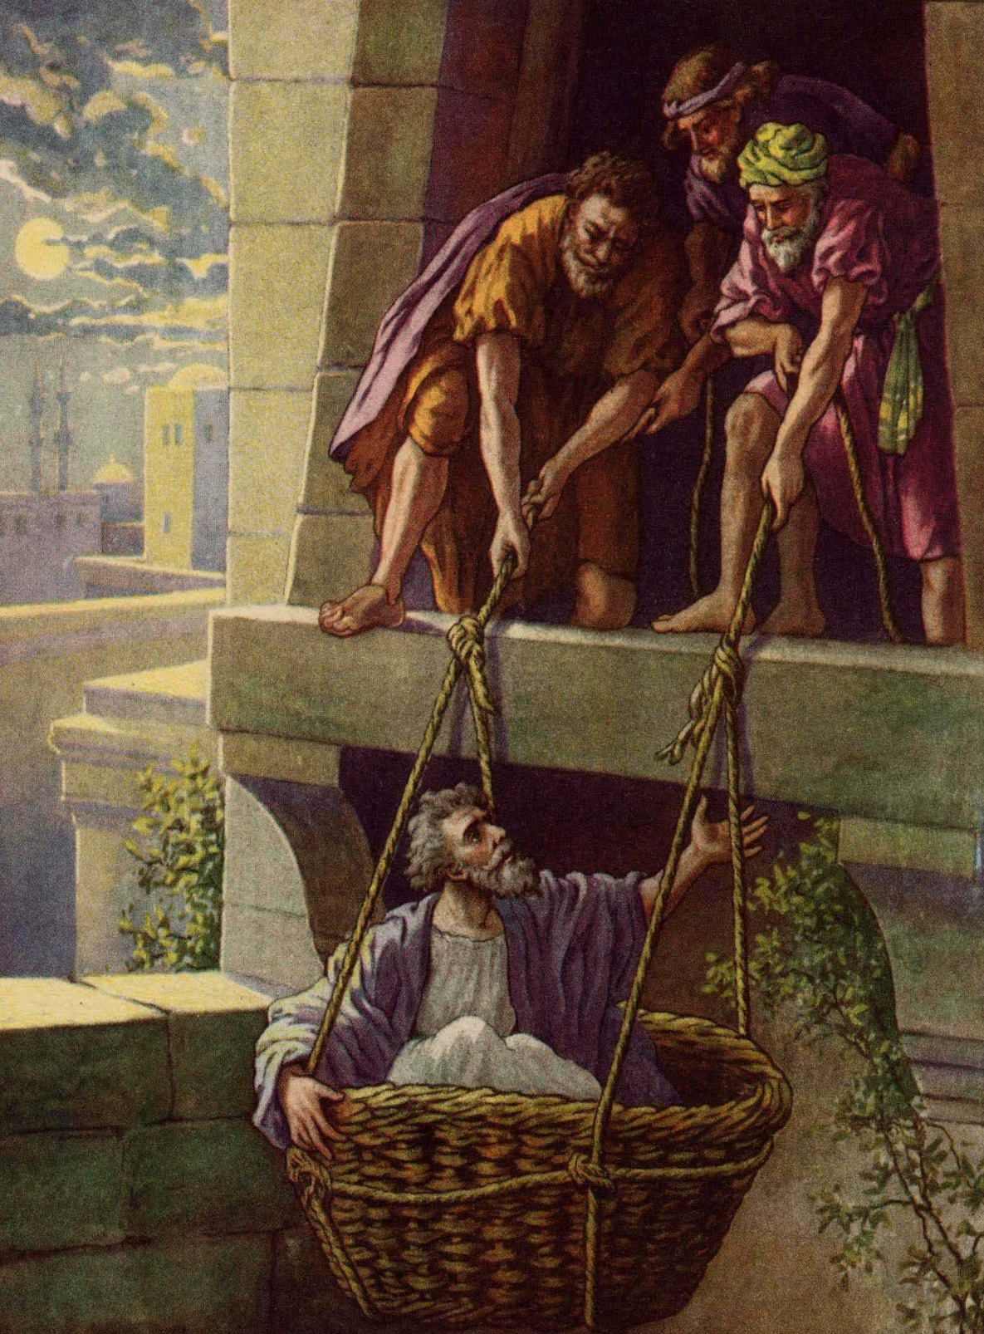
THE PERSECUTOR, NOW THE PERSECUTED
Saul had totally changed directions. He had persecuted
followers of Christ, now he was teaching them of Christ –
“But all that heard him were amazed, and said; Is not this he that destroyed them which called on this name in Jerusalem, and came hither for that intent, that he might bring them bound into the chief priests?” (9:21).
The Jews couldn’t believe this was the same man!
“But Saul increased the more in strength, and confounded the Jews which dwelt at Damascus, proving that this is very Christ [Messiah]” (9:22).
Satan doesn’t want any one to change who has been against Christ, so when they do, expect plenty of opposition –
“… the Jews took counsel to kill him…. Watched the gates [Damascus] day and night to kill him… took him by night, and let him down by the wall in a basket” (9:23-25).
It was Saul’s 1st narrow escape—it would not be his last.

Slide 6
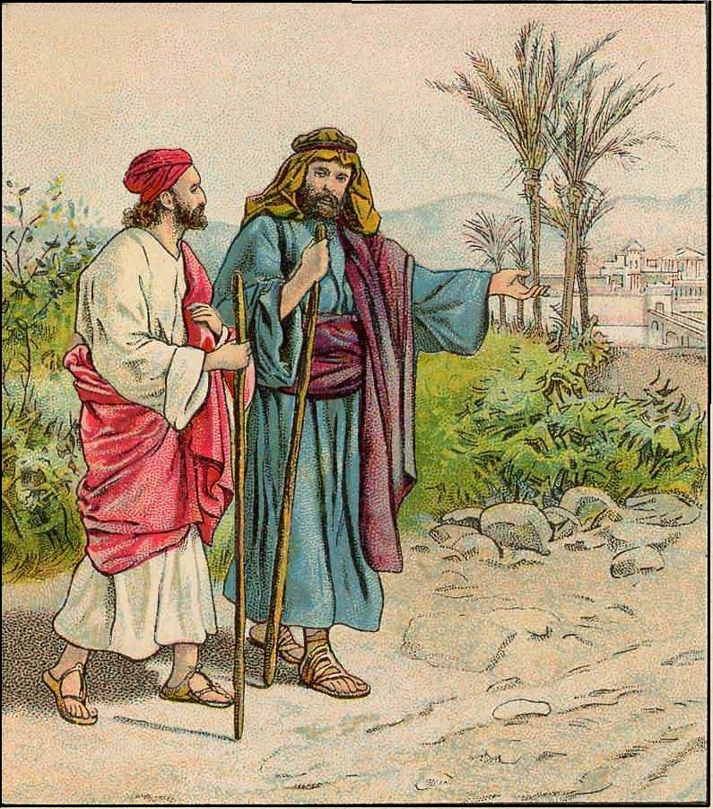
TO THE DESERT (A.D. 35-38)
After Saul’s conversion and calling to go the Gentiles with
this new gospel of God’s grace, he immediately went to
Jerusalem to inform the 12 Apostles that he was now one
of them and be taught everything they knew of Christ,
right? That’s what most in Christendom think, but that is
NOT what happened –
“Neither went I up to Jerusalem to them which were
apostles before me; but I went into Arabia…” (Gal. 1:17).
No. Saul went into the desert for up to a 3-year seminary
instruction from Christ concerning this new dispensation.
Then and only then, did Saul go to Jerusalem –
“… I went up to Jerusalem to see Peter (Gal. 1:18)… the
disciples… were all afraid of him, and believed not that he was a disciple. But Barnabas took him, and brought him to the apostles, and declared unto them how he had seen the Lord in the way, and how he had spoken boldly at Damascus in the name of Jesus” (Acts 9:26-29).
Even the 12 were fearful of him, but Barnabas pled the case of his genuine change of heart.

Slide 7
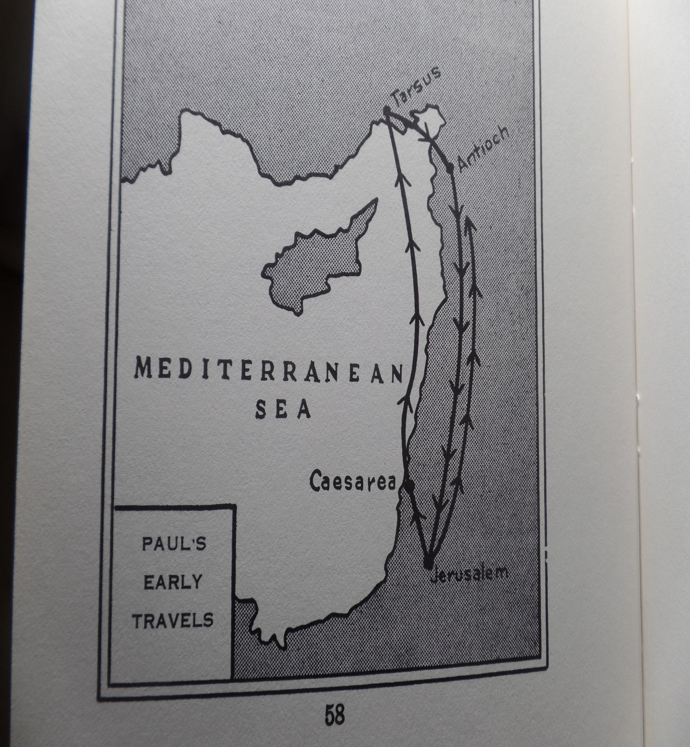
SAUL TO TARSUS (A.D. 38-45)
“And he spake boldly in the name of the Lord Jesus, and disputed against the Grecians: but they went about to slay him. Which when the brethren knew, they brought him down to Caesarea, and sent him forth to Tarsus” (9:30).
With so many death threats, Christ spoke to Saul –
“Make haste, and get thee quickly out of Jerusalem: for they will not receive thy testimony concerning me”
(Acts 22:18).
God was setting the scene for the ministry of Paul the Apostle, but it would not be from Jerusalem as was that of the 12, “… beginning at Jerusalem” (Lk. 23:47).
Paul went home to Tarsus, his temporary base of operations, until God called him to begin his 3-missionary journeys, “Afterwards I came into the regions of Syria and Cilicia” (Gal. 1:21). There he brought Gentiles to Christ, “… the brethren which are of the Gentiles in Antioch, and Syria, and Cilicia” (Acts 15:23).
“ACTS,” C.R. Stam, p. 58

Slide 8
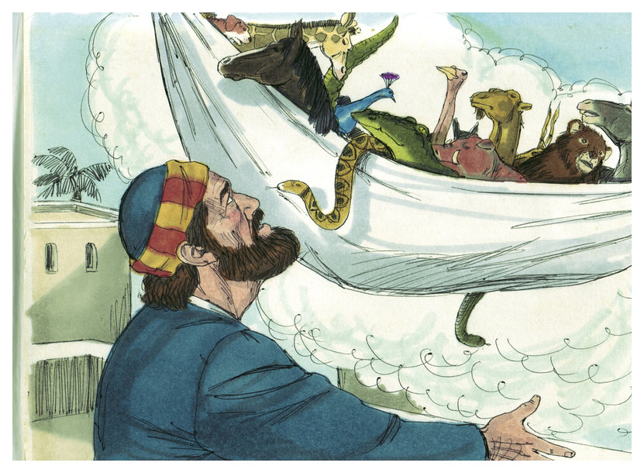
PETER’S VISION OF THE SHEET (A.D. 41)
God’s purpose in sending Peter to the house of a Gentile was NOT that Peter was to begin to evangelize the Gentiles because Saul had already been given that charge (Acts 22:21), but rather that the door to the Gentiles was being opened to Paul, the ‘apostle of the Gentiles’ (Rom. 11:13). To do that, God gave Peter a vision –
“And he saw heaven opened… a great sheet… all manner of 4-footed beasts… Rise, Peter; kill and eat… Not so Lord; for I have never eaten any thing that is common or unclean…” (Acts 10:11-14).
Peter, a Jew, was to have nothing to do with Gentiles –
“And he said unto them, Ye know how that it is an unlawful thing for a man that is a Jew to keep company, or come unto one of another nation [Gentile]…” (10:28).
God was showing Peter that his brother Paul was to go to the Gentile nations, and that he [Peter] was to accept it.

Slide 9
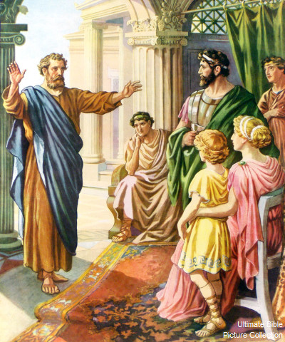
NO RESPECTOR OF PERSONS, NOW (A.D. 41)
Something else was changing as Peter spoke to Cornelius –
“Then Peter opened his mouth, and said, Of a truth I perceive that God is no respecter of persons [now]: that every [Gentile] nation he that feareth him, and worketh righteousness, is accepted of him” (10:34).
God was showing Peter that the ‘middle wall of partition’ (Eph. 2:14) that God had erected between Jews & Gentiles
(Eph. 2:11-13), making Jews God’s favored people, was being torn down—that, now, God was reaching out to Gentiles (Mt. 10:5), and He was going to use His new apostle [Paul] to do so. And to prove it, there was coming
a change in how Gentiles would be saved. No longer would it be ‘repent and be baptized’ (Mk. 1:4; Acts 2:38), because Gentiles had not been in a covenant relationship with God, to come back to [repentance], and water washing, which cleansed the priests; the new baptism given Paul for the Gentiles would be a spiritual one (1Cor. 12:13).

Slide 10
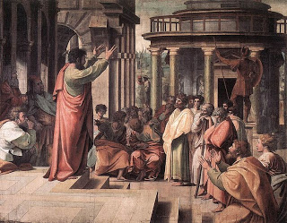
Peter’s evangelization of Cornelius and his household would be the last Gentile Peter ever went to because that was God’s will. When news of it reached the leaders in Jerusalem, they interrogated Peter for doing such a thing –
“And when the apostles and brethren that were in Judea heard that the Gentiles had also received the word of God. And when Peter was come up to Jerusalem, they that were of the circumcision [Jews] contended [made to differ] with him” (Acts 11:1,2).
Peter told them that God had sent him to an uncircumcised
Gentile to save his household, despite his own protests –
“Forasmuch then as God gave them the like gift as he did unto us [salvation], who believed on the Lord Jesus Christ: what was I, that I could withstand God? (11:17).
This Gentile [Cornelius] was the exception, because until that time, the Bible says, “… preaching the word to none but unto the Jews only” (11:19).

Slide 11
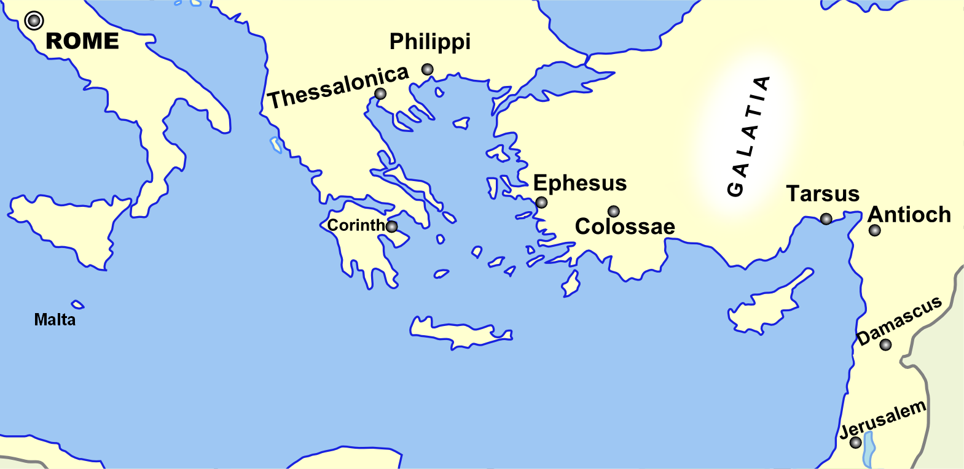
After the saving of Cornelius, many more Gentiles were
being saved (A.D. 42) –
“... When they came to Antioch, spake unto the [Greek
Gentiles] preaching the Lord Jesus. And the hand of the
Lord was with them: and a great number believed, and
turned unto the Lord. Then glad tidings of these things
came unto the ears of the of the church at Jerusalem:
and they sent forth Barnabas, that he should go as far
as Antioch” (11:20-22).
When the word of Gentile salvation reached Jerusalem,
they sent Barnabas to Antioch, Syria, to find out what
was going on. Arriving in Antioch, “… when he
[Barnabas] came, and had seen the grace of God, was
glad… then departed Barnabas to Tarsus, for to see Saul: And when he had found him, he brought him unto Antioch… a whole year they assembled with the church [Gentile assembly]… were called Christians first at Antioch” (11:23-26). The stage was set—God had opened the door to the heathen (Eph. 2:11-13), that’s the grace of God! The base of operations for this new ministry was Antioch [not Jerusalem] where believing Gentiles were called CHRISTIANS for the FIRST time.

Slide 12
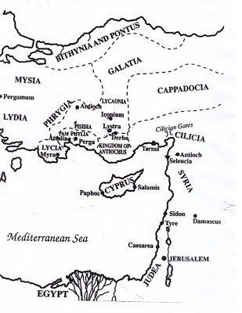
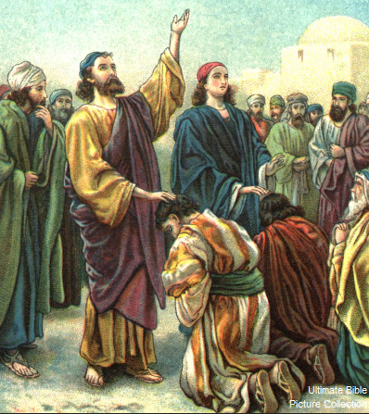
PAUL’S 1ST MISSIONARY JOURNEY (A.D. 45-48)
“Now there were in the [Gentile] church that was at Antioch… As they ministered to the Lord… Separate me Barnabas and Saul for the work thereunto I have called them… So they, being sent forth by the Holy Spirit, departed unto Seleucia; and from thence to Cyprus” (Acts 13:1-4).
The door to the Gentiles now open, the Spirit sent His hand chosen servants [Barnabas & Saul] to call Gentiles to ‘the grace of God,’ but throughout the Book of Acts, any Jews who were receptive. They sailed from the port city of Seleucia to Cyprus –
“And when they were at Salamis, they preached the word of God in the synagogues of the Jews” (13:5).
God will give the Jews ~15 more years to hear until He pronounces them deaf (Acts 28:27), that’s why Saul, until the close of Acts goes to the ‘Jew 1st and then to the Gentile’ (Rom. 1:16). There is no report that any Jews were saved at Salamis.

Slide 13
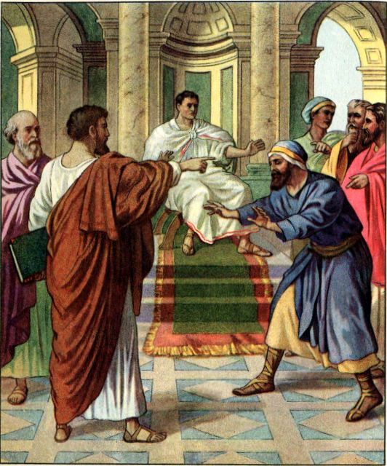
ELYMAS THE SORCERER
“And when they had gone through the isle unto Paphos, they found a certain sorcerer, a false prophet, a Jew, whose name was Bar-jesus [a.k.a. Elymas the sorcerer]: Which was with the deputy of the country, Sergius Paulus, a prudent man; who called for Barnabas and Saul, and desired to hear the word of God” (13:6,7).
After they crossed the island and arrived at Paphos, the capital and seat of the Roman governor, Sergius Paulus,
a false prophet [Jew] tried to prevent Saul from witnessing to the governor –
“Then Saul (who is also called Paul), filled with the Holy Spirit, set his eyes on him, and said… thou child of the devil… thou shalt be blind… for a season… Then the proconsul, when he saw what was done, believed, being astonished at the doctrine of the Lord” (13:9-12). Saul became Paul; a Gentile was saved because a Jew was blinded; Israel remains in spiritual blindness today.
Part of the recovered ancient site where Paul converted Sergius Paulus and then set sail for Galatia –
“Now when Paul and his company loosed from Paphos, they came to Perga in Pamphylia”
(Acts 13:13).

Slide 14
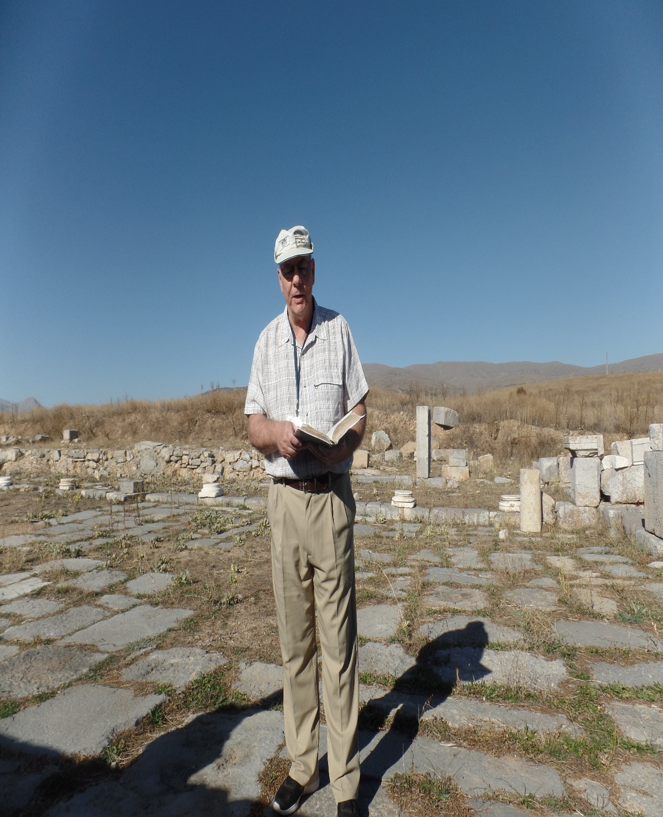
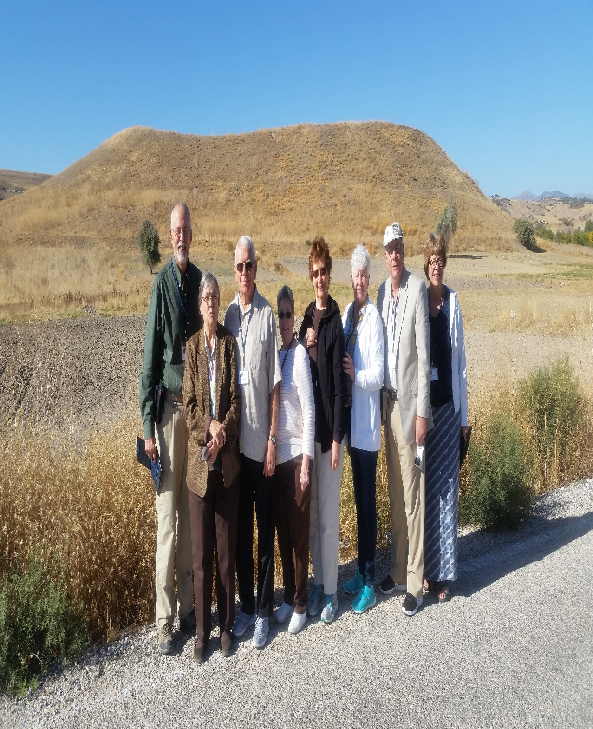
PISIDIAN ANTIOCH (A.D. 45)
“But when they departed from Perga, they came to Antioch in Pisidia, and went into the synagogue on the Sabbath day… Then Paul stood up… Men of Israel… give audience. The God of this people of Israel chose our fathers…” (13:14-17).
Paul’s gave the Jews a history lesson on God’s dealing with them, how He had promised a Savior (13:23), and He had come, died and been raised from the dead (13:34), but they had rejected Him, “Behold, ye despisers… I work a work in your days… which ye shall in no wise believe” (13:41). Paul told them the Law couldn’t save them, their only hope was believing in the Lord Jesus Christ (13:38,39). This set off a fire storm and Paul was forced to move to Iconium (13:8-18), and Lystra – “came certain Jews from Antioch and Iconium… having stoned Paul, drew him out of the city, supposing he had been dead” (13:19).
“I knew a man in Christ [Paul]…
such an one caught up to the third
heaven” (2Cor. 12:1,2).
Synagogue in Pisidian Antioch
Lystra where Paul was stoned to death and
caught up to the 3rd heaven (2Cor. 12:2)
(2017)
Synagogue in Pisidian Antioch
(2017)

Slide 15
Paul and company finished their 1st journey (A.D. 48) –
“And thence sailed to Antioch [Syria]… the grace of God for the work which they fulfilled. And when they were come, and had gathered the [Gentile] church [Antioch] together, they rehearsed all that God had done with them, and how he had opened the door of faith unto the Gentiles” (14:26,27).
When word got back to Jerusalem of Paul’s gospel of grace
being accepted by Gentiles, James, the Lord’s brother, was bothered by Paul’s teaching, so he wrote to his scattered Jews –
“James, a servant of God… to the 12 tribes which are scattered abroad (Jas. 1:1)… For whosoever shall keep the whole law, and yet offend in one point, he is guilty of all (2:10)… Ye see then how that by works a man is justified, and not by faith only” (2:24).
As Paul was preaching faith alone in Christ, James said, NOT SO!
WE JEWS ARE STILL UNDER THE LAW, AND WE MUST KEEP IT!
Who’s right? BOTH!! How can both be right? Because there was an overlapping of God’s 2-programs at that time. How could it be settled? God arranged for a council of the 2-parties.

Slide 16
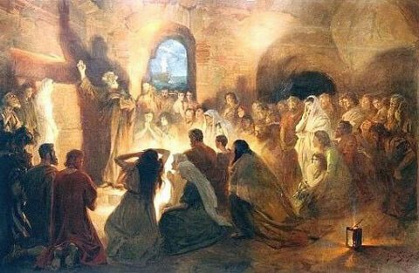
JERUSALEM COUNCIL (A.D. 49)
“And certain men which came down from Judea taught the brethren, and said, Except ye be circumcised after the manner of Moses, ye cannot be saved… There rose up certain of the sect of the Pharisees which believed, saying, That is was needful to circumcise them, and to command them to keep the law of Moses” (Acts 15:1).
Paul was NOT going to stand for Gentiles being put under the Law of Moses. From Antioch, he went up to Jerusalem to settle this matter –
“… I went up again to Jerusalem with Barnabas, and took Titus with me also. And I went up by revelation [God told him to go], and communicated unto them THAT gospel which I preached among the Gentiles... Titus, who was with me, being a Greek [Gentile], was compelled to be circumcised” (Gal. 2:1-3).
The 1st thing the Jews wanted to do was to circumcise Titus! Paul would NOT have this, and didn’t give an inch!

Slide 17
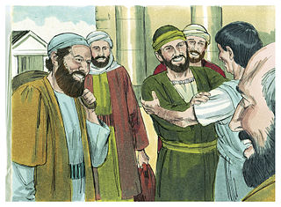
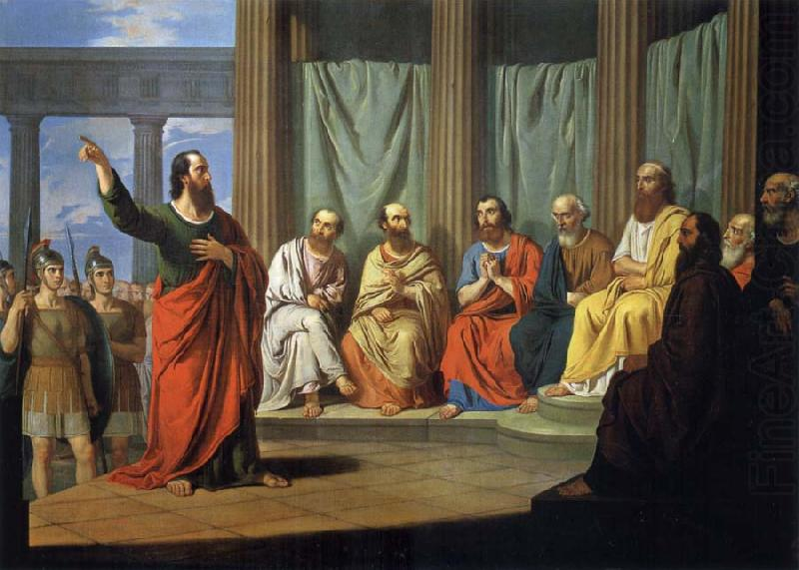
JERUSALEM COUNCIL (cont’d)
“To whom we gave place by subjection, no, not for an hour; that the truth of the gospel [of grace] might continue [Gentiles]… these who seemed to be somewhat in conference added nothing to me. But contrariwise, when they saw that the gospel of the uncircumcision [Gentiles] was committed unto me, as the gospel of the circumcision [Jews] was unto Peter” (Gal. 2:5-7).
How many gospels AT THAT TIME? Two. The gospel of grace to the Gentiles; the gospel of the kingdom to the Jews. That’s what Paul [God] said. Their reaction?
“And when James, Peter, and John, whom seemed to be pillars, perceived the grace that was given unto me, they gave to me and Barnabas the right hand of fellowship; that we should go to the heathen [Gentiles], and they unto the circumcision [Jews]” (2:9).
They agreed! Somebody better tell the Pope that Peter’s ministry was being restricted to JEWS ONLY!

Slide 18
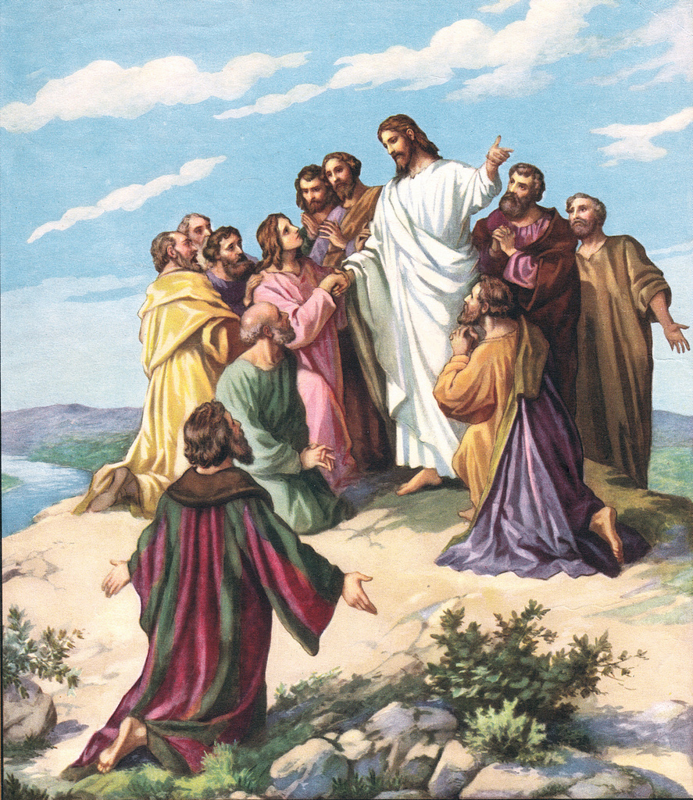
A GREATER COMMISSION
The so-called Great Commission given by our Lord to the 12 to go unto all nations (A.D. 31) with the gospel of the kingdom (Mt. 28:18-20) was now rescinded [pause] because of Israel continued rejection of Messiah. As God now held that program in abeyance, He ushered in the present program of His grace to both Gentiles & Jews, a GREATER COMMISSION (A.D. 55) –
“To wit, that God was in Christ, reconciling the world unto himself, not imputing their trespasses unto them; and hath committed unto us the word of reconciliation. Now then we are ambassadors of Christ, as though God did beseech you by us… be ye reconciled to God”
(2Cor. 5:19,20).
The 12’s commission was an earthly ministry from man to man; Paul’s was a heavenly commission from Christ to man. Of which would you rather be part?

Slide 19
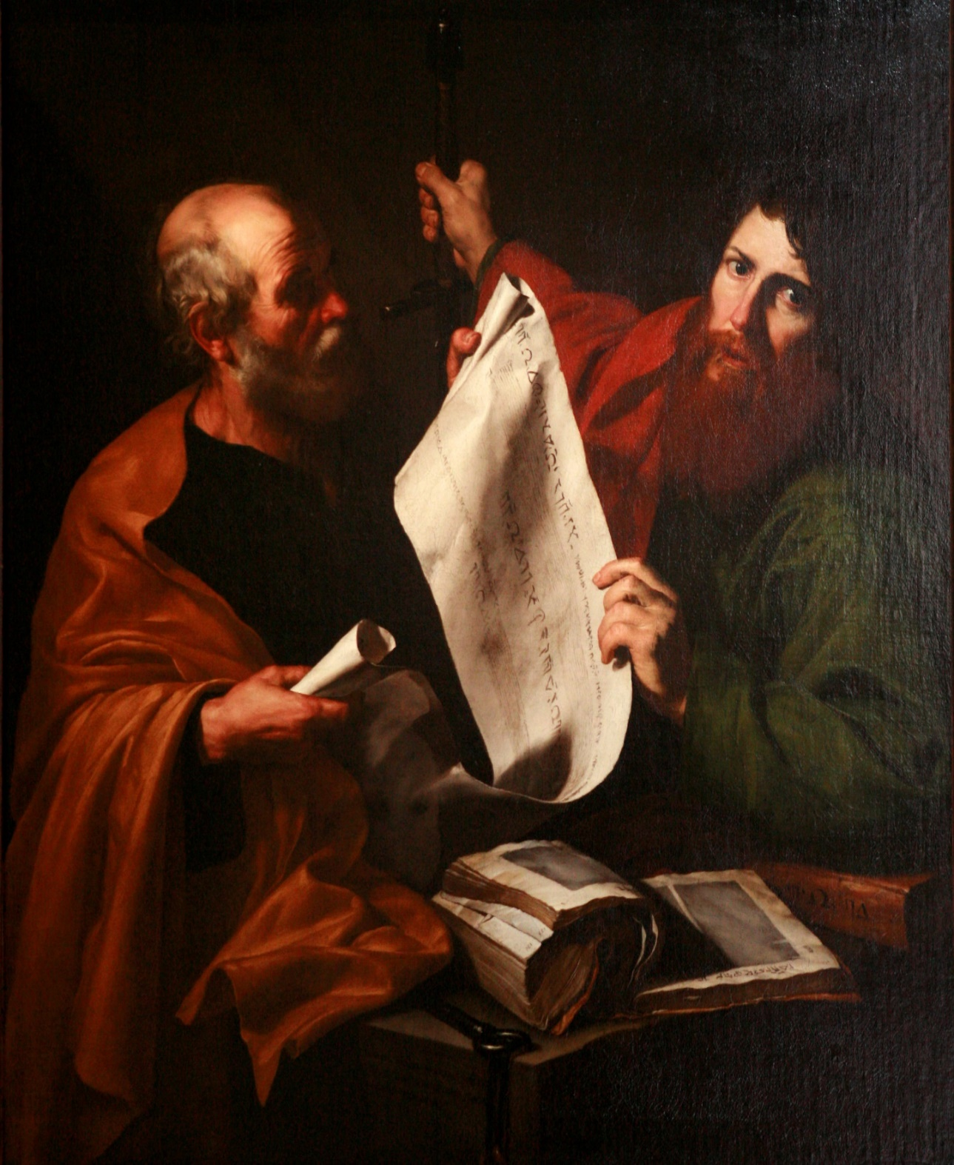
PAUL’S 2nd MISSIONARY JOURNEY (A.D. 51-55)
“But Paul thought not good to take him with them [John Mark], who departed from them from Pamphylia, and went not with them to the work. And the contention was so sharp between them, that they departed asunder… and so Barnabas took Mark, and sailed unto Cyprus; And Paul chose Silas, and departed, being recommended by the brethren unto the grace of God. And he went through Syria and Cilicia, confirming the churches” (Acts 15:38,39).
Sometimes friends must part company for the greater good. Silas would prove to be an able body servant, and besides, they would soon find another servant of the Lord –
“Then came he to Derbe and Lystra: and, behold, a certain disciple was there, named Timothy… Him would Paul have to go forth with him” (Acts 16:1-3).
Paul’s 2nd trip would soon take him to new places.

Slide 20
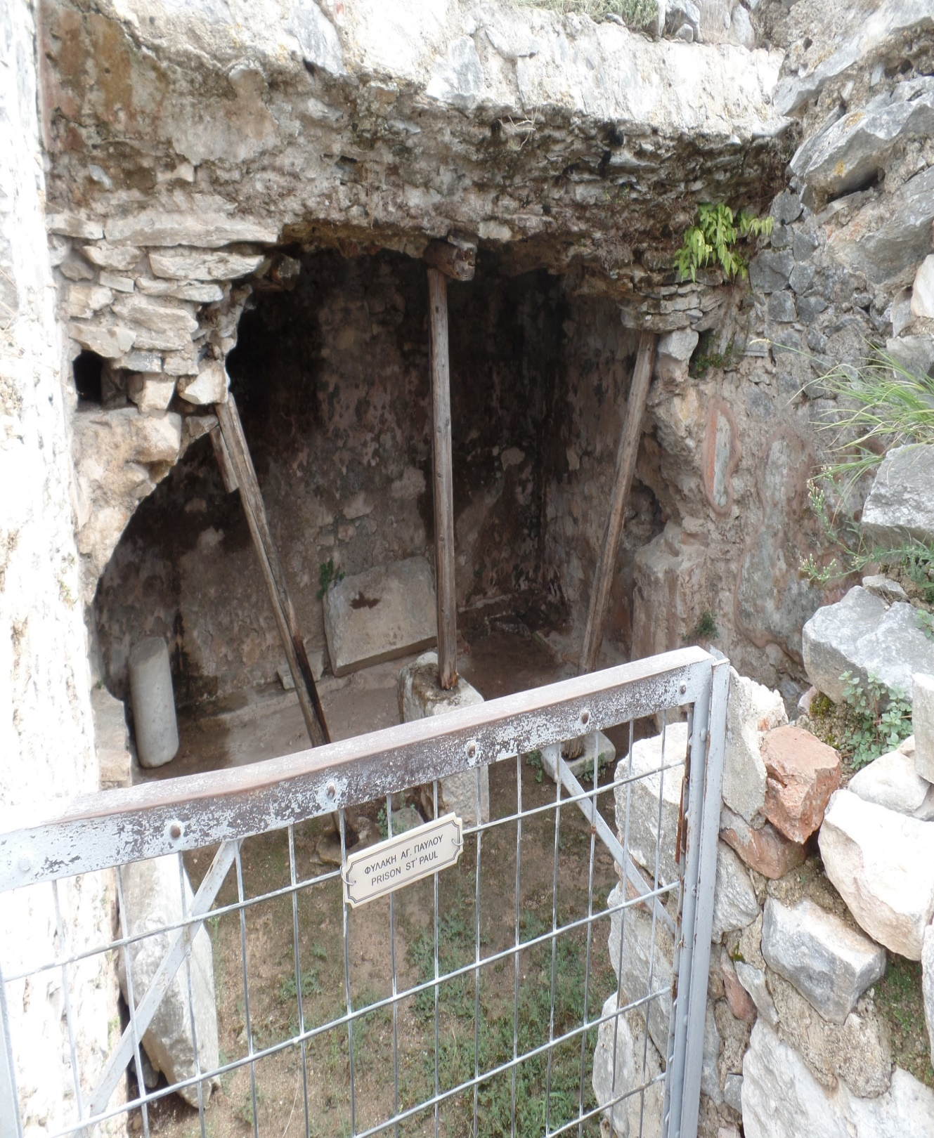
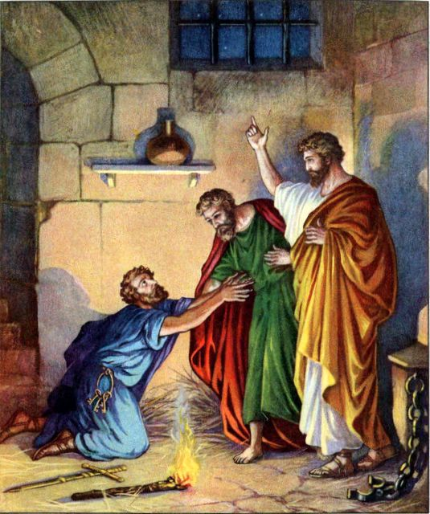
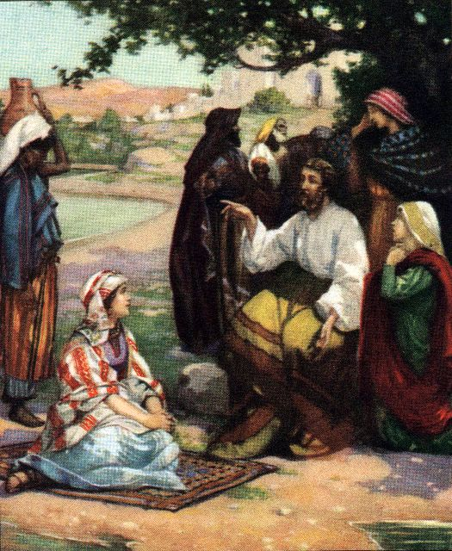
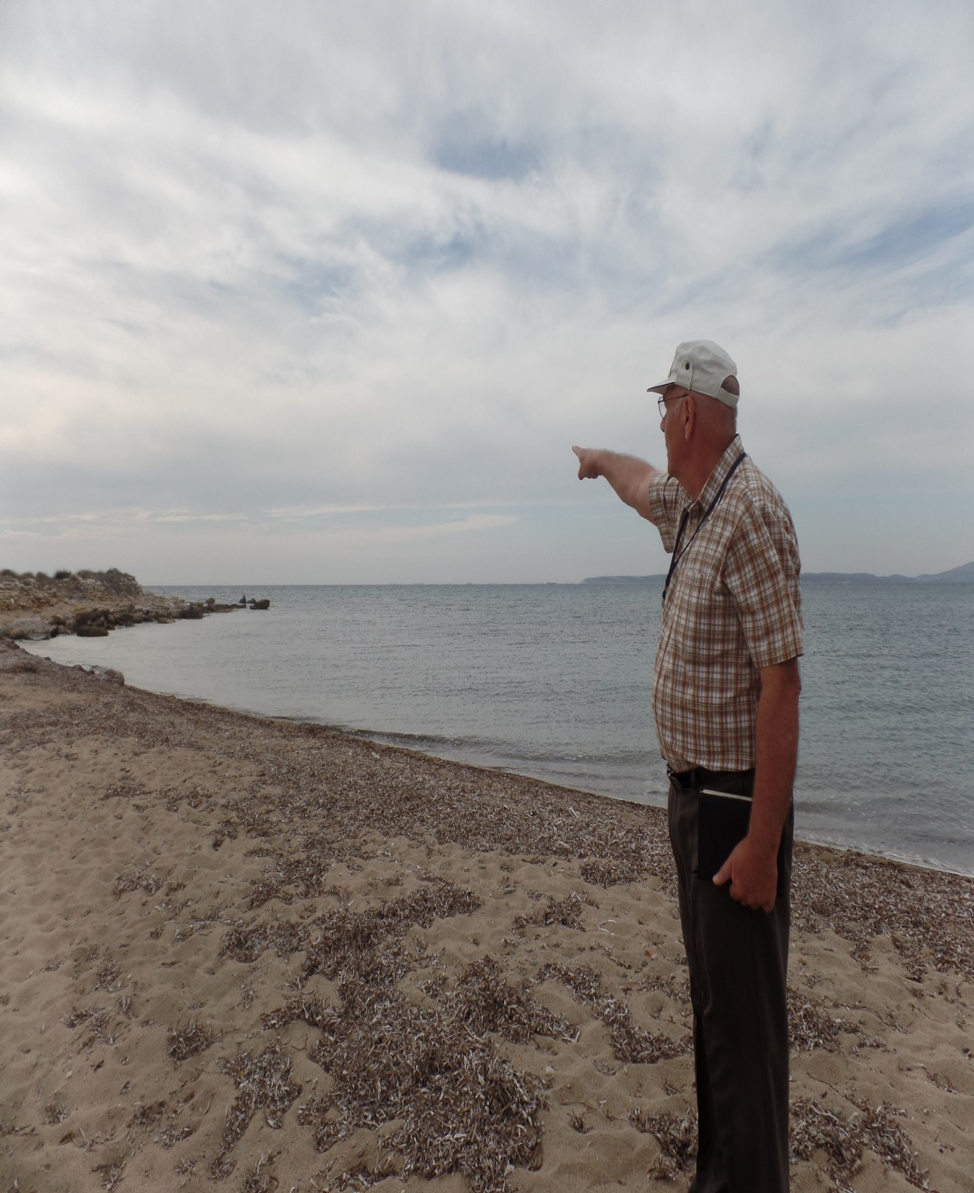
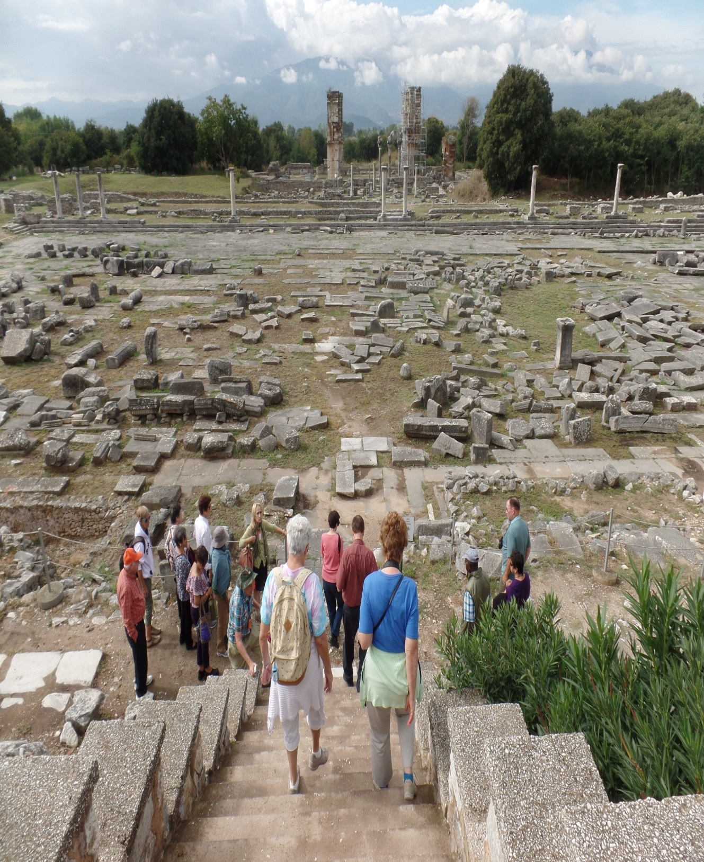
MACEDONIAN VISION (A.D. 51)
“Now when they had gone throughout Phrygia and the region of Galatia… a vision appeared to Paul in the night; There stood a man of Macedonia … Come over and help us… we endeavored to go… gathering that the Lord had called us to preach the gospel to them” (16:6-10).
The H.S. led Paul (Luke joins them), to Europe, as they arrived in Philippi, where he led Lydia to Christ –
“And a certain woman named Lydia, a seller of purple, of the city of Thyatira… whose heart the Lord opened… unto the things spoken of Paul” (16:14).
Next, Paul was arrested and jailed, but when the jailer asked, “Sirs, what must I do to be saved? And they said, Believe on the Lord Jesus Christ, and thou shalt be saved…” (16:25-31).
There were many highs but now came word of problems in the churches of Galatia.

Slide 21
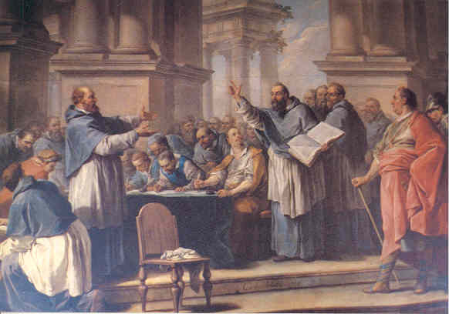
LEGALISM (A.D. 58)
“O foolish Galatians, who hath bewitched you, that
ye should not obey the truth, before whose eyes
Jesus Christ hath been evidently set forth, crucified
among you?” (Gal. 3:1).
Judaizers had infiltrated Paul’s churches in Galatia
trying to coerce Gentile converts to the gospel of
grace to go back under the Law. Paul was furious,
and wrote them a scathing epistle, calling them
foolish! He can’t believe that they would so easily
give up their freedom under grace –
“Christ hath redeemed us from the curse of the law
… Wherefore then serveth the law? It was added
because of transgressions, till the seed [Christ]
should come… the law was our schoolmaster… but after faith is come [Christ], we are no longer under a school master. For ye are all the children of God by faith in Christ Jesus” (3:13,19,24,26).
Good grief!
Next time – Paul’s ministry of God’s grace continues.

