Slide 1
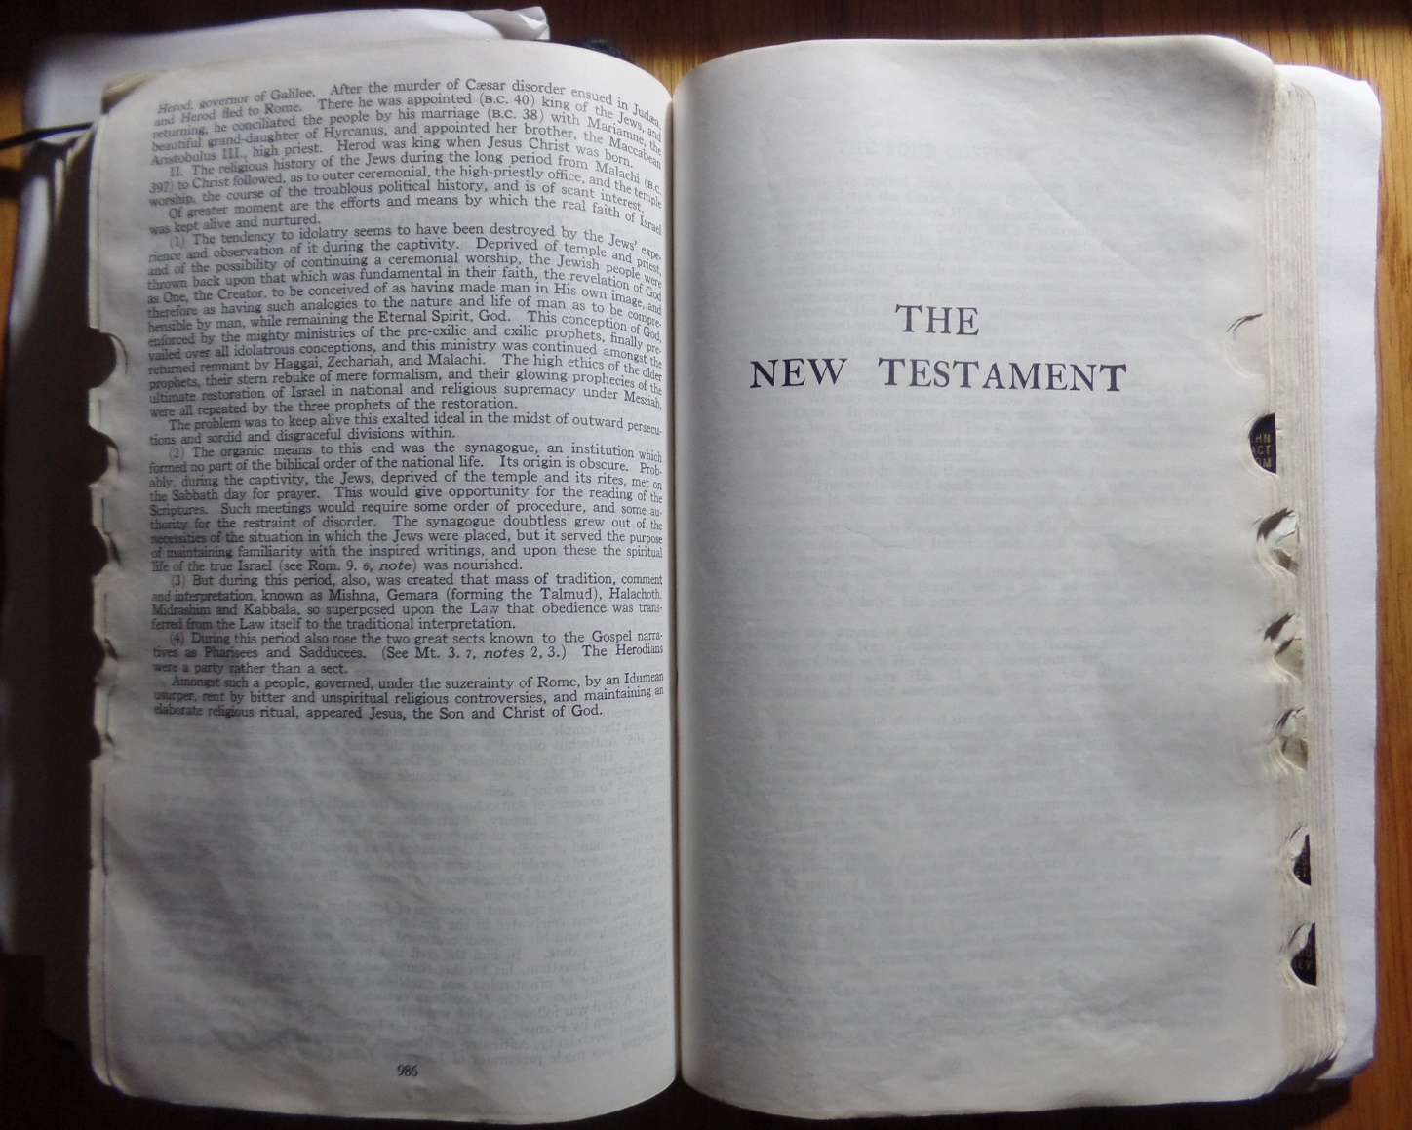
LESSON 40
WEEK 40 OF 52
(Lk. 1-5; Mt. 1-8;
Jn. 1-4; Mk. 1,2)
THROUGH THE BIBLE IN 2018
Last time we saw Malachi’s prediction of a messenger to prepare the way for Israel’s Messiah; this time the fulfillment.
In many Bibles, including the SCOFIELD STUDY BIBLE, there is a page that immediately follows the Book of Malachi and before the Book of Matthew, and it says –
THE NEW TESTAMENT
That page has caused untold confusion since Guttenberg first started printing Bibles in 1439 A.D. What that page implies is that everything following is under the NEW TESTAMENT and that now He is writing about us. Both are incorrect! Keep reading and you will see why.

Slide 2
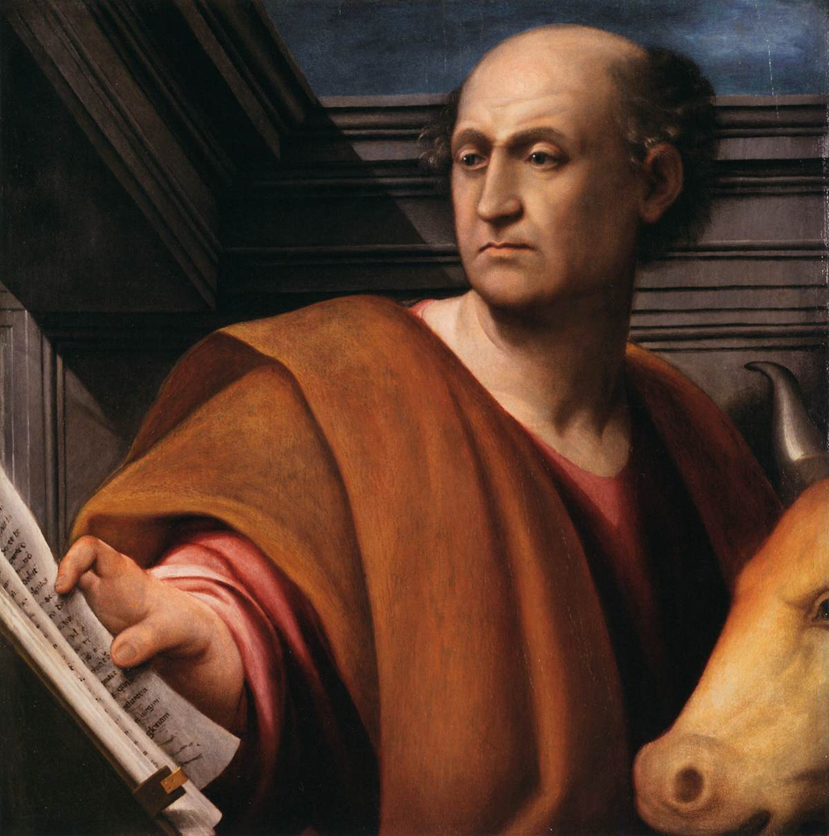
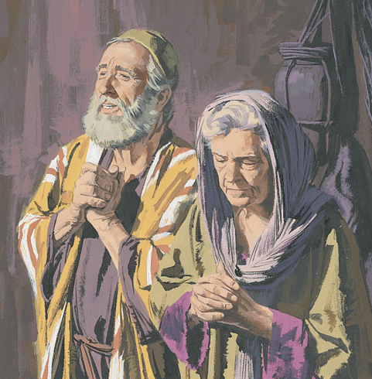
THE BOOK OF LUKE
“The writer of the third Gospel is called by Paul “the beloved physician” (Col. 4:14); and, as we learn from the Acts, was Paul’s frequent companion. He was of Jewish ancestry… Tradition says that he was a Jew of Antioch [Syria], as Paul was from Tarsus. The date of Luke falls between A.D. 63-68 A.D… Theme… ‘Son of Man,’ and the key verse, ‘For the Son of man is come to seek and to save that which was lost’ (19:10)” (Old Scofield, p. 1070).
We begin with the 3rd Gospel because it gives the earliest account of John the Baptist’s beginning –
“There was in the days of Herod, the king of Judea, a certain priest name Zacharias… and his wife Elisabeth… both righteous before God… they had no child… well stricken in years…” (Lk. 1:5-7).
Luke lays the foundation for John the Baptist: had devout parents, but childless in their old age; lived under King Herod.

Slide 3
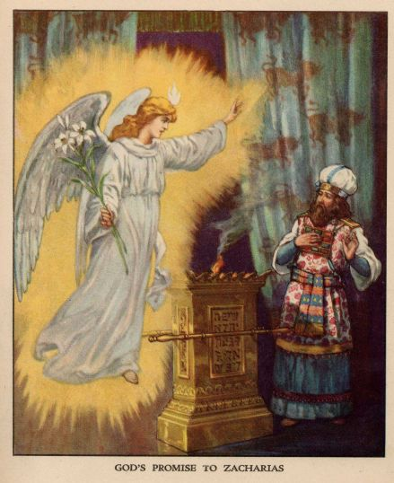
Luke records that Zacharias, while in the temple fulfilling his priestly duties, was told by an angel of their son’s birth –
“For he [John] shall be great in the sight of the Lord… he shall be filled with the Holy Spirit, even from his mother’s womb. And many of the children of Israel shall he turn to the Lord their God”
(1:11-16).
Notice John’s goal was to turn Jews to their Messiah –
“Blessed be the Lord God of Israel: for he hath visited and redeemed his people… the house of his servant David; As he spake by the mouth of his holy prophets [Isaiah, et. al.]… that we [Jews] should be saved from our enemies [in the kingdom]… to remember his holy covenant [nation, land, blessing]… which he sware to our father Abraham… to give knowledge of salvation unto his people [Jews] by the remission of their sins” (1:68-77).
From the beginning, God’s plan had been to send His Son to save His chosen nation, Israel, and they would then take the truth of God to the Gentile world.

Slide 4
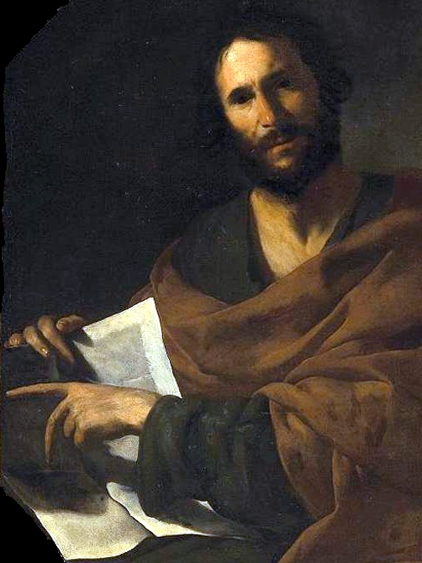
THE BOOK OF JOHN
“The 4th Gospel was written by the Apostle John (Jn. 21:24)… The theme is indicated both in the prologue (1:1-4), and in the last verse of the Gospel (20:31), and is: The incarnation of the eternal Word, and Son of God, Himself God, in Jesus the Christ… The prominent words are, ‘believed’ and ‘life’…”
(Old Scofield, p. 1114).
The prologue sets the stage –
“In the beginning was the Word, and the Word was with God, and the Word was God… And the Word was made flesh [1st coming of Christ], and dwelt among us, (and we beheld his glory, the glory as of the only begotten of the Father,) full of grace and truth” (Jn. 1:1,14).
The 2nd Person of the Trinity is God, has always been God and has always existed with God, but, in eternity past, was designated to be separated out to come to earth to carry out the means whereby sinful man can be redeemed from sin.

Slide 5
BELIEVE ON HIS NAME
“But as many as received him [faith], to them gave he power to become the sons of God, even to them that believe on his name [Messiah], which were born, not of blood, nor of the will of the flesh, nor of the will of man, but of God” (1:12,13).
The grace through faith part was believing He was the long awaited and promised Messiah, “Behold my servant [Messiah]… I have put my spirit upon him…” (Isa. 42:1). The O.T. prophets spoke of a coming Messiah to Israel.
“Thou art the Christ [Messiah], the Son of the living God” (Mt. 16:16).
Peter acknowledged this fact, as did John the Baptist –
“John bare witness of him… He that cometh after me is preferred before me: for he was before me. And of his fullness have all we [Israel] received, and grace for grace. For the law was given by Moses, but grace and truth came by Jesus Christ” (1:15-17).

Slide 6
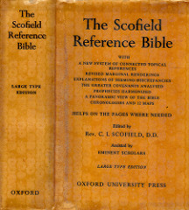
John confirmed that though Christ’s earthly ministry began after John’s, it was more important than John’s, because He was the eternal 2nd Person of the Trinity, whose fullness was now manifested in human form [Messiah] –
“Grace is the kindness and love of God our Saviour toward man… It is, therefore, set in contrast to law, under which God demands righteousness from man, as, under grace, he gives righteousness to man… Law is connected to Moses and works; grace with Christ and faith… Law demands blessings be earned; grace is a free gift…” (Old Scofield, p. 1115).
Christ could not immediately appear and then die on a cross and be resurrected from the dead to begin a new
dispensation [of grace]. His earthly ministry would be that of grace and truth—He was a gift sent from God to be believed on [grace] + He was the truth that the O.T. writers and prophets had written of for thousands of years, that, He was the seed of a woman who would defeat Satan but it would cost Him his life (Gen. 3:15).

Slide 7
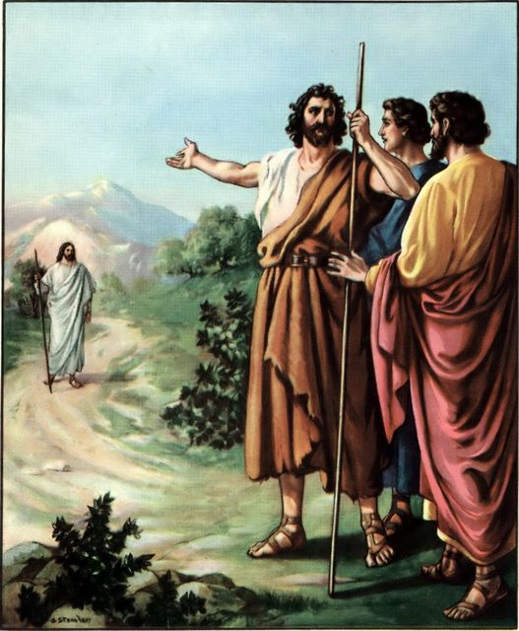
Christ’s earthly ministry, however, would be under the dispensation of law –
“Now I say that Jesus Christ was a minister of the circumcision [Jews] for the truth of God, to confirm the promises made unto the fathers” (Rom. 15:8).
Why under Law?: 1). He had to confirm the O.T. promises made to Abraham, Isaac, and Jacob; 2). A will [old or new] cannot be enacted until one’s death; God was offering Israel
a new and better ‘Will & Testament’ (Heb. 9:16,17).
THE WATER RITE
John’s role was to prepare the way for the Messiah and he
did so through a baptism of repentance –
“The next day John seeth Jesus coming unto him, and saith, the Lamb of God, which taketh away the sin of the world… he should be made manifest to Israel, therefore am I come baptizing with water (1:29-31)… He came unto his own [Israel] his own received him not” (1:11).

Slide 8
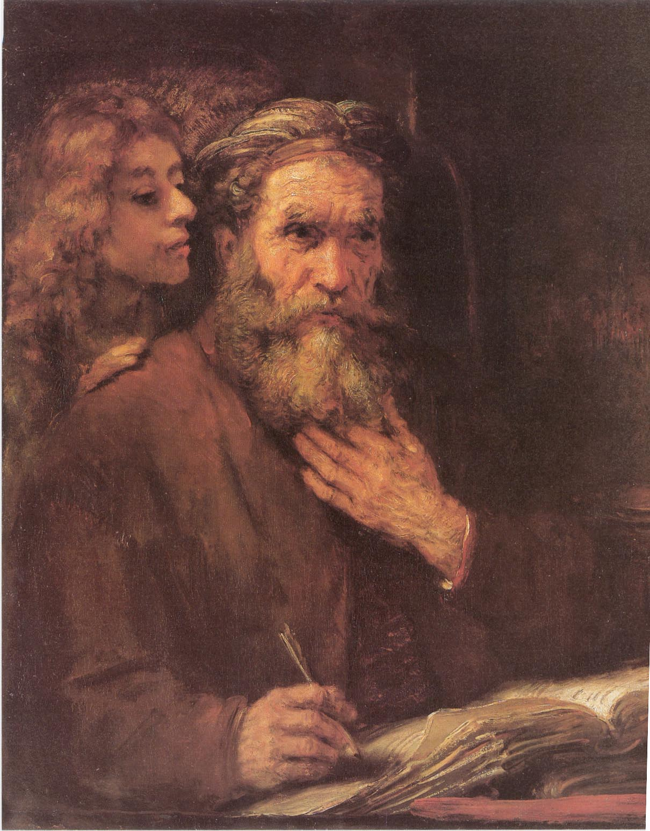
THE GOSPEL OF MATTHEW
“The writer of the first Gospel was Matthew, also called Levi, a Jew of Galilee who had taken service as a tax-gatherer under the Roman oppressor… hated… the prominent character of Christ In Matthew is that of the covenanted King, David’s righteous Branch (Jer. 23:5)…” (Old Scofield, p. 993).
Matthew begins with the lineage from Christ backward to Abraham (1:1-17), emphasizing the importance of Israel in the big picture of God –
“Now the birth of Jesus Christ was on this wise: When as his mother Mary was espoused to Joseph, before they came together, she was found with child of the Holy Ghost… not wanting to put her away publically [divorce]… the angel appeared unto him in a dream… she shall bring forth a son, and thou shalt call his name JESUS: for he shall save his people [Israel] from their sins” (1:18; Jn. 1:11).
Consistent with God’s plan, Christ came to first save Israel.

Slide 9
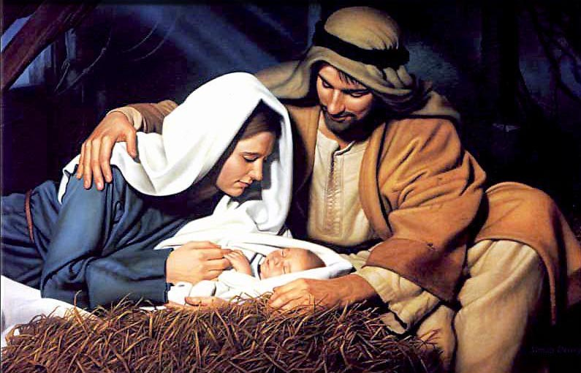
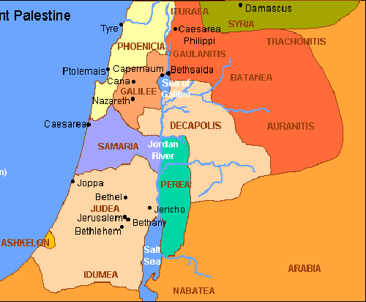
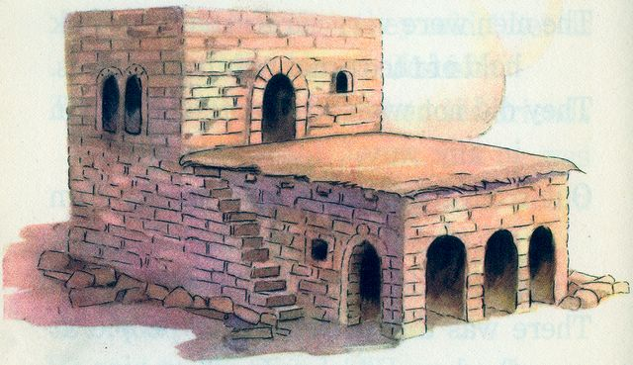
CHRIST’S BIRTH
“And it came to pass in those days, that there went out a decree from Caesar Augustus, that all the world should be taxed… And all went to be taxed, every one into his own city. And Joseph also went up from Galilee… into Judea, unto the city Of David, which is called Bethlehem… To be taxed with Mary his espoused wife, being great with child” (Lk. 2:1-5).
Being of David’s lineage, Joseph went to Bethlehem to register for the census imposed by Caesar. It was a rugged 3-day journey. Likely, they planned to lodge with relatives, but, the plan seemingly changed as they arrived.
“And so it was, that, while they were there, she brought forth her firstborn son, and wrapped him in swaddling clothes, and laid him in a manger; because there was no room for them in the [Gr. kataluma, guest room]” (2:7).
No wooden stable behind the motel; Christ was born in the lowest level of a house with the livestock.

Slide 10
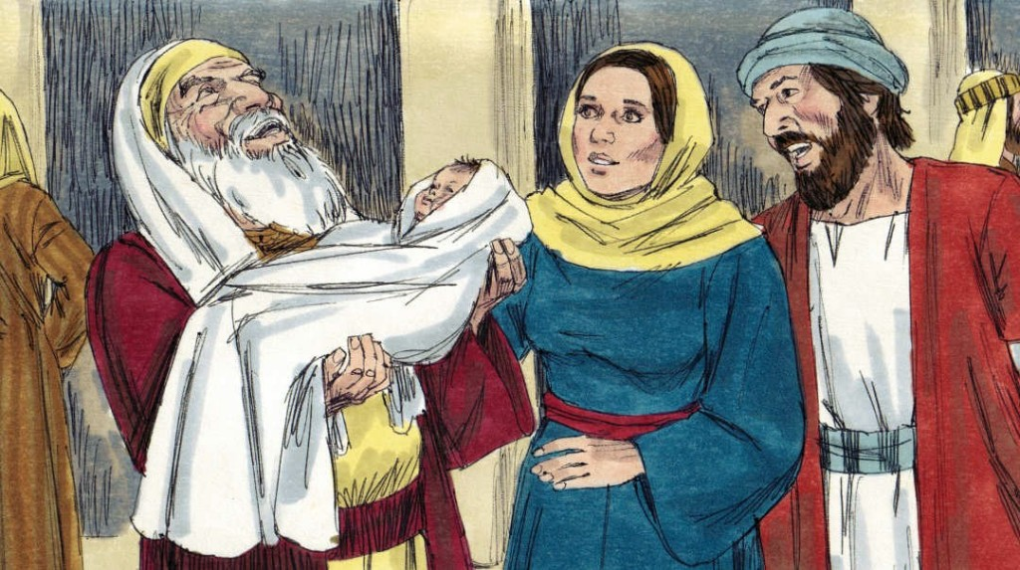
CHRIST’S CIRCUMCISION & DEDICATION
“And when the 8 days were accomplished for the circumcising of the child… And when the days of her purification according to the law of Moses were accomplished, they brought him to Jerusalem, to present him to the Lord” (2:21,22).
The Law of Moses required strict observance for childbearing:
circumcision on the 8th day (Lev. 12:3); 33-days of purification after delivery (Lev. 12:1-8). His circumcision would have likely been done while in Bethlehem. The next requirement was to go to the temple in Jerusalem [5-miles away] to dedicate their 1st born (Lev. 13:2,12) and to provide an offering for Mary’s purification (Lev. 12:1-8) –
“And to offer a sacrifice according to that which is said in the law of the Lord (2:24)… And if she be not able to bring a lamb, then she shall bring two turtledoves, or two young pigeons” (Lev. 12:8).
Mary offered the latter because that’s all they could afford.

Slide 11
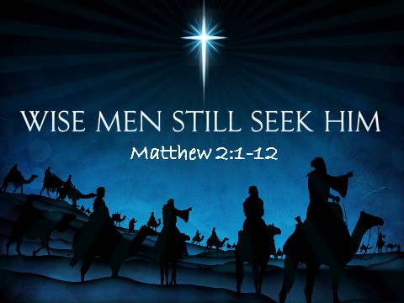
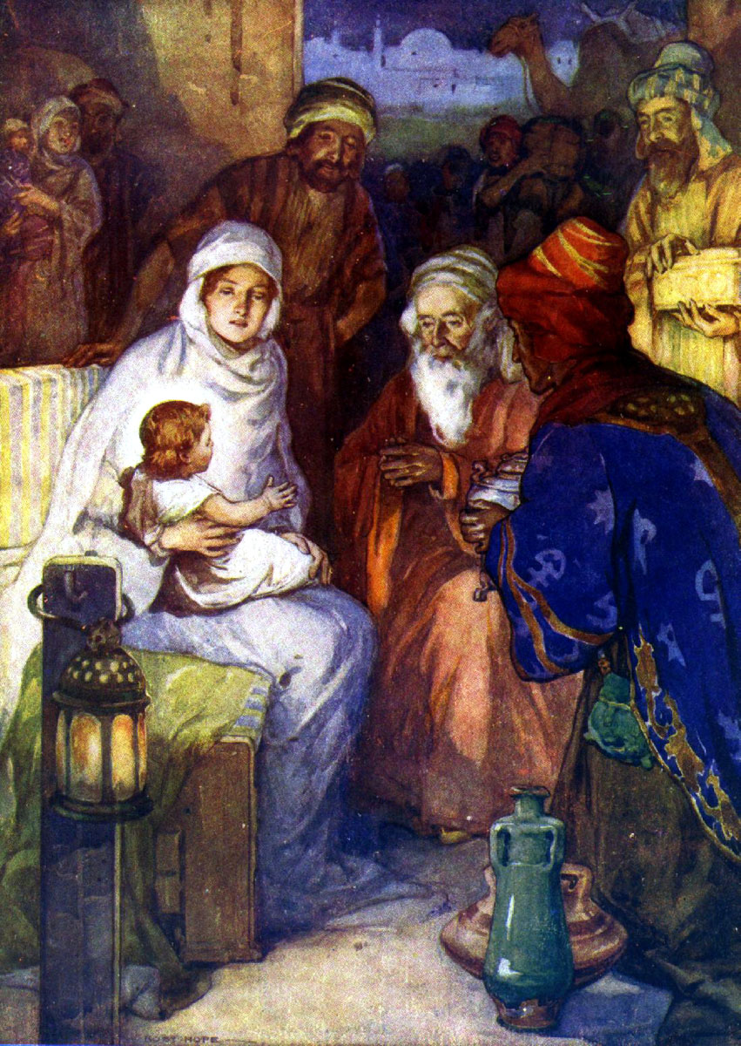
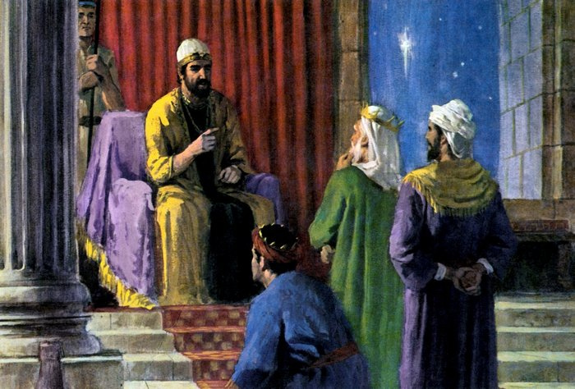
THE MAGI
“Now when Jesus was born in Bethlehem of Judea in the days
of Herod the king, behold, there came wise men from the east
to Jerusalem, Saying, Where is he that is born King of the Jews?
For we have seen his star in the east, and are come to worship
him” (Mt. 2:1,2).
While that’s true, much of tradition isn’t: they did see His star
in the east, but it did not lead them; they knew where to begin
their search for the King of the Jews, in Jerusalem; the star
never led them to nor stopped over the nativity in Bethlehem.
Their arrival, as much as 2-years after Christ’s birth (2:16), was
to Herod, asking if he had any information (2:3) –
“When they had heard the king, they departed; and, lo, the
star, which they saw in the east, went before them, till it came
and stood over where the young child was… they were come into the house…” (2:9,11).
Where did their search lead them, with help from HIS STAR?
“… they returned into Galilee, to their own city Nazareth” (Lk. 2:39).

Slide 12
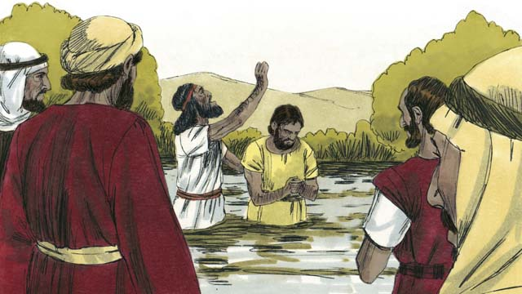
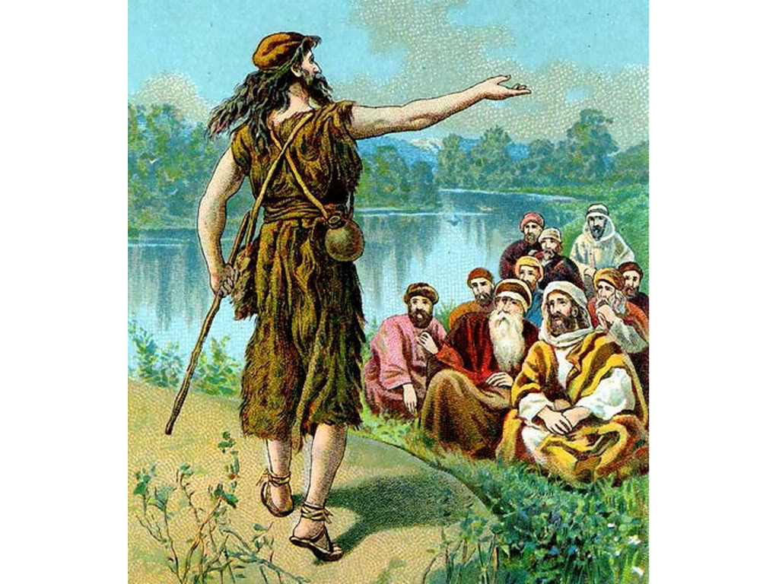
JOHN THE BAPTIZER
“In those days came John the Baptist, preaching in the wilderness of Judea, and saying, Repent ye: for the kingdom
of heaven is at hand. For this is that was spoken of by the prophet Isaiah, saying The voice of one crying in the wilderness, Prepare ye the way of the Lord…” (Mt. 3:1-3).
John, son of a priest, preached that the kingdom of heaven was at hand, or very near. Shocked? No. They knew from Isaiah (40:3) that a preacher such as John was coming.
“Then went out to him Jerusalem, and all Judea, and all the region round about Jordan, and were baptized of him in Jordan, confessing their sins” (3:5,6).
Alarmed? No. They knew from Moses that one day God was going to make them a ‘kingdom of priests’ (Exo. 19:6), and the 1st requirement of a priest was to be washed (Exo. 29:4).
Neither were they surprised when he asked them to confess their sins because they knew they were spiritually backslidden.

Slide 13
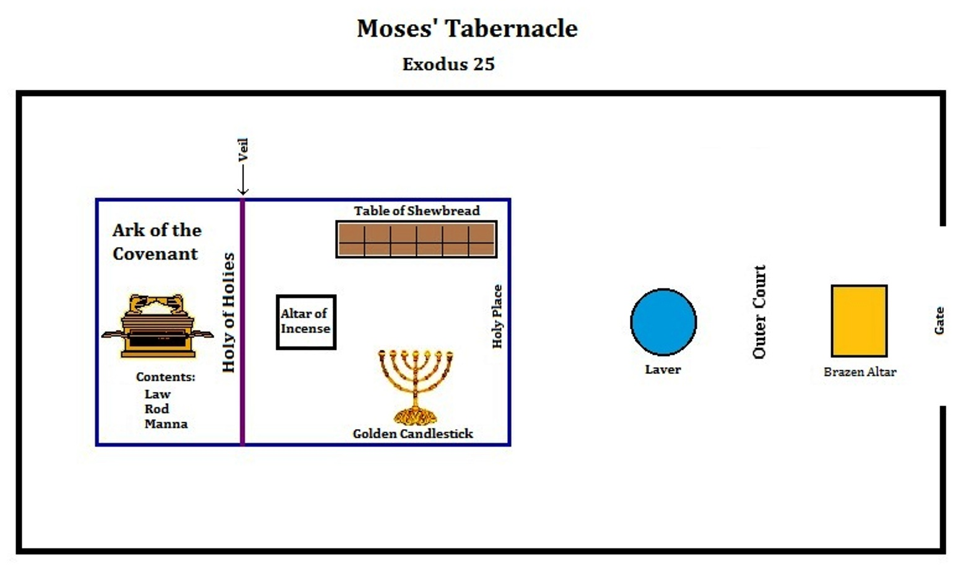
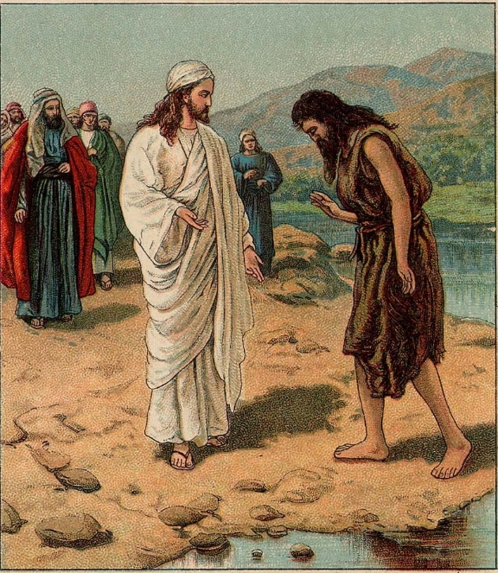
BAPTISM OF CHRIST
“Then cometh Jesus from Galilee to Jordan unto John, to be baptized of him. But John forbade him, saying, I have need to be baptized of thee, and comest thou to me? And Jesus answering said unto him, Suffer it to be so now: for thus it becometh us
to fulfil all righteousness. Then he suffered him”
(3:13-15).
John knew he was a sinner and needed to be water washed; he knew Jesus didn’t, but Jesus persisted that He, too, needed the ceremonial cleansing.
But, why?
Before beginning his ministry, every priest including the high priest, needed to be ceremonially cleansed (Exo. 29:4). Jesus submitted to the same ritual because the Law required it. He fulfilled every letter of the Law, before beginning His earthly ministry.

Slide 14
THE HOLY SPIRIT
“And Jesus, when he was baptized, went up straightway out of the water: and, lo, the heavens were opened unto him, and he saw the Spirit of God descending like a dove, and lighting upon him: And lo a voice from heaven, saying, This is my beloved Son, in whom I am well please” (Mt. 3:16,17; Isa. 42:1).
Receiving the Holy Spirit validated His Messiahship and confirmed the ministry He had received of the Father.
GOSPEL OF MARK
“The writer of the second Gospel, Mark, called also John, was the son of one of the New Testament Marys, and nephew of Barnabas. He was an associate of the apostles, and is mentioned in the writings of Paul and of Luke…Theme… Jehovah’s servant… Everywhere the servant character of the incarnate Son is manifest”
(Old Scofield, p. 1045).
The shortest Gospel, Mark gets right to the point.

Slide 15
“John did baptize in the wilderness, and preach the baptism
of repentance for the remission of sins. And there went out
unto him all the land of Judea, and they of Jerusalem, and
were all baptized of him in the river of Jordan, confessing
their sins” (Mk. 1:4,5).
This water washing was essential in God’s program with
Israel as Mark emphasized at the end of his Gospel –
“He that believeth [Messiah] and is baptized shall be saved;
but he that believeth not shall be damned” (16:16).
Water baptism was an outward demonstration or proof of the Jews’ faith, and along with faith in Messiah completed their terms of salvation. Saul of Tarsus after his conversion –
“And now why tarriest thou? Arise, and be baptized, and wash away thy sins, calling on the name of the Lord” (Acts 22:16).
Why water? Because the total efficacy of Christ’s blood had
NOT yet been revealed—it was still hidden in God at this point.

Slide 16
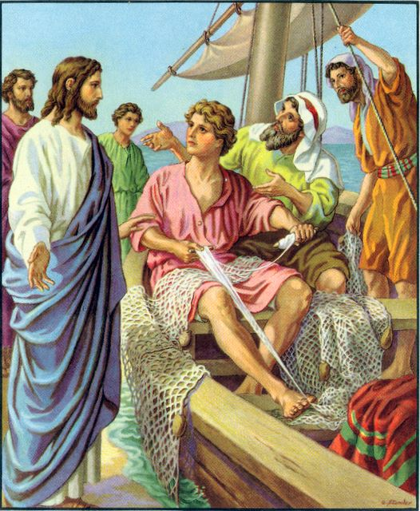
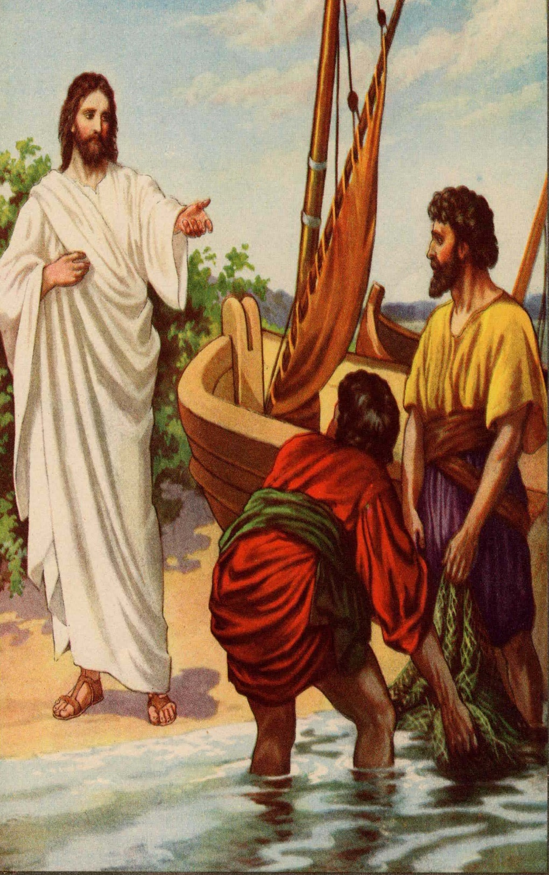
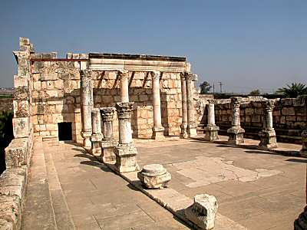
THE CALL OF SIMON & ANDREW
“Now as he walked by the sea of Galilee, he saw Simon and Andrew his brother casting a net into the sea: for they were fishers. And Jesus said unto them, Come ye after me, and I will make you to become fishers of men… And when he had gone a little farther thence, he saw James the son of Zebedee, and John his brother… he called them… they left their father… and went after him” (1:16,17).
Jesus began to call the 12 Disciples.
“And they went into Capernaum; and straightway on the Sabbath day he entered into the synagogue and taught. And they were astonished at his doctrine: for he taught them as
one that had authority, and not as the scribes… a man with an unclean spirit… I know thee who thou art, the Holy One of God… Hold they peace, and come out of him… he came out” (1:21-26).
Jesus spoke with power; His ability to cast out demons [who knew who He was] validated His authority.

Slide 17
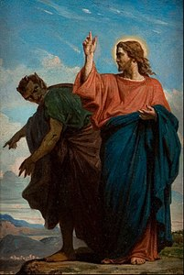
GENEALAGY OF CHRIST
“And Jesus himself began to be about 30-years of age, being the son of Joseph… son of Heli… son of David… son of Seth … which was the son of Adam…” (Lk. 3:23-38).
Whereas Matthew lineage of Christ stopped at Abraham to emphasize Israel’s importance, Luke’s was extended to Adam, emphasizing Christ’s place in all of humanity.
TEMPTATION OF CHRIST
“Then was Jesus led up of the Spirit into the wilderness to be tempted of the devil. And when he had fasted 40-days, he was afterward hungry. And when the temper came to him, if thou be the Son of God, command that these stones be made bread… cast thyself down [temple]… if thou wilt fall down and worship me…” (Mt. 4:1-11).
Three times Satan tempted Christ: place the flesh over the spirit; do something dramatic; worship the ‘god’ of this world; but, in each case Christ refuted him with Scripture.

Slide 18
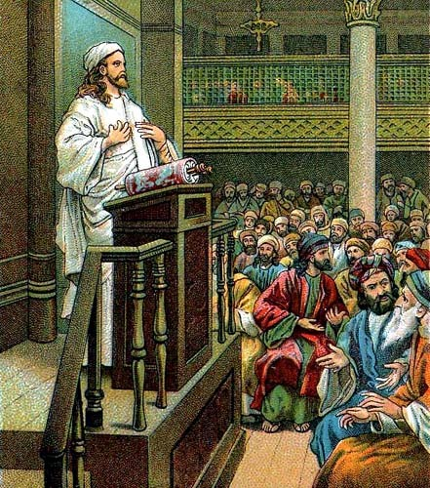
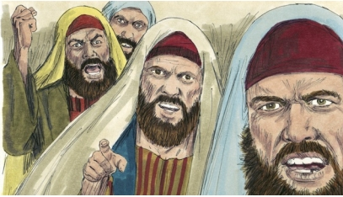
GOSPEL OF THE KINGDOM
“And Jesus went about all Galilee, teaching in their synagogues,
and preaching the gospel of the kingdom, and healing all manner
of sickness and disease among the people” (4:23).
Jesus preached of a kingdom of heaven come to earth where
disease would be eradicated.
SYNAGOGUE IN NAZARETH
Early in His ministry, Jesus preached in the synagogue in his
childhood home, where He quoted Isa. 61:1,2, which spoke of
His 1st coming, but left out His 2nd coming, “the day of vengeance.”
When He stopped, every eye was fastened on Him, because He
was the carpenter’s son, and He was saying, He was the Messiah!
He added, “No prophet is accepted in his own country” (Lk. 4:24).
He was right. Guess what happened then?
“And all they in the synagogue, when they heard these things,
were filled with wrath… thrust him out of the city… led him unto the brow of the hill… they might cast him down headlong… passing through the midst went his way”(4:28-30). He escaped only because His time had not yet come.
Mt. Precipice in Nazareth (2018)

Slide 19
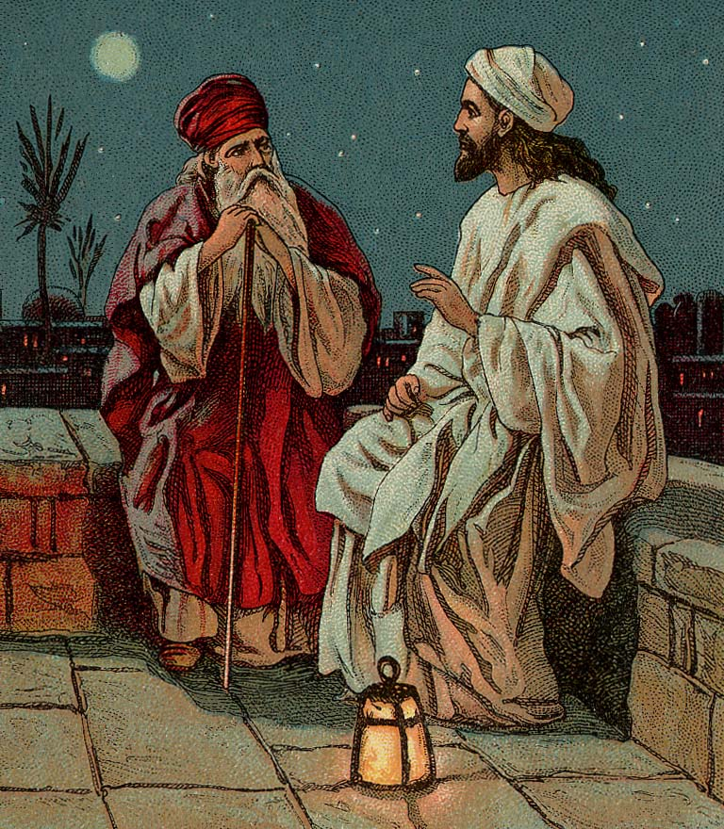
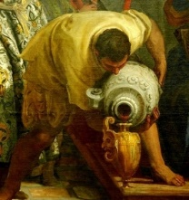
WEDDING IN CANA
“And the 3rd day [7-day celebration] there was a marriage in Cana of Galilee… This beginning of miracles did Jesus in Cana of Galilee, and manifested forth his glory…” (Jn. 2:1-11).
This was the 1st of 8 sign miracles in the Book of John, turning water into wine. It’s spiritual meaning? Christ had come as the Bridegroom for His bride Israel, but she was not ready for marriage [and won’t be until the millennial kingdom when Christ returns and then will turn Israel the nation ‘from water into wine’].
BORN AGAIN
“There was a man of the Pharisees, named Nicodemus, a ruler of the Jews… How can a man be born when he is old?... Jesus… Except a man be born of water and of the Spirit, he cannot enter into the kingdom of God” (Jn. 3:3).
There are theories what is the ‘water’ [birth, baptism], but here
He is emphasizing the spiritual [NOT physical] realm. Likely it is “washing of water by the word” (Eph. 5:26).
The Holy Spirit’s washing of believers by hearing of the Word.

Slide 20
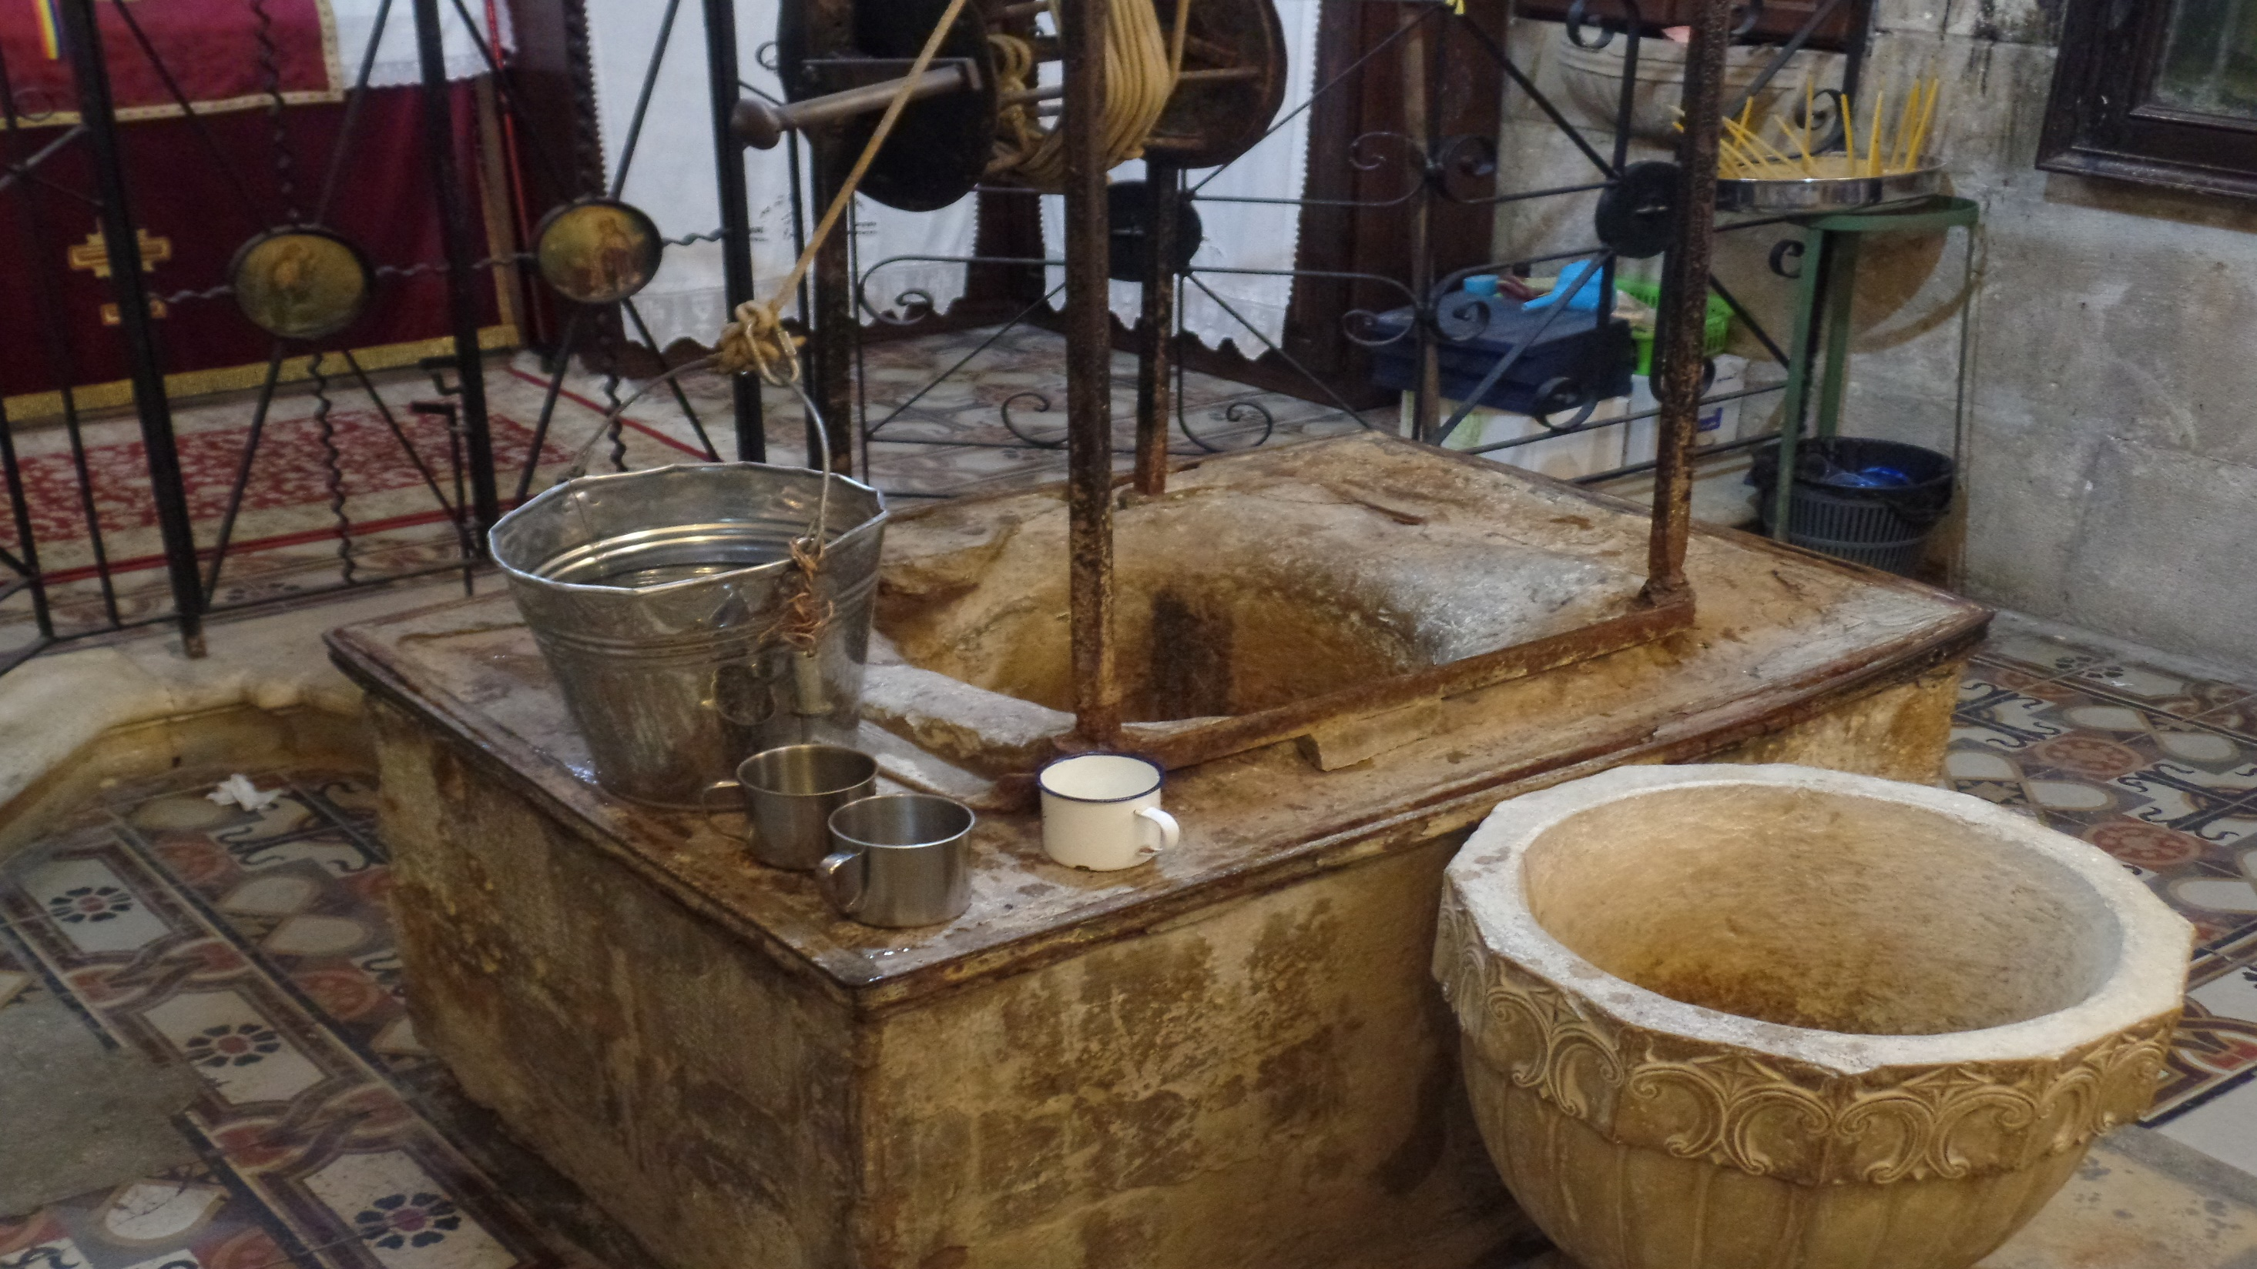
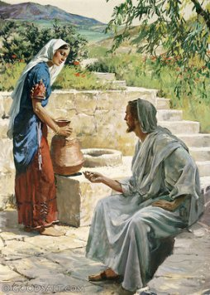
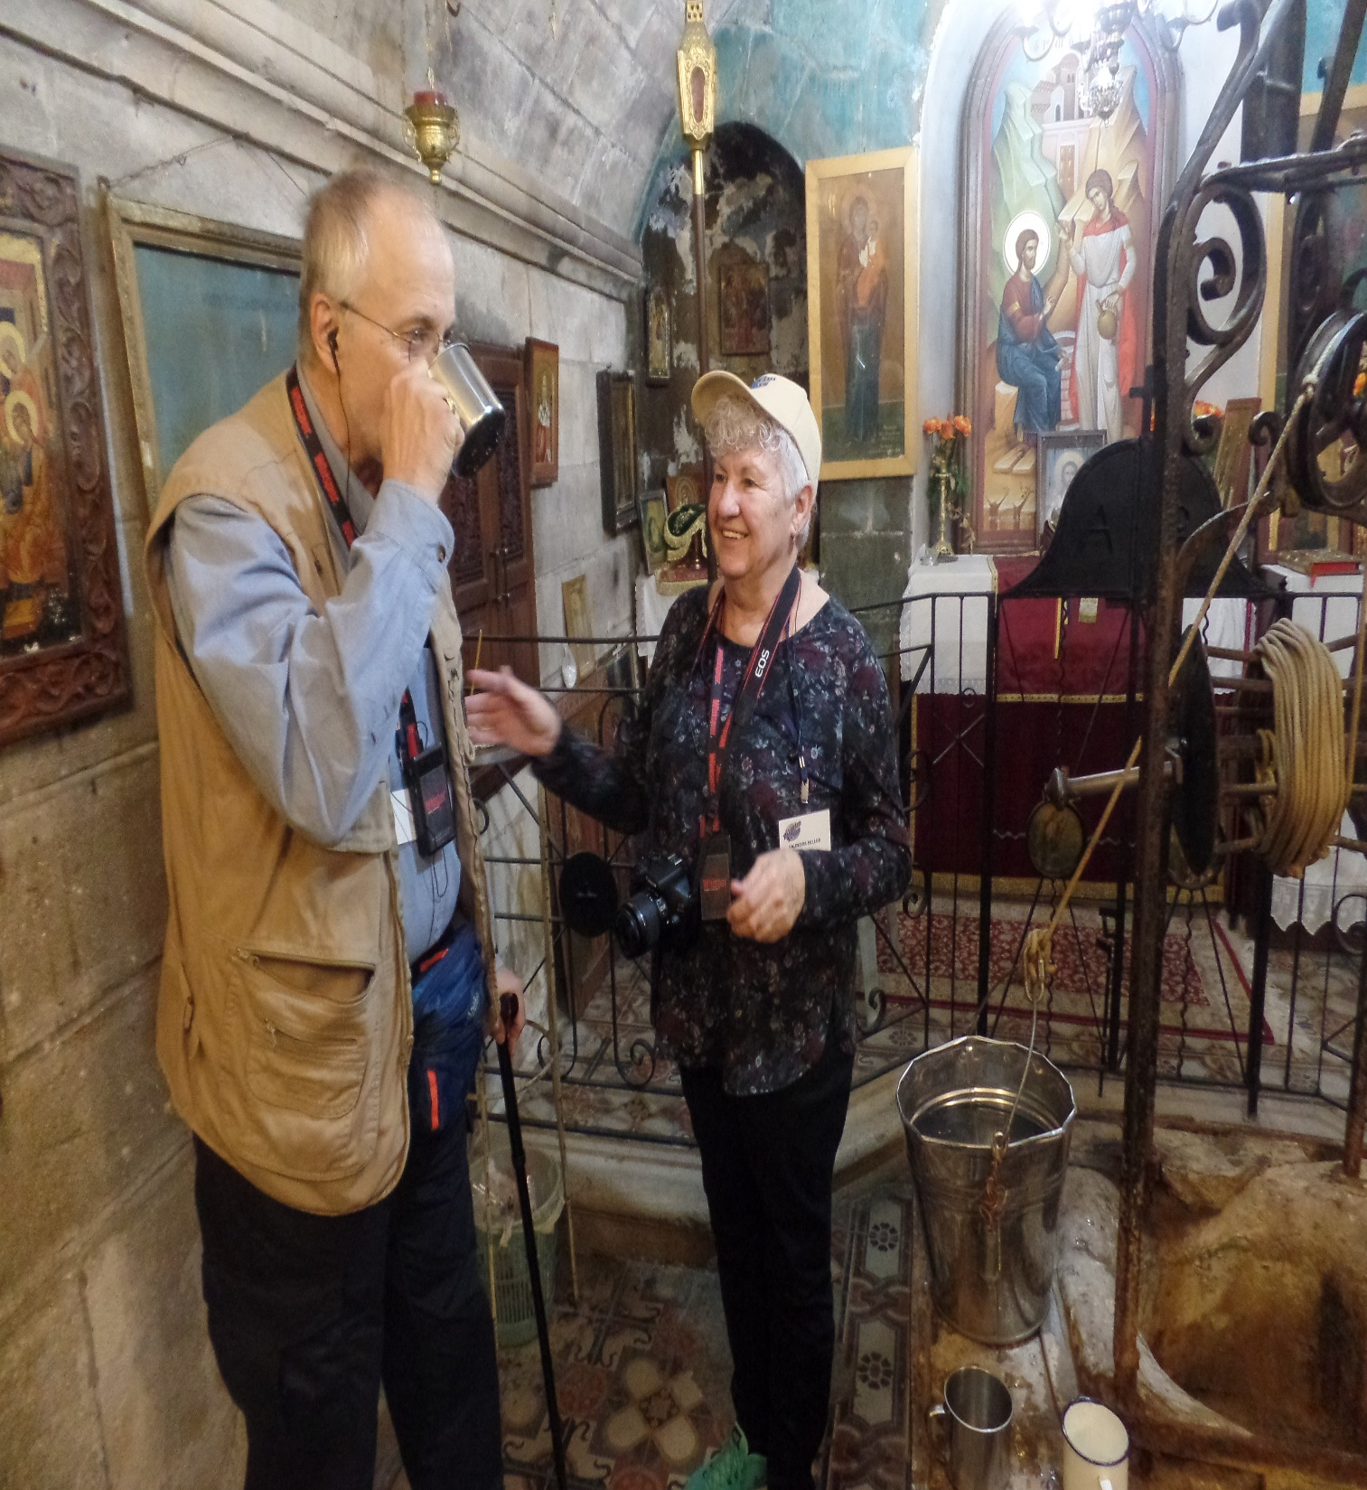
THE SAMARITAN WOMAN
“He left Judea, and departed again into Galilee… cometh he to a city of Samaria… 6th hour… There cometh a woman of Samaria to draw water: Jesus saith , Give me a drink… the Jews have no dealings with the Samaritans… Whosoever drinketh of the water I give him shall never thirst” (4:3-13).
Again, Jesus emphasized the spiritual realm [He is the living water]. Jews hated Samaritans and could not worship together, “Ye worship ye know not what: we know what we worship: for salvation is of the Jews” (4:22).
God had used Israel to implement His 1st [Old] Covenant and in the future would give them a New Covenant. The Samaritans were teaching something different.
Drinking from Jacob’s Well (2018)

Slide 21
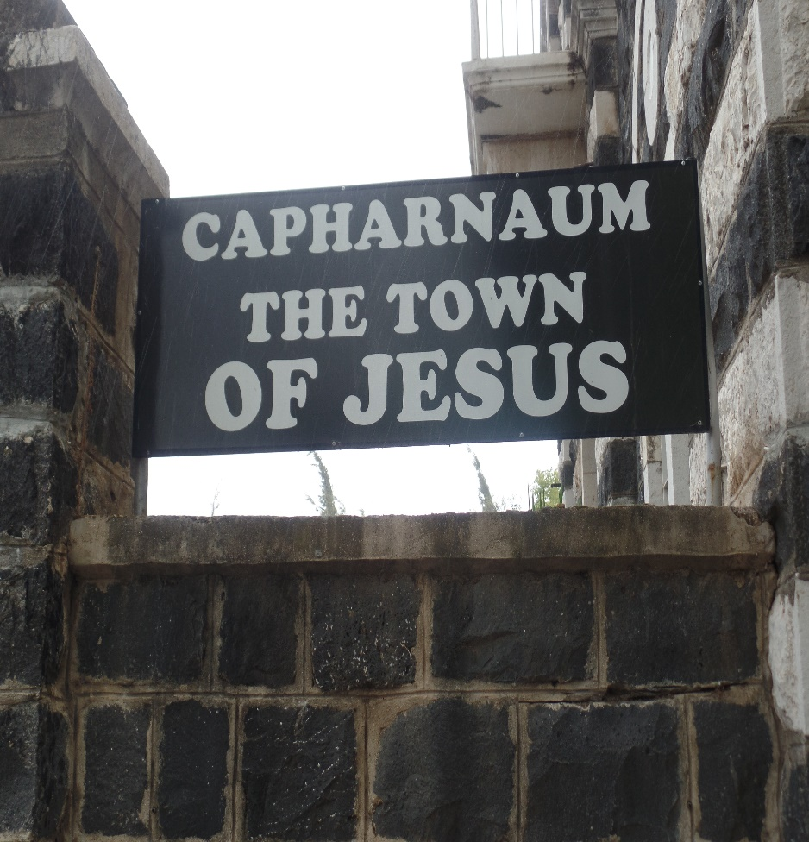
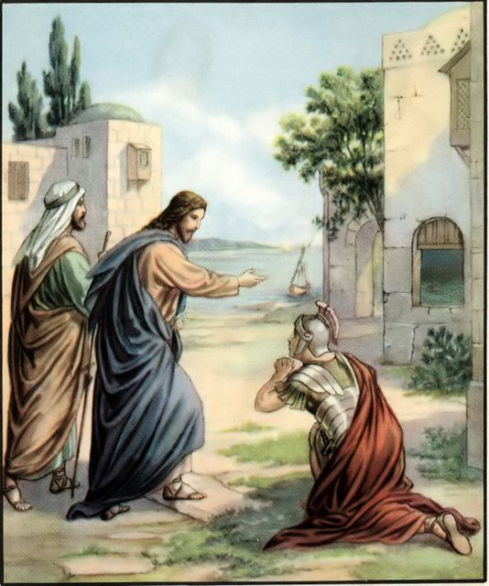
THE CENTURION
“And when Jesus was entered Capernaum, there came a Centurion
… Lord, my servant lieth at home sick.. Jesus… I will heal him”
(Mt. 8:5-13). Only 1 of 2 Gentiles healed during Christ’s 3 ½ yr.
ministry. “…The centurion answered and said, Lord, I am not
worthy that thou shouldest come under my roof: but speak the
word only, and my servant shall be healed” (8:8).
This Gentile, though high ranking in the world, knew his place in
the spiritual realm. God, at this time, was still very much a
respecter of persons. Jesus marveled at the centurion’s faith –
“… I have not found so great faith, no, not in Israel. And I say unto
you, That many shall come from the east and west, and shall sit down with Abraham… in the kingdom of heaven. But the children [unsaved Jews] of the kingdom shall be cast out into outer darkness: there shall be weeping and gnashing of teeth” (8:10-12).
Many Jews wrongly believed that simply being of the seed of Abraham would secure their place in God’s kingdom. Here Jesus tells them their kingdom will be in hell!
Next time – More of Christ’s earthly ministry to Israel.
(Israel 2018)

