Slide 1
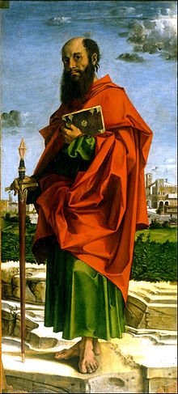
LESSON 51
WEEK 51 OF 52
(Philip; 1Tim.; Tit.;
1Pet.; Heb.)
THROUGH THE BIBLE IN 2018
Last time – the Revelation of the Mystery given to Paul.
This time – the beginning of the transition to the End Times.
PHILIPPIANS (A.D. 63)
“Paul and Timotheus, the servants of Jesus Christ, to all the saints in Christ Jesus which are at Philippi… I thank my God upon every remembrance of you, always in every prayer of mine for you all making request with joy, for your fellowship in the gospel from the first day until now; Being confident of this very thing, that he which hath begun a good work in you will perform it until the day of Jesus Christ” (Phil. 1:1-6).
The Philippian believers were near and dear to Paul’s heart.
They had quickly received and embraced his message of God’s grace and Paul promised them it would be worth it,
that Christ would finish the work He started in them, that this life was only the beginning of an eternal life with Him.

Slide 2
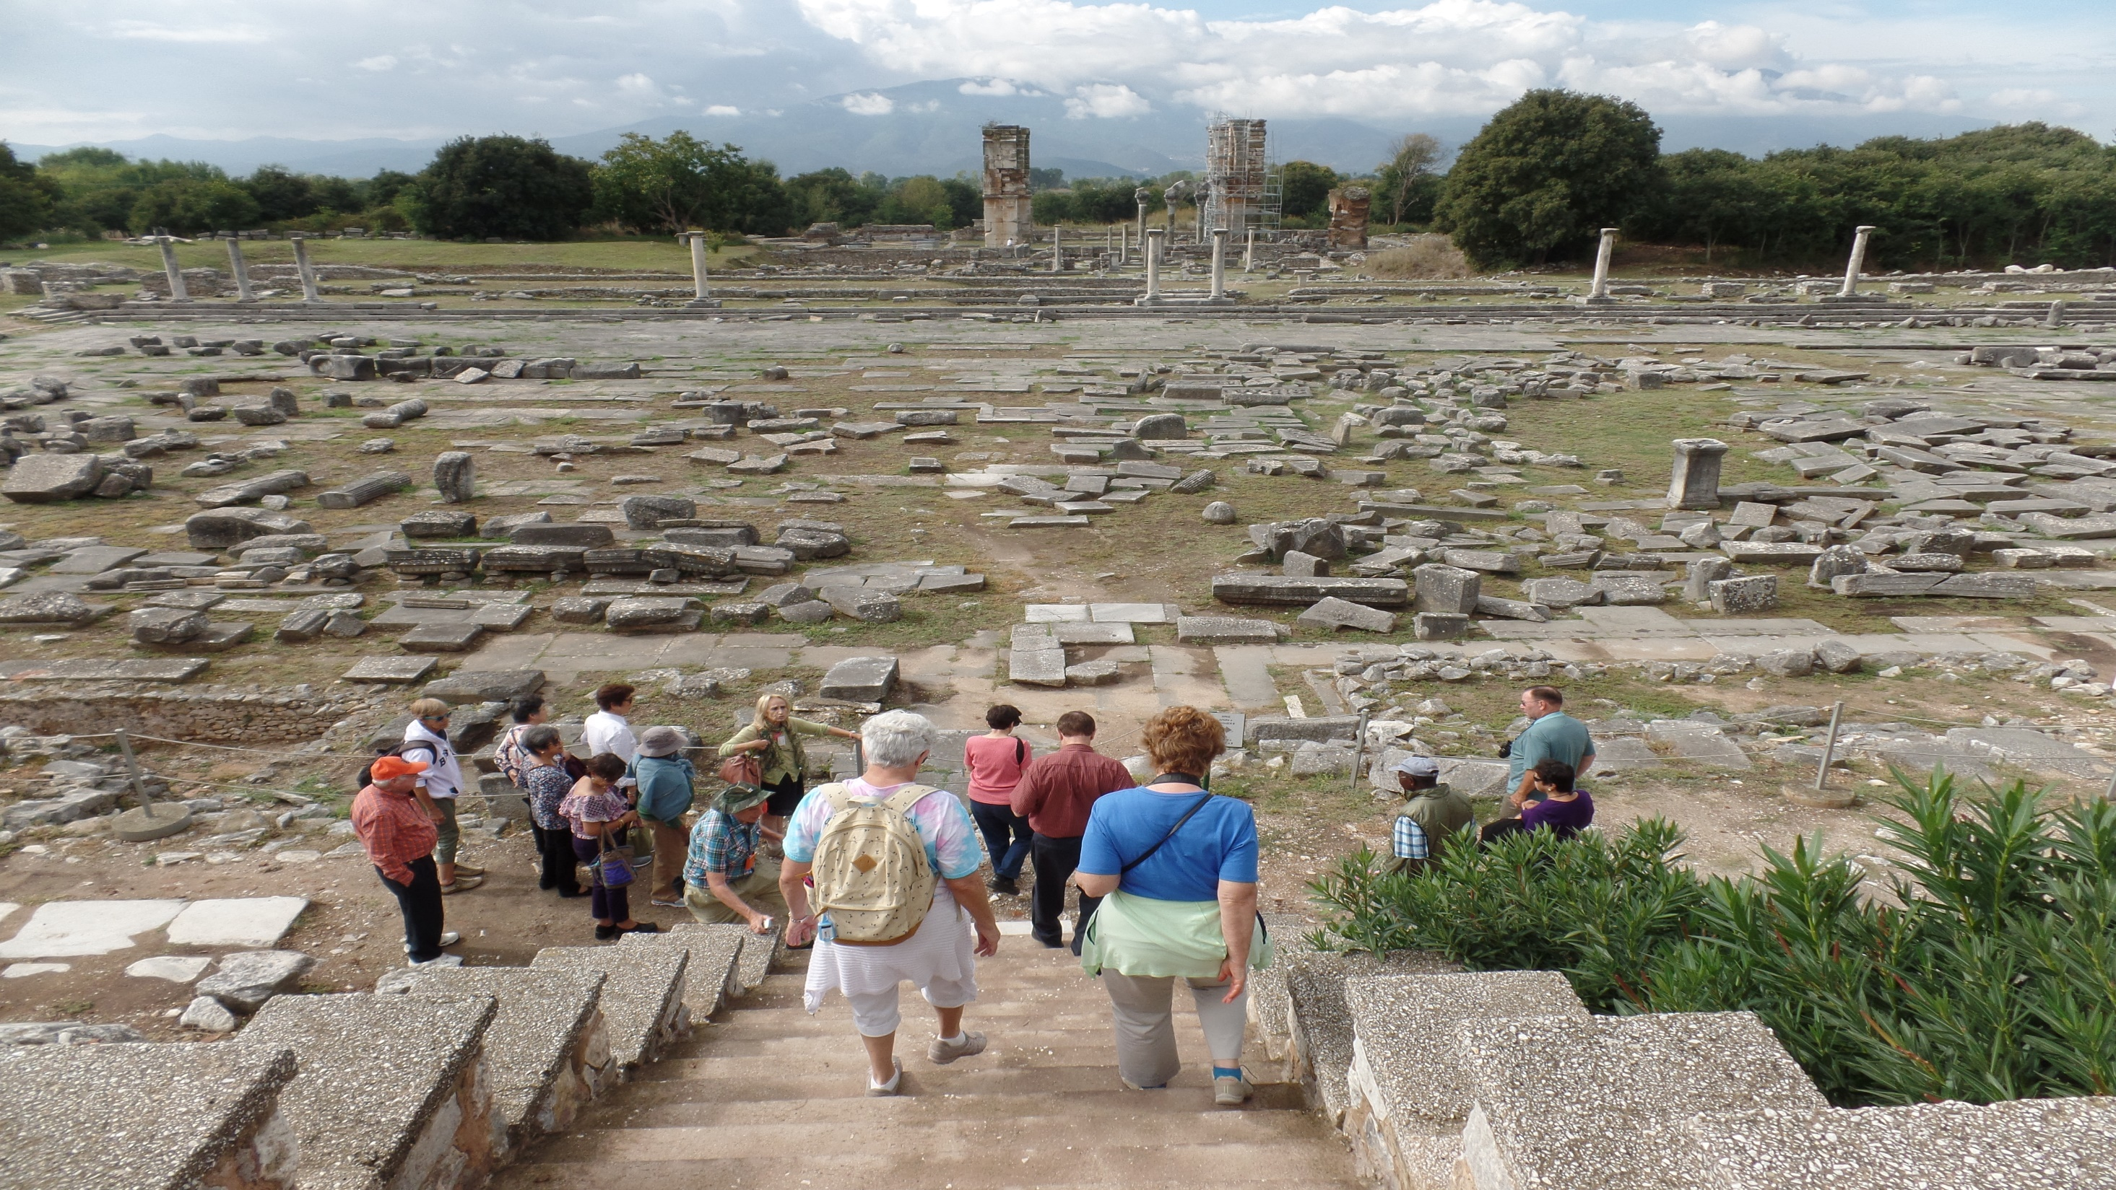
Philippi (2015)

Slide 3
“According to my earnest expectation and my hope, that in nothing I shall be ashamed, but with all boldness, as always, so now also Christ shall be magnified
in my body, whether it be by life, or by death” (Phil. 1:20).
Paul’s reason for living was Christ—Paul’s reason for dying
was Christ. He would live for Christ and he would die for Him.
During his early ministry, Paul had been beaten to death and
was translated to heaven where he saw Christ. Though he
was told not to say much (2Cor. 12:4), he did offer this –
“For to me to live is Christ, and to die is gain… For I am in a
strait betwixt two, having a desire to depart, and to be with
Christ; which is far better” (Phil. 1:21,22).
Few words, but big meaning. Christ was not finished with
Paul on earth, so he returned to finish his ministry to the
Gentiles and of the dispensation of the grace of God –
“Nevertheless to abide in the flesh is more needful for you… I
know that I shall abide and continue with you all for your
furtherance and joy of faith” (Phil. 1:24,25).

Slide 4
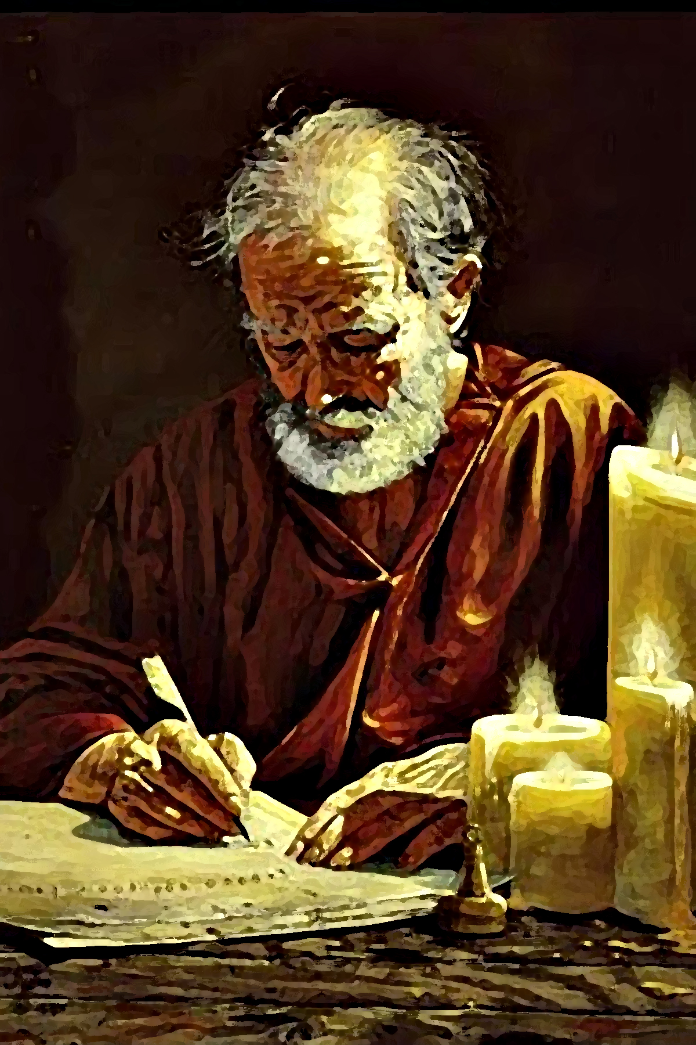
Why was Paul so enamored with Christ? He tells us in
Chapter 2 –
“But made himself of no reputation, and took upon him the form of a servant, and was made in the likeness of men: And being found in fashion as a man, he humbled himself, and became obedient unto death, even the death of the cross” (Phil. 2:7,8).
When YOU get to heaven you will NEVER desire to come back to this broken, corrupted, and painful life on earth. But, that is exactly what our Lord chose to do.
He left paradise to come to earth to be mistreated, mocked, ridiculed and demeaned, which culminated in an unjust sentence and submission to the worst form of
capital punishment known to man—to die in our place on a cross for our sin. That’s why Paul loved him so much—and that’s why we should all love Him even though it is hard for us to understand fully the depths of agape love Christ has for us, i.e. Philippians.

Slide 5
Saul’s Biography
“Though I might also have confidence in the flesh. If any man… might trust in the flesh, I more: circumcised on the 8th day, of the stock of Israel, of the tribe of Benjamin, an Hebrew of Hebrews; as touching the law, a Pharisee; Concerning zeal, persecuting the church; touching the righteousness which is in the law, blameless” (Phil. 3:4-6).
No one in the 1st century had a better resume & biography than Saul of Tarsus; he had everything a man could want. He had everything but Christ –
“But what things were gain to me, those I counted loss for Christ… I count all things but loss for the excellency of the knowledge of Christ Jesus my Lord: for whom I
have suffered the loss of all things, and do count them as dung, that I may win Christ. And be found in him not having mine own righteousness, which is of the
law, but that which is through the faith of Christ…”

Slide 6
… righteousness which is of God by faith” (Phil. 3:7-9).
Saul thought he had it all, but he had nothing. Paul who had nothing, had everything –
“That I may know him, and the power of his resurrection, and the fellowship of his sufferings, being made confirmable unto his death; If by any means I might attain unto the resurrection of the dead”
(Phil. 3:10,11).
He desperately wanted his readers to know that he had once been wrong [but thought he was right], and that they, too, should come to the understanding of what he had… “Brethren, be followers together of me, and mark them which walk so as ye have us for an [example]… that they are the enemies of the cross of Christ” (Phil. 3:17,18). Don’t make the same mistake Saul did—follow Paul as he followed Christ!
Paul knew how spiritually far he had come having once been Christ’s greatest enemy and he never forgot it.

Slide 7
The impact of Paul’s faith in Christ on his life?
“Rejoice in the Lord always: and again I say rejoice” (Phil. 4:4).
Paul’s life, despite the often difficult circumstances he found himself, was now one of great JOY! He didn’t have all the answers, but he knew the One who did, so he advised his readers to –
“Be careful for nothing; but in every thing by prayer and supplication [petition] with thanksgiving let your requests be known unto God, and the peace of God, which passeth all understanding, shall keep your hearts and minds through Christ Jesus” (Phil. 4:6,7).
Unlike the earthly kingdom (Mt. 7:7), we now don’t get everything we ask for, Christ will decide, but even NO should give us peace, because its His decision for us,
“I can do all things through Christ which strengtheneth me” (Phil. 4:13) – If God chooses, YOU CAN DO IT!

Slide 8
1TIMOTHY (A.D. 65) – Pastoral Epistle
“Paul, an apostle of Jesus Christ… unto Timothy, my own son in the faith… As I besought thee to abide still
at Ephesus… that thou mightiest charge some that they teach no other doctrine” (1Tim. 1:1-3).
Things had gotten worse in A.D. 65 when he wrote this letter to Timothy from Philippi. The legalism had now spread from the Galatian churches to the mega-church in Ephesus where Paul left Timothy to pastor and to command them to teach no other doctrine than Paul’s message of God’s grace!
“From which some having swerved [deviate from truth] having turned aside unto vain jangling [empty babble]; desiring to be teachers of the law” (1Tim. 1:6,7).
Many were abandoning his simple message of freedom under grace to the burden of keeping commandments, rites & rituals under law. He must again try to correct them of this errant doctrine.

Slide 9
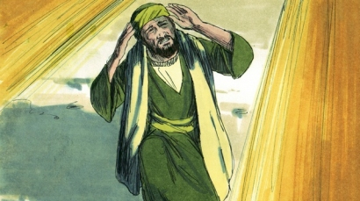
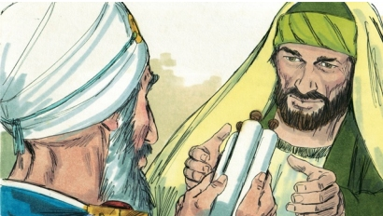
Paul had once been a legalist himself, a teacher of the law,
doing that which was “contrary to sound doctrine” of Christ
(1Tim. 1:10), “a blasphemer, and a persecutor, and injurious …”, but he had done it “ignorantly in unbelief” (1Tim. 1:13).
Christ forgave Paul because there had been no one to set him straight, but with Paul’s conversion and calling which provided a written record of Christ’s tenants of grace, THERE WILL BE NO EXCUSE FOR THOSE WHO CONTINUE TO TEACH ANY OTHER DOCTRINE! Paul was the first to know these truths –
“And the grace of our Lord was exceeding abundant with faith and love which is in Christ Jesus… came into the world to save sinners; of whom I am chief [first]. Howbeit for this cause I obtained mercy, that in me first Jesus Christ might show forth all longsuffering, for a pattern to them which should hereafter believe on him to life everlasting”
(1Tim. 1:14-16).

Slide 10
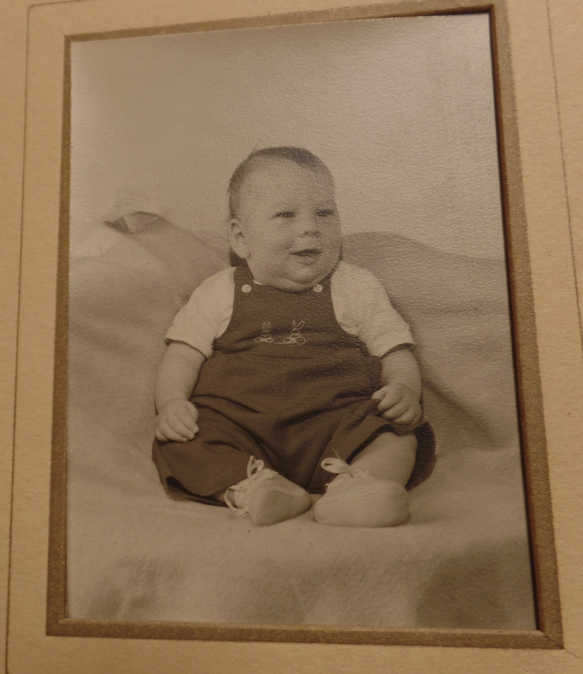
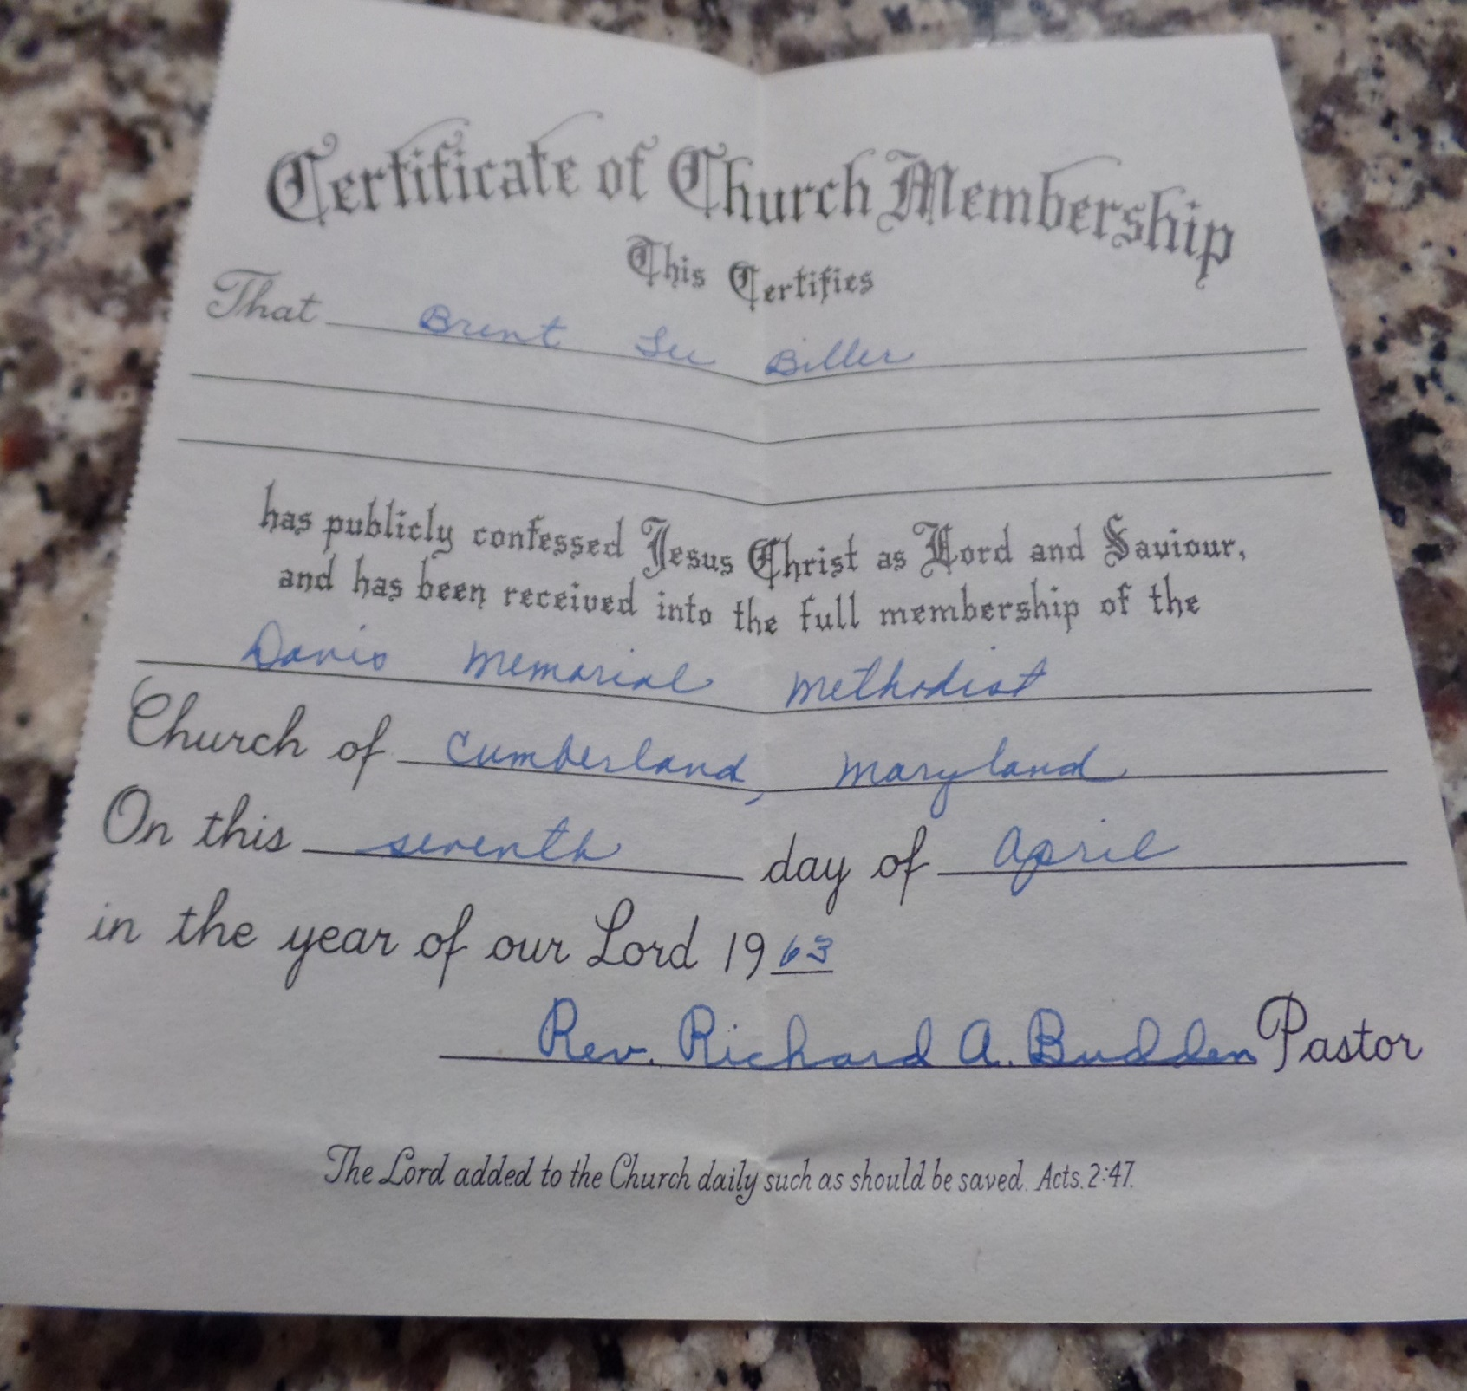
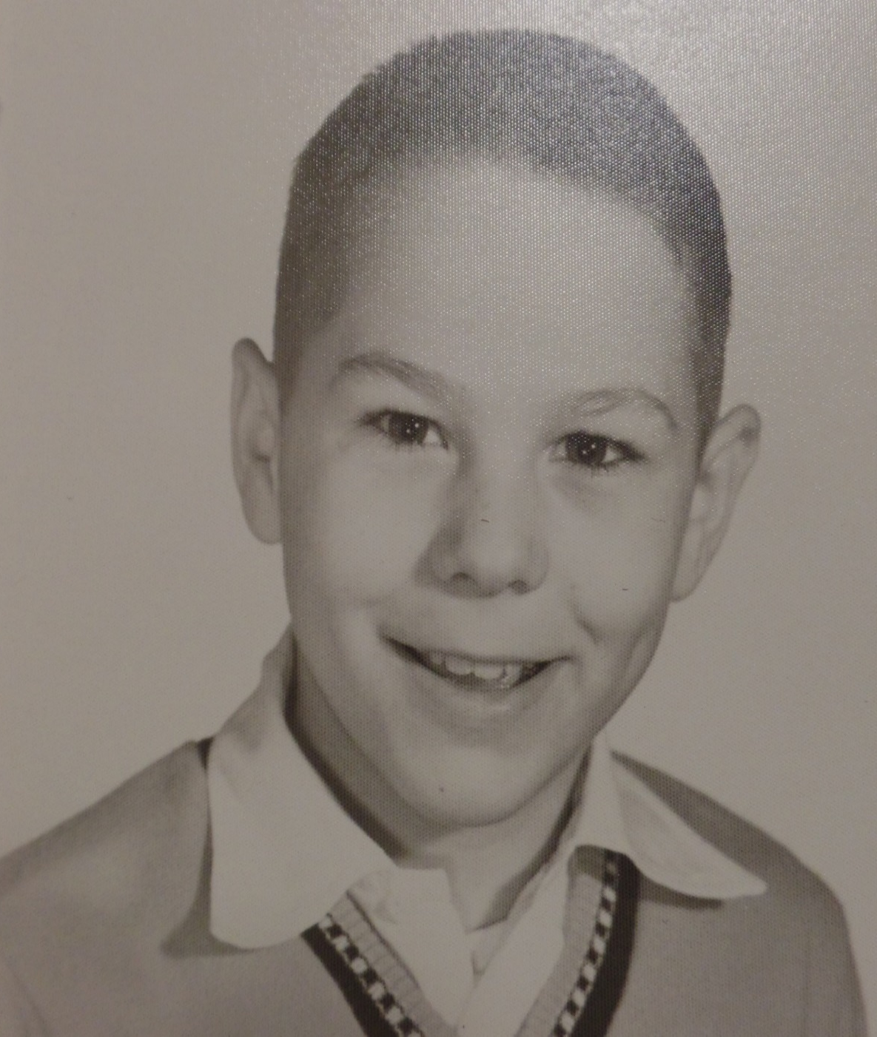
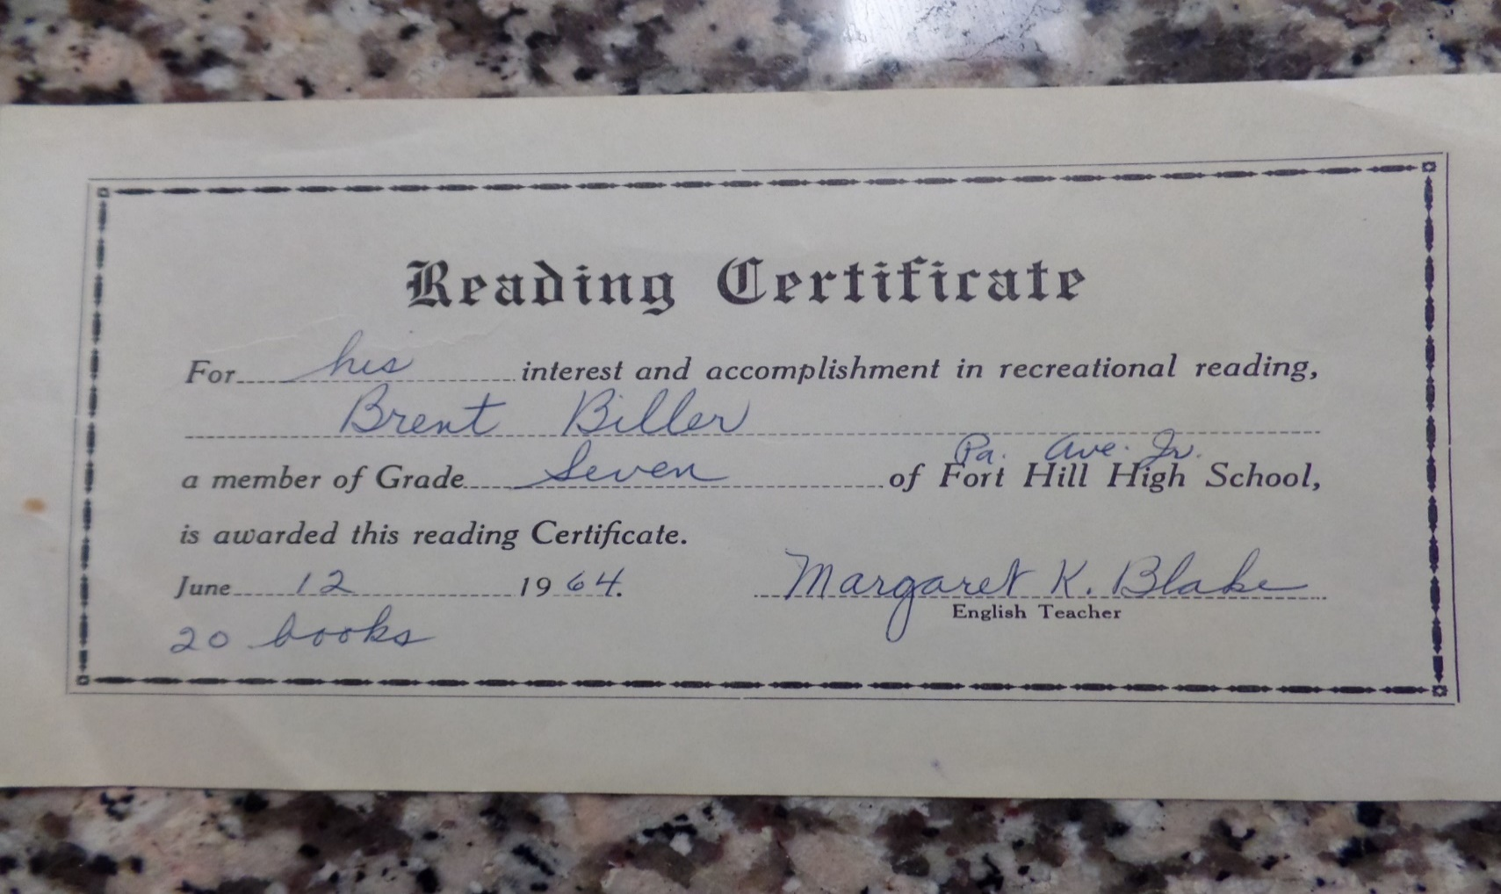
Like Saul, many live life believing they are ‘right’ with God.
MY BIOGRAPHY
Water baptized as an infant.
A good student who loved to read.
Religious credentials.

Slide 11
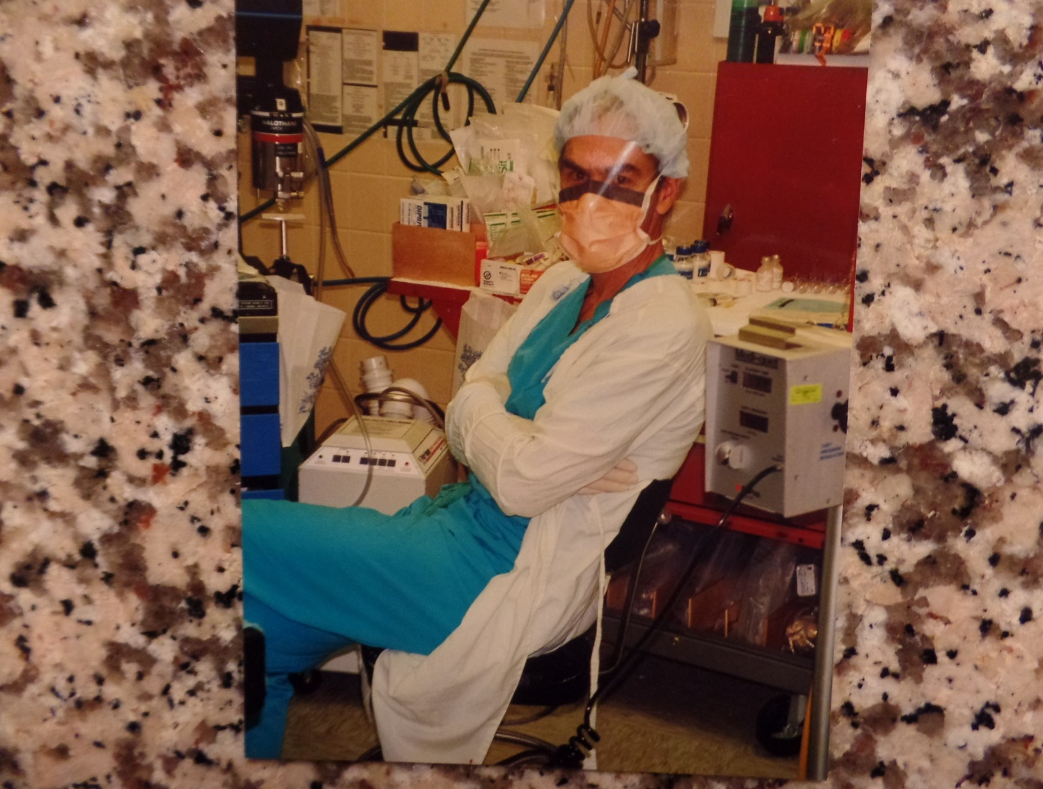
G.I. Bill paid for education
as Nurse Anesthetist
Like Saul, I had everything a
man could want…
except Christ.
3-Year Army Service
High School Graduation

Slide 12
GOD’S GOAL
“… God our savior; who will have all men to be saved, and come unto the knowledge of the truth… there is one God… one mediator between God and men… Christ Jesus… gave himself a ransom for all, to be testified in due time… I am ordained a preacher… an apostle, a teacher of the Gentiles in faith and [truth]” (1Tim. 2:3-7). Christ had a plan for Paul, and for us.
MY BIOGRAPHY (cont’d)
Like my Dad, I was a late bloomer spiritually. At age 40, I was unsaved, but at 41 Christ called, and I answered. Not only did Christ save me, but shortly after that gave me the ‘Grace Message,’ a seminary degree, the founding pastorship of a grace church, and a prison ministry at a Federal Correction Institution. He has lately given me the honor of leading small groups of believers to the lands of the Bible [Greece, Rome/Malta, Turkey, Israel] –
“I can do all things through Christ which strengtheth me”
(Phil. 4:13). I boast in Christ, not in myself.

Slide 13
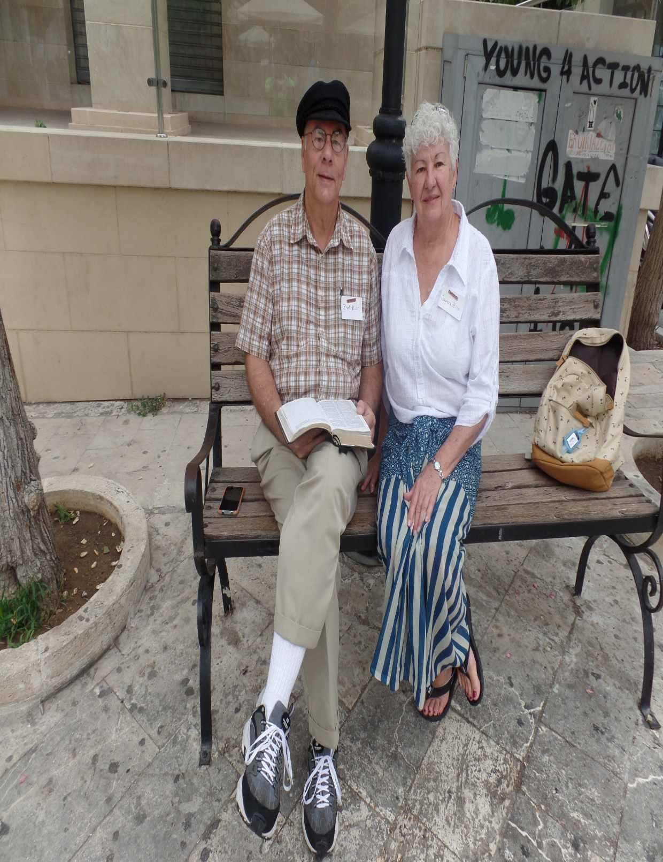
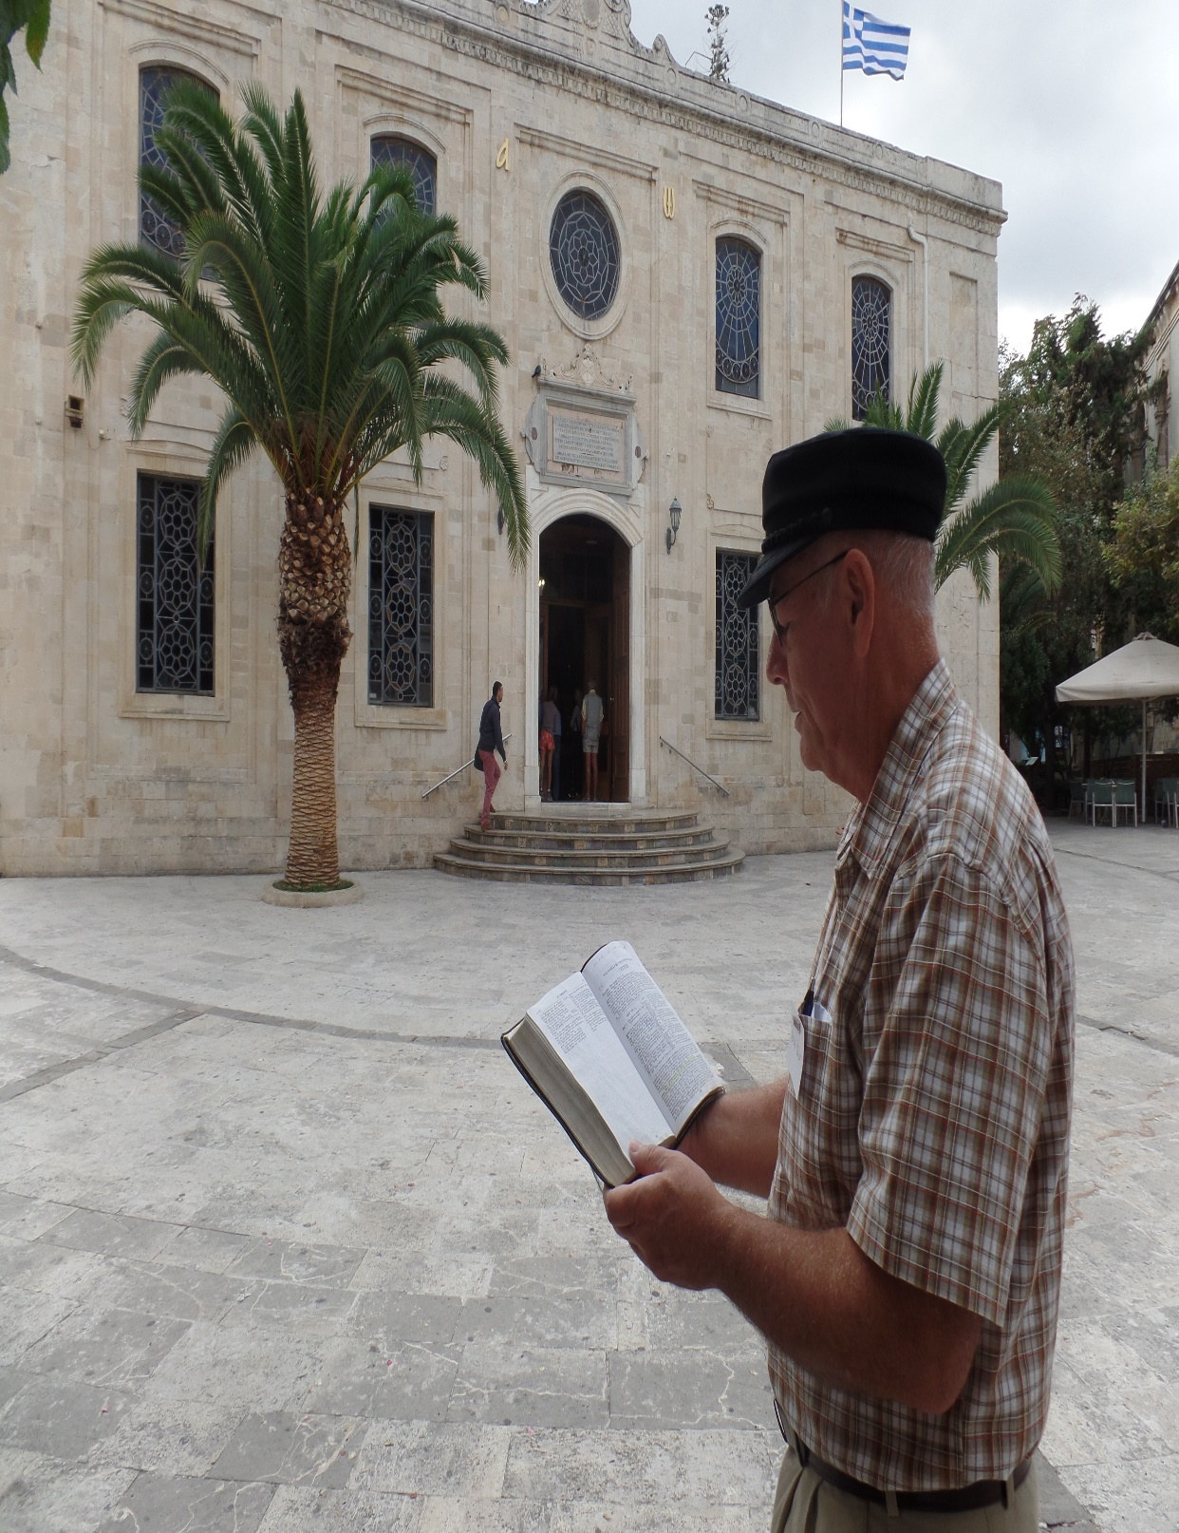
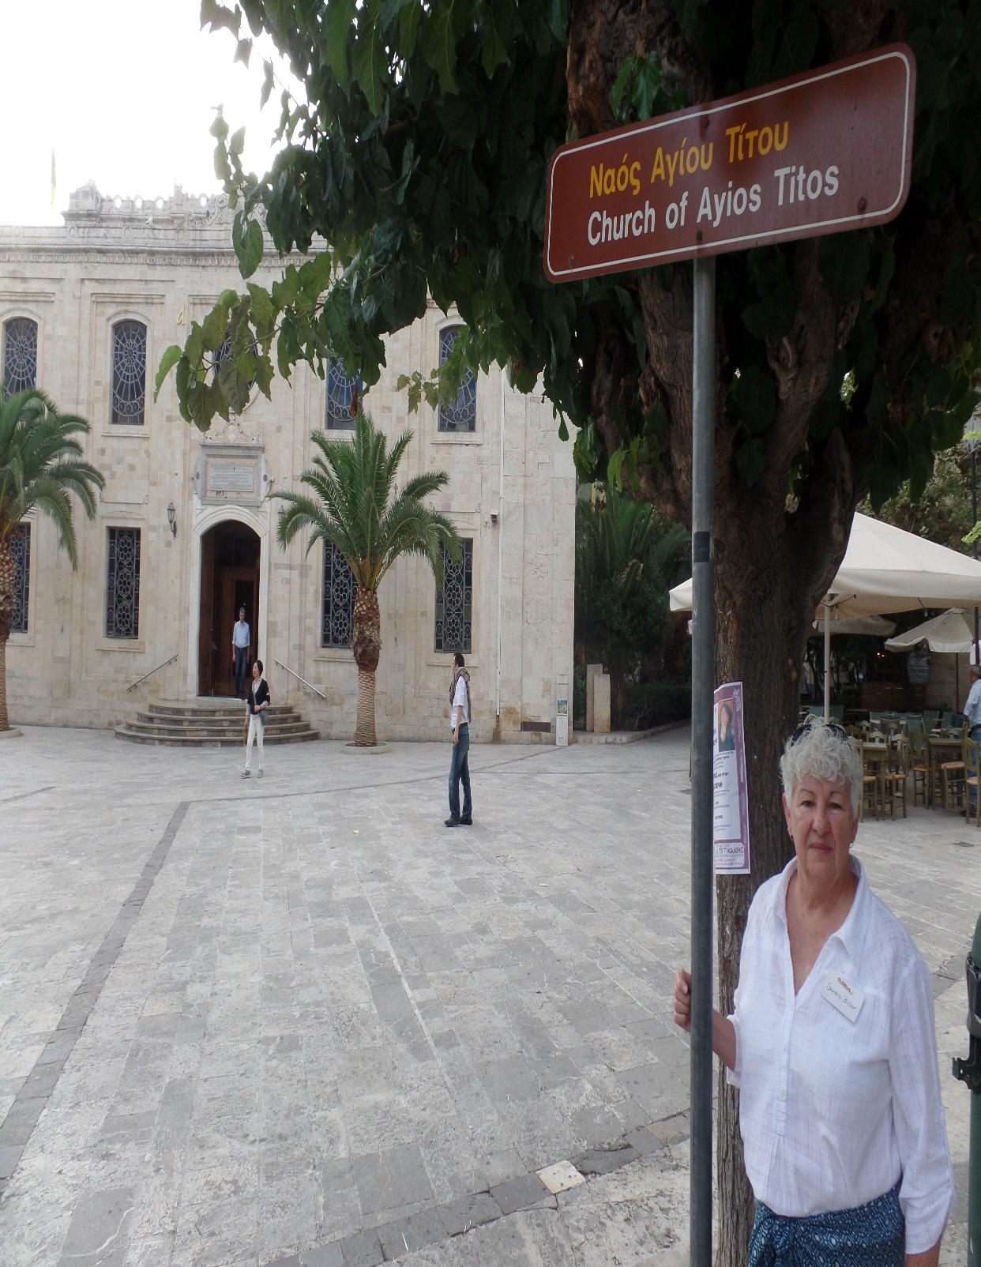
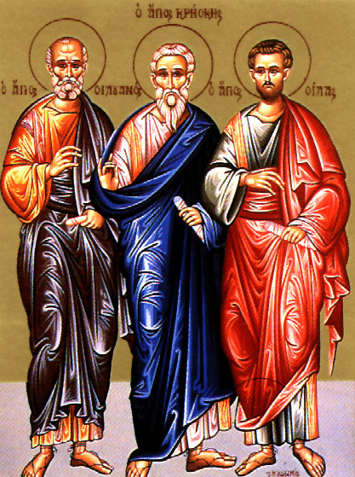
TITUS (A.D. 66) – Pastoral Epistle
“Paul, a servant of God… according to the faith of God’s elect, and a acknowledging of the truth which is after godliness; In hope of eternal life, which God, that cannot lie, promised before the world began. But hath in due times manifested his word through preaching, which is committed unto me… To Titus, mine own son after the common faith… For this cause left I thee in Crete, that thou shouldest set in order the things that are wanting…” (Tit. 1:1-6a).
Following the release from his 1st incarceration in Rome, Paul dropped Titus off on the isle of Crete to sure up the churches, which were in a disorganized mess. He chose Titus to set things straight.
If Timothy was Paul’s right arm, Titus was his left; older and more strong willed [like an army general], he was the perfect choice to put some order in the churches on Crete.
St. Titus Church
Crete (2015)

Slide 14
CHURCH LEADERS
“… ordain elders in every city, as I had appointed thee” (Tit. 1:5b).
A biblical principle in establishing a Christian church is to appoint leaders. 1Tim. 3 & Tit. 1 provides a list of requirements of such leaders: a volunteer who has a desire to carry out this ‘good work’; a good report in the community; has control over and manages his own household well; not a beginner; has a basic knowledge of the faith; sober-minded and responsible; not doing it for personal gain.
THE NEXT GENERATION
“That the aged men be… sound in faith… aged women… be in behavior as becometh holiness … teachers of good things; that they may teach the young women… to love their husbands, to love their children… young men… a pattern of good works” (Tit. 2:1-7). The next generation will be what we teach and show them to be.

Slide 15
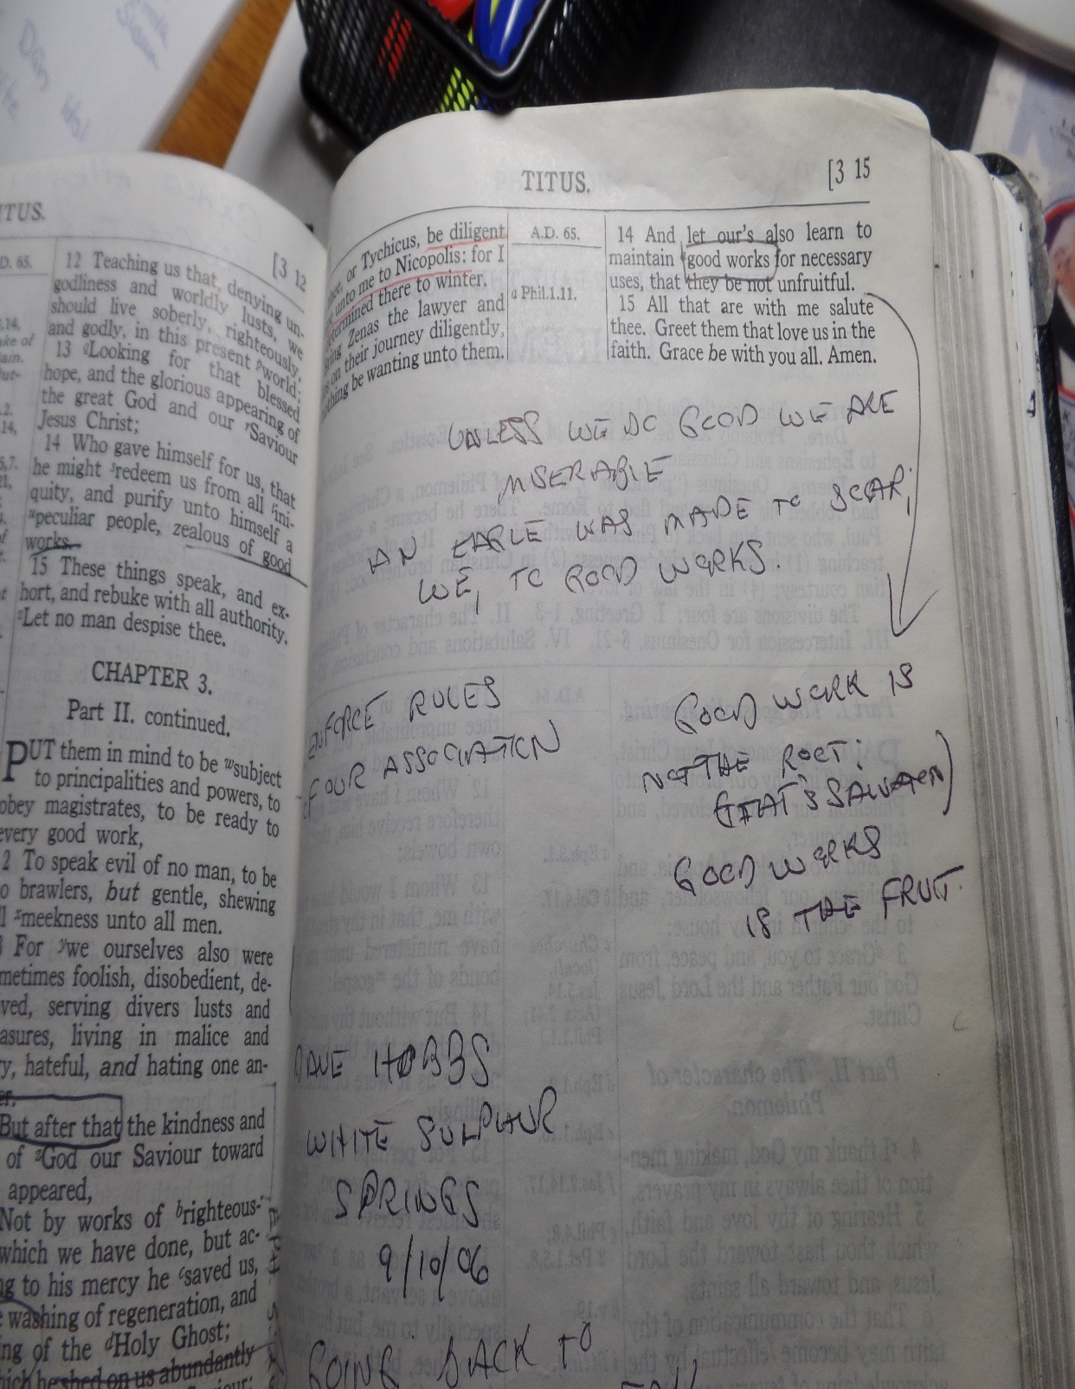
ALL MEMBERS OF THE LOCAL CHURCH
“For the grace of God hath bringeth salvation hath appeared to all men, teaching us that denying ungodliness and worldly lusts, we should live soberly, righteously, and godly in this present world: Looking for that blessed hope, and the glorious appearing of the great God and Savior Jesus Christ; Who gave himself for us, that he might redeem unto himself a peculiar people, zealous of good works” (Tit. 2:11-14).
A great passage on the walk of the believer during this Church age—we are waiting for the next event on God’s timeline, the sudden appearing of Jesus Christ [rapture], but we are not to be idle—to do good works.
(I took these notes from a message by Pastor Dave Hobbs, at the White Sulphur Springs Conference, in ‘06. His favorite book of the Bible was TITUS –
“Unless we do good works we are miserable. An
eagle was made to soar, we to good works”).

Slide 16
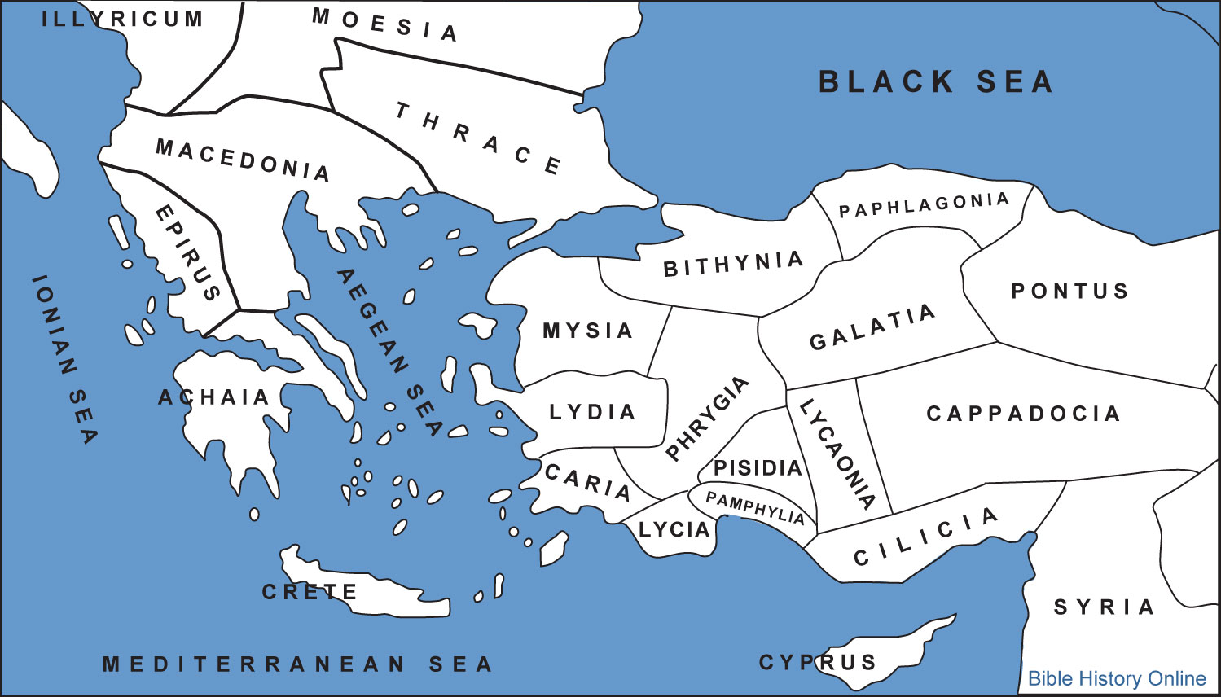
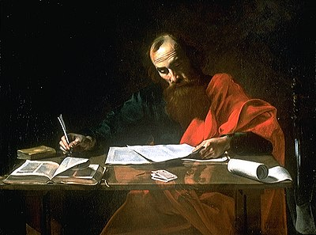
1PETER (A.D. 60)
“Peter, an apostle of Jesus Christ, to the strangers scattered throughout Pontus, Galatia, Cappadocia, Asia, and Bithynia…” (1Pet. 1:1).
Writing in about 60 A.D., while Paul is under house arrest in Rome where he writes the ‘Prison Epistles,’ Peter wrote to the same audience as did James, the Jews who had been ‘scattered’ as a result of Saul’s persecution. They had not returned to Jerusalem but had remained in these Roman provinces, which make up modern day Turkey. Peter wrote to encourage them not to abandon the faith, “… the resurrection of Jesus Christ from the dead” (1Pet. 1:3).
The only gospel the 12 preached was that of Christ’s Messiahship (Mt. 16:16), but now after the fact (Jn. 20:9), they had come to believe in the importance of His death, burial, resurrection (Acts 1:3). Though the 12 believed it, the majority of the nation of Israel didn’t.

Slide 17
“Who are kept by the power of God through faith unto salvation ready to be revealed in the last time… though now for a season… ye are in heaviness through manifold temptations (1Pet. 1:5,6)… Be sober, be vigilant; because your adversary the devil, as a roaring lion, walketh about , seeking whom he may devour”
(1Pet. 5:8).
Peter’s epistles looks to the end times when the antichrist will try to destroy believing Jews during the tribulation. They also demonstrate the Jewishness of the kingdom program as promised by God to Moses at Mt. Sinai (Exo. 19:6) –
“Chosen of God, and precious… are built up a spiritual house, an holy priesthood (1Pet. 2:4,5)… But ye are a chosen generation, a royal priesthood, an holy nation,
a peculiar people” (1Pet. 2:9).
Israel’s priesthood will recommence in the Millennium as they are led by their King/Priest. Who is He?

Slide 18
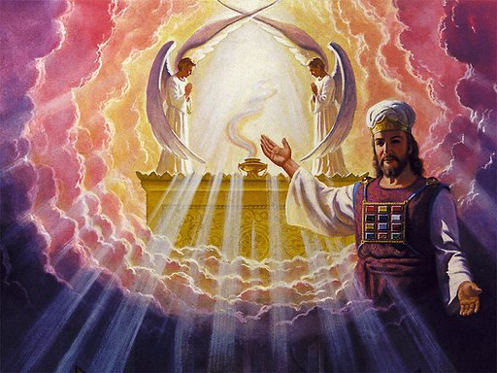
ISRAEL’S HIGH PRIEST
“… For this Melchisedec, king of Salem, priest of the most high God, who met Abraham… being by interpretation King of righteousness, and after that also King of Salem, which is, King of peace; Without father, without mother, without descent, having neither beginning of days, nor end of life; but made like unto the Son of God; abideth a priest continually” (Heb. 7:1-3).
Who will be Israel’s High Priest? None other than the Lord Jesus Christ who once appeared in the O.T. in disguise to meet Father Abraham. But, He will not be in the human lineage of Levi and Aaron, but, as the text says, He will be supernatural—THE SON OF GOD.
Why? Because the Levitical priesthood was lacking –
“If therefore perfection were by the Levitical priesthood, what further need was there that another priest should rise after the order of Melchisedec (Heb. 7:11)…

Slide 19
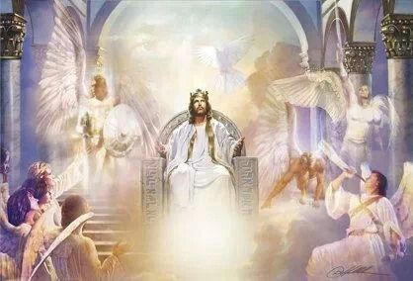
“… for the [old] law made nothing perfect (Heb. 7:19)… Who needeth not daily as those high priests, to offer up sacrifices, first for his own sins, and then for the people’s: for this he did once, when he offered up himself (Heb. 7:27)… Neither by the blood of goats and calves, but by his own blood he entered in once into the holy place, having obtained eternal redemption for us (Heb. 9:12)… but now once… hath he appeared to put away sin by the sacrifice of himself” (Heb. 9:26).
The best the Levitical priesthood could do was to ‘cover’ the sins of the people of Israel, but Christ’s once-for-all-sacrifice forever satisfied the Father’s justice against sin (Rom. 3:25). Paul could then write to Hebrews –
“… We have such an high priest, who is set on the right hand of the throne of the Majesty in the heavens; A minister of the sanctuary, and of the true tabernacle, which the Lord pitched, and not man” (Heb. 8:1,2).

Slide 20
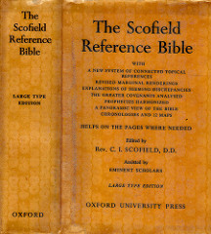
PURPOSE OF THE LETTER TO THE HEBREWS
“Writer. The authorship of Hebrews has been in controversy from
the earliest times. The book is anonymous, but the reference –
‘And account that the long-suffering of our Lord is salvation; even
as our beloved brother Paul also according to the wisdom given
unto him hath written unto you; As also in all his epistles, speaking
in them of these things; in which are some things hard to be
understood…’ (2Pet. 3:16), seems conclusive that Paul was the
writer… Theme… Judaism has come to an end… the writer had in
view the danger ever present to Jewish professed believers of
either lapsing back into Judaism, or pausing short of true faith in
Christ Jesus… The key-word is ‘better’… Christ is better than
angels… Moses… Joshua… Aaron; and the New Covenant than the
Mosaic… Church truth does not appear, the ground of gathering only being stated, ‘Let us go forth therefore unto him without the camp [Gentiles]…” (Heb. 13:13)–Old Scofield’s notes, p. 1291.
The Messianic kingdom program promised to Israel was about to run out [placed on-hold for 2,000+ years], so Paul desperately tried one last time to get his fellow countrymen to follow him. The Jews would have understood these things, but not the Mystery given to the Gentiles.

Slide 21
THE FAITH HALL OF FAME
“Through faith we understand that the worlds were framed by the word of God, so that things which are seen were not made of things which do appear” [ex-nihilo] (11:3). Faith is believing God and its proof are the individuals through whom He laid out His plans and purposes –
“By faith Abel offered unto God a more excellent sacrifice than Cain… (11:4); By faith Enoch was translated that he should not see death… that he pleased God (11:5); But without faith it is impossible to please him: for he that cometh to God must believe that he is, and that he is a rewarder of them that diligently seek him (11:6); By faith Noah, being warned of God of things not seen as yet… prepared an ark (11:7); By faith Abraham, when he was called to go out into a place… obeyed… not knowing whither he went (11:8);
Through faith also Sara herself received strength to conceive seed (11:11);
By faith Moses… kept the Passover, and the sprinkling of blood (11:24-29); Rahab… Gideon… Samson… David… Samuel… the prophets” (Heb. 11:31-32)
… And these all, having obtained a good report through faith…” (11:39).

Slide 22
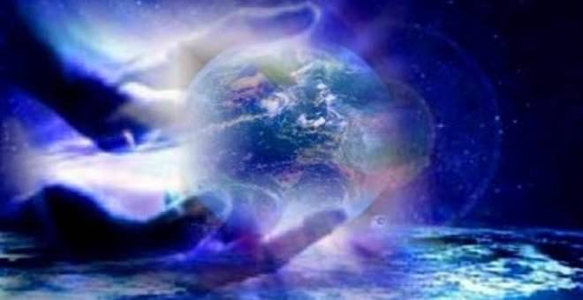
Next time – Our last lesson – End Times and the New Heaven and New Earth.

