Slide 1
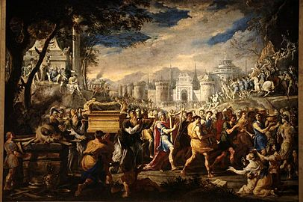
THROUGH THE BIBLE IN 2018
LESSON 15
WEEK 15 OF 52
(1 Sam. 4–Psa. 52)
Last time we saw the faithlessness of the period of the Judges in contrast to the obedience of a Moabite woman, Ruth, and the calling of Samuel to be the prophet [spokesperson] of God to Israel.
“Now Israel went out against the Philistines to battle…” (4:1).
Israel’s main enemy at that time were the Philistines, and lacking faith that they could defeat them, they brought the Ark from Shiloh to the battlefield falsely believing it would bring them victory. It did not—”And the Philistines fought, and Israel was smitten… there fell of Israel [30,000]… And the ark of God was taken; and the two sons of Eli… were slain” (4:10,11). When Eli heard the news of the ark and his sons, he fell backward over his chair, broke his neck, and he died 98-years old, having served his nation and God for 40-years (4:18).

Slide 2
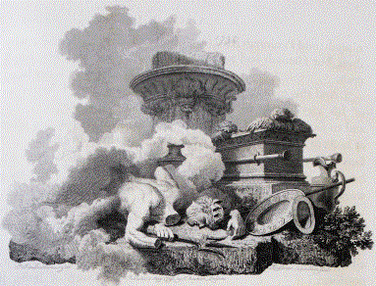
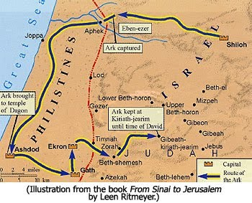
The Philistines brought the captured Ark to Ashdod
and set it in the place of their god Dagon (5:1,2).
God intervened and brought His wrath upon that
city and the statue of Dagon –
“… the hand of the LORD was against the city with a
very great destruction: and he smote the men of the
city, both small and great, and they had emerods in
their secret parts” (5:3-6,9).
The Philistines desecrated the Ark by touching and
looking into it, which not even the Levites were
allowed to do (Nu. 4:5,15,20) – “And he [God] smote
[Philistines]… because they had looked into the ark
of the LORD… [50,070] men…” (6:19).
The Philistines saw it as a curse and sent it back to
the Israelites – “… fetched up the ark… and brought it
into the house of Abinadab…” (7:1,2), where it
remained for the next 20-years as Shiloh had no
doubt been destroyed by the Philistines.

Slide 3
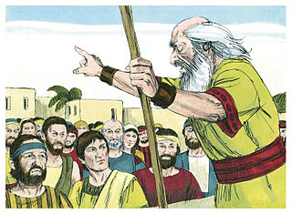
The Ark was finally back on Israelite ground. Hopefully, they had learned it was not the Ark that Israel should place their faith and trust in, but the God who had given it to them. Samuel’s first official act as prophet was to encourage the Hebrew people to abandon their practice of idolatry –
“And Samuel spoke to all the house of Israel, saying, If ye do return unto the LORD with all your hearts, then put away the strange gods and Ashtaroth from among you… serve him only: and he will deliver you out of the hand of the Philistines. Then the children of Israel did put away Baalim and Ashtarosh, and served the LORD only” (7:3,4).
But, for how long?

Slide 4
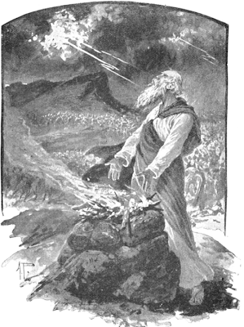
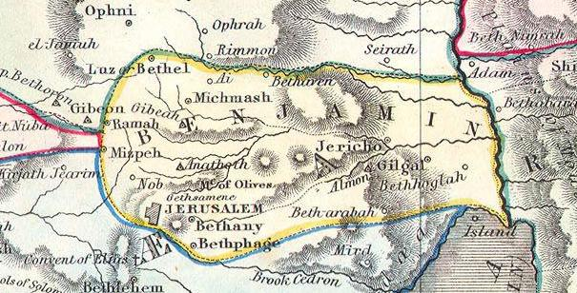
With God’s help, Israel soundly defeated the Philistines in Mizpeh –
“And Samuel took a suckling lamb, and offered it for a burnt-offering… and cried unto the LORD for Israel; and the LORD heard him (7:9)… the Philistines drew near to battle against Israel: but the LORD thundered with a great thunder… and they were smitten before Israel (7:10)… Then Samuel took a stone, and set it between Mizpeh and Shen… saying, Hitherto hath the LORD helped us. So the Philistines were subdued, and they came no more into the coast of Israel: and the hand of the LORD was against the Philistines all the days of Samuel” (7:12,13).
“And Samuel judged Israel all the days of his life. And he went from year to year in circuit to Bethel, and Gilgal, and Mizpeh… his return was to Ramah; for there was his house…” (7:15-17).

Slide 5
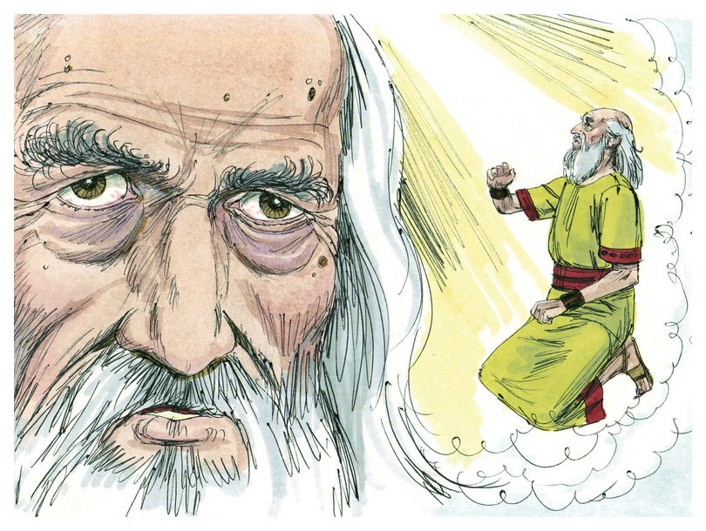
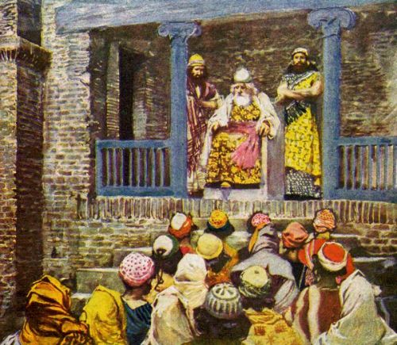
ISRAEL DEMANDS A KING
“And it came to pass when Samuel was old, that he made his sons judges over Israel… his sons walked not in his ways, but turned aside after lucre, and took bribes, and perverted judgment” (8:1-3).
Like the sons of Eli, the sons of Samuel were evil and did not serve the God of Israel.
“Then all the elders of Israel gathered themselves together, and came to Samuel unto Ramah [home], and said unto him, Behold thou art old, and thy sons walk not in thy ways: now make us a king to judge us like the nations. But the thing displeased Samuel… prayed unto the LORD (8:4-6); [LORD]… they have not rejected thee [Samuel], but they have rejected me, that I should not reign over them” (8:7).
Israel made yet another major blunder.

Slide 6
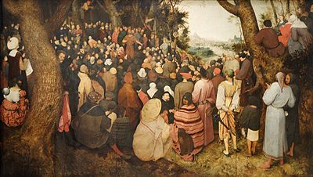
Samuel reported to the people that God would permit them to have a king, but he also told them they would regret it because: 1). a king would take their sons to build a large army; 2). their daughters into forced labor; 3). the people would become subjects of the king who would take 1/10 of everything they produced (8:11-18). He told them it would become so bad –
“… ye shall cry out in the day because of your king which ye shall have chosen; and the LORD will not hear you in that day” (8:18), but it did not dissuade them –
“Nevertheless the people refused to obey the voice of Samuel; and they said, Nay, but we will have a king over us” (8:19).

Slide 7
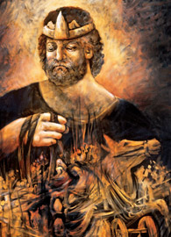
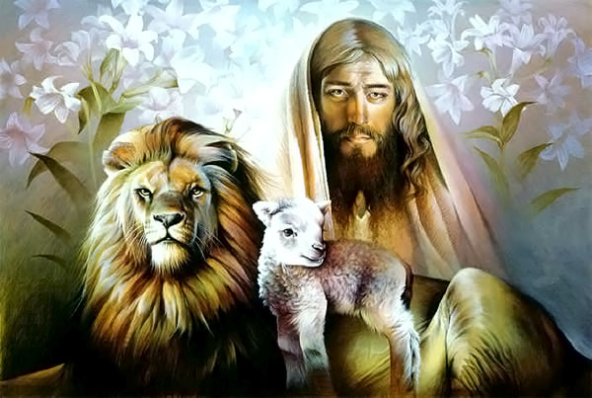
“Now there was a man of Benjamin… he had a son, whose
name was Saul, a choice young man, and goodly: and there
was not among the children of Israel a goodlier person than
he: from his shoulders and upward he was higher than any
of the people” (9:1,2).
God permitted the peoples choice of Saul to be the 1st king
of Israel.
“Now the LORD had told Samuel in his ear a day before
Saul came, saying… I will send thee a man out of the land
of Benjamin, and thou shall anoint him to be captain [king]
over my people Israel…” (9:16).
Next Samuel anointed Saul with oil (Exo. 30:23-33) and he
received the Holy Spirit (10:6), both indicating he was
chosen of the LORD, but only by His permissive will.
One thing was missing—a king ‘after the LORD’s own heart’
(1Sam. 13:14) would be chosen to foreshadow the Messiah and he would come through tribe of Judah (Gen. 49:10; Rev. 5:5). Saul was not that man.

Slide 8
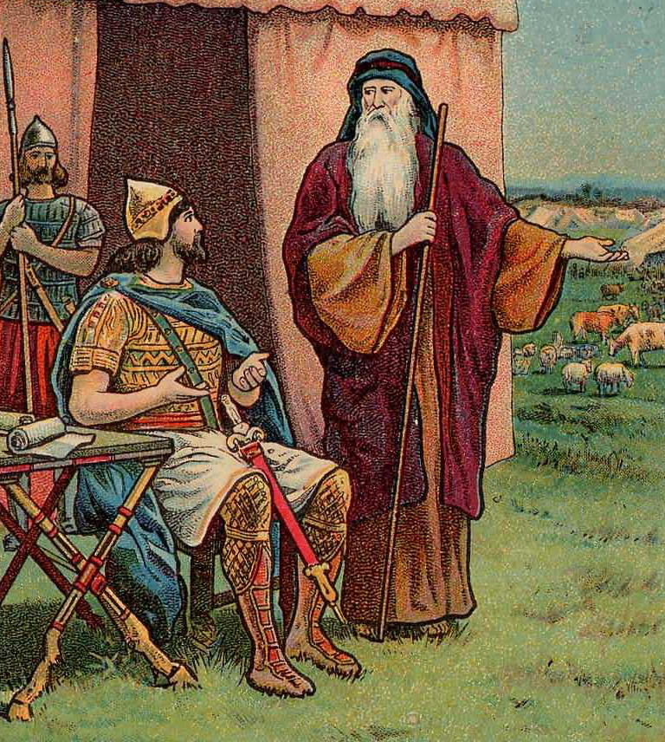
Saul was told to go to Gilgal and wait for Samuel to come and offer a sacrifice (10:8) as he had done previously, but Saul did not heed – “And he tarried [7] days, according to the set time that Samuel had appointed: but Samuel came not to Gilgal [late]… and Saul said, Bring hither a burnt-offering to me… and he offered the burnt-offering [bad!]… Samuel came… And Samuel said, What hast thou done?... Saul, Thou hast done foolishly: thou hast not kept the commandment of the LORD thy God, which he commanded thee: for now would the LORD have established thy kingdom upon Israel forever. But now thy kingdom shall not continue [through you]: the LORD hath sought a man after his own heart…”
(13:8-14).
Another major aspect of God’s plan for Israel was to include a king over a unified earthly kingdom. Here Samuel tells Saul, he will not be that king.

Slide 9
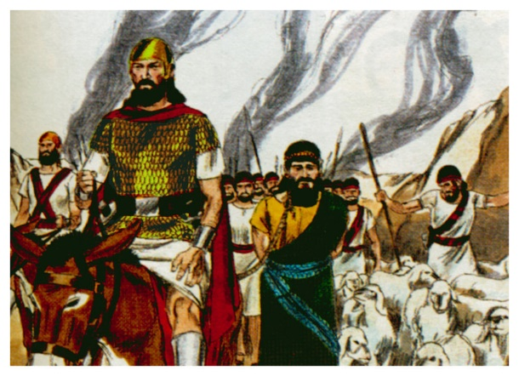
SAUL’S INCOMPLETE OBEDIENCE
“Samuel also said unto Saul, The LORD sent me to
anoint thee to be king over the people… now hearken
thou unto the voice of the words of the LORD… I
remember that which Amalek did to Israel…when he
came up from Egypt. Now go and Smite Amalek, and
utterly destroy all that they have, and spare them not…
man, woman, infant… ox and sheep…” (15:1-3).
Because the Amalekites had savagely attacked Israel on
their journey from the wilderness to Canaan, God said
He would avenge that act (Exo. 17:8-16), and Saul was
to carry it out.
“And Saul smote the Amalekites… but Saul spared [king]
Agag, and the best of the sheep, and of the oxen… and
would not utterly destroy them (15:7-9)… And Samuel said unto him, The LORD hath rent the kingdom of Israel from thee this day, and hath given it to a neighbor of thine, that is better than thou… And Samuel came no more to see Saul until the day of his death… repented that he had made Saul king over Israel” (15:28,35). God would now choose the next king of Israel.

Slide 10
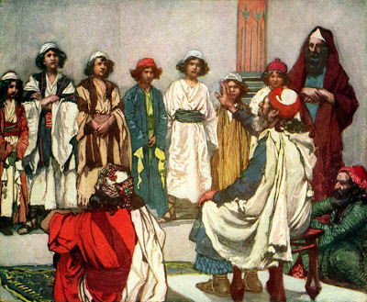
Saul had been the people’s choice [God’s permissive will],
but now God [directive will] would choose Israel’s greatest king and He would send Samuel to find him –
“… fill thine horn with oil, and go, I will send thee to Jesse
the Bethlehemite: for I have provided me a king among
his sons” (16:1).
Jesse was the grandson of Boaz and Ruth (Ru. 4:18-21),
which would produce the lineage of David and then to the Messiah. Samuel interviewed 7-sons of Jesse, but none were chosen – “But the LORD said unto Samuel, Look not on his countenance, or on the height of his stature… for the LORD seeth not as man seeth; for man looketh on the outward appearance, but the LORD looketh on the heart… the LORD hath not chosen these… Are these all thy children?... There remaineth yet the youngest… he keepeth the sheep… Jesse, Send and fetch him” (16:6-10).

Slide 11
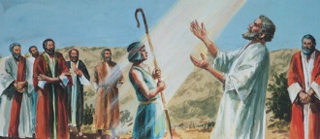
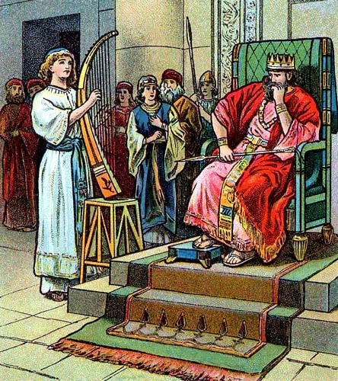
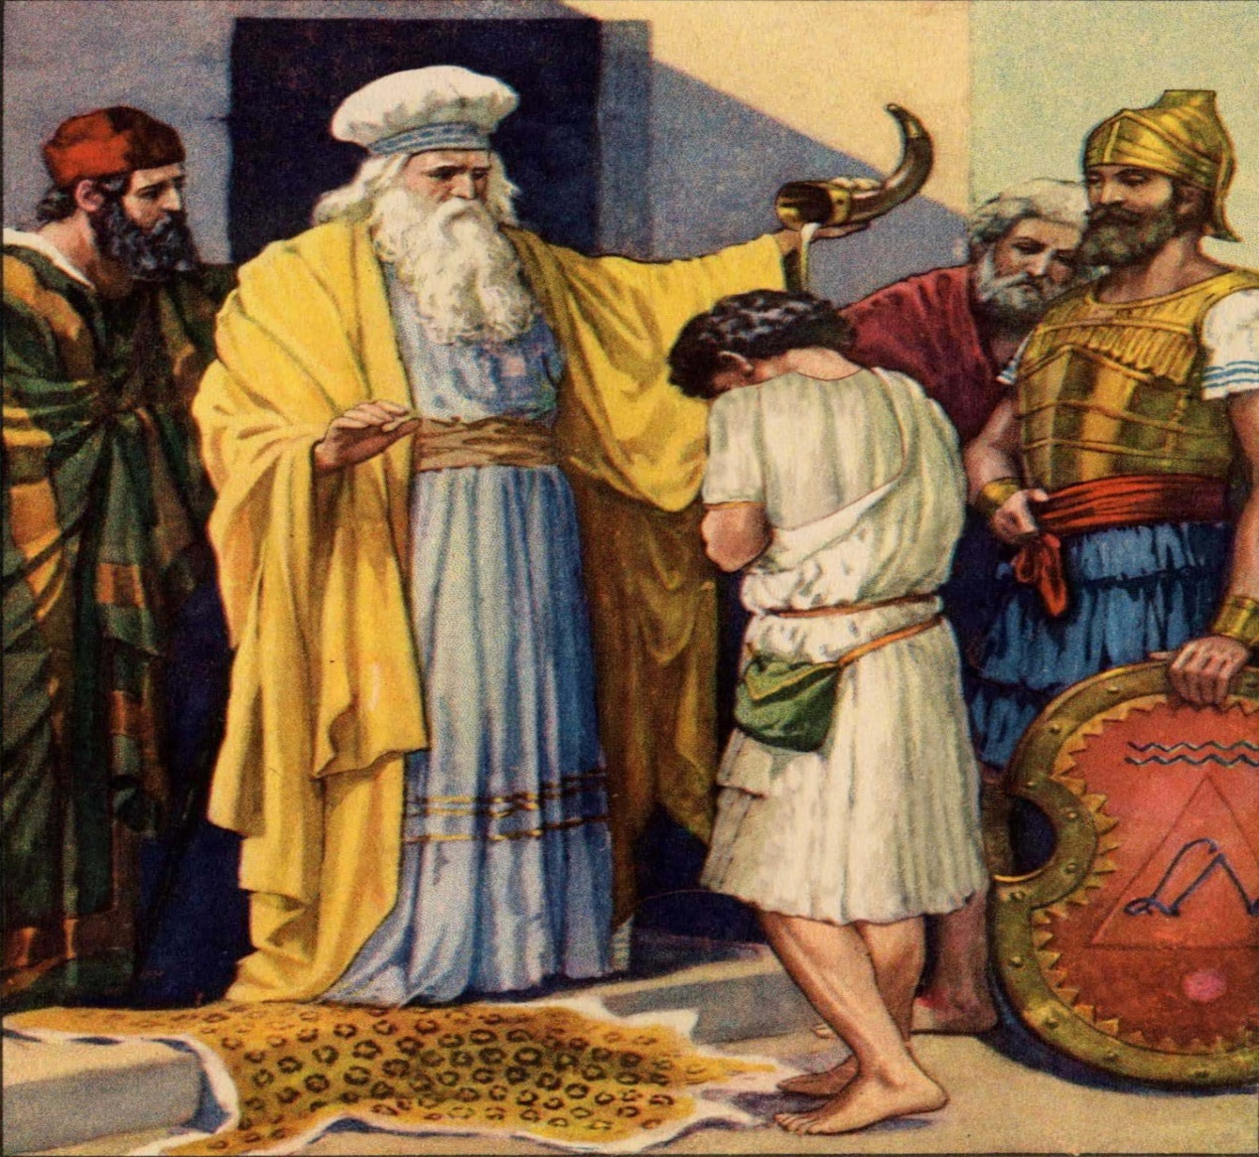
“And he went, and brought him in. Now he was ruddy,
and withal of a beautiful countenance, and goodly to
look at. And the LORD said, Arise, anoint him: for this
is he. Then Samuel took the horn of oil, and anointed
him in the midst of his brethren: And the Spirit of the
LORD came upon David from that day forward. So
Samuel rose up, and went to Ramah” (16:12,13).
God’s selection of David to be the next king of Israel
had been made known and would one day come to
pass, but in the meantime…
“But the Spirit of the LORD departed from Saul, and an
evil spirit from the LORD troubled him” (16:14).
Saul’s troubled spirit could only be soothed by music
and he sought a musician. Guess who?
“… when the evil spirit from God was upon Saul, that
David took an harp, and played with his hand: so Saul
was refreshed… evil spirit departed from him” (16:23).

Slide 12
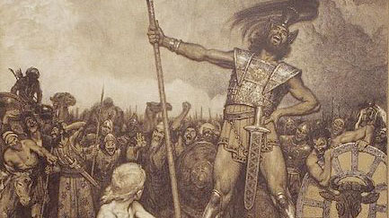
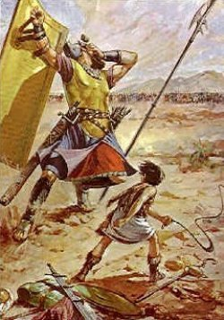
DAVID AND GOLIATH
“Now the Philistines gathered together their armies to battle…
And the Philistines stood on a mountain on the one side, and
Israel… on the other side… And there went out a champion
out of the camp of the Philistines, named Goliath, of Gath
whose height was [9’9”] tall… And he stood and cried out..
Choose you a man… and let him come down to me… if he be
able… to kill me, then we will be your servants…” (17:1-9).
Then what?
“When Saul and all Israel heard those words of the Philistine,
they were dismayed, and greatly afraid… (17:11)… And David
said to Saul… thy servant [David] slew both the lion and the
bear: and this uncircumcised Philistine shall be as one of
them… five smooth stones… I come to thee in the name of the
LORD of hosts, the God of the armies of Israel… took thence a stone, and slang it, and smote the Philistine in his forehead…
So David prevailed… with a sling and a stone…” (17:34-50).

Slide 13
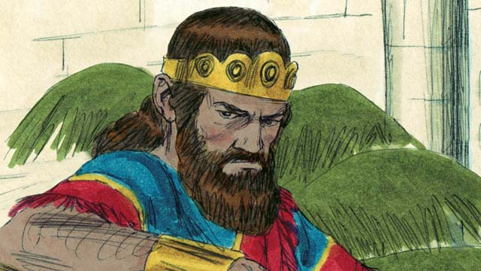
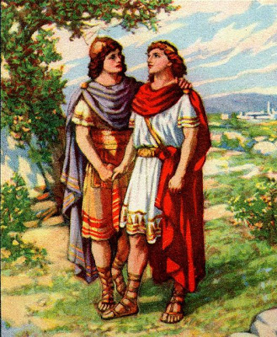
JOHNATHAN AND DAVID
“Then Jonathan and David made a covenant, because he loved him as his own soul” (18:1).
David had been chosen of God to be Israel’s next king. He had the loving heart of a shepherd by destroying wild animals that threatened them, and the courage to go up against a giant. On the finer side of life he was a musician and would be a writer of psalms [praises to God], and he became best friends with one whose father would try to kill him.
Having been made the commander of Israel’s army, they even wrote a song about him – “Saul has slain his thousands, and David his ten thousands” (18:7).
“And Saul was very wroth, and the saying displeased him… And Saul eyed David from that day forward” (18:9).

Slide 14
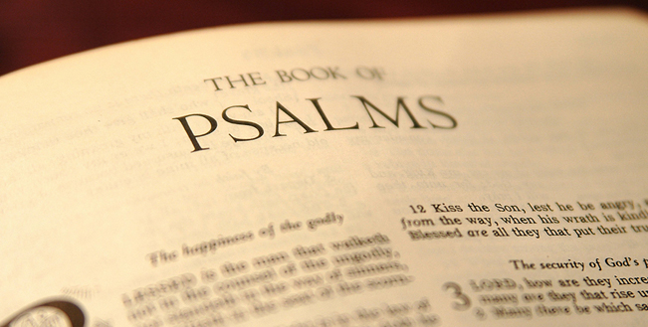
DAVID’S LIFE OF EXILE
“And David fled… and came before Jonathan… What is
my sin before thy father, that he seeketh my life? (20:1).
David asked his friend why his father was trying to kill
him. Neither knew the reason, but God did, and He
next led David into a period of 10-years [age 20-30]
wandering and fleeing the maniacal Saul.
THE BOOK OF PSALMS
“The simplest description of the five books of Psalms is
that they were the inspired prayer-and-praise book of
Israel. They are revelations of truth, not abstractly, but
in the terms of human experience. The truth revealed
is wrought into the emotion, desires, and sufferings of the people of God [Israelites] by the circumstances through which they pass… The imprecatory Psalms are the cry of the oppressed in Israel for justice—a cry appropriate and right in the earthly people of God, and based upon a distinct promise in the Abrahamic Covenant; but a cry unsuited to the Church, a heavenly people who have taken their place with a rejected and crucified Christ” – Old Scofield, p. 599.

Slide 15
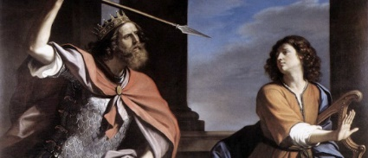
“And the evil spirit from the LORD was upon Saul, as he sat in his house with his javelin in his hand. And Saul sought to smite David… with the javelin; but he slipped out of Saul’s presence, and he smote the javelin into the wall: and David fled, and escaped that night” (19:9,10).
David escaped the harrowing experience and later lamented over it –
“In the LORD put I my trust: how say ye to my soul, Flee as a bird to your mountain? For, lo, the wicked bend their bow, they make ready their arrow upon the string, that they may privily shoot at the upright in heart… The LORD trieth the righteous: but the wicked and him that loveth violence his soul hateth”(Psa. 11:1,2).
Until he ascertained why Saul wanted to kill him, he will temporarily flea Saul’s presence.

Slide 16
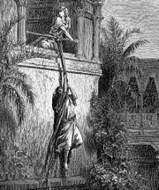
“Saul also sent messengers unto David’s house, to watch him, and to slay him in the morning: and Michal David’s wife told him, saying, If thou save not thy life tonight, tomorrow thou shalt be slain. So Michal let David down through a window: and he went, and fled, and escaped” (19:11).
Saul hired assassins and attempted to slay David as he lay in his bed, but he escaped. Later, David reflected on that event in one of his psalms –
“Deliver me from my enemies, O my God: defend me from those who rise up against me… consume them in wrath… that they not be… Unto thee, O my strength, will I sing: for God is my defense, and the God of my mercy” (59:1,13-17).
With God’s help, David again narrowly escaped Saul’s efforts to kill him. It will not be the last.

Slide 17
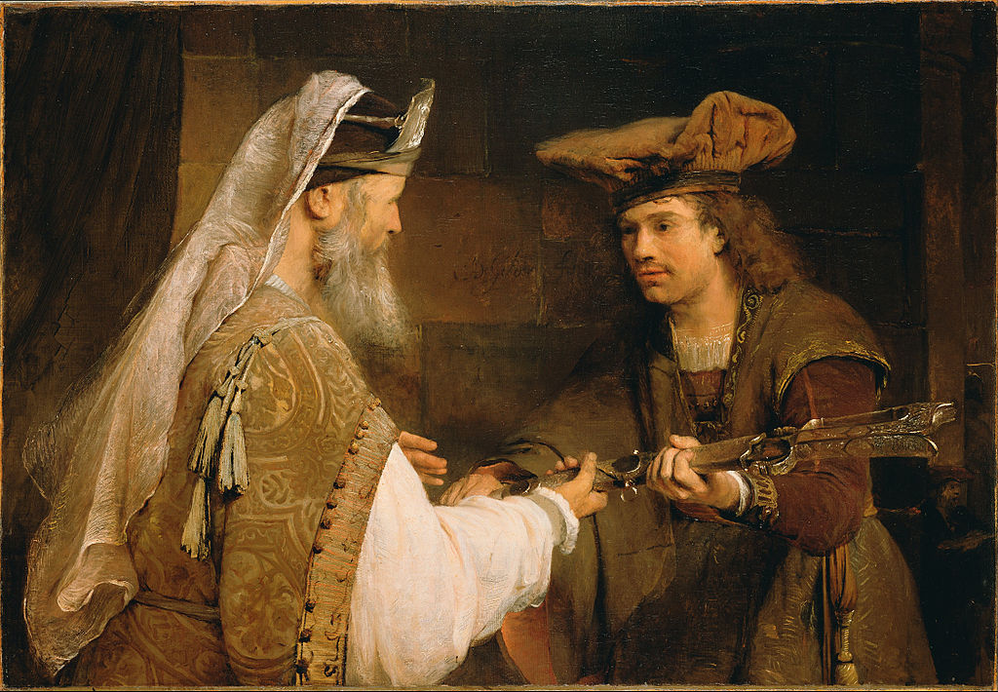
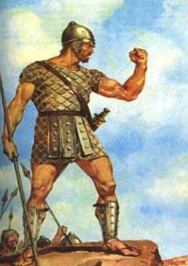
DAVID GOES TO THE PRIEST
“Then came David to Nob to Ahimelech the priest… (1Sam. 21:1).
David was now on the run trying to escape the spies of Saul who were everywhere (21:7). Fearing for his life, he asked the priest for a weapon and was given the sword of Goliath of which they had taken possession after David’s slaying of the giant (21:9).
“I sought the LORD, and he heard me, and delivered me from all my fears” (Psa. 34:4).
DAVID AT GATH
“And David arose, and fled that day for fear of Saul, and went to Achish the king of Gath… Then said Achish unto his servants, Lo, ye see the man is mad…” (21:10,14).
David even feigned insanity to avoid capture by Saul.

Slide 18
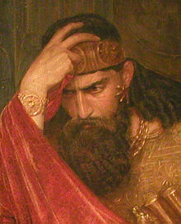
“Then came up the Ziphites to Saul to Bigeah, saying, Doth not David hide himself with us in strong holds in the wood, in the hill of Hachilah… Now therefore, O king, come down according to all the desire of thy soul… and our part shall be to deliver him into the king’s hand… (23:19,20)… See therefore, and take knowledge of all the lurking places where he hideth himself… (23:23)… Saul also and his men went to seek him… he pursued after David in the wilderness of Maon (23:25)… David made haste to get away for fear of Saul… (23:26)… But there came a messenger unto Saul, saying, Haste thee, and come; for the Philistines have invaded the land… And David went up from thence, and dwelt in strong holds in En-gedi”
(23:27-29).
On the run, David barely escaped Saul’s advances and network of spies, finally seeking refuge in the Judean wilderness while Saul went to fight the Philistines.

Slide 19
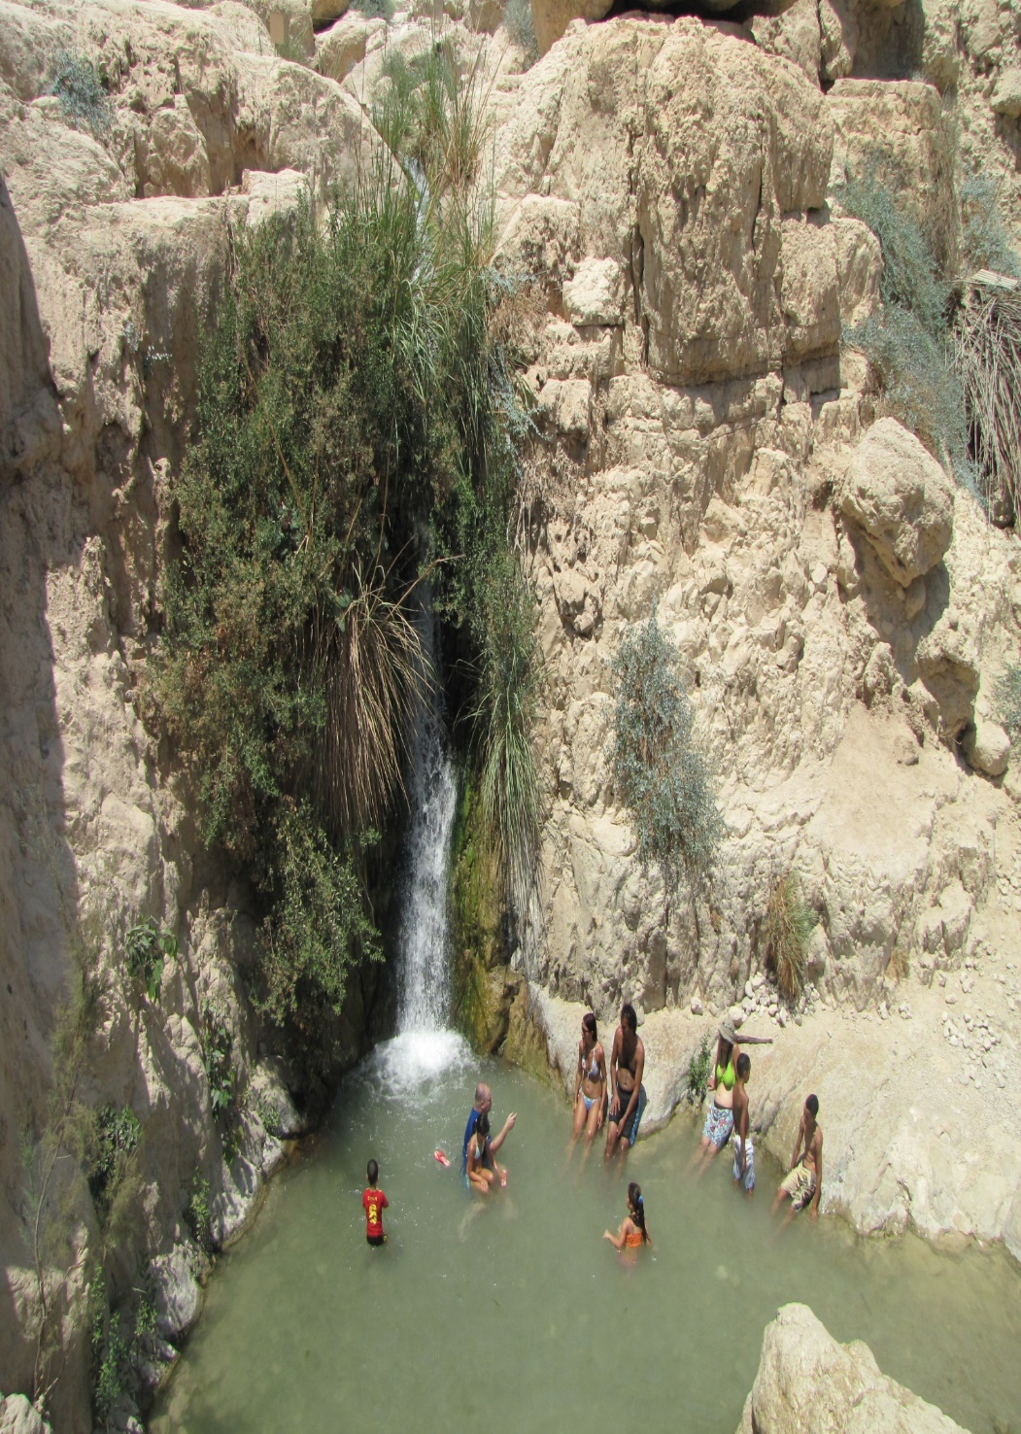
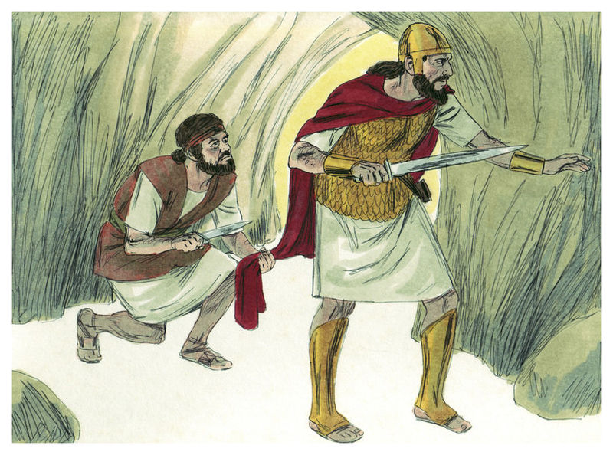
DAVID AT EN-GEDI
“And it came to pass, when Saul was returned from following the Philistines, that it was told him, saying, Behold David is in the wilderness of En-gedi” (24:1).
Saul nearly found David hiding in a cave—David was close enough to kill Saul, “… David arose, and cut off the skirt of Saul’s robe privily…” (24:4), but he could not kill him –
“… The LORD forbid that I should do this thing unto my master… to stretch forth mine hand against him, seeing he is the anointed of the LORD” (24:6).
David, the psalmist, looked back at that time – “O LORD my God, in thee do I put my trust; save me from all them that persecute me, and deliver me” (Psa. 7:1).
“The LORD is my light and my salvation; whom shall I fear? The LORD is the strength of my life; of whom shall I be afraid? (Psa. 27:1).

Slide 20
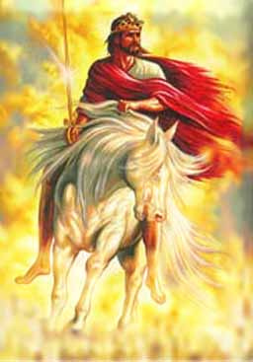
“In thee, O LORD, do I put my trust; let me never be
ashamed: deliver me in thy righteousness (31:1)… I
sought the LORD, and he heard me, and delivered
me from all my fears (34:1)… But I am like a green
olive tree in the house of God: I trust in the mercy
of God for ever and ever” (52:8).
Despite severe persecution from Saul, David trusted
God would preserve his life until he became the
next king of Israel. David knew the LORD was with
him at every turn but that did not keep him from
being fearful. He prayed and asked God to help him
overcome his fear, but he struggled with it.
Little did he know that the fear the LORD helped him
to overcome during this 10-year period, would help
to make him the most courageous and fearless king
Israel ever knew.
Next time – Saul contacts a fortune teller

