Slide 1
THE STUDY OF GOD’S WORD
“For Whatsoever things were written aforetime [past], [i.e. God’s earthly program Israel]… were written for
our [God’s heavenly program Church] … learning, that we [Church] through the patience and comfort of the scriptures might have hope –
[‘to anticipate with pleasure’] (Strong’s Concordance)”
(Rom. 15:4).

Slide 2
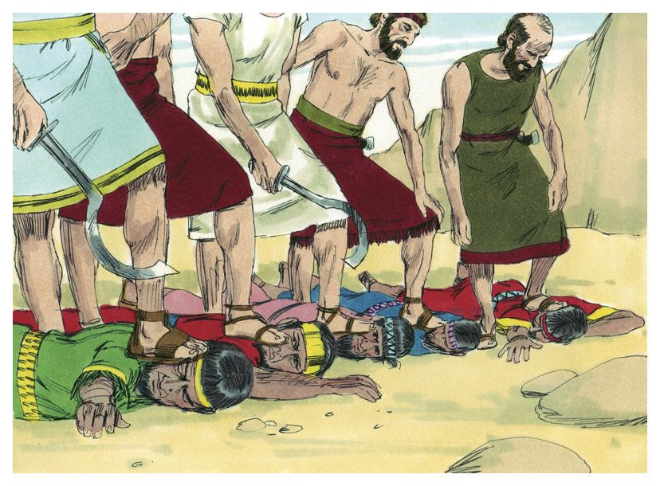
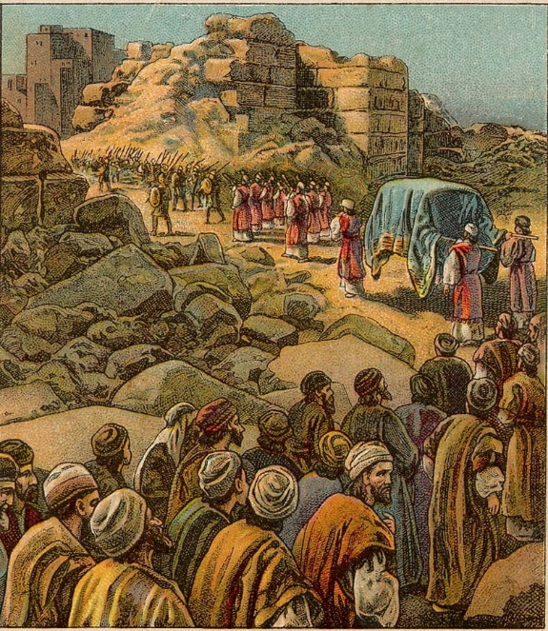
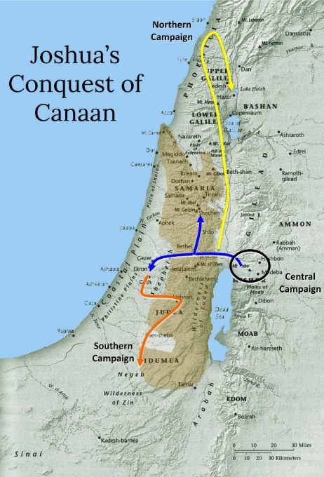
THROUGH THE BIBLE IN 2018
LESSON 13
WEEK 13 OF 52
(Josh. 12–Judg. 7)
Last time we saw Joshua conquer the promised land with God’s help.
Chapter 12 lists the kings that were defeated by Joshua –
“Now these are the kings of the land, which the children
of Israel smote, and possessed their land on the other
side of Jordan…” (12:1); “… the king of Jericho… Ai…
Hebron… et al.” (12:7-24).
A total of 16 kings from S. Canaan (12:9-16) and 15 kings
from N. Canaan (12:17-24) were slayed by Israel. In an
area 150 X 50 miles Joshua defeated 31 kings.
“There has never been a greater war for a greater cause.
The battle of Waterloo decided the fate of Europe, but
this series of conquests in Canaan decided the fate of the
world” (Henry T. Sell, Bible Study by Periods, Chicago:
Fleming H. Revell Co., 1899, p. 83).

Slide 3
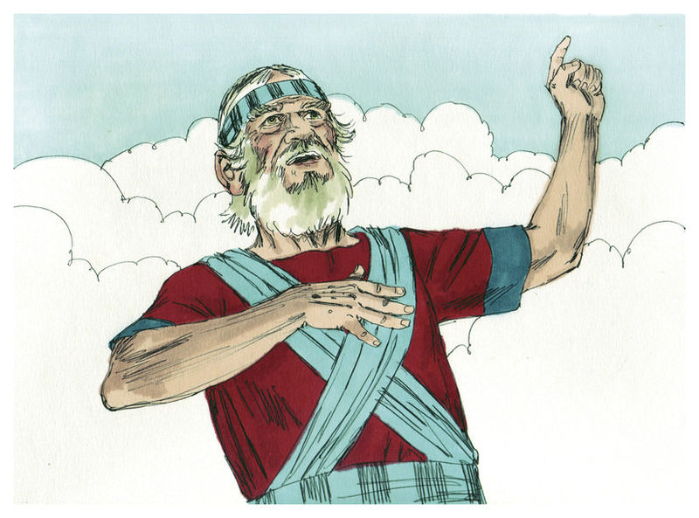
THE ADMINISTRATOR
Now that the land had been conquered from the pagan Gentile nations by the aged commander Joshua [~100], God then used him to become the administrator over the occupying Israelite nation.
The last half of the Book of Joshua reads like a title deed book of landowners—which it was. After 430 years in Egypt, God began to lead Israel to their homeland, and after many, many heartaches and disappointments because of their disobedience, Israel now occupied the land promised them from the time of Abraham, Isaac, and Jacob.
Israel was now free to till the land, tend to their flocks, have their children and praise God for His bountiful blessings—they were home!

Slide 4
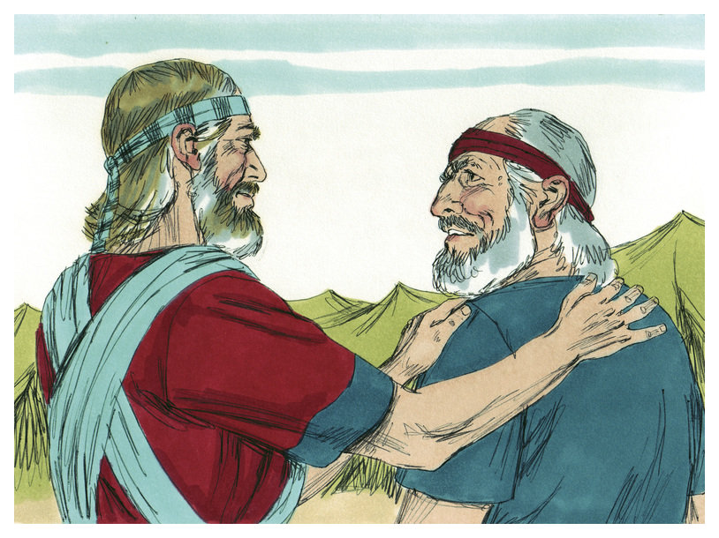
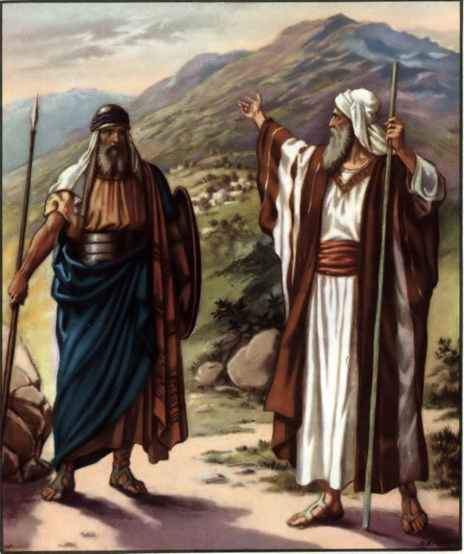
SPEECH OF CALEB
As Joshua began to allocate the land, the now 85-year old Caleb (14:10) stepped forward to speak to Joshua, his old friend and fellow spy of the day > 45-years ago when they searched out the promised land. They were the only two to believe God that the land could be theirs –
“Forty years old was I when Moses the servant of the LORD sent me from Kadesh-barnea to spy out the land: and I brought him word again as it was in mine heart… As yet I am as strong [in the faith] this day as I was in the day that Moses sent me… then I shall be able to drive them out [current enemies], as the LORD said. And Joshua blessed him, and gave to Caleb… Hebron became the inheritance of Caleb…” (14:7-14).

Slide 5
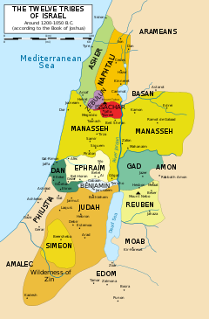
After allocating the 2½ tribes’ land east of the Jordan, then Joshua turned to the 9½ tribes west of the Jordan river –
“By lot was their inheritance, as the LORD commanded by the hand of Moses, for the [9] tribes, and for the [1/2] tribe” (14:2).
That had been the plan given to Moses from God and how each tribe would be given a parcel of land according to the size of their tribe, and now it was up to Joshua how to implement it –
“This then was the lot of Judah of the tribe of the children of Judah…” (15:1).
The land allocation was by casting lots and Judah being the largest drew first. Her location in the south put her next to several enemies, Moabites, Philistines, et. al., and within their land. Caleb believed God would help drive them out.

Slide 6
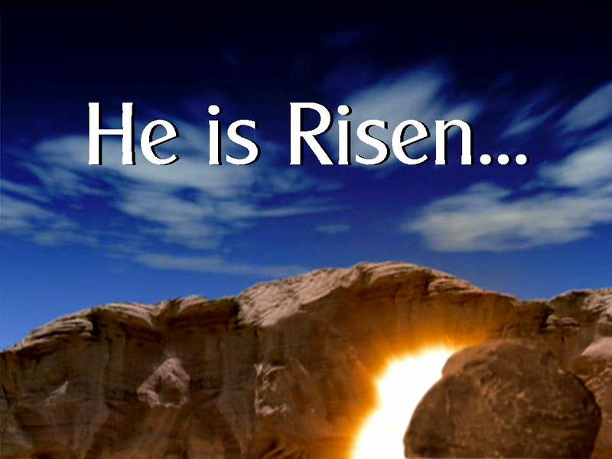
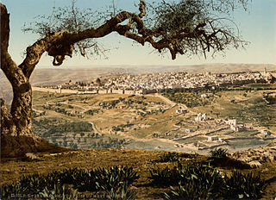
Judah was able to drive out many who inhabited their parcel of land, but one city that Judah was unable to drive out, probably because of their strategic and highly defensible location on a mountain, was Jerusalem –
“As for the Jebusites the inhabitants of Jerusalem, the children of Judah could not drive them out…” (15:63).
This would become problematic in the future because God had long ago destined Jerusalem
to be the capital of His mighty nation, and a place where the most important event in the history of the world would take place.
Israel would conquer Jerusalem during the reign of king David and become the capital of Israel, but we are getting ahead of our story.

Slide 7
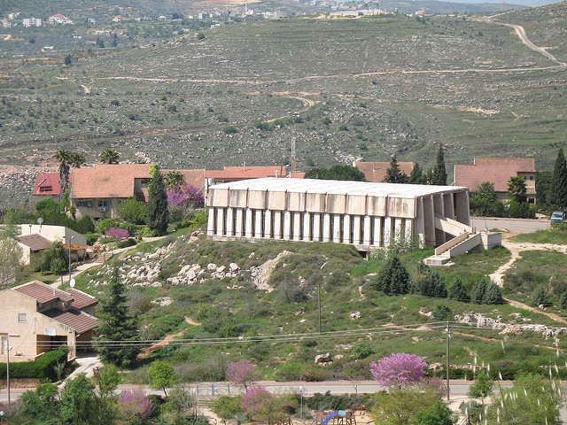
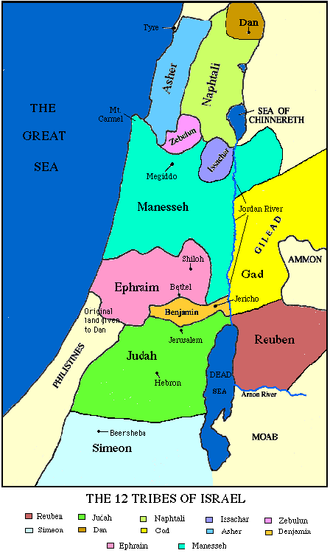
Next Joseph’s two sons inherited large tracts of
land (16:1), some of the most fertile in Israel –
Ephraim and Manesseh [with a part E. of Jordan].
“And they drave not out the Canaanites that dwelt
in Gezer… and serve under tribute” (16:10).
Ephraim was given a large territory, but like Judah
they did not drive out all the pagan squatters, and
allowed them to remain so they could force them
to pay tribute. This would prove to be a grave
mistake and they would pay for it dearly.
“… the children of Israel assembled together at
Shiloh, and set up the tabernacle…” (18:1).
Joshua chose the central location of Shiloh to set
up the tabernacle. It would remain there for the
next 300-years, a symbol of God’s blessing on Israel
and the focus of the nation’s worship as it had been since its inception in the wilderness of Sinai.
It now had a home, albeit temporary.

Slide 8
Next the land allotment for: Benjamin (18:11-28); Zebulon (19:10-16); Issachar (19:17-23); Asher (19:24-31); Naphtali (19:32-39); Dan (19:40-48).
Whereas Caleb’s inheritance was allotted first, Joshua, ever the gentleman, waited till last –
“When they had made an end of dividing the land for inheritance… the children of Israel gave an inheritance to Joshua the son of Nun among them” (19:49).
Consistent with his humble nature, Joshua asked for a piece of land within Ephraim (Timnath Serah) which was both mountainous and lacked fertility. He built a city and lived out his life there. The LORD had used him as a spy, a commanding general, an administrator, and finally, a city builder. He was one of Israel’s most respected patriarchs.

Slide 9
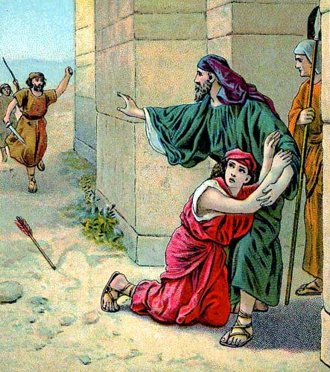
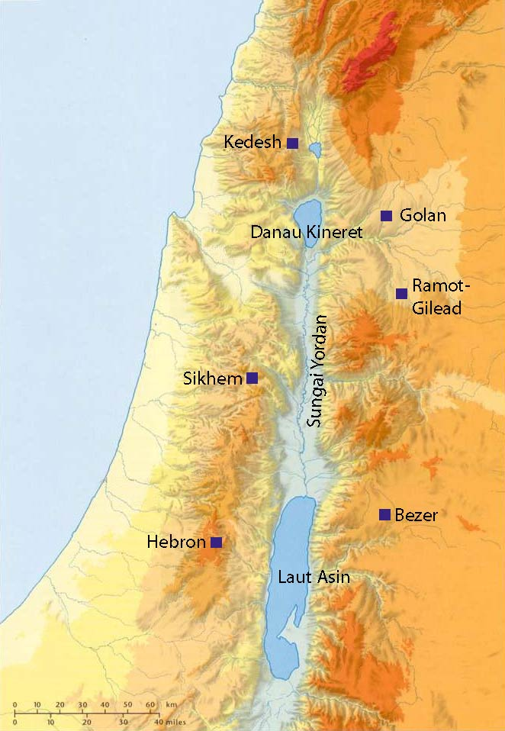
CITIES OF REFUGE
Shortly after Moses received the 10 Commandments at Mt. Sinai, he received instructions concerning the cities
of refuge (Exo. 21:12,13). In the ancient world vigilantism was wide-spread, so God did everything possible to prevent it with His chosen nation, especially during the cases of accidental deaths –
“Speak to the children of Israel… that the slayer that killeth any person unawares and unwittingly may flee thither: and they shall be your refuge from the avenger
of blood” (20:1-3).
Six cities were chosen on both sides of the Jordan river: [west side] – Kedesh, Shechem, Hebron; [east] – Bezer, Ramoth, Golan.
They would foreshadow the One of whom the Psalmist
spoke – “God [Christ] is our refuge and strength, an ever present help in trouble” (Psa. 46:1).

Slide 10
CITIES OF THE LEVITES
“Then came near the heads of the fathers of the Levites unto Eleazar the priest, and unto Joshua the son of Nun, and unto the heads of the fathers of the tribes of the children of Israel; And they spake unto them at Shiloh in the land of Canaan, saying, the LORD commanded by the hand of Moses to give us [Levites] cities to dwell in… And the children of Israel gave unto the Levites out of their inheritance…” (21:1-3)…“All the cities of the Levites within the possession of the children of Israel were [48] cities with their suburbs” (21:41).
These 48 cities were donated by the 12-tribes and scattered throughout Canaan as places of residence for
the Levites who owned no parcel of land themselves.
That way any Israelite in the country was no more than a 10-mile walk of a Levite, one who knew and could explain to them the Law of Moses.

Slide 11
THE SOLDIERS RETURN HOME
“Then Joshua called the Reubenites, and the Gadites, and the half tribe of Manasseh, and said unto them, Ye have kept all that Moses the servant of the LORD commanded you, and have obeyed my voice in all that I commanded you: Ye have not left your brethren these many days unto this day, but have kept the charge of the commandment of the LORD your God. And now the LORD… hath given you rest… return ye, and get you unto your possession…” (22:1-4).
The 2½ tribes who wanted to settle on the east side of the Jordan river had promised Moses they would help their brothers to settle the land on the west side. They did so, and Joshua praised them for their dedication.
The weary soldiers now returned home after the 7-year struggle to occupy their land, and finally they could settle down and begin to enjoy the fruits of their labors (22:8).

Slide 12
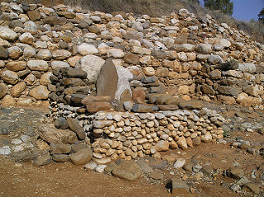
CIVIL WAR
Because the 2½ tribes on the east side of the
Jordan river felt isolated from their brothers
on the west side, they built an imposing altar
on a high hill (22:10). It was seen as an act of
apostasy, however, because the one true altar
was in the tabernacle, which was located at
Shiloh –
“And the children of Israel heard of it, the
whole congregation… gathered themselves
together at Shiloh, to go up to war against
them [2 ½ eastern tribes] (22:12).
Fortunately, the eastern 2½ tribes abandoned
their project – “And the thing pleased the
children of Israel; and the children of Israel pleased God, and did not intend to go up against them in battle, to destroy the land wherein the children of Reuben and Gad dwelt” (22:33,34).

Slide 13
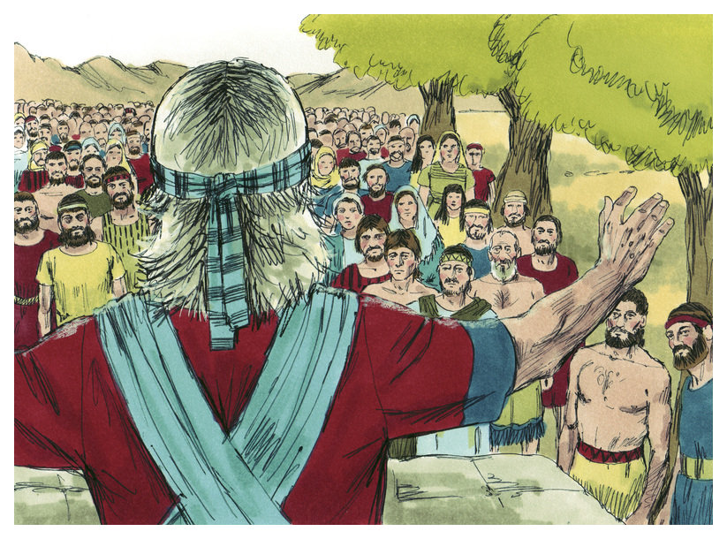
JOSHUA’S LAST SPEECH
“And it came to pass a long time after that the LORD
had given rest unto Israel from all their enemies
round about, that Joshua waxed old and stricken in
age” (23:1).
The aged warrior and peace maker gave his last
message to the nation of Israel, first to the leaders
(23:1-16) and then to the people (24:1-28) –
“And Joshua gathered all the tribes of Israel to
Schechem… and they presented themselves before
God. And Joshua said unto all the people, Your
fathers dwelt on the other side of the flood [flood
crested Euphrates R.] in old time, even Terah, the
father of Abraham… and they served other gods…” (24:1,2).
Joshua gave the nation a history lesson beginning with the call of Abraham, Isaac, and Jacob, their Egyptian bondage, and Exodus. He reminded them of their wilderness wanderings, and crossing Jordan into their land, but concerned that they might become complacent…

Slide 14
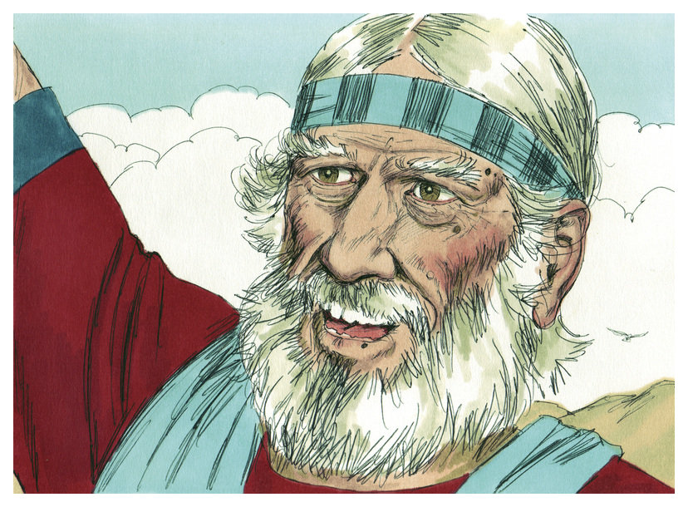
… he uttered these words – “Now therefore fear the
LORD, and serve him in sincerity and in truth: and put
away the gods which your fathers served… and serve
ye the LORD. And if it seem evil unto you to serve the
LORD, choose you this day whom ye will serve;
Whether the gods which your fathers served… or the
gods of the Amorites, in whose land ye dwell: but as
for me and my house, we will serve the LORD” (24:14,15).
Perhaps the most quoted, well known and loved of any
O.T. passage concerning the servanthood of believers.
THE DEATH OF JOSHUA
“And it came to pass after these things, that Joshua the
son of Nun, the servant of the LORD, died, being [110]
years old” (24:29).
The only person to ask God to extend daylight for
24-hrs. (10:13), which He did, was dead.

Slide 15
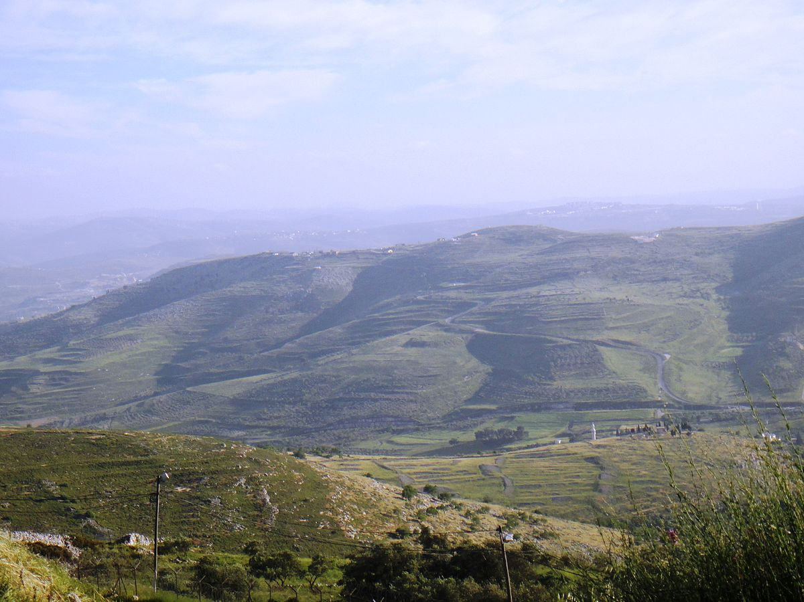
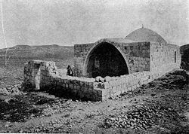
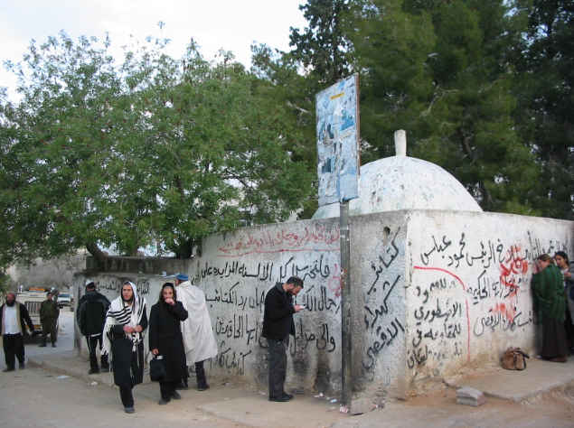
THE BURIAL OF JOSHUA
“And they buried him in the border of his inheritance in Timnath-serah, which is in mount Ephraim, on the north side of the hill of Gash” (24:29,30).
Joshua was buried in his hometown, on a hill top in the parcel of land given his tribe (the traditional site of his entombment).
It is also recorded that the bones of Joseph which he requested to be brought with the Israelites when they left Egypt, were buried in Schechem (24:32), not far from Joshua’s burial site.
Joshua’s death and burial brought an end to the age of the great Patriarchs of Israel. From Abraham to Joshua, Israel had a series of strong leaders—what would they do now without one?

Slide 16
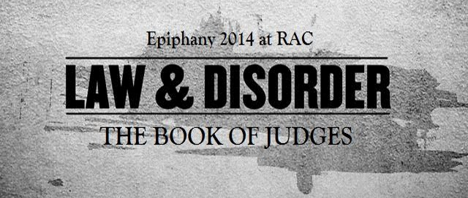
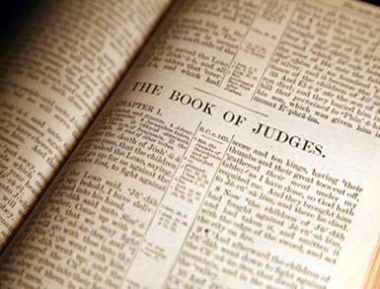
The death of Joshua connects the Books of JOSHUA and
JUDGES. It was likely written by inspiration by the prophet
Samuel who was a writer (1Sam. 10:25). It bridges the gap
between strong military type leaders [Moses, Joshua] and
a system or loosely knit confederation of local leaders called
“Judges,” during a period of 305-years.
“Now after the death of Joshua it came to pass, that the
children of Israel asked the LORD, saying, Who shall go up
for us against the Canaanites first, to fight against them?”
(Jud. 1:1).
The Israelites were obviously concerned. Though they had invaded and occupied their promised land as God said they would do, they had not driven out all the pagan tribes, which caused them fear that the Canaanites who lived among them would rise up and defeat them. Their solution? Ask the LORD what to do.

Slide 17
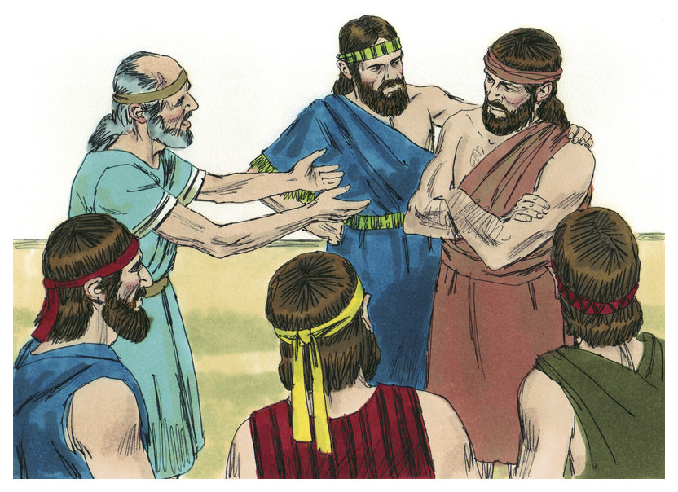
THE LORD ANSWERS
“And the LORD said, Judah shall go up: behold, I have delivered the land into his hand. And Judah said unto Simeon his brother, Come up with me into my lot, that we may fight against the Canaanites: and I likewise will go with thee into thy lot. So Simeon went with him” (1:2,3).
Having no strong central leader, the two
largest southern tribes combined their forces and together attacked the Canaanites who lived among them.
“And Judah went up; and the LORD delivered the Canaanites and the Perizzites into their hand: and they slew of them in Bezek [10,000] men” (1:4).
So far, so good.

Slide 18
“And Judah went with Simeon his brother, and
they slew the Canaanites that inhabited Zephath,
and utterly destroyed it.. Also Judah took Gaza
with the coast therof… And the LORD was with
Judah; and he drave out the inhabitants of the
mountains; but could not drive out the inhabitants
of the valley, because they had chariots of iron.
And they gave Hebron unto Caleb, as Moses said:
and he expelled thence the three sons of Anak
(1:17-20)… And the children of Benjamin did not
drive out the Jebusites that inhabited Jerusalem
(1:21)… Neither did Manasseh drive out the
inhabitants of Beth-Shean and her towns… nor the
inhabitants of Megiddo (1:21-27)… When Israel
was strong, that they put the Canaanites to tribute,
and did not utterly drive them out” (1:28).
Against the direct command of God, the Israelites
accepted rent money for the land from the Canaanites instead of driving the pagans out!

Slide 19
The other tribes did follow God’s command, right?
“Neither did Ephraim drive out the Canaanites … neither did Zebulun drive out… neither did Asher… neither did Naphtali… And the Amorites forced the children of Dan into the mountain: for they would not suffer them to come down to the valley” (1:29-34).
When Israel had both the spiritual and military God given ability to drive out the enemy, they
didn’t use it—they accepted the status quo—they got lazy—and, it cost them dearly!
By not doing as God commanded, they now were in their land, but surrounded by those who would destroy them if they got the opportunity to do so. Satan had definitely won this round.

Slide 20
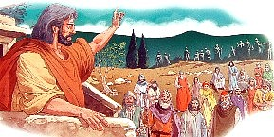
God‘s reaction?
“And the anger of the LORD was hot against Israel; and he
said, Because that this people hath transgressed my
covenant which I commanded their fathers, and have not
hearkened unto my voice; I will also not henceforth drive
out any from before them of the nations which Joshua left
when he died” (2:20).
God’s answer was that because they didn’t obey Him, he
would not be with them as He had been with Joshua.
GOD INSTITUTES JUDGES
“Nevertheless the LORD raised up Judges, which delivered
them out of the hand that spoiled them… then the LORD
was with the judge… when the judge was dead… followed
other gods… (2:16-19).
Israel repeated this cycle again and again—God gave them
a leader, Israel obeyed him until he died, and then they
reverted back to idol worship and then God would raise up another judge.

Slide 21
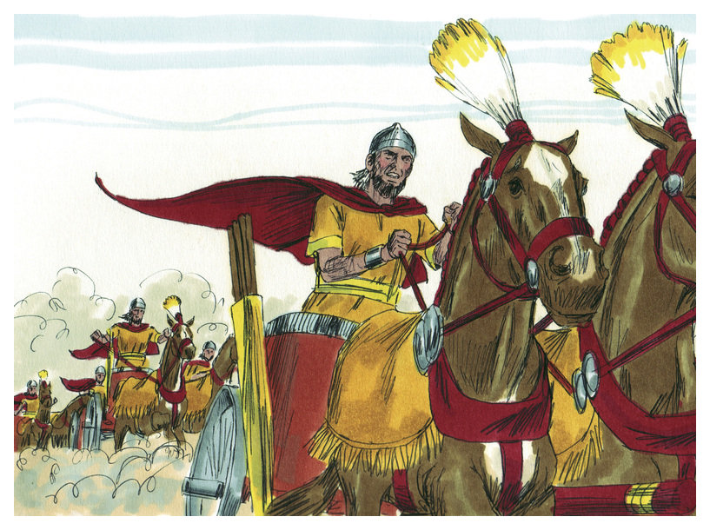
Othniel – “And the Spirit of the LORD came
upon him, and he judged Israel, and went out to
war…” (3:9-14).
Ehud – “But when the children of Israel cried
unto the LORD… raised them up a deliverer,
Ehud…” (3:15-30).
Shamgar – “… which slew of the Philistines
[600] men…” (3:31-4:3).
4,5. Deborah [female Judge] & Barak (4:4-5:31).
Gideon – “Behold, I will put a fleece of wool
in the floor; and if the dew be on the fleece only,
and it be dry upon all the earth beside, then shall
I know that thou will save Israel by mine hand…”—
His army from 22,000 to 300 men (6:11-7:15).
He walked by sight, we walk by faith (2Cor. 5:7).
Next time – the remainder of the Judges, Ruth, and the prophet Samuel.

