Slide 1
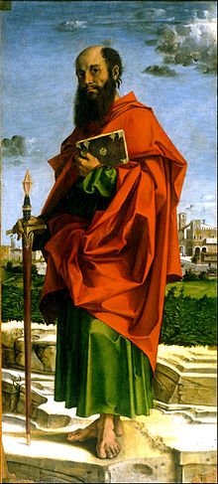
LESSON 50
WEEK 50 OF 52
(Rom. 11-16; Col.;
Acts 20-28; Phile.
Ephesians)
THROUGH THE BIBLE IN 2018
Last time – Paul’s Gospel of grace; This time – The revelation of the mystery given to the Apostle of the Gentiles (A.D. 57).
“For I speak to you Gentiles, inasmuch as I [Paul] am the
apostle of the Gentiles, I magnify my office” (Rom. 11:13).
Since the time of Abraham, there was a God imposed
separation between Jews & Gentiles, as God dealt exclusively
with the chosen nation Israel, but now that wall of separation
was being removed, “… hath broken down the middle wall of
partition between us” (Eph. 2:15). Paul was the apostle
chosen of God to go to the Gentiles. What about Peter?
“For he [Christ] that wrought effectually in Peter to the
apostleship of the circumcision [Jews], the same was mighty
in me [Paul] toward the Gentiles” (Gal. 2:8).
Peter apostleship was to the Jews—Paul’s to the Gentiles.

Slide 2
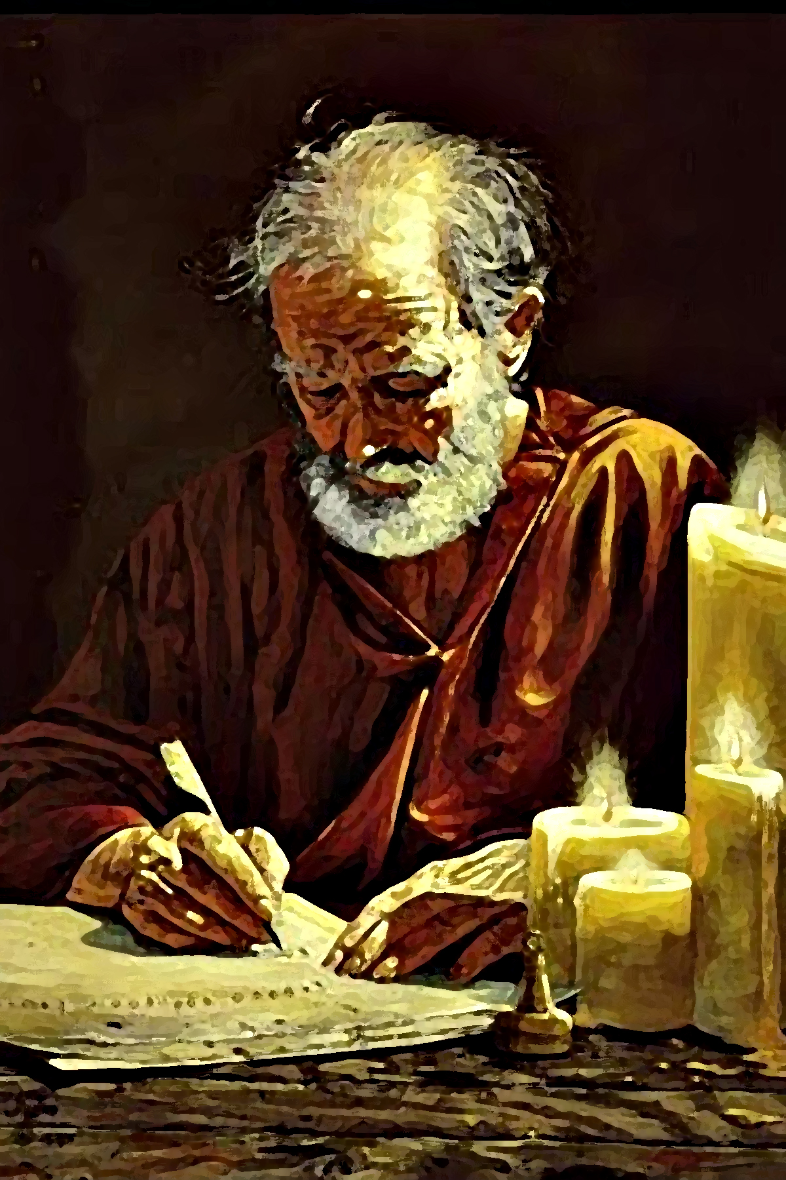
The Gentiles were now in God’s focus, but why?
“For I would not, brethren, that ye should be ignorant of this mystery… that blindness in part is happened to Israel, until the fullness of the Gentiles be come in… For as ye [Gentiles] in time past have not believed, yet have now obtained mercy through their [Israel’s] unbelief… ” (11:25,30).
For the 1st 2,000 years of history [4,000 B.C.–2,000 B.C.] Gentiles disbelieved God and were set aside (Gen. 3-11). The next 2,000 years [2,000 B.C.– Christ], He dealt with the Jews (Gen. 12 – Acts 28), and they, too, disbelieved Him by rejecting His Son [Messiah]. God should have disowned both Gentiles & Jews, but do you know what He has done for the past 2,000 years?
“For God hath concluded them all in unbelief, that he might have mercy upon all” (11:32). He opened the door to both to be saved during this age of grace.

Slide 3
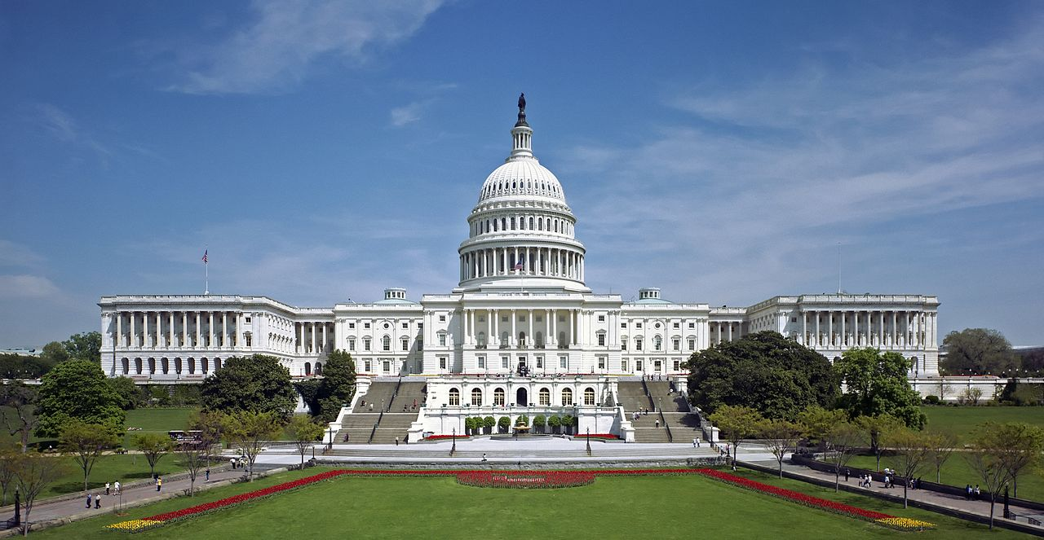
GOVERNMENT
“Let every soul be subject unto the higher powers [man].
For there is no power but of God: the powers that be are
ordained of God. Whosoever therefore resisted the power,
resisteth the ordinance of God: and they that resist shall
receive to themselves [judgment by the government]. For
rulers are not a terror to good works, but to the devil… do
that which is good, and thou shalt have praise of the same.
For he is a minister of God to thee for good. But if thou do
that which is evil, be afraid… Render therefore to all their
dues: tribute to whom tribute is due; custom to whom
custom is due…” (Rom. 13:1-3).
God gave us human government (Gen. 9:5). Rulers are
given their positions by God [but, elected by us]. Obeying
the law makes one a minister of God; break the law
[disobeying God] and are subject to the punishment of
the law. We are to pay taxes, customs, etc. If we don’t like rulers, elect new ones! Should we pray for them? Yes, “… prayers… for kings [leaders], and for all that are in authority” (1Tim. 2:1,2).

Slide 4
“For whatsoever things were written aforetime [past] were written for our learning, that we through patience and comfort of the scriptures might have hope” (15:4).
Why study the O. T./Gospels? To understand Israel’s program, which contain trans-dispensational truths.
“Now the God of patience and consolation grant you to be likeminded one toward another according to Christ Jesus. That ye may with one mind and one mouth glorify God, even the Father of our Lord Jesus Christ” (Rom. 15:5,6). In glorifying God, we are to be of one accord.
“Now I say that Jesus Christ was a minister of the circumcision [Jews] for the truth of God, to confirm the promises made unto the fathers” (15:8).
Christ’s earthly ministry was to the Jews because it was to them that God’s original covenant promises were made. Christ confirmed them—a King over a kingdom of heaven on earth and Israel as the head nation.

Slide 5
“I commend unto you Phebe, our sister, which is a servant… Greet Priscilla and Aquila my helpers in Christ… greet the church that is in their house…”
(Rom. 16:1-5).
Some believe that Paul was anti-female, but this is a false. He entrusted the delivery of the very important epistle to the ROMANS to a business woman, Phebe, for whom he had great respect, calling her ‘a servant of man.’ He did tell unruly women to watch their behavior (1Tim. 2:11), as he did unruly men
(1Cor. 5:1,5).
He complemented the young couple, Aquila & Priscilla, and their service to Christ. He commended those who were having church in their house [we did], which today some would frown upon [we wouldn’t]. Paul’s goal was to emphasize the truths given him to give to us from Christ, not the place where we meet.
The Body of Christ should be mindful of that.

Slide 6
THE REVELATION OF THE MYSTERY (A.D. 57)
“Now to him that is of power to stablish you according to my gospel, and the preaching of Jesus Christ, according to the revelation of the mystery, which was kept secret since the world began, but now is made manifest… made known to all nations for the obedience of faith” (Rom. 16:25,26).
A foundational passage for the Body of Christ: Christ is establishing believers in Paul’s gospel [3-times he calls it my gospel]; these truths have been hidden in God until revealed to Paul; now revealed, they are to be obeyed by all believers [they supersede the marching orders given of God previously to others, i.e. Israel].
That’s why 14 of 27 Books of the New Testament were written by Paul, and that’s why he could later write –
“Those things, which ye have both learned, and received, and heard, and seen in me, do: and the God of peace shall be with you” (Phil. 4:9).

Slide 7
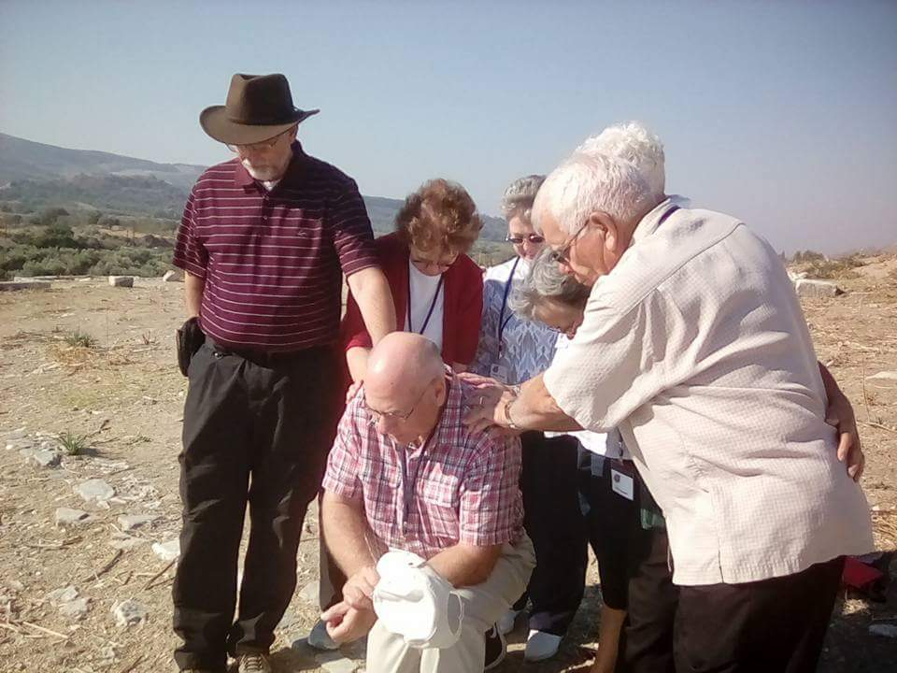
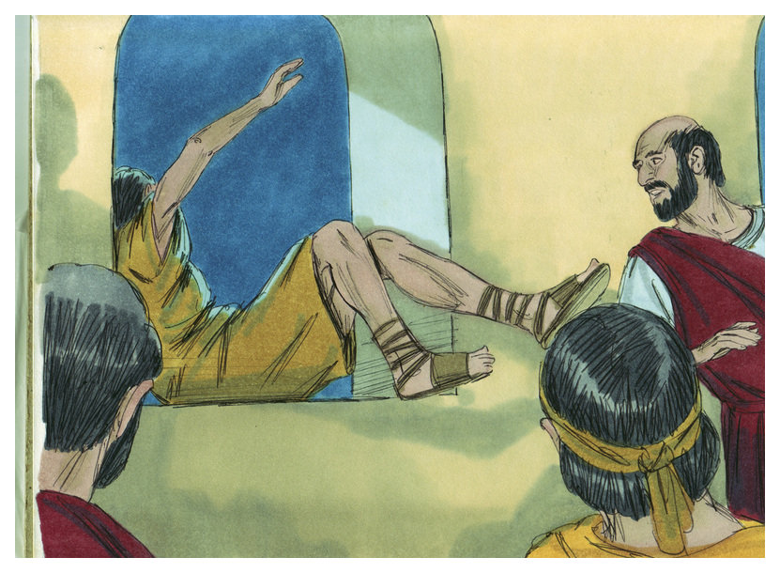
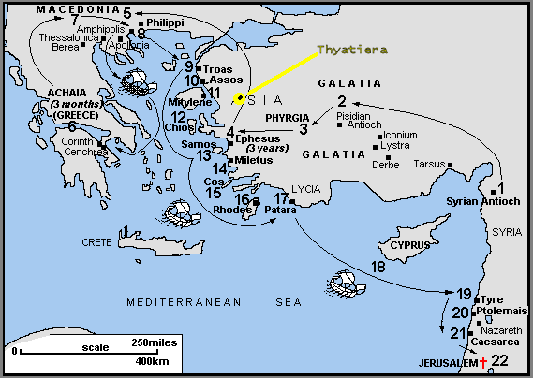
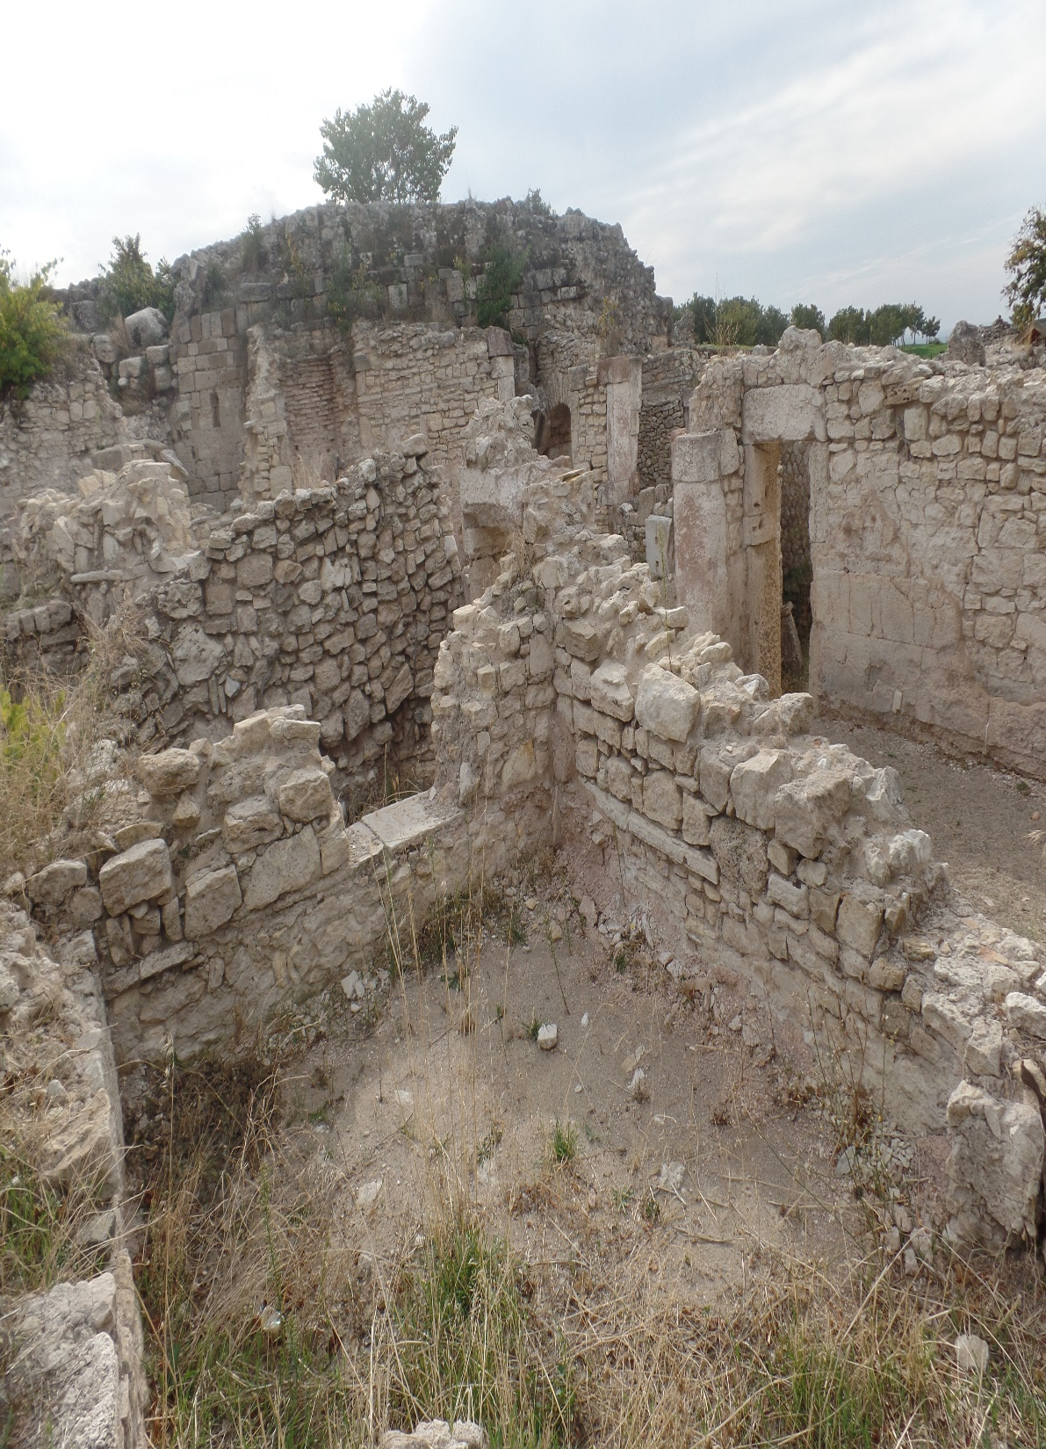
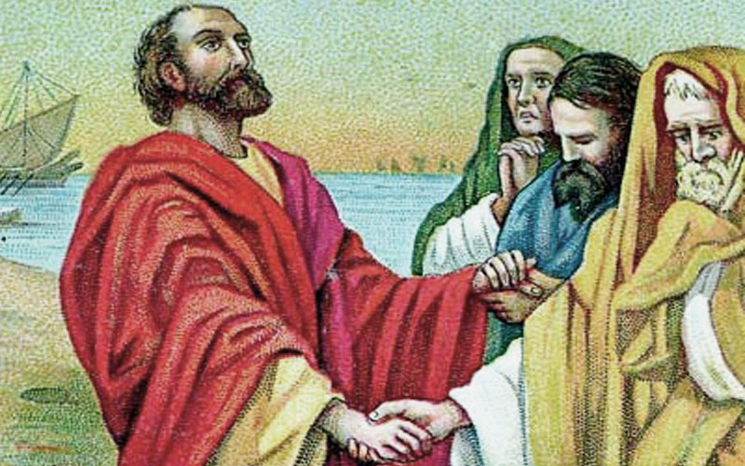
PAUL’S LAST TRIP TO JERUSALEM (A.D. 58)
“And we sailed away from Philippi… and came to Troas… where we abode 7-days” (Acts 20:6).
Paul left Macedonia for Troas. As he was preaching late into the night a young man, Eutychus, went to sleep and fell from his 3rd story perch. Not to worry, Paul raised him back to life (20:7-10).
“And we sailed thence… we came to Miletus… sent to Ephesus, and called the elders of the church. And when they came to him, he said unto them… I have been with you all seasons [3-years]… I kept back nothing that was profitable unto you… I go bound in the spirit to Jerusalem, not knowing the things that shall befall me there… I might finish my course… and the ministry, which I have received… the gospel of the grace of God… they should see his face no more” (20:15-24).
Near the end of his 3rd journey, Paul said good bye to the Ephesian elders—his future unknown.
Miletus (2017)
Troas (2017)

Slide 8
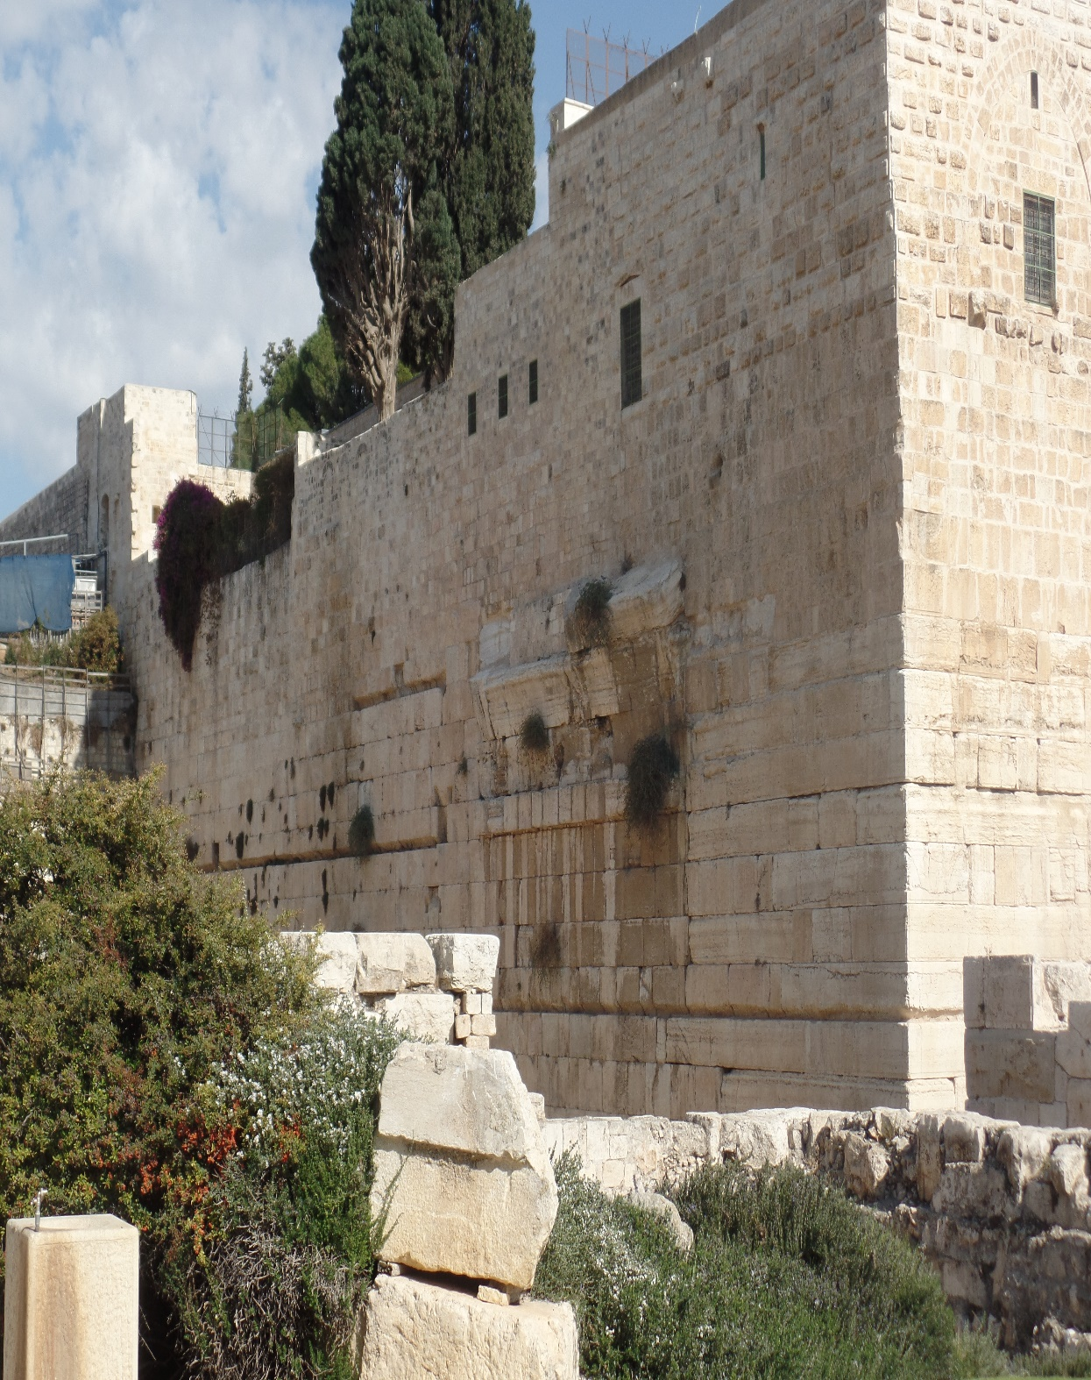
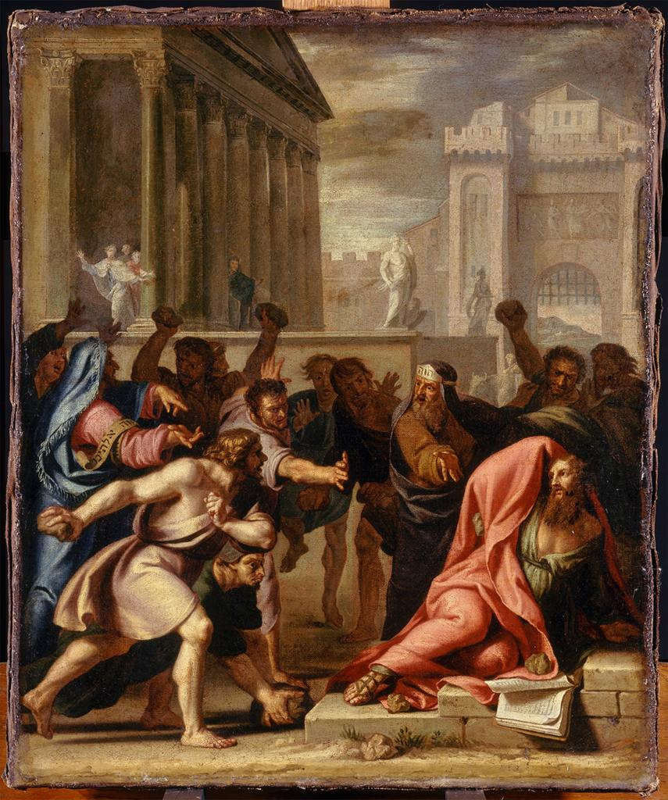
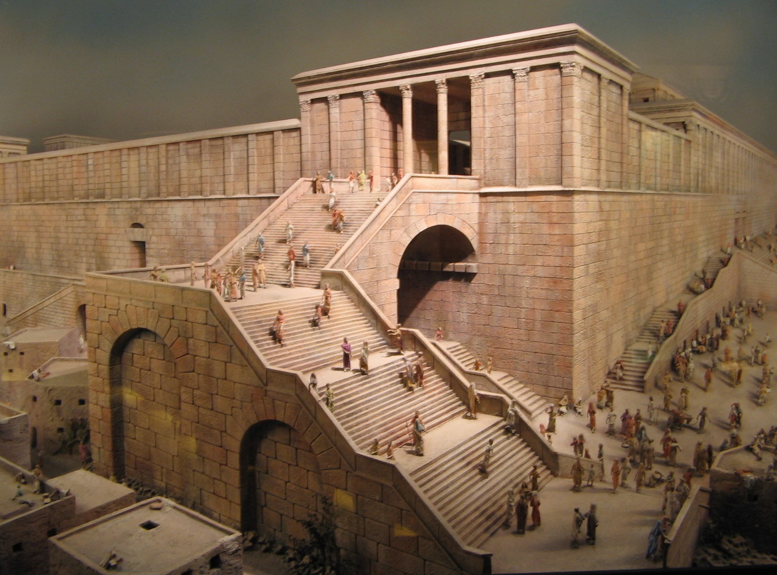
PAUL GOES TO JERUSALEM
“Then Paul answered… I am ready to die at Jerusalem for the name of the Lord Jesus… we took to our carriages, and went up to Jerusalem” (21:13,14).
What he found was a city full of Jews “all zealous of the law (21:20)… [Paul] stirred up all the people, and laid hands on him… this man teacheth against the [Jews] and the law… polluted this holy place (21:27,
28)… went about to kill him (20:31)… Away with him
(21:36)… it is not fit that he should live” (22:22).
About to be killed by the unsaved Jews, Paul received
a vision from Christ, “Make haste, and get thee quickly out of Jerusalem: for they will not receive thy testimony concerning me… Depart: for I will send thee far hence unto the Gentiles” (20:18,21).
Christ wanted Paul to see for himself that the majority his fellow countrymen would NOT receive their Messiah. Where would Paul be sent next?

Slide 9
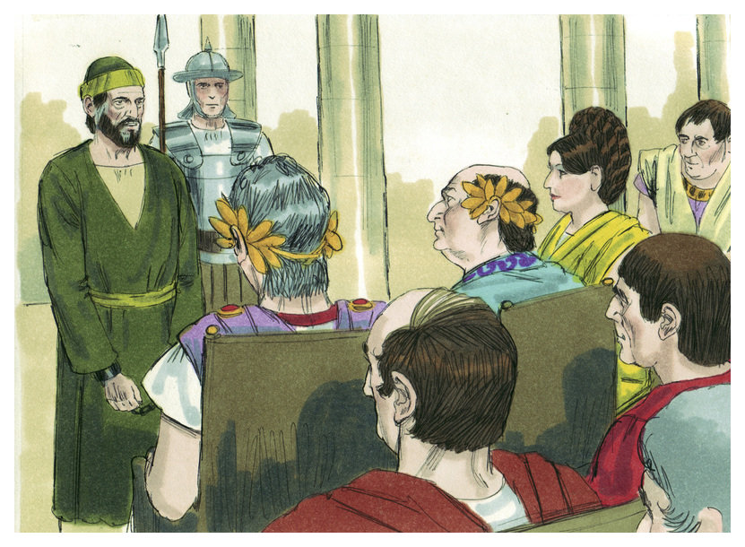
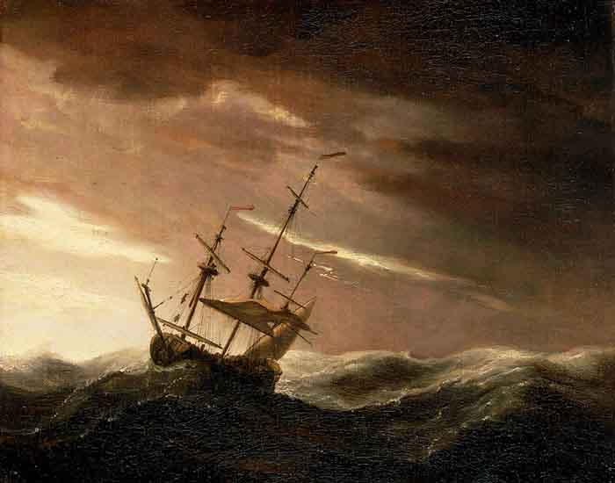
PAUL APPEALS TO ROME (A.D. 58-60)
“… the Lord stood by him, and said, Be of good cheer, Paul: for as thou hast testified of me in Jerusalem, so must thou bear witness also at Rome…” (23:11).
Paul appeared before the Roman and Jewish authorities, but getting no satisfaction, he appealed to Rome, “I appeal unto Caesar… [Festus] unto Caesar shalt thou go” (25:11,12).
His interaction with King Agrippa is particularly noteworthy –
“King Agrippa, believest thou the prophets? I know that thou believest. Then Agrippa said unto Paul, Almost thou persuades me to be a Christian” (26:27,28).
Almost persuaded? Enough to escape hell?
Paul next boarded a ship bound for Rome, but being
late in the Fall, they ran into trouble at sea.

Slide 10
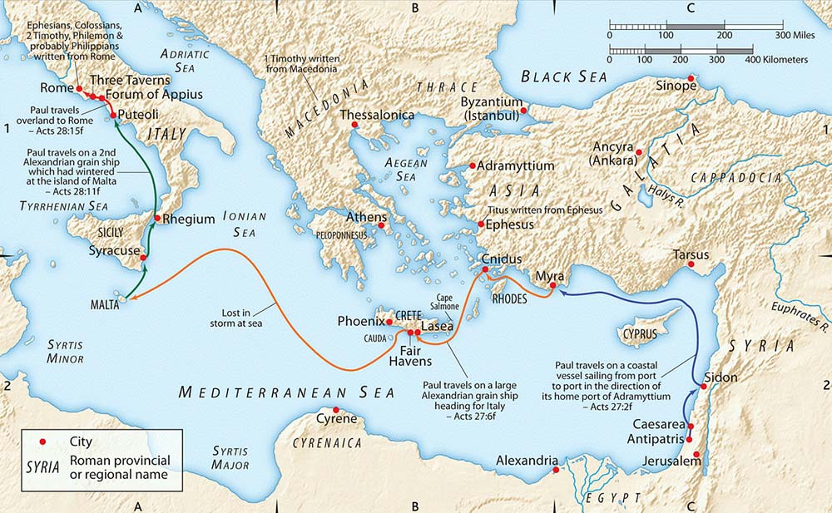
LOST AT SEA
“But not long after there arose against it a tempestuous wind, called Euroclydon… And we be exceedingly tossed with a tempest… all hope that
we should be saved was taken away”
(Acts 27:14-20).
Had Christ gotten Paul through a mob, beatings, arrest, interrogations, and jail only to let him die in
a storm at sea?
Knowing their lives were at risk, Paul intervened –
“And now I exhort you to be of good cheer: for there shall be no loss of any man’s life among you, but of the ship… except these abide in the ship, ye cannot be saved” (Acts 27:21-29,31).
For 14-days the ship was lost at sea, but as Paul prophesied, though the ship was lost, not a person on board was lost.

Slide 11
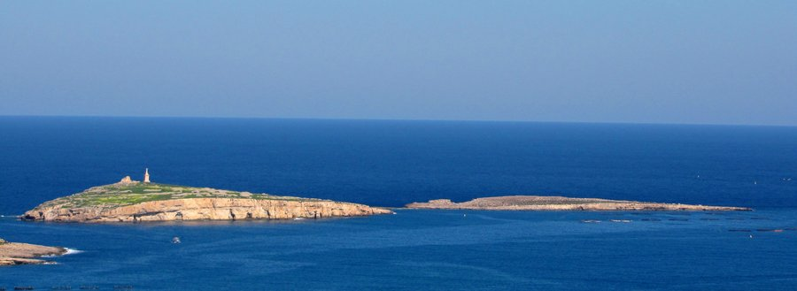
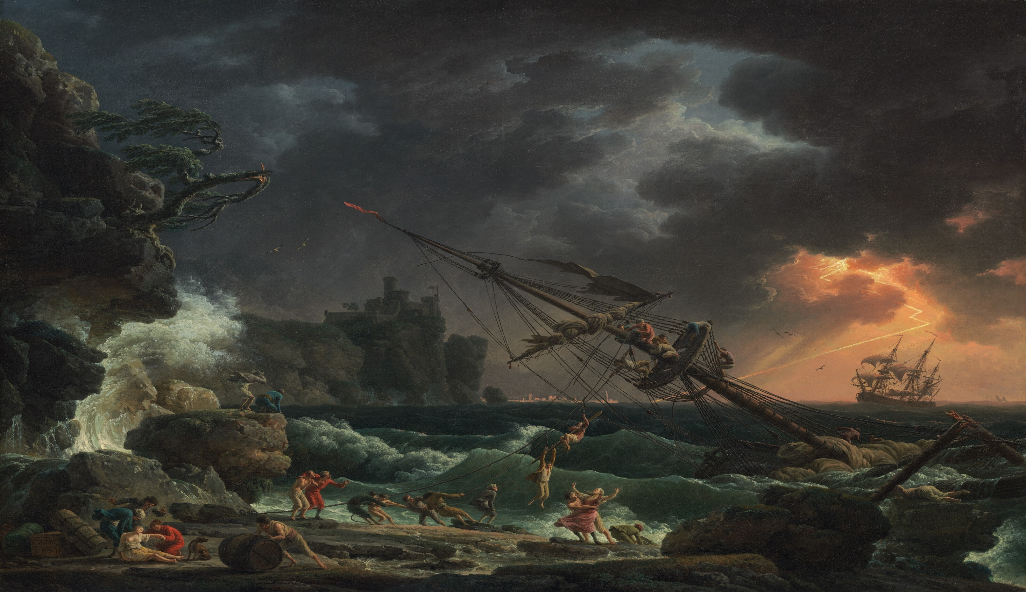
“And the soldiers’ counsel was to kill the prisoners, lest any of them should swim out, and escape. But the centurion, willing to save Paul, kept them from their purpose; and commanded that they which could swim should cast themselves into the sea, and get to land… And so it came to pass, that they escaped all safe to land [276 souls]” (Acts 27:42-44).
God wanted Paul in Rome, and nothing was going to stop him from getting there.
ST. PAUL’S ISLAND, MALTA (2016)

Slide 12
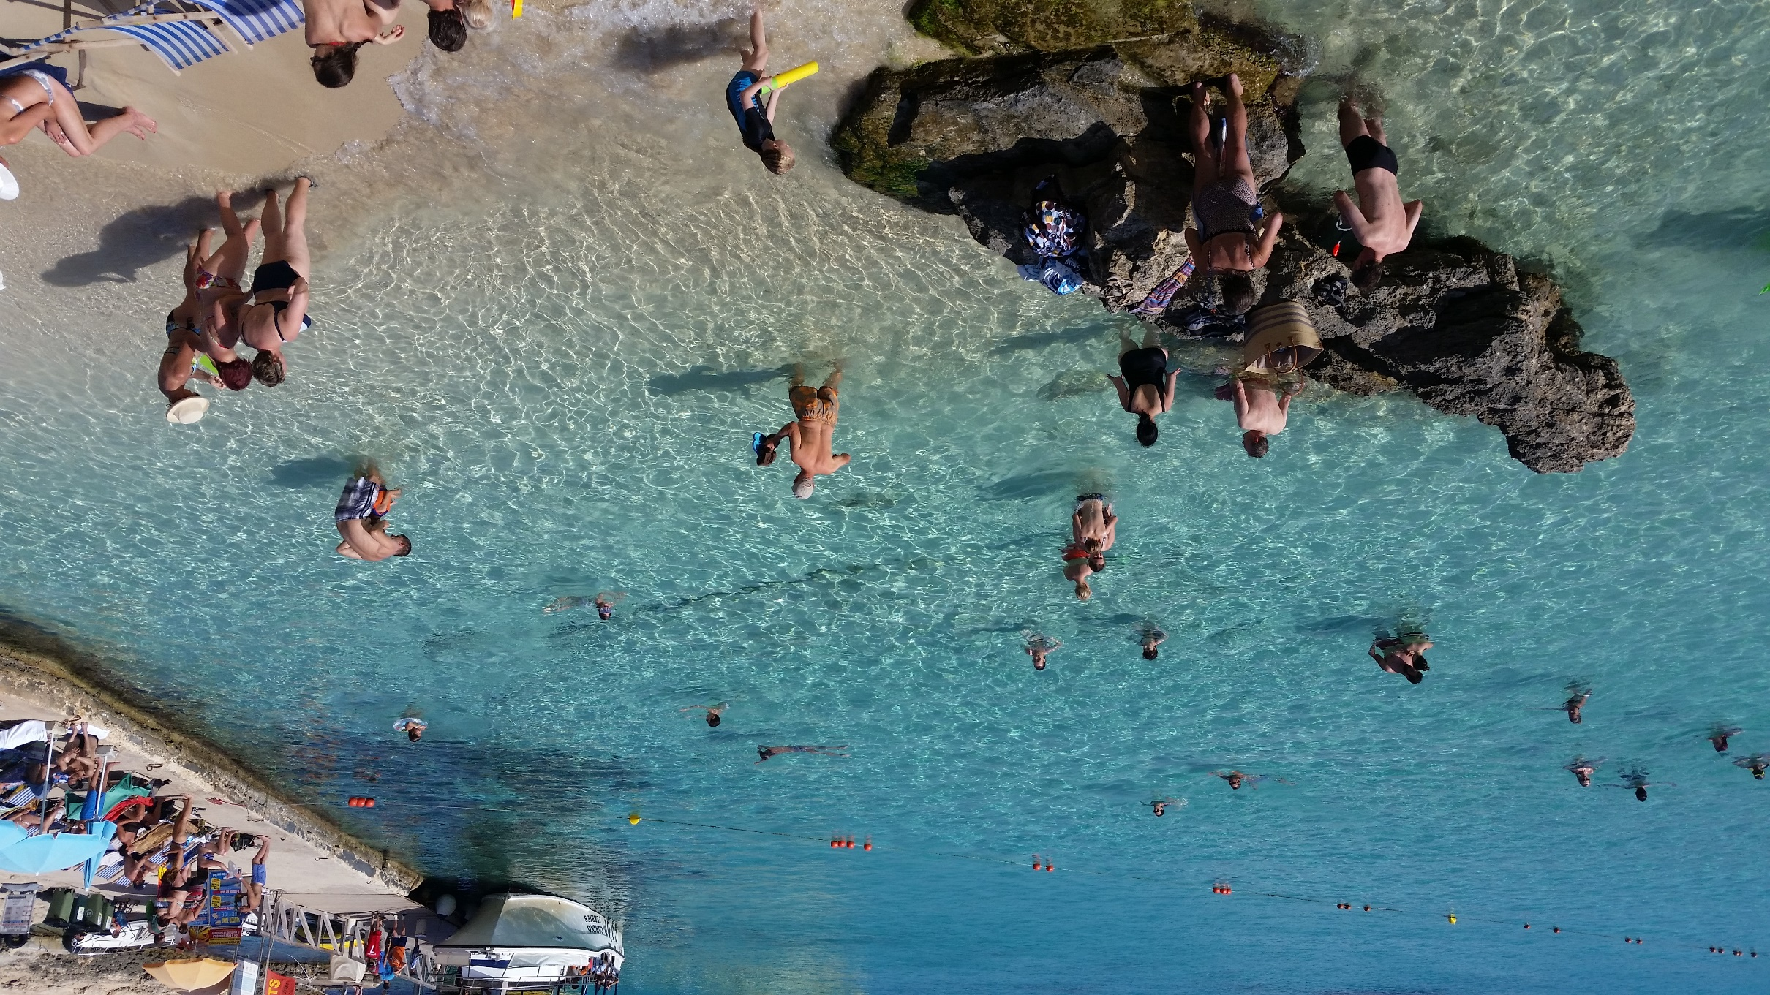
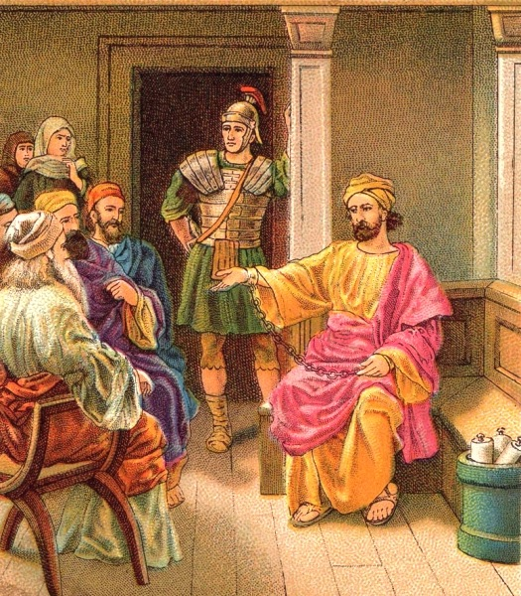
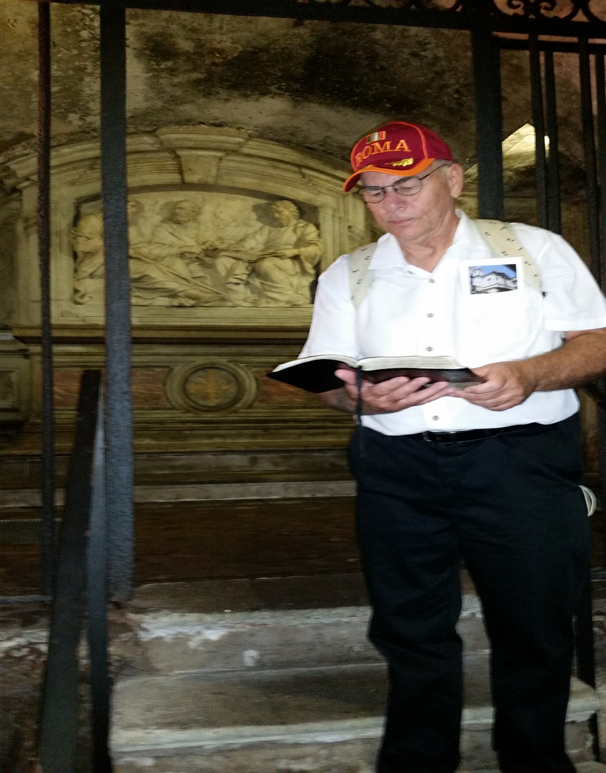
HOUSE ARREST IN ROME (A.D. 61-63)
After wintering on the island of Malta, Paul continued on to Rome where he was delivered and placed under house arrest –
“And when we came to Rome, the centurion delivered the prisoners to the captain of the guard: but Paul was suffered to dwell by himself with a soldier that kept him… And Paul dwelt two whole years in his own hired house…” (Acts 28:16,30).
It is here during those 2-years that he wrote the often referred to ‘prison epistles’ – Ephesians, Colossians,
Philemon, Philippians, and had wonderful opportunity to witness –
“All the saints salute you, chiefly they that are of Caesar’s household” (Phil. 4:22).
While under house arrest in Rome, Paul made converts to Christ of those in the Emperor’s palace.
Rome (2016)

Slide 13
ISRAEL’S PERSISTENT BLINDNESS
“… Well spake the Holy Spirit by Isaiah the prophet unto our fathers, Saying, Go unto this people, and say, Hearing ye shall hear, and shall not understand; and seeing ye shall see, and not perceive: the heart of this people is waxed gross, and their ears are dull of hearing, and their eyes have they closed; lest they should see with their eyes, and hear with their ears, and understand with their heart, and should be converted, and I should heal them… Be it known therefore unto you [Israel], that the salvation of God is sent unto the Gentiles, and that they will hear it” (28:27,28).
God’s decree finally came and here Paul stated that he would no longer evangelize the Jews but go only to the Gentiles [Peter would continue to go to the Jews until the end of his life]. Next Paul would concentrate on his writing ministry; letters to 3-churches and 1-individual.

Slide 14
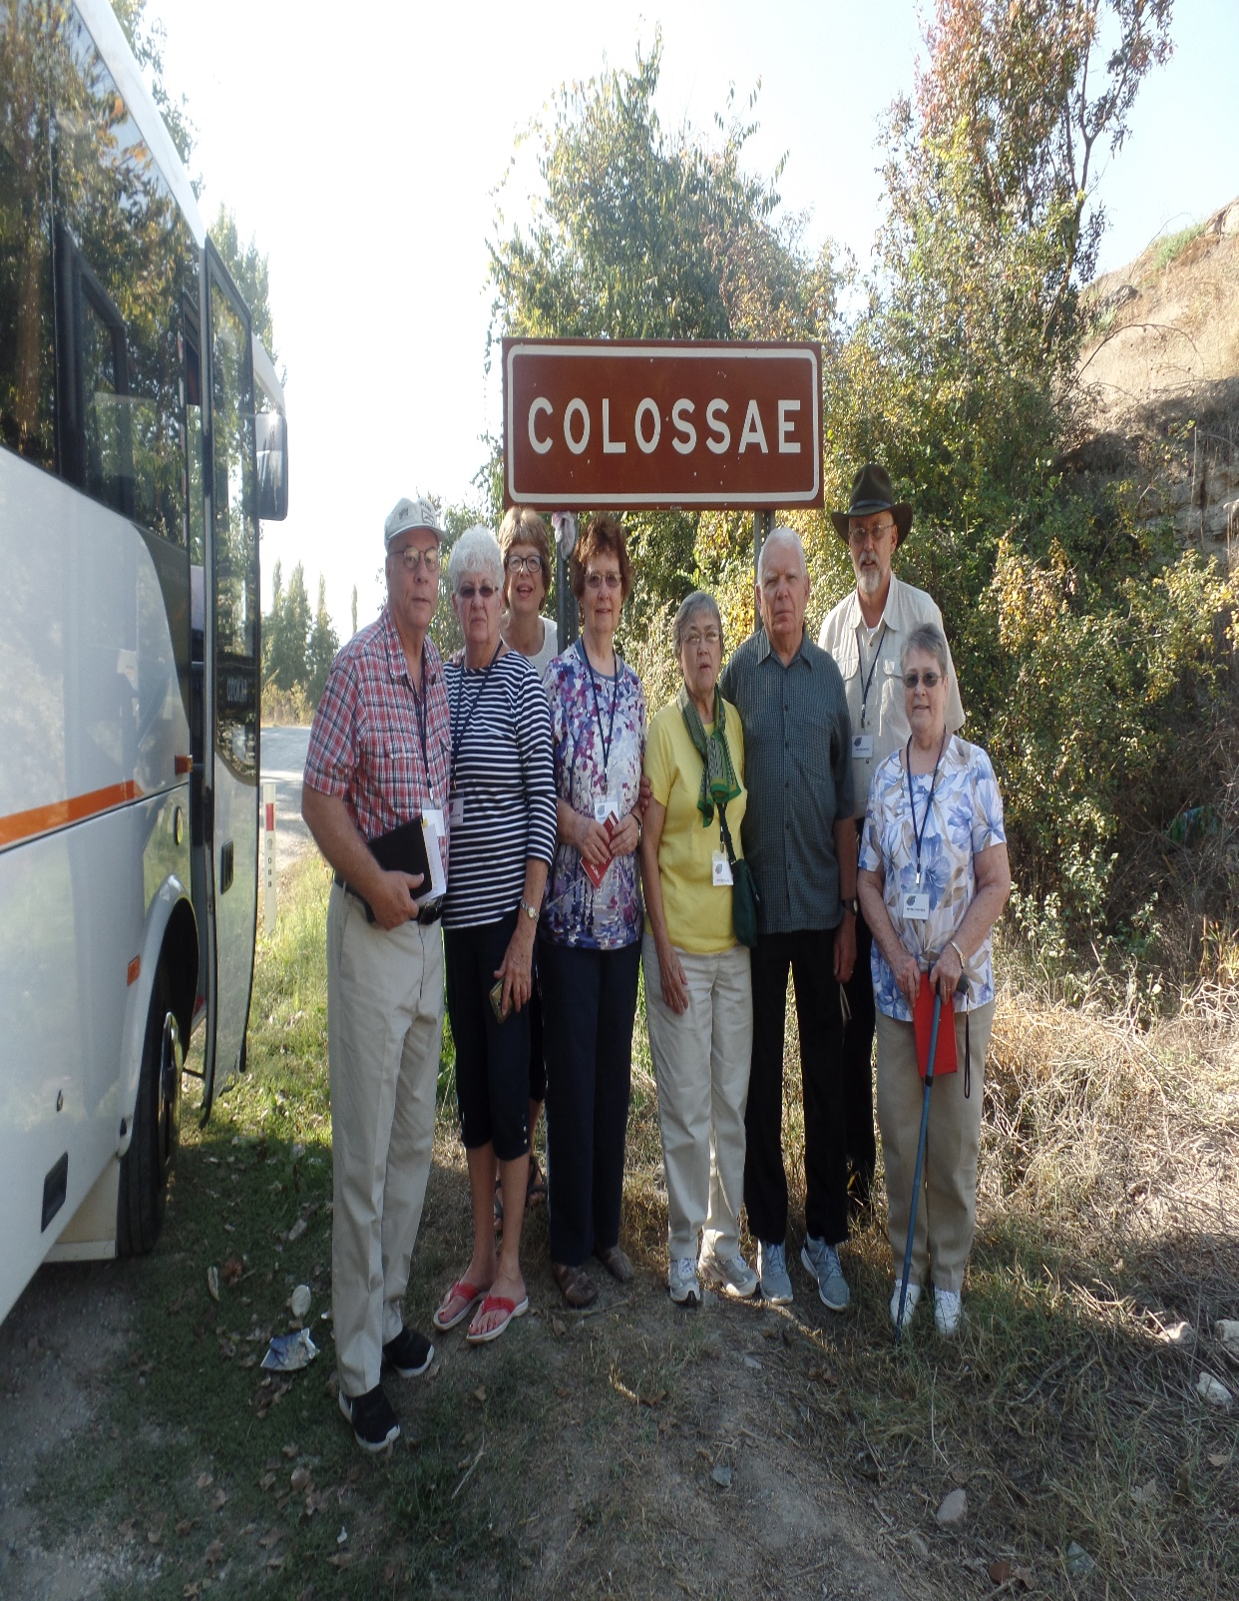
COLOSSIANS (A.D. 61-63)
“Paul, an apostle of Jesus Christ by the will of God, and Timotheus our brother… Since we heard of your faith in Christ Jesus and of the love which ye have to all the saints, for the hope which is laid up for you in heaven, whereof ye heard before in the word of the truth of the gospel… and knew the grace of God in truth”
(Col. 1:1-6).
Ephaphras had heard Paul preach in Ephesus and was converted, went back home to Colossee and with the help of Philemon, established the Colossian church in his house (1:7). It’s theme, the HEADSHIP OF CHRIST –
“For by him [Christ] were all things created, that are in heaven… earth, visible and invisible… all things were created by him, and for him… And he is the head of the body, the church; who is the beginning the firstborn from the dead…” (1:16-18).
Christ is the Head—we are members of His Body.
(2017)

Slide 15
TOTALLY FORGIVEN
“For in him dwelleth all the fullness of the Godhead bodily. And ye are complete in him, which is the head of all principality and power… And you, being dead in yours sins… hath he quickened together with him, having forgiven you all trespasses” (2:9,10,13).
Having conquered sin and death, Christ from heaven is now willing and able to completely identify the grace age believer with Himself!
Is our life in-Christ incomplete? NO, COMPLETE!
Are some of our sins forgiven? NO, ALL FORGIVEN!!
THE LAW NAILED TO THE CROSS
“Blotting out the handwriting of ordinances that was against us, which was contrary to us, and took it out of the way, nailing it to his cross…” (2:14).
The Law of Moses was a performance based system, which was impossible for sinful man to do, so God ended it! Nailing it to the Cross! Replaced it with grace.

Slide 16
THE LAW NAILED TO THE CROSS (cont’d)
“Let no man therefore judge you in meat, or in drink, or in respect of any holy day, or of the new moon, or of the Sabbath days: Which are a shadow of things to come; but the body is of Christ” (2:16,17).
The system of Law required the keeping of special holy/Sabath days, which were calculated and kept year after year. Today the believer spends 24/7 IN-CHRIST, so we are to be thankful and relish the fact that we don’t have to spend our days carrying out a list of required rules and regulations, which were only a shadow and inferior. What we have is the reality—we are the BODY OF CHRIST.
“If ye then be risen with Christ, seek those things which are above, where Christ sitteth on the right hand of God” (3:1).
Instead of rule keeping, spend your time thinking about all the wonderful spiritual blessings we have in Christ.

Slide 17
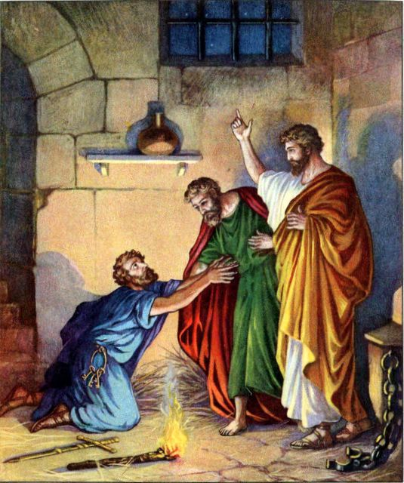
PHILEMON
“Writer. The Apostle Paul (1.1). Date. Probably A.D. 64.
It is one of the Prison Epistles. Theme. Onesimus (“profitable”), a slave of Philemon, a Christian of Colosse, had robbed his master and fled to Rome. There he became a convert through Paul, who sent him back to Philemon with this letter. It is of priceless value as a teaching (1) in practical righteousness; (2) in Christian brotherhood; (3) in Christian courtesy; (4) in the law of love” (Old Scofield, p. 1286).
“Paul, a prisoner of Jesus Christ, and Timothy our brother, unto Philemon our dearly beloved, and fellowlabourer… and to the church in thy house” (Phile. 1:1).
Though they were on opposite ends of the cultural spectrum, they were spiritual brothers – “For we are all the children of God by faith in Christ Jesus… There is neither Jew nor Gentile… bond nor free… male nor female: for ye are all one in Christ Jesus” (Gal. 2:26-28).

Slide 18
EPHESIANS (A.D. 61-63)
“Theme… It contains the highest church truth… The
church here is the true church, “His Body,” not the local
church, as in Philippians, Corinthians, etc… the divisions:
I. The apostolic greeting (1:1,2); II. Position; the believer’s
standing “in Christ” and “in the heavenlies” through pure
grace (1:3–3:21); III. Walk and service (4:1-5,17); IV. The
walk and warfare of the Spirit-filled believer (5:18–6:24)”
(Old Scofield, p. 1249).
“Paul, an apostle of Jesus Christ by the will of God, to the
saints which are at Ephesus, and to the faithful in Christ
Jesus” (Eph. 1:1).
Notice this lofty Epistle [Paul Sadler called it the ‘Alps’ of
Paul’s letters] was not written just to the Ephesian believers but to everyone who is in-Christ.
“Blessed be the God and Father of our Lord Jesus Christ, who hath blessed us with all spiritual blessings in heavenly places in Christ” (1:3).
Every spiritual blessing the believer receives today emanates from Christ as part of His heavenly ministry as He dispenses His grace to us. Examples?

Slide 19
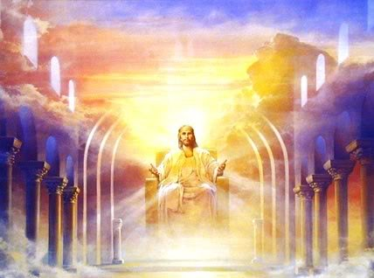
Christ has ‘chosen us in Him’ in eternity past (1:4) ‘having predestinated us unto the adoption of children’, which is Him bringing everything to pass through His foreknowledge (1:5); Christ knew you would say yes, so He made you His child.
His grace [Christ’s unearned favor on us] made us totally ‘accepted in the beloved’ (1:6); we didn’t earn our position as His child, His grace made it possible.
By what means? ‘… through [faith in] his blood, the forgiveness of sins, according to the riches of his grace’ (1:7); we’re saved by simply believing in His finished work.
Why does He do this? ‘he hath abounded toward us in all wisdom … Having made known unto us the mystery of his will, according to his good pleasure which he hath purposed in himself’ (1:8,9); He saved us because of His deepest love for us.
His ultimate goal, ‘That in the dispensation of the fullness of times [eternity future] he might gather together in one all things in Christ… that we should be the praise of his glory’ (1:10-12); what He loves most [YOU], He wants with Him for all eternity.
After believing in Christ, ‘ye were sealed with the Holy Spirit’ (1:13); it is permanent.
The indwelling of the H.S. is the ‘earnest’ or down payment for heaven (1:14);
you are eternally secure IN-CHRIST.

Slide 20
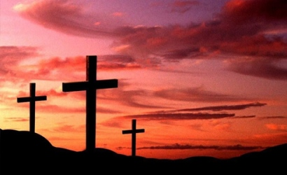
How far has Christ brought you?
“For by grace are ye saved through faith; and that not of yourselves: it is the gift of God: Not of works, lest any man should boast. For we are his workmanship, created in Christ Jesus unto good works, which God hath before ordained that we should walk in them. Wherefore remember, that ye being in time past Gentiles… without Christ, being aliens from the commonwealth of Israel… strangers… having no hope, and without God in this world…
But now in Christ Jesus ye who sometimes were far off are made nigh by the blood of Christ” (2:8-13). Believe it and be saved!

Slide 21
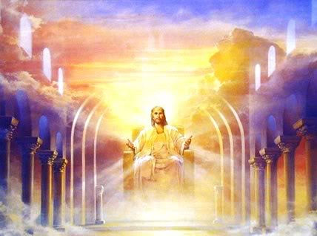
THE DISPENSATION OF GRACE
“For this cause I Paul, the prisoner of Jesus Christ for you Gentiles, if ye have heard of the dispensation of the grace of God which is given me to you-ward…
Which in other ages was not made known unto the sons of men, as it is now revealed… by the Spirit. That the Gentiles should be fellowheirs… and partakers of his promise in Christ by the gospel.
Whereof I am made a minister, according to the gift of the grace of God given unto me by the effectual working of his power… that I should preach among the Gentiles the unsearchable riches of Christ; And to make all men see what is the fellowship of the mystery, which from the beginning of the world hath been hid in God… that now… might be known by the church the manifold wisdom of God” (3:1-10).
Next time – More Pauline truth.

