Slide 1
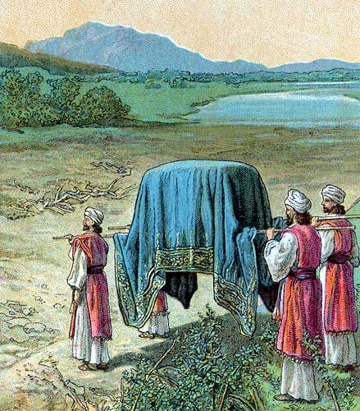
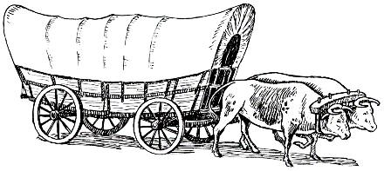
THROUGH THE BIBLE IN 2018
LESSON 9
WEEK 9 OF 52
(Num. 7–22)
Last time we saw God call Israel to be a holy nation—this time their service.
TABERNACLE SERVANTS
“And it came to pass on the day that Moses had
fully set up the tabernacle, and had anointed it,
and sanctified it, and all the instruments thereof,
both the alter and all the vessels thereof… that
the princes of Israel, heads of the house of their
fathers, who were the princes of the tribes, and
were over them that there numbered, offered”
(Num. 7:1,2).
Next the leaders of each of the 12 tribes brought gifts in order to make the tabernacle mobile –
6 covered wagons, 12 oxen (7:3), which were given to the Levites (7:5) for transporting the tabernacle. However, the sacred objects were not to be placed in the wagons – “But unto the sons of Kohath… the service of the sanctuary belonging unto them was that they should bear upon their shoulders” (7:9).

Slide 2
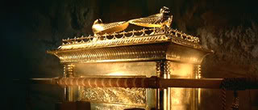
The tribal leaders brought many other gifts to the LORD including: twelve chargers of silver, twelve silver bowls, twelve golden spoons, twelve bullocks, rams, lambs, etc. (7:10-88).
Christ seemed please with the outpouring of gifts from the 12 tribes of Israel as He spoke to Moses from the Holy of Holies –
“And when Moses was gone into the tabernacle of the congregation to speak with him, then he heard the voice of one speaking unto him from off the mercy seat that was upon the ark of testimony, and from between the two cherubims: and he spake unto him” (7:89).
Next Christ gave orders for service in the tabernacle.

Slide 3
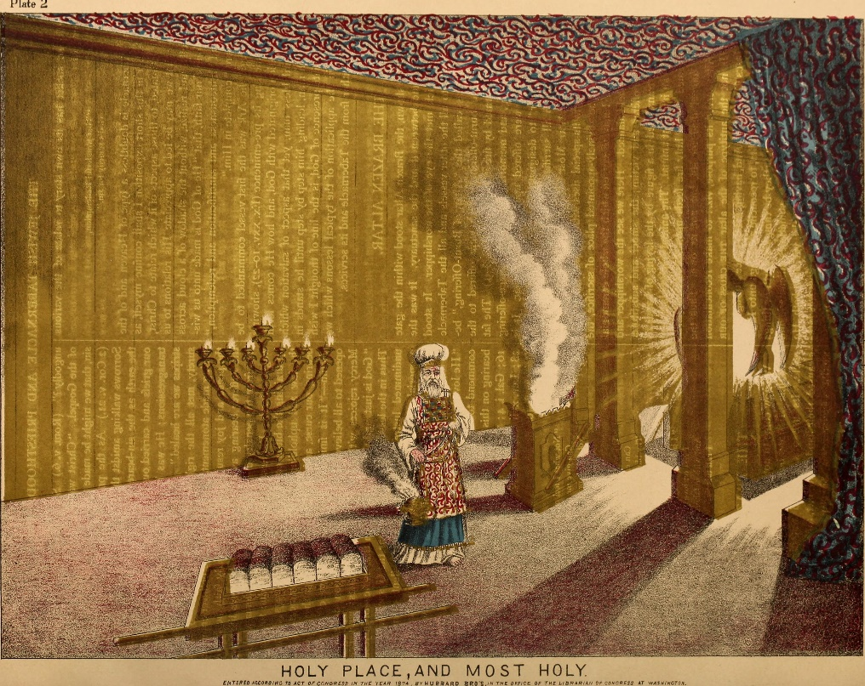
“And the LORD spake unto Moses, saying, Speak unto
Aaron, and say unto him, when thou lightest the lamps,
the [7] lamps shall give light over against the candle-
stick… And this work of the candlestick was of beaten
gold… according unto the pattern which the LORD had
showed Moses, so he made the candlestick” (8:1).
Because the sanctuary was pitch dark, the priests were
to carry lamps which shed light ahead of them in order
to lead them to the candlestick which provided light for
the enclosed area.
They didn’t know it at the time, but the candlestick
represented Christ—”As long as I am in the world, I am
the light of the world” (Jn. 9:5).
Later, Paul wrote – “For ye [Body of Christ] were sometimes darkness, but now ye are light in the Lord: walk as children of light” (Eph. 5:8)… “Ye are the
children of light” (1Thess.5:5).

Slide 4
CLEANSING OF THE LEVITES
“And the LORD spoke unto Moses, saying, Take the Levites from among the children of Israel, and cleanse them. And thus shalt thou do unto them, to cleanse them: sprinkle water of purifying upon them, let them shave [trim] all their flesh [hair], and let them wash their clothes, and so make themselves clean” (8:5,6).
Earlier, Moses washed Aaron and his sons with water (Lev. 8:6), but now this symbolic cleansing was necessary before the whole tribe of Levi could begin their priestly duties and foreshadowed John the Baptist’s ministry in preparing the whole nation of Israel to be ‘a kingdom of priests’ (Exo. 19:6). We know at that time Israel rejected Messiah and the earthly kingdom was delayed, but there will come a day yet future in which true spiritual Israel will accept him and they will be cleansed – “For I will take you from among the heathen, and gather you out of all countries, and I will bring you into your own land. Then will I sprinkle clean water upon you, and ye shall be clean from all your filthiness…” (Eze. 36:24,25).

Slide 5
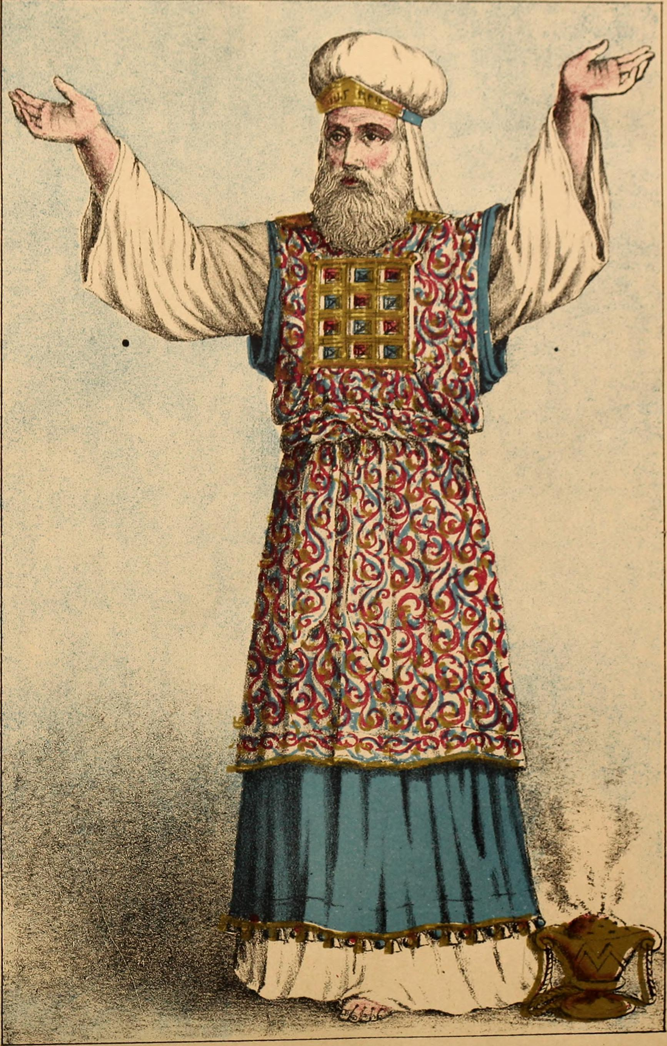
“And after that sanctifying went the Levites in to do their service in the tabernacle of the congregation before Aaron, and before his sons: as the LORD commanded Moses concerning the Levites, so did they unto them… from [25] years old and upward they shall go in to wait upon the service of the tabernacle… And from the age of [50] years they shall cease…” (8:22–25).
Those Levites who were responsible for assisting the priests and transporting of the tabernacle were to be between 30-50 years old, but those who served in the capacity of priest could serve between 25-50 years. They could still participate after 50 but served under the younger men (8:26).

Slide 6
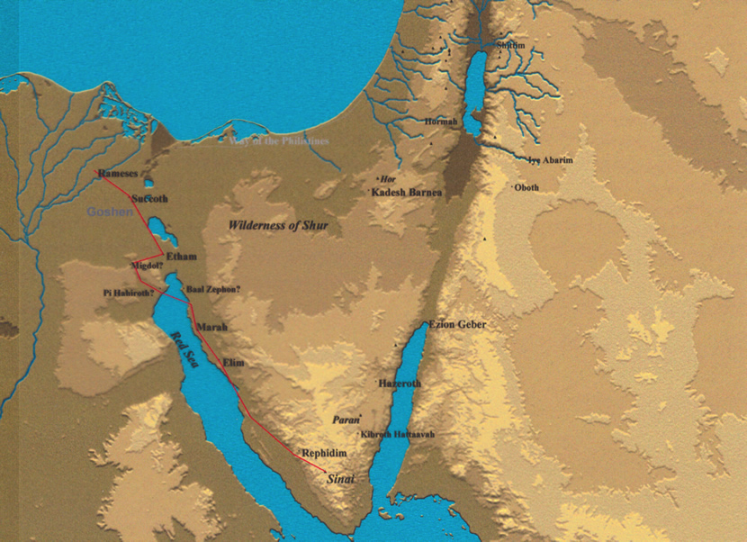
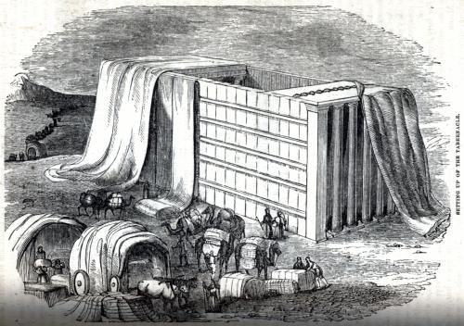
“And it came to pass on the [20th] day of the [2nd] month,
in the [2nd] year [after the Exodus], that the cloud was
taken up from off the tabernacle of the testimony. And
the children of Israel took their journeys out of the
wilderness of Sinai; and the cloud rested in the
wilderness of Paran” (10:11,12).
Almost 15-months after leaving Egypt, with Christ
leading them, Israel’s journey to their promised land
had begun. How long would it take?
THE GUIDING CLOUD
“And on the day that the tabernacle was reared up the
cloud covered the tabernacle… And when the cloud
was taken up from the tabernacle, then after that the
children of Israel journeyed: and in the place where
the cloud abode, there the children of Israel pitched
their tents” (9:15-17).
The operating instructions were clear—when Christ wanted Israel to move, the cloud moved. When the cloud stopped—they were to stop, pitch their tents, and set up the tabernacle.

Slide 7
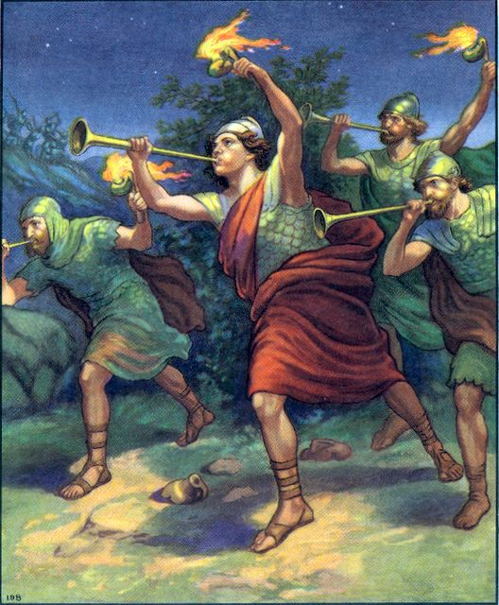
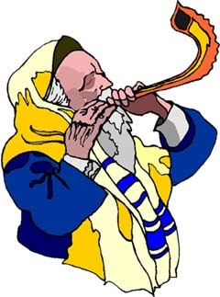
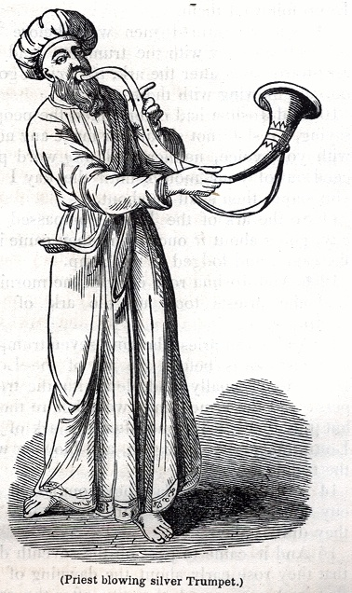
TRUMPETS
Two silver trumpets were used by the priests to alert the
Israelites when to move. Two trumpets alerted the whole
assembly to present themselves before the tabernacle [where
Christ was] (10:3). One trumpet alerted the clan leaders (10:4).
Specific trumpet blasts alerted the east camp (10:5) to move
first, then the south camp (10:6), etc. Prophetically, the Feast
of Trumpets [October] will be to alert Israel of the 2nd coming of
Christ at the end of the tribulation. Trumpets were also used –
“And if ye go to war in your land against the enemy that
oppresseth you, then ye shall blow an alarm with the trumpets;
and ye shall be remembered before the LORD your God, and ye
shall be saved from your enemies” (10:9). Trumpets were also
used “… in your solemn days… ye shall blow with trumpets… A memorial before your God” (10:10).
When an oppressor of Israel raised his hand against them, the LORD would lead them into the battle for it was His battle to win. Trumpets were also used at the beginning of major feast days to celebrate the presence of God on these special occasions.

Slide 8
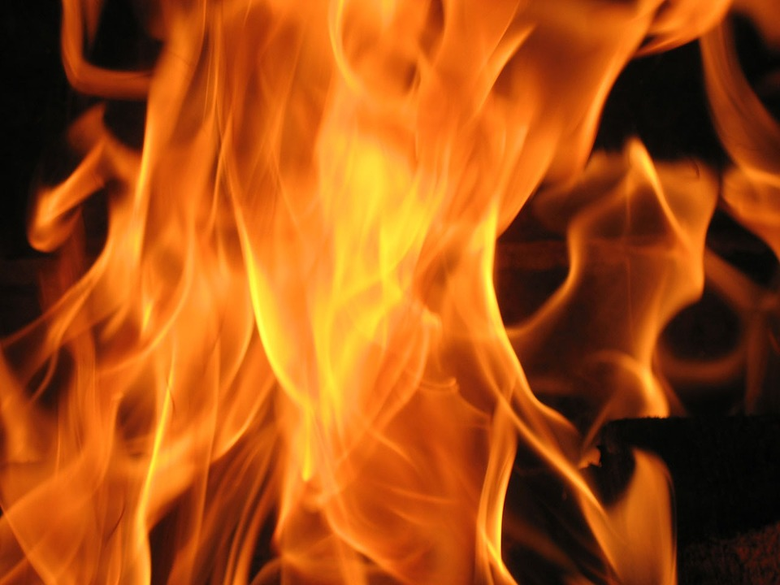
“And when the people complained, it displeased the
LORD… and his anger was kindled; and the fire of the
LORD burnt among them, and consumed them that
were in the uttermost parts of the camp” (11:1).
Again, the Israelites murmured and this time they paid
for it as the judgment of God fell on them, which
stopped their complaining, but not for long –
“… and the children of Israel also wept again, and said,
Who shall give us flesh to eat? We remember the fish,
which we did eat in Egypt freely; the cucumbers…
melons… leeks… onions… garlic… there is nothing at all,
beside this manna…” (11:4-6).
Next they complained about eating nothing but manna,
remembering the good food they had enjoyed in Egypt. Moses asked God why all this trouble came on him – ”… Wherefore hast thou afflicted thy servant… I am not able to bear all this people alone, because it is too heavy on me… kill me, I pray thee… (11:11-15). Did God kill Moses?

Slide 9
“And the LORD said unto Moses, Gather unto me [70]
men of the elders of Israel… bring them unto the
tabernacle... and I will come down and talk with thee
there: and I will take of the [Holy] spirit which is upon
thee, and will put it upon them; and they shall bear the
burden of the people with, that thou bear it not thyself
alone” (11:16,17).
God understood Moses’ burden and gave him the help
he sorely needed. To authenticate their calling, God
gave them the H.S. enabling them to prophesy (11:25),
including 2 who were not with the others and to whom
Joshua protested, but Moses set him straight (11:26-29).
“And say thou unto the people, sanctify yourselves
against to morrow, and ye shall eat flesh: for ye have
wept in the ears of the LORD…” (11:18,19).
God would not only provide meat for one or two meals,
He would give them enough to gorge on for a month and
be sick (11:20). Be careful for what you ask God!

Slide 10
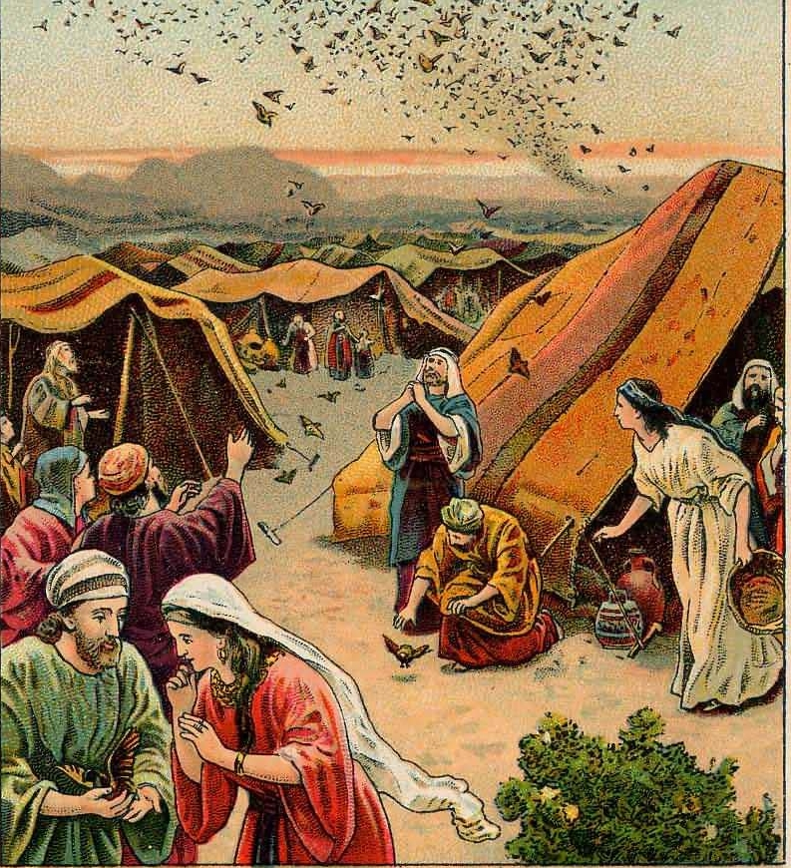
“And there went forth a wind from the LORD, and
brought quails from the sea, and let them fall by
the camp… And the people stood up all that day,
and all that night, and all the next day, and they
gathered the quails [60 bushels]” (11:31,32).
God provided murmuring Israel meat, but He was
not happy with them. While gorging themselves,
God sent a plague and many died, naming the site,
‘graves of craving.’
God had been completely faithful to Israel
throughout the Exodus and wilderness journeys,
and He was not about to let them die of starvation
in the desert. The people’s physical craving for
food was more important than believing God had
delivered them from bondage and would provide
everything needed for their preservation.
The Apostle Paul would write of the enemies of Christ – “Whose end is destruction, whose God is their belly… who mind earthly things” (Phil. 3:19).

Slide 11
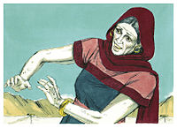
“And Miriam and Aaron spake against Moses
because of the Ethopian woman whom he had
married… And they said, Hath the LORD indeed
spoken only by Moses? Hath he not spoken also
by us? And the LORD heard it” (12;1,2).
Jealousy reared its ugly head in Moses’ elder
siblings. They either lost faith in Moses’ leader-
ship skills or blamed it on his marriage to a
Cushite woman, which was not against the rule
of not marrying Canaanite women (Exo. 34:11).
God’s anger was again kindled and He quickly
settled the matter saying that usually He spoke
through dreams and visions, but with Moses He
spoke face to face (12:5-8) indicating his choice of Moses as Israel’s leader. Miriam’s punishment? Leprosy (12:10-13), which caused her separation outside the camp for 7-days (12:14,15).

Slide 12
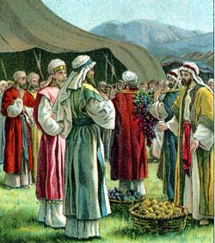
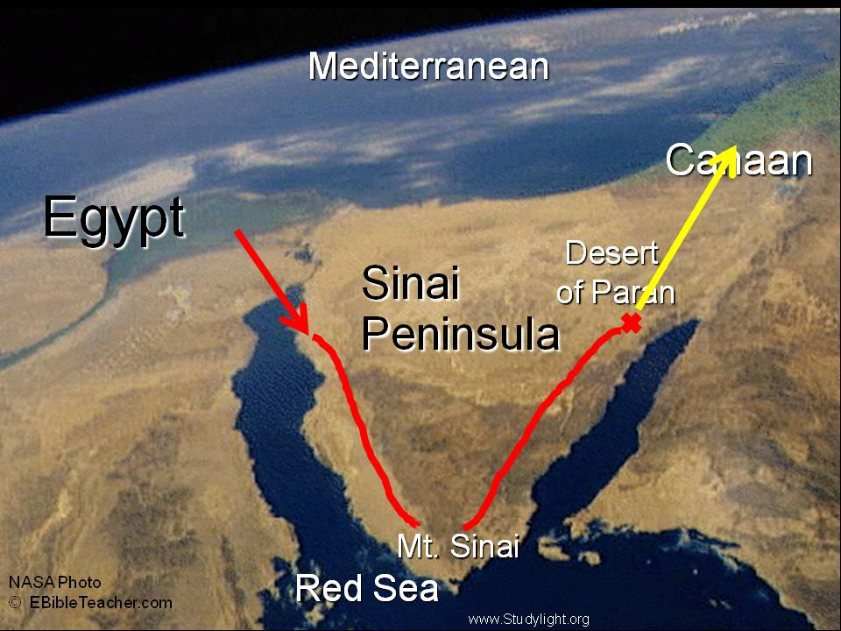
THE 12 SPIES
“And the LORD spake unto Moses, saying, Send
thou men, that they may search the land of
Canaan, which I give unto the children of Israel:
of every tribe of their fathers shall ye send a man,
every one a ruler among them… Of the tribe of
Judah, Caleb… These are the names of the men
which Moses sent to spy out the land. And Moses
called Joshua” (13:1,6,16).
12 leaders were selected to spy out the land
promised to them, including Caleb and Joshua.
“And see the land, what it is, and the people that
dwelleth therein, whether they be strong or
weak, few or many… bring of the fruit of the land.
Now was the time of the first ripe grapes (13:18-20)… So they went up, and searched the land… and came unto Hebron… where the children of Anak, were… cut down from thence a branch with one cluster of grapes, and they bare it between two upon a staff… returned from searching the land after [40] days” (13:21-25).

Slide 13
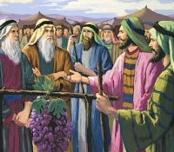
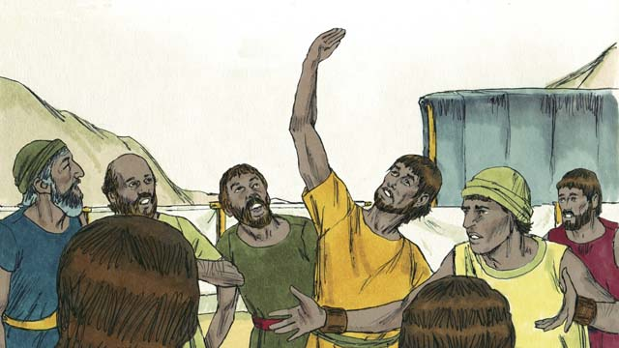
“And they went and came to Moses, and to Aaron, and
to all the congregation of the children of Israel, unto the
wilderness of Paran, to Kadesh; and brought back word
unto them, and unto all the congregation, and shewed
them the fruit of the land… We came unto the land
whither thou sentest us, and surely it floweth with milk
and honey; and this is the fruit of it” (13:26).
The 12 returned from their spy mission to Cana bearing
evidence that the land was indeed bountiful, but then
the bad news –
“Nevertheless the people be strong that dwell in the
land, and the cities are walled, and very great; and
moreover we saw the children of Anak there… Hittites…
Jebusites… Amorites… Canaanites…” (13:29).
(Where have we seen this before?) “Observe thou that which I command thee this day: behold, I drive out before thee the Amorite… Canaanite… Hittite… Perizzite… Hivite… Jebusite” (Exo. 34:11).
Christ already promised HE would drive out these pagan tribes, but Israel now had lost faith…

Slide 14
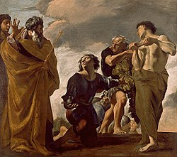
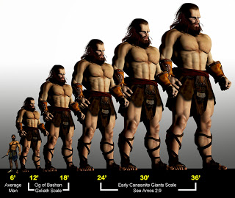
… that is, all but two – “And Caleb stilled the people
before Moses, and said, Let us go up at once, and
possess it: for we are well able to overcome it. But
the men that went up with him said, We be not able
to go up against the people; For they are stronger
than we. And they brought up an evil report of the
land… men of great stature. And there we saw the
giants, the sons of Anak… and we were in our own
sight as grasshoppers, and so we were in their sight”
(13:30-33).
Caleb & Joshua believed God—the rest doubted
their ability to subdue a land that included giants.
The reaction of the people?
“And all the congregation lifted up their voice, and
cried; and the people wept that night” (14:1).
They were that close to their promised land, but Satan now prevented them from going in!

Slide 15
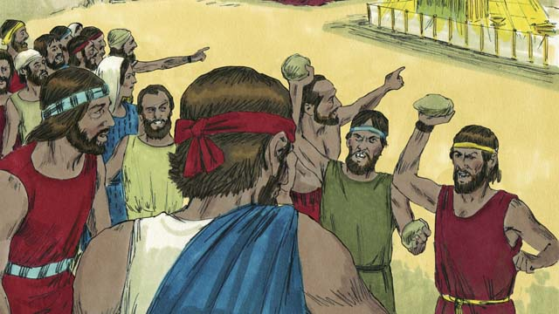
Guess what happened next? – “And all the children of
Israel murmured against Moses and against Aaron…
Would God that we had died in the land of Egypt! Or
would God we had died in the wilderness!... [Why] hath
the LORD brought us into this land, to fall by the sword,
that our wives and our children should be a prey? Were
it not better for us to return into Egypt?... Let us make a
captain, and let us return to Egypt” (14:2-4).
After all God had done for them they were unholy and
unthankful [ironically, exactly what the Bible says of the
majority of the Body of Christ near the end of the
dispensation of grace (2Tim. 3:2)].
“And Joshua… and Caleb… rent their clothes. And spake
unto all the company of Israel, saying, The land, which
we pass through to search it, is an exceeding good land.
If the LORD delight in us, then he will bring us into this
land… Only rebel not ye against the LORD… stone them
with stones” (14:6-10).

Slide 16
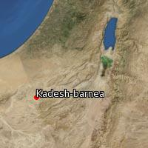
God’s reaction – “And the LORD said unto Moses,
How long will this people provoke me? And how
long will it be ere they believe me, for all the signs
which I have shewed among them. I will smite
them… and disinherit them, and will make of thee
a greater nation and mightier than they”
(14:11,12).
Again, God was ready to start over with a new
nation through Moses, but again Moses intervened
for his rebellious people (14:13-22). God relented,
but said this –
“Surely they shall not see the land which I sware
unto their fathers, neither shall any of them that
provoked me see it: But my servant Caleb… him
will I bring into the land… his seed shall possess
it…” (14:23,24).
At Kadesh-Barnea, Israel was just 65-miles [3-4 day
journey] from their promised land.

Slide 17
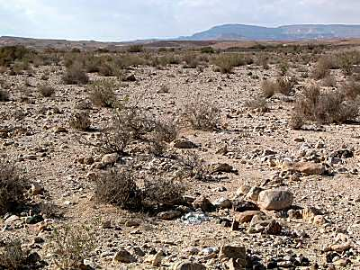
“I have heard the murmurings of the children of Israel… against me. Say unto them, As truly as I live, saith the LORD, as ye have spoken in mine ears, so will I do to you: Your carcasses shall fall in this wilderness; and all that were numbered of you... from [20] years old and upward, which have murmured against me…
ye shall not come into the land which I sware to make you dwell save Caleb… and Joshua… But the little ones, which ye said should be a prey, them will I bring in, and they shall know the land which ye have despised… your children shall wander in the wilderness [40] years… in this wilderness they shall be consumed, and there they shall die” (14:27-35).

Slide 18
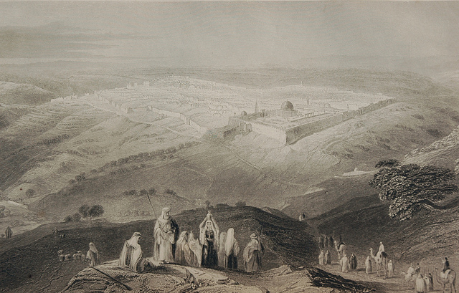
“And Moses told these sayings unto all the children of Israel: and the people mourned greatly. And they rose up early in the morning, and got them up into the top of the mountain, saying, Lo, we be here, and will go up into the place which the LORD hath promised: for we have sinned. And Moses said, Wherefore now do ye transgress the commandment of the LORD? … Go not up, for the LORD is not among you; that ye be not smitten before your enemies”
(14:39-42).
The Israelites then changed their mind, but it was too late! They now had two choices: try to enter into the land without God and be slaughtered by the enemies, or die a slow death over the next 40-years in the wilderness. What would you choose?

Slide 19
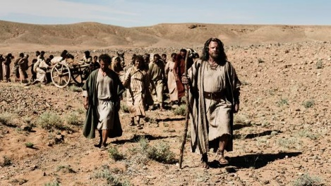
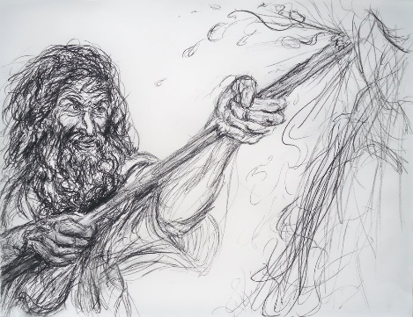
Chapters 15-21 compose the 40-years of wilderness
wandering. Ironically, God still dealt with them as if
they were preparing to go into the promised land
(15:2), perhaps preparing those who would be
going in. Some of the events during that time:
Aaron’s rod that budded was placed in the ark
(17:10); ashes of a red heifer + water was used for
personal purification (19); the death of Miriam –
“Then came the children of Israel… in the 1st month
[40th year] in Kadesh; and Miriam died there, and
was buried there” (20:1).
Miriam’s death marked the beginning of the last
year of Israel’s desert wandering.
Another complaint of no water (20:2), but this time
Moses disobeyed God and smote the rock instead
of speaking to it (20:8-11). The LORD said – ”… because ye believed me not… ye shall
not bring this congregation into the land which I have given them” (20:8-12; Lk. 12:48).

Slide 20
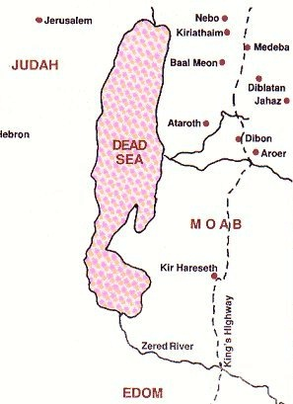
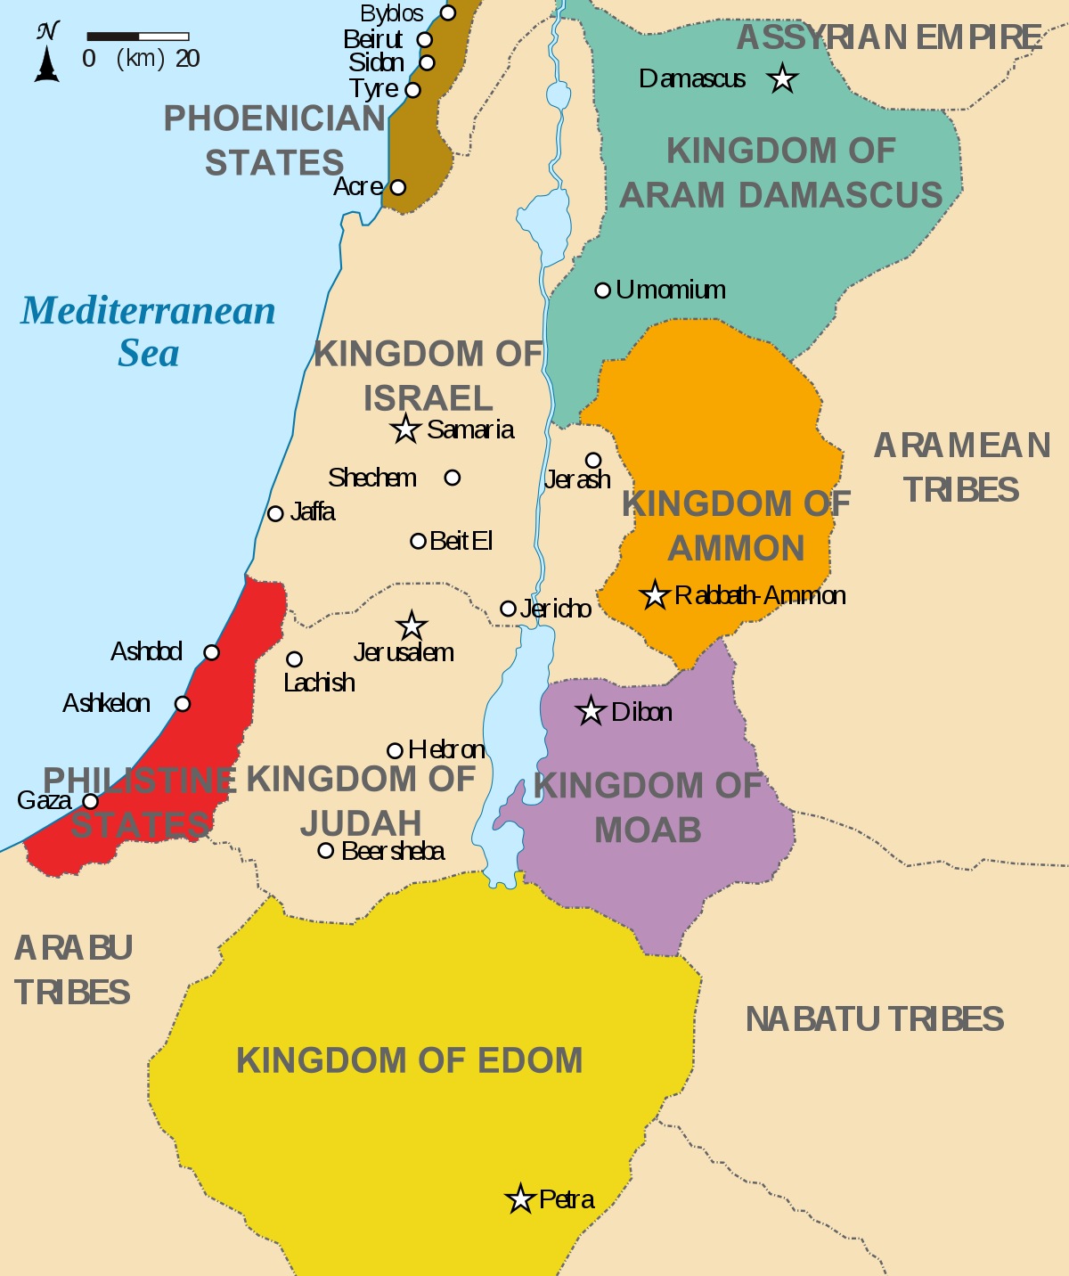
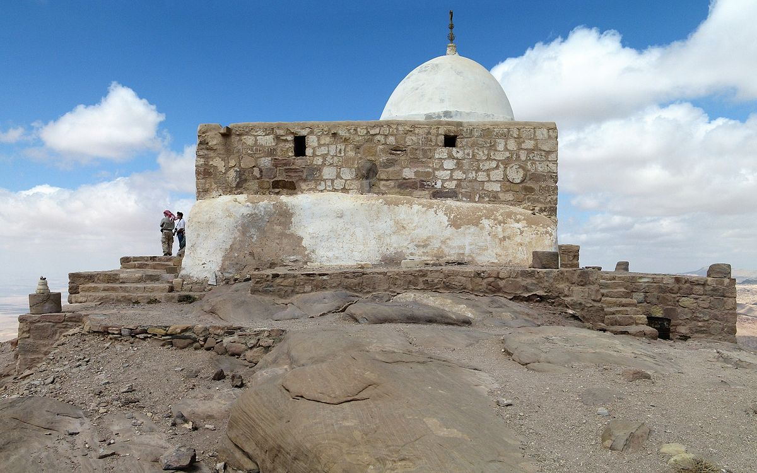
“And Moses sent messengers from Kadesh unto the King of Edom… Let us pass, I pray thee, through thy country… we will go by the king’s highway, we will not turn to the right hand nor to the left, until we have passed thy borders. And Edom said unto him, Thou shalt not pass by me, lest I come out against thee with the sword” (20:14-18).
Anxious to get Israel in position to enter Canaan, Moses asked permission to pass through Edom via an established route, the king’s highway, but was refused. God never forgave Edom for that sin. As a result, Moses went eastward through Moab.
Next was the death of Aaron, but not before going up to Mount Hor, removing his garment of high priest and giving it to his son, Eleazar. Israel mourned his death for 30-days (20:23-29).

Slide 21
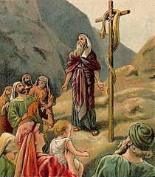
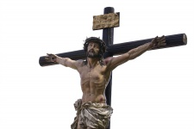
THE BRASS SERPENT
“And the people spake against God, and against Moses, Wherefore
have ye brought us up out of Egypt to die in the wilderness? For there is no bread, neither is there any water; and our soul loatheth this light bread [manna]. And the LORD sent fiery serpents among the people, and they bit the people, and much people of Israel died” (21:5,6).
This time when the Israelites murmured, God sent poisonous snakes
to bite and kill them, causing their immediate repentance –
“… We have sinned… pray unto the LORD that he take away the
serpents from us… And Moses made a serpent of brass, and put it
upon a pole… if a serpent had bitten any man, when he beheld the
serpent of brass, he lived…” (21:7-9). A foreshadowing of the cross –
“And as Moses lifted up the serpent in the wilderness, even so must
the Son of man be lifted up [cross]” (Jn. 3:14).
Next time – The false prophet Balaam and his talking donkey
(Num. 23 – Deut. 2).

