Slide 1
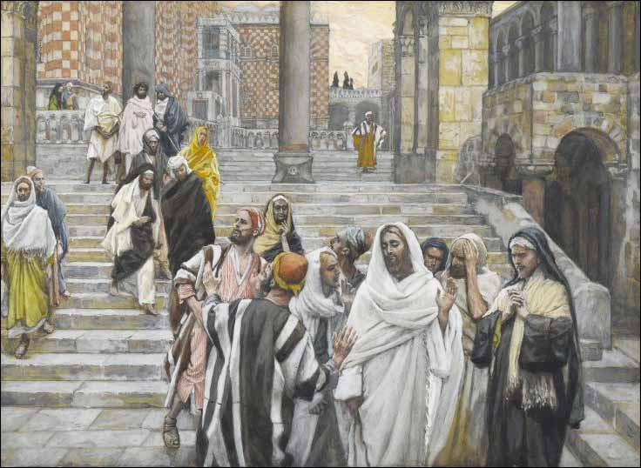
LESSON 43
WEEK 43 OF 52
(Mt. 18; Jn. 7-10;
Lk. 10,12-17)
THROUGH THE BIBLE IN 2018
More of Christ’s earthly ministry to Israel.
“After these things Jesus walked in Galilee: for he would not walk in Judea, because the Jews sought to kill him” (Jn. 7:1).
It had become public knowledge that the leadership of Israel plotted to kill Jesus so He restricted His ministry to the area around the Galilee. But, something forced Him to go to Jerusalem, the feast of Tabernacles, a required feast of the Jews. He waited after the others left for Jerusalem and then secretly went up Himself (7:10). There, He began to teach, asking and answering questions of those Jews that were there –
“And the Jews marveled, saying, How knoweth this man letters, having never learned? Jesus answered them, and said, My doctrine is not mine, but his that sent me” (7:15,16).
Telling them He was the Son of His Father God, they railed…

Slide 2
… and called him a devil (7:20). Back and forth they went until the last day [day 7] of the feast
of Tabernacles when a priest ceremoniously carried a pitcher of water through the crowds, and
Jesus spoke –
“If any man thirst, let him come unto me, and drink. He that
believeth on me, as the scripture hath said, out of his belly shall
flow rivers of living water (But this spake he of the [Holy] Spirit,
which they that believe on him should receive: for the Holy
Spirit was not yet given; because that Jesus was not yet
glorified [resurrected from the dead])” (7:37-39).
The Jews were split: some thought He was the Prophet spoken
of by Moses (Deut. 18:15); others, the Christ [Messiah], but
doubted that He would come out of the Galilee (7:40,41). As
the seed of David, He would come out of Bethlehem (7:42) –
“So there was a division among the people…” (7:43). Not only were the people divided, so were
those who had come to arrest him, “Then came the officers to the chief priests and Pharisees;
and they said unto them, Why have ye not brought [arrested] him?” (7:45). Those sent to arrest
Him now wondered if He was the Messiah (7:46)… Nicodemus – He deserves a fair trial (7:51).

Slide 3
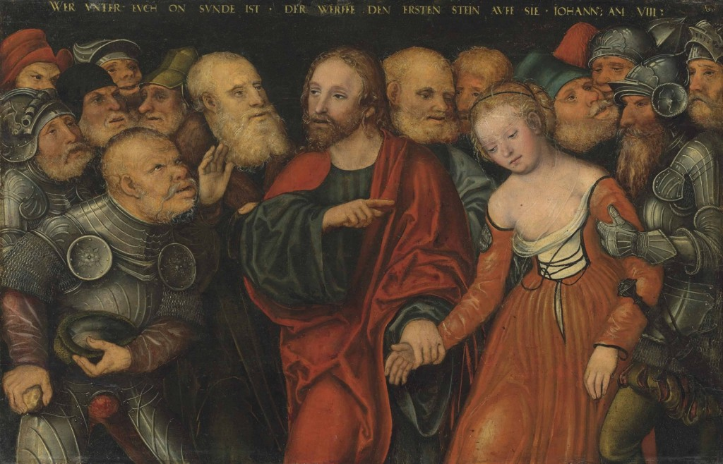
“And every man went unto his own house” (7:53). The feast had ended and people went home, Jesus to the Mt. of Olives (8:1), but the next A.M. came back to the temple and began to teach (8:2). As usual, the Jewish leaders showed up to try to trap Him into something for which they could try Him. They thought they found it, a woman caught in the act of adultery (8:4), whom the Law said should be stoned (8:5).
Then Jesus said, “He that is without sin among you, let him first cast a stone at her” (8:7). He turned the tables away from her to them, as they all knew they had sinned, and one by one walked away (8:9), leaving Him alone with the woman. Notice Jesus didn’t brow beat nor condemn her, “Neither do I condemn thee” (8:11a). His 1st coming was not to decide one’s eternal judgment, but to save and to heal. The accusers had all left and without 2-witnesses she could not be tried, so Jesus’ only admonishment was –
“… go, and sin [commit adultery] no more” (8:11b).

Slide 4
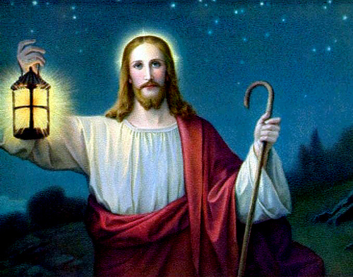
LIGHT OF THE WORLD
“Then spake Jesus again unto them, saying, I am the light of the world: he that followeth me shall not walk in darkness, but shall have the light of life” (8:12).
After the feast of Tabernacles, Jesus again taught in the temple, telling the leaders that He was THE LIGHT, a common theme in the Book of John – “He [John the Baptist] was not that Light, but was sent to witness of that Light… [Christ] was the true Light, which lighteth every man that cometh into the world” (Jn. 1:8,9), but the world had rejected THE LIGHT (1:10), as now did Israel (1:11).
Again, He said He was sent of the Father (8:18), and the crowd asked, where was His father. He told them they were not of His Father (8:19), which infuriated them further. When He told them, “Before Abraham, was, I am (8:58)… Then took they up stones to cast at him: but Jesus hid himself, and went out of the temple…” (8:59).
He escaped death again, because it was not yet His time.

Slide 5
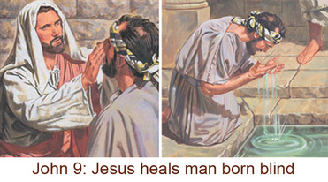
THE BLIND MAN HEALED
“And as Jesus passed by, he saw a man which was blind from his birth” (Jn. 9:1).
This is the 6th miracle of John and it involved 2-kinds of blindness: physical & spiritual. The 12 asked Jesus what sin had caused his blindness, his or his parents (9:2), and the Master answered, neither (9:3), meaning that disease and afflictions came after Adam’s sin and was part of the fallen world, therefore no one sin necessarily brings forth a particular illness or disease. Jesus went on to say that it was not a particular sin that made this man blind, but that through his blindness God’s glory would be shone when Jesus healed him (9:3,4).
This blind man was physically healed because of his faith,
“I was blind, now I see (9:25)… I believe, and he worshipped him” (9:38). The Pharisees were worse than the blind man; they thought they could see, were in fact [spiritually] blind, and their sin still with them [unsaved] (9:41).

Slide 6
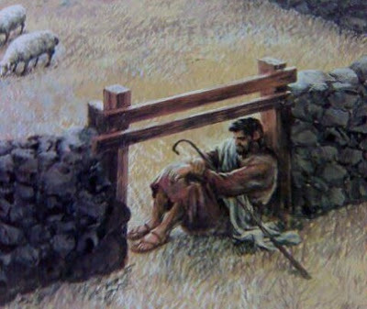
THE GOOD SHEPHERD
Not only was Christ the ‘light of the world,’ and the
‘bread of life’, He was also the ‘Good Shepherd.’ In this
passage, Jesus provided much dispensational truth
about His earthly ministry to Israel –
“… I say unto you, He that entereth not by the door into
the sheepfold, but climbeth up some other way, the
same is a thief and a robber. But he that entereth in by
the door is the shepherd of the sheep” (10:1,2).
Satan tried to get into the sheepfold to steal the sheep
any way he could, but there was only 1 proper way to
enter the kingdom, the door—there was only 1-way to
be saved—through Christ, “I am the door of the sheep”
(10:7). A devoted shepherd was one who would do anything to protect his sheep—Christ was that Shepherd— “I am the good shepherd: the good shepherd giveth his life for the sheep” (10:11). The Father had sent His Son with a plan – “… I lay down my life, that I might take it up again. No man taketh it from me… I have the power to lay it down… to take it up again” (10:17,18). That, He did.

Slide 7
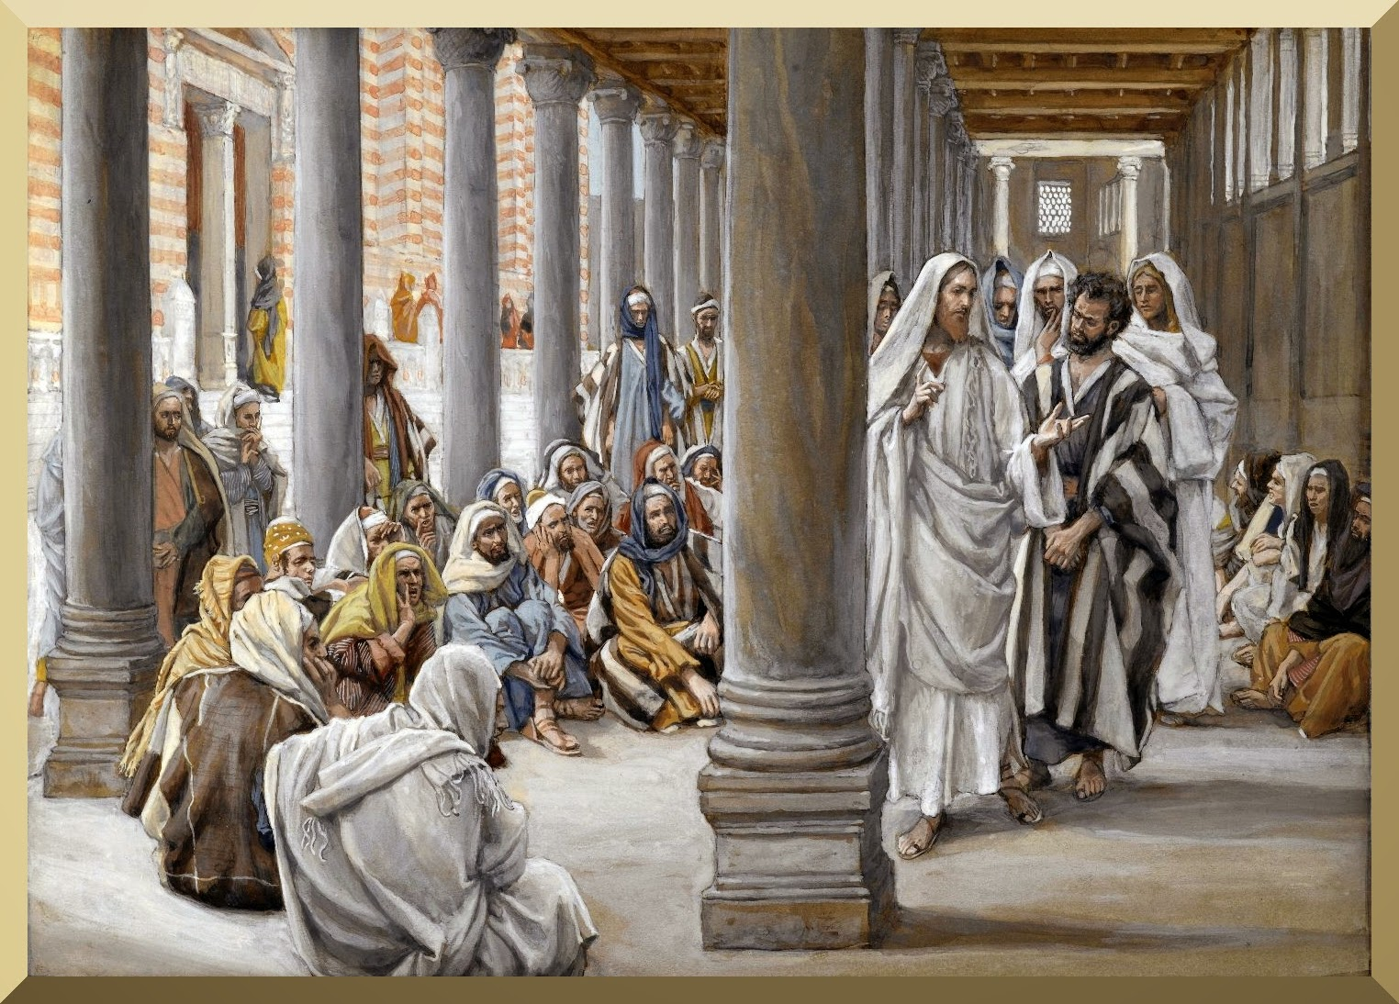
NOT MY SHEEP
“And it was at Jerusalem the feast of the dedication, and it was winter. And Jesus walked in Solomon’s porch. There came the Jews round about him, and said unto him… If thou be the Christ, tell us plainly” (10:22-24).
During the festival of lights [Hanukah], the Jews persisted in showing their ignorance. His response?
“… I told you, and ye believed not: the works that I do in my Father’s name, they bear witness of me. But ye believe not, because ye are not my sheep… My sheep hear my voice, and I know them, and they follow me:
And I give to them eternal life; and they shall never perish, (1) neither shall any man pluck them out of my hand… (2) I and my father are one” (10:25-30).
A strong verse for Israel’s [Jews] eternal security
A strong verse to refute the J.W.’s/others who deny
His deity.

Slide 8
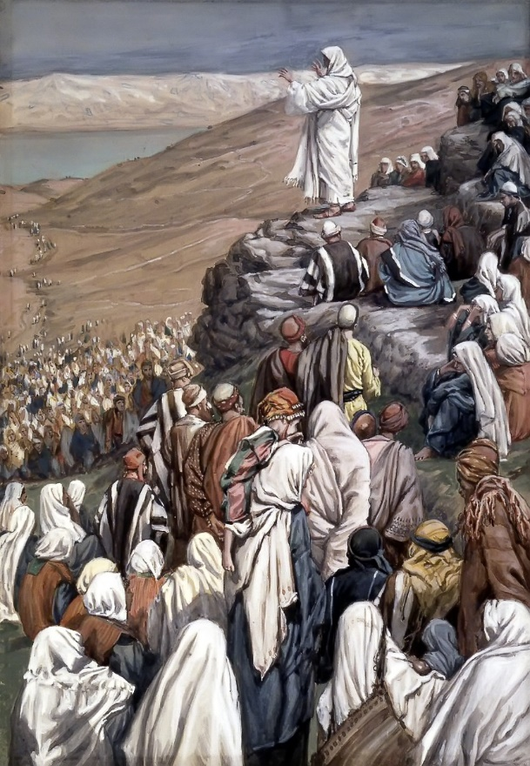
70 SENT ONES
“After these things the Lord appointed other 70 also, and sent them 2 by 2 before his face into every city and place, whither he himself would come” (Lk. 10:1).
Just as 12 was Israel’s number so was 70: the number of the family of Jacob who were initially in Egypt (Exo. 1:5); number of elders chosen by Moses in the wilderness (Exo. 24:1); years of Babylonian
captivity (Jer. 25:11); 70 weeks of years [490 yrs.] (Dan. 9:24); Sanhedrin; scholars who translated the Septuagint.
“Go your ways: behold, I send you forth as lambs among wolves. Carry neither purse, nor script, nor shoes: and salute no man by the way… heal the sick, and say unto them, The kingdom of God is come nigh unto you… they receive you not…” (10:3-11).
Take nothing, God will supply your need, preach the kingdom, if they won’t receive you shake the dust off your shoes and move on –
“But I say unto you, that it shall be more tolerable in that day for Sodom, than for that city” (10:12).

Slide 9
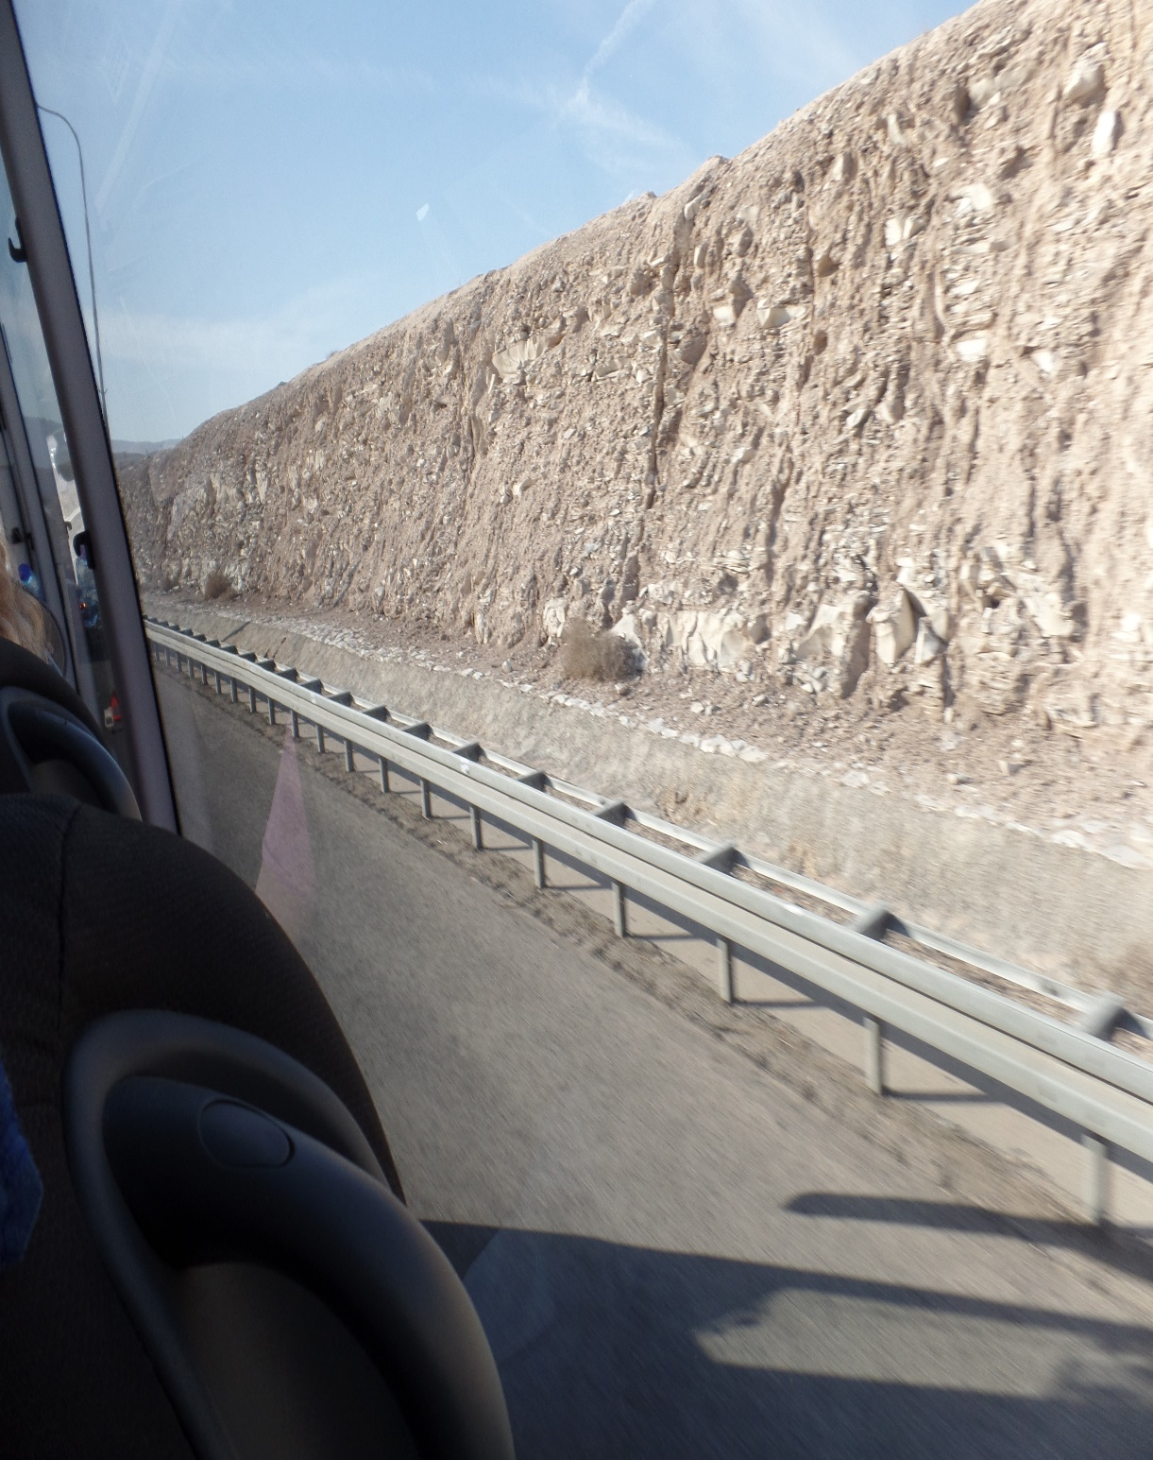
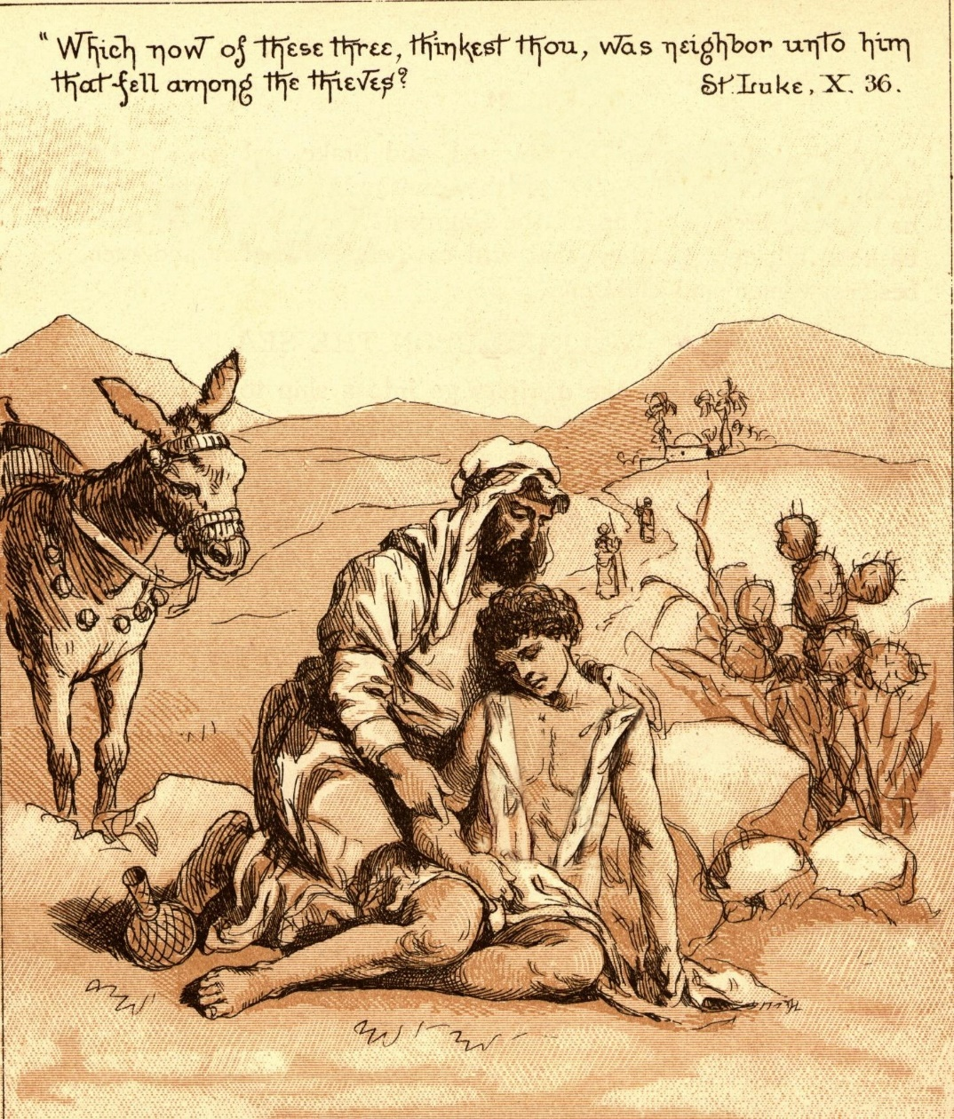
THE GOOD SAMARITAN
“… A certain man went down from Jerusalem to Jericho, and fell among thieves, which stripped him of his raiment, and wounded him, and departed, leaving him half dead…” (10:30).
Jesus told a parable about a Jew who had been attacked, robbed, and left for dead on the Jericho road. A priest and Levite passed by but offered no assistance to one of their own (10:31,32). Then a Samaritan came, stopped, offered assistance by dressing his wound and then took him to a nearby place of public lodging –
“… and set him on his beast, and brought him to an inn [Gr. pandocheon] (10:34), where he left him telling the innkeeper that he would pay for any further expenses.
Christ told this story because Samaritans hated Jews, but this man overcame his prejudice with good, which Christ commended for his mercy and compassion (10:36,37).
Jericho Road (2018)

Slide 10
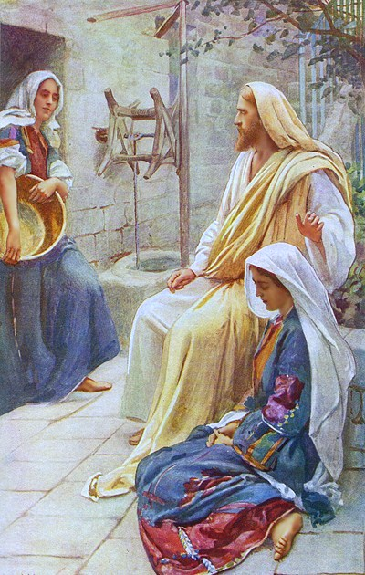
MARY & MARTHA
“Now it came to pass, as they went, that he entered into a certain village: and a certain woman named Martha received him into her house. And she had a sister called Mary, which also sat at Jesus’ feet, and heard his word” (10:38,39).
In the village of Bethany, Jesus visited the house and became close friends with these 2-sisters, Martha & Mary. Martha invited Jesus into her house at which time Mary sat at His feet, a position of submission as a student before her teacher. This disturbed Martha –
“But Martha was cumbered about much serving, and came to him, and said, Lord, dost thou not care that my sister hath left me to serve alone? Bid her therefore that she help me” (10:40).
Like Israel, Martha was more concerned for the physical realm, Mary, the spiritual, for which Jesus gently chastened Martha and complimented Mary.

Slide 11
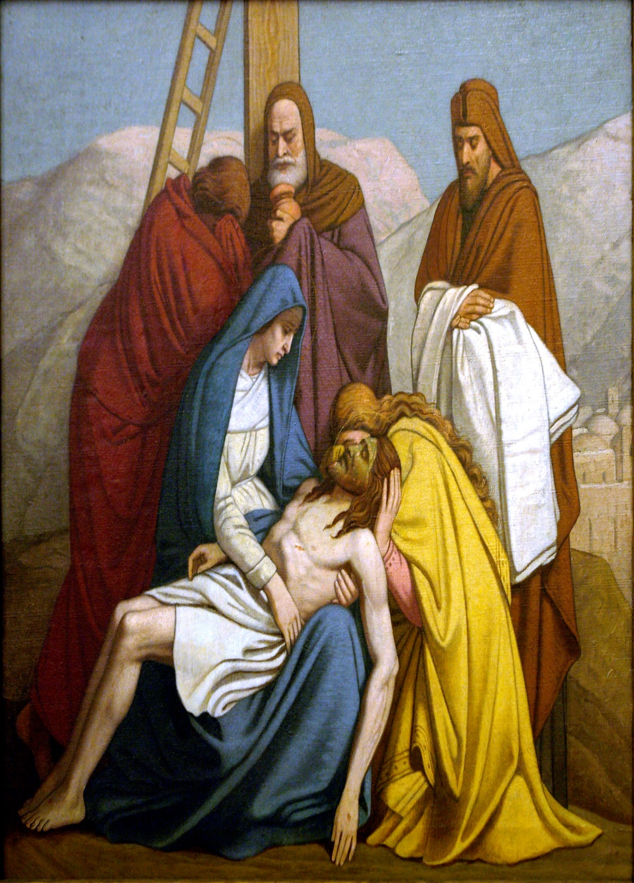
CHRIST THE DIVIDER
“I am come to send [figurative] fire on the earth… But I have a baptism to be baptized with; and how am I straitened till it be accomplished! Suppose ye that I am come to give peace on earth? I tell you, Nay; but rather division” (12:49-51).
At Christmas we sing carols of His birth bringing ‘peace
on earth,’ but that’s not what this says—Christ’s ministry did not bring peace between men—it brought DIVISION. His life was like a firestorm of controversy, which would culminate in His baptism [placed into, identification with] of death. His ministry began with the baptism of water; it ended with a baptism of death [cross].
“… there shall be 5 in one house divided, 3 against 2, and
2 against 3. The father shall be divided against the son, and the son against the father; the mother against the daughter… daughter against the mother…” (12:52,53).
Christ divided families for or against; He still does.

Slide 12
REPENTANCE
Israel was in a covenant relationship with God, but they often wandered far from it, so ‘repentance’ [an about face] was their on-going command. Two examples: Pilate had killed some Galileans and mixed their blood with animal sacrifices (13:1); others had died when a tower fell on and killed them (13:4). Jesus told the hearers that those killed in these 2-events, either murdered or by accidental death—both died in their sin and unless they had REPENTED [i.e. saved], they would be eternally lost.
“I tell you… except [all] ye repent, ye shall all likewise perish” ((13:5).
We, Gentiles, were never in the same covenant relationship with God, therefore, we are not told to REPENT [turn around and come back], but rather… JUST COME!

Slide 13
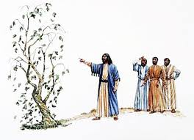
THE BARREN FIG TREE
“He spake also of this parable; A certain man had a fig tree planted in his vineyard; and he came and sought fruit thereon, and found none… 3 years I come seeking fruit on this fig tree, and find none: cut it down… Lord, let it alone this year also, till I dig about it, and dung it: and if it bear fruit, well: and if not, then after that thou shalt cut it down” (13:6-9).
Spiritual meaning?—for Jesus’ 3-year earthly ministry, He looked for spiritual fruit from Israel, but found none, which justified it being cut down (withdrawing his ministry to Israel). But, He didn’t. From the cross He forgave Israel (Lk. 23:34), giving them another chance. On the upcoming holy day of Pentecost, Peter told them to REPENT (Acts 2:38), but only a small number did [3,000 out of 3 million; .1%], so at the end of Acts that lifeless tree was cut down (ministry withdrawn) –
“… the heart of this people [Israel] is waxed gross… their eyes have they closed… salvation of God is sent unto the Gentiles, and that they will hear it” (Acts 28:25-28).

Slide 14
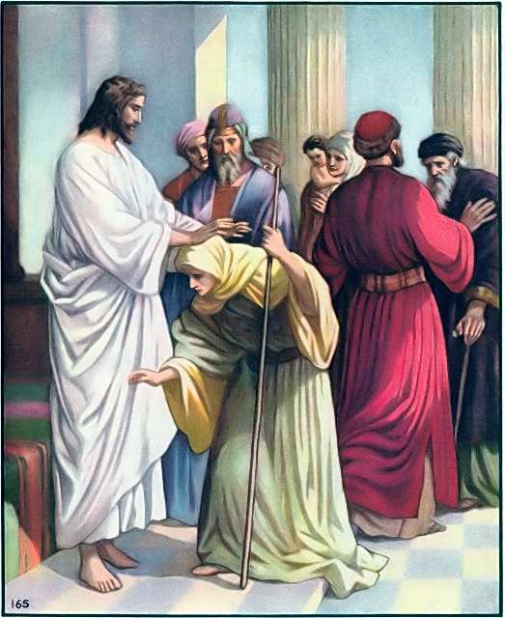
HEALED ON THE SABBATH
“And he was teaching in one of the synagogues on the Sabbath… there was a woman which had a spirit of infirmity 18-years, and was bowed together, and could in no wise lift herself up… And he laid his hands on her: and immediately she was made straight, and glorified God” (13:10-13).
Another case of healing on the Sabbath. Why?
“For the Son of man is Lord even of the Sabbath day” (Mt. 12:8).
Jesus Christ created the Sabbath for the Jewish people
to have a day’s rest from their labor and to worship Him. The Jewish leaders had reduced the Sabbath to nothing more than a ritual to catch Law breakers –
“And the ruler of the synagogue answered with indignation, because Jesus healed on the Sabbath day… there are 6-days in which men ought to work…

Slide 15
… an not on the Sabbath day (13:14)… [Jesus] thou hypocrite, doth not each one of you on the Sabbath loose his ox or his donkey from the stall, and lead him away to watering? And ought not this woman, being a daughter of Abraham, whom Satan hath bound, lo, these 18-years be loosed from this bond on the Sabbath day? And when he had said these things, all his adversaries were ashamed: and all the people rejoiced for all the glorious things that were done by him” (13:15-17).
Finally, they saw their hypocrisy. They loosed their animals from their stall for a drink of water on the Sabbath, but Jesus wasn’t supposed to loose this poor, afflicted woman from 18-years of bondage by Satan.
DO WE KEEP THE SABBATH TODAY?
No. The only commandment absent from the Pauline epistles. Why? No need. We are saved and placed IN-CHRIST—We spiritually rest in-Christ every day!

Slide 16
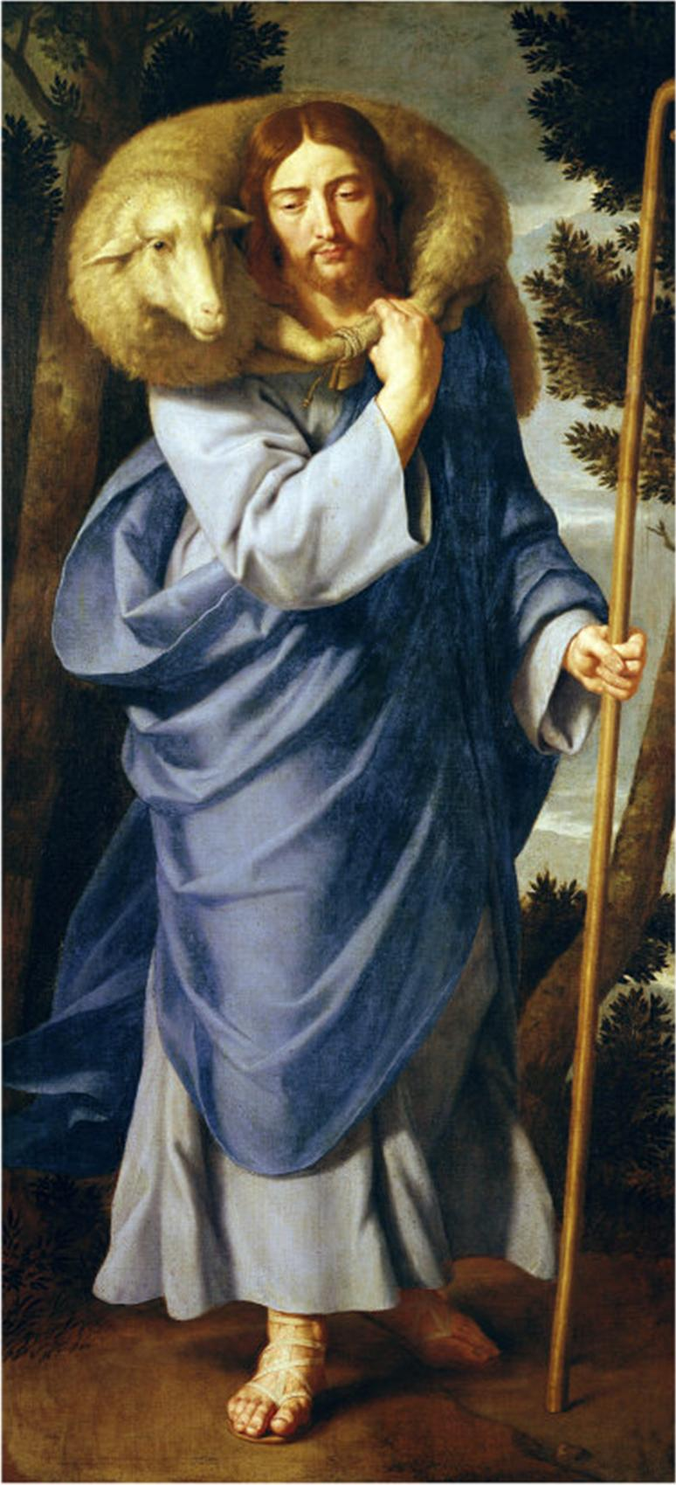
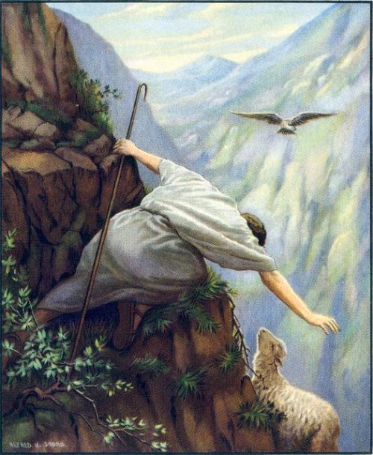
THE LOST SHEEP
“Then drew near unto him all the publicans and sinners for to hear him. And he spake this parable unto them, saying, What man of you, having 100 sheep, if he lose one of them, doth not leave the 99 in the wilderness, and go after that which is lost, until he find it? And when he hath found it, he layeth it on his shoulders, rejoicing” (15:1-4).
Another parable about lost Israel. The 99 in the wilderness are the self righteous [lost but don’t know they’re lost]. The 1 represents the publicans/sinners who knew they were lost. Who is the shepherd most concerned with? The 1 who knows he’s lost and
wants to be found [saved]!
“I say unto you… joy in the presence of the angels of God over 1 sinner that repenteth, more than over 99 just persons, which need no repentance” (15:10).
Out of 100, would you rather have 1 saved or none?

Slide 17
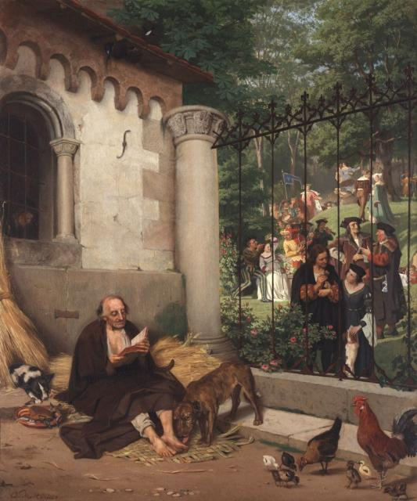
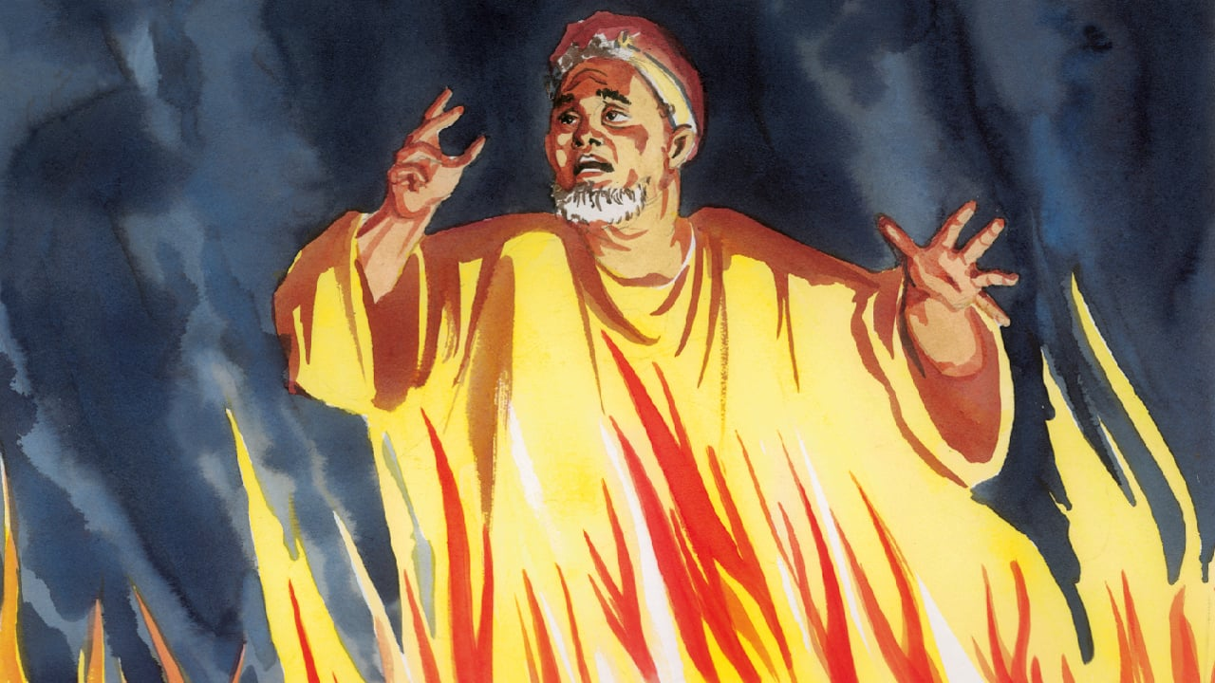
RICH MAN & LAZARUS
A well known Bible story about a rich man and a beggar named Lazarus. They both died and the scene moved to the after world—Lazarus in the bosom of Abraham and the rich man in hell –
“And in hell he lifted up his eyes, being in torments, and seeth Abraham afar off, and Lazarus in his bosom. And he cried and said, Father Abraham, have mercy on me, and send Lazarus, that he may dip the tip of his finger in water, and cool my tongue; for I am tormented in this flame” (16:23,24).
The rich man was in a place of unrelenting torment, he could see Lazarus in a place with no torments [paradise], but he could not get there. He asked for the smallest act of mercy—he received none. If he could not be helped, he asked that someone be sent to his family, but the answer was—just as you wouldn’t hear, neither would they.

Slide 18
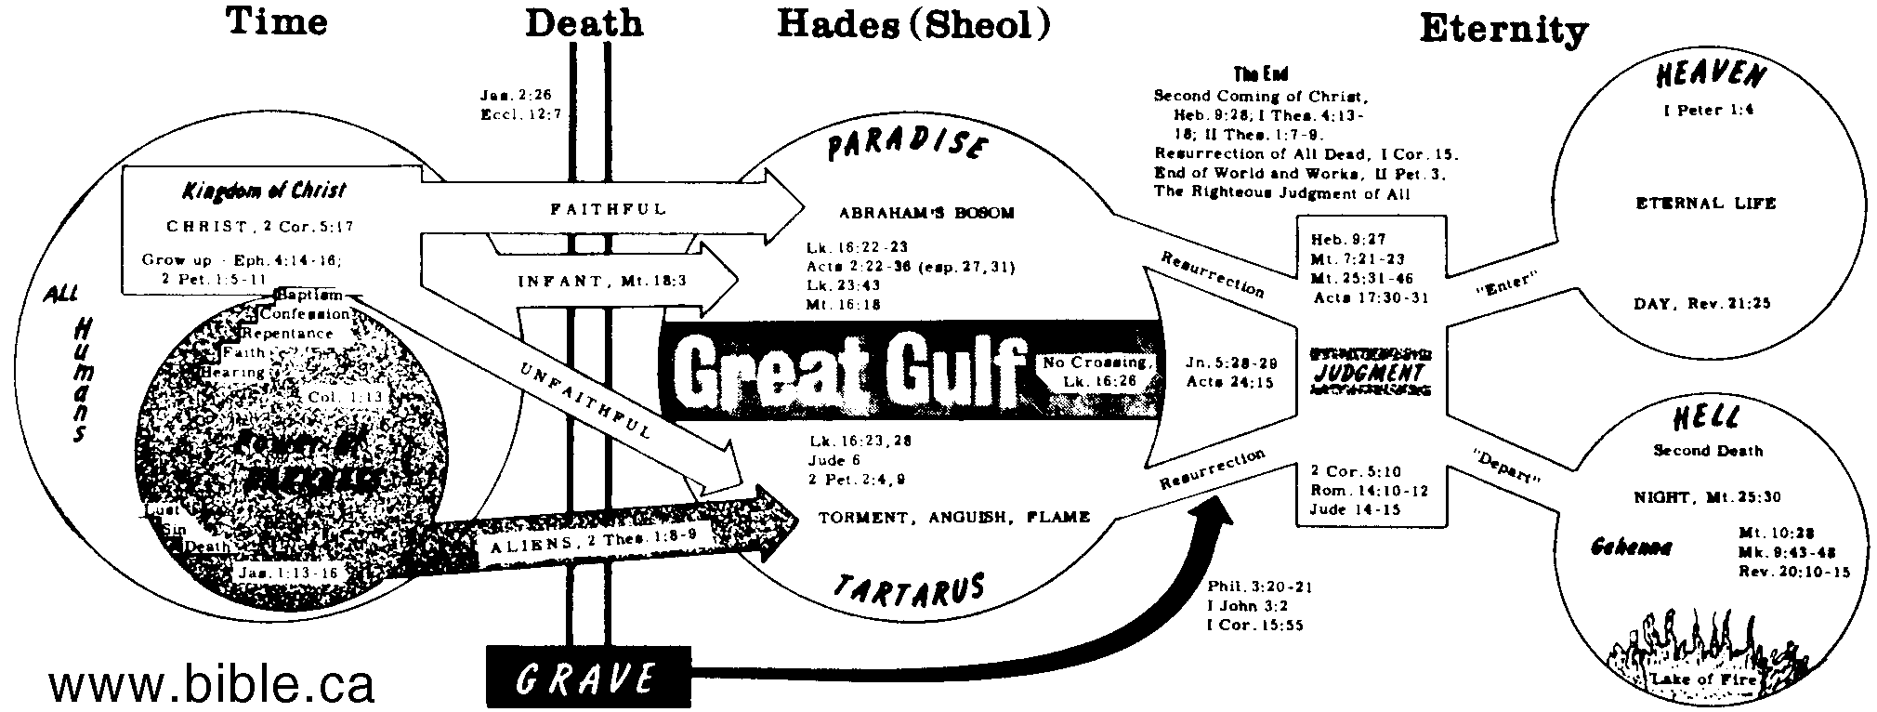
RICH MAN & LAZARUS (cont’d)
There are many truths we can learn from this narrative: there is consciousness after physical
death and we do retain a physical body (16:23); the unsaved feel pain; the saved are comforted (16:24,25); a great gulf exists between the saved & the lost (16:26); there is no escape from hell, and no way to warn loved ones of its reality; each person born has one lifetime to make man’s most important decision, heaven or hell; there are no 2nd chances.

Slide 19
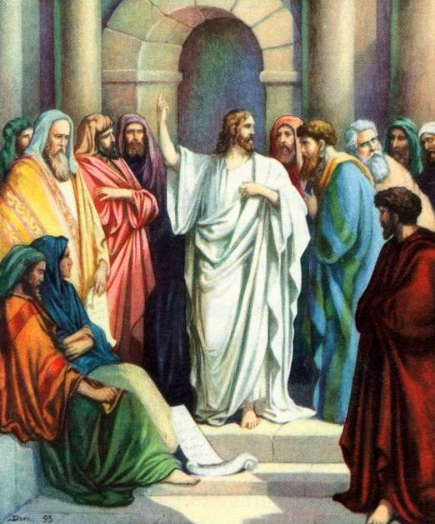
THE EARTHLY KINGDOM
“And when he was demanded of the Pharisees, when the kingdom of God should come, he answered them and said, The kingdom of God cometh not with observation: Neither shall they say, Lo here! Or, lo there! For behold, the kingdom of God is within you” (17:20,21).
One of the worst interpretations of the K.J.V. –
“Gr., entos = ‘in the midst.’ It could not be said of a self-righteous, Christ rejecting Pharisee, that the kingdom of God, as to its spiritual content, was within him… the kingdom was actually ‘in the midst’ of the Pharisees in the persons of the King and His disciples. Ultimately the kingdom will come, with outward show” (Old Scofield, p. 1100).
The kingdom was in their ‘midst’ had ‘come near’ in the Person of Christ + little flock. It will appear in its fullness and dramatically [outward show] at His 2nd coming.

Slide 20
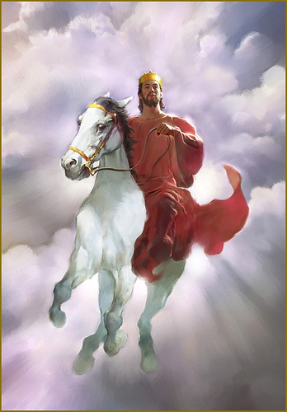
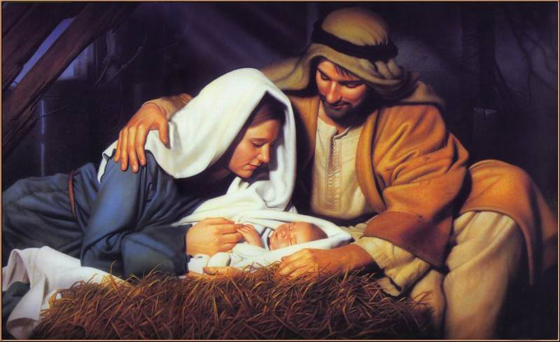
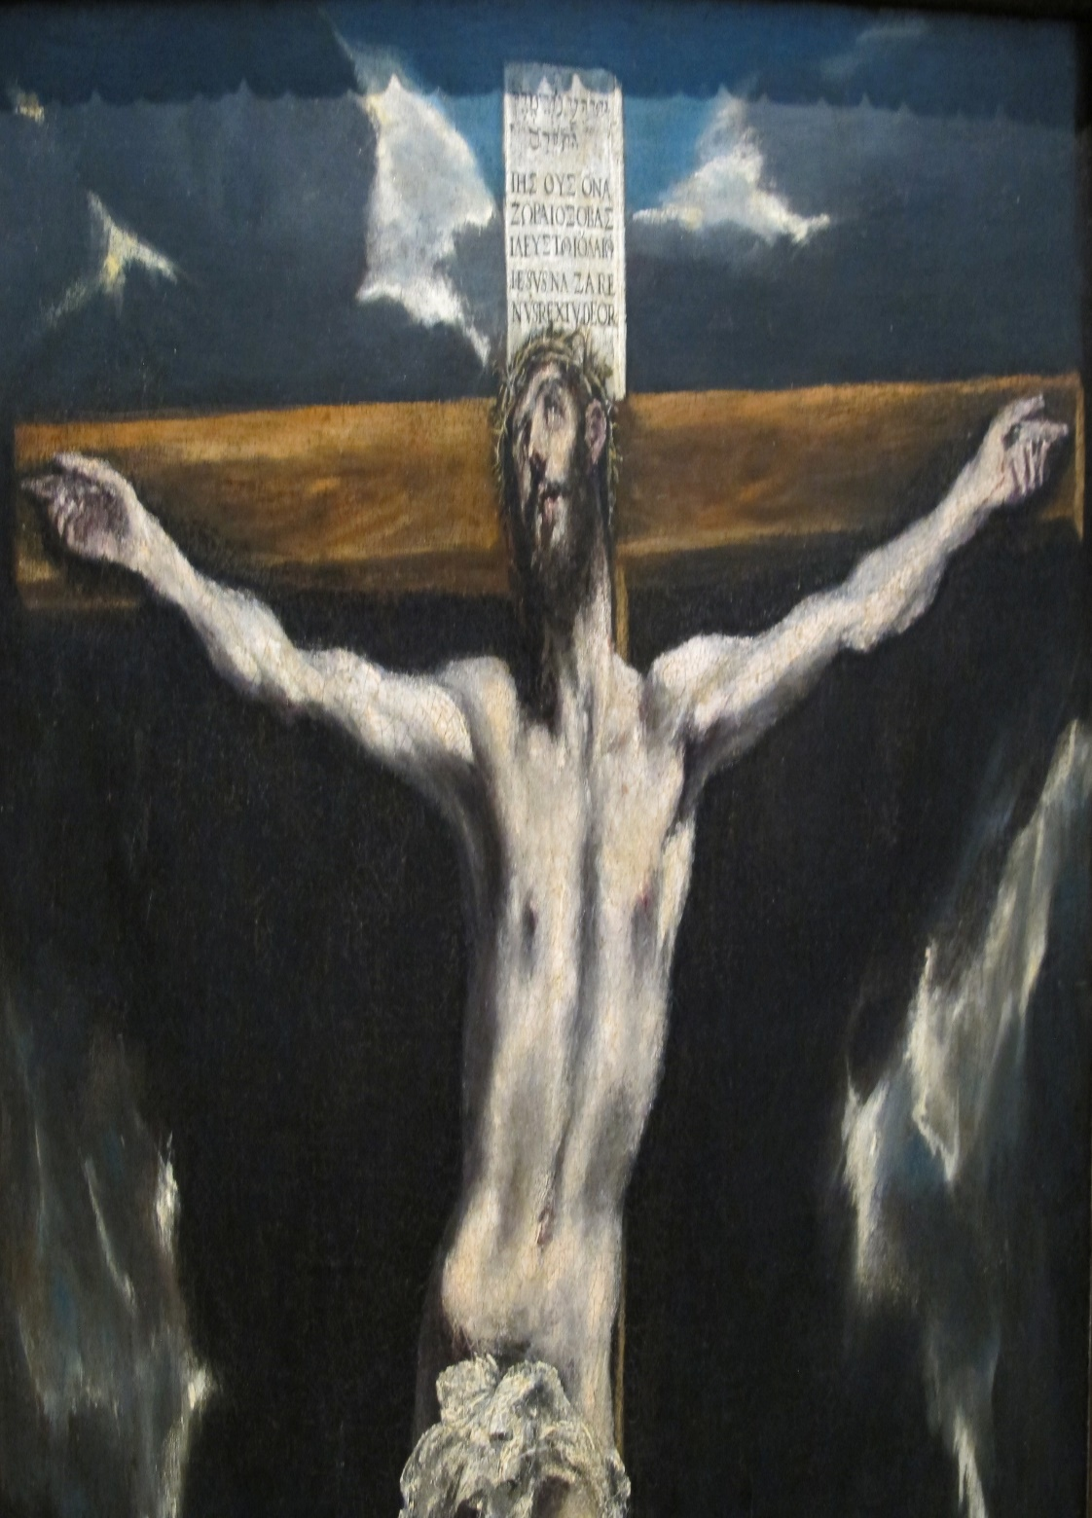
CHRIST’S 2ND COMING
As undramatic as was His 1st coming, His 2nd coming will be the most dramatic event in the history of man.
“For as the lightning, that lighteneth out of the one part under heaven, shineth unto the other part under heaven; so shall also the Son of man be in his day. But first must he suffer many things, and be rejected of this generation” (17:24,25).
Between His 1st and 2nd comings, is the most important event in the history of the universe—the passion of Christ.
“Whosoever shall seek to save his life shall lose it; and whosoever shall lose his life shall preserve it” (17:33).
Anyone who takes the ‘mark of the beast’ to stay alive during the tribulation, will lose his spiritual, eternal life –
“… any man worship the beast… receive his mark… shall drink of the wine of the wrath of God… he shall be tormented with fire and brimstone…” (Rev. 14:9,10).

Slide 21
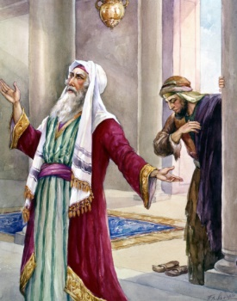
Next time – The Pharisee and the Publican

