Slide 1
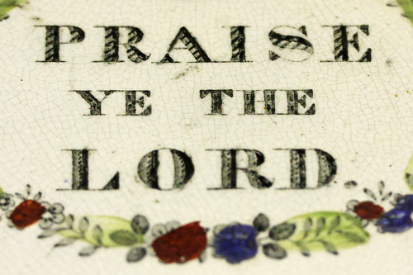
LESSON 22
WEEK 22 OF 52
(1Kg.1-4; Prov.1-3)
THROUGH THE BIBLE IN 2018
Last time we saw the zenith of David’s kingdom on earth; this time his death, and his son Solomon follows him on the throne.
This group of praise psalms exalt the God of Israel for who He is and all that He has done for them—
“Praise ye the LORD…” (Psa. 111:1).
“Praise ye the LORD…” (Psa. 112:1).
“Praise ye the LORD…” (Psa. 113:1).

Slide 2
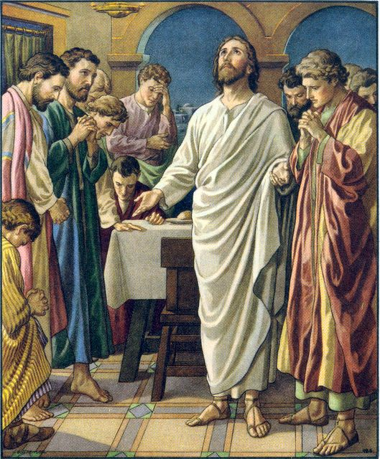
JESUS LEADS THE SINGING
It was customary for Jews to begin the Passover with singing
(Psa. 113, Praise ye the LORD) and to finish the meal with
singing –
“And when they had sung an hymn, they went out into the
mount of Olives” (Mk. 14:26).
In the Upper Room following the Passover meal and the
Lord’s Supper, do you know what song Jesus and the 11 sang?
“I shall not die, but live, and declare the works of the LORD.
The LORD hath chastened me sore: but he hath not given me
over unto death” (118:16,17).
The apostles were oblivious to what He was about to do.
“The stone which the builders refuses is become the head stone of the corner. This is the LORD’s doing; it is marvelous in our eyes” (118:22,23).
Though rejected then, Christ will become the Capstone of the kingdom during His millennial reign.

Slide 3
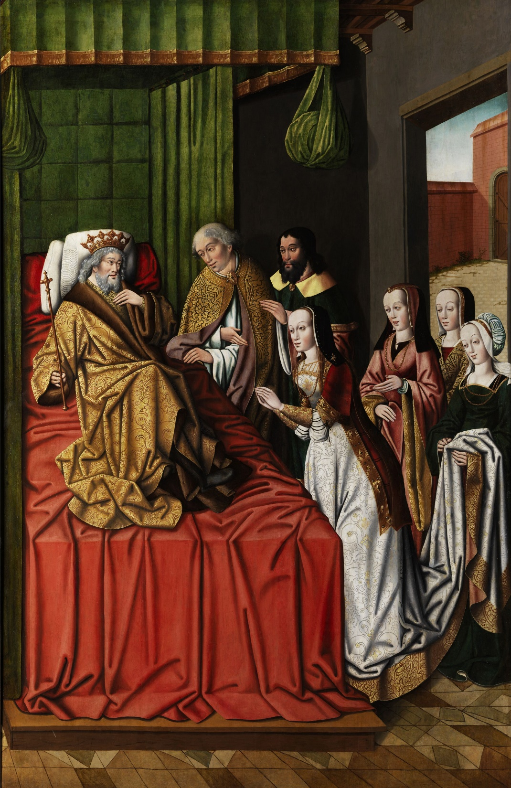
DAVID’S OLD AGE
“Now king David was old and stricken in years; and
they covered him with clothes, but he got no heat. Wherefore his servants said unto him, Let there be sought for my lord the king a young virgin: and let her stand before the king, and let her cherish him, and let her lie in thy bosom, that my lord the king may get heat… So they sought for a fair damsel… and brought her to the king. And the damsel was very fair, and cherished the king, and ministered to him: but the king knew her not” (1Kg. 1:1-4).
King David, 70, weak and in poor health, was provided a damsel [Abishag] to help maintain his body temperature, which was consistent with the medical customs and practices of the day. Sensing his impending death, another of his sons attempted a coup.

Slide 4
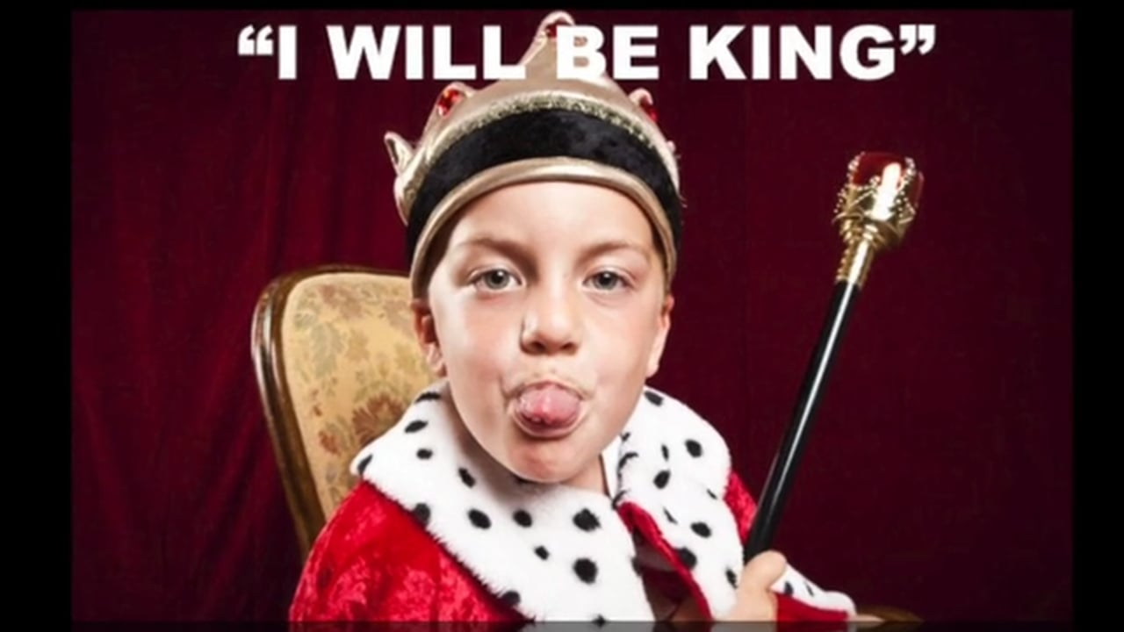
“Then [son] Adonijah… exalted himself, saying,
I will be king: and he prepared him chariots and horsemen…” (1:5).
Adonijah was the 4th son of David (2Sam. 3:4),
spoiled and self centered, the eldest living at that time after the death of Absalom. He enlisted the help of Joab, David’s commander –
“And he conferred with Joab… and with Abiathar the priest; and they following Adonijah helped him” (1:7).
Adonijah threw a banquet in order to enlist others to follow him, but he didn’t invite his father, Nathan the prophet, nor his younger brother Solomon who had already been
chosen to follow David on the throne
(1:10,11).
Now what?

Slide 5
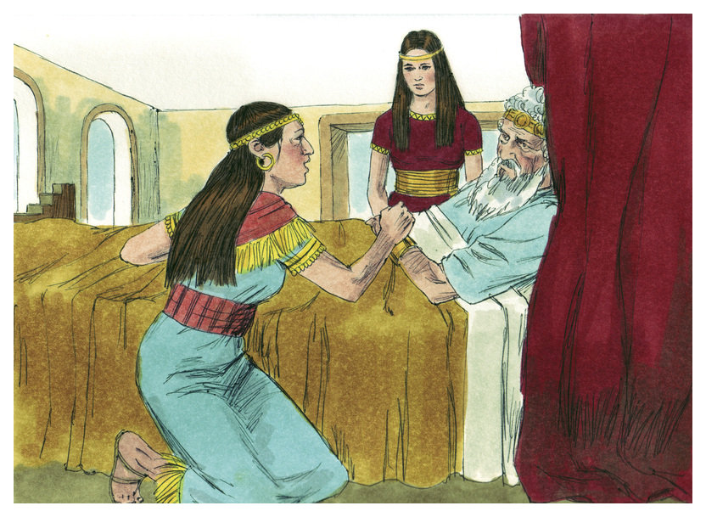
DAVID INFORMED
“And Bath-sheba went in unto the king into the chamber: and the king was very old… And Bath-sheba bowed, and did obeisance unto the king. And the king said, What wouldest thou? (1:15,16).
Bath-sheba spoke with David about the matter.
“And she said unto him, My lord, thou swarest by the LORD thy God… saying, Assuredly Solomon thy son shall reign after me, and he shall sit upon my throne. And now, behold, Adonijah reigneth; and now, my lord the king, thou knowest it not… And thou, my lord, O king, the eyes of all Israel are upon thee, that thou shouldest tell them who shall sit on the throne of my lord the king after him” (1:17-20).
After Bath-sheba informed David of the coup, Nathan requested an audience with the king.

Slide 6
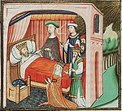
“And, lo, while she yet talked with the king, Nathan
the prophet also came in” (1:22).
Nathan asked David the same question – Who have
you chosen to be king after you?
“Then king David answered and said, Call me
Bath-sheba. And she came into the king’s presence, and stood before the king… As the LORD liveth, that that redeemed my soul out of all distress, even as I sware unto thee by the LORD God of Israel, saying, Assuredly Solomon thy son shall reign after me, and he shall sit upon my throne in my stead…” (1:28-30).
David reiterated his choice and quickly had Solomon anointed the next king of Israel –
“And Zadok the priest took an horn of oil out of the
tabernacle, and anointed Solomon… and the people
… rejoiced with great joy…” (1:39,40).

Slide 7
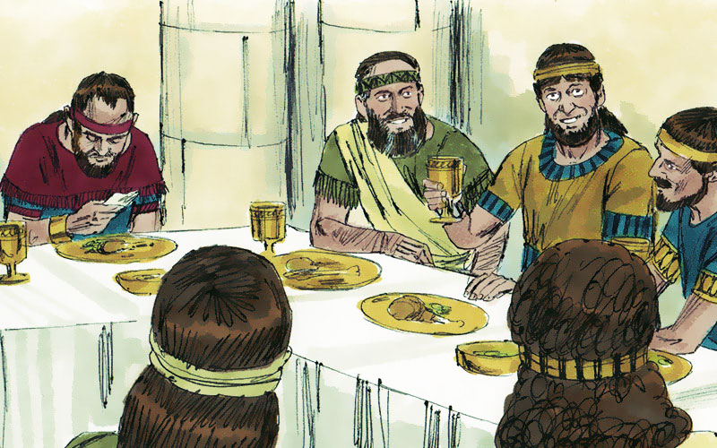
ADONIJAH’S RETREAT
“And all the guests that were with Adonijah
were afraid, and rose up, and went every man his way. And Adonijah feared because of Solomon, and arose, and went… And it was told Solomon, saying, Behold, Adonijah feareth king Solomon… And Solomon said, if he will shew himself a worthy man, there shall not an hair of him fall to the earth; but if wickedness shall be found in him, he shall die” (1:49-52).
Normally newly installed kings would slay those who were in competition for their throne, but Solomon showed mercy and allowed Adonijah to live as long as he promised that he would be a loyal supporter of his half-brother.
That promise would soon be put to the test.

Slide 8
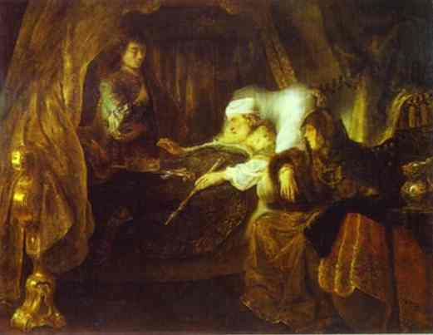
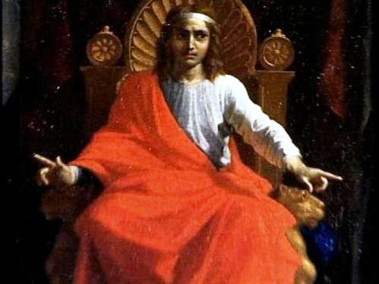
THE CHARGE TO SOLOMON
“Now the days of David drew nigh that he should die;
and he charged Solomon his son, saying, I go the way
of all the earth: be thou strong therefore, and shew
thyself a man. And keep the charge of the LORD thy
God, to walk in his ways, to keep his statutes, and his
Commandments… as it is written in the law of Moses…
That the LORD may continue his word which he spake
concerning me… there shall not fail thee a man on the
throne of Israel [Davidic Covenant]” (2:1-4).
David told Solomon to trust God and keep the Law and he will have a long reign on the throne of Israel.
THE DEATH OF DAVID
“So David slept with his fathers, and was buried in the
city of David… reigned over Israel [40] years… Then sat Solomon upon the throne of David his father; and his kingdom was established greatly” (2:10-12).

Slide 9
ADONIJAH EXECUTED
Solomon had shown mercy to his half-brother, but
would have no part of a scheme to make David’s virgin
nursemaid, Abishag, his wife (2:13-17) still having hope
of taking Solomon’s throne. It did not succeed and
Solomon had him executed (2:24,25). Solomon knew
that God had placed him on the throne of Israel and to
secure his position it would become necessary to purge those who would try to take it from him.
JOAB EXECUTED
Because Joab had sided with Adonijah, he was caught
and executed (2:28-34).
SHIMEI EXECUTED
A Levite, Shimei had conspired with Absalom and he,
too, was caught and executed (2:46) – “And king
Solomon shall be blessed, and the throne of David shall
be established for ever… The kingdom was established
in the hand of Solomon” (2:45).

Slide 10
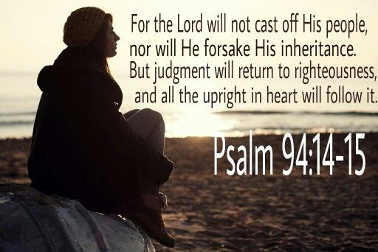
Coups and Satan’s attempt to interrupt the Davidic
Covenant caused David to write this series of Psalms –
“Fret not thyself because of evil-doers, neither be thou
envious against the workers of iniquity” (Psa. 37:1).
This one seems to be written directly to Solomon
concerning those who would try to dethrone him.
“Now also when I am old and grey-headed, O God,
forsake me not; until I have shewed thy strength unto
this generation, and thy power to every one that is
to come” (71:18).
David, old and gray, hoped he had done enough to
show his and the next generation the power of God.
Have we done the same for our generation/next? “For the preaching of the cross is to them that perish foolishness, but unto us which are saved it is the power of God” (1Cor. 1:18).
“For the LORD will not cast off his people, neither will he forsake his inheritance” (94:14).
Though written to Israel, God has made the same promises to the Body of Christ today –
“And hath raised us up together, and made us sit in heavenly places in Christ Jesus” (Eph. 2:6).

Slide 11
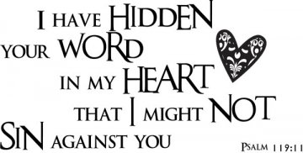
What does this verse have to do with B.D.T.L.B. and G.B.F.?
It is a pledge we ask the children to recite at the opening of each day of V.B.S.
Can you think of any thing more important to teach our children during that very important week of July 15-19?
Do you have a job that week? If not… may I ask why not? What ever excuse you use will not be accepted –
“… so that they are without excuse” (Rom. 1:20).
“Thy word is a lamp unto my feet, and a light unto my path” (119:105).
The only way to light a dark spiritual world is for the believer to share the Word of God with others.

Slide 12
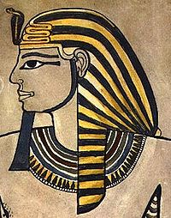
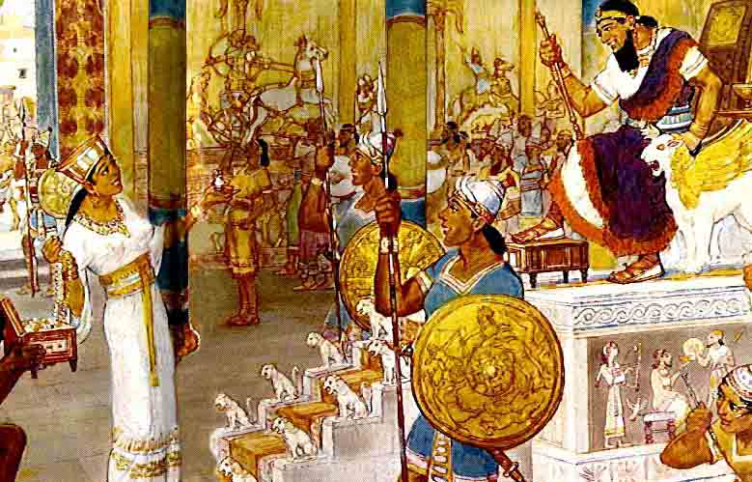
A PEACE TREATY WITH EGYPT
“And Solomon made affinity with Pharaoh king of Egypt, and took Pharaoh’s daughter, and brought her into the city of David, until he had made an end of building his own house, and the house of the LORD, and the wall of Jerusalem round about” (1Kg. 3:1).
In order to achieve the peace that God had promised
Israel, he made a peace treaty with Egypt and secured
it by taking Pharaoh’s daughter as his wife. Good idea?
Hebrews were not to marry outside their faith. It is apparent that Solomon did so for political reasons. He brought his new bride to Jerusalem while he was busy with several building projects.
“And Solomon loved the LORD, walking in his statutes of David his father…” (3:3:a).
Solomon began O.K., but can he sustain it?

Slide 13
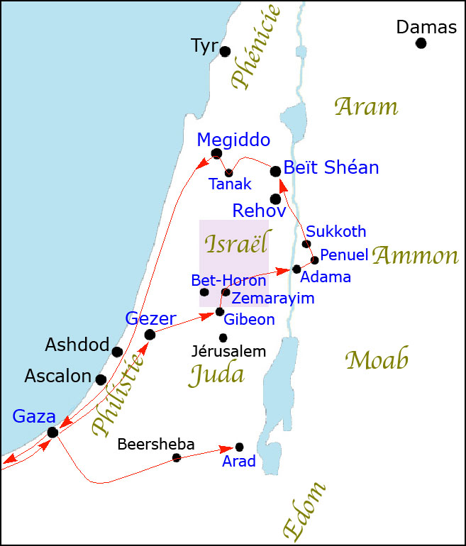
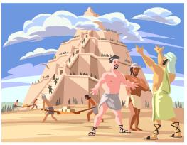
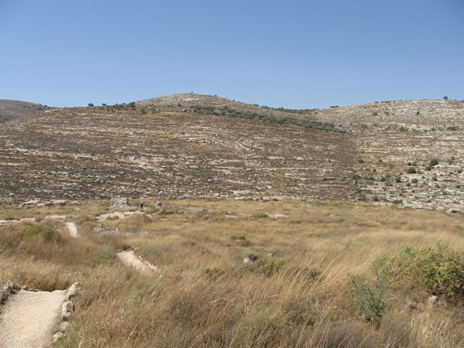
HIGH PLACES
“Only the people sacrificed in high places, because there was no house [temple] built unto the name of the LORD, unto those days… he [Solomon] sacrificed and burnt incense in high places” (3:2,3b).
From the time of the tower of Babel, pagans had worshipped in ‘high places’ in order to get closer to their gods. The Canaanites had practiced the same and had even influenced the Israelites to do also during the time of the Judges. The Law forbid any worship outside the tabernacle (Lev. 17:3,4), but in this one case it was accepted because after being separated from the ark it had been moved to Gibeon after the destruction of Shiloh by the Philistines –
“And the king went to Gibeon to sacrifice there; for that was the great high place: [1,000] burnt offerings
did Solomon offer upon that altar” (3:4).
‘High place’ at Gibeon, site of the
tabernacle, 5-miles north of Jerusalem

Slide 14
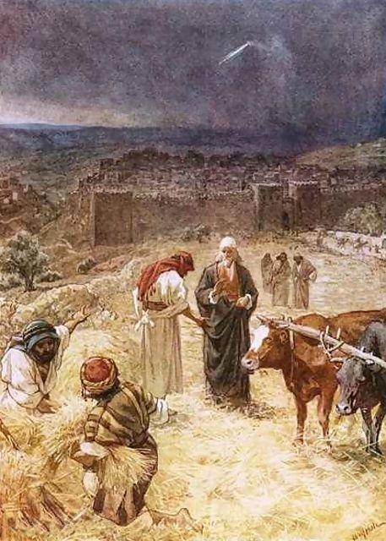
Why did Solomon go to a ‘high place’ to offer sacrifices to
God, when his father David had brought the Ark of the
Covenant to Jerusalem and then bought the ‘threshingfloor’
[site of the future temple] where he worshipped?
“And David built there an altar unto the LORD, and offered
burnt-offerings and peace-offerings, and called upon the
LORD; and he answered him from heaven by fire upon the
altar of burnt-offering. And the LORD commanded the
angel; and he put his sword again into the sheath thereof.
At that time when David saw the LORD had answered him
in the threshing floor of Ornan the Jebusite, then he
sacrificed there. For the tabernacle of the LORD, which
Moses made in the wilderness, and altar of the burnt-
offering, were at that season in the high place at Gibeon.
But David could not go before it to enquire of God: for he
was afraid because of the sword of the angel of the LORD” (1Chron. 21:29,30).
David made this site his regular place of worship just north of the city walls, no longer going to the tabernacle in Gibeon, which he perceived by the angel’s sword not to do.

Slide 15
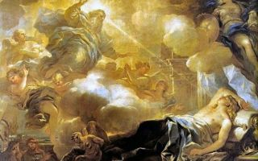
SOLOMON’S PRAYER FOR WISDOM
In Gibeon the LORD appeared to Solomon in a dream by night: and God said, Ask
what I shall give thee. And Solomon said, Thou hast shewed unto thy servant David
my father great mercy, according as he walked before thee in truth, and in
righteousness, and in uprightness of heart with thee; and thou hast given him a son
to sit on his throne… And now O LORD my God… I am but a little child: I know not
how to go out or come in… Give therefore thy servant an understanding heart to
judge thy people, that I may discern between good and bad… And the speech
pleased the LORD, that Solomon had asked this thing… And God said unto him,
because thou hast asked this thing, and hast not asked for thyself long life… riches…
lo, I have given thee a wise and understanding heart: so that there was none like
thee before thee, neither after thee shall any arise like unto thee. And I have also
given thee… both riches, and honour… lengthen thy days” (3:5-13).

Slide 16
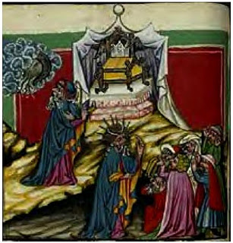
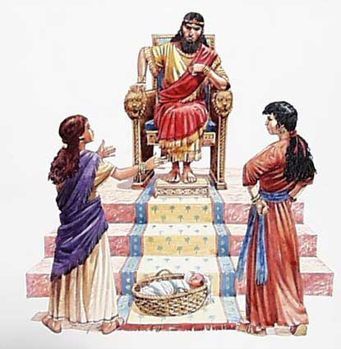
“And Solomon awoke; and behold, it was a dream. And he came to Jerusalem, and stood before the ark of the covenant of the LORD, and offered up burnt-offerings, and peace-offerings, and made a feast to all his servants” (3:15).
Solomon’s first act of discernment was to restrict his offerings to God in Jerusalem as did his father.
THE WISDOM OF SOLOMON
“Then came there two women, that were harlots, unto the king, and stood before him. And the one woman said, O my lord, I and this woman dwell in one house; and I was delivered of a child with her in the house. And it came to pass the third day after that I was delivered, that this woman was delivered also… And this woman’s child died in the night; because she overlaid it…” (3:16-19).

Slide 17
“And she arose at midnight, and took my son from beside me… and laid it in her bosom, and laid her dead child in my bosom. And when I rose in the morning to give my child suck, behold, it was dead… it was not my son, which I did bear. And the other woman said, Nay; but the living is my son, and the dead is thy son…. Thus they spake before the king” (3:20-22).
How would Solomon settle this difficult case?
“And the king said, Bring me a sword… Divide the living child in two, and give half to the one, and half to the other… O my lord, give her the living child… Then the king answered and said, Give her the living child… she is the mother thereof… All Israel saw the wisdom of God in him”
(3:24-27).
Solomon had truly been gifted in God’s wisdom.

Slide 18
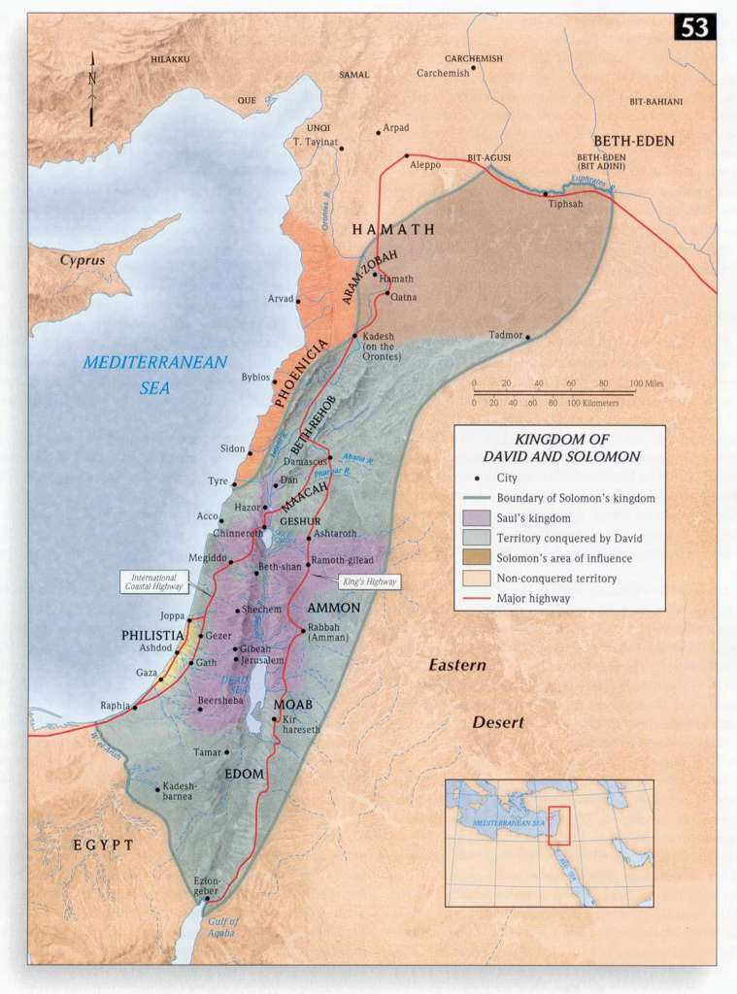
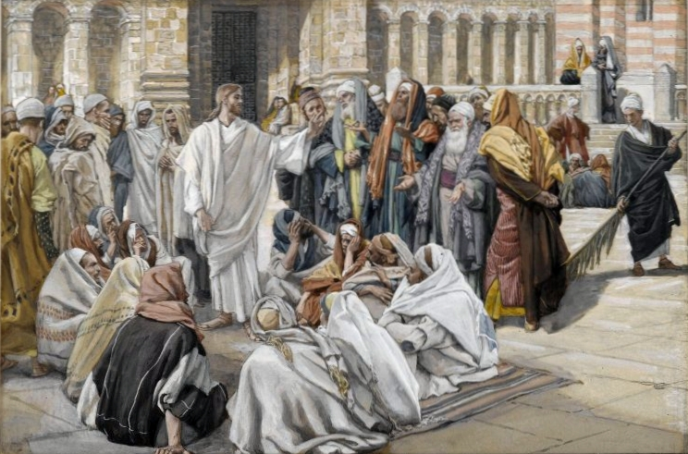
DELEGATION OF AUTHORITY
Solomon showed his wisdom as an administrator over the
operation of his vast kingdom –
“So king Solomon was king over all Israel. And these were
the princes which he had…” (4:1).
Solomon appointed [11] top officials over his government: priests, scribes, recorders of daily events, commanders of
the army, etc. (4:2-6). Next he chose [12] officials to provide the requirements for the royal household (4:7-18).
ISRAEL’S PROSPERITY
“Judah and Israel were many, as the sand which is by the
sea in multitude, eating and drinking, and making merry”
(4:20)… and Solomon gathered [1,400] chariots and [12,000] horsemen… the king made silver and gold at Jerusalem as plenteous as stones…“ (2Chron. 1:14,15).
Solomon was quickly becoming the wealthiest king on earth.

Slide 19
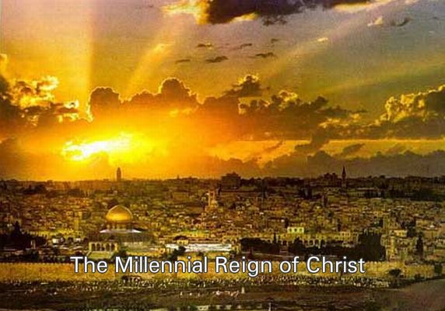
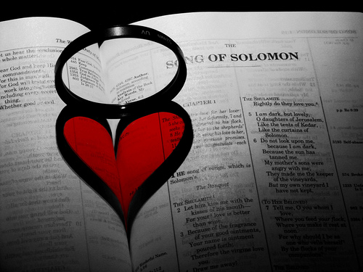
A PSALM OF SOLOMON
“… thy righteousness unto the king’s son… bring peace to the people… he shall save… and shall break in pieces the oppressor… In his days the righteous flourish... Kings shall bring presents… all kings shall bow before him: all nations serve him” (Psa. 72).
As Solomon triumphantly began to reign over his kingdom, this psalm anticipates Christ’s rule over the His kingdom, which will also include a marriage –
THE SONG OF SOLOMON
Written by Solomon, this book is God’s authority on love and marriage, but also a spiritual marriage, i.e. Christ + Israel, as they enter the earthly kingdom as husband and wife and live happily ever after eternally!

Slide 20
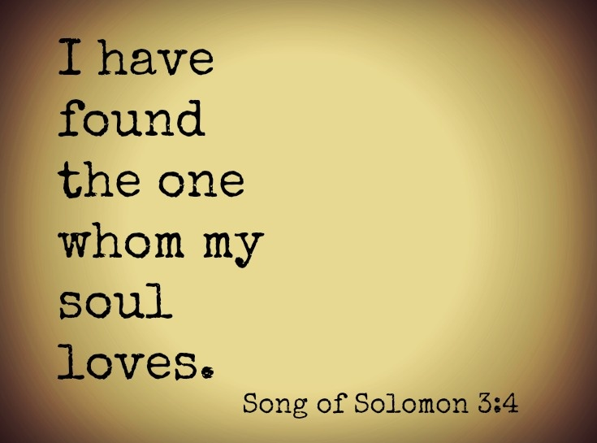
THE SONG WRITER
Solomon, who reigned 40 years [971-931 B.C.] was a prolific song writer, 1,005 songs (1Kg. 4:32), and this is one—a love song, consists of 4-parts:
Courtship (1:2-3:5) – “Let him kiss me with the kisses of his mouth: for thy love is better than wine…” (1:2).
Wedding procession (3:6-5:2) – “I sleep, but my heart waketh:
It is the voice of my beloved” (5:2).
Mature love (5:2-8:4) – “I am my beloved’s, and his desire is toward me” (7:10).
Their life together (8:5-14) – “Many waters cannot quench love, neither can the floods drown it…” (8:7).
The Song of Solomon is God’s endorsement of the various aspects of love within the marriage bond –
“Marriage is a sacred institution, the basis for human society, and should be held in high honor among all men” (How this
pastor begins every marriage ceremony).

Slide 21
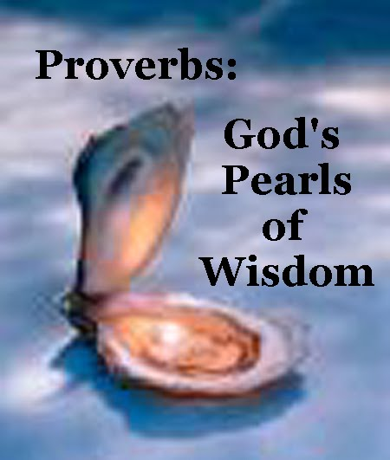
THE PROVERBS
“And he [Solomon] spake [3,000] proverbs… (2Kg. 4:32).
Not only was Solomon a prolific song writer, but even greater in his writing of God-given ‘wise sayings’ in how to live many aspects of life. Though written to Israel, they are timeless in many of their applications to life in general.
“The proverbs of Solomon the son of David, king of Israel.
To know wisdom and instruction; to perceive the words of understanding. To receive the instruction of wisdom, justice, and judgment, and equity… A wise man will hear, and will increase in learning; and a man of understanding shall attain unto wise counsels (1:1-5)… Trust in the LORD with all thine heart; and lean not unto thine own understanding” (3:5).
Want to be wise? Listen to God and godly, wise people around you.
Next time – More wisdom from God

