Slide 1
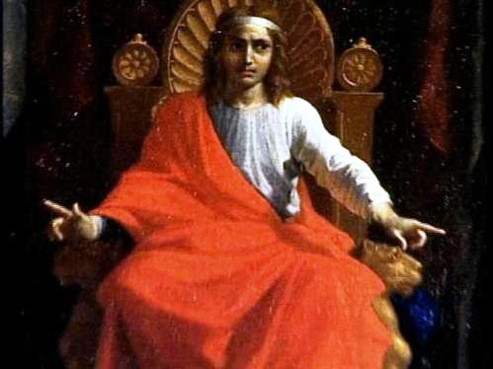
THROUGH THE BIBLE IN 2018
LESSON 23
WEEK 23 OF 52
(Prov.4-24)
Last time we saw Solomon take David’s throne and begin a 40-year reign. He was a prolific song writer [Song of Solomon] as well as more than
3,000 wisdom sayings called proverbs.
God said to Solomon – “ I have given thee a wise and understanding heart: so that there was none like thee before thee, neither after thee shall any arise like unto thee” (3:12).
“My son [Solomon], if sinners entice thee, consent thou
not… (1:10)… My son… (2:1)… My son… (3:1)… Hear, ye
children, the instruction of a father, and attend to know
understanding (4:1)… For I was my father’s son, tender
and only beloved in the sight of my mother” (4:3).
As a young king, Solomon began to write those things
which his father David and mother Bath-sheba had
taught him and his siblings.
Are we sharing our wisdom with children today?

Slide 2
“He taught me also, and said unto me, Let thine heart retain my words: keep my commandments and live. Get wisdom, get understanding: forget it not; neither decline from the words of my mouth… Wisdom is the principal thing: therefore get wisdom: and with all thy getting get understanding” (4:4-7).
Solomon was quoting his parents and in turn teaching his children, as Hebrew Scriptures dictated –
“That thou mightiest fear the LORD thy God, to keep all his statues and his commandments, which I command thee, and thy son, and thy son’s son, all the days of thy life…” (Deut. 6:2).
The greatest gift you can give your children and grandchildren [all children] is to pass along the wisdom that God has given to you.

Slide 3
“And, ye fathers, provoke not your children to wrath: but bring them up in the nurture and admonition of the Lord” (Eph. 6:4).
Don’t wait until they’re grown to start teaching your children, because they are likely to resist it [‘wrath’—don’t tell me what to do!].
Begin early and often and you will have the best chance to make a godly connection with them. Likely hearing his father David tell him to seek wisdom and understanding is what caused Solomon to ask God for it.
“Give therefore thy servant an understanding heart… that I may discern between good and bad…” (1Kg. 3:9).
We don’t have to be the king of Israel to want the same thing for ourselves and all children.

Slide 4
Notice the things that wisdom can bring in one’s life –
“… honour… grace… glory… (4:8,9). I have taught thee
in the way of wisdom; I have led thee in right paths”
(4:11).
The opposite –
“Enter not into the path of the wicked, and go not in
the way of evil men. Avoid it, pass not by it, turn from
it, and pass away” (4:14,15).
Better to preach wisdom to the young, than have to
deal with the consequences when they are old.
Solomon’s teaching included ‘strange women’ –
“For the lips of a strange woman drop as an honeycomb,
and her mouth is smoother than oil: But her end is bitter
as wormwood, sharp as a two-edged sword. Her feet go
down to death; her steps take hold on hell… Remove thy
way far from her house: Lest thou give thine honour unto others…” (5:3-9).

Slide 5
“For the ways of man are before the eyes of the LORD, and he pondereth all his goings. His own iniquities shall take the wicked himself, and he shall be holden with the cords of his sins. He shall die without instruction; and in the greatness of his folly he shall go astray” (5:21-23).
God knows all and sees all—nothing escapes His scrutiny. When man rejects God and the wisdom of His teachings he becomes bound by sin and his life is surely on the way of destruction.
God calls this sinful lifestyle “folly” which is used 21 times in PROVERBS.
To ignore God and yield to sin is folly.

Slide 6
FOOLISH FINANCES
“My son, if thou be surety for thy friend, if thou hast stricken
thy hand with a stranger. Thou art snared with the words of
thy mouth… Do this now, my son, and deliver thyself… go
humble thyself… give not sleep to thine eyes… deliver thyself
… as a bird from the hand of the fowler” (6:1-5).
It is folly to get oneself into a bad financial situation with
either a friend or distant relative, e.g. co-sign a note with a
high interest rate when it is likely you may be stuck holding
the bag. What to do?
GET OUT OF IT AS SOON AS POSSIBLE!!!
Be very cautious when either lending or borrowing money,
especially when high interest rates apply, and even more so when you can’t afford to lose the money. Still good advice today from Shakespeare’s Hamlet, 1602 –
“Neither a borrower nor a lender be, for loan oft loses both itself and a friend.”

Slide 7
“The fear of the LORD is to hate evil: pride, and arrogancy, and the evil way, and the forward mouth, do I hate” (8:13).
This proverb tells us that wisdom is making the right moral choices. God hates evil, therefore
we should hate evil as well. These can be manifested in a prideful, arrogant attitude, which usually begins with the things that we utter from our mouth.
“The proverbs of Solomon. A wise son maketh a glad father: but a foolish son is the heaviness of his mother” (10:1).
C.I. Scofield – “A fool in Scripture is never a mentally deficient person, but rather one arrogant and self-sufficient; one who orders his life as if there were no God” (Old Scofield, p. 678).
WATCH
WHAT
YOU
SAY!

Slide 8
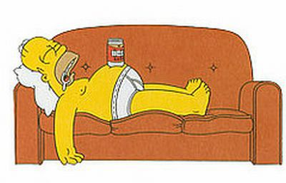
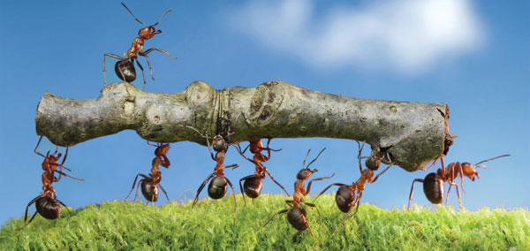
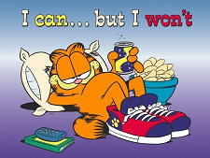
WORK ETHIC
“He becometh poor that dealeth with a slack hand: but the hand of the diligent maketh rich” (10:4).
A lazy person will often become poor whereas a hard worker will usually be rewarded for his productivity. An ant is a good example –
“Go to the ant, thou sluggard; consider her ways, and be wise… provideth her meat in the summer, and gathereth her food in the harvest” (6:6,8).
Another example of laziness can be one who sleeps excessively –
“How long wilt thou sleep, O sluggard? When wilt thou arise out of thy sleep? (6:9).

Slide 9
The Apostle Paul had much to say about the work ethic –
“… to work with your hands, as we commanded you” (1Thess. 4:11).
When believers failed to respond, he wrote –
“For even when we were with you, this we commanded you, that if any not work, neither should he eat” (2Thess. 3:10).
There is another, perhaps even more important reason to possess a good work ethic and that is you will be rewarded in heaven by Christ –
“Let him that stole steal no more: but rather let him labour, working with his hands the thing that is good…” (Eph. 4:28).
Work is a good work! Keep it up!

Slide 10
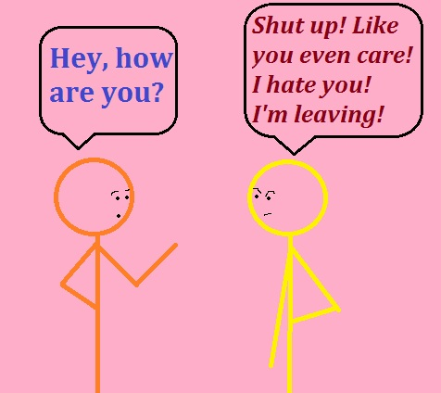
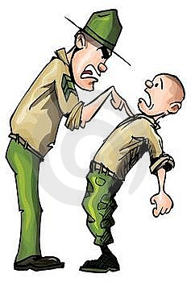
“Whoso loveth instruction loveth knowledge: but he that hateth [correction] is [dull minded]” (12:1).
Want a recipe for certain failure? Refuse to be taught by someone who knows…
… and, refuses to be corrected when someone who knows tries to show you a better way. If you do, then you are dull-minded and have no one to blame for your failures, but you.
“There is that speaketh like the piercings of a sword…” (12:18a).
A military drill sergeant has to be speak harshly to teach the new recruit discipline, but in other realms it can pierce like a sword –
“Even so the tongue is a little member, and boasteth great things… how great a matter a little fire kindleth! … But the tongue can no man tame; it is an unruly evil, full of deadly poison” (Jas. 3:5-8).

Slide 11
“There is that speaketh like the piercings of a sword: but the tongue of the wise is health” (12:18).
The person with wisdom does not use words like a sword that can cut, but rather words that will cure.
“There is a way which seemeth right unto a man, but the end thereof are the ways of death” (14:12).
This principle is further developed in the N.T. where Paul tells us we are born sinners (Rom. 5:12) and that, “… in time past ye walked according to the prince of the power of the air, the spirit that now worketh in the children of disobedience”
(Eph. 2:2).
Before our salvation, we thought what we were doing was right, but we were wrong. Had we not heeded Christ’s call we would have died a 2nd spiritual, eternal death (Rev. 20:14).

Slide 12
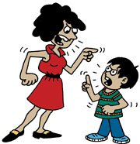
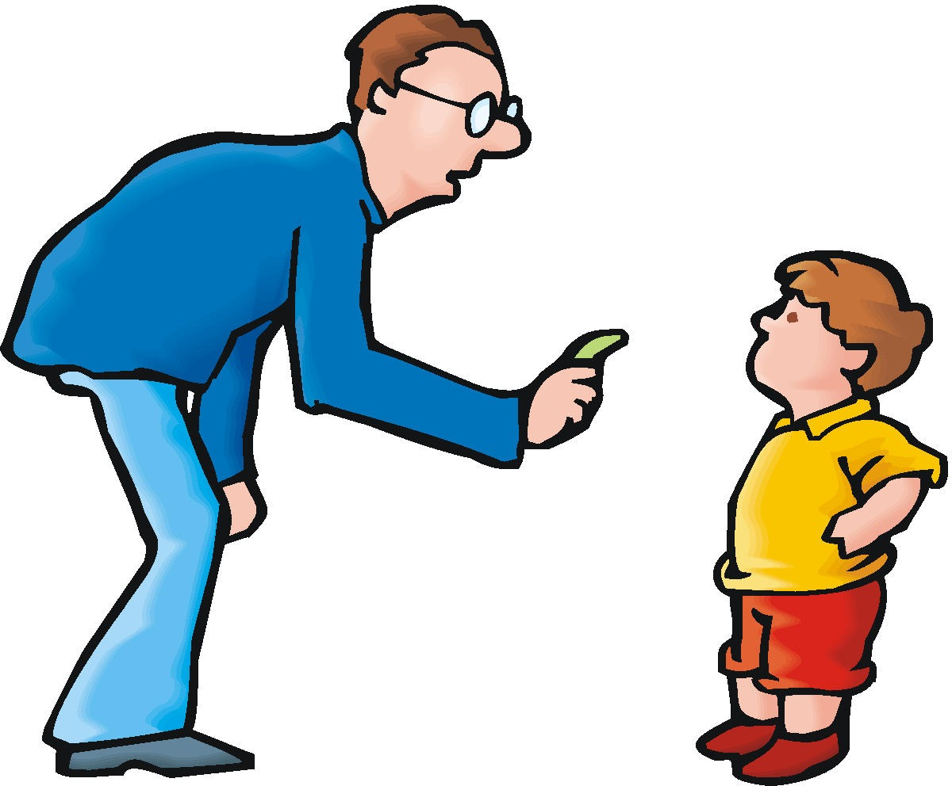
TRAINING AND DISCIPLINE OF CHILDREN
“Train up a child in the way he should go: and when he is old, he will not depart from it” (22:6).
Whether parents should discipline their children is what modernism asks, but the Bible is clear in that it is not only necessary but mandatory. Many in the modern age believe parents should reason with the child in question, but again, the Bible teaches otherwise –
“He that spareth his rod hateth his son: but he that loveth him chasteneth him [promptly] (13:24) … Chasten thy son while there is hope, and let not thy soul spare for his crying” (19:18).
Choose one: #1. temporary pain; #2. life-long anguish. Better to have the child shed a few tears now, than before officers of the law later.

Slide 13
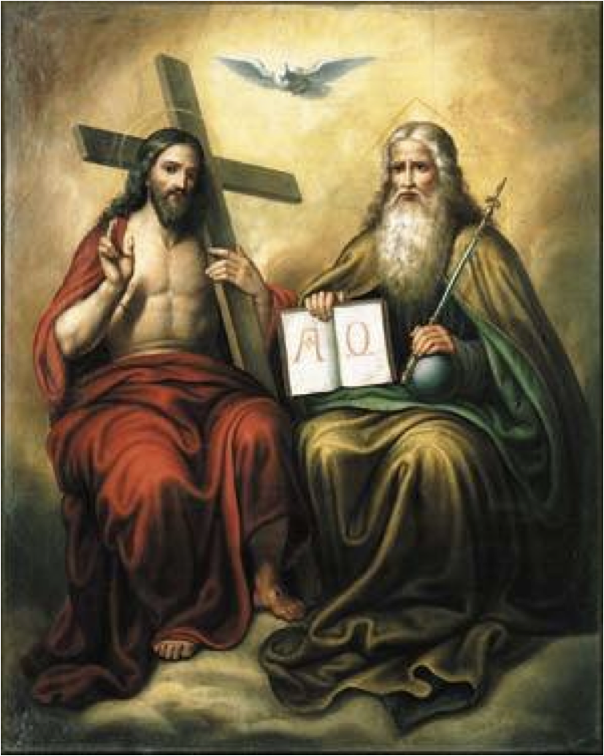
“The eyes of the LORD are in every place,
beholding the evil and the good” (15:3).
God is omniscient and omnipresent, knowing
all that man does—for that reason, he sent His
Son to comfort the righteous and convict the lost.
“The sacrifice of the wicked is an abomination
unto the LORD: but the prayer of the upright is
his delight” (15:8).
God wants the unsaved to know that whatever
they think they are sacrificing to Him, will not be
accepted, “Without faith it is impossible to please
him” (Heb. 11:6).
For the saved, something as small as a righteous
prayer will please the LORD.
“Hell and destruction are before the LORD: how
much more then the hearts of the children of men?” (15:11).
If God can see into hell, he can surely see into the hearts of man (Jer. 17:9,10).

Slide 14
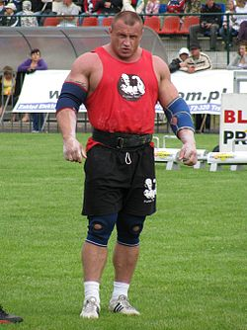
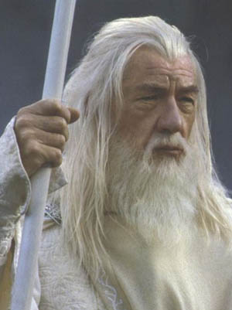
“The glory of young men is in their strength…”
(20:29a).
God recognizes the various stations of man’s life.
People will usually accomplish more physically when
they are young. However, God also recognizes the
importance of old age –
“… the beauty of old men is the grey head” (20:29)…
“A [silver-haired] head is a crown of glory… if it be found in the way of righteousness” (16:31).
God wants us to accomplish much when we’re young,
physically strong and vibrant, but there is something
to look forward to in the future. We shouldn’t look
forward to growing old just to still be alive, but rather
it should be the ‘crown of glory’ in our life with Christ.
We should have more to offer then, than at any other
time in our life. An old un-saved person has no more to offer God than a young un-saved person.

Slide 15
“An high look, and a proud heart, and the [celebration, hymn] of the wicked, is sin” (21:4).
The greatest sin of the flesh is ‘pride’ (1Jn. 2:16), because it
keeps unsaved man content and fulfilled within himself. He
looks at God with disdain because he doesn’t believe God has
anything to offer him that he doesn’t already have. In fact, he
celebrates [sings of] his pride [sin]. A prideful, full of himself
unsaved man cannot see his true standing before God because
of pride which blinds him –
“But if our gospel be hid, it is hid to them that are lost. In whom
the god of this world [Satan] hath blinded the minds of them that
believe not…” (2Cor. 4:3,4).
Maintaining that prideful thinking will ultimately [physical death]
lead to the 2nd eternal death and a fall from any chance of God’s
grace – “Pride goeth before destruction, and an haughty spirit
before a fall” (16:18).
The only remedy? Let God’s conviction to allow –
“… the light of the glorious gospel of Christ…” to shine into our dark, prideful heart and humble us.

Slide 16
“The king’s heart is in the hand of the LORD, as the rivers of water: he turneth it whithersoever he will” (21:1).
Not only David and Solomon, but all kings [leaders] of nations are in the hand of God. That’s why we can understand that though some were the enemies of Israel [Egypt, Babylonia, Persia, et. al.], God directed their actions like a farmer does when he digs irrigation ditches for his fields—he hardened Pharaoh’s heart until the Passover; he directed Nebuchadnezzar to destroy Jerusalem, but later saved him; allowed Cyrus to keep the Israelites in captivity until the 70 years were up and then allowed them to return home.
“There is no wisdom nor understanding nor counsel against the LORD” (21:30).
Though Satan tries [short term] to thwart God’s plans, his actions will prove folly in the end.

Slide 17
“He that hath a bountiful [good] eye shall be blessed; for he giveth of his bread to the poor” (22:9).
A Hebraism – A ‘good eye’ was someone who was generous and shared what he had. An ‘evil eye’ was a skin flint who wouldn’t share.
Through Paul, Christ instructs us to –
“Charge them that are rich in this world, that they be not [skin flint], nor trust in uncertain riches, but in the living God, who giveth us richly all things to enjoy; That they do good, that they be rich in good works, ready to distribute [to help those less fortunate]…” (1Tim. 6:17,18).

Slide 18
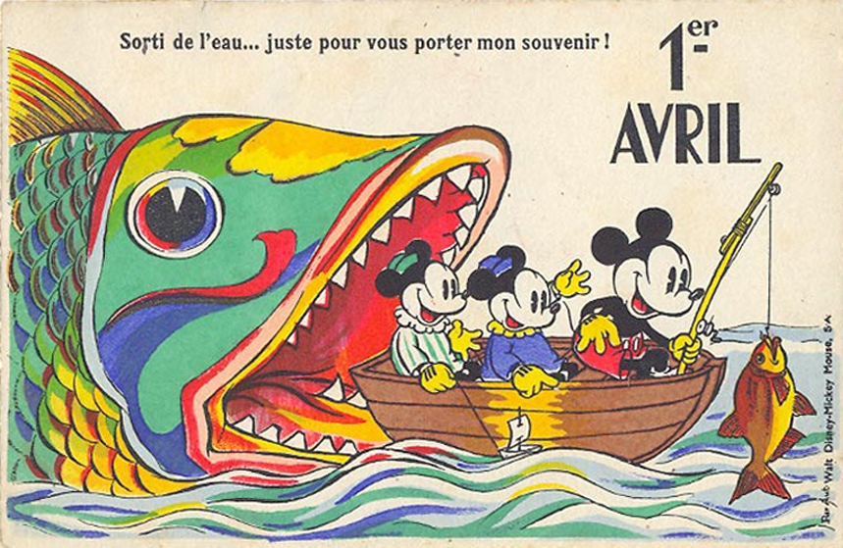
FOOLS
One cannot begin to learn the things of God without a healthy reverence [trusting, obeying, serving, etc.] for Him. One who doesn’t is a FOOL, because they despise wisdom and instruction –
“The fear [reverence] of the LORD is the beginning of knowledge: but fools despise wisdom and instruction” (1:7).
Fool(s), foolish, foolishly(ness) is a common theme in PROVERBS, mentioned 100 times in all its forms, coming from 3-Hebrew words:
Thickheaded/stubborn – “Understanding is a wellspring of life unto him that hath it: but the instruction of fools is folly” (16:22).
This fool arrogantly rejects information thinking that he knows all he needs to know.
BEWARE OF MAN-EATING FISH!

Slide 19
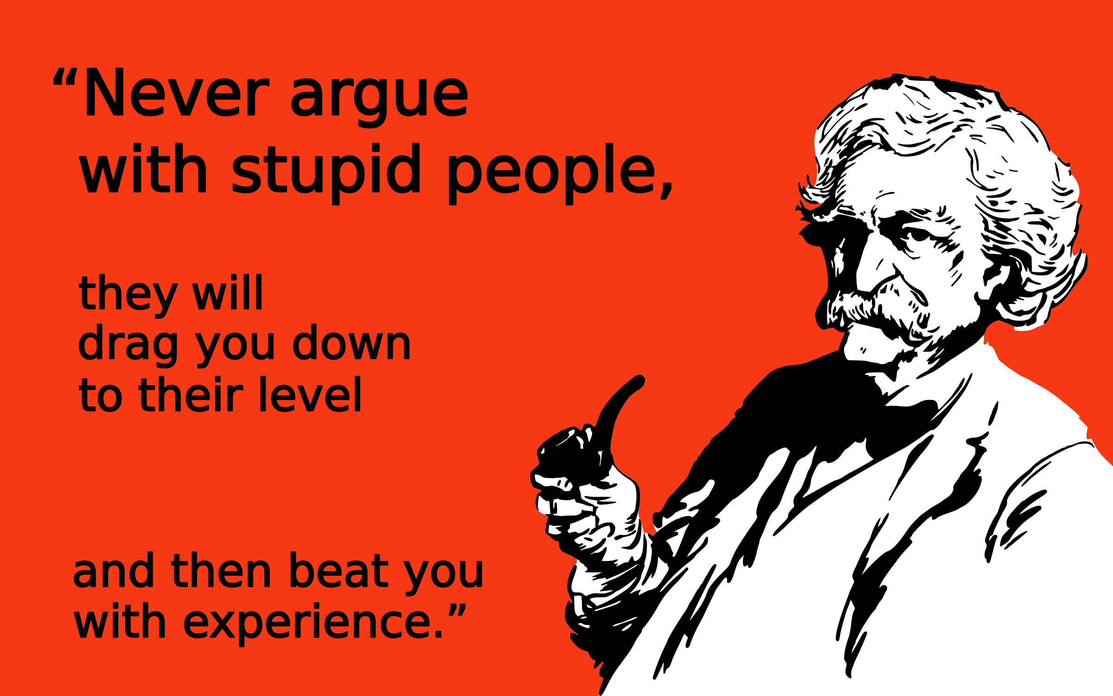
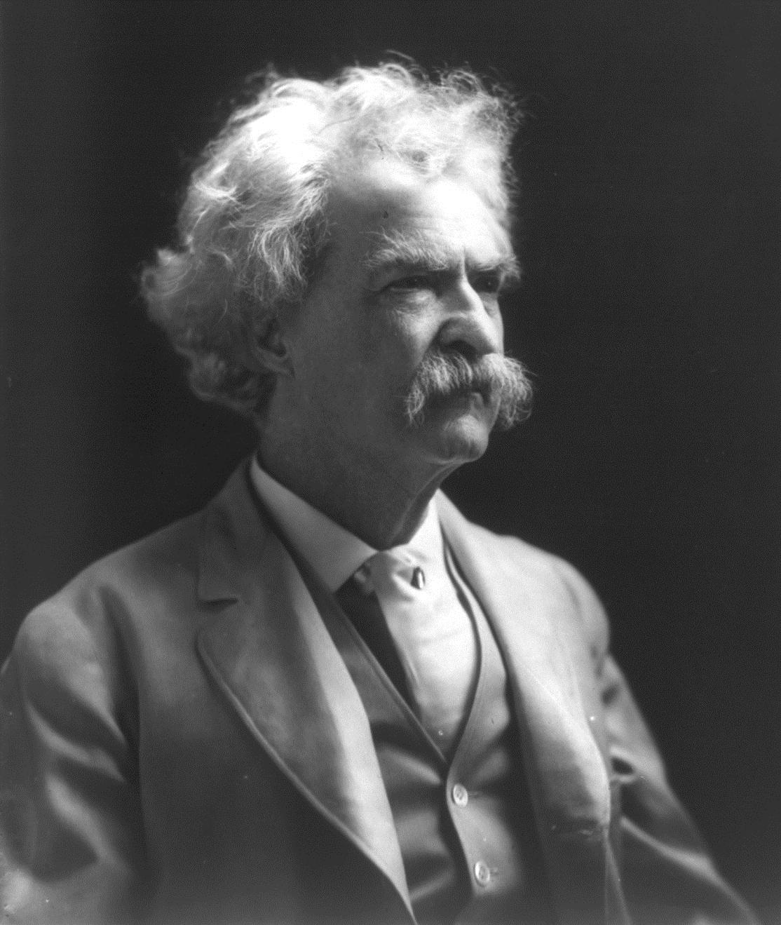
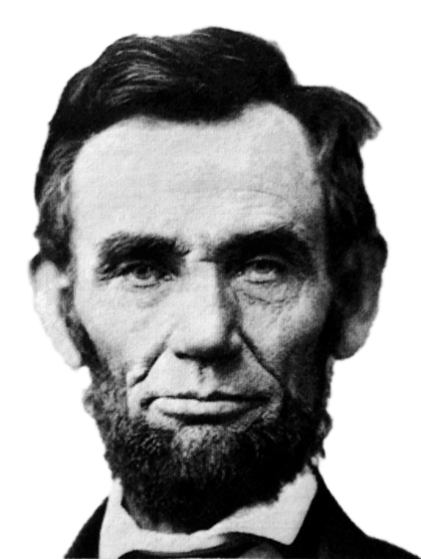
Mentally dull/shallow – “Wisdom is too high for a
fool: he openeth not his mouth in the gate” (24:7).
This fool can’t comprehend deeper things, therefore when he appeared in the gate where legal matters were tended to, he kept quiet. This prompted a popular saying –
“He who represents [lawyers] himself has a fool for a client” – Abraham Lincoln.
“It is better to remain silent and be thought a fool, than to open your mouth and remove all doubt,” attributed to both Lincoln and Mark Twain, but based on a proverb –
“Even a fool, when he holdeth his peace, is counted wise; and he that shutteth his lips is esteemed a man of understanding” (17:28).
Point? Sometimes you will look smarter when you choose to be quiet than to open your mouth and show your stupidity. Another Mark Twain saying –

Slide 20
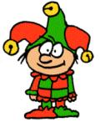
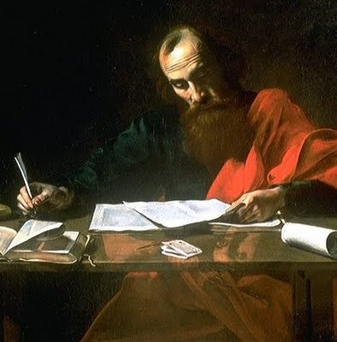
3. Silly/simpleton – “He that begetheth a fool doeth it to
his sorrow: and the father of a fool hath no joy”
(17:21).
The court jester or class clown is a fool who brings shame to his parents and his silliness makes him look childish.
“For ye suffer fools gladly, seeing ye yourselves are wise” (2Cor. 11:19).
Sarcastically, Paul called the Corinthians foolish because they listened to the false teachers instead of him.
“Be not thou envious against evil men, neither desire to be with them. For their heart studieth destruction, and their lips talk of mischief” (24:1,2).
Don’t ever want to be like an unbeliever and his godless world system because a guilty verdict awaits him at the great white throne judgment (Rev. 20:11-15).
Next time – Solomon prepares to build the temple

Slide 21
