Slide 1
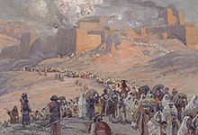
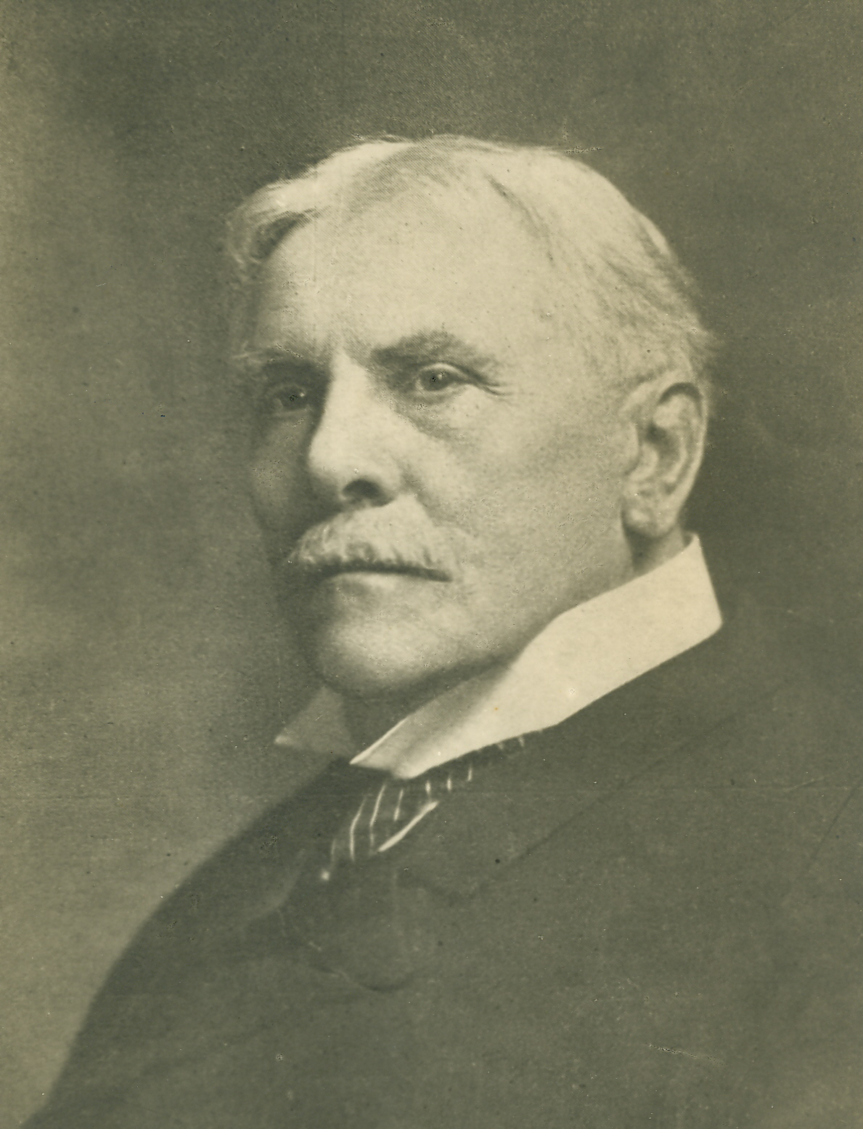
THROUGH THE BIBLE IN 2018
LESSON 35
WEEK 35 OF 52
(Ezek. 1-22)
Last time we saw Jeremiah’s lamentation over the destruction of Jerusalem and the captivity of its people; this time the prophet Ezekiel.
“Ezekiel was carried away to Babylon… (2Kg. 24:11-16). Like Daniel… he prophesied out of the land [Babylon], and his prophecy [also] follows the method of symbol and vision. Unlike the pre-exilic prophets, whose ministry was primarily to either Judah or the 10-tribe kingdom [Israel], Ezekiel is the voice of Jehovah [Christ] to the ‘whole house of Israel.’ Speaking broadly, the purpose of his ministry is to keep before the generation born in exile the national sins which had brought Israel so low (Ezek. 14:23); to sustain the faith of the exiles
by predictions of national restoration… The events recorded in Ezekiel cover a period of 21 years”
(Old Scofield, p. 840).

Slide 2
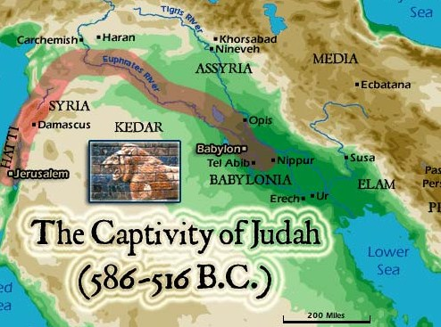
EZEKIEL
“Now it came to pass in the [30th] year, in the [4th] month, in the [5th] day of the month, as I was among the captives by the river of Chebar, that the heavens were opened, and I saw visions of God… the word of the LORD came expressly to Ezekiel the priest…” (Ezek. 1:1,2).
Jehoiakin was Judah’s last authorized king, but was captured and deported to Babylon after only 3-months on the throne. Ezekiel’s ministry began at age 30 [age required of priests (Num. 4:3)] in the 5th year of Jehoiakin’s exile, which places the date of his ministry at about 593-571 B.C., ending at age 52. He is one of 3-prophets who were also priests: Jeremiah (Jer. 1:1); Zechariah (Zech. 1:1). Ezekiel’s book was written during the time he was a Jewish captive in Babylon.

Slide 3
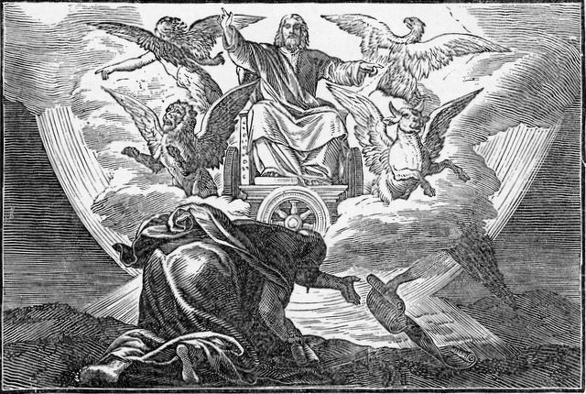
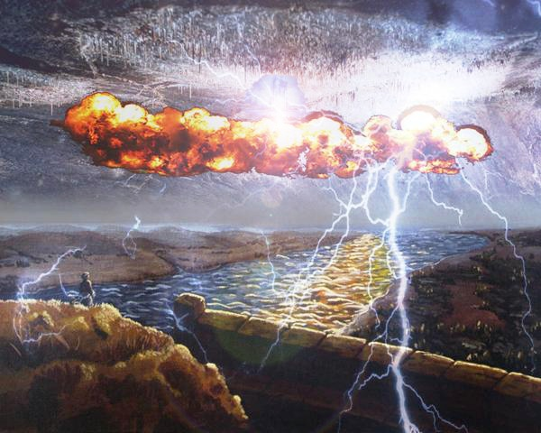
EZEKIEL’S 1ST VISION
“And I looked and, behold… a great cloud, and a fire infolding itself, and a brightness was about it, and out of the midst thereof as the colour of amber, out of the midst of the fire… came the likeness of 4-living creatures…” (1:4,5).
Ezekiel’s first vision came out of a thunderstorm, 4-creatures, but who turned out to be cherubim, having faces of “man… lion…ox…eagle” (1:10), who were bearing the chariot/throne of God (1:26). Under it were wheels, always facing forward, but moved in any direction God wanted to go (1:15-21).
Ezekiel was looking at the glory of God in all His splendor and he reacted by bowing down in the LORD’S presence –
“This was the appearance of the likeness of the glory of the LORD. And when I saw it I fell upon my face, and I heard a voice of one that spake” (1:28).
God told Ezekiel [called the ‘Son of man’ 93 times in the book] to stand up (2:1) and then he received the Holy Spirit (2:2).

Slide 4
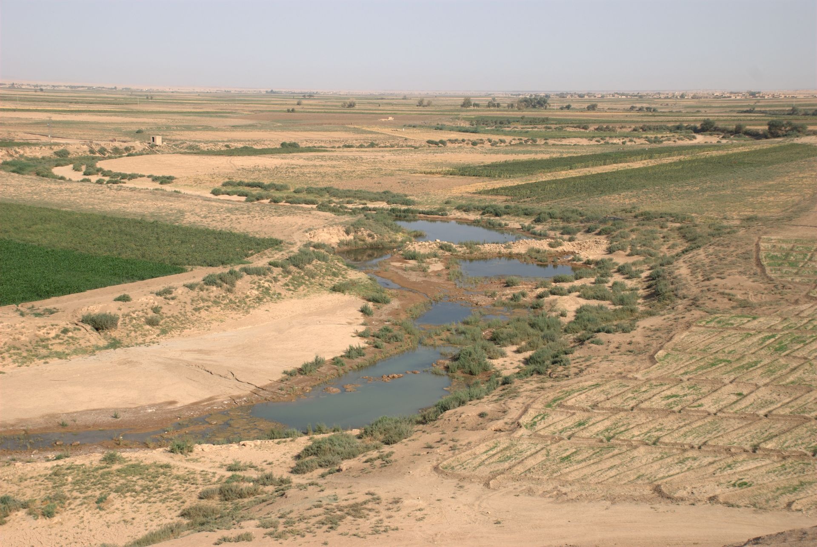
God told Ezekiel to speak His words and not to be afraid –
“And thou, son of man, be not afraid of them, neither be afraid of their words, though briers and thorns be with thee, and thou dost dwell among scorpions… hear what I say unto thee…” (2:6-8).
And, God cautioned Ezekiel not to expect great results –
“And he said unto me, Son of man, go, get thee unto the house of Israel, and speak with my words unto them… But
the house of Israel will not hearken unto thee; for they will
not hearken unto me…” (3:7).
The Jews would prove to be just as obstinate in captivity as they had before they were invaded, at least in the beginning.
EZEKIEL’S 2ND VISION
“… Arise, go forth into the plain, and I will there talk with thee … behold, the glory of the LORD… I fell on my face” (3:22,23).
Somewhere in the fertile crescent, God spoke to Ezekiel again.

Slide 5
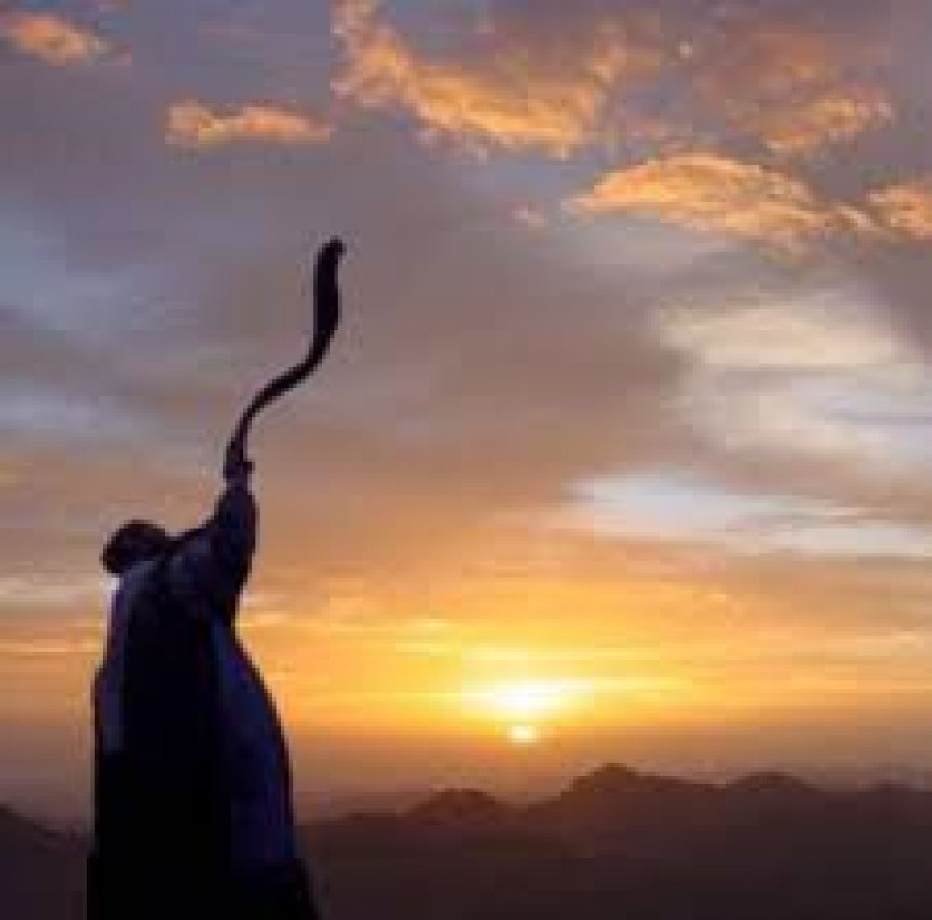
The 1st part of Ezekiel’s ministry was before Judah’s defeat by the Babylonians, overlapping the ministry of Jeremiah.
“Son of man, I have made thee a watchman unto the house of Israel… give them warning from me… behold, they shall put bands upon thee… thou shalt not go out among them… go, shut thyself within thine house” (3:25).
God called Ezekiel to be the watchman over Israel in captivity, but he was to do it while restricted to his own house.
SIGN OF THE TILE
“… take thee a tile, and lay it before thee, and portray upon it the city, even Jerusalem. And lay siege against it…” (4:1).
Here God shows Ezekiel that Babylon had laid final siege against Jerusalem.
SIGN OF THE SHARP KNIFE
Chapter 5 illustrates the destruction of Jerusalem. If the inhabitants had not died of starvation, many would face death by the sword and destruction of the city.

Slide 6
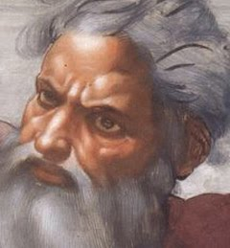
Here Ezekiel gives the reader a breakdown of judgment that will fall on the inhabitants of Jerusalem –
“A third part of thee shall die with the pestilence, and with famine shall they be consumed in the midst of thee: and a third part shall fall by the sword round about thee; and I will scatter a third part into all the winds…” (5:12).
1/3 will die from the famine & disease in the years that lead up to the siege.
1/3 will die from the carnage of the siege itself (slaughter by the soldiers swords; and fire that burned much of the city of Jerusalem).
1/3 will be led into Babylonian captivity, which will last 70-years.

Slide 7
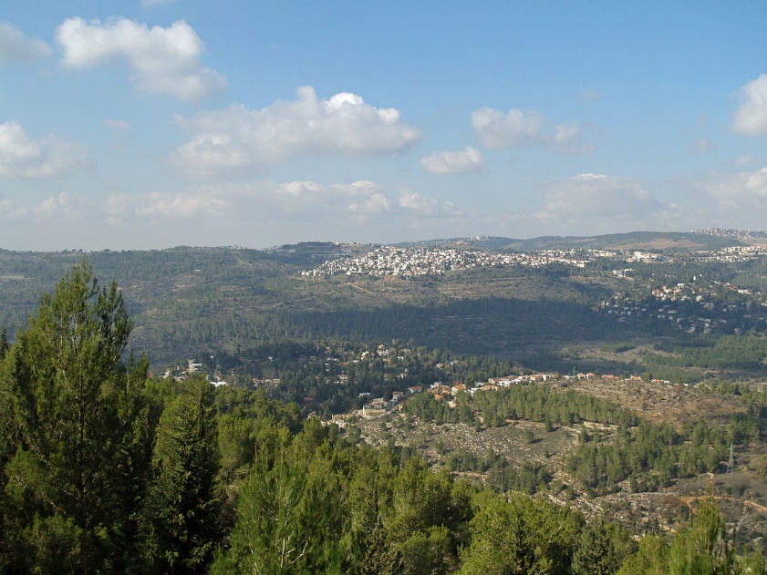
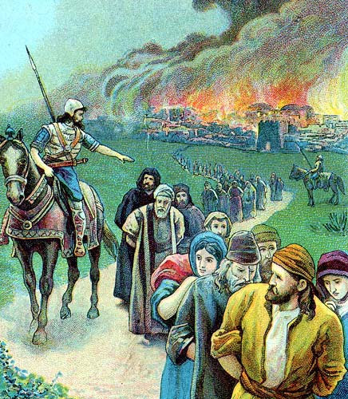
MESSAGES AGAINST THE MOUNTAINS
“Son of man, set thy face towards the mountains of Israel, and prophesy against them… Thus saith the LORD God to the mountains, to the river, and to the valleys; Behold, I will bring a sword upon you, and I will destroy your high places. And your altars shall be desolate, and your images shall be broken… and ye shall know that I am the LORD” (6:1).
Israel’s pagan worship sites, where ever they were, would be destroyed and God would use Babylon to do it.
A REMNANT
“Yet will I leave a remnant, that ye may have some that shall escape the sword among the nations, when ye shall be scattered through the countries” (6:8).
Ever faithful, God will not allow the whole nation to perish, but will take a remnant into captivity, where He will continue to deal with them.

Slide 8
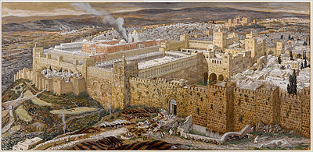
EZEKIEL’S 3RD VISION
“… and the spirit lifted me up between the earth and the
heaven, and brought me to the door of the inner gate that
looketh toward the north… and behold, the glory of the
God of Israel was there… He said unto me, Son of man,
seest thou what they do? Even the great abominations that
the house of Israel committeth here, that I should go far off
from my sanctuary… and he brought me to the door of the
court… I went in and saw every form of creeping things, and
abominable beasts, and all the idols of the house of Israel…
thou shalt see greater abominations… he brought me into
the inner court… [25] men… their backs toward the temple
of the LORD, and their faces toward the east; and they
worshipped the sun toward the east” (8:3-16).
The Holy Spirit took Ezekiel to the temple in Jerusalem, which had been desecrated by every imaginable object of Canaanite worship. Things got worse the further he went. Instead of facing the holiest place, they turned their backs on God and worshiped the sun god to the east!

Slide 9
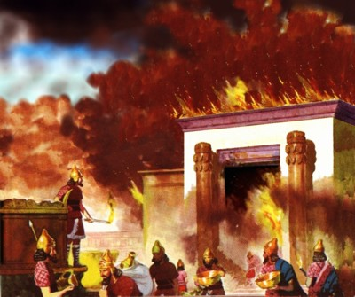
GOD’S DEPARTURE FROM THE TEMPLE
“Then did the cherubims lift up their wings, and the wheels beside them; and the glory of the God of Israel was over them above… went up from the midst of the city, and stood upon the mountain which is on the east side of the city…” (11:22,23).
Christ would not share His temple with false gods. As
He told Solomon after its dedication, “… [If] you go and serve other gods… Then will I cut off Israel out of the
land which I have given them; and this house, which I have hallowed for my name, will I cast out of my sight…”
(1Kg. 9:6,7).
Not only did Christ tell Solomon that if they worshiped other gods, that He would drive Israel into captivity, He would depart from the temple and then destroy it.
He did as He said—Ezekiel saw a vision of Christ leaving the temple before it was razed to the ground by fire.

Slide 10
“And the word of the LORD came unto me saying, Son of man, what is that proverb that ye have in the land of Israel, saying, The days are prolonged, and every vision faileth? Tell them… Thus saith the LORD God; I will make this proverb to cease, and they shall no more use it as a proverb in Israel; but say unto them, The days are at hand… there shall no more any vain vision nor flattering divination within the house of Israel… it shall be no more prolonged” (12:21-25).
There was a saying (proverb) going around Jerusalem that because the city had not been destroyed yet, the prophet’s visions had failed— were meaningless, and God wasn’t going to do it.
God told Ezekiel that He would stop the rumor, once-and-for-all, by bringing His judgment upon the city, and He did.

Slide 11
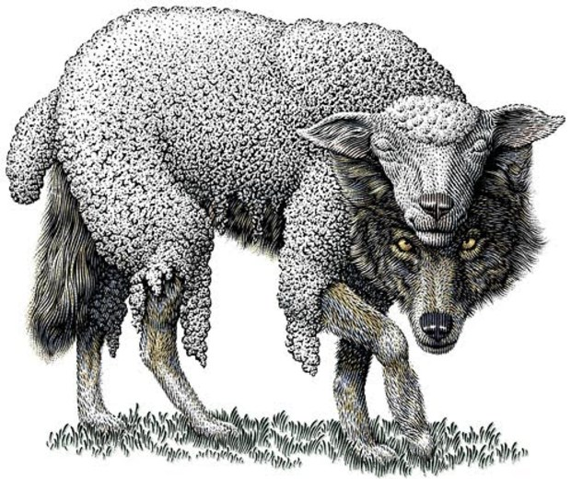
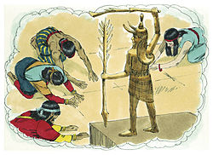
IDOLS IN THEIR HEARTS
“Then came certain of the elders of Israel unto me, and sat before me, And the word of the LORD came unto me saying, Son of man, these men have set up their idols in their heart, and put the stumblingblock of their iniquity before their face: should I be enquired of at all by them? Speak to them, and say unto them… Every man of the house of Israel that setteth up his idols in his heart… turn yourselves from your idols; and turn away your faces from all your abominations…” (14:1-6).
Some elders of Israel came to Ezekiel’s house [in Babylon] to enquire something, but God let him know that they still harbored an idolatrous heart. Though they no longer worshiped a statue, their heart was bent toward it, rather than toward the God of Israel. What should Ezekiel do?
Ezekiel asked God whether he should even converse with them since they were wolves in sheep’s clothing, but God said to tell them, GET RIGHT WITH GOD!

Slide 12
A HYPOTHETICAL
“Son of man, when the land sineth against me by trespassing grievously, then will I stretch out mine hand upon it…” (14:12,13).
Previously, God stated that He would punish the land of Israel with a variety of judgments: famine & disease, slaughter by the invading army, destruction of the city, and wild beasts, etc.
Here, God adds a hypothetical.
What if God placed 3 of the most godly men in the Bible in the land that had been stained with the sin of idolatry, would they have made a difference?
Like, Noah, Daniel, and Job.
Would they have made any difference?

Slide 13
“Though Noah, Daniel, and Job, were in it… they shall deliver neither son or daughter; they shall but deliver their own souls by their righteousness” (14:20).
Israel had hardened their heart so much against God, at that time, that not even the prophets could dissuade them from apostasy. That same spiritual
hardness will get much worse during the last part of the tribulation –
“And the rest of the men which were not killed by these plagues yet repented not of the works of their hands, that they should not worship devils, and idols of gold… which neither can see, nor hear, nor walk” (Rev. 9:20).

Slide 14
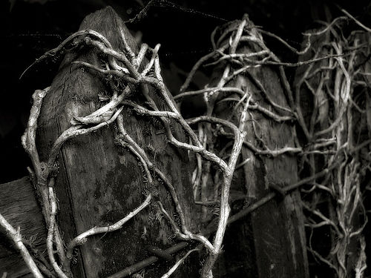
VISION OF THE BURNING VINE
Next God asked Ezekiel a question – How is the wood
of a vine better than the wood of a tree in the forest?
(15:1-8).
Answer – it’s able to bear fruit
God asked Ezekiel another question – If it can’t bear
fruit, if it’s a withered or dead vine, is it as good as the
wood of a tree in the forest?
Answer – of course not!
God asked Ezekiel yet another question – If that dead,
withered vine went through a fire, would it be more
or less valuable?
Answer – LESS!!! His point?
The illustration is about Judah—she had stopped bearing spiritual fruit; she was withered and dead spiritually, and now she would be consumed by the fire of God’s wrath because she was of no use to Him.

Slide 15
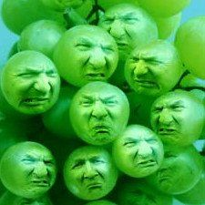
THE PROVERB OF SOUR GRAPES
“The word of the LORD came unto me again, saying, What
mean ye, that ye use this proverb concerning the land of
Israel, saying, The fathers have eaten sour grapes, and the
children’s teeth are set on edge? As I live, saith the LORD
God, ye shall not have occasion any more to use this proverb
in Israel” (18:1-3).
Another saying going around Jerusalem at that time implied
that God’s judgment was unfair because the fathers [adults]
had been pagan worshipers, but innocent children were
being punished unjustly along with their idolatrous parents –
”Yet ye say, The way of the LORD is not equal [unfair]” (18:25).
This thinking, in part, had stemmed from the Law – “Thou shalt not bow down thyself to them, nor serve them: for I the LORD am a jealous God, visiting the iniquity of the fathers upon the children unto the 3rd and 4th generation of them that hate me” (Exo. 20:5). But, the Jews had misunderstood what God meant. A sinful act on the part of the parents [idolatry] would likely carry over for several generations and such was the perfect example of Israel at that time…

Slide 16
… The majority of Jewish parents had become idol worshippers and their children continued to do the same. Therefore, both were guilty before God!
God was angered that He was being accused of unfairness by the constant repeating of this false proverb. He said He would put a stop it, but how?
He would judge each person individually—man, woman, or child –
“Behold, all souls are mine; as the soul of the father, so also the soul of the son is mine: that soul that sinneth, it shall die. But if a man be just, and do that which is lawful and right… hath walked in my statues, and hath kept my judgments… he shall surely live” (18:4,9).
This was not the individual personal judgment that will determine one’s place in eternity, but rather a judgment on those who practiced idol worship, or not.

Slide 17
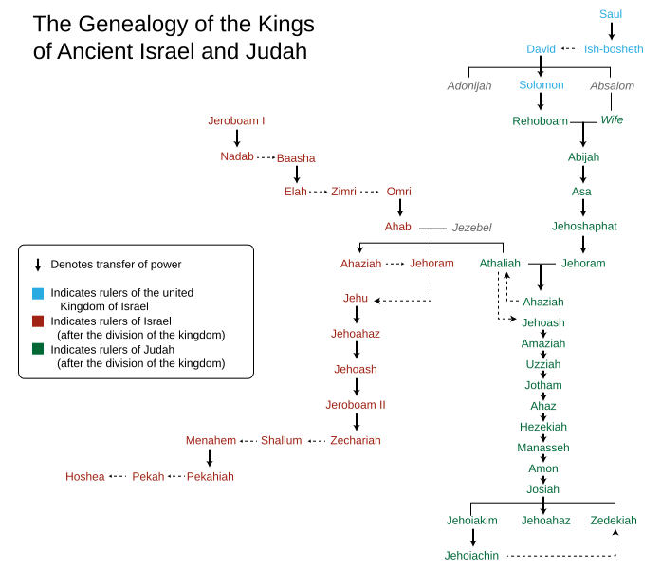
LAMENT FOR THE KINGS
“Moreover take thou up a lamentation for the [kings] of Israel” (19:1-14).
This was Ezekiel’s lament [mourning or grief] for the last kings of Judah written in 594 B.C. (7 years later, in 587 B.C., Jerusalem would fall to the Babylonians).
King Jehoahaz was the people’s choice to become king after the assassination of his father king Josiah, but served only 3-months until captured and taken to Egypt where he died (2Kg. 23:33,34). Pharaoh Neco placed his brother, Jehoiakim, on the throne and ruled 10 years, and was replaced by his son Jehoiachin (19:5) serve 3-mo., until he was deported to Babylon. Zedekiah, the last king of Judah, was a puppet king by Nebuchadnezzar and the last to sit on David’s throne until the return of Messiah. This lament was for the end of the ruling kings of Israel. Israel was the mother of her many kings, but sadly their disobedience brought it to an end until Messiah returns.

Slide 18
THE SIGHING PROPHET
“And the word of the LORD came unto me, saying, Son of man, set thy face toward Jerusalem, and drop thy word toward the holy places, and prophesy against the land of Israel. And say to the land of Israel, Thus saith the LORD; Behold, I am against thee, and will draw forth my sword out of its shealth, and will cut off from thee the righteous and the wicked” (21:1,2).
Now in Babylon captivity, God wants the Jews to know why they are there—their apostasy, which caused God’s wrath to be directed against their land & holy places –
“Sigh therefore, thou son of man… with bitterness sigh before their eyes… Wherefore sighest thou?... Every heart shall melt, and all hands shall be feeble… knees shall be weak…” (21:6,7).
Ezekiel’s grief represented Israel’s pain of seeing their beloved land & holy places being destroyed.

Slide 19
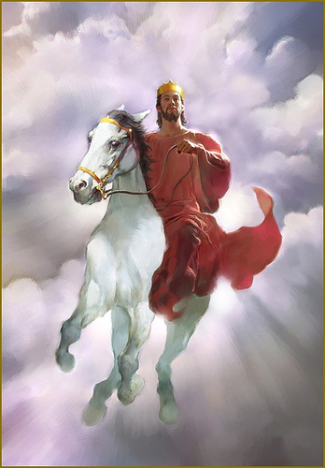
NO KING UNTIL MESSIAH
“Thus saith the LORD God; Remove the diadem, and take
off the crown… exalt him that is low, and abase him that
is high. I will overturn… it: and it shall be no more until he
come whose right it is; and I will give it him” (21:26,27).
King Zedekiah was the last king of Judah and because he
tried to thwart God’s plan for Babylon to conquer Judah,
he was deposed, his royalty stripped [crown removed]
and the poor residents would replace him in the land.
He was brought as low as possible when he was blinded
and taken into captivity. There would be no more kings
of Israel or Judah until… the KING of kings returns to the
earth in a blaze of glory! In eternity past, Christ was
chosen to be God’s rightful King over the earthly kingdom.
The Israelites had demanded a king (1Sam. 8:5) and
Samuel told them they would be sorry (1Sam. 8:11-18),
and they were.
God, will finally, give the nation their ‘rightful’ King!

Slide 20
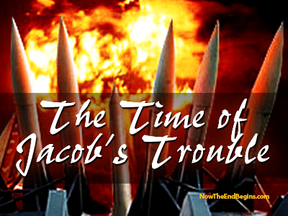
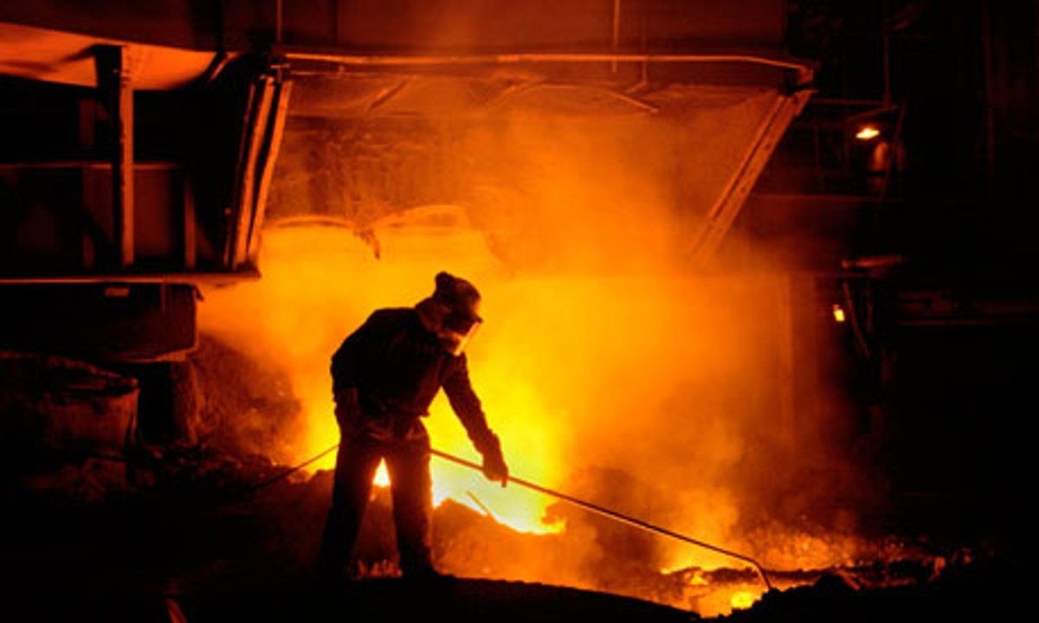
GOD’S BLAST FURNACE
“And the word of the LORD came unto me, saying, Son of man, the house of Israel is to me is dross: all they are [the dross of] brass… tin… iron… lead, in the midst of the furnace; they are even the dross of silver… because ye are all become dross…” (22:17-19).
Mining produces a combination of the pure substance [e.g. silver] and impurities [dross or slag]. To separate the pure from the impure, intense heat is applied, as in the case of modern day blast furnaces. Ezekiel told Israel they had become worthless [dross], and that God was going to put them through His ‘blast furnace,’ to separate the pure from the impure [believing from unbelieving Israel]. When?
“As silver is melted in the midst of the furnace, shall ye be melted in the midst thereof; and ye shall know that
I the LORD have poured out my fury upon you” (22:22).
Next time – Ezekiel’s future restoration of Israel.

