Slide 1
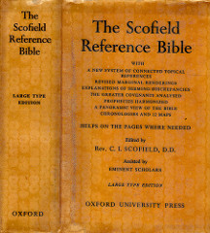
THROUGH THE BIBLE IN 2018
LESSON 28
WEEK 28 OF 52
(Isa. 1-12; Amos 1-9;
Micah)
Last time we saw the ministry of the prophets Elisha and Jonah; this time
God calls Isaiah, Amos, and Micah to warn Israel of her apostasy.
BOOK OF ISAIAH –
“Isaiah is justly accounted the chief of the writing
prophets. He has the more comprehensive testimony and is distinctively the prophet of redemption… The New Testament Church does not appear (Eph. 3:3-10), but Messiah in His Person and sufferings, and the blessing of the Gentiles through Him, are in full vision… Isaiah is in two chief divisions: I. Looking toward the captivities, Ch. 1-39; II. Looking beyond the captivities, Ch. 40-66… The events cover a period of 62 years” [Ussher’s dates] – (Old Scofield, p. 713).

Slide 2
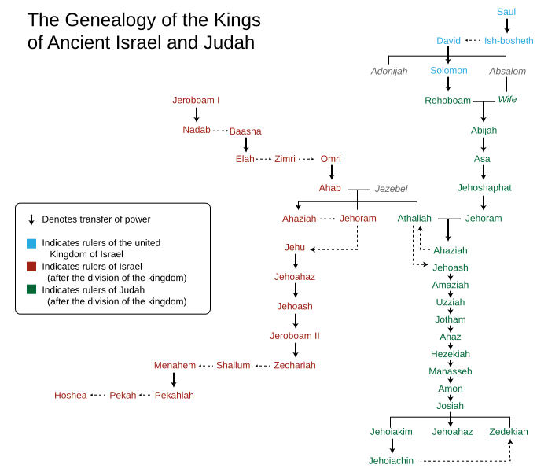
THE MAJOR PROPHET ISAIAH
“The vision of Isaiah the son of Amoz, which he saw concerning Judah and Jerusalem in the days of Uzziah, Jotham, Ahaz, And Hezekiah, kings of Judah” (Isa. 1:1).
Isaiah, “Yahweh is salvation,” was likely a resident of Jerusalem, and his 60+ year ministry overlapped 4- kings of Judah. He was married (8:3) and had 2-sons (7:3; 8:3). Tradition teaches that he was martyred by King Menasseh, and the catholic father, Justin Martyr (100-165 A.D.) said that he was, “sawn asunder” (Heb. 11:37).
Isaiah prophesied during the time when pagan worship was rampant in both the northern [Israel] and southern [Judah] kingdoms. Isaiah was sent from God to turn Judah back to the God of their forefathers.

Slide 3
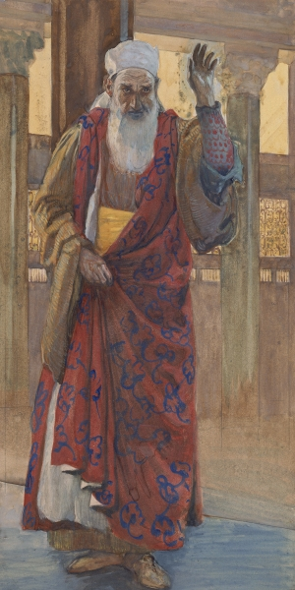
“Hear, O heavens, and give ear, O earth: for the LORD hath spoken, I have nourished and brought up the children [of the nation of Israel], and they have rebelled against me. The ox knoweth his owner, and the donkey his master’s crib: but Israel doth not know, my people doth not consider. A sinful nation, a people laden with iniquity, a seed of evildoers… corrupters: they have forsaken the LORD, they have provoked the Holy One
of Israel unto anger, they have gone away backward”
(1:2-4).
Although God had called Isaiah to prophesy against the southern kingdom, His rebuke was against all Israel,
but few would heed. From the time Isaiah began, in
40-years the northern kingdom [Israel] would fall to the Assyrian invasion [722 B.C.]; the southern kingdom [Judah] would hold out 175-years [586 B.C.] before its conquering by King Nebuchadnezzar of Babylon.

Slide 4
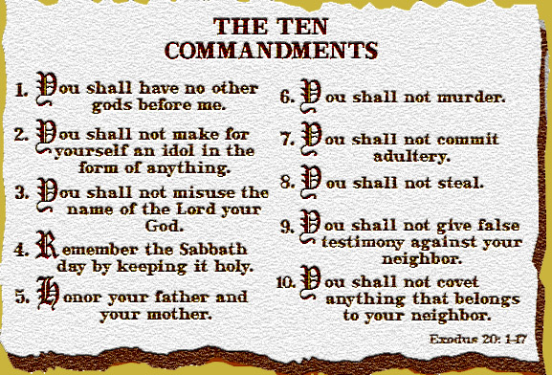
“Except the LORD of hosts had left unto us a very small remnant, we should have been as Sodom… Gomorrah. Hear the word of the LORD, ye rulers of Sodom; give ear unto the law of our God, ye people of Gomorrah” (1:9,10).
At the time of Isaiah [760 B.C.] the overwhelming majority of both Jewish rulers and the people had broken the Law
of Moses and its First Commandment, “Thou shalt have
not other gods before me” (Exo. 20:3). Only a very small remnant hadn’t—God had promised Solomon [at the dedication of the temple] what His judgment would be
for their disobedience –
“But if ye shall at all turn from following me, ye or your children, and will not keep my commandments… but go
and serve other gods, and worship them: Then will I cut
off Israel out of the land which I have given them…”
(1Kg. 9:6,7).
If Israel would not heed, God would drive them off His land.

Slide 5
“To what purpose is the multitude of your sacrifices unto me? Saith the Lord: I am full of the burnt-offerings of rams… I delight not in the blood of bullocks, or of lambs… or goats. When ye come to appear before me… bring no more vain oblations; incense is an abomination unto me; the new moons and Sabbaths… I am weary to bear them. And when ye spread forth your hands, I will hide mine eyes from you: yea, when ye make many prayers, I will not hear… Wash you, make you clean: put away the evil of your doings from before mine eyes…” (1:12-16).
The sacrificial worship system, holy days and Sabbaths, that God had given Israel had now become an abomination to Him. Why? At the same time they were practicing the Law of Moses they were carrying out the worship of pagan gods. God was incensed at their hypocrisy!

Slide 6
“If ye be willing and obedient, ye shall eat the good of the land: But if ye refuse and rebel, ye shall be devoured with the sword… the LORD hath spoken it” (1:19,20).
The message Isaiah delivered was clear—Israel STOP your pagan worship of the false gods of the Canaanites and come back to a right relationship with Him, OR ELSE!
ISRAEL’S LATTER DAYS
After his strong warning against the nation of Israel, the prophet lapsed into a time of prophesy, which he did
often in his writings –
“And it shall come to pass in the last days, that the [kingdom] of the LORD’S house shall be established in the top of the mountains [Jerusalem]… and all [Gentile] nations shall flow into it. And many people… let us go up… to the house of the God of Jacob…” (2:2,3).
Kingdom blessings on Israel and Gentiles who obeyed God.

Slide 7
Before Israel can receive her future kingdom blessings from God during the Millennium [1,000-years], she
must go through a period of chastisement [7-years of tribulation] for her past sins –
“For the day of the LORD of hosts shall be upon every one that is proud and lofty, and upon every one that is lifted up; and he shall be brought low (2:12)… And the idols he shall utterly abolish. And they shall go into the holes of the rocks, and into the caves of the earth, for fear of the LORD, and for the glory of his majesty, when he ariseth to shake terribly the earth (2:18,19)… For Jerusalem is ruined, and Judah is fallen: because their tongue and their doings are against the LORD… Woe unto their soul! ... Woe unto the wicked!... The LORD standeth up to plead… to judge the people…” (3:8-13).
God will show no mercy on those who reject Him at that time.

Slide 8
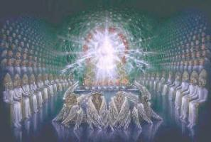
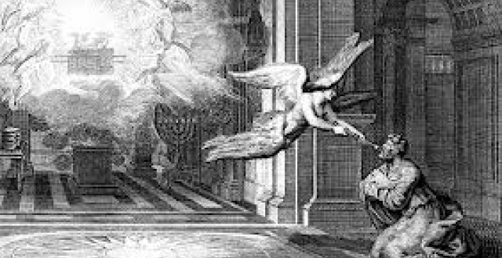
ISAIAH’S CALL TO MINISTRY
“In the year that king Uzziah died I saw also the LORD sitting upon a throne, high and lifted up, and his train filled the temple. Above it stood the seraphims… And one cried unto another, and said, Holy, holy, holy, is the LORD of hosts: the whole earth is full of his glory… Then said I, Woe is me! For I am undone; because I am a man of unclean lips, and I dwell in the midst of a people of unclean lips: for mine eyes have seen the King, the LORD of hosts… one of the seraphims… a live coal… touched thy lips… thine iniquity is taken away…” (6:5-7).
Isaiah had a vision of Christ in the Most Holy Place.
In comparison to Christ’s holiness, Isaiah identified
himself with the sinfulness of Israel, but he received the cleansing of sin by fire, which the nation sorely needed. All in preparation of his ministry to Judah.

Slide 9
A SIGN IS GIVEN
“And it came to pass in the days of Ahaz the son of Jotham, the son of Uzziah, king of Judah, that Rezin the king of Syria, and Pekah, king of Israel went up toward Jerusalem to war against it (7:1)… within [65] years shall Ephraim [northern kingdom] be broken, that it be not a people (7:8)… Moreover the LORD spake again unto Ahaz, saying, Ask thee a sign of the LORD thy God… But Ahaz said, I will not ask, neither will I [test] the LORD…” (7:1,8-12).
King Pekah [Israel] conspired with King Rezin [Syria] to invade Judah, which worried King Ahaz. Isaiah told him not to worry that in 65-years the northern kingdom would not even exist. Ahaz didn’t believe him so Isaiah told Ahaz to ask God for a sign, but he refused believing he was testing God.
What does this have to do with the birth of Christ?

Slide 10
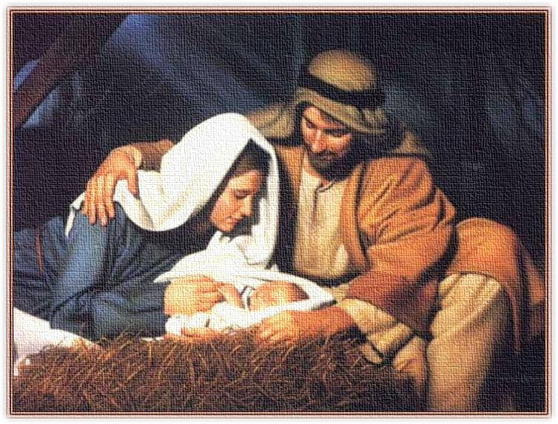
“Therefore the LORD himself shall give you a sign; Behold, a virgin shall conceive, and bear a son, and shall call his name Immanuel” (7:14).
This is Isaiah’s 1st Messianic prophesy—the virgin birth. Why here? As King Ahaz didn’t believe Isaiah that in 65-years the northern kingdom would be destroyed, so the nation of Israel will not believe that God had sent His Son [Messiah], despite the fact that God gave them the most miraculous sign possible. How many virgins do you know that conceived and delivered a son?
“Behold, a virgin shall be with child, and bring forth a son, and they shall call his name Immanuel, which being interpreted is, God with us (Mt. 1:23)… He came unto his own, and his own received him not” (Jn. 1:11).

Slide 11
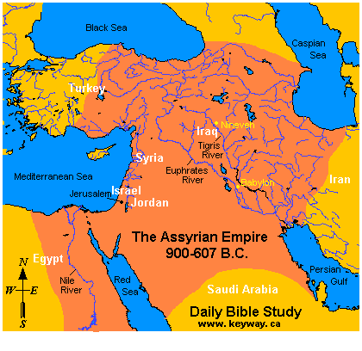
PROPHESY OF ASSYRIAN INVASION
“Now therefore, behold the LORD bringeth up upon them the waters of the river, strong and many, even the king of Assyria, and all his glory: and he shall come up over all his channels, and go over all his: And he shall pass through Judah… He shall reach even to the neck (8:7,8)… And he [God] shall be for a sanctuary; But for a stone of stumbling and for a rock of offense to both the houses of Israel (8:14)… Seek unto them that have familiar spirits… wizards… should not a people seek unto their God?” (8:19).
Because of their continued apostasy, God told Isaiah that He will send Assyria like a tidal wave. They will conquer Israel in 722 B.C., and invade Judah, but God will spare Judah for now.
For those who believed God, He will be a sanctuary; for those who don’t, a stumbling stone/rock of offense. Isaiah asked, why would anyone seek fortune tellers [to contact the dead] when one can seek answers from the living God?

Slide 12
BOOK OF AMOS
“The words of Amos, who was among the herdmen of Tekoa, which he saw concerning Israel in the days of Uzziah king of Judah, and in the days of Jeroboam the son of Joash king of Israel…” (1:2).
Amos, a herdsman from Tekoa [10-miles south of Jerusalem], from Judah, was called of God to prophesy mainly to the northern kingdom [Israel]. His ministry began shortly after Isaiah, but did not last nearly as long as Isaiah’s, about 10-years. Israel was at the height of its power and experiencing great economic prosperity, but was morally bankrupt –
“… and a man [son] and his father will go in unto the same maid, to profane my holy name” (2:7).
Bethel & Dan had become Israel’s sites of worship, but nothing outside of the temple in Jerusalem was accepted of God (4:4).

Slide 13
“Hear ye this word which I take up against you, even a lamentation, O house of Israel. The virgin of Israel is fallen; she shall no more rise; she is forsaken upon her land” (5:1,2).
Though written during a very prosperous economic time, Amos speaks to Israel like a preacher’s funeral message—she is spiritually dead. Though God’s judgment on her nationally had already been decided, Amos reached out to individuals, that they might turn from their wicked ways –
“For thus saith the LORD, and ye shall live… Seek him that maketh… Orion… The LORD is his name… seek good, and not evil, that ye may live: and so the LORD, the God of hosts be with you… that the LORD will be gracious unto the remnant of Joseph” (5:4,8).
In every age [dispensation], God calls out to a remnant of believers to heed His advice.

Slide 14
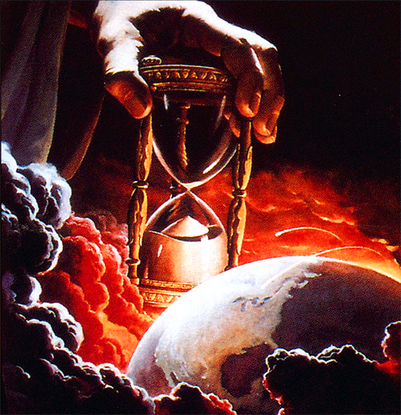
Like Isaiah, Amos paused in his chastisement of Israel, and looked into the future and the tribulation –
“Therefore the LORD, the God of hosts saith thus; Wailing shall be in all streets; and they shall say in all the highways, Alas! Alas!... And in the vineyards shall be wailing: for I will pass through thee, saith the LORD. Woe unto you that desire the day of the LORD!... The day of the LORD is darkness, and not light. As if a man did flee from a lion, and a bear met him; or went into the house, and leaned his hand on the wall, and a serpent bit him. Shall not the day of the LORD be darkness, and not light? Even very dark, and no brightness in it?” (5:16-19).
Many in Christendom reject the doctrine of ‘end-times,’ and say its not possible to know what the book of Revelation is about. FOOLISHNESS! Ask Isaiah or Amos if they believed the tribulation was coming.

Slide 15
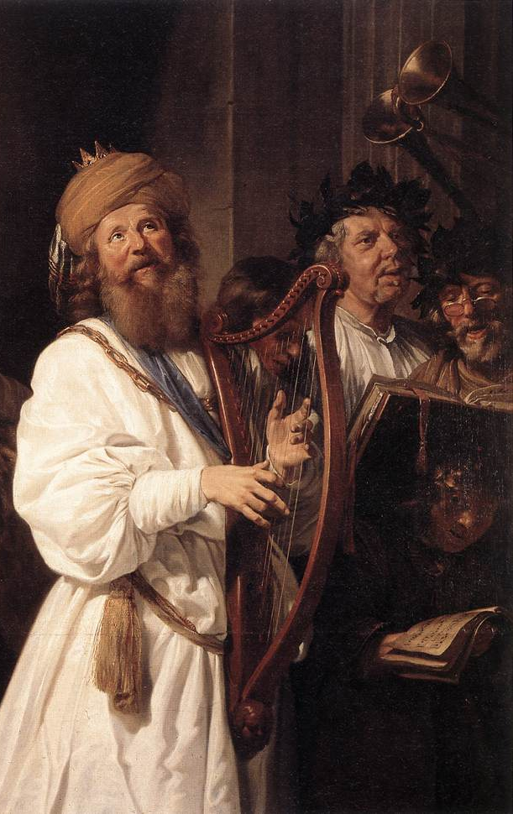
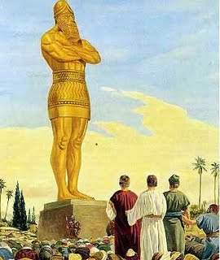
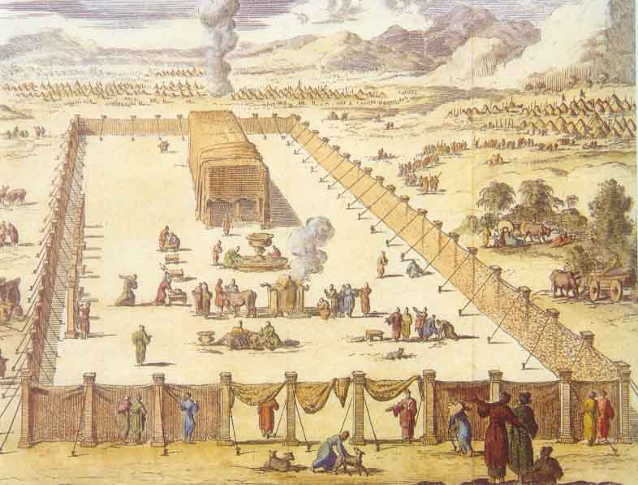
After sharing the horrors of the future ‘day of the LORD’ [tribulation], Amos went back to writing about the subject at hand, the apostasy of Israel –
“I hate, I despise your feast days, and I will not accept your solemn assemblies. Though ye offer me burnt-offerings… I will not accept them… Take thou away from me noise of thy songs:
for I will not hear the melody of thy viols [stringed instruments]” (5:21-23).
Amos declared that God had had enough with the hypocrisy
of most Jews at that time. The things that he required of Moses and the Israelites in the wilderness, now God despised! Why?
“Have ye offered unto me sacrifices and offerings in the wilderness 40-years, O house of Israel? But ye have born the tabernacle of your Moloch… your god, which ye made to yourselves. Therefore will I cause you to go into captivity beyond Damascus, saith the LORD” (5:25-27).

Slide 16
AMOS’ AUTOBIOGRAPHY
“Then answered Amos… I was not prophet, neither was I a prophet’s son; but I was a herdman, and a gatherer of sycamore fruit: And the LORD took me as I followed the flock and the LORD said unto me, Go, prophesy unto my people Israel…” (7:14,15).
Amos wanted his readers to know that he was not born into a family of prophets or schooled to learn how to be one, but rather, chosen of God while a simple sheep rancher and fruit grower, to bring the chastisement of God on the people of the northern kingdom.
“Thus hath the LORD God shewed unto me; and behold a basket of summer fruit. And he said, Amos, what seest thou? And I said, a basket of summer fruit. Then said the LORD unto me, The end is come upon my people of Israel…” (8:1,2).
The judgment of God was about to fall on Israel.

Slide 17
KINGDOM BLESSINGS
Amos, like the other prophets of God, always gave them good news after giving them bad news –
“In that day will I raise up the tabernacle of David that is fallen, and close up the breaches thereof; and I will raise up his ruins, and I will build it as in the days of old… Behold the days come, saith the LORD, that the plowman shall overtake the reaper, and the treader of grapes him that soweth seed; and the mountains shall drop sweet wine… And I will bring again the captivity of my people Israel, and they shall build the waste cities, and inhabit them… And I will plant them upon their land, and they shall no more be pulled up out of their land which I gave given them…” (9:11,13-15).

Slide 18
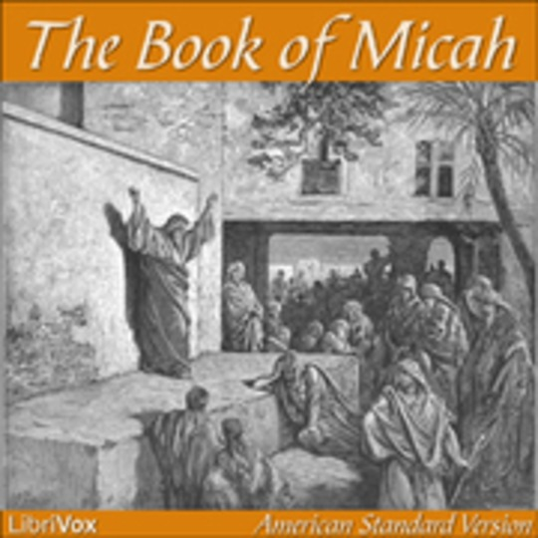
BOOK OF MICAH
“The word of the LORD that came to Micah the Morasthite in
the days of Jotham, Ahaz, and Hezekiah, kings of Judah, which
he saw concerning Samaria and Jerusalem” (1:1).
Micah [“Who is like Yahweh?”] was from a town in Judah
[Moresheth] 25-years S.W. of Jerusalem. Like Isaiah, and Amos
before him, Micah prophesied about the impending invasion of
the northern kingdom by Assyria –
“Therefore I will make Samaria as an heap of the field… and all
the graven images thereof shall be beaten to pieces, and all the
hires thereof shall be burned with the fire, and all the idols
thereof will I lay desolate” (1:6).
Israel had a long history of prophets of God and false prophets [Satan], who said that as long as they were keeping the rites & rituals of the Law, God would tolerate it. They were wrong!
“But truly I [Micah, not the false prophets] am full of the power by the spirit of the LORD, and of judgment, and of might, to declare unto Jacob his transgression, and to Israel his sin” (3:8).

Slide 19
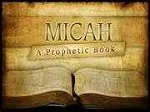
BIRTH PROPHESY
“But thou Bethlehem Ephratah, though thou be little among
the thousands of Judah, yet out of thee shall he come forth
unto me that is to be ruler in Israel; whose goings forth have
been from of old, from everlasting” (5:2).
Micah then prophesied of the place of the Messiah’s birth—a
small town 5-miles S.W. of Jerusalem where Rachel died in
childbirth with Benjamin, and the birth place of David, the son of Jesse. God had promised Israel in the past that if they disobeyed Him, He would withhold his physical blessings from them –
“Therefore also will I make thee sick in smiting thee, in making thee desolate, because of thy sins. Thou shalt eat, but not be satisfied… take hold, but not deliver… sow, but not reap” (6:13-15).
Israel was living a meaningless life, full of burdens, with little joy, awaiting the judgment of God.
“… and [king] Ahaz… reigned [16] years in Jerusalem… and did not that which was right in the sight of the LORD his God, like his father David… and made his son pass through the fire, according to the abominations of the heathen…” (2Kgs. 16:1-4).
King Ahaz of Judah practiced infanticide—he offered his baby son as a burnt offering to his god!

Slide 20
“Ahaz sent messengers to Tiglath-pileser king of Assyria, saying, I am thy servant and thy son; come up, and save me out of the hand of the king of Syria… king of Israel, which rise up against me” (16:7,8).
King Ahaz asked the king of Assyria for help against Israel & Syria [dumb move], giving him a bribe from the treasures of the temple and palace (16:8), but then died and replaced by king Hezekiah (16:20). Next Hoshea became the last evil king of Israel (17:1) and was invaded by Assyria –
“Against him [Hoshea] came up Shalmaneser king of Assyria; and Hoshea became his servant… gave him presents” (17:3).
God’s judgment on Israel had fallen –
“Then the king of Asyria came up throughout all the land, and went up to Samaria, and besieged it [3] years. In the [9th] year of Hoshea the king of Assyria [Shalmaneser]… carried Israel away into Assyria…” (17:5,6).
Next time – Hezekiah withstands Assyria’s assault on Judah.

