Slide 1
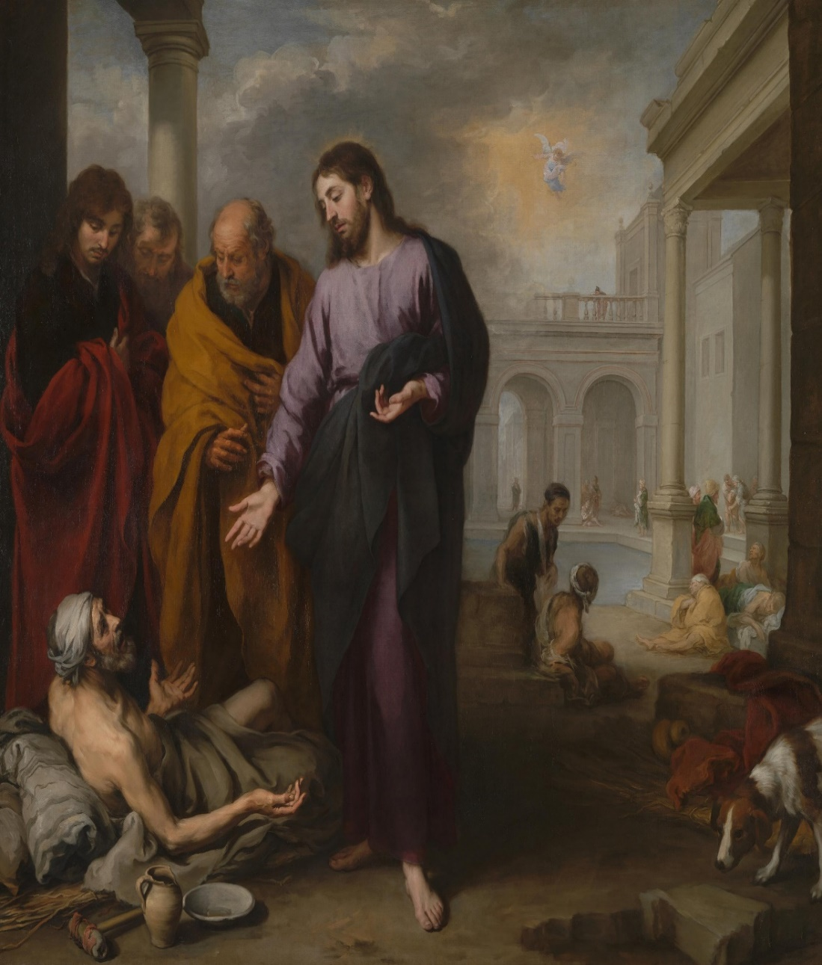
LESSON 41
WEEK 41 OF 52
(Lk. 6-8,11; Mk. 3;
(Mt. 5-7,9,11-13; Jn. 5)
THROUGH THE BIBLE IN 2018
Last time we saw John announce the Messiah; this time more of Jesus’ earthly ministry to Israel.
THE SABBATH
“Jesus saith unto him, Rise, take up thy bed, and walk. And immediately the man was made whole, and took up his bed and walked: and on the same day was the Sabbath”
(Jn. 5:8,9).
Jesus healed many during His 3-year ministry, some on the Sabbath, including this lame man at the ‘pool of Bethesda,’ which provoked the Jews to believe He was breaking the Sabbath. He disagreed with them, saying –
“My Father worketh [Sabbath] hitherto, and I work” (5:17).
God had rested on the 7th day after His work of creation (Gen. 2:2), but that didn’t mean He was idle ever 7th day: He was sustainer of all things (Col. 1:18); the giver of life (Jer. 1:5); interceded in the events of history (2Chron. 36:19), etc.

Slide 2
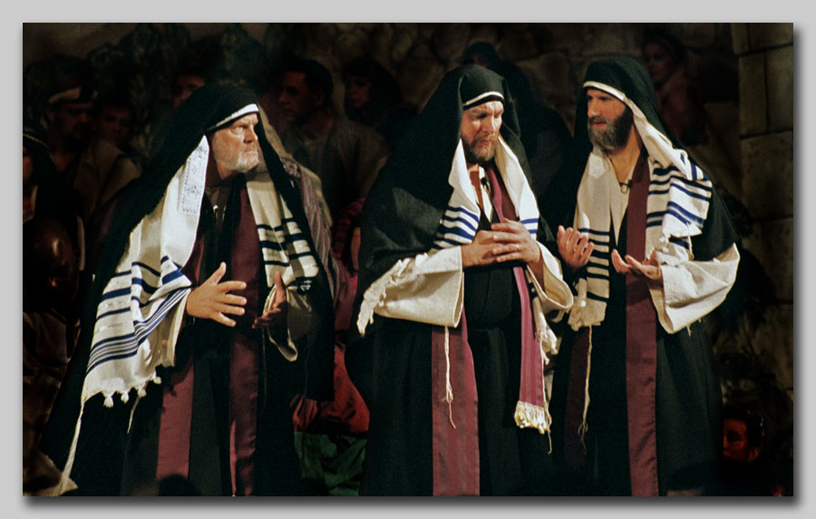
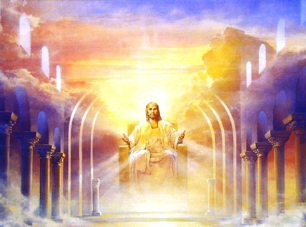
“Therefore the Jews sought the more to kill him, because he not only had broken the Sabbath, but said also that God was his Father, making himself equal with God” (Jn. 5:18).
The Jewish authorities began to plot His death.
CHRIST THE JUDGE
“For the Father judgeth no man, but hath committed all judgment unto the Son: That all should honour the Son, even as they honour the Father” (5:22,23).
There is only One who was delegated to judge the thoughts and intents of the heart and that is the Son of God.
RESURRECTIONS
“Marvel not at this: for the hour is coming, in which all that are in the graves shall hear his voice, and shall come forth; they that have done good [faith], unto the resurrection of life; and they that have done evil [faithless], unto the resurrection of damnation” (5:28,29).
Only the true Judge [Christ] can make this determination.

Slide 3
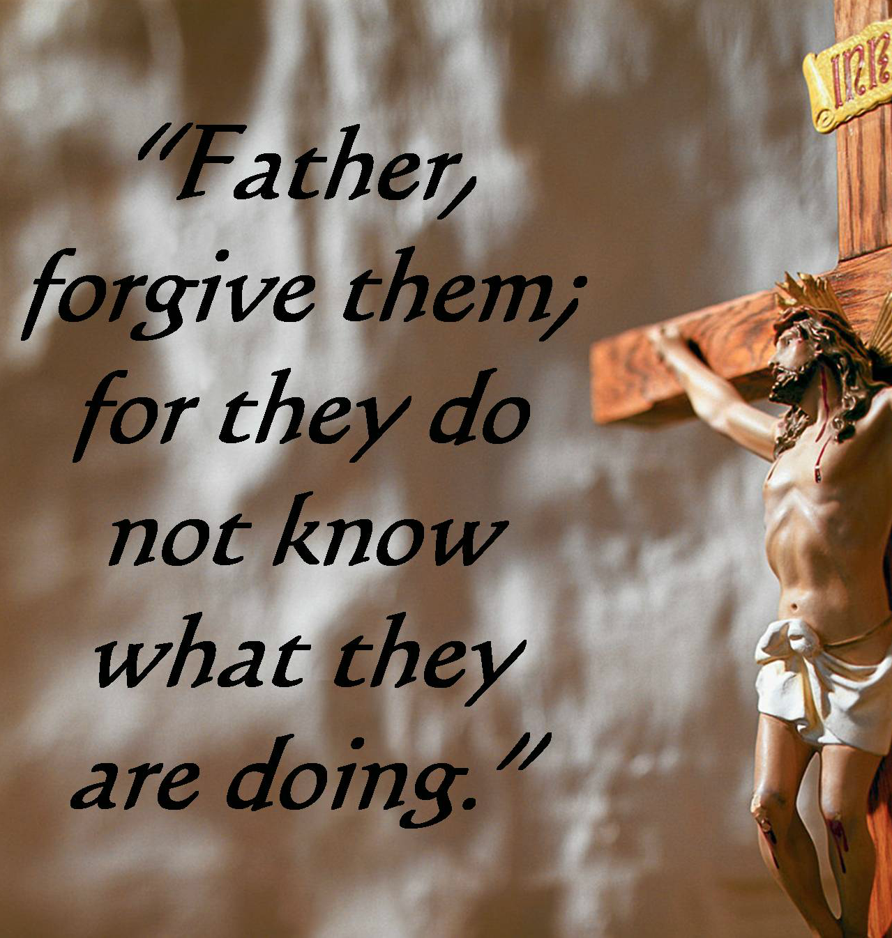
THE UNPARDONABLE SIN
“Wherefore I say unto you, All manner of sin and blasphemy shall be forgiven unto men: but the blasphemy against the Holy Spirit shall not be forgiven unto men. And whosoever speaketh a word against the Son of man, it shall be forgiven Him: but whosoever speaketh against the Holy Spirit, it shall not be forgiven him, neither in this world, neither in the world to come” (Mt. 12:31,32).
The Jewish leadership had made their decision—they were against Jesus, but here Jesus gave them the truth concerning BLASPHEMY, which is to “To speak evil against, rail” (Strong’s Concordance, p. 114).
Those who were speaking evil and railing against the Messiah, were committing blasphemy, but they could be forgiven, if they changed their mind (Lk. 23:34).
From the cross He gave them that opportunity, because they had done so in ignorance.

Slide 4
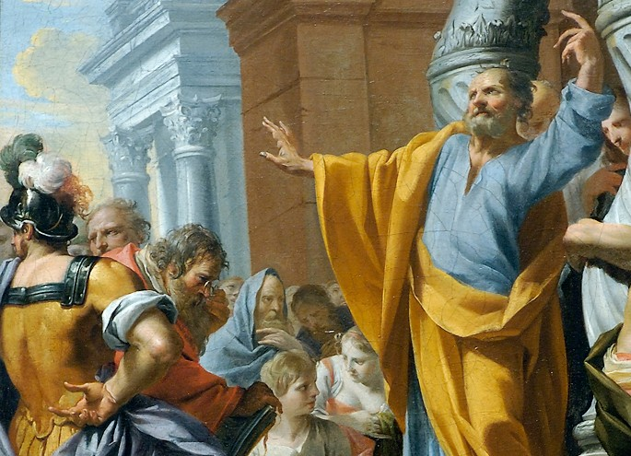
THE UNPARDONABLE SIN (con’t)
However, if Israel persisted in their blasphemy against the Son of God, their opportunity for forgiveness would run out. When?
At Pentecost. Why? Because the Holy Spirit had now opened their eyes to the truth that this Jesus of Nazareth was the Messiah –
“Therefore let all the house of Israel know assuredly, that God hath made that same Jesus, whom ye have crucified, both Lord [Master] and Christ [Messiah]” (Acts 2:36).
If Israel continued to reject Messiah after the Holy Spirt had opened their eyes to the truth, then there was nothing more God could do to save them.
What is the ‘unpardonable sin’?
UNBELIEF!
Can you commit it today? Not if you are a believer!
Every unbeliever is committing the unpardonable sin.

Slide 5
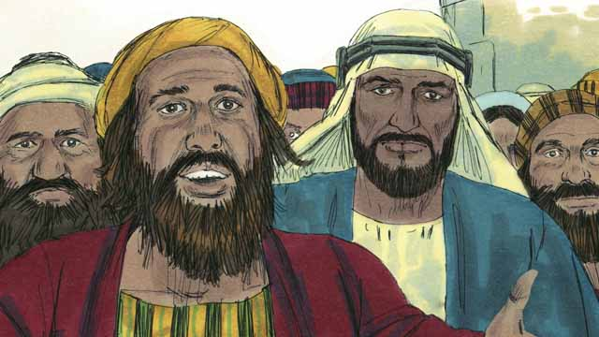
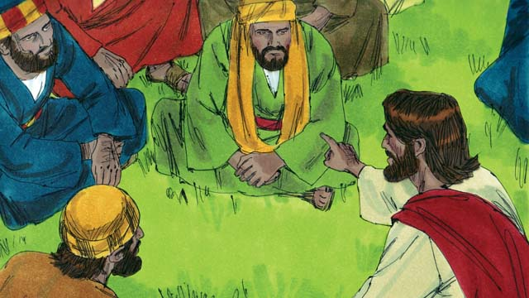
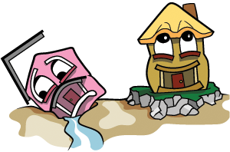
WHO IS MY BROTHER?
“There came then his brethren and his mother, and, standing without, sent unto him, calling him… Behold, thy mother and thy brethren without seek for thee… Who is my mother and my brethren? And he looked round about on them… and said, Behold, my mother and my brethren. Whosoever shall do the will of God, the same is my brother … sister… mother” (Mk. 3:31-35).
Though we are to honor our father, mother (Exo. 20:12), and family, it is those who are of like precious faith that we are the spiritually closest to.
THE HOUSE BUILT ON THE ROCK
“Whosoever cometh to me, and heareth my sayings, and doeth them…He is like a man which built a house… laid the foundation on a rock… when the flood arose… beat hard upon that house… could not shake it” (Lk. 7:47-49).
Christ was that ‘rock,’ and anything else would be swept away and destroyed.

Slide 6
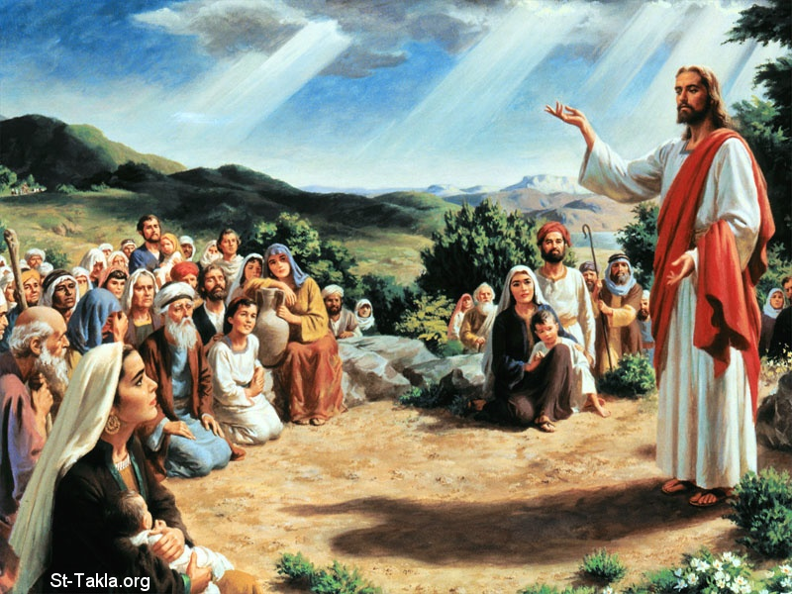
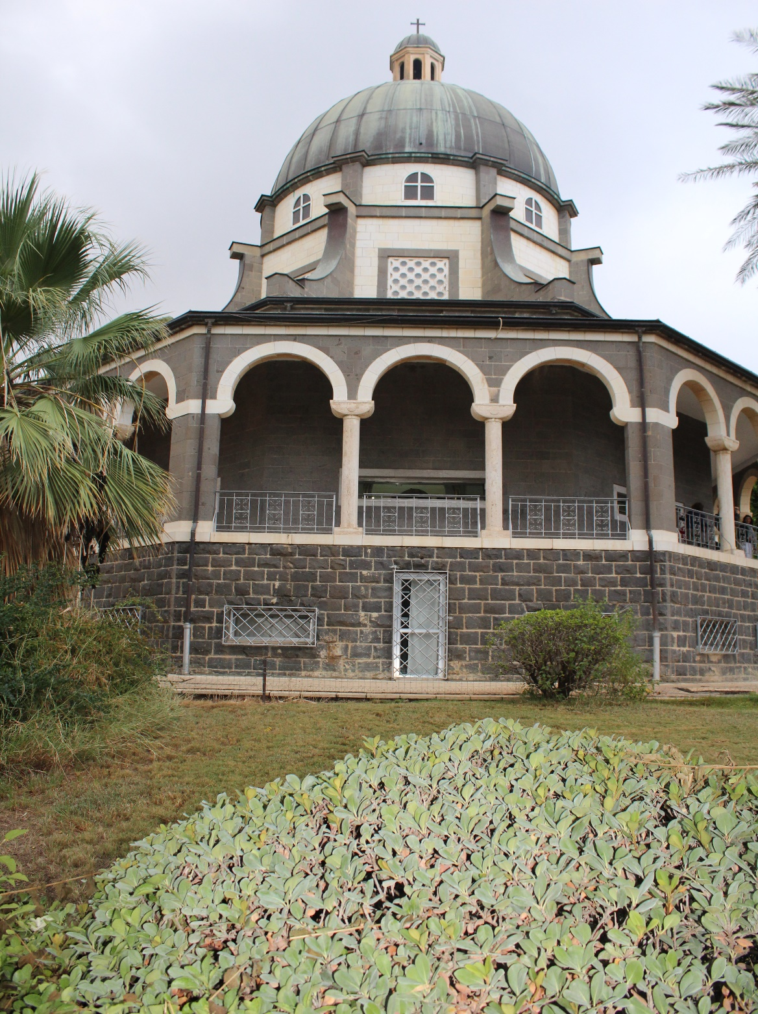
THE SERMON ON THE MOUNT
“And seeing the multitudes, he went up into a mountain… opened his mouth, and taught them, Saying, Blessed are the poor in spirit: for their’s is the kingdom of heaven… they shall inherit the earth… pure in heart for they shall see God [the Son]… those which are persecuted… for their’s is the kingdom of heaven” (Mt. 5:1-10).
C.I. Scofield – “Having announced the kingdom of heaven as at hand,’ the King declares the principles of the kingdom … divine constitution for the righteous government of the earth…” (Old Scofield, p. 1001).
Given a ‘new heart’ (Ezek. 36:26) and made ‘a holy nation’ (Exo. 19:6) at the beginning of the millennial kingdom, the Jews will have no problem in keeping NEW COVENANT [Law] as opposed to their failure at keeping His OLD COVENANT [Law]. Then, they will be the ‘salt of the earth’ and the ‘light of the world’ (5:13,14), which they were not as His 1st coming.
Church of the Beatitudes
(2018)

Slide 7
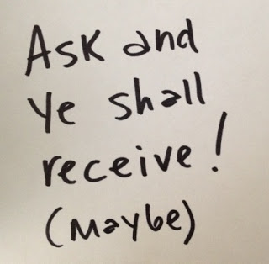
ASK AND YOU WILL RECEIVE
“Ask, and it shall be given you; seek, and ye shall find; knock,
and it shall be opened to you: For every one that asketh
receiveth; and he that seeketh findeth; and to him that
knocketh it shall be opened…” (Mt. 7:7-11).
Is that true? In the kingdom of heaven on earth, it will be
true! Every Jew will do the will of God –
“And I will put my Spirit within you and cause you to walk in
my statutes, and ye shall keep my judgments and do them”
(Ezek. 36:27).
Every petition, every prayer, every thought, deed, and action will be in the will of God. The only things they will ask for will be what God wants them to have—and He will grant each one! Does He do that today? Of course not, because much of what we ask for comes from our sin nature –
“…for what I would, that do I not; for what I hate, that do I” (Rom. 7:15). How do we pray?
“Be careful for nothing… let your requests be made known unto God… And the peace of God, which passeth all understanding… through Christ Jesus” (Phil. 4:6,7). God doesn’t promise us answered prayer—He promises us peace that He will give us what we need, not what we want.

Slide 8
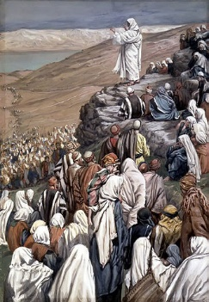
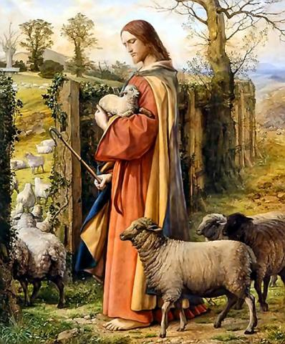
SHEEP WITHOUT A SHEPHERD
“But when he saw the multitudes, he was moved with compassion on them, because they fainted, and were scattered abroad, as sheep having no shepherd” (9:36).
Jesus saw unsaved Israel like sheep having no shepherd, wandering aimlessly until they were so exhausted they passed out! The priests should have been shepherding
the sheep, but they were corrupt and did everything possible to keep the sheep from God’s Shepherd [Christ].
“Then saith he unto his disciples, The harvest truly is
plenteous, but the labourers are few; Pray ye therefore
the Lord of the harvest, that he will send forth labourers
into this harvest” (9:37,38).
Nearly the whole nation of Israel was unsaved, so there
was a huge harvest awaiting. But, there were few laborers aside from the 12 Disciples, whom Christ told to pray to the Father to send help.

Slide 9
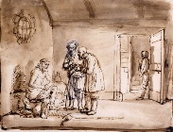
JOHN QUESTIONS THE MESSIAH
“And John calling unto him two of his disciples sent them to Jesus, saying, Art thou he that should come? Or look we for another? … And Jesus answering said unto them, Go your way, and tell John what things ye have seen and heard… blind see, the lame walk, lepers cleansed, deaf hear, the dead are raised, to the poor the gospel is preached. And blessed is he whosoever shall not be offended in me”
(Lk. 7:19-23).
John’s ministry was brief [<1 yr.] and now he was in prison
and the kingdom had not yet come. Why, he asked, or was there another who would bring it in?
Answer – He [Jesus] was Messiah, confirmed by the miracles He performed and that John should not lose faith that the kingdom had not yet been established (Christ did NOT tell John why, nor did He reveal to any others including the 12, because He had come to die on a cross, be buried, and raise from the dead—the kingdom would be delayed).

Slide 10
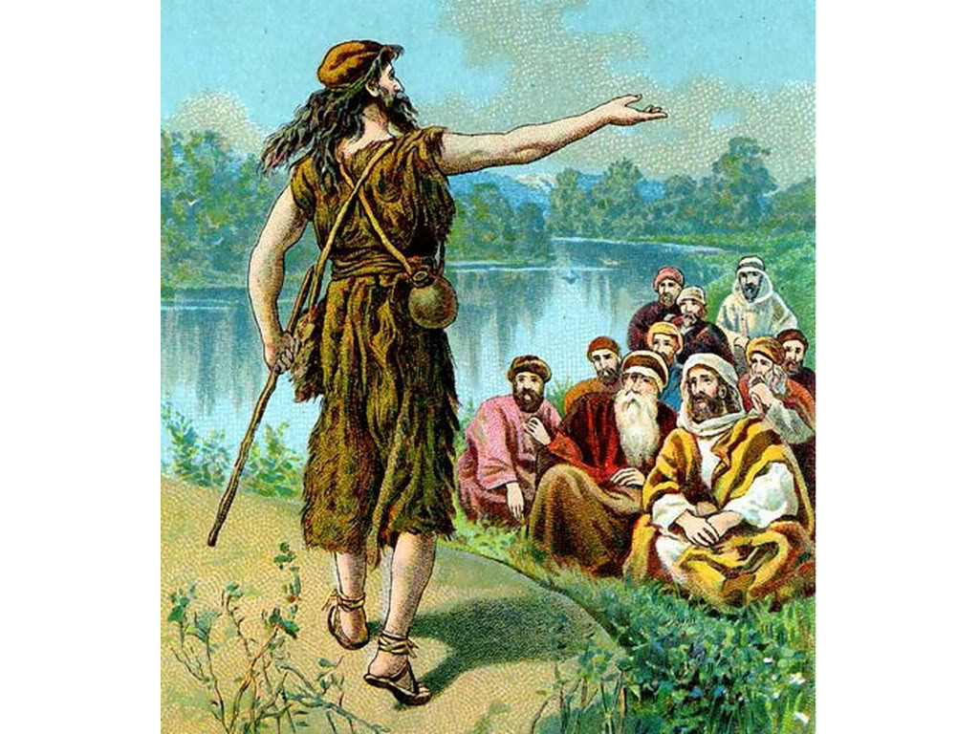
GREATER THAN A PROPHET
“And when the messengers of John were departed, he [Jesus] began to speak unto the people concerning John, What went ye out into the wilderness for to see? A reed shaken with the wind?... A man clothed in soft raiment?... A prophet? Yea, I say unto you, and much more than a prophet… For I say unto you, among those that are born
of women there is not a greater prophet than John the Baptist: but he that is least in the kingdom of God is greater than he” (7:24-28).
After the messengers left, Jesus asked the crowd if they knew who John really was—not just a prophet but the one chosen to announce the arrival of Messiah. But then He said, the least in the kingdom will be greater than John.
Meaning? The least in the kingdom will have a new heart, peace & forgiveness, perfect fellowship with Christ, etc. At present, John, in prison, and about to be beheaded, didn’t even know for sure that Jesus was the Messiah.

Slide 11
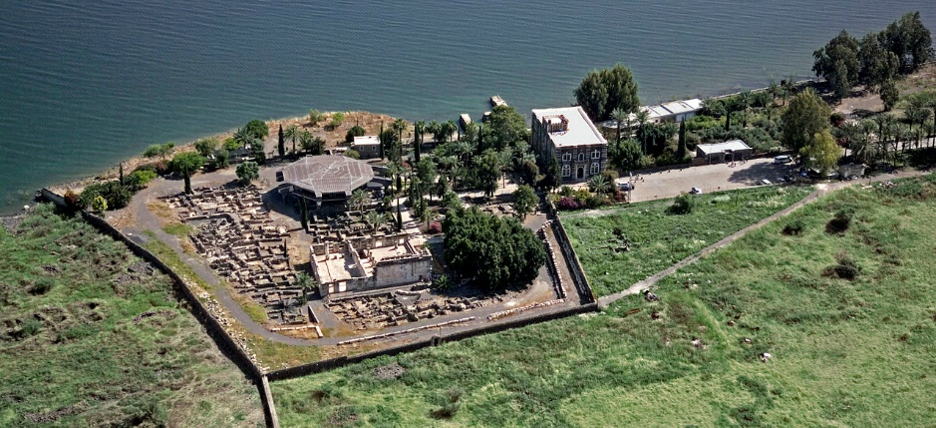
WOE ON THESE CITIES
“Then began he to upbraid the cities wherein most of his mighty works were done, because they repented not: Woe unto thee, Chorazin!... Bethsaida! For if the mighty works, which were done in you, had been done in Tyre and Sidon, they would have repented… And thou Capernaum, which art exalted unto heaven, shalt be brought down to hell… But I say unto you, that it shall be more tolerable for the land of Sodom in the day of judgment, than for thee” (Mt. 11:20-24).
Jesus spent most of His 3-yr. ministry in the northern Galilee in the vicinity of the above mentioned cities, including His place of residence, Capernaum. He did more miracles/teaching here than any other, in fact, had Tyre & Sidon, or even Sodom, had seen such display of godly power, they would have converted. Because their citizens rejected Christ, their judgment will be worse than those of Sodom.

Slide 12
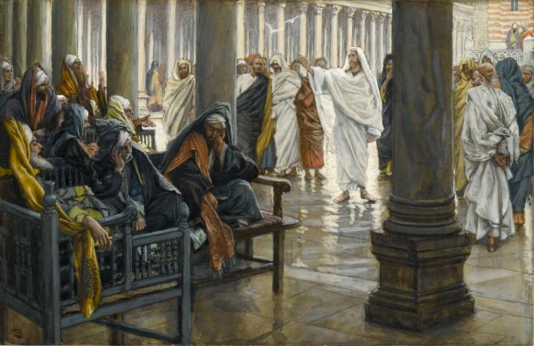
WOE ON RELIGIOUS LEADERS
“… he went in, and sat down to meat. And when the Pharisee saw it, he marveled that he had not first washed before dinner. And the Lord said unto him, Now do ye Pharisees make clean the outside of the cup and the platter; but your inward part is full of ravening and wickedness… But woe unto you, Pharisees! For ye tithe mint and rue and all manner of herbs, and pass over judgment and the love of God: these ought ye to have done, and not to leave the other undone… for ye love the uppermost seats in the synagogues, and greetings in the markets…” (Lk. 11:37-44).
Jesus failing to do the ritualistic handwashing, chastised the Pharisees because of their hypocrisy—they washed outside but were filthy inside; they tithed in minute detail [herbs], but overlooked the big, spiritual things like the love and justice of God. Each time they tried to trap Him, “Laying wait for him, and seeking to catch something out of his mouth, that they might accuse him” (11:54).

Slide 13
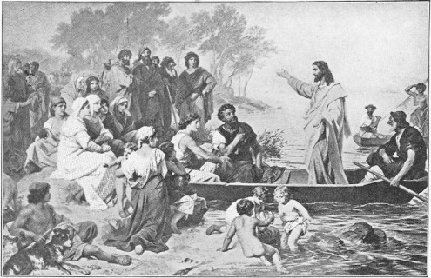
MYSTERIES OF THE KINGDOM
“The same day went Jesus out of the house, and sat by the
sea side. And great multitudes were gathered together unto
him, so that he went into a ship, and sat; and the multitude
stood on the shore. And he spake many things unto them in
parables…” (Mt. 13:1-3).
By this time, most had rejected Jesus as Messiah, so He used
parables to teach truths concerning the kingdom of heaven to
those who believed, but kept it from those who didn’t –
“And the disciples came, and said unto him, Why speakest
thou unto them in parables? He answered… because it is given unto you to know the mysteries of the kingdom of heaven, but to them it is not given… they seeing see not; and hearing they hear not, neither do they understand”(13:10-13).
Christ did not want unbelieving Jews to know the wonderful
blessings that awaited believing Jews. Does Christ want unbelievers today to know the peace that heaven will bring?
NO!!! “Now we have received, not the spirit of the world, but the Spirit which is of God; that
we might know the things that are freely given to us of God” (1Cor. 2:9).

Slide 14
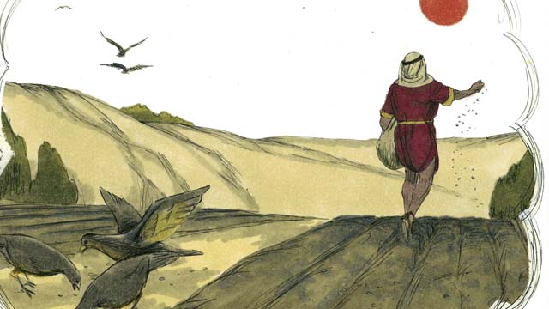
PARABLE OF THE SOWER
“Hear ye therefore the parable of the sower. When any one heareth the word of the kingdom, and under standeth it not, then cometh the wicked one, and catcheth away that which was sown in the heart…” (13:18,19).
The sower is Christ, the seed is the gospel of the kingdom, and the soil represents 4-different kinds of hearers:
One who hears it but doesn’t understand it, and Satan comes and takes it away;
One who receives it, but because of its shallowness, it cannot endure;
One who allows the cares of the world to distract them, producing no fruit;
One who receives it, holds onto it, and allows it to bear fruit. Only #4 is good, which is consistent with what Jesus said of eternal life – Many shall go through the wide gate into hell, but few will go through the narrow gate into the kingdom of heaven (Mt. 7:13,14).

Slide 15
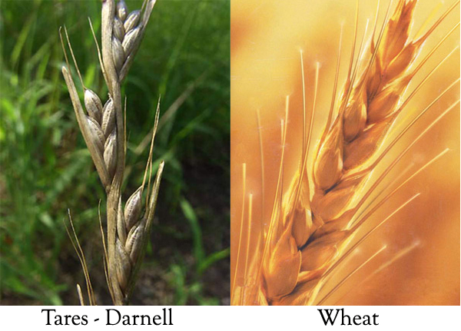
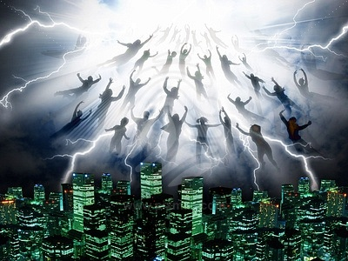
PARABLE OF THE WHEAT & THE TARES
“Another parable put he forth unto them, saying, The kingdom of heaven is likened unto a man which sowed good seed in his field: But while men slept, his enemy came and sowed tares among the wheat, and went his way…” (13:24-30).
Jesus also interpreted this parable: the 1st sower is Jesus who sows good seed [children of the earthly kingdom], but Satan also comes and sows evil seed. Both grow together [Christ’s earthly ministry & the tribulation when the gospel of the kingdom is preached], but at the end of the tribulation the unsaved are plucked up and cast into hell whereas the saved enter into the kingdom with Christ.
This cannot be meant for the present dispensation of grace where the opposite will occur: at the end of our age, the saved are ‘caught up’ and taken to heaven; the unsaved left to go through the tribulation.

Slide 16
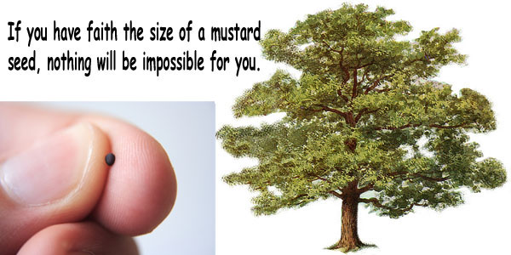
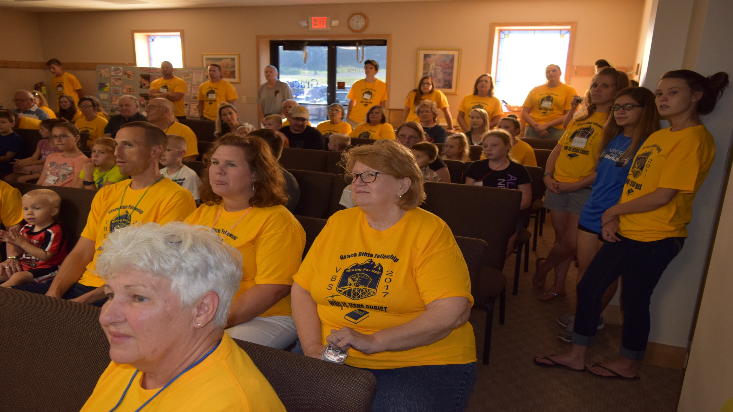
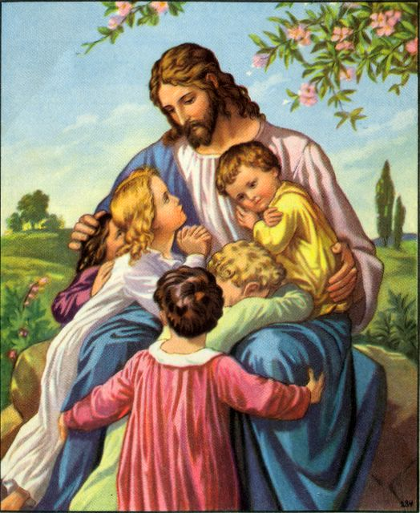
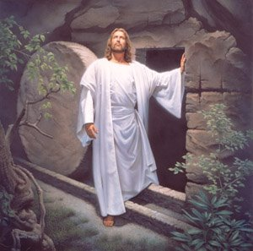
FAITH OF A MUSTARD SEED
“Another parable… the kingdom of heaven is like a grain of mustard seed, which a man took, and sowed in his field: Which is the least of all seeds: but when it is grown, it is the greatest… becometh a tree, so that the birds… come and lodge in the branches thereof” (13:31,32).
How much faith did it require to believe Jesus was the Messiah of whom the O.T. prophets promised would come?
Childlike faith—faith the size of a mustard seed.
How much faith does it take today to believe that Christ died and rose from the dead?
Childlike faith—faith the size of a mustard seed.
How big can that seed grow?

Slide 17
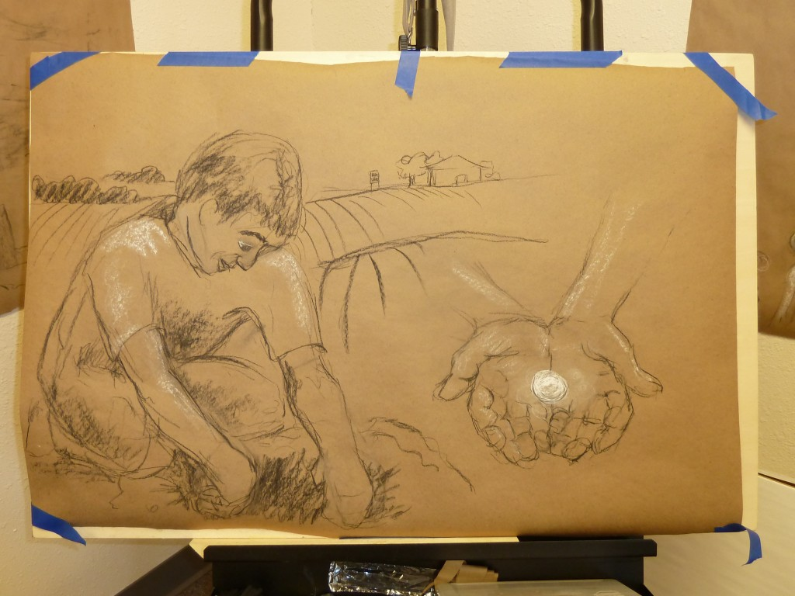
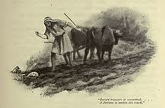
THE HID TREASURE
“Again, the kingdom of heaven is like unto a treasure hid in a field; the which when a man hath found, he hideth, and for joy thereof goeth and selleth all that he hath, and buyeth that field” (13:44). The Lord did not interpret this parable, but Dr. Scofield did –
“Our Lord is the buyer at the awful cost of His blood (1Pet. 1:18), and Israel… hidden in ‘the field,’ the world (v. 38), is the treasure (Exo. 19:5; Psa. 135)” (Old Scofield, p. 1017). Christ sold all He had in order to purchase the redemption of Israel.
THE PEARL
“Again, the kingdom of heaven is like unto a merchant man, seeking goodly pearls, who when he had found
one pearl of great price, went and sold all that he had, and bought it” (13:45,46). Christ is the merchant who gave everything to purchase remnant Israel.

Slide 18
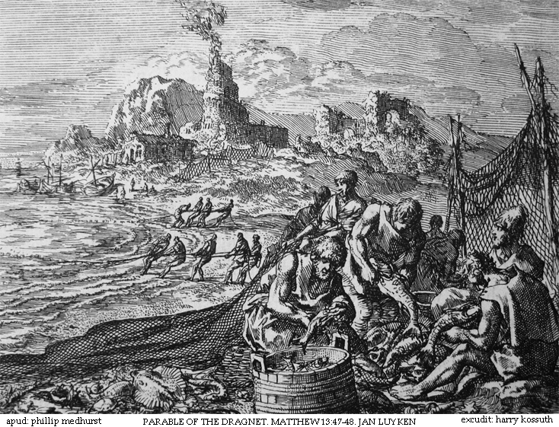
THE DRAG NET
“Again, the kingdom of heaven is like unto a net, that was cast into the sea, and gathered of every kind, which when it was full, they drew to shore, and sat down, and gathered the good… and cast the bad away. So shall it be at the end of the world: The angels shall come forth, and sever the wicked from the just, and shall cast them into the furnace of fire: there shall be wailing and gnashing of teeth” (13:47-50).
At the end of the tribulation at Christ’s 2nd coming, He will separate the saved from the unsaved—the saved go into the kingdom of heaven on earth, the unsaved into hell.
“Jesus saith to them, Have ye understood all these things? They say unto him, Yea, Lord” (13:51).
They understood this kingdom, but they were clueless to the fact He first had to die and come a 2nd time to establish it.

Slide 19
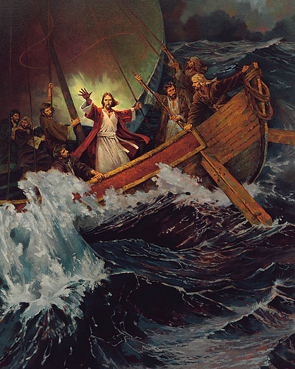
JESUS STILLS THE STORM
“Now it came to pass on a certain day, that he went into a ship with his disciples: and he said unto them, let us go over unto the other side of the lake. And they launched forth. But as they sailed he fell asleep: and there came down a storm of wind on the lake; and they were filled with water, and were in jeopardy. And they came to him, and awoke him, saying, Master, we perish. Then he arose, and rebuked the wind and the raging of the water: and they ceased and there was a calm. And he said unto them, Where is your faith? And they being afraid wondered, saying one to another, What manner of man is this! For he commendeth even the winds and water, and they obey him” (Lk. 8:22-25).
Why did Jesus ask that?
Because He had already told them where they were going to—the other side of the lake!

Slide 20
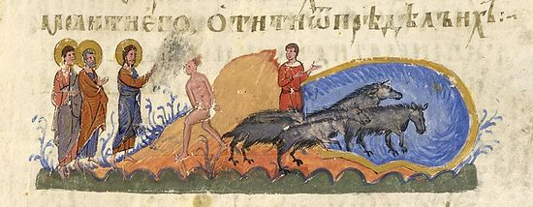
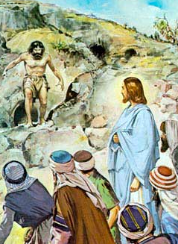
LEGION
“And they arrived at the country of [the tribe of Gad]
the Gadarenes, which is over against Galilee. And when he went forth to land, there met him a certain man, which had devils long time, ware no clothes, neither abode in any house, but in the tombs… And Jesus asked him, What is thy name? And he said, Legion: because many devils were entered into him” (8:26-30).
Why were there so many cases of demon possession during His earthly ministry? As Christ was trying to save the lost for the kingdom—Satan possessed them, requiring Him to spend much time in demon exorcisms –
“And there was a herd of many swine feeding on the mountain… then went the devils out of the man, and entered into the swine: and the herd ran violently… into the lake” (8:32,33).
Why swine? They were unclean, so Jesus allowed their request to go into unclean animals rather than sheep.

Slide 21
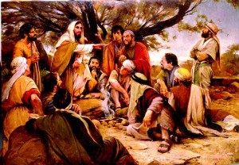
Next time – Jesus sends out the 12

