Slide 1
THROUGH THE BIBLE IN 2018
LESSON 17
WEEK 17 OF 52
(1Chron. 1–10)
Last time we saw David chosen to be king over Judah—now what?
Ist & 2nd CHRONICLES record the history of Israel and were originally written as one scroll, its author unknown. They cover the time from the death of Saul to the Babylonian captivities. The most important aspect of these books are the blessings of God on Israel through the kingship of David, their greatest king.
1st CHRONICLES:
Genealogies (1:1-9, 44)
Death of Saul to coronation of David (10:1-12, 40)
David’s kingship to his death (13:1-29, 30)

Slide 2
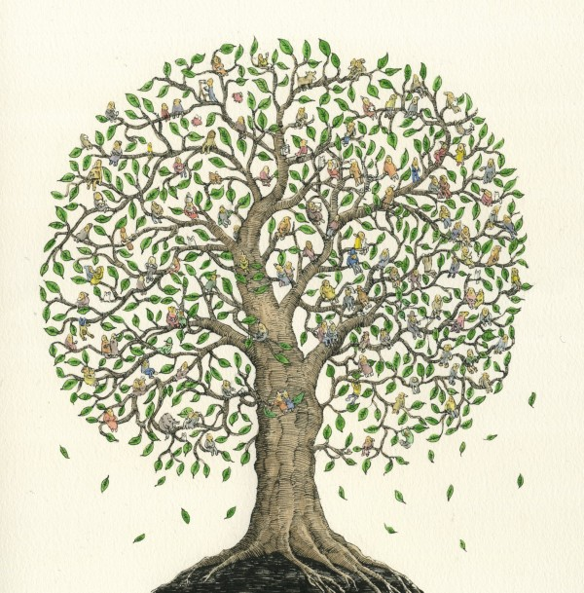
The genealogies document the lineage of David and the tribe of Judah as they will come to the forefront of God’s blessings:
1Chron. 1:1 – Adam, Seth, Enoch
“ 1:2 – …. Mahalalel, Jared
“ 1:2 – … Methuselah, Lamech
“ 1:3 – Noah, Shem, Ham, and Japheth
“ 1:17 – Sons of Shem… Arphaxad…
[Shem’s line to Abraham]
“ 1:24–27 – Shem, Arphaxad, Shelah… Nahor, Terah, Abram
“ 1:28 – Sons of Abraham; Isaac and Ishmael
“ 2:1,2 – Sons of [Jacob] Israel: Reuben, Simeon, Levi, Judah,
Issachar, Zebulon, Dan, Joseph, Benjamin, Naphtali,
Gad, Asher
“ 2:3 – Sons of Judah…
“ 2:11 – … Salma begat Boaz
“ 2:12 – And Boaz begat Obed, and Obed began Jesse
“ 2:13-15 – And Jesse begat… David the [7th son of Jesse]

Slide 3
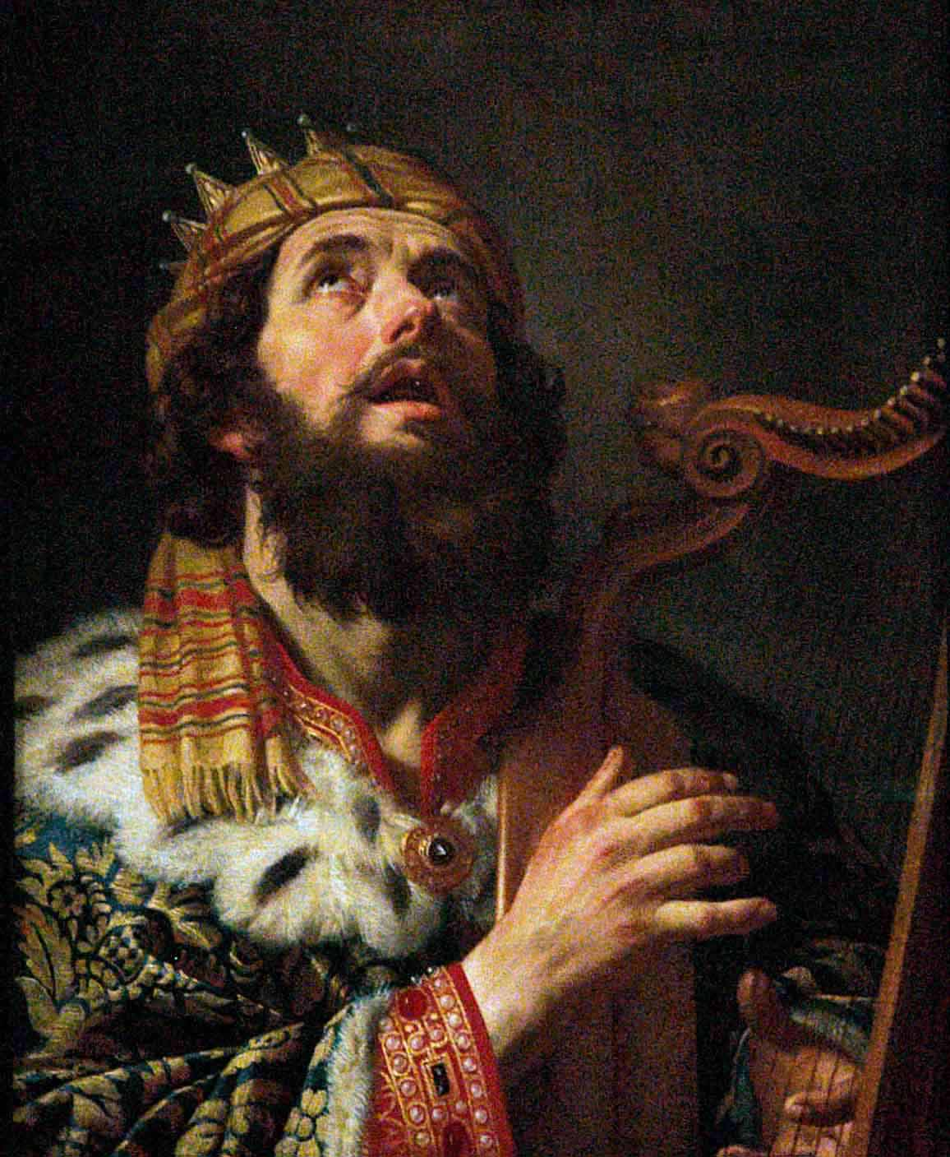
“O send out thy light and thy truth: let them lead me; let them bring me unto thy holy hill, and to thy tabernacles. Then will I go unto the altar of God, unto God my exceeding joy, yea, upon the harp will I praise thee, O God my God” (Psa. 43:3,4).
David is looking forward to the day that Jerusalem will be the capital of the nation and where all will come to worship God.
“How thou didst drive out the heathen with thy hand, and plantedst them… For they got not the land in possession by their own sword… but thy right hand, and thine arm…” (44:2,3).
Though Joshua led them into the promise land, it was Christ who defeated their enemies.

Slide 4
“I will make thy name [Jn. 1:12] to be remembered in all generations: therefore shall the people praise thee for ever and ever” (45:17).
God had given Israel an eternal promise and they would some day [during the kingdom of heaven on earth] remember and praise the One who made it possible.
“But God will redeem my soul from the power of the grave: for he shall receive me” (49:15).
A common theme in the O.T. is that God will redeem the righteous but destroy the wicked.
“How amiable are thy tabernacles, O LORD of hosts! My soul longeth, yea, even fainteth for the courts of the LORD” (84:1,2).
The nation longs for a place in Jerusalem where they can proudly come to worship their God.

Slide 5
“Thou hast taken away all thy wrath: thou hast turned thyself from the fierceness of thine anger” (85:3).
Israel had first hand experienced God’s wrath because of their disobedience, but He was always ready to forgive them when they repented from their sinful acts.
“His foundation is in the holy mountains. The LORD loveth the gates of Zion more than all the dwellings of Jacob. Glorious things are spoken of thee, Oh city of God” (87:1-3).
The city of Jerusalem will one day be the most important city on earth because it will be there Israel will be the Holiest nation on earth and Christ will sit on David’s throne as their King.

Slide 6
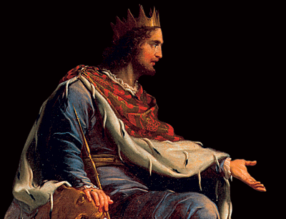
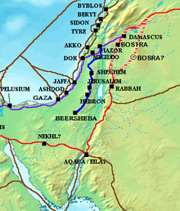
The Chronicler continued his theme of the importance of David’s lineage including his children –
“Now these were the sons of David, which were born unto him in Hebron; the firstborn Amnon… Ahinoam… Daniel… Absalom… Adonijah… Shephatiah… Ithream… These [6] were born unto him in Hebron; and there he reigned [7 ½] years… (1Chron. 3:1-4)… and in Jerusalem he reigned [33] years. And these were born unto him in Jerusalem… Solomon… [9-total]…” (3:4-8).
David fathered 15-sons, the first 6 born in Hebron while he was king of Judah, and the last 9 in Jerusalem when he became king of all of Israel.

Slide 7
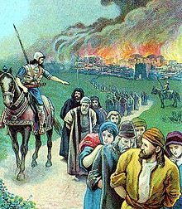
Next the lineage from King David [1,000 B.C.] to King Zedekiah [600 B.C.] –
“And Solomon’s son was Rehoboam… Abia… Asa… Jehoshaphat… Hezekiah… Manasseh… Josiah… Jehoiakim… Zedekiah…” (3:10-15).
Zedekiah was the last king of Judah (Jer. 34:2) before Nebuchadnezzar king of Babylon destroyed Jerusalem
and took the last of the Israelites into a 70-year captivity. The last thing king Zedekiah saw was the murder of his sons before he was blinded –
“Then the king of Babylon slew the sons of Zedekiah… before his eyes… moreover he put out Zedekiah’s eyes, and bound him with chains to carry him to Babylon”
(Jer. 39:6,7).
Next the Chronicler [Historian] returned to the lineage of Judah who would become the principle tribe of Israel.

Slide 8
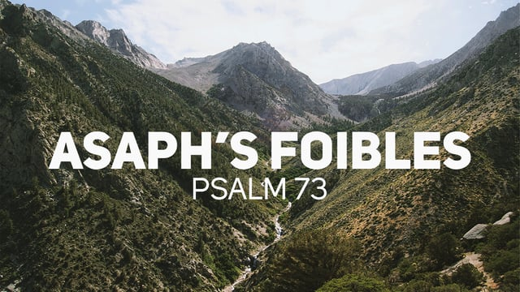
Though the Chronicler begins with the tribe of Judah
because of the importance of this largest tribe, he
provided the genealogy of all 12 tribes –
“The sons of Judah…” (4:1)
“The sons of Simeon…” (4:22)
“Now the sons of Reuben the firstborn of Israel…” (5:1)
“And the children of Gad…” (5:11)
Back to the Psalms –
“Truly God is good to Israel, even to such as are of a
clean heart… For I was envious at the foolish, when I
saw the prosperity of the wicked” (Psa. 73:1).
Written by Asaph, a Levite [lineage of Gershom], a
famous singer and psalmist [writer], he revealed here
his jealousy of the wicked who appear to prosper above that of Israel.
“I cried unto God with my voice… my soul refused to be comforted…” (77:1,2).
Again, Asaph, struggled with the thought that the enemies of Israel were prospering more than they were.

Slide 9
Asaph –
“Give ear, O my people, to my law… We will not hide them [613 laws] from their children, shewing to the generation to come the praises
of the LORD… For he established a testimony in Jacob, and appointed a law in Israel [at Mt.
Sinai]… That the generation to come might know them, even the children which should be born; who should arise and declare them to their children” (78:1-5).
The psalmist here reiterates the importance of the Mosaic Law given to Israel. Like Moses and Joshua before him, he emphasized the importance of knowing and obeying it and to making sure it is passed down to their children and their children’s children.

Slide 10
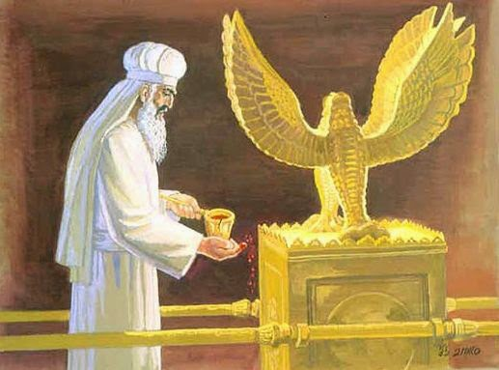
BACK TO 1CHRONICLES
“The sons of Levi; Gershon, Kohath, and Merari.
And the sons of Kohath; Amram… And the children of Amram; Aaron, and Moses... The sons also of Aaron; Nadab, and Abihu, Eleazar… begat Phinehas…” (1Chron. 6:1-4).
Next the Chronicler lists the sons of Levi who would all serve in the tabernacle, but only the sons of Kohath would be priests, and only those in the line of Aaron would be high
priests –
“But Aaron and his sons offered upon the alter of the burnt-offering, and on the altar of incense, and were appointed for all the work of the place most holy, and to make an atonement for Israel, according to all that Moses the servant of God had commanded” (6:49).

Slide 11
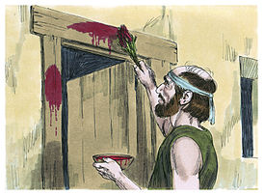
BACK TO THE PSALMS
“For this was a statute for Israel, and a law of the God of Jacob. This he ordained in Joseph for a testimony, when he went out through the land of Egypt… I am the LORD thy God, which brought thee out of the land of Egypt…” (81:4,5,10).
The Psalmist reminded Israel that their God delivered them from Egyptian bondage and the feast of Passover should be remembered forever.
One of the saddest of all the psalms –
O LORD God of my salvation, I have cried day and night before thee. For my soul is in troubles and my life drawth nigh unto the grave… I am afflicted and ready to die…” (88:1,3,15).
Read this when you are at the end of your rope and know there have been others just like you.

Slide 12
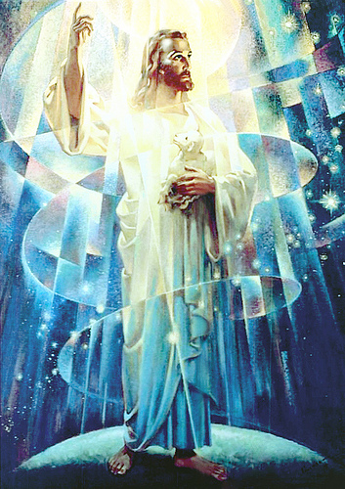
“It is a good thing to give thanks unto the LORD,
and to sing praises unto thy name, O most High.
To shew forth thy loving-kindness in the morning,
and thy faithfulness every night” (92:1,2).
Israel was taught to be thankful all the day long
because they had such a loving God—shouldn’t
we do the same?
“And let the peace of God rule in your hearts, to
which also ye are called in one body; and be ye
thankful” (Col. 3:15), but unfortunately, the end of
the Age of Grace will produce the opposite –
“This know also, that in the last days perilous times
shall come. For [saved] men shall be lovers of their
own selves… unthankful, unholy (2Tim. 3:1,2).
“The LORD reigneth, he is clothed with majesty… thy
throne is established of old: thou art from everlasting…” (93:1,2).
This psalm anticipates the reigning and ruling of Christ over all creation.

Slide 13
“The sons of Issachar…” (7:1)
“The sons of Benjamin…” (7:6)
“The sons of Naphtali…” (7:13)
“The sons of Manasseh…” (7:14)
“The sons of Ephraim…” (7:20)
“The sons of Asher…” (7:30)
1CHRONICLES 8:1 – goes into more detail than Ch. 7:6-12 concerning the Benjaminites – Why?
1CRONICLES 8:33-40 provides information concerning the lineage of
Saul and Jonathan [Benjaminites] –
“And Ner begat Kish, and Kish begat Saul, and Saul begat Jonathan…” (8:33).

Slide 14
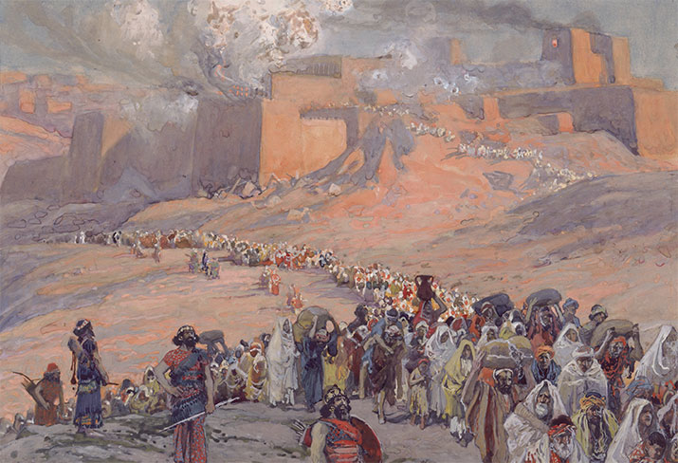
“So all Israel were reckoned by genealogies; and, behold, they were written in the book of the kings of Israel and Judah, who were carried away to Babylon for their transgression” (9:1).
Here the author looks ahead to the time when the Israelites are taken to Babylon for a 70-year captivity because of their persistent idol worship.
And, then gives their locations upon their return –
“Now the first inhabitants that dwelt in their possessions in their cities were, the Israelites, the priests, Levites… and in Jerusalem dwelt of the children of Judah… Benjamin… Ephraim… Manasseh…” (9:2,3).

Slide 15
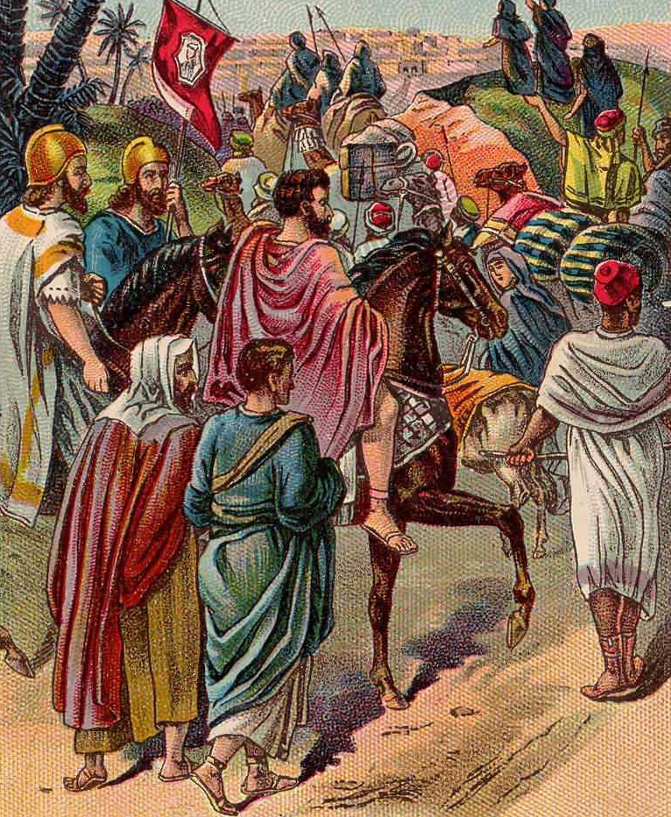
1CHRONICLES VS. NEHEMIAH
Whereas 1CHRONICLES [1,000 B.C.] looks to the future in terms of the return from the Babylonian exile, the Book of NEHEMIAH records it in real time [525 B.C.] –
“And I said unto the king [Artaxerxes of Persia], if it please the king, and if thy servant have found favour in thy sight, that thou wouldest send me unto Judah, unto the city of my fathers’ sepulchers [Hebron], that I may build it (2:4)… And at Jerusalem dwelt certain of the children of Judah, and of the children of Benjamin…”
(Neh. 11:4).
Nehemiah asked the king of Persia to allow the Israelites to return to their land to rebuild Hebron and Jerusalem after its destruction 70-years earlier, because God had decreed it to be done.

Slide 16
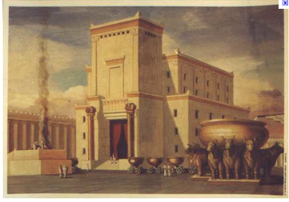
Upon their return [525 B.C.], 1CRONICLES lists the names and tribes of the returnees –
“And of the priests…” (9:10-13)
“And of the Levites…” (9:14-25), and their duties –
“And the porters were… who hitherto waited in the king’s gate eastward: they were porters in the companies of the children of Levi…” (9:17,18).
These Levites were in charge of opening and closing of the gates to the temple.
“For these Levites, the four chief porters, were in their set office, and were over the chambers and treasuries of the house of God [temple]. And they lodged round about the house of God, because the charge was upon them…” (9:26,27).
The Levites were in charge of operation of the temple.

Slide 17
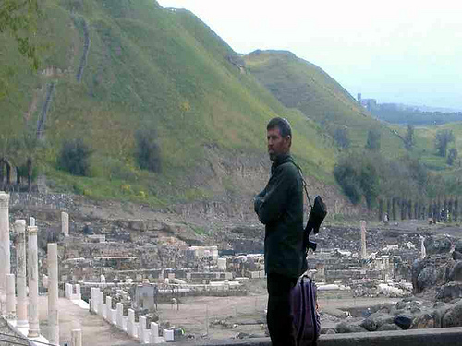
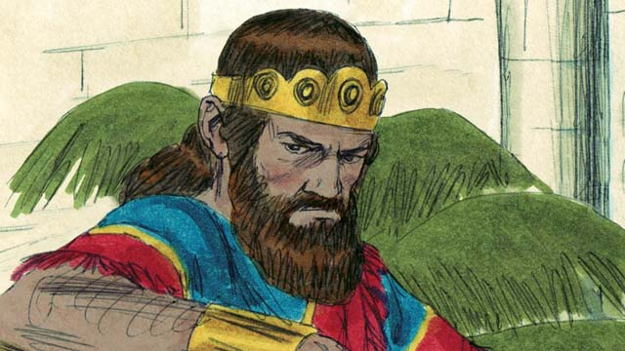
The emphasis of 1&2 CHRONICLES is to show the importance of David as compared to Saul. Though Saul was divinely chosen to be Israel’s 1st king, David was God’s ultimate choice to become king over the whole nation of Israel [all 12 tribes]. Therefore, the Chronicler again repeats the demise of Saul in preparation of David’s kingship –
“Now the Philistines fought against Israel; and the men of Israel fled from before the Philistines, and fell down slain in mount Gilboa. And the Philistines followed hard
after Saul, and after his sons… slew the sons of Saul. And the battle went hard against Saul, and the archers hit him, and he was wounded of the archers” (10:1-3).

Slide 18
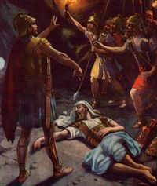
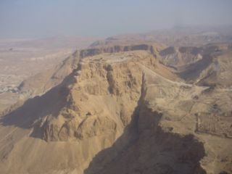
THE DEATH OF SAUL
“Then said Saul to his armour-bearer, Draw thy sword, and thrust me through therewith; lest these uncircumsied come and abuse me. But his armourbear would not; for he was sore afraid. So Saul took a sword, and fell on it. And when his armourbearer saw that Saul was dead, he fell likewise on the sword, and died” (10:4,5).
With God’s protection withdrawn from Saul,
he took his own life rather than allow the enemy to take him alive.
About a thousand years later, as Israel is again defeated, this time by the 10th Roman Legion under General Titus, 965 Jews take their own lives rather than be taken captive, at… MASADA!

Slide 19
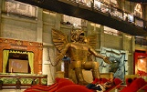
SAUL’S BODY DEFILED
“And it came to pass on the morrow, when the Philistines came to strip the slain, that they found Saul and his sons fallen in mount Gilboa. And when they had stripped him, they took his head, and his armour, and sent into the land of the Philistines round about, to carry tidings unto their idols, and to the people. And they put his armour in the house of their gods, and fastened his head in the temple of Dagon” (10:8-10).
Do you see why God wanted Israel to drive out the pagan idol worshipers, and if they did not leave they were to slay every—man, woman, and child!

Slide 20
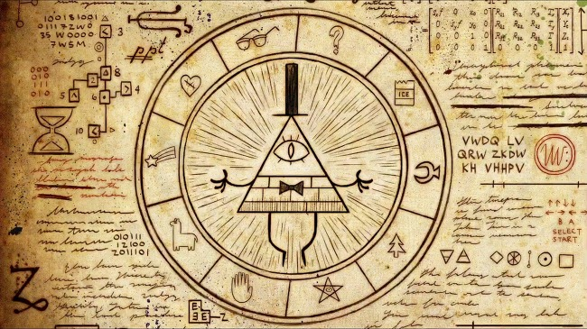
“So Saul died for his transgression which he committed against the LORD, even against the word of the LORD, which he kept not, and also for asking counsel of one that had a familiar spirit, to enquire of it; And enquired not of the LORD; Therefore he slew him, and turned the kingdom unto David the son of Jesse” (10:13,14).
God took Saul’s life for 2-reasons: 1. he performed an animal
sacrifice, rather than ask the LORD what to do; 2. he contacted a medium [after he sought the LORD, but got no answer]. Remember this passage before you read your next horoscope or get your fortune told. Why? Would you rather trust your fate to the powers of darkness, or to the God of the universe?
“[Christ] who hath delivered us from the power of darkness, and hath translated us into the kingdom his dear Son. In whom we have redemption through his blood, even the forgiveness of sins” (Col. 1:13).
Next time – David becomes king over all of Israel.

