Slide 1
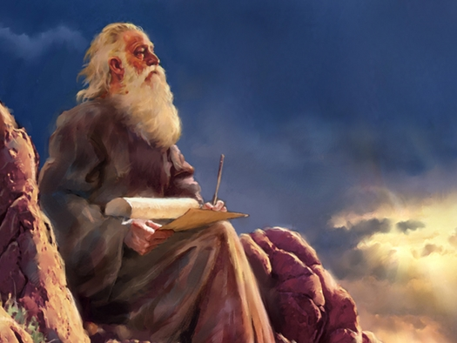
THROUGH THE BIBLE IN 2018
LESSON 12
WEEK 12 OF 52
(Deut. 23-Josh. 11)
Last time we saw Moses lead the next generation of Israelites to the edge of Canaan where he recited the 2nd reading of the Law.
Moses continued to educate the next generation of
Israelites of the 613 Commandments in the Law covering
a myriad of subjects in their relationship with God.
To God’s dismay (Mal. 2:16), divorce was rampant in the
ancient times so He instructed the Israelites how to
prevent it, and limiting the circumstances when it could
be used – “When a man hath taken a wife, and married
her and it come to pass… he hath found some unclean-
nes in her: then let him write her a bill of divorcement…
may not take her again to be his wife” (24:1).
“When a man hath taken a new wife, he shall not go out
to war… one year” (24:5). This law was to show the importance of the home in that the husband’s military duty was delayed for 1-yr.

Slide 2
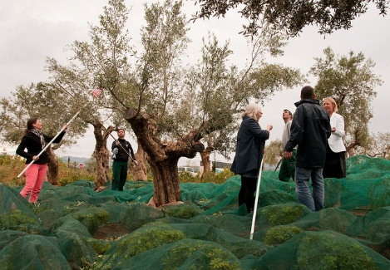
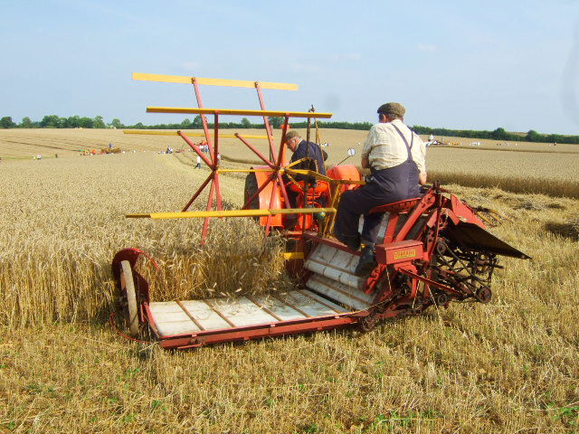
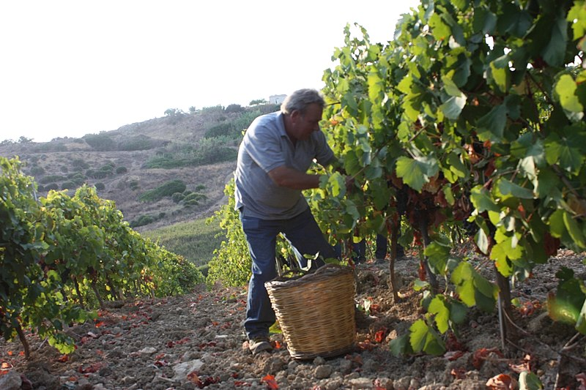
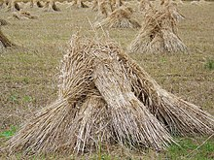
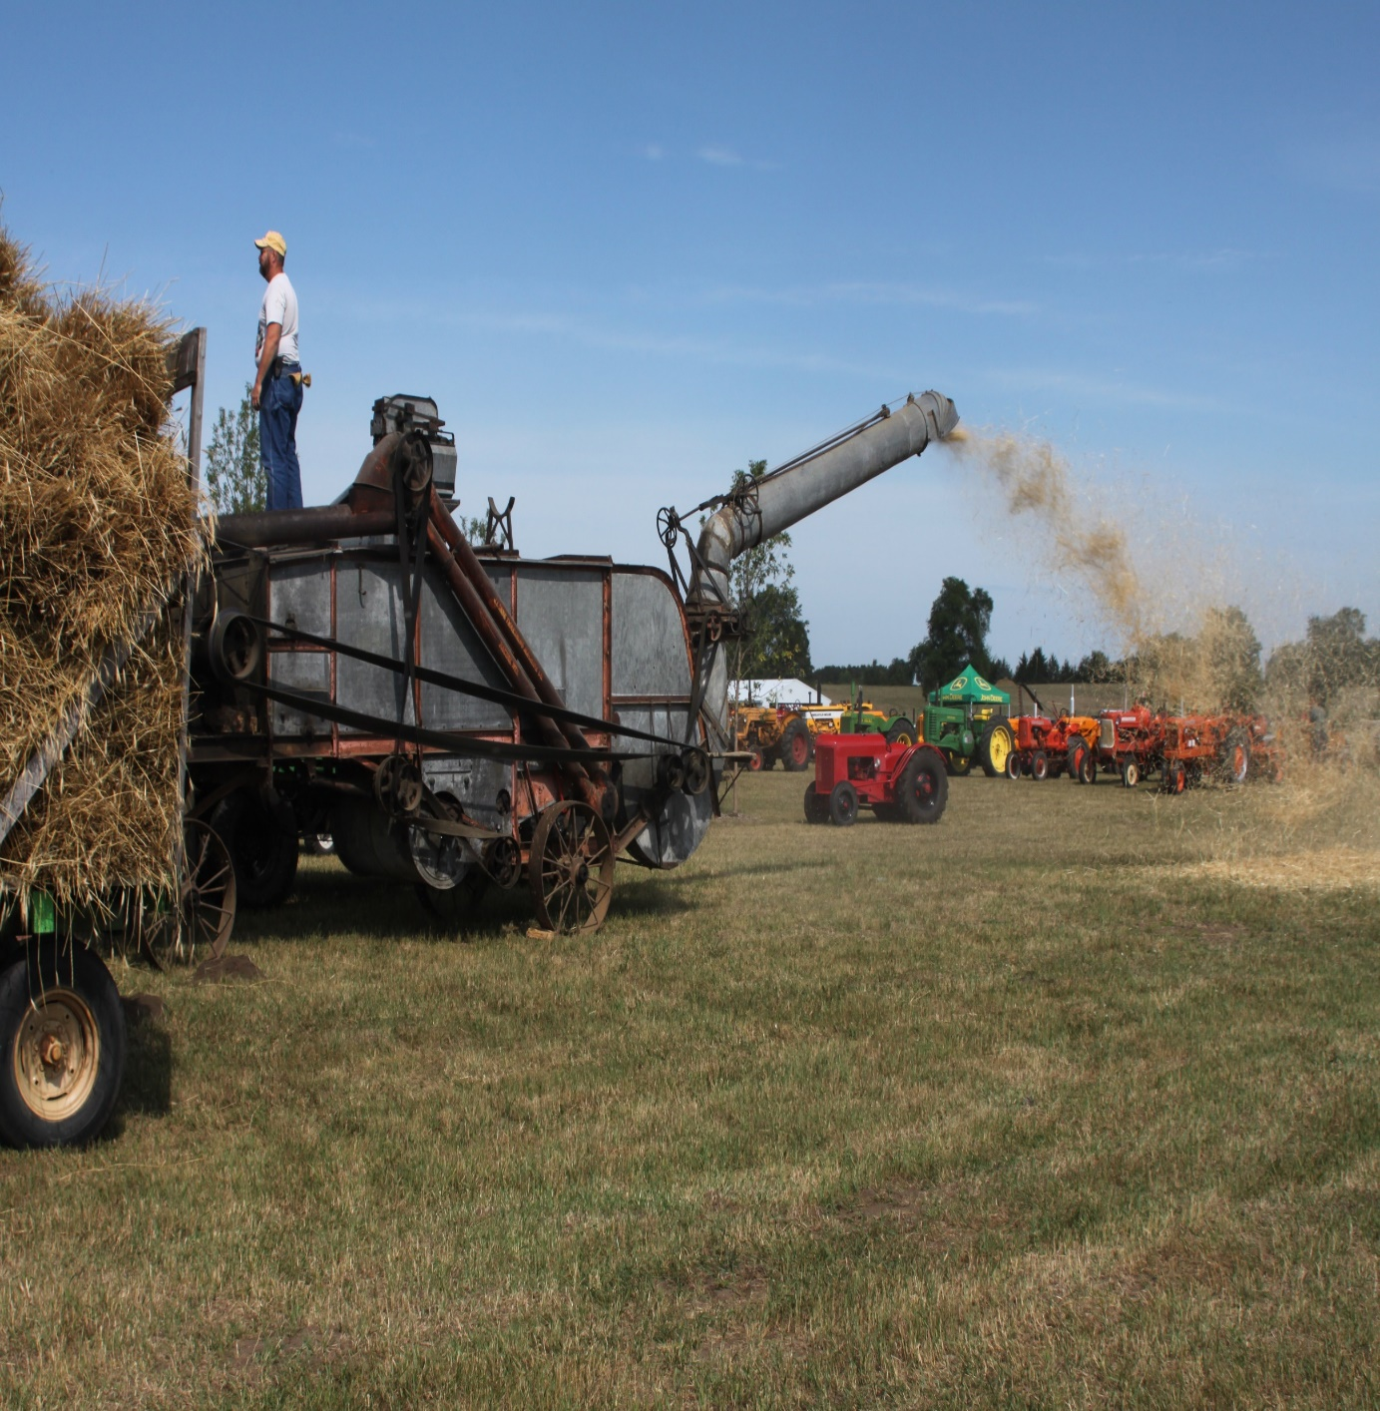
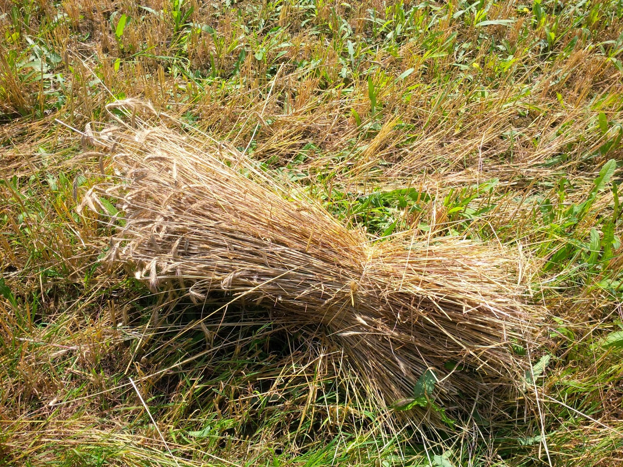
HELPING THE POOR
“When thou cutest down thine harvest in thy field, and hast forgot a sheaf in the field, thou shalt not go again to fetch it: it shall be for the stranger, for the fatherless, and for the widow; that the LORD thy God may bless thee in all the work of thine hands” (24:19).
The Law of Moses showed mercy and help for the poor. As God had provided for the land owner, he would in turn provide for others who needed it. The same for the olive producer –
“When thou beatest thine olive tree, thou shalt not go over the boughs again; it shall be for the stranger, for the fatherless, and for the widow” (24:20).
The same for the grape harvest (24:21).

Slide 3
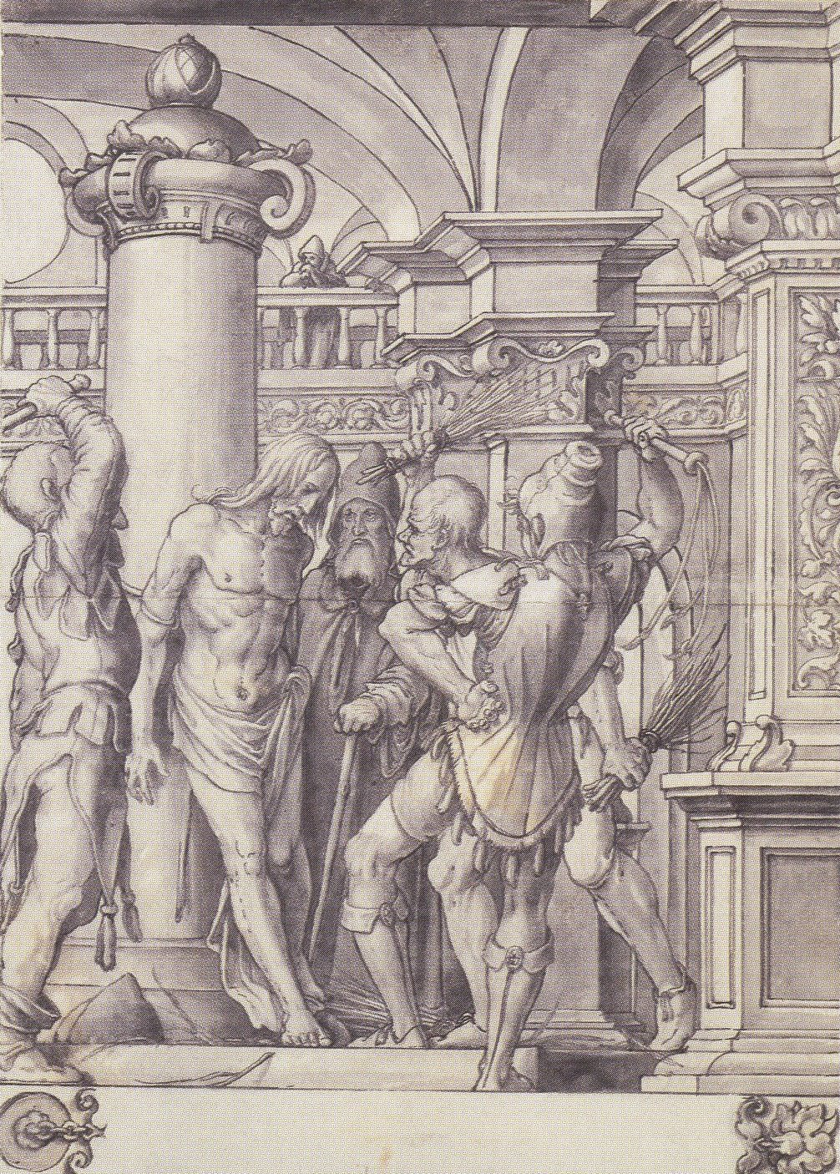
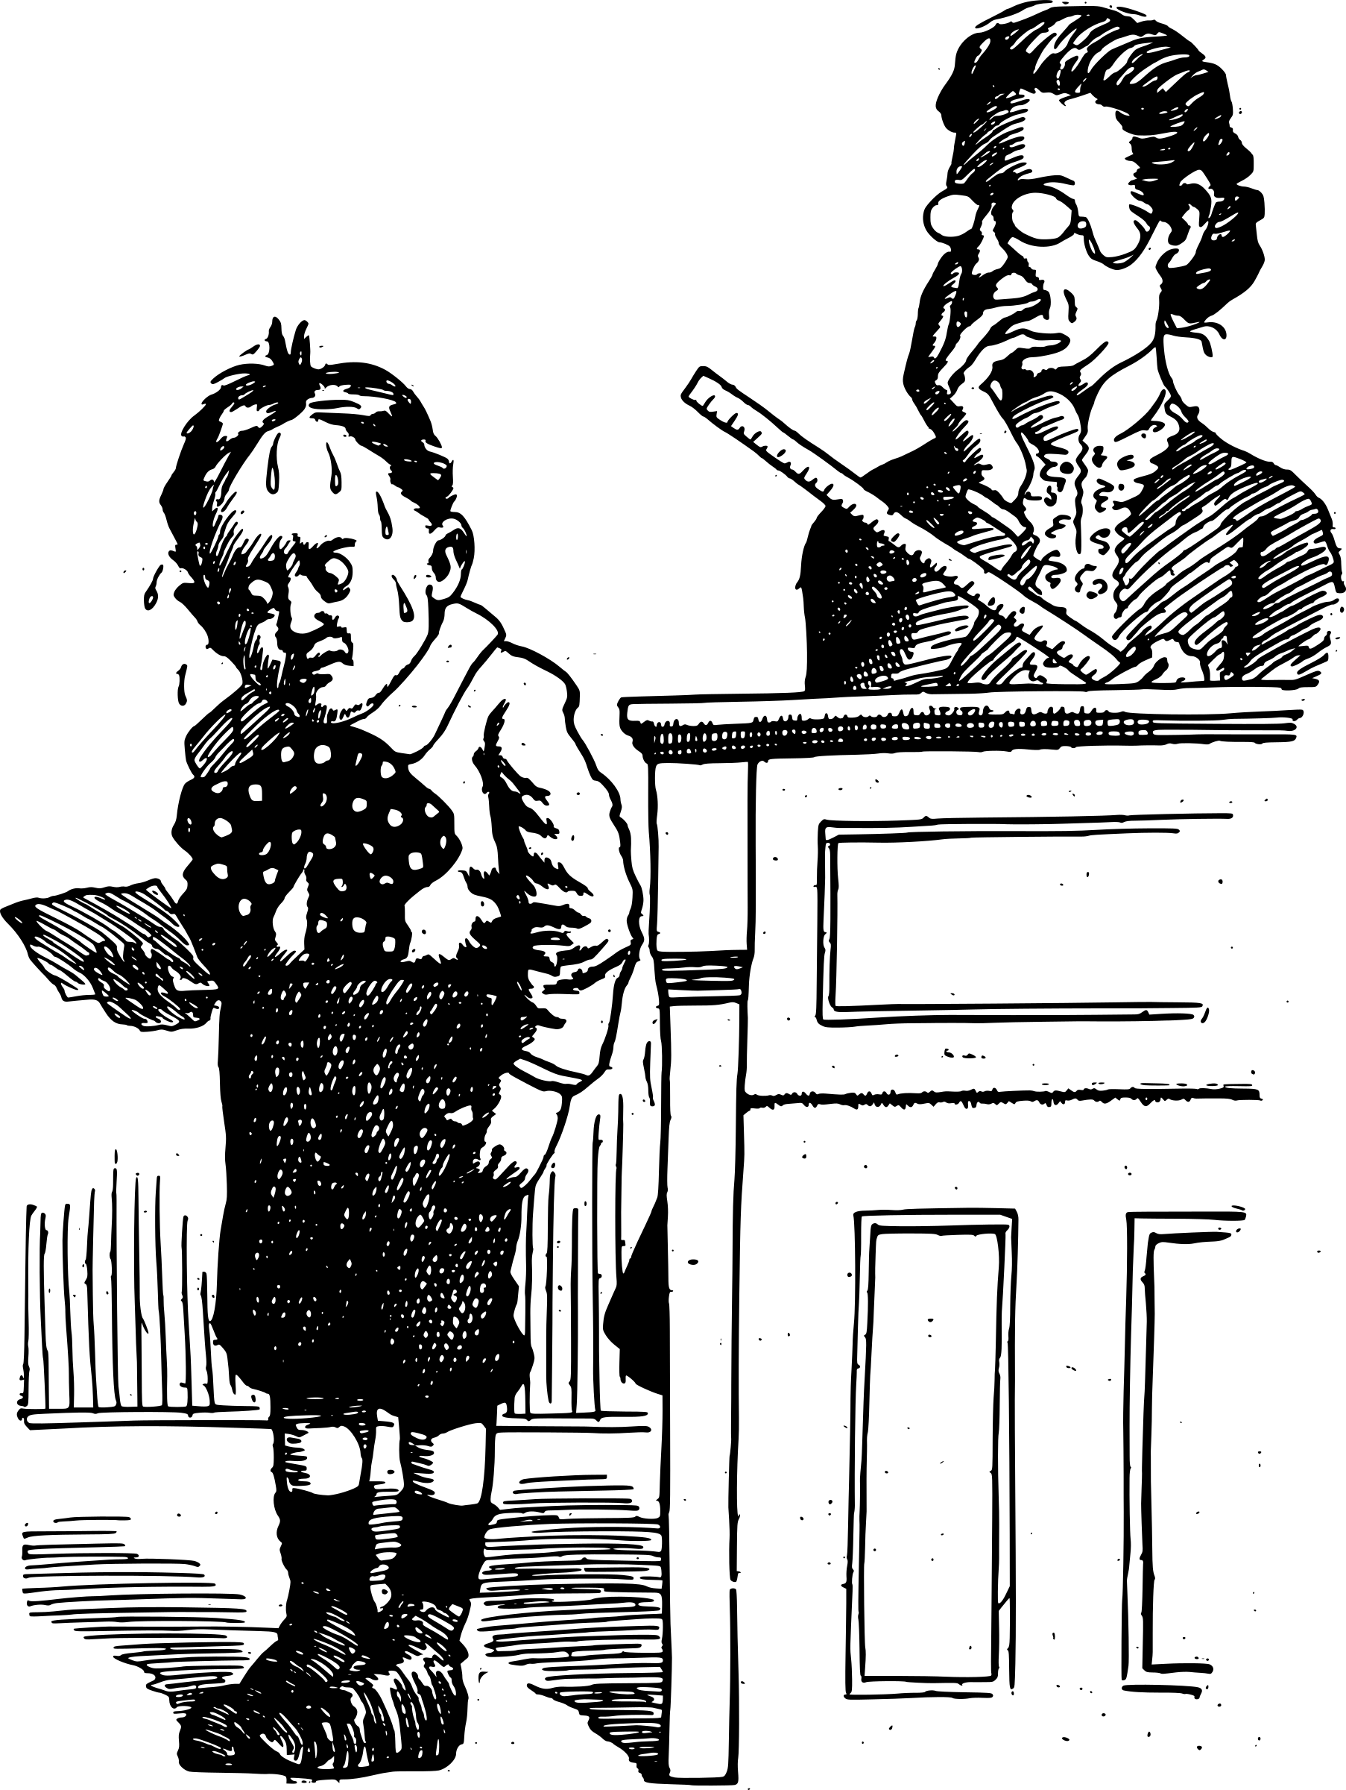
CORPORAL PUNISHMENT
If there be a controversy between men, and they come unto judgment, and the judges may judge them; then
they shall justify the righteous, and condemn the wicked. And it shall be, if the wicked man be worthy to be beaten… before his face, according to the fault, by a certain number. Forty stripes he may give him, and not exceed…” (25:1-30).
The judge was to decide and then ensure that appropriate punishment was carried out. Anything above 40-lashes could prove fatal, so the practice was limited to that or below considering the degree of offense. This practice was used to deter future bad behavior.
The most famous case was our Lord’s –
“Then Pilate therefore took Jesus, and scourged him”
(Jn. 19:1).

Slide 4
WEIGHTS & MEASURERS
“Thou shalt not have in thy bag divers weights, a great and a small. Thou shalt not have in thine house divers measurers, a great and a small. But thou shalt have a perfect and just weight, a perfect and just measure shalt thou have; that thy days be lengthened in the land. For all that do such things, and all that do unrighteously, are an abomination unto the LORD” (25:13-16).
The Israelites were not to cheat in their business dealings like the Gentiles, but rather be honest so that the LORD could bless them and give them long life in the land where He
put them –
“A false balance is abomination to the LORD: but a just weight is his delight” (Prov. 11:1).

Slide 5
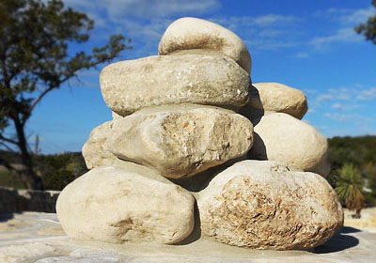
“And Moses with the elders of Israel commanded the people… And it shall be on the day when ye shall pass over Jordan unto the land… that thou set thee up great stones, and plaster them with plaster: And thou
shalt write upon them all the words of the law… Therefore it shall be when ye be gone over Jordan, that he shall set up these stones…” (27:1-6).
Israel was to hold a dedication ceremony and build a monument as proof that God had kept His promise of a land given to the Israelites.
“And there shalt thou build an altar unto the LORD thy God, and altar of stones: thou shalt not lift up any iron tool upon them” (27:5).

Slide 6
Chapter 28 list the conditional blessings and curses
concerning the land which they are about to enter –
“And it shall come to pass, if thou shalt hearken
diligently unto the voice of the LORD… to observe
and to do all his commandments which I command
thee this day, that the LORD thy God will set thee
on high above all the nations of the earth: And all
these blessings shall come on thee, and overtake
thee, if thou shalt hearken unto the voice of the
LORD thy God” (28:1,2). “Blessed shalt thou be in
the city [merchants], and blessed shalt thou be in
the field [farmers]… fruit of thy body… fruit of thy
ground… cattle… sheep [fertility of people, crops,
and livestock]… basket… thy store [plenty of food to buy in the stores]… comest in… goest out [joy in every part of life]… thine enemies that rise up
against thee to be smitten [defeat her enemies]” (28:3-7).

Slide 7
“But it shall come to pass, if thou wilt not hearken
unto the voice of the LORD thy God, to observe to
do all his commandments and his statues which I
command thee this day; that all these curses shall
come upon thee, and overtake thee: Cursed shalt
thou be in the city… field… basket… store… fruit of
thy body… fruit of thy land… livestock… comest in…
goest out. The LORD shall send upon thee cursing,
vexation, and rebuke, in all that thou settest thine
hand unto for to do, until thou be destroyed, and
until thou perish quickly; because of the wickedness
of thy doings, whereby thou hast forsaken me”
(28:15-20).
If Israel rejected God by failing to keep His Law, then
merchants and farmers would suffer, famine would ensue, birthrates among man and beast would decrease, life in general would be burdensome—everything that Israel tried would fail miserably.

Slide 8
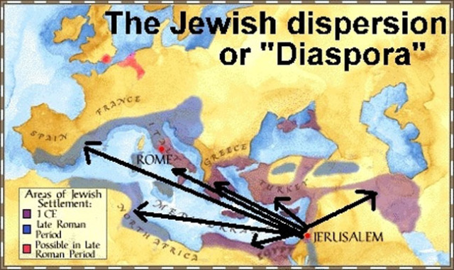
The ultimate punishment for Israel’s rebellion would not be the whole nation’s relocation to a nearby country [Babylon], but a world-wide scattering –
“… and ye shall be plucked from off the land… and the LORD shall scatter thee among all people, from the one end of the earth even unto the other; and there thou shalt serve other gods, which neither thou nor thy fathers have known…” (28:63,64).
This warning would come true in A.D. 70 when God would scatter the Jews to every nation in the world. The Diaspora would last 2,000-years until 1948 when He would begin to bring them back home, which He promised to do in preparation for the ‘Last Days.’

Slide 9
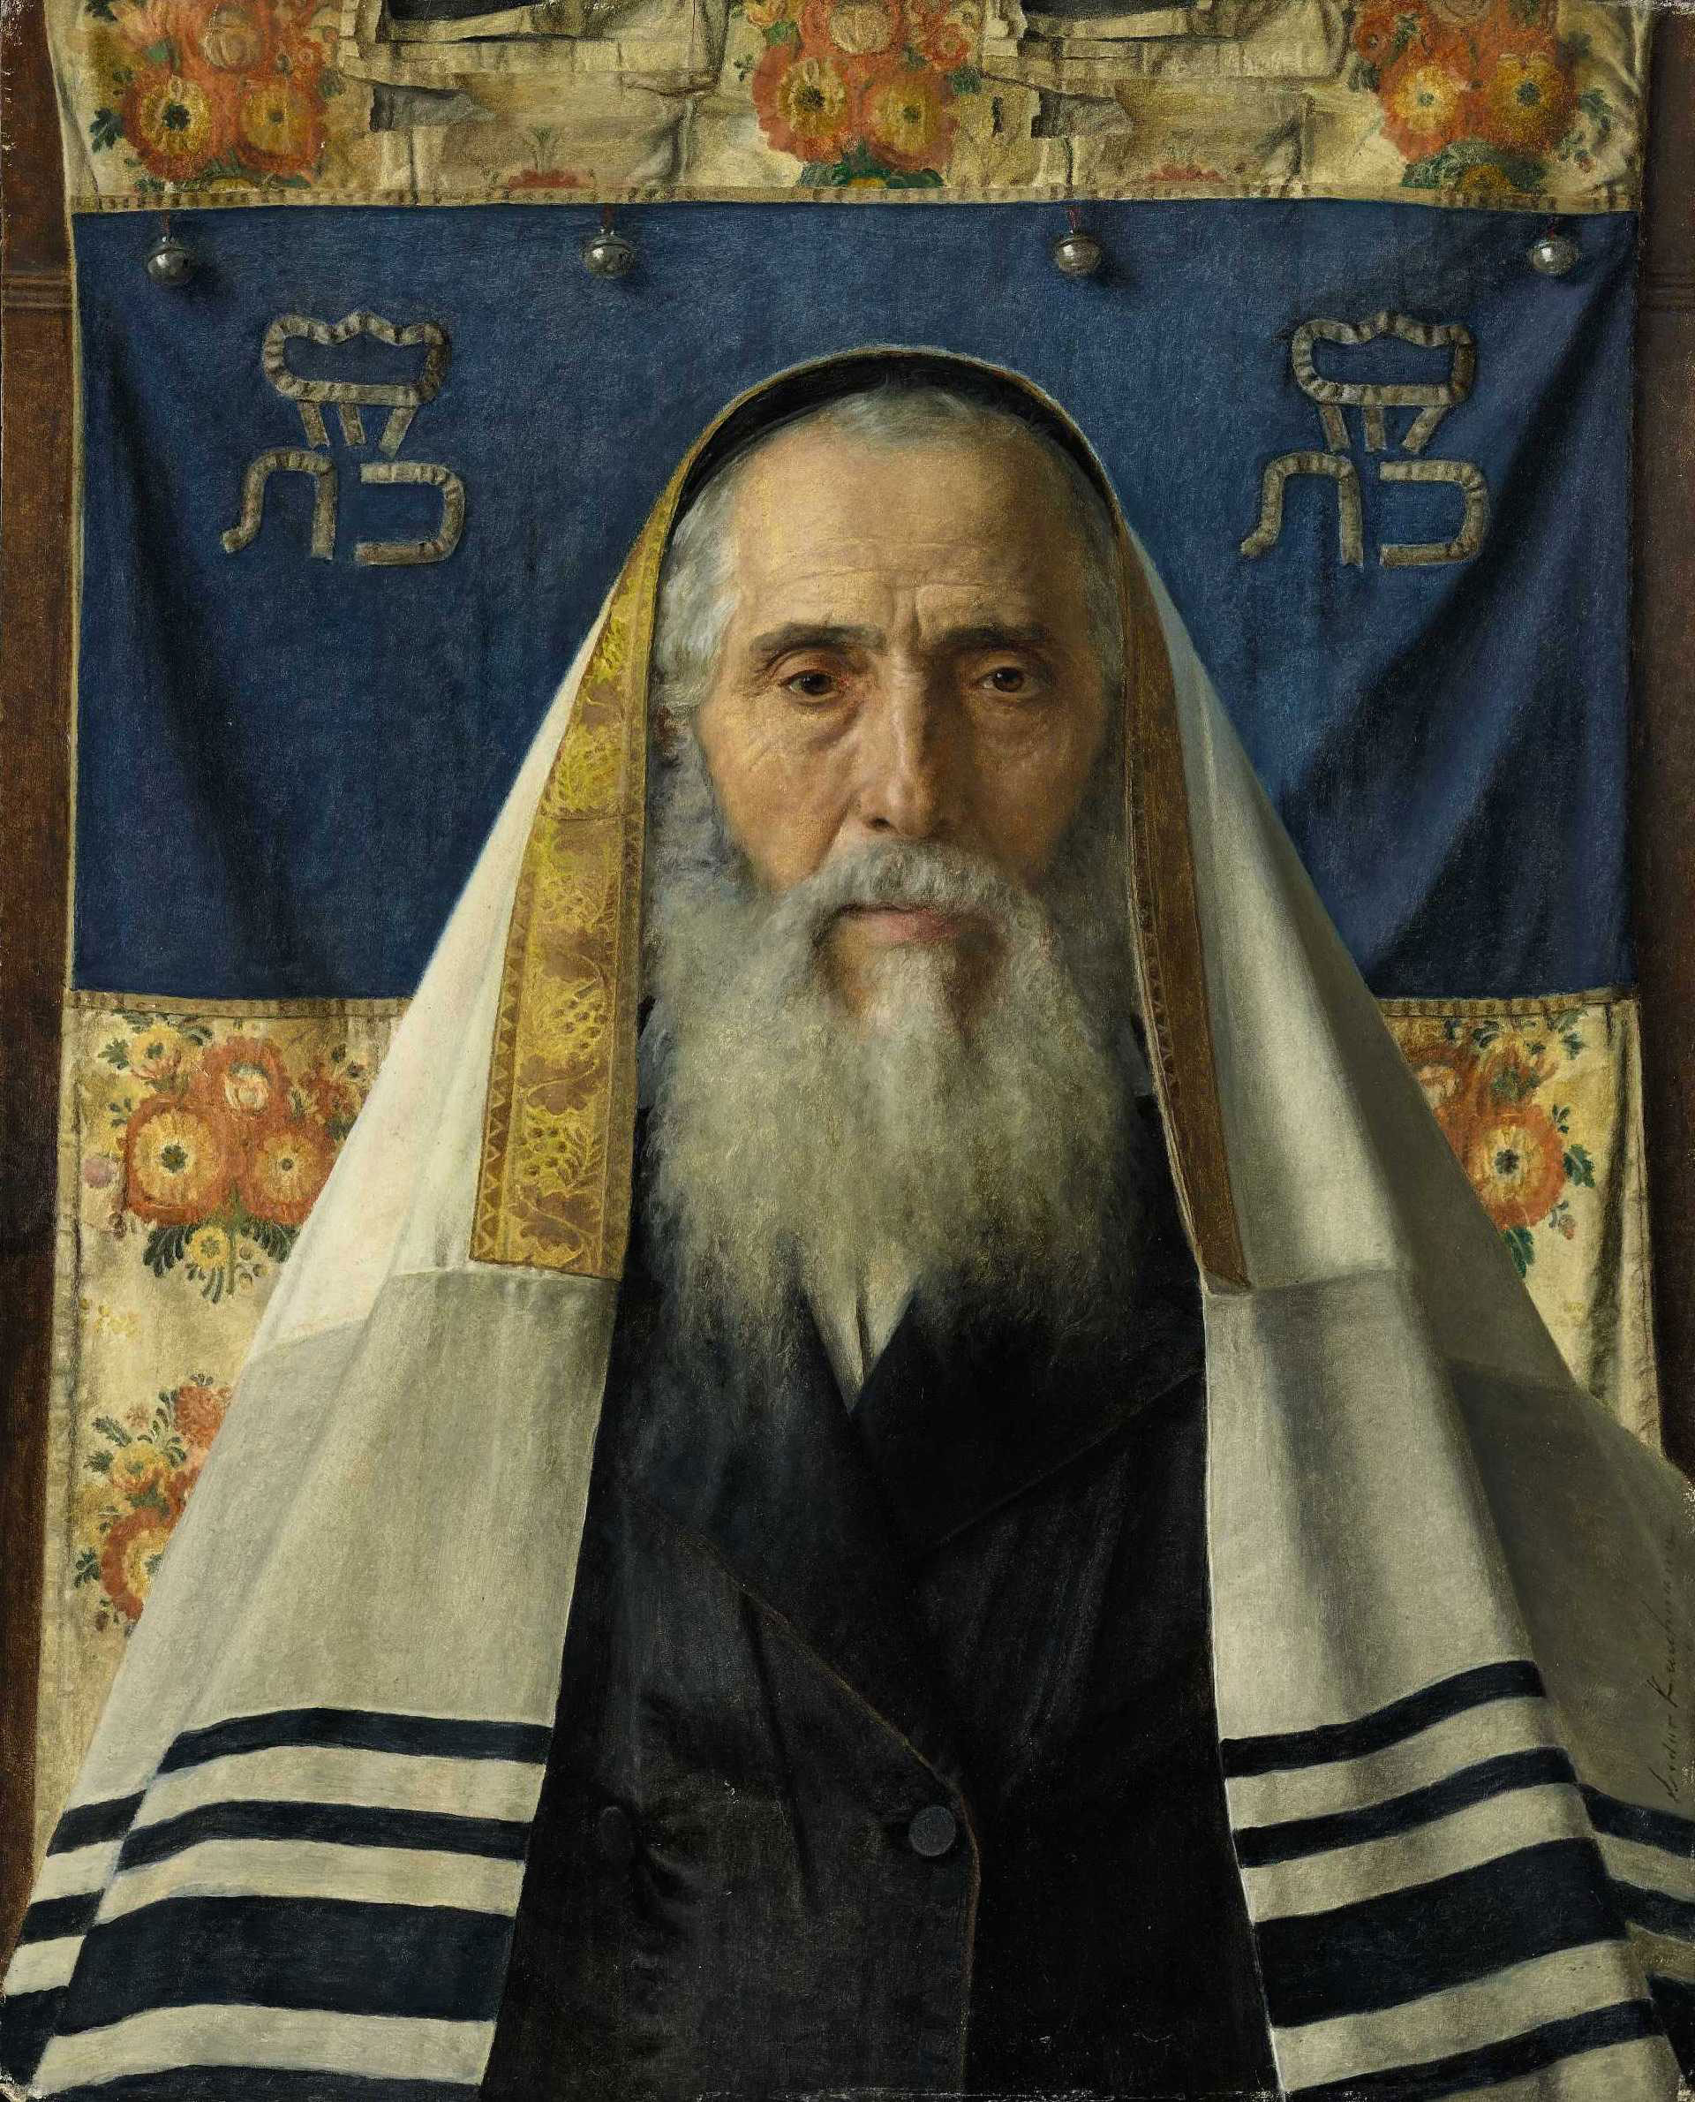
“And among these nations shalt thou find no
ease, neither shall the sole of thy foot have rest:
but the LORD shall give thee there a trembling
heart, and failing of eyes, and sorrow of mind:
And thy life shall hang in doubt before thee: and
thou shalt fear day and night, and shalt have
none assurance of thy life” (28:65,66).
Scattered among the Gentiles, the Israelites
whom God had promised peace and security if
they obeyed Him, would now suffer insecurity,
fear of survival day in and day out, reaching
such a low point in their existence that no
nation would even want them as slaves as
they had been in Egypt – “… and no man shall
buy you” (28:68).
That would be the plight of the Israelites during the world-wide diaspora that lasted two millennia.

Slide 10
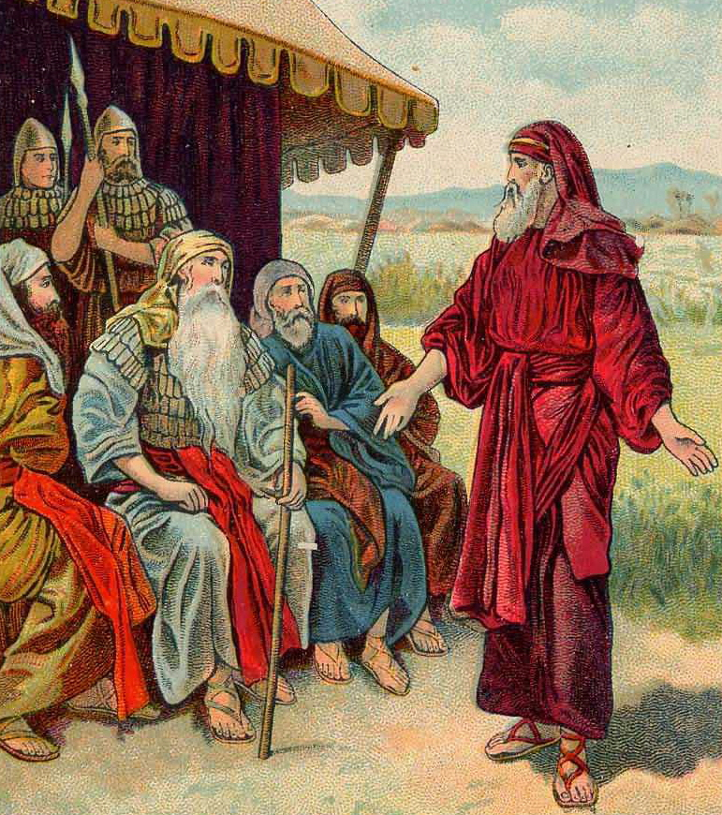
“And he [Moses] said unto them, I am [120] years old
this day; I can no more go out and come in : also the
LORD hath said unto me, Thou shalt not go over the Jordan” (31:2).
Moses knew his days were numbered –
“And the LORD said unto Moses, Behold, thy days approach that thou must die: call Joshua, and present yourselves in the tabernacle… that I may give him a charge. And Moses and Joshua went…” (31:14).
What did God tell Moses and Joshua?
“And the LORD said unto Moses, Behold, thou shalt
sleep with thy fathers; and this people will rise up, and go a whoring after the gods of the strangers of the land… and will forsake me, and break my covenant which I have with them” (31:16).
The news could not have been worse.

Slide 11
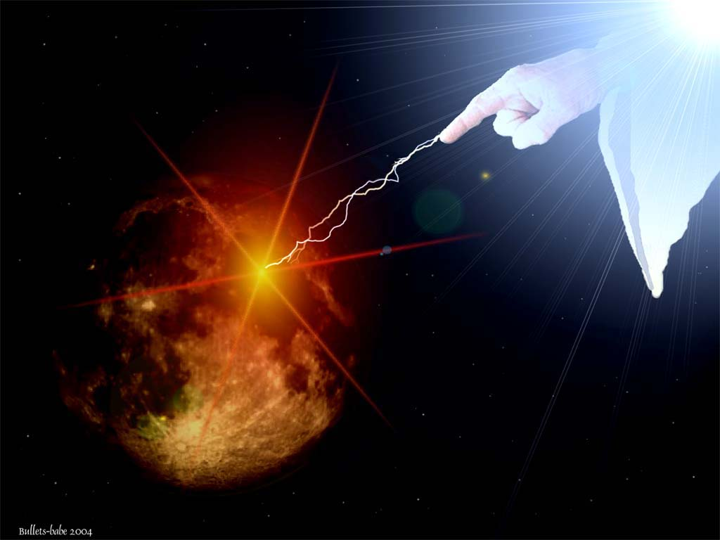
“Then my anger shall be kindled against them in that day, and I will forsake them, and I will hide my face from them, and they shall be devoured, and many evils and troubles shall befall them; so that they will say in that day, Are not these evils come upon us, because our God is not among us?... I surely hide my face… in that they are turned unto other gods” (31:17).
The God of Abraham, Isaac, and Jacob had tolerated much from His chosen nation—but, one thing HE COULD NOT—HE WOULD NOT tolerate was the Israelites worshipping false gods. That was the greatest disrespect they could possibly show Him, and for which He would withdraw His presence from among them—He would turn His face from them!

Slide 12
“And it came to pass, when Moses had made an
end of writing the words of this law in a book…
commanded the Levites, which bare the ark of
the covenant… take this book of the law, and put
it in the side of the ark… that it may be there for
a witness against thee. For I know thy rebellion,
and thy stiff neck: behold, while I am yet alive…
how much more after my death?... children in
whom is no faith” (31:26,27; 32:20).
Moses served God like no other until this time –
“And Moses made an end of speaking all these
words to all Israel… which ye shall command
your children to observe to do, all the words of
this law. For it is not a vain thing for you; because
it is your life: and through this thing ye shall prolong your days in the land, whither ye go over Jordan to possess it” (32:45-47).
Moses’ life came to an end, but not before God showed him Israel’s promised land.

Slide 13
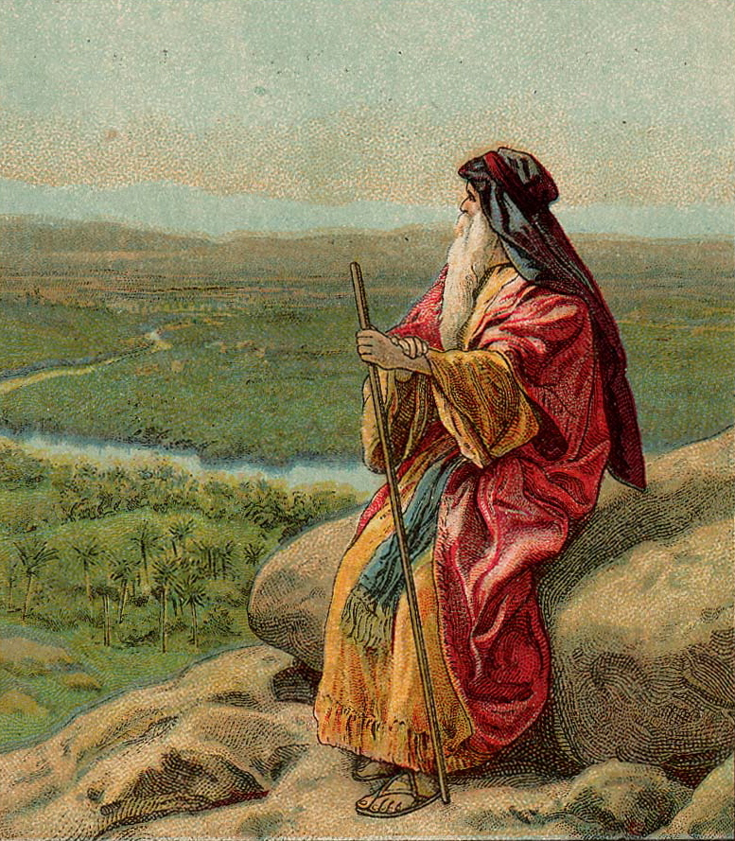
“And Moses went up from the plains of Moab unto the mountain of Nebo, to the top of Pisgah, that is over against Jericho. And the LORD showed him all the land… This is the land which I sware unto Abraham… Isaac… Jacob, saying, I will give it unto thy seed: I have caused thee to see it with thine eyes, but thou shalt not go over thither. So Moses died there in the land of Moab, according to the word of the LORD. And he buried him in a valley in the land of Moab, over against Beth-peor: but no man knoweth his sepulcher unto this day. And Moses was [120] years old when he died: his eye was not dim, nor his natural force abated. And the children of Israel wept for Moses in the plains of Moab [30] days…” (34:1-8).
Moses – “I will say of the LORD, He is my refuge and my fortress: my God; in him will I trust” (Psa. 91:2).

Slide 14
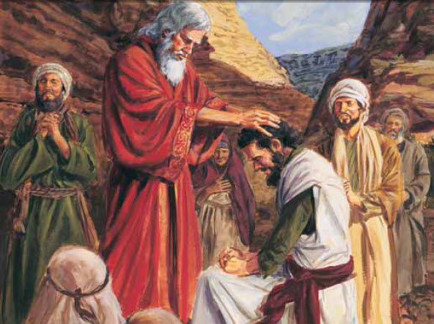
“And Joshua the son of Nun was full of the spirit of wisdom; for Moses had laid his hands upon him… And there arose not a prophet since in Israel like unto Moses, whom the LORD knew face to face, in all the signs and the wonders, which the LORD sent him to do in the land of Egypt to Pharaoh, and to all his servants, and to all his land, and in all that mighty hand, and in all the great terror which Moses showed in the sight of all Israel” (34:9-12).
The mantle had now been passed to Joshua who was chosen of God to bring the Israelites into their promised land, but was his faith strong enough to make up for the lack of faith shown by the nation?
That was the question.

Slide 15
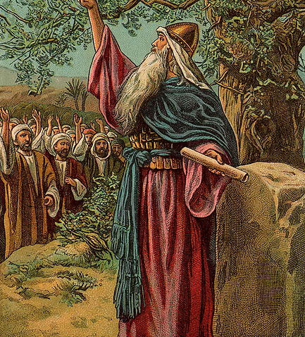
MOSES’ SUCCESSOR
“Now after the death of Moses the servant of the LORD
it came to pass, that the LORD spake unto Joshua the
son of Nun, Moses’ minister, saying, Moses my servant
is dead; now therefore arise, go over this Jordan, thou,
and all this people, unto the land which I do give to
them, even to the children of Israel” (Josh. 1:1,2).
Joshua, from the tribe of Ephraim (Num. 13:8), had
been Moses’ young assistant, but after his death he
became the God chosen leader of Israel. It would be
up to him to fulfill God’s next part of the plan—leading
the nation across the Jordan river and into Canaan, the
land of promise.
“There shall not any man be able to stand before thee
all the days of thy life: as I was with Moses, so I will be
with thee: I will not fail thee, nor forsake thee” (1:5).
Their land was a gift from God, but with His help, they would have to fight for every inch of it.

Slide 16
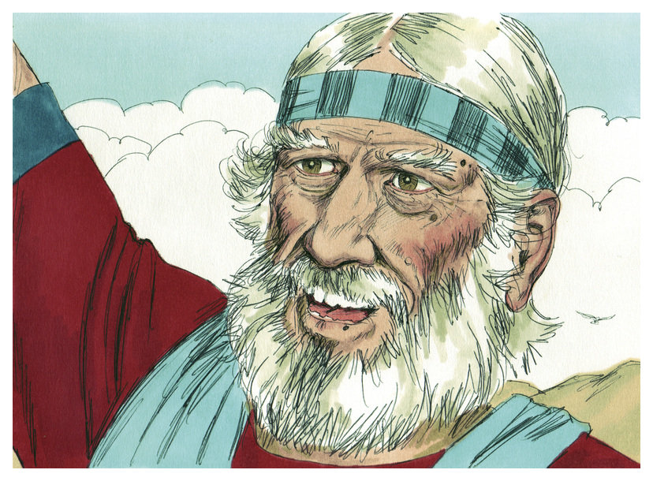
“Then Joshua commanded the officers of the people, saying, Pass through the host, and command the people, saying, prepare you victuals [meals]; for within [3] days ye shall pass over this Jordan, to go in to possess the land, which the LORD your God giveth you to possess it” (1:11).
The commander’s first order of business was to heed God’s declaration to prepare to cross and they would need enough food to survive for 3-days until they got a foot hold in Canaan.
His 2nd order of business was to remind the 2½ tribes [Reuben, Gad, ½ tribe of Manasseh] who had taken possession of the land east of the Jordan river that they had promised to fight with the other tribes to help conquer the land (1:12-15), which they agreed to do (1:16-18).

Slide 17
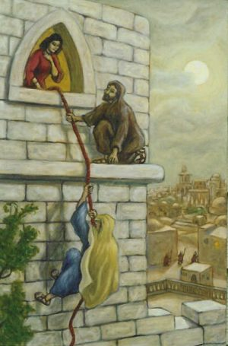
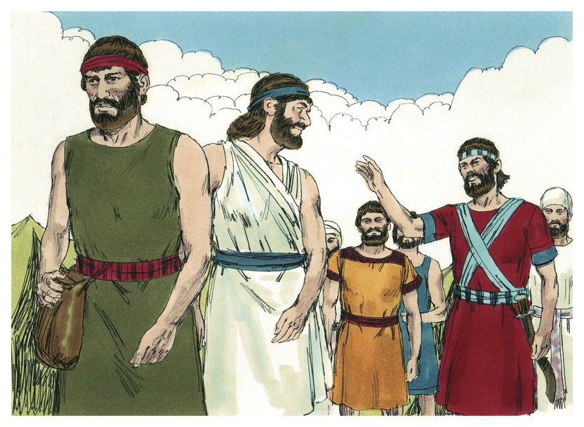
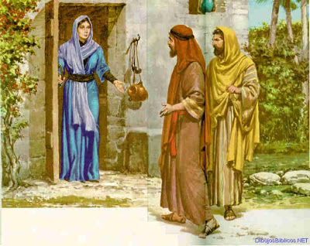
THE SPIES and THE HOUSE OF RAHAB
“And Joshua… sent… two men to spy secretly, saying, Go view the land, even Jericho. And they went, and into an harlot’s house, named Rahab, and lodged there” (2:1).
The spies were led to Rahab’s house where they found refuge to carry out their covert mission. It was an act of grace in that God used a harlot who came to believe God, “By faith the harlot Rahab… (Heb. 11:31).
“I know that the LORD hath given you the land, and that your terror is fallen upon us, and that all the inhabitants of the land faint because of you” (2:9), as God said – “I will send my fear before thee…” (Exo. 23:27).
For hiding the spies, Rahab made one request, to save her family when Israel destroyed the city, to which they agreed they would be spared (2:12-14). Then they left.

Slide 18
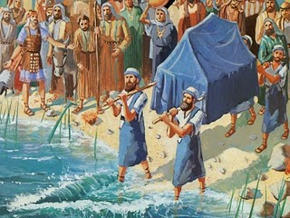
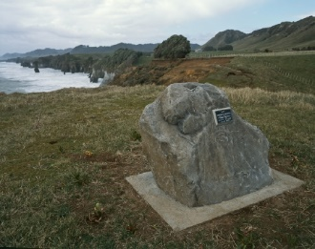
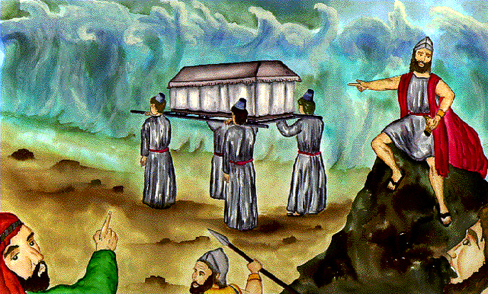
CROSSING OVER JORDAN
“And Joshua rose early in the morning… and came to Jordan… When ye see the ark of the covenant… and the priests the Levites bearing it, then ye shall remove from your place, and go after it” (3:1-3).
No longer would Israel follow the cloud, but instead the Ark of the Covenant, which represented God [Christ] Himself. It was at flood stage in the spring during the first grain harvest (3:15), and just like the Red Sea, the waters stopped flowing to allow the Israelites to walk on dry ground (3:16,17). Then the water returned to normal (4:18). To remember the day, Israel erected a stone memorial (4:5).
As the Canaanites watched the 2-million Israelites cross the Jordan river, “their heart melted” (5:1), but God had other important business before they attacked.

Slide 19
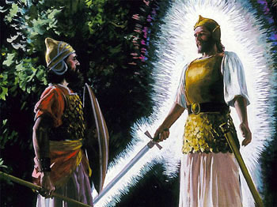
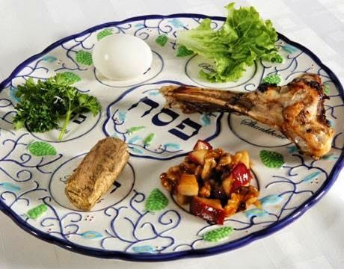
“At that time the LORD said unto Joshua, Make thee sharp
knives, and circumcise again the children of Israel the 2nd
time” (5:2). Before they took possession of the land, the
LORD had all the 2nd generation of Israelites circumcised.
“And the children of Israel encamped in Gilgal, and kept
the Passover on the [14th] day of the month at even in the
plains of Jericho” (5:10). The 2nd thing Israel did was to
keep the Passover.
The third thing they did was to feast on local food, “And
they did eat of the old corn… on the morrow after the
Passover, unleavened cakes… manna ceased…” (5:11).
FRIEND OR FOE?
“… Joshua was by Jericho… lifted up his eyes and looked…
a man with his sword drawn… Art thou for us?” (5:13,14). Who is it? A Christophany telling Joshua that the LORD was leading the fight to take Jericho and all the land in front of them –
“Loose thy shoe from off thy foot: for the place whereon thou standest is holy. And Joshua did so” (5:15).

Slide 20
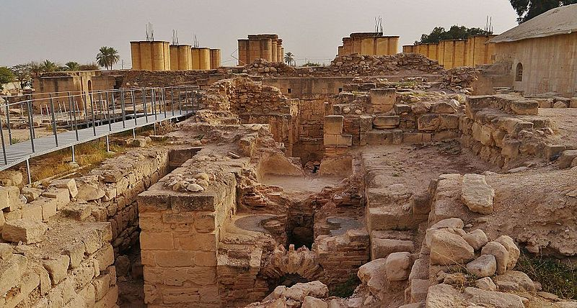
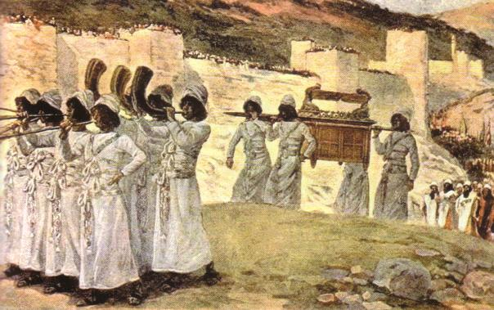
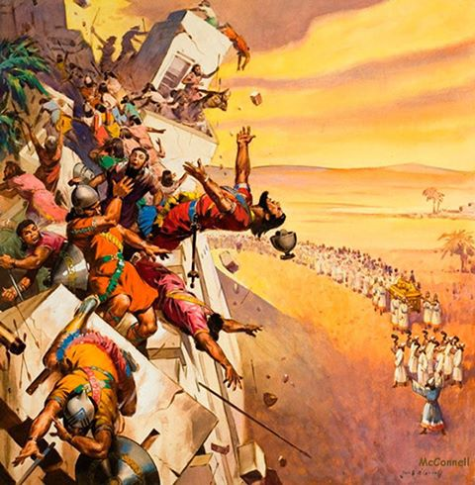
CONQUEST OF JERICHO
“And the LORD said unto Joshua, see I have given into thine hand Jericho… ye shall compass the city, all ye men of war, and go
round about the city once. Thus shalt thou
do six days. And [7] priests shall bear before the ark [7] trumpets… and the [7th] day ye shall compass the city [7] times, and the priests shall blow with the trumpets… long blast… when ye hear… all the people shall shout with a great shout; and the wall of the city shall fall down flat… so that the people went up into the city… and they took the city” (6:1-5,20).
Archeological evidence shows the walls fell straight down instead of falling outward just
as the Bible says.

Slide 21
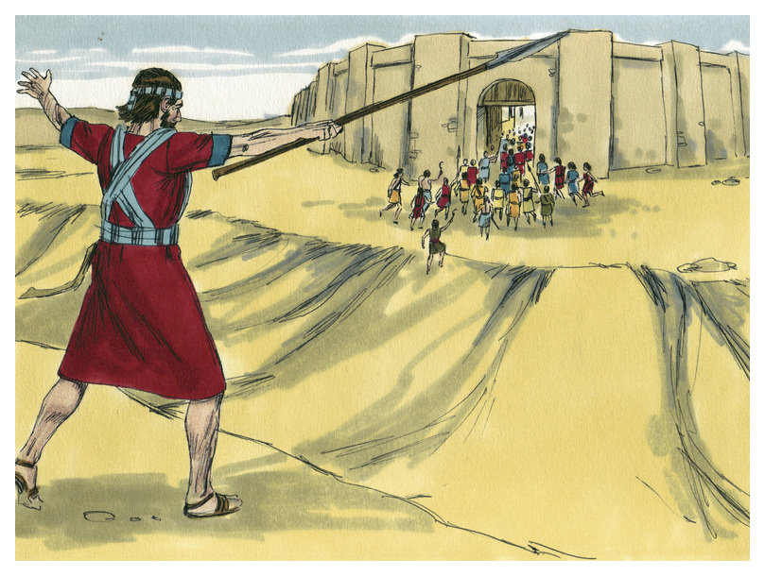
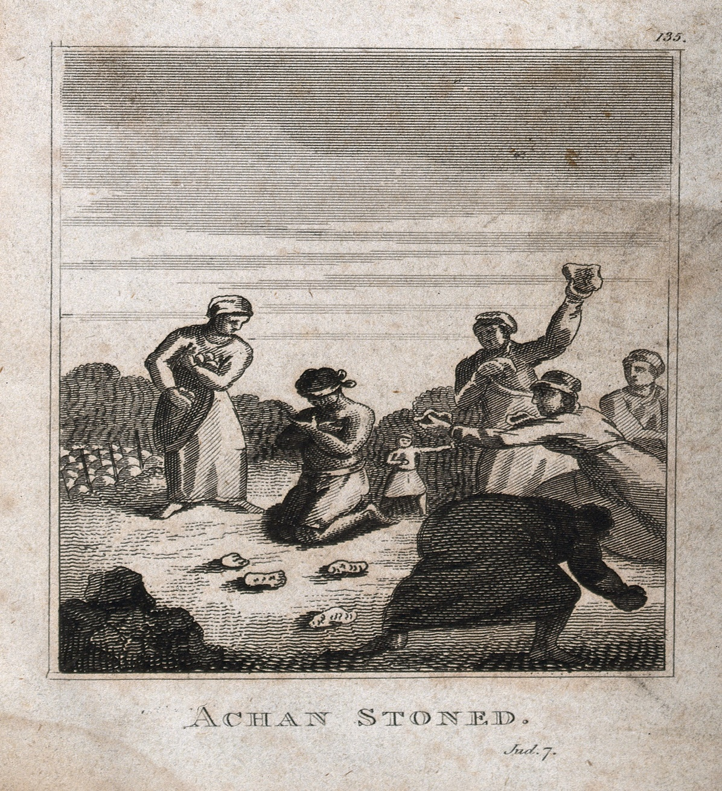
ACHAN’S SIN
“But the children of Israel committed a trespass in the accursed thing: for Achan… took of the accursed thing: and the anger of the LORD was kindled against the children of Israel” (7:1).
Ai, the next city to conquer, deemed easy to defeat, so Joshua sent a small group, 3,000, but were soundly defeated (7:2-5). Joshua was devastated (7:6-9) and asked God, why? God told him that someone had taken an accursed thing [spoil of war], which they had been forbidden to do
(7:10-12).
They found Achan and the booty [expensive garment, silver & gold] and he and his family were put to death in the valley of Achor— ”the valley of trouble” (7:18-26).
God’s faith in Israel was restored and they conquered Ai (8:1-35).

Slide 22
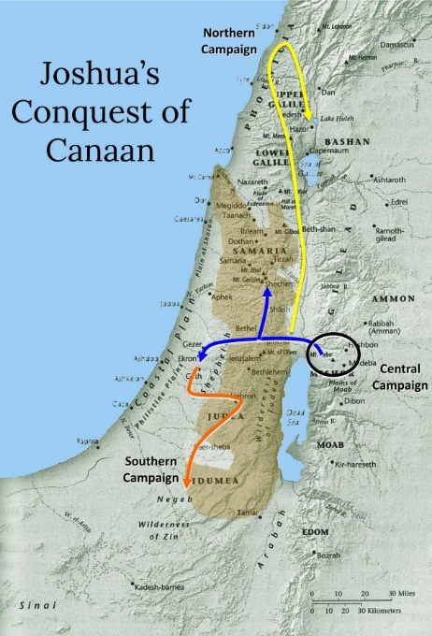
ISRAEL’S CONQUEST OF CANAAN
Chapters 9-11 record a series of victories and Israel’s conquest of Canaan –
“And Joshua took the whole land, according to all that the LORD said unto Moses; and Joshua gave it for an inheritance unto Israel according to their divisions by their tribes. And the land rested from war” (11:23).
After the early defeat at Ai, Joshua and the Israelites did as God commanded and they defeated the southern, central, and finally the northern territories.
Next time – Joshua, the last great leader of Israel passes away, to be replaced by a government of Judges (Josh. 12–Judg. 7).

