Slide 1
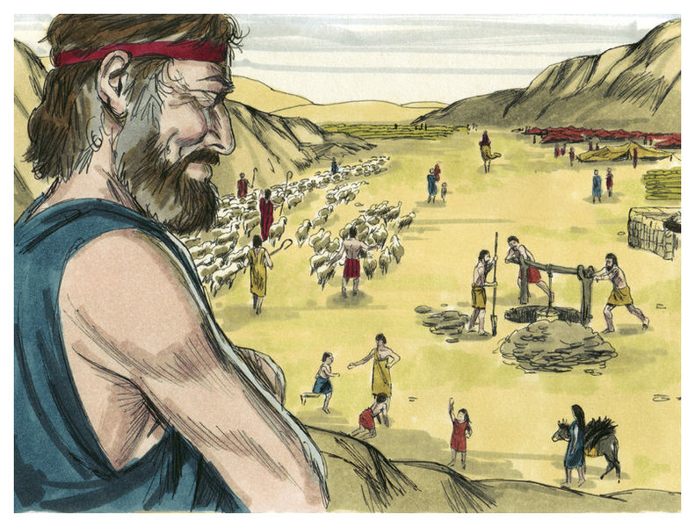
LESSON 3
WEEK 3 OF 52
(Job 40-42;)
(Gen. 12-29)
THROUGH THE BIBLE IN 2018
Last time we saw God clear Job of the charges made against him by Satan and use
him to intervene in the lives of his friends.
“So the Lord blessed the latter end of Job more than his
beginning...” (42:12-15).
God restored to Job twice the number of livestock and gave
him ten children probably as a token of God’s grace. Since
he had repented of his prideful ways, there was no further
need for the suffering and testing that God through Satan
had placed on Job.
“... an hundred and forty years [later]... Job died... old and
full of days” (Job 42:16,17).
Symbolic of God’s blessing, Job lived longer after his testing
than before. He death came not in the middle of his calamities as he had prayed for
(3:20-26; 10:18-22), but in a ripe old age where he had the opportunity to know his
great-great-grandchildren.

Slide 2
Conclusion: What have we learned from studying the Book of Job?
1. Job is probably the oldest book in the Bible but has modern day lessons for believers
2. It deals with some of mankind’s most important problems:
a. Why man suffers
b. Man’s relationship with God during times of suffering
3. God is not obligated to continually bless man [physically] for his obedience
4. From time to time God tests man to witness his spiritual growth
5. Man is to trust God always, even when he may not understand the circumstances
6. God is always right & just – man should never think otherwise
7. God’s plans & purposes for mankind includes trials & tribulations
8. Life’s trials & tribulations does not mean God has forsaken man
9. During those times man should continue to love God and know that God loves him
10. God’s two main purposes in the book of Job were:
a. To present Satan’s strategy against mankind, but prove to him and mankind that God is
ultimately in charge even though He does give Satan a measure of power & influence
b. Development of Job’s spiritual insight – Job’s ultimate lesson was that when brought into the presence of God, Job is revealed to himself – he saw himself as arrogant and prideful in his attempt to criticize God, and as a result he changed his behavior

Slide 3
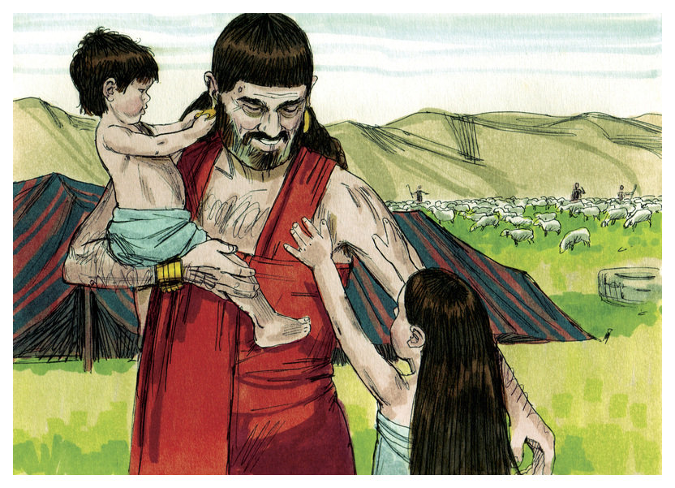
Message to believers – DO NOT attack, malign, challenge, accuse, test, or try to corner God, all
of which Job tried to do.
12. God doesn’t always give His reasons for what
He does so get used to it! He doesn’t owe you
any explanations (though He has given us
many). But like Job, we, during such times, can
come to a deeper, more loving relationship with
Him by trusting Him more fully.
Best application for us: “Yea doubtless, and I count
all things but loss for the excellency of the knowledge of Christ Jesus my Lord: for whom I have suffered the LOSS OF ALL THINGS, and do count them but dung, that I MAY WIN CHRIST. And be found in him, not having mine own righteousness, which is of the law, but that which is through the faith of Christ, the righteousness which is of God by faith” (Phil. 3:8,9).

Slide 4
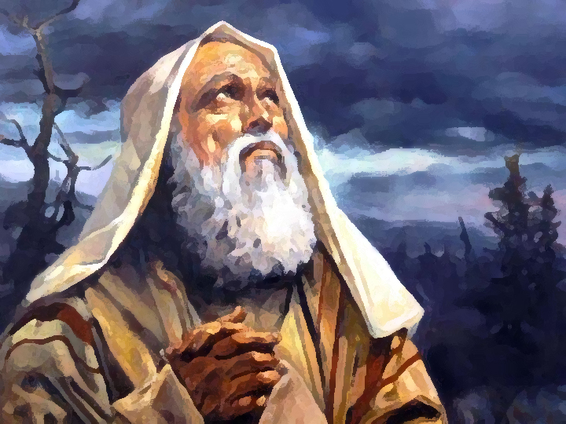
Back TO OUR CHRONOLOGICAL NARRATIVE
“And Terah took Abram his son… and they went forth with them from Ur of the Chaldees, to go into the land of Canaan…” (Gen. 11:31).
When all the Gentiles nations of the world turned against Him, God chose one man through whom He would make a Holy nation.
ABRAHAMIC COVENANT
“Now the LORD said unto Abram, Get thee out of thy country, and from thy kindred, and from thy father’s house, unto a land that I will shew thee:
And I will make of thee a great nation, and I will bless thee, and make thy name great; and thou shalt be a blessing. And I will bless them that bless thee, and curse him that curseth thee: and in thee shall all families of the earth be blessed” (Gen. 12:1-3).

Slide 5
ABRAHAMIC COVENANT
Great Name
Promised Land
Great Nation [Israel]
Blessing to all Nations
“By faith Abraham, when he was called to go out into a place which he should after receive for an inheritance, obeyed; and he went out, not knowing whether he went” (Heb. 11:8).
God would use Father Abraham in a monumental way to carry out His plan to form a Holy nation. He would begin his journey in Ur of the Chaldees, but
stopped in Haran (11:31), awaiting the death of his father, Terah (11:32), an idol worshipper –
“Your Fathers dwelt on the other side of the [Euphrates R.]… even Terah, the father of Abraham… and they served other gods” (Josh. 24:2).

Slide 6
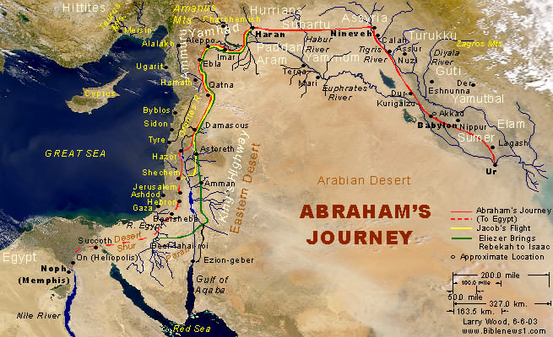
Out of respect, Abram took his father as far as Haran where he stopped until his father died according to the instructions given him from God, “Get thee out of thy country, and from thy kindred, and from thy father’s house” (12:1).
Abram, 75, took Sarai his wife, his nephew, Lot, “… and into the land of Canaan they came” (12:5), stopping at Shechem inhabited by the Caananites [descendants of Ham & Canaan] (12:6).
What were the first two things to happen as Abram entered the land?
The LORD spoke to Abram.

Slide 7
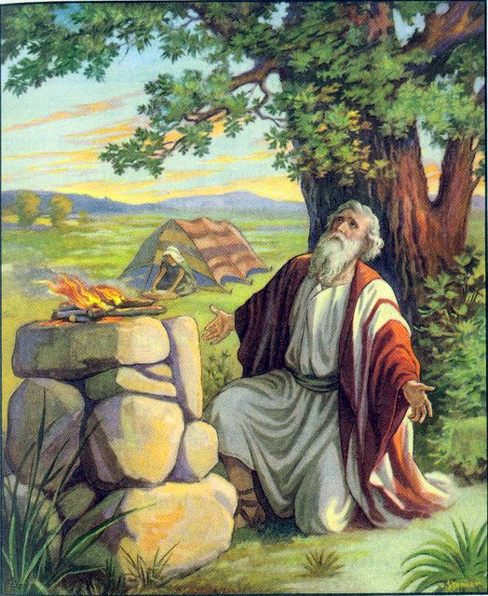
“And the LORD appeared unto Abram [Shechem], and said, Unto thy seed will I give this land: and there builded he an alter unto the LORD, who appeared unto him” (Gen. 12:7).
2nd – Abram did a burnt offering to God.
Who is to inherit this land? Abram’s seed (who that seed was, is still hotly disputed today. We will let the Word of God tell us).
“By faith he sojourned in the land of promise, as in
a strange country, dwelling in [tents]…” (Heb. 11:9).
Guess what happened then?
“And Abram journeyed, going on still toward the south. And there was a famine in the land: and Abram went down into Egypt…” (Gen. 12:9,10).
Did God promise Abram the land of Egypt??!! No.
Why did he go to Egypt? A famine (a test). He failed.

Slide 8
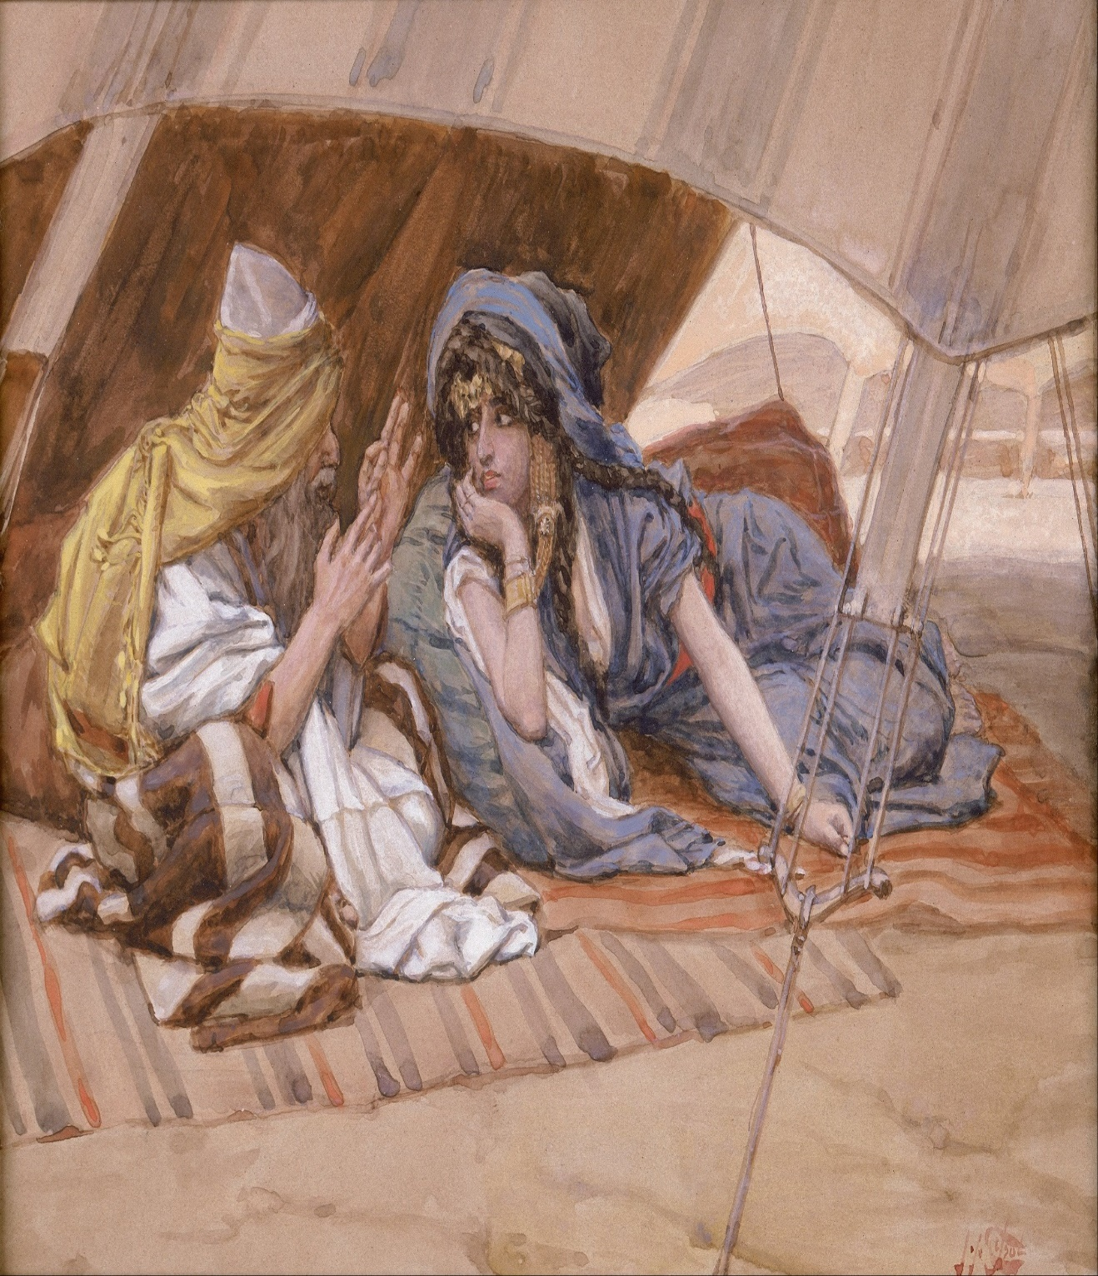
Like Noah, Abram believed God, but neither were
without their own personal sin –
“… when the Egyptians shall see thee [Sarai]… this
is his wife… they will kill me… I pray thee thou art
my sister…” (Gen. 12:11-13).
God helped Abram get out of that mess and back to
the land of Canaan they went –
“And Abram went up out of Egypt, he, and his wife
… And Lot with him…” (Gen. 13:1).
(Any time those chosen to be the seed of Abram are
off their Promised Land, it is never a good situation).
Why do Abram and Lot part company?
“And the land was not able to bear them… so that
they could not dwell together” (13:5,6); or, “… from
thy kindred”(12:1).

Slide 9
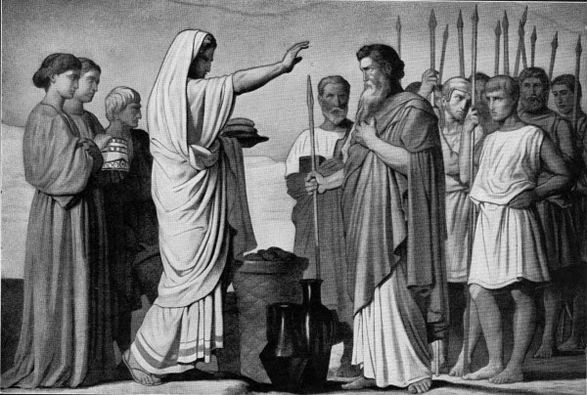
Abram armed his servants and defeated some
neighboring kings. After recovering his nephew Lot
who had been captured, along with the spoils of war,
he encountered another king –
“And Melchizedek king of Salem brought forth bread
and wine: and he was the priest of the most high
God. And he blessed him, And said, Blessed be Abram
of the most high God, possessor of heaven and earth…
and gave him tithes of all…” (14:14-20).
Who is this person?
“… King of righteousness… King of peace… without
father, without mother, without descent [birth],
having neither beginning of days, nor end of life: but
made like unto the Son of God; abideth a priest continually” (Heb. 7:1-3).
Abram encountered a physical manifestation [Theophany, Christophany] of the pre-incarnate
Jesus Christ.

Slide 10
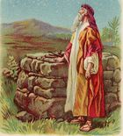
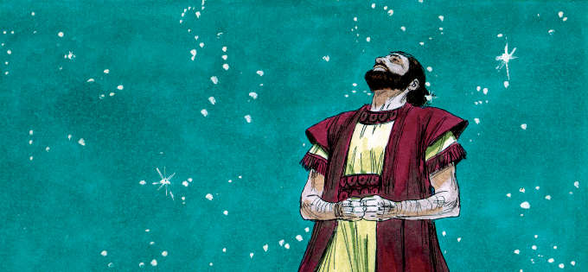
“For all the land which thou seest, to thee will I give it, and to thy seed for ever” (13:15).
Again, God promised Abram and his seed this land [Land of Canaan].
“And I will make thy seed as the dust of the earth… Look now toward heaven, and tell the stars, if thou be able to number them… So shall thy seed be ” (13:15; 15:5).
God promised Abram’s seed the land, but that the nation which comes from him will be as numerous as the dust of the earth and stars in the sky.
(Israel has never become that large but will be during the millennial kingdom).
Again, Abram offered burnt offerings – “Then Abram removed his tent, and came and dwelt… Hebron, and built there an altar unto the LORD” (13:18), a sign of his continued faith in God.

Slide 11
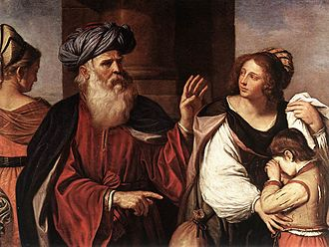
“Now Sarai Abram’s wife bare him no children: and she
had an handmaid, an Egyptian, whose name was Hagar
… I pray thee, Go in unto my maid; it may be that I may
obtain children by her… after Abram had dwelt ten years
in the land of Canaan, and gave her to her husband
Abram to be his wife” (16:1-3). Then what? “And Abram
was [86] when Hagar bare Ishmael to Abram” (16:16).
Good idea? No, bad idea.
“And God said unto Abraham [17:5], As for Sarai thy wife
... Sarah shall her name be. And I will bless her, and give
thee a son also of her…” (17:15).
Abraham’s reaction?
“Then Abraham fell upon his face, and laughed… Shall a child be born unto him that is [100]? And shall Sarah, that is [90]…”? But, Sarah believed God could – “Through faith also Sara herself received strength to conceive seed… when she was past age, because she judged him faithful who had promised” (Heb. 11:11).

Slide 12
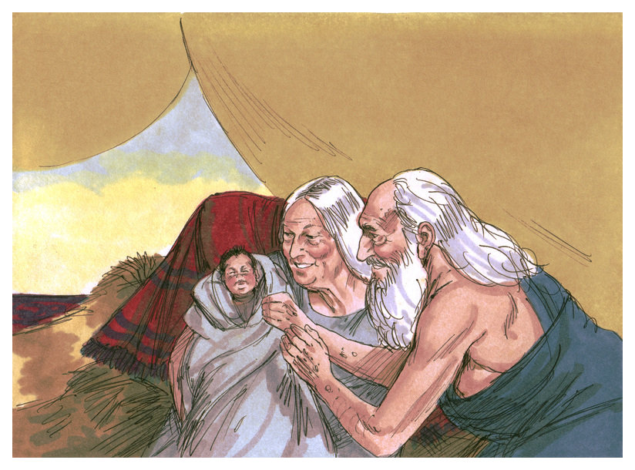
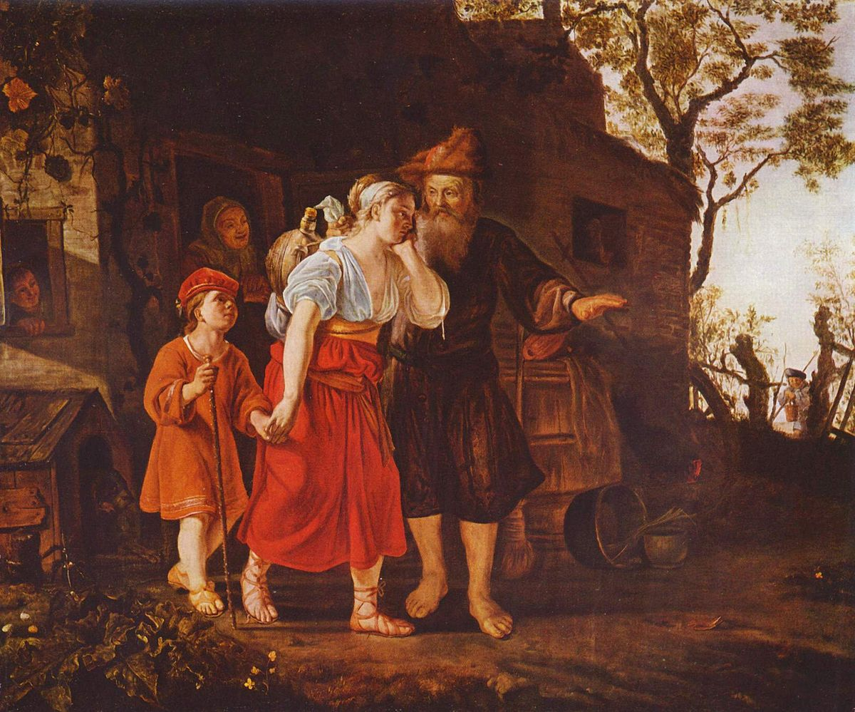
BIRTH OF ISAAC
“For Sarah conceived, and bare Abraham a son
in his old age… called the name… Isaac. And Abraham circumcised (17:9-12) his son Isaac being eight days old, as God had commanded him (21:1-5); “… for in Isaac shall thy seed be called” (21:12).
God’s plan had long ago been decided—Abraham’s blessing would pass not through Ishmael, but through his son by Sarah [Isaac]. Unfortunately, the seed of Ishmael would become a thorn in Israel’s
side even unto today –
“And also of the son of the bondwoman will I make
a nation [Arab], because he is thy seed” (21:13).
With that, Abraham cast off Hagar & Ishmael –
“… Hagar… and the child… and sent her away”
(21:14).

Slide 13
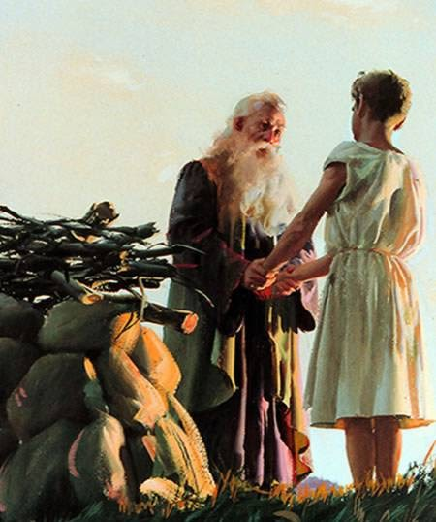
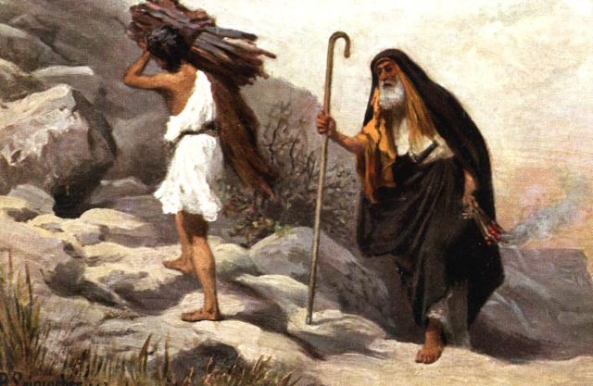
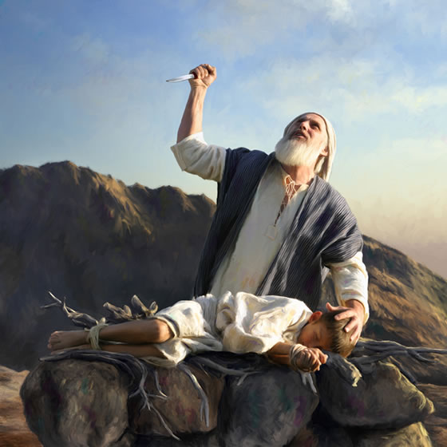
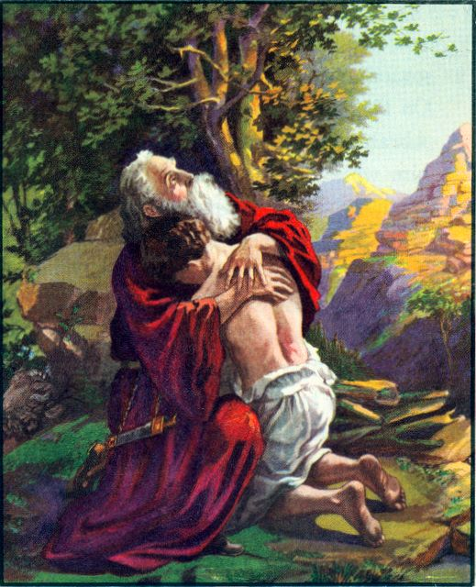
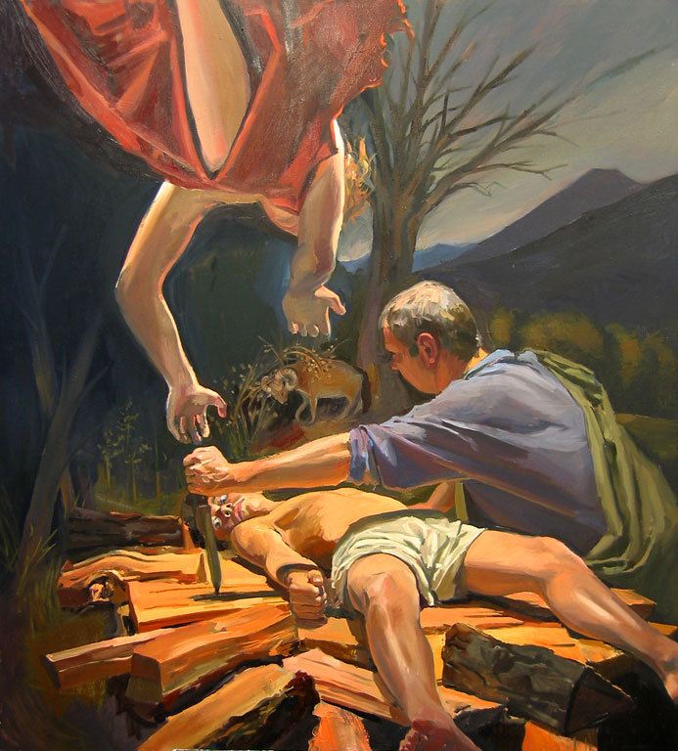
OFFERING OF ISAAC
“And it came to pass after these things, that God
did [test] Abraham… Take now… thine only son
Isaac, who thou lovest, and get thee into the land
of Moriah [Jerusalem]; and offer him there for a
burnt offering [sacrifice]… And Abraham took the
wood of the burnt-offering, and laid it upon Isaac
his son… and they went up together… built an
alter… bound… his son, and laid him on the alter
upon the wood… and took the knife to slay his
son. And the angel of the LORD called unto him
out of heaven, and said… Lay not thine hand
upon the lad… for now I know thou fearest God, seeing thou hast not withheld thy son, thine only
son from me. And Abraham lifted up his eyes... behind him a ram [lamb]… and took the ram and
offered him up for a burnt offering in the stead of his son” (22:1-12). Here’s the rest of the story –
“Accounting that God was able to raise him up, even from the dead; from whence also he received
him in a figure” (Heb. 11:17-19). God spared Isaac—He would not spare His only begotten Son!

Slide 14
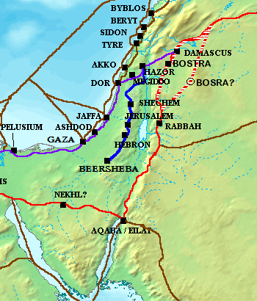
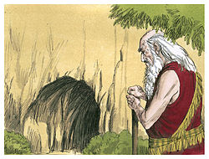
“And Sarah was [127] years old… and Sarah died… And Abraham came to mourn for Sarah, and to weep for her…” (23:1-3).
Abraham purchased a cave to bury his wife in the place where he now called home –
“And after this, Abraham buried Sarah his wife in the cave of the field of Machpelah… the same is Hebron in the land of Canaan” (23:1-3; 19).
Abraham wanted ownership so he purchased
the land –
“… the land is worth four hundred shekels of
silver… bury therefore thy dead” (23:15).
Canaan had become Abraham’s home [not Mesopotamia] and his wife was the first to be buried there .

Slide 15
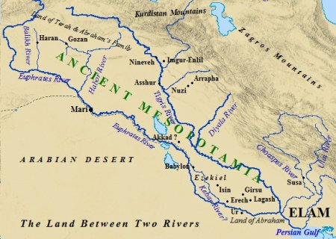
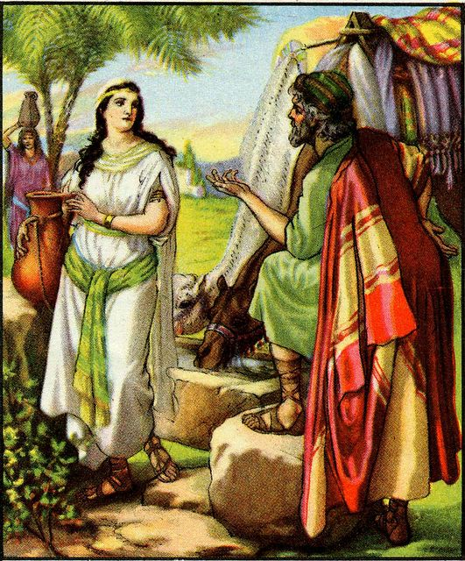
A BRIDE FOR ISAAC
“… thou shalt not take a wife unto my son of the daughters of the Canaanites, among whom I dwell. But thou shalt go unto my country, and to my kindred and take a wife unto my son Isaac” (24:3,4).
Abraham advised Isaac to take a wife in the city where his brother still resided and who worshipped the same God as Abraham (31:53) –
“… and he [Abraham’s chief steward] arose, and went to Mesopotamia, unto the city of Nahor” (24:10).
There he found Isaac a godly wife –
“And Isaac… took Rebekeh, and she became
his wife; and he loved her: and Isaac was comforted after his mother’s death” (24:67).

Slide 16
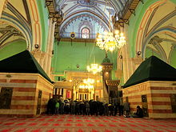
“Then again Abraham took a wife, and her name was Keturah. And she bare him [6 sons]” (25:1,2).
But notice Abraham’s last will & testament –
“And Abraham gave all that he had unto Isaac” (25:5).
And then Abraham died –
“And these are the days of the years of Abraham’s life which he lived [175 years]… and died in a good old age, an old man, and full of years; and was gathered to his people… Isaac and Ishmael buried him in the cave at Machpelah [Hebron]…” (25:7-9).
“And these all, having obtained a good report
through faith, received not the promise” (Heb. 11:39).
Though Abraham died believing God, he did not see
the fulfillment of God’s plans for the nation of Israel.
[These are the burial tombs of Abraham,
Isaac, Jacob, and their wives in Hebron].

Slide 17
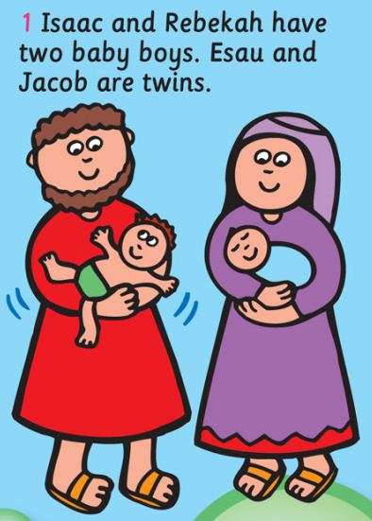
“And it came to pass after the death of Abraham, that God blessed his son Isaac…” (25:12).
God’s blessing on the chosen lineage of
Abraham continued –
“And Isaac was [40] years old when he took
Rebekah to wife… and Rebekah his wife conceived. And the children struggled together within her… And the LORD said unto her, Two nations are in
thy womb, and two manner of people… the one people shall be stronger… the elder shall serve the younger… were twins in her womb… Esau… Jacob… Isaac was [60] years old when she bare them” (25:20-23).
The struggle between these two began in the womb, but God had already destined which one He would use to continue Israel’s blessing.

Slide 18
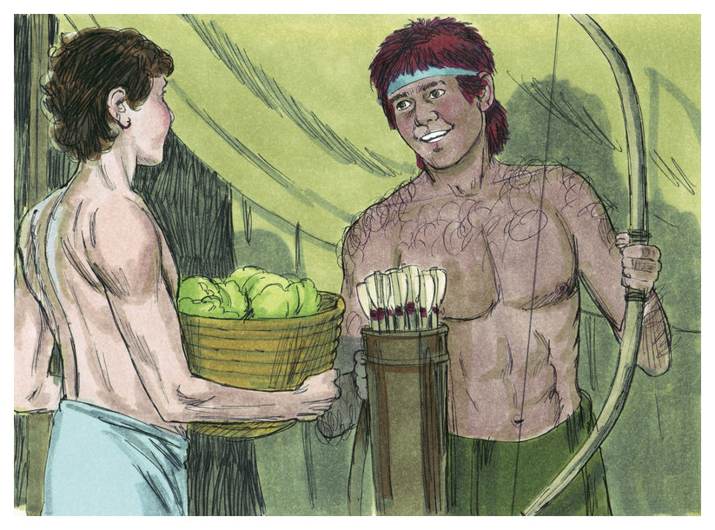
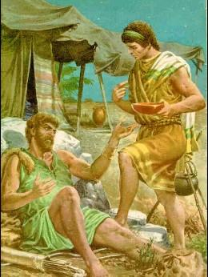
SALE OF THE BIRTHRIGHT
“And the boys grew: and Esau was a cunning hunter, a man of the field; and Jacob was a plain man, dwelling in tents. And Isaac loved Esau… but Rebekah loved Jacob”(25:27,28).
The parents had chosen their favorite son, but who would God choose? He would put them to a test –
“And Jacob said, Sell me this day thy birthright. And Esau said, Behold, I am at the point to die: and what profit shall this birthright do to me… and he sold his birthright unto Jacob… Then Jacob gave Esau bread and pottage of lentiles; and he did eat… and rose up, and went his way: thus Esau despised his birthright” (25:31-33).
But the story is not quite over as Jacob must find a way to convince his father [Isaac] to give him his last blessing.

Slide 19
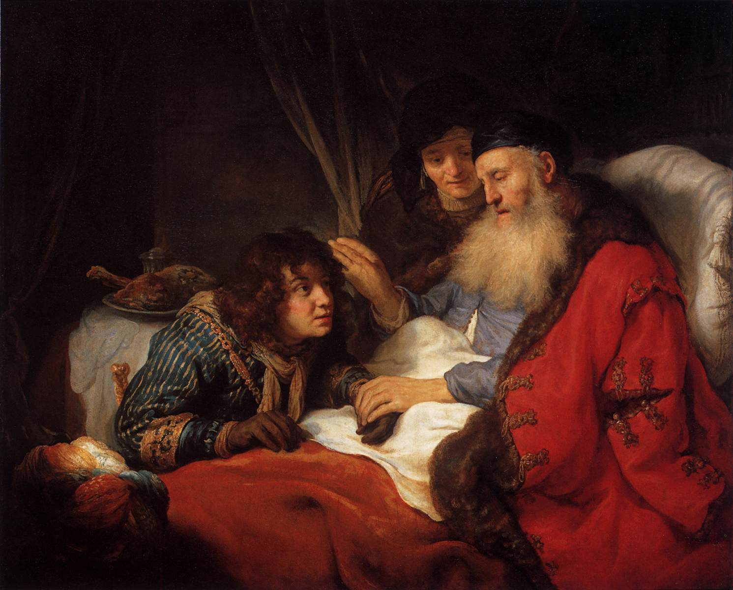
“And it came to pass, that when Isaac was old, and his eyes were dim, so that he could not see, he called Esau his eldest son… and said unto him… I am old, I know not the day of my death” (27:1,2).
Both sons tried to curry favor with their dying father: Esau is forthright; Jacob connives, but receives the blessing from his father, Isaac –
“Let people serve thee [Jacob], and nations bow down to thee [nation of Israel]” (27:29).
Though certainly not under the best circumstances, God’s will was done through Jacob who knew and appreciated the importance of the lineage of Abraham and God’s promise of making a great nation through his offspring.

Slide 20
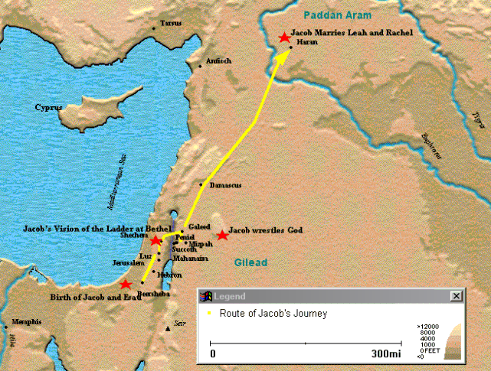
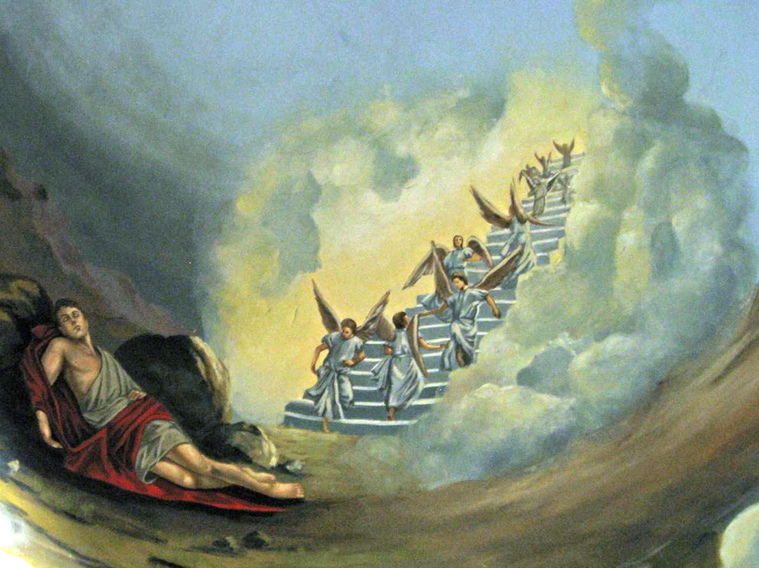
“And Isaac called Jacob, and blessed him, and charged him, and said unto him Thou shalt not take a wife of the daughters of Canaan. Arise, go to Padam-aram, to the house of Bethuel thy mother’s father; and take thee a wife from thence of the daughters of Laban thy mother’s brother. And God Almighty bless thee, and make thee fruitful, and multiply thee, that thou mayest be a multitude of people. And [God] give… the blessing of Abraham, to thee, and to thy seed…” (28:1-4).
Jacob obeyed and went toward Haran, but along the way he had a dream –
“And he dreamed, and behold a ladder set up on the earth, and the top of it reached to heaven… angels ascending and descending on it… the land whereon thou liest, to thee [Jacob] will I [God] give it, and to thy seed [Israel]” (28:12-15).

Slide 21
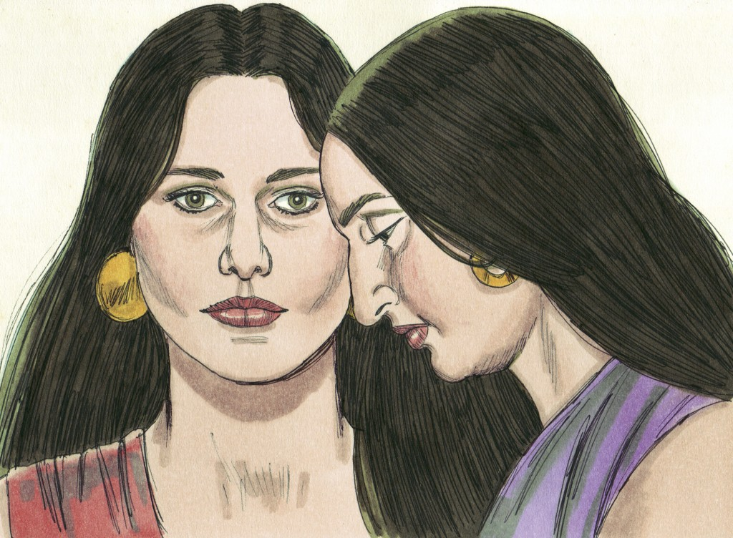
JACOB’S WIVES
“Then Jacob went on his journey, and came into the land of the people of the east [Haran]” (29:1)… And [uncle] Laban had two daughters… the elder was Leah… younger Rachel… and Jacob loved Rachel… I will serve seven years for Rachel…” (29:16-18).
Things didn’t go exactly as planned –
“And Laban said, It must not be so done in our country, to give the younger before the firstborn… he [Jacob] loved also Rachel more than Leah, and served with him [Laban] yet seven other years” (29:26,30).
During those 14 years, Jacob started having babies, with first wife Leah –
“And Leah conceived… Reuben… Simeon… Levi… Judah…” (29:32-35).
Jacob’s first 4 sons were with wife Leah, but he has 8 more
to go. Stay tuned.
Next time – Gen. 30-47.

