Slide 1
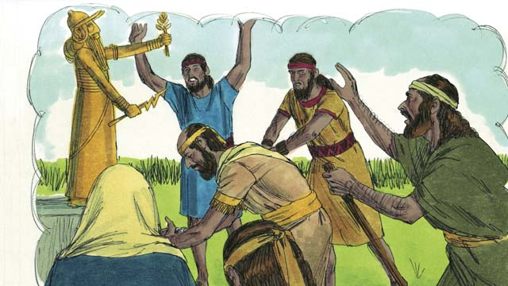
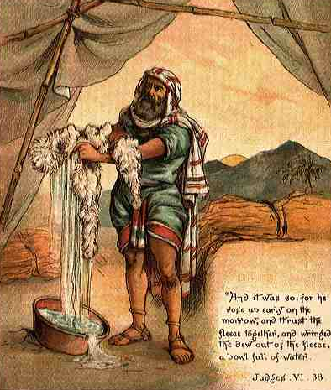
THROUGH THE BIBLE IN 2018
LESSON 14
WEEK 14 OF 52
(Judg. 8–1 Sam. 3)
Last time we saw God choose Judges to govern over His chosen nation.
After Gideon’s [6th Judge] military success over the Midianites,
the Israelites offered him a promotion to be their king –
“Then the men of Israel said unto Gideon, Rule thou over us,
both thou, and thy son, and thy son’s son also; for thou hast
delivered us from the hand of Midian. And Gideon said unto
them, I will not rule over you, neither shall my son rule over
you: the LORD shall rule over you” (Jud. 8:22,23).
After Gideon’s defeat of Midian, Israel enjoyed 40-years of
peace (8:28). After Gideon’s death, Israel returned to idolatry –
”And it came to pass, as soon as Gideon was dead, that the
children of Israel turned again, and went a whoring after Baalim, and made Baal-berith their god. And the children of Israel remembered not the LORD their God…” (8:33).

Slide 2
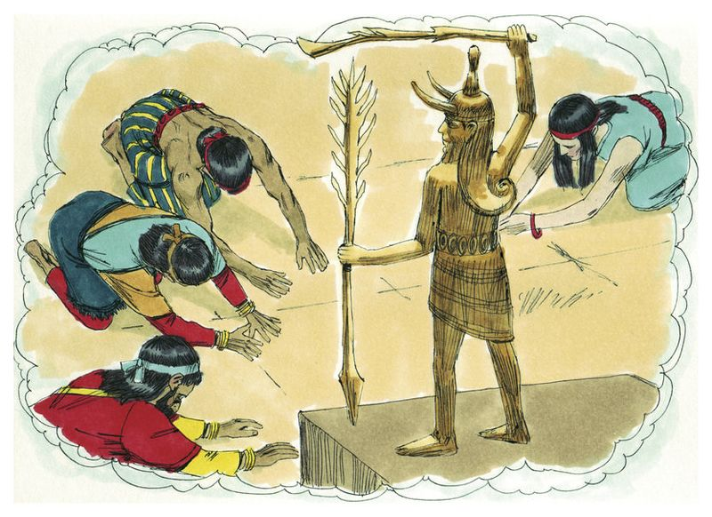
Tola was chosen as Israel’s 7th Judge, a man of Issachar,
in Mt. Ephraim – “And he judged Israel [23] years, and
died…” (10:1,2).
Jair, the 8th Judge, a Gileadite, judged Israel [22] years,
and had 30-sons (10:3-5).
Did anything change?
“And the children of Israel did evil again in the sight of
the LORD, and served Baalim, and Astaroth, and the
gods… and forsook the LORD, and served not him”
(10:6,7). God’s reaction?
“And the anger of the LORD was hot against Israel, and
he sold them into the hands of the Philistines, and into
the hands of the children of Ammon…” (10:7,8).
God punished Israel with invading armies for 18-years –
“And the children of Israel cried unto the LORD, saying, We have sinned against thee… [God said] – Go and cry unto the gods which ye have chosen; let them deliver you…” (10:10-14 c.f. 2Tim. 3:4).

Slide 3
“And the children of Israel said unto the LORD, We have
sinned: do thou unto us whatsoever seemeth good unto
thee; deliver us only, we pray this day. And they put away
the strange gods from among them, and served the LORD:
and his soul was grieved for the misery of Israel” (10:15).
Israel kept failing their test of HIS-STORY.
Did it cause God to hate them? No, but it did cause Him
to grieve for the misery they brought on themselves. But,
that doesn’t happen today, right?
“And grieve not the holy Spirit of God…” (Eph. 4:30).
Satan knew Israel’s weakness—the practice of idol worship
that surrounded them—and, he enticed them with it again
and again. During this Age of Grace, Satan, too, plays on inherent weaknesses we have that surround us. God’s reaction?
It grieves God to see the misery we cause ourselves when we succumb to our weaknesses.

Slide 4
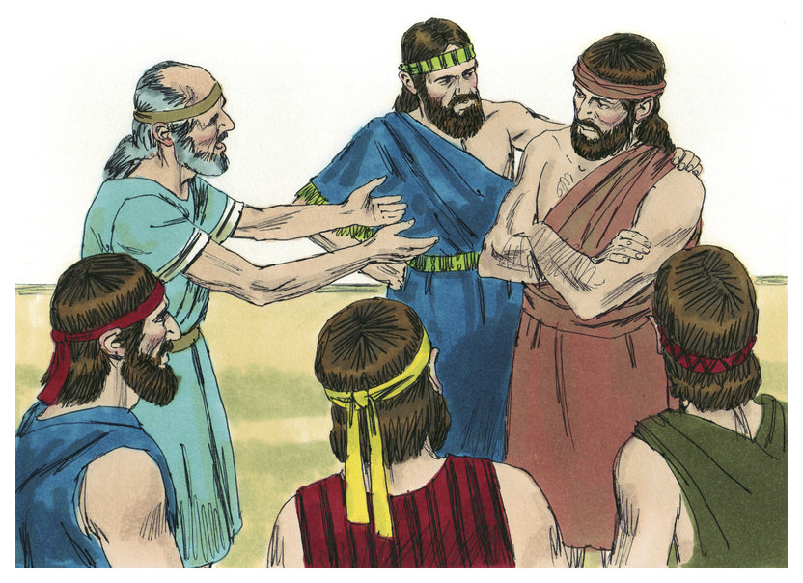
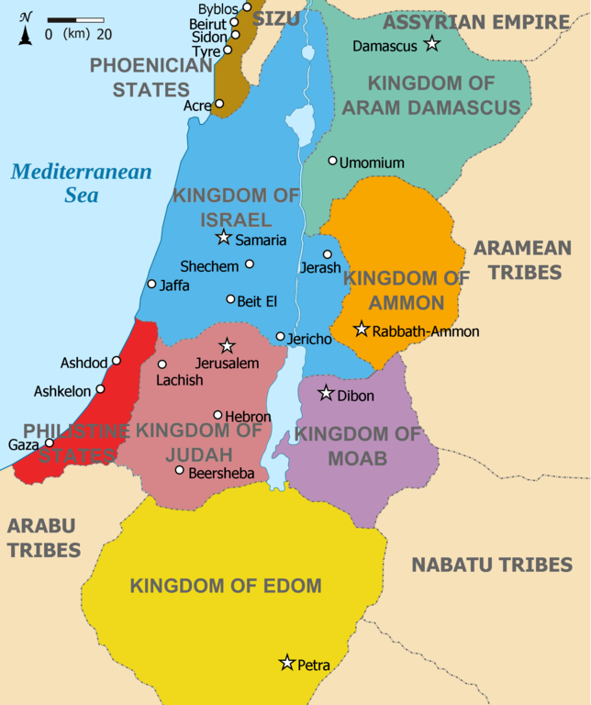
“Now Jephthah [9th Judge] the Gileadite was a mighty
man of valour, and he was the son of an harlot” (11:1).
When Ammon invaded their land, Israel needed a strong
leader, but he also turned out to be a diplomat –
“… Israel took away my land, when they came up out of
Egypt… now therefore restore those lands again
peaceably,” said the king of Ammon. Jephthah answered,
“Israel took not away the land of Moab, nor the land of
Ammon: But when Israel came up from Egypt, and
walked through the wilderness unto the Red Sea, and
came to Kadesh; Then Israel sent messengers unto the
king of Edom, saying, Let, I pray, pass through thy land:
but the king of Edom would not… like manner… the king
of Moab” (11:13-17).
Israel sent messengers to other kings in the area requesting right of passage, but all refused. As a result, “The LORD God of Israel delivered [king] Sihon and all his people into the land of Israel, and they smote them: so Israel possessed all the land of Amorites” (11:21).

Slide 5
Jephthah told the king of Ammon that Israel asked nicely just to pass through their land on their journey to their promised land, but every nation refused, at which time the LORD gave them permission to then conquer the lands in question, including HIS!
“Wilt not thou possess that which Chemosh thy god giveth thee to possess? So whomsoever the LORD our God shall drive out from before us, them will we possess” (11:23).
Jephthah ‘tongue-in-cheek’ – if the king of Ammon wanted their land back, then they should consult their god [Chemosh], and see if he could deliver LIKE THE GOD OF ISRAEL DID! Chemosh did not deliver, but the God of Israel did as Jephthah defeated Ammon – “So Jephthah passed over the children of Ammon to fight against them; and the LORD delivered them into his hands” (11:32).
Pagan gods were powerless when compared to Israel’s God.

Slide 6
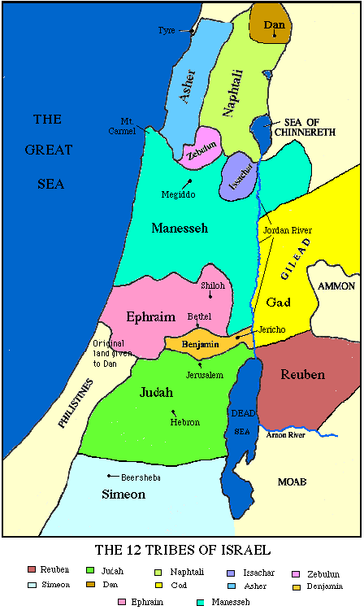
JUDGES 10-12
“And after him Ibzan of Bethlehem judged Israel. And he had
[30] sons and [30] daughters from abroad for his sons.
And he judged Israel [7] years… died… and was buried at
Bethlehem [Zebulon]” (12:8-10)… “And after him Elon, a
Zebulonite, judged Israel; and he judged Israel [10] years…
died, and was buried… in the country of Zebulun” (12:11,12).
The 10th and 11th Judges were from the tribe of Zebulon.
“And after him Abdon… judged Israel… [8] years… died…
buried in… Ephraim” (12:13-15). Anything change?
“And the children of Israel did evil again in the sight of the
LORD; and the LORD delivered them into the hands of the
Philistines [40] years” (13:1).
Nothing changed. Israel backslid again. That doesn’t happen today, right?
“So then they that are in the flesh cannot please God…” (Rom. 8:8).

Slide 7
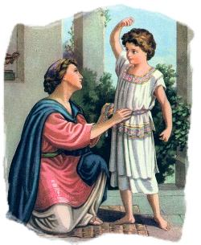
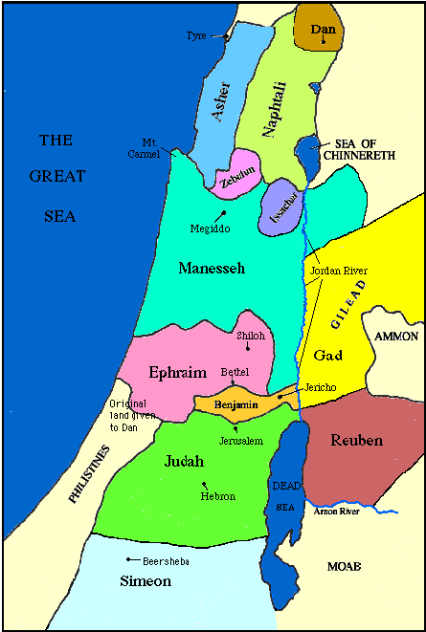
“And there was a certain man of Zorah, of the family of the
Danites… his wife was baren, and bare not. And the angel
of the LORD appeared unto the woman, and said unto her,
Behold… thou shalt conceive, and bear a son” (13:2,3)… And
the woman bare a son, and called his name Samson: and the
child grew, and the LORD blessed him. And the Spirit of the
LORD began to move him…” (13:24,25).
Sampson would be Israel’s 13th Judge and would be called
of God to battle the increasingly powerful Philistines. What
does Sampson do? Marry a Philistine –
“And Sampson went down to Timnath, and saw a woman…
of the daughters of the Philistines. And he came up and told
his father and his mother… get her for me to wife” (14:1,2).
It seemed bizarre to his parents that Sampson would want to marry an enemy of Israel and forbidden by the Law of Moses (Deut. 7:3), but they didn’t know that this time the LORD would use it for good.

Slide 8
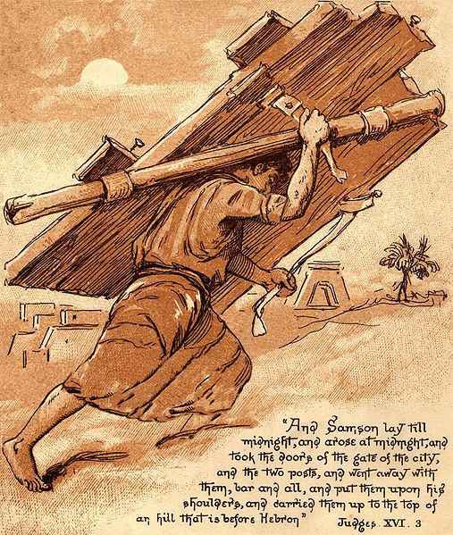
“Then went Samson to Gaza, and saw there an harlot, and went in unto her [bad!]. And it was told the Gazites, saying, Samson is come thither. And they compassed him in, and laid wait for him all night… we shall kill him. And Samson… arose at midnight, and took the doors of the gate of the city… and put them on his shoulders, and carried them up to the top of an hill that is before Hebron” (16:1-3).
Samson’s strength was surpassed only by that of his propensity to commit immorality.
“And it came to pass afterward, that he loved a woman… whose name was Delilah. And the lords of the Philistines came up unto her, and said unto her, Entice him… we may prevail against him…” (16:4,5).
Delilah set up Samson.

Slide 9
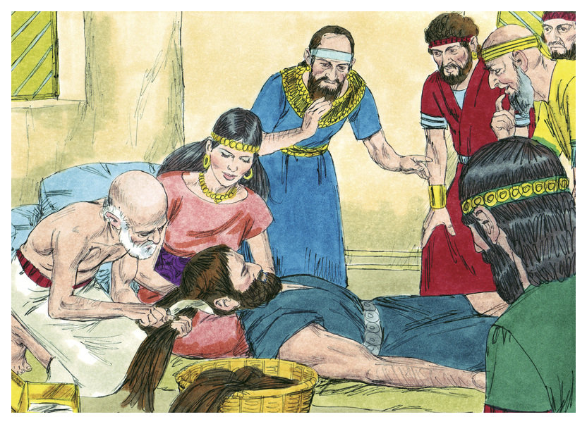
The Philistine leaders devised a plot to capture Samson by bribing Delilah to find out the source of Samson’s strength (16:5,6), finally revealing it to her – “There hath not come a razor upon mine head; for I have been a Nazarite unto God from my mother’s womb: if I be shaven, then my strength will go from me, and I shall become weak, and be like any other man” (16:17). While sleeping, “… she called for a man [Philistine] and she caused him to shave off the seven locks of his head… and his strength went from him” (16:19).
His superhuman strength was not because of a Nazarite vow, but a supernatural enablement by the Holy Spirit (15:14). Awakening, Samson did not know the Spirit had departed (16:20), which also meant he no longer was a Judge of Israel.

Slide 10
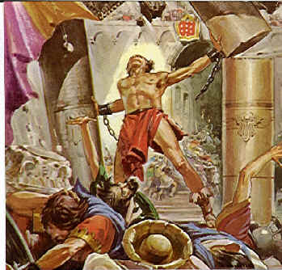
“But the Philistines took him, and put out his eyes, and
brought him down to Gaza, and bound him with fetters
of brass… then the lords of the Philistines gathered them
together for to offer a great sacrifice unto Dagon their
god… our god [Dagon] delivered Samson our enemy into
our hand… And they said, Call for Sampson, that he may
make us sport… set him between the pillars … O LORD
God… strengthen me… only this once …” (16:21-28).
Samson asked God to renew his strength one last time
so he could avenge their barbarous act of blinding him—
He did – “And Samson took hold of the two middle pillars
… Let me die with the Philistines… and the house fell
upon… all the people” (16:29,30).
Samson killed more Philistines in his death than during
his life [>1,030]. He judged Israel [20] years (16:31), and though he proved that with God’s help he could destroy temples with his strength, his moral weakness hindered his testimony of faith.

Slide 11
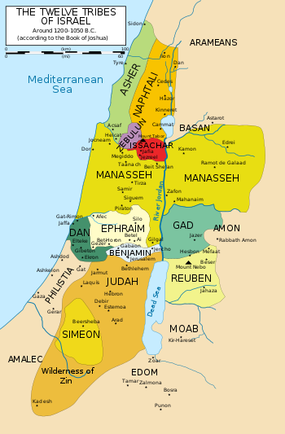
ISRAEL’S SPIRITUAL CONDITION
THE GOOD – God had put Israel in their land as
He promised.
THE BAD – Israel did not heed God by driving
out the pagan tribes, but lived among them.
THE UGLY – With no central, ruling authority or
leader, they quickly regressed and worshiped
the gods they had been warned not to do.
Because of their lack of faith, the pagan tribes
were pushing at least one tribe from their God-
given place –
“… In those days the tribe of the Danites sought
them an inheritance to dwell in” (18:1).
The tribe of Dan was forced off their parcel of
land by the Philistines, and moved north, where they would spiritually decline further and become a prominent site of pagan worship –
“And the children of Dan set up the graven image” (18:30).

Slide 12
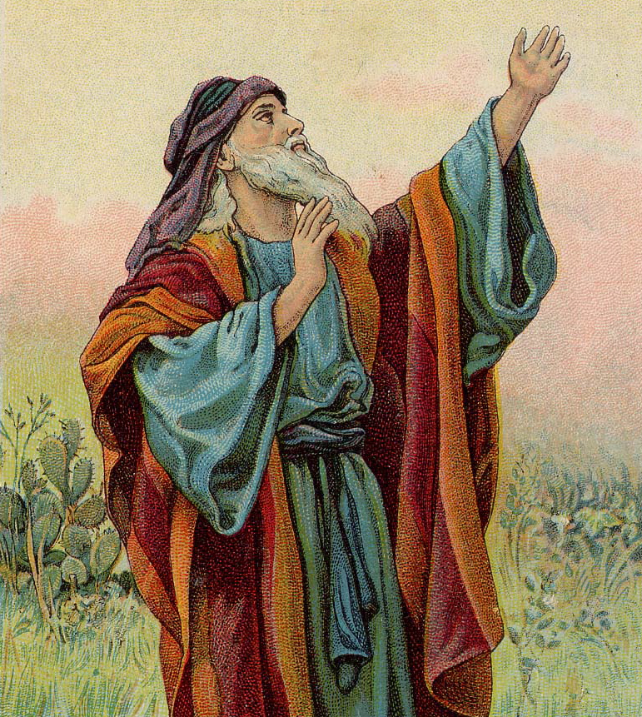
Civil, political, and spiritual unrest marked the close of the Book of Judges. What had begun as the fulfillment of God’s promise to Abraham of a good land had now deteriorated to near anarchy and moral degradation on behalf of the nation of Israel. Israel’s overall condition can be summarized by the sad commentary of the last verse –
“In those days there was no king in Israel: every man did that which was right in his own eyes” (21:25).
Israel floundered in their unbelief. God had been so good to them, forgiving them time and again for their bad decisions—
Something had to change.
What would come next?

Slide 13
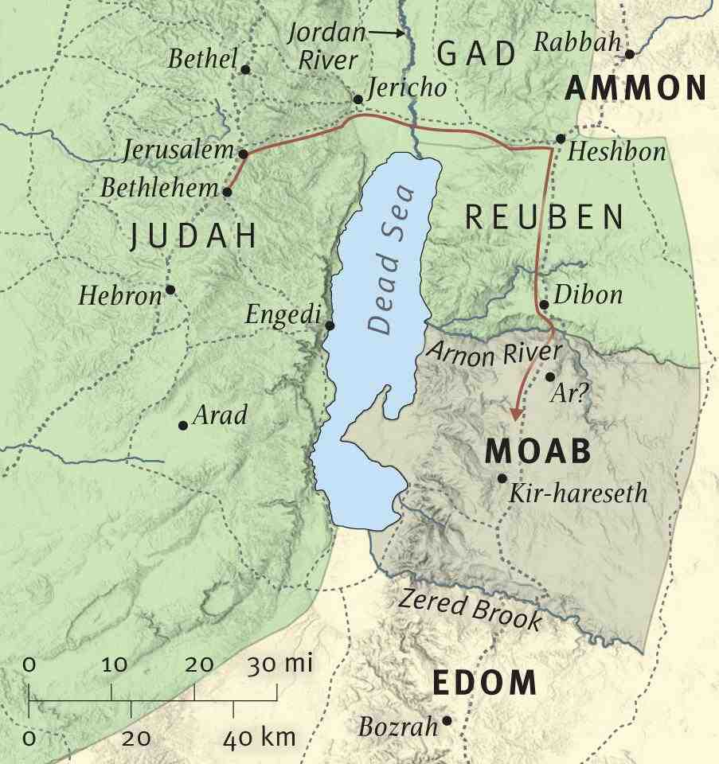
BOOK OF RUTH
“Now it came to pass in the days when the judges ruled, that there was a famine in the land. And a certain man of Bethlehem-Judah went to sojourn in the country of Moab, he, and his wife, and his two sons” (Ruth 1:1).
The Book of Judges showed Israel as a nation, including its leaders, as one of wavering faith and moral laxity. The Book of Ruth, is one of contrast in that it depicts a few individuals of strong faith and of high moral ideals. The setting is in Moab, a nation birthed from the son of incestuous relationship between Lot and his two daughters (Gen. 19:30-38).
Pagan Moab remained a enemy of Israel, but Ruth, a woman of Moab, forsook idolatry and converted to the faith of the Israelites.

Slide 14
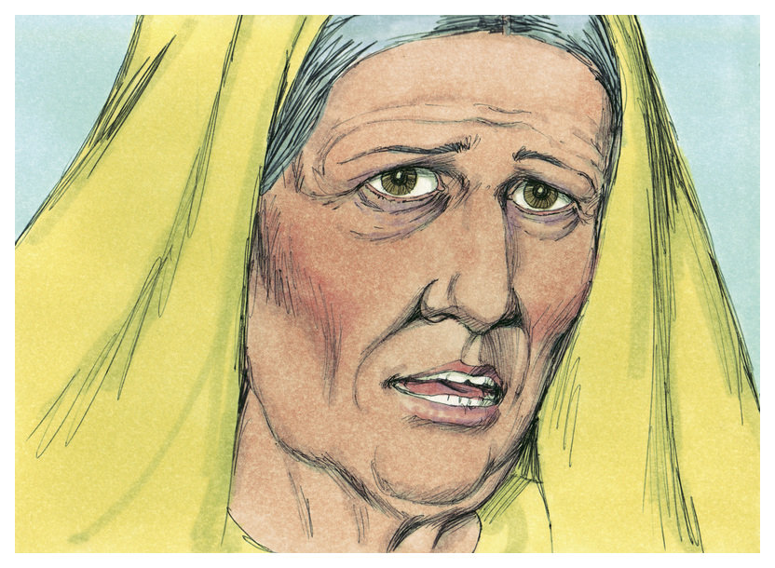
SOJOURN TO MOAB
Elimelech and Naomi, and their two sons, Mahlon and
Chilion, left their Jewish home in Bethlehem Ephratah
and traveled to Moab to seek relief from the famine (1:2),
where Elimelech promptly died (1:3), and Naomi was left
to raise her sons alone. The sons took wives, Orpah and
Ruth, and they lived in Moab for 10-years (1:4), at which
time both sons died (1:5), leaving the 3-women alone.
Hearing that the famine was over, Naomi decided to
return to her homeland [Israel] (1:6), but she advised the
young women not to accompany her –
“And Naomi said unto her two daughters-in-law, Go, return each to her mother’s house… she kissed them; and they lifted up their voice, and wept” (1:8,9).
Orpa did as Naomi said, but Ruth resisted. Naomi said – “Behold thy sister-in-law is gone back unto her people, and unto her gods: return thou after thy sister-in-law” (1:15).

Slide 15
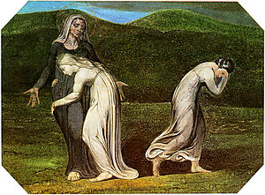
“And Ruth said, Don’t ask me to leave thee, or to return from following after thee: for whither thou goest, I will go; and where thou lodgest, I will lodge: thy people shall be my people, and thy God my God: Where thou diest, will I die, and there will I be buried: the LORD do so to me, and more also, if ought but death part thee and me [till death do we part]” (1:16,17).
A convert [Gentile proselyte], in a moment of despair, showed more heart-felt faith in the God of Abraham, Isaac, and Jacob than the nation of Israel herself during the 300+ year period of the Judges.
“So Naomi returned, and Ruth… with her… returned out of the country of Moab: and they came to Bethlehem in the beginning of the barley harvest” (1:22).
Naomi & Ruth returned to Canaan just in time for the spring barley harvest.

Slide 16
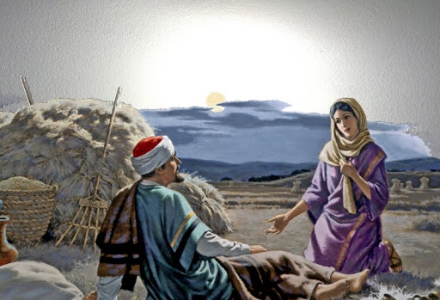
“And Naomi had a kinsman of her husband’s, a
mighty man of wealth, of the family of Elimelech;
and his name was Boaz” (2:1).
Boaz, a relative of Naomi’s dead husband and a
wealthy farmer, was introduced to Ruth –
“And Ruth… said unto Naomi, Let me now go to
the field, and glean ears of corn after him in whose
sight I shall find grace” (2:2).
Ruth, a foreigner, a convert to the Hebrew faith
[outsider], wanting to find a new life in a strange
land, needed the grace of God, and she found it in
Boaz –
“Then she fell on her face, and bowed herself to
the ground, and said unto him, Why have I found
grace in thine eyes, that thou shouldest take
knowledge of me, seeing I am a stranger?” (2:10).
Here Boaz is a type of Christ in whom Ruth finds the grace of God.

Slide 17
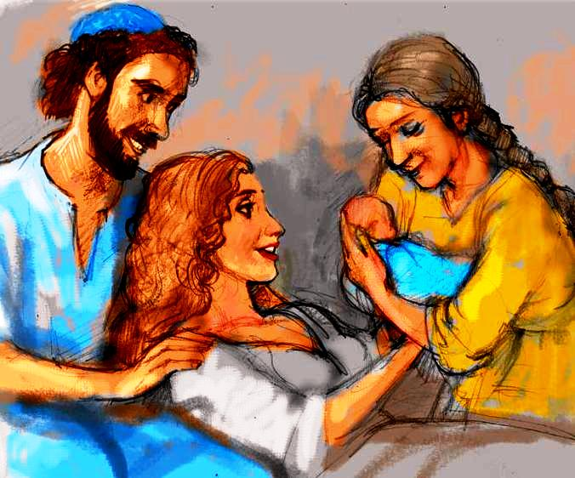
“So Boaz took Ruth, and she was his wife… the LORD
gave her conception, and she bare a son” (4:13).
A fairytale like ending—Boaz married Ruth, and bore
him a son [she was barren in her first marriage], who
would become the lineage of both a future king of
Israel, and the Savior of all mankind.
“And the women her neighbours gave it a name,
saying, There is a [grandson] born to Naomi; and
they called his name Obed [‘worshiper’]: he is the
father of Jesse, the father of David” (4:17).
A life that began with deprivation and loss had come
full circle. Naomi’s life had become full and complete
as she watched the grace of God poured out on Ruth
and herself. Boaz had become the kinsman-redeemer
of their family—a type of Christ who would be the
same for the world.
As a bonus, the child whom she nursed would be the grandfather of Israel’s greatest king [David], and through whose lineage the Messiah would come.

Slide 18
THE BOOKS OF SAMUEL
Samuel was the last of Israel’s Judges but also the first in a series of prophets to come. The two books of SAMUEL connects the period of the Judges with that of the future Kings of Israel.
Samuel was the son of a descendent of Levi (1Chron. 6:33-38), but lived in the land given Ephraim, the central hill country about 15-miles north of Jerusalem. Samuel, the son of a priest, was born (1:19,20), lived (7:17), died and was buried (25:1) in Ramah.
Samuel’s father, Elkanah (1:1), regularly went to the tabernacle at Shiloh (1:3) another 15-miles north of Ramah. He had two wives—because Hannah was barren he married Peninnah who gave him children (1:2), but…

Slide 19
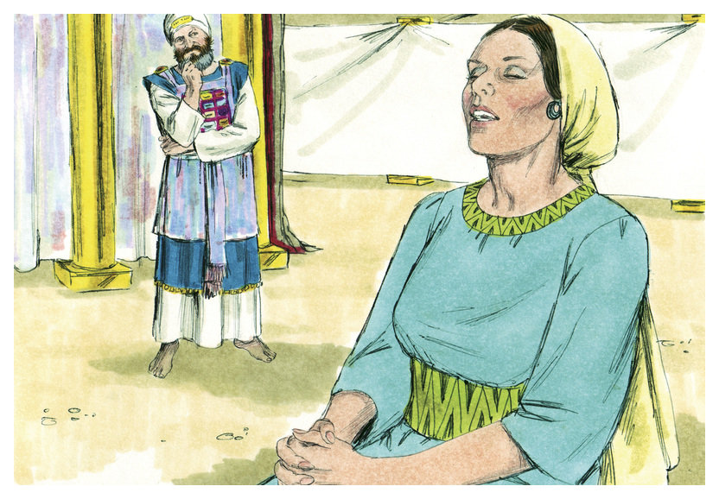
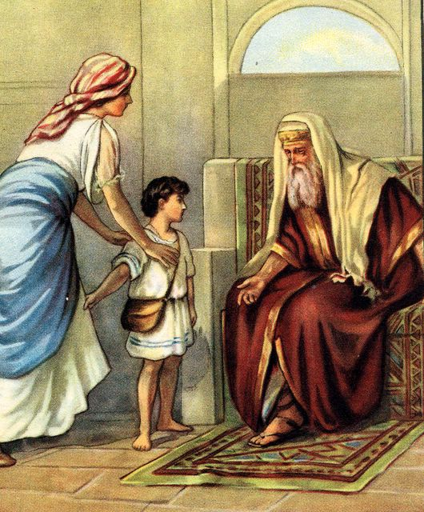
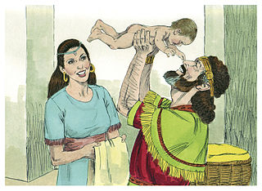
… Hannah desperately wanted a child and who regularly petitioned God – “… she went up to the house of the LORD… she wept…” (1:7). At one of the feast days at the tabernacle she vowed a [Nazarite] vow that if God would give her a son she would give him to God (1:10,11)—Eli, the priest, heard it – “… Go in peace; and the God of Israel grant thee thy petition that thou hast asked of him” (1:17).
God did, and Hannah conceived – “… bare a son, and called his name Samuel, saying, Because I have asked him of the LORD” (1:20).
“And when she had weaned him… brought him unto the house of the LORD in Shiloh… as long as he liveth he shall be lent to the LORD” (1:28).
Samuel lived with Eli in the tabernacle.

Slide 20
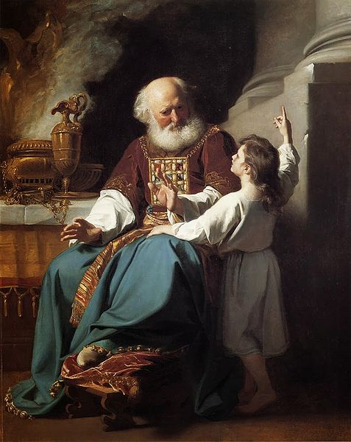
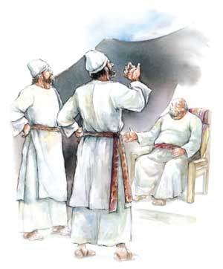
THE EVIL SONS OF ELI
“Now the sons of Eli were sons of Belial; they knew not the LORD (2:12).
Not only did the people of Israel do that which they wanted to—so did these two priests! Because of the corruption of the priesthood by the sons of Eli, God said – “And this shall be a sign unto thee, that shall come upon thy two sons, on Hophni and Phineas; in one day they shall die both of them. And I will raise up a faithful priest, that shall do according to that which is in mine heart and mind” (2:34,35).
SAMUEL AS A CHILD
“But Samuel ministered before the LORD, being a child… And the child Samuel grew on and was in favour both with the LORD, and also with men” (2:18,26).

Slide 21
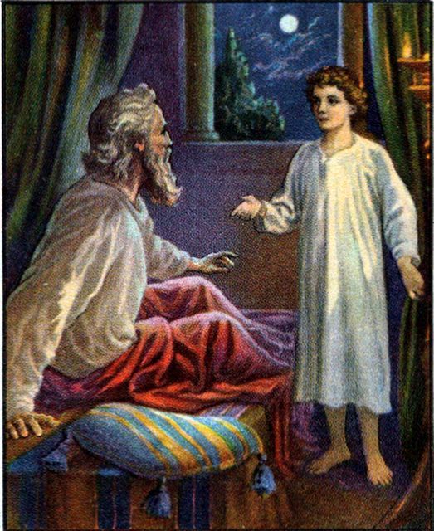
SAMUEL THE PROPHET-PRIEST
The candlestick was to be supplied with enough olive
oil to burn continuously (Exo. 27:20,21), went out –
“… when Eli [priest] was laid down in his place, and His
eyes began to wax dim, that he could not see; and ere
the lamp of God went out in the tabernacle of the LORD,
where the ark was, and Samuel was laid down to sleep;
That the LORD called Samuel: and he answered, Here
am I” (1Sam. 3:1-4).
Finally informed that it was the LORD, not Eli, who was
calling him, Samuel responded – “And the LORD came,
and stood, and called… Samuel, Samuel. Then Samuel answered, Speak; for thy servant heareth… I will do a thing in Israel… I will judge his [Eli’s] house… because his sons made themselves vile… And all Israel from Dan [N] to Beersheba [S] knew that Samuel was established to be a prophet of the LORD” (3:10-20). The whole nation of Israel would know that Samuel was a prophet of God.
Next time – Against God’s will, Israel gets a king (1Sam. 4–Psa. 7, 27, 31, 34, 52).

