Slide 1
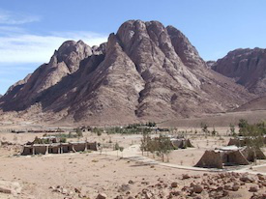
LESSON 6
WEEK 6 OF 52
(Exo. 19-38)
THROUGH THE BIBLE IN 2018
Last time we saw God lead Israel out of captivity, through the Red Sea, and into the wilderness, but why?
MOUNT SINAI
“In the third month [June], when the children of
Israel were gone fourth out of the land of Egypt,
the same day came they into the wilderness of
Sinai… and there Israel camped before the mount”
(19:1,2).
We know God wanted to free the Israelites from
their Egyptian bondage, but why lead them here
to this seemingly god-forsaken wilderness?
“And Moses went up to God, and the LORD called
unto him out of the mountain, saying…. Ye have seen what I did unto the Egyptians, and how I bare you on eagles’ wings, and brought you unto myself…” (19:3,4).
This is where God wanted His people in order to give them the next installment of His plan.

Slide 2
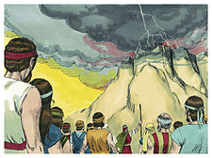
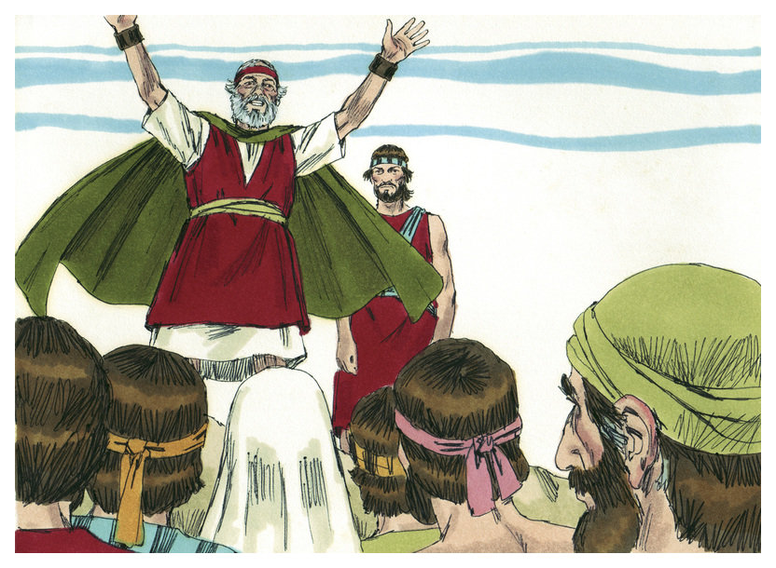
DISPENSATION OF LAW
“And the LORD said unto Moses, Come up to me into the
mount… and I will give thee tablets of stone, and a law,
and commandments which I have written…” (24:12).
Moses did as God said –
“Now therefore, if ye [Israel] will obey my voice indeed,
and keep my covenant [Law], then ye shall be a peculiar
treasure unto me above all people… And ye shall be unto
me a kingdom of priests and an holy nation… (19:5,6).
… And Moses came and called for the elders of the people,
and laid before their faces all these words which the LORD
commanded him” (19:7).
The Law was a conditional agreement between God and
Israel. IF they kept it, Israel would become the most
blessed nation on earth, and would be used of God as a
royal priesthood, eventually taking their God to the Gentile nations throughout the world.

Slide 3
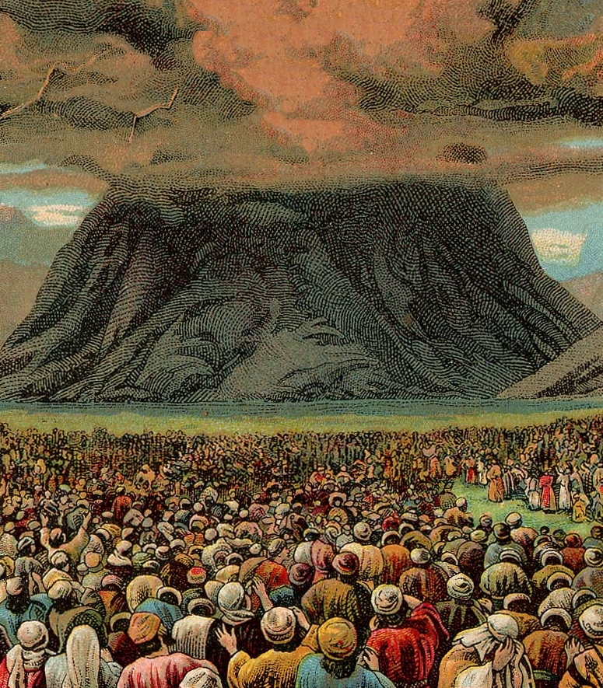
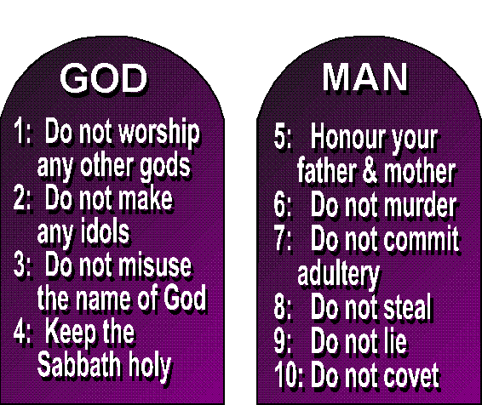
Would Israel agree to keep the Law?
“And all the people answered together,
and said, All that the LORD hath spoken
we will do. And Moses returned the
words of the people unto the LORD” (19:8).
Israel said they would, but will they?
THE DECALOGUE (1st 10 of 613)
“… I am the LORD thy God… thou shalt
have no other gods... Thou shalt not make
unto thee any graven image… not take the
name of the LORD in vain… keep the Sabbath…
honor father & mother… not murder… not
commit adultery… not steal… not bear false
witness… not covet…” (20:1-17).
The 1st four laws dealt with man honoring God;
the 2nd six with man’s responsibility to man.

Slide 4
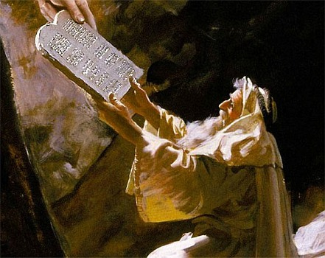
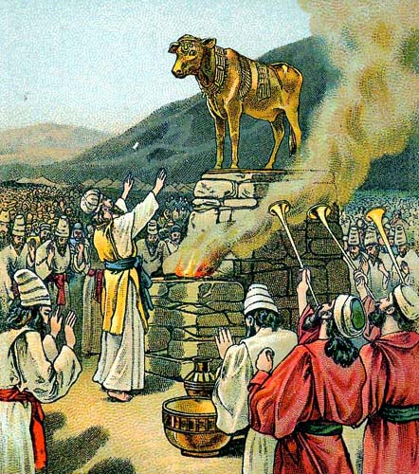
Just to make sure Israel understood God, He repeated His
most important instruction to them –
“Ye shall NOT make with me gods of silver… gods of gold…”
(20:23).
A short time later Moses went to the mountain –
“And he gave unto Moses, when he had made an end of
communing with him upon mount Sinai, two… tablets of
stone, written with the finger of God (Exo. 31:18)…
… And when the people saw that Moses delayed [40 days]
to come down of the mount, the people gathered themselves
together unto Aaron, and said unto him… make us gods… the
people break off the golden earrings… and brought them to
Aaron. And he fashioned it with a graving tool, after he had
made it a molten calf… and they said…
These be thy gods, O Israel, which brought thee up out of the land of Egypt” (32:1-4).

Slide 5
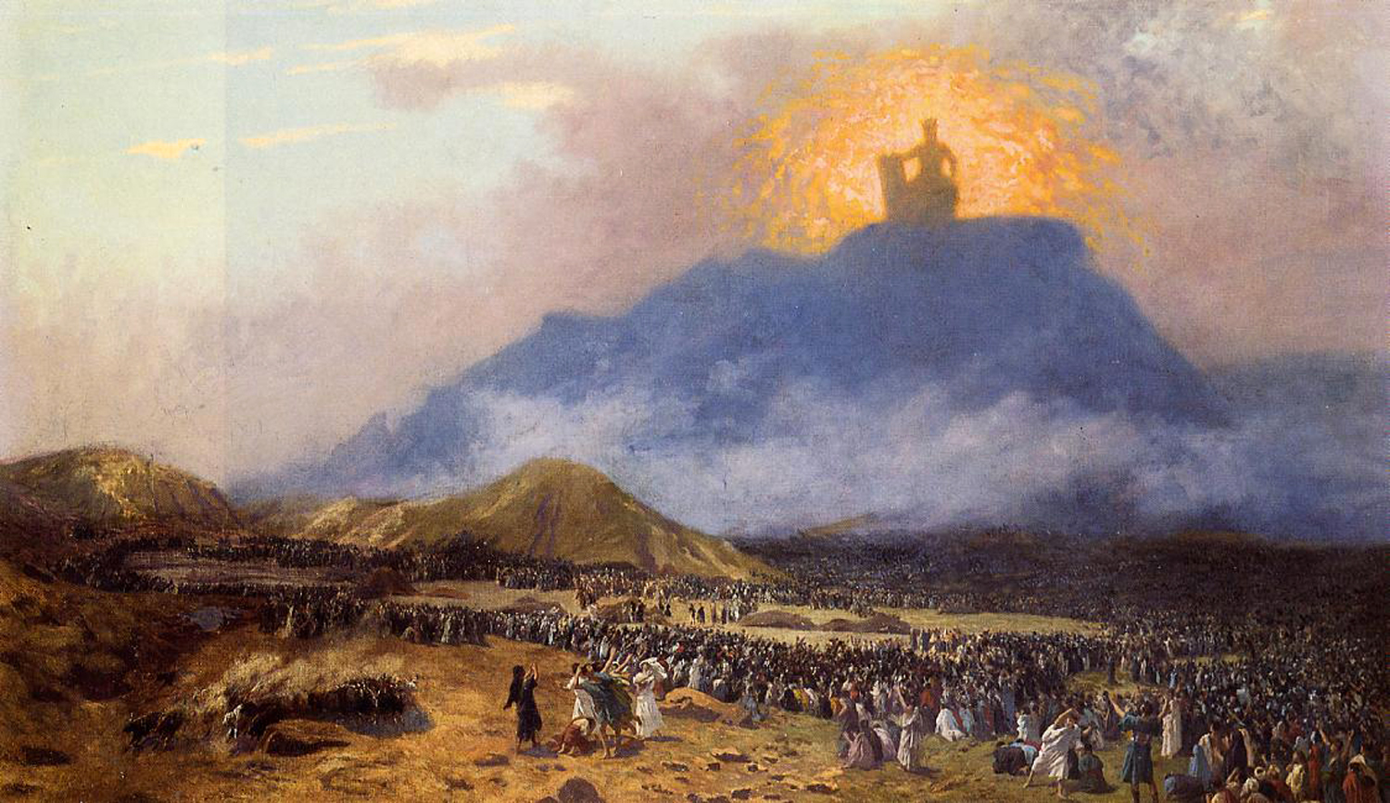
“They have turned aside quickly out of the way which I commanded them: they have made
them a molten calf, and have worshipped it…
and said, These be thy gods O Israel, which have brought thee up out of the land of Egypt” (32:8).
God’s reaction?
“… Let me alone, that my wrath may wax hot
against them, and that I may consume them: and
I will make of thee [Moses] a great nation” (32:10).
God considered destroying the whole nation and
starting anew with Moses, but Moses interceded
for them reminding Him of the promise He had made, and God relented (32:13,14).
God wasn’t the only one who was furious at the Israelites.

Slide 6
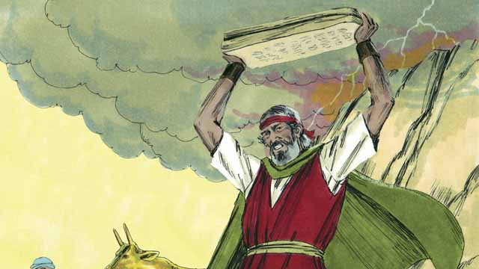
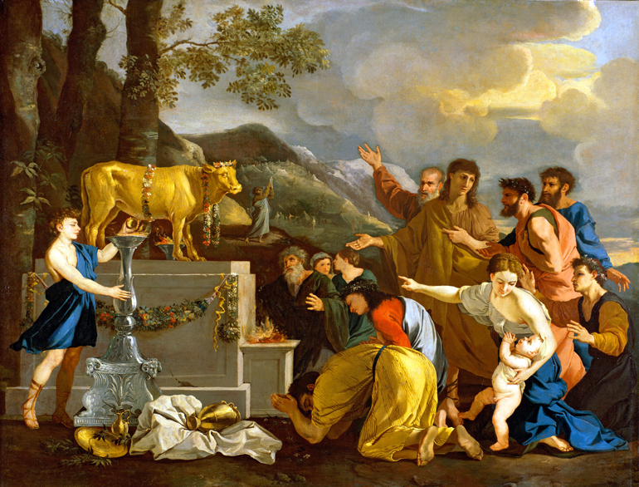
“And it came to pass, as soon as he came nigh unto the camp, that
he saw the calf, and the dancing: and Moses’ anger waxed hot, and
he cast the tablets out of his hands, and brake them beneath the
mount. And he took the calf … and burnt it in the fire… ground it
to powder… upon the water… drink it” (32:19,20).
Moses, too, was furious! He thrust down the tablets of stone
which represented Israel breaking God’s Law even before they had
received it. He asked Aaron what happened and he blamed the
people (32:21-23; Deut. 9:20).
“Then Moses stood in the gate of the camp, and said, Who is on the
LORD’S side? Let him come unto me… and there fell of the people
that day about [3,000] men…” (32:26-28).
The persistent idol worshippers DIED [broke 1st Com.]; those who
believed God [kept 1st Com.], LIVED.
Would you rather risk trying to keep the 10 Commandments to be saved, or place your faith in
the only ONE [Jesus Christ] whom the Bible says kept them perfectly? (2Cor. 5:21).

Slide 7
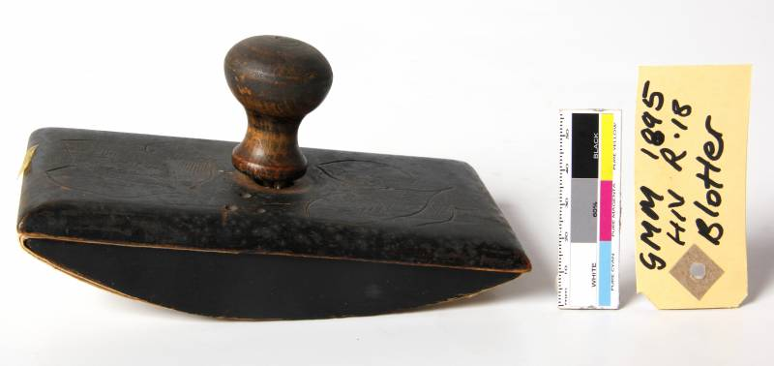
“… Moses said unto the people, Ye have sinned
a great sin: and now I will go up unto the LORD…
make an atonement for your sin. And Moses
returned unto the LORD, and said… Oh, this
people have sinned a great sin… Yet now, if
thou wilt forgive their sin; and if not, blot me,
I pray thee, out of thy book which thou hast
written” (32:31,32).
Moses appealed to the mercy of God on behalf
of the sinful Israelites, and said if the judgment
of God fell on them—let it fall on him as well.
God’s answer –
“… LORD said… whosoever hath sinned against me, him will I blot out of my book” (32:30-33).
God would not blot Moses’ name, but he would those who had persisted in their sin against Him. Israel had demonstrated that the [Law] agreement they had willingly accepted of God,
they would not keep. The breaking of God’s Law would produce very grave consequences.

Slide 8
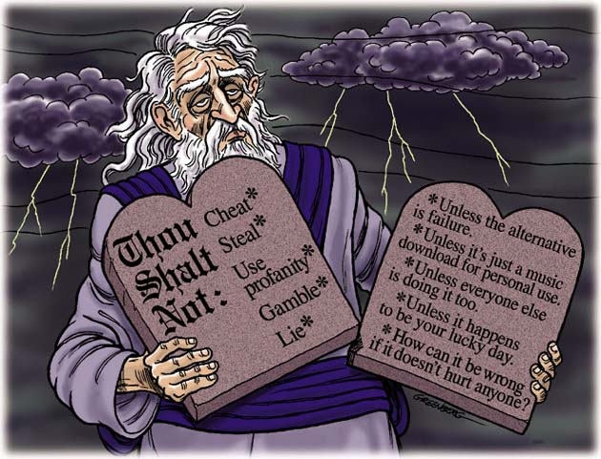
“For as many as are of the works of the law are under the curse: for it is written, Cursed is every one that continueth not in all things which are written in the book of the law TO DO THEM (Gal. 3:10; Deut. 27:26).
God wanted Israel to become a Holy nation after His name, but He had to prove to them that if they tried to accomplish it by their WORKS—they were doomed.
Why?
Each Israelite had inherited Adam’s sin nature, which drove their flesh to sin against God. So, it was not a matter of if, but when they sinned against God
[breaking His laws], they were deserving of DEATH!
The Law was a performance based system and with a sin nature, all under it are doomed for failure –
SIN = DEATH.

Slide 9
That’s why the 10 Commandments were placed in an ark [coffin] – in some cases, breaking the
Law meant DEATH!
The first evidence of that were those 3,000 who
persisted in breaking the 1st Commandment DIED.
But, the others [Aaron] who had broken the same
[worshiped the golden calf] changed their mind, repented, and God showed them mercy.
This would become the basis for the Law of Moses—when an Israelite sinned [broke the Law],
but was repentant [sorrow], he could offer a sacrifice for his sin—believing [faith] that God would show him mercy. He was kept righteous essentially by FAITH, but that also required proof of faith [WORK], i.e. a sacrificial offering. We believe they were saved by FAITH + WORKS.
Today we are not under Law but Grace (Rom. 6:14) and because Christ has finished His work of
redemption [death, burial, resurrection], there is no work that we can do to prove it. We are
saved by FAITH ALONE in Christ alone (Eph. 2:8,9).
SIN = DEATH FAITH = LIFE

Slide 10
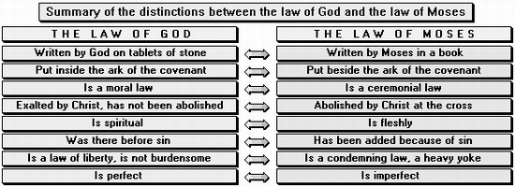
GOD’S DEALING WITH ISRAEL UNDER LAW
God had to give Israel a chance under this very stringent system of Law or else they might all die leaving no nation to fulfill His promises. How? He gave them a temporary system that could work—when they broke the Law [civil, moral] they came to the tabernacle with a sacrifice [ceremonial].
Civil, Moral, Ceremonial
Civil law – rules of government
“If a man steal an ox, or a sheep, and kill it, or sell it; he shall restore five oxen for an ox, and four sheep for a sheep” (22:1).
Moral law – rules of man’s conduct before God and man
“Thou shalt have no other gods before me” (20:3); Thou shalt not steal” (20:15).
Ceremonial law – rules on religious life which showed God’s mercy, i.e. sacrifice—restore fellowship with God after breaking moral & civil law.

Slide 11
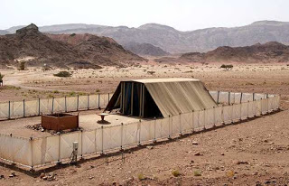
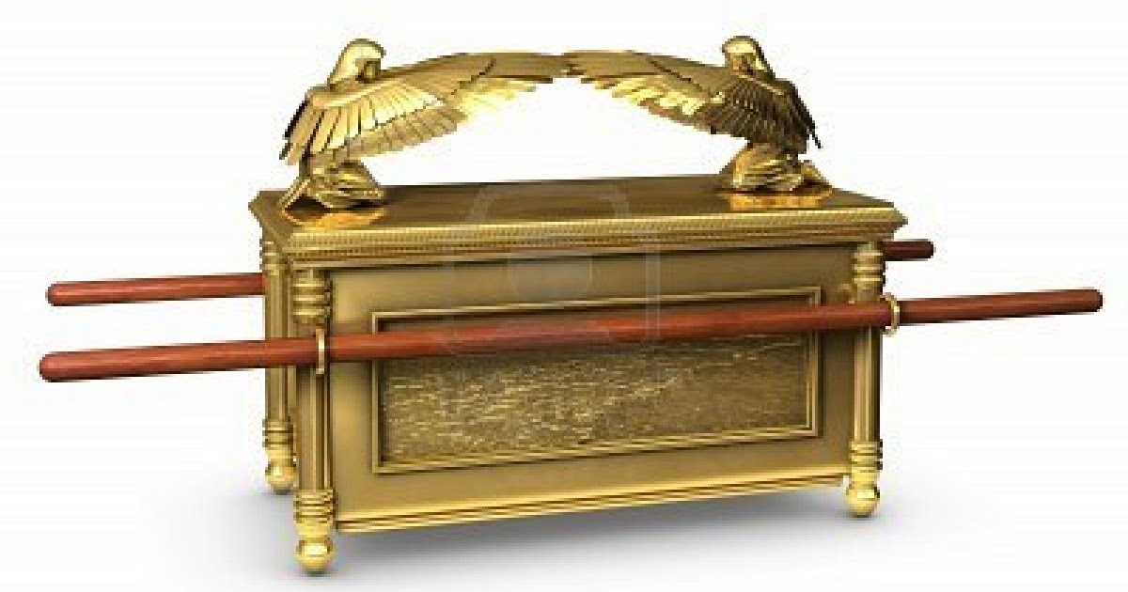
THE TABERNACLE
“And let them make me a sanctuary; that I may dwell
among them. According to all that I shew thee, after
the pattern…” (25:8).
The first thing God wanted was a place to reside close
to His people, but it would also have deeper spiritual
meaning, modeled after the one in heaven (Heb. 8:5).
“And they shall make an ark [coffin]… overlay it with
pure gold… a mercy seat… two cherubims… And there
I will meet with thee, and I will commune with thee
from above the mercy seat…” (25:10-22).
Christ would reside close to His people in the Holiest
place in the tabernacle invisibly enthroned above the
mercy seat of the ark of the covenant. From there
Christ would fellowship with His chosen nation.
[At this time, God had no fellowship with Gentiles, excepts proselytes (Eph. 2:11,12; Exo. 12:48)].

Slide 12
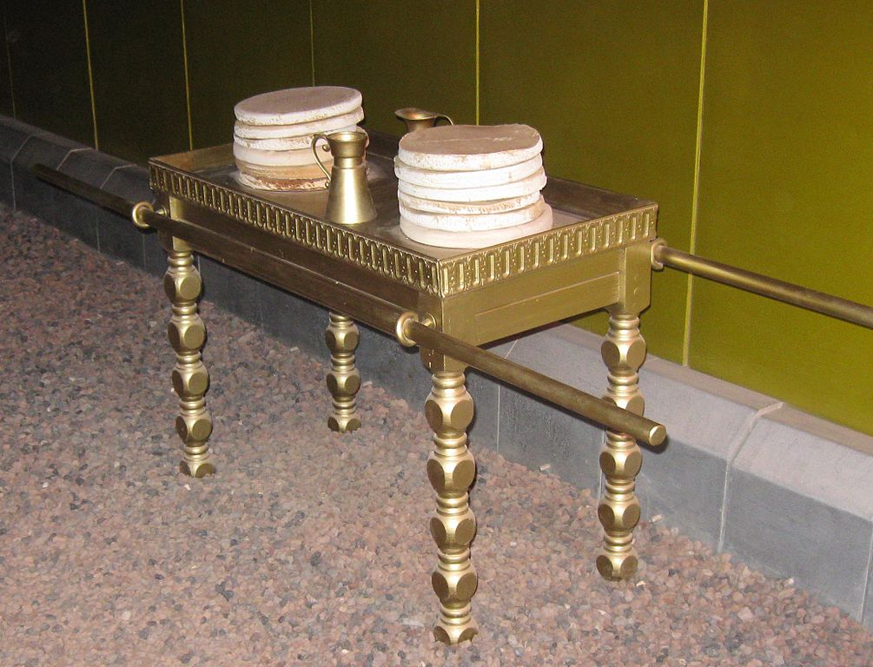
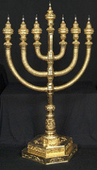
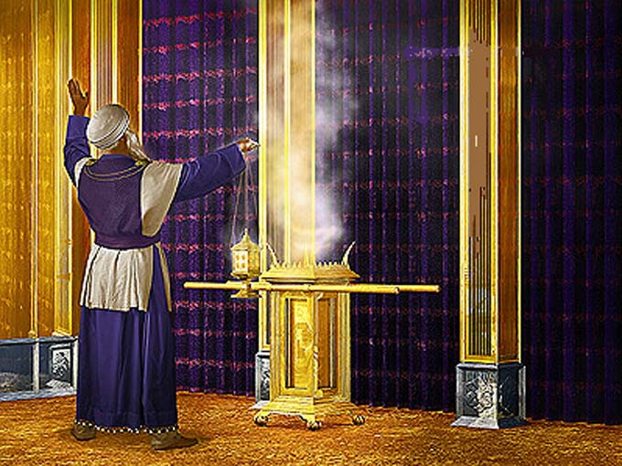
“… according to all that I shew thee, after the pattern of the tabernacle…” (25:9).
Not only did Moses receive the Law from God on Mt. Sinai, but he also was shown how to build the contents of the tabernacle from the model in heaven (Heb. 8:5).
“Thou shalt also make a table… overlay it with pure gold… set upon the table showbread before me always” (25:30).
“And thou shalt make a candlestick of pure gold… bring pure olive oil… to cause the lamp to burn always” (25:31; 27:20).
“And thou shalt make an altar to burn incense upon… overlay it with pure gold” (30:1).

Slide 13
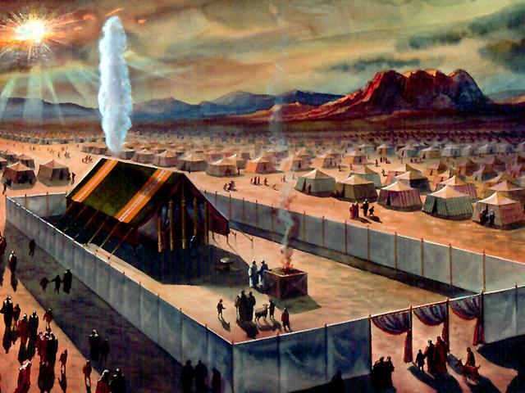
“And Moses took the tabernacle, and pitched it
without the camp… and called it the Tabernacle of
the congregation … As Moses entered into the
tabernacle, the cloudy pillar descended, and stood
at the door of the tabernacle, and the LORD talked
with Moses” (33:7-9).
The tabernacle was complete, but Moses wanted
more —a personal relationship with the One for
whom it was built.
“And he [Moses] said, I beseech thee, shew me thy
glory… Thou canst not see my face: for there shall no
man see me, and live… And he said, I will make all my
goodness pass before thee, and I will proclaim the
name of the LORD (Jn. 1:12) before thee; and will be
gracious to whom I will be gracious, and will shew
mercy on whom I will shew mercy” (33:18-20). Moses got his answer.

Slide 14
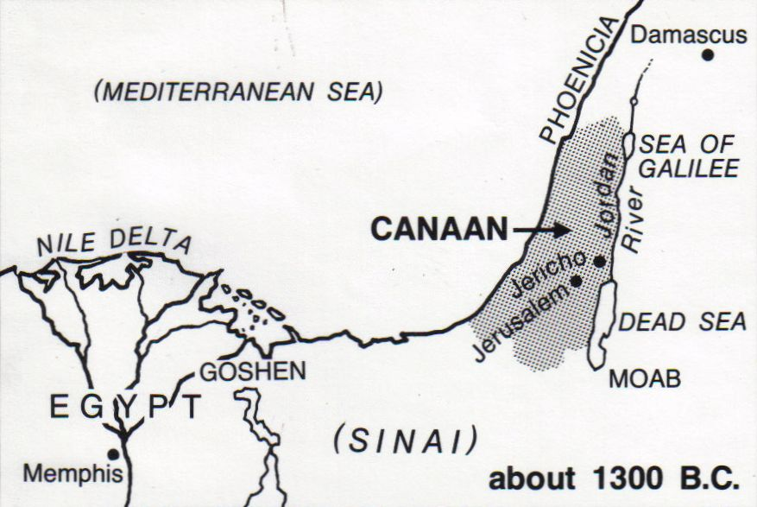
RENEWED COMMISSION
“And he said, Behold, I make a covenant: before all thy people I will do marvels, such as have not been done in all the earth, nor in any nation: and all the people among which thou art shall see the word of the LORD…
… Observe thou that which I command thee this day: behold, I [Christ] will drive out before thee the Amorite, and the Canaanite, and the Hittite, and Perizzite, and the Hivite, and the Jebusite” (34:11).
God was always way ahead with His plans & purposes concerning Israel—He would bless them, unless…
“Lest thou make a covenant with the inhabitants of the land, and they go a whoring after their gods…” (34:15,16).
God would do everything He had promised Israel, if
they worshipped only Him!

Slide 15
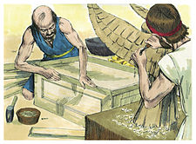
God chose the best craftsmen to make the contents of
the tabernacle – “… I [God] have put wisdom, that they
may make all that I have commanded them” (35:1-11).
But, they had to be very careful when they worked –
“… Six days shall work be done, but on the [7th] day
there shall be unto you a holy day, a Sabbath of rest to
the LORD: Whosoever doeth work therein shall be put
to death” (35:1,2).
Whether they knew it or not, the practice of the Sabbath
foreshadowed Israel’s kingdom rest for 1,000-years.
“And Moses spake unto all the congregation of the
children of Israel… take ye from among you an offering
unto the LORD: whosoever is of a willing heart, let him bring it, an offering of the LORD; gold, and
silver, and brass” (35:4,5).
Exodus Ch. 25-31 are the instructions to build the tabernacle; 35-40 carrying it out. That explains
the repetition of similar information concerning the tabernacle.

Slide 16
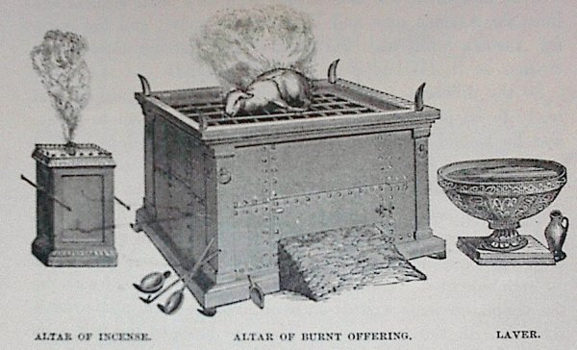
“And he made the altar of burnt offering… and he
made the horns thereof on the four corners; the
horns thereof were of the same; and he overlay it
with brass And he made all the vessels of the altar…
pans to receive his ashes, and his shovels, and his
basins… make of brass” (38:1; 27:1-3).
The brazen alter was located in the courtyard where
the burnt offering was carried out [It is not the same
as the altar of incense located insider the sanctuary
of the tabernacle].
“And he made the laver of brass, and the foot of it
of brass… to wash withal: and thou shalt put it
between the tabernacle of the congregation and the
[brazen] altar, and thou shalt put water therein… For
Aaron and his sons shall wash their hands and feet… when they go into the tabernacle… that they die not… or to burn offering made by fire unto the LORD” (38:8; 30:18-20).

Slide 17
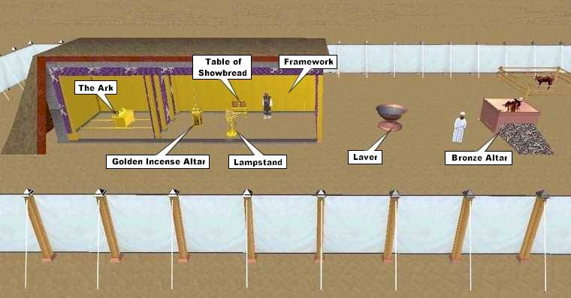
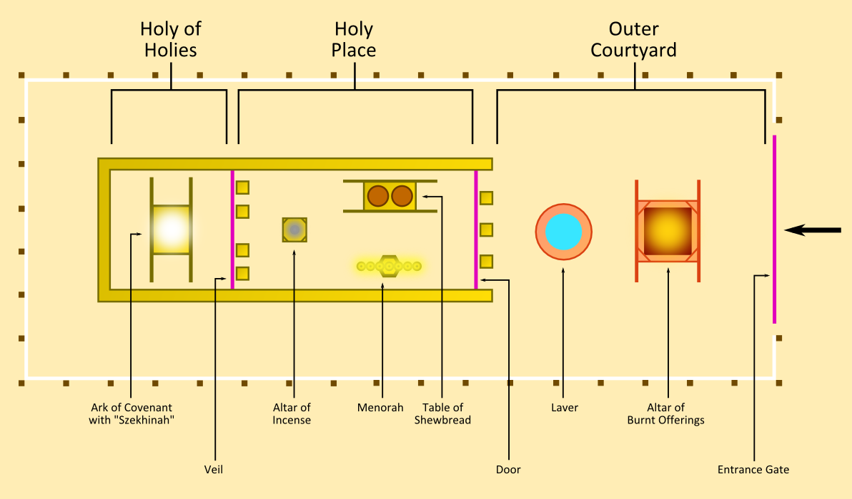

Slide 18
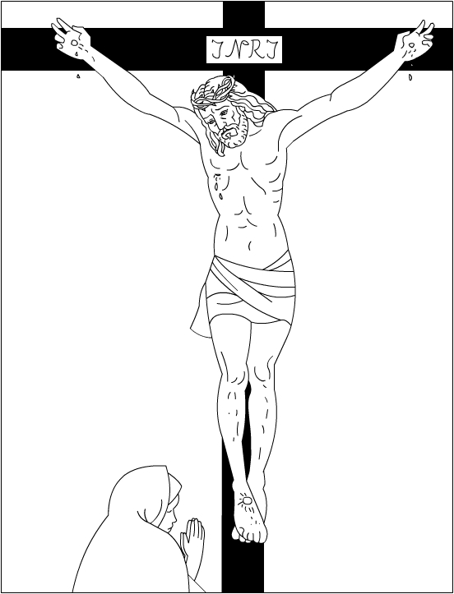
The tabernacle was a veiled picture of the Cross

Slide 19
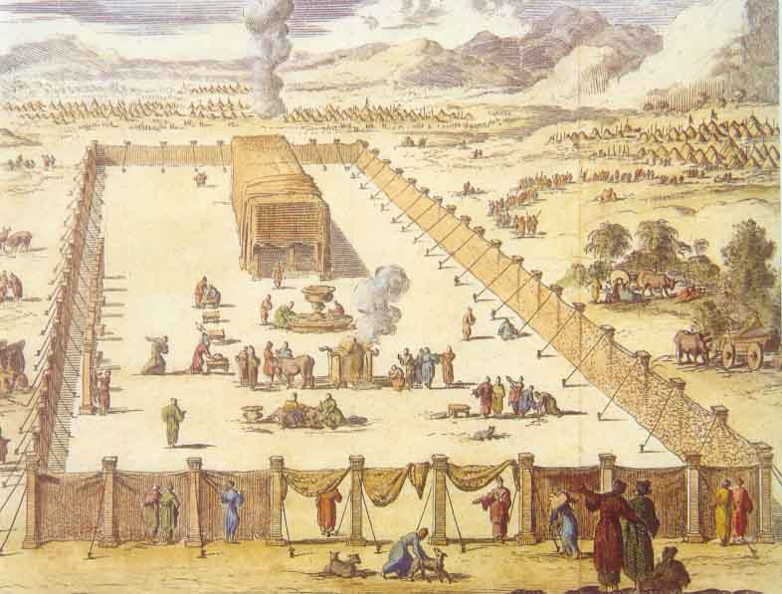
Next time – The tabernacle in action
Exo. 39 – Lev. 18

