Slide 1
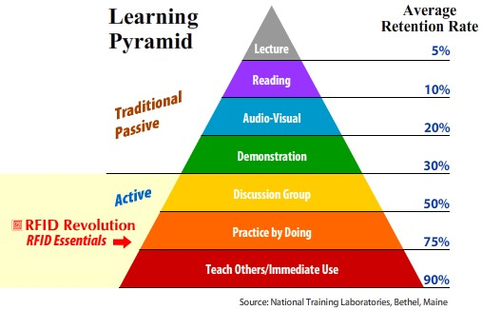

Slide 2
THROUGH THE BIBLE IN 2018
LESSON 2
WEEK 2 OF 52
(Job 16-40)
Last time we saw Satan appear before God to accuse Job of loving God only
because of the blessings he had received from God. Satan believed that
relationship would quickly dissipate once those blessings were removed.
God permitted the test to take place only that Job’s life would be spared.
Then Satan attacked:
Satan’s 1st assault
Satan’s assault begins when Job’s children are feasting in the house of the eldest brother.
This beginning assault is by human cause: Sabeans – stole 1,000 oxen and 500 donkeys, and
slaughtered servants (1:13-16).
Satan’s 2nd assault
Satan’s next attack is by natural cause: a fire from heaven (1Kg. 18:38) [lightening], caused a
tremendous fire which burned up the 7,000 sheep and the servants (1:16).
Satan’s 3rd assault
This attack was again by human cause: The Chaldeans from 3 sides attacked and stole 3,000
camels and killed more servants (1:17).

Slide 3
Satan’s 4th assault
Satan’s next attack was again of the ‘natural’ kind: What appears to be a tornado like whirlwind from the nearby Arabian desert, destroys the house killing Job’s children (1:18,19).
In a short period of time through both human and natural causes, all of Job’s livestock had been stolen, his servants slaughtered, and his children killed. Job’s life had been turned upside down and he was helpless to stop it or understand why. What would he do? WHAT WOULD YOU DO?
The Permissive Will of God
As we have learned, God did not create evil, but because of free will He permitted it to exist.
When Lucifer ‘willed’ to be like God (Isa. 14:14), he introduced sin into creation, and into man (Rom. 5:12). In the Book of Job, we see the permissive will of God at work. The goodness of
God would not lead Him [God] to cause man to suffer for suffering’s sake, but out of suffering
we can see good come about (Rom. 8:28). Job will be stronger and closer to God at the end
than the beginning. He will be purged with fire, causing him to be destroyed or shine brighter.
Satan’s role – Satan does has a role in God’s big picture. God did not cause Satan to fall, but God will use him to carry out His plans & purposes. Satan’s evil, accusatory nature leads him to cause strife within God’s creation, and God has permitted him to have a limited amount of power…

Slide 4
… and purpose (Lk. 4:6,7; Eph. 2:2; 2Cor. 4:4). But, God uses that strife in the believer’s life to make him [believer] stronger. God chastens those he loves (Heb. 12:6), and because the devil is so willing to participate, God will permit him a degree of limited & temporary success. While some of life’s trials & tribulations are instigated by God [especially under the Old Covenant], most are instigated by Satan.
Examples?
God’s judgments against Israel (Deut. 28:15) – Instigated by God or Satan?
Paul’s ‘thorn in the flesh’ (2Cor. 12:7) - Instigated by God or Satan?
The death of a young person (Job 1:19) – Instigated by God or Satan?
The attack on the World Trade Center (2Tim. 3:13) – Instigated by God or Satan?
In these examples where Satan’s will is to maim and destroy, God is always present and trying to bring something good out of something bad (Rom. 8:28). Satan intends one thing – God another, and it is always God’s will which ultimately prevails.
Satan is used of God as messenger of destruction, but in the end Job’s faith is stronger and his blessings greater than when he began. We should pray that God gives us the grace to receive these trials & tribulations as lessons of God for our betterment, and not of God’s punishment.

Slide 5
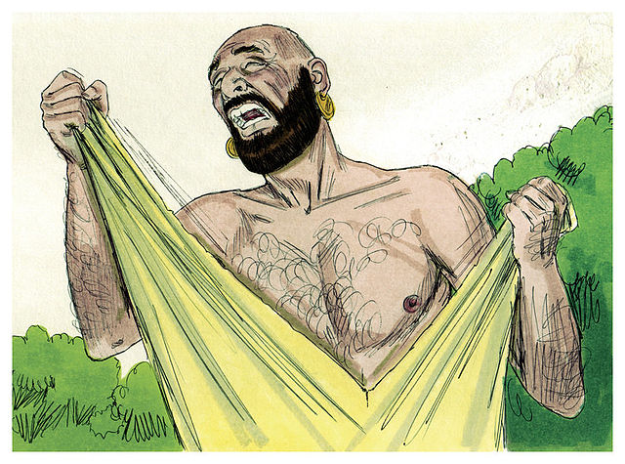
JOB’S REACTION TO BAD NEWS
What questions do you suppose went around in Job’s head? Why me, Lord? Why is all of this happening to me? Are you angry with me, God? Have I not pleased you in some way? Is there some hidden sin in my life? Some lack of worship? Why, God, Why?
Unbelievably, after losing his children and all his sources of wealth, and with it his status as the greatest man in the east, Job worshiped God (1:20).
These pre-Hebrew & Hebrew rituals were classic examples of mourning and total submission to God: renting one’s clothing [shock & mourning] (Gen. 37:29,34; Isa. 37:1; Ezek. 9:3); shaving one’s hair [loss of personal glory] (Isa. 15:2; Jer. 41:5); falling to the ground [not in suffering, but in total submission to God] (Josh. 7:6).

Slide 6
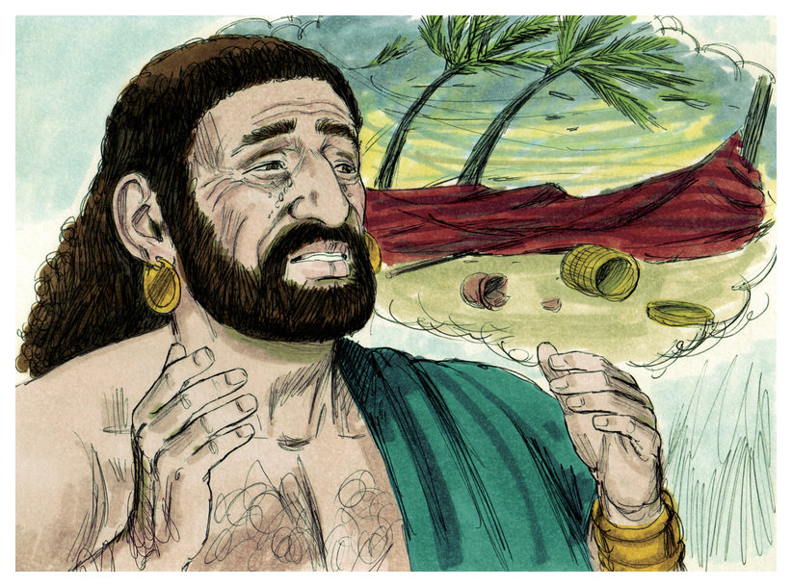
His first thoughts were that this overwhelming loss in his life was somehow parallel to his birth and yet future death. He was naked at birth and will also be at the time of his death (1:21a). At this present time, he also felt very naked [vulnerable] before the Creator and the whole creation.
As every believer should, Job also recognized God’s sovereignty—God gives man life, and one day will end his life, but in all things he blessed God (1:12b).
For all of this, Job praised God! This is truly remarkable that after all the adversity Job has experienced, he is able to give God adoration.
He turns his woe into worship. At this point in time, who is winning as part of the original agreement – God or Satan?

Slide 7
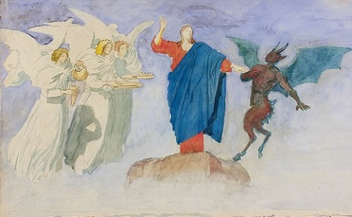
Satan has so far failed to rattle Job. Despite his tremendous onslaught of death and destruction, Job never lost faith.
This concept must be learned in any age by every true believer – that God is Sovereign over his creation and we can only accept God’s rule while not always understanding every aspect of it. We are to love and honor God during bad times as well as good trusting that ‘all things are being worked out for good to them that love God’ (Rom. 8:28).
The scene shifts one more time from earth to heaven, and Satan again shows up to converse with God (2:1-5). This time he turns the screws tighter by desiring to attack Job himself. He asserts that many will allow their family and fortune to be destroyed but when it comes to his own skin, he will do anything to protect it including cursing God.

Slide 8
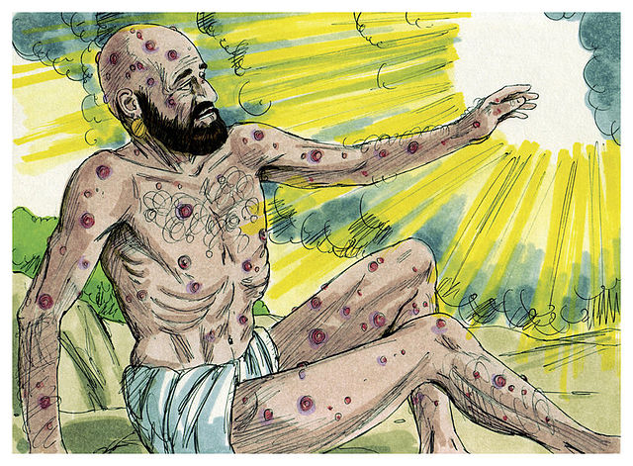
The hedge of protection has been removed from Job’s family and wealth, but now it is about to stripped from
his person. God will allow Satan to inflict his body with disease from head to foot. As before, Satan is not permitted to take Job’s life. Why? There would be no
way to assess Job’s faithfulness if he were killed. The scene shifts again from heaven to earth as we see Job afflicted with a severe case of the boils or painful open
skin sores all over his body. Also included were:
Inflamed ulcerous sores (2:7); itching (2:8); degenerative changes in facial skin (2:7,12); loss of appetite (3:24); depression (3:24,25); loss of strength (6:11); worms (7:5); weeping sores (7:5); difficulty in breathing (9:18); darkness under the eyes (16:16); foul breath (19:17); weight loss (19:20; 33:21); chronic pain (30:17); restlessness (30:27); blackened skin, peeling skin, and fever (30:30).

Slide 9
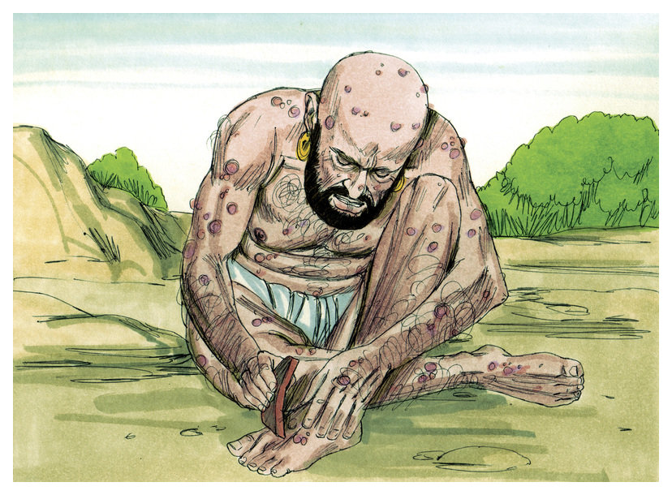
The next scene on earth finds Job sitting on a garbage or dung heap outside the city.
Poor Job!
“So went Satan forth from the presence of the LORD, and smote Job with sore boils from the sole of his feet unto his crown. And he took him a potsherd to scrape himself withal; and he sat down among the ashes” (2:7,8).
Once the most important and respected man
in the area now sits in a heap of garbage, scratching his inflicted skin with a piece of broken pottery!
Previously, the wealthiest man in the area, a judge & counselor of men, now a humiliating scourge of society – a piece of garbage.

Slide 10
Current Spiritual Implications:
This is a good place to pause and to reflect on what we have learned so far from Job and can
apply to our lives:
We are born with nothing and we will die with nothing (physically)
Job believed in and trusted God for who He was, and everything he received (children, wealth, position) was a gift or loan from God. He learned that as quickly as God gave it, God could take
it away for reasons he did not understand. These things were not Job’s but God’s.
Man’s tendency is to blame someone (God) when his goals are frustrated, and his will (man’s)
not accomplished. What we can learn from Job is that man’s will sometimes clashes with God’s will, and we must always give way to God’s will (Isa. 55:9, God’s ways are above our ways).
Consider all good things from God as temporal blessings (family, friends, home, wealth,
position).
Occasionally dwell on the fact of what your life would be like if these things were taken away.
Would you be thankful to God you had them for a while, or would you be angry at God that you had them no longer?

Slide 11
As God tested Job (through the messenger of Satan), so did God with Paul (Acts 9:16). How did Paul suffer for Christ? Prison bars, blindness, hunger/thirst, physical beatings, betrayal of his friends, just to name a few. What did Paul (and we should) believe about this suffering? Paul considered his losses but DUNG compared to how much he had gained in Christ (Phil. 3:7-11).
Today we want to know WHY? Job & Paul didn’t know why, but yet trusted God with their lives.
Job’s wife told him to ‘curse God and die’ (2:9). Why did she say it? Was she right? No. His response is that it would be wrong to only follow God when things are going well and reject Him when adversity appears (2:10). Job firmly believed that God was sovereign over all things, even times when God permits Satan to carry out his destructive forces.
Job was an extraordinary man. Despite the loss of his family, wealth, position, and apparent support of his wife, his faith stood up to the worst possible onslaught of the devil, and his relationship with God was unshakable.
Job actions vindicated God and proved that Satan was wrong in his assessment of Job’s faith.
Although he may continue to work from behind the scenes, Satan must have known he was defeated and does not appear again in the remainder of the story of Job.

Slide 12
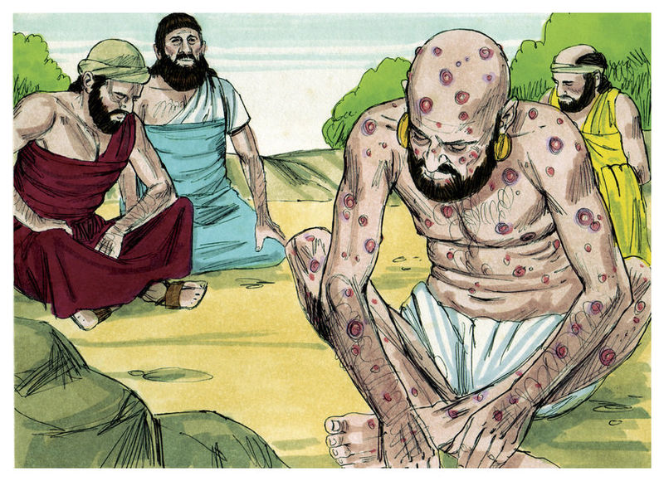
Spiritual lesson – most people (many Christians) believe that when trouble comes, God is either angry at the individual or that He has turned His back on them. The Book of Job rejects that notion, and teaches us that God uses Satan as an instrument of evil to test man’s faith to see how deep the conviction really is.
Next Job’s three closest friends come to comfort and mourn with him. Their interaction with Job composes the largest section of the book (2:11-37:24). Evidently some time has elapsed before the arrival of the friends, and we begin to see a change in Job’s frame of mind.
One of steadfast faith begins to give way to self pity and the thought that God may have treated him unfairly.
Though Job’s friends came with a sincere heart and meant to comfort a hurting friend (2:11), their positive attitude quickly turned to one of reproach & criticism.

Slide 13
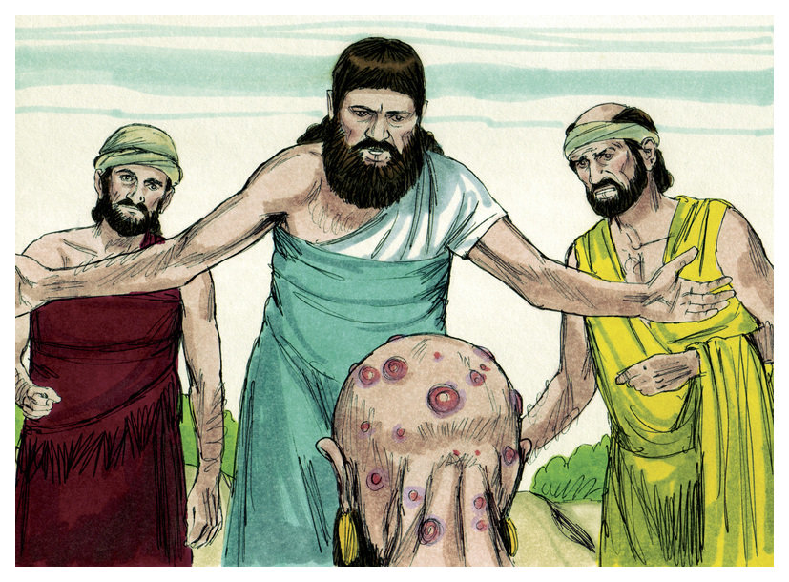
The study of Job’s friends will gain us much fruitful information as to how NOT to conduct ourselves in the face of someone who is suffering. We will learn what NOT to say to someone who is grieving.
What Job needed was empathy, compassion, and understanding; what he got was judgment, condescension, and condemnation. They drew on their own life experiences rather than applying
solid godly truths.
Their love and understanding for their friend quickly gave way to fault finding as they start preaching to Job rather than listening to a hurting man. They made the mistake of believing they knew exactly
what God was doing with Job when, in fact, they knew nothing of the sort.
Job needed love – from them he got attitude.

Slide 14
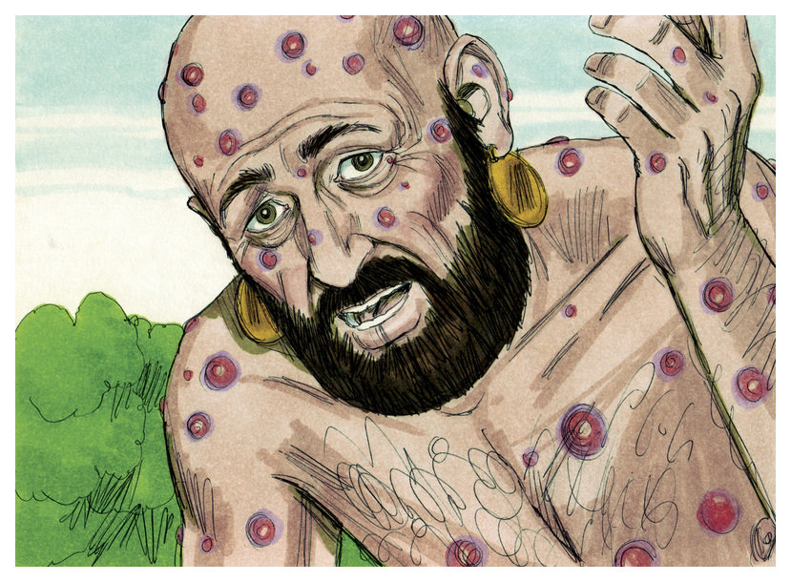
After 7 days of silence, Job respond to his friends (3:1,2). His previously undaunted positive attitude now gives way to bitterness and self pity. Why?
It would appear that after some period of time reality has set in. Job’s circumstances are not a bad dream from which he can wake up. In a study of Death & Dying the first reaction to a traumatic event is often SHOCK! The events have finally caught up with Job and he can’t believe it. As a consequence, Job’s mind tries to compensate for this trauma by going through several stages, the 1st is denial.
Job reasons that this would not be happening at all if had never been born (3:3). Emotionally, Job (and others who experience sudden traumatic experiences) feels isolated from life and totally alone. It is often during this time that outbursts of anguish, despair, and heartache come pouring out. It is a cry for help. The overwhelming emotion is one of total aloneness.

Slide 15
Notice what Job doesn’t do – he doesn’t curse God, but rather curses himself and the day he was born (“Cursed be the day I was born: let not the day my mother bare me be blessed” (Jer. 20:14-18). Do some people ask God to die? Yes. What should we say vs. not say to them?
We can make matters worse by saying the wrong things to an emotionally traumatized person.
The friends response.
Eliphaz (and the friends to follow) falsely conclude that those who are righteous ought to expect uninterrupted blessings & prosperity from God while evil doers are bound to undergo suffering. If that be the case then those like Abel (martyred by his brother), David (fled the persecution of Saul), Isaiah (believed to have been sawed in half), Jeremiah (placed in a dungeon), and Daniel (thrown into a lion’s den & fiery furnace), and all of the apostles including Paul, should be viewed as evil does because all suffered terrible persecution.
Unfortunately, today many teach & preach that same incorrect, HEALTH & WEALTH (Prosperity) theology, and then when it fails [as it often does], it brings shame, guilt, and defeat as one hasn’t enough faith to succeed in life much less to please God.
Don’t believe it!
Suffering can be used of God to make us stronger and draw us closer to our Lord & Savior.

Slide 16
Notice that Job’s tone begins to change as he begins to speak. What mood change is coming? What punctuation mark do you see after Job 6:2,8,9,25? It appears that Job is beginning to enter into the 2nd stage of grief which is anger.
From the standpoint of grief/trauma, Job seems to be normal in the display of emotions and conduct during this terribly difficult time in his life. The loss of his children, fortune, position in life, and health would have most certainly been a great shock to him. A feeling of overwhelming isolation must have set in when he found himself sitting on a garbage heap all alone. Job manifested a typical reaction of denial by wishing he had never been conceived, all aspects of the 1st stage of grief = shock—denial.
After rather calmly receiving bad news, and receiving little if any emotional support from his wife and friends, but instead judgmentalism condescension, and criticism, Job enters into the 2nd stage = anger. He begins to vent [others bottle it up] these feelings but receives little support.
Quickly his anger seems to plummet into full blow depression – the 3rd stage of grief.
“Man that is born of a woman is of few days, and full of trouble… cut down like a faded flower…” (14:1,2). Job laments what a sad and brief life man has on this earth, and then there is the grave. What stage of grief does it appear that Job cannot get out of?

Slide 17
“Oh that thou wouldest hide me in the grave... If a man die, shall he live again? all the days of
my appointed time...” (14:13-15). This passage seems to ask about eternal life. What does Job
think about eternal life? Does Job think it he will live again after this present life is finished
(19:25)? How does that compare with us (2Cor. 5:8; Eph. 2:6,7)?
What are a few things we can learn from the friends mistakes? They believed Job evil when he
wasn’t; They believed Job had lost favor with God, when he had not; They reckoned wrongly that
God was punishing Job for some sin; They brought him more misery than comfort through their
false accusations; They failed to live out a foundational principle of any relationship with God –
to treat others as you would be treated (golden rule); They were wrong in their basic theology
that God categorically blesses the righteous and condemns the wicked. No righteous person
should expect to live a life without tribulation in it—in Job’s day or any day (Mt. 5:45); Job asked
for mercy from his friends, but they turned a cold shoulder to him; Though Job was a righteous
man before God, the friends pushed him dangerously close to bringing charges of unfairness
against God. A question – Are you helping God or hurting God with the life you are living?
That leads us to the last stage of grief = acceptance. Job came to accept things in his life when
God spoke to him! (But, don’t expect God to speak to you—now, God speaks to us through His
instruction manual – the Bible).

Slide 18
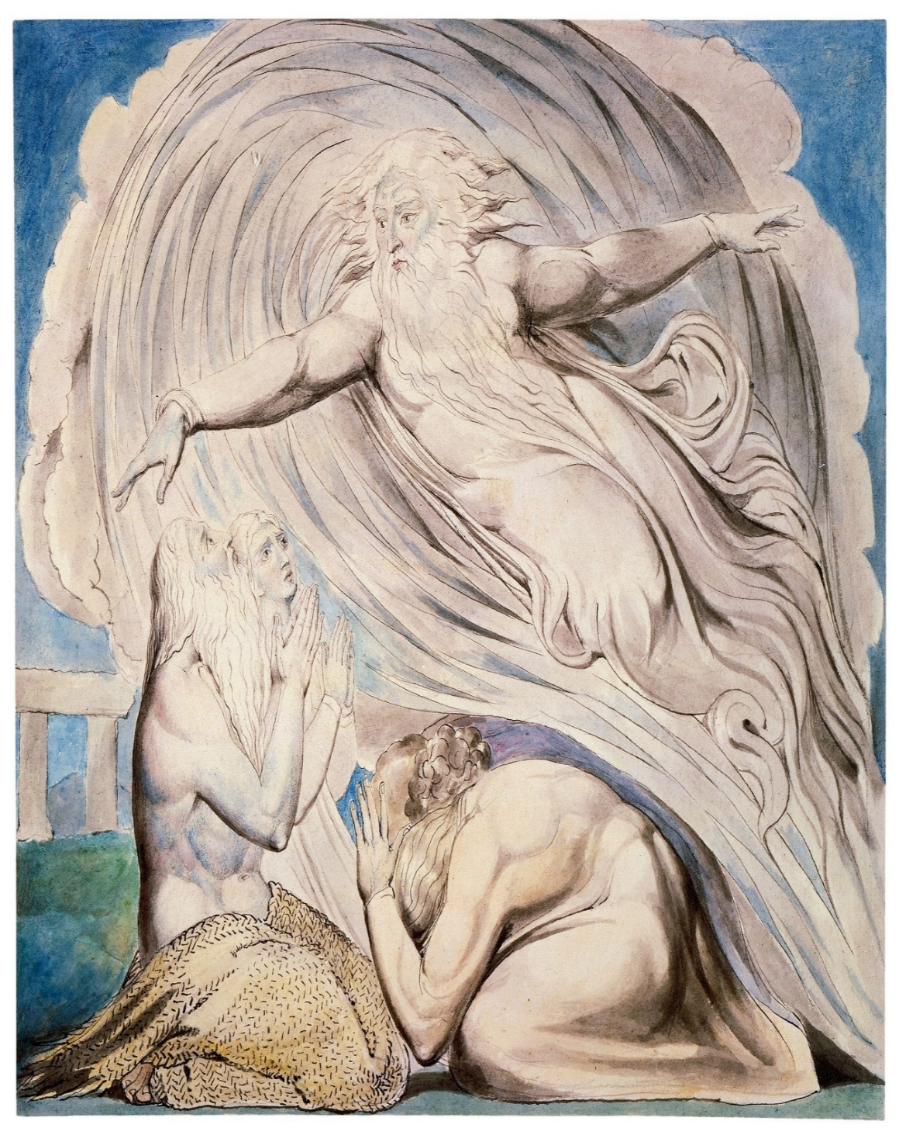
The last part of the Book of Job is the interaction between God and Job:
Ch. 38:1 –40:2 = God’s 1st address
Ch. 40:3-5 = Job’s 1st answer
Ch. 40:6-41:34 = God’s 2nd address
Ch. 40:1-6 = Job’s 2nd answer
God answers Job in a whirlwind (38:1,2)—
WHO IS THIS THAT QUESTIONS MY WISDOM
WITH SUCH IGNORANCE??!!
Here God tells Job who He is—The Creator & Sustainer of all things and He doesn’t suffer fools gladly!
Next to Him, Job was nothing, and therein is the message to mankind. God is God and mankind is but part of His creation, an important part, but nonetheless without Him we would still be “the dust of the earth.” God continues…

Slide 19
“Gird up thy loins like man; for I will demand of
thee, and answer thou me” (38:3).
Annoyed, God lambasts Job with a series of rhetorical questions –
“Where were you when I laid the foundations of the earth? declare, if thou have understanding… laid the measures… who hath stretched the line… who laid
the cornerstone… when the morning stars sang together, and all the sons of God shouted for joy… or shut up the sea… when I made the cloud…” (38:4-9).
God continues – “Have the gates of death been opened unto thee?... where light dwelleth… entered into the treasures of the snow… hail… hath rain a father? Or who hath begotten the drops of dew?” (38:17-28).
What would you do if God spoke to you like that?

Slide 20
Here’s what Job did –
“Then Job answered the LORD, and said, I am vile; what shall I answer thee? I will lay mine hand upon my mouth” (40:3,4).
Having gained tremendous insight into His creative power, genius, sovereign and providential control, and love over everything, Job confesses his own unworthiness and lack of knowledge.
Job accepts that God was right! He, nor any other human being has the wisdom to question, much less condemn God for being unfair!
Job realizes how arrogant it was to question God’s ability to rule the universe that He alone created. Job now knows that anything he knew of God and creation had come only by hearing (oral tradition). He had not been an eye witness to such events nor has any of mankind.

Slide 21
Job, like all mankind, has to be satisfied with having only a 2nd hand and therefore limited knowledge of what God has done.
Seeing Him face to face changed every thing and deepened Job’s reverence and awe inspiring regard
for God.
Job was wrong in some of his thoughts of God (not
all those concerning his friends because the trials & tribulations were not caused by some hidden sin),
and says…
“I’m sorry” (42:6) and God undoubtedly forgave him.
Job humbled himself before God, was repentant and sorry for what he said and took back the accusations he made to God in pride. Job’s response should be a life lesson for all of us.

Slide 22
The Epilogue – God’s final decree on the three critics of Job, and finally, Job himself.
God directs his anger at the three friends, “My wrath is kindled against thee, and against thy two friends: for ye have not spoken of the thing that is right, as my servant Job hath” (42:7). Why? Because they limited God’s sovereign ability to use suffering for purposes of spiritual growth of
Job and to inform readers since of the dynamics between God and Satan.
The result was that they had cruelly condemned innocent Job. How was Job right before God? Had Job not questioned the unjustness of God? Yes, but he never went so far as to curse God,
as Satan had predicted he would do (1:11; 2:5,9). And, to his credit, Job repented of his sin of
pride which was accepted by God (42:6,7).
The three were given instructions by God to atone for their sin (42:8). Never before had the
three even prayed for Job. Job had longed for a mediator between he and God (16:19-21),
and ironically, Job was now interceding for them!
Job’s repentance, mediation and forgiving spirit by helping his friends to be restored to God,
paved the way for God’s restoration of Job. It appears that Job’s disease had been healed, his wealth reinstated, as well as he being reunited with his remaining family (42:10-17).
Next time – The conclusion of the Book of Job & what it means to us, but one last thing…

Slide 23
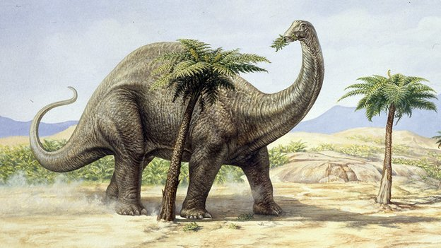
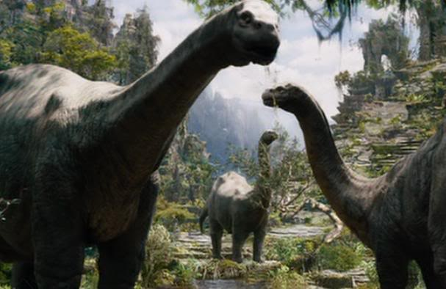
DINOSAURS
“Behold now behemoth, which I made with thee; he eateth grass as an ox… his strength is in his loins… He moveth his
tail like a cedar… His bones are like bars of iron. He is the chief of the ways of God: he that made him can make his sword to approach unto him” (40:15-19).
Here God tells us of His creation of the dinosaurs [a term not coined until the 1860’s from a British scientist], which occurred on day 6 of creation along
with man.
As He had the omnipotence to create
behemoth, He can also bring about His extinction for reasons God has not revealed.
Behemoth is a dinosaur, a dinosaur is he. He eateth grass as an ox, his tail like a cedar tree. His bones are strong as bars of iron, he’s chief in the ways of God. Behemoth is a dinosaur, a mighty sauropod.
Let’s look in the Bible, let’s look in the book of Job. Turn to chapter 40, in verse 15 we’re told. All the mighty creatures that Job must have known, in the jungle of the region where behemoth made his home.
(Chorus)
Some say behemoth is nothing more than this. An elephant or a hippo, but I don’t think it fits. Because they don’t have a tail like a cedar tree. Behemoth seems much more like a dinosaur to me.
(Chorus)
Written by Buddy Davis, Creation Museum

