Slide 1
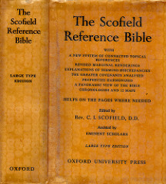
THROUGH THE BIBLE IN 2018
LESSON 27
WEEK 27 OF 52
(2Kg.1-15; Jonah)
Last time we saw a series of mostly evil kings rule the two kingdoms; this time the ministry of the prophets Elisha and Jonah
2KINGS –
“This book continues the history of the [2] kingdoms to the captivities. It includes the translation of Elijah and the ministry of Elisha. During this period Amos and Hosea prophesied in Israel, and Obadiah, Joel, Isaiah, Micah, Nahum, Habakkuk, Zephaniah, and Jeremiah in Judah… the events recorded in 2Kings cover a period of 308 years [896-588 B.C. (Ussher’s dates)]” – Old Scofield, p. 421.

Slide 2
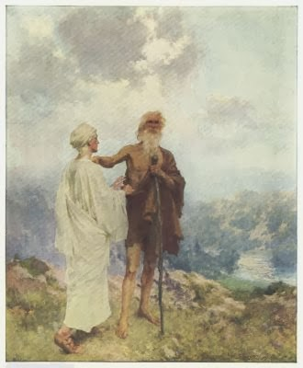
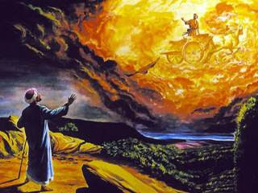
ELIJAH’S TRANSLATION
“And it came to pass, when the LORD would take Elijah into heaven by a whirlwind, that Elijah went with Elisha from Gilgal” (2Kg. 2:1).
Elijah, the 2nd person to be translated to heaven without death,
Enoch 1st (Gen. 5:24), but before he left, he turned to Elisha –
“… Elijah [mentor] said to Elisha [student], Ask what I shall do
for thee, before I be taken away from thee. And Elisha said, I
pray thee, let a double portion of thy spirit be upon me. And he
said, Thou hast asked a hard thing… if thou see me when I am
taken from thee [sign], it shall be so unto thee… And it came to
pass, as they still went on, and talked, that, behold, there
appeared a chariot of fire, and horses of fire… and Elijah went
up by a whirlwind into heaven [sign]. And Elisha saw it… and
took up the mantle of Elijah that fell from him… the spirit of
Elijah doth rest on Elisha…” (2:9-15).
God gave Elisha a sign that his request was granted – “For the Jews require a sign” (1Cor. 1:22).

Slide 3
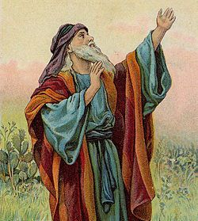
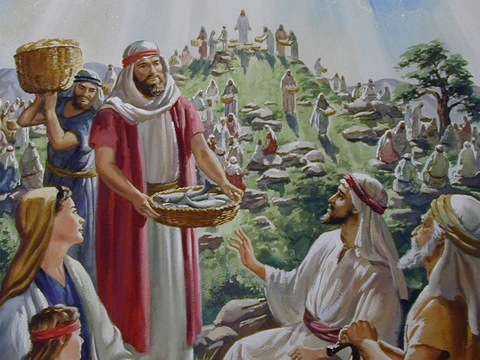
ELISHA’S ANNOINTING
“And he took the mantle of Elijah that fell from him, and went back, and stood by the bank of Jordan… smote the waters… they parted hither… and Elisha went over” (2:13,14).
Elisha would continue in the footsteps of Elijah, having been chosen of God and empowered by the Holy Spirit evidenced by his parting of the waters like Moses.
ELISHA’S MIRACULOUS FEEDING
“And there came a man from Baal-shalisha, and brought [Elisha] bread of the firstfruits, [20] loaves of barley, and full ears of corn in the husk… Give unto the people, that they may eat… He said again, Give the people, that they may eat: for thus saith the LORD, They shall eat, and shall leave thereof…” (4:42-44).
Elisha’s miracle foreshadowed that of Christ’s feeding the multitudes with food left over (Jn. 6:1-13).

Slide 4
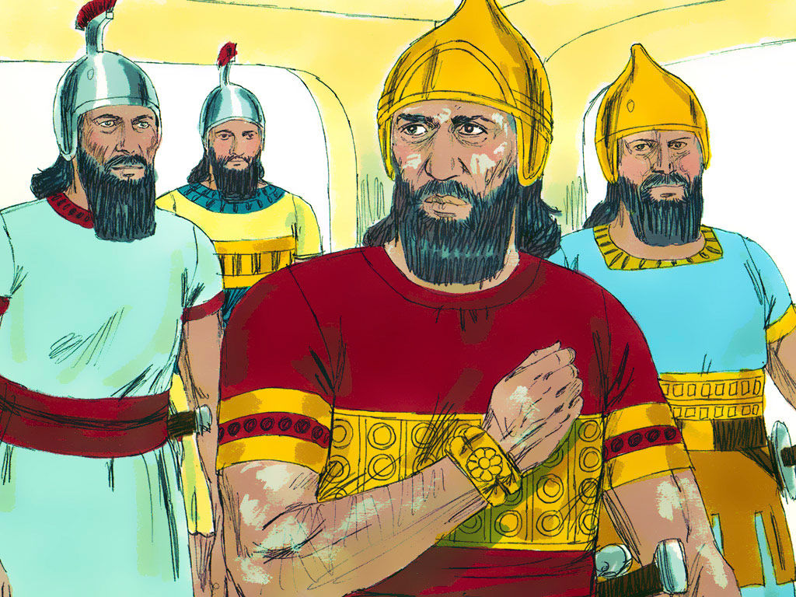
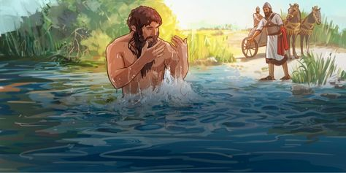
HEALING OF NAAMAN
“Now Naaman, captain of the host of the king of Syria, was a great man with his master, and honourable, because by him the LORD had given deliverance unto Syria: he was also a mighty man in valour, but he was a leper” (5:1).
Elisha’s ministry was now reaching beyond Israel, as he healed a godly man of Syria, who had leprosy.
“So Naaman came with his horses and with his chariot, and stood at the door of the house of Elisha. And Elisha sent a messenger unto him, saying, Go and wash in Jordan [7] times… and thou shall be clean… dipped himself [7] times… his flesh came again like unto the flesh of a little child… I know there is no God in all the earth, but in Israel” (5:9-16).
Naaman, one of few believing Gentiles at the time, was healed by faith in the God of Israel.

Slide 5
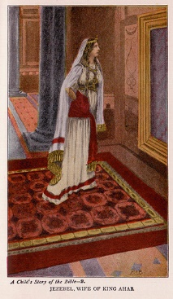
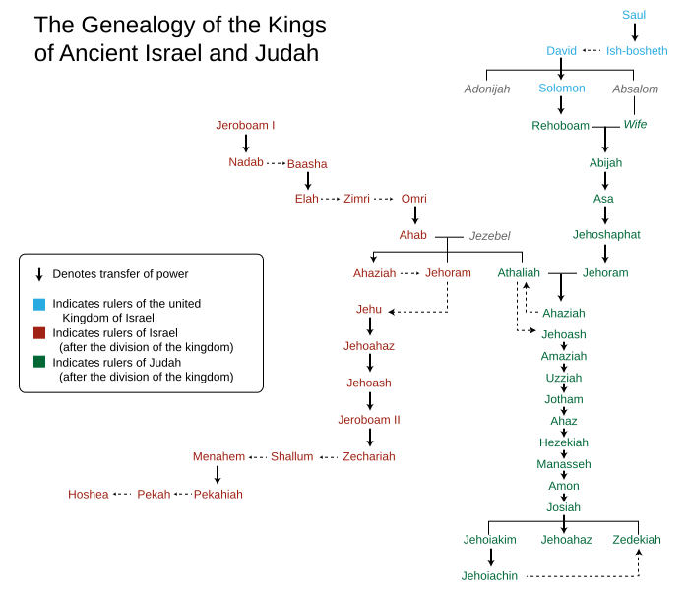
KING JEHU
The series of evil kings continued in the northern kingdom [Israel]. Next Jehu killed Jehoram and took the throne in 841 B.C. Why? Because Jehoram was an idol worshipper –
“And Jehu drew a bow with his full strength, and smote Jehoram…” (9:24).
The killing rampage continued –
“But when Ahaziah the king of Judah saw this, he fled… And Jehu followed after him, and said, Smite him also… And they did… he fled to Megiddo, and died there. And his servants carried him in a chariot to Jerusalem, and buried him in his sepulcher with his fathers in the city of David” (9:27,28).
Still more killing as Jehu found Jezebel, had her cast
out a window, fulfilling a prophesy of Elijah, “shall dogs eat the flesh of Jezebel” (9:36).

Slide 6
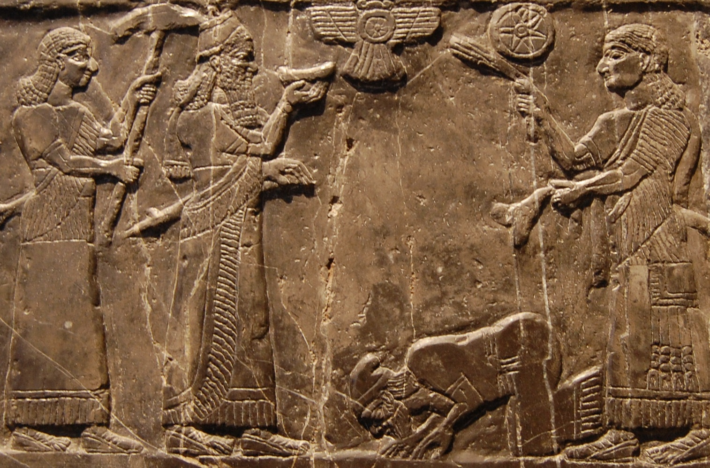
JEHU’S RAMPAGE CONTINUES
Not content to dethrone two kings, Jehu set about to plot the executions of the remaining [70] descendants of King Ahab –
“And Ahab had [70 surviving relatives] in Samaria… slew [70] persons, and put their heads in baskets, and sent him them to Jezreel… lay them in 2 heaps at the entering in of the gate… so Jehu slew all that remained of the house of Ahab in Jezreel, and all his great men, and his kinsfolks, and his priests, until he left him none remaining” (10:1,7,11).
The destruction of the house of Ahab fulfilled the prophesy against the evil king –
“Behold, I will bring evil upon thee, and will take away thy posterity…” (1Kg. 21:21).
God did what He said He was going to do.

Slide 7
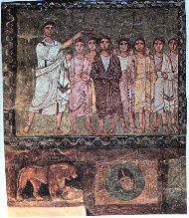
Next Jehu met some relatives of the deceased King Ahaziah
[Judah], who had been in Jerusalem visiting with family. When
he asked who they were –
“Jehu met with the brethren of Ahaziah king of Judah, and said,
Who are ye? And they answered, We are the brethren of
Ahaziah; and we go down to salute the children of the king and
queen” (10:13).
When he found out who they were, he put them to death. Not
only did Jehu kill two kings, Jezebel, and 70 members of Ahab’s
family [Israel], he then executed family members of the dead
king of Judah. Why?
He was ridding the land of apostates as called for since Moses –
“… [if ye] go and serve other gods [brother, son, daughter, wife, friend]… not consent unto him, nor hearken to him… nor pity him… spare… conceal… but thou shalt surely kill him… stone him with stones, that he die” (Deut. 13:6-10). What’s worse? Killing an idol worshipper or allowing him [her] to cause many others to spend eternity in hell? Under the Old Covenant, the latter.

Slide 8
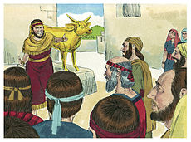
DESTRUCTION OF BAAL
“Now therefore call unto me [king Jehu] all the prophets of Baal, all his servants, and all his priests: for I have a great sacrifice to do to Baal… but Jehu did it in subtilty, to the intent that he might destroy the worshippers of Baal… And Jehu sent through all Israel: and all the worshippers of Baal, came… into the house of Baal… go in and slay them; let none come forth. And they smote them with the edge of the sword… Thus Jehu destroyed Baal out of Israel…” (10:19-28).
Jehu pretended to be a Baal worshipper in order to entice all the Baal worshippers in Israel [northern kingdom] to gather for a gigantic sacrifice. They did and he killed them all as the Law of Moses required.

Slide 9
“And the LORD said unto Jehu, Because thou hast done well… in my eyes… thy children of the 4th generation shall sit on the throne of Israel” (10:19-30).
Jehoahaz, Jehoash, Jeroboam II, and Zechariah would all rule the northern kingdom [Israel] as descendants
of King Jehu. Just when it looked like the northern kingdom finally had a godly king –
“But Jehu took no heed to walk in the law of the LORD God of Israel with all his heart (10:31)… And Jehu slept with his fathers: and they buried him in Samaria. And Jehoahaz his son reigned in his stead. And the time that Jehu reigned over Israel in Samaria was [28] years” [842-814 B.C.] (10:35,36).
In the end, he failed God by rejecting the essence of the Law of Moses, but God would honor his promise to put 4-generations on the throne of Israel. Will they be good or evil kings?

Slide 10
NEXT SERIES OF KINGS
On Judah’s throne, Ahaziah succeeded Jehoram [given an incurable disease of the bowels (2Chron. 21:18)], who also did evil (22:4), and was then killed by Jehu (22:9). Athaliah (Ahaziah’s wicked mother & daughter of Jezebel) had all the royal family of Judah killed. With no males remaining except for an infant [Jehoash], who was hid for 6-years (22:12), she ruled Judah during that time. But, young Jehoash assumed the throne at age [7] who then had the evil queen put to death (23:15).
Jehoida, high priest under Jehoash, carried out a spiritual reform, broke down the house of Baal, re-established
burnt-offerings to God [Law] – “And Jehoida made a
covenant between him, and between all the people
[Judah]… that they should be the LORD’s people” (23:16).
The 9th century B.C. was a hectic, bloody, evil time but God raised up Jehoida to do His work of keeping Mosaic Law.

Slide 11
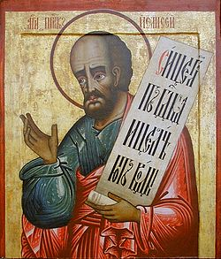
“And the rest of the acts of Jehoash, and all that he did, and his might wherewith he fought against Amaziah king of Judah, are they not written in the book of the chronicles of the kings of Israel? And Jehoash slept with his fathers; and Jeroboam sat upon his throne: and Jehoash was buried in Samaria with the kings of Israel”
(2Kg. 13:12,13).
Remember, the kings of Israel [northern kingdom] will be buried in Samaria, whereas the kings of the southern kingdom [Judah] will always be buried in Jerusalem.
DEATH OF ELISHA
“Now Elisha was fallen sick of his sickness whereof he died (13:14)… And Elisha died, and they buried him…” (13:20).
Elisha died and was buried [unlike Elijah who was translated alive], having served God 55 years
[853-798 B.C.].

Slide 12
“In the 2nd year of Jehoash son of Jehoahaz king of Israel reigned Amaziah the son of Jehoash king of Judah. He was [25] when he began to reign, and reigned [29] years in Jerusalem… And he did that which was right in the sight of the LORD, yet not like David his father: he did according to all things as Jehoash his father did. Howbeit the high places were not taken away: as yet the people did sacrifice and burnt incense on the high places” (2Kg. 14:1-4).
King Amaziah kept the Law of Moses as Israel’s system of worship, but like his father, he did not tear down the pagan worship ‘high places’ like some other kings before him had done. It would cost him as he was attacked by King Jehoash of Israel who breached the wall in Jerusalem and took Amaziah captive, and looted the city, “… he took all the gold and silver, and all the vessels that were found in the house of the LORD… the king’s house…” (14:11-14).

Slide 13
“And Jehoash slept with his fathers, and was buried in Samaria with the kings of Israel; and Jeroboam his son reigned in his stead” (2kg. 14:16).
Next Jehoash died and was succeeded by Jeroboam II.
“And Amaziah the son of Jehoash king of Judah… fled to Lachish; but they sent after him… and slew him there. And they brought him on horses; and he was buried at Jerusalem with his fathers in the city of David” (14:17-20).
Amaziah king of Judah was killed and succeeded by his son Azariah [Uzziah], who was 16-years old (14:21).
Jeroboam II reigned [41] years over Israel –
“And he did that which was evil in the sight of the LORD” (14:23,24). He died, and his son Zachariah reigned in his place (14:29).

Slide 14
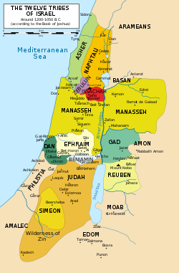
JONAH THE PROPHET
“He [Jeroboam II] restored the coast of Israel from the entering of Hamath unto the sea of the plain, according to the word of the LORD God of Israel, which he spake by the hand of his servant Jonah, the son of Amittai, the prophet, which was of Gather-hepher” (2Kg. 14:25).
Jonah, meaning ‘dove,’ was called of God from a town near Nazareth in the tribe of Zebulun. He lived during the reign of Jeroboam II, the most powerful of all the kings of the northern kingdom [Israel]*, so the story of Jonah took place sometime between [785-744 B.C.]. He was the only prophet who was called but first ran from God. His ministry was referred to by Christ (Mt. 12:41; LK. 11:32), the others: Elijah (Mt. 17:11,12); Elisha (Lk. 4:27); and Isaiah (Mt. 15:7).
*Jeroboam’s grandfather [Jehoahaz] paid tribute to Assyria, but that was now stopped and their territory expanded.

Slide 15
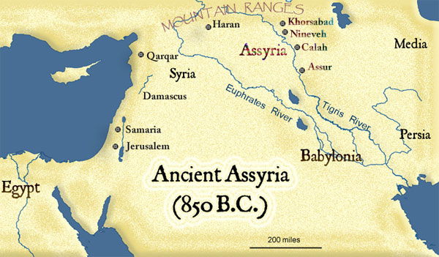
THE SETTING BEHIND JONAH
Assyria lay to the north east of Israel, dating back
to the Genesis account –
“And the sons of Ham; Cush… Canaan… and Cush
begat Nimrod… and the beginning of his kingdom
was Babel… out of that land went forth Asshur [Assyria], and builded Nineveh… the same is a
great [important] city” (Gen. 10:6-12).
Assyria had pagan roots from the beginning as Nimrod began his kingdom [Babel = confusion], which spread north through the fertile crescent
[Mesopotamia], eventually forming the nation of
Assyria with its capital, Nineveh.
During the times of the Kings, Assyria had become
a formidable foe and God would in the future allow Assyria to invade and conquer the northern kingdom because of their continued pagan worship.

Slide 16
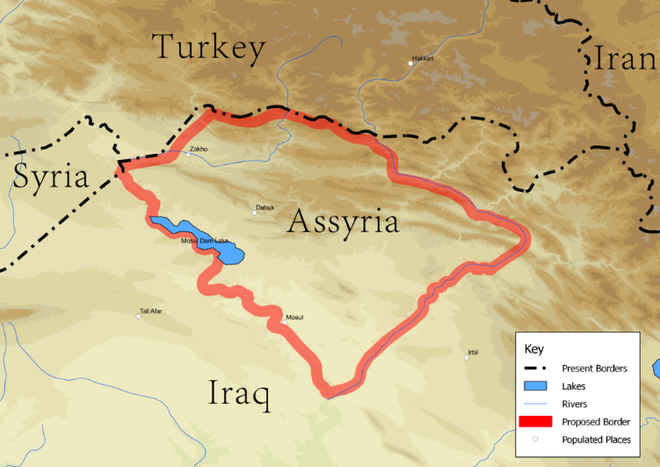
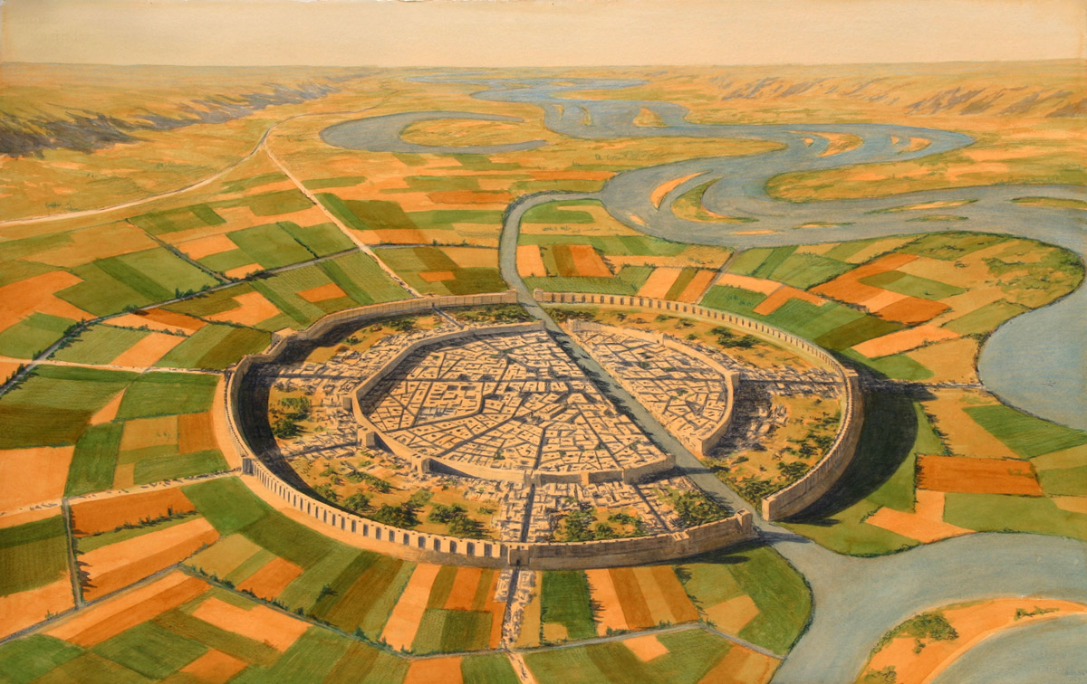
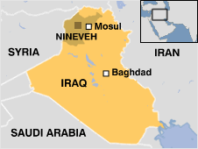
JONAH SENT TO NINEVEH
“Now the word of the LORD came unto Jonah the son of Amittai, saying, Arise and go to Nineveh, that great city, and cry against it; for their wickedness is come up before me” (Jon. 1:1,2).
God sent Jonah to an enemy nation of Israel to condemn it because of its evil. This was not the first time God sent prophets [Elijah and Elisha] outside of Israel. But, this time was different in that he was warning a neighboring [Gentile] nation of his impending judgment on them. Nineveh was located on the bank of the Tigris river, about 550 miles from Samaria, the capital of the northern kingdom [today Nineveh would be in Iraq, near the modern city of Mosel]. The city was surrounded by both an outer and inner wall making it virtually impenetrable for any invading army, but God would find a way to penetrate it.

Slide 17
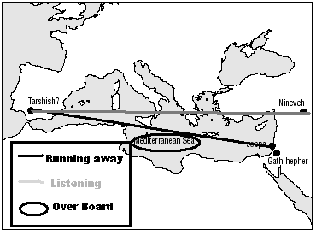
“But Jonah rose up to flee unto Tarshish from the presence of the LORD, and went down to Joppa; and he found a ship going to Tarshish: so he paid the fare thereof, and went down into it, to go with them unto Tarshish from the presence of the LORD” (Jon. 1:3).
Jonah did the opposite of what God wanted—
He went to Joppa [Jaffa] on the coast of Israel and boarded a ship for Tarshish [Spain?].
Next God sent a tempest which threatened the ship (1:4), but Jonah was asleep in the lower deck (1:5). The captain awakened Jonah and told him to call on his god to rescue them (1:6). Jonah was blamed for the storm (1:7) because he told the sailors he was running away from God (1:8-10). Jonah told them to throw him overboard (1:12), which they did (1:15).

Slide 18
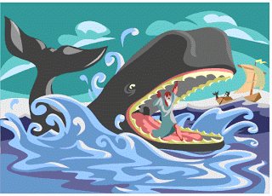
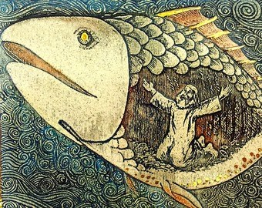
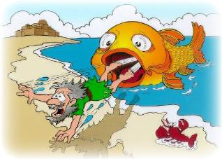
THE GREAT FISH
“Now the LORD had prepared a great fish to swallow up
Jonah. And Jonah was in the belly of the fish three days
and three nights” (Jon. 1:17).
Notice this was all by the hand of God—it was His plan for the
great fish to swallow Jonah, but in exactly 72-hours safely
return him to dry land. This was a type or foreshadow of the
death, burial, and resurrection of Christ.
“Then Jonah prayed unto the LORD his God out of the fish’s
belly (2:1)… waters compassed me… weeds were wrapped
about my head (2:5)… I remembered the LORD: and my prayer
came in unto thee, into thine holy temple (2:7)… Salvation
[protection] is of the LORD (2:9). And the LORD spake unto the
fish, and it vomited out Jonah upon the dry land” (2:10).
“No miracle of Scripture has called forth so much unbelief…” – Old Scofield, p. 944.
But, Christ quoted Jonah (Mt. 12:39,40). Would Christ quote a fable?

Slide 19
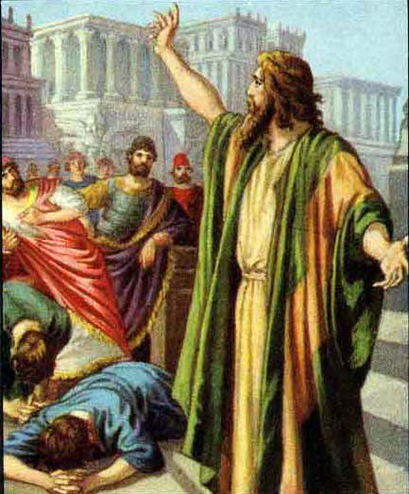
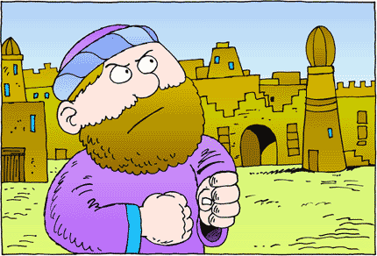
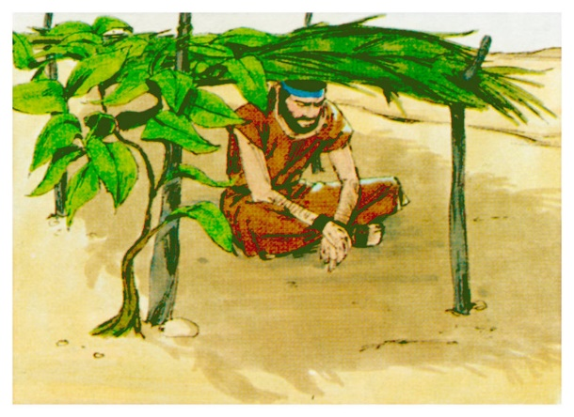
JONAH’S 2ND CHANCE
“And the word of the LORD came unto Jonah the 2nd time,
saying, Arise, go unto Nineveh… preach unto it the
preaching that I bid thee. So Jonah arose, went unto
Nineveh… three days’ journey” (3:1-3).
This time Jonah obeyed God. Though well fortified, Jonah
took his time and within 3-days after he arrived, he had
preached throughout the city, and no one stopped him –
“… and he cried, and said, Yet [40] days, and Nineveh shall
be overthrown” (3:4).
His message was simple; change your evil ways in 40-days
[period of grace] or be destroyed. The result? They repented –
“And God saw their works [sackcloth & ashes], that they turned from their evil way…” (3:10).
Jonah should have been elated when he saw their response, but he wasn’t, “But it displeased Jonah exceedingly, and he was very angry” (Jon. 4:1), sitting in a booth despondent (4:5-8).
How do we explain Jonah’s ungodly and juvenile-like behavior?

Slide 20
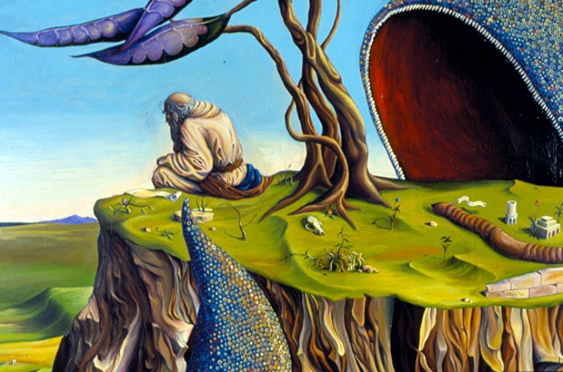
CONCLUSION
Jonah was a type of Israel who wanted Yahweh to be their God,
but no one else's God. Israel will remain in that hard-hearted
state until their spiritual ‘heart transplant’ (Ezek. 36:26) at the
beginning of the millennial kingdom, and then be a beacon to
all nations. The gourd & the worm? Jonah cared more his own
physical comfort than the eternal fate of all the citizens of
Nineveh (4:6-11), whereas God’s concern is with the spiritual
welfare of all people – “[God] who will have all men to be saved”
(1Tim. 2:4), rather than the physical welfare of a few like Jonah.
Sadly, Nineveh backslid and Assyria would spiral down to become
the most ruthless nation on earth (Nah. 3:1-4), whom God would
use to bring judgment on the northern kingdom.
Why is the reader left hanging? Jonah/Israel should have
embraced the Assyrians after converting Nineveh and further
grounded the nation in the God of Israel. If they had, Assyria would not have back slid nor been in the position that God would use them to destroy Israel—but they didn’t, and the rest is history.

Slide 21
MORE KINGS COME AND GO
Uzziah reigned 52 yr. in Judah (2Kg. 15:1-5) followed by his son Jotham (15:32-38). They were good kings [kept the Law], but bad in that they allowed high places to remain.
Next Zechariah, (15:8,9), Shallum (15:13-15), Manahem (15:16-22), Pekahiah (15:22-24), Pekah (15:27-31), all ruled Israel, but were all evil kings.
BACKGROUND OF GOD’S CHASTISEMENT OF ISRAEL
“And Pul the king of Assyria came against the land, and Menahem gave Pul [1,000] talents of silver [tribute] (15:19)… In the days of Pekah king of Israel came Tiglath-pileser king of Assyria, and took [several cities in the north], and carried them captive to Assyria” (15:29). This was the 1st deportation of Jews of the northern kingdom to Assyria in 733 B.C., as God’s punishment for their continued apostasy.
Next time – God calls more prophets to warn His people

