Slide 1
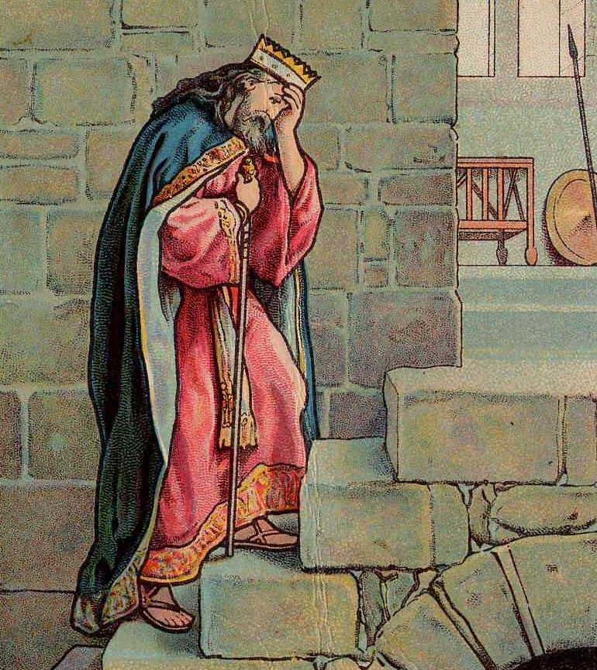
THROUGH THE BIBLE IN 2018
Last time we saw David’s sin
with Bath-sheba. This time
David prays for forgiveness.
LESSON 20
WEEK 20 OF 52
(2Sam.13–21)
“Have mercy upon me, O God, according to thy
loving kindness: according to the multitude of thy
tender mercies blot out my transgression. Wash
me thoroughly from mine iniquity, and cleanse me
from my sin” (Psa. 51:1,2).
Having acknowledged his sin, David throws himself
on the mercy of God and asked for forgiveness but,
lets the reader know that our sin nature has always been with us –
“Behold, I was shapen in iniquity; and in sin did
my mother conceive me” (51:5).

Slide 2
DAVID’S REPENTANCE
“Purge me with hyssop [water holding plant], and I shall
be clean: wash me, and I shall be whiter than snow.
Make me to hear joy and gladness… Hide thy face from
my sins, and blot out all mine iniquities. Create in me a
clean heart, O God: and renew a right spirit within me.
Cast me not away from they presence; and take not thy
holy Spirit from me” (51:7-11).
After the sins of adultery and conspiracy to commit
murder, David’s life was joyless, his heart broken, and
he cried out to God to restore him. Above all he prayed
that God would not remove the Holy Spirit from him.
Why? He knew what devastation came upon Saul when
God withdrew the Holy Spirit from him! David knew this could not be fixed by bringing animal sacrifices (51:16), but the sacrifice of a broken spirit – “The sacrifices of God are a broken spirit:
a broken and contrite [humble] heart…” (51:17). And then, God would accept his “burnt offering… bullocks upon thine alter” (51:19).

Slide 3
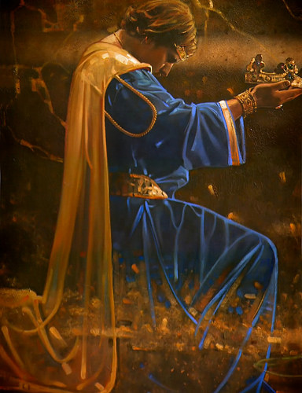
PSALM OF FORGIVENSS
Psalm 51 was David’s request for forgiveness;
Psalm 32 was that forgiveness had been granted –
“Blessed is he whose transgression is forgiven, whose sin is covered. Blessed is the man unto whom the LORD imputeth not iniquity, and in whose spirit there is no guile [deception]… I acknowledge my sin unto thee, and mine iniquity have I not hid. I said, I will confess my transgressions unto the LORD; and thou forgavest the iniquity of my sin” (32:1-5).
David’s joy had returned knowing that his sins had been forgiven [i.e. covered at the present, but totally removed at the time of Christ’s death –
“… to declare his righteousness for the remission of sins that are past, through the forbearance of God” (Rom. 3:25)].

Slide 4
Now that David has been forgiven, he petitioned God to help him remain in a right relationship with Him –
“Bow down thine ear, O LORD, hear me: for I am poor and needy. Preserve my soul… for I cry unto thee daily… For thou, LORD, art good, and ready to forgive; and plenteous in mercy unto all them that call upon thee…” (86:1-5).
Now that David has been re-established in his right relationship with God, his attention turned to the worship system given from God to Israel –
“I was glad when they said unto me, Let us go into
the house of the LORD. Our feet shall stand within thy gates, O Jerusalem… Whither the tribes go up, the tribes of the LORD, unto the testimony of Israel, to give thanks unto the name of the LORD… Pray for the peace of Jerusalem…” (122:1-6).

Slide 5
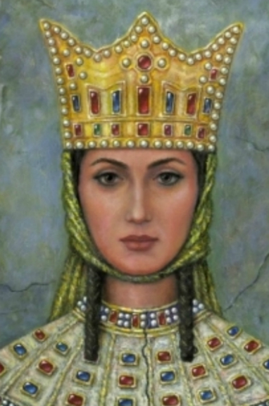
CONSEQUENCES OF SIN
Though God had forgiven David of his sins, the consequences of such would come to haunt him –
“Now therefore hast thou despised the commandment of the LORD, to do evil in his sight? Thou has killed the Hittite with the sword, and hast taken his wife to be thy wife… Now therefore the sword shall never depart from thine house; because thou has despised me…” (2Sam. 12:9,10).
What’s that mean? It means that David would suffer similar tragedies within his own household –
“And it came to pass after this, that Absalom [full brother] the son of David had a fair sister, whose name was Tamar, and Amnon [half-brother] the son of David loved [lusted after] her” (2Sam. 13:1).
The half-brother lusted after his half-sister.

Slide 6
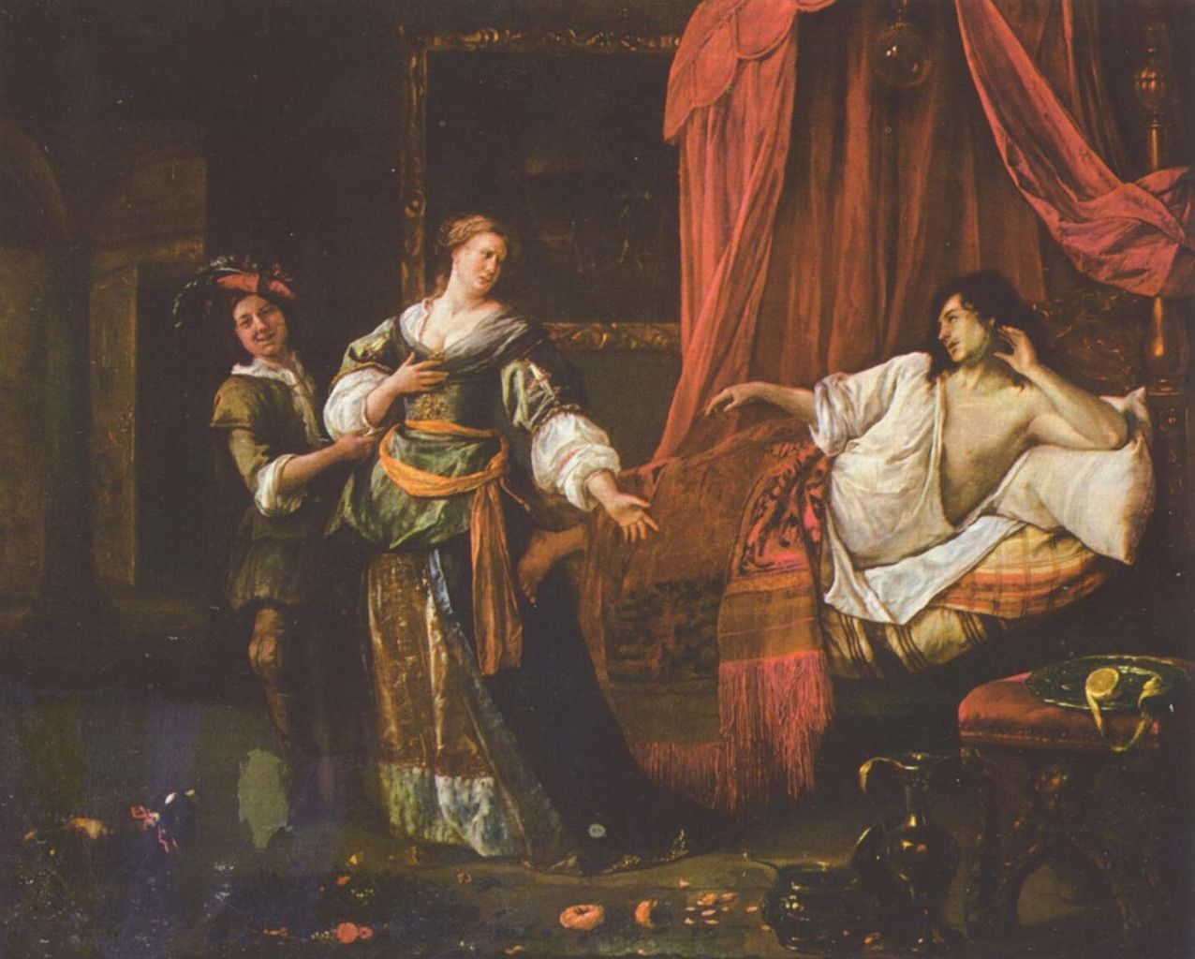
THE SIN OF AMNON
“And Amnon was so vexed, that he fell sick for his sister
Tamar; for she was a virgin; and Amnon thought it hard
for him to do anything to her” (13:2).
Amnon could not think of a way to win the love of his
half-sister so he asked a friend [Jonadab] his advice,
which was to pretend to be sick so that Tamar would
show empathy to him – “Lay thee down on thy bed,
make thyself sick: and when thy father cometh to see
thee, say unto him, I pray thee, let my sister Tamar
come, and give me meat…” (13:3-5). So he did, and
the deception worked—Tamar brought him cakes
(13:6-8), but instead of eating, Amnon promptly
dismissed the other male servants in the room (13:9),
and then –
“… he took hold of her… Come lie with me, my sister”
(13:11).

Slide 7
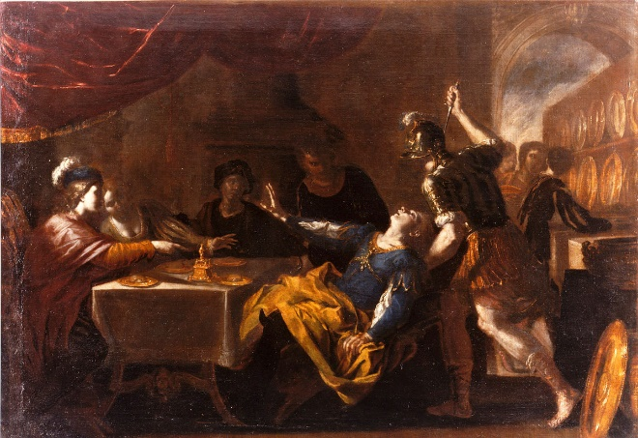
“And she answered him, Nay, my brother, do not force
me; for no such thing ought to be done in Israel: do
not thou this folly” (13:12).
The Law banned incest (Lev. 18:9), and those who did
were to be cut off from their own people (Lev. 20:17).
“Howbeit he would not hearken unto her voice: but,
being stronger than she, forced her, and lay with her”
(13:14).
When Absalom found out about it – “… for Absalom
hated [his half-brother] Amnon, because he had forced
his sister Tamar” (13:22). This will not end well.
“And the servants of Absalom did unto Amnon as…
commanded… and when I say to you, Smite Amnon:
then kill him…” (13:28,29).
After getting him drunk at a party, on a prearranged signal, the servants of Absalom killed Amnon.
An ill advised sexual encounter caused a murder to be committed [the same as David did!].

Slide 8
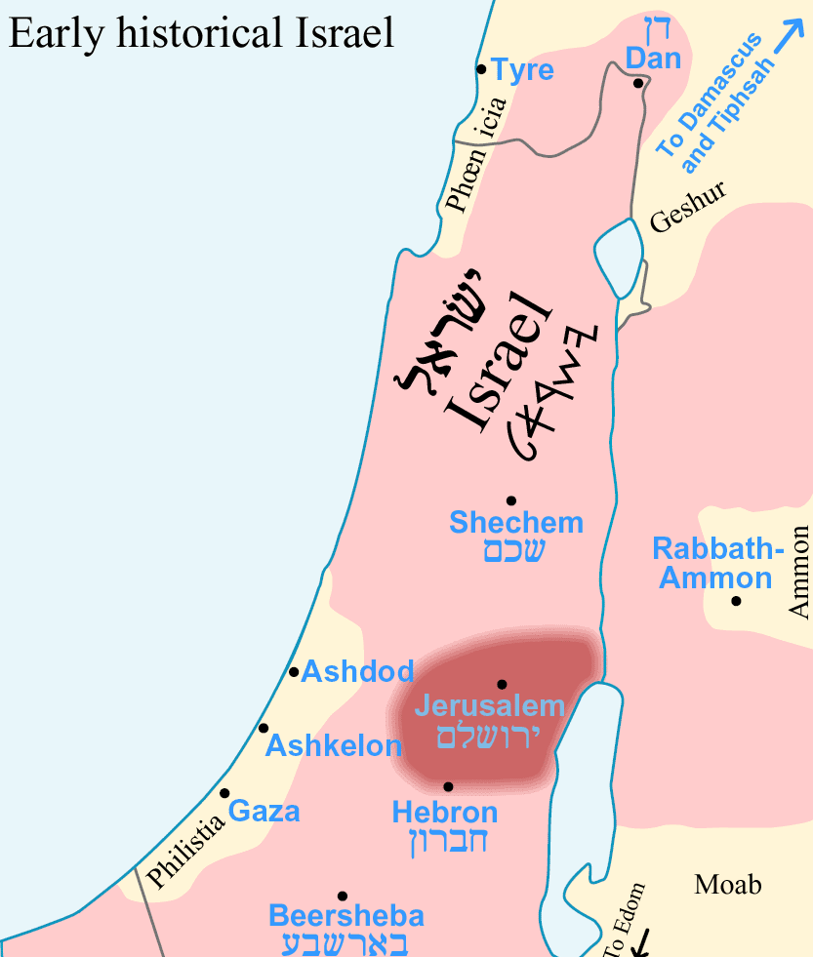
After the murder, Absalom fled to Geshur and was estranged from his father for [3] years while David mourned Amnon’s death (13:37-39).
ABSALOM’S RETURN
“So Joab arose and went to Geshur, and brought Absalom to Jerusalem” (14:23).
Though he returned to Jerusalem, David had not yet forgiven Absalom of his sin –
“So Absalom dwelt [2] full years in Jerusalem, and saw not the king’s face” (14:28).
Finally after 5-years David agreed to meet Absalom –
“… and when he had called for Absalom, he came to
the king, and bowed himself on his face to the ground before the king: and the king kissed Absalom” (14:33).
But, David had waited too long; now Absalom had an
unforgiving spirit toward his father.

Slide 9
ABSALOM CONSPIRES AGAINST DAVID
Because his father had shown an unforgiving heart for
so long, Absalom conspired to make David pay for the pain of rejection from his father. Over the next 4-years Absalom gained the support of the people of Israel away from his father the king –
“… so Absalom stole the hearts of the men of Israel” (15:6).
A COUP
“But Absalom sent spies throughout all the tribes of Israel, saying, As soon as ye heard the sound of the trumpet, then ye shall say, Absalom reigneth in Hebron” (15:10).
Of all places, Absalom’s coup began in the city where David’s reign had begun, Hebron.
What would David do as Satan threatened his throne?

Slide 10
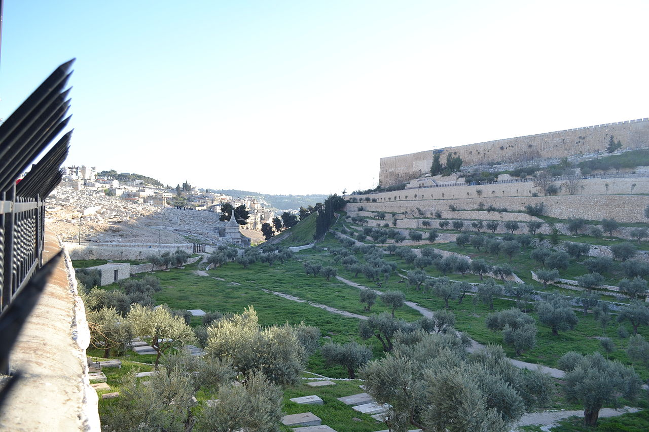
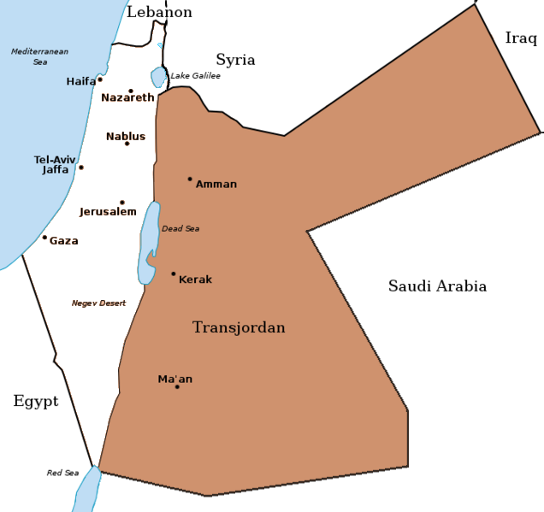
DAVID’S FLIGHT FROM JERUSALEM
“And there came a messenger to David, saying, The
hearts of the men of Israel are after Absalom. And
David said unto all his servants that were with him in Jerusalem, Arise, and let us flee; for we shall not escape Absalom… bring evil upon us, and smite the city with
the edge of the sword” (15:13,14).
David fled Jerusalem rather than risk its destruction by Absalom, traveling to the Transjordan, east of Jerusalem by crossing the Kidron Valley and Mt. of Olives –
“And David went up by the ascent of mount Olivet, and wept as he went up, and had his head covered, and he went barefoot… and the people went up, weeping as
they went up” (15:30). David’s despair was obvious.
And then, “… Absalom came into Jerusalem” (15:37).
As David fled, Absalom took control of Jerusalem.

Slide 11
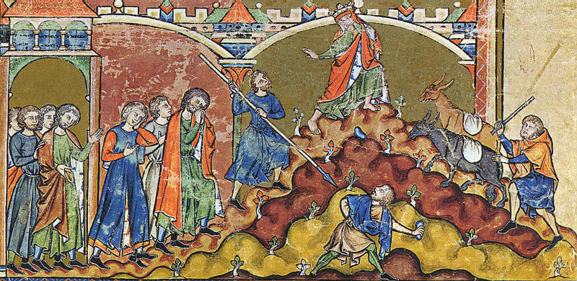
PSALMS OF DAVID FLEEING ABSALOM
“LORD, how are they increased that trouble me! Many are they that rise up against me” (Psa. 3:1).
Though David is distraught by the actions of
his son, he knows that God is with him.
“But thou, O LORD, art a shield for me; my glory, and the lifter up of mine head” (3:3).
David trusts the LORD for deliverance.
“I laid me down and slept; I awakened; for the
LORD sustained me” (3:5).
David knows not to lose precious sleep over his predicament –
“I will not be afraid of [10,000] of people, that
have set themselves against me round about” (3:6), nor fear Absalom’s army.

Slide 12
Because the LORD had intervened in David’s life before to save him; he believes He will do the same again –
“Arise, O LORD; save [protect] me, O my God: for thou hast smitten all mine enemies upon the cheek bone; Thou hast broken the teeth of the ungodly. Salvation [protection] belongeth unto the LORD; thy blessings upon thy people” (3:7,8).
“Who have said, With out tongue will we prevail; Our lips are our own: who is lord over us? (12:4).
Though Abasalom had flattered the Israelites with his lips, his arrogant attitude would not win out –
“But I have trusted in thy mercy… I will sing unto the LORD, because he hath dealt bountifully with me” (13:5,6).
God would protect David—it was His will to do so.

Slide 13
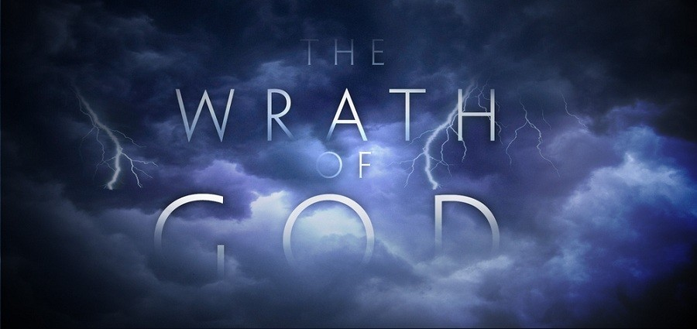
IMPRECATORY PRAYER
“Draw me not away with the wicked, and with the
workers of iniquity, which speak peace to their
neighbors, but mischief is in their hearts. Give
them according to their deeds, and according to
the wickedness of their endeavors; give them after
the work of their hands; render to them their
desert” (28:3,4).
Again, David prayed that God will administer justice
on those who are perpetrating this evil upon him.
“For it was not an enemy that reproached me; then
I could have borne it; neither was it he that hated
me that did magnify himself against me; then I would
have hid myself from him: But it was thou, a man
mine equal… mine acquaintance. We took counsel
together, and walked unto the house of God in
company. Let death seize upon [Absalom], and let [him] go down quick into hell…” (55:12-15).

Slide 14
COMPETITORS FOR THE THRONE
As David fled Jerusalem and Absalom sought his father’s throne, it
jeopardized the DAVIDIC COVENANT, the promise of God that a
series of kings would be enthroned leading to the Messiah.
Absalom was positioned to be king over the southern kingdom
[Judah] and now Saul‘s grandson [Mephibosheth], whom David
treated as a son, attempted to resurrect Saul’s dynasty over the
northern kingdom – “Where is thy master’s son?... he abideth at
Jerusalem: for he said, To day shall the house of Israel restore me
the kingdom of my father” (16:3).
Now David has two adversaries: Absalom & Mephibosheth.
“And Absalom, and all the people of the men of Israel, came to
Jerusalem…” (16:15). A previous friend of David seeing that he
had been deposed, said of the new king, “God save the king” (16:16). Absalom asked his advisor what to do and was told,
“Go in unto thy father’s concubines, which he hath left to keep
the house…” (16:21), which he did (16:22), showing utter
contempt for his father.

Slide 15
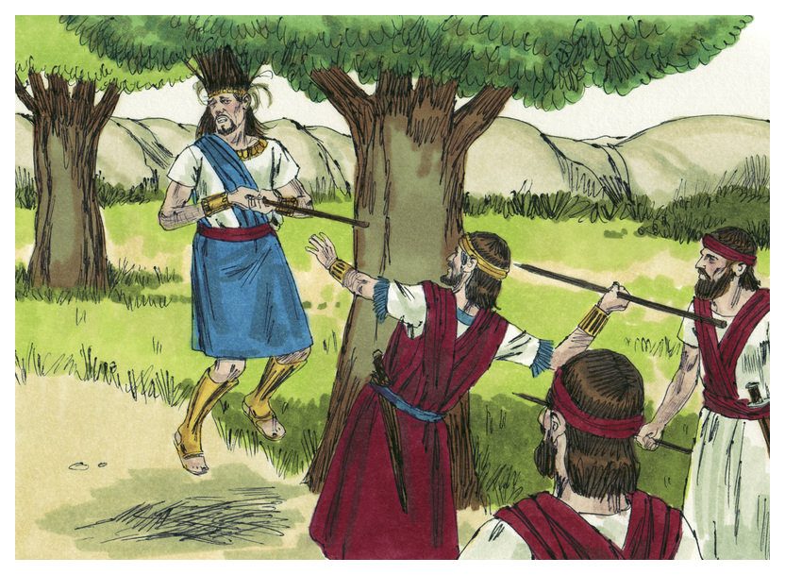
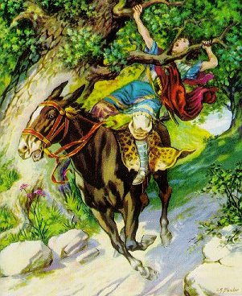
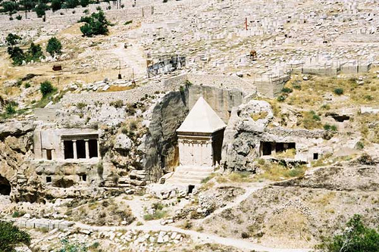
Another advisor plotted the death of David –
“And I will come upon him while he is weary and weak handed, and will make him afraid: and all the people will flee; And I will smite the king only” (17:2).
But, David’s army was revived with supplies (17:27-29), and was ready to fight Absalom’s army. At the last moment, David instructed his soldiers not to kill
Absalom (18:5).
THE BATTLE
“So [Absalom’s army] was slain before the solders of David, and there was there a great slaughter that day
of [20,000 men]” (18:7,8).
Absalom tried to escape but his hair became entangled in an oak tree and despite David’s orders his soldiers killed him (18:8-14).
David erected a monument to Absalom in the Kidron Valley that still stands today (18:18).

Slide 16
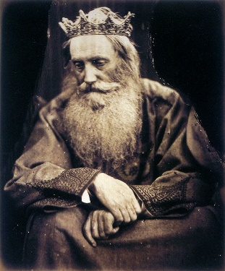
Things had not gone as David would have wanted with Absalom, but it didn’t diminish his love for the LORD –
“Judge me, O LORD; for I have walked in mine integrity: I have trusted in the LORD (Psa. 26:1)… I waited patiently for the LORD… He brought me up also out of an horrible pit… he hath put a new song in my mouth (40:2,3)… As a snail which melteth, let every one [wicked] pass away (58:7)… Thou wilt prolong the king’s life: and his years as many generations (61:6)… My soul, wait thou only upon God (62:5)… The righteous shall be glad in the LORD, and shall trust in him” (64:10).
David had won the battle but he had lost a son, “… the king weepeth and mourneth for Absalom… the king covered his face… cried with a loud void, O my son Absalom, O Absalom, my son, my son” (2Sam. 19:1-4).
Joab told David that he believed David would have rather had Absalom lived and David and his army perish (19:5,6)!

Slide 17
DAVID’S REINSTATEMENT AS KING
With his death, the followers of Absalom decided to accept David as their king (19:14,15). The 2nd conspirator, Mephibosheth, made his case that he had not tried to conspire to raise Saul’s kingdom to new life (19:26,27) so the rebellion ended with David reinstated king over both kingdoms of Israel. The DAVIDIC COVENANT and David’s place in it was again secure.
David was never the same after this period in his life, wishing he would have died rather than hearing of the violent deaths of his two sons, Amnon (13:28,29) and Absalom (18:15), both a consequence of his sin (12:10).
A DROUGHT
“Then there was a famine in the [last] days of David [3] years, year after year; and David inquired of the LORD. And the LORD answered, It is for Saul, and for his bloody house…” (21:1).

Slide 18
PACT WITH GIBEON
Israel had made a covenant with the Gibeonites during the time of Joshua (9:15-21). After Joshua defeated Jericho and Ai, the Gibeonites were next in their cross hairs, but they pretended to be non-residents of the land of Canaan, and escaped destruction by Joshua and his forces.
Though done deceitfully, God recognized Israel’s promise of their safety to allow them to become proselytes and to do menial work as they served the nation of Israel.
Though the events were not recorded in the Bible, Saul attacked and killed some Gibeonites –
“… It is for Saul, and for his bloody house, because he slew the Gibeonites…” (21:1).
As if David didn’t have enough heartache over this last part of his life, God now held Israel responsible for the broken promise between Saul and the Gibeonites.

Slide 19
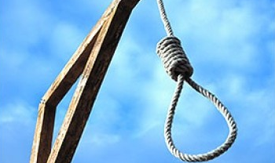
“Wherefore David said unto the Gibeonites, What shall I do
for you? And werewith shall I make the atonement, that ye
may bless the inheritance of the LORD?” (21:3).
David asked them what he could do to make things right.
They refused monetary payment, “… We will have no silver
nor gold…” (21:4), but they did agree on a premise that had
been a part of the Law but rarely used – ‘An eye for an eye’
(Exo. 21:23-25).
The Gibeonites asked for [7] men of Saul’s bloodline and
David turned over [7] sons and grandsons of Saul for a
public execution by hanging –
“And he delivered them into the hands of the Gibeonites,
and they hanged them in the hill before the LORD; and they
fell all [7] together, and were put to death in the days of the harvest, in the first days, in the beginning of barely harvest… And he brought up… the bones of Saul… Jonathan his son, and they gathered the bones of them that were hanged… and buried them in the country of Benjamin… in the sepulcher of Kish his father” (21:9). All were executed together in the spring of the year 1021 B.C. and then buried together, a fitting ending of a curse from God.

Slide 20
DAVID’S LAST BATTLE
“Moreover the Philistines had yet war again with Israel; And David went down, and his servants with him, and fought against the Philistines: and David waxed faint” (21:15).
Now old and weak, David was nearly killed so his men vowed that this should never happen again –
“Thou shalt go no more out with us to battle, that thou quench
not the light of Israel” (21:17).
Do you know why David gathered ‘5-smooth stones’ (1Sam. 17:40) when he went to battle against Goliath? Because there were [4] more giants who were eventually killed by David’s army –
“These [4] were born to the giant in Gath, and fell by the hand of David [Goliath], and [4] by the hand of his servants” (21:22).
All the satanically produced giants [“There were giants in the earth in those days… (Gen. 6:4)] who had inhabited the earth from the time of Noah were now eradicated once and for all.

Slide 21
“For there is no faithfulness in their mouth; their inward part is very wickedness; their throat is an open sepulcher… Destroy them, O God; let them fall by their own counsels; cast them out in the multitude of their transgressions; for they have rebelled against thee” (5:9,10).
Another imprecatory prayer, but the Apostle Paul does use part of it to describe the lying lips of unbelievers during the Age of Grace (Rom. 3:13).
“I am feeble and sore broken… my heart panteth, my strength faileth me: as for the light of mine eyes, it also is gone from me” (38:8,10).
David’s health continued to deteriorate as he is in heart failure and has cataracts [nearly blind].
“Yea, mine own familiar friend, in whom I trusted, which did eat of my bread, hath lifted up his heel against me” (41:9).
Another Messianic psalm – As Absalom betrayed David, so will Judas betray Christ (Jn. 13:18).
“My soul thirsteth for God, for the living God: when shall I come and appear before God?” (42:2).
David is ready to die and wants to see God face to face.
Next time – David sins again

