Slide 1
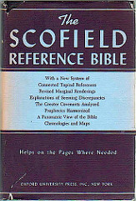
LESSON 52
WEEK 52 OF 52
(2Tim.; 2Pet.;
Jude; 1,2,3 Jn.; Revelation
THROUGH THE BIBLE IN 2018
Last time – the beginning of the transition to the End Times.
This time – events leading up to eternity future.
2 PETER (A.D. 66)
Writer. The Apostle Peter (1:1); Theme. 2nd Peter and 2nd
Timothy have much in common. In both, the writers are
aware that martyrdom is near; both are singularly sustained
and joyful; both foresee apostasy… In Peter the false teachers
deny redemption truth (2:1)... But in none of these Epistles is
the tone one of dejection or pessimism. God and His promises
are still the resource of the believer” (Old Scofield, p. 1317).
The last books of the Bible, 2Peter, 1,2,3 John, Jude, Revelation,
are about the completion of God’s earthly program with Israel;
2Timothy, the final book of the Church & its destiny in the
heavenlies.

Slide 2
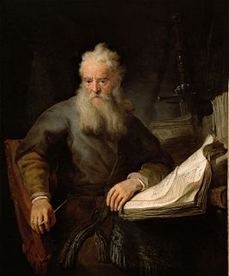
2PETER
“Simon Peter, a servant and an apostle of Jesus Christ to them that have obtained like precious faith with us through the righteousness of God and our Savior Jesus Christ. Grace and peace be multiplied unto you through the knowledge of God, and of Jesus our Lord (2Pet. 1:1,2)… brethren give diligence to make your calling and election sure…” (2Pet. 1:10).
By the end of his life, Peter was sounding more and more like Paul, but that was his hope early on when it came to redemption—to have the Jews saved like the Gentiles –
“But we believe that through the grace of our Lord Jesus Christ we [Jews] shall be saved, even as they [Gentiles]” (Acts 15:11).
But not everything, “And to this agree the words of the prophets: as it is written, after this [Israel regathered], I will return, and will build again the tabernacle of David, which is fallen down…” (Acts 15:15,16). All will be saved by grace [Christ’s blood], but the Jews will retain their promise & fulfillment of an earthly nation, King & kingdom.

Slide 3
FALSE PROPHETS & SPIRITUAL DECLINE
“… even as there shall be false teachers among you, who privily shall bring in damnable heresies, even denying the Lord that brought them and bring upon themselves swift destruction. And many shall follow their [destructive] ways…” (2Pet. 2:1,2).
Again, very similar to what Paul writes of the last days of the age of grace. Satan’s attack will be on all believers of Christ, which will adversely affect their spiritual behavior –
“For if God spared not the angels that sinned… and spared not the old world, but saved Noah the 8th person, a preacher of righteousness, bringing in the flood upon the world of the ungodly; And turning the cities of Sodom and Gomorrah into ashes… making them an example unto those that after should live ungodly; And delivered just Lot, vexed with the filthy conversation of the wicked…” (2Pet. 2:4-7). His point?
If God can sort out the godly from the ungodly in the O.T.,
He will surely be able to do the same in the end times.

Slide 4
THE LAST DAYS
“This 2nd epistle, beloved, I now write unto you… knowing there shall come in the last days scoffers… saying, Where is the promise of his coming? For this they willingly are ignorant of that by the word of God… But the heavens and the earth, which are now, by the same word are kept in store, reserved unto fire against the day of judgment and perdition of ungodly men. But, beloved, be not ignorant of this one thing, that one day is with the Lord as 1,000 years, and 1,000 years as one day. The Lord is not slack concerning his promise… but is longsuffering to us-ward, not willing that any should perish, but that all should come to repentance” (2Pet. 3:1-9).
Peter had hoped that Christ would shortly return with the kingdom (Acts 1:6), but 35-years later, he knew it was not going to happen in his lifetime. He tells his Jewish believers not to give up hope, that God is simply giving the unbelieving masses more time to be saved, but that He will come.

Slide 5
2ND COMING OF CHRIST
“But the day of the Lord will come as a thief in the night…
The heavens will pass away with a great noise, and the elements shall melt with fervent heat, the earth also and the works that are therein shall be burned up… Nevertheless we, according to his promise, look for new heavens and a new earth, wherein dwelleth righteousness” (2Pet. 3:10-13).
Peter is giving his readers God’s final timeline: 2nd coming of Christ; the dissolution [destruction by fire] of the present earth & heavens, which will be renovated into a new earth & heavens where only the righteous will reign eternally.
BROTHER PAUL
“… even as our beloved brother Paul also according to the wisdom given unto him hath written unto you [HEBREWS]; As also in all his epistles, speaking in them of these things; in which are somethings hard to be understood [Mystery]…” (2Pet. 3:15,16). With Israel’s kingdom program now on-hold, Peter directed his Jewish readers to Paul and his epistles.

Slide 6
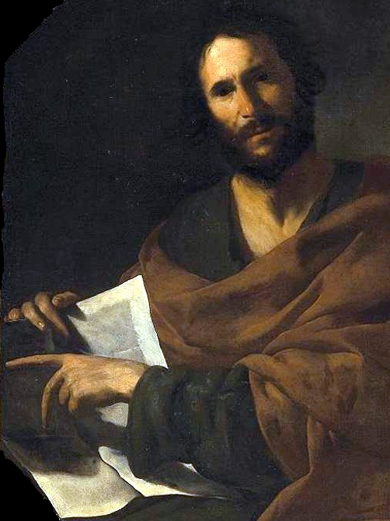
1ST JOHN (A.D. 50’s or 60’s)
“That which was from the beginning, which we have heard, which we have seen with out eyes, which we have looked upon, and our hands have handled, of the Word of life” (1Jn. 1:1).
The Apostle John wrote these epistles after his gospel, telling the reader [Jews] that he had been with, had heard, had seen, and had touched His Lord. Whereas John, the youngest of the 12, had been like a son to Jesus, now John is the father-figure, and calls those to whom he now writes, “My little children” (1Jn. 2:1), the next generation of Jews. John tells them, “Love not the world, neither the things that are in the world. If any man love the world, the love of the Father is not in him” (1Jn. 2:15).
END TIMES
“Little children, it is the last time [last days]; and as ye have heard that antichrist shall come, even now are there…

Slide 7
“… many antichrists; whereby we know that it is the last time [last days]. They went out from us, but they were not of us; for if they had been of us, they would no doubt have continued with us” (1Jn. 2:18).
No doubt John had encountered many who hoped Jesus was the Messiah, but in the end rejected Him because He didn’t establish the earthly kingdom, instead offering Himself up to die on the cross. John warned the last generation alive [tribulation] that ‘antichrist shall come,’ but leading up to that there shall be many who deny Him. Until that time arrives, however, he encourages them to show the love of the Father that was in their Lord, Jesus Christ –
“Beloved, if God so loved us, we ought also to love one another… God is love…” (1Jn. 4:11-16), a transdispensational truth. John’s theme was ‘love,’ but he never relinquished the legalism of Israel’s program, “… he that doeth the will of God abideth forever (2:17)… and keep his commandments”
(5:2,3), that is specific to Israel, NOT us.

Slide 8
2 & 3 JOHN (A.D. 50’s or 60’s)
“… that which we had from the beginning, that we love one another… this is love, that we walk after his commandments” (2Jn. 5). Theirs was faith + works; ours faith alone; the Law was nailed to the cross; the keeping of laws, rites & rituals no longer required for salvation (Col. 2:14,16).
He also provided some good advice when other religious groups [J.W., Mormons, etc.] come to your door and try to sway you to their faith –
“If there come any unto you, and bring not this doctrine, receive him not into your house, neither bid him God speed. For he that biddeth him God speed is partaker of his evil deeds” (2Jn. 10,11).
“I have no greater joy than to hear that my children walk in truth” (3Jn. 4). After love, John’s 2nd theme is truth – “And the Word was made flesh, and dwelt among us, full of grace and truth” (Jn. 1:14). John had one more book to write, but first let’s look at the Book of Jude.

Slide 9
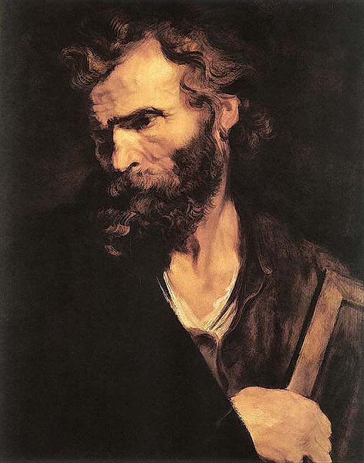
JUDE (A.D. 66)
“Jude, the servant of Jesus Christ, and brother of James [brother of the Lord]…” (1:1).
Like 2Timothy and 2Peter, apostasy [false teaching] is a major theme in Jude – “For there are certain men crept in unaware, who were before of old ordained to this condemnation, ungodly men, turning the grace of our God into various vices, and denying the only Lord God, and our Lord Jesus Christ” (v.4). Not only did Jude expose ungodly men, but angels –
“And the angels which kept not their first estate, but left their own habitation, he hath reserved in everlasting chains under the darkness unto the judgment of the great day” (v.6).
1/3 of the angels (Rev. 12:4) created by God turned against Him, bringing upon themselves eternal judgment.
“And Enoch also, the 7th from Adam, prophesied of these cometh with 10,000 of his saints [holy ones]” (v.14); other places called angels (Mt. 24:31; 25:31; Mk. 8:38).

Slide 10
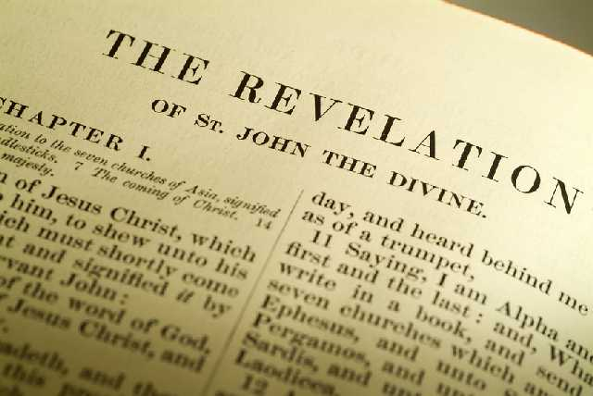
REVELATION [date unsure, probably 50’s or early 60’s]
“WRITER. The Apostle John. Theme. The Revelation of Jesus
Christ, presented in a 3-fold way: 1. time, past, present,
future; 2. relationships—to the [assemblies]; to the
tribulation; to the kingdom; 3. in His offices—High Priest;
Bridegroom, King-Judge. While Christ is thus the central
theme of the book, all of the events move toward one
consummation, the bringing in of the covenanted kingdom
… the key phrase… The world kingdom of our Lord and of
his Christ has come. The book is, therefore, a prophecy”
(Old Scofield, p. 1330).
“The Revelation of Jesus Christ, which God gave unto him,
to shew unto his servants things which must shortly come
to pass; and sent and signified it by his angel unto his
servant John… of all things that he saw” (Rev. 1:1,2).
The Apostle John was given visions of Christ unveiling the end times: 7-years of tribulation; 2nd coming of Christ; battle of Armageddon; 1,000-year kingdom; white throne judgment; eternity. The book is written in symbolic or figurative language.

Slide 11
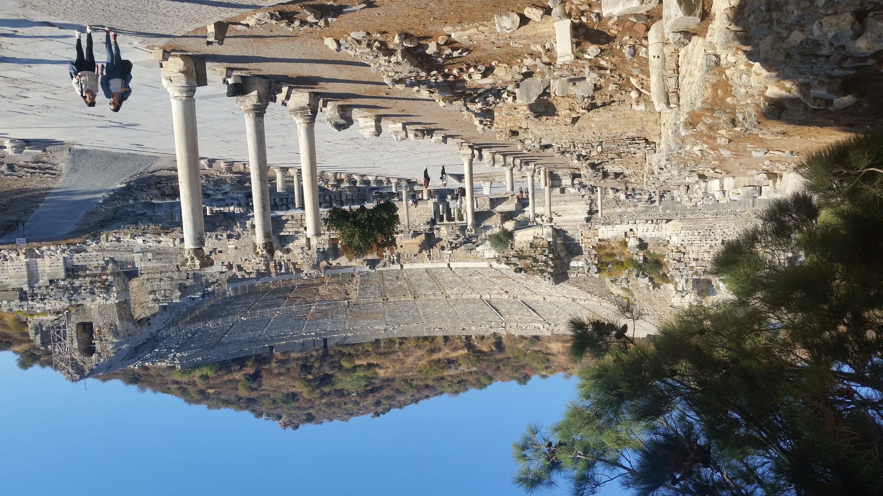
Church in Ephesus (2017)

Slide 12
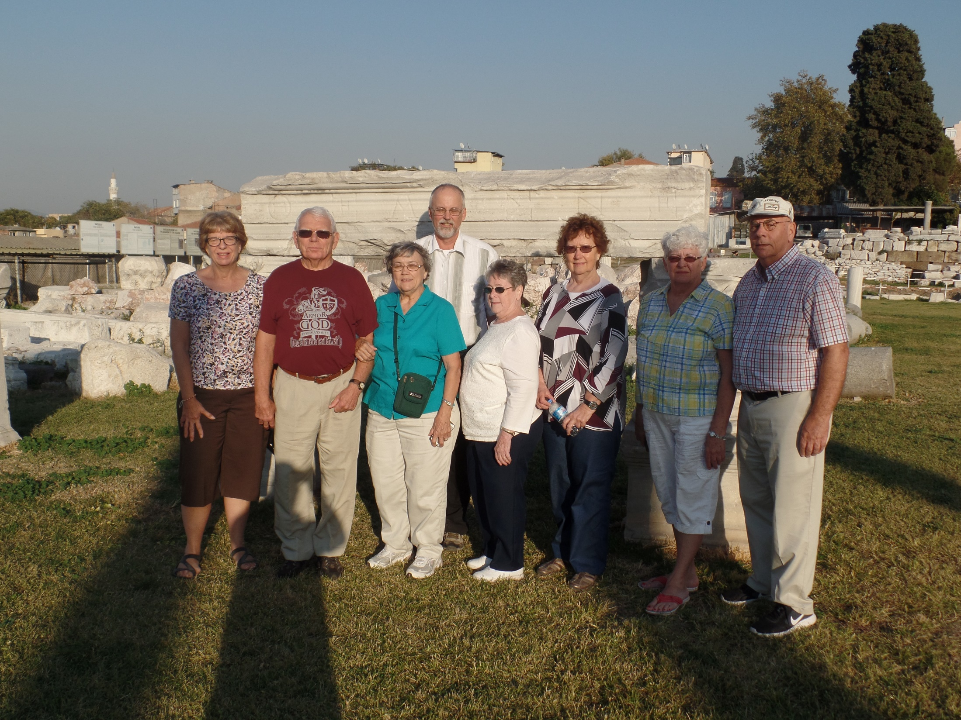
Church at Smyrna (2017)

Slide 13
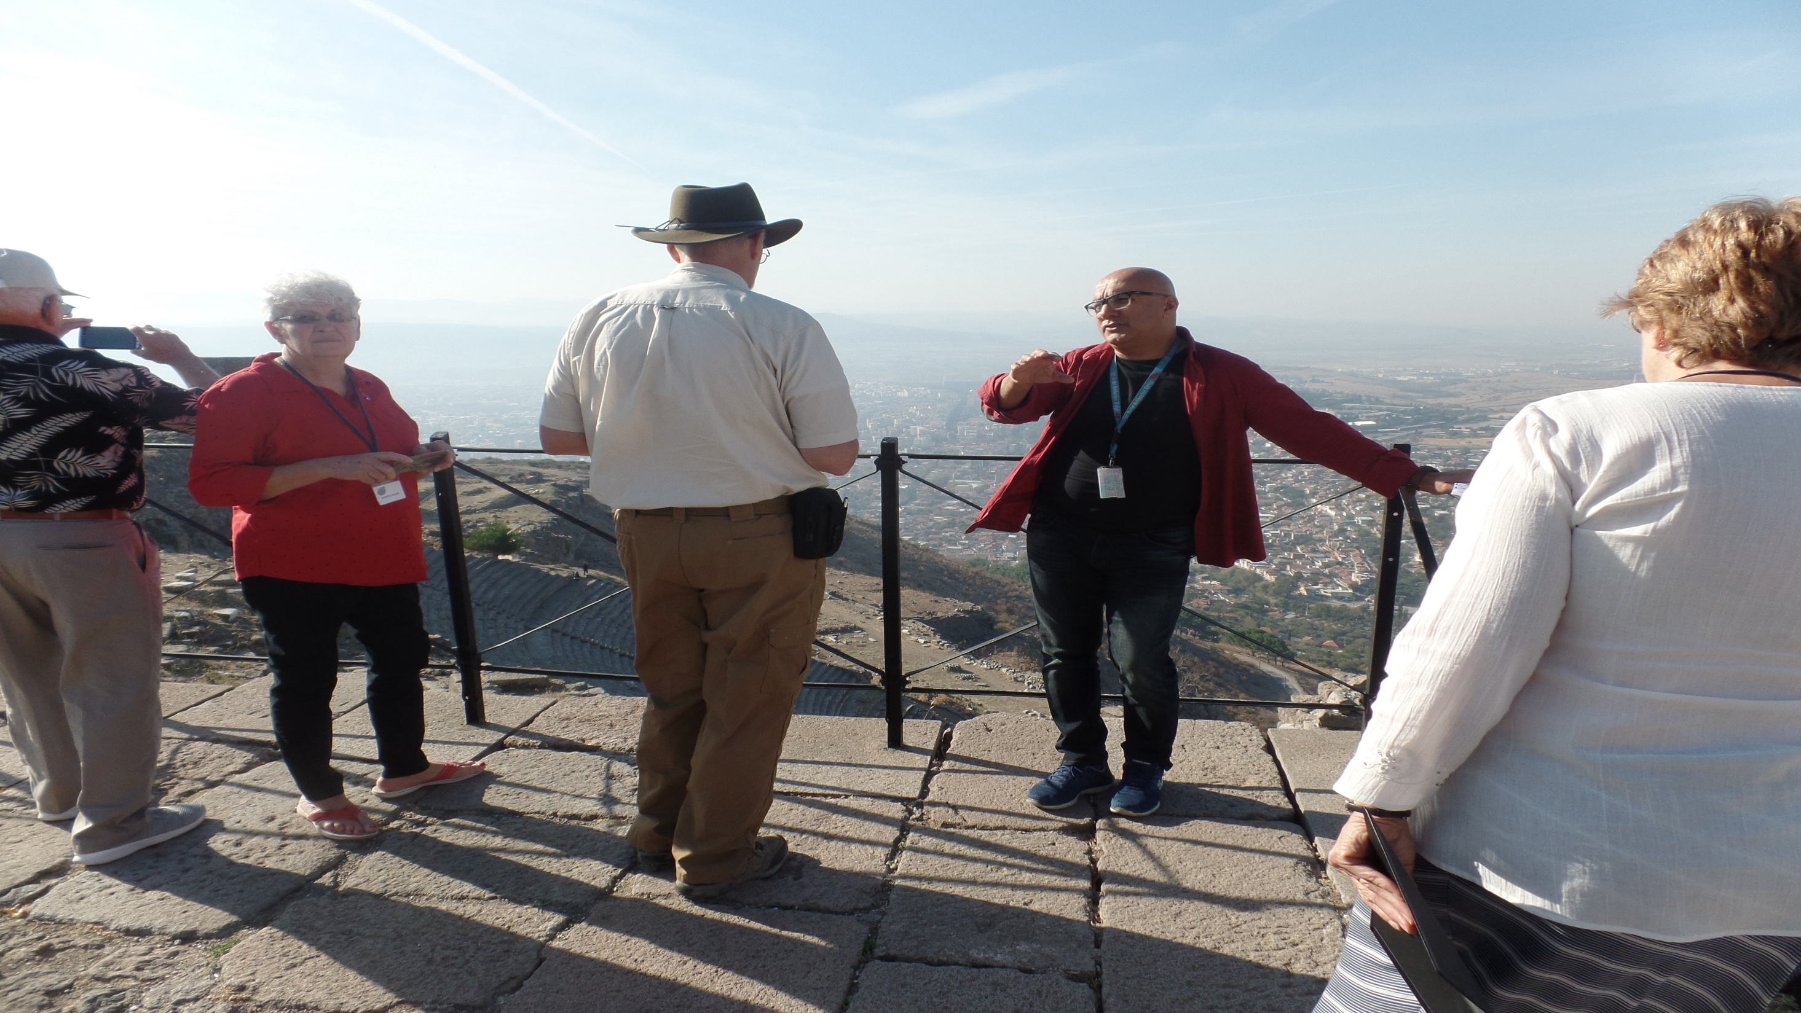
Church at Pergamos (2017)

Slide 14
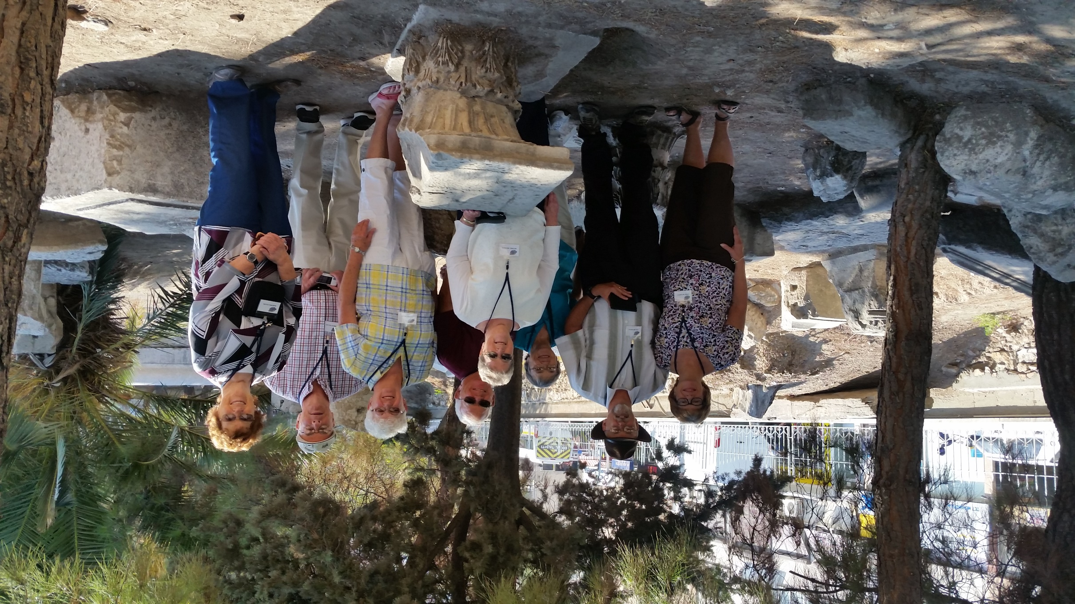
Church at Thyatira

Slide 15
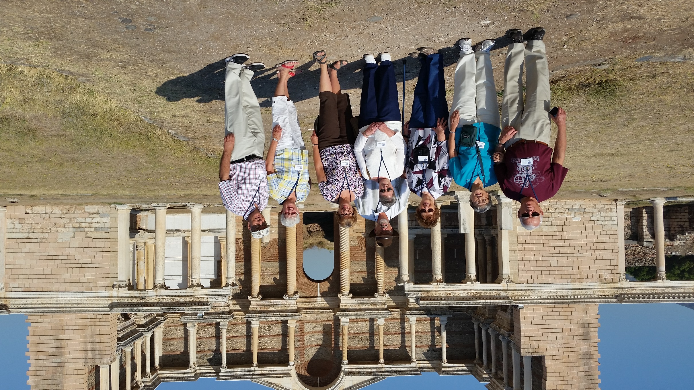
Church at Sardis (2017)

Slide 16
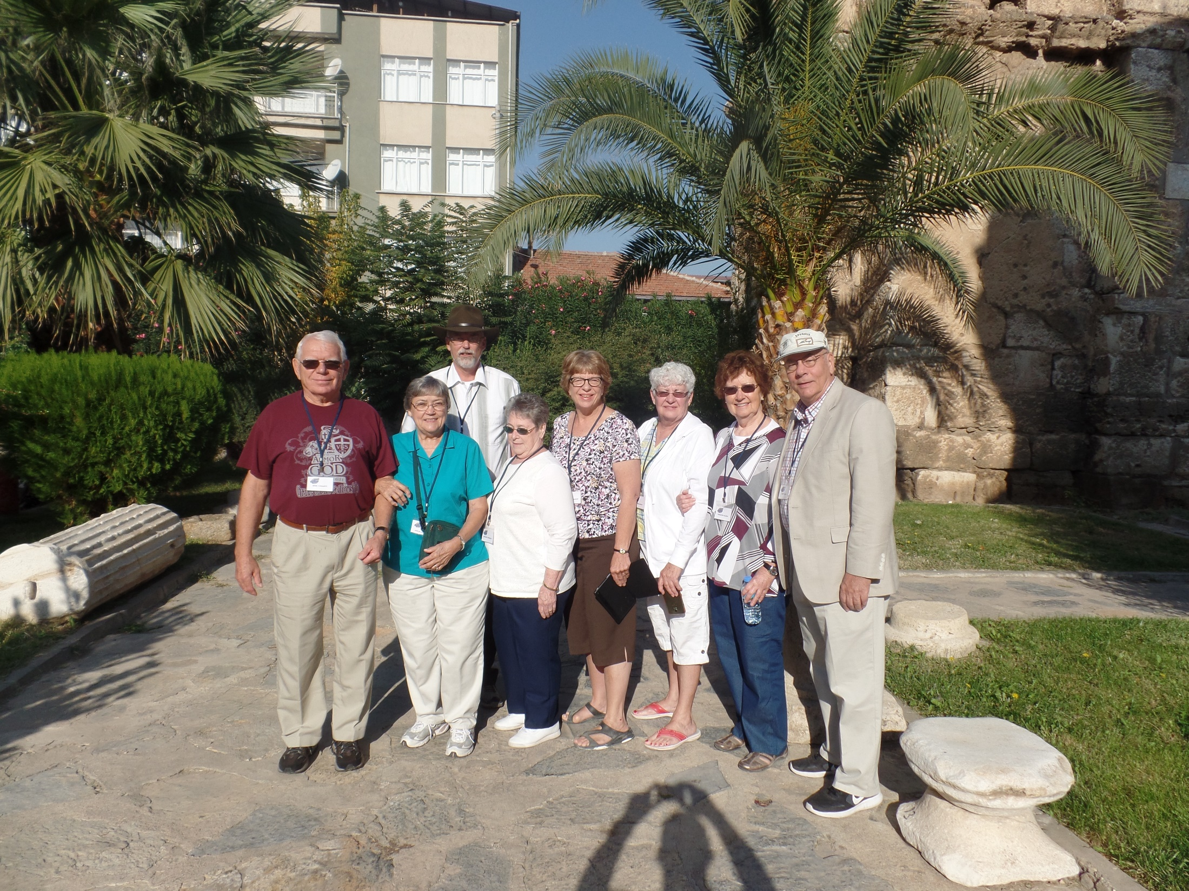
Church at Philadelphia (2017)

Slide 17
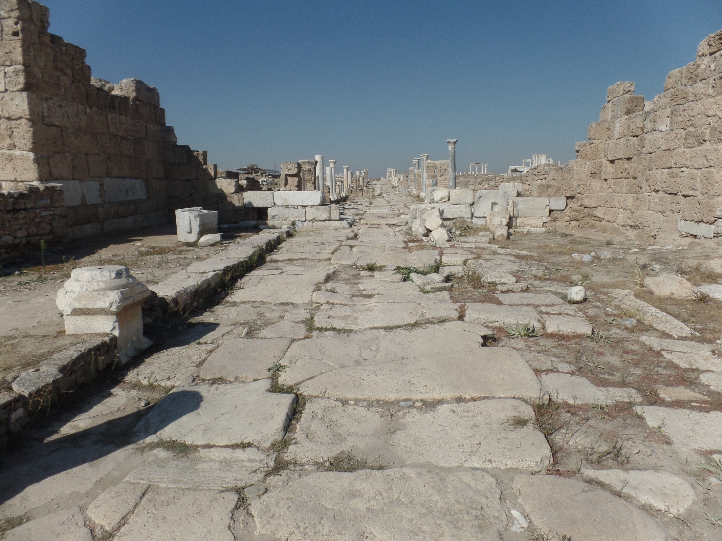
Church at Laodicea (2017)

Slide 18
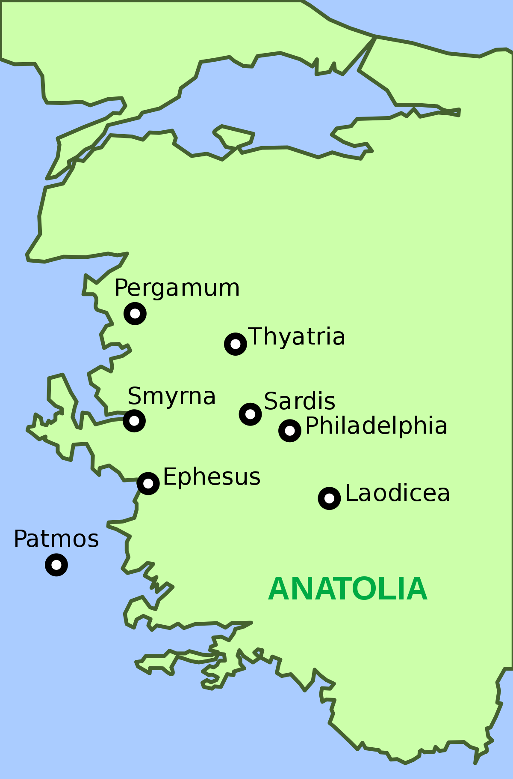
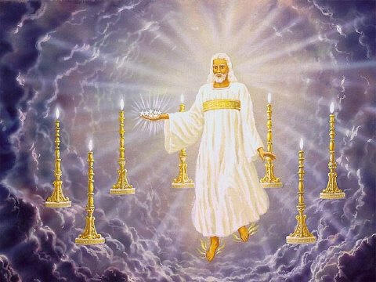
“John to the 7 churches which are in Asia…” (Rev. 1:4).
John, from the isle of Patmos while under arrest by the Roman Emperor, wrote to 7 assemblies [‘ecclesia’] in 7 different cities in western Turkey, giving a spiritual report card of each. It encompasses 3 phases of time –
“Write the things which thou [John] has seen [Gospels, 1,2,3
Jn., past], and the things which are [Rev. 2,3, present], and the things which shall be hereafter [Rev. 4-22, yet future].”
John wrote of Christ’s earthly ministry [A.D. 29-31], is now writing to those ‘scattered (Messianic) Jews’ [A.D. 50’s or 60’s],’ who are teetering in their faith. It is a spiritual report card, most of which is not good. It is the glorified Christ speaking to these mentioned 7-assemblies through John –
“And I turned to see the voice that spake with me. And being turned, I saw 7 golden candlesticks; And in the midst… one like unto the Son of man, clothed with a garment down to the foot… his hair like wool… white as snow… his eyes like a flame of fire… and his feet like unto fine brass…

Slide 19
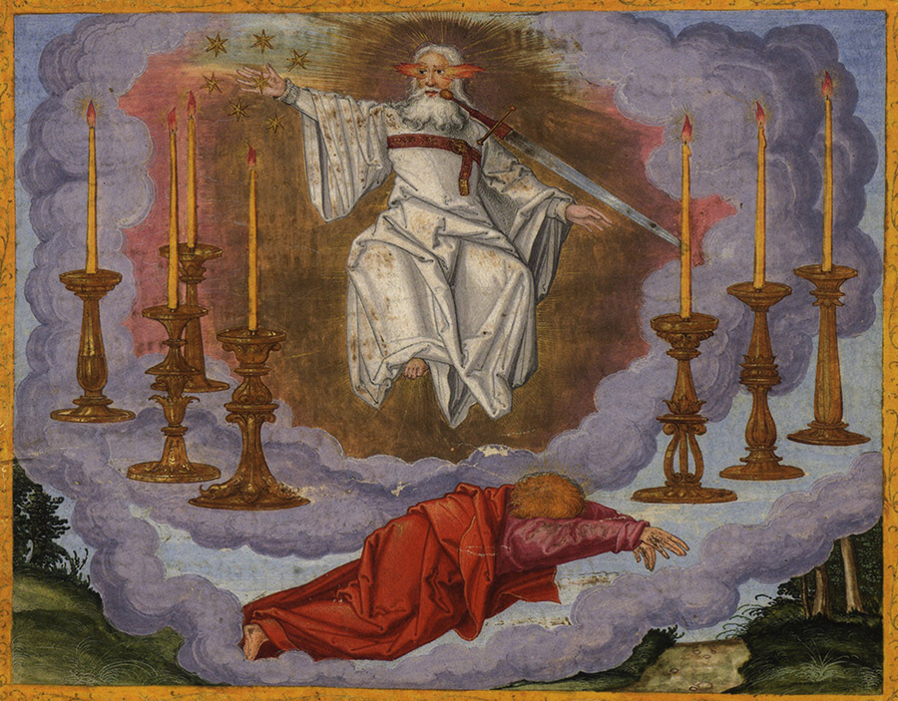
“… as if they burned in a furnace; and his voice as the sound of many waters. And in his right hand 7 stars: and out of his mouth went a sharp two-edged sword: and his countenance was as the sun shineth in his strength” (Rev. 1:13,16).
John’s reaction when he saw the glorified Christ?
“And when I saw him, I fell at his feet as dead. And he laid his right hand upon me, saying unto me, Fear not; I am the first and the last: I am he that liveth, and was dead; and, behold,
I am alive forever more, Amen; and I have the keys of hell and death” (Rev. 1:17,18).
Why did John collapse in His presence? Because he had never seen His Lord present Himself as JUDGE, which is how Christ is presented throughout the Book of Revelation until the kingdom when He begins His reign as a benevolent King.
Chapter 4-18 – depicts the 7 years of tribulation of which the O.T. prophets (Jer. 30:7) and Jesus warned (Mt. 24). It will be 7 years of hell on earth [before heaven comes to earth].

Slide 20
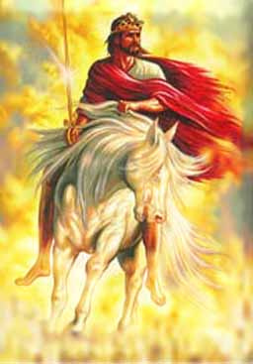
TRIBULATION
“Who is worthy to open the book… to lose the seals thereof” (Rev. 5:2).
Three series of God’s judgments will come upon the earth: seal; trumpet; vial [bowl], each worse than the previous –
“Yea, I will gather you [Israel], and blow upon you in the fire of my wrath… ye shall know that I the LORD have poured out my fury upon you” (Eze. 22:21,22).
Why? In the midst of His wrath, like a blast furnace, God will make Israel decide once-and-for-all whether Christ is her Messiah, or not. At the end of the 7-years upon His 2nd coming (Rev. 19:11-16), true, spiritual Israel will see her error, mourn (Zech. 12:10), and be saved in 1 day (Isa. 66:8), as Christ will establish His kingdom of heaven on earth –
“Blessed and holy is he that hath part in the 1st resurrection… they shall be priests of God and of Christ, and shall reign with him a thousand years” (Rev. 20:6).
Israel’s covenant promises now are fulfilled.

Slide 21
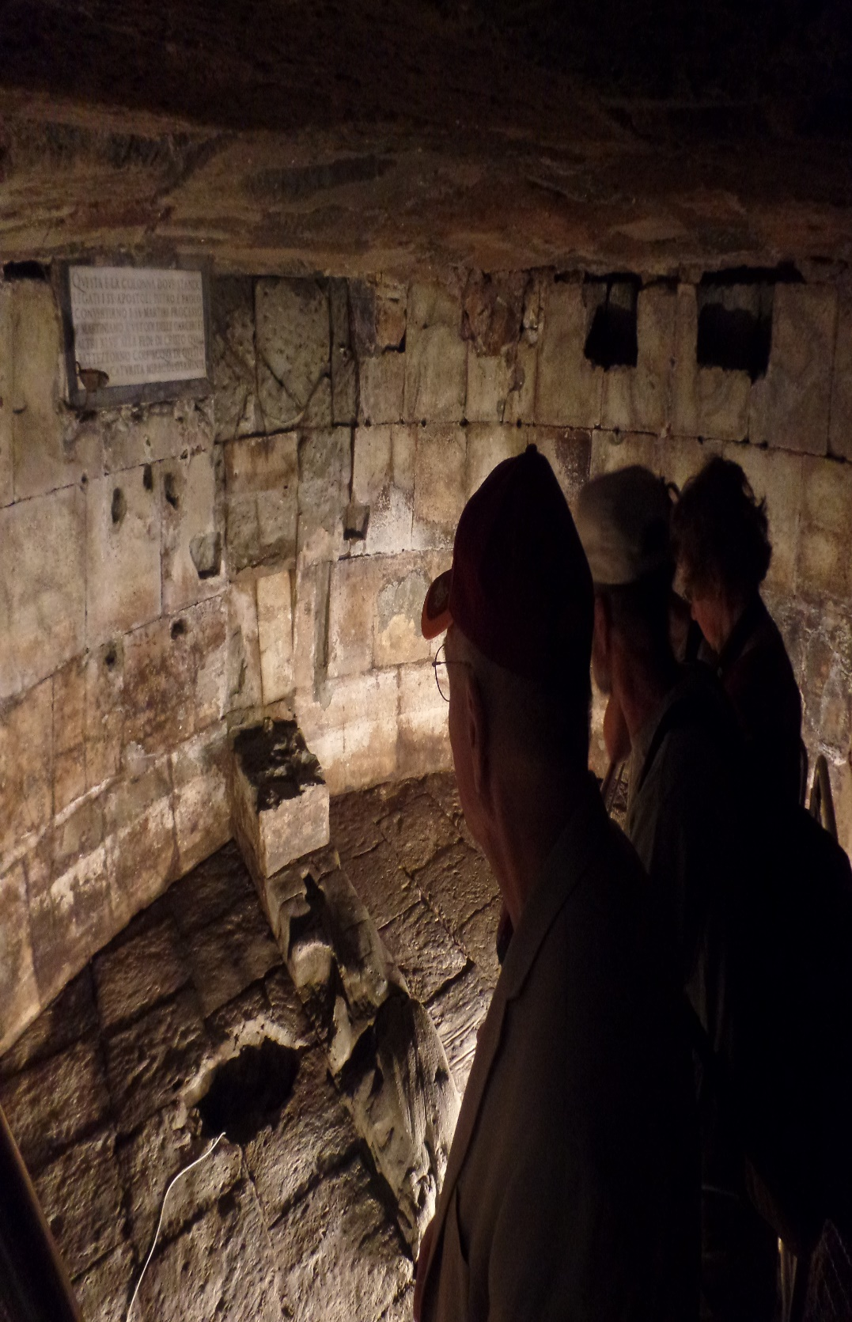
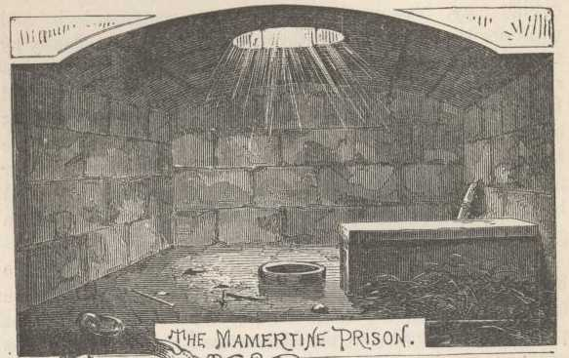
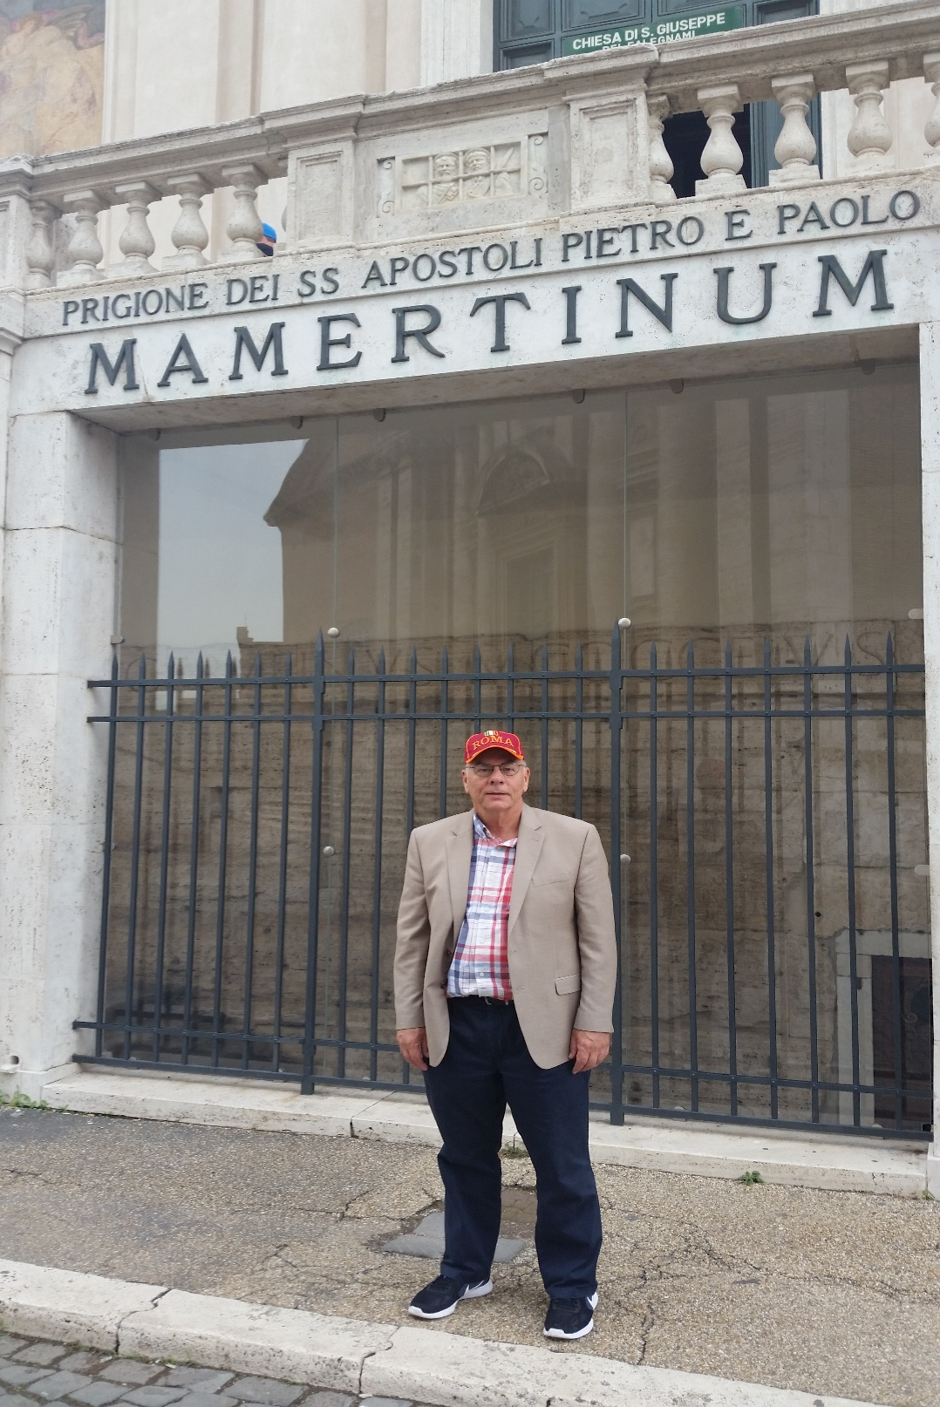
In A.D. 67, Paul was re-arrested, taken to Rome, and this time incarcerated in the infamous Mamertine prison where he wrote his final epistle –
“Paul, an apostle of Jesus Christ… to Timothy, my dearly beloved son…” (2Tim. 1:1,2).
The apostle of grace knew this would not look good—he was now in the dungeon prison where the worst offenders throughout the Roman Empire were placed, murderers, thugs, and thieves despite the fact he had done nothing to deserve such harsh punishment. It was all part of his calling –
“Be not ashamed of the testimony of our Lord, nor of me his prisoner: but be thou partaker of the afflictions of the gospel … Who hath saved us, and… called us with an holy calling, not according to our works, but according to his own purpose and grace, which was given us in Christ Jesus before the world began… who abolished death, and hath brought life and immortality to light through the gospel” (2Tim. 1:8-10).

Slide 22
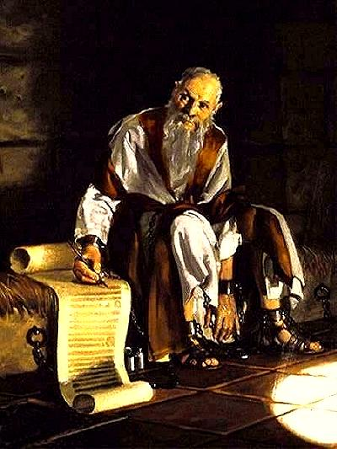
Though Paul had made a herculean effort in getting out the ‘grace message,’ it had NOT been sustained as many had begun to retreat from it. He tells Timothy, “Hold fast the
form of sound words, which thou hast heard of me…” (1:13).
It was so bad that – “This thou knowest, that all they which
are in Asia be turned away from me” (2Tim. 1:15).
In a dungeon in Rome, he knew that many had abandoned the gospel of grace even before his death, so it was more important than ever to impress upon Timothy, “… my son be strong in the grace that is in Christ Jesus” (2Tim. 2:1).
Paul also wrote about the end of the dispensation of grace –
“This know also, that in the last days perilous times shall come. For [believers] shall be lovers of their own selves, covetous, boasters, proud, disobedient to parents, unthankful, unholy… despisers of those that are good…
lovers of pleasures more than lovers of God; Having a form
of godliness [religion], but denying the power thereof: from such turn away” (2Tim. 3:1-5).

Slide 23
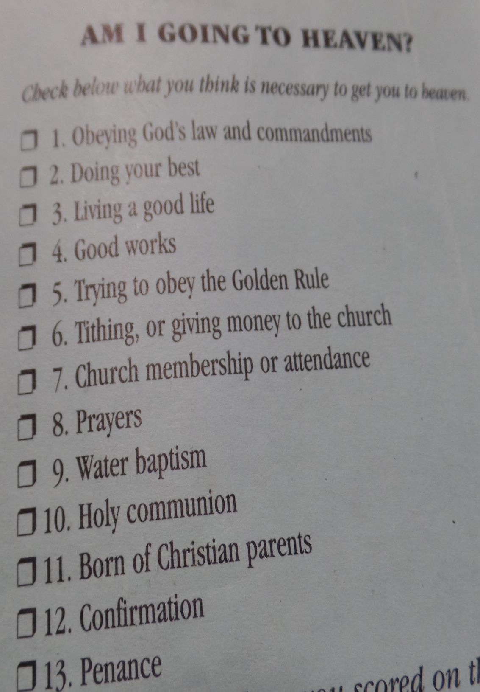
END TIMES
The spiritual decline that began before Paul’s death would continue until the end of the age of grace.
At the beginning, Paul instructed believers to follow him
to learn how to follow Christ (1Cor. 11:1). At the end, he says NOT to follow most in Christendom, because they
are NOT following Christ as Paul’s pattern for believers today.
At the end, most churches, pastors, and believers will
have been taught and continue to embrace a mixture of Grace + Law, Faith + Works, Scripture + Tradition, where believers spend a life time checking and unchecking the various lists required of different denominations—adding untold confusion to God’s simple message of grace –
CHRIST’S BLOOD FOR YOUR SIN!
Why has this happened and what is the only remedy?
The Bible tells us in the following passages…

Slide 24
STUDY THE BIBLE RIGHTLY DIVIDED
“Study to shew thyself approved unto God, a workman that needeth not to be ashamed, rightly dividing the word of truth” (2Tim. 2:15), which when added to –
“All scripture is given by inspiration of God, and is profitable for doctrine [teaching], for reproof [analyze], for correction, for instruction in righteousness: That the man of God may be perfect [complete], thoroughly furnished unto all good works” (2Tim. 3:16,17). Together, they tell the reader to believe the whole Bible, but determine where you fit in it.
Unfortunately, in neither case has it been followed. For the 1st 1,500 years the Roman Catholic Church forbid the private possession of the Bible. The Protestant Reformation brought the Bible into every home, but over the last 500 years, it has become irrelevant & obsolete to many.
In the last days, the Body of Christ will make the same mistake Israel did, “In those days… every man did that which was right in his own eyes” (Jud. 21:25).

Slide 25
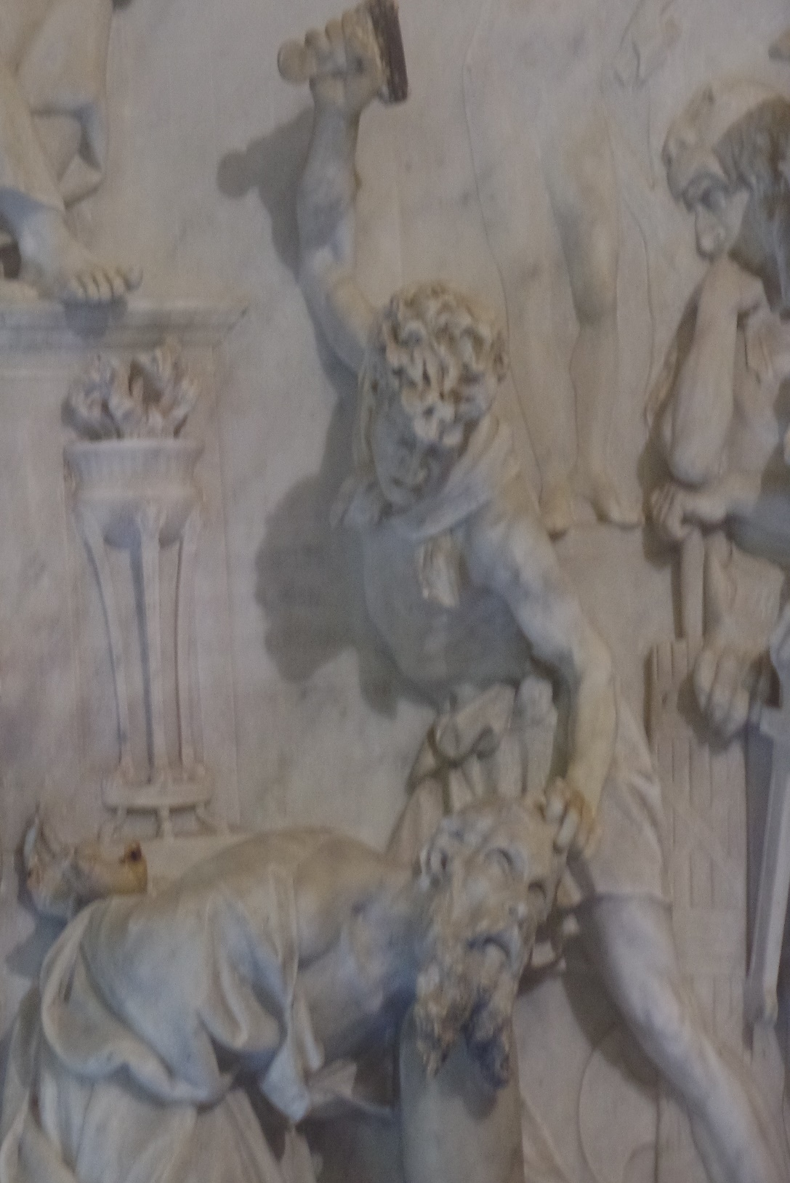
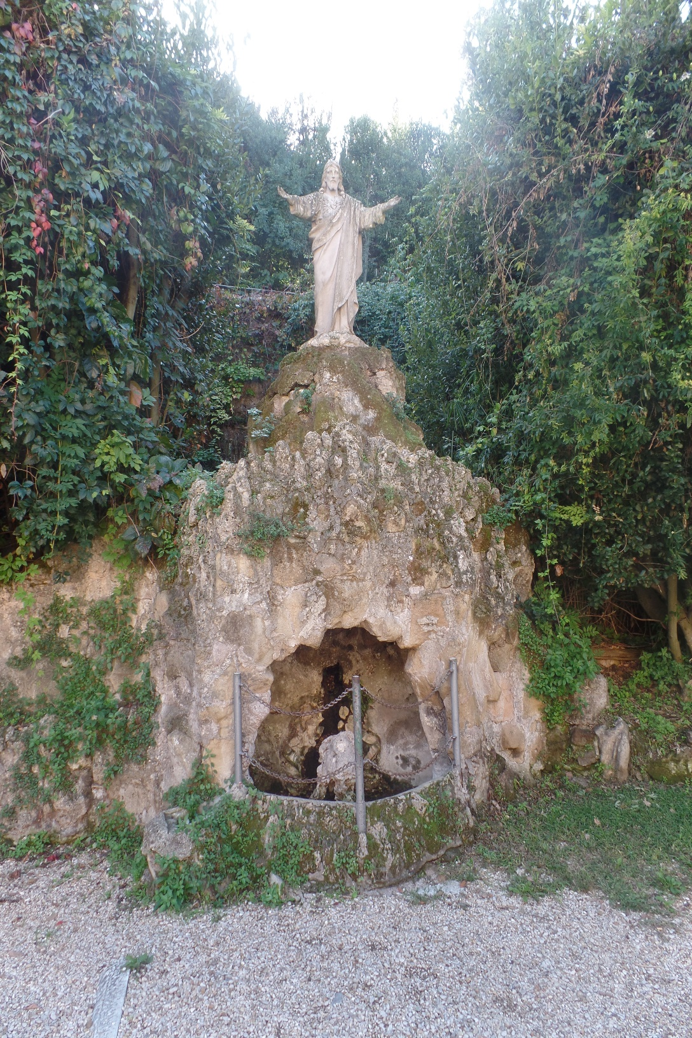
PAUL’S FINAL WORDS
“I charge thee before God, and the Lord Jesus Christ… Preach the word; be instant in season, out of season; reprove, rebuke, exhort with all longsuffering and doctrine. For the time will come when they will not endure sound doctrine; but after their own lusts shall they heap to themselves teachers, having itching ears; And they shall turn away their ears from the truth…” (2Tim. 4:1-4).
In the last days of the present age, believers will NOT believe God’s Word, instead they will seek out teachers that will tell them what they want to hear.
“I have fought the good fight, I have finished my course, I have kept the faith (2Tim. 4:7)… And the Lord shall deliver me… will preserve me unto his heavenly kingdom” (2Tim. 4:18).
Paul did everything God asked him do. He battled Satan, he completed his assignment, he kept the faith given him from Christ. He will be rewarded in heaven for his work on earth, and so will all who labor for Christ in this life.
Rome (2016)

Slide 26
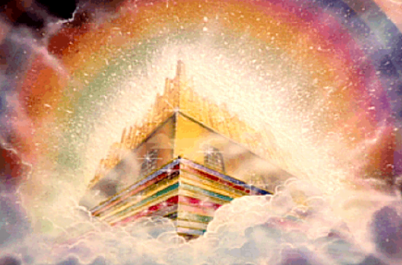
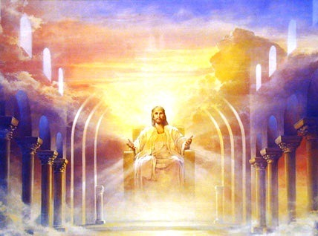
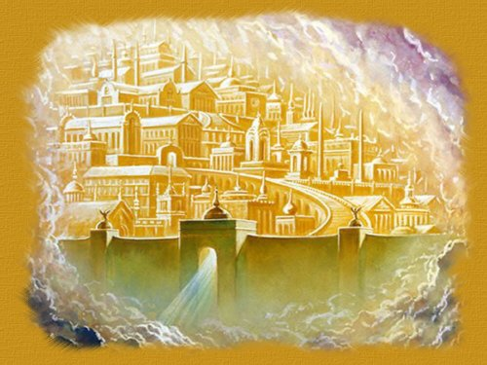
NEW HEAVEN AND EARTH
“And I saw a new heaven and a new earth: for the first heaven… earth were passed away… And I John saw the holy city, new Jerusalem coming down from God out of heaven… And I heard a great voice out of the heaven saying, Behold, the tabernacle of God is with men, and he will dwell with them, and they shall be his people, and God himself shall be with them, and be their God… shall wipe away all tears… no more death, neither sorrow, nor crying… any more pain… And he that sat upon the throne said, Behold, I make all things new… And he said unto me, It is done. I am Alpha and Omega, the beginning and the end… And he carried me away in the spirit to a great and high mountain, and showed me that great city, the holy Jerusalem…” (Rev. 21:5).
Christ’s last verbal admonition is not to add to, or take away from the Word of God (Rev. 22:18,19).

Slide 27
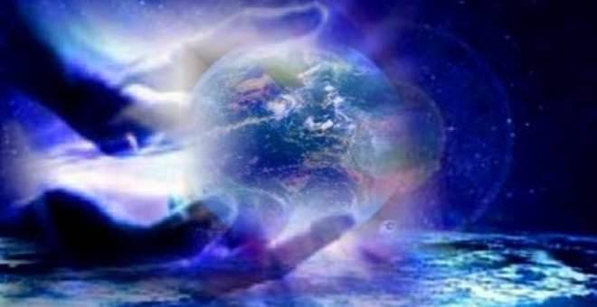
Paul’s last words on eternity future –
“For God, who is rich in mercy, for his great love wherewith he loved us… And hath raised us up together, and made us sit together in heavenly places in Christ Jesus: That in the ages to come [Eternity] he might show the exceeding riches of his grace in his kindness toward us through Christ Jesus” (Eph. 2:6,7).
May God continue to richly bless your study of His Word.
The end.

