Slide 1
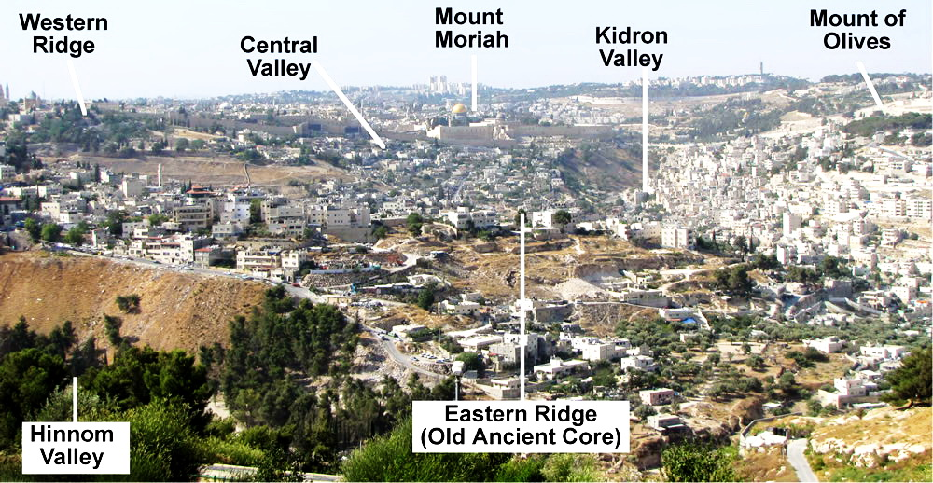
In our last lesson, we saw God’s promise to use the Babylonian army to exact His punishment on those in land of Israel who perpetrated the heinous act of infanticide –
“… and there were they justly punished for the blood
of the tortured children burned alive in sacrifice to
Molech. Such cruelty to children never contemplated
by the loving heart of God”
(Williams Bible Commentary, p. 542).
“Thus will I do unto this place, saith the LORD, and to
the inhabitants thereof, and even make this city as
Tophet” (19:12). What is Tophet?
Williams Commentary – “Tophet, so-called from Toph, a drum, which was
beaten to drown the agonizing cries of the burning
children. They were innocent, but their murderers
were guilty, and therefore, judged” (Ibid, p. 542).
Jeremiah, alone, could not express the outrage God
felt, so He raised up another prophet to speak for
Him.

Slide 3
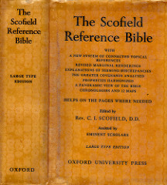
LESSON 34
WEEK 34 OF 52
(2Kg. 24,25; Habak; Jer. 41-52; Lam. 1-5)
THROUGH THE BIBLE IN 2018
Last time we saw the destruction of Jerusalem; this time Habakkuk speaks and Jeremiah laments.
BOOK OF HABAKKUK
“It seems most probable that Habakkuk prophesied in the latter years of Josiah. Of the prophet himself nothing is known. To him the character of Jehovah was revealed in terms of the highest spirituality. He alone of the prophets was more concerned that the holiness of Jehovah should be vindicated than that Israel should escape chastisement. Written on the eve of the captivity, Habakkuk was God’s testimony to Himself against idolatry… As a whole the Book of Habakkuk raises and answers the question of God’s consistency with Himself in view of permitted evil. The prophet thought that the holiness of God forbade him to go on with evil Israel” (Old Scofield, p. 955).

Slide 4
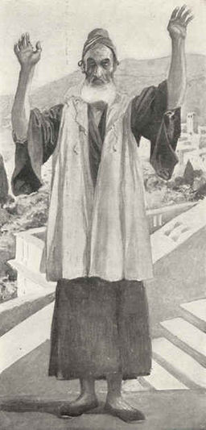
“The burden which Habakkuk the prophet did see. O LORD, how long shall I cry, and thou wilt not hear! Even cry out unto thee of violence, and thou wilt not save! (Hab. 1:1,2).
The prophet questioned why God was taking so long to punish the Jews when all he saw around him was ‘violence.’
“Why dost thou shew me iniquity… Therefore the law is slacked, and judgment doth never go forth: for the wicked doth compass about the righteousness…” (1:3,4).
Habakkuk asked God why He didn’t see all the sinfulness going on in the land and why He allowed the Law breakers
to go unpunished.
God did see and was about to judge them.
“Behold ye among the heathen…” (1:5a).
In the short run, Israel will be dispersed among the Gentile nations [first to Assyria and then Babylon, to be followed by Persia, Greece, and Rome], the successive world-empires, which the prophet Daniel will later reveal.

Slide 5
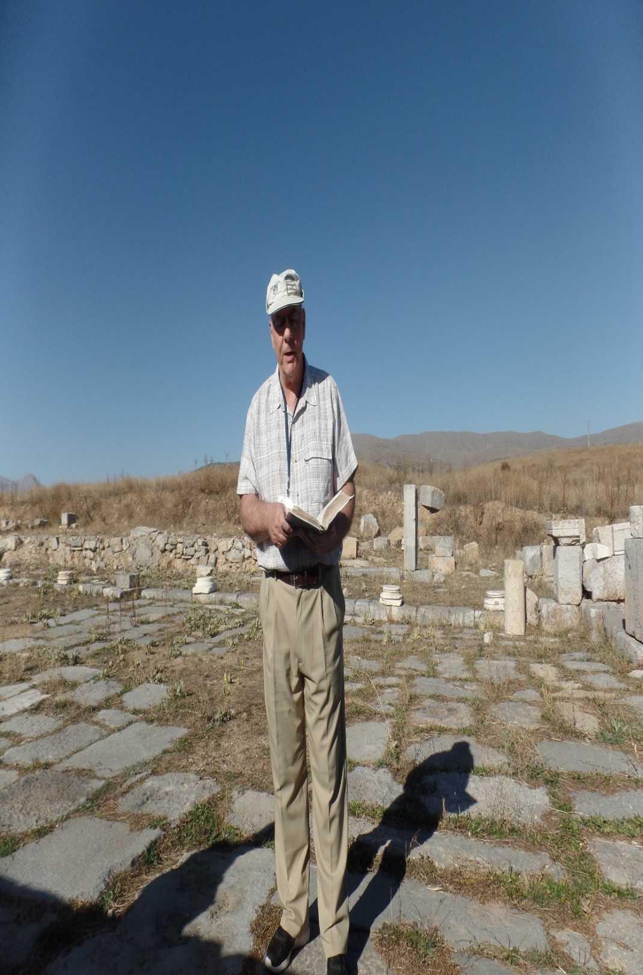
“… and regard, and wonder marvelously: for I will work a work in your days, which ye will not believe, though it be told you” (1:5b).
Habakkuk told Judah that he was called of God to tell them of their sin and that God’s justice required that He punish them. At the synagogue in Pisidian Antioch on his 1st missionary journey, Paul gave the Jews a history lesson of Israel’s rebellious nature –
“Men and brethren, children of the stock of Abraham… to you is the word of this salvation sent. For they that dwell in Jerusalem, and their rulers, because they knew him not, nor yet the voices of the prophets which are read every Sabbath day, they have fulfilled them in condemning him… And when they had fulfilled all that was written of him, they took him down from the tree [cross], and laid him in a sepulcher. But God raised him from the dead… And we declare unto you glad tidings [good news of salvation]…
Synagogue in Pisidian Antioch
where Paul quoted Habakkuk.

Slide 6
“… how that the promise which was made unto the
fathers, God hath fulfilled the same unto us their children, in that he hath raised up Jesus… Be it known unto you therefore, men and brethren, that through this man is preached unto you the forgiveness of sins: And by him all that believe are justified from all things, from which ye could not be justified by the law of Moses. Beware therefore, lest that come upon you, which is spoken of in the prophets [Habakkuk]: Behold, ye despisers, and wonder, and perish: for I work a work in your days, a work which ye shall in no wise believe, though a man declare it unto you” (Acts 13:26-41).
Habakkuk declared to Judah that God’s chastisement was coming because of their continued idolatry—but, they didn’t believe it. Paul, 671-yr. later, quoted Habakkuk, and revealed to Israel Christ’s work of salvation—but, they didn’t believe that either! Paul, like Habakkuk, cried out to Israel, but in neither case would they hear.

Slide 7
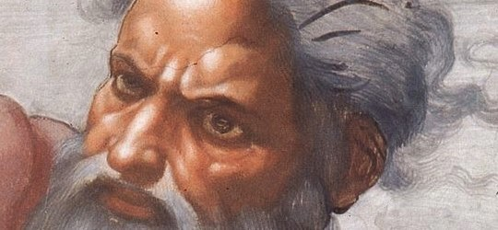
GOD’S ANSWER
“For, lo, I raise up the Chaldeans, that bitter and hasty nation, which shall march through the breadth of the land, to possess the dwelling places that are not their’s. They are terrible and dreadful: their judgment and their dignity shall proceed of themselves” (1:6,7).
Like Job, God answered Habakkuk, that His retribution on Judah’s sin was going to be carried out through the
Babylonians, and it was going to be dreadful. In the end, because of their savagery to the Jews, God would hold Babylon responsible as He had Assyria, and both would be punished by losing their empires to someone
mightier. Habakkuk described their arrogant, mocking attitude, and that their POWER was their god –
“They shall come all for violence… they shall scoff at kings… they shall deride every strong hold, and offend, imputing this his power unto his god” (1:10,11).

Slide 8
“Art thou not from everlasting, O LORD my God, mine Holy One? We shall not die… thou hast ordained them for judgment … them for correction” (1:12).
Habakkuk tried to reason this out. As God was everlasting and His decisions immutable [unchangeable], He had to keep His covenant promise with Abraham & Moses that Israel would become the holiest and greatest nation on earth. How could they be sent into Babylonian oblivion unless this was a temporary judgment and corrective action on God’s part?
“Thou art of purer eyes than to behold evil, and canst not look upon iniquity [sin]; wherefore lookest thou upon them that deal treacherously, and holdest thy tongue when the wicked devoureth that man that is more righteous than he?” (1:13).
A well known verse, but in a not-so-well-known or understood setting…

Slide 9
… Habakkuk wondered how such a holy God, who cannot as much as look upon sin, could use such an evil nation to bring about His judgment upon the Jews. Job asked a similar question (Job 19:7). Like Job, Habakkuk awaited God’s reply, and it came –
“And the LORD answered me, and said, Write the vision, and make it plain upon tablets, that he may run that readeth it” (2:2).
Habakkuk was told that God’s answer would be clear and that he should write it down and then spread the message to all who would listen. The answer? God’s will is sovereign. Therefore, He will correct Israel’s sinful behavior through the instrument of Babylon who shall in turn be destroyed for her own godless behavior. How could Habakkuk question and not love a LORD who could do that? He did –
“Yet I will rejoice in the LORD, I will joy in the God of my salvation” (3:18).

Slide 10
A recent article in the B.B.I. Bulletin written by Pastor Andy Kern, posed this question –
“Have you ever felt as if you were wrestling with what God was doing in your life?... Perhaps you have struggled to trust in God’s goodness in difficult times. We all have, so you are not alone. As a matter of fact, there was a prophet of God who lived in the kingdom of Judah toward the end of the 7th century B.C. who was struggling with what the Lord was doing in the world around him. His name was Habakkuk, and he is the author of the book of the O.T. which bears his name… He wrestled with injustice among his people… The Lord’s response was not what Habakkuk wanted to hear. God was indeed working in the world, but not in the way most would have expected. He said He was working to raise up the Chaldeans to bring destruction upon Judah and take its people captive as a judgment from God (Hab. 2:5-11)… Like many of us are inclined to do when things do not go our way, Habakkuk questioned God’s methods… wondered how God could use such a sinful nation to enact judgment upon Judah…

Slide 11
…Thus, while Judah would fall to Babylon due to sin and rebellion against God, so to would Babylon be judged for its evil, demonstrating the holiness and justice of the Lord. Even though the process would be painful for Habakkuk and the Israelites, the Lord would be shown to be good and righteous, the true God who can be trusted at all times… We can learn much from Habakkuk. You and I might struggle with what is happening around us in the world today, or wrestle with issues in our lives, but we can always trust the Lord and his plan. We always have reason to rejoice in Him… Because of the glory to come the Apostle Paul reminds us to look ahead, as he writes, “For our light affliction, which is but for a moment, is working for us a far more exceeding and eternal weight of glory, while we do not look at the things which are seen, but at the things which are not seen. For the things which are seen are temporary, but the things which are not seen are eternal” (2Cor. 4:17,18). Paul also knew the Lord was with him, even in difficult times, and He is always with us. May we learn from the examples of Habakkuk and Paul before us to walk by faith, and not by sight, through all of life’s adversities (2Cor. 5:7).”

Slide 12
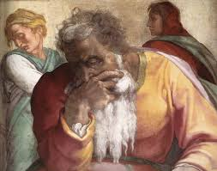
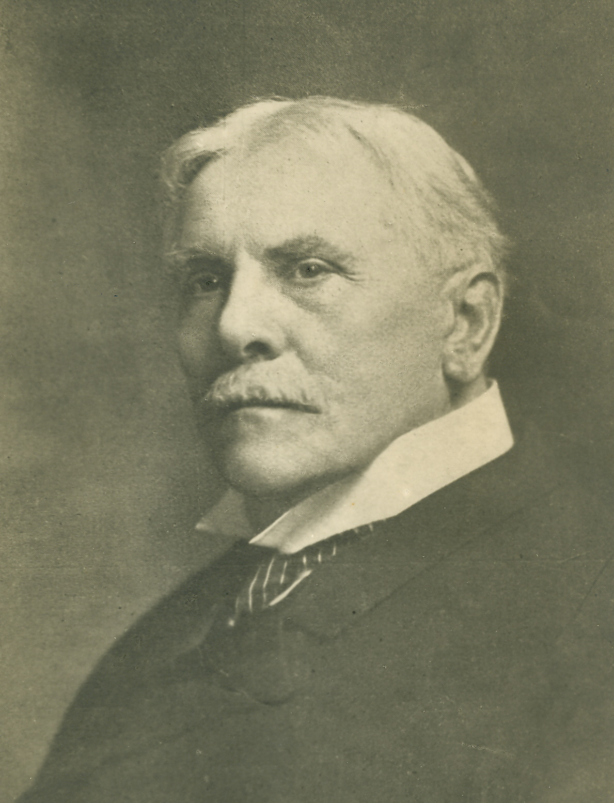
TIMES OF THE GENTILES
“The word of the LORD which came to Jeremiah the prophet against the Gentiles” (Jer. 46:1).
In this next section [Ch. 45-52], Jeremiah rendered prophecies concerning several prominent Gentile nations –
“A near and a far fulfillment of these prophecies against Gentile powers are to be distinguished. In Chapter 46, the near vision is of a Babylonian invasion of Egypt, but verses 27,28 look forward to the judgment of the nations…” (Old Scofield, p. 822). Scofield refers the reader to his note in (Mt. 25:32) –
“This judgment is to be distinguished from the great white throne… the persons judged are from living [Gentile] nations… three classes are present, sheep, goats, brethren; the time is at the return of Christ (v. 31); and the scene is on earth…”
(Old Scofield, p. 822).
God will hold accountable the actions of Gentiles in their treatment of His people the Jews.

Slide 13
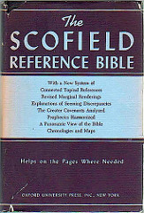
JUDGMENT OF THE NATIONS
“…The test in this judgment is the treatment accorded by the [Gentile] nations to those whom Christ here calls ‘my brethren.’ These ‘brethren’ are the Jewish Remnant who will have preached the Gospel of the kingdom to all nations during the tribulation after Armageddon, and the deliverance of Israel” (Old Scofield, p. 1036).
PROPHECIES AGAINST GENTILE POWERS
EGYPT –
“Against Egypt, against the army of Pharaoh-necho… which Nebuchadnezzar king of Babylon smote in the 4th year of Jehoiakim the son of Josiah king of Judah” (26:2).
When God decided to use one nation to punish another, e.g. Babylon to chasten Judah, He didn’t want interference from a 3rd nation, i.e. Egypt. The Egyptians would pose no threat to God’s use of the mighty Babylonians, “Egypt is like a very fair heifer, but destruction cometh… out of the north” (46:19).

Slide 14
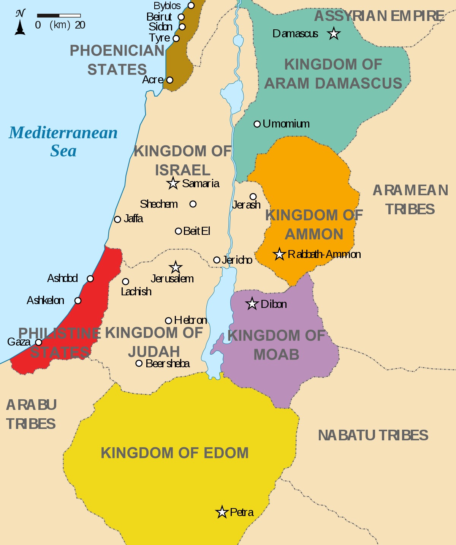
PHILSTIA
“The word of the LORD that came to Jeremiah the prophet against the Philistines… Behold, waters rise up out of the north, and shall be an overflowing flood, and shall overflow the land, and all that is therein; the city, and them that dwell therein: then the men shall cry, and all the inhabitants of the land shall howl” (47:1).
God will use Babylon like a floodwater to defeat the nation of the Philistines, an old archrival, and fierce enemy of Israel. She, too, will get her punishment.
TYRE & SIDON
“At the noise of stamping of the hoofs of his strong horses, at the rushing of his chariots, and at the rumbling of his wheels…Because of the day that cometh to spoil… cut off Tyrus and Sidon…” (47:3,4).
Nebuchadnezzar’s army will pulverize Tyre & Sidon.

Slide 15
MOAB
“Against Moab thus saith the LORD of hosts… come, and let us cut it off from being a nation… the sword shall pursue thee… For because thou hast trusted in thy works and in thy treasures, thou shalt also be taken: and Chemosh [god] shall go forth into captivity with his priests and his princes together…” (48:1,7).
As God punished Israel, so will He do the same to those who have caused injury to His favored nation. Moab, one of the earliest idol worshippers, will likewise go into captivity and with her will go her worthless idols, and with all those who worshipped them.
AMMON
“Concerning the Ammonites, thus saith the LORD… I will cause an alarm to be heard… it shall be a desolate heap… their king shall go into captivity, and his priests…” (49:1,3).
Another Gentile nation who despised God’s Israel.

Slide 16
Against Philistia, Tyre (47:1)… Moab (48:1)… Ammonites (49:1)… Edom (49:7)… Damascus (49:23), etc.
God had installed Babylon to be the next world-empire and any who trifled with them would experience their
[and God’s] wrath. Ironically, as God defended His choice of Babylon to be His instrument of chastisement, she, too, would receive the chastisement of God, in part, because of her persistent idol worship –
“The word of the LORD spake against Babylon and against the land of the Chaldeans by Jeremiah the prophet… publish and conceal not: say, Babylon is taken… her idols… images are broken in pieces. For out of the north there cometh up a nation against her, which shall make her land desolate… ” (50:1-3).
Each succeeding conquering empire in the future would be used of God to defeat the preceding empire. Next on the scene would be…

Slide 17
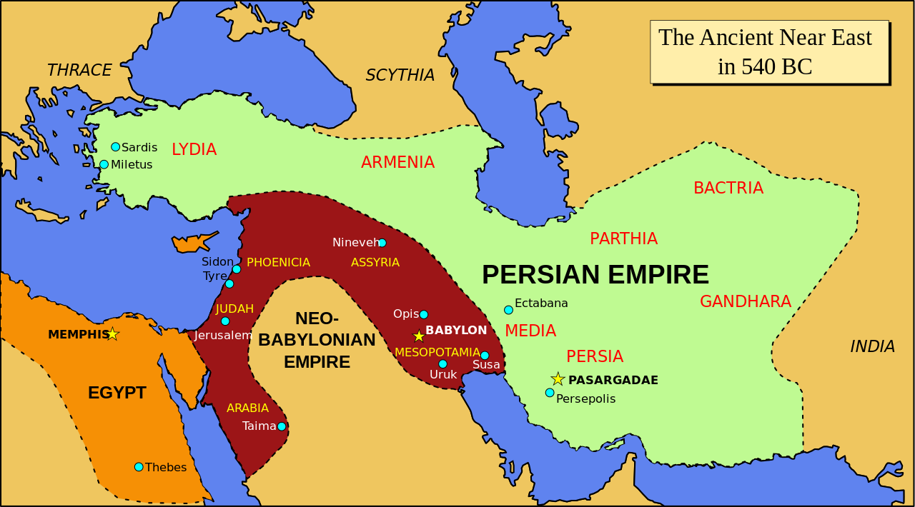

Slide 18
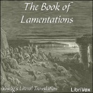
BOOK OF LAMENTATIONS
“The touching significance of this book lies in the fact that it is the disclosure of the love and sorrow of Jehovah for the very people whom He is chastening—a sorrow wrought by the Spirit in the heart of Jeremiah” (Old Scofield, p. 834).
FIRST LAMENTATION
“How doth the city sit solitary, that was full of people! How is she become a widow! She that was great among the nations, and princess among the provinces!... Judah is gone into captivity… she dwelleth among the heathen… the ways of Zion do mourn, because none come to the solemn feasts… she is in bitterness… for the LORD hath afflicted her for the multitude of her transgressions: her children are gone into captivity before the enemy… Jerusalem hath greviously sinned; therefore she is removed…” (Lam. 1:1-5).
Jeremiah’s heart was broken, which is the theme of this book.

Slide 19
SECOND LAMENTATION
Charles Swindol has correctly summarized this chapter as “Words from the Woodshed” (The Bible Knowledge Commentary, p. 1214).
“The LORD hath swallowed up all the inhabitants of Jacob, and hath not pitied: he hath thrown down in his wrath the strong holds of the daughter of Judah; he
that brought them down to the ground (2:2)… And he hath violently taken away his temple… he hath destroyed the places of the assembly: the LORD hath caused the solemn feasts and Sabbaths to be forgotten in Zion… cast off his altar… abhorred his sanctuary… (2:6,7)… Their heart cried unto the LORD… let tears run down like a river day and night… The young and the old lie on the ground in the streets” (2:18-21).
Because of her disobedience, God’s blessings on Israel had now been replaced with His curses as the Law of Moses stipulated (Deut. 28:1,2,15).

Slide 20
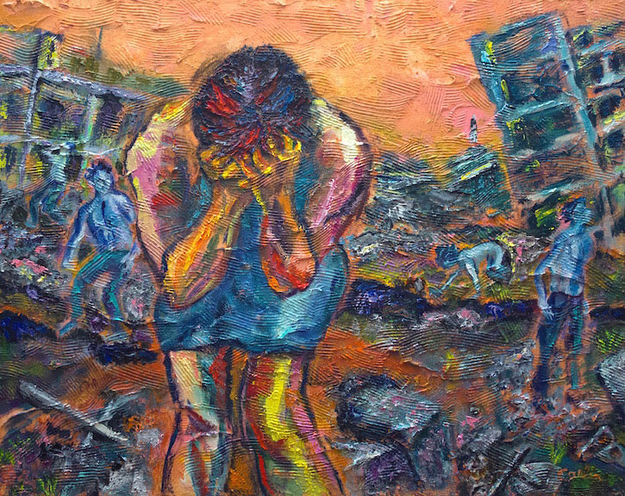
THIRD LAMENTATION
Jeremiah’s personal thoughts – “I am the man that
hath seen affliction by the rod of his wrath… My flesh
and my skin hath he made old… Also when I cry and
shout, he shutteth out my prayer… my strength…
my hope is perished…” (3:1-18).
FOURTH LAMENTATION
Jeremiah turns again to God’s wrath – “The LORD
hath brought forth his fury; he hath poured out his
fierce anger, and hath kindled a fire in Zion, and it
hath devoured the foundations thereof”(4:11).
FIFTH LAMENTATION
The final lament is a petition – “Remember, O LORD,
what is come upon us” (5:1) – Jeremiah says, Don’t
forget us, LORD. Don’t worry, He won’t.
The whereabouts of Jeremiah’s death is unknown. Tradition says that he went [captive] to Egypt, where he was stoned to death (Heb. 11:37).

Slide 21
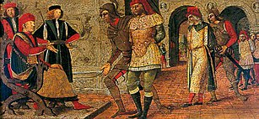
A SIGN OF ISRAEL’S FUTURE BLESSINGS
“And it came to pass in the [37th] year of the captivity of Jehoiachin king of Judah… that Evil-Merodach king of Babylon in the first year of his reign lifted up the head of Jehoiachin king of Judah, and brought him forth out of prison. And spake kindly unto him, and set his throne above the throne of the kings that were with him in Babylon, and changed his prison garments: and he did continually eat bread before him all the days of his life…” (52:31-33).
God said that He would chastise the nation of Israel for 70-years [Babylonian captivity], which He did. But He still loved them and here shows a small gesture that He has not forgotten them. The last rightful king of Judah was released from Babylonian prison and was treated fairly in the new king’s palace.
This was a sign that God would restore His chosen people.

Slide 22
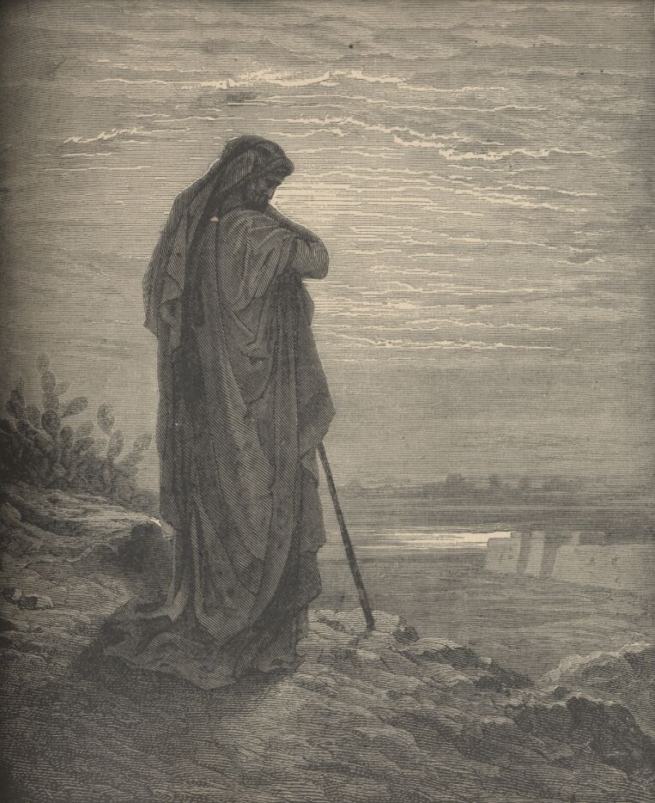
A prophet was called of God, an office not sought after –
“All flattery abandoned, ye who enter here. To be a prophet is both
a distinction and an affliction. The mission he performs is distasteful
to him and repugnant to others; no reward is promised him and no
reward could temper its bitterness. The prophet bears scorn and
reproach. He is stigmatized as a madman… The prophets duty is to
speak to the people, whether they hear or refuse to hear. A grave
responsibility rests upon the prophet”
(THE PROPHETS, Abraham Heschel, Prince Press, p. 18,19).
From their own mouth – “Cursed be the day on which I was born…
Why did I come forth out of the womb, to see sorrow, and spend my days in shame? (Jer. 20:14,17,
18)… They hate him who rebuketh in the gate, they abhor him who speaketh truth (Amos 5:10)…
thou son of man, be not afraid of them… though briars and thorns be with thee… fear them not,
nor be dismayed at their looks… [they] are impudent and stubborn: I send you to them, and you
shall say, Thus saith the LORD God… And whether they hear or refuse to hear…
they will know there has been a prophet among them” (Ezek. 2:6; 3:8,9).
Next time – The prophet Ezekiel speaks from Babylonian captivity.

