Slide 1
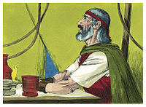
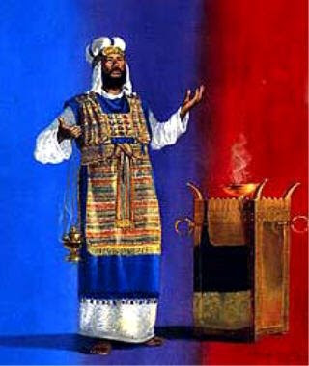
THROUGH THE BIBLE IN 2018
LESSON 7
WEEK 7 OF 52
(Exo. 39–Lev. 18)
Last time we saw the layout of the wilderness tabernacle and how it was a picture of the Cross. This time, the operation of the tabernacle.
HIGH PRIEST
“And of the blue, and purple, and scarlet, they made cloths of service, to do service in the holy place, and made the holy garments for Aaron; as the LORD commanded Moses”
(Exo. 39:1).
Moses’ brother Aaron was chosen to be Israel’s first high priest and his regal attire would befit the importance of his office.
“And the LORD spake unto Moses, saying, on the first day of the first month shalt thou set up the tabernacle of the tent of the congregation…” (Exo. 40:1).
After everything had been made concerning the tabernacle, God instructed Moses when, how, and who should set it up.

Slide 2
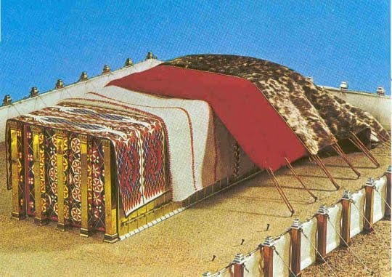
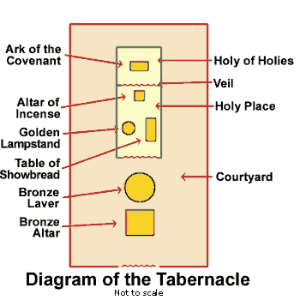
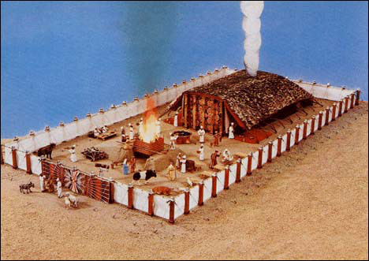
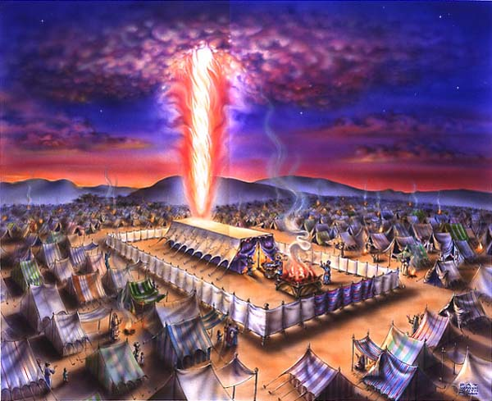
“And it came to pass in the first month [April] in the second year [after the Exodus from Egypt], on the first day of the month, that the tabernacle was reared up. And Moses reared up the tabernacle … and put the covering of the tent… and he took and put the testimony [tablets] into the ark… and put the mercy seat above upon the ark… and he brought the ark into the tabernacle, and set up the vail… and he put the table… and he put bread in order upon it… and he put the candlestick in the tent… and he lighted the lamps… and he put the golden alter before the vail… and he burnt sweet incense thereon… and he put the altar of burnt offering by the door… and he set the laver between… and put water there, to wash withal… so Moses finished the work (Exo. 40:17-33). Then a cloud covered the tent… the glory of the LORD filled the tabernacle… For the cloud of the LORD was upon the tabernacle by day, and fire was on it by night …” (Exo. 40:34-38). Moses did as the LORD said.

Slide 3
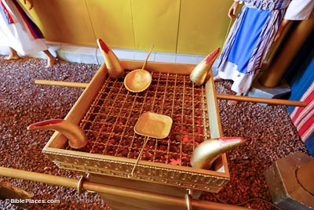
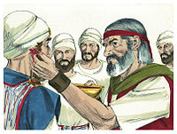
Moses did one more thing before he was finished
setting up the tabernacle –
“Whereupon neither the first [old] testament was
dedicated without blood. For when Moses had
[earlier] spoken every precept to all the people
according to the law, he took the blood of calves
and of goats… And he sprinkled both the book [Law],
and all the people, saying, this is the blood of the
[old] testament which God hath enjoined unto you…
…Moreover he [present] sprinkled with blood both
the tabernacle, and all the vessels of the ministry.
And almost all things are by the law purged with
blood; and without the shedding of blood is no
remission [forgiveness]” (Heb. 9:18-22).
Israel could have no relationship with God under the Old Covenant without the shedding of innocent BLOOD.

Slide 4
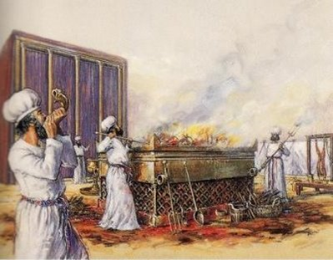
OPERATION OF THE TABERNACLE
“Speak unto the children of Israel, and say unto them, if any man of you bring an offering unto the LORD… and he [Israelite] shall kill the bullock before the LORD: and the priests, Aaron’s sons, shall bring the blood and sprinkle the blood round about upon the [bronze] altar that is by the door of the tabernacle… cut it into pieces… he [priest] shall wash the inwards and the legs with water: and the priest shall bring it all, and burn it upon the altar… it is a burnt-sacrifice, an offering made by fire, of a sweet savour unto the LORD” (Lev. 1:2-17).
This ritual and many like it (Lev. 2-7) was required of God as mandated under the Old Covenant.
But, why were they required and what did they mean?

Slide 5
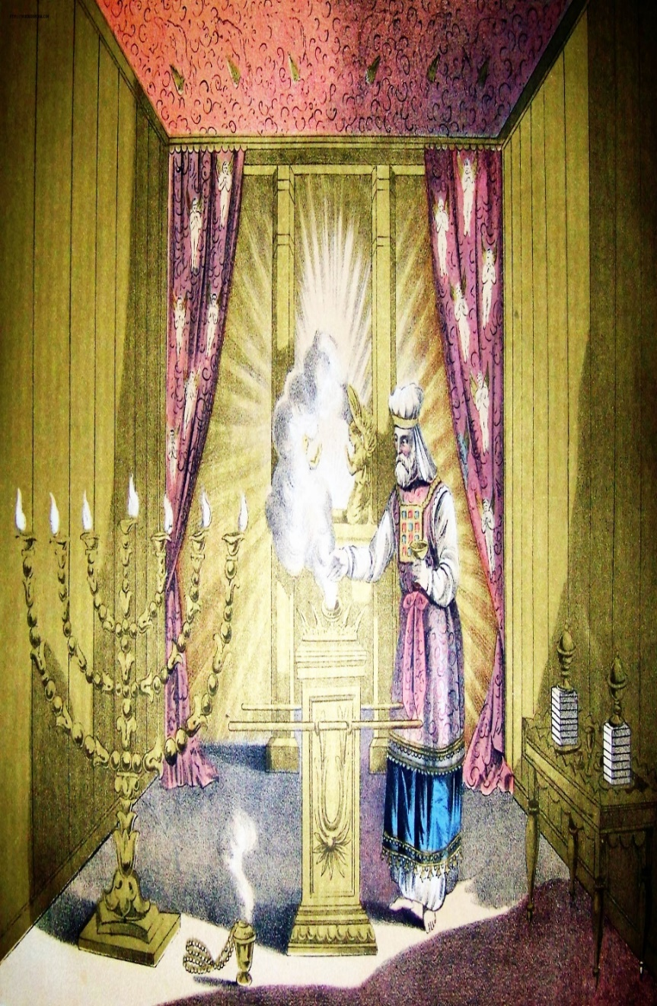
EPISTLE TO THE HEBREWS
“… seeing that there are priests that offer gifts according to the [old
covenant] law. Who serve unto the example and shadow of
heavenly things, as Moses was admonished of God when he was
about to make the tabernacle…” (Heb. 8:4,5). “For if that first [old]
covenant had been faultless, then should no place have been
sought for the second [new covenant]… not according to the [old]
covenant that I made with their fathers… they [broke]…” (8:9).
Because of the Israelites sin-nature, the Old Covenant [Law of
Moses] was impossible to keep. They sinned—they sacrificed,
and they repeated it over, and over, and over –
“… in which were offered both gifts and sacrifices, that could not make him perfect [sinless]” (9:9)… “Neither by the blood of goats and calves… sprinkling the unclean [sinners] sanctifieth to the purifying of the flesh” (9:12,13).
This first system of righteousness God gave to Israel was a monumental case in futility, but thankfully it was only meant to be temporary until something better came along!

Slide 6
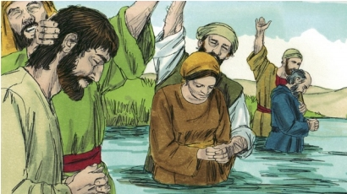
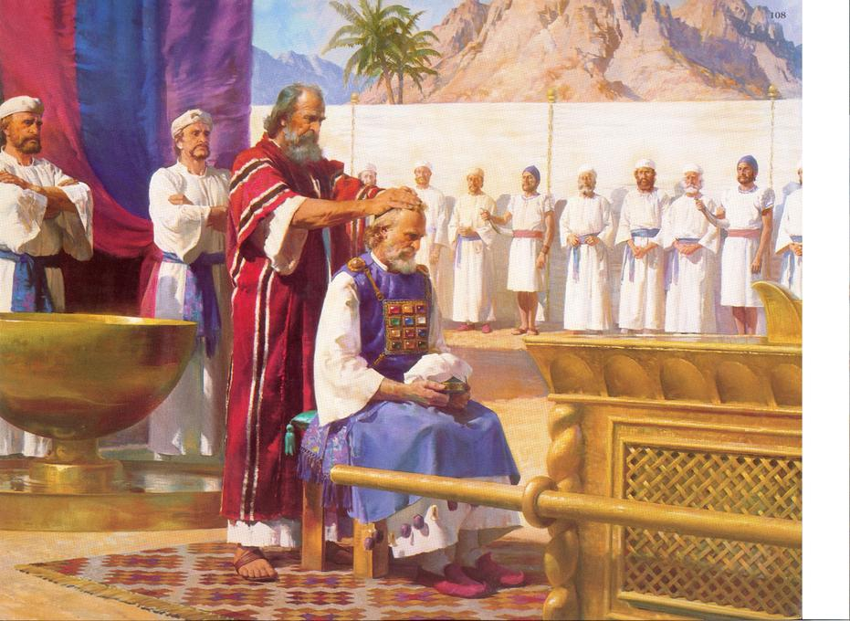
“Take Aaron and his sons with him, and the garments, and
the anointing oil… And Moses brought Aaron and his sons,
and washed them with water” (8:2,6).
Aaron and his sons [priesthood] had to be symbolically
made clean [holy], which was done through a series of God-
given rituals including washing with water. Not only did they
wash themselves, but they washed their utensils, their
garments, even parts of the sacrificed animals – “… divers
[different] washings [baptisms]” (Heb. 9:10).
When John the Baptist was called of God to prepare Israel for
their Messiah, the first thing he did was to WASH those who
believed – “John did baptize [wash] in the wilderness, and
preach the baptism [washing with water] of repentance for the remission of sins” (Mk. 1:4).
In order for Israel to become ‘an holy nation… kingdom of priests’ (Exo. 19:6), each Jew had to
confess their sins and be symbolically cleansed [water]. They could not be saved without
this washing – “He that believeth and is baptized [washed] shall be saved…” (Mk. 16:16).

Slide 7
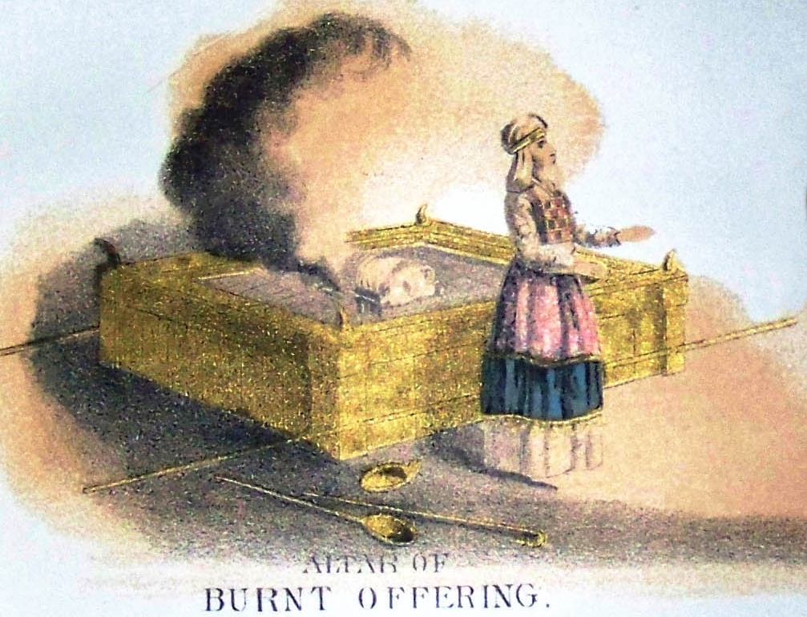
“And Moses said unto Aaron, Go unto the alter,
and offer thy sin-offering, and thy burnt-offering,
and make an atonement for thyself, and for the
people” (9:7).
Aaron was to make offerings to God for himself and then for the Israelites.
After carrying out all these rituals, the priests could then begin to carry out their day-to-day priestly work for the people of Israel.
“And there came a fire out from before the LORD, and consumed… the burnt offerings… when the people saw, they shouted and fell on their faces” (9:24).
God was in their midst and from time to time
demonstrated His power of the miraculous to prove it!

Slide 8
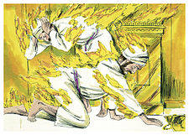
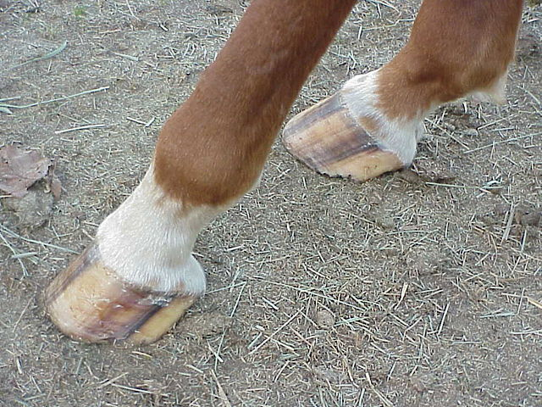
STRANGE FIRE
“And Nadab and Abihu, the sons of Aaron took either from
them his censer, and put fire therein, and put incense there-
on, and offered strange fire before the LORD which, he
commanded them not. And there went out fire from the
LORD, and devoured them, and they died before the LORD”
(10:1,2).
Perhaps overly eager to begin their priestly duties, these
sons of Aaron got ahead of God and paid for it with their life.
DIETARY LAWS
“Speak unto the children of Israel, saying, These are the
beasts which ye shall eat among all the beasts that are on
the earth… is clovenfooted, and chewth the cud… that shall
ye eat… make a difference between the unclean and the
clean…” (11:1-47).
These food laws were an extremely important part of God’s instructions for this time (Heb. 9:10).

Slide 9
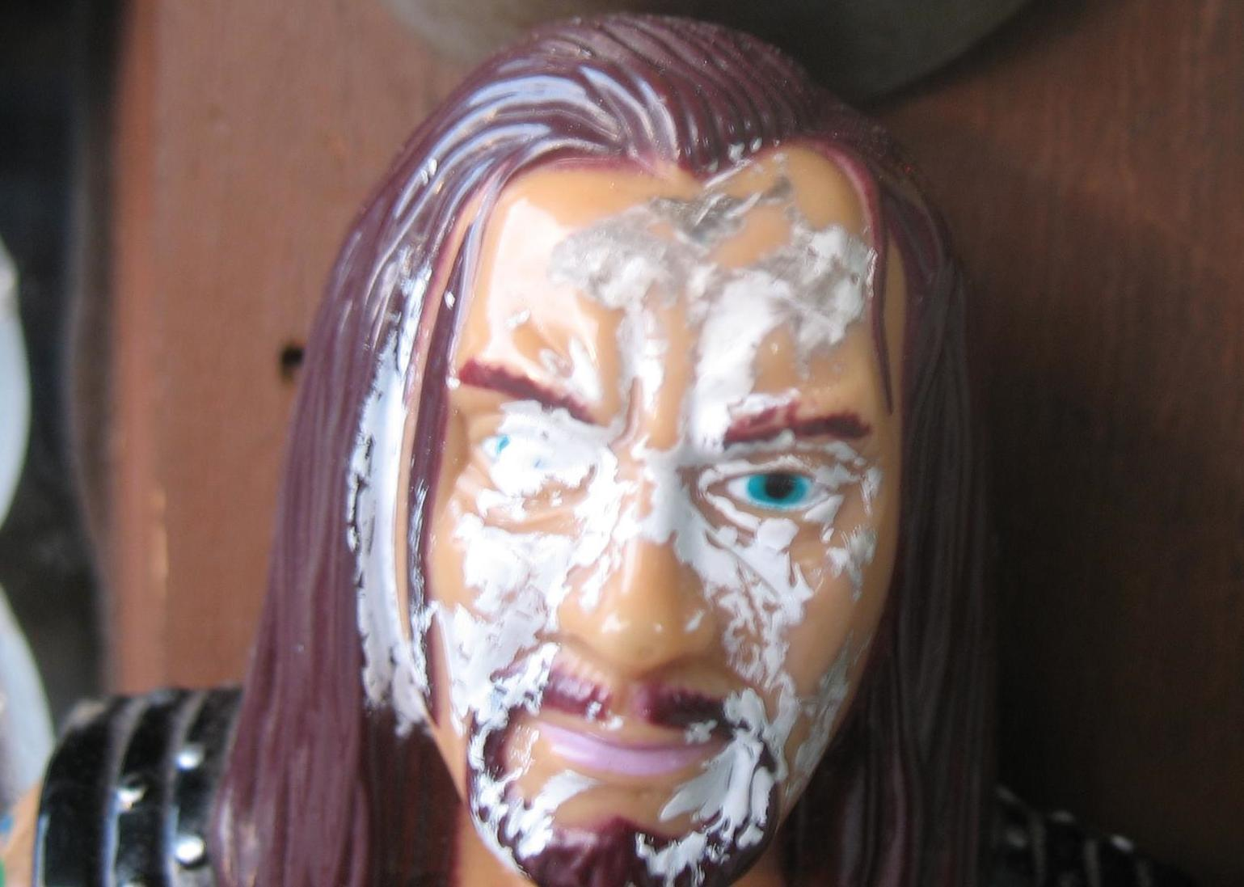
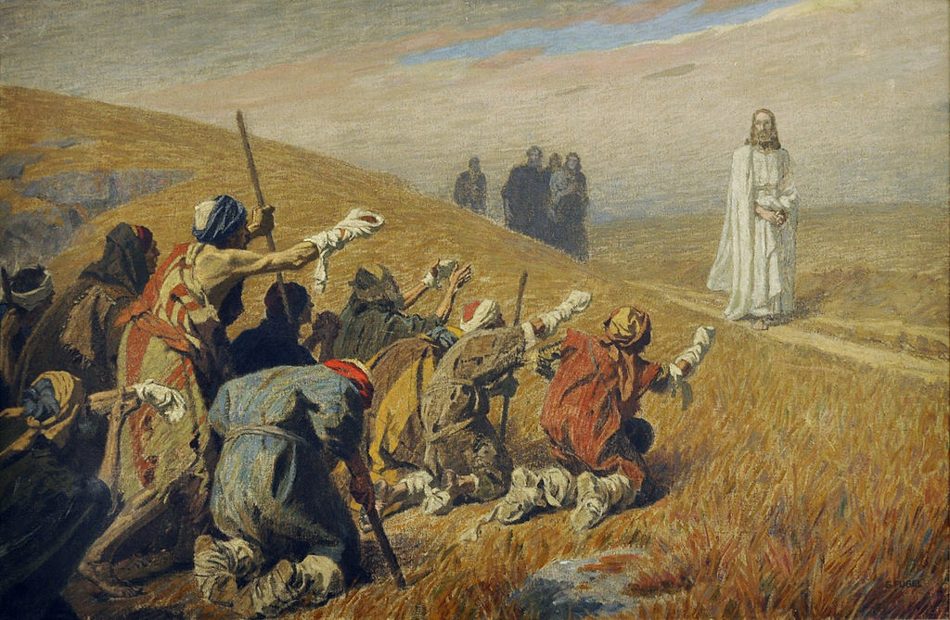
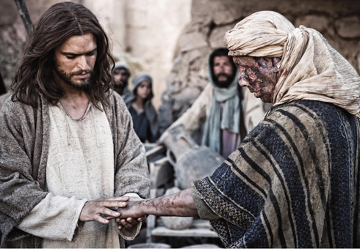
DISEASE
“And the LORD spake unto Moses and Aaron, saying, when a man shall have in the skin of his flesh a rising, a scab, or bright spot, and it be in the skin of his flesh like the plague of leprosy; then he shall be brought into Aaron the priest, or unto one of his sons the priests … shut him up… pronounce him unclean…” (13:1-11).
Another duty of the priests was to diagnose and then quarantine those who were afflicted with diseases like leprosy.
During His earthly ministry, Jesus healed a leper (Mt. 8:3), in fact, many lepers (Mt. 11:5).
In Israel’s millennial kingdom, disease will be largely eradicated (Isa. 11:5,6) and death will be rare (Isa. 65:20).

Slide 10
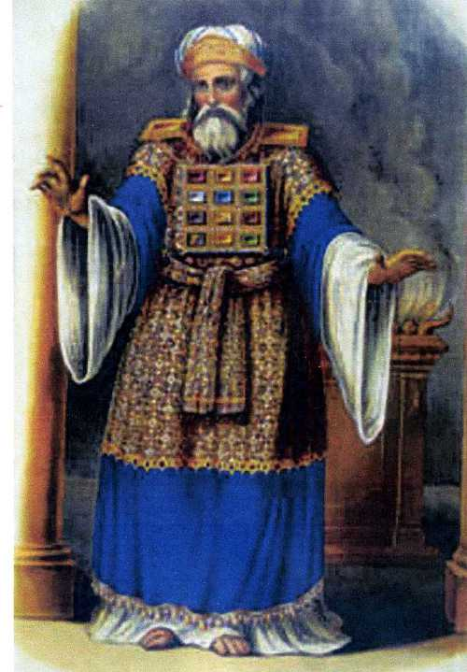
DAY OF ATONEMENT
“And the LORD spake unto Moses after the death of the two
sons of Aaron, when they offered before the LORD, and died”
(16:1).
God required exact rules as to how the priestly duties were
carried out, especially that of the high priest. The bottom of
Aaron’s garment contained bells – “And it shall be upon Aaron
to minister: and his sound shall be heard when he goeth in
unto the holy place before the LORD, and when he cometh
out, that he die not” (Exo. 28:35).
“Speak unto Aaron thy brother, that he come not at all times
into the holy place within the vail before the mercy seat, which
is upon the ark; that he die not: for I will appear in the cloud
upon the mercy seat” (16:2).
No one had access to Christ who was invisibly enthroned above the ark of the covenant in the Holy of Holies except on one specific occasion, but first Aaron must prepare himself to do so.

Slide 11
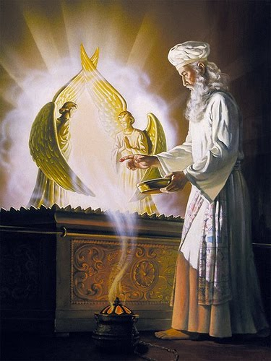
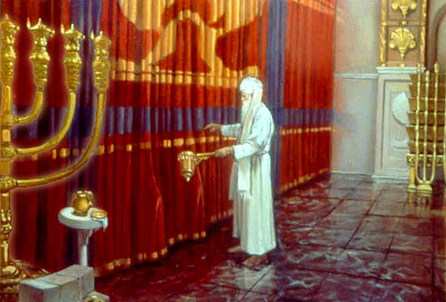
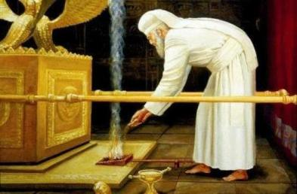
“Thus shall Aaron come into the holy place… he wash his flesh in water… put on holy linen … And Aaron shall offer his… sin offering… an atonement for himself… take a censer full of burning coals of fire from the [bronze] altar… put the incense upon the fire before the LORD, that the cloud of the incense may cover the mercy seat that is upon the testimony [ark], that he die not” (16:3-13).
On the Day of Atonement, Aaron went beyond the vail and entered the Holiest place 3 times:
1. to make a smoke screen;
2. to offer blood for his sin;
3. to offer blood for the nation’s sin—
“And he shall take the blood…and sprinkle it with his finger upon the mercy seat… [7] times (16:14)… uncleanliness of the children of Israel” (16:16).

Slide 12
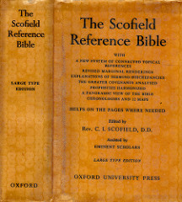
“Atonement. In the O.T. atonement is the English word used to translate the Hebrew words which mean ‘cover,’ (at-one-ment)… The Levitical offerings ‘covered’ the sins of Israel until, and in anticipation of the Cross, but it did not ‘take away’ those sins (Heb. 10:4). These were the ‘sins done aforetime’ (covered) in the meantime by the Levitical sacrifices, which God ‘passed over’ (Rom. 3:25)… God’s righteousness was never vindicated [fulfilled] until, at the Cross, Jesus Christ was set forth a propitiation [sacrificial payment]… It was the Cross, not the Levitical sacrifices which made ‘at-one-ment.’ The O.T. sacrifices enabled God to go on with a guilty people because they typified the Cross. To the offerer [Israelites] they were the confession of his desert of death, and the expression of his faith; to God they were ‘shadows’ (Heb. 10:1) of which Christ was the reality" – Old Scofield, p. 148.

Slide 13
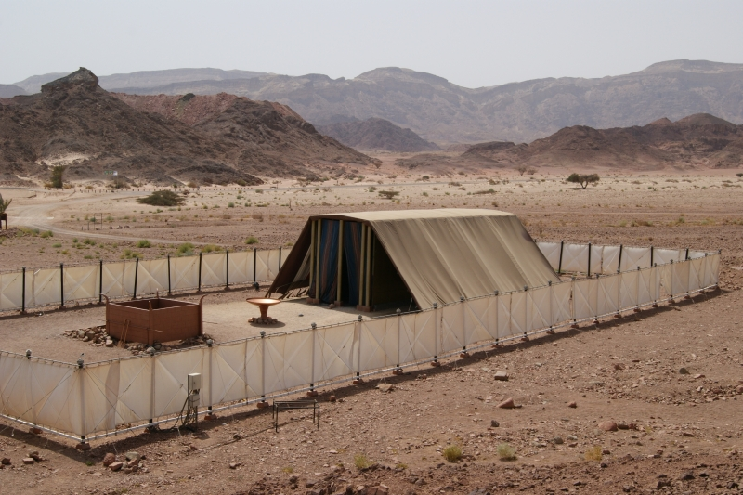
The same thing that the priests did daily [sprinkling of blood before the vail (Lev. 4:6)], Aaron did once a year beyond the vail (16:14,15) in the Holy of Holies. But, it only covered Israel’s sin. Though God commanded Israel to do these daily sacrifices and a yearly Day of Atonement, over and over—for 1,500 years Israel carried out these rituals—NOT ONE SIN was removed.
Not until Christ –
“For the law having a shadow of good things to come [Christ’s sacrificial payment], and not the very image of the things, can never with those [animal] sacrifices which they offered year by year continually make the comers thereunto perfect [sinless]” (Heb. 10:1).

Slide 14
“Now when these things were thus ordained, the priests went always into the first tabernacle [Holy Place], accomplishing the service of God. But unto the second [Most Holy Place] went the high priest alone once every year, not without blood, which he offered for himself, and the [sins] of the people” (Heb. 9:6,7).
Aaron’s sons [priests] did their daily priestly duties in the Holy Place; Aaron [high priest] went into the Most Holy Place once a year [Day of Atonement] for the collective sins of the nation for the whole year.
But, there is one more Holy place.

Slide 15
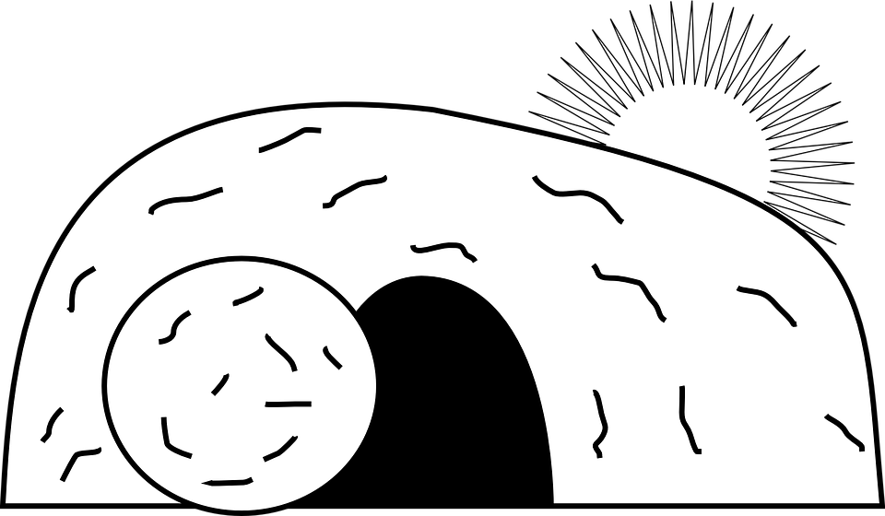
“The Holy Ghost this signifying, that the way into the holiest of all was not yet made manifest, while as the first tabernacle was yet standing… But Christ being come an high priest of good things to come, by a greater and more perfect tabernacle, not made with hands, that is to say, not of this [earthly] building (Heb. 9:6-8).
The Holiest of all places is not on earth…
Following His Resurrection – “For Christ is not entered into the holy places
made with hands [temple in Jerusalem], which are the figures of the
true; but into heaven itself, now to appear in the presence of God
for us. Nor yet that he should offer himself often, as the high
priest entereth into the holy place every year with blood of
others… but now once in the end of the [age of Law] hath
he appeared to put away sin by the sacrifice of himself”
(Heb. 9:24-26).
After His death, burial, and resurrection, Christ had one more
mission—to sprinkle His blood on the mercy seat in heaven. Now atonement was complete.

Slide 16
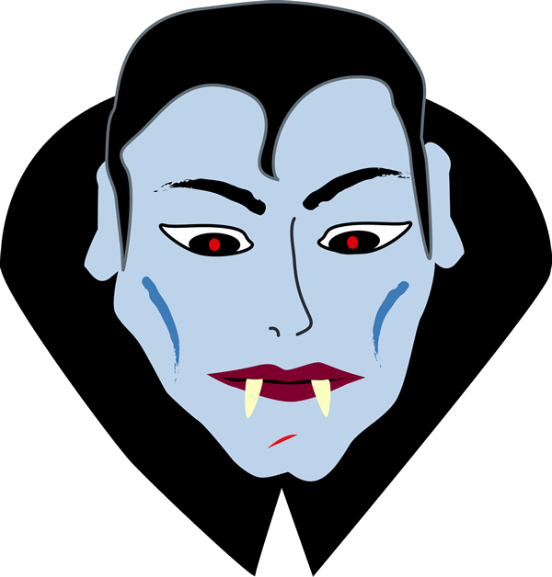
“And whatsoever man there be of the house of Israel, or of the strangers [proselytes] that sojourn among you, that EATETH any manner of blood: I will even set my face against that soul that eateth blood, and will cut him off from among his people” (17:10).
I can see that someone like Dracula would be
abhorrent to God –
“For the life of the flesh is in the blood: and I have given it to you upon the altar to make an atonement for your souls: For it is the blood that maketh an atonement for the soul” (17:11).
I can also see why God holds blood so important in the salvation process, but what I cannot see
is that a small group of religious zealots use
this passage as their basis for not permitting…

Slide 17
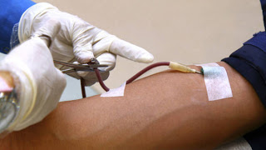
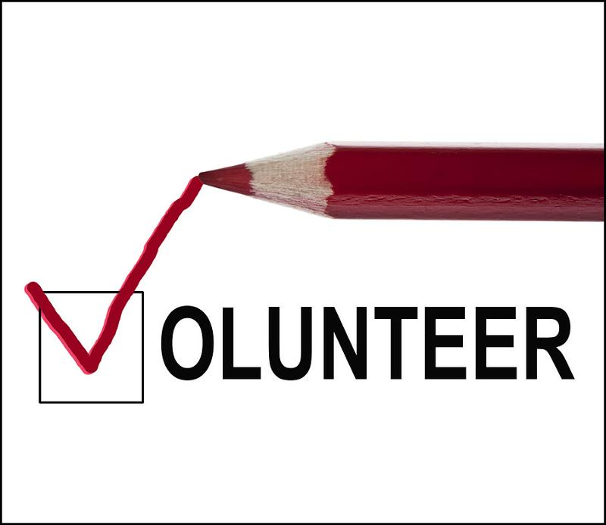
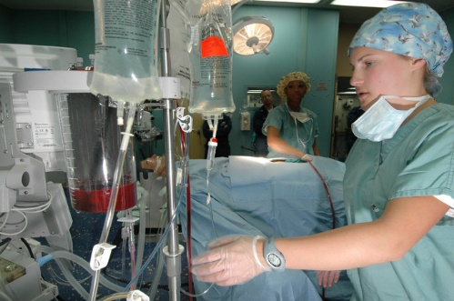
J.W.’s hierarchy go to great lengths to prevent their membership from engaging in blood transfusions even when a life is at stake, believing they will be
‘cut off’ from God. Courts will not intervene in the decision of an adult who refuses blood under any circumstances, but will intervene and allow the transfusion of a minor in life threatening situations. Ironically, they will accept a technical loop hole such as the use of a Cell-Saver.

Slide 18
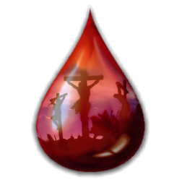
REAL MEANING
“For the life of the flesh is in the blood: and I have given it to you upon the altar to make an atonement for your souls: For it is the blood that maketh an atonement for the soul” (17:11).
Old Scofield, p. 150 – “The value of life is the measure of the value of the ‘blood.’ This gives the blood of Christ its inconceivable value. When it was shed the sinless God-man gave his life… It is not the blood in the veins of the sacrifice [animal or Christ], but the blood upon the altar which is efficacious. The Scripture knows nothing of salvation by the imitation or influence of Christ’s life, but only by that life yielded up on the cross.”
The J.W.’s do NOT believe in the Divinity of Christ, therefore minimize His finished work.
We believe it was everything
concerning our salvation!

Slide 19
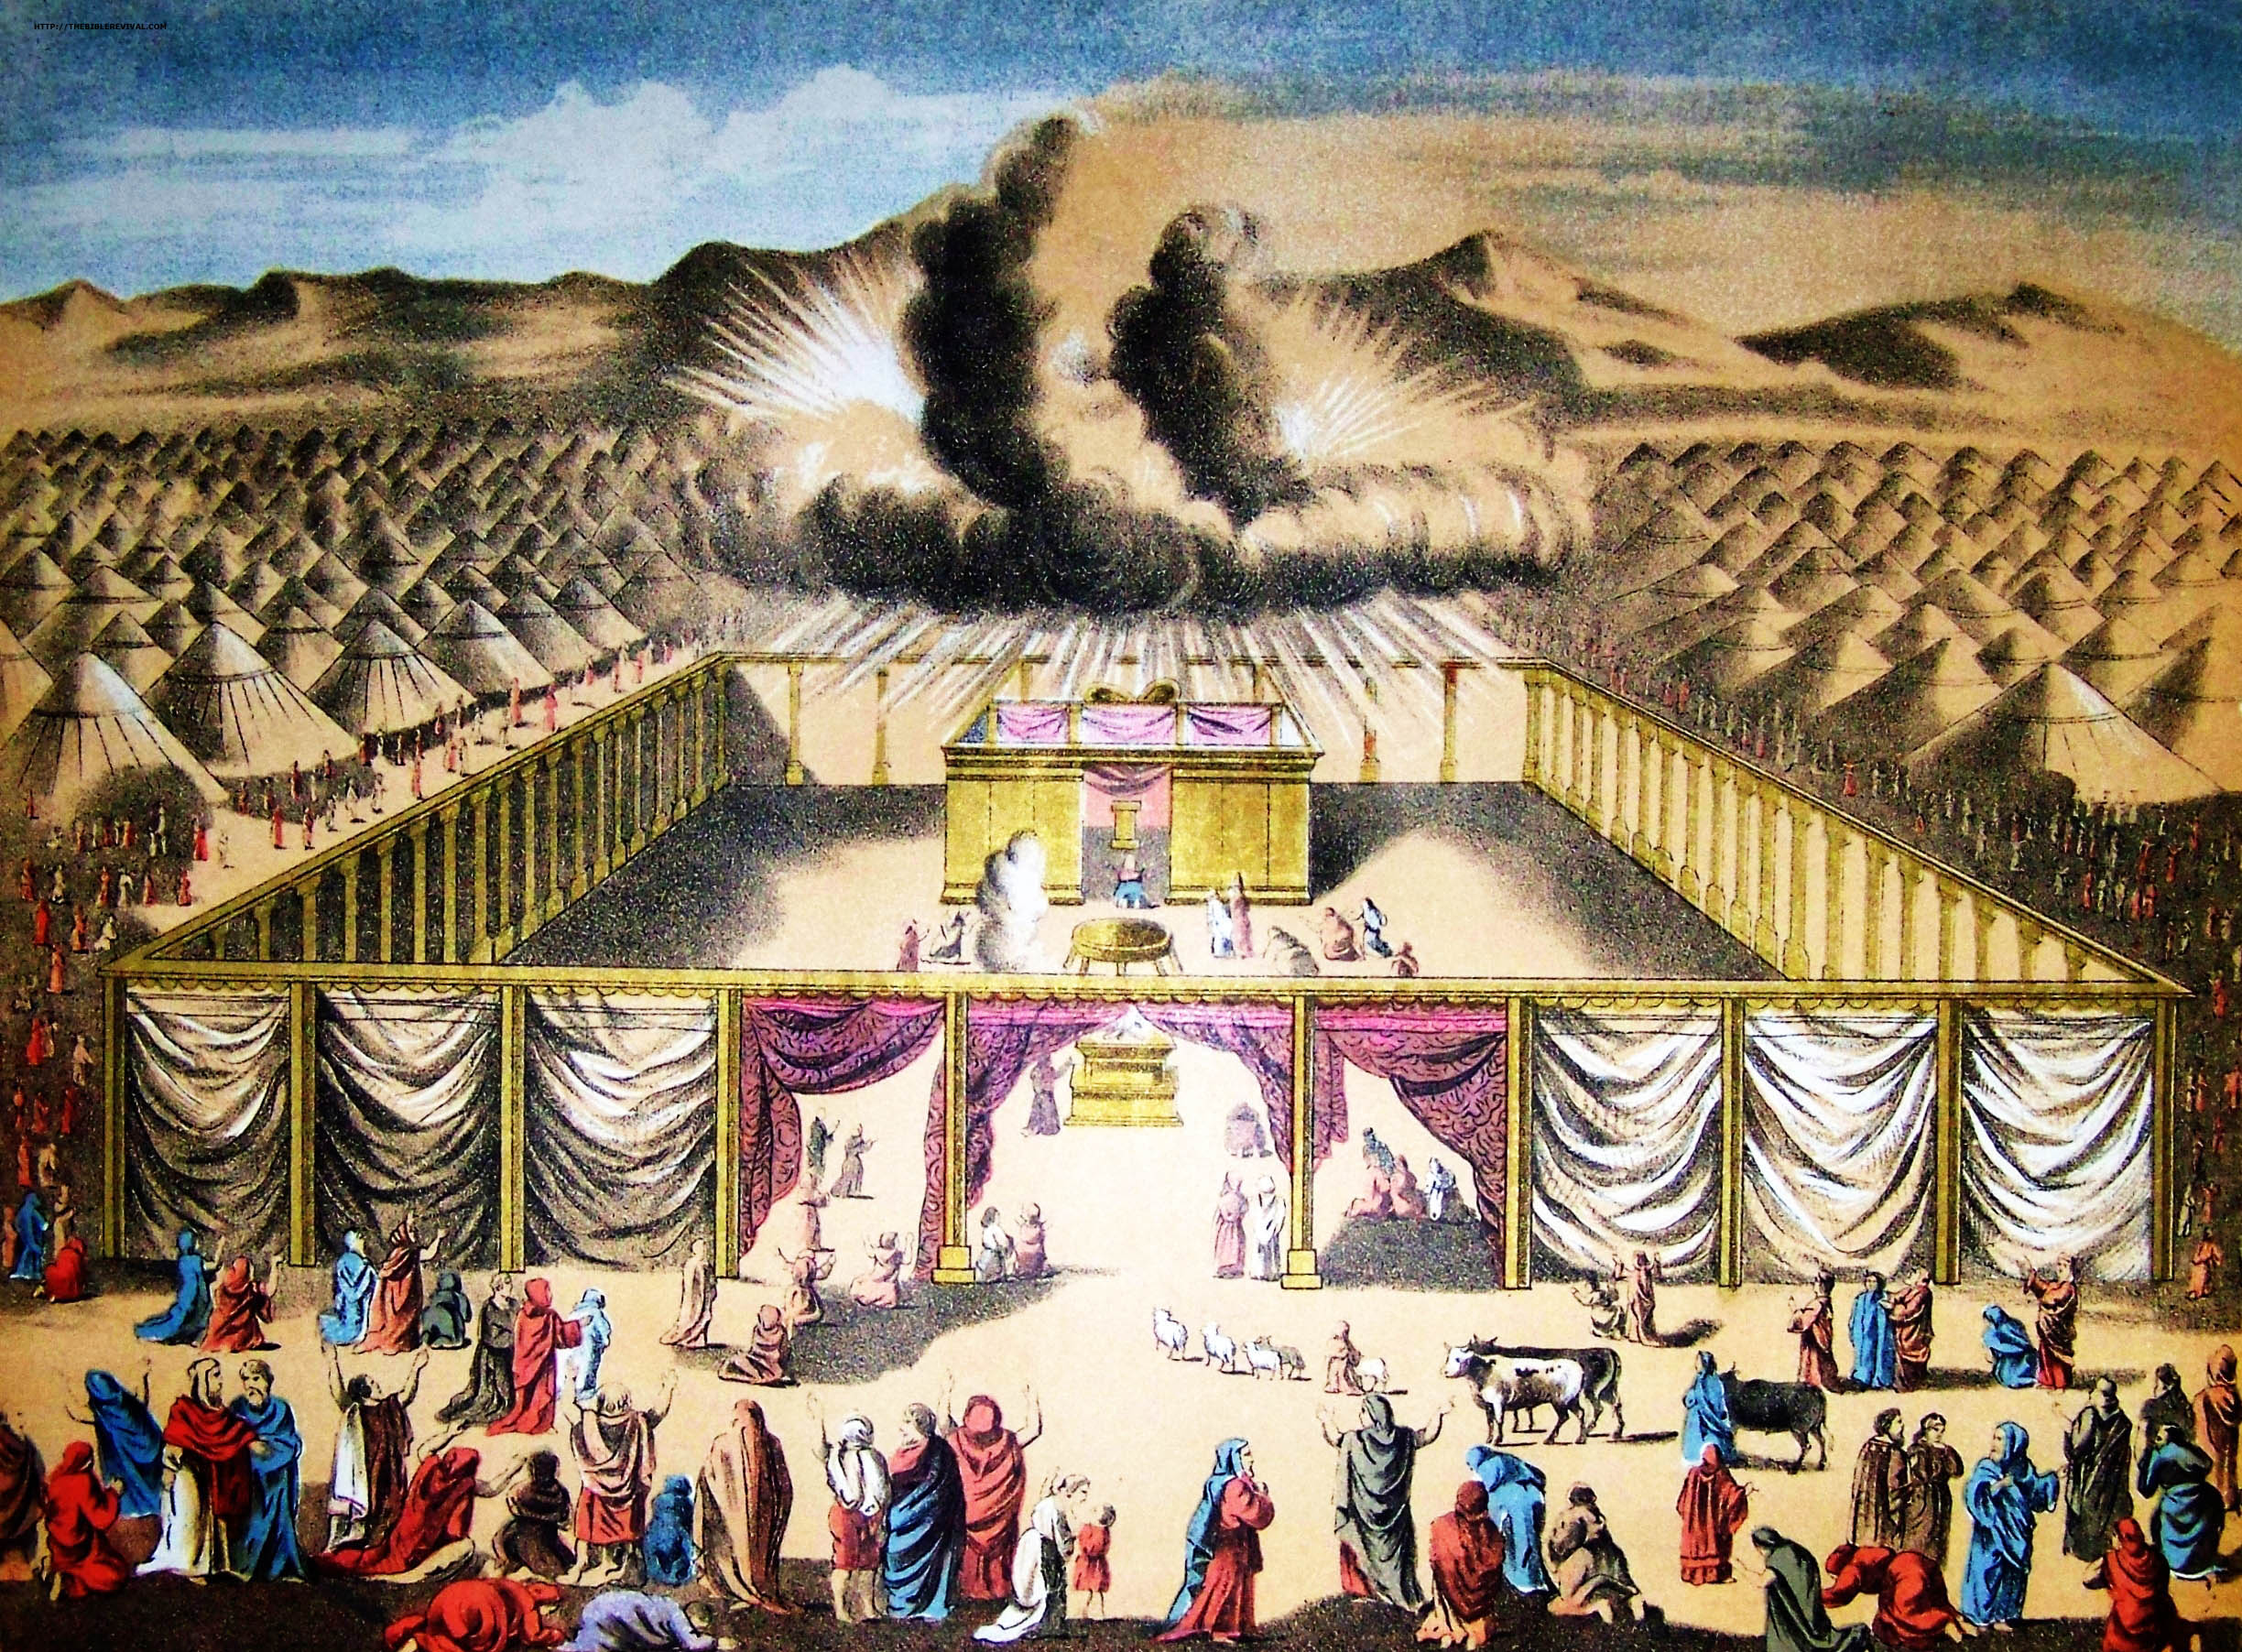
NEXT TIME – LEV. 19 - NUM. 6
THE CENSUS
ISRAEL’S FEAST DAYS:
SPRING
PASSOVER
UNLEAVENED BREAD
FIRST FRUITS
PENTECOST
FALL
TRUMPETS
DAY OF ATONEMENT
TABERNACLES

