Slide 1
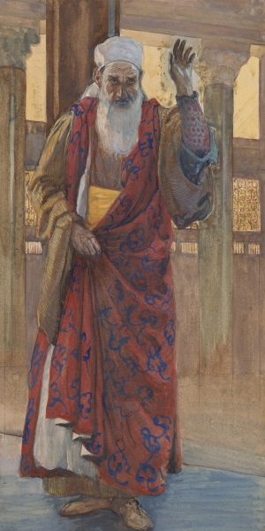
THROUGH THE BIBLE IN 2018
LESSON 30
WEEK 30 OF 52
(Isa. 28-48; 2Kg. 19)
Last time we saw a view of the future
apocalypse; this time God speaks with
another tongue.
“Woe to the crown of pride, to the drunkards of Ephraim, whose glorious beauty is a fading flower… overcome with wine!... shall be trodden under foot” (Isa. 28:1-3).
Isaiah next pronounced a series of ‘woes,’ first on the northern kingdom [Israel] for not heeding God. In addition to their practice of idolatry and failure to keep the Law, he also blamed them for their wealth and excessive life style. God was watching and He didn’t like what He saw—His judgment was about to fall.
“But they have also erred through wine, and through strong drink… all tables are full of vomit… no clean place…” (28:7,8).
He described their behavior like a banquet full of drunkards, who had vomited all over the tables, a filthy sight before God.

Slide 2
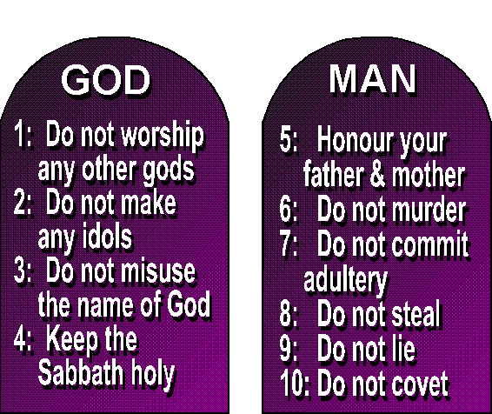
“Whom shall he teach knowledge? And whom shall he make to understand doctrine? Them that are weaned from the milk and drawn from the breasts. For precept must be upon precept; line upon line… here a little, and there a little” (28:9,10).
Thus far, Isaiah was laying a large part of the blame of the immoral behavior of Israel on their religious leaders, priests and so-call prophets [false], who were receiving revelations from
their gods, but were ignorant of the doctrine already given them from God through Moses [Law]. Isaiah was making them look like children and wanted them to turn from their [spiritual] diet of milk to the deep truths they had been given. God had laid out His [613] Laws at Sinai beginning with the basic precept that HE IS THE ONLY TRUE GOD. God had revealed it slowly beginning with the first 10 laws. The first 4-laws were how to honor Him; the next 6 were how they were to honor their fellowman.
“The secret things belong unto the LORD our God:
but those things which are revealed belong to us
and to our children for ever, that we may DO ALL
THE WORDS OF THIS LAW” (Deut. 29:29).
God’s plan for Israel was given a little at a time,
but they had rejected it, and now they would pay.

Slide 3
“For with stammering lips and another tongue will he speak to this people… yet they would not hear. But the word of the LORD was unto them precept upon precept… line upon line… here a little, and there a little; that they might go, and fall backward, and be broken, and snared, and taken” (28:11-13).
If Israel would not listen to Isaiah as he spoke to them, then God would use another set of lips, another tongue—that is, another NATION [Assyria] to speak judgment to them, which would cause them to fall even further backward, to be broken and snared, and taken into captivity.
This is the first use of a ‘tongue,’ which God used TO SPEAK TO ISRAEL [not the Body of Christ], concerning His judgment upon them. It was a known language [Assyrian], but it was God’s warning to Israel of His judgment to come. Every time Israel heard an invading army with a foreign tongue they didn’t understand, they should know that God’s judgment was upon them – Assyrian, Babylonian, Media-Persia, Greek, Roman.

Slide 4
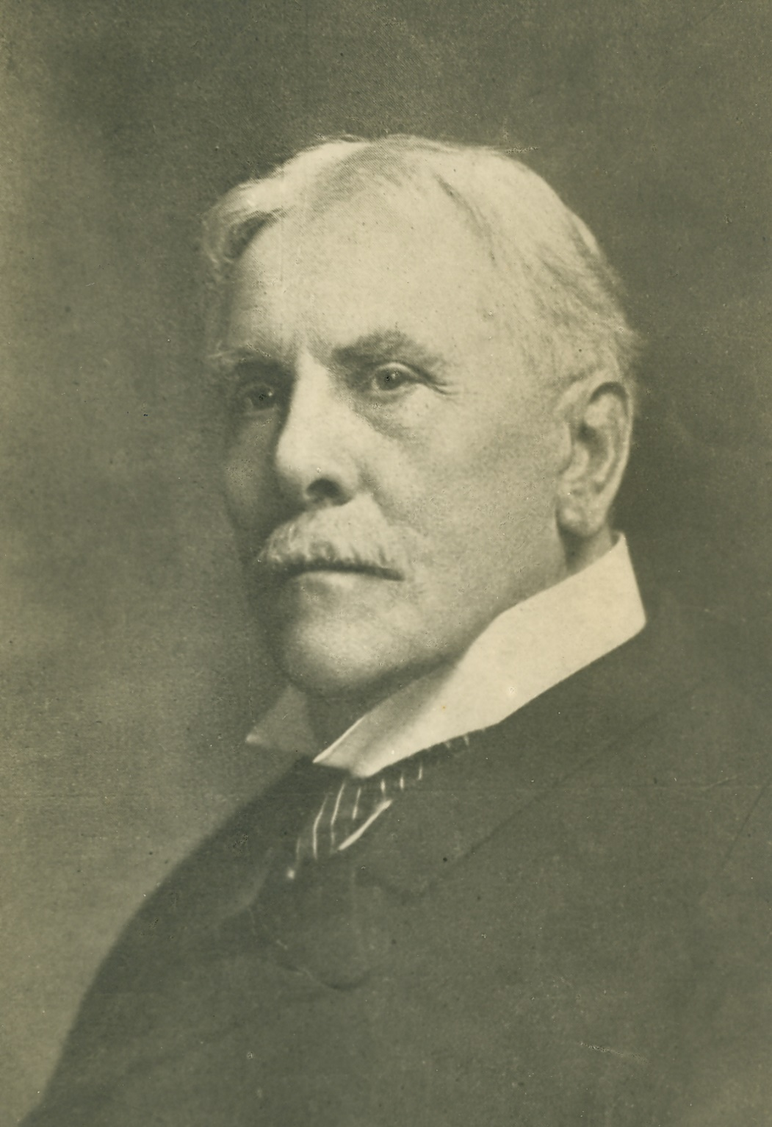
WOE ON JERUSALEM [JUDAH]
“Woe to Ariel… the city where David dwelt!... Yet I will distress Ariel, and there shall be heaviness and sorrow…” (29:1,2).
The first ‘woe’ was on the northern kingdom evidenced by invasion of the Assyrian army and the 1st exile of Jews into captivity; this second was on Ariel, “lion of God,” which is Jerusalem [Judah]. Though the city will be surrounded by Assyria, causing tremendous hardships, God will not let the southern kingdom fall yet, but she will greatly suffer.
“Here, as often in prophecy, and especially in Isaiah, the near and far horizons blend. The near view is of Sennacherib’s invasion… the far view is that of the final gathering of the Gentiles [Armageddon] against Jerusalem at the end of the great tribulation (Psa. 2:5; Rev. 7:14), when a still greater deliverance will be wrought” (Old Scofield, p. 737).
Isaiah had perhaps a clearer and wider view of God’s plan than any Jewish prophet.

Slide 5
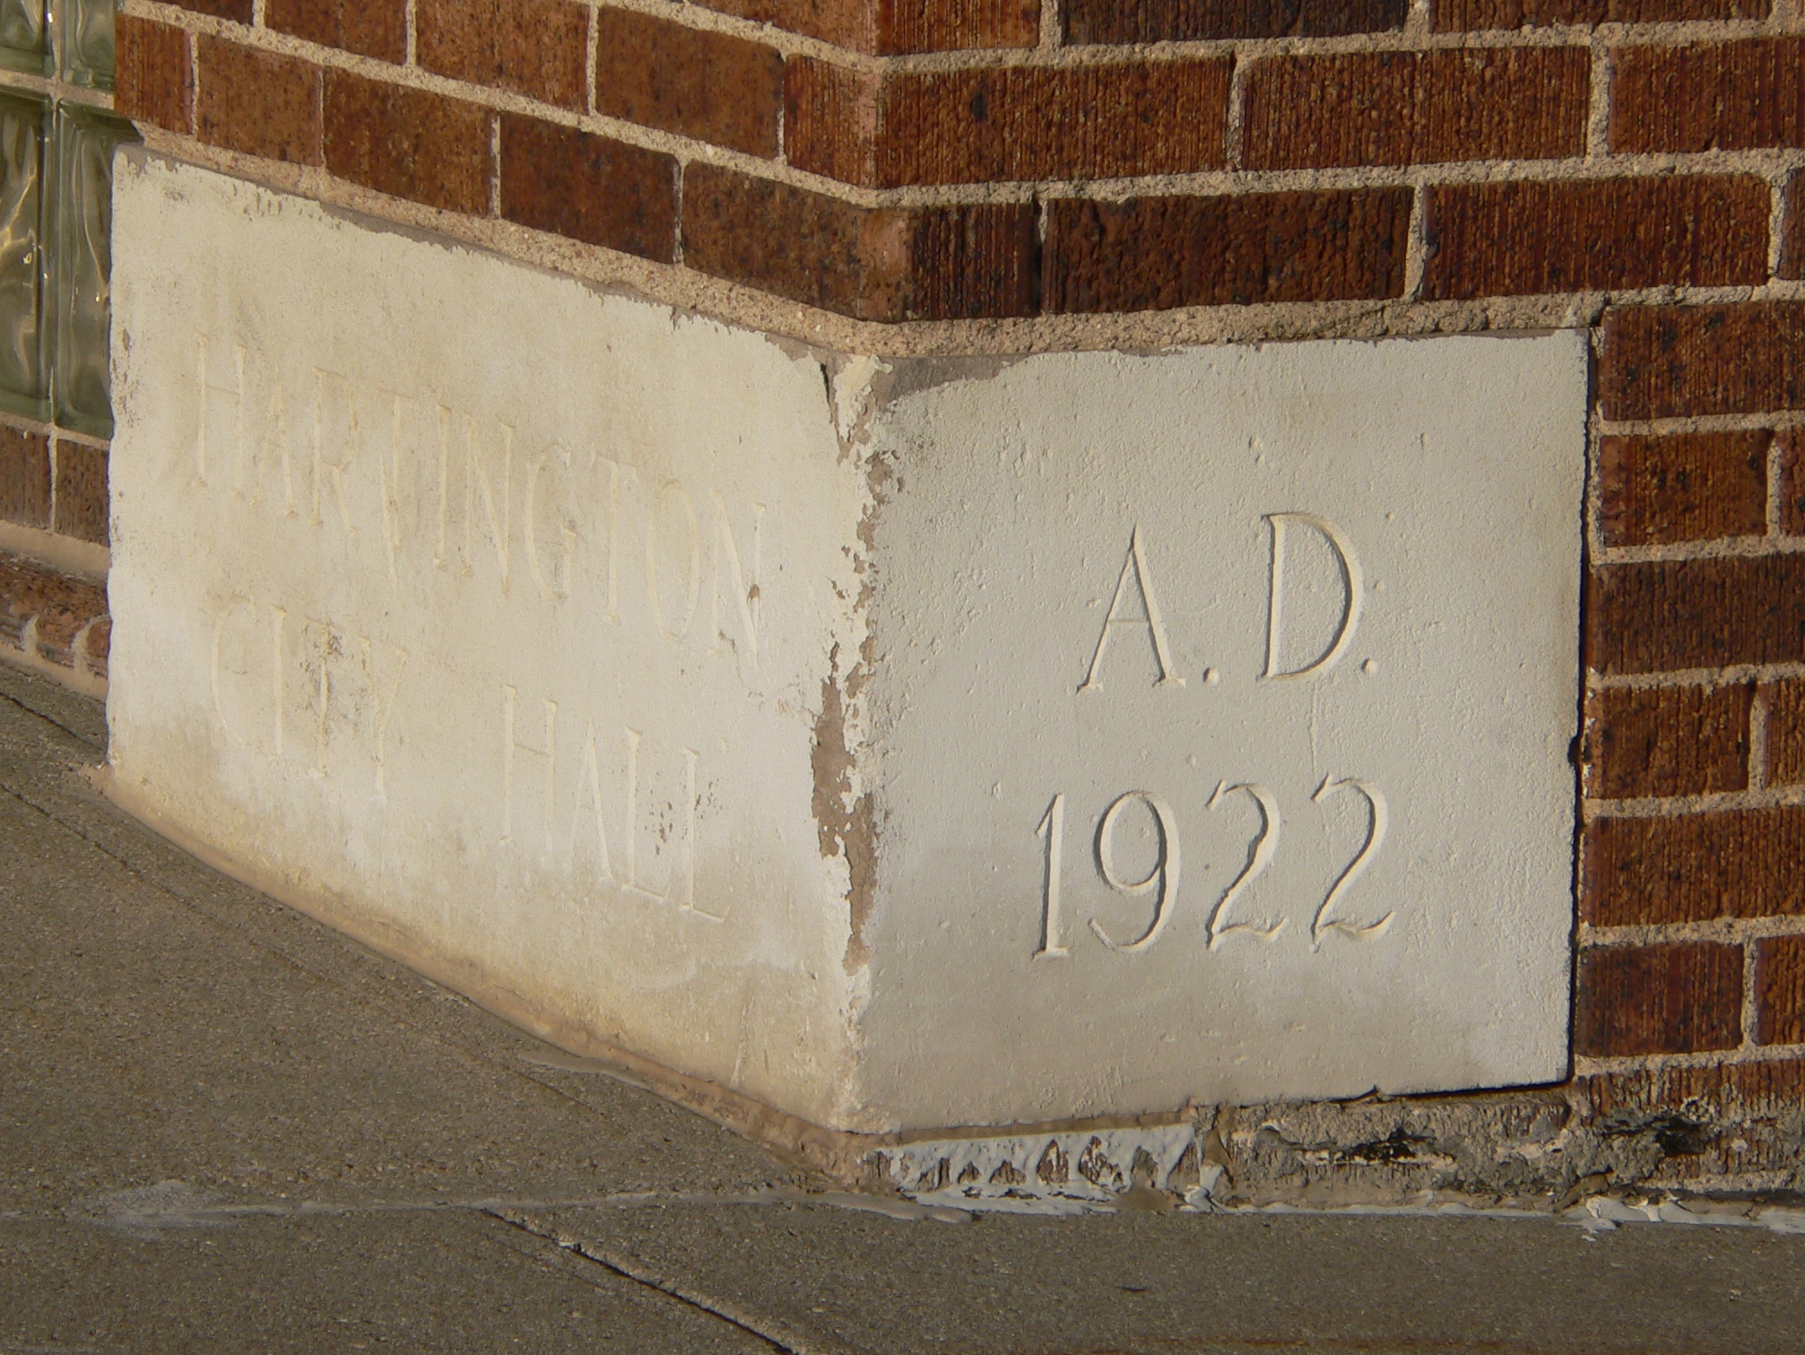
“Woe to the rebellious children, saith the LORD, that take counsel, but not of me… That walk to go down into Egypt, and have not asked at my mouth; to strengthen themselves in the strength of Pharaoh, and to trust in the shadow of Egypt!... Be your shame… your confusion” (30:1-3).
The next woe was Judah’s alliance with Egypt to withstand the Assyrian attack. Isaiah told Israel who their only partner should be, “Therefore thus saith the Lord God, Behold, I lay
in Zion for a foundation a stone, a tried stone, a precious corner stone, a sure foundation” (Isa. 28:16).
The leaders of Judah were placing their trust in pagan gods and a nation [Egypt] to help them in averting disaster with Assyria, but the only sure foundation was the God of Israel, whose Son in the future would likewise be rejected –
“The stone which the builders rejected…” (Mk. 12:10).
Christ, the chosen corner stone of the earthly kingdom, was
rejected at His 1st coming.

Slide 6
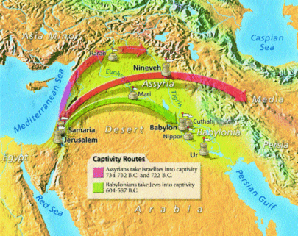
WOE ON ASSYRIA AND ISRAELITES
“Woe to thee that spoilest [destroyer]… and dealest treacherously [traitor]… the ambassadors of peace shall weep bitterly. The highways lie waste … Lebanon is hewn down: Sharon is like a wilderness; and Bashan and Carmel shake off their fruits…” (33:1).
The next ‘woe’ was on both Assyria whom God used to destroy Israel and those who were traitors [unbelieving Israelites]. There would be no peace treaties. Assyria would produce terror every where: no traveling for fear; the forests of Lebanon cut down; orchards, rich farm lands a desert; Though God used Assyria to punish Israel, she would be destroyed by the next empire, Babylon.

Slide 7
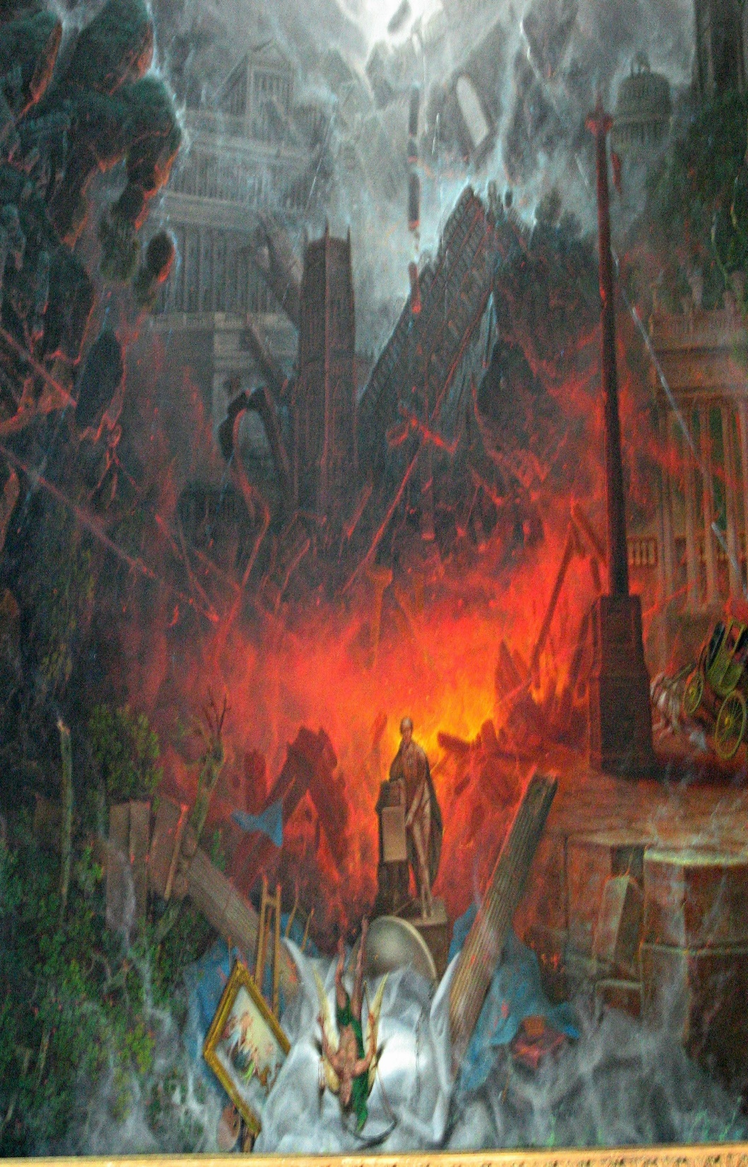
ARMAGEDDON
“Come near, ye nations, to hear; and hearken, ye people: let the earth hear… For the indignation of the LORD is upon all nations; and his fury upon all their armies. Their slain also shall be cast out, and their stink shall come up out of their carcases” (34:1-3).
After Isaiah had pronounced God’s judgment on Israel [near future], he then did the same in the far future [Gentile nations]—the terrible carnage during the last 3½ years of the tribulation –
“… like unto the Son of man, having on his head a golden crown, and in his hand a sharp sickle… and blood came out of the winepress, even unto the horses bridles (Rev. 14:14,20)… and he [Christ] treadeth the winepress of the fierceness of his wrath…” (Rev. 19:15,18).
None can stand up to the judgment & wrath of God.

Slide 8
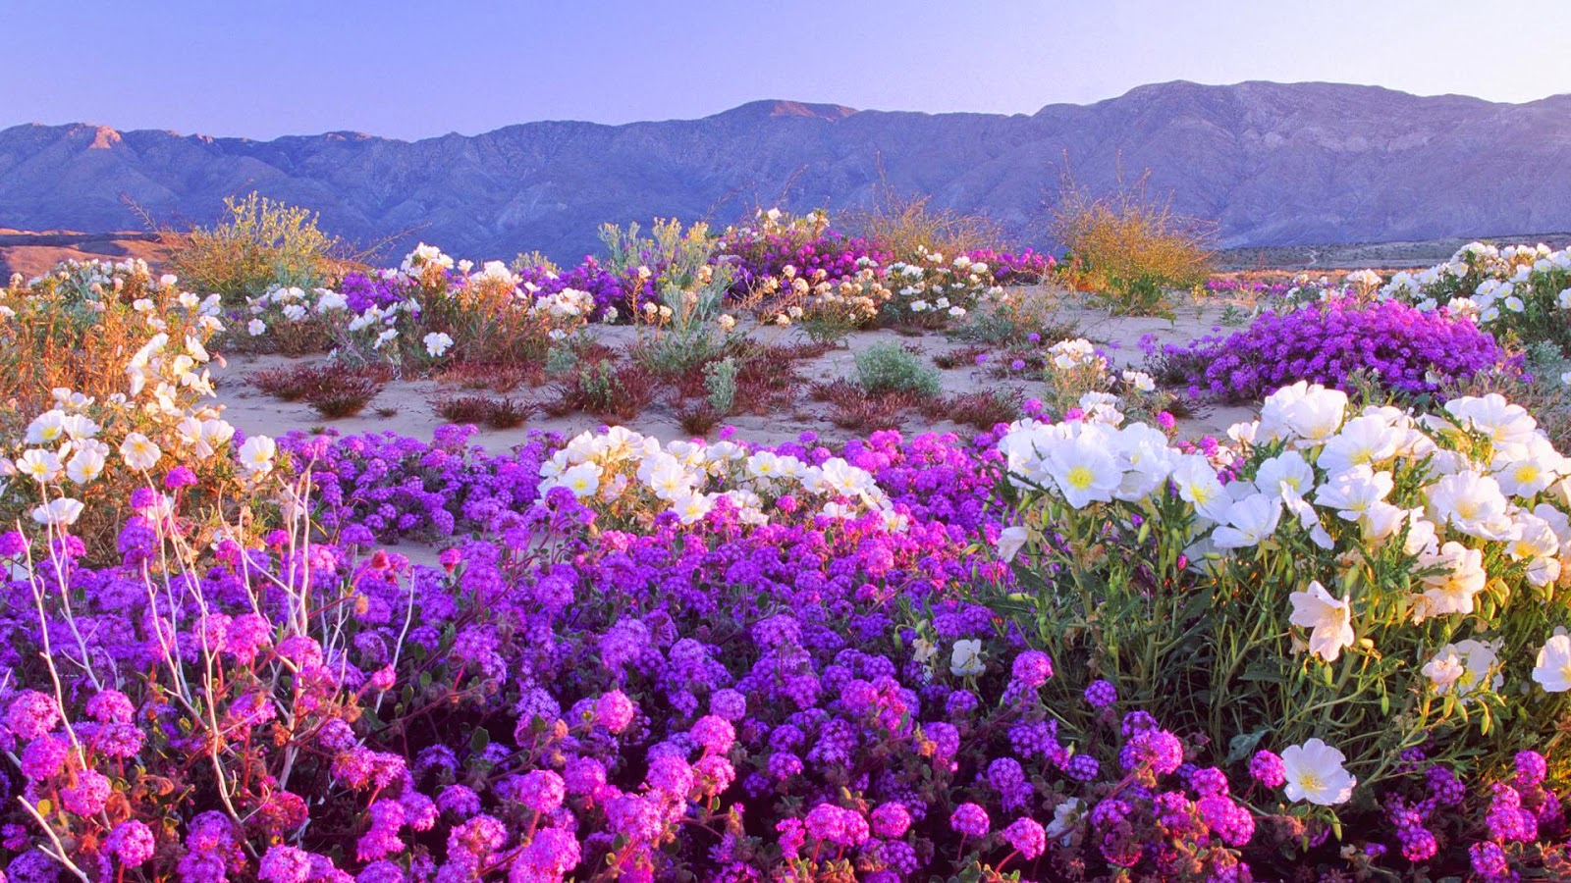
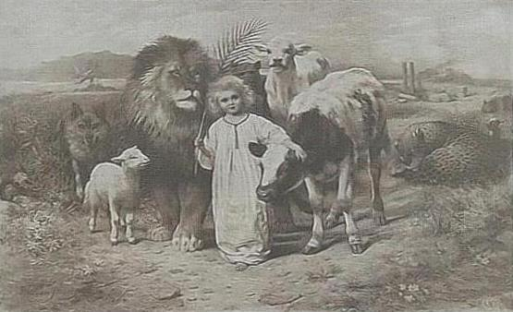

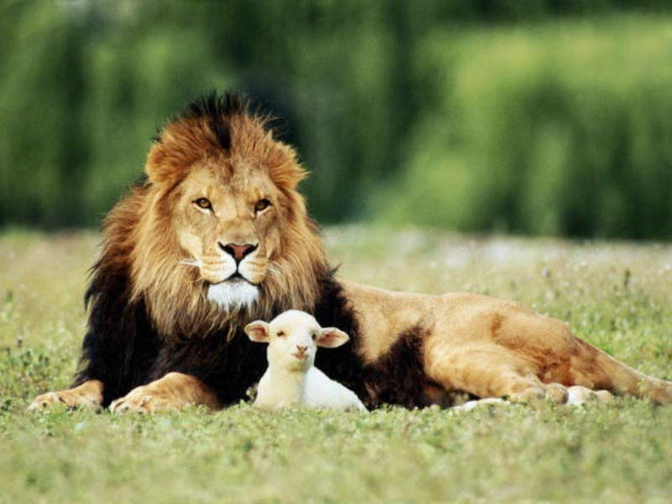
KINGDOM BLESSINGS
“The wilderness and the solitary place shall be glad for them; and the desert shall rejoice, and blossom as the rose… then the eyes of the blind shall be opened, and the ears of the deaf shall be unstopped… the lame man leap as an [deer], and the tongue of the dumb sing… and the ransomed of the LORD shall return, and come to Zion with songs and everlasting joy…” (35:1-10).
Following the tribulation and the curse lifted, life will return as it was during the Garden of Eden—the earth is revived, mankind disease-less, nothing but pure bliss.
“The wolf also shall dwell with the lamb, and the leopard shall lie down with the kid; and the calf and the young lion… and a little child shall lead them… They shall not hurt nor destroy in all my holy mountain” (11:6-9).
As He promised, God will bring heaven to earth.

Slide 9
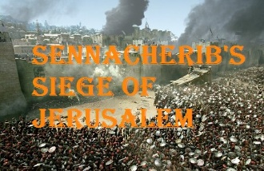
ASSYRIA INVADES JUDAH
“Now it came to pass in the [14th] year of king Hezekiah, that Sennacherib king of Assyria came up against all the defensed cities of Judah, and took them” (36:1).
In 701 B.C., after conquering the northern kingdom, Sennacherib king of Assyria, destroyed 46 walled cities of Judah, and now laid siege against Jerusalem –
“And the king of Assyria sent [his field commander] to Jerusalem unto king Hezekiah with a great army… say
ye now to Hezekiah, Thus saith the king of Assyria,
What confidence is this wherein thou trustiest?”
(36:2-4).
The king’s commander asked a representative of Hezekiah in whom were they trusting to defeat his mighty Assyrian army, and added –
“Thus saith the [Assyrian] king, Let not Hezekiah deceive you: for he shall not be able to deliver you” (36:14).

Slide 10
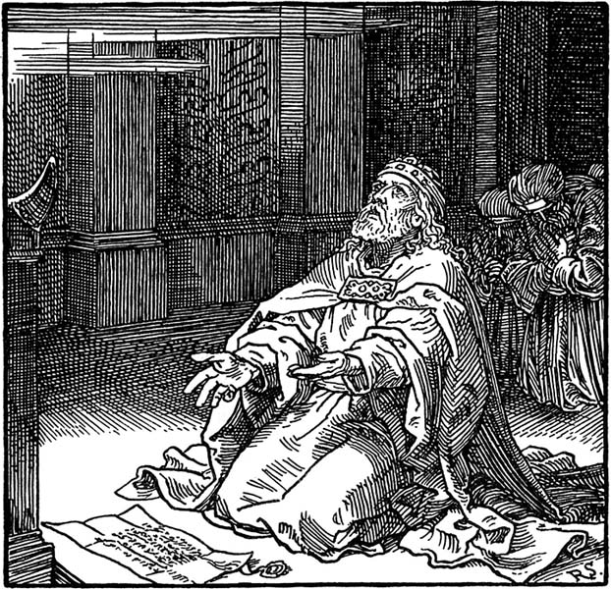
What did Hezekiah do? Surrender or be destroyed?
Neither!
“And it came to pass, when king Hezekiah heard it, that he rent his clothes, and covered himself in sackcloth, and went into the house of the LORD” (37:1).
Hezekiah knew he couldn’t defeat the Assyrian army himself, so he went to the temple seeking God’s help. Messengers were also sent to solicit Isaiah’s counsel –
“So the servants of king Hezekiah came to Isaiah. And Isaiah said unto them, thus saith the LORD… be not afraid… I will send a blast upon him [Assyrian king]… and he shall hear a rumour, and return to his own land… cause him to fall by the sword in his own land” (37:5-7).
The rumor was that the Ethiopian king was coming to Assyria to make war, which caused Sennacherib to leave
Jerusalem and return home. Back in Nineveh his sons murdered him by the sword as God had said (37:38).

Slide 11
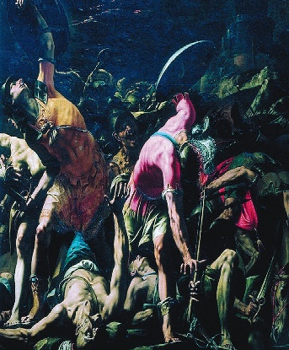
JUDAH’S REPRIEVE
“Then Isaiah sent unto Hezekiah, saying, Thus saith the LORD God of Israel, Whereas thou hast prayed to me against Sennacherib king of Assyria (37:21)… I will put my hook in thy nose, and my bridle in thy lips, and I will turn thee back by the way by which thou camest (37:29)… the king of Assyria, He shall not come into this city (37:33)… For I will defend this city to save it for mine own sake, and for my servant David’s sake” (37:35).
Though God did use Assyria to punish the northern kingdom, He spared the southern kingdom because of their faith. But, how long would Judah remain faithful to God?
THE ASSYRIAN ARMY DESTROYED
“Then the angel of the LORD [Christ] went forth, and smote in the camp of the Assyrians [185,000]: and when they arose early in the morning, they were all dead corpses” (37:36).
Sennacherib’s army was destroyed as Christ had promised.

Slide 12
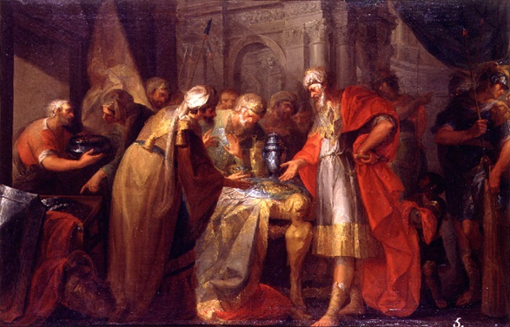
PRAYER TO LIVE
“In those days was Hezekiah sick unto death. And Isaiah the prophet came unto him, and said unto him… Set thy house in order: for thou shalt die, and not live. Then Hezekiah turned his face toward the wall, and prayed unto the LORD. And said, Remember now, O LORD, I beseech thee, how I have walked before thee in truth and with a perfect heart, and have done that which is good in thy sight… Isaiah, Go, and say to Hezekiah … I have heard thy prayer, I have seen thy tears: behold I will add unto thy days [15] years” (38:1-5).
Hezekiah asked God for more life and was granted it, but what would he do with it?
“At that time… the son of… the king of Babylon, sent letters and a present to Hezekiah: for he had heard he had been sick, and was recovered. And Hezekiah was glad of them, and shewed them the house of his precious things…” (39:1).
Isaiah asked Hezekiah why he did such a thing (39:3), and…

Slide 13
ISAIAH’S PROPHECY OF BABYLON
“… Then said he, What have they seen in thine house? And Hezekiah answered, All that is in mine house have they seen: there is nothing among my treasures that I have not shewed them… [Isaiah said] Behold, the days come, that all that is in thine house, and that which thy fathers have laid up in store until this day, shall be carried to Babylon: nothing shall be left, saith the LORD. And of thy sons that shall issue from thee, which thou shalt begat, shall they take away; and they shall be eunuchs in the palace of the king of Babylon” (39:4).
Isaiah told Hezekiah that in the future Babylon would invade Jerusalem, and confiscate every prize possession he had in the royal palace, and take his sons into captivity where they would be made eunuchs [castrated servants] in the palace
of the Babylonian king. To do that, Babylon would have to
be the next world empire, and to do that, they would have
to overthrow the yoke of bondage by the Assyrians.

Slide 14
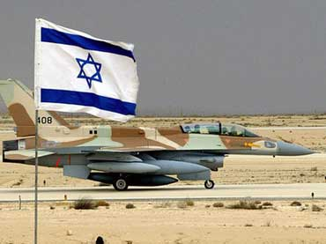
“In Judah is God known: his name is great in Israel. In
Salem also is his tabernacle, and his dwelling place in
Zion. There break he the arrows of the bow, the shield,
and the sword, and the battle… He shall cut off the princes: he is terrible to the kings of the earth” (Psa. 76:1-3).
Again, this praise psalm, fits perfectly with God’s swift and overwhelming defeat of the Assyrian army. Christ was the invisible fighter jet for Israel in the 7th century B.C.
ISRAEL’S REDEMPTION
Isaiah chapters 1-39 are about the chastisement of
God on both kingdoms; chapters 40-48 are about God’s
2-fold plan of Christ’s suffering and His glorious 2nd coming—the fulfillment of God promises and blessings on the delivered nation –
“Comfort ye, comfort ye my people, saith your God…
that her iniquity is pardoned…” (Isa. 40:1,2).

Slide 15
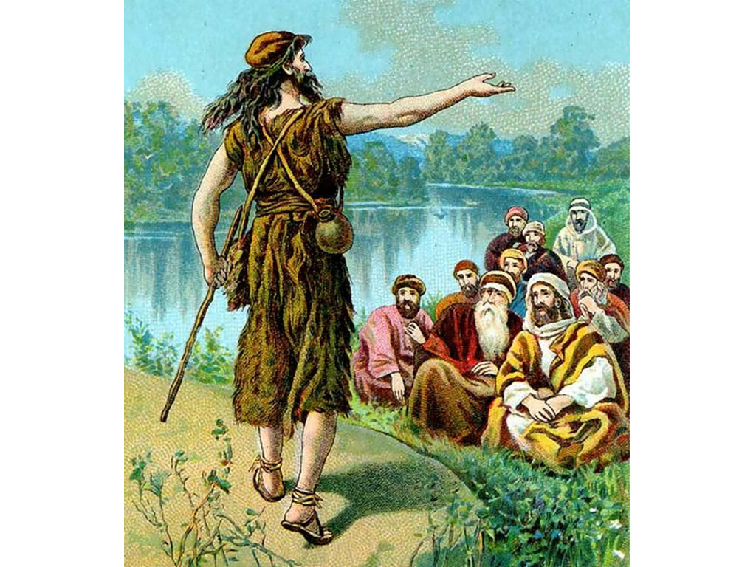
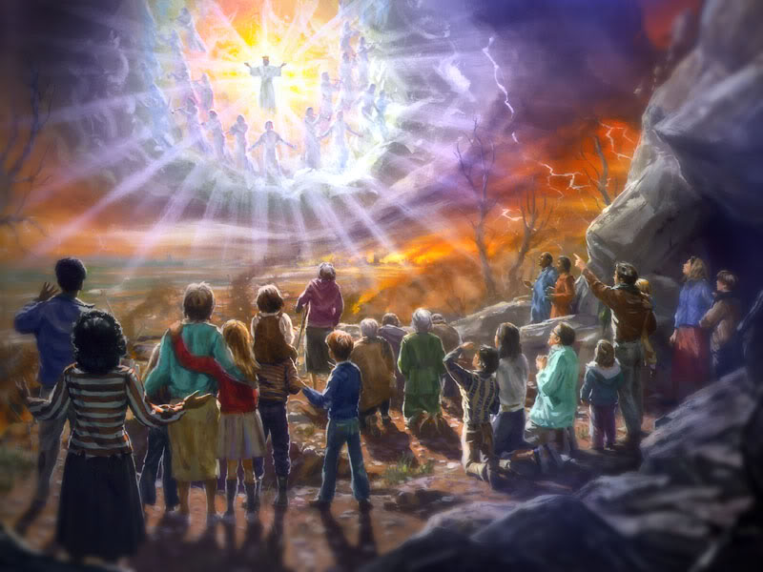
THE HERALD
“The voice of him that crieth in the wilderness, Prepare ye the way of the LORD, make straight in the desert a highway for our God” (40:3).
As Isaiah called Israel to repentance, so did John the Baptist 700-years later, of which Isaiah prophetically spoke (Mt. 3:1-4; Mk. 1:1-4; Lk. 1:76-78; Jn. 1:23). That straight desert highway would not be accomplished in Isaiah’s day nor John’s, but It will during the millennial kingdom –
“Every valley shall be exalted, and every mountain and hill shall be made low; and the crooked shall be made straight, and the rough places plain: And the glory of the LORD shall be revealed, and all flesh shall see it together: for the mouth of the LORD hath spoken it” (40:4,5).
Christ came the 1st time to suffer; the 2nd in glory!

Slide 16
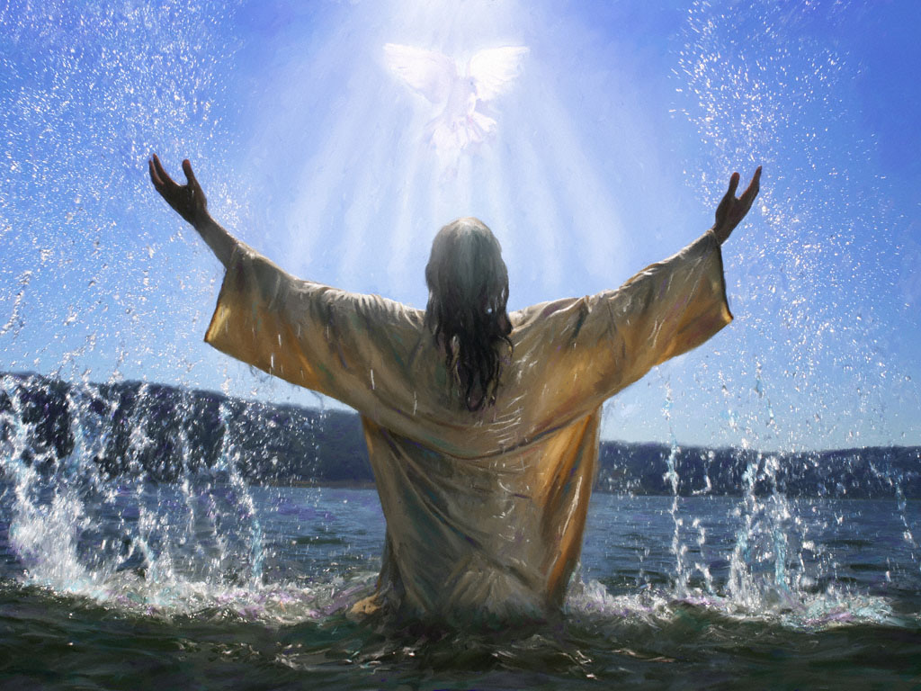
1st COMING OF MESSIAH
“Behold my servant, whom I uphold: mine elect, in whom my soul delighteth: I have put my spirit upon him: he shall bring forth judgment to the Gentiles (42:1 c.f. Mt. 3:16).
Isaiah had thus far revealed that Messiah would come
twice: the first to suffer [1st coming]; the 2nd in His glory
to establish heaven on earth. Both parts of His plan
hinged on His chosen nation, Israel –
“I the LORD have called thee [Israel] in righteousness,
And will hold thine hand, and will keep thee, and give for
a covenant for the people, for a light to the Gentiles; To open the blind eyes, to bring out the prisoners from the prison, and them that sit in darkness out of the prison house” (42:6,7).
God’s plan was such—He would use Israel to reach all the nations of the world, but because she was blind herself, He must first reach and convert her, i.e. His earthly ministry.

Slide 17
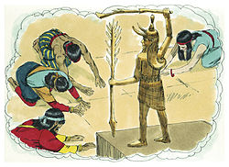
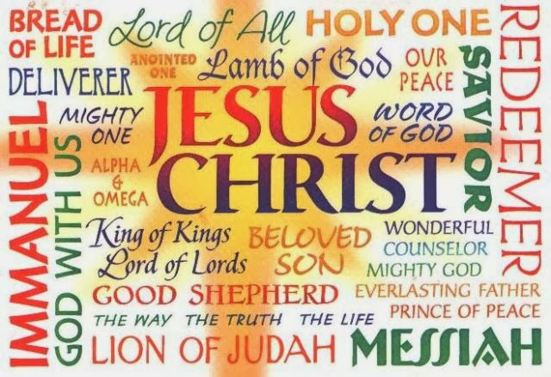
THE LIVING, SOVERIGN GOD
“Thus saith the LORD the King of Israel, and his redeemer the
LORD of hosts; I am the first, and I am the last; and beside me
there is no God” (44:6). Why is He unique among the gods?
“And who, as I, shall call, and shall declare it, and set it in
order for me, since I appointed the ancient people? And the
things that are coming, and shall come, let them shew unto
them” (44:7).
Only God can declare what He is going to do [through the
prophets], and then bring it to pass on His timetable.
THE DEAD, DUMB IDOLS
“They that make a graven image are vanity [empty]… no profit… see not… nor know… The smith with the tongs both worketh in the coals, and fashioneth it with hammers, and worketh it with the strength of his arms: yea, he is hungry, and his strength faileth… and is faint (44:9-12)… carpenter stretcheth out his rule… he maketh it after the figure of a man… he heweth down cedars… for a man to burn… and warm himself… bake bread… he maketh a god, and falleth down and worshippeth it…” (44:13-15). What fool would worship a god made with the hands of man?!!

Slide 18
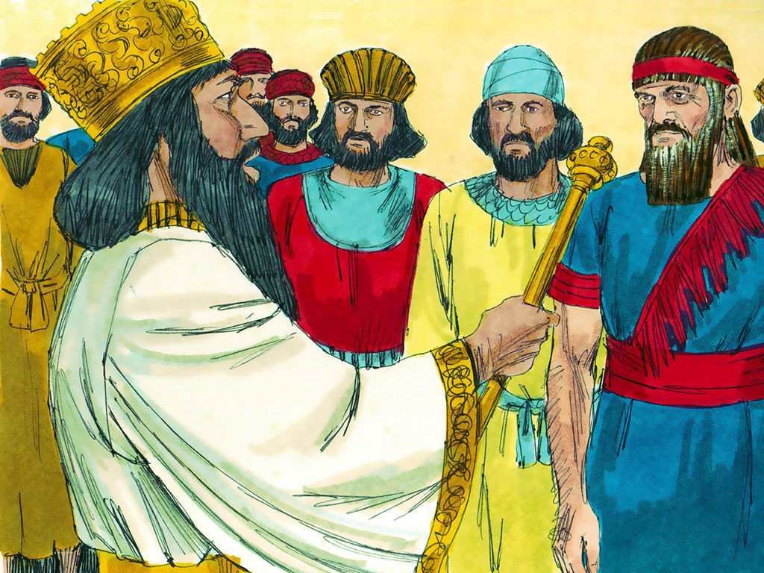
RETURN OF THE EXILES
Next Isaiah reversed direction and gave God’s promise that after their exile to Assyria and then to Babylon, He will return them to their own land. To do that He will soften the heart of their captive king –
“That said of Cyrus, He is my shepherd, and shall perform all my pleasure: even saying to Jerusalem, Thou shalt be built; and to the temple, Thy foundation shall be laid” (44:28).
God allowed Nebuchadnezzar of Babylon to invade Judah
and burn Jerusalem to the ground as His chastisement for their idol worship. But, after 70-years and their repentance, He would cause king Cyrus of Persia to release the captives
so they can return and rebuild Jerusalem and the temple.
“I am the LORD, and there is none else, there is no God beside… I form the light, and create darkness: I make peace, and create evil [sorrow, disaster, calamity] (45:6,7; Hab. 1:13).

Slide 19
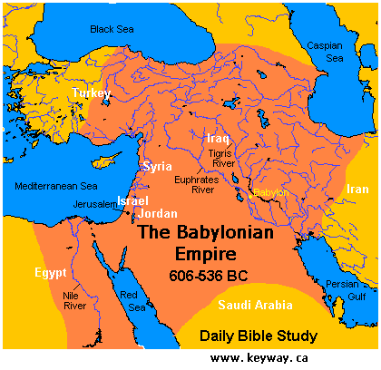
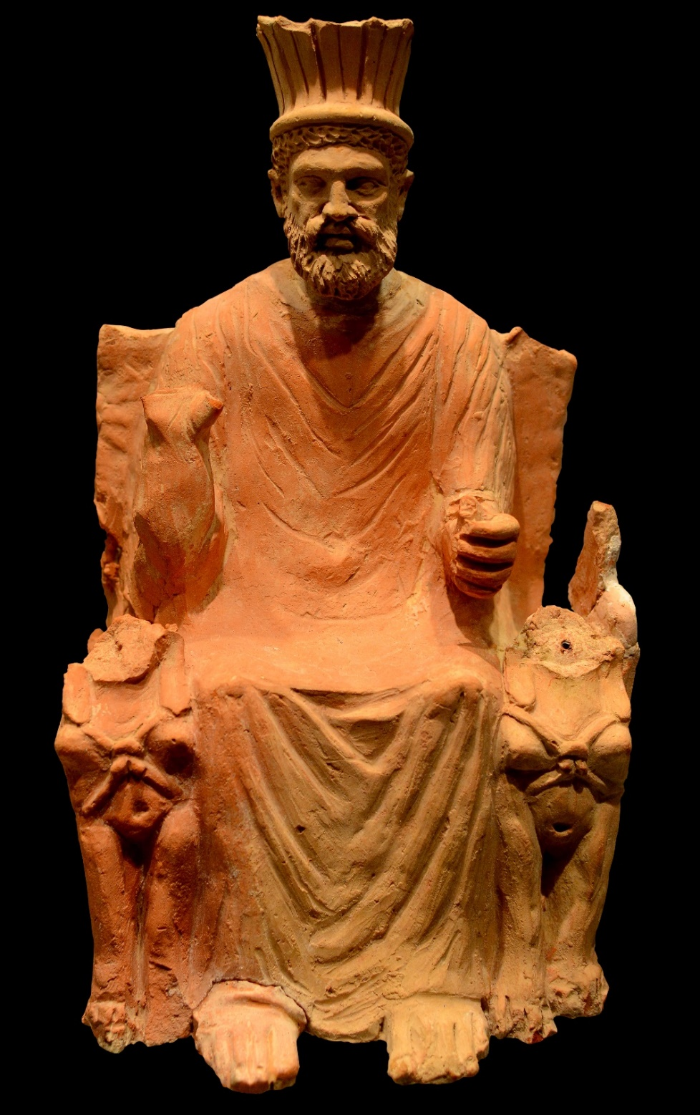
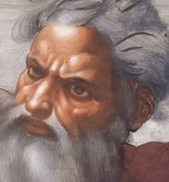
THE SOVEREIGNTY OF GOD
God used Assyria to crush Israel and would use Babylon to do the same with Judah, but like Assyria, Babylon was also a nation who worshipped idols, which was an abomination to God –
“Bel… Nebo… [Babylonian] idols were upon the beasts, and upon the cattle: your carriages were heavy loaden; they are a burden to the weary beast. They stoop… they could not deliver the burden, but themselves are gone into captivity” (46:1,2).
Isaiah’s prediction of Babylon’s defeat 150 yr. before!
God then had every right to punish them for their idolatry [as He had Israel], which He did by using king Cyrus of Persia to conquer and carry them into captivity. Each conquering empire was to –
“Remember this… bring it again to mind, O ye transgressors… for
I am God, and there is none else; I am God, and there is none like me, declaring the end from the beginning, and from ancient times that things that are not yet done, saying, my Counsel shall stand, and I will do all my pleasure” (46:9,10).

Slide 20
“Come down, and sit in the dust, O Babylon, sit on the ground: there is no throne, O daughter of the Chaldean (47:1)… I was wroth with my people… and given them into thine hand: thou didst SHEW THEM NO MERCY; upon the ancient hast thou very heavily laid thy yoke” (47:6).
Though God was angry at the Jewish people and had given them into the hands of their captors, He held both Assyria & Babylon guilty because of their excessively harsh treatment
of God’s people, so He brought judgment upon both of them.
“Hear ye this, O house of Jacob, which are called by the name of Israel (48:1)… For my name’s sake will I defer mine anger… that I cut thee not off [now]” (48:9).
Thus far, Israel had failed to believe God, which resulted in a 70-year exile. They deserved even more severe punishment, but God would defer that until a later time. When is that?
THE TRIBULATION!

Slide 21
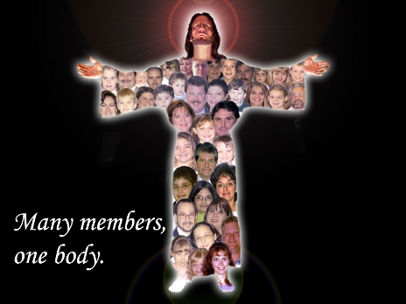
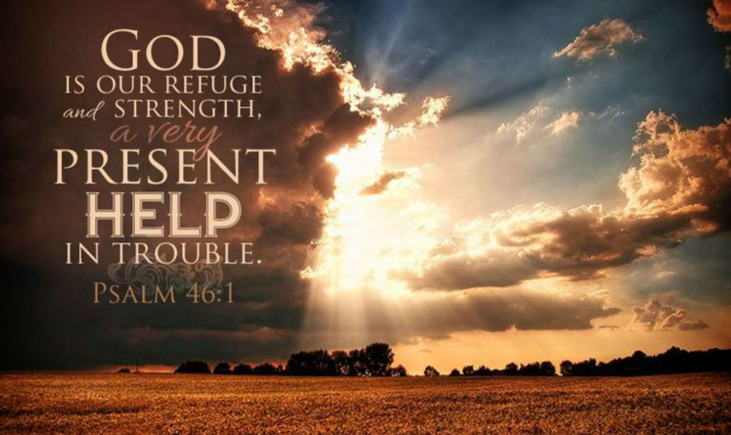
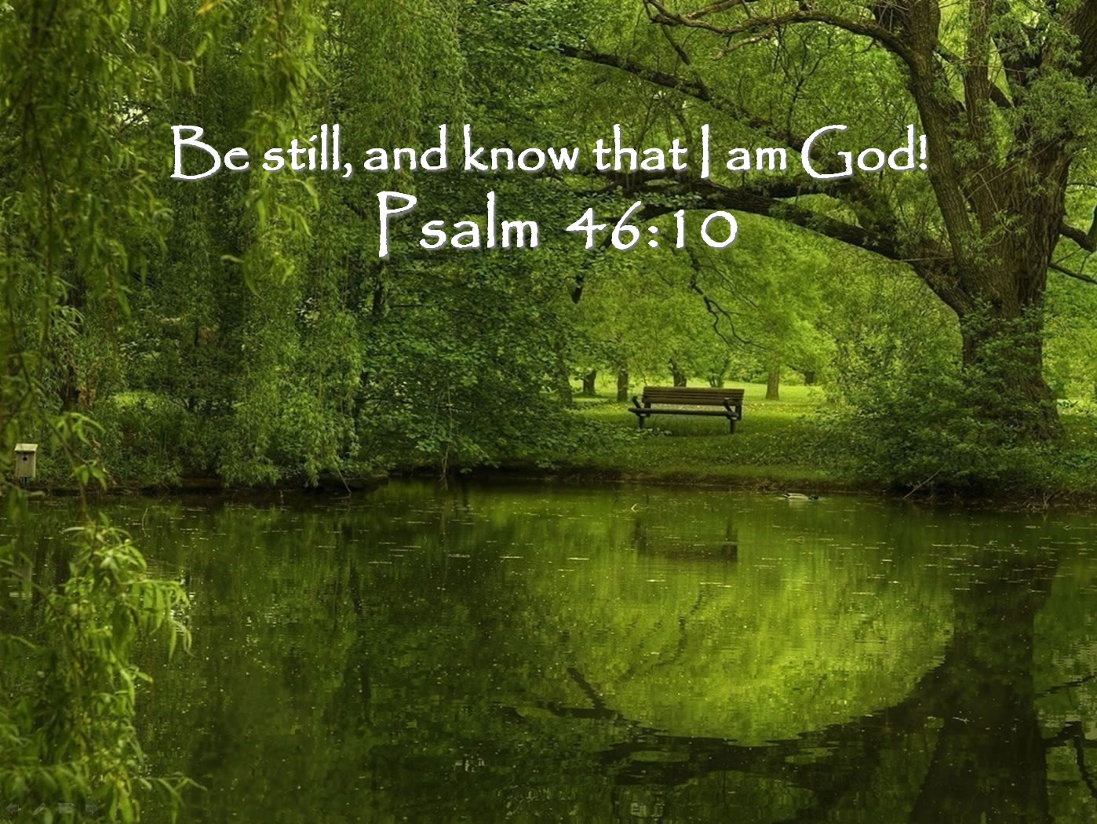
“God is our refuge and strength, a very present help in trouble… God is in the midst of her: she shall not be moved… the heathen raged, the kingdoms were moved… Be still and know that I am God…” (Psa. 46).
Again, it sounds like this was written directly to Judah in 701 B.C. when Assyria was poised to destroy her, but God defended her. Amidst the chaos, He wanted them to, “Be still and know that I am God.” Shouldn’t we be doing the same amid noise and chaos all around us?
“Praise ye the LORD. Praise ye the name of the LORD… For the LORD hath chosen Jacob unto himself, and Israel for a peculiar treasure… Blessed be the LORD out of Zion, which dwelleth at Jerusalem. Praise ye the LORD” (135).
God had chosen Israel for a special purpose [light to the Gentiles], but has He not chosen us as members of ‘His Body’ for an even more important purpose?
Next time – a snapshot of the cross 700-yr. before
“For I determined not to know any thing
among you, save Jesus Christ, and him
crucified” (1Cor. 2:2).

