Slide 1
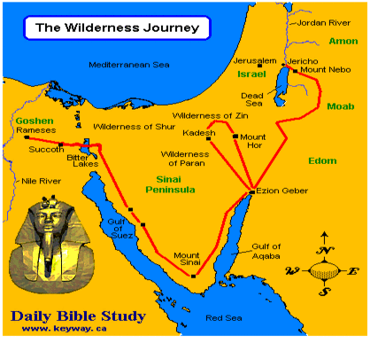
THROUGH THE BIBLE IN 2018
LESSON 10
WEEK 10 OF 52
(Num. 23–Deut. 2)
Last time we saw Israel disbelieve God and wander 40 years in the wilderness. This time we will see them inch closer to their promised land.
“And the children of Israel set forward, and pitched in the plains of Moab on this side Jordan by Jericho” (22:1).
Word went quickly that Israel had defeated king Arad and
the Canaanites (21:1-4); king Sihon and the Amorites (21:21-25,31); king Og of Bashan (21:33-35). This gave Israel control of the entire Transjordan as they gained position to enter Canaan from the east. “And Balak [king of Moab]… saw all that Israel had done… And Moab was sore afraid…” (22:2-4).
Moab should not have feared since the Moabites were distantly related to the Israelites (Gen. 19:26-37) whom the LORD said were not to be provoked (Deut. 2:9). This would lead to a very unusual story, made possible only because of the supernatural ability of God.

Slide 2
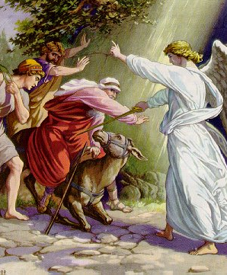
THE PROPHET BALAAM
The king of Moab knew he was outmatched by the
Israelites so his only recourse was to hire a prophet
to put a curse on Israel – “He sent messengers therefore unto Balaam… there is a people come out of from Egypt… they cover the face of the earth, and they abide over against me. Come now therefore, I pray thee, curse me this people; for they are too mighty for me…” (22:5-7).
But then, God spoke to Balaam – “Thou shalt not
go… not curse [Israel]… for they are blessed” (22:12).
His permissive will allowed him to go but knew he
“loved the wages of wickedness” (2Pet. 2:15).
Balaam began the journey (22:21), but “God’s anger
was kindled because he went: and the angel of the
LORD stood in the way…“ (22:22).

Slide 3
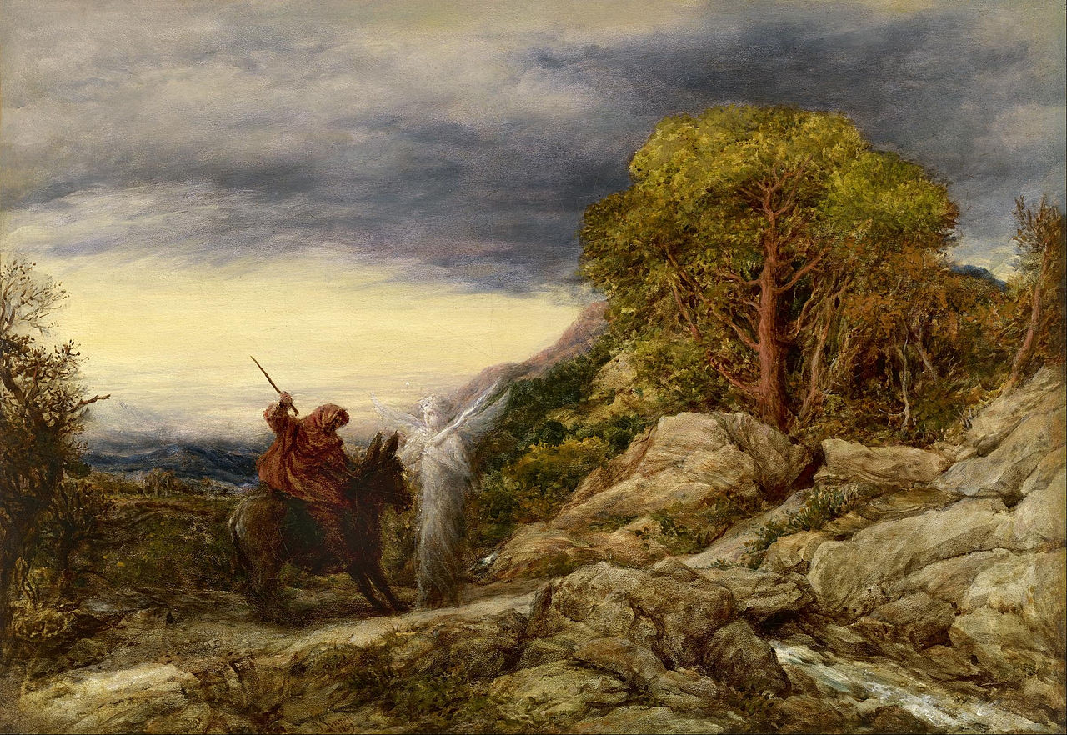
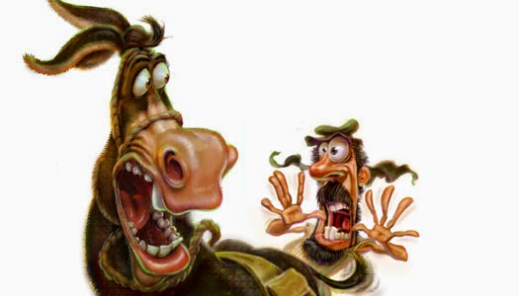
“And the donkey saw the angle of the LORD standing in the way, and his sword drawn in his hand: and the donkey turned aside out of the way, and went into the field: and Balaam smote the donkey, to turn her into the way… And when the donkey saw the angel of the LORD, she thrust herself unto the wall, and crushed Balaam’s foot… and he smote her again… and he smote her with a staff” (22:23-27).
After being struck 3-times the donkey had enough –
“And the LORD opened the mouth of the donkey, and she said unto Balaam, What have I done unto thee, that thou hast smitten me these three times?”
(22:28).
Finally, the LORD opened the eyes of Balaam to see the angel (22:31), agreeing to go to Balak, but only to speak that which the LORD told him to say (22:35).

Slide 4
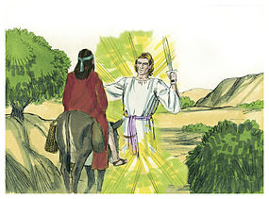
God allowed Balaam to go to the king of Moab, but
instead of cursing Israel God would use him to to reveal
Himself – “Blessed is he that blesseth thee, and cursed is
he that curseth thee” (24:9). Obviously, King Balak was
not happy with Balaam blessing Israel – “And Balak’s
anger was kindled against Balaam” (24:10).
Here is one of many cases in the Bible where God uses
something bad [a false prophet solicited to place a curse
on Israel], but turns it into something good—Balaam
espousing how God had blessed His nation, Israel.
Balaam had also been revealed that out of Israel would
come future royalty, referring to Messiah –
“… there shall come a Star out of Jacob, and a Sceptre
shall rise out of Israel” (24:17).
Next God predicted the future defeat and captivity of Israel by the Assyrians – ”… Asshur shall carry thee [Israel] away captive” (24:22).

Slide 5
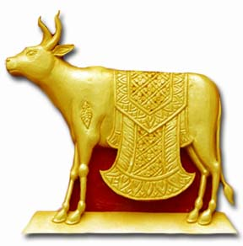
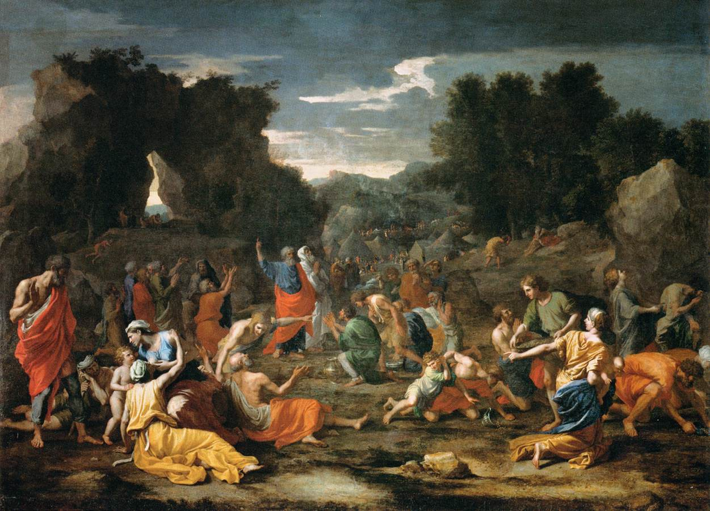
IDOL WORSHIP
“And Israel abode in Shittim [Moab], and the people
[Israelites] began to commit whoredom with the
daughters of Moab. And they [Moabites] called the
people [Israelites] unto the sacrifices of their gods:
and the people did eat, and bowed down to their
gods” (25:1,2). God’s reaction?
“And Israel joined himself unto Baal-peor: and the
anger of the LORD was kindled against Israel… Slay ye
every one his men that were joined unto Baal”
(25:3-5).
Though Baal did not place a curse on Israel, he had a
very negative effect in that many began to participate
in idol worship. Their punishment? Death for those
who broke the 1st Commandment.
A NEW CENSUS
Because the previous generation had all died in the wilderness, a new count was taken (26:2)—the grand total was 601,730 (similar to the 603,550 taken forty years earlier).

Slide 6
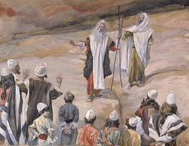
DIVISION OF THE LAND
“And the LORD spake unto Moses, saying,
Unto these [tribes of Israel] the land shall be
divided for an inheritance… to many thou
shalt give the more inheritance, and to few
thou shalt give the less inheritance” (26:52-54).
The size of tribe would determine how large a
parcel of land, but by lot where it would be
located (26:56). The Levites had no allocation
of land (26:62) because of their responsibility
to the tabernacle and worship system.
“These are they that were numbered by Moses
and Eleazar the priest, who numbered the
children of Israel in the plains of Moab by
Jordan near Jericho… There was not left a man
of them, save Caleb… and Joshua…” (26:63-65).
Moses and Aaron had carried out the previous census, this one Moses and Aaron’s son. All had died of the previous generation except Moses, Joshua, and Caleb as God said would happen.

Slide 7
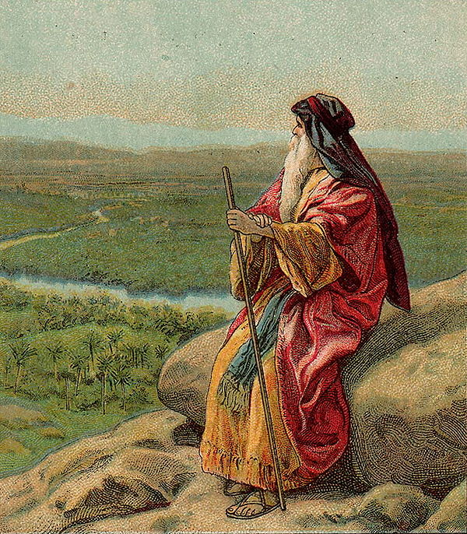
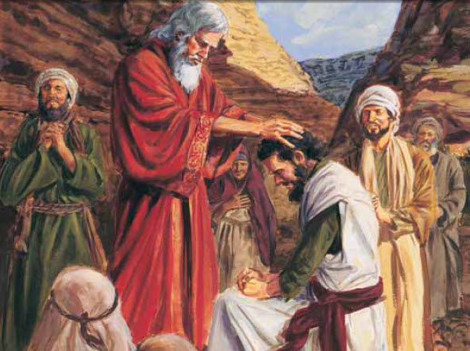
“And the LORD said unto Moses, Get thee up into this mount Abarim, and see the land which I have given unto the children of Israel. And when thou hast seen it, thou also shall be gathered unto thy people, as Aaron thy brother was gathered. For ye rebelled against my commandment in the desert of Zin… the water of Meribah in Kadesh”
(27:12-14).
MOSES’ SUCCESSOR
“Let the LORD, the God of the spirits of all flesh, set a man over the congregation, which may go out before them, and which may lead them out, and which may bring them in; that the congregation of the LORD be not as sheep which have noshepherd…Take thee Joshua… and lay thine hand upon him…” (27:16-18).

Slide 8
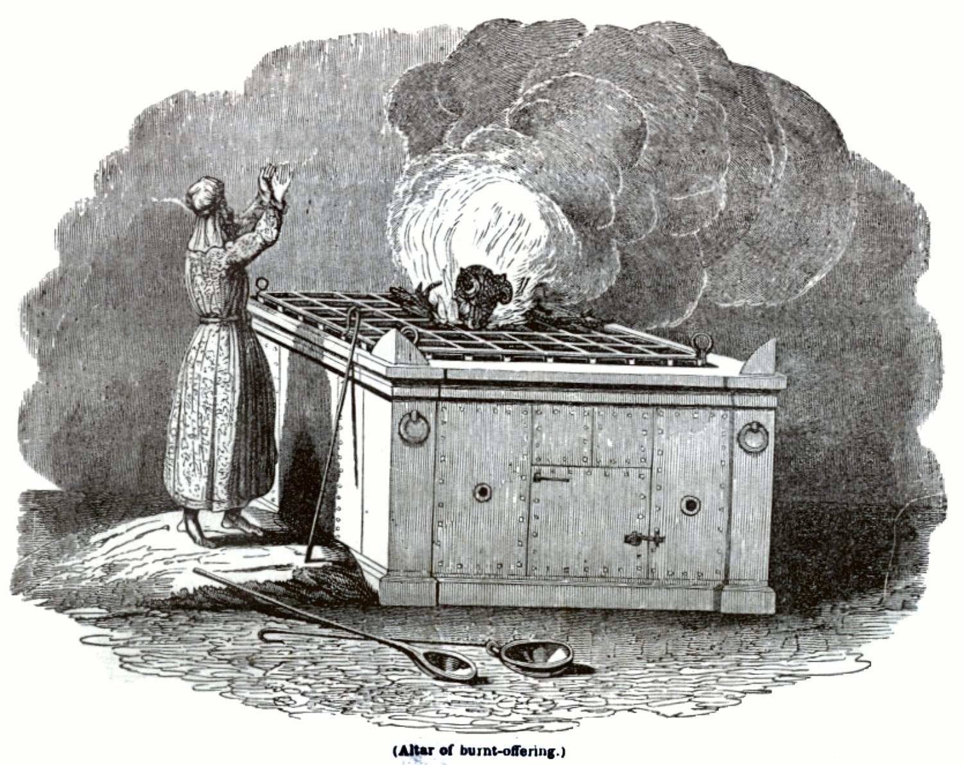
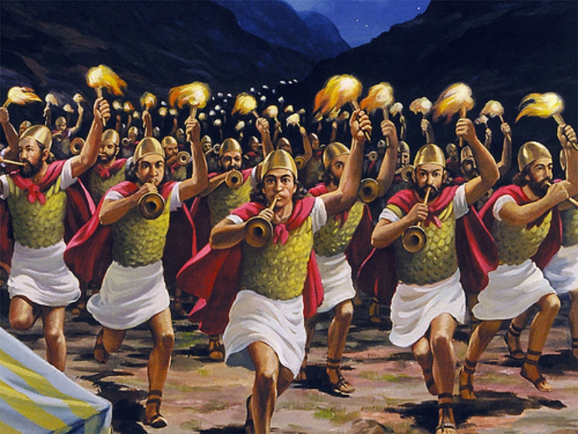
Because the previous generation had all died, there
was a need to reiterate the commands of God given
at Mt. Sinai to the new generation of Israelites. This
was the final instruction concerning the Sabbath –
“And on the Sabbath day two lambs of the first year
without spot, and two tenth deals of flour for a
meat-offering, mingled with oil, and the drink-
offering… This is the burnt-offering of every Sabbath”
(28:9,10).
MOSES’ LAST CAMPAIGN
“And the LORD spake unto Moses, saying, Avenge the
children of Israel of the Midianites; afterward shalt
thou be gathered unto thy people” (31:1).
God punished Midian who was in league with Moab
[Num. 22:4] for their role in Israel’s pagan worship of
Baal of Peor. This was a holy war as Phinehas [grandson of Aaron], led the march with the holy Items of the tabernacle, as 12,000 Israelites killed every Midianite male (31:1-7).

Slide 9
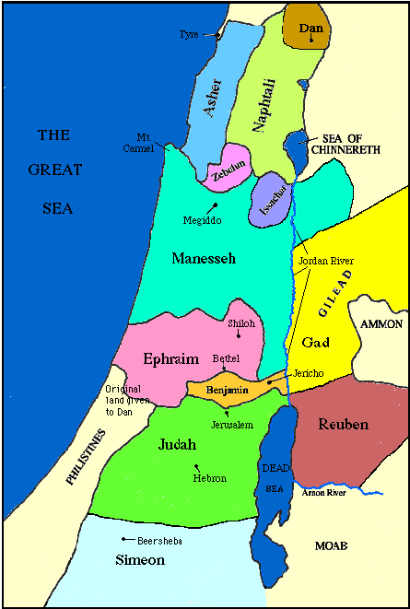
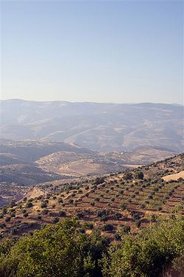
“Now the children of Reuben and the children of Gad had a very great multitude of cattle: and when they saw… the land of Gilead, that, behold, the place was a place for cattle… came and spake unto Moses, and to Eleazor… if we have found grace in thy sight, let this land be given unto thy servants for a possession, and bring us not over Jordan” (32:1-5).
After conquering Moab, the leaders of Reuben & Gad saw the potential for cattle farming and petitioned Moses for land east of the Jordan river. His first reaction was to say, no, believing that the other tribes might resist crossing the Jordan to drive out the Canaanites (32:6-15). But, they promised after settling there, they would go fight with the other tribes to free the land (32:16-32). Moses finally agreed and these two tribes along with ½ the tribe of Manasseh settled east of the Jordan river (32:33-42).

Slide 10
Chapter 33 of Numbers is a summary of Israel’s journeys from the time they left Egypt until they arrived at their present destination in the plains of Moab.
MOSES’ FINAL INSTRUCTIONS
“And the LORD spake unto Moses in the plains of Moab by Jordan near Jericho, saying… When ye are passed over Jordan into the land of Canaan; Then ye shall drive out all the inhabitants of the land from before you, and destroy all their pictures… molten images… pluck down all their high places. And ye shall dispossess the inhabitants of the land, and dwell therein: for I have given you the land to possess it” (33:50-53).

Slide 11
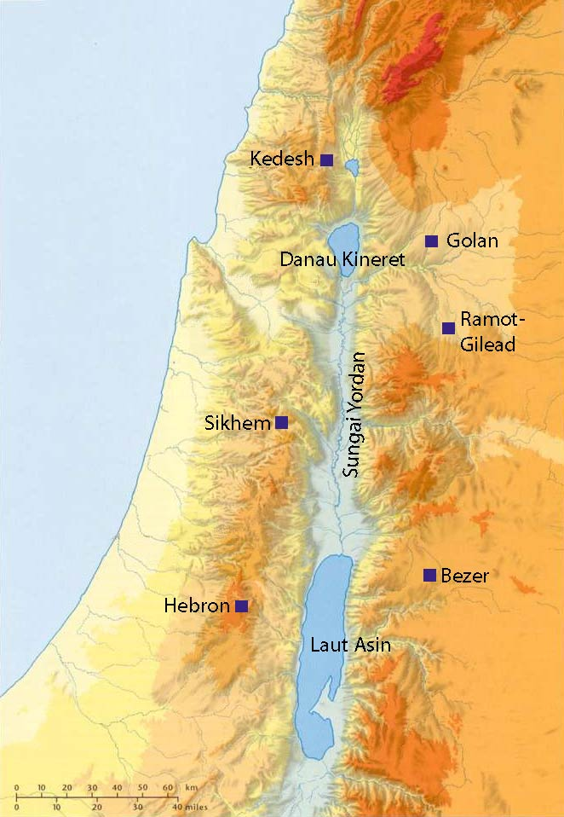
ALLOTTMENT OF LAND
“And the LORD spake unto Moses, saying, the [2]
tribes (Reuben & Gad] and the [1/2] tribe
(Manesseh) have received their inheritance on
this side Jordon near Jericho eastward… These
are the names of the men which shall divide the
land [west of Jordan] unto you: Eleazor the priest,
and Joshua… And ye shall take one prince of every
tribe, to divide the land by inheritance” (34:15-17).
Eleazor and Joshua would supervise the allotment
process with one leader from each tribe.
CITIES OF REFUGE
God’s plan for the land included a specific number
of cities within each allotment. A small number of
these were to be for refuge. If an Israelite
committed an accidental crime, he could find a safe haven until he was tried in a court of law—it did NOT mean he could escape the law.

Slide 12
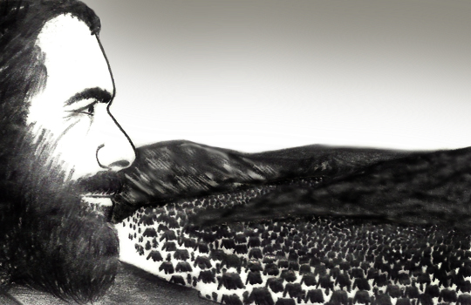
“These are the commandments and judgments, which the LORD commanded by the hand of Moses unto the children of Israel in the plains of Moab by Jordan near Jericho” (36:13).
The Book of NUMBERS ends with the authentication that the Words written in it are of God and written down to be preserved by His servant Moses. It gets its name from the census God called for in numbering the children of Israel.

Slide 13
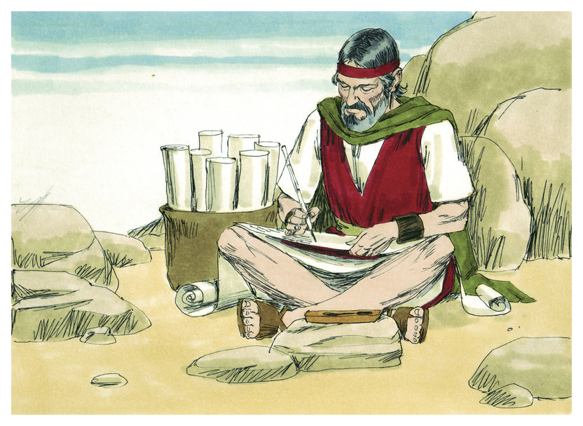
THE BOOK OF DEUTERONOMY
“These be the words which Moses spake unto all
Israel on this side Jordan in the wilderness…”
(Deut. 1:1).
Moses completed the writing of the first five books of the O.T., Pentateuch, just before the Israelites were to cross the river Jordan into Canaan. He provided a 2nd [deutero] reading of the Law, which he received at Mt. Sinai 40-years earlier. His goal in doing so was to make Israel see the importance of their obedience to God as set forth in the commandments of the Law. If Israel refused to heed, they would find insurmountable odds as they entered this land of paganism. If they obeyed God, there would be no end of the blessing God would lavish upon the nation He had created after His own Name. Israel = GOD FIGHTS!

Slide 14
The Book of Deuteronomy is delivered in a 3-part message:
1st address – 1:1 to 4:59 [Introduction] –
“These be the words which Moses spake unto all Israel on this side Jordan in the wilderness…”
(Deut. 1:1).
2nd address – 5:1 to 26:15 [General requirements
of the Law] – “And Moses called all Israel, and said unto them, Hear, O Israel the statues and judgments which I speak in your ears this day, that ye may learn them, and keep, and do them” (5:1).
3rd address – 26:16 to 34:12 [Specific details of the Law] – “This day the LORD thy God hath commanded thee to do these statutes and judgments: thou shalt therefore keep them and do them with all thine heart, and with all thy soul” (26:16).

Slide 15
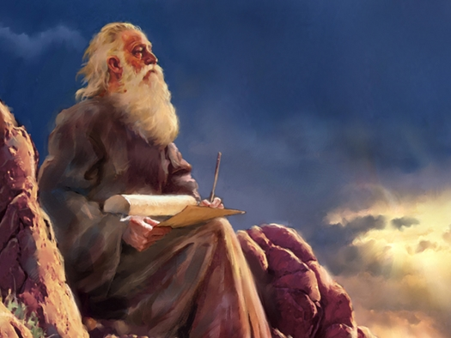
A REVIEW OF ISRAEL’S HISTORY
It should have taken Israel just 11 days to journey
(150 miles; 13.5 mi. per day) from Mt. Horeb [Sinai]
to Kadesh-barnea, but it took them 40-years (1:2) –
“And it came to pass in the [40th] year, in the [11th]
month, on the [1st] day of the month, that Moses
spake unto the children of Israel, according unto all
that the LORD had given him in the commandment
unto them” (Deut. 1:3).
Christ had been a good husband to Israel (Jer. 31:32),
but she had spurned Him – “To whom our fathers
would not obey, but thrust him from them, and in
their hearts turned back again into Egypt…” (Acts 7:39),
being ‘stiffnecked and uncircumcised in heart and ears’
they had resisted the Holy Spirit (Acts 7:51). Moses
sternly warned them as the next generation of Israelites was about to enter into their promised land—DON’T DO IT AGAIN!!!

Slide 16
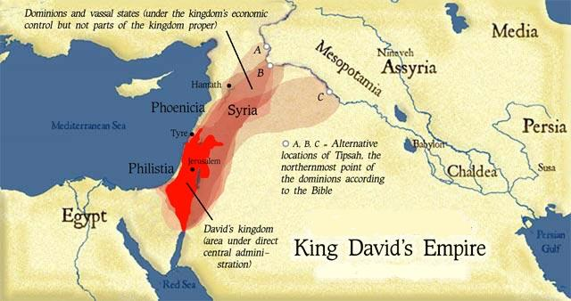
PROLOGUE
“On this side Jordan, in the land of Moab, began
Moses to declare this law, saying, the LORD our
God spake unto us in Horeb, saying, Ye have dwelt
long enough in this mount: Turn you, and take
your journey, and go to the mount of the Amorites,
and unto all the places nigh thereunto, in the plain
in the hills, and in the vale, and in the south, and
by the sea side, to the land of the Canaanites, and
unto Lebanon, unto the great river Euphrates.
Behold, I have set the land before you: go in and
possess the land which the LORD sware unto your
fathers, Abraham, Isaac, and Jacob, to give unto
them and to their seed after them” (1:5-8).
The same promise of the land given to Abraham, Isaac, and Jacob was given to Moses to give to the descendants of the patriarchs.

Slide 17
Moses continued to give the next generation of
Israelites a history lesson of the events of the past
40-years:
Israel became a large and mighty nation and
God would continue to increase and bless them
(1:10,11)
They had become so large that Moses needed
help to govern them (1:15-17), which he received
From Horeb [Sinai] to Kadesh they went through
150-miles of horrific desert which had no food or
water (1:19), yet God provided
At Kadesh they sent 12 men to spy out the land
of Canaan some saying it was a good land
(1:21-25)
But, the majority were fearful of those who lived
there (1:26-28)

Slide 18
They should not have been afraid because God was going to do the fighting for them – “The LORD your God which goeth before you, he shall fight for you, according to all that he did for you in Egypt before your eyes” (1:30)
But Israel lacked faith in the One who created and preserved them (1:32)
And, who led them to their next destination by a cloud by day and a pillar of fire by night (1:33)
As a result, God would allow only Caleb and Joshua [of that generation], and the children under 20 to see their promised land (1:36-39)
All the others would die in the wilderness –
“But as for you [disbelievers], turn you, and
take your journey into the wilderness…” where
they were to die (1:40)

Slide 19
They were sorry for disbelieving God, but it was too late as He imposed judgment on them (1:41)
If Israel proceeded to enter Canaan, they should
know God was not with them and would likely
be destroyed by the enemy (1:41)
Moses reminded Israel of their defeat at the hands
of the Amorites – “So I spake unto you; and ye
would not hear, but rebelled against the
commandment of the LORD, and went
presumptuously up into the hill. And the Amorites
which dwelt in that mountain, came out against
you, and chased you, as bees do, and destroyed
you in Seir, even unto Hormah. And ye returned
and wept before the LORD; but the LORD would
not hearken to your voice, nor give ear unto you”
(1:43-45).

Slide 20
Next God told Israel to proceed on through Edom –
“And command thou the people saying, Ye are to
pass through the coast of your brethren the children
of Esau… and they shall be afraid of you: take ye
good heed unto yourselves… meddle not with them…
I have given [Edom] unto Esau for a possession”
(2:1-5)
But, Edom refused to allow Israel to pass through
their land (Num. 20:14-21), a sin which God never
forgave –
“Thus saith the Lord God; Because that Edom hath
dealt against the house of Judah… I will also stretch
out my hand upon Edom, and will cut off man and
beast from it; and I will make it desolate…”
(Eze. 25:12-14). God had nothing good to say about
Edom after she refused passage through her land.
Next time – Moses continues the 2nd reading of the Law (Deut. 3-23).

