Slide 1
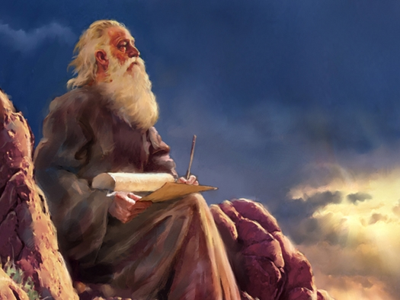
THROUGH THE BIBLE IN 2018
LESSON 11
WEEK 11 OF 52
(Deut. 3 – 23)
Last time we saw Moses lead the next generation of Israelites to the edge of Canaan where he recited the accomplishments that Israel attained when they believed God as well as their disasters when they disbelieved Him.
“Now therefore hearken, O Israel, unto the statues and
unto the judgments, which I teach you, for to do them,
that ye may live, and go in and possess the land which
the LORD God of your fathers giveth you” (Deut. 4:1)…
“For what nation is there so great, who hath God so nigh
unto them, as the LORD our God is in all things that we
call upon him for? What nation is there so great, that
hath statues and judgments so righteous as all this law,
which I set before you this day?” (4:7,8).
One purpose of the Law was to make Israel the envy
among the Gentile nations because of their morality and close personal relationship with God, and to take Him to the rest of the world.

Slide 2
Moses reiterated all that God had done at Sinai—how
He had taken them out of Egypt to commune with them
in the wilderness, but they had disobeyed Him even
Moses & Aaron –
“Furthermore the LORD was angry with me… and sware
that I should not go into Jordan… not go in unto the good
land… But I must die in this land [Moab]… Take heed unto
yourselves, lest ye forget the covenant of the LORD your
God, which he made with you…” (4:21-23)… “And the
LORD was very angry with Aaron to have destroyed him:
and I prayed for Aaron also the same time” (9:20).
Moses knew Israel would likely forget and repeat the
same sin [idolatry] they committed at Sinai –
“… a jealous God. When ye shalt begat children, and children’s children, and ye shall have remained long in the land, and corrupt yourselves, and make a graven image… do evil in the
sight of the LORD thy God, to provoke him to anger… scatter you among the nations, and ye
shall be left few in number among the heathen, whither the LORD shall send you…” (4:24-28).

Slide 3
Moses painted a very bleak picture in Israel’s future: the
Assyrian/Babylonian captivity and the ‘end time’ –
“When thou art in tribulation, and all these things are
come upon thee, even in the latter days, if thou turn to
the LORD thy God, and shalt be obedient unto his voice…
is a merciful God; he will not forsake thee, neither
destroy thee, nor forget the covenant of thy fathers…”
(4:30,31).
On several occasions, Israel would forget what Moses
told them, but God would never forget the promises He
made to Abraham, Isaac, and Jacob. He would punish
His people for their disobedience, but He would always
take them back when they showed repentance.
After reviewing these things, Moses then began the 2nd
reading of the Law to Israel – “And this is the law which Moses set before the children of Israel… after they came forth out of Egypt” (4:44).

Slide 4
“… Hear O Israel, the statues and judgments which I speak in your ears this day, that ye may learn them, and keep and do them… The LORD made not this covenant with our fathers, but with us… who are all of us here alive this day” (5:1-3).
Though God had made the original promises of a mighty nation, a land of promise, and many blessings to the fathers, Moses wanted this present generation to know it was now up to them to carry it out. It was being given to those who LIVE, not to those who were DEAD.
Next Moses repeated the 10 Commandments (5:7-21) –
“These words the LORD spake unto all your assembly in the mount out of the midst of the fire, of the cloud, and of the thick darkness, with a great voice… he wrote them in two tablets of stone, and delivered them unto me” (5:22,23).

Slide 5
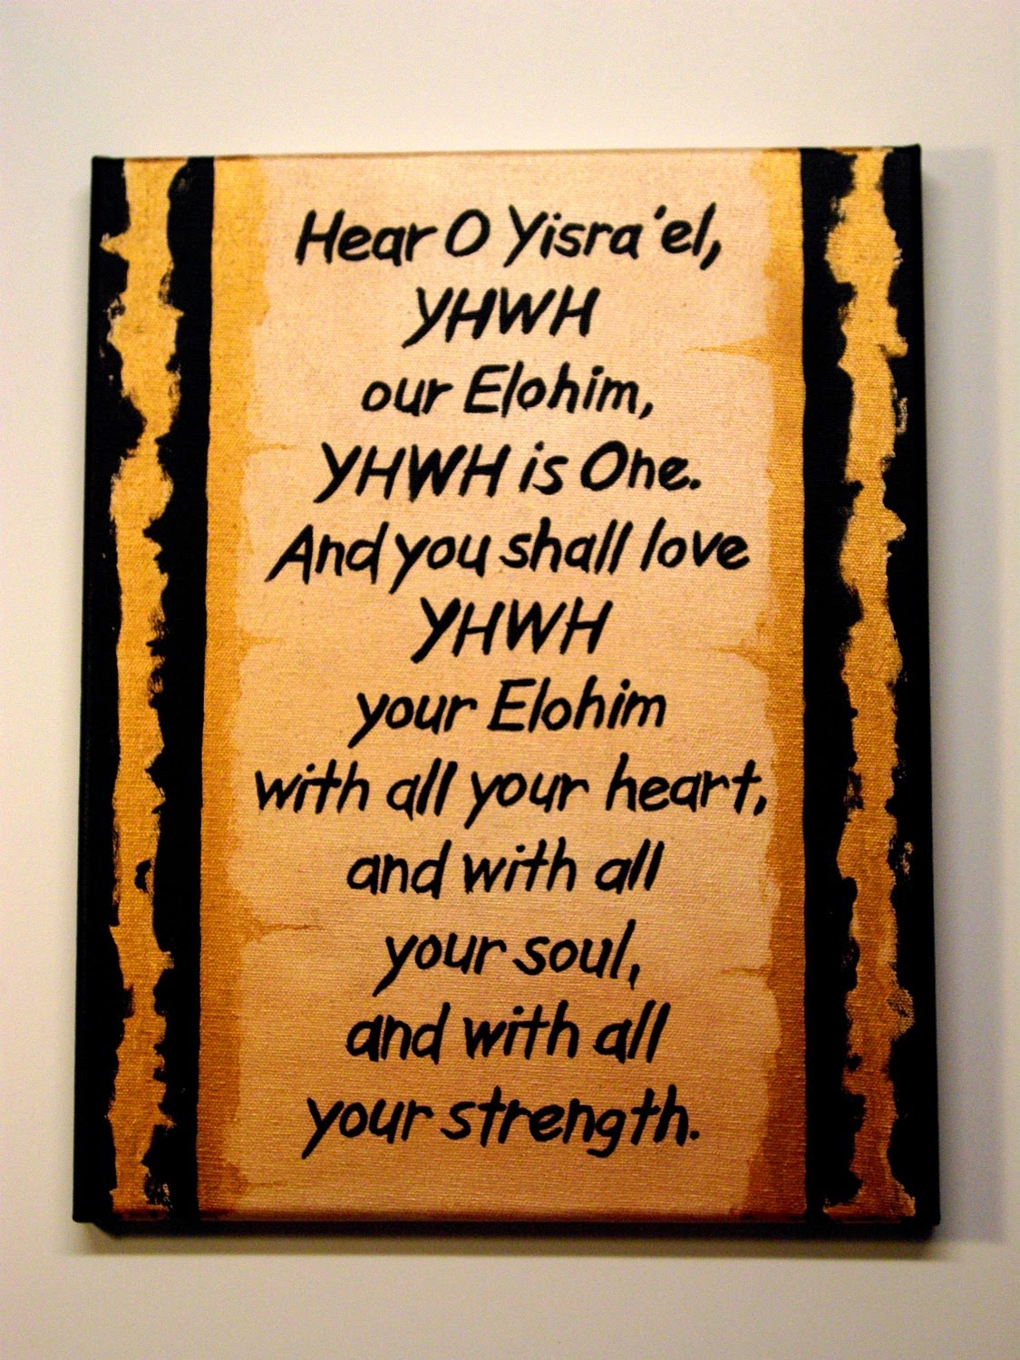
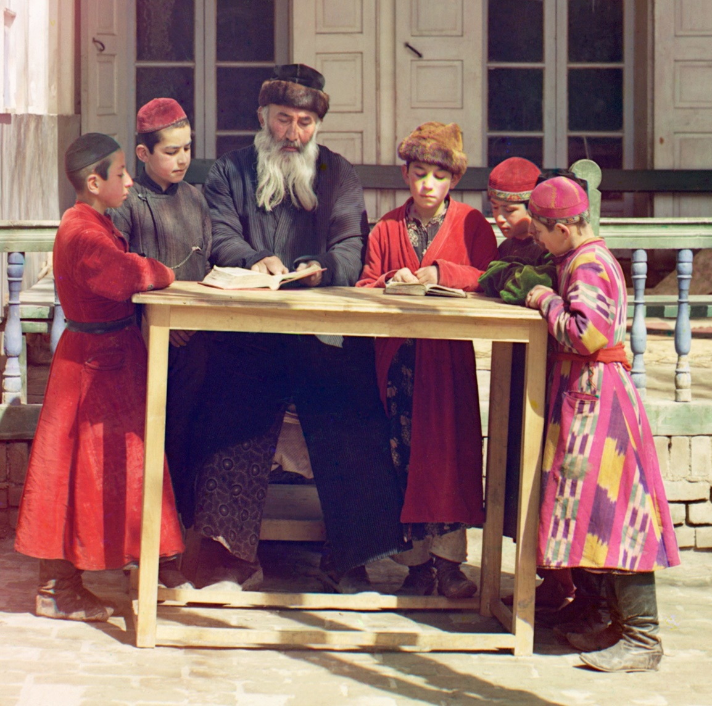
THE SHEMA
“Hear, O Israel; the LORD our God is one LORD; and thou
shalt love thy LORD thy God with all thine heart, and with
all thy soul, and with all thy might” (6:4,5).
This is the foundational principle of Judaism and the 1st
commandment set Israel’s God apart from every other
god. The Hebrews were to have the closest personal
relationship with God and the expression of Israel’s faith
was to love God with all their being and that was to be
manifested by the keeping of His laws.
“And these words, which I command thee this day, shall
be in thine heart: And thou shalt teach them diligently
unto thy children, and shalt talk of them when thou
sittest in thine house.. walkest by the way… liest down…
thou risest up” (6:6-9).
Nothing in the Jewish culture was more important than teaching their children of the importance of their God. Can we say the same today concerning our children and Christ?

Slide 6
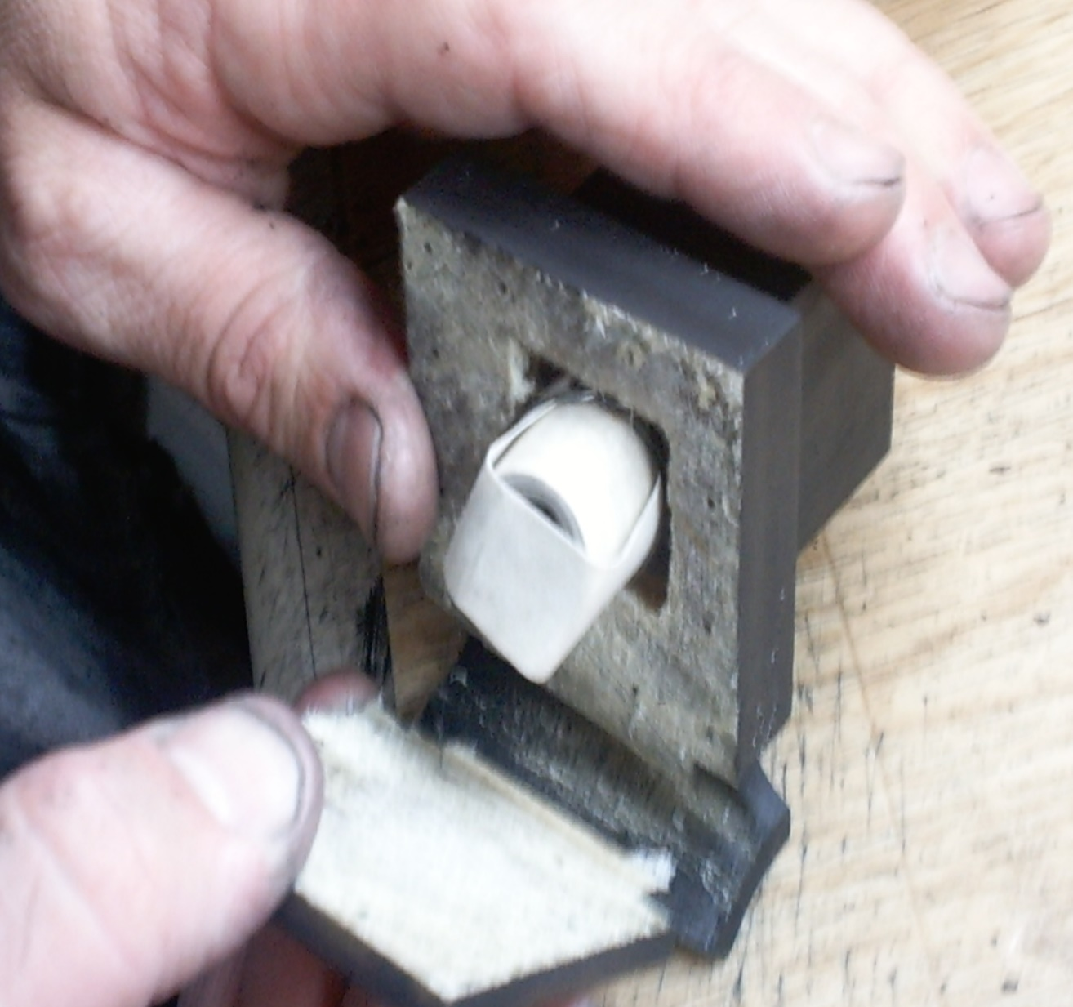
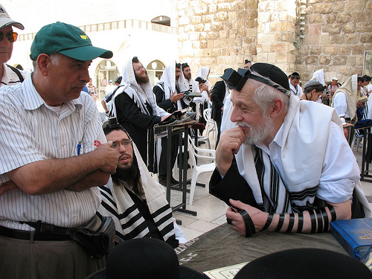
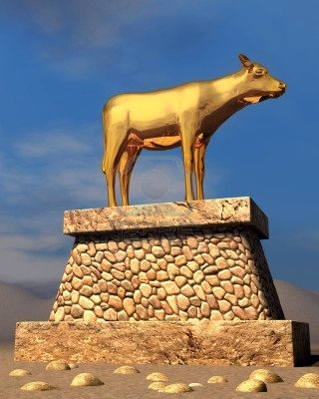
“And thou shalt bind them for a sign upon thine hand, and they shall be as frontlets between thine eyes” (6:8).
Present day Orthodox Jews take this passage literally by placing Scripture in these containers
[phylacteries] and wearing them as a constant reminder of their importance.
GOD FIGHTS
“When the LORD thy God shall bring thee into the land… and hath cast out many nations before thee, the Hittites… Girgashites… Amorites… Canaanites… Perizzites… Hivites… Jebusites, seven nations greater and mightier than thou… though shalt smite them, and utterly destroy them; make no covenant with them, nor shew mercy unto them” (7:1,2).
Israel was to show the squatter nations no mercy.

Slide 7
Why was Israel to utterly destroy the Gentile nations who inhabited the land of Canaan?
“The LORD did not set his love upon you, nor choose you, because ye were more in number than any people for ye were the fewest of all people. But
because the LORD loved you, and because he would
keep the oath which he had sworn unto your fathers…
he is God, the faithful God, which keepeth covenant
and mercy WITH THEM THAT LOVE HIM, and keep his
laws to a thousand generations. And repayeth them
that hate him to their face, to destroy them” (7:7-10).
Moses gave several reasons why He dealt with pagan
nations as He did:
Their hatred of God brought forth unbridled wickedness, which because He is God of all nations, demanded His judgment (just like His judgment upon Israel when needed)
Because He had sworn an oath to the patriarchs that He must fulfill—He was not blessing Israel for their sake, but for HIS SAKE
The land was a gift to fulfill His eternal plan [heaven on earth]—not because they deserved it – “… giveth thee not this land… for thy righteousness; for thou art a stiffnecked people” (9:5,6)

Slide 8
In chapters 10,11, Moses repeated the same message
given to the former generation of Israelites – “And it
shall come to pass, if ye shall hearken diligently unto my
commandments which I command you this day, to love
the LORD your God and to serve him with all your heart
and with all your soul, that I will give you… the first rain
and the latter rain, that thou mayest gather in thy corn,
and thy wine, and thine oil. And I will send grass in thy
fields for thy cattle, that thou mayest eat and be full…
Take heed that your heart not be deceived, and ye turn
aside, and serve other gods, and worship them. And
then the LORD’s wrath be kindled against you… no rain…
no fruit…” (11:13-17).
It was a straight forward message—If Israel did what God said, they would be the most blessed and prosperous nation on earth—if they disobeyed God, they would suffer the consequences.

Slide 9
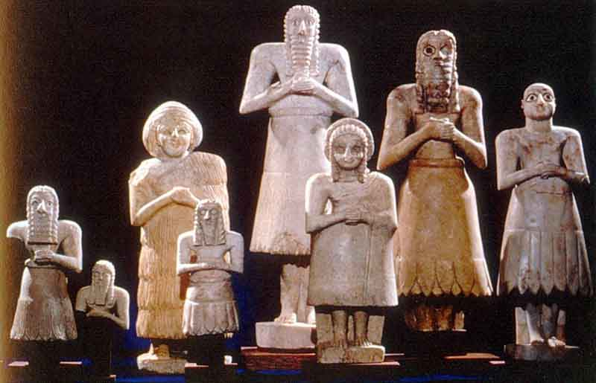
RELICS OF PAGANISM
“Ye shall utterly destroy all the places, wherein the nations
which ye shall possess served their gods, upon the high
mountains, and upon the hills, and under every green tree.
And ye shall overthrow their altars, and break their pillars,
and burn their groves with fire; and ye shall hew down the
grave images of the gods, and destroy the names of them
out of that place” (12:1-3)… “Take heed to thyself that thou
be not snared by following them, after that they be destroyed
before thee; and that thou enquire not after their gods,
saying, How did these nations serve their gods… for every
abomination to the LORD, which he hateth, have they done
unto their gods; for even their sons and their daughters they
have burnt in the fire to their gods” (12:30,31).
God knew what the Israelites would find when they entered
the land—when they encountered them they were to be
obliterated so that not even a memory of them was left. The worst atrocity of pagan worship to God was infanticide or human sacrifices.

Slide 10
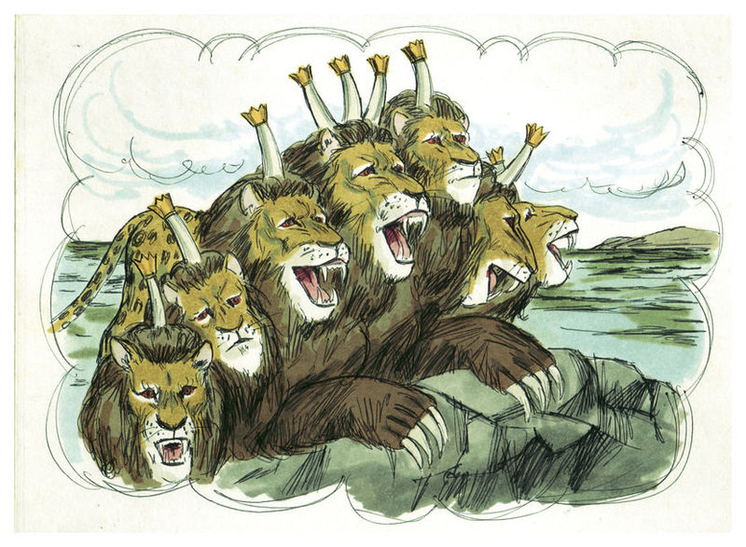
FALSE PROPHETS
“If there arise among you a prophet, and giveth thee a sign or a wonder, and the sign or the wonder comes to pass… Let us go after other gods, which thou hast not known, and let us serve them; Thou shalt not hearken unto the words of that prophet or that dreamer of dreams…” (13:1-3).
God would use prophets to speak to the nation of Israel [Isaiah, Jeremiah, et. al.] so Satan would mimic God using false prophets with their satanic given ability to produce signs & wonders and to see into the occult. The test was whether their ‘words’ were consistent with or in opposition to the truth of God—Satan can never speak God’s truth.

Slide 11
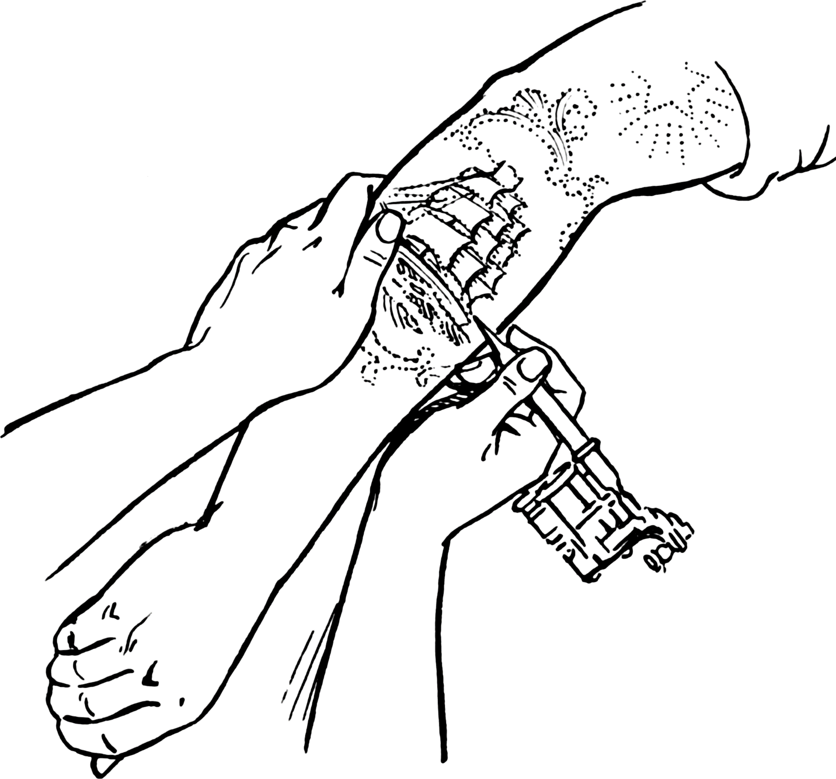
BODY DEFILEMENT
“Ye are the children of the LORD your God: ye shall not cut yourselves, nor make any baldness between your eyes for the dead. For thou art an holy people unto the LORD thy God, and the LORD hath chosen thee to be a peculiar people unto himself, above all the nations that are upon the earth” (14:1,2).
Paganism incorporated many different superstitious practices concerning the skin markings of a person, some involving the dead.
The Apostle Paul reminds us today of the sacredness of our physical body – “Know ye not that ye are the temple of God…
if any man defile the temple of God, him shall God [defile]”
(1Cor. 3:16,17).
Today, the believer is eternally secure in Christ, but when he engages in activities like this he is defiling or desecrating his service to Christ [for rewards].

Slide 12
RIGHTEOUS JUDGES
“Judges and officers shalt thou make thee in all thy gates… throughout the tribes: and they shall judge the people with just judgment. Thou shalt not wrest judgment; thou shalt not respect persons, neither take a gift: for a gift doth blind the eyes of the wise, and pervert the words of the righteous” (16:18,19).
Judges must be impartial and blind when it comes to hearing cases before them. Bribes are meant to cause favoritism—condemned.
“At the mouth of two witnesses, or three witnesses, shall he that is worthy of death be put to death; but at the mouth of one witness he shall not be put to death” (17:5).
One could lie; two independent ones couldn’t.

Slide 13
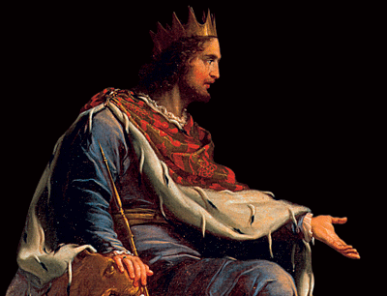
KINGSHIP
“When thou art come unto the land… and shalt say,
I will set a king over me, like as all the nations that
are about me; Thou shalt in any wise set him king
over thee, whom the LORD thy God shall choose:
one from among thy brethren…” (17:14,15).
Christ wanted to be their invisible King to rule over
Israel from the most holy place in the tabernacle/
temple. Visibly they were to be ruled by judges
and the priesthood, but Moses allowed for the
possibility that Israel might demand a literal king
[which she did], so he gave several qualifications:
Had to be chosen of God [if he failed, it was
because he wasn’t qualified]
He must be an Israelite
He must not have the strongest military in the region, but depend on God for her might
Prohibition against many wives, i.e. foreign women to form allegiances, but induce idolatry
Not become obsessed with wealth

Slide 14
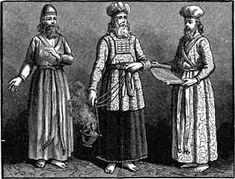
LEVITES
“The priests the Levites, and all the tribe of Levi,
shall have no part nor inheritance with Israel:
they shall eat the offerings of the LORD made by
fire, and his inheritance. Therefore shall they
have no inheritance among their brethren: the
LORD is their inheritance, as he hath said unto
them” (18:1,2).
Levi was one of the sons of Jacob [Leah]. He had
three sons: Gershom [curtains, coverings], Kohath
[sacred objects], Merari [wood framing]; Aaron
was the grandson of Kohath and only his kin could
be priests (Num. 3:10), known as sons of Aaron.
Those of the other 2-sons were ministers or
assistants to the priests (Num. 18:1-7), and became teachers of the Law (Deut. 33:10).
Because of their total dedication to the tabernacle, they did not receive an allocation of land, but were supported by the required 1/10th (Num. 18:21) giving of the other 11 tribes.

Slide 15
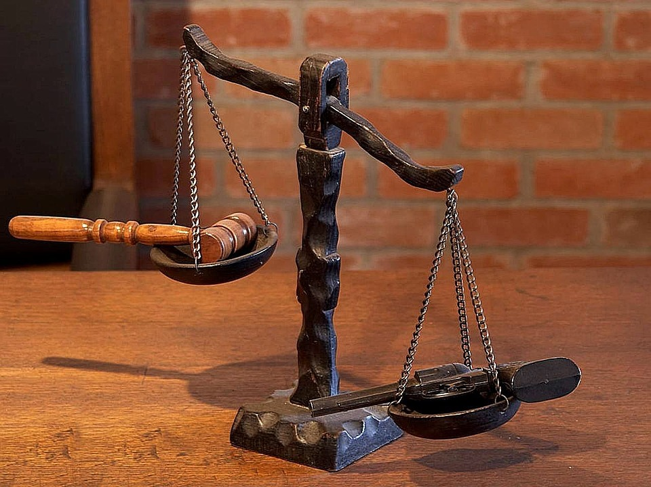
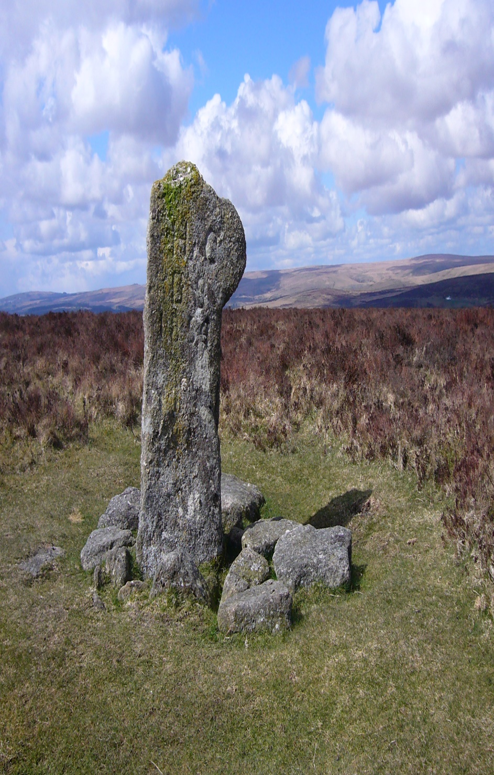
BOUNDARY STONE
“Thou shalt not remove thy neighbor’s landmark, which they of old time have set in thine inheritance, which thou shalt inherit
in the land that the LORD thy God giveth thee to possess” (19:14).
After Israel was given possession of the land, property was marked by a boundary stone, and moving such stone was tantamount to stealing one’s property. It was a cursed thing
to do so –
“Cursed be he that removeth his neighbor’s landmark. And all the people shall say, Amen” (Deut. 27:17).
LAW OF RETRIBUTION
“And thine eye shall not pity; but life shall go for life, eye for eye, tooth for tooth, hand for hand, foot for foot” (19:21; 25:12).
This part of the Law was meant to regulate the degree of punishment so that ‘the punishment fit the crime.’

Slide 16
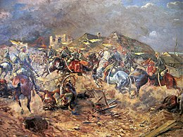
LAW OF WARFARE
“When thou goest out to battle against thine
enemies, and seest horses, and chariots, and a
people more than thou, be not afraid of them:
for the LORD thy God is with thee, which brought
thee up out of the land of Egypt” (20:1).
Israel should have never feared the appearance of
her enemies' might, even when outnumbered,
because God had proved in the Exodus from Egypt
that He could and would destroy even the largest
of armies.
“When thou comest nigh unto a city to fight against
it, then proclaim peace… all the people that is found
therein shall be tributaries unto thee, and they shall serve thee. And if it will make no peace with thee, but will make war against thee, then thou shalt besiege it… smite every male thereof with the edge of the sword. But the women, … the little ones… cattle… even all the spoil thereof, shalt thou take unto thyself…”(20:10-14).
A peaceful resolution should first be sought, but if rejected, then attack with the power of God.

Slide 17
LAW OF WARFARE (cont’d)
When Israel faced an enemy outside of Canaan
(20:15) but still within the territory promised them,
they could offer that nation peace at which time
that nation would become the servants of Israel.
They were to slay the men but allow the women,
children, livestock to live—all acceptable as the
spoils of war.
“But of the cities of these people… thou shalt save
alive nothing that breatheth. But thou shall utterly
destroy them; namely the Hittites, Amorites,
Canaanites, Perizzites, Hivites, and the Jebusites; as
the LORD thy God hath commanded thee”
(20:16,17).
But, those within Canaan, they were to utterly destroy—every man, woman, child, beast, and take no spoils of war. Why? “That they teach you not to do after all their abominations, which they have done unto their gods; so should ye sin against the LORD your God” (20:18).

Slide 18
WAR BRIDE
“When thou goest forth to war against thine enemies, and the LORD thy God hath delivered them into thine hands, and thou hast taken them captive, and seest among the captives a beautiful woman, and hast a desire unto her, that thou wouldest have her to thy wife…” (21:10-14).
If an Israelite soldier happened to capture a ‘beautiful woman’ from a battle with a distant nation [not a Canaanite], then he could have her as his wife, if he…
Shaved her head
Cut her fingernails
Bought her new clothes
Mourned her separation from her parents for 1-mo.
Got married
If he changed his mind, he couldn’t sell her, but, had to let her go free

Slide 19
MISCELLANEOUS LAWS
A persistently rebellious son was to be brought before the rulers and stoned (21:18-21).
“And thou shalt stone him [a false prophet] with stones, that he die; because he hath
sought to thrust thee away from the LORD thy God… And all Israel shall hear, and fear,
and shall do no more any such wickedness as this is among you” (13:10,11) – capital
punishment was meant to be a deterrent.
2. Someone who committed a crime worthy of death shall have his corpse hanged on a
tree to deter others from committing the same offense (21:22,23). Paul used this verse
in referencing Christ’s substitutionary death for sinners – “Christ hath redeemed us from
the curse of the law, being made a curse for us: for it is written, Cursed is every one that
hangeth on a tree” (Gal. 3:13).
3. If you recovered a stray animal [livestock] you were obligated to try to restore it to its
given owner (22:1-4).
4. Cross dressing was forbidden in that it could lead to homosexuality (22:5).
5. Pre-marital and marital purity emphasized (22:13-19).
6. Infidelity and lying about one’s virginity punishable by death (22:20-29).

Slide 20
7. Prohibition on marrying his step-mother as that constituted an incestuous relationship
(22:30).
8. Castration was often performed in pagan rituals, so that person was not to be part of Israel’s
worship service (23:1).
9. One who was born of an Israelite and a foreign idol worshipper was not permitted to partake
in the solemn assembly to discourage others from doing so (23:2,3).
10. Israel was not to treat Edom & Egypt as enemies, but neither were they to make peace with
them (23:7).
Escaped slaves [non-Israelites] could be provided sanctuary until their case decided
(23:15,16).
Temple prostitutes forbidden (23:17,18).
Israelites who had become poor were not to be charged interest (23:19).
Israelites could charge interest when loaning money to foreigners (23:20).
Where we get the oath that we swear on the Bible (23:21-23).
One could stop and eat of the field or vineyard, but no carry out (23:24,25).
Next time – (Deut. 24 – Joshua 11) – Moses dies; Joshua leads Israel into Canaan.

