Slide 1
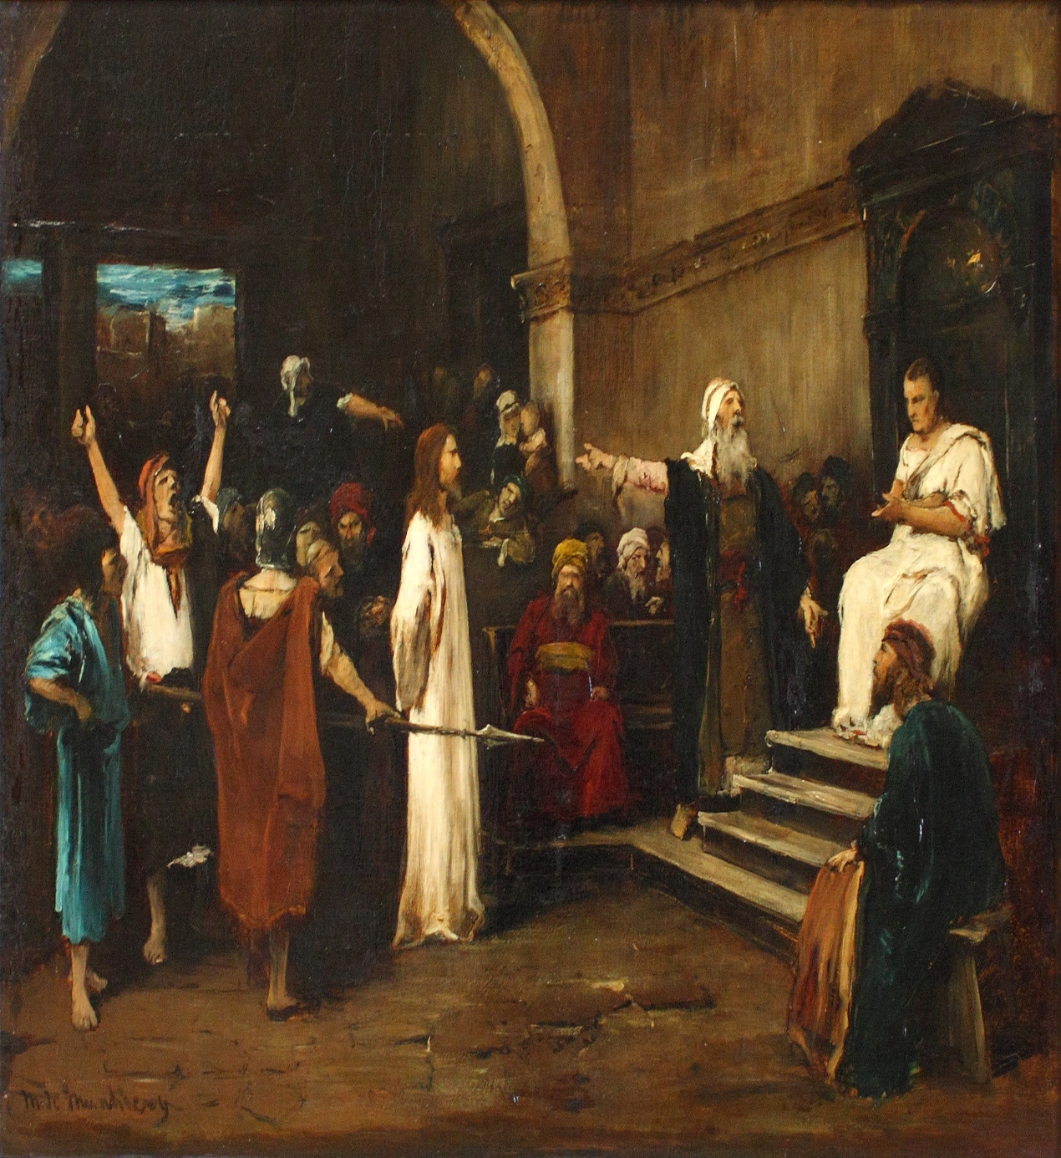
LESSON 46
WEEK 46 OF 52
(Mt. 27,28; Mk. 15,
16; Lk. 23,24; Jn. 18- 21; Acts 1-8)
THROUGH THE BIBLE IN 2018
Jesus’ Death, burial, resurrection, Pentecost, stoning of Stephen.
JESUS TAKEN TO PILATE
“When the mourning was come, all the chief priests and elders of the people took counsel against Jesus to put him to death: And when they had bound him, they led him away, and delivered him to Pontius Pilate the governor” (Mt. 27:1,2).
The Sanhedrin [70 Jewish elders] having met during the night [illegal], now brought Jesus to the Roman governor to invoke the death sentence which they had no power to do – “Then said Pilate unto them, Take ye him, and judge him according to your law. The Jews said unto him, It is not lawful for us to put any man to death” (Jn. 18:31).
The Gospel of Luke give us an additional account of the trials of Jesus.

Slide 2
JESUS BEFORE PILATE (Cont’d)
“And the whole multitude of them arose, and led him unto Pilate. And they began to accuse him, saying, We found this fellow perverting the nation, and
forbidding to give tribute to Caesar, saying that he himself is
Christ [Messiah] a King. And Pilate asked him, saying, Art
thou King of the Jews?... Thou sayest it” (Lk. 23:1-3).
Pilate’s main concern was whether Jesus was a king, because
that would be subversive to the Roman Emperor. Jesus
confirmed that He was; His was a different kind of kingship –
“Jesus answered, My kingdom is not of this world [1st coming]:
if my kingdom were of this world [2nd coming], then would my
servants fight [battle of Armageddon], that I should not be
delivered to the Jews…Thou sayest I am a king. To this end
was I born [He was the rightful King, but Israel rejected His
kingship and kingdom], and for this cause came I into the
world, that I should bear witness unto the truth [cross]…
[Pilate said] I find in him no fault at all” (Jn. 18:36-38).
To Pilate, this man posed no threat to him or the empire.

Slide 3
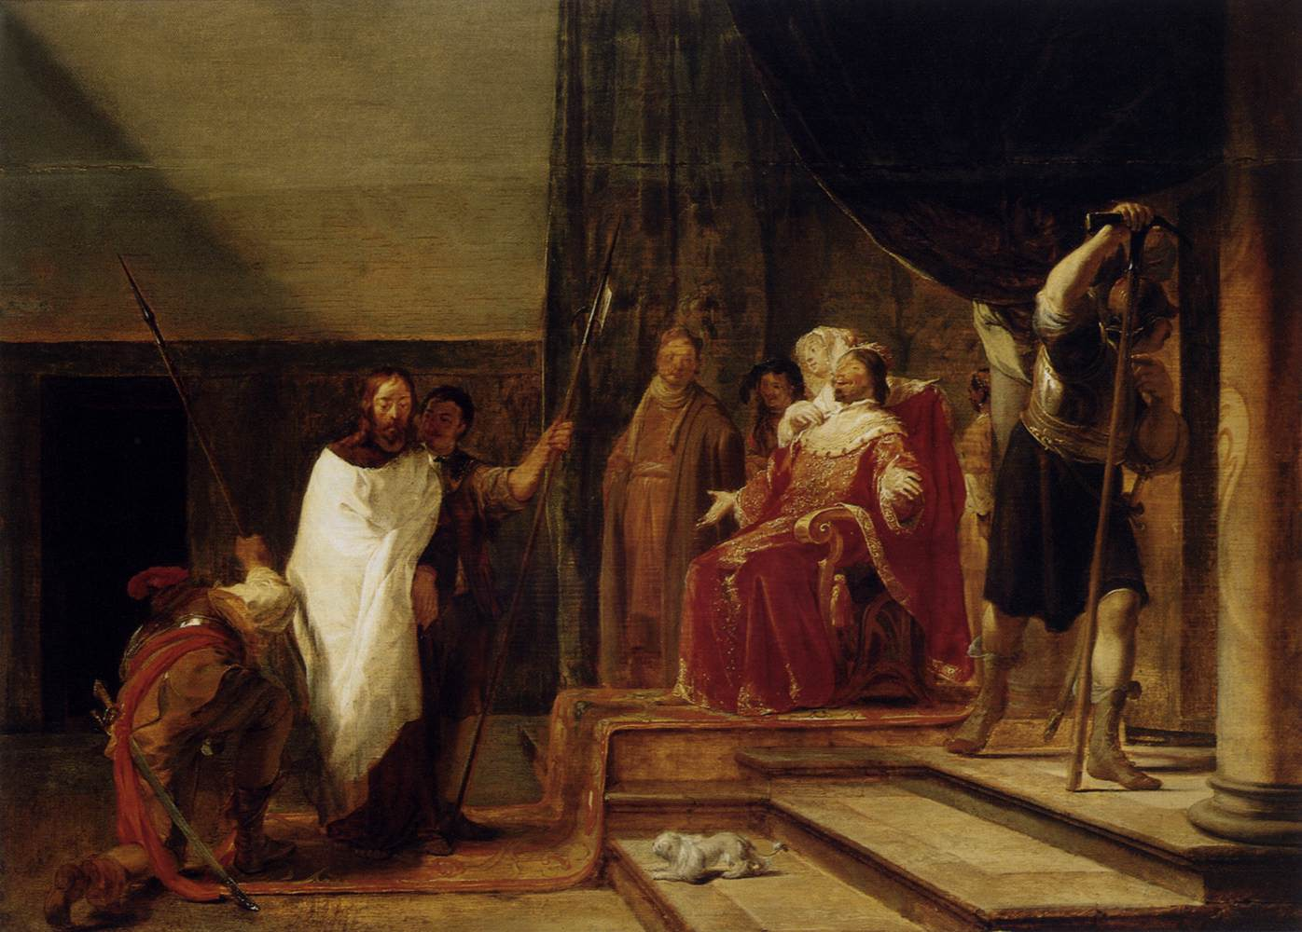
JESUS BEFORE HEROD
“Then said Pilate… I find no fault in him. And they [Jews] were the more fierce, saying, He stirreth up the people, teaching throughout all Jewry, beginning from Galilee… When Pilate heard Galilee… he sent him to Herod, who himself was in Jerusalem at that time” (Lk. 23:1-7).
Having found no fault in Him, when he heard Galilee, he passed Him off to Herod whose jurisdiction was Galilee –
“And when Herod saw Jesus, he was exceeding glad… he had heard many things of him; and he hoped to have seen some miracle done by him… he [Jesus] answered him nothing… Herod… mocked him, and arrayed him in a gorgeous robe, and sent him again to Pilate” (Lk. 23:8-12).
Herod got nowhere with Him, so he mocked Him and sent Jesus back to Pilate who reiterated that he found nothing worthy of death, nor did Herod, so his decision was –
“I will therefore chastise him, and release him” (Lk. 23:16).

Slide 4
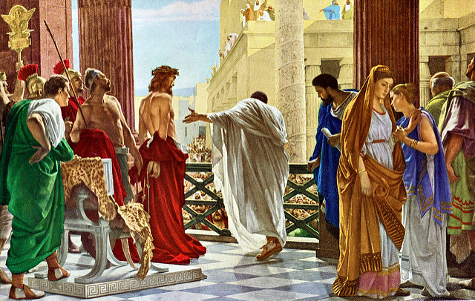
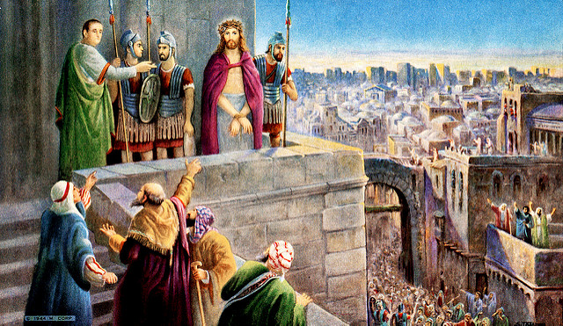
BARABBAS
“But ye have a custom, that I should release unto you one at the Passover: will ye therefore that I release unto you the King of the Jews? Then cried they all again, saying, Not this man, but Barabbas. Now Barabbas was a robber”
(Jn. 18:39,40).
Pilate had previously indulged the Jews on their spring holy day of Passover by releasing one of their own. Pilate asked who they wanted released –
“And they cried out all at once, saying, Away with this man, and release unto us Barabbas (Who for a certain sedition made in the city, and for murder, was cast into prison)”
(Lk. 23:18,19).
The crowds in Jerusalem made perhaps the worst decision in history—they shouted for the release a man who had a mile long rap sheet over that of their Messiah who had been sent from God to save them, but it was the will of the Father that it be so.

Slide 5
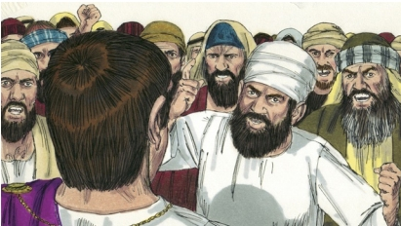
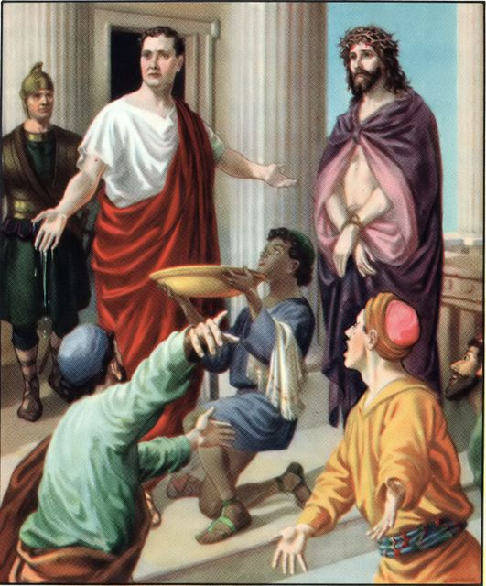
“Pilate therefore, willing to release Jesus, spake again to them. But they cried, saying, Crucify him…” (Lk. 23:20,21).
Pilate was dumbfounded by the Jews hatred of this man –
“And he [Pilate] said unto them the 3rd time, Why, what evil hath he done? I have found no cause of death in him: I will therefore chastise him, and let him go. And they were instant with loud voices… he might be crucified. And the voices of them… prevailed…” (Lk. 23:22-25).
Louder they yelled! Crucify Him!
“When Pilate saw that he could prevail nothing, but that rather a tumult was made, he took water, and washed his hands… I am innocent of the blood of this just person…
Then answered all the people… His blood be on us, and on our children” (Mt. 27:24,25).
Jews have been persecuted for the past 2,000 years for having killed Jesus; those who have done so—anti-Semitic.
Pilate finally relented, released the murderer, and ordered the itinerate preacher to be executed (Lk. 23:25).

Slide 6
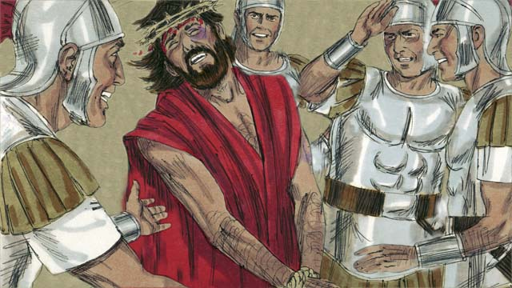
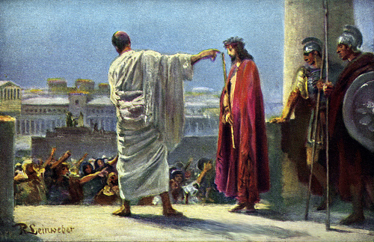
CROWN OF THORNS
“Then the soldiers… took Jesus into the common hall… stripped him, and put on a scarlet robe… platted a crown of thorns, they put it upon his head… bowed the knee before him, and mocked him, saying, Hail, King of the Jews!... spit on him… smote him on the head…”
(27:27-31).
Another prophesy fulfilled –
“Behold, we go up to Jerusalem, and all things written
by the prophets… shall be accomplished. For he [Christ] shall be delivered to the Gentiles, and shall be mocked, and spitefully entreated, and spitted on” (Lk. 18:32 c.f.
Isa. 53, Psa. 22).
“… and he [Pilate] said unto the Jews, Behold your King!... [the crowds yelled] We have no king but Caesar”
(Jn. 19:14,15).
The trial over, Christ was condemned to die by crucifixion.

Slide 7
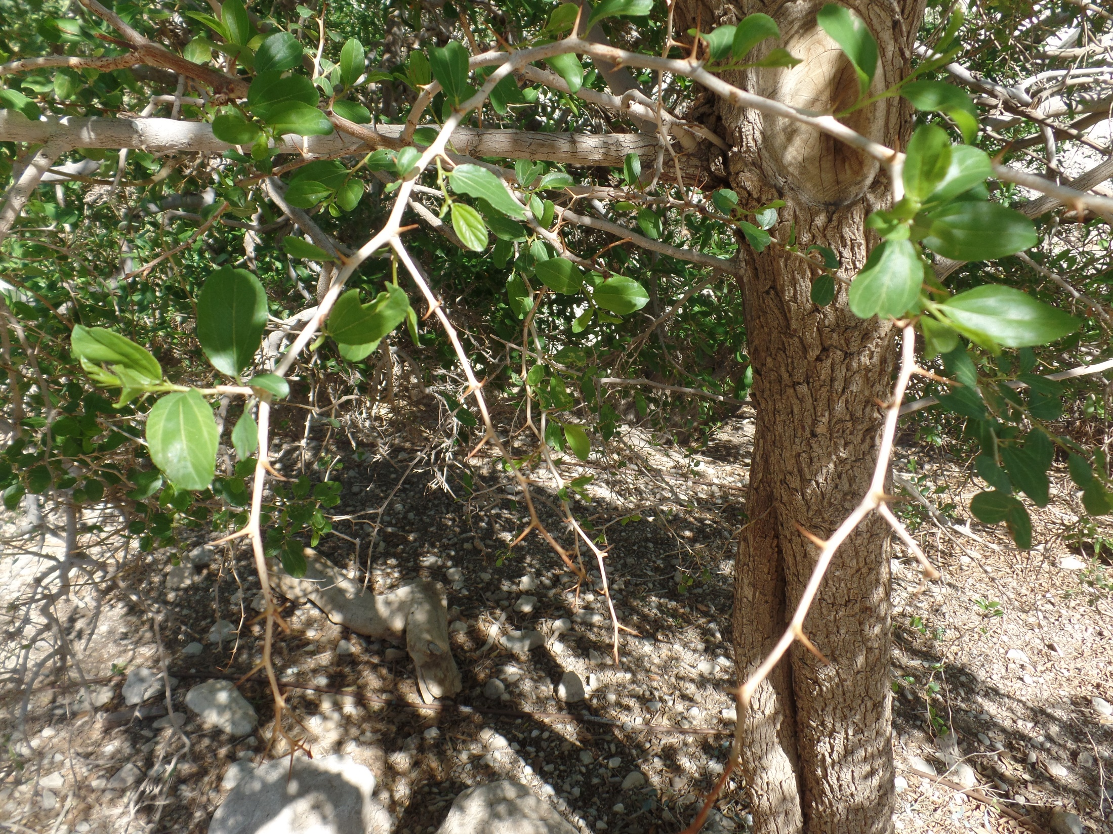
Tree of thorns (2018)
Israel

Slide 8
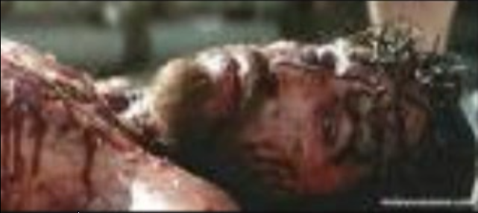
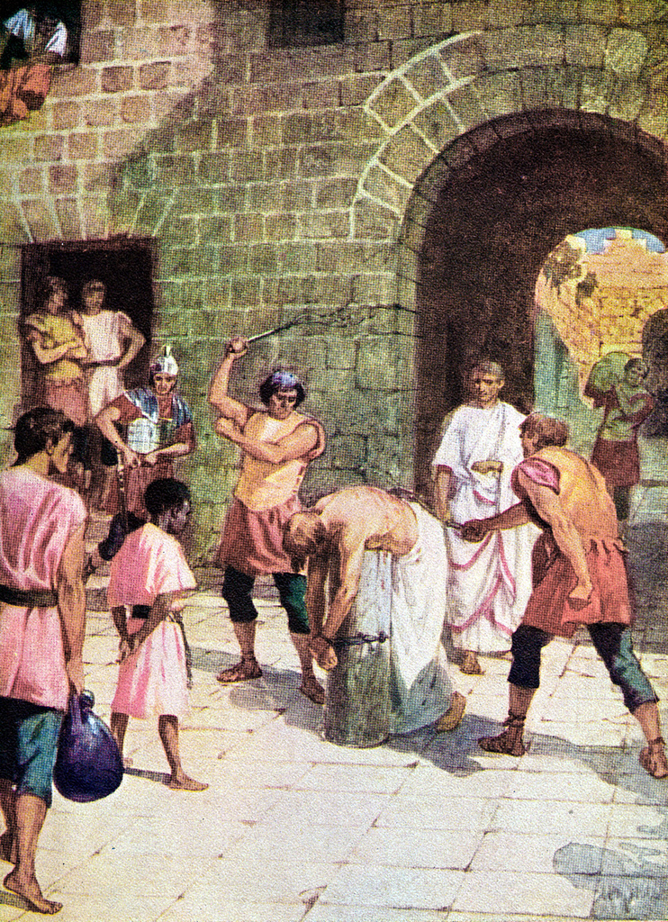
THE SCOURGING
“… and when he had scourged Jesus, he [Pilate] delivered him to be crucified” (Mt. 27:26b).
The Romans took cruelty to another level. The flogging Jesus received would have been a death sentence for most, but He must not die at the end of a whip. Little did they know, the soldiers were fulfilling yet another prophesy –
“As many were astonished at thee; his visage was so marred more than any man, and his form more than the sons of men” (Isa. 52:14).

Slide 9
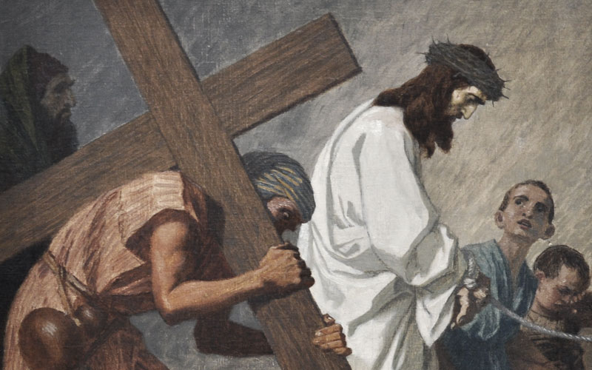
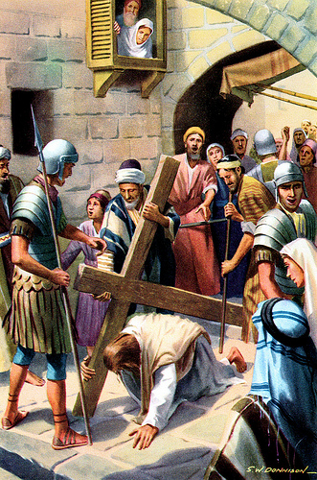
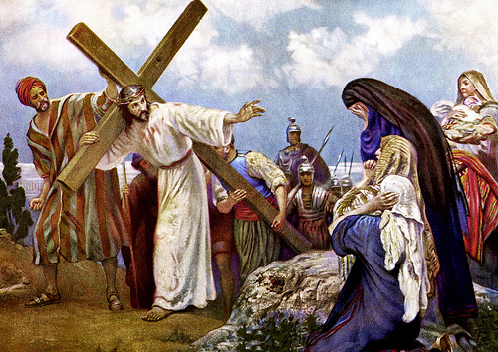
JESUS SPEAKS TO THE CROWD
“But Jesus turned and said, Daughters of Jerusalem, weep not for me, but weep for yourselves, and for your children. For, behold, the days are coming, in which
they shall say, Blessed are the barren, and the wombs that never bare… They shall they say to the mountains, Fall on us; and to the hills, Cover us” (Lk. 23:28-30).
The descendants of these same Jews who live during
the tribulation, will suffer the wrath of God for their continued rejection of Christ.
“And he bearing his cross (Jn. 19:17a)… they found a
man of Cyrene, Simon by name: him they compelled
to bear his cross” (Mt. 27:32).
Because of the tremendous beating He endured, it is likely Jesus fell under the weight of His cross and was relieved of it by a bystander, one Simon of Cyrene. The Book of John has no one bearing His cross but Himself.

Slide 10
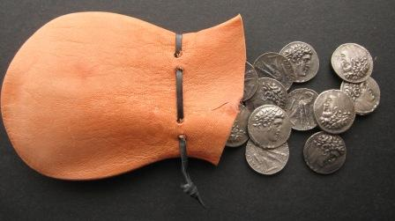
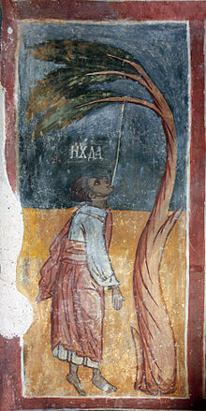
JUDAS’ SUICIDE
“Then Judas, which betrayed him, when he saw that he was condemned, repented himself, and brought again the 30 pieces of silver to the chief priests and elders, Saying, I have sinned in that I have betrayed the innocent blood… What is that to us? And he cast down the pieces of silver in the temple, and departed, and went and hanged himself” (Mt. 27:3-5).
Was Judas sorry he betrayed Jesus? Yes.
Did Judas’ repentance result in his salvation?
Probably not. Judas became disenchanted with Christ’s
earthly ministry because he thought the kingdom should have been established, but he was wrong. Christ’s 1st coming was to pay for man’s sin [Cross]; the 2nd coming will be to bring the kingdom of heaven to earth [King].
Many believe suicide is the unforgiveable sin because of Judas. Judas was not, NOT SAVED because of suicide; he was not saved because of his failure to believe in the ministry the Father had sent His son to carry out [Cross].

Slide 11
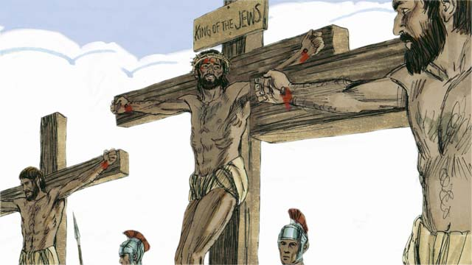
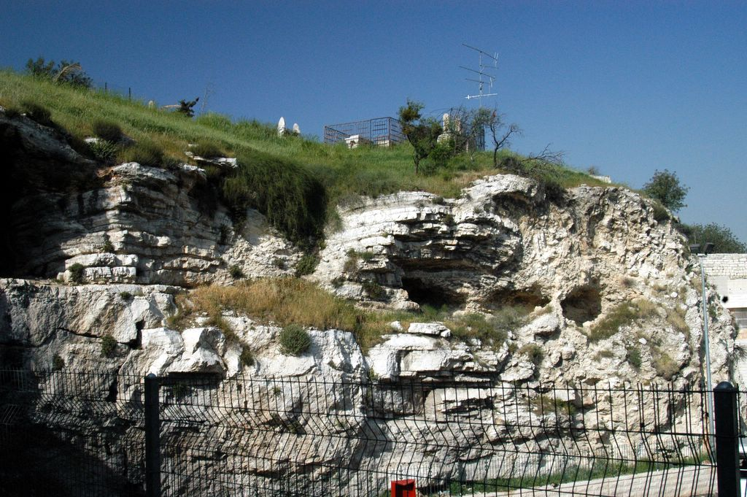
GOLGOTHA
“… went forth into a place called the place of a skull,
which is called in the Hebrew Golgotha: Where they crucified him, and two other with him, on either side
one, and Jesus in the midst. And Pilate wrote a title,
and put it on the cross… JESUS OF NAZARETH THE
KING OF THE JEWS” (Jn. 19:17).
In the 1800’s, a British officer visiting Jerusalem, pointed out that this rock face looked very much like ‘the place of a skull,’ making it a popular visitors site ever since.
The Book of Luke gives us more information on the
others who were crucified with Christ –
“And one of the malefactors which were hanged railed
on him, saying, If thou be Christ, save thyself and us.
But the other rebuked him, saying, Dost not thou fear God, seeing thou art in the same condemnation?... And he said unto Jesus…

Slide 12
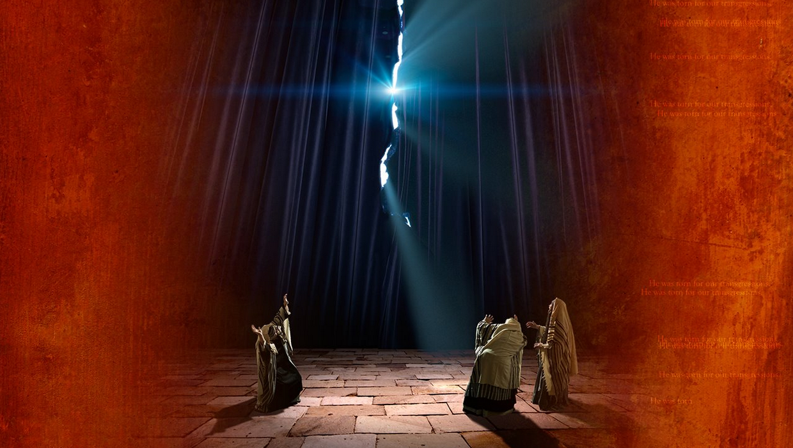
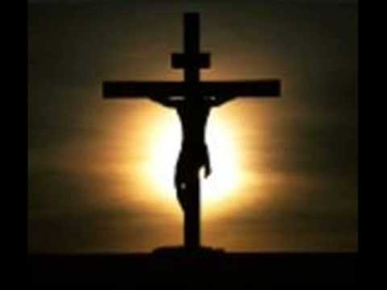
…said unto Jesus, Lord, remember me when thou comest into thy kingdom. And Jesus said unto him, Verily I say unto thee, To day shalt thou be with me in paradise” (23:39-43).
Two men crucified with Jesus, one on His right and one on His left—one mocked Him; one trusted Him.
“And it was about the 6th hour [12 noon], and there was a darkness over all the earth until the 9th hour [3 P.M.]. And the sun was darkened, and the veil of the temple was rent in the midst” (23:44,45).
During that 3-hours of darkness, God had turned His face away—the man who hung on that cross had become the embodiment of all sin for all time.
The veil in the temple was rent from top to bottom, something only God could do. The separation from God and man had been removed.

Slide 13
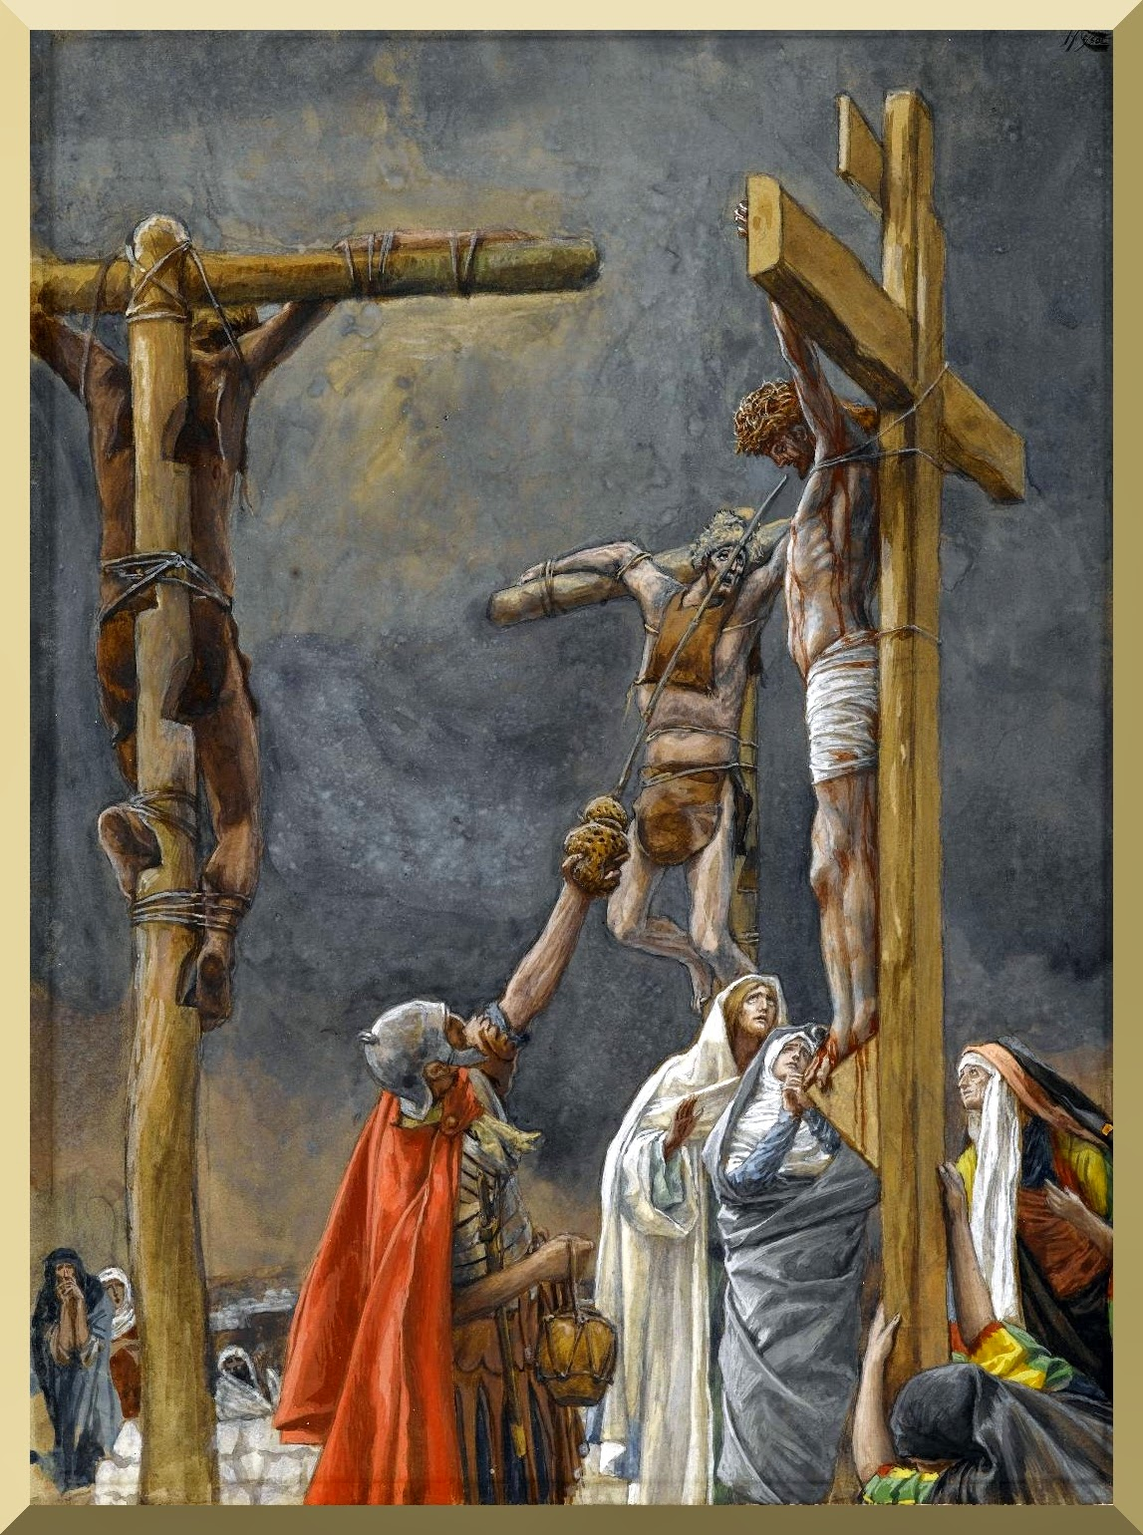
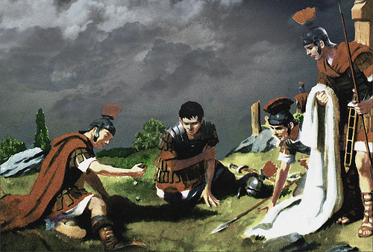
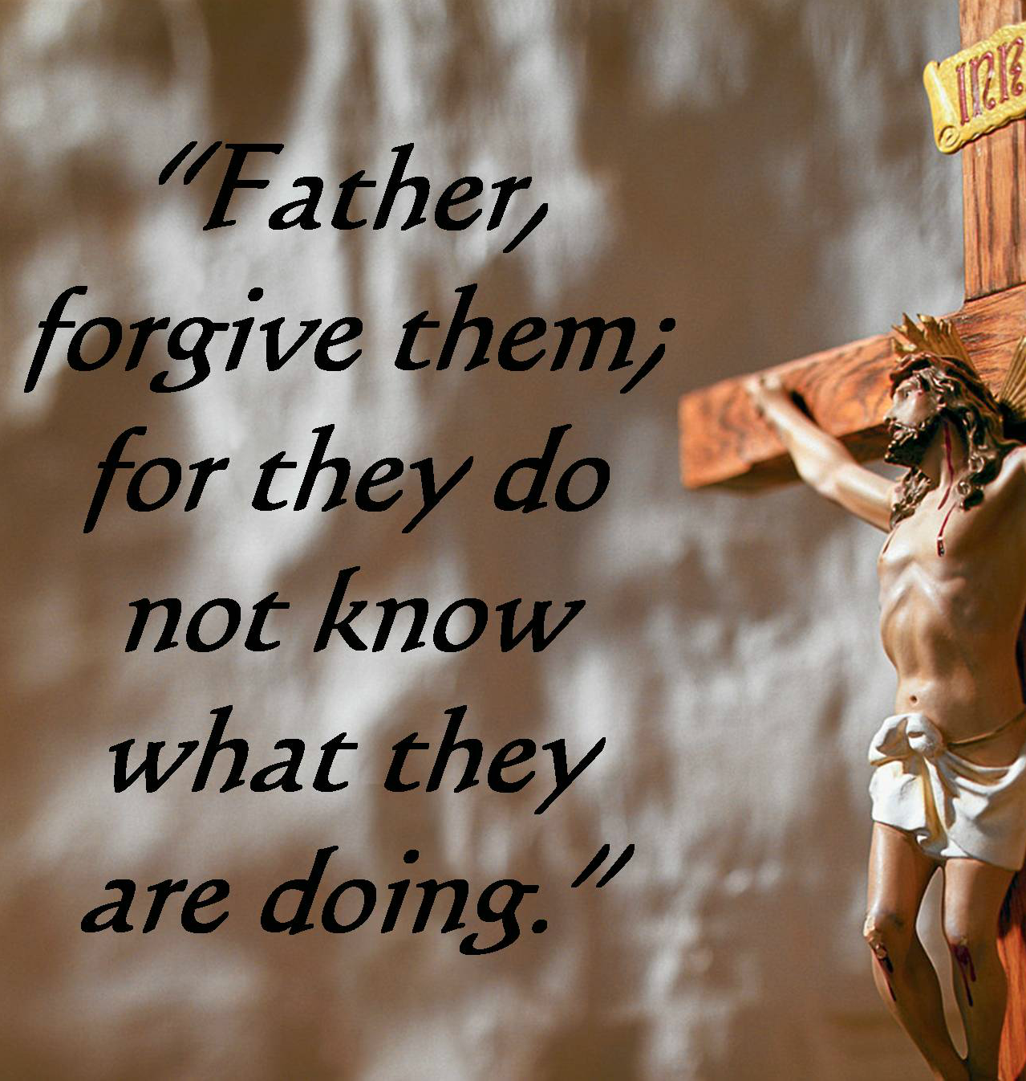
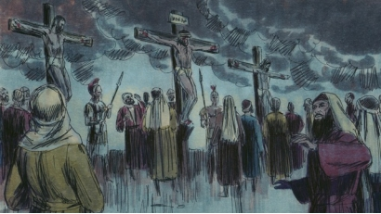
SERIES OF EVENTS
“And when they were come unto a place called Golgotha… They gave him vinegar to drink mingled with gall… he would not drink” (Mt. 27:33,34).
Upon arrival, Jesus refused a drink to dull His senses. Next they parted his garments by lot, also fulfilling prophesy (27:35 c.f. Psa. 22:18).
His 1st cry from the cross –
“Then said Jesus, Father, forgive them; for they know not what they do” (Lk. 23:34).
Israel was crucifying Him in unbelief; at Pentecost they would be given full understanding of their deed.
“And the people stood beholding… He saved others; let him save himself, if he be Christ…” (23:35).
They mocked Him. They offered Him vinegar (23:36); He gave His mother to John (Jn. 19:26,27); and, then Jesus uttered the most heart wrenching petition…

Slide 14
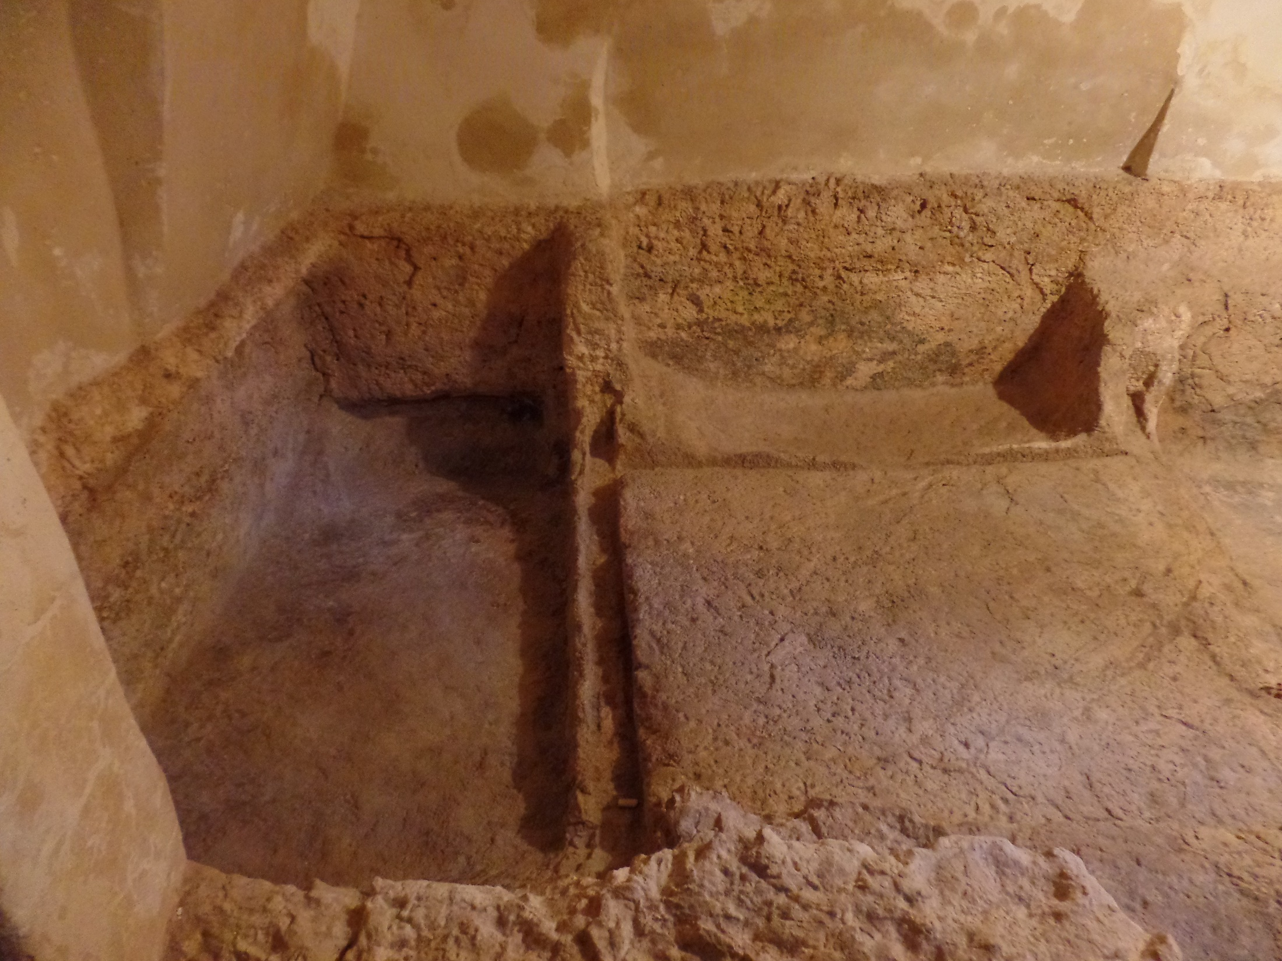
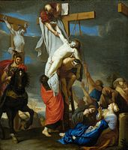
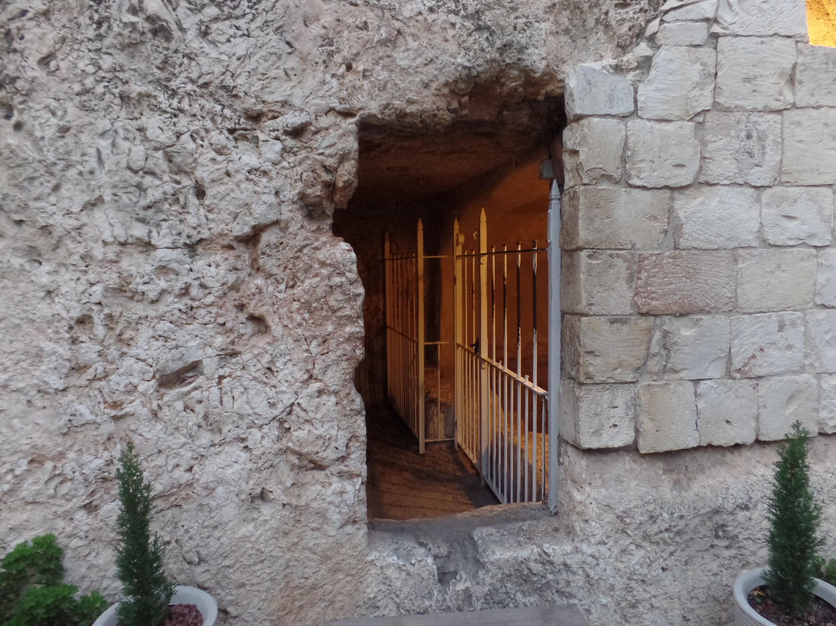
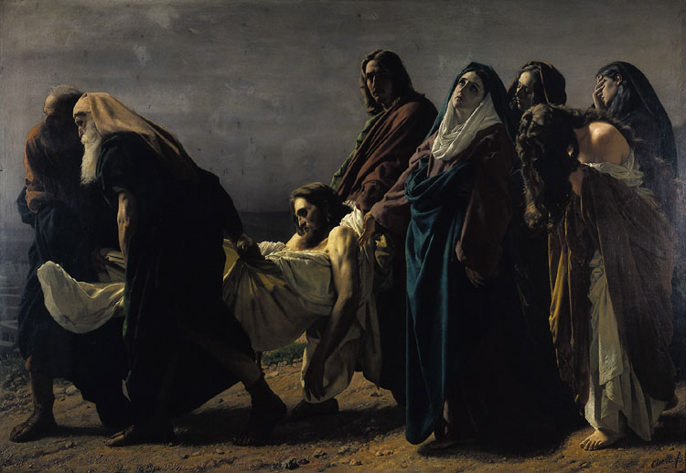
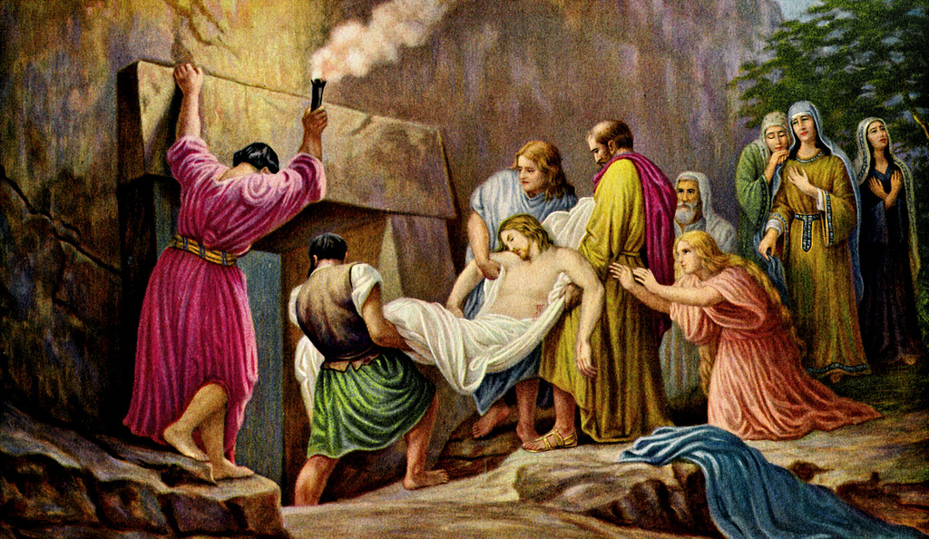
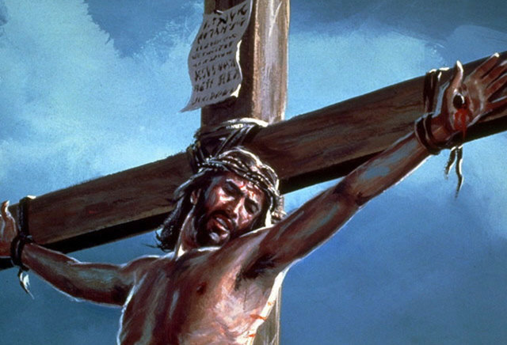
FORSAKEN
“… My God, my God, why hast thou forsaken me?
(Mt. 27:45).
In their humanity, both David (Psa. 22:1) and Jesus felt forsaken, but in the spiritual realm neither were.
Nearing cardiovascular collapse secondary to severe dehydration from the scourging and fluid depletion, Jesus said, “I thirst” (Jn. 19:28); Not a bone was broken, fulfilling another prophecy (Jn. 19:36; Psa. 34:20). Having completed the Father’s plan of payment for man’s sin, He said, “It is finished (19:29)… And when Jesus had cried with a loud voice, he said, Father, into thy hands I commend my spirit: and having said thus, he gave up the ghost” (Lk. 23:46).
He had come to earth to give His life a ransom for many (Mt. 20:28), and that He did!
Joseph of Arimathea and Nicodemus asked Pilate for His body, which was laid in a new tomb (Mt. 27:58-60).
1st century A.D. burial tomb

Slide 15
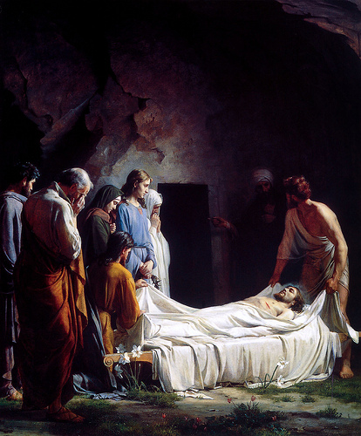
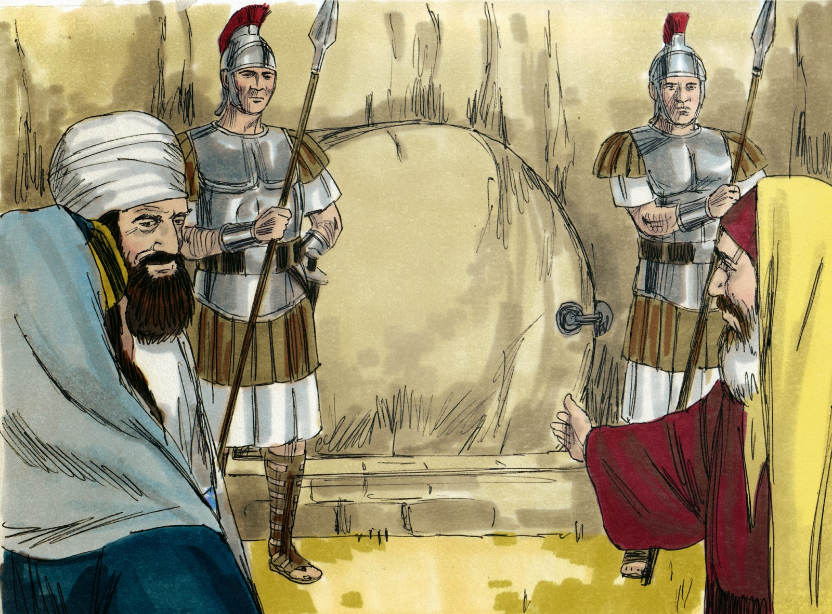
BURIAL
“When the evening was come, there came a rich man of Arimathea, named Joseph, who also himself was Jesus’ disciple… And when Joseph had taken the body, he wrapped it in a clean linen cloth, and laid it in his own new tomb, which he had hewn out in the rock (Mt. 27:57-60)… Now in the place where he was crucified there was a garden; and in the garden a new sepulcher, wherein was never man yet laid”
(Jn. 19:41).
Joseph carefully and lovingly laid His Lord’s body in
his own recently hewn tomb, His burial fulfilled yet another prophesy, of himself, “… and he made his grave with the rich in his death” (Isa 53:9).
Worried that someone might steal the body and claim Jesus had been resurrected from the dead, Pilate permitted a guard to watch the tomb until the 3-days were past (Mt. 27:63-66).

Slide 16
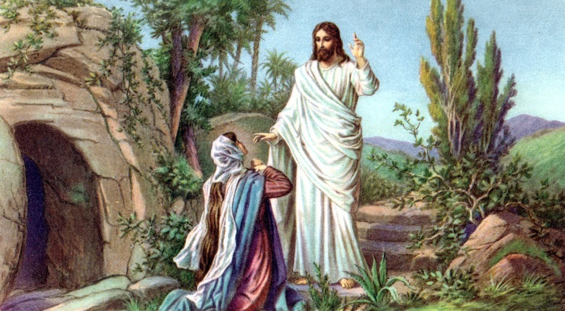
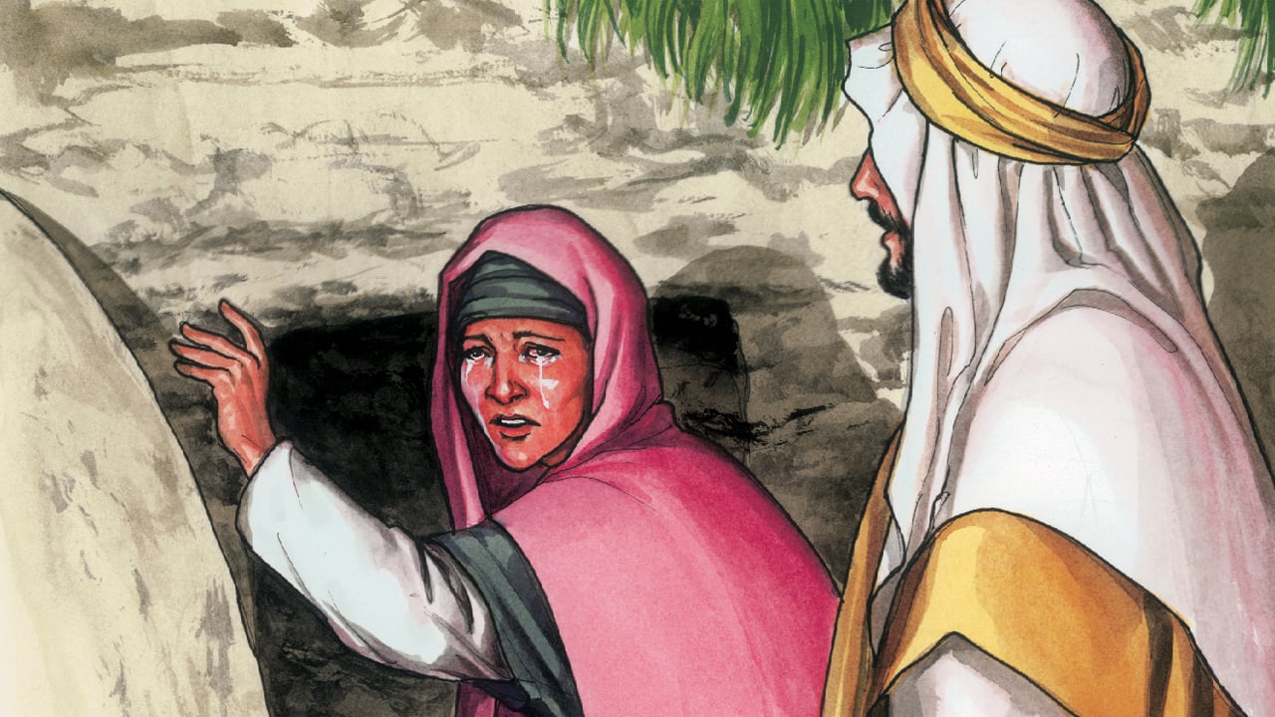
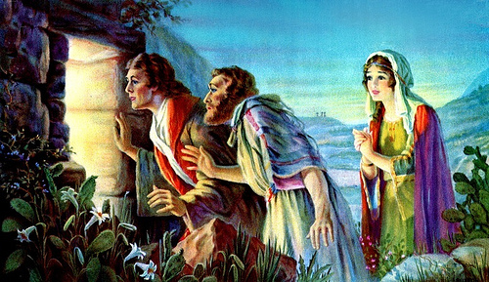
RESURRECTION
“The 1st day of the week cometh Mary Magdalene early, when it was yet dark, unto the sepulcher, and seeth the stone taken away… they have taken away
the Lord…” (Jn. 20:1,2). Peter and John were the
next to reach the empty tomb –
“… looking in, saw the linen clothes lying… saw, and believed. For as yet they knew not the scripture, that he must rise again from the dead” (Jn. 29:5-9).
How could the disciples preach the gospel of the death, burial, and resurrection of Christ [our gospel], when they had not been given understanding of it until they saw the empty tomb? THEY COULD NOT HAVE!
“But Mary stood without… weeping… Jesus saith unto her, Woman, why weepest thou?... Jesus saith… Mary… Touch me not for I am not yet ascended to my Father” (Jn. 20:11-17). Christ had one more thing to do.

Slide 17
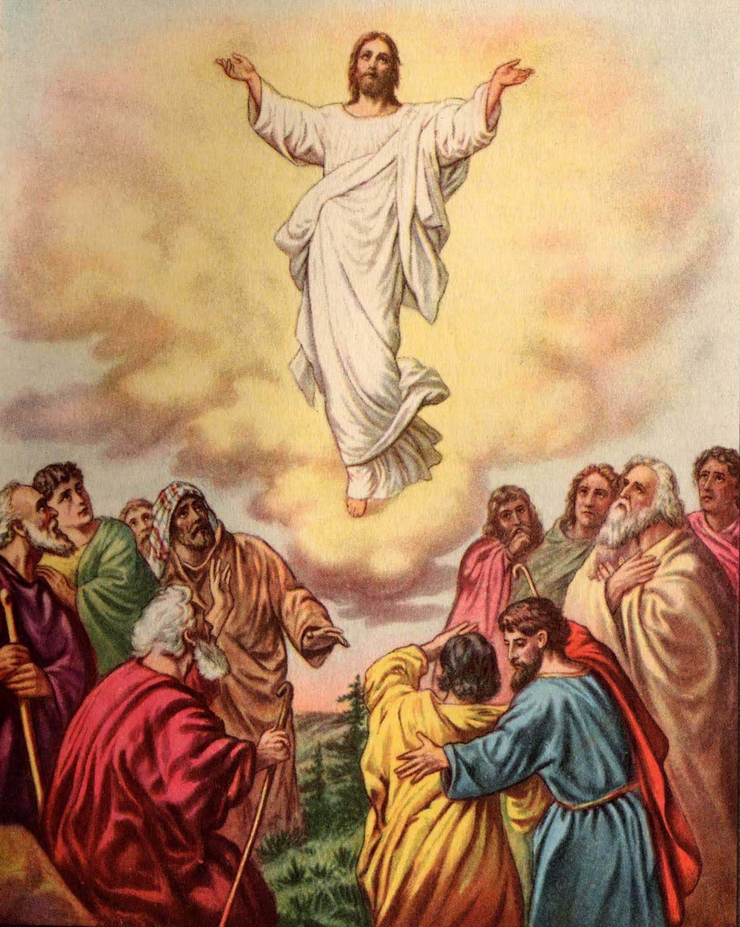
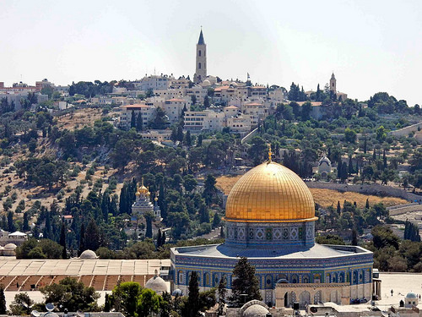
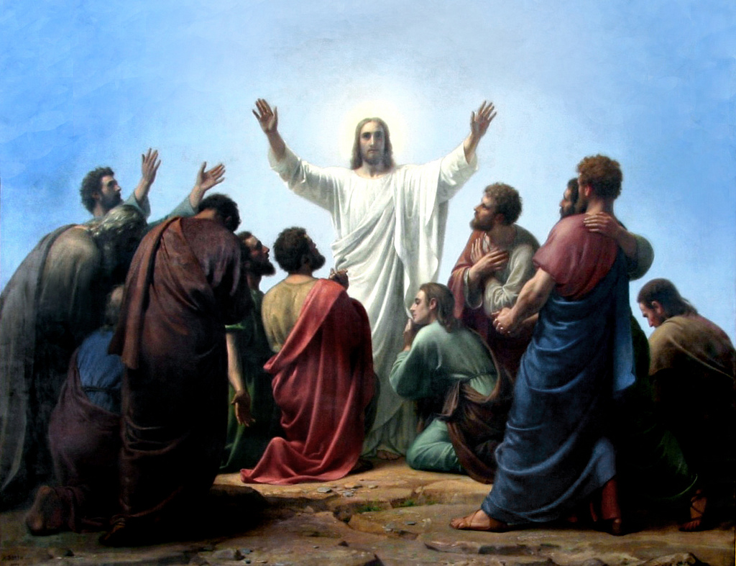
POST RESURRECTION
After His resurrection, Christ spent time teaching the disciples what they didn’t learn earlier –
“To whom also he shewed himself alive after his passion by many infallible proofs, being seen of them 40-days, and speaking of things pertaining to the kingdom of God” (Acts 1:3).
He told them to wait for the baptism with the Holy Spirit (1:5). They asked Christ only one question (1:6), Would He now restore the kingdom to Israel?
He did not give them an answer (1:7) because they wouldn’t have liked it! The answer would have been, NO. Little did they know [He did!] that Israel would continue to reject Him and the kingdom so that it would be delayed another 2,000-years. With that, Christ ascended back to the Father (1:10,11), but promised the 2nd coming would take place here—at the mount of Olives.

Slide 18
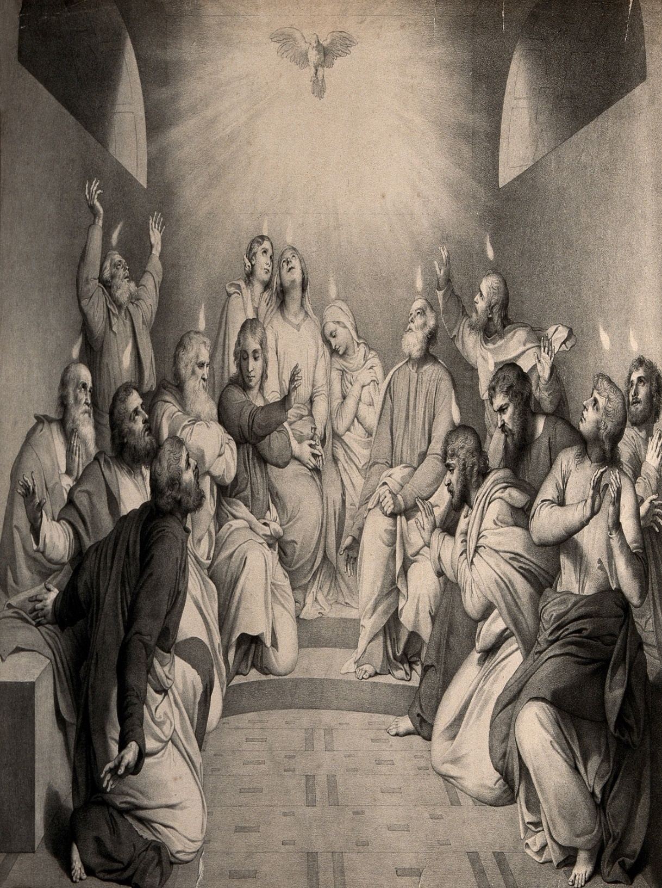
PENTECOST
“And when the day of Pentecost was fully come, they were all with one accord in one place. And suddenly there came a sound from heaven as a rushing mighty wind, and it filled all the house where they were sitting… and sat upon each of them. And they were all filled with the Holy Ghost, and began to speak with other tongues [known languages], as the Spirit gave them utterance” (Acts 2:1-4).
Christ ascended back to heaven 40-days after His resurrection. On day 50, He poured out the Holy Spirit as He said He would do (1:5). Why?
“But ye shall receive power, after the Holy Spirit is come upon you: and ye shall be witnesses unto me in Jerusalem… Judea… Samaria… uttermost part of the earth” (1:8).
Without Christ, they would need the H.S. for their commission to witness for Christ to the world.

Slide 19
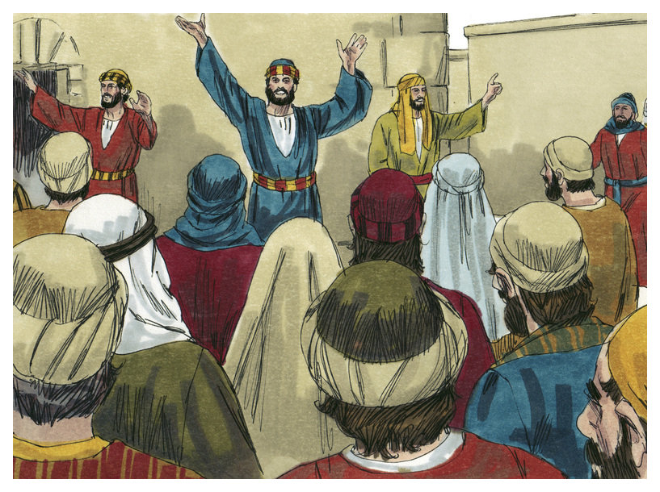
WITNESS TO ISRAEL
They were to begin their commission to witness for Christ in Jerusalem, but to whom?
“And there were dwelling at Jerusalem Jews… out of every nation under heaven (2:5)… Jews and proselytes [converts to Judaism] (2:10)… Ye men of Judea, and all ye [Jews] that dwell in Jerusalem, hearken to my words” (2:14).
Jesus told them when the Comforter is come, “he will guide you to all truth” (Jn. 16:13). What truth?
That they had killed their Messiah! He forgave them from the cross (Lk. 23:34) because they didn’t know, but now the H.S. had given them full knowledge –
“Therefore let all the house of Israel know assuredly, that God hath made that same Jesus ye have crucified, both Lord and Christ” (2:36).
How many now believed it? <1/10th of 1% (2:41).

Slide 20
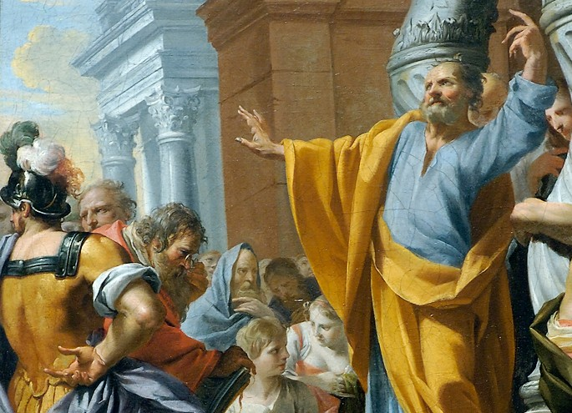
The witness for Christ couldn’t go forward to all
the world with such meager results as that so
Peter tried again –
“Repent ye therefore, and be converted, that your
sins may be blotted out, when the times of
refreshing shall come from the presence of the
Lord; And he shall send Jesus, which was before
preached unto you: Whom the heaven must
receive until the times of restitution of all things,
which God hath spoke by the mouth of all his holy
prophets since the world began” (3:19-21).
Peter told Israel that Christ went back to heaven,
but if they would repent, He would return with
their long awaited kingdom of heaven on earth. Did they? About 5,000 did, still less than 1% of the nation (4:4). Until the nation converted, “Unto you 1st God, having raised up his Son Jesus, sent him to bless you, in turning away everyone of you from his iniquities” (3:26), the kingdom was on hold. Now what? Maybe they would listen to someone else…

Slide 21
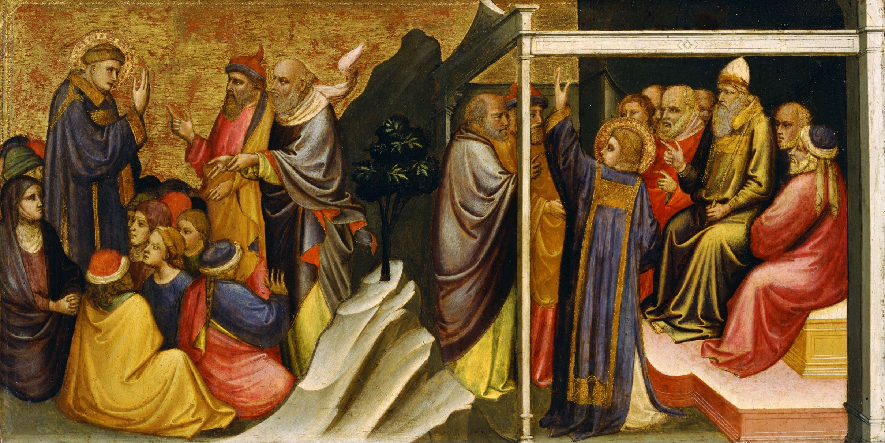
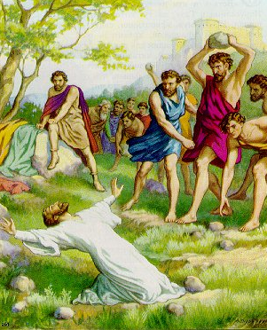
STEPHEN
“And Stephen, full of faith and power, did great wonders and miracles among the people… all that sat in the council… saw his face as it had been the face of an angel… Men, brethren… The God of glory appeared unto our father Abraham…” (6:8; 7:2).
Stephen, a deacon, stood before the Sanhedrin, showing them God’s goodness to their nation, but how they were “…stiffnecked…. always resist the Holy Spirit: as your fathers did, so do ye (7:51)…. Which of your prophets have not your fathers persecuted? And they have slain them which shewed before of the coming of the Just One; of whom ye have been now the betrayers and murderers” (7:52).
He called them murderers. Their response? They stoned Stephen to death (7:59,60). Strike 3! At that moment, God began setting Israel aside in unbelief, choosing an unlikely man to usher in a new program.

Slide 22
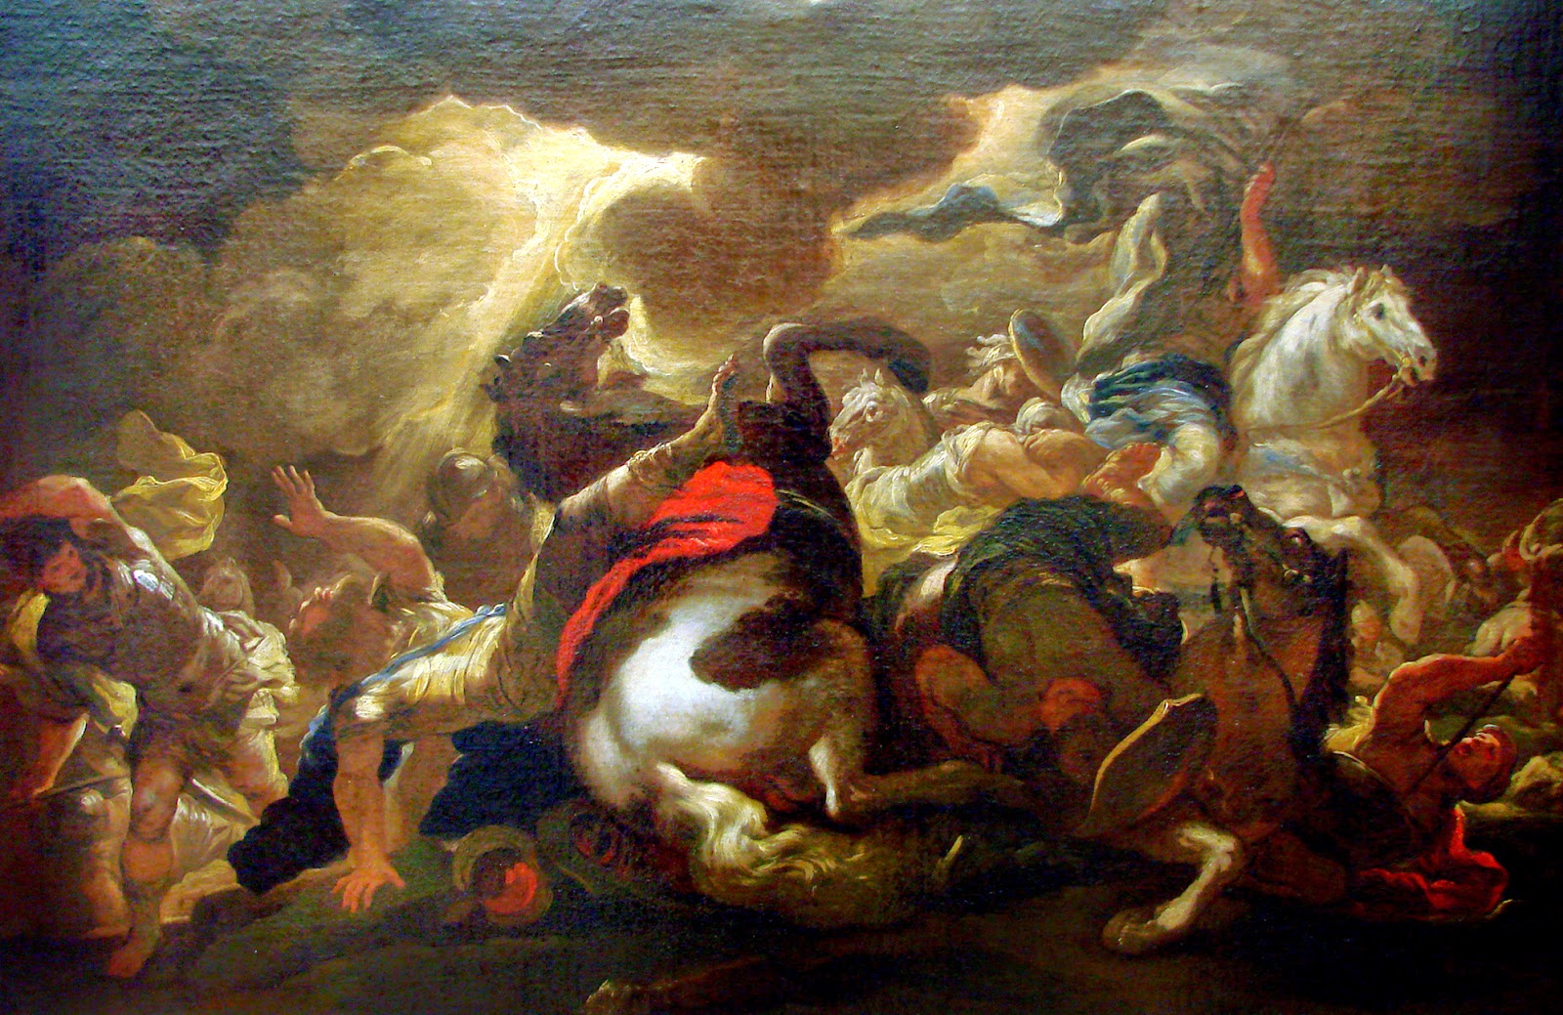
Next time – SAUL’S CONVERSION

